Slide 1
Generalized Fluid System Simulation Program (GFSSP) Version 6 – General Purpose Thermo-Fluid Network Analysis Software
Alok Majumdar, Andre Leclair, Ric Moore
NASA/Marshall Space Flight Center
&
Paul Schallhorn
NASA/Kennedy Space Center
Thermal Fluids Analysis Workshop (TFAWS)
August 15-19, 2011, Newport News, VA

Slide 2
Content
Introduction
Additional Capabilities of Version 6
  Fluid Mixture Option with Phase Change
  Pressure Regulator Model with Forward Looking Algorithm
  Prescribed Flow Option
  Two-dimensional Navier-Stokes Solver
  SI Option
Concluding Remarks

Slide 3
Introduction
GFSSP stands for Generalized Fluid System Simulation Program
It is a general-purpose computer program to compute pressure, temperature and flow distribution in a flow network
It was primarily developed to analyze
  Internal Flow Analysis of a Turbopump
  Transient Flow Analysis of a Propulsion System
GFSSP development started in 1994 with an objective to provide a generalized and easy to use flow analysis tool for thermo-fluid systems

Slide 4
Development History
Version 1.4 (Steady State) was released in 1996
Version 2.01 (Thermodynamic Transient) was released in 1998
Version 3.0 (User Subroutine) was released in 1999
Graphical User Interface, VTASC was developed in 2000
Selected for NASA Software of the Year Award in 2001
Version 4.0 (Fluid Transient and post-processing capability) is released in 2003
Version 5 (Conjugate Heat Transfer) is released in 2007

Slide 5
Network Definition
O
2
= Boundary Node
H
+ O
+N
= Internal Node
2
2
2
= Branch
GFSSP calculates pressure, temperature, and concentrations at nodes and calculates flow rates through branches.
H
2
H
+ O
+N
2
2
2
N
2

Slide 6
Program Structure
Solver & Property Module
Graphical User Interface (VTASC)
User Subroutines
Equation Generator
Equation Solver
Fluid Property Program
New Physics
Input Data
File
Time dependent
process
non-linear boundary
conditions
External source term
Customized output
New resistance / fluid
option
Creates Flow Circuit
Runs GFSSP
Displays results graphically
Output Data File

Slide 7
Mathematical Closure
Unknown Variables Available Equations to Solve
1. Pressure 1. Mass Conservation Equation
2. Flowrate 2. Momentum Conservation Equation
3. Fluid Temperature 3. Energy Conservation Equation of Fluid
4. Solid Temperature 4. Energy Conservation Equation of Solid
5. Specie Concentrations 5. Conservation Equations for Mass Fraction of Species
6. Mass 6. Thermodynamic Equation of State
7

Slide 8
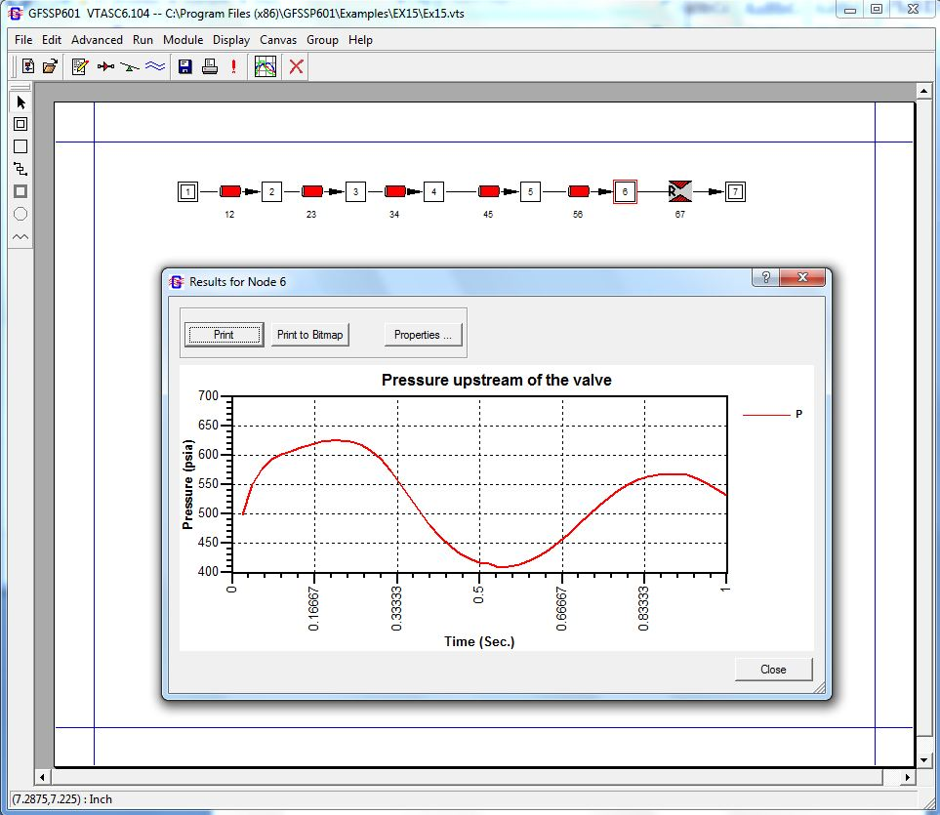
Graphical User Interface

Slide 9
Capabilities
Steady or unsteady flow
Compressible or incompressible flow
Single fluid or mixture
25 flow resistance and 33 fluid options
Options for new components and physics through User Subroutine
Options for new fluid through table look-up
Conjugate Heat Transfer
Interface with Thermal Analysis Code, SINDA-G/PATRAN
Translator of SINDA/Fluint Model

Slide 10
Additional Capabilities of Version 6
Fluid Mixture Option with Phase Change
Pressure Regulator Model with Forward Looking Algorithm
Prescribed Flow Option
Two-dimensional Navier-Stokes Solver
SI Option

Slide 11
Fluid Mixture Option with Phase Change
The mixture capability in earlier versions of GFSSP does not allow phase change in any constituent of the mixture
In liquid propulsion applications, there are situations where one of the constituents is saturated, i.e. mixture of liquid and vapor in equilibrium
  For example during purging of liquid oxygen by ambient helium, a mixture of helium, LO2 and GO2 exist
Why is there such a limitation?
  Because the energy conservation equation of the mixture is solved in terms of temperature
  For calculating phase change, energy equation for each species must be solved in terms of enthalpy or entropy

Slide 12
Mathematical Formulation
Mass Conservation
  Mixture Mass
  Concentration of Species
Momentum Conservation
  Mixture Momentum
Energy Conservation
  Temperature option
    Energy Conservation is formulated in terms of temperature
    Applicable for gas mixture
  Enthalpy option – 1
    Temperature is calculated by an iterative Newton-Raphson method
  Enthalpy option - 2
    Separate Energy Equations are solved for Individual Species
    Applicable for liquid-gas mixture with phase change
12

Slide 13
Enthalpy Option - 1
Mixture Enthalpy Equation
Temperature Equation
Temperature equation is solved iteratively adjusting T_{i} until right hand side of Temperature equation becomes zero
13

Slide 14
Separate Energy Equation for Individual Species (SEEIS) – Enthalpy Option - 2

Slide 15
Thermodynamic Properties
Temperature and other properties of individual species are calculated from node pressure and enthalpy of the species:
The nodal properties are calculated by averaging the properties of species:
Temperature is currently calculated by averaging based on molar concentration of species
Alternate method of temperature calculation based on Vapor Liquid Equilibrium for multi-component, multi-phase mixture is in progress
15

Slide 16
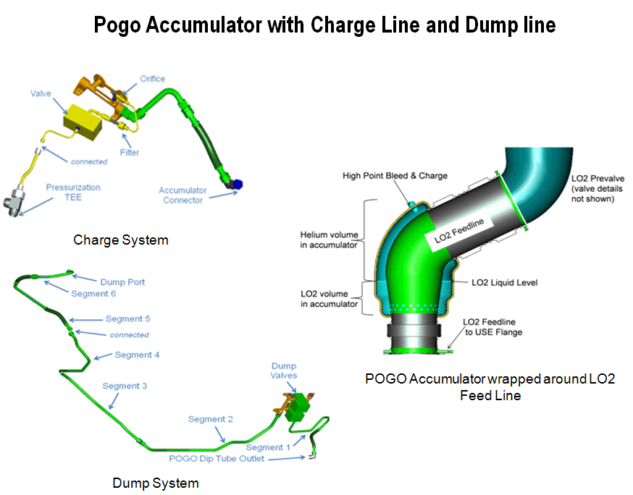

Slide 17
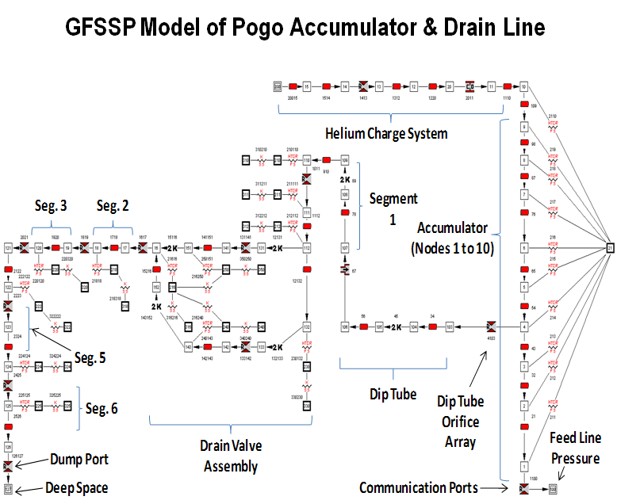

Slide 18
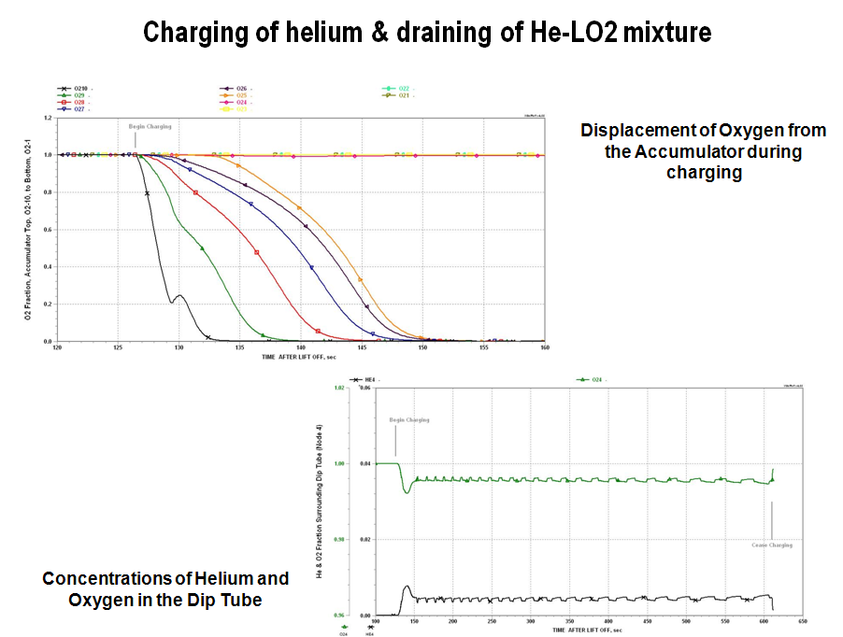

Slide 19
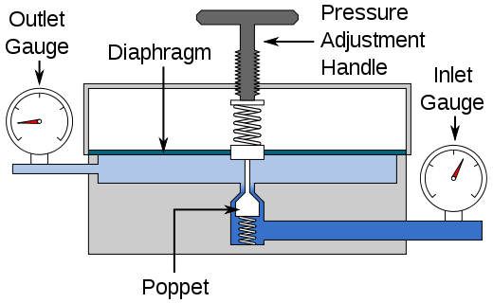
Pressure Regulator Model with Forward Looking Algorithm
In Marching Algorithm, area is guessed and adjusted only once in each time step
Adjustment of area is calculated based on difference between calculated and desired pressure
Area adjustment can be done by backward differencing algorithm (Schallhorn-Majumdar) or forward looking algorithm (Schallhorn-Hass)
Schallhorn-Hass Algorithm has been implemented in GFSSP Version 602

Slide 20
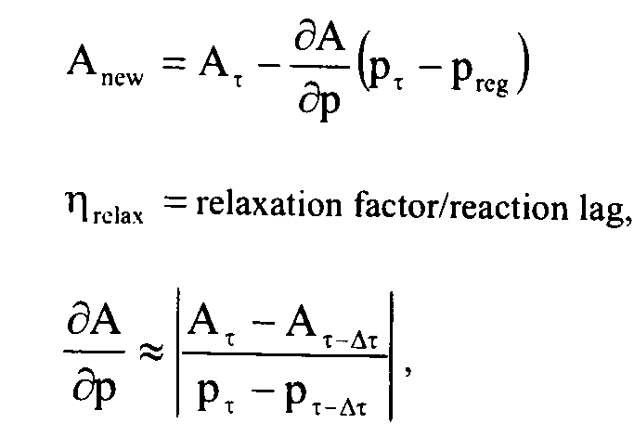
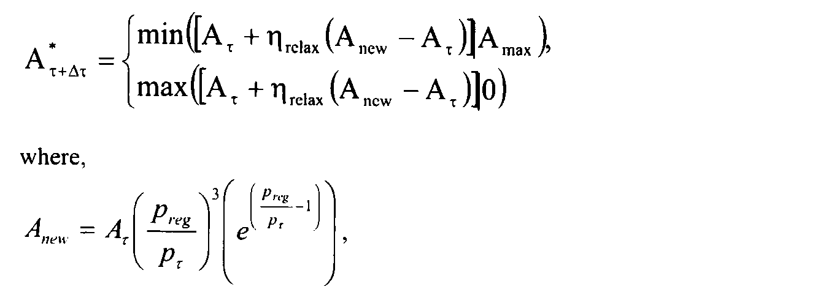
Backward & Forward Differencing Algorithm
Forward Differencing Scheme
Backward Differencing Scheme

Slide 21
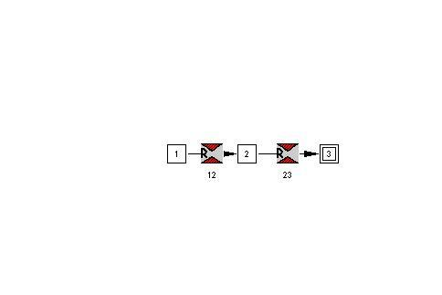
Application of Forward Looking Algorithm
Reference: Forward Looking Pressure Regulator Algorithm for Improved Modeling Performance with the Generalized Fluid System Simulation Program by Paul Schallhorn & Neal Hass, AIAA Paper No. 2004-3667
Air tank
Ambient
Pressure Regulator
Exit

Slide 22
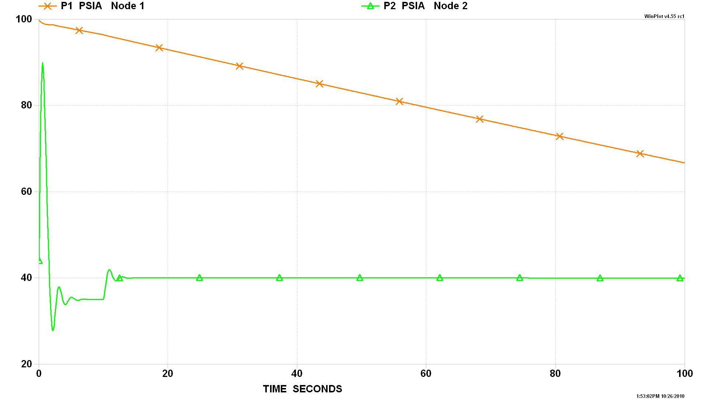
Pressure History
(Schallhorn & Haas Algorithm)
Tank Pressure
Note oscillations over time
Pressure downstream of regulator

Slide 23
Fixed Flow Option
A new branch option has been introduced to fix flowrate in a given branch
The fixed flow branch can only be located adjacent to a Boundary Node
For unsteady option, a history file will be needed to specify flowrate and area at all timesteps
With this new option a user can prescribe either pressure or flowrate as boundary condition
Flow Regulator option is also available in unsteady mode to fix flowrate in an internal branch

Slide 24
Algorithm for Fixed Flow Option(Schallhorn)
Pump Characteristics
Pump Characteristics
Operating Point
Operating Point
System Characteristics
System Characteristics

Slide 25
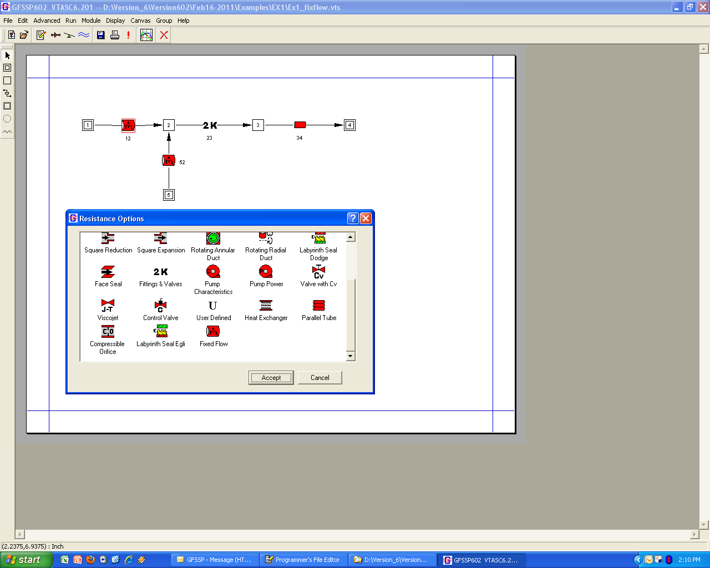
New Resistance Option – Fixed Flow

Slide 26
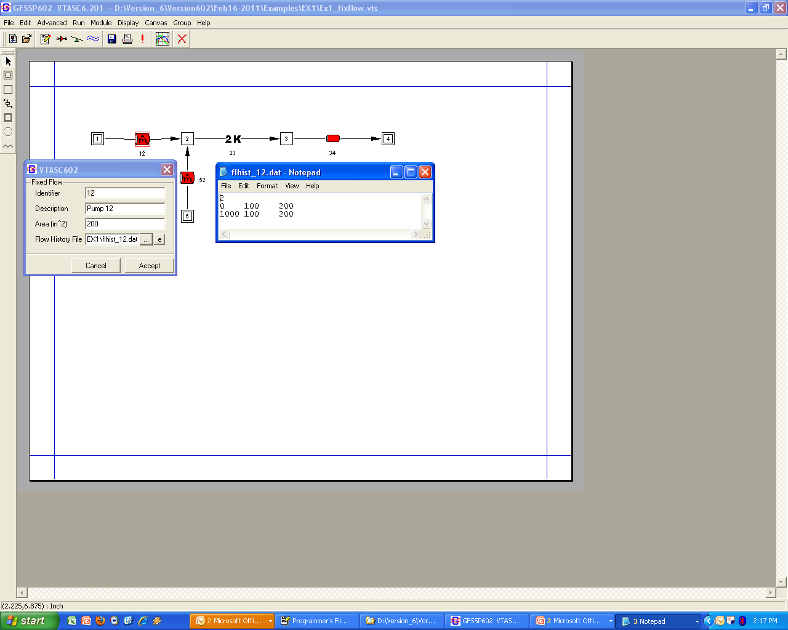
Properties of Fixed Flow Option
Flowrate
Area

Slide 27
Results of Fixed Flow Option

Slide 28
Two-dimensional Navier-Stokes Solver
Higher fidelity solutions are often needed that are not within the capacity of system level codes.
GFSSP’s momentum equation has been extended to perform multi-dimensional calculation

Slide 29
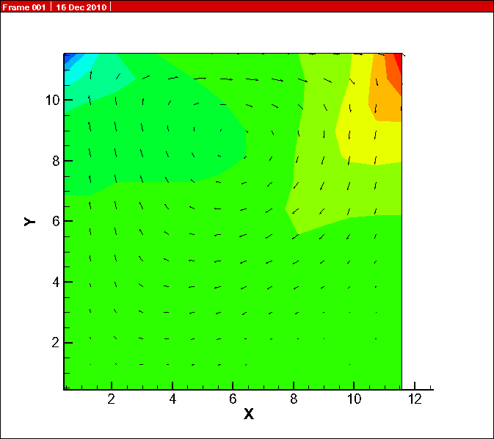
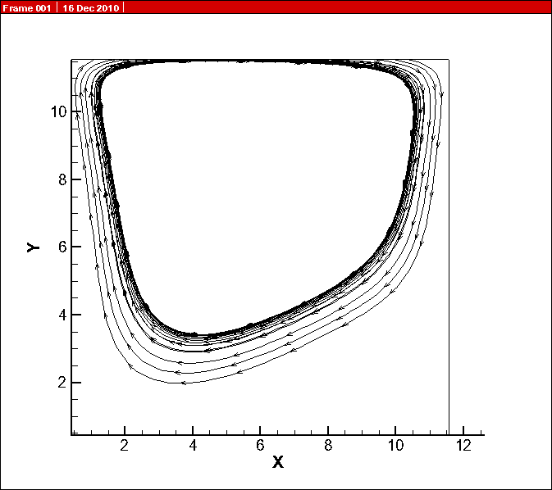
Shear Driven Square Cavity Centerline Velocity Distribution
Shear Driven Square Cavity Centerline Velocity Distribution
Shear Driven Square Cavity Centerline Velocity Distribution
Velocity Field and Pressure Contours
Predicted Stream Traces

Slide 30
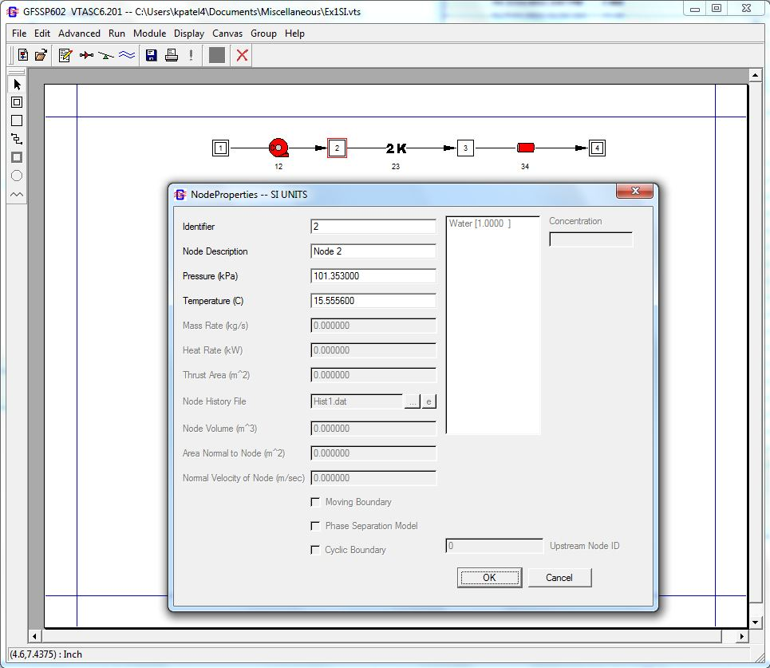
S I Option
SI Option is for input/output
GFSSP solver works in Engineering Unit
User Subroutine must be in Engineering Unit

Slide 31
Concluding Remarks
GFSSP Version 6 will have additional capabilities to model:
  Fluid Mixture Option with Phase Change
  Pressure Regulator Model with Forward Looking Algorithm
  Prescribed Flow Option
  Two-dimensional Navier-Stokes Solver
  SI Option
GFSSP is available (with no cost) to all Federal Government Organizations and their Contractors
Concepts/NREC has the license for commercial distribution to domestic and international Companies or Universities
A process is in work to make an educational version available to all Accredited US Universities for teaching and research

Slide 32
Acknowledgement
The authors wish to acknowledge Melissa Van Dyke of NASA/MSFC and KSC’s Launch Service Program for the support of the work

Slide 33
References
Generalized Fluid System Simulation Program - Majumdar; Alok Kumar, Bailey; John W. ; Schallhorn; Paul Alan ; Steadman; Todd E. , United States Patent No. 6,748,349, June 8, 2004
Majumdar, A. K., “Method and Apparatus for Predicting Unsteady Pressure and Flow Rate Distribution in a Fluid Network,” United States Patent No. US 7,542,885 B1, June 2, 2009.
Hass, Neal and Schallhorn, Paul, “Method of simulating flow-through area of a pressure regulator”, United States Patent No. US 7890311 ,February 15, 2011
Generalized Fluid System Simulation Program (Version 5) – User’s Manual by Alok Majumdar, Todd Steadman and Ric Moore (available in http://gfssp.msfc.nasa.gov/links.html )
Majumdar, A. K., “A Second Law Based Unstructured Finite Volume Procedure for Generalized Flow Simulation”, Paper No. AIAA 99-0934, 37th AIAA Aerospace Sciences Meeting Conference and Exhibit, January 11-14, 1999, Reno, Nevada.

Slide 34
References
Majumdar, A. & Steadman, T, “Numerical Modeling of Pressurization of a Propellant Tank”, Journal of Propulsion and Power, Vol 17, No.2, March-April 2001, pp- 385-390.
Cross, M.F., Majumdar, A. K., Bennett, J.C., and Malla, R. B., “Modeling of Chill Down in Cryogenic Transfer Lines”, Volume 39, No. 2, March-April, 2002, pp 284-289.
LeClair, Andre & Majumdar, Alok, “Computational Model of the Chilldown and Propellant Loading of the Space Shuttle External Tank”, AIAA-2010-6561, 46th AIAA / ASME / SAE / ASEE Joint Propulsion Conference, July 25-28, 2010, Nashville, TN
Majumdar, A and Ravindran, S.S., “Numerical Prediction of Conjugate Heat Transfer in Fluid Network”, Volume 27, No. 3, May-June 2011, pp 620-630.
Schallhorn, Paul & Majumdar, Alok, “Implementation of Finite Volume based Navier Stokes Algorithm within General Purpose Flow Network Code”, submitted for 50th AIAA Aerospace Sciences Meeting to be held on 9-12 January, 2012 in Nashville, Tennessee.

