Slide 1
DOE and Statistical Methods
Wayne F. Adams
Stat-Ease, Inc.
TFAWS 2011

Slide 2
Agenda Transition
The advantages of DOE
              The design planning process
              Response Surface Methods Strategy of Experimentation
              Example AIAA-2007-1214

Slide 3
Agenda Transition
The advantages of DOE
              The design planning process
              Response Surface Methods Strategy of Experimentation
              Example AIAA-2007-1214

Slide 4
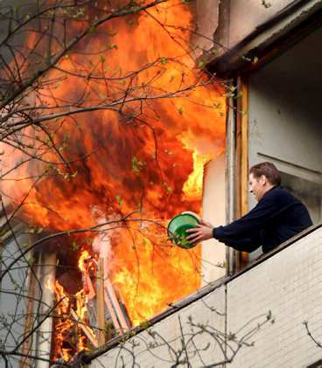
Reasons to Have Scientists
Engineers, Physicist, etc.
Fix problems happening now.
Reduce costs w/o sacrificing quality.
PUT OUT FIRES!
Ensure the mission will be a success
Notes:
Note the small bucket representing the typical budget for experiments.

Slide 5

Build a Better Scientist
A few scientists already know the answers
There are more problems than scientists.

Slide 6
Build a Better Scientist
Most scientists can make very good guesses.
All scientists can conduct experiments and draw conclusions from the results.

Slide 7
Build a Better Scientist
Best guesses and even certain knowledge require confirmation work.
Experiments produce data
  data confirms guesstimates.
  through statistical analysis, data can be interpreted to find solutions.
  interpreted data leverages knowledge to solve problems in the future.
Experiments do NOT replace subject matter experts

Slide 8
Build a Better Scientist
"I do not feel obliged to believe that the same God who has endowed us with sense, reason, and intellect has intended us to forgo their use."
- Galileo Galilei
Notes:
"I do not feel obliged to believe that the same God who has endowed us with sense, reason, and intellect has intended us to forgo their use."
- Galileo Galilei

Slide 9
Design of Experiments
DOE (Design of Experiments) is:
  “A systematic series of tests, in which purposeful changes are made to input factors,
  so that you may identify causes for significant changes in the output responses.”
  Have a Plan
Controllable Factors “x”
Process
Responses “y”
Noise Factors “z”
Notes:
DOE definition.

Slide 10
Iterative Experimentation
Conjecture
Analysis
Design
Experiment
Expend no more than 25% of budget on the 1st cycle.
Notes:
Iterative experimentation is what we advocate. In this workshop we are forced to focus on the DOE process and on Analysis. Once you’re back at work you must supply the subject matter knowledge for Conjecture about your particular processes/products and you will have to perform experiments to get the data we provide in class.

Slide 11
DOE Process (1 of 2)
Ask the Scientist
Identify the opportunity and define the objective.
  Before talking to the scientist.
State objective in terms of measurable responses.
  Define the change (Δy) that is important to detect for each response. (Δy = signal)
  Estimate experimental error (σ) for each response. (σ = noise)
  Use the ratio (Δy/σ) to estimate power.
Select the input factors to study. (Remember that the factor levels chosen determine the size of Δy.)
Notes:
The “DOE Process” stage on the “Iterative Experimentation” slide implies a four step process. Following the process will help you choose the right design for the job.

Slide 12
DOE Process (2 of 2)
Ask the Statistician
Select a design and:
  Evaluate aliases
  Evaluate power.
Examine the design layout to ensure all the factor combinations are safe to run and are likely to result in meaningful information (no disasters).
  Ask the scientist again
Notes:
The “DOE Process” stage on the “Iterative Experimentation” slide implies a four step process.

Slide 13
Design of Experiments
Controllable Factors “x”
Let’s brainstorm.
What process might you experiment on for best payback?
How will you measure the response(s)
What factors can you control?
Write it down.
Process
Responses “y”
Noise Factors “z”
Notes:
Get out your note pad and get to work. ☺

Slide 14
Topic for Today
Using Designed Experiments
No meaningful improvements found with a one factor at a time experiment.
B+
Even the long shot Team C tries
26
19
C+
Current Operating conditions produce a response of 17 units.
To be succesful the response needs to at least double.
Team B Gives it a go
B-
C-
17
25
A-
A+
Team A works on their factor but cannot double the response

Slide 15
Topic for Today
Using Designed Experiments
16
128
Two solutions to the problem found by uncovering the important interactions
B+
85
26
19
C+
21
C+
A new hire engineer volunteers to do a designed experiment
B-
C-
C-
17
25
A-
A+

Slide 16
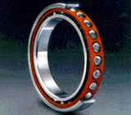
Topic for Today
Grand finale
The last example was based on a
real occurrence at SKF.
Ultimately SKF improved their actual bearing life
from 41 million revolutions on average
(already better than any competitors),
to 400 million revs* – nearly a ten-fold improvement!
*(“Breaking the Boundaries,” Design Engineering, Feb 2000, pp 37-38.)
Notes:
One of the keys to the success of Christer Hellstrand and his engineering team was getting permission to set aside a production line for experimental purposes.

Slide 17

Excuses to Avoid DOE
OFAT is What We’ve “Always Done”
“It's too early to use statistical methods.”
“We'll worry about the statistics
after we've run the experiment.”
“My data are too variable to use
statistics.”
“Lets just vary one thing at a time
so we don't get confused.”
“I'll investigate that factor next.”
“There aren't any interactions.”
“A statistical experiment would be
too large.”
“We need results now, not after some experiment.”
Notes:
Most people are taught to vary only one-factor-at-a-time (OFAT), so when you suggest doing factorials, expect some objections like these.

Slide 18
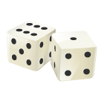
Why OFAT Seems To Work
OFAT approach confirmed a correct guess.
There are only main effects active in the process.
Sometimes it is better to be lucky.
  The experiment path happened to include the optimum factor combinations.
The current operating conditions were poorly chosen.
  Changing anything results in improvements.

Slide 19
Why OFAT Fails
16
128
There are interactions.
The current conditions are stable but not optimal.
The scientist guessed incorrectly and the OFAT experiment never approaches optimal settings.
B+
26
85
19
C+
21
B-
C-
17
25

Slide 20
Why OFAT Fails
OFAT has problems when multiple responses relate differently to the factors.
OFAT takes more time than DOE to reach the same conclusions.
Time is money!

Slide 21
Motivation for Factorial Design
Want to understand how factors interact.
Want to estimate each factor effect independent of the existence of other factor effects.
Want to estimate factor effects well; this implies estimating effects from averages.
Want to obtain the most information in the fewest number of runs.
Want a plan to achieve goals rather than hoping to achieve goals.
Want to keep it simple.
Notes:
Two-level factorial design was developed to meet these desirable DOE properties.

Slide 22
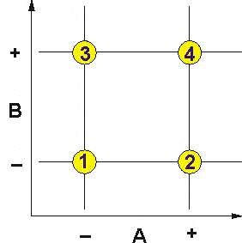
Two-Level Full Factorial Design
Keeping it Simple
Run all high/low combinations of 2 (or more) factors
Use statistics to identify the critical factors
2² Full Factorial
What could be simpler?
Notes:
Two-level full factorials include experiments at all combinations of the factor levels:
2x2 = 4, 2x2x2 = 8, etc.

Slide 23
Design Construction
Understanding Interactions
Std | A | B | C | AB | AC | BC | ABC
1 | – | – | – | + | + | + | – | y₁
2 | + | – | – | – | – | + | + | y₂
3 | – | + | – | – | + | – | + | y₃
4 | + | + | – | + | – | – | – | y₄
5 | – | – | + | + | – | – | + | y₅
6 | + | – | + | – | + | – | – | y₆
7 | – | + | + | – | – | + | – | y₇
8 | + | + | + | + | + | + | + | y₈
With eight, purpose-picked runs, we can evaluate:
three main effects (MEs)
three 2-factor interactions (2FI)
one 3-factor interaction (3FI)
as well as the overall average
Notes:
This is a two-level, three factor design, called a 2³ factorial design, which produces 8 runs.
This is the complete design matrix, including interactions. It includes all seven of the effects we can evaluate (in addition to the overall mean) with the eight runs: -- three main effects (MEs), three 2-factor interactions (2FI) and one 3-factor interaction (3FI).

Slide 24
Design Construction
Independent Effect Estimates
Std | A | B | C | AB | AC | BC | ABC
1 | – | – | – | + | + | + | – | y₁
2 | + | – | – | – | – | + | + | y₂
3 | – | + | – | – | + | – | + | y₃
4 | + | + | – | + | – | – | – | y₄
5 | – | – | + | + | – | – | + | y₅
6 | + | – | + | – | + | – | – | y₆
7 | – | + | + | – | – | + | – | y₇
8 | + | + | + | + | + | + | + | y₈
Note the pattern in each column:
All of the +/- patterns are unique.
None of the patterns can be obtained by adding or subtracting any combination of the other columns
This results in independent estimates of all the effects.
Notes:
This is a two-level, three factor design, called a 2³ factorial design, which produces 8 runs.
This is the complete design matrix, including interactions. It includes all seven of the effects we can evaluate (in addition to the overall mean) with the eight runs: -- three main effects (MEs), three 2-factor interactions (2FI) and one 3-factor interaction (3FI).

Slide 25
Relative Efficiency
DOE vs. OFAT
To get average estimates using OFAT that have the same precision as DOE, two observations are needed at each setting.
Hidden Replication
Average observations
Avg(+A) – Avg(-A) estimate the A effect
B
B
A
A
Relative efficiency = 6/4 = 1.5
The more factors there are the more efficient DOE’s become.
Hidden Replication
Average of four
observations
Avg(+A) – Avg(-A)
B
B
C
C
A
A
Relative efficiency = 16/8= 2.0
Notes:
These charts illustrate how factorials, by using an orthogonal matrix to estimate effects in parallel, provide information much more efficiently than (OFAT) experimentation, which follows a serial path. Remember that to determine each response with the same precision, we need to repeat a data point the same number of times in each experiment.
In the two variable two-level factorial design, each level was measured at two points, so for the same precision in OFAT we need to measure each point twice. Therefore OFAT requires 6 runs with relative inefficiency of 1.5 when compared to factorial design.
For a 3-factor design we need four runs at each level for same precision, or 16 runs total for OFAT vs 8 for factorial -- 2.0 times less efficient.
Obviously the relative efficiency of the factorial DOE gets better and better as the number of factors in the experiment increases. The ability to see interactions provides an added bonus not available with OFAT. Also note that the conclusions in a factorial design are based on more different combinations than the corresponding OFAT, i.e., they have a wider inductive basis!

Slide 26
Relative Efficiency
Fractional Factorial
All possible combinations of factors is not necessary with four or more factors.
When budget is of primary concern…
Fractional factorial designs can be used with four or more factors and still provide interaction information.
  4 – 12 runs (Irregular fraction) less than 16
  5 – 16 runs (Half-fraction) less than 32
  6 – 22 runs (Min Run Res V) less than 64

Slide 27
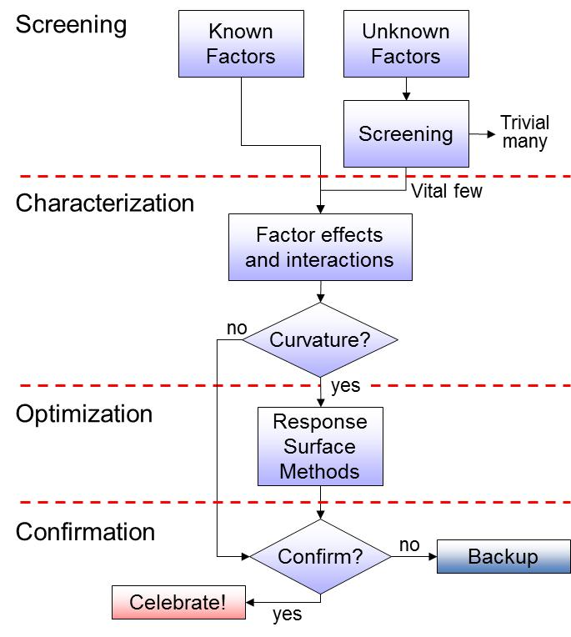
Agenda Transition
Basics of factorial design:
Microwave popcorn
  Multiple response optimization

Slide 28

Two Level Factorial Design
As Easy As Popping Corn!
Kitchen scientists* conducted a 2³ factorial experiment on microwave popcorn. The factors are:
  A. Brand of popcorn
  B. Time in microwave
  C. Power setting
A panel of neighborhood kids rated taste from one to ten and weighed the un-popped kernels (UPKs).
* For full report, see Mark and Hank Andersons' “Applying DOE to Microwave Popcorn”, PI Quality 7/93, p30.
Notes:
We will analyze the first response “Taste” together and then you will analyze the second response “UPKs” (weight of un-popped kernels, technically called “UPKs” by popcorn manufacturers). Then together we will look for the best operating conditions.
See reference for complete report. You can find it on the www.statease.com website.

Slide 29
Two Level Factorial Design
As Easy As Popping Corn!
 | A | B | C | R₁ | R₂
Run | Brand | Time | Power | Taste | UPKs | Std
Ord | expense | minutes | percent | Rating* | oz. | Ord
1 | Costly | 4 | 75 | 75 | 3.5 | 2
2 | Cheap | 6 | 75 | 71 | 1.6 | 3
3 | Cheap | 4 | 100 | 81 | 0.7 | 5
4 | Costly | 6 | 75 | 80 | 1.2 | 4
5 | Costly | 4 | 100 | 77 | 0.7 | 6
6 | Costly | 6 | 100 | 32 | 0.3 | 8
7 | Cheap | 6 | 100 | 42 | 0.5 | 7
8 | Cheap | 4 | 75 | 74 | 3.1 | 1
*Transformed linearly by ten-fold (10x) to make it easier to enter.
Notes:
Note that in this array, listed in randomized run order, the actual levels of factors are shown. We call this an “uncoded” or “actual” representation of factors. It’s useful for the technician (or cook) who runs the experiment, but not for calculations.

Slide 30
Two Level Factorial Design
As Easy As Popping Corn!
 | A | B | C | R₁ | R₂
Run | Brand | Time | Power | Taste | UPKs | Std
Ord | expense | minutes | percent | rating | oz. | Ord
1 | + | – | – | 75 | 3.5 | 2
2 | – | + | – | 71 | 1.6 | 3
3 | – | – | + | 81 | 0.7 | 5
4 | + | + | – | 80 | 1.2 | 4
5 | + | – | + | 77 | 0.7 | 6
6 | + | + | + | 32 | 0.3 | 8
7 | – | + | + | 42 | 0.5 | 7
8 | – | – | – | 74 | 3.1 | 1
Factors shown in coded values
Notes:
Better coded (pun off “butter coated”) factor levels, run order and standard order.

Slide 31
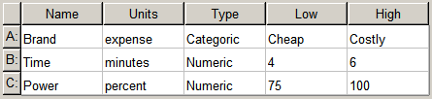
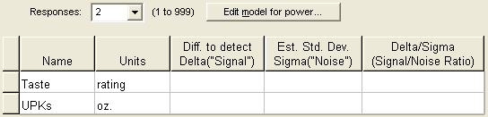
Popcorn Analysis via Computer!
Instructor led (page 1 of 2)
Build a design for 3 factors, 8 runs.
Enter response information
Notes:
Enter factor information.

Slide 32
Popcorn via Computer!
The experiment and results
Std ord | A: Brand expense | B: Time minutes | C: Power percent | R₁: Taste rating | R₂: UPKs oz.
1 | Cheap | 4.0 | 75.0 | 74.0 | 3.1
2 | Costly | 4.0 | 75.0 | 75.0 | 3.5
3 | Cheap | 6.0 | 75.0 | 71.0 | 1.6
4 | Costly | 6.0 | 75.0 | 80.0 | 1.2
5 | Cheap | 4.0 | 100.0 | 81.0 | 0.7
6 | Costly | 4.0 | 100.0 | 77.0 | 0.7
7 | Cheap | 6.0 | 100.0 | 42.0 | 0.5
8 | Costly | 6.0 | 100.0 | 32.0 | 0.3
Notes:
Set up the popcorn experiment in Design-Expert software.

Slide 33
R₁ - Popcorn Taste
A-Effect Calculation
Notes:
Here’s the basic way of calculating effects: the average of A at its high setting minus the average of A at its low setting.

Slide 34
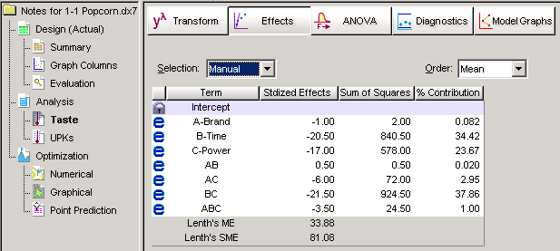
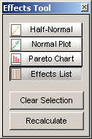
Popcorn Analysis – Taste
Effects Button - View, Effects List
Notes:
The software does all the effect calculations using the expanded design matrix.
The “% contribution” was added at the request of a major client who likes to highlight the heavy hitters on a sum of squares basis. This can be somewhat confusing when interactions are significant.

Slide 35
Popcorn
Analysis Matrix in Standard Order
Std. Order | I | A | B | C | AB | AC | BC | ABC | Taste rating | UPKs oz.
1 | + | – | – | – | + | + | + | – | 74 | 3.1
2 | + | + | – | – | – | – | + | + | 75 | 3.5
3 | + | – | + | – | – | + | – | + | 71 | 1.6
4 | + | + | + | – | + | – | – | – | 80 | 1.2
5 | + | – | – | + | + | – | – | + | 81 | 0.7
6 | + | + | – | + | – | + | – | – | 77 | 0.7
7 | + | – | + | + | – | – | + | – | 42 | 0.5
8 | + | + | + | + | + | + | + | + | 32 | 0.3
I for the intercept, i.e., average response.
A, B and C for main effects (ME's).
These columns define the runs.
Remainder for factor interactions (FI's)
Three 2FI's and One 3FI.
Notes:
This is the expanded design matrix in standard order. It includes columns for all eight of the effects we can evaluate with the eight runs: the overall mean (column labeled I for identity) plus seven effects -- three main effects (MEs), three 2-factor interactions (2FIs) and one 3-factor interaction (3FI).
How are the signs for the interaction columns computed? Answer – by multiplying the main effect columns.

Slide 36
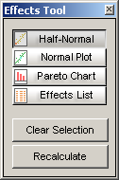
Popcorn Analysis – Taste
Effects - View, Half Normal Plot of Effects
Notes:
Design-Expert ranks the absolute values of the effects from low to high and constructs a half-normal probability plot. The significant effects fall to the right on this plot. Starting on the right select the largest effects. Look for a definite gap between the keepers and the trivial many effects near zero.

Slide 37

Half Normal Probability Paper
Sorting the vital few from the trivial many.
Significant effects:
The model terms!
Negligible effects: The error estimate!
Notes:
The effects BC, B and C are the big fish (keepers!). The other effects that line up near zero will be thrown back in to pool for an estimate of error.

Slide 38
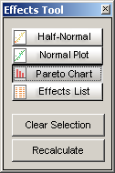
Popcorn Analysis – Taste
Effects - View, Pareto Chart of “t” Effects
Notes:
After using the half-normal plot to pick effects, look at the Pareto Chart to reinforce your selection. This is a good way to communicate to others because it’s simply an ordered bar-chart that anyone can figure out, unlike the half-normal plot, which most people haven’t ever seen before.
Here’s the guidelines for assessing effects on this Pareto Chart designed especially for this purpose:
(Big) effects above the Bonferroni Limit (a conservative statistical correction for multiple comparisons*) are almost certainly significant.
(Intermediate) effects that are above the lower t-Value Limit are possibly significant.
(Small) effects below the t-Value limit are probably not significant.
*(For details, see DOE Simplified, 2nd Ed, Chapter 3 – “How to Make a More Useful Pareto Chart.”)

Slide 39
Popcorn Analysis – Taste
ANOVA button
Analysis of variance table [Partial sum of squares]
Sum of Mean F
Source Squares df Square Value Prob > F
Model 2343.00 3 781.00 31.56 0.0030
B-Time 840.50 1 840.50 33.96 0.0043
C-Power 578.00 1 578.00 23.35 0.0084
BC 924.50 1 924.50 37.35 0.0036
Residual 99.00 4 24.75
Cor Total 2442.00 7
P-value guidelines
p < 0.05 Significant ☺
p > 0.10 Not significant ☹
0.05 < p < 0.10 Your decision (is it practically important?)
Notes:
Model Sum of Squares (SS): Total of the sum of squares for B, C, and BC (the selected factors).
SSModel = 840.50 + 578.00 + 924.50 = 2343.00
Model DF (Degrees of Freedom): Number of model parameters, not including the intercept.
dfModel = 3
Model Mean Square (MS): Estimate of model variance.
MSModel = SSModel/dfModel = 2343.0/3 = 781.0
Residual Sum of Squares: Total SS for the terms estimating experiment error, those that fall on the normal probability line.
SSResidual = 2.00 + 0.50 + 72.00 + 24.50 = 99.00
Residual df (Degrees of Freedom)
dfResidual = Corrected Total df - Model df = 7 - 3 = 4
Residual Mean Square (MS): Estimate of error variance.
MSResidual = SSResidual/dfResidual = 99.00/4 = 24.75
F Value: Test for comparing model variance with residual variance.
= MSModel/MSResidual = 781.00/24.75 = 31.56
Prob > F: Probability of observed F value if the null hypothesis is true. The probability equals the tail area of the F-distribution (with 3 and 4 DF) beyond the observed F-value. Small probability values call for rejection of the null hypothesis.
Cor Total: Total sum of squares corrected for the mean, SS = 2442.00 and df = 7.

Slide 40
Analysis of Variance (taste)
Sorting the vital few from the trivial many
Null Hypothesis:
There are no effects, that is: H₀: Δ_{A}= Δ_{B}=…= Δ_{ABC}= 0
F-value:
If the null hypothesis is true (all effects are zero) then the calculated F-value is ≈ 1.
As the model effects (Δ_{B}, Δ_{C} and Δ_{BC}) become large the calculated F-value becomes >> 1.
p-value:
The probability of obtaining the observed F-value or higher when the null hypothesis is true.
Notes:
The F-distributions and associated statistics are named after Sir Ronald Fisher. He developed the technique for application to agricultural experiments. In fact, Fisher’s landmark paper is entitled “The Differential Effect of Manures on Potatoes.”

Slide 41
Popcorn Analysis – Taste
ANOVA (summary statistics)
Std. Dev. 4.97 R-Squared 0.9595
Mean 66.50 Adj R-Squared 0.9291
C.V. % 7.48 Pred R-Squared 0.8378
PRESS 396.00 Adeq Precision 11.939
Want good agreement between the adjusted R² and predicted R²; i.e. the difference should be less than 0.20.
Adequate precision should be greater than 4.
Notes:
Std. Dev.: Square root of the Residual mean square (sometimes referred to as Root MSE).
= SqRt(24.75) = 4.97
Mean: Overall average of the response.
C.V. (Coefficient of Variation): The standard deviation as a percentage of the mean.
= 100 x (Std. Dev.)/Mean = 100 x 4.97/66.50 = 7.48%
R-squared: The multiple correlation coefficient.
= 1 - [SSResidual/(SSModel + SSResidual)]
= 1 - [99.00/(2343.00+99.00)] = 0.9595
Adj R-Squared: R-Squared adjusted for the number of model parameters relative to the number of runs.
= 1 - {[SSResidual/DFResidual]/[(SSModel + SSResidual)/(DFModel + DFResidual)]}
= 1 - {[99.00/4]/[(2343.001+ 99.00)/(3 + 4)]} = 0.9291
Pred R-Squared: Predicted R-Squared. A measure of the predictive capability of the model.
= 1 - (PRESS/SSCor Total) = 1 - (396.00/2442.00) = 0.8378
Adeq Precision: Compares the range of predicted values at design points to the average prediction error. Ratios greater than four indicate adequate model discrimination.
PRESS (Predicted Residual Sum of Squares): A measure of how this particular model fits each point in the design. The coefficients are calculated without the first point. This model is then used to estimate the first point and calculate the residual for point one. This is done for each data point and the squared residuals are summed. Used to calculate the Pred R-Squared.

Slide 42
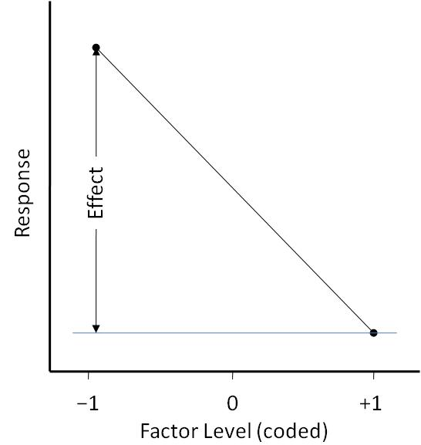
Popcorn Analysis – Taste
ANOVA Coefficient Estimates
Coefficient Standard 95% CI 95% CI
Factor Estimate DF Error Low High VIF
Intercept 66.50 1 1.76 61.62 71.38
B-Time -10.25 1 1.76 -15.13 -5.37 1.00
C-Power -8.50 1 1.76 -13.38 -3.62 1.00
BC -10.75 1 1.76 -15.63 -5.87 1.00
Coefficient Estimate: One-half of the factorial effect (in coded units)
Notes:
Coefficient Estimate: The coefficients listed in the factorial post-ANOVA section are based on coded (low level = -1, high level = +1) units. The graph shows how the coefficients relate to the effects. Get into the habit of using coded units, because this makes interpretation much easier.
Standard Error: The standard deviation associated with the coefficient estimate.
95% CI: 95% confidence interval on the coefficient estimate. An interval calculated to bracket the true coefficient 95% of the time. These intervals exclude 0 when significant. They convey the uncertainty that comes from variability in the sample data.
VIF (variance inflation factor): Measures how much the variance of the coefficient is inflated by the lack of orthogonality in the design. If the coefficient is orthogonal to all the other coefficients in the model, the VIF is one.

Slide 43
Popcorn Analysis – Taste
Predictive Equation (Coded)
Final Equation in Terms of Coded Factors:
Taste =
+66.50
-10.25*B
-8.50*C
-10.75*B*C
Std | B | C | Pred y
1 | − | − | 74.50
2 | − | − | 74.50
3 | + | − | 75.50
4 | + | − | 75.50
5 | − | + | 79.00
6 | − | + | 79.00
7 | + | + | 37.00
8 | + | + | 37.00
Notes:
Design-Expert provides equations to predict response using coded or actual (original) units. Coding makes direct comparisons between coefficients possible. Otherwise they change depending on the unit of measure.
To see how the coded prediction model works, let’s reproduce the results for the first combination in standard order (Std #1) with the values B=-1 and C=-1:
Pred y = 66.50 −10.25(-1) − 8.50(-1) − 10.75(-1)(-1)
= 66.50 +10.25 +8.50 − 10.75
= 74.50

Slide 44
Popcorn Analysis – Taste
Predictive Equation (Actual)
Final Equation in Terms of Actual Factors:
Taste =
-199.00
+65.00*Time
+3.62*Power
-0.86*Time*Power
Std | B | C | Pred y
1 | 4 min | 75% | 74.50
2 | 4 min | 75% | 74.50
3 | 6 min | 75% | 75.50
4 | 6 min | 75% | 75.50
5 | 4 min | 100% | 79.00
6 | 4 min | 100% | 79.00
7 | 6 min | 100% | 37.00
8 | 6 min | 100% | 37.00
Notes:
Here’s the equation in terms of actual factor levels. The coefficients are quite different from those in the coded equation. They depend on the units of measure. In some cases even the sign changes.
Lets see how the coded prediction model works by plugging in the values B=4, and C=75.
y = -199.00 +65.00(4) +3.62(75) -0.86(4)(75)
= -199.00 +260.00 + 271.50 – 258.00
= 74.50
Another problem with use of actual measures is round-off error. Notice the additional decimal places that the software lists to avoid this problem.

Slide 45
Popcorn Analysis – Taste
Predictive Equations
Coded Factors:
Taste =
+66.50
-10.25*B
-8.50*C
-10.75*B*C
Actual Factors:
Taste =
-199.00
+65.00*Time
+3.62*Power
-0.86*Time*Power
For understanding the factor relationships, use coded values:
  Regression coefficients tell us how the response changes relative to the intercept. The intercept in coded values is in the center of our design.
  Units of measure are normalized (removed) by coding. Coefficients measure half the change from –1 to +1 for
  all factors.
Notes:
This slide recaps the two forms of predictive models. We recommend you work only with the coded equation. Then you can do a fair comparison of effects.
Remember, regardless of the form of model, do not extrapolate except to guess at conditions for the next set of experiments. The model is only an approximation, not the real truth. It's good enough to help you move in proper direction, but not to make exact predictions, particularly outside the actual experimental region.

Slide 46
Factorial Design
Residual Analysis
Data
(Observed Values)
Signal + Noise
Analysis
Filter Signal
Model
(Predicted Values)
Signal
Residuals
(Observed - Predicted)
Noise
Independent N(0,σ²)
Notes:
Examine the residuals to look for patterns that indicate something other than noise is present.
If the residual is pure noise (it contains no signal), then the analysis is complete.

Slide 47
Popcorn Analysis – Taste
Diagnostic Case Statistics
Diagnostics → Influence → Report
Diagnostics Case Statistics
Internally Externally Influence on
Std Actual Predicted Studentized Studentized Fitted Value Cook's Run
Order Value Value Residual Leverage Residual Residual DFFITS Distance Order
1 74.00 74.50 -0.50 0.500 -0.142 -0.123 -0.123 0.005 8
2 75.00 74.50 0.50 0.500 0.142 0.123 0.123 0.005 1
3 71.00 75.50 -4.50 0.500 -1.279 -1.441 -1.441 0.409 2
4 80.00 75.50 4.50 0.500 1.279 1.441 1.441 0.409 4
5 81.00 79.00 2.00 0.500 0.569 0.514 0.514 0.081 3
6 77.00 79.00 -2.00 0.500 -0.569 -0.514 -0.514 0.081 5
7 42.00 37.00 5.00 0.500 1.421 1.750 1.750 0.505 7
8 32.00 37.00 -5.00 0.500 -1.421 -1.750 -1.750 0.505 6
See “Diagnostics Report – Formulas & Definitions” in your Handbook for Experimenters”
Notes:
Design-Expert software produces a table of case statistics via the Diagnostics step, on the Influence side of the floating toolbar under the Report button.
Plots of these case statistics make it easy to validate your predictive model.

Slide 48
Factorial Design
ANOVA Assumptions
Additive treatment effects
  Factorial: An interaction model will adequately
  represent response behavior.
Independence of errors
  Knowing the residual from one experiment gives
  no information about the residual from the next.
Studentized residuals N(0,σ²):
    Normally distributed
    Mean of zero
    Constant variance, σ²=1
Check assumptions by plotting studentized residuals!
Model F-test
Lack-of-Fit
Box-Cox plot
S Residuals
versus
Run Order
Normal Plot of
S Residuals
S Residuals
versus
Predicted
Notes:
The diagnostic plots of the case statistics are used to check these assumptions.
Note: Studentized residuals are the “raw” residual normalized by dividing it by its standard error. In the case of a non-orthogonal or unbalanced design, the “raw” residuals are not members of the same normal distribution because they have different standard errors. Studentizing them maps them all to the standard normal distribution, puts them all on an equal basis and allows them to go on the same plots. The studentized residuals have a standard error of 1 and therefore the three-sigma limits are just ±3.

Slide 49
Popcorn Analysis – Taste
Diagnostics - ANOVA Assumptions
Notes:
The normality plot of residuals is used to confirm the normality assumption:
If all is okay, residuals follow a straight line, i.e., are normal.
Some scatter is expected, look for definite patterns, e.g., "S" shape.
NOTE: Although there are statistical tests available for checking normality (i.e. Anderson-Darling), they are not appropriate in this case because the residuals are correlated with each other, violating a fundamental assumption of the statistical test for normality. So, we have to make do with a simple visual evaluation.
The residuals vs predicted plot is used to confirm the constant variance assumption:
All the points should be within the three-sigma limits.
Variance (scatter) should be approximately constant over the range of predictions.
Look for definite patterns, e.g., megaphone “<" shape.

Slide 50
Popcorn Analysis – Taste
Diagnostics - ANOVA Assumptions
Notes:
The residuals vs run chart (yours may be different due to the differing random run order) is used to confirm the independence assumption:
All the points should be within the three-sigma limits.
Should exhibit approximately random scatter (no trends) over time.*
*(Note: Presuming run-order is random, trends may not invalidate the results, but it is good to know about such time-relating lurking variable.)
Use the predicted vs actual plot to see how the model predicts over the range of data:
Plot should exhibit random scatter about the 45⁰ line.
Clusters of points above or below the line indicate problems of over or under predicting.

Slide 51
Popcorn Analysis – Taste
Diagnostics - ANOVA Assumptions
Notes:
The Box-Cox plot tells you whether a transformation of the data may help. Without getting into the details just yet, notice that it says “none” for recommended transformation. That’s all you need to know for now.

Slide 52
Popcorn Analysis – Taste
Influence Check
Notes:
Note: your graphs are likely different due to the differing random run order
The externally studentized residuals plot is used to identify model and data problems. Look for values outside the red limits. A high value indicates a particular run does not agree well with the rest of the data, when compared using the current model.

Slide 53
Popcorn Analysis – Taste
Model Graphs – Factor “B” Effect Plot
Don’t make one factor plot of factors involved in an interaction!
Notes:
In this case, the software warns you that factor B is involved in an interaction. You might say it’s a parent term. Do not make plots of any main effect that is a "parent". Remember – The significant BC interaction means that the effect of factor B depends on the level of factor C. The one-factor plot for B averages over the two levels of factor C.
Consider for the microwave-popcorn process making this statement: “As time goes up, taste goes down.” That is not always true as you will see on the next slide showing the interaction. In fact, when power is low, time actually created an increase (albeit, not significant) in taste.

Slide 54
Popcorn Analysis – Taste
Model Graphs – View, Interaction Plot (BC)
Notes:
Now you get the whole story about factor B. Note the difference in the time effect at the two levels of concentration. At 75% power there is no difference between 4 and 6 minutes. At 100% power there is a time effect that is twice that seen on the previous (incorrect) slide of the main effect of time.
The LSD bars are visual aids in helping to interpret effect plots. If the LSD bars for two means overlap, the difference in those means is not large enough to be declared significant using a t-test. Note that the LSD bars for all the means except the one at 6 minutes and 100% power overlap (cover the same Taste range.)

Slide 55

Popcorn Analysis – Taste
Model Graphs: View, Contour Plot and 3D Surface (BC)
To display the rotation tool go to “View”, “Show Rotation”.
Enter -- h: 10 v: 85
Notes:
The contour plot of the BC interaction clearly dispels the myth that two-level designs can only fit linear (1st order) models. Remember that 2FIs are second order terms.
The 3d surface plot of the BC interaction shows that 2FIs allow for twisting the plane, but do not allow for hills or depressions; squared terms (e.g. B² and C²) are required for modeling such non-linear behavior.
By the way, in the newer-versions of Design-Expert you can directly-rotate 3d plots with your mouse when is displaying a hand () as the cursor. Try it!

Slide 56
Popcorn Analysis – Taste
BC Interaction Plot Comparison
Notes:
When looked at end-on, the 3D graph shows where the interaction plot comes from. Since the surface is a twisted plane, the interaction graph can capture all the curvature.

Slide 57
Popcorn Analysis – UPKs
Your Turn!
Analyze UPKs:
Pick the time and power settings that maximize popcorn taste while minimizing UPKs.
Notes:
Now it is time for you to exercise your new knowledge.

Slide 58
Popcorn Revisited!
Choose factor levels to try to simultaneously satisfy all requirements. Balance desired levels of each response against overall performance.
Notes:
How would you set up the microwave for best popcorn taste and yield? (Answer: high power and low time.)

Slide 59
Agenda Transition
Basics of factorial design:
Microwave popcorn
  Multiple response optimization
  Introduce numerical search tools to find factor settings to optimize tradeoffs among multiple responses.

Slide 60
Popcorn Optimization
The next few pages provide a BRIEF introduction to graphical and numerical optimization.
To learn more about optimization:
  Read Derringer’s article from Quality Progress:
www.statease.com/pubs/derringer.pdf
  Attend the “RSM” workshop - “Response Surface Methods for Process Optimization!”
Notes:
Derringer, G. C., “A Balancing Act: Optimizing a Product's Properties”, Quality Progress, June 1994. Reprint on web site with permission from the publisher – the American Society for Quality.

Slide 61
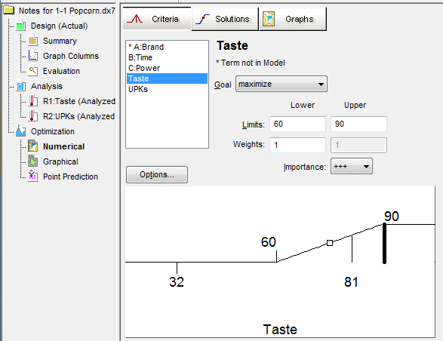
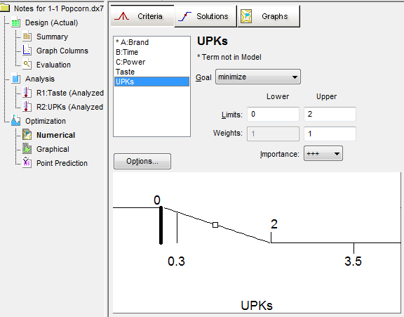
Popcorn Optimization
Numerical
Go to the Numerical Optimization node and set the goal for Taste to “maximize” with a lower limit of “60” and an upper limit of “90” – well above the highest result (a stretch).
Set the goal for UPKs to “minimize” with a lower limit of “0” and an upper limit of “2”.
Notes:
Use numerical optimization to maximize taste* and minimize un-popped kernels (UPK).
*The stretch target of 90 suffices to drive this up, but to serve more as a benchmark you could optionally enter the highest rating of 100 as the upper limit. However, this will make no difference in the optimization results. Also, a taste of 90 is plenty good!

Slide 62
Popcorn Optimization
Numerical
3. Click on the “Solutions” button:
Solutions
# Brand* Time Power Taste UPKs Desirability
1 Cheap 4.00 100.00 79 0.7 0.642 Selected
2 Cheap 4.04 100.00 78.14 0.694 0.628
3 Cheap 6.00 75.00 75.5 1.4 0.394
*Has no effect on optimization results.
Take a look at the “Ramps” view for a nice summary.
Notes:
Here are the solutions. Note that due to the algorithm convergence, you can get differing number of solutions. The first two solutions shown here are the same for all practical purpose, and the third solution meets the criteria, but is not as good.

Slide 63
Popcorn Optimization
Numerical
4. Click on the “Graphs” button and by right clicking on the factors tool pallet choose “B:Time” as the X1-axis and “C:Power” as the X2-axis: Choose “Contour” and “3D Surface” from the “Graphs Tool”:
Notes:
Contour and 3D graphs showing two optimums.

Slide 64
Popcorn Optimization
Numerical
5. Choose “Interaction” from the “Graphs Tool”:
Taste decreasing
UPKs increasing
Notes:
This graph shows the two optimums and their sensitivity to time (factor B) as a function of power (factor C).
Starting at the left (the optimum at 100% power – color-coded red), as time is increased the taste decreases and eventually falls below our minimum of 60 and desirability is then zero.
Starting at the right (the optimum at 75% power – color-coded black), as time is decreased the UPKs increase and eventually exceed our maximum of 2 and desirability is then zero.

Slide 65
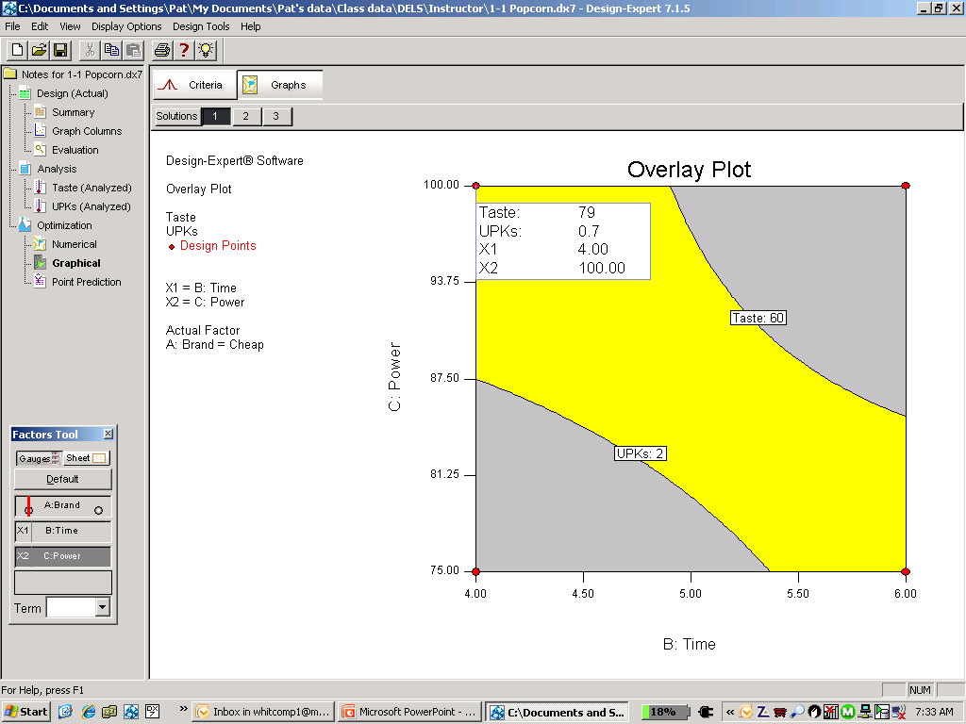
Popcorn Optimization
Graphical
Notes:
The lower limit for taste (since its goal is maximize) and the upper limit for UPKs (since its goal is minimize) are carried over to the graphical optimization.
To produce this view, right-click on the factors tool palette and choose “B:Time” as the X1-axis and “C:Power” as the X2-axis.

Slide 66
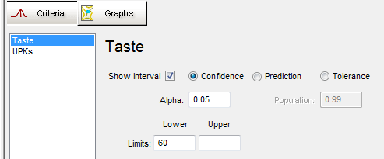
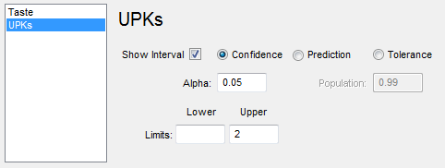
Popcorn Optimization
Graphical
Let’s add confidence intervals to the graph to find a comfortable operating region.
Notes:
These boundaries are based on one experiment that only samples the process. Thus, they are subject to uncertainty. It helps to get a feel for how much of a buffer is needed to reduce the chances of going out of the specifications.

Slide 67
Popcorn Optimization
Graphical
Graphical optimization including confidence interval:
Notes:
Choose from confidence intervals, prediction intervals, or tolerance intervals to more accurately define the final design space. For more details, attend our RDTA workshop (offered for private sessions only.)

Slide 68
Popcorn Optimization
Graphical – More Demanding
Drag the Taste and UPK responses to more-demanding levels of ~70 and ~1.5; respectively. Then flag the new sweet spot (via a right-click).
Notes:
If you discover that the proposed region is large, you can tighten up the specs and close in on the “optimum” conditions! In this case, we can achieve an even better yield and taste than originally expected.

Slide 69
Popcorn Summary
From this case we learned how to:
  Calculate effects
  Select effects via the Half Normal Plot
  Interpret an ANOVA
  Validate the ANOVA using Residual Diagnostics
  Interpret model graphs
  Use numerical and graphical optimization
  Now we’re off and running!
Notes:
Summary of lessons learned from the popcorn case study.

Slide 70
2^{k} Factorial Design
Advantages
    What could be simpler?
    Minimal runs required.
      Can run fractions if 4 or more factors.
    Have hidden replication.
    Wider inductive basis than OFAT experiments.
    Show interactions.
      Key to Success - Extremely important!
    Easy to analyze.
    Interpretation is not too difficult.
    Can be applied sequentially.
    Form base for more complex designs.
      Second order response surface design.
Notes:
The reason people use OFAT experimentation is ignorance, they don’t know a better way to experiment. Now you know a better way!

Slide 71
Agenda Transition
The advantages of DOE
              The design planning process
              Response Surface Methods Strategy of Experimentation
              Example AIAA-2007-1214

Slide 72
Design Selection
Depends on the Purpose
Use Res IV fractional factorials when:
  some of the significant factors are unknown
  the number of runs is limited
  Resolution IV designs are not appropriate for characterization or optimization.
Notes:
Screening DOE – Finding a subset of factors for further study.

Slide 73
Design Selection
Depends on the Purpose
Use Res V fractional factorials or full factorials when:
  the number of runs is not as limited
  center points are added to detect curvature
  an interaction model with insignificant curvature can be used for optimization.
  a more powerful screening design is needed
Notes:
Characterization – Quantifying main effects and interactions, moving through the factor space toward the optimum.

Slide 74
Design Selection
Depends on the Purpose
Use Response surface designs when:
  the important factors are known
  the goal is optimization
  factor ranges are well-defined
  can still fit lower-order interaction models
  can often be obtained by augmenting previous factorial experiments
Notes:
Optimization – Finding the factor levels within the region of interest that best meet response requirements.

Slide 75
Response Surface Methodology
Subject Matter
Knowledge
Factors
Design of Experiments
  Region of Operability
  Region of Interest
Process
Responses
Empirical Models
(polynomials)
ANOVA
Contour Plots
Optimization
Notes:
Here is a flow chart on RSM. As you can see, it all starts and ends with subject matter knowledge. You need this to pick the right factors and levels, and appropriate responses. Then you do your DOE and fit empirical models, statistically validated via ANOVA. Finally you generate contour plots and do your optimization. Often the cycle must be repeated until you reach a satisfactory conclusion, or run out of money. The fitting is done using least-squares-regression supported by analysis of variance (ANOVA) to ensure that the resulting model is statistically significant. This process is empirical in nature. All that matters is that the model points in the proper direction for improvement. Ideally, the pictures (contour, 3D) tell the story.
According to George Box: “All models are wrong, but some are useful. Only God knows the [true] model.”

Slide 76
RSM DOE Process (1 of 2)
Identify opportunity and define objective.
  Write it down!
State objective in terms of measurable responses.
  Define the goal for each response.
    Detection of important factors
    Optimization of the response
  Estimate experimental error (σ) for each response.
Notes:
The “RSM DOE Process” stage on the “Iterative Experimentation” slide implies a five step process. Following the process will help you choose the right design for the job.

Slide 77
RSM DOE Process (2 of 2)
Select the input factors and ranges to study.
(Consider both your region of interest and region
of operability.)
Select a design to achieve the objective:
  Size design using
    Power for detecting effects
    Precision (FDS) for optimization
  Examine the design layout to ensure all the factor combinations are safe to run and are likely to result in meaningful information (no disasters).
Notes:
Properly sizing a design is critical when planning a DOE.

Slide 78
Polynomial Approximations
A decent approximation of any continuous mathematical function can be made via an infinite series of powers of x, such as that proposed by Taylor. For RSM, this takes the form:
  The higher the degree of the polynomial, the more closely the Taylor series can approximate the truth.
  The smaller the region of interest, the better the approximation. It often suffices to go only to quadratic level (x to the power of 2).
  If you need higher than quadratic, think about:
    A transformation
    Restricting the region of interest
    Looking for an outlier(s)
    Consider a higher-order model
Notes:
Review points on slide re: polynomial expansions.
Based on experience, it turns out that second order polynomials, called quadratics, usually prove sufficient to give an adequate view of the true response surface. Cover up last line in equation with cubic terms, so only quadratic shown. How does this equation differ from a factorial model? (Answer: the squared terms. The factorial model for two factors is semi-quadratic - it gives the second order interaction but not pure curvature.)

Slide 79
Least Squares Regression
Residual Analysis
Data
(Observed Values)
Signal + Noise
Analysis
Filter Signal
Model
(Predicted Values)
Signal
Residuals
(Observed - Predicted)
Noise
Independent N(0,σ²)
Notes:
Examine the residuals to look for patterns that indicate something other than noise is present.
If the residual is pure noise (it contains no signal), then the analysis is complete.

Slide 80
Residual (Noise) Sources
When analyzing a physical experiment noise comes from three main sources.
factors that are not controlled,
including measurement factors
approximation (polynomial) isn’t a perfect emulation of the true response behavior creating lack-of-fit
poor control of the controlled factor settings

Slide 81
Residual (Noise) Sources
Replicates provide an estimate of the variation caused by unaccounted for variables.
Referred to as Pure Error.
Lack-of-fit is the difference between the modeled trend and the average observations.
Lack of control (error) in the factor settings can propagate to the responses.

Slide 82
Lack of Fit
Six Replicated Design Points
SS_{residuals} = SS_{pure error} + SS_{lack of fit}
SS_{pure error} = SS of the replicates about their means
SS_{lack of fit} = SS of the means about the fitted model.
Is the variation about the model greater than what is expected given the variation of the replicates about their means?
Notes:
The lack of fit F-test is: (Lack of Fit MS) / (Pure Error MS)
The numerator is the difference between the mean vs predicted values and the denominator is the difference between the replicates and their mean value.
After fitting a linear model to the data in the top picture, the variation of the replicated design points about their means is about the same as the variation of the means from fitted line; i.e. the lack of fit is insignificant.
For more information, download the article found on Page 2 of the May 2004 Stat-Teaser:
www.statease.com/news/news0405.pdf

Slide 83
Lack-of-Fit
Six Replicated Design Points
1st order model – significant lack of fit.
2nd order model – insignificant lack of fit.
Notes:
After fitting a linear model to the data, the variation of the replicated design points about their means is much less than the variation of their means from fitted line; i.e. the lack of fit is significant. Adding a quadratic term to the linear model curves the line so it once again goes through the averages of the paired data points and the lack of fit becomes insignificant.

Slide 84
Model Selection
Lack of Fit Tests
The lack of fit test compares the residual error to the pure error from replicated design points. A residual error significantly larger than the pure error may indicate that something remains in the residuals that may be removed by a more appropriate model.
Lack-of-fit requires:
  Excess design points (beyond the number of parameters in the model) to estimate variation about the fitted surface.
  Replicate experiments to estimate “pure” error.
Notes:
No model can explain the inherent variation in the process being studied. This variation is estimated by replicating runs and is called pure error. Variation of the design points about the fitted model is estimated by having more unique mixtures than there are coefficients in the model estimated. If the variation about the fitted model is not significantly larger than the variation among the replicates, the lack of fit is insignificant.

Slide 85
“Good” Response Surface Designs
A Statistician’s Wish List
Allow the polynomial chosen by the experimenter to be estimated well.
Give sufficient information to allow a test for lack of fit.
  Have more unique design points than coefficients in model.
  Replicates to estimate “pure” error.
Remain insensitive to outliers, influential values and bias from model misspecification.
Be robust to errors in control of the factor levels.
Permit blocking and sequential experimentation.
Provide a check on variance assumptions, e.g., studentized residuals are N(0, σ²).
Generate useful information throughout the region of interest, i.e., provide a good distribution of .
Do not contain an excessively large number of trials.
Notes:
Here is a checklist against which we can gauge design quality.
Discuss “good” points on slide re: RSM.
You design an RSM experiment for a specific polynomial and you need good estimates of the coefficients for that polynomial.
You need to pick additional design points beyond the number required to estimate the coefficients to make sure that we can describe the behavior in the region that we’re studying. An example - say you want to fit a linear model. How many points do you need? Answer - 2 points. Now what if you want to see if the linear model is the correct choice, what should you do? Answer - add a point in the middle to be used for testing for the model fit. For testing our model fit, we need both extra unique design points and replicates. We need replicates to provide the error of replication “pure error” in order to do the test for model fit.
Another reason for adding more design points is to reduce leverages.
Another reason for extra design points is that we estimate our regression coefficients by averaging over all the data points, so the variation in the control of the factor levels will be included in the error. This becomes more of a problem with minimal point designs that we will be discussing later.
We often use sequential experimentation and the addition of extra blocks to our design while we are exploring the design space or looking for an appropriate model. For instance, you may augment a factorial design to a CCD, or you may add points so that you can move from a quadratic model to a cubic model.
Make sure that there are no leverages close to or equal to 1 as this can throw off the residual analysis.
Provide a good distribution of the error associated with the coefficient estimates. We want uniform precision across the design space. For instance, we replicate the center of a CCD to reduce the “bump” that occurs in the standard error plot.
We don’t want to do more work than necessary!

Slide 86
Agenda Transition
The advantages of DOE
              The design planning process
              Response Surface Methods Strategy of Experimentation
              Example AIAA-2007-1214

Slide 87

Strategy of Experimentation
Screening in the presence of two-factor interactions
Transition to characterization design
Transition to Response Surface Method (RSM) design
Confirmation
Mark Anderson and Pat Whitcomb (2007), DOE Simplified, 2nd edition, Productivity Press, chapter 8.
Notes:
Contents of Section 6.

Slide 88
Agenda Transition
Screening in the Presence of 2FIs
Learn proper screening techniques
Transition to characterization design
Transition to RSM design
Confirmation

Slide 89

Arc-Welding Process
This case illustrates the iterative progression of designs through the strategy-of-experimentation flowchart.
Screening – Res III
  “Do-over” with Res IV
Characterization
Curvature test
  Transition to RSM
Confirmation
Notes:
It will be good to work through a process development from start to finish through a series of iterative experiments.

Slide 90

Arc-Welding Case Study
The back-story:
Jim's fabrication shop won a bid for a job with Stan's MonoRailCar Company. Stan has asked Jim to ensure that the welds, the weak point mechanically, have high tensile strength. Jim must experiment to improve the welds.
The goal:
Find factor settings that increase tensile strength of the welds.
Notes:
The good news is that Jim won the bid. The bad news is that he cannot deliver without first improving the welds.

Slide 91

Arc-Welding Case Study
This is new territory for Jim and his engineers so they must brainstorm how to get the best welds for this project. Their fishbone chart shows 22 possible variables that affect mechanical strength.
After much discussion, they narrow down the field by more than half to 10 factors. Of these 10 factors, 2 are known to create substantial effects:
  Current
  Metal substrate (two “SS” types of stainless steel)
The other 8 have unknown effects. They will be studied in a screening design. However, the last of these chosen factors don’t have much support – it might be dropped.
Continue for detail on factors
Notes:
The other factors, those not chosen for experimentations now or later, will be held constant at their current levels.

Slide 92
Arc-Welding Process
Factors for Screening Experiment
 | Factor | Standard | Range
A | Angle | 65 degrees | 60 - 80 deg
B | Substrate Thickness | 8 mm | 8 - 12 mm
C | Opening | 2 mm | 1½ - 3 mm
D | Rod diameter | 4 mm | 4 - 8 mm
E | Rate of travel | 1 mm/sec | ½ - 2 mm/sec
F | Drying of rods | 2 hr | 2 - 24 hr
G | Electrode extension | 9 mm | 6 - 15 mm
H | Edge prep | Yes | No-Yes
The edge prep (H) takes time: Is it really necessary?
Notes:
Start designs by creating a list of factors, their standard conditions, and test ranges.
The last factor is on the ‘bubble’ (tossed into the list on a whim), is categorical.

Slide 93
Screening Designs
Purpose: Quickly sift through a large number of factors to find the critical few for further study.
Tool: Fractional factorials.
One of the engineers learned that it’s possible to saturate designs with factors up to one less than the number of runs. For example, 7 factors can be studied in only 8 runs! The manager Jim likes this idea a lot. [Unfortunately the last factor must be over-looked. ☹]
Why not do as many factors
in as few runs as possible?
Notes:
Now let’s use two-level fractional factorials to screen a set of factors to find those with large main effects. The temptation is to go to the maximum factors in minimum runs, especially if you are ignorant or uncaring about aliasing of interactions.

Slide 94

Arc Welding
Screening Design (page 1 of 3)
Identify opportunity and define objective.
Determine if any of the top 7 factors have an influence on tensile strength.
State objective in terms of measurable responses.
Want to correctly identify main effects. (There is a possibility that interactions could exist.)
  Define the change (Δy) that is important to detect for each response. Δ_{tensile} = 2500 psi
  Estimate error (σ): σ_{tensile} = 1000 psi;
  c. Calculate signal to noise: Δ/σ = 2.5
Notes:
This is a classic example of a situation where a screening design is appropriate. But is this the right approach?

Slide 95
Arc Welding
Screening Design (page 2 of 3)
Select the input factors to study.
Factor | Name | Units | Type | Low Level (−) | High Level (+)
A | Angle | degrees | numeric | 60 | 80
B | Substrate Thickness | mm | numeric | 8 | 12
C | Opening | mm | numeric | 1.5 | 3.0
D | Rod diameter | mm | numeric | 4 | 8
E | Rate of travel | mm/sec | numeric | 0.5 | 2.0
F | Drying of rods | hr | numeric | 2 | 24
G | Electrode extension | mm | numeric | 6 | 15
Notes:
Seven factors for screening.

Slide 96
Arc Welding
Screening Design (page 3 of 3)
4. Select a design:
  Evaluate aliases (fractional factorials and/or blocked designs) During build
  Evaluate power (desire power > 80% for effects of interest) Order: Main effects
  Examine the design layout to ensure all the factor combinations are safe to run and are likely to result in meaningful information (no disasters)
  2⁷⁻⁴ design
Notes:
Use a fractional factorial design for screening.

Slide 97
Resolution III Design
Fractional Factorial
Let’s try using resolution III design for screening these factors to find the vital few for further study.
  [A] = A + BD + CE + FG + BCG + BEF + CDF + DEG
  [B] = B + AD + CF + EG + ACG + AEF + CDE + DFG
  [C] = C + AE + BF + DG + ABG + ADF + BDE + EFG
  [D] = D + AB + CG + EF + ACF + AEG + BCE + BFG
  [E] = E + AC + BG + DF + ABF + ADG + BCD + CFG
  [F] = F + AG + BC + DE + ABE + ACD + BDG + CEG
  [G] = G + AF + BE + CD + ABC + ADE + BDF + CEF
Notes:
Here’s the 7 factor in 8 run option for a standard 2-level design. What do you think about this alias structure? (Answer: it’s a can of worms. Because this is now a saturated resolution III design, with a maximum number of factors in a minimal number of runs, each main effect is confounded with many two factor interactions.)
George Box likens running designs like this to kicking your TV to make it work. Maybe you’ve tried this on your PC!

Slide 98
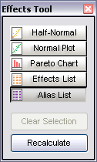
Arc Welding
Screening Design
Three main effects stand out, but are they really the correct effects?
Look at the aliases!
Notes:
In Design-Expert a selected effect can be right-clicked to see their individual alias structure.

Slide 99
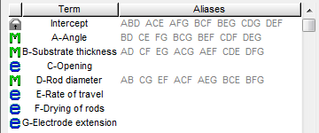
Arc Welding
Screening Design
The selected (M) terms (main effects) are each aliased with three two-factor interactions! Thus one must consider other possible families of effects, such as:
A, B and D = AB, CG, and/or EF
B, D and A = BD, CE, and/or FG
A, D and B = AD, CD, and/or EG
Notes:
With a Resolution III design, the main effects are confounded with two-factor interactions, making it impossible to know the truth.

Slide 100
Screening in the Presence of 2FIs
Fractional Factorial
Summary:
  ☺ Found effects!
  ☹ No idea if the labels are correct, no idea if the truth involves interactions or not!
  ☹ Is guaranteed to give the wrong answer if interactions exist.
Notes:
Summary of Resolution III design. The only thing learned from a resolution III design is something is causing a change in the response. More work is required to determine which factors are truly involved.

Slide 101
Better Choice for Screening Design
Using a resolution III design for screening is a setup for failure – just a waste of time. Besides aliasing, power may also be an issue.
Better choice: A resolution IV design that will completely separate the main effects from the 2FI’s.
  Regular fraction: 2⁷⁻³ design – 7 factors in 16 runs.
  Minimum Run Res IV: 7 factors in 14 runs (but consider adding 2 more runs – just in case a few do not go as planned, that is, “stuff happens.”)
  Why not include the marginal factor? This can be done in a MR4+2 with 18 runs.
Notes:
Let’s use the right design for screening – at least Resolution IV.

Slide 102
Minimum Run Resolution IV
MR4 Designs*
MR4 designs are for minimum-run screening.
They often offer considerable savings versus a standard 2^{k-p} fraction with the same resolution.
MR4 designs require only two runs for each factor (that is, runs = 2 times k).
However, to be conservative, add two more runs.
Notes:
* Screening Process Factors In The Presence of Interactions, Mark Anderson and Pat Whitcomb, presented at AQC 2004 Toronto. May 2004. Available as PDF at: www.statease.com/pubs/aqc2004.pdf/.

Slide 103
MR4 (+2) Designs
Provide Considerable Savings
k | 2^{k-p} | MR4+2 |  | k | 2^{k-p} | MR4+2
5 | 16 | 12 |  | 16 | 32* | 34
6 | 16 | 14 |  | 17 | 64 | 36
7 | 16 | 16 |  | 19 | 64 | 40
8 | 16* | 18 |  | 20 | 64 | 42
9 | 32 | 20 |  | 21 | 64 | 44
10 | 32 | 22 |  | 25 | 64 | 52
11 | 32 | 24 |  | 30 | 64 | 62
12 | 32 | 26 |  | 35 | 128 | 72
13 | 32 | 28 |  | 40 | 128 | 82
14 | 32 | 30 |  | 45 | 128 | 92
15 | 32 | 32 |  | 50 | 128 | 102
*No savings for 8, 16 (or 32) factors.
Notes:
Note that in some cases there are large savings. Two additional runs added to the minimum number make the MR4+2 designs robust to missing data. Therefore, these (arguably) make a better choice even for the 8, 16 or 32 factor options.

Slide 104
Minimum Run Resolution IV
(MR4+2) Designs
Problems:
  If even 1 run lost, design becomes resolution III –
  main effects become badly aliased.
  Reduction in runs causes power loss – may miss significant effects.
    Evaluate power before doing experiment.
Solution:
  To reduce chance of resolution loss and increase power, consider adding some padding:
    Whitcomb & Oehlert “MR4+2” designs
Notes:
If even one run in a MR4 design is lost, the design becomes a resolution III design – a disaster! Adding two runs makes the “MR-4 +2” design robust to this problem.
Suggestion – in a screening experiment use a model with only about HALF the main effects to evaluate power. In other words, choose the Main Effects model, and then double-click on about half the terms to put them in error.

Slide 105
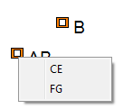
Arc Welding
Screening Design
Now it is clear that only two main effects are active. Subject matter knowledge suggests that the AB interaction is more likely than the other 2FIs seen via a right-click.
On to characterization >>
Notes:
CE and FG are aliased with AB. However, with good process understanding it can be presumed that AB is the correct interaction. Often, significant parent terms can be used as a guide to pick the correct interaction from resolution IV analysis, but not always. Interactions picked this way must be backed up with more data collection via confirmation runs and/or resolution V and higher factorial designs.

Slide 106
Screening in the Presence of 2FIs
MR4+2 Design (8 factors in 18 runs)
Summary:
  ☺ Correctly selected all main effects!
  ☺ In the presence of two-factor interactions, only designs of resolution IV (or higher) can ensure accurate screening.
Use resolution IV designs for screening!
Notes:
We suggest you always use a resolution IV (or higher) design for screening.

Slide 107
Agenda Transition
Screening in the Presence of 2FIs
Transition to characterization design
Combine known factors with the vital few in a Res V design
Transition to RSM design
Confirmation

Slide 108
Arc Welding
Screening to Characterization
Recall that two factors, current and metal substrate, “known” to be important were set aside from the screening process.
Now we combine the two “known” factors with the two “vital few” factors discovered during screening and create a characterization design (Angle and substrate thickness.)
Notes:
Transition from screening to characterization.
Factors C (current) and D (metal substrate) are brought into play and combined with A (angle) and B (substrate thickness).

Slide 109
Center Points in Factorial Designs
Why add center points:
  By looking at the difference between the average of the center points and the average of the factorial design points, you get an indication of curvature.
  Replicating the center point gives an estimate of pure error.
Notes:
Here’s a nice enhancement to standard two-level factorials; add some center points. The center point, as shown in 3-factor design, is run at the midpoint of all factors, or in this representation, the (0,0,0) coordinate in coded (-1/+1) units. The addition of a center point, replicated several times, provides these advantages:
- An estimate of pure error at baseline conditions
- A check for pure quadratic curvature

Slide 110
Center Points in Factorial Designs
2³ factorial with center point 3³ Three-level factorial
(8 runs plus 4 cp’s = 12 pts) (27 runs + 5 cp’s = 32 pts)
Notes:
A factorial with a center point is not the same as running three levels of each factor.
The three-level factorial with 5 center points is one of the designs provided on the “Response Surface” tab.

Slide 111
Why Add Center Points?
To validate the factorial model in the current design space.
To estimate curvature, typically when you think the optimum is inside the factorial cube.
To provide a model independent estimate of experimental error, i.e. pure error.
To check process stability over time. (Suggestion: Space the center points throughout the design by modifying their run order.)
If the standard operating conditions occur at the center point, then the CPs provide a control point. ☺
Notes:
Situations when an experimenter should consider adding center points to their design.

Slide 112
Center Points
Impact of Categoric Factors
Watch out for proliferation of center points:
  In a design with categoric factors the number requested are added for each combination of the categoric factors.
  In a blocked design the number requested are added to each block.
Example: Consider a 2⁵ full factorial with 2 categoric factors, 2 blocks and 3 center points. In this case 24 center points are added; 3 at each of the 4 combinations of the categoric factors in each of the 2 blocks.
(3 x 4 x 2 = 24)
Notes:
Blocks and categoric factors increase the total number of center points added to a design. This must be taken into consideration when planning your DOE. It may be necessary to sort out the categoric factors prior to adding center points.

Slide 113
Arc Welding
Characterization Design (page 1 of 5)
Identify opportunity and define objective.
Determine if there are interactions among four factors – the vital few that influence tensile. (Two known from the start, plus two identified via the screening experiment.)
State objective in terms of measurable responses.
Correctly identify interactions and test for curvature.
  Define the change (Δy) that is important to detect for each response. Δ_{tensile} = 2500 psi
  Estimate error (σ): σ_{tensile} = 1000 psi
  c. Calculate signal to noise: Δ/σ = 2.5
Notes:
All responses have to be considered when evaluating power.

Slide 114
Arc Welding
Characterization Design (page 2 of 5)
Select the input factors to study.
Factor | Name | Units | Type | Low Level (−) | High Level (+)
A | Angle | degrees | numeric | 60 | 80
B | Substrate Thickness | mm | numeric | 8 | 12
C | Current | Amp | numeric | 125 | 160
D | Metal substrate |  | categoric | SS35 | SS41
Three center points are added to test for curvature.
Due to the categoric factor, six runs will be added to the design (three for each categoric combination)
Notes:
Recall the current and metal substrate (stainless steel types) are the known factors held in reserve until after the screening of unknown factors.
Characterization designs often have center points to test for curvature. In this case, with the categoric factor, the number of requested center points will be doubled.

Slide 115
Arc Welding
Characterization Design (page 3 of 5)
4. Select a design:
  Evaluate aliases (fractional factorials and/or blocked designs) Not relevant in this experiment.
  Evaluate power (desire power > 80% for effects of interest) Order: Main effects
  Examine the design layout to ensure all the factor combinations are safe to run and are likely to result in meaningful information (no disasters)
  2⁴ design
Notes:
Since there are only 4 factors, the full factorial makes sense.

Slide 116
Arc Welding
Half-Normal Plot of Effects
Notes:
The AB interaction is confirmed! Recall that it could have been CE and/or FG. Further work with a resolution V design cleared up the aliasing.

Slide 117
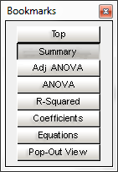
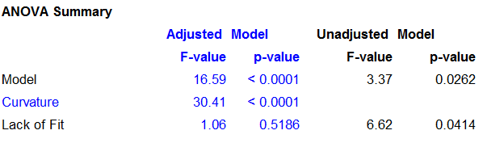
Arc Welding
ANOVA Summary
The model is significant – good!
Curvature is significant – causing lack-of-fit. ☹
There is insignificant lack-of-fit after curvature adjustments; no additional problems besides curvature. Interesting!
Notes:
This ANOVA consists of the terms D, AD, B, A, C, AB. Here is the breakdown that comes along with center points:
Adjusted model: The factorial model is augmented with coefficients to adjust the mean for curvature; i.e. remove curvature SS from lack of fit SS. This provides the factorial model coefficients you would get if there were no center points. This model separates problems due to curvature from those due to the model not fitting the factorial points. This model is only appropriate for calculating diagnostics. It is not appropriate for prediction since quadratic coefficients needed to model curvature are aliased with one another.
Unadjusted model: The factorial model coefficients are fit using all the data (including center points); this is the usual regression model. Since the quadratic coefficients needed to model curvature are aliased with one another curvature cannot be modeled and curvature SS is now included in lack of fit SS. This model is appropriate for both diagnostics and prediction.
If curvature is not significant, then the two models (adjusted and unadjusted) are comparable and the diagnostics should be viewed using the unadjusted model.

Slide 118
Arc Welding
AB & AD Interactions
Curvature is significant: As the interaction graphs show, the average of the center points falls above the interaction lines.
Notes:
Curvature is significant - the lines miss (fall below) the middle of the center points.

Slide 119
Arc Welding
Graph Columns
Curvature appears in every numeric factor!
Notes:
Graph Columns provides a very helpful view of things before you get bogged down in the statistical analysis.

Slide 120
Arc Welding
Graph Columns
Curvature appears in every numeric factor!
Notes:
Graph Columns provides a very helpful view of things before you get bogged down in the statistical analysis.

Slide 121
Arc Welding
Graph Columns
Curvature appears in every numeric factor!
Notes:
Graph Columns provides a very helpful view of things before you get bogged down in the statistical analysis.

Slide 122
Arc Welding
Graph Columns
Replicated center points only provide a test for curvature.
More work is needed to identify which factors cause the curvature in the response.
Curvature is an aliased combination of all the possible quadratic effects.
SS(curvature) = SS(A^2) + SS (B^2) + SS(C^2)

Slide 123
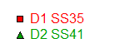
Arc Welding
Characterization Design – AD Analysis
Can we still answer some questions? (Yes!)
Which substrate works best?
Why continue to test the other?
Given the significant curvature what should be done next?
Notes:
The SS41 works best throughout the space – at the outer edges and the middle. Keep working with that material only and forget about the SS35. In any case, the significant curvature indicates that even higher tensile strength might be possible in the middle of the design space. On to RSM designs!

Slide 124
Arc Welding
Characterization Design – Conclusions
  SS41 has higher tensile and should be used in future optimization studies.
  There is significant curvature. What is causing this?
  An RSM design is required to fully understand the nonlinear behavior in the center of the design space.
Notes:
Recall the experimentation circle. Can we stop experimenting yet?
RSM = Response Surface Methods

Slide 125
Agenda Transition
Screening in the Presence of 2FIs
Transition to characterization design
Transition to RSM design
Significant curvature leads to RSM
Confirmation

Slide 126
Arc Welding
Optimization Design – Augmenting to RSM
  We can reuse the information from the SS41 substrate runs.
  Because substrate no longer changes, this factor can be removed.
  Limiting the experiment to critical changeable factors is the main advantage to sequential experiments.
  Result – Fewer total runs!
  Learn and adapt as you go.
Notes:
Recall the experimentation circle. Can we stop experimenting yet?

Slide 127
Arc Welding
Optimization Design – Augmenting to RSM
  The remaining runs are a three-factor design with three center-points.
  Such a design can be augmented into a central composite or other response surface design.
  The best part is 11 out of 19 runs are already done!
Notes:
Recall the experimentation circle. Can we stop experimenting yet?

Slide 128
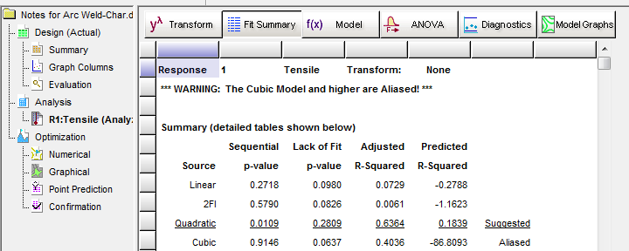
Arc Welding
RSM – Fit Summary
  The Fit Summary evaluates models built up from the mean to linear, 2FI (two-factor interaction) and quadratic (mainly used for RSM) orders. The suggested model is carried forward for further analysis.
Notes:
The quadratic model comes out best by far according to these key stats.

Slide 129
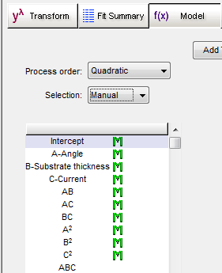
Arc Welding
RSM – Model Selection
  Various selection algorithms can be employed but to keep things simple, we will just go with the quadratic model in this case.
Notes:
Consider applying the backward selection to reduce the model. However, in most cases this won’t change the end results materially.
Learn more about model reduction in our Response Surface Methods for Process Optimization (RSM) workshop.

Slide 130
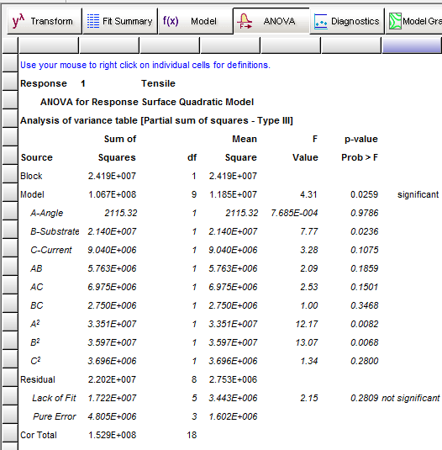
Arc Welding
RSM – ANOVA
So far,
so good!
Notes:
The overall model is significant with insignificant lack of fit.

Slide 131
Arc Welding
RSM – Diagnostics
Not bad!
Notes:
The rules for diagnostics are the same as for factorial designs.

Slide 132
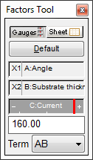
Arc Welding
RSM – Model Graph
Slide the C:Current bar left (-) to right (+) and see how this affects Tensile.
Notes:
Single-response RSM experiments with just a few important model factors are easy to assess via contour and 3D surface plots. Simply locate the hot spot and right-click to set a flag. Then use the numerical optimizer to pinpoint it more precisely.

Slide 133
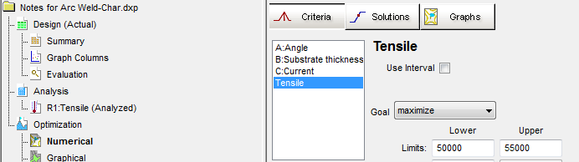
Arc Welding
RSM – Numerical Optimization (1/2)
Recall that as a condition for the MonoRailCar Company bid, Jim and his engineers must ensure that the welds, the weak point mechanically, provide high tensile strength. Assume that these must exceed 50,000 psi – the higher the better (55,000 suffices).
Notes:
The 55,000 level at the upper side provides a stretch target.

Slide 134
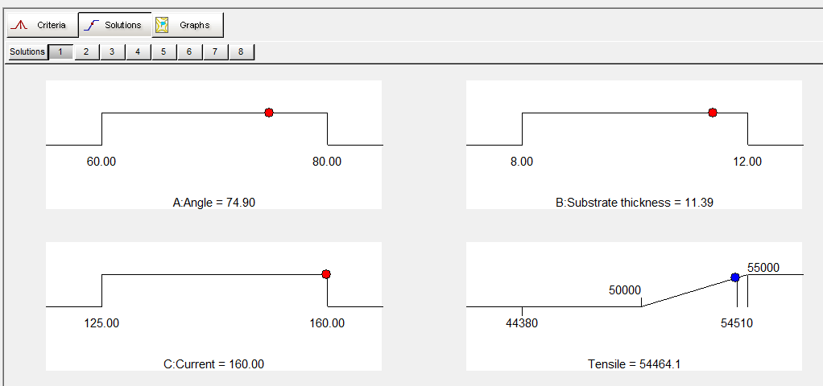
Arc Welding
RSM – Numerical Optimization (2/2)
Here’s a good solution!
Notes:
There are other combinations that differ slightly from this.

Slide 135
Agenda Transition
Screening in the Presence of 2FIs
Transition to characterization design
Transition to RSM design
Confirmation

Slide 136
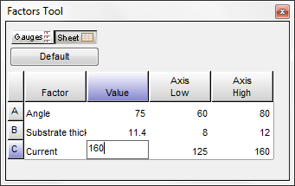
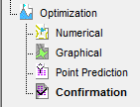
Arc Welding
Confirmation (1/2)
Based on the series of experiments they ran, Jim and his engineers settle on conditions for welds that will satisfy Stan, the owner of MonoRailCar Company. Here they are as entered for the confirmation runs:
Notes:
This Factors Tool in Design-Expert allows users to enter specific levels.

Slide 137
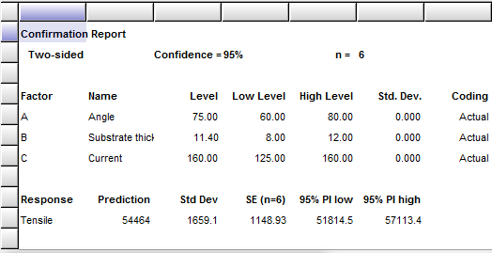
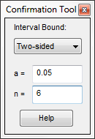
Arc Welding
Confirmation (2 of 2)
Here are the results for 6 confirmatory welds:
54944, 53227, 57386, 57514, 53323, 55125.
These come out on average at 55,253 – well-within the adjusted prediction interval (PI). Success! ☺.
Notes:
Always confirm your predictions!
Some Statistical Details:
FAQ from a Life Prediction Engineer emailed to stathelp@statease.com.
“I completed a successful experiment that led us to a new and improved [process] that now might meet all customer specifications. A dozen (12) follow-up [runs]exhibited average responses that fell within the prediction intervals (PI) presented by the new Confirmation node that came out with Design-Expert version 8.04. However, should we also worry whether each of the individual blends fall within the PI showed under the Point Prediction screen? Perhaps this creates a ‘double jeopardy,’ that is, being overly harsh in prosecuting the confirmation results.”
Answer from Stat-Ease StatHelp:
“Your instincts are correct: Focus on the average of the number (n) runs you complete for the confirmation – not the individual results. Statistical models only predict the average behavior of the system. If the average confirmation response is within the confirmation node’s prediction interval, then the model is confirmed.
Do not worry whether each of the individual blends fall within the original PI showed under the Point Prediction screen. This requires another statistical interval that contains the next outcome, and then the next outcome, followed by the next outcome, and so on and so forth. The formula for such an interval can be found in, Hahn and Meeker, Statistical Intervals, Wiley, 1991, pp. 62-64, Section 4.8 “Prediction Interval to Contain All of m Observations.” The prediction interval that contains m future outcomes is quite a bit wider than the prediction interval for 1 future outcome.
Even with this “all of m” corrected interval the conclusion drawn depends on how many fall (and how far) outside the limits these observations go. Take a look at the general distribution of the confirmation observations. One of the requirements for confirmation work is that it be done at the same conditions as the original block of experimental runs. If there is a consistent bias towards one side of the interval, then something different (random effects) probably occurred during the design than during the confirmation. Unfortunately (but being realistic), a whole host of things that can cause the confirmation to fail, not the least of which being that the model is wrong.”

Slide 138

Strategy of Experimentation
Wrap-up
  Option 1: Test all 10 factors in a single
  response surface method (RSM) design.
    Requires 80 runs or so.
    No flexibility to adapt along the way.
  Option 2: Sequential Experimentation (BEST!)
    Only 48 runs required – 18 for screening,
    22 to characterize, and 8 more for RSM optimization.
    Several chances to adapt as needed before committing all of the available time and resources!
Notes:
Option 1 employs a MR5-cored central composite design (CDD) – covered in our RSM class.

Slide 139
Agenda Transition
Brief description of designed experiments
  The advantages of DOE
                The design planning process
              Response Surface Methods Strategy of Experimentation
              Example AIAA-2007-1214

Slide 140
Aerobraking Example
The following example comes from a paper written by John A. Dec, “Probabilistic Thermal Analysis During Mars Reconnaissance Orbiter Aerobraking”, AIAA-2007-1214.
Aerobraking is a technique using atmospheric drag to reduce the spacecraft’s periapsis velocity thereby lowering the apoapsis altitude and velocity on each pass through the atmosphere. Eventually the desired orbit is achieved.

Slide 141
Aerobraking Example
The problem with this method is it is possible to destroy the solar arrays with excessive aerodyamic heating.
The purpose of the experiment is to understand the impact of materials properties of the spacecraft along with the in flight environment on the temperature of the solar arrays.
The PATRAN simulator was used to provide responses as it is not possible to physically control factors.
10 PATRAN runs can be done per hour and computer time is limited to 48 hours or 480 run budget.
Notes:
The PATRAN simulator used a deterministic model to produce the temperature response. Replicate runs returned the same value.

Slide 142
RSM DOE Process (1 of 2)
How things change with simulators
Identify opportunity and define objective.
  Model the aero-dynamic heating
State objective in terms of measurable responses.
  Find settings to keep the maximum solar array temperature under 175 C.
  Estimate experimental error ?
    A deterministic simulator is being used to provide the measured observations.
    There is no experimental error!

Slide 143
RSM DOE Process (2 of 2)
How things change with simulators
Select the input factors and ranges to study.
  25 factors are considered as having an effect on the solar array temperature.
Select a design to achieve the objective:
  Size the design
    Different rules apply with simulators
  Examine the design layout to ensure all the factor combinations are safe to run and are likely to result in meaningful information (no disasters).

Slide 144
Residual (Noise) Sources
How things change with simulators
Simulations usually mute the noise sources.
All the factors are controlled.
  Anything not being varied as a factor is fixed.
Lack-of-fit between the model and observations is the only “real” source of error.
Some simulators have a stochastic component to mimic realistic noise.
Notes:
The stochastic (random) component is usually a wiggle around the input (factor) settings indentified as POE. Occasionally, a simulator will also add random normal deviates to the response to mimic unexplained and/or measurement variation.

Slide 145
Residual (Noise) Sources
How things change with simulators
Replicates will consistently provide the same response. There is no pure error.
Lack-of-fit is the difference between the modeled trend and the observations.
The real world variation is severely underestimated by simulated responses.
This causes more effects to appear statistically significant.

Slide 146
“Good” Response Surface Designs
How things change with simulators
Allow the polynomial chosen by the experimenter to be estimated well.
Give sufficient information to allow a test for lack of fit.
  Have more unique design points than coefficients in model.
  Replicates to estimate “pure” error.
Remain insensitive to outliers, influential values and bias from model misspecification.
Be robust to errors in control of the factor levels.
Permit blocking and sequential experimentation.
Provide a check on variance assumptions, e.g., studentized residuals are N(0, σ²).
Generate useful information throughout the region of interest, i.e., provide a good distribution of .
Do not contain an excessively large number of trials.
Notes:
Replicates no longer produce different results. No “pure error” to test lack-of-fit against.
It is assumed the simulator will provide the correct response value for any given input. Point 3 should not be a concern, but if the assumption isn’t true, the false response will be modeled.
The Variance now only contains lack-of-fit noise. Designing for the correct order polynomial is the only way to fit the correct model.

Slide 147
“Good” Response Surface Designs
How things change with simulators
Allow the polynomial chosen by the experimenter to be estimated well.
Must have more unique design points than coefficients in model.
Remain insensitive to outliers, influential values and bias from model misspecification.
Be robust to errors in control of the factor levels.
Permit blocking and sequential experimentation.
Do not contain an excessively large number of trials.

Slide 148
Design Considerations
How things change with simulators
Latin Hypercube, uniform, distance based, etc.
  Pro – Space Filling
  Con – Not designed to fit polynomial models.
Central composite, Box-Behnken, etc.
  Pro – Efficient for estimating quadratic models
  Cons –
    have built in replicates that should be removed
    limited to a quadratic model
    unconstrained factor region

Slide 149
Recommended Designs
How things change with simulators
Optimal designs
  built for a custom polynomial model
  can be constrained
  easily augmented with distance based runs
  can over specify the required number of runs to improve the approximation.

Slide 150
Aerobraking Example
Simulation Experiments
25 factors are thought to be important for controlling solar array temperatures.
15 of the 25 factors were chosen by brainstorming to limit the size of the experiment.
Brainstorming relies on opinion and “known” facts.
Drag pass duration
Atmospheric density
Heat transfer coefficient
Periapsis velocity
Initial solar array temperature
Orbital heat flux
Orbital Period
Solar constant at Mars
Mars albedo
Mars Planetary IR
Aerodynamic heating accommodation coefficient
M55J graphite emissivity
ITJ solar cell emissivity
M55J graphite thermal conductivity
M55J graphite specific heat
Aluminum honeycomb core thermal conductivity
Aluminum honeycomb core specific heat
ITJ solar cell thermal conductivity
ITJ solar cell specific heat
ITJ solar cell absorptivity
M55J graphite absorptivity
Outboard solar panel mass distribution
Solar cell layer mass distribution
Contact resistance
View factors to space
Notes:
The earth was flat for a long time due to a known fact.

Slide 151
Aerobraking Example
The original concept had 25 factors.
Brainstorming reduced this number down to 15 critical factors to vary as inputs to the PATRAN simulator.
Can sequential experiments improve the efficiency of the process and provide data driven decisions?
Let’s look at the numbers!

Slide 152
Strategy of Experimentation
Wrap-up (25 factors)
  Option 1: Test 25 factors in a single response surface design.
    Requires 377 runs or so.
    No flexibility to adapt along the way.
    Provides a complete picture
  Option 2: Sequential Experimentation (BEST!)
    Only 191 runs required
      50 runs for screening 25 factors
      141 runs to optimize 15 factors with an optimal design for a quadratic model.
Notes:
377 runs for a quadratic model across 25 continuous factors. This would have fit the 480 run budget outlined in AIAA-2007-1214.
191 runs makes this a one-day experiment even leaving budget for follow up confirmation experiments.

Slide 153

What actually happened
15 factors were chosen through brainstorming and expert opinion.
A 296 run central composite design was fed into the PATRAN simulation.
  This design included 10 replicated center points.
The analysis was used to guide the project.
140 Terabytes of data later...
Notes:
Image Credit: NASA/JPL-Caltech

Slide 154
Uncertainty Approaches
There is uncertainty about what factor settings the vehicle will experience during aerobraking.
Uncertainty must be understood to determine the safe operating windows.

Slide 155
Uncertainty Approaches
Original Method
The model generated from the analysis was used in a Monte-Carlo simulation.
Each pass used its own navigation plan, providing...
  the drag pass duration
  expected atmospheric density
  initial array temperature
  periapsis velocity
Other factors were maintained at a fixed setting.

Slide 156
Uncertainty Approaches
Original Method
The Monte-Carlo was asked to simulate across a +/- 3 standard deviation wiggle in the factor settings.
The proportion of times the window exceeded 175 C was calculated to determine safety.
If all the required orbital passes were deemed safe enough, the aerobraking plan was accepted.

Slide 157
Uncertainty Approaches
A statistical approach
Interval estimates use the estimated standard deviation (Root mean square) to produce a band around the predictions.
Propagation of error is used in conjunction with the polynomial model to estimate how much variation is transmitted from uncertain factors to the response.
Combining the two provides the most realistic estimate of what can be expected in flight.

Slide 158
Interval Estimates
Definitions
CI is for the Mean
PI is for an Individual
TI is for a proportion of the population
Be conservative - use the wide tolerance interval
Prediction
CI
PI
TI
Notes:
As you can see from the diagram the distribution of the means is narrower. This is predicted by the central limit theorem, which says that the variance of averages will be the variance of the individuals divided by n, where n is the sample size. Thus the confidence interval (CI) is always smaller than the prediction interval (PI), which is based on an individual. The prediction interval is smaller than the tolerance interval (TI) which is based on a proportion of the individuals (population).

Slide 159
Tolerance Interval
Portion of Population
  A 99% tolerance interval (TI) with 95% confidence is an interval which will contain 99% (P=0.99) of all outcomes from the same population with 95% (α=0.05) confidence estimating the mean and standard deviation of the population.
  P and α can be set independently. A common setting is P=99% of the population with 95% (α=0.05) confidence in the estimates.

Slide 160
Propagation of Error
Experiment Requirements
  Factors that might be uncontrolled in the “real world” can be controlled during the experiment.
  Knowledge about how a factor varies in the real world.
    A normal distribution can be used as a guide.

Slide 161
Propagation of error
Goal: Estimate realistic error
What is POE?
The amount of variation transmitted to the response
(using the transfer function):
  from the lack of control of the control factors and variability from uncontrolled factors
  (you provide these standard deviations),
  plus the normal process variation
  (obtained from the ANOVA).
It is expressed as a standard deviation.
Notes:
is a powerful tool in the battle to reduce variation. Luckily software handles the heavy lifting with the math.

Slide 162
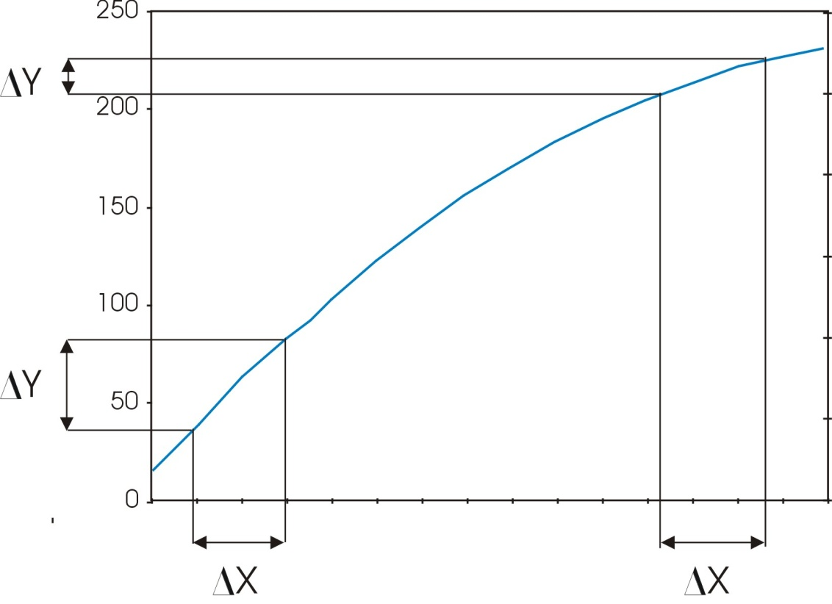
Propagation of error
Just a little mathematical explanation
Flat regions are where variation in the factors transmits the least variation to the response.
The slope is the 1st derivative of the prediction equation.
Notes:
Now we will quantify the transmitted variation using POE. As you can see in this example, it involves some math. We start by establishing a predictive model. Then the first derivative of the prediction model will minimize the slope.

Slide 163
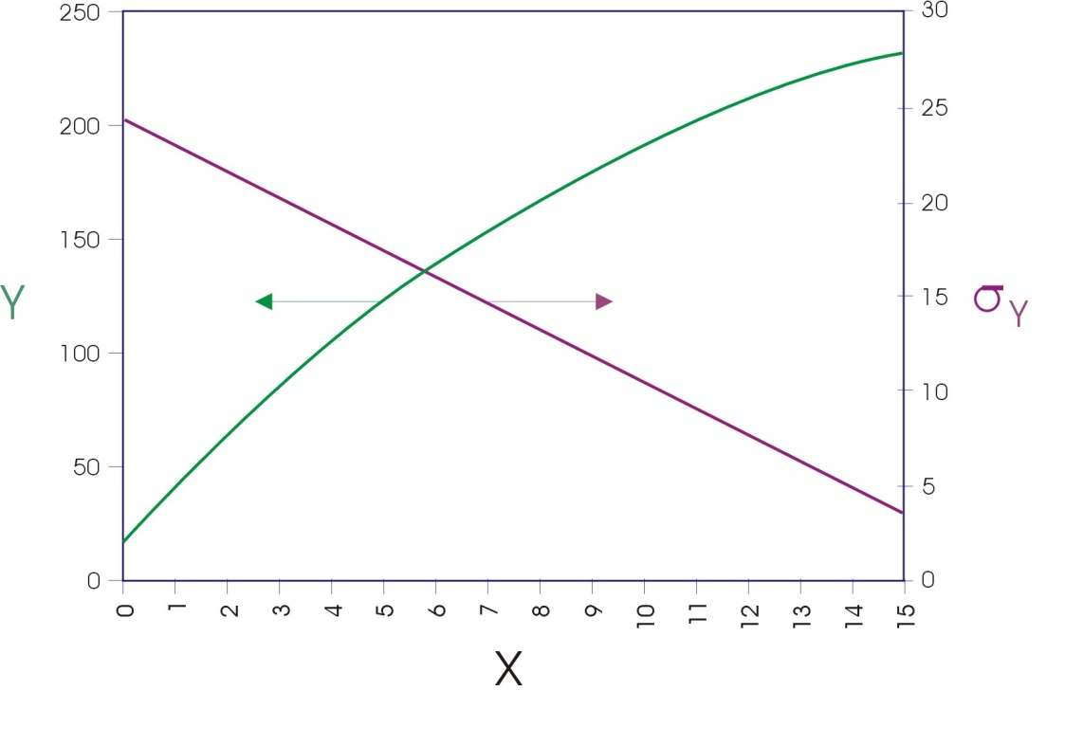
Propagation of error
Just a little mathematical explanation
Assume σ_{x} = 1 and σ_{resid} = 0
As the slope approaches zero, the variation transmitted to Y decreases.
Notes:
The slope of the line determines how much variation gets transmitted. We need to quantify this at any given level of X. Calculus provides the answer in the form of partial derivatives of the response Y with respect to each of the X factors. We mustn’t forget the underlying error embodied in the residual variation (sigma-squared resid). The resulting prediction of standard deviation is superimposed on the original response plot.
Note: the POE is generated from the equation in actual, not coded form. It’s easy to get tripped up by this, so be careful.

Slide 164
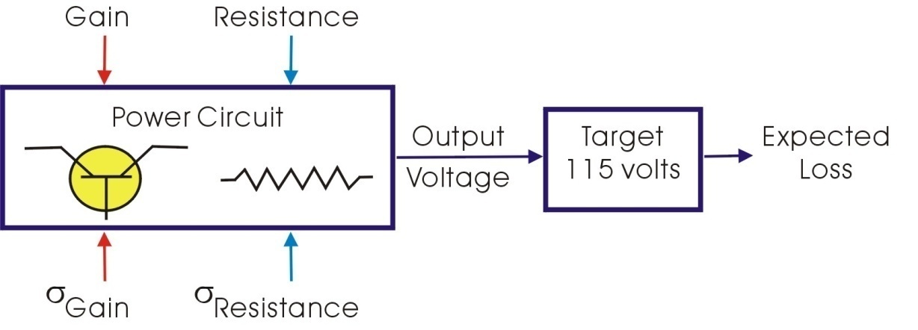
Power Circuit Design Example
Consider two control factors:
Transistor Gain – nonlinear relationship to output voltage
Resistance – linear relationship to output voltage
The variation in gain and resistance about their nominal values is known. Both variances are constant over the range of nominal values being considered.
Notes:
Here’s an example from Taguchi.

Slide 165
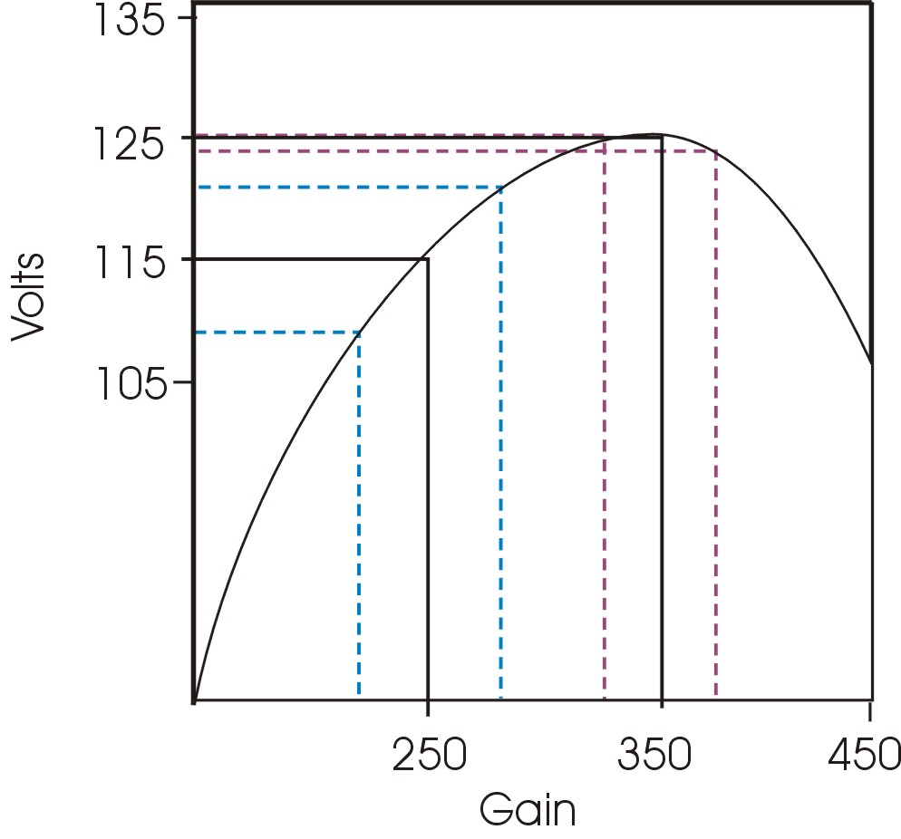
Power Circuit Design Example
(reduce variation)
Variation is reduced by using a nominal gain of 350.
That shifts the output off-target to 125 volts.
Notes:
Voltage is directly proportional to gain only up to a point, beyond which it becomes inversely proportional. By setting gain at the peak point of 350, the transmitted variation will be minimized. If we had chosen to run at 250, the variation would have been larger.
One problem: voltage is now too high (125 versus the target of 115). What can be done about this?

Slide 166
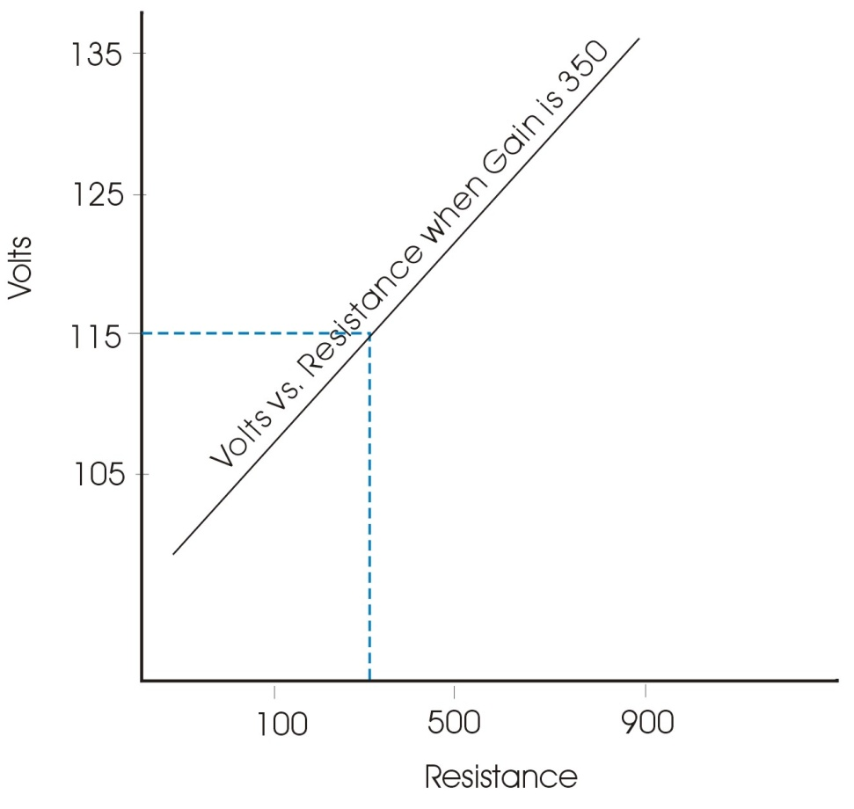
Power Circuit Design Example
(return to target)
Decrease the nominal resistance from 500 to 250.
This corrects the output to the targeted 115 volts.
Notes:
Fortunately the second factor, resistance, affects response in a linear fashion, so it can be used to adjust voltage back to target. POE will not be affected by this change.

Slide 167
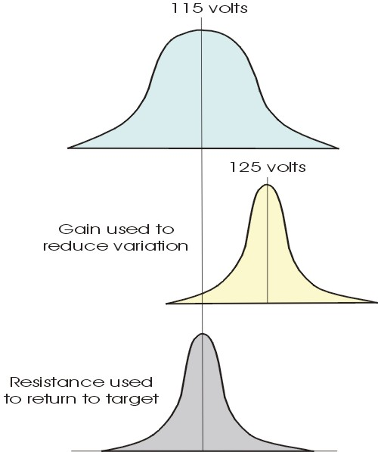
Power Circuit Design Example on target with reduced variation
To illustrate the theory, the control factors were used in two steps: first to decrease variation and second to move back on target.
In practice, numerical optimization can be used to simultaneously obtain all the goals.
Notes:
Here you can see the whole story laid out in the form of before, middle and after response distributions. Notice how much the variation is reduced.

Slide 168
POE
Summary
Control by Uncontrolled interactions are used to set the control factors to minimize the impact of the uncontrolled variables.
Control by Control interactions - provide a mechanism to move the process to target outcomes.
POE - used equivalently to find settings that minimize the impact of uncontrolled variables and the impact of variation in the control factors on the response.
Notes:
Summary of learning points.

Slide 169
Propagation of error
Summary of Important Considerations
Understanding of transmitted variation depends on:
  Boundaries of the factor space.
    The model must adequately represent actual behavior.
    There must be significant curvature within the boundaries.
  The order of the polynomial model.
    Non-linear (higher-order terms) provide opportunities to find plateaus (slopes approaching zero).
    Linear effects allow us to adjust nominal values to target.
  Nature of variation in control factors.
  Is the variation
    Independent of the factor level? (more on next slide)
    Proportional to the factor level? (more in two slides)
Notes:
Summary of POE.

Slide 170

Propagation of error
Summary of Important Considerations
3a. If the variation is independent of the size of the controllable factor level, it can be adjusted to reduce the transmitted variation.
BIG Assumption → Constant Error
Notes:
A big assumption for POE in Design-Expert.

Slide 171
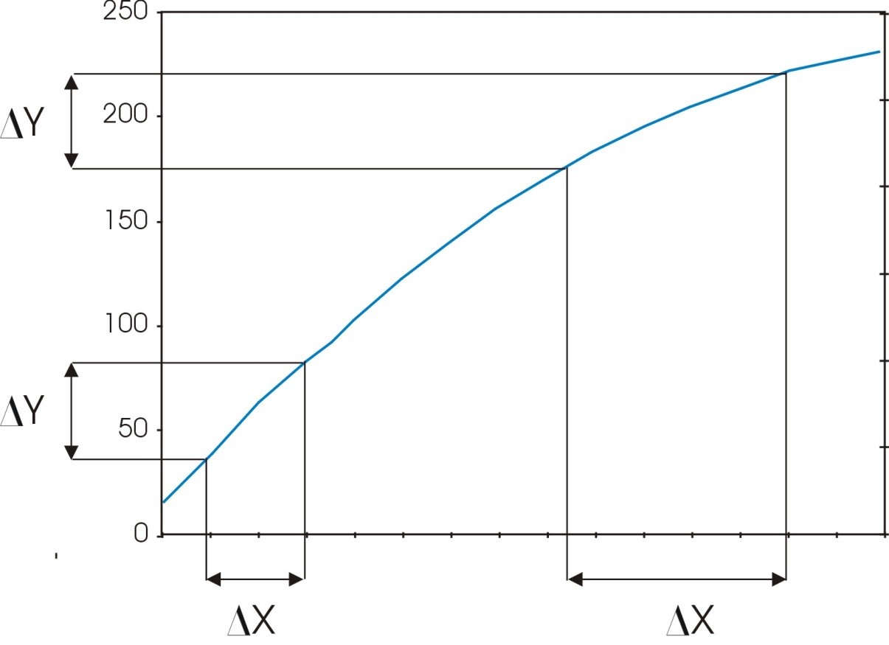
Propagation of error
Summary of Important Considerations
3b. If the variation is a percentage of the size of the controllable factor level, changing the factor level may not change the transmitted variation.
Violation of assumption of constant error
Notes:
Proportional error needs specialized software.

Slide 172
Propagation of error
Summary of Important Considerations
POE estimates are only available when:
  The response has been analyzed.
  The relationship between the factors and response is modeled by at least a second order polynomial.
  The model is hierarchically well formed
  The standard deviation around factor settings are provided.
  Actual units of measure for the factors and factor standard deviation must be used to estimate POE to get a realistic picture.
Notes:
If POE doesn’t appear in Design-Expert check for these common problems.

Slide 173
Propagation of error
Using POE adjusted intervals
POE adds to the estimated standard deviation.
POE replaces Root Mean Square as the estimate for the population standard deviation.
Because the standard errors are larger, intervals are wider when POE adjustments are included.

Slide 174
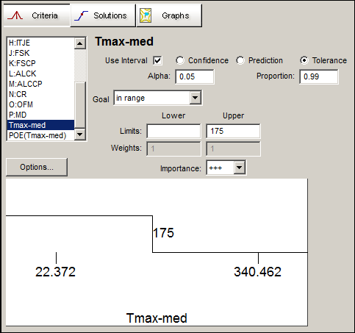
Propagation of error
Using POE adjusted intervals
If POE estimates exist they are automatically added to all interval estimates making them wider.
Interval estimates can be added to optimization criteria.

Slide 175
Optimization
Including intervals
Optimization makes use of the lower and upper bounds of interval estimates by comparing them to specifications.
The goal is to find solutions where the entire interval estimate is within specifications.
175
Upper Bound
If the interval is within specifications the desirability score is 1.
Notes:
If the interval is within specifications the desirability score is 1.
As the interval bounds go out of spec, but the average prediction stays within specifications, the desirability score approaches 0.
The desirability becomes 0 when the mean prediction is outside the specifications.

Slide 176
Optimization
Including intervals
Optimization makes use of the lower and upper bounds of interval estimates by comparing them to specifications.
The goal is to find solutions where the entire interval estimate is within specifications.
175
Upper Bound
As the interval bounds go out of spec...
Notes:
If the interval is within specifications the desirability score is 1.
As the interval bounds go out of spec, but the average prediction stays within specifications, the desirability score approaches 0.
The desirability becomes 0 when the mean prediction is outside the specifications.

Slide 177
Optimization
Including intervals
Optimization makes use of the lower and upper bounds of interval estimates by comparing them to specifications.
The goal is to find solutions where the entire interval estimate is within specifications.
175
µ
...but the average prediction stays within specifications,
the desirability score approaches 0.
Notes:
If the interval is within specifications the desirability score is 1.
As the interval bounds go out of spec, but the average prediction stays within specifications, the desirability score approaches 0.
The desirability becomes 0 when the mean prediction is outside the specifications.

Slide 178
Optimization
Including intervals
Optimization makes use of the lower and upper bounds of interval estimates by comparing them to specifications.
The goal is to find solutions where the entire interval estimate is within specifications.
175
µ
The desirability becomes 0 when the mean prediction is outside the specifications.
Notes:
If the interval is within specifications the desirability score is 1.
As the interval bounds go out of spec, but the average prediction stays within specifications, the desirability score approaches 0.
The desirability becomes 0 when the mean prediction is outside the specifications.

Slide 179
Optimization
How does it help
Optimization finds where the system best meets the specified goals.
The Desirability score can also be used to determine if the system is approaching a failure boundary.
  Set the factors to match current conditions
  Observe the desirability score plot to see how much tolerance the system has under these conditions.
Notes:
If the interval is within specifications the desirability score is 1.
As the interval bounds go out of spec, but the average prediction stays within specifications, the desirability score approaches 0.
The desirability becomes 0 when the mean prediction is outside the specifications.

Slide 180
Propagation of error
Applied to Aerobreaking (AIAA-2007-1214)
At nominal conditions, high density combined with higher than expected heat transfer will cause problems as temperatures start to exceed 175 C.

Slide 181
Propagation of error
Applied to Aerobreaking (AIAA-2007-1214)
Looking at a short drag pass duration, it is obvious this should only be attempted in low density environments.

Slide 182
Propagation of error
Applied to Aerobreaking (AIAA-2007-1214)
The acceptable density range increases a small amount if low duration passes are coincidental with times of low solar flux (Qs).

Slide 183
The Wrap-Up
  Start with an appropriate design.
    Achieve the six entries on the statisticians wish list.
  Provide estimates for factor standard deviation
  Fit good and useful polynomial models to the trend in the data.
  Use optimization including POE adjusted intervals to find where the mission is likely to succeed.

Slide 184
The Wrap-Up
  Iterative experiments
    Save runs
    Provide data driven decisions
    Allow the experimenter to adjust to new knowledge
  Much more efficient that one factor at a time unless you really do not have interactions.
  Statistics do not provide the interpretation – YOU DO!

Slide 185

Statistics Made Easy®
For all the new features in v8 of Design-Expert software, see www.statease.com/dx8descr.html
Best of luck for your experimenting!
Thanks for listening!
Wayne F. Adams, MS. Stats
Stat-Ease, Inc.
wayne@statease.com
stathelp@statease.com
For future presentations, subscribe to DOE FAQ Alert at www.statease.com/doealert.html.
Notes:
Image Credit: NASA/JPL-Caltech

