Slide 1
An Equation-free Based Coupling Approach for Long-term Cryogenic Tank Behavior Predictions Qiyun Cheng, Shanbin Shi, and Wei Ji | Rensselaer Polytechnic Institute Mamoru Ishii | Purdue University Michael Harris | NASA Kennedy Space Center
TFAWS Cryothermal Paper Session
Presented By Qiyun Cheng
Advisor: Dr. Wei Ji
Thermal & Fluids Analysis Workshop TFAWS 2022 September 6th-9th, 2022
Virtual Conference

Slide 2
Contents
Background
Technic Approach
Equation-free Modeling
Equation-free Based Coupling Approach
Research Objectives
Equation-free Based Coupling Approach Applications
Pipe Flow with Periodical Pressure Boundary
Cryogenic Tank Self-pressurization
Conclusions

Slide 3
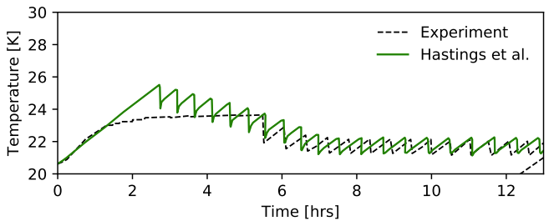
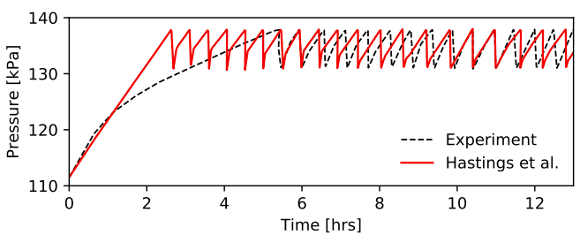
Background
Cryogenic storage tank used in NASA’s space missions
Propellant & life support consumables
Heat leaks from surroundings lead to excessive tank pressures
Self-pressurization process
Cryogenic storage tank management
Active cooling method (jet injection)
Periodical behaviors
Similar heating-depressurization cycles
Disturbed initial/boundary conditions
E. Ramos, Ph. D. dissertation, Georgia Institute of Technology, May 2021

Slide 4
Background (Cont’d)
Complex phenomenon in microgravity environment
Thermal stratification
Natural convection
Need fast and accurate numerical tools for long-term tank behavior predictions
High fidelity CFD simulation is computational expensive
Fast nodal code simulation lacks fine-scale details inside the lumps
All parameters are the same in one lump, no distribution
Flow patterns inside the lump affect heat transfer
Coupled method is desired to take advantages of both approaches

Slide 5
Technic Approach
Equation-free Modeling
Object:
Use the microscopic simulator to obtain the macroscopic solutions with reasonable computational consumption
Assumptions:
An accurate microscopic simulator exists
Macroscopic governing equations are unavailable
The macroscopic phenomenon is more important

Slide 6
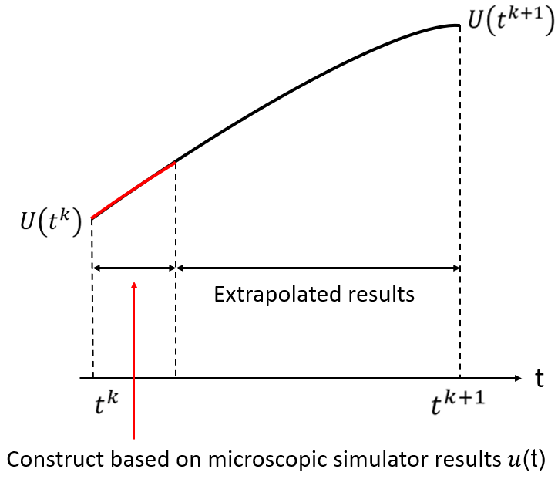
Technic Approach (Cont’d)
Equation-free Modeling
Macroscopic time steper:
Given the macroscopic initial condition $U\left(t^{k}\right)$ at time $t^{k}$, create the corresponding microscopic initial condition $u\left(t^{k}\right)$.
Run microscopic simulator over a short interval to obtain $u$(t).
Construct the macroscopic evolution of $U\left(t\right)$ based on the microscopic results.
Extrapolate the macroscopic results to $t^{k+1}$.
I.G. Kevrekidis, G. Samaey,"Equation-free multiscale computation: algorithms and applications", Annual Review of Physical Chemistry, 60: 321–344 (2009).
S. Sirisup, et al. "Equation-free/Galerkin-free POD-assisted computation of incompressible flows." Journal of Computational Physics 207.2: 568-587 (2005).

Slide 7
Technic Approach (Cont’d)
Equation-free Based Coupling Approach
Adapt the equation-free modeling idea to coupling approach
Equation-free Modeling
Equation-free Based Coupling
Macroscopic simulator
Nodal Code
Doesn’t exist
Run for the whole problem
Construct and extrapolate
Corrections
Microscopic simulator
CFD Code
Use in each time step
Run for a short period

Slide 8
Technic Approach (Cont’d)
Equation-free Based Coupling Approach
Assume the CFD model is accurate
Derive the conversion equation between the two codes is impossible
Adapt the equation-free idea to find the conversion correlations
CFD code governing equation (Volume Averaged Result):
$$\frac{∂}{∂t}\frac{\sum{ρ_{i}e_{i}{V_{i}}^{2}}}{V}=\frac{1}{V}\sum_{ⅈ}{(\sum_{f_{i}}{\left(h_{fi}+K_{fi}\right)}{FR}_{fi}V_{i}+\sum_{f_{i}}{k_{i}∇T_{fi}⋅{\vec{A}}_{f}}V_{i}−\frac{∂}{∂t}\left(ρ_{i}K_{i}\right){V_{i}}^{2}+S_{i}{V_{i}}^{2})}$$
Nodal code governing equation:
$$\frac{de}{dt}=\sum_{k}{{\hat{n}}_{k}h_{k}∗{FR}_{k}}+GF_{tie}∗\left({TL}_{i}−{TL}_{j}\right)+QDOT$$
Equation-free corrections

Slide 9
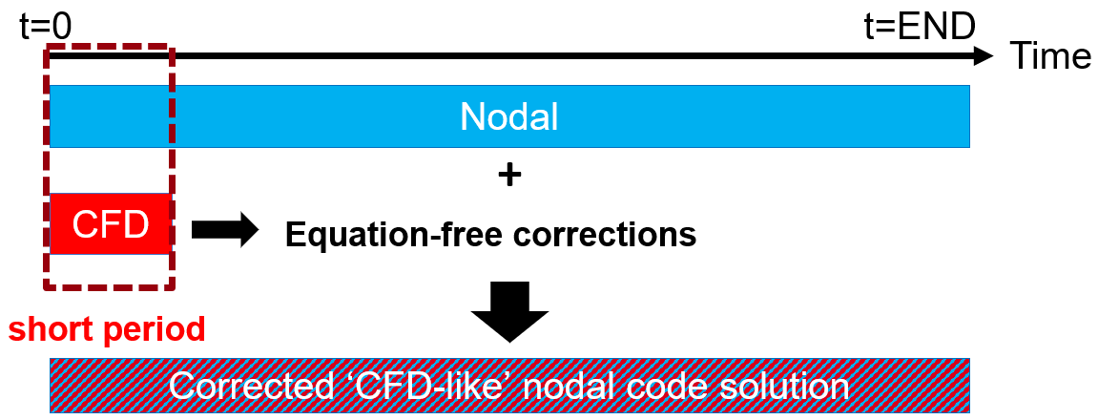
Technic Approach (Cont’d)
Equation-free Based Coupling Approach
Periodical behavior of cryogenic tanks
Co-solve for the first cycle to get the equation-free corrections
Use the nodal code for the rest of similar cycles with corrections
Corrections are obtained through the on-the-fly co-solve process
Expect better performance by introducing Nodal code solutions
No 1D/3D data transfer error

Slide 10
Research Objectives
Efficient use of the CFD and nodal tools based on the equation-free based coupling approach.
Fit the data within the first cycle (Co-solving period)
Extrapolate the corrections to the whole problem (disturbed conditions)

Slide 11
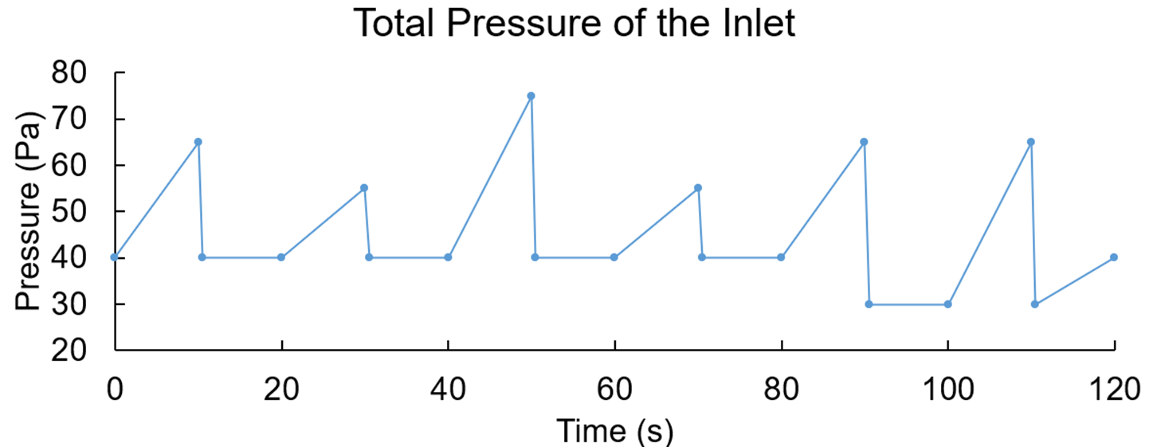
Equation-free Based Coupling Approach Applications
Pipe Flow with Periodical Pressure Boundary
Internal laminar flow of a straight, circular pipe
Change the inlet pressure to mimic the heating-depressurization cycle
P inlet
P outlet = 0
Liquid: Water
Pipe length = 1 m
Inner diameter = 0.01 m
Laminar flow: 0 < Re < 2,000

Slide 12
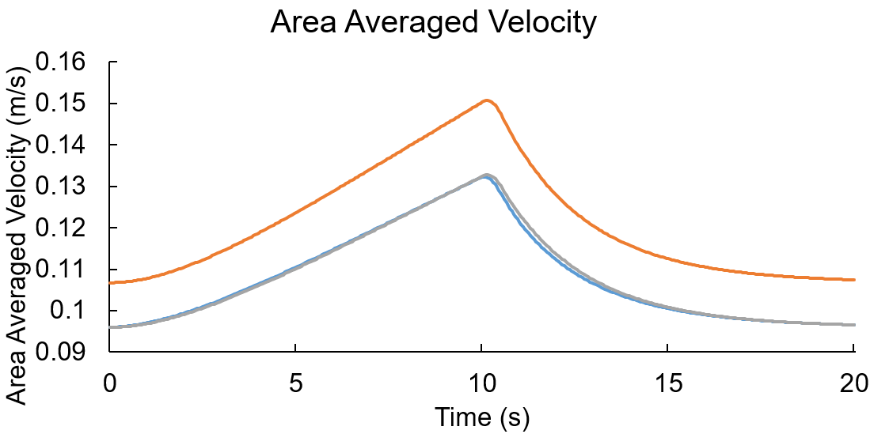
Equation-free Based Coupling Approach Applications
Pipe Flow with Periodical Pressure Boundary
Results of the first cycle
Equation-free Based Approach
Y = Nodal(t) * 0.8362 + 0.006732
Nodal code
CFD code
Difference from the hydrodynamic entrance effect

Slide 13
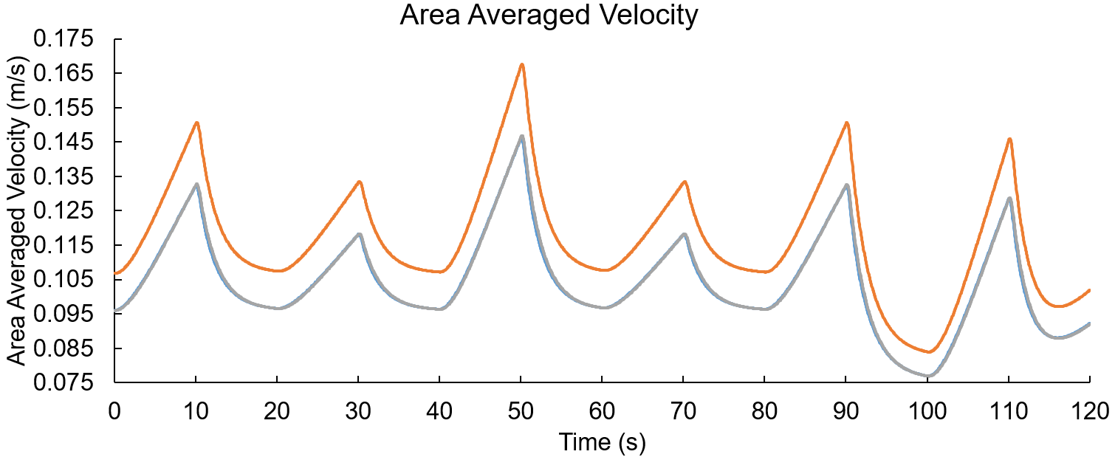
Equation-free Based Coupling Approach Applications
Pipe Flow with Periodical Pressure Boundary
Equation-free based coupling results
Equation-free Modeling
Y = Nodal(t) * 0.8362 + 0.006732
Nodal code
CFD code

Slide 14
Equation-free Based Coupling Approach Applications
Pipe Flow with Periodical Pressure Boundary
The correlation can correct the hydrodynamic entrance effect in that geometry within a range of fluid parameter changes.
Reynold number goes slightly beyond the laminar region.
$C_{i}:$ CFD result at time $t_{i}$
$N_{i}:$ Nodal result at time $t_{i}$
$C_{i}(r):$ CFD result at time $t_{i}$, position r
$N_{i}(r):$ Nodal result at time $t_{i}$, position r
$$t_{1}: (C_{1},N_{1})$$
$$t_{1}: (C_{1}(r),N_{1}(r))$$
$$t_{2}: (C_{2},N_{2})$$
$$t_{2}: (C_{2}(r),N_{2}(r))$$
…
…
$$t_{n}: (C_{n},N_{n})$$
$$t_{n}: (C_{n}(r),N_{n}(r))$$
$$CFD=Nodal∗f+g$$
$$CFD(r)=Nodal(r)∗f(r)+g(r)$$

Slide 15
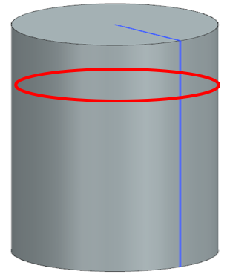
Equation-free Based Coupling Approach Applications
Cryogenic Tank Self-pressurization
Heat Flux
Liquid and vapor nitrogen, 75% filling level
Initial pressure: 100kPa
Initial temperature: 77.24K (uniform, saturated)
Adiabatic side and bottom walls
No inlet and outlet, the tank is pressurized
Constant heat flux from the lid.
R=0.5m
Case1: heat flux = 50 W/m^2, flow time = 100s
Case2: heat flux = 80 W/m^2, flow time = 200s
H=1m
Adiabatic wall

Slide 16
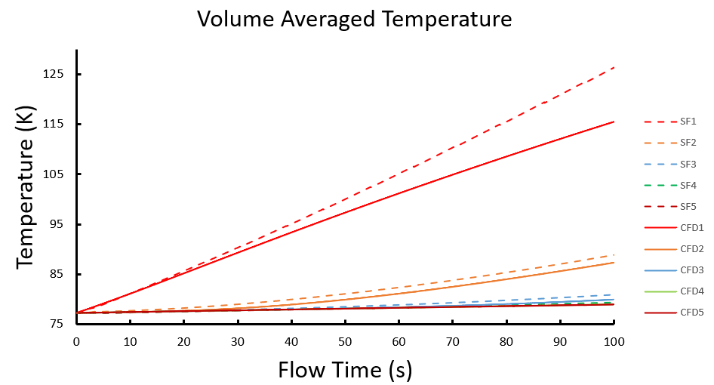
Equation-free Based Coupling Approach Applications
Volume Averaged Temperature Results Comparison (Heat Flux = $50W/{m^{2}}$)
1
2
3
Vapor
4
5
Liquid

Slide 17
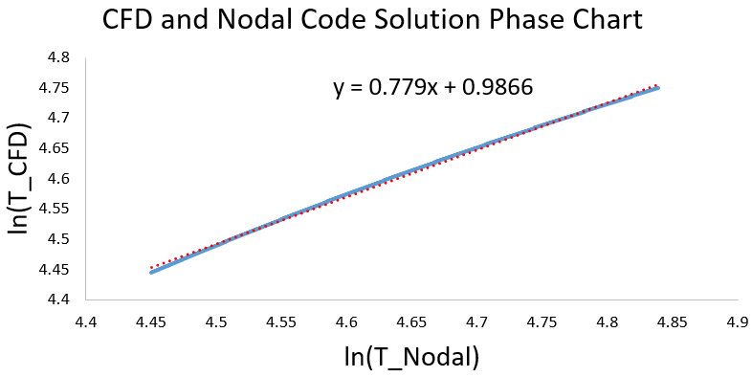
Equation-free Based Coupling Approach Applications
Equation-free Corrections
Linear regression
Phase diagram of SF1-CFD1
$$T_{CFD} =\left[\begin{matrix}T_{CFD0} \\ ⋮ \\ T_{CFD100}\end{matrix}\right],T_{SF} =\left[\begin{matrix}1 \\ ⋮ \\ 1\end{matrix} \begin{matrix}T_{SF0} \\ ⋮ \\ T_{SF100}\end{matrix}\right],A=\left[\begin{matrix}α_{0} \\ α_{1}\end{matrix}\right]$$
$$T_{CFD}=T_{SF}A$$

Slide 18
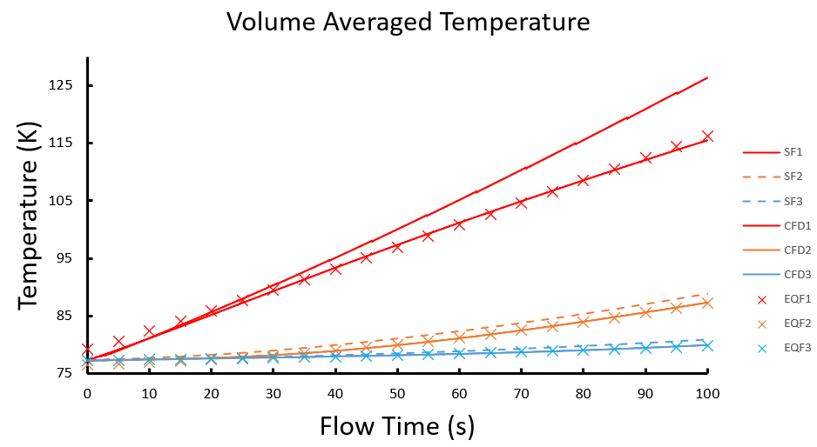
Equation-free Based Coupling Approach Applications
Corrected Results Comparison of Heat Flux = $50W/{m^{2}}$

Slide 19
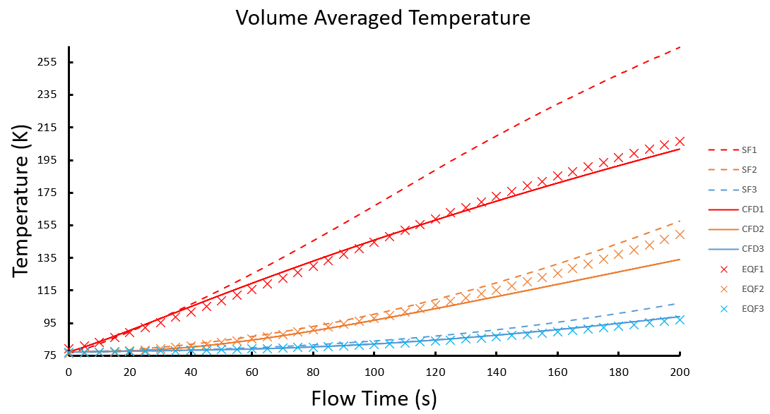
Equation-free Based Coupling Approach Applications
Extrapolate to Heat Flux = $80W/{m^{2}}$

Slide 20
Conclusions
Equation-free based coupling approach
Capable to correct the nodal code results with disturbed conditions
Easy to apply and computational efficient
No 1D/3D data transfer error
Planned activity
Use equation-free coupling approach to tanks with heat-depressurization cycles
Validate the coupling approach with experiment data

Slide 21
Acknowledgement
This work was supported by an Early-Stage Innovations Grant through the NASA’s Space Technology Research Grants Program under Grant 80NSSC20K0303.
The authors would like to thank C&R Technologies (CRTech) for providing the computational software SINDA/FLUINT & Thermal Desktop for this research.

Slide 22
Thank You
and
Questions?
For further details contact:
Qiyun Cheng
chengq3@rpi.edu

