Slide 1
Advanced Two-Phase Cooling System for Modular Power Electronics Kuan-Lin Lee and Sai Kiran Hota Advanced Cooling Technologies, Inc.
TFAWS Passive Thermal Paper Session
Presented By Sai Kiran Hota
Thermal & Fluids Analysis Workshop TFAWS 2022 September 6th-9th, 2022
Virtual Conference
Distribution B: SBIR Data Rights

Slide 2
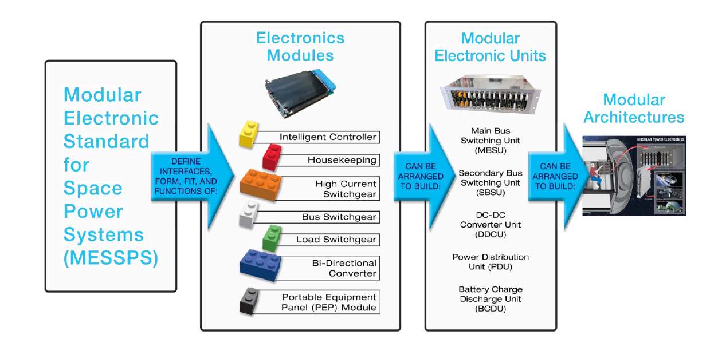
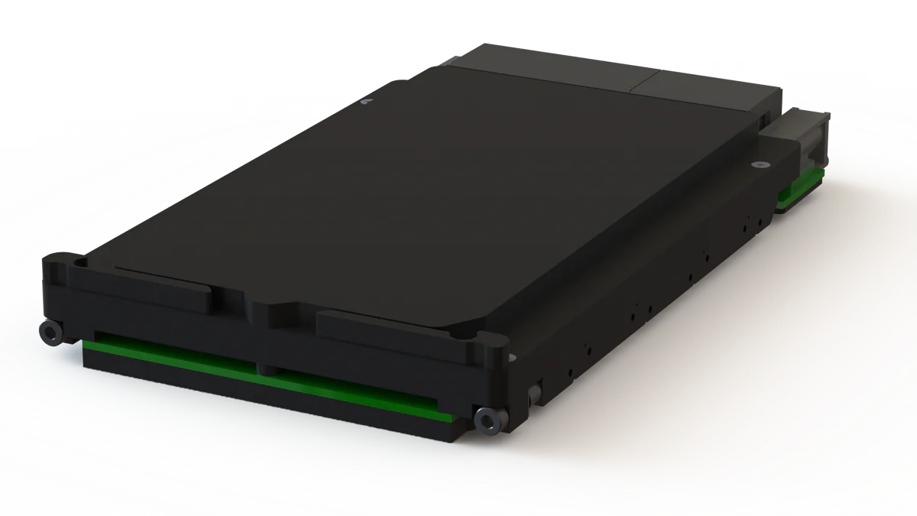
Thermal Management of Modular Power Electronics
Standardizing power electronics architecture allows for interoperability and reusability across various electronics platforms
Potential applications include Gateway, Lunar Habitat, NEP etc
Continuously evolving high-power electronics poses the challenges of managing high waste-heat flux emanating from the chips
As such, conventional conduction-based heat spreaders cannot handle high heat loads due to their thermal conduction limitations
ACT proposed to develop two-phase heat spreaders)
Thermal heat spreaders- Hi-K™ plate and Pulsating heat pipe (PHP) were developed and their performance was compared against the conduction card
7 standardized electronics modules are identified which can be arranged to build different electronics units.
Commercial conduction cooled 3U electronics modules
Distribution B: SBIR Data Rights

Slide 3
Modular Power Electronics System
The developed two-phase cooling system consists of
Two-phase based heat spreaders: Hi-K™ plate and/or Pulsating Heat Pipe (PHP) heat spreaders
Isothermal Card Edge (ICE-Lok™): mechanical and thermal card retainer
Distribution B: SBIR Data Rights

Slide 4
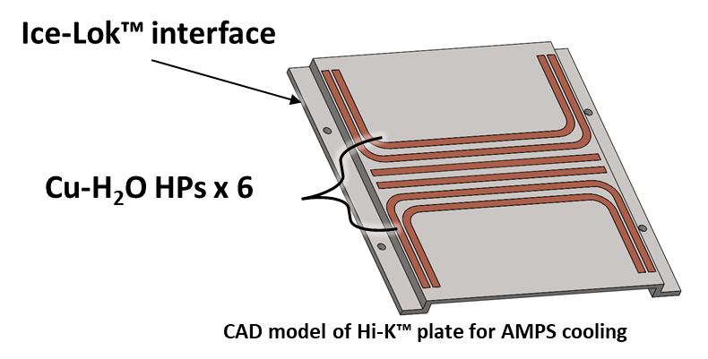
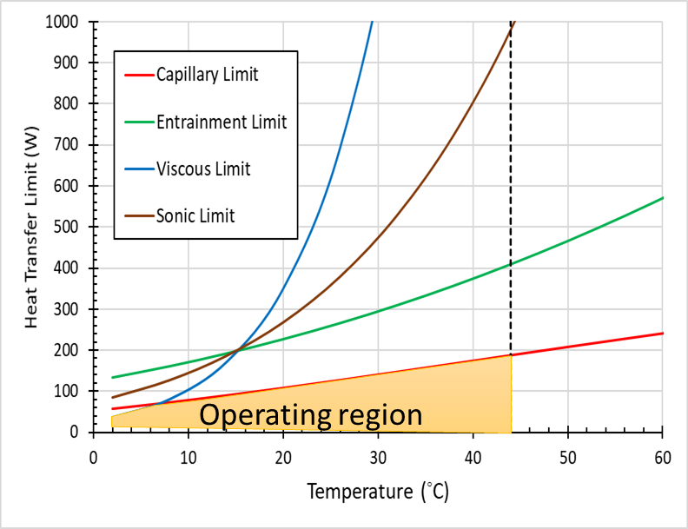
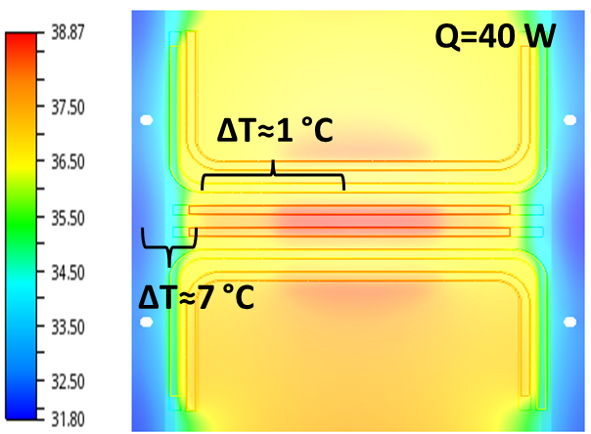
Design of Hi-k™ Plate Heat Spreader
Hi-K™ plate is essentially embedded copper-water heat pipes in an aluminum plate
A Hi-k™ plate with 6 cu-H2O heat pipes was designed and fabricated using ACT’s established fabrication approaches
From heat pipe limits calculations, maximum heat transfer limit with Hi-K™ plate was 180 W
$ΔT$ across the stepped edge is much higher than the heat pipe plane
Heat transfer across the stepped plane is conduction limited as opposed to two-phase in heat pipe plane
Distribution B: SBIR Data Rights

Slide 5
Pulsating Heat Pipe (PHP)
In a PHP, heat is delivered by the pulsation of the working fluid in PHP channels
Operating Principle:
Heating at the evaporating region causes increasing of local vapor pressure (bubble expansion)
Simultaneously, condensation at the cooled regions results in decreasing vapor pressure (bubble shrinkage)
The pressure differences induces pulsation of working fluid
Effective thermal conductivity of PHP can be higher than ~1000 W/m-K
In the characterization test, PHP showed ~ 3.7 x higher thermal conductance over conduction side
Acetone
Empty
Distribution B: SBIR Data Rights

Slide 6
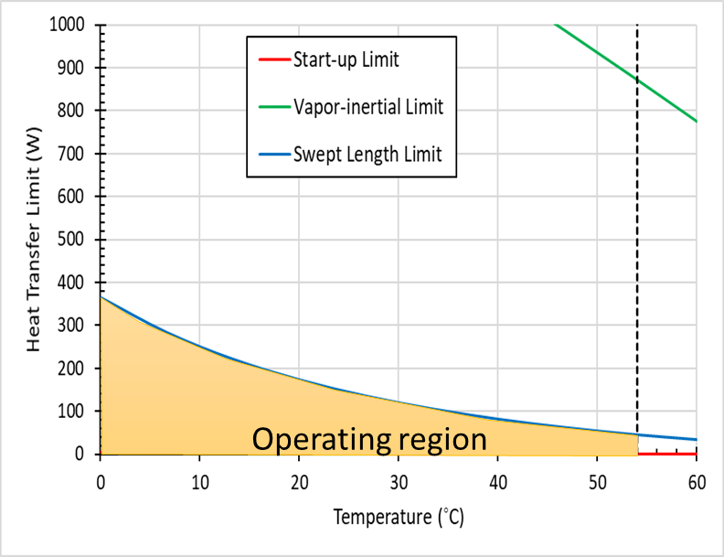
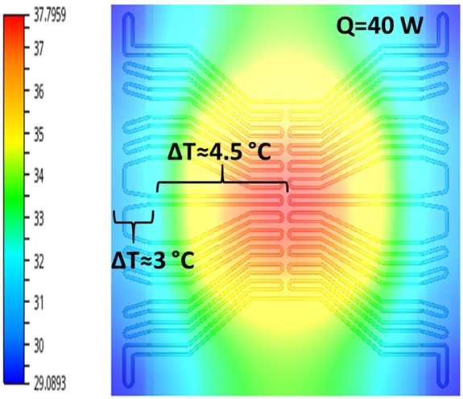
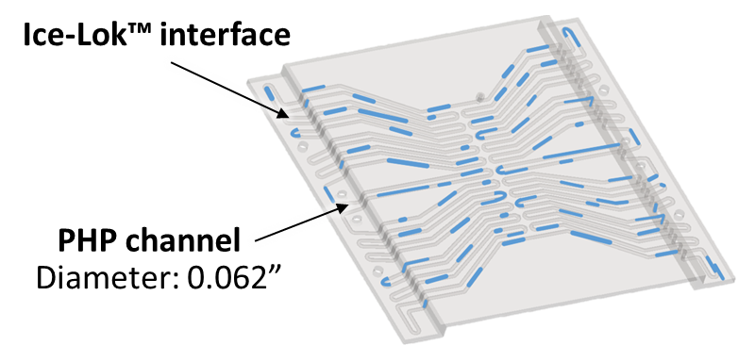
Design of PHP
PHP with 1.6 mm channel diameter and 24 turns was fabricated and propylene was used as the working fluid
From limit calculations, maximum heat transfer limit with PHP was ~ 80 W
$ΔT$ across the stepped edge is relatively comparable to the 2D plane
Two-phase channels along the stepped plane
$ΔT$ across the stepped edge is much lower in comparison to the Hi-K™ plate
PHP was 3D printed with Aluminum alloy
Distribution B: SBIR Data Rights

Slide 7
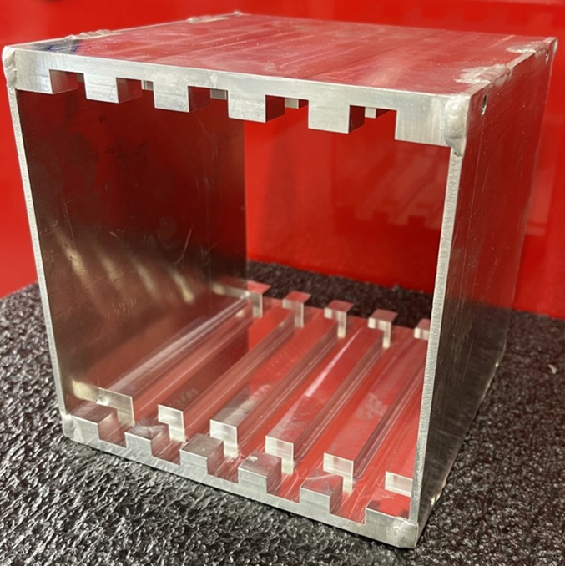
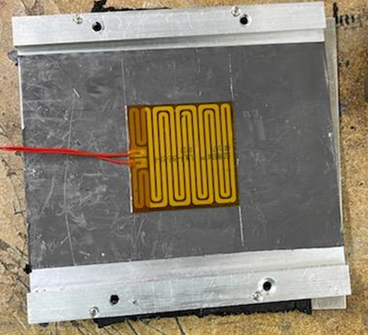
Performance Testing of the Cooling System
A mock 5-card chassis enclosure was constructed for performance testing of the cooling system
Dimensions are according to Modular Standards for Space Power Systems (MESSPS)
2 in x 2 in film heater was used to simulate heat source
Film heater attached to the back of the heat spreader
Back plate was 1/8” thick flat aluminum plate
ICE-Lok™ was used as the card retainer
Chassis enclosure
Film
heater
ACT’s ICE-Lok™
Distribution B: SBIR Data Rights

Slide 8
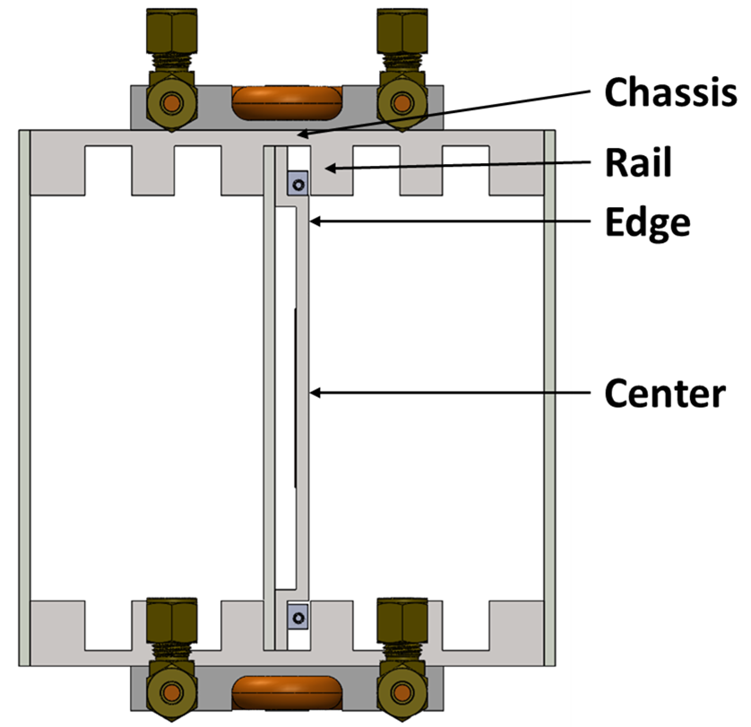
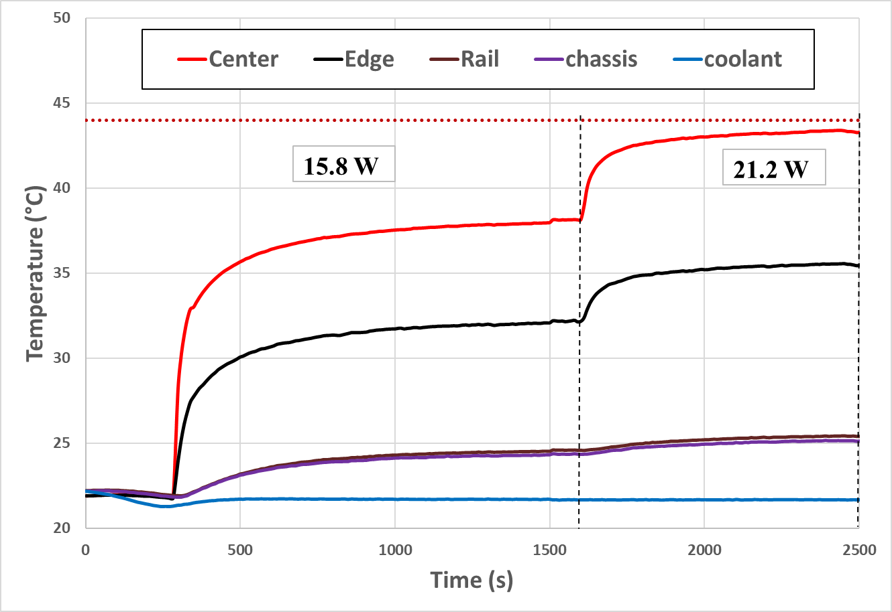
Performance Testing of the Cooling System – Baseline
Maximum heat transfer rate was 21.2 W with aluminum plate
Maximum allowable temperature at center of the heat spreader < 44 °C
R center to edge = 0.75 °C/W ; R source to sink = 2.07 °C/W
Maximum allowable power is 21.2 W
Distribution B: SBIR Data Rights

Slide 9
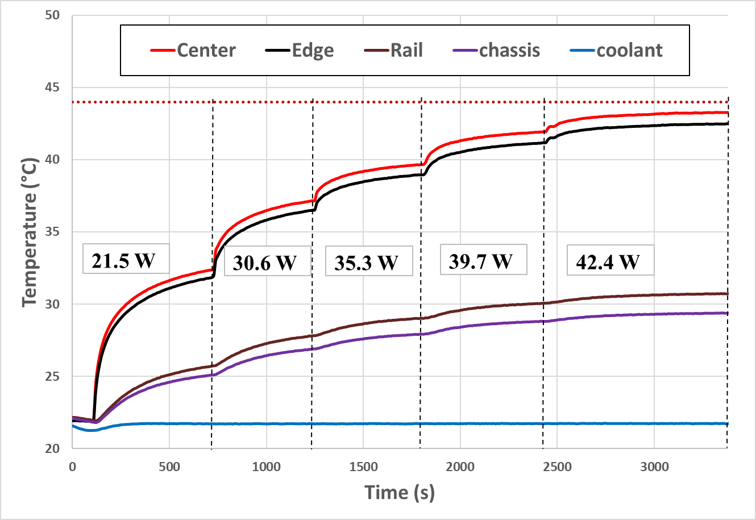
Performance Testing of the Cooling System – Hi-k™ Plate
98% more power can be applied with Hi-K™ plate over baseline case
Hi-K™ plate was tested with incremental powers until center reached 44 °C
R center to edge = 0.05 °C/W; R source to sink = 1.02°C/W
Up to 42.4 W of heat can be applied: improvement of 98% over baseline case
Distribution B: SBIR Data Rights

Slide 10
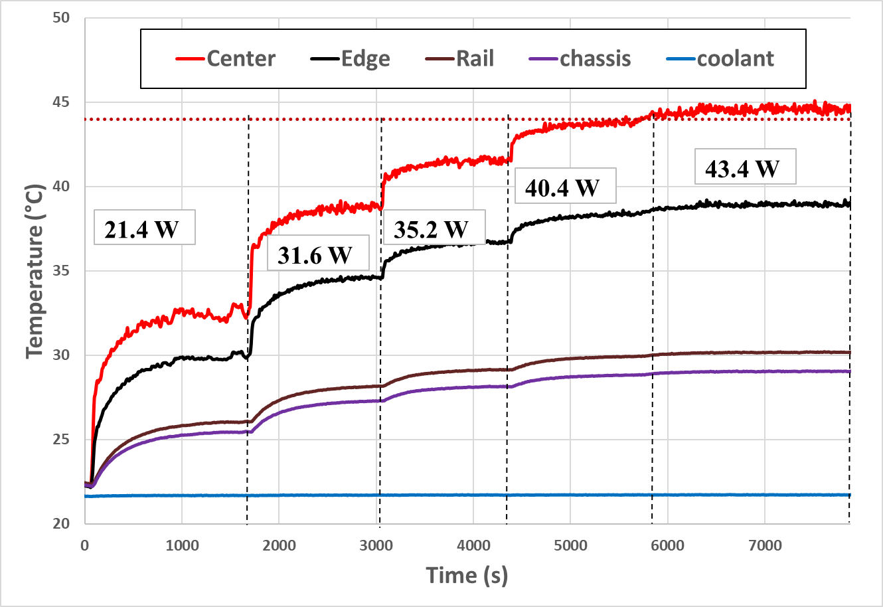
Performance Testing of the Proposed Cooling System- PHP
100% more power can be applied with PHP over baseline case
PHP (60% propylene) was tested until card maximum temperature reaches 44 °C
R center to edge = 0.18 °C/W ; R center to sink = 1.01 °C/W
Up to 43 W of heat can be applied: improvement of 100% over baseline case
Distribution B: SBIR Data Rights

Slide 11
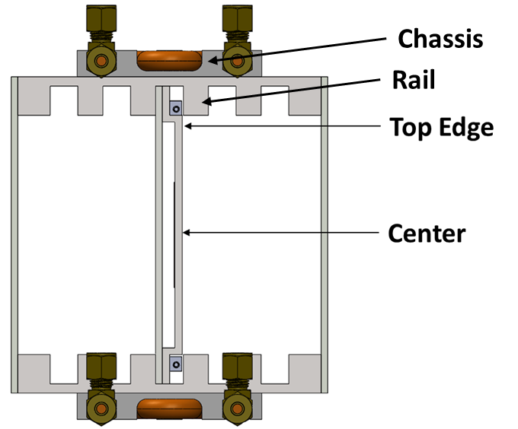
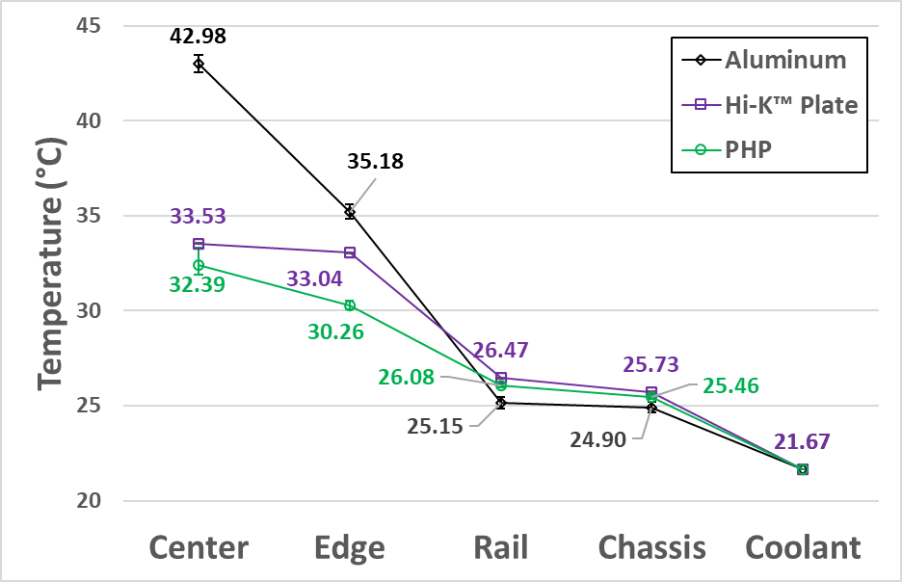
Thermal Performance Comparison of the Cooling System
Instantaneous profile at 21 W
At constant heat sink (coolant) temperature, aluminum plate has the highest center temperature
PHP center temperature is about 1.15 °C lower than that of the Hi-K™ plate system
Although, center to edge ΔT is lower with the Hi-K™ plate, PHP has better conductance because of the two-phase channels across the stepped plane instead of plate conduction in the Hi-K™ plate
Distribution B: SBIR Data Rights

Slide 12
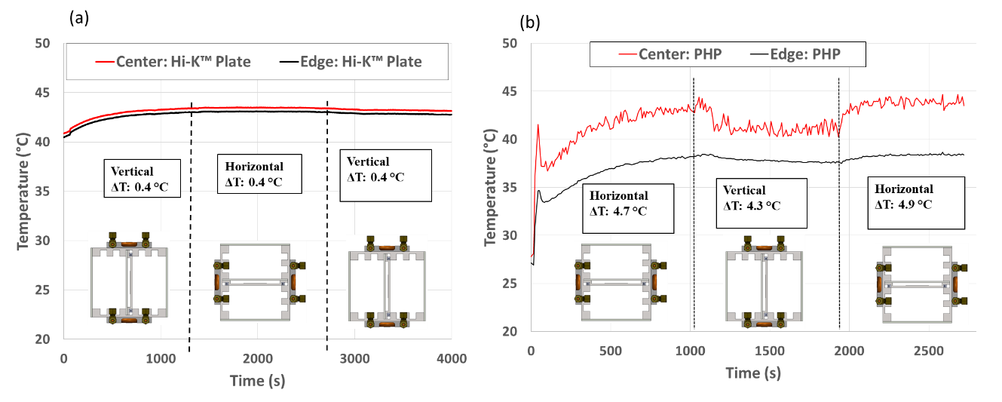
Performance of the Heat Spreaders With Varying Orientation
The performance of the electronics cooling system with varying gravity was performed to determine the influence of gravity on the heat spreader performance
ΔT of both Hi-K™ plate and PHP based system was found to be unaffected by gravity
Distribution B: SBIR Data Rights

Slide 13
Conclusions
Advanced electronics cooling system with two-phase heat spreaders based on Hi-K™ plate (embedded heat pipe) and pulsating heat pipe technology were developed and tested with ICE-Lok™ as card retainer
The findings are summarized in the Table below
Heat spreader | Overall Thermal Resistance (C/W) | Maximum heat load while keeping max card temp below 44C (W) | Weight (grams)*
Aluminum plate (baseline) | 2.07 | 20.8 | 153.8
Hi-K™ plate | 1.02 | 42.5 (+98%) | 170.4*
PHP plate | 1.01 | 43 (+100%) | 137.8*
*Note: (1) Weight comparison is based on same thickness (2) Hi-K plate mass can be further reduced by removing excessive base plate thickness (3) PHP mass can also be reduced by reducing overall thickness
Distribution B: SBIR Data Rights

Slide 14
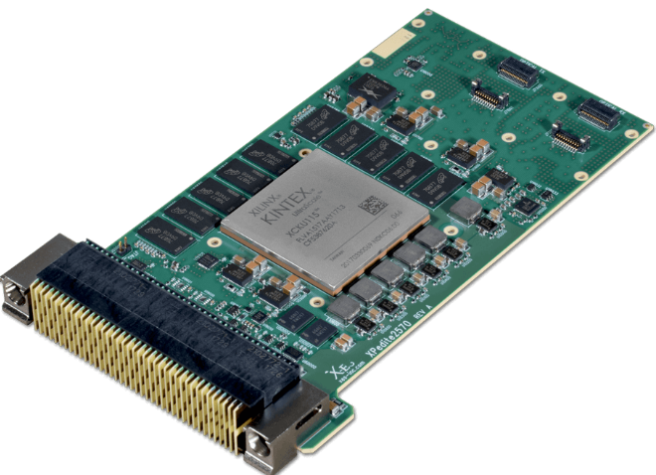
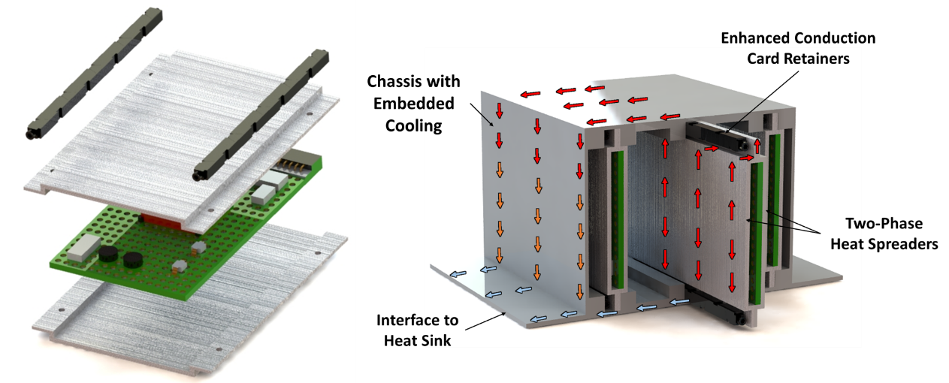
Future Direction
Goals: Mature two-phase based heat spreader and develop integrated PHP based chassis enclosure
Heat spreader: Develop PHP heat spreader
Development of performance prediction tools
Improve & establish manufacturing practices for PHP plate fabrication
160 mm
100 mm
Example 3U card layout
Development of ICE-Lok™ for 3U- card & chassis following VITA 48.2 standards
Development of PHP-based chassis enclosure
Assemble and perform system level testing with two-phase components
Advanced Cooling for Modular Electronic Units (MEU)
Distribution B: SBIR Data Rights

Slide 15
Acknowledgement
This program was sponsored by NASA SBIR Phase I (#80NSSC21C0211)
Special thanks to our program manager – Dr. Jeffery Didion (GSFC)
NASA AMPS team: Jeff Csank and Brent Gardner
ACT team:
Technician: Justin Boyer, Eugene Sweigart, Jonathan Murray
ACT Sales and Marketing team: Megan Ulrich, Shane Bahn
Thanks for your attention
Any Questions?
Distribution B: SBIR Data Rights

