Slide 1
Advanced Hot Reservoir Variable Conductance Heat Pipe with Enhanced Reliability Kuan-Lin Lee, Calin Tarau, William Anderson Advanced Cooling Technologies, Inc. Cho-Ning Huang, Chirag Kharangate and Yasuhiro Kamotani Case Western Reserve University
TFAWS Passive Thermal Paper Session
Presented By Kuan-Lin Lee
Thermal & Fluids Analysis Workshop TFAWS 2022 September 6th-9th, 2022
Virtual Conference

Slide 2
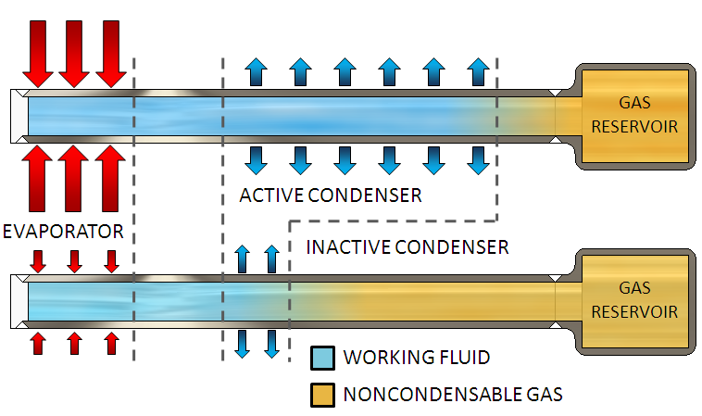
Variable Conductance Heat Pipes for Lunar Night Survival
Future planetary landers and rovers need a variable thermal link between heat sources and sink with large turn-down ratio
During the lunar day, higher high transfer rate will allow the shrinkage of the radiators.
During the lunar night at very low sink temperature (100K), the thermal link must be as ineffective as possible to maintain payload temperature with minimum survival power
Standard VCHPs with a cold-biased reservoir are most often used for temperature control in spacecraft applications
Reservoir temperature can be actively controlled by electrical heaters
Roughly need 1-2 W of electricity power to heat the reservoir for lunar night survival
Every 1 Watt of heat corresponds to ~5kg of battery mass through 14 days lunar shadow

Slide 3
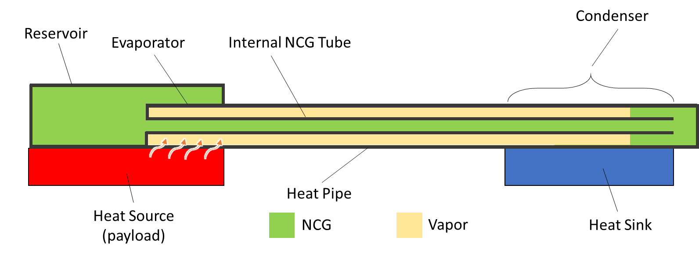
Hot Reservoir VCHP and Fluid Management Challenges
Reservoir is located near the evaporator and its temperature will follow heat source temperature
Reservoir can be integrated or non-integrated
Can offer much tighter thermal control than regular VCHP
Eliminate electric power required to keep reservoir warm during 14 days lunar night
ISS test showed that fluid management of HR-VCHP is a challenge
Prevent working fluid liquid entering the reservoir
Remove excessive working fluid from reservoir (purging) more efficiently than diffusion
W. G. Anderson et al., “Variable Conductance Heat Pipes for Variable Thermal Links,” 42nd International Conference on Environmental Systems (ICES 2012), San Diego, CA, July 15-19, 2012.

Slide 4
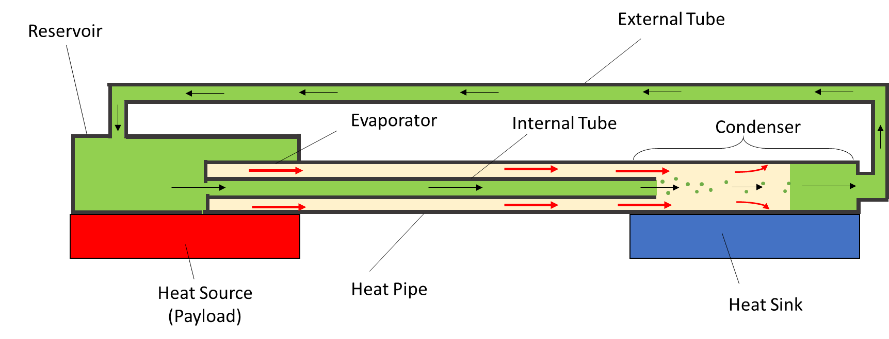
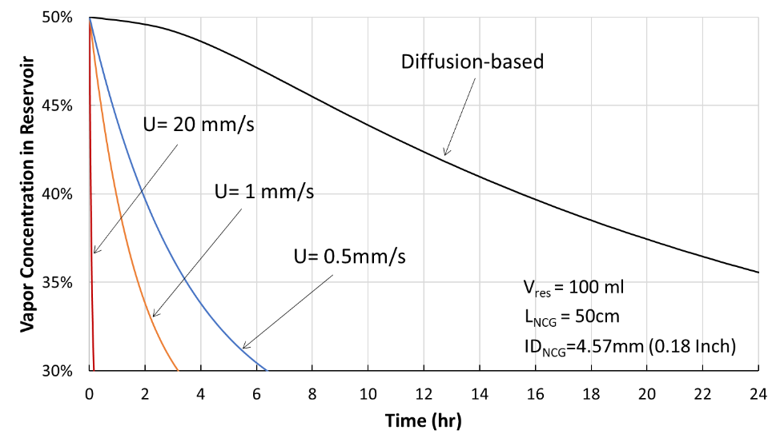
Advanced Hot Reservoir VCHP Concept
A loop is created by connecting the condenser and the reservoir with an external tube
Some momentum of vapor in the heat pipe section can be transferred to the NCG to generate a secondary flow – Momentum induced flow
Momentum induced flow will be able to remove excessive moisture in the reservoir effectively
The concept was successfully demonstrated both numerically and experimentally in Phase I

Slide 5
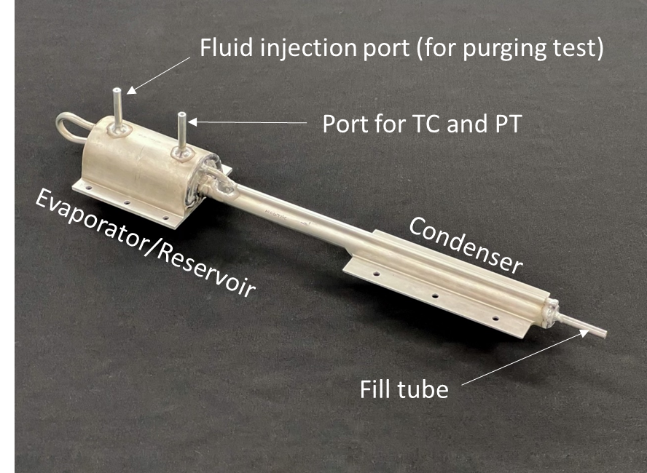
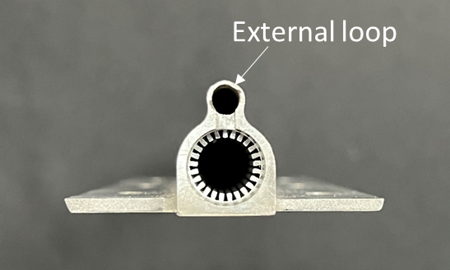
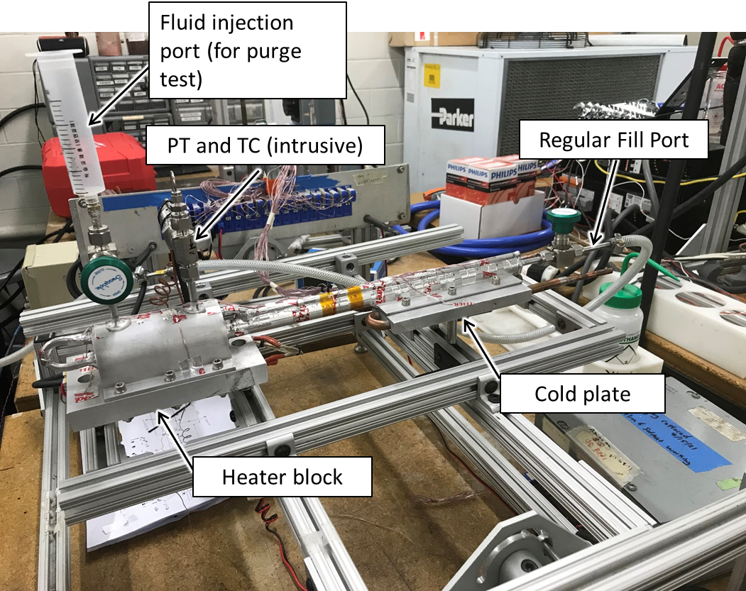
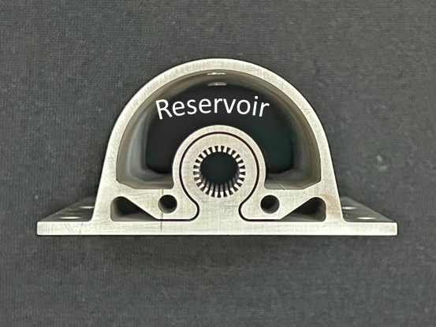
Adv. Hot Reservoir VCHP Prototype Development
Both reservoir and external tube were integrated with the main heat pipe body
Envelope material is aluminum 6061
Thermal control performance and reliability of the prototype were tested using acetone and toluene as working fluid

Slide 6
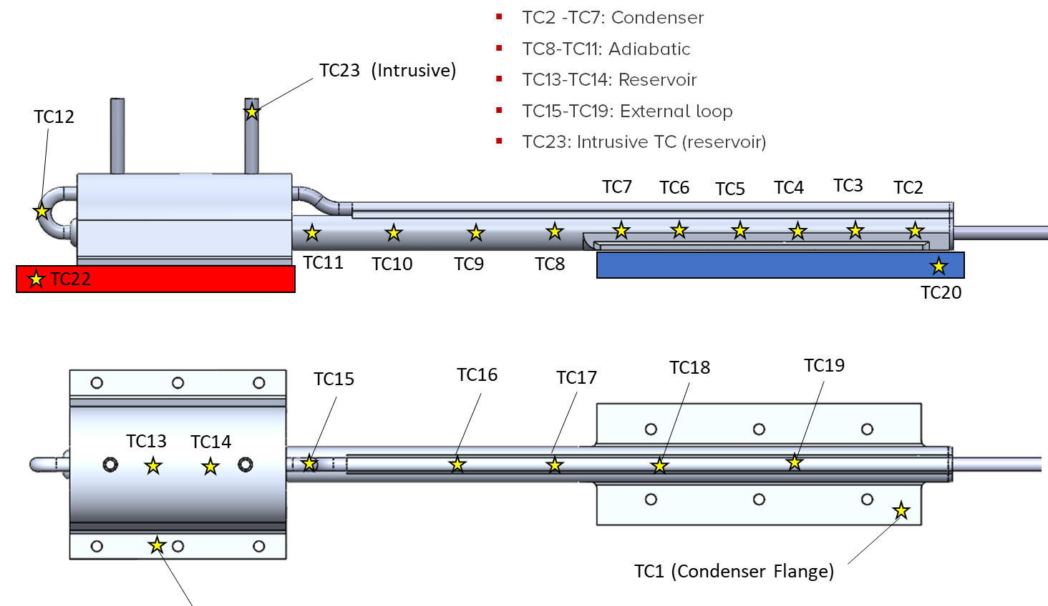
TC Maps

Slide 7
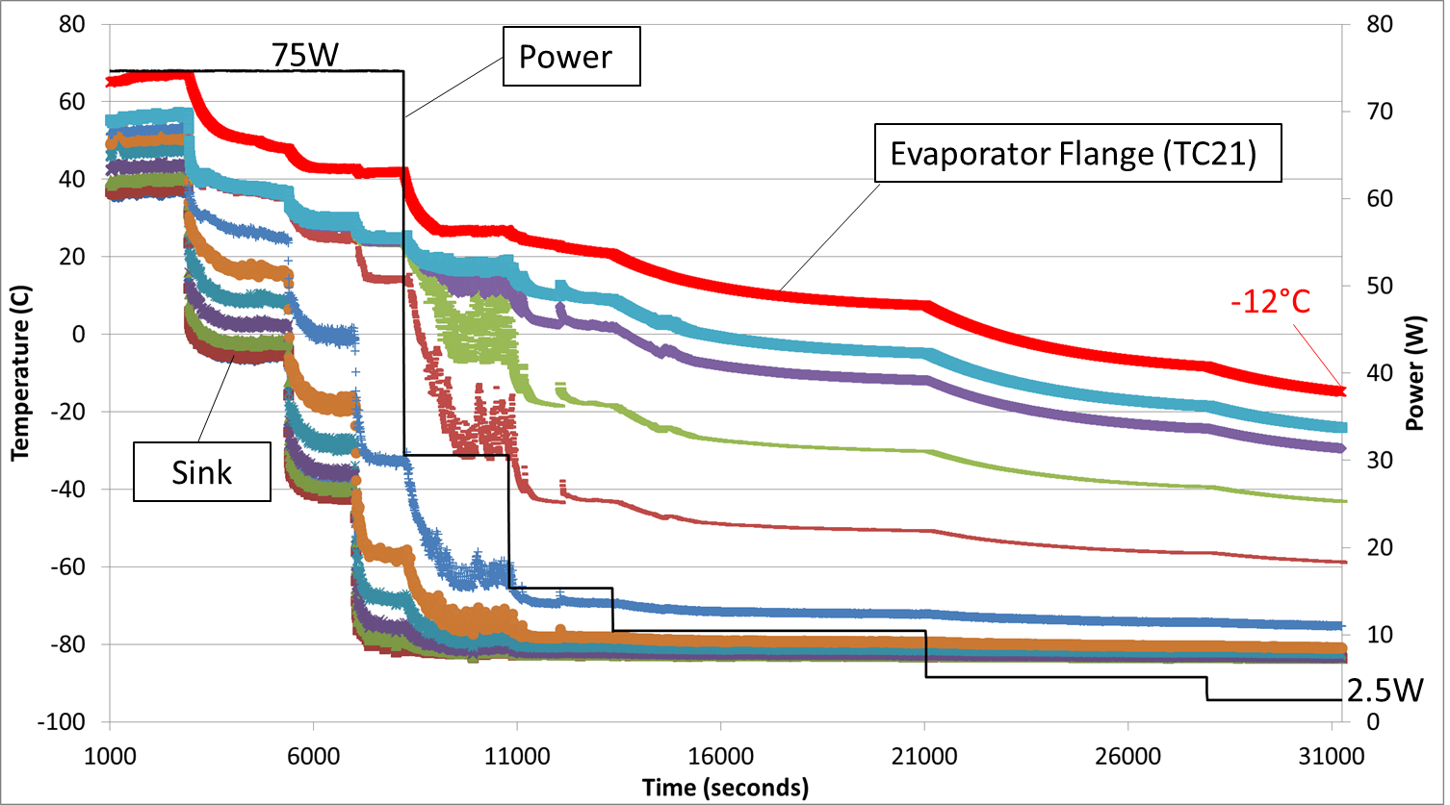
Thermal Control Test Results
Heat pipe is initially operating at 40C sink temp with 75W of heat input
Evaporator temperature = 65C
Thermal conductance = 3.03 W/K
Evaporator temperature drops 20C while the sink temperature decreases to -80C
Power is then scaled down from 75W to 2.5W at sink temperature of -80C
Evaporator temperature = -12C
Thermal resistance = 0.037 W/K
The corresponding turn-down ratio is 82
Lower sink temperature will reveal an even higher turn-down ratio

Slide 8
VCHP Reliability Testing
Objective: Demonstrate that the VCHP can quickly recover from abnormal situations, including
Some working fluid liquid enter the hot reservoir
ALL working fluid is in the reservoir (extreme case)
The following tests were performed consecutively to characterize VCHP reliability
Regular startup (baseline)
Purge test
Critical startup
Two working fluid were tested:
Acetone
Toluene

Slide 9
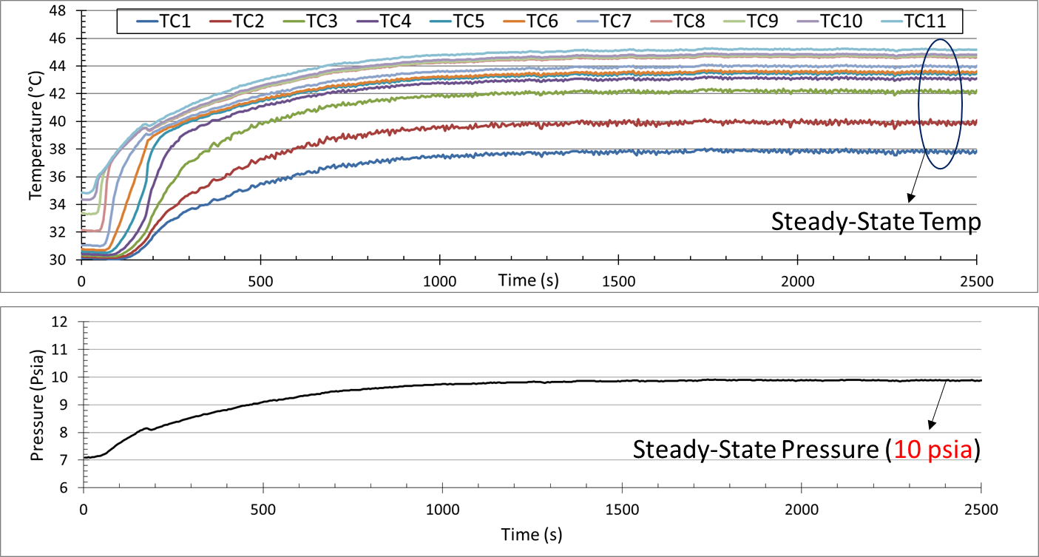
Regular Startup (Baseline)
Working fluid and NCG were charged from the regular fill tube
Start the pipe immediately after charging (i.e. dry reservoir)

Slide 10
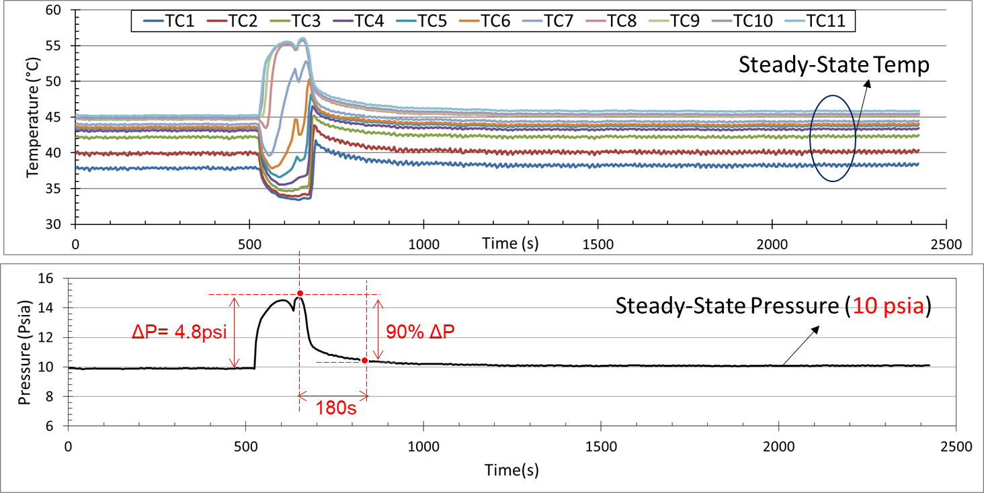
Purge Test (Acetone)
At t = 525 sec, 0.5 ml of working fluid liquid was added to the reservoir
Estimated purge flow velocity = 1.2 cm/s

Slide 11
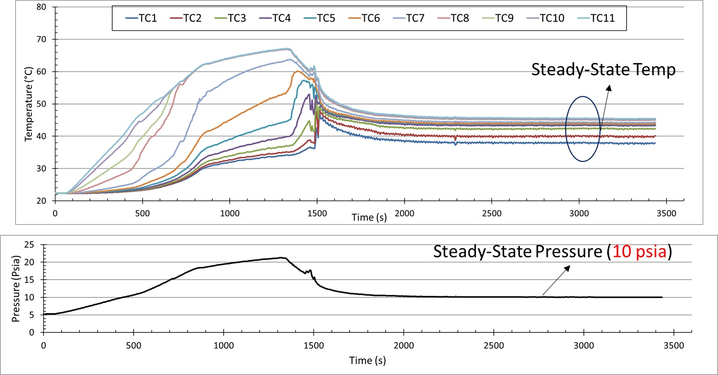
Critical Startup Test (Acetone)
ALL the working fluid was charged in the reservoir
Evaporator was initially DRY

Slide 12
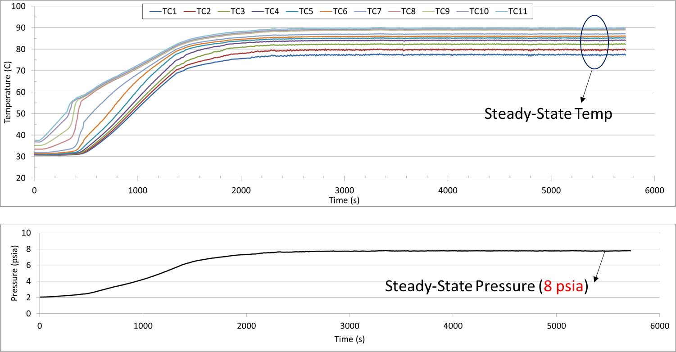
Regular Startup (Toluene)

Slide 13
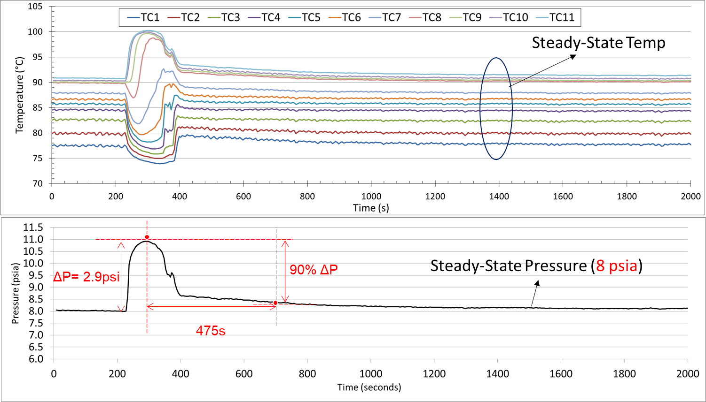
Purge Test (Toluene)
Estimated purge flow velocity = 2.1 cm/s

Slide 14
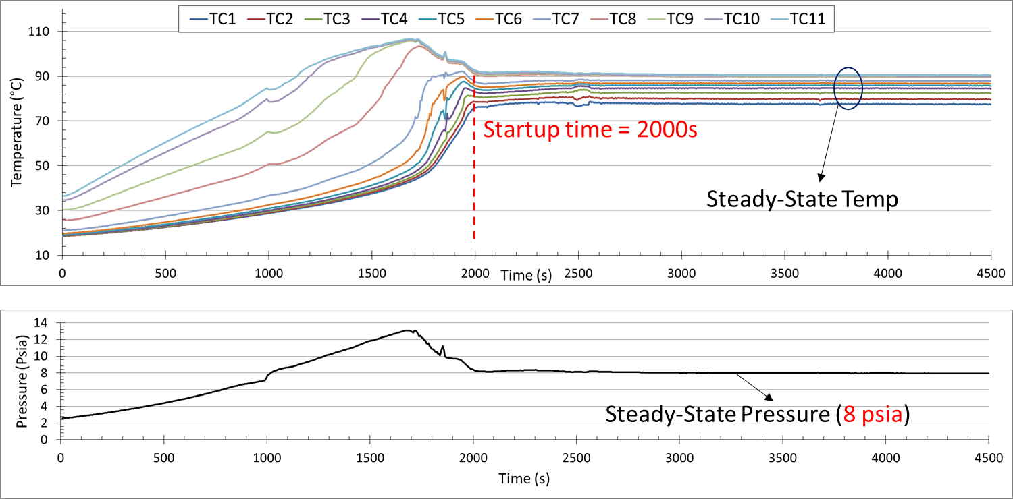
Critical Startup Test (Toluene)
ALL the working fluid was charged in the reservoir
Evaporator was initially DRY

Slide 15
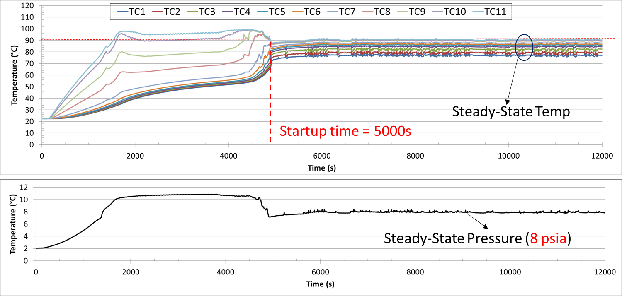
Critical Startup Test – Regulated Heating
ALL the working fluid was charged in the RESERVOIR
ON-OFF controlled heater was used to keep evaporator below 100C

Slide 16
Acknowledgement
This program was sponsored by NASA STTR Phase II ( (80NSSC20C0023)
Special thanks to our program manager – Dr. Jeffery Farmer (MSFC)
ACT team:
Technician: Phil Texter and Larry Waltman
Thanks for your attention
Any Questions?

