Slide 1
Model Checks: How to Ensure a Model is Working as Intended Kim Martin (NASA Langley) Brian Comber (NASA Goddard)
TFAWS Technical Course
Thermal & Fluids Analysis Workshop TFAWS 2023 August 21-25, 2023
NASA Goddard Space Flight Center
Greenbelt, MD
Notes:
Kim

Slide 2
Course Outline
Basics of Thermal Desktop Model Reviews
Thermal Desktop Model Checklist
Goddard and Langley Model Audit Outputs
Additional Tools
Demos
Notes:
Kim

Slide 3
Basics
Why should you do a model review?
Independent assessment builds confidence in the model both for the analyst and project
Another perspective can show longstanding model mistakes and incorrect simplifications
Even experienced analysts can use a second opinion and outside checks
Builds model knowledge and capability in early career analysts
When should a model review be done?
Commonly at Langley, before milestone project reviews like Preliminary Design Review (PDR) and Critical Design Review (CDR)
Additional reviews could be done as needed (e.g. prior to system-level testing, model delivery, or integration into a higher-level model)
What does a model review encompass?
All aspects of the model, including base geometry, thermal desktop elements like connectivity/heat sources/model logic, thermal radiation, and results
Could be done in conjunction with document review (e.g. model reports, project milestone slides)
Notes:
Kim

Slide 4
Basics
Who should perform a model review?
For simple models with common features, any engineer with exposure to thermal modeling practices
It can be valuable even for early-career engineers to do model reviews, to gain exposure to model techniques
For specialized models with unusual features or analysis techniques, it is valuable to select a reviewer familiar with the subject matter
Best practice is that the reviewer is not an engineer associated with the project
How long should a model review take?
For many Langley thermal models (electronics boxes, small satellites), two weeks is a standard window to give the reviewer
For more complicated models, a monthlong window might be more realistic
Actual labor time is typically ½ day to 2 days
Larger models, such as full spacecraft, might take months and multiple analysts
Request a model review as soon as reasonably possible, to ensure time to assign reviewer and complete the review
Notes:
Kim

Slide 5
Basics
What should be delivered for a model review?
The model, with all relevant files
Thermophysical and optical property files
External model logic files
Any xref files
Supporting documentation or files (e.g., CAD, review slides)
Model log or documentation, if used
Model output template, if used

Slide 6
Basics
Self reviews vs. peer reviews
The checks in this document can be used by the original analyst as well
It is a good practice to self-review a model using some or all of these checks prior to requesting an independent review
Reference documents when doing a review
NASA Passive Thermal Control Engineering Guidebook
Cross-center thermal best practices document
Cross-Program Design Specification for Natural Environments (DSNE)
General reference document for common space and planetary thermal environments
Lunar Thermal Analysis Guidebook (LTAG)
Moon-specific environmental document, with Thermal Desktop modeling guidelines
This Slide Package
Most common issues found during model reviews
Units
Property assignments
Incorrect logic
Radiation surface assignment
Contactor errors
Notes:
Kim

Slide 7
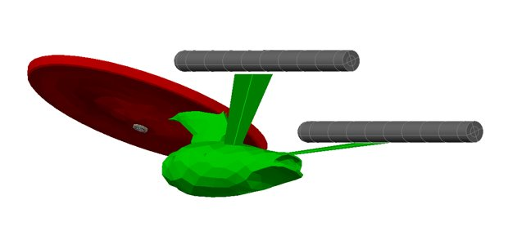
Demo Model
We generated this future NASA concept as a way to show some of these checks in real-time today
We will switch back and forth between a detailed checklist and this model as the course progresses
Model demos denoted by

Slide 8
Model Units
Check unit preferences in Thermal Desktop
General standard for NASA is all SI units, but some projects may choose to make exceptions, particularly for lengths
Caution: check user logic for problems that could arise from changing units
Make note of model units for reviewing:
Model objects that use symbols
xrefs
Command: Rcpreferences

Slide 9
Sanity Check Against CAD
Ideally, Computer Aided Design (CAD) and Thermal Desktop geometry should have the same coordinate system for ease of import
Checker should import CAD and ensure that the thermal geometry reasonably matches.
Check critical dimensions like thicknesses, if necessary
Determine if the model is using surfaces vs. solids properly
If post-processing data mappers are present in the model, ensure that they align with thermal model
Notes:
Kim

Slide 10
Radiation Analysis Groups
View model by each analysis group (via Model Browser)
Check for missing or extraneous surfaces
Zoom Extents is useful to make sure all surfaces are visible on screen
May not work correctly if xrefs are used
If symbol-driven assemblies or trackers are used, try changing the symbols to make sure the whole radiation group moves together
Ensure that there is only one external radiation analysis group and internally-facing surfaces do not use that group
Command: Rcmodelbrowser
Notes:
Kim
ENTERPRISE

Slide 11
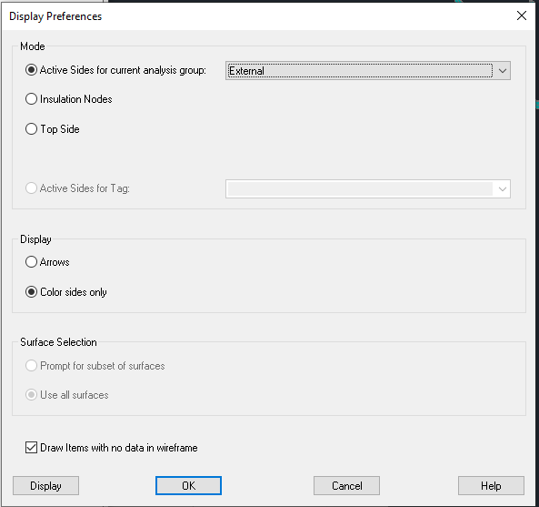
Radiation Analysis Groups
Display active sides for each analysis group
Look for inverted or double-sided surfaces that don’t make physical sense
Command: editActivePrefs
Notes:
Kim
ENTERPRISE

Slide 12
Optical Properties
View model by optical properties
Property name, absorptivity, emissivity
Look for unexpected changes in properties on single bodies, or unreasonable values
Look for surfaces assigned DEFAULT optical properties in the model browser
Command: editPropData
Notes:
Kim

Slide 13
Thermophysical Properties
View model by material properties
Property name, conductivity, specific heat, density, thickness
Look for unexpected changes in properties on single bodies, or unreasonable values
Look for properties assigned DEFAULT material in the model browser
Be sure to assign unique colors to property names when viewing by name
Command: editThermoPropData
Notes:
Kim

Slide 14
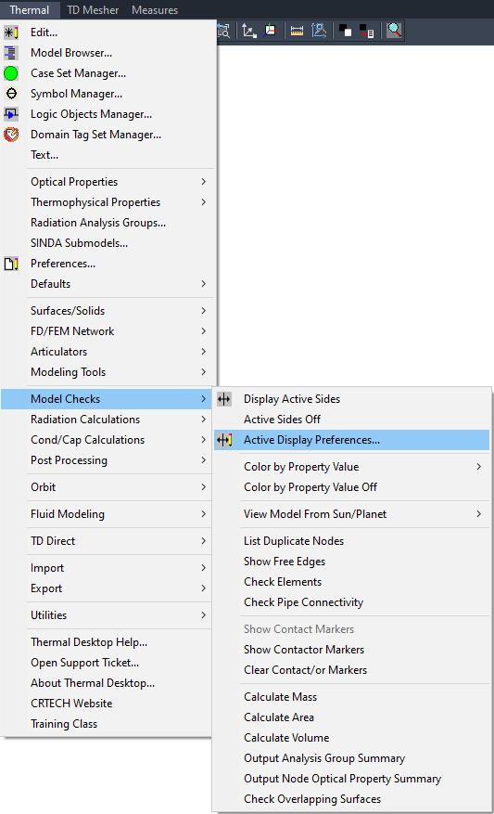
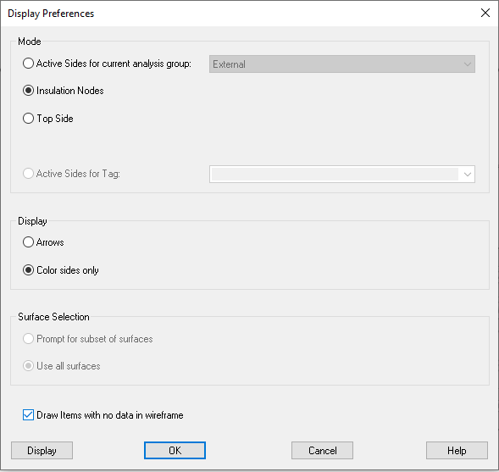
Insulated and Multilayer Insulation (MLI)-Covered Surfaces
View surfaces that have insulation via Model Checks → Display Active Sides → Insulation)
Ensure insulated surfaces are using insulation-related optical properties
Command: editActivePrefs
Notes:
Kim

Slide 15
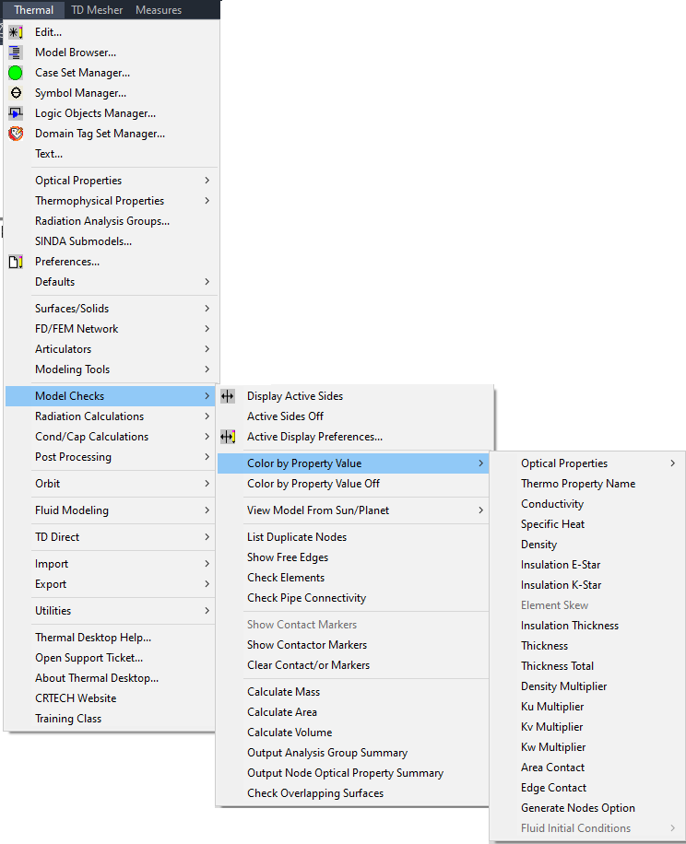
Insulated and MLI-Covered Surfaces
Plot surfaces by e* value
Plot surfaces by k* if applicable
Command: RcPlotEStar
RcPlotKStar
Notes:
Kim
ENTERPRISE

Slide 16
Optical Property Database
Verify that all optical properties have properly assigned values
No placeholder values
All properties have reliable sources listed, such as published papers or vendor datasheets
Check for duplicate properties with similar names
Check that aliases are set appropriately
Command: editPropData
Notes:
Kim

Slide 17
Thermophysical Property Database
Verify that all material properties have properly assigned values
No placeholder values
All properties have reliable sources listed, such as published papers or vendor datasheets
Check for duplicate properties with similar names
Check that temperature-dependent properties have properties over all temperatures predicted for the material
Check that aliases are set appropriately
Command: editThermoPropData
Notes:
Kim

Slide 18
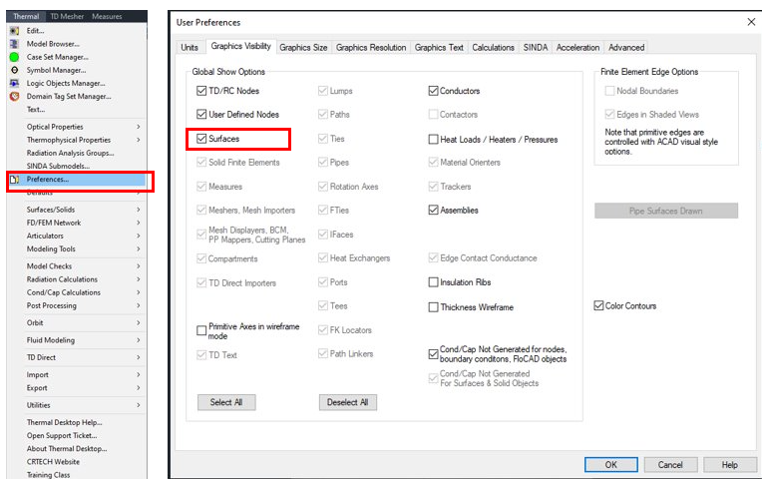
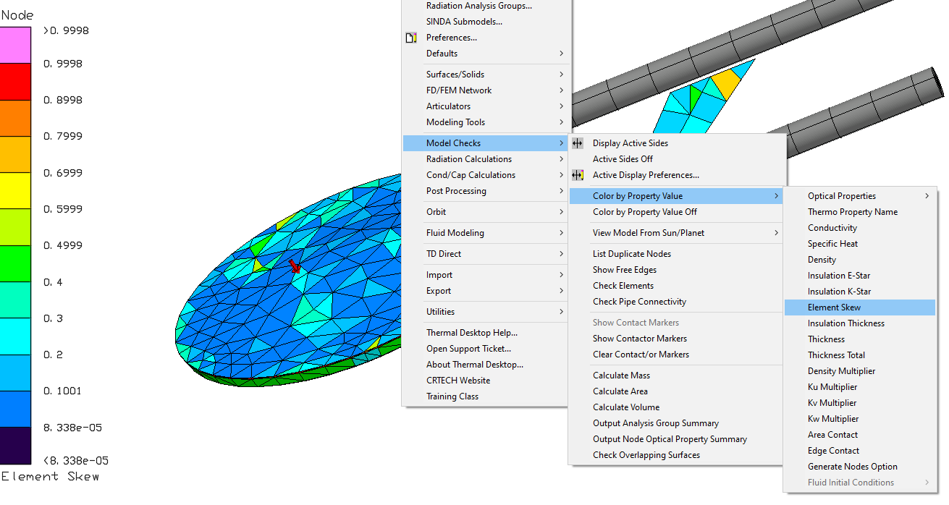
Mesh Density
Turn on surface visibility
Visually check for reasonable mesh density
Are there sufficient nodes to capture heat paths?
Are there nodes located where contactors are connecting?
Are there places where it would be better to merge nodes instead of using high-value conductors?
Plot by skew
Thermal Desktop will abort the run (if checked in User Preferences: Calculations) if skew is above 0.999
Address areas of unacceptably high skew by re-meshing if possible
Command:
Rcpreferences
Command:
_RcPlotSkew
Notes:
Kim

Slide 19
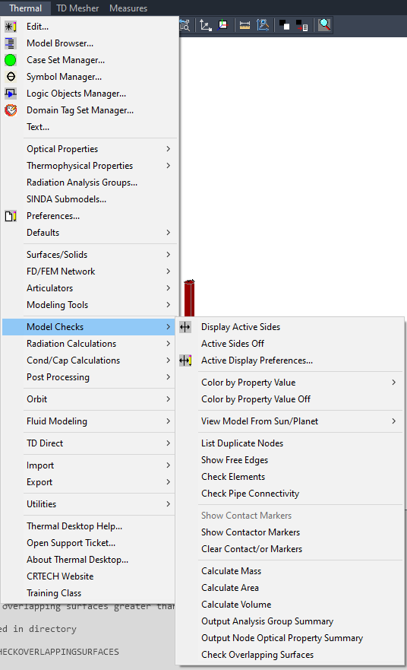
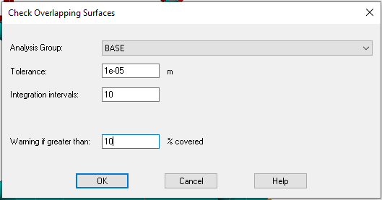
Geometry Checks
Overlapping Surfaces
Writes a log file (CheckOverlappingSurfaces.log) to model directory listing any surfaces overlapping above user-input threshold value
Tool described later in presentation can help parse the output
Show Free Edges
Highlights discontinuities in finite elements with a red line
Shows the outline of a finite element mesh as well, which is normal
Show material orienters for anisotropic solids and surfaces and verify proper assignment and alignment
Command: RcCheckOverlappingSurfaces
RcFreeEdges
Notes:
Kim
ENTERPRISE

Slide 20
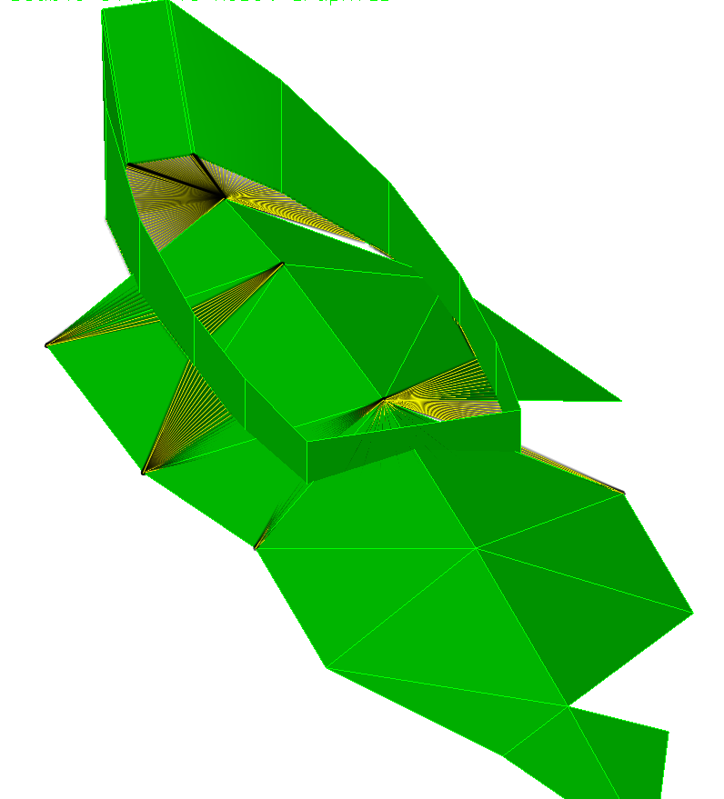
Conductors/Contactors
Show all contact/contactor markers
Verify that the contactor faces are set up in a physically meaningful way
For a large model, it may be better to do this in batches
Open each contactor via the model browser
Check contactor values
Check warning messages
Via “show calcs” in each contactor and checking the command window output, or run a case and check the ContactorData folder
Use “Display Only” for the from and to surfaces separately
Best practice is that the “from” surface has larger area than the “to” surface. If this is the case, the contactor will show up as green in the Model Browser.
Red contactor indicates the “from” surface is larger than the “to” surface
Contactor Markers
Command: RcShowContactorMarkers
RcShowContactMarkers
Notes:
Kim

Slide 21
Mass
Do model mass check
Select the whole model, or portions, and use the “Calculate Mass” feature
Is the model close to total mass Current Best Estimate (CBE)?
Are submodel masses close to submodel mass CBE?
Command: RcCalcMass
Notes:
Kim

Slide 22
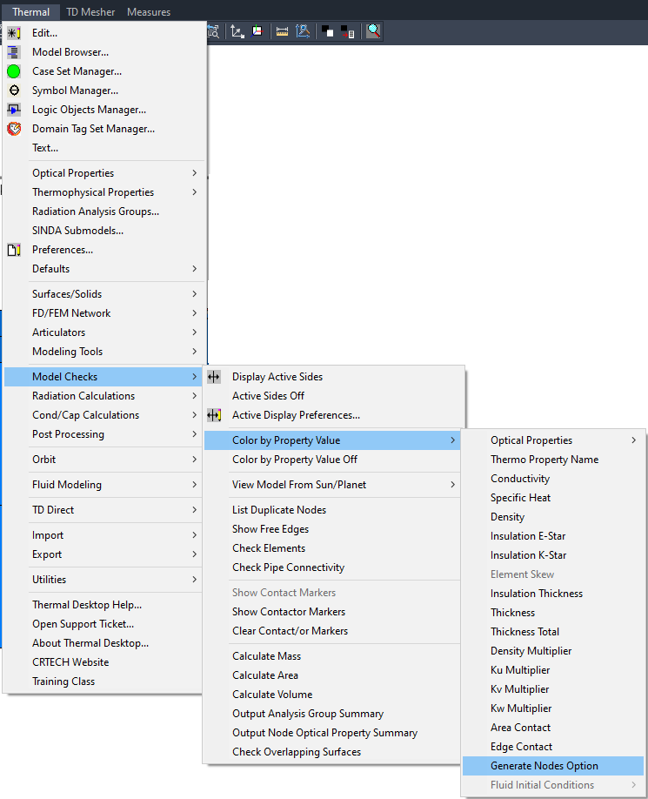
Nodes
Check nodes by shape of node
Sphere: Diffusion or generated by surface
Cube: Overridden to arithmetic
Pyramid: Overridden to boundary
Check for arithmetic nodes overridden by surface, use "Generate Nodes Option" by sequence shown in screenshot
0=material property, 1=arithmetic
Ensure arithmetic nodes or diffusion nodes not associated with surfaces are properly applied
Command: RcPlotGenNodes
Notes:
Kim’s

Slide 23
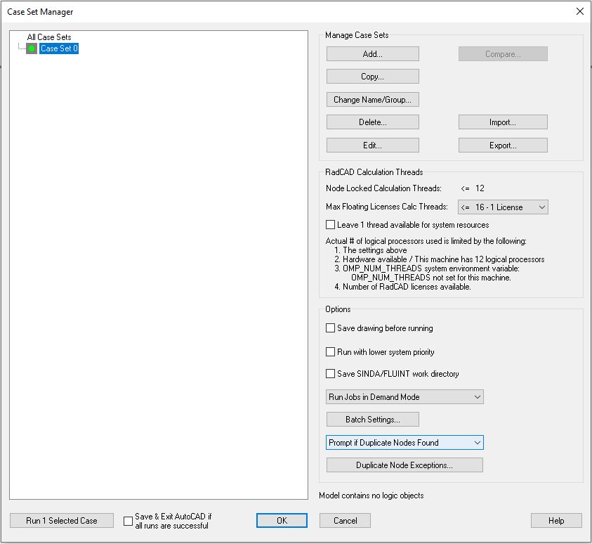
Nodes
Disposition any duplicate nodes
In the case set manager, ensure that "prompt if duplicate nodes found" is checked
Duplicate nodes may be acceptable for merged interfaces, but generally not desirable (merge nodes instead)
Use "Duplicate Node Exceptions" in case set manager and maintain the warning for the future
Command: RcCaseSet
Notes:
Kim

Slide 24
Conductance/Capacitance
Check multipliers on density and conductivity on surfaces and solids
A large override may indicate a nonphysical representation
If using a density override, use conductivity override values to match
Check nodes over-ridden for thermal mass
Create cc file and check for errors
Command: RcPlotDensityMult
RcPlotKuMult
RcPlotKvMult
RcPlotKwMult
Notes:
Kim

Slide 25
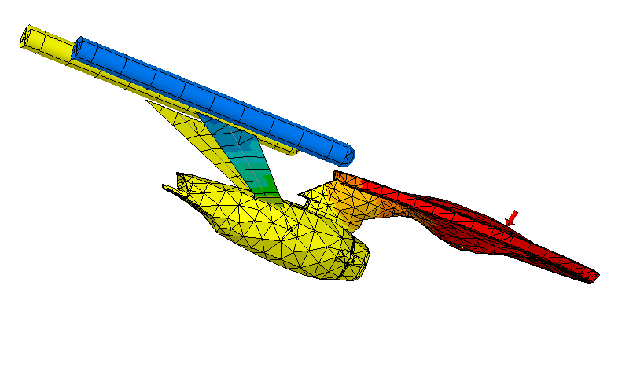
Model Connectivity Test
Save as a new model and check internal connectivity
Connect each internally-continuous body to a boundary node, turn off radiation and convection, and run steady state to ensure that all surfaces are connected as intended
Turning off all heat loads except for one or adding a very high-value heat load can help visualize the heat flow
Notes:
Kim

Slide 26
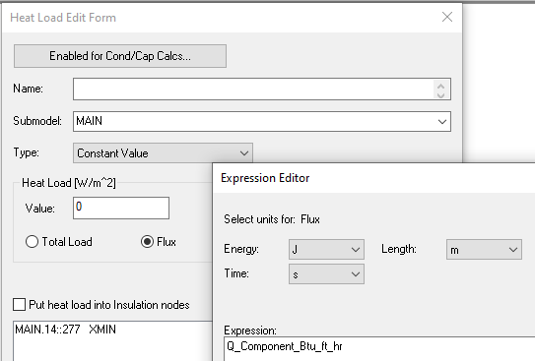
Heaters and Heat Loads
In the model browser, check each heater and heat load and Thermo-Electric Cooler (TEC)
Plot surfaces and markers for each heatload, to understand where they are applied
Verify consistent units (absolute? Per area?)
Verify enable/disable flags
Verify thermal heat dissipation is electronics waste heat and not necessarily electronics power
Check heater performance in .sav or .out to ensure they are working as expected. Print out duty cycles in .us* file.
Notes:
Brian

Slide 27
Symbols
View model by symbols in Model Browser, and ensure that correct symbols are used
Symbols that are not used may indicate an oversight
Check symbols in symbol manager for consistency
Does the model follow a symbol naming convention?
Confusing naming convention could result in duplicate symbols (e.g. flag_op vs. switch_op vs. power_state vs. op_flag)
Are symbol units clarified in the comment block?
Are the units identified consistent with the model units? And if not, is the appropriate conversion done when using the symbol?
Symbols that do not have a “+” next to them are never used in the model
Notes:
Brian

Slide 28
Logic
Check logic in enable blocks to ensure logic turns on and off consistently
Can temporarily manipulate model enable flags to check that logic turns on and off in the correct conditions
Save a separate version before making any changes like this
Check each logic object (e.g. arrays, PID controllers)
Check unit consistency in logic objects
This can be particularly hard to catch for time- or temperature-based array interpolations
Check that time-based logic matches the duration of cases
Look for logic in include files
Actually read the cautions that come up in the command line when the model is run
Command: RcLogic
Notes:
Brian

Slide 29
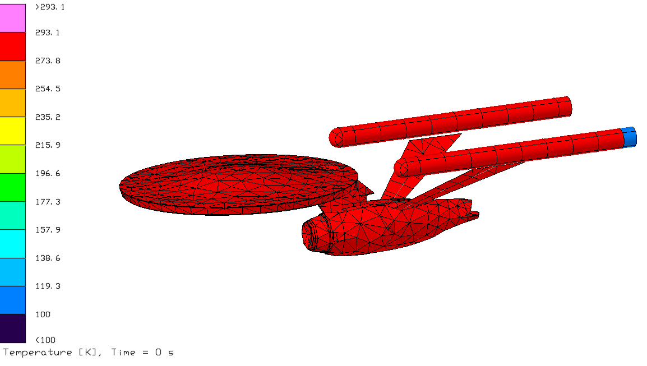
Initial Condition - Temperature
Run a transient case that is not initialized from another case or steady state, and view the temperature at the first timestep
Is the temperature consistent throughout?
Set the initial temperature symbol to a different value, re-run the case and replot the temperature at the first timestep
Does this change the initial temperature of all nodes?

Slide 30
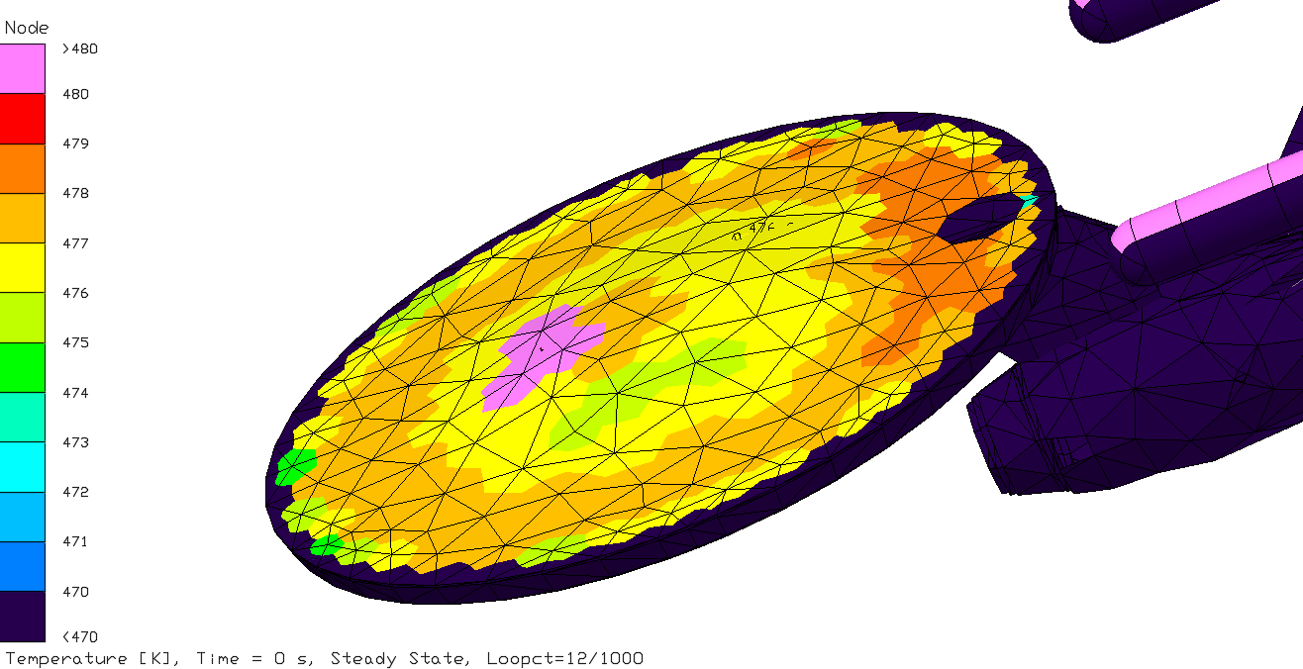
Measures
Ensure that measures are contacting the correct surfaces
Display measures on color plot and make sure they are the correct color
Ensure that measures move with articulators if necessary
Note: this color plot also indicates node density issues

Slide 31
Orbits
Check orbits for valid parameters
Solar flux, planetshine, and albedo have sensible min/max values per guiding documents like DSNE
Plot orbits
Check whether the model seems oriented correctly
Command: RcManageOrbits
RcShowOrbit
Notes:
Brian
Enterprise

Slide 32
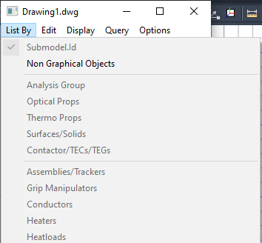
Trackers and Assemblies
In the model browser, check assemblies and trackers
Is it a consistent body, with no surfaces/solids left out?
Check operation of trackers by viewing model around orbit
Notes:
Brian

Slide 33
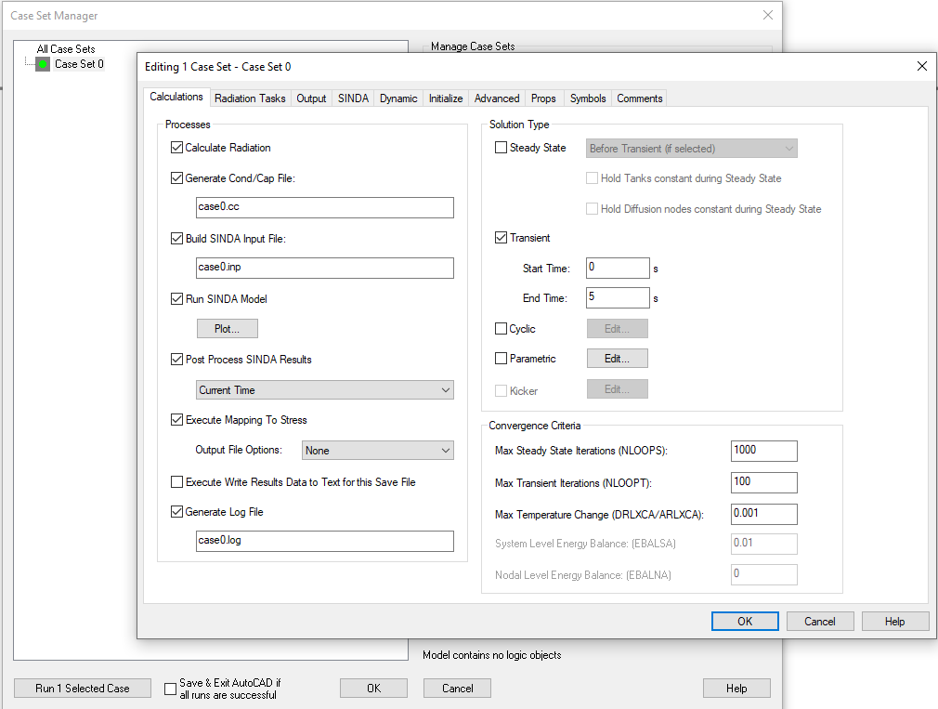
Analysis Cases
On the "Calculations" tab:
Check for reasonable values on:
A/DRLXCA (default value is 0.001. Some users may increase this to speed up model runs, but a much larger value could result in poor convergence)
DTIMEI (should be 0 except in exceptional circumstances)
EBALSA <0.01 and EBALNA < 0.001 for steady state runs
DTMPCA < 0.1 and ATMPCA < 5
Check for steady-state versus transient, and sufficient length of transient
If running steady state for a case with heater, it is best to run a transient run afterward, to allow heaters to cycle to their setpoint
Notes:
Brian
A/DRLXCA: temperature-based convergence criteria per iteration
DTIMEI: user-enforced timestep
EBALSA/EBALNA: Energy-based convergence criteria, SS only
DTMPCA/ATMPCA: temperature-based convergence criteria per time step

Slide 34
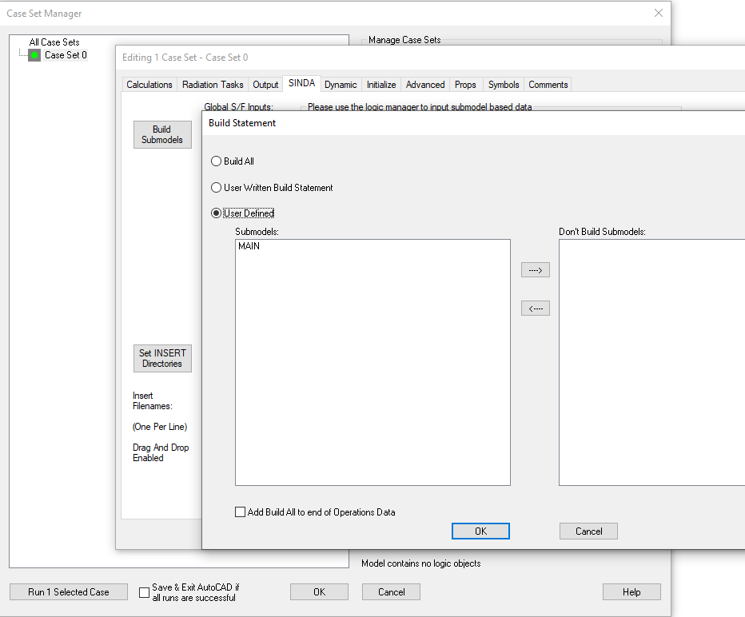
Analysis Cases
Check BUILD block
Verify that case-specific submodels (e.g., Thermal Vacuum (TVAC) configuration, ground support equipment, convection, landed surface, launch are only built in appropriate cases)
Notes:
Brian

Slide 35
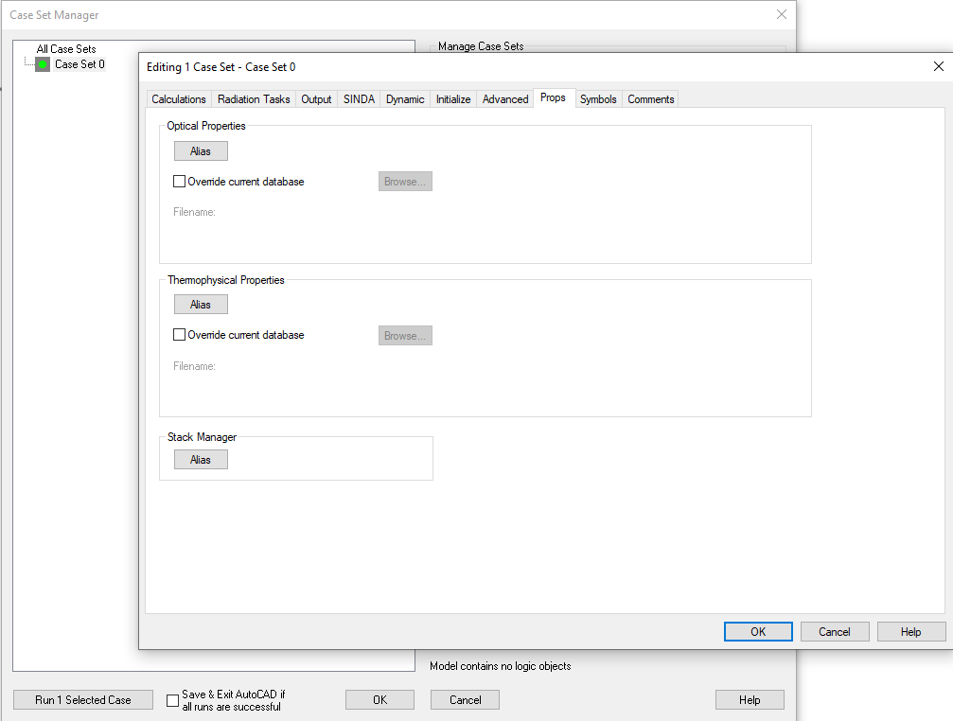
Analysis Cases
On the "Props" tab: check thermophysical/ optical property aliases
If properties have a permanent alias, strongly consider changing the property itself and not using an alias
On the "Symbols" tab: Check symbol overrides
e.g. Operational cases use op flags and op heater setpoints
Ensure reasonable number of symbol overrides and no permanent overrides that only exist on Case Set Manager
Note: Goddard best practice is to use separate .tdp and .rco files for Beginning of Life (BOL)/End of Life (EOL) and to deliver models with all property aliases removed
Notes:
Brian

Slide 36
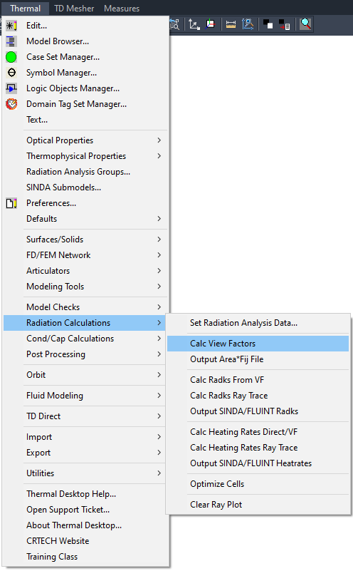
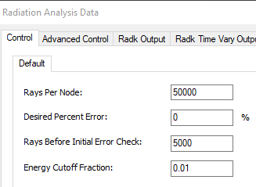
Analysis Cases – radks Settings
Check number of rays reasonable
Generally, 50k rays at a minimum, and 500k is an all-around "good" number, but it depends on geometry
Tall, thin structures may need more rays
To check:
Plot heat rates and look for unexpected heat rate hot spots
Check that total view factor (Fij) is >0.98
"Output Area*Fij File" option under the Radiation Calculations submenu, then open the AREAFIJ.XLS file to examine Fij values
Can also double the number of rays and ensure that the results do not change
Command: outputAreaFij
Notes:
Brian

Slide 37
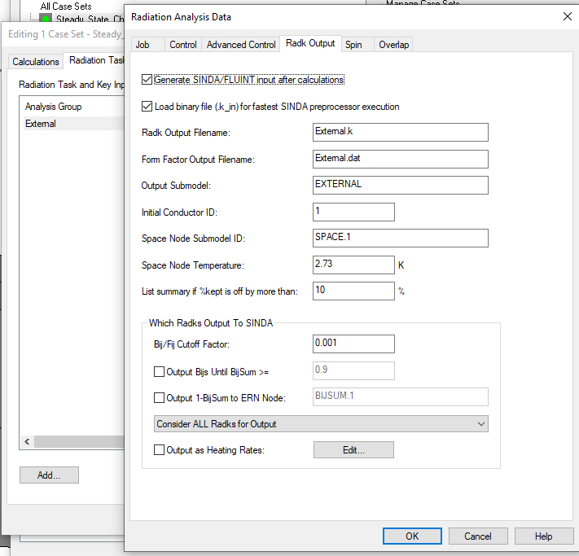
Analysis Cases – radks Settings
Model checker should view radiation analysis groups by temperature
For radiation groups with large differences in temperature, ensure that the energy is well book-kept, not just the view factors
Small view factors can be a majority of the energy in some cases
Set Bij/Fij Cutoff factor low AND output Bij very high for such radiation groups
Be aware of cases with low emissivity and high temperature range (i.e., sun shields) that may need additional consideration for non-grey behavior
Notes:
Brian

Slide 38
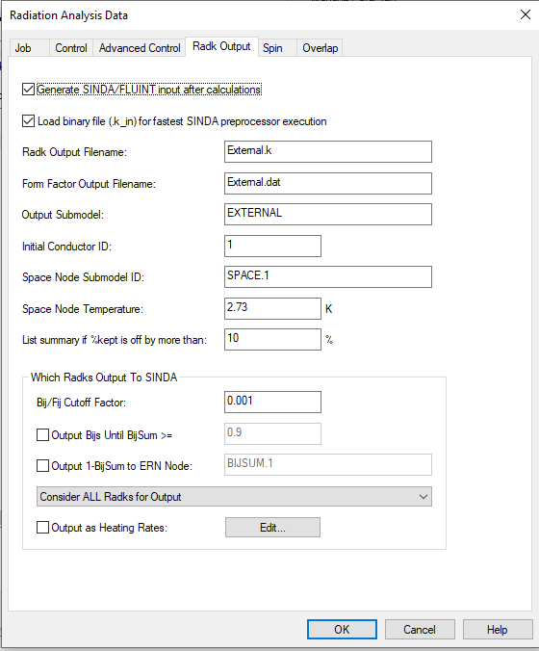
Analysis Cases – radks Settings
Verify space node temperature
If set with a symbol, check whether it is changed in case symbol overrides
Double check after loading .sav file by creating a node and naming it SPACE.1 and read temperature
Check radks to space setting
Disabled for internal groups?
Enabled for groups with view to space?
Notes:
Brian

Slide 39
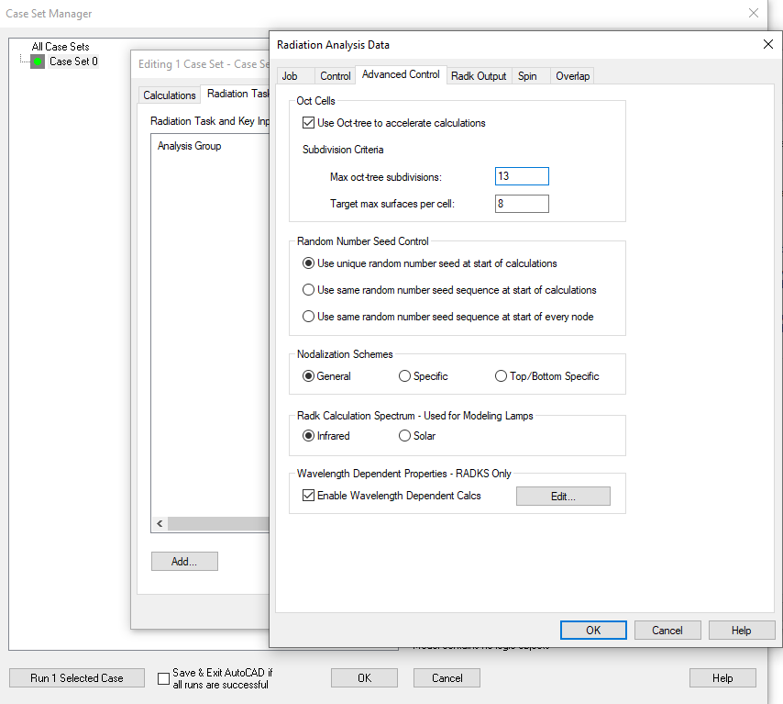
Analysis Cases – radks Settings
Check that the correct orbit is selected for the case name
Ideally, verify that radks output files have user-identifiable names (not auto-generated)
Check correct spectrum used
This is a setting not often used for purely space-based analysis, but in thermal testing where lamps are used
Check oct tree settings
Thermal: Radiation Calculations: Optimize Cells will provide optimum settings for the particular model
Usually, 13 oct tree subdivisions and 8 max surfaces per cell
Notes:
Brian

Slide 40
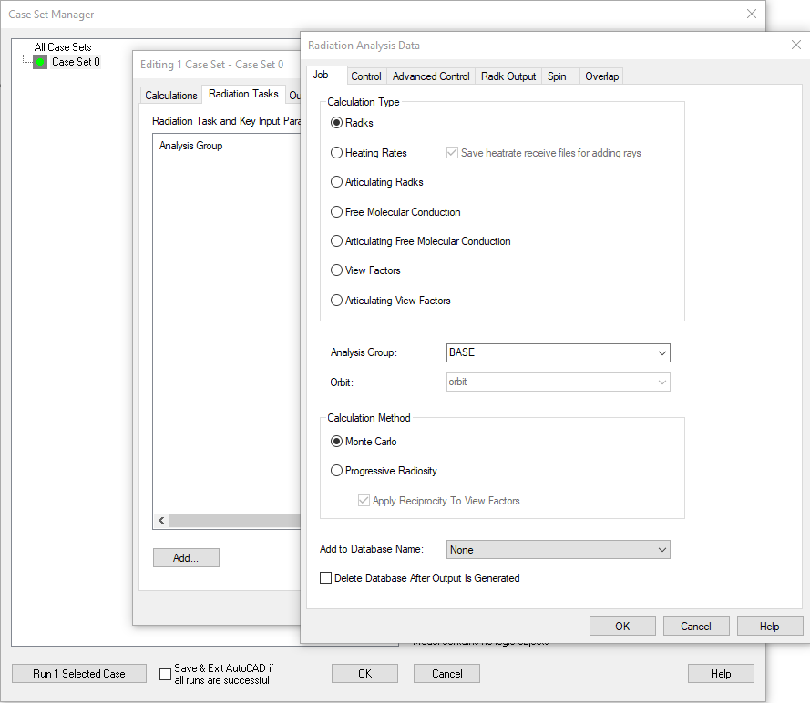
Analysis Cases – radks Settings
Verify articulating radks used where necessary
Important for systems with parts that will move during a case
Verify that an appropriate percent of radks are being printed
Especially for models with big temperature differences, sometimes small views can be a lot of heat
Notes:
Brian

Slide 41
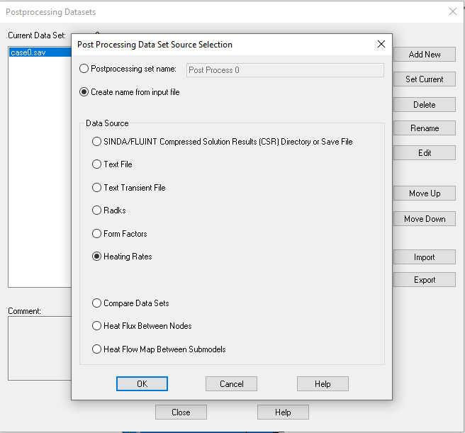
Results
Run a few cases to make sure they run
Ask originating analyst which cases are most applicable
Check all warning and caution messages (including cautions about symbol unit mismatch)
Check for balanced heat in/out
View thermal results on the model, looking for:
Large gradients
Sudden temperature changes
Unreasonable min/max values
View absorbed solar/planetary flux on model
Notes:
Brian

Slide 42
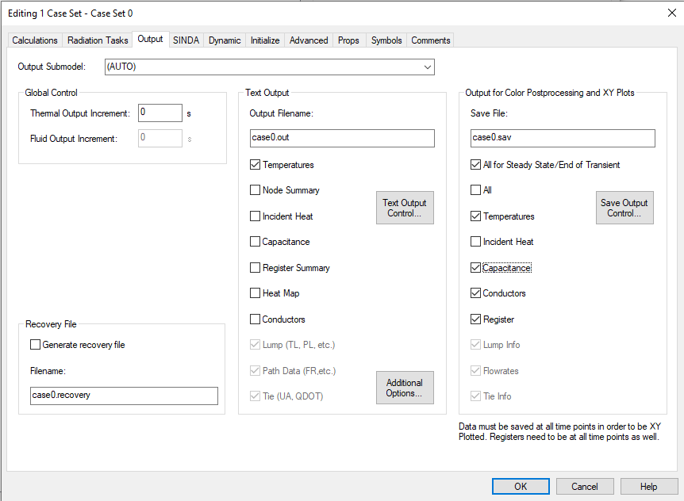
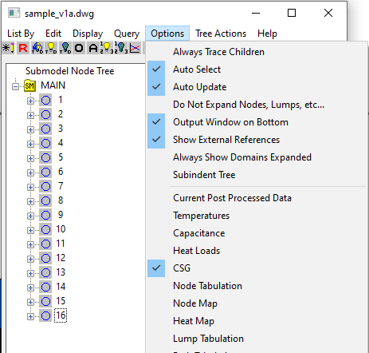
Debugging Slow Models
If a model is running slowly, calculating minimum thermal time constant (CSGMIN) can identify why
Enable outputting capacitance and conductors on the .sav file and run the case
In the model browser, enable CSG output
Smaller CSG values indicate low mass/high conductivity nodes
Additional tools include CALL SETTL and PRINTTL, which will report which nodes are limiting for each timestep
Improvement options include:
Increasing mesh density
Changing to arithmetic nodes (if applicable)
Decreasing artificially high contactor/conductor values used for internal contact
Merging nodes instead of using contactors/conductors for internal contact
Notes:
Brian
Enterprise?

Slide 43
Best Practices
While not affecting model accuracy, these best practices can help avoid confusion and mistakes, and speed up model reviews
No unused optical or thermophysical properties in model after delivery
No duplicate properties (i.e., multiple aluminum 6061 T6's) unless controlled by different organizations
No thermal entities (heat loads, heaters, etc.) allowed to be disabled in model delivery
Inactive surfaces only used as blockers need to be in their own submodel called INACTIVE
Verify Software version is latest/project required
Check consistent MLI nodal offsets
Symbols grouped by tabs
Avoid nesting assemblies
Check for good naming convention for submodels (usually using prefixes)
Use layers in a way that avoids confusion among your group members
For example, model is on one layer and organized by submodels, but CAD surfaces are on other layers
Do not allow important model details to hide in obscure layers.
When a model is intended to be xref'd, use a consistent prefix to keep track of which symbols and submodels belong to which models
Steady state heaters set to damped proportional control
Contactors, conductors, heat loads, heaters, surfaces/solids should have descriptive comments
Contactors should use ray trace algorithm, if possible, for face connections
Heat Loads, heaters, conductors, contactors, etc., are defined in the same submodel as the nodes on which they are applied
Sensor and thermostat locations should be modeled as measurement points to keep node numbers down. Put them in a unique submodel
Property values should include reference/source
Avoid include files if possible – put user defined logic in Logic Manager
No use of symmetry as a model reduction tactic in subsystem or system level models
Use a consistent naming convention for symbols (Langley uses Hungarian notation)
The names of all symbols are prefaced by type, and the prefixes are standardized
Can also include units as a suffix. e.g. T_initial_shuttle_C (initial temperature of the shuttle, in °C), or Qflx_torpedo_W_m2 (heat flux of a photon torpedo, in W/m^2)
Notes:
Brian

Slide 44
Useful Tools
A few useful tools were developed at Goddard to make it easier for the model reviewer to survey the entire model very quickly for a select few common model issues that can be very time-intensive to find
Surface Consistency Check
Uses the "output to TSS" feature in Thermal Desktop and Excel VBA to read that output
Lists all surfaces and flags any that seem to need MLI properties and do not have them or have effective emissivity without a proper outer layer property
Lists all optical properties that appear for a particular thermophysical property to ensure that no unrealistic pairings appear (ex: tiodize on aluminum or the presence of the "DEFAULT" property)
Mass and Conductivity Multiplier Finder
Somewhat made obsolete by "color by" feature in TD for multipliers, but can show at a glance if large multipliers are used to fix model mass so that reviewer can check for accuracy.
Conductance Reader
List all conductors and check for very large conductances that can make the model run slowly
Overlapping Surfaces Clean-Up
Reads the checkoverlappingsurfaces output from Thermal Desktop and sorts by percentage. It cleans up the many duplicates that currently (2020) exist in the TD output
Flags the T^4 ratio of the two surface temperatures to highlight small overlaps that might be below a model audit threshold (say, 10%), but could be so different in temperature that they should be fixed (i.e., a warm object sticking through a cold one).
FilePlottingTools v3.1 (Langley)
Notes:
Brian

Slide 45
Surface Consistency Check Output
Shows each thermophysical property and the various optical properties that pair with it. Manually review and highlight pairs that merit further review by the modeler. Example: A titanium part that has an Invar optical property, or any use of the DEFAULT property, which we discourage
Button jumps to an example of the selected pairing in the full list
In full list, highlights any line that has "MLI-ish" numbering (user inputs what a typical difference between surface and MLI node would be) but lacks an MLI outer layer optical property from a user input list. Example: this surface has total difference between the associated node numbers of 200,000, but the top optical property on this one-sided element is black paint. MLI isn't painted
In full list, highlights any line that has a listed property associated with MLI, but no "MLI-ish" nodalization. This will mostly result in flagging single layer soft structure, but it is a nice sanity check.
Notes:
Brian

Slide 46
Overlapping Surfaces Clean-Up Output
This lister prints out all of the overlapping surfaces from TD's output but cleans up obvious duplicates. User then dispositions the list by searching for the surface name (i.e., EF0C5) in the model browser and examining each pair. In this case, we dispositioned anything over 10% overlapping as below:
The tool also lists the temperatures of the respective surfaces and highlights surfaces that have significant T^4 ratios or emissivity values for which an object poking through another, even at a low overlap percentage, could be a problem. In this example, these highlighted overlaps are well below the threshold of 10% that we were individually checking via TD, but could still be a problem.
Notes:
Brian

Slide 47
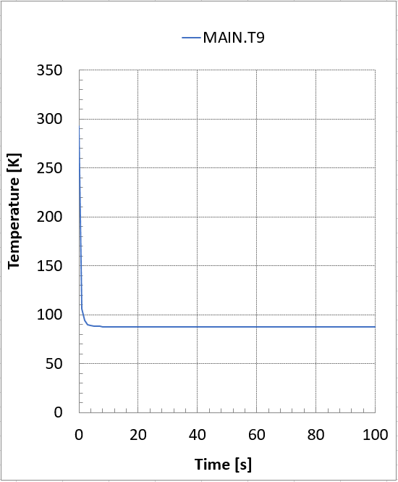
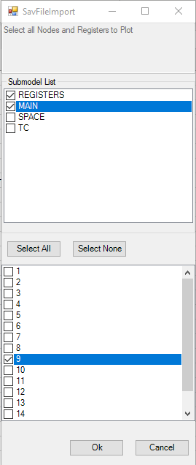
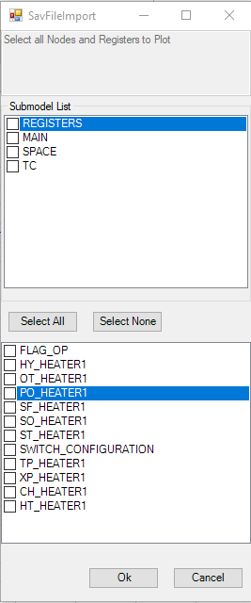
FilePlottingTools
FilePlottingTools is an Excel-based VBA tool
Allows rapid plotting of registers and temperatures saved to .sav file or .us* files
Use a template excel file to easily compare model output to temperature limits
Available from Langley on request

Slide 48
Goddard Process for Recent Large Telescope
Reviewer is an outsider to the flight model build
119 individual model checks (with some overlaps)
Each is individually dispositioned
Additionally, the reviewer keeps a running list of issues as the checklist is worked through. These are given a severity and fix implementation difficulty rating
Notes:
Brian

Slide 49
Goddard Output for Recent Large Telescope
Summary slide shows model version, other documentation reviewed, and a quasi risk square with green being a non-critical and easy to correct issue, and red being a really critical, very hard to fix problem with the model.
The top 5 issues are listed for the modeler to consider.
This, the tools, and the checklist/issue list are given to the modelers for disposition and discussion.
Notes:
Brian

Slide 50
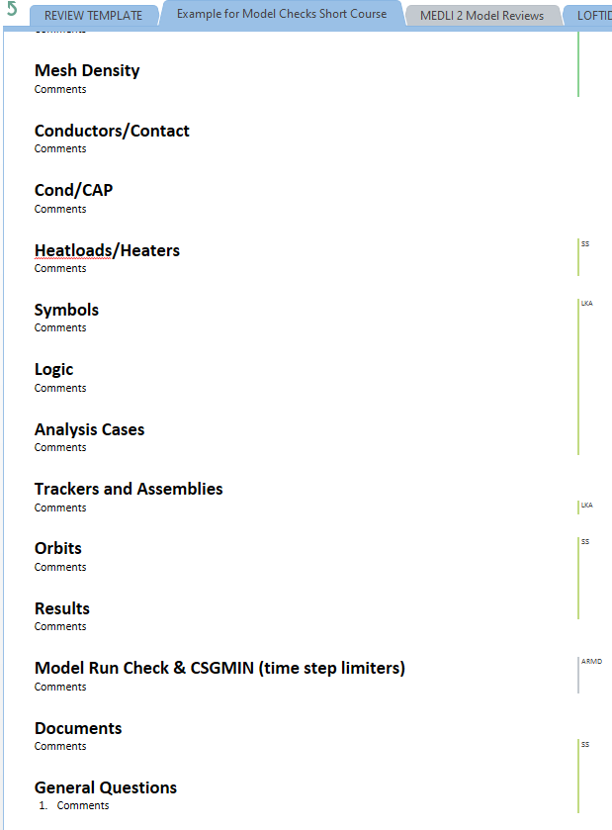
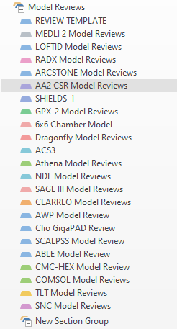
Langley OneNote Model Review Template

Slide 51
Other Model Checks
TVAC balances provide a check of the model
Even times of powering on the system in air or during TVAC transitions can be useful for the analyst to get a first look at the model behavior
Notes:
Brian

Slide 52
Conclusions
Model checking should be a standard practice for missions at all levels
Level of rigor might depend on the complexity and scope of the project, from self checks to peer checks to independent checks
This presentation has provided an in-depth set of checks to make
This full list could take weeks on a complicated model
However, even casual model checks can be useful, especially if done as the model is being built
We hope that this presentation can help all of us catch modeling errors early and improve the overall accuracy of our predictions
Notes:
Brian

