Slide 1
MLI Standards and Best Practices
TFAWS Passive Thermal Paper Session
Presented By Aerothreads
Thermal & Fluids Analysis Workshop TFAWS 2018 August 20-24, 2018
NASA Johnson Space Center
Houston, TX

Slide 2
About Us
Aerothreads specializes in
Multi Layer Insulation (MLI):
Consultation
Design
Fabrication
Installation
Critical Support Services
Notes:
Good Morning
Myself – Lead thermal blankt specialist
Aleks Bogunovic - CEO
Casey Kelby – Thermal Engineer
Aerothreads specializes in multi layer insulation: Consultation, Design, Fabrication, Installation and Critical Support services
We are a Women Owned SB and a SBA Certified HUBZone SB located in College Park MD

Slide 3
Outline
Section 1 – MLI Overview
Design, fabrication, installation
Section 2 – Requirements, Design considerations, and Best Practices
Thermal
Mechanical
Contamination
Electrical
Material
Section 3 – MLI Trends
MMOD
Cryogenic
Space Station/Beta-cloth
Exotics

Slide 4
Section 1 – MLI Overview

Slide 5
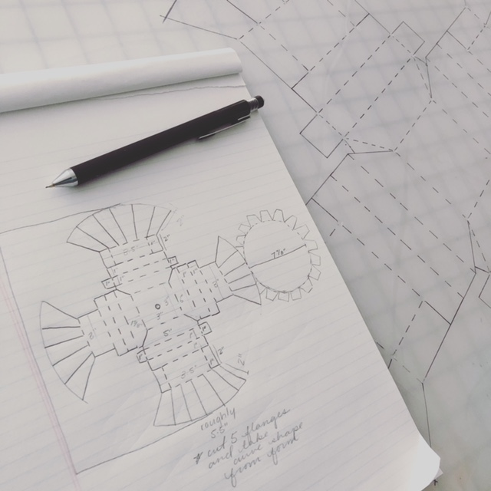
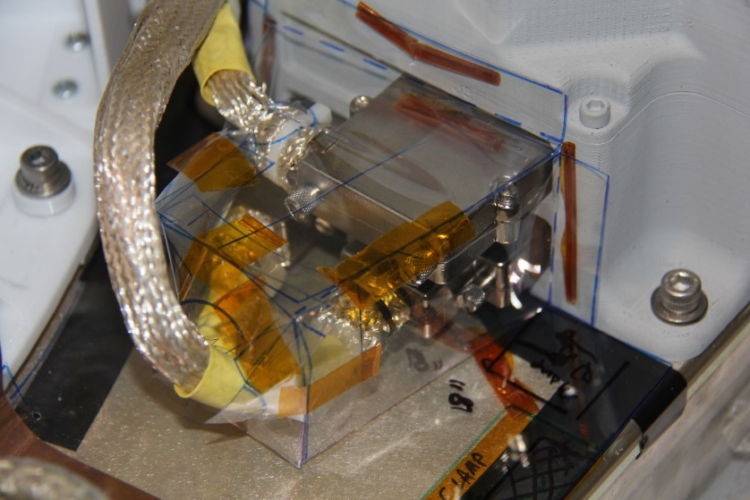
MLI Overview
Design and templating
Mechanical drawing
CAD model
Rapid prototypes
Flight hardware
Notes:
First step: design and templating is the most critical and time consuming step in blanketing.
-MLI design begins from either: mechanical drawing, CAD model, rapid prototypes or flight hardware
-Create the templates by hand using melinex, an anti-static clear poly film
-templates are then fit-checked on hardware and modified for proper fit and to mark any cut-outs, slits, protrusions, harnessing, or anything else that could affect the fit of the blanket
-This process is a lot like draping material for clothing…a lot of design considerations only come up when you are physically working on the hardware and are able to problem-solve on the spot
The further away from flight-like the hardware is in when we template, the greater the impact in later fit, modifications, and function of the MLI. We can start with CAD files to reduce time spent on the hardware or travel if you are located outside of the MD area, but often times there are components that are not represented in CAD models. Final template design should be fit checked on flight hardware in flight configuration before beginning MLI fabrication.

Slide 6
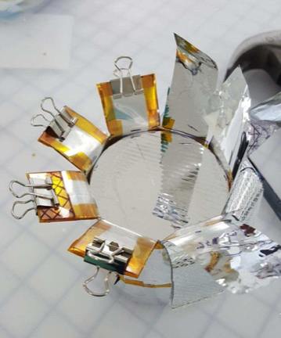
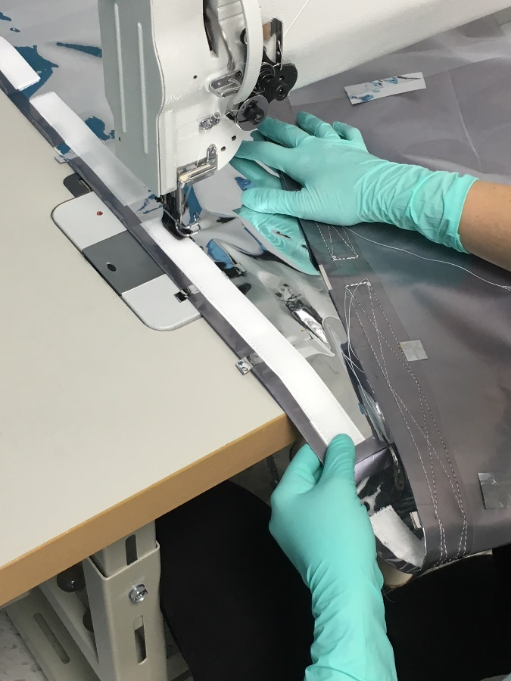
MLI Overview
Installation
Test
Flight/pre-ship
Launch support
Fabrication
Formed vs. flat
Sewn overlays
Built to print
Notes:
-Aerothreads fabricates all of our blankets on a form, unless specifically required to fab. flat
-This ensures that all layers and shift around every corner and shape that the blanket takes, which eliminates any potential compression/shorting of the blanket
-We use various forms and techniques to cut the blanket in shape, as well as edge-tape the MLI in the formed position. This ensures that every layer of the blanket layers perfectly inline with the others, making superior fit and function of the MLI(see pic on left)
-MLI is typically edge-taped with tape that matches the outer-layer of the blanket. Some blankets require a sewn overlay, or stitched Velcro, those blankets are stitched on an industrial machine and finished by hand
-We also support installation of MLI for test, flight, and for final launch-site close-outs
-For test, MLI can be installed so it can be more easily removed and with access requirements specific for GSE
-ideally the majority of blankets are closed-out prior to thermal vacuum testing, only leaving points for shipping access or launch-site testing
-Final installations include: grounding to the hardware, securing mechanical fasteners, seam-taping to control directional venting, and an overall engineering walk-thru to ensure flight readiness
-Final closeouts for launch readiness include: verification of grounding, any final close-outs, and an overall inspection

Slide 7
Section 2 – Requirements, Design Considerations, and Best Practices

Slide 8
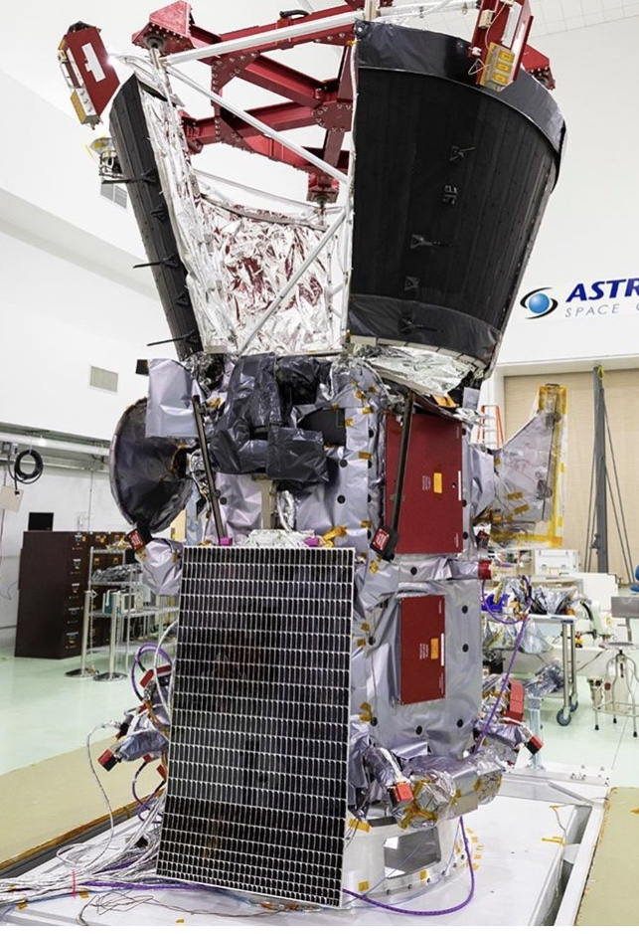
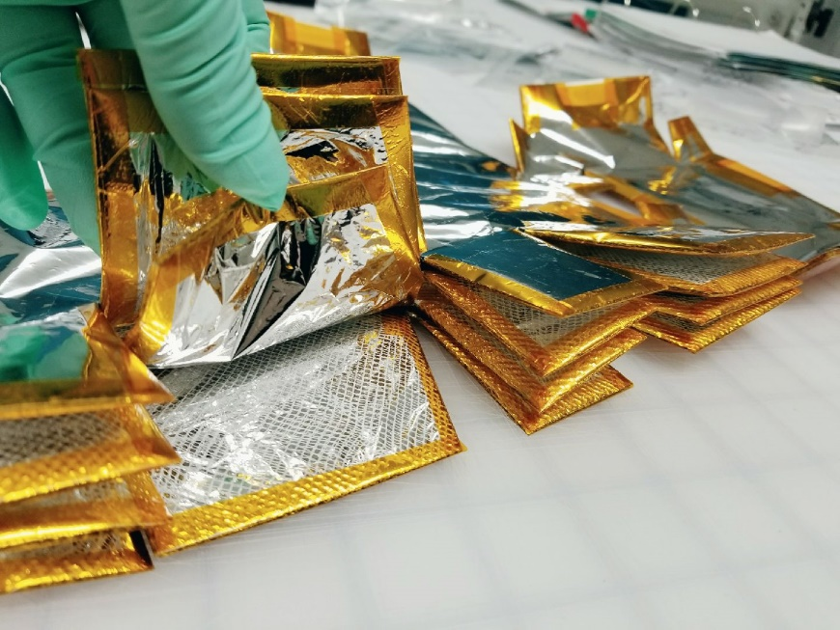
Thermal Requirements
Areas to be blanket
Radiator surfaces
MLI materials and layup
High-temperature, cryogenic, and other specialty MLI requirements
Notes:
Areas to be blanketed: where MLI begins and ends, critical areas, places to avoid overlaps

Slide 9
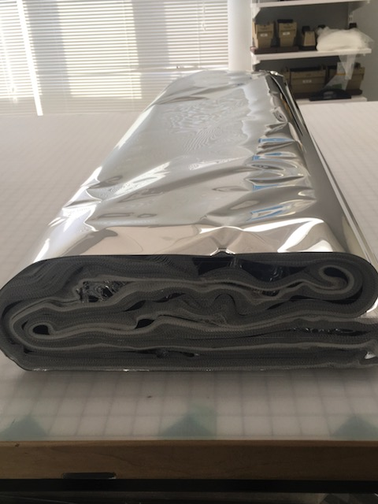
Thermal – Design Considerations
Thickness of layup
Keep-out zones, tight clearances
High-temperature
Adhesive concerns
Stitched construction
Cryogenic
One-time installation, access considerations
Overlap thickness
Material fragility
Sensitive outer layers
Material thickness
Notes:
Thickness of layup: Known ahead of time, can influence how the MLI is designed. If the layup is especially thick, like pictured, being aware of tight clearances is important. Thicker blanket = harder to make complex, form-fitting MLI
Temperatures ranges can affect the type of adhesive that is used. Stitched construction can be used to mitigate tape failing concerns if there are extreme temperature ranges.
Cryogenic requirements call for more critical MLI design. Typically cryo MLI are a one-time installation, once they go on they cannot come off without ruining the blanket. Layer to layer or shell-to-shell closeouts also increase thickness in overlap areas.
Specialized outer layers can require different techniques in order to preserve fragile coatings on the film. Fabricating with a protective cover, fabricating sets of MLI for test and flight spares, can all help minimize damaging the film. Thinner outer layers are more fragile than something heavier, and depending on the use (how many times the blankets are opened, need to come on and off, etc) using a thicker/thinner outer material should be considered.

Slide 10
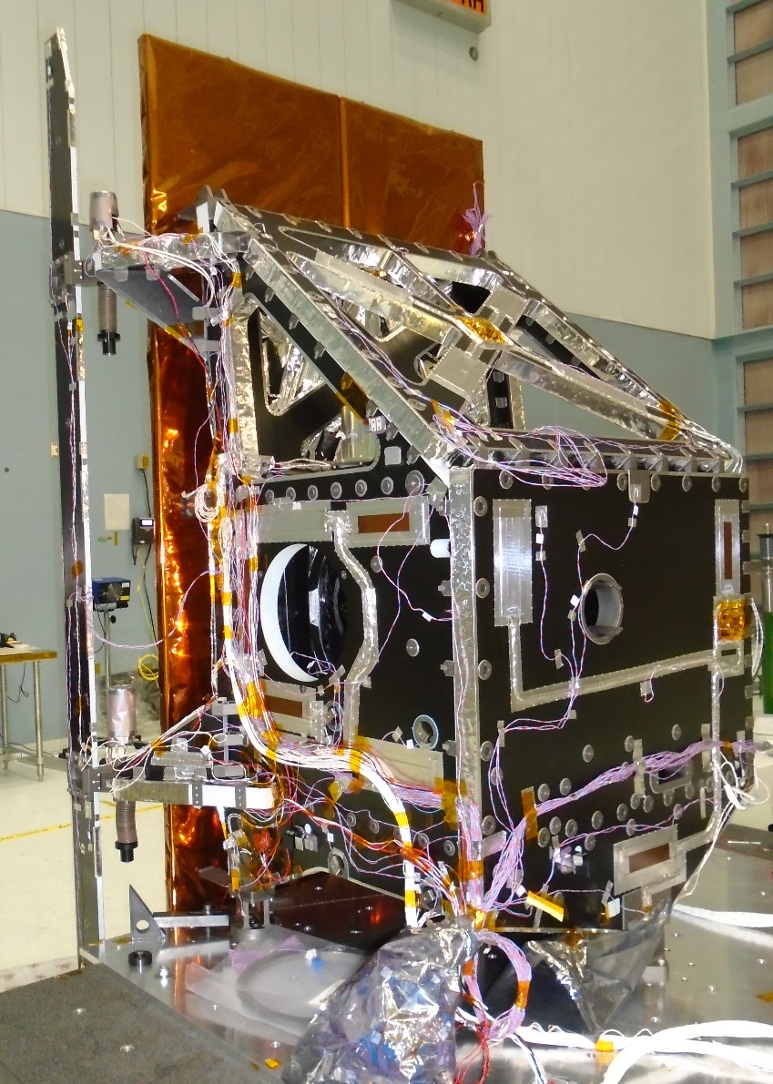
Mechanical Requirements
Access
Harness ports
Lift points
Optical cubes
GSE accommodations
Integration
Keep-out zones
Mechanisms
Gimbals
Hardware interfaces
Notes:
Mechanical requirements affect the design and fabrication of MLI. Once MLI is installed, it can block access to: Harness ports, lift points, optical cubes, GSE accommodations, launch locks. MLI can be designed to accommodate these features, and being aware of them while designing and templating the MLI is critical.
Understanding the integration flow with mechanical hardware as well as keep-out zones also affects the design and planning of MLI.
Mechanisms can create unique considerations when it comes to MLI. Gimbaled hardware, tight clearances, and interfaces require more complex designs, precision fabrication, and skilled integration.

Slide 11
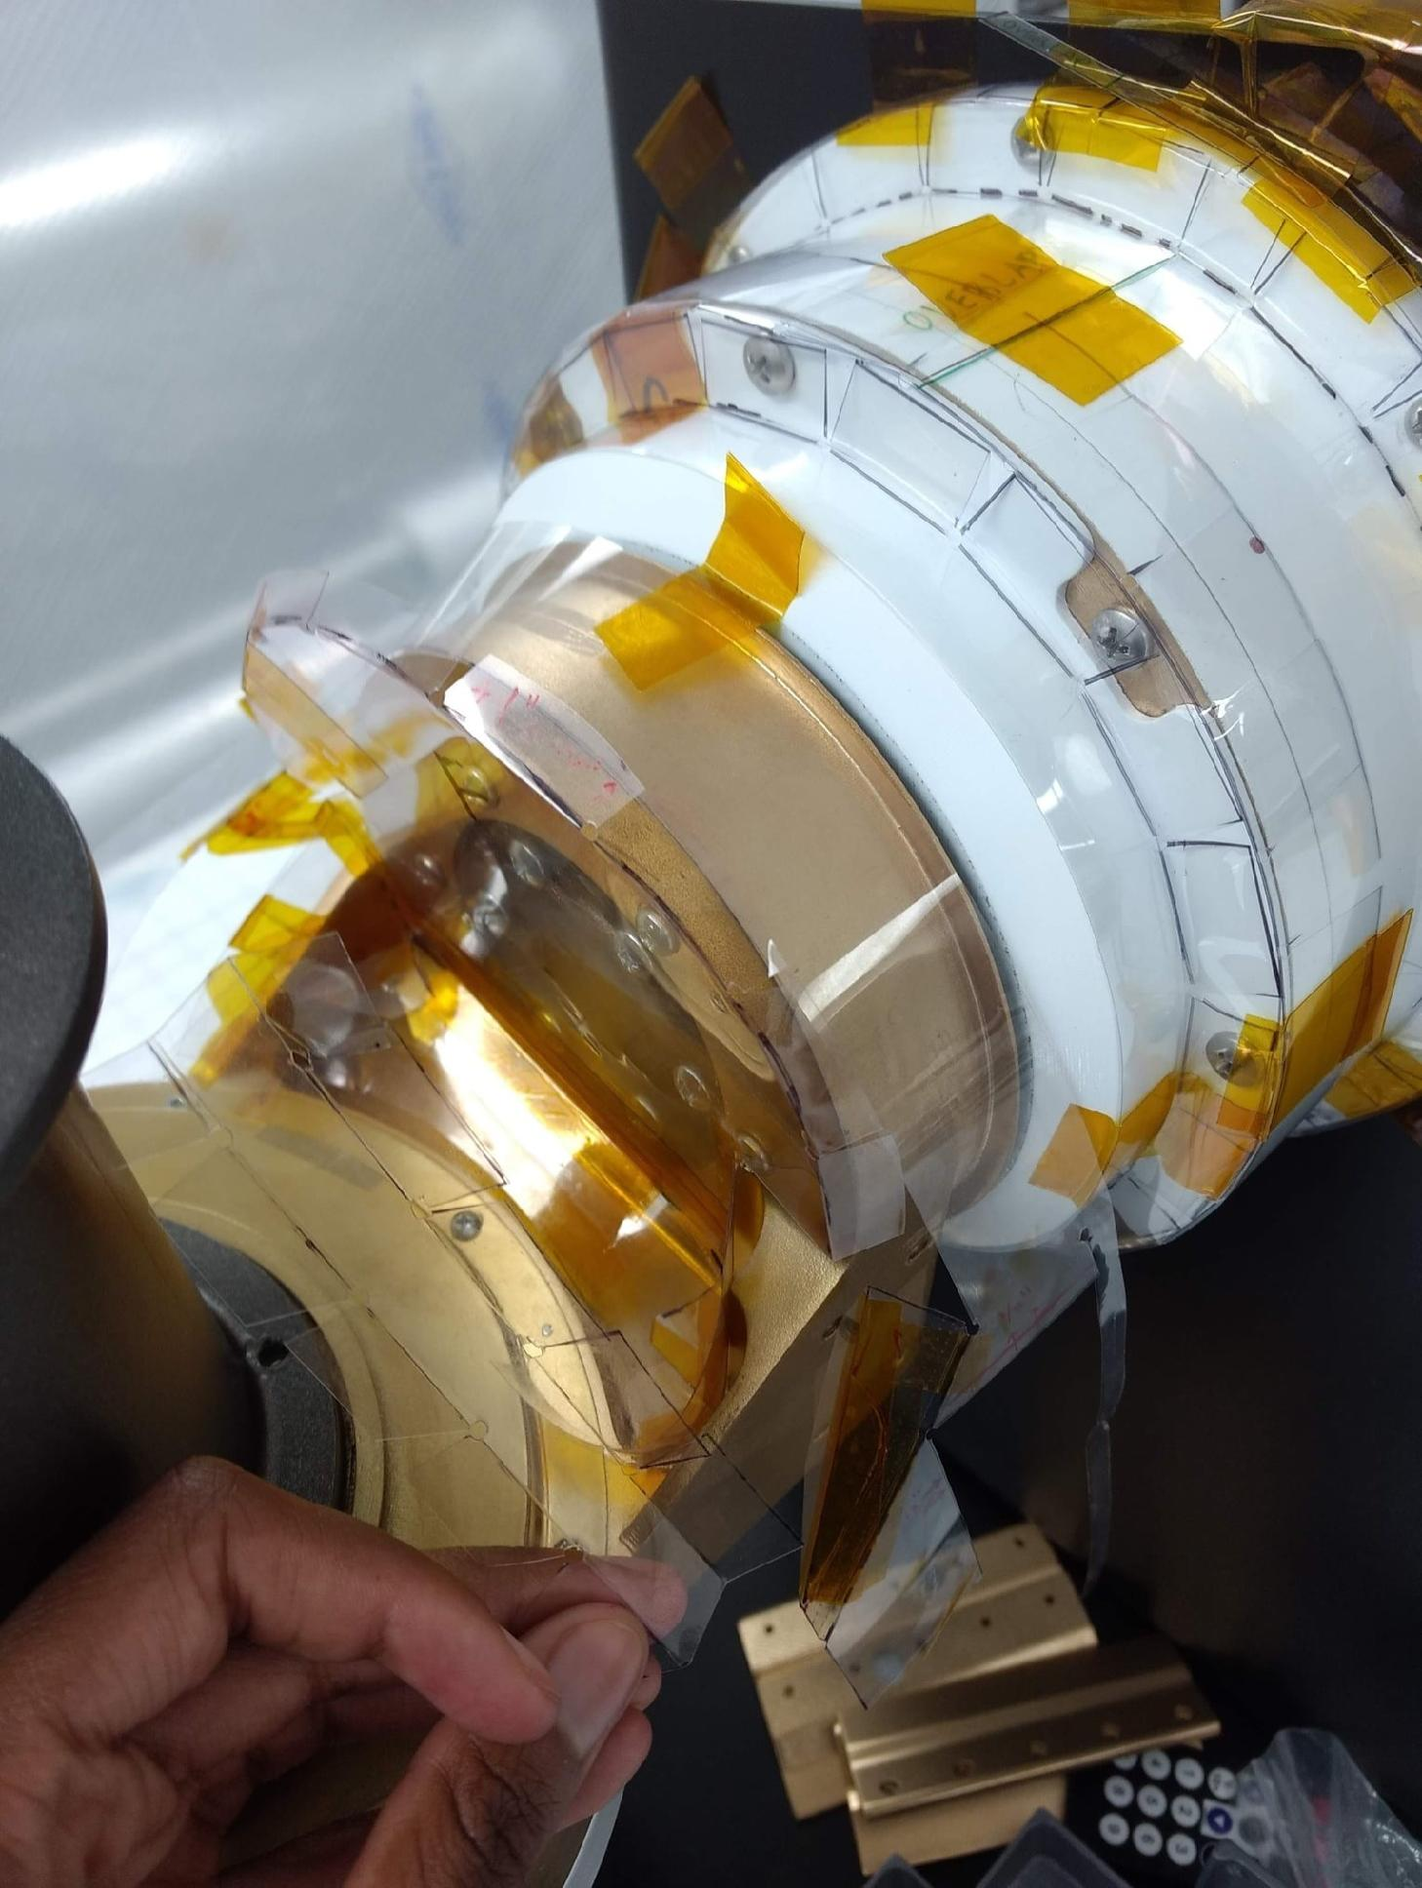
Mechanical – Design Considerations
MLI attachment/bonded fasteners
Buttons (G-10)
Click-bonds
TC 105s
Velcro
Dual Lock
Custom
Snake bites
Hardware accommodations
Where can MLI attach to?
Flaps, overlaps, design additions for access points
MLI designed to accommodate integration flow
Notes:
There are many ways to attach MLI to the hardware. Fasteners allow the blanket to either be attached directly to the hardware, or fastener to itself so the blankets are relying solely on tape. Depending on hardware, location of MLI, clearances, and blanket material these are the options that should be considered
Hardware accommodations –
Especaially when it comes to complex mechanical designs, determining where MLI can attach to

Slide 12
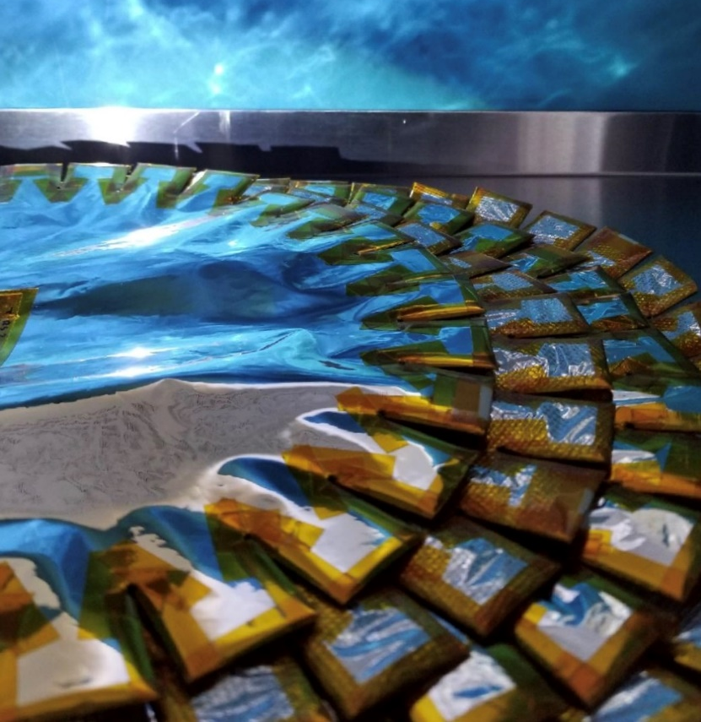
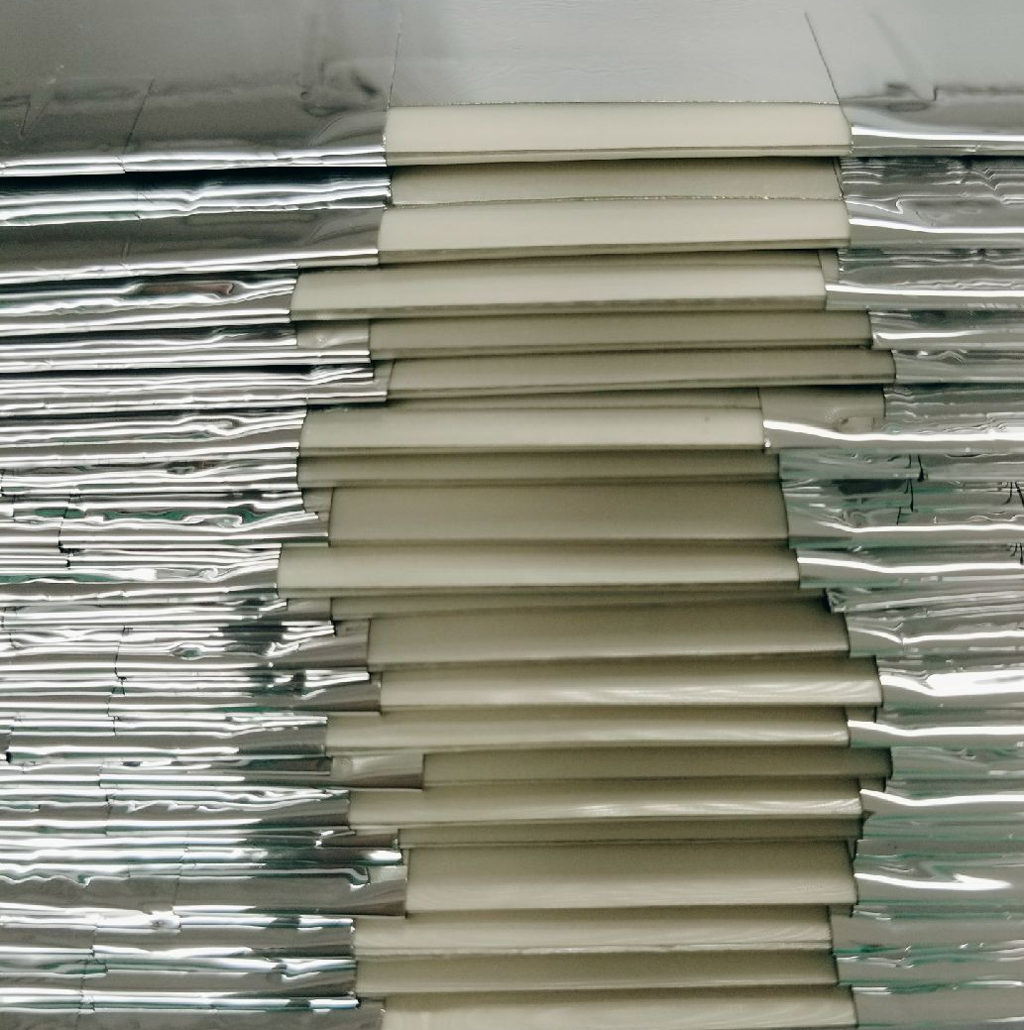
Contamination Requirements
Vacuum bake-out
Pre-fabrication
Post-fabrication
Venting
Filtered vents
Directional venting
Internal materials
Perforated layers
Notes:
Cleanliness: white light inspection, black light inspection, IPA wipe, nitrogen purge ,bagging requirements..etc etc
-limitations: velcro

Slide 13
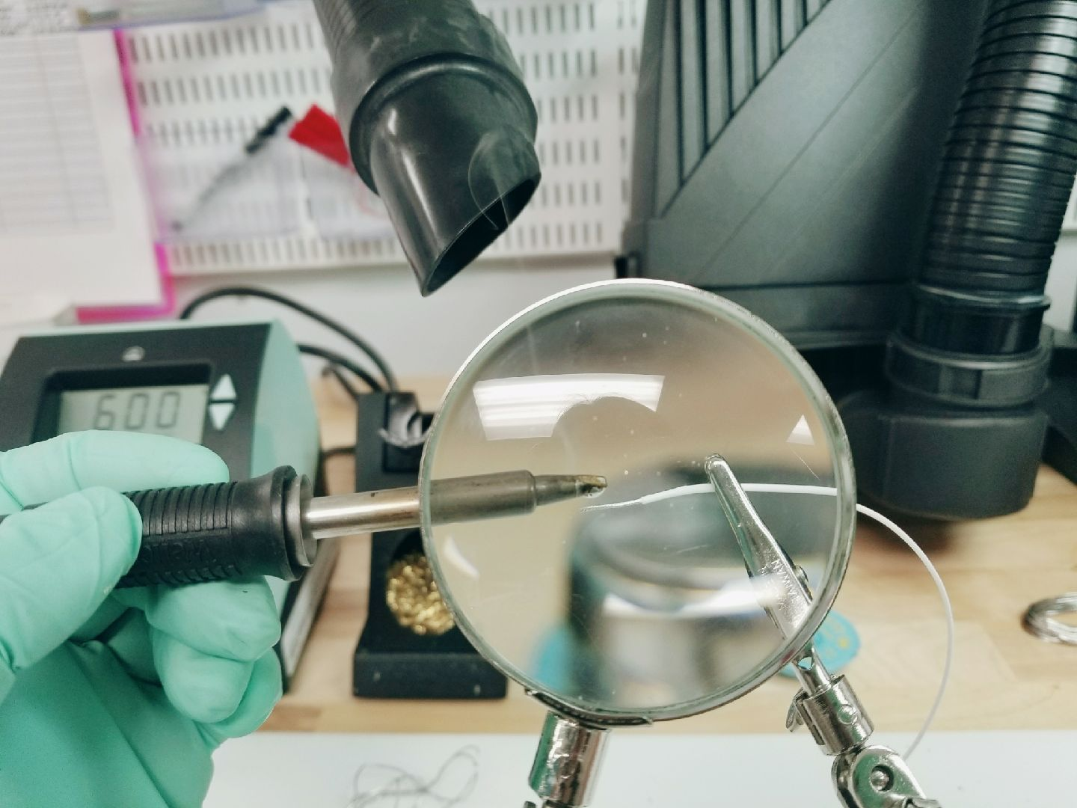
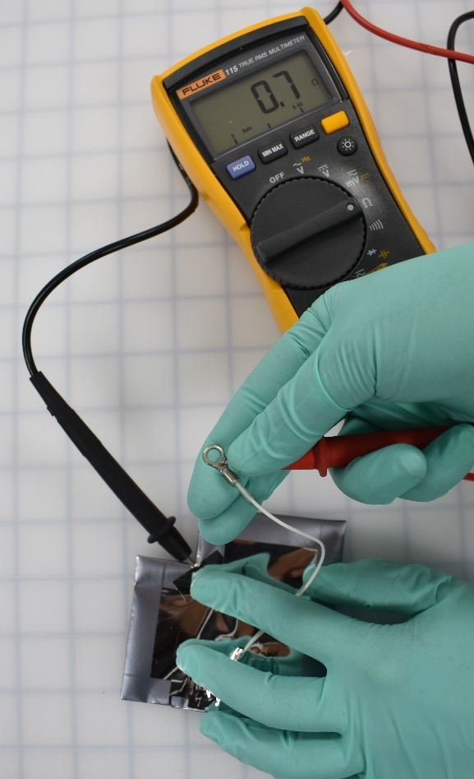
Electrical Requirements
Operating environment
Material considerations
Hardware ground locations
Grounding standards
J-Standard
NASA Standard
Customer specified
Notes:
LEO – more surface charging

Slide 14
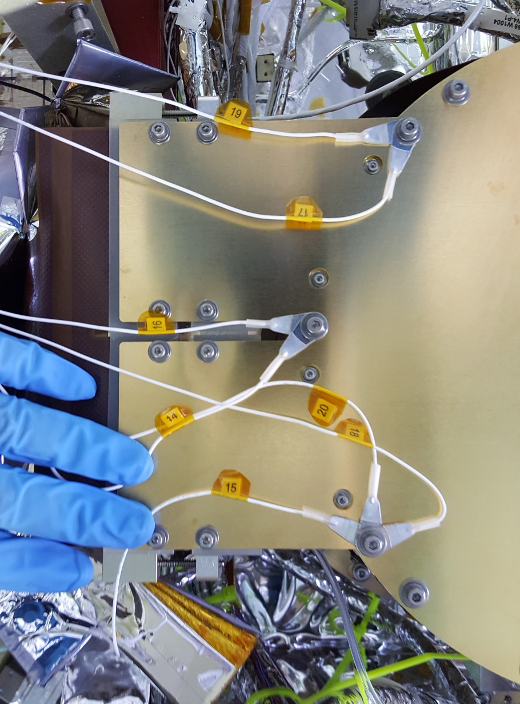
Electrical – Design Considerations
Grounding/bonding:
Soldered or crimped lugs
Redundancy
Ground wire resistance requirement
# of grounds per MLI
SLI grounding
Operating Environment
Outer layer/coatings
Conductive adhesive
Ground locations
Hardware accommodations
Integration sequence
Pin/socket (for access)

Slide 15
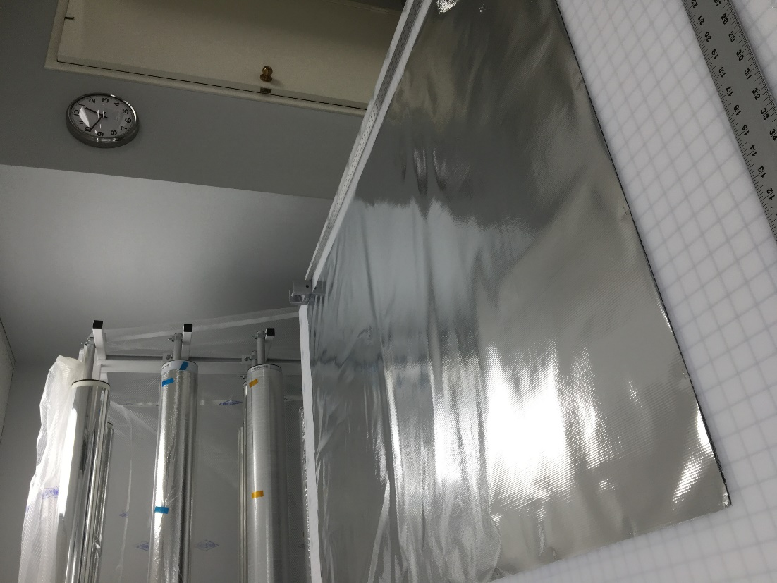
Material Selection – Common Materials
Specialized Outer Layers
Metallized Polyimide (Kapton HN)
Carbon filled Polyimide (Kapton XC & CB)
Metallized (VDA)
Stamet
FEP (Teflon)
Metallized (VDA)
Silver / Inconel

Slide 16
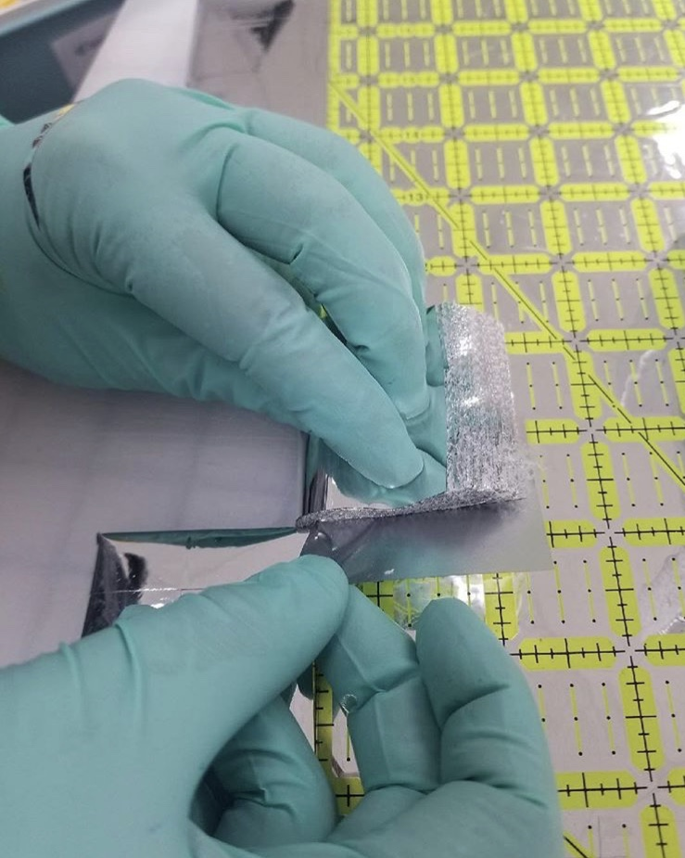
Material Selection – Common Materials
Inner Layer Options
Polyester or Polyimide
0.25 mil PET
0.30 mil Polyimide (Kapton HN)
Spacer options
Netting
Embossed inner films

Slide 17
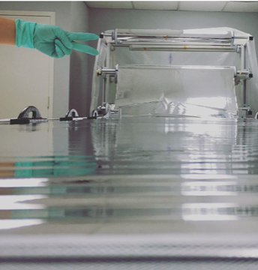
Material Selection – Considerations
Storage
19 deg C +/- 9 deg C (65 deg F +/- 15 deg F)
50% RH +/- 10%
Suspended cores for shipping, boxed storage in original packaging materials
Packaging
Utilize heat sealed bags with desiccant and humidity indicator cards
Nitrogen purge for sensitive coatings

Slide 18
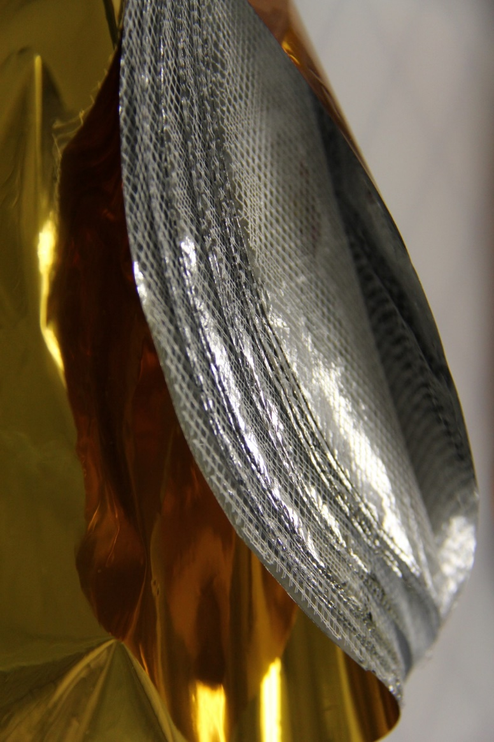
Material Selection – Considerations
Shelf life
12 month shelf life
Known aging of coatings and adhesives
Coating fragility
Germanium
Indium Tin Oxide (ITO)
Vacuum Deposited Aluminum (VDA), Stamet, Silver/Inconel

Slide 19
Section 3 – MLI Trends

Slide 20
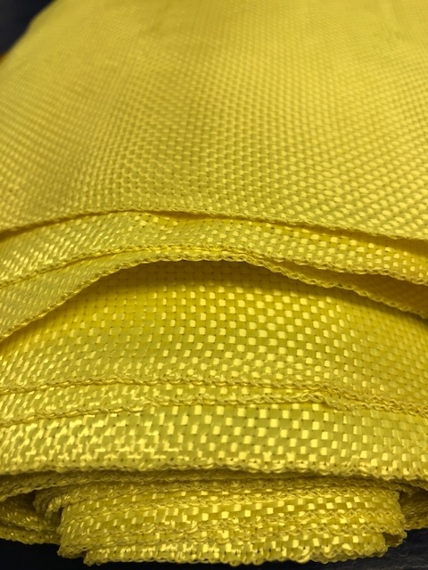
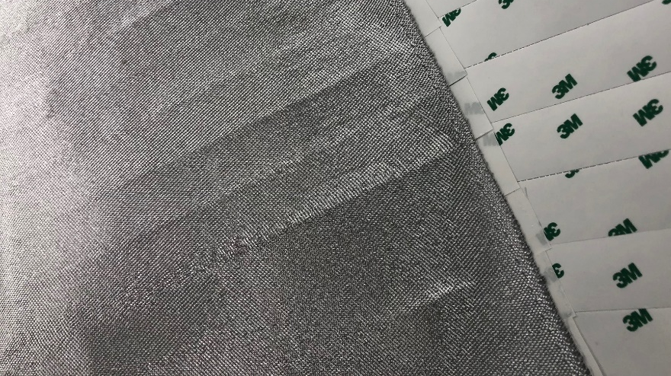
MLI Trend - MMOD
Material Considerations
Material lead time
Material thickness
Rigidity
Mass
Boxier designs
Micrometeoroid Orbital Debris (MMOD)
Stand-off from hardware
Spacing
Sewn MLI
Whipple shield

Slide 21
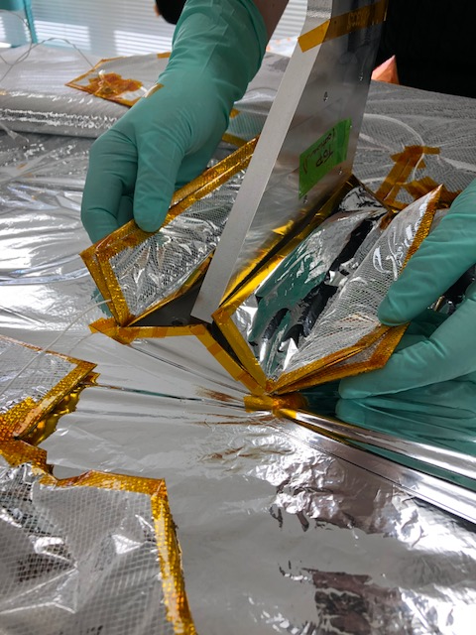
MLI Trend - Cryogenic
Cryogenic MLI Considerations
Material lead time
Layup thickness
Layer-to-layer closeout vs. shell-to-shell
Access to hardware
Installation sequence
One-time use
Grounding schematic
Longer design, fabrication, and installation time

Slide 22
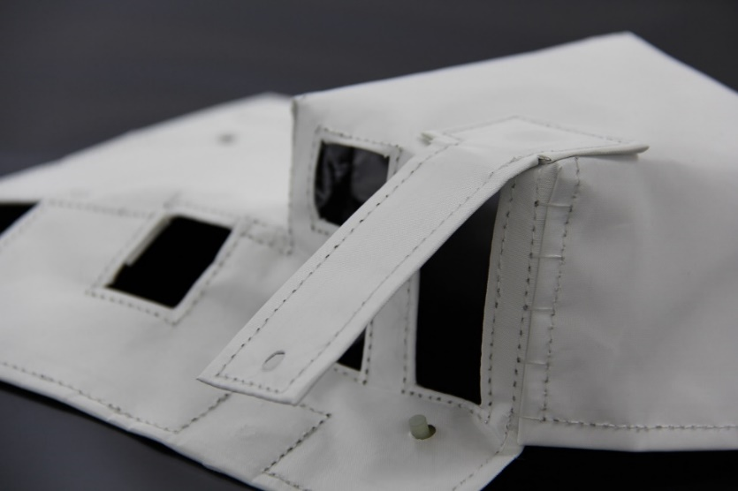
MLI Trend – Space Station/Beta cloth
Considerations
Material lead time
Layup thickness
Sewn construction
Reinforced inner layer
Accessibility
Modifications (limited ability)
Grounding requirements
Complexity of MLI
Hand-stitch/fastener use instead of tape

Slide 23
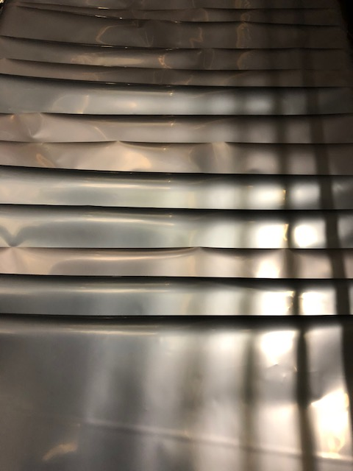
MLI Trend – Exotic Material
Stamet/GBK
Material lead time
Handling considerations
Cost
Protective layers
Conductive tape
Cleaning considerations
New photo

Slide 24
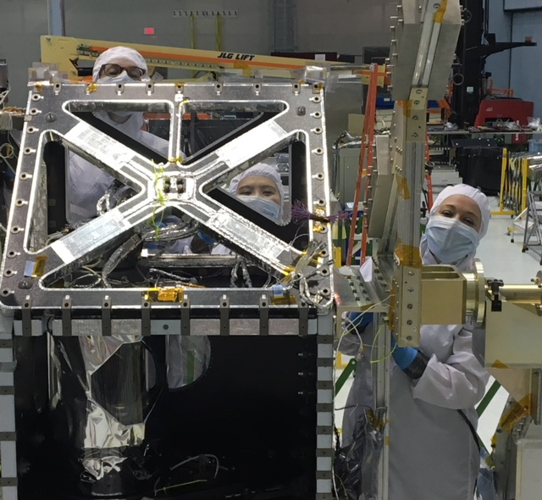
Questions?

