Slide 1
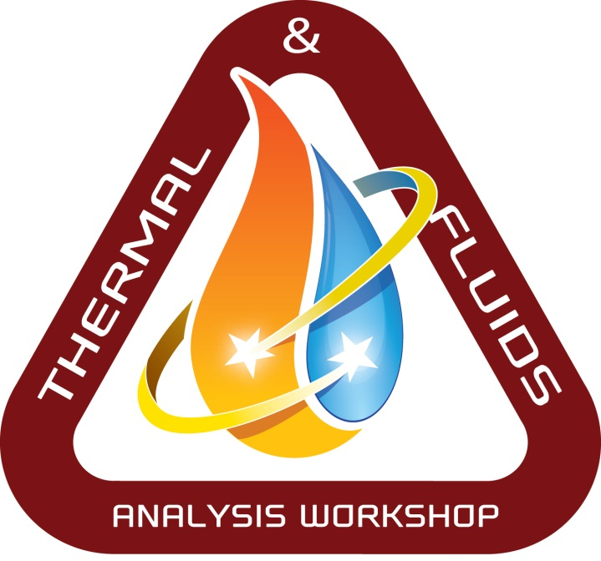
Systems Engineering for Thermal Engineers Matt Garrison Systems Engineer Reformed Thermal Engineer NASA Goddard Space Flight Center
GSFC· 2023

Slide 2
Traceability
This material comes from a few places:
The GSFC Product Development Lead training
The GSFC Systems Engineering Education and Development program (SEED)
The NASA Systems Engineering Handbook
Fernando Pellerano’s short course during TFAWS 2015
My own 7 years as an instrument systems engineer and payload systems engineer
This comes from the perspective of GSFC robotic flight projects. Systems practices vary some center-to-center and project-to-project.
Notes:
To solve a complex problem, we must deal with the problem in a way that fits with how we think.
Engineering at any level involves some of this type of thinking—we always break the problem up into more manageable chunks.
Systems engineering typically refers to problems which are so complex that different people must work on the different pieces of the problem.
Specialists handle the details and systems engineers make sure the pieces work together to form something which is more than the sum of its parts.
INCOSE--
System designer decides how to break up system. Requirements owner manages requirements which define system and subsystems. System analyst confirms that the designed system will meet requirements. Val/Ver Engineer makes sure the system does meet requirements. Ops Engineer maintains system through operations and end-of-life. Glue role makes sure things don’t fall through the cracks. CI, TM, IM, PE are fairly obvious. Coordinator facilitates group actions. Last one refers to engineers involved with information technology—formerly maintainers of mainframe computer system.

Slide 3
What we’ll talk about
What is systems engineering?
Why do we even have this?
What are all of these processes and tools?
How to work with systems engineers?
Where does thermal engineering fit into this?
Things I learned after switching from thermal to systems
Notes:
To solve a complex problem, we must deal with the problem in a way that fits with how we think.
Engineering at any level involves some of this type of thinking—we always break the problem up into more manageable chunks.
Systems engineering typically refers to problems which are so complex that different people must work on the different pieces of the problem.
Specialists handle the details and systems engineers make sure the pieces work together to form something which is more than the sum of its parts.
INCOSE--
System designer decides how to break up system. Requirements owner manages requirements which define system and subsystems. System analyst confirms that the designed system will meet requirements. Val/Ver Engineer makes sure the system does meet requirements. Ops Engineer maintains system through operations and end-of-life. Glue role makes sure things don’t fall through the cracks. CI, TM, IM, PE are fairly obvious. Coordinator facilitates group actions. Last one refers to engineers involved with information technology—formerly maintainers of mainframe computer system.

Slide 4
What even is systems engineering?
“Systems engineering at NASA requires the application of a systematic, disciplined engineering approach that is quantifiable, recursive, iterative, and repeatable for the development, operation, maintenance, and disposal of systems integrated into a whole throughout the life cycle of a project or program.” - NASA Procedural Requirement 7123.1C Section 1.1.1
This is a horrible definition of systems engineering.
Notes:
To solve a complex problem, we must deal with the problem in a way that fits with how we think.
Engineering at any level involves some of this type of thinking—we always break the problem up into more manageable chunks.
Systems engineering typically refers to problems which are so complex that different people must work on the different pieces of the problem.
Specialists handle the details and systems engineers make sure the pieces work together to form something which is more than the sum of its parts.
INCOSE--
System designer decides how to break up system. Requirements owner manages requirements which define system and subsystems. System analyst confirms that the designed system will meet requirements. Val/Ver Engineer makes sure the system does meet requirements. Ops Engineer maintains system through operations and end-of-life. Glue role makes sure things don’t fall through the cracks. CI, TM, IM, PE are fairly obvious. Coordinator facilitates group actions. Last one refers to engineers involved with information technology—formerly maintainers of mainframe computer system.

Slide 5
What even is systems engineering?
What’s a System?: The combination of elements that function together to produce the capability to meet a need. The elements include all hardware, software, equipment, facilities, personnel, processes, and procedures needed for this purpose.
Flight projects
Infrastructure
A building
Government (some systems work better than others)
Systems Engineering is:
Breaking a complex problem up into smaller, more manageable pieces in a logical way
Defining the needs and constraints for those smaller problems so that a single group can work them to resolution
Making sure that those pieces come together in a way that addresses the original problem
Notes:
To solve a complex problem, we must deal with the problem in a way that fits with how we think.
Engineering at any level involves some of this type of thinking—we always break the problem up into more manageable chunks.
Systems engineering typically refers to problems which are so complex that different people must work on the different pieces of the problem.
Specialists handle the details and systems engineers make sure the pieces work together to form something which is more than the sum of its parts.
INCOSE--
System designer decides how to break up system. Requirements owner manages requirements which define system and subsystems. System analyst confirms that the designed system will meet requirements. Val/Ver Engineer makes sure the system does meet requirements. Ops Engineer maintains system through operations and end-of-life. Glue role makes sure things don’t fall through the cracks. CI, TM, IM, PE are fairly obvious. Coordinator facilitates group actions. Last one refers to engineers involved with information technology—formerly maintainers of mainframe computer system.

Slide 6
Why do we do this?
Humans (or groups of humans) are better at addressing simpler problems, so it helps to break complex problems into many smaller problems
NASA missions are definitely complex problems
The more complicated the effort the more likely it is to run into cost, schedule, and technical issues.
Notes:
To solve a complex problem, we must deal with the problem in a way that fits with how we think.
Engineering at any level involves some of this type of thinking—we always break the problem up into more manageable chunks.
Systems engineering typically refers to problems which are so complex that different people must work on the different pieces of the problem.
Specialists handle the details and systems engineers make sure the pieces work together to form something which is more than the sum of its parts.
INCOSE--
System designer decides how to break up system. Requirements owner manages requirements which define system and subsystems. System analyst confirms that the designed system will meet requirements. Val/Ver Engineer makes sure the system does meet requirements. Ops Engineer maintains system through operations and end-of-life. Glue role makes sure things don’t fall through the cracks. CI, TM, IM, PE are fairly obvious. Coordinator facilitates group actions. Last one refers to engineers involved with information technology—formerly maintainers of mainframe computer system.

Slide 7
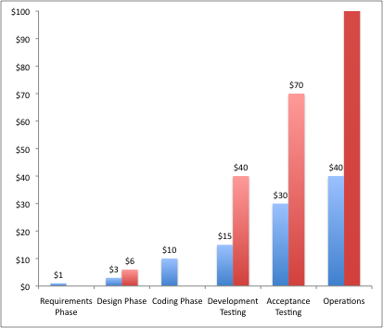
Why do we do this?
200
OMV
Planned
Actual
180
$1000
160
GRO 78
GALL
TDRSS
140
IRAS
HST
CEN
Percent Overrun
120
100
GOES I-M
TETH
MARS
LAND 76
80
MAG
ACT
STS
LAND 78
COBE
60
ERB 77
40
SEASAT
ERB 80
HEA
UARS
GRO 82
20
EUVE/EP
VOYAGER
ISEE
DE
SMM
ULYSSES
IUE
PION/VEN
Phase
B
Phase
C
Phase
C
Phase
D
Phase
D
Phase
E
5
10
15
20
25
30
Relative Cost of Requirement Errors (“Extra Time Saves Money,” Warren Kuffel Computer Language, December 1990)
Percent of Project Cost Spent for Requirements Development
Gruhl, W. “Lessons Learned, Cost/Schedule Assessment Guide”, Internal presentation, NASA Comptroller’s office, 1992.
Ignoring requirement development can lead to major cost overruns
Notes:
To solve a complex problem, we must deal with the problem in a way that fits with how we think.
Engineering at any level involves some of this type of thinking—we always break the problem up into more manageable chunks.
Systems engineering typically refers to problems which are so complex that different people must work on the different pieces of the problem.
Specialists handle the details and systems engineers make sure the pieces work together to form something which is more than the sum of its parts.
INCOSE--
System designer decides how to break up system. Requirements owner manages requirements which define system and subsystems. System analyst confirms that the designed system will meet requirements. Val/Ver Engineer makes sure the system does meet requirements. Ops Engineer maintains system through operations and end-of-life. Glue role makes sure things don’t fall through the cracks. CI, TM, IM, PE are fairly obvious. Coordinator facilitates group actions. Last one refers to engineers involved with information technology—formerly maintainers of mainframe computer system.

Slide 8
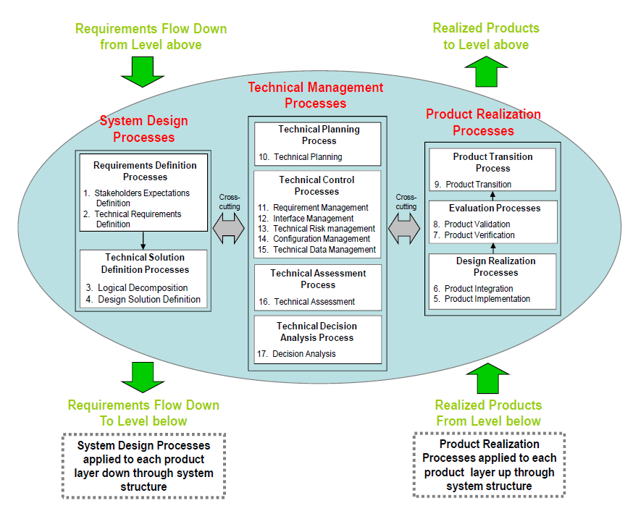
Systems Engineering Processes
Notes:
To solve a complex problem, we must deal with the problem in a way that fits with how we think.
Engineering at any level involves some of this type of thinking—we always break the problem up into more manageable chunks.
Systems engineering typically refers to problems which are so complex that different people must work on the different pieces of the problem.
Specialists handle the details and systems engineers make sure the pieces work together to form something which is more than the sum of its parts.
INCOSE--
System designer decides how to break up system. Requirements owner manages requirements which define system and subsystems. System analyst confirms that the designed system will meet requirements. Val/Ver Engineer makes sure the system does meet requirements. Ops Engineer maintains system through operations and end-of-life. Glue role makes sure things don’t fall through the cracks. CI, TM, IM, PE are fairly obvious. Coordinator facilitates group actions. Last one refers to engineers involved with information technology—formerly maintainers of mainframe computer system.

Slide 9
Decomposition
Functional decomposition is when you start with a high-level function and break it down into smaller functions (parallel, serial, or asynchronous).
This example is loosely based on the Zipline service
Quickly deliver medical supplies to scattered rural doctors
Supplies readied for transport
Supplies available
Doctor requests supplies
Supplies delivered
Capability reset for next request
Notes:
To solve a complex problem, we must deal with the problem in a way that fits with how we think.
Engineering at any level involves some of this type of thinking—we always break the problem up into more manageable chunks.
Systems engineering typically refers to problems which are so complex that different people must work on the different pieces of the problem.
Specialists handle the details and systems engineers make sure the pieces work together to form something which is more than the sum of its parts.
INCOSE--
System designer decides how to break up system. Requirements owner manages requirements which define system and subsystems. System analyst confirms that the designed system will meet requirements. Val/Ver Engineer makes sure the system does meet requirements. Ops Engineer maintains system through operations and end-of-life. Glue role makes sure things don’t fall through the cracks. CI, TM, IM, PE are fairly obvious. Coordinator facilitates group actions. Last one refers to engineers involved with information technology—formerly maintainers of mainframe computer system.

Slide 10
Decomposition
Physical decomposition is when you define the total system and break it into smaller, manageable sub-systems
Although we call it a physical decomposition it includes people, software, and processes
Medical supply delivery system
Home base
Computer Ordering System
Transporters
Notes:
To solve a complex problem, we must deal with the problem in a way that fits with how we think.
Engineering at any level involves some of this type of thinking—we always break the problem up into more manageable chunks.
Systems engineering typically refers to problems which are so complex that different people must work on the different pieces of the problem.
Specialists handle the details and systems engineers make sure the pieces work together to form something which is more than the sum of its parts.
INCOSE--
System designer decides how to break up system. Requirements owner manages requirements which define system and subsystems. System analyst confirms that the designed system will meet requirements. Val/Ver Engineer makes sure the system does meet requirements. Ops Engineer maintains system through operations and end-of-life. Glue role makes sure things don’t fall through the cracks. CI, TM, IM, PE are fairly obvious. Coordinator facilitates group actions. Last one refers to engineers involved with information technology—formerly maintainers of mainframe computer system.

Slide 11
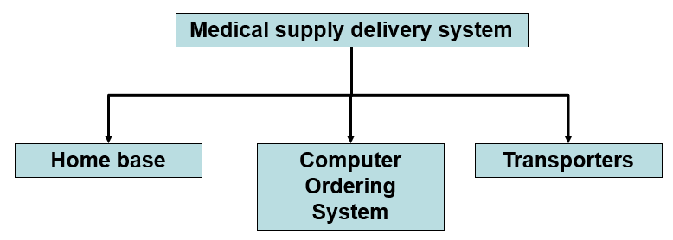
Decomposition
A good decomposition allows you to define subsystems and subfunctions so that each function belongs to just 1 element
But what about this one?
Notes:
To solve a complex problem, we must deal with the problem in a way that fits with how we think.
Engineering at any level involves some of this type of thinking—we always break the problem up into more manageable chunks.
Systems engineering typically refers to problems which are so complex that different people must work on the different pieces of the problem.
Specialists handle the details and systems engineers make sure the pieces work together to form something which is more than the sum of its parts.
INCOSE--
System designer decides how to break up system. Requirements owner manages requirements which define system and subsystems. System analyst confirms that the designed system will meet requirements. Val/Ver Engineer makes sure the system does meet requirements. Ops Engineer maintains system through operations and end-of-life. Glue role makes sure things don’t fall through the cracks. CI, TM, IM, PE are fairly obvious. Coordinator facilitates group actions. Last one refers to engineers involved with information technology—formerly maintainers of mainframe computer system.

Slide 12
Decomposition
Decomposition can be iterative. You may need to make some design decisions to make progress.
If the Transporters are low-cost, one-shot devices:
Capability reset for next request
Maintain supply of transporters
Home base
If the Transporters are reusable:
Capability reset for next request
Return to base
Transporter
Receive returning transporter
Home base
Notes:
To solve a complex problem, we must deal with the problem in a way that fits with how we think.
Engineering at any level involves some of this type of thinking—we always break the problem up into more manageable chunks.
Systems engineering typically refers to problems which are so complex that different people must work on the different pieces of the problem.
Specialists handle the details and systems engineers make sure the pieces work together to form something which is more than the sum of its parts.
INCOSE--
System designer decides how to break up system. Requirements owner manages requirements which define system and subsystems. System analyst confirms that the designed system will meet requirements. Val/Ver Engineer makes sure the system does meet requirements. Ops Engineer maintains system through operations and end-of-life. Glue role makes sure things don’t fall through the cracks. CI, TM, IM, PE are fairly obvious. Coordinator facilitates group actions. Last one refers to engineers involved with information technology—formerly maintainers of mainframe computer system.

Slide 13
Requirements
Requirements are how we document the needs, goals, and objectives of the system
Part of the systems job is to take the higher-level system requirements and flow them down to the elements
Requirements should be owned by the element they apply at. The systems engineer can help flow down requirements to subsystems but they shouldn’t own them.
Functional and performance requirements often follow the functional decomposition.
The medical supply delivery system shall have at least 2 weeks of supplies available at all times
The home base shall have at least 200 sqft of refrigerator space.
The medical supply delivery system shall cover an area with a radius of at least 100 miles.
The transporter shall have a range of at least 100 miles (or 200 if we’re returning it to home base)
Notes:
To solve a complex problem, we must deal with the problem in a way that fits with how we think.
Engineering at any level involves some of this type of thinking—we always break the problem up into more manageable chunks.
Systems engineering typically refers to problems which are so complex that different people must work on the different pieces of the problem.
Specialists handle the details and systems engineers make sure the pieces work together to form something which is more than the sum of its parts.
INCOSE--
System designer decides how to break up system. Requirements owner manages requirements which define system and subsystems. System analyst confirms that the designed system will meet requirements. Val/Ver Engineer makes sure the system does meet requirements. Ops Engineer maintains system through operations and end-of-life. Glue role makes sure things don’t fall through the cracks. CI, TM, IM, PE are fairly obvious. Coordinator facilitates group actions. Last one refers to engineers involved with information technology—formerly maintainers of mainframe computer system.

Slide 14
Requirements
Use the word “shall” when defining requirements and only for requirements:
“The attitude control system shall point the instrument boresight to within 6 arc seconds of the commanded attitude.”
Make it clear to the reader exactly what must be done.
Requirements should be:
Achievable
A requirement that violates a law of physics or even just a programmatic constraint isn’t valid
Measurable
Avoid vague statements like “shall point as accurately as possible”
Verifiable
If no one can demonstrate that a system does or does not meet a requirement, then there is no requirement
Document rationale!
Capture the why while it is fresh.
Enable future changes—people are afraid to change things they don’t understand.
Challenge “borrowed” or legacy requirements – “we’ve always done it that way” is not a justification

Slide 15
Key and Driving Requirements
Key Requirement: A requirement where the consequence of not meeting the requirement has significant impact or high sensitivity on the mission’s ability to meet negotiated success criteria, as assessed by the requirement owner.
Driving Requirement: A requirement where compliance is deemed particularly difficult or the likelihood of needing additional resources to meet the requirement is significant, as assessed by the requirement implementer.
Key Requirements are important, Driving Requirements are hard
The combined list of Key and Driving Requirements are what you should be losing sleep over
Finding a design solution meeting the key and driving requirements has the highest priority and should be completed prior to other (lower priority) requirements.
Be very mindful of any driving requirement that is not a key requirement.
Notes:
To solve a complex problem, we must deal with the problem in a way that fits with how we think.
Engineering at any level involves some of this type of thinking—we always break the problem up into more manageable chunks.
Systems engineering typically refers to problems which are so complex that different people must work on the different pieces of the problem.
Specialists handle the details and systems engineers make sure the pieces work together to form something which is more than the sum of its parts.
INCOSE--
System designer decides how to break up system. Requirements owner manages requirements which define system and subsystems. System analyst confirms that the designed system will meet requirements. Val/Ver Engineer makes sure the system does meet requirements. Ops Engineer maintains system through operations and end-of-life. Glue role makes sure things don’t fall through the cracks. CI, TM, IM, PE are fairly obvious. Coordinator facilitates group actions. Last one refers to engineers involved with information technology—formerly maintainers of mainframe computer system.

Slide 16
Interfaces
Subsystem leads have authority and expertise within their subsystem; Systems only needs to get involved if they have an issue that goes outside of their bounds (technical or programmatic)
Systems engineering often lives in the interfaces. This means that the difficulty of the systems jobs scales with the square of the number of elements.
Our medical supply delivery system has 3 elements, which means 6 possible interfaces
Adding a 4th element like a Transporter Recovery Truck increases that to 12 possible interfaces; 33% increase in elements doubles the number of interactions!
Assume everything interacts with everything else until proven otherwise!
 | A | B | C | D
A |  | 1 | 2 | 3
B | 4 |  | 5 | 6
C | 7 | 8 |  | 9
D | 10 | 11 | 12
 | A | B | C
A |  | 1 | 2
B | 3 |  | 4
C | 5 | 6
Notes:
To solve a complex problem, we must deal with the problem in a way that fits with how we think.
Engineering at any level involves some of this type of thinking—we always break the problem up into more manageable chunks.
Systems engineering typically refers to problems which are so complex that different people must work on the different pieces of the problem.
Specialists handle the details and systems engineers make sure the pieces work together to form something which is more than the sum of its parts.
INCOSE--
System designer decides how to break up system. Requirements owner manages requirements which define system and subsystems. System analyst confirms that the designed system will meet requirements. Val/Ver Engineer makes sure the system does meet requirements. Ops Engineer maintains system through operations and end-of-life. Glue role makes sure things don’t fall through the cracks. CI, TM, IM, PE are fairly obvious. Coordinator facilitates group actions. Last one refers to engineers involved with information technology—formerly maintainers of mainframe computer system.

Slide 17
Managing Technical Resources
There are often quantified system-level requirements that get allocated among two or more subsystems.
This is simple for additive parameters like mass and power
It can be more complicated for parameters with more math like point spread functions or signal to noise ratios
If complicated models are needed to derive the subsystem components this might not be the right process to use.
Systems is responsible for negotiating which elements get how much of that value.
Extra allocation can be given to subsystems with higher perceived risks
The medical supply delivery system shall deliver supplies anywhere within its range in 60 minutes or less.
The home base shall prepare a delivery in within 10 minutes of receipt of order.
The transporter shall deliver the supply anywhere within the range within 40 minutes
Notes:
To solve a complex problem, we must deal with the problem in a way that fits with how we think.
Engineering at any level involves some of this type of thinking—we always break the problem up into more manageable chunks.
Systems engineering typically refers to problems which are so complex that different people must work on the different pieces of the problem.
Specialists handle the details and systems engineers make sure the pieces work together to form something which is more than the sum of its parts.
INCOSE--
System designer decides how to break up system. Requirements owner manages requirements which define system and subsystems. System analyst confirms that the designed system will meet requirements. Val/Ver Engineer makes sure the system does meet requirements. Ops Engineer maintains system through operations and end-of-life. Glue role makes sure things don’t fall through the cracks. CI, TM, IM, PE are fairly obvious. Coordinator facilitates group actions. Last one refers to engineers involved with information technology—formerly maintainers of mainframe computer system.

Slide 18
Managing Resource Margins
Current Best Estimate is your known knowns, so the transporter should think they can make a delivery in 30 minutes
This shouldn’t contain any uncertainty or margin.
Contingency is to cover your known unknowns, so hopefully the transporter is comfortable forecasting they’ll make it in 40 minutes given their 30 minute current best estimate.
This is where you apply margin based on the immaturity of your design.
Various organizations and standards may have guidelines that define this for you (AIAA S-120 is a standard one of these for mass)
Margin is to cover the unknown unknowns and is often carried at the system level. That’s where the missing 10 minutes is being held.
Annoyingly the actual % margin calculation can be different organization to organization, and resource to resource within a single organization.
Allocations to subsystems should encompass CBE + Contingency at a minimum, plus some margin beyond that so that the subsystems can mitigate some of their own risks.
Many organizations have requirements defining minimum margin at various stages of development
Notes:
To solve a complex problem, we must deal with the problem in a way that fits with how we think.
Engineering at any level involves some of this type of thinking—we always break the problem up into more manageable chunks.
Systems engineering typically refers to problems which are so complex that different people must work on the different pieces of the problem.
Specialists handle the details and systems engineers make sure the pieces work together to form something which is more than the sum of its parts.
INCOSE--
System designer decides how to break up system. Requirements owner manages requirements which define system and subsystems. System analyst confirms that the designed system will meet requirements. Val/Ver Engineer makes sure the system does meet requirements. Ops Engineer maintains system through operations and end-of-life. Glue role makes sure things don’t fall through the cracks. CI, TM, IM, PE are fairly obvious. Coordinator facilitates group actions. Last one refers to engineers involved with information technology—formerly maintainers of mainframe computer system.

Slide 19
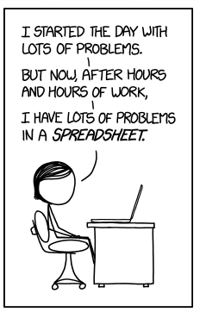
Risks
Risk Management is one of the most important tools of the systems engineer
Everything is inherently risky, and that risk goes up as your system gets more complex and more sensitive to inputs
Higher complexity -> harder to foresee undesirable behaviors
Higher sensitivity -> harder to correct an undesirable behavior before things get bad.
The risk system is a way to gather, organize, and prioritize all the things you think could go wrong.
Making Progress, XKCD [https://xkcd.com/1906] by Randall Monroe.
5
4
3
2
1
 | 1 | 2 | 3 | 4 | 5
L
I
K
E
L
I
H
O
O
D
CONSEQUENCES
Notes:
To solve a complex problem, we must deal with the problem in a way that fits with how we think.
Engineering at any level involves some of this type of thinking—we always break the problem up into more manageable chunks.
Systems engineering typically refers to problems which are so complex that different people must work on the different pieces of the problem.
Specialists handle the details and systems engineers make sure the pieces work together to form something which is more than the sum of its parts.
INCOSE--
System designer decides how to break up system. Requirements owner manages requirements which define system and subsystems. System analyst confirms that the designed system will meet requirements. Val/Ver Engineer makes sure the system does meet requirements. Ops Engineer maintains system through operations and end-of-life. Glue role makes sure things don’t fall through the cracks. CI, TM, IM, PE are fairly obvious. Coordinator facilitates group actions. Last one refers to engineers involved with information technology—formerly maintainers of mainframe computer system.

Slide 20
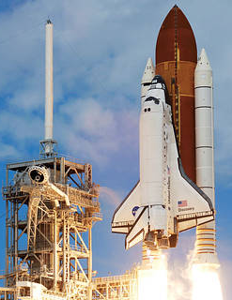
Some projects are riskier than others
Different missions will be more or less tolerant of risk based on mission classification:
Any crewed spacecraft will be even less tolerant to a risk, especially if it could be a personnel safety issue.
Flagship, high-priority missions have the resources to mitigate more risks, and it’s a bigger issue if they fail.
Low-cost probes can (and must) accept more risk in order to make their budgets work.
Do No Harm payloads are just that; you can take any performance risk you want as long as you meet the minimum requirements to not harm the host spacecraft
Notes:
To solve a complex problem, we must deal with the problem in a way that fits with how we think.
Engineering at any level involves some of this type of thinking—we always break the problem up into more manageable chunks.
Systems engineering typically refers to problems which are so complex that different people must work on the different pieces of the problem.
Specialists handle the details and systems engineers make sure the pieces work together to form something which is more than the sum of its parts.
INCOSE--
System designer decides how to break up system. Requirements owner manages requirements which define system and subsystems. System analyst confirms that the designed system will meet requirements. Val/Ver Engineer makes sure the system does meet requirements. Ops Engineer maintains system through operations and end-of-life. Glue role makes sure things don’t fall through the cracks. CI, TM, IM, PE are fairly obvious. Coordinator facilitates group actions. Last one refers to engineers involved with information technology—formerly maintainers of mainframe computer system.

Slide 21
Risks: Technical vs Programmatic
Many risks have technical causes but might be programmatic in nature. If you’re going to have to spend time and money to fix it, it should be classified as a programmatic risk.
Likely a programmatic risk unless:
It won’t happen or be detectable until after launch (residual risk)
The project has decided that they can’t/won’t spend the resources to fix it if it occurs.
Sometimes there may be a paired technical risk with a programmatic risk. Track the paired risks separately.
Example: fatigue failure of a component on the ground is a programmatic risk (you’re not going to launch with a known failed component) but if it survives ground testing it could still fail on launch (residual risk)
Note that safety risks are different; they have consequences related to harm of personnel or critical facilities.
Notes:
To solve a complex problem, we must deal with the problem in a way that fits with how we think.
Engineering at any level involves some of this type of thinking—we always break the problem up into more manageable chunks.
Systems engineering typically refers to problems which are so complex that different people must work on the different pieces of the problem.
Specialists handle the details and systems engineers make sure the pieces work together to form something which is more than the sum of its parts.
INCOSE--
System designer decides how to break up system. Requirements owner manages requirements which define system and subsystems. System analyst confirms that the designed system will meet requirements. Val/Ver Engineer makes sure the system does meet requirements. Ops Engineer maintains system through operations and end-of-life. Glue role makes sure things don’t fall through the cracks. CI, TM, IM, PE are fairly obvious. Coordinator facilitates group actions. Last one refers to engineers involved with information technology—formerly maintainers of mainframe computer system.

Slide 22
How to work a risk
Potential Risk
Is it an actual risk?
What is the likelihood?
What is the consequence?
Analyze the Risk
Can the risk be avoided?
What is the handling strategy?
(Mitigate, watch, research, accept)
All the while Communicating to peers and up the chain of command
Plan
Strategy
Research
Is the Plan on track?
Is there a change in likelihood or consequence?
Track
Progress
Mitigate or Watch
NO
YES
Finished?
Disposition
Close or Accept
Control
Notes:
To solve a complex problem, we must deal with the problem in a way that fits with how we think.
Engineering at any level involves some of this type of thinking—we always break the problem up into more manageable chunks.
Systems engineering typically refers to problems which are so complex that different people must work on the different pieces of the problem.
Specialists handle the details and systems engineers make sure the pieces work together to form something which is more than the sum of its parts.
INCOSE--
System designer decides how to break up system. Requirements owner manages requirements which define system and subsystems. System analyst confirms that the designed system will meet requirements. Val/Ver Engineer makes sure the system does meet requirements. Ops Engineer maintains system through operations and end-of-life. Glue role makes sure things don’t fall through the cracks. CI, TM, IM, PE are fairly obvious. Coordinator facilitates group actions. Last one refers to engineers involved with information technology—formerly maintainers of mainframe computer system.

Slide 23
How Risks Go Away
Risks can end one of a few ways:
Closed – This is no longer a risk either because the likelihood or consequence has gone to zero.
Withdrawn – This was never actually a risk (the “Given that” statement was shown to be false)
Accepted – The project has decided that this is real but that they will not do anything about it.
Residual – Any accepted risk at delivery of the system is considered residual. Residual risks at launch have to get briefed to the program and HQ.
Notes:
To solve a complex problem, we must deal with the problem in a way that fits with how we think.
Engineering at any level involves some of this type of thinking—we always break the problem up into more manageable chunks.
Systems engineering typically refers to problems which are so complex that different people must work on the different pieces of the problem.
Specialists handle the details and systems engineers make sure the pieces work together to form something which is more than the sum of its parts.
INCOSE--
System designer decides how to break up system. Requirements owner manages requirements which define system and subsystems. System analyst confirms that the designed system will meet requirements. Val/Ver Engineer makes sure the system does meet requirements. Ops Engineer maintains system through operations and end-of-life. Glue role makes sure things don’t fall through the cracks. CI, TM, IM, PE are fairly obvious. Coordinator facilitates group actions. Last one refers to engineers involved with information technology—formerly maintainers of mainframe computer system.

Slide 24
Verification vs Validation
System Verification
Did I build the thing right?
Example:
Pass/fail tests against requirements
System Validation
Did I build the right thing?
Should occur throughout all phases of development
Example:
During Requirement Development
Do I have the right requirements?
Are the requirements complete and correct?
Day-in-the-life testing driven by ConOps
On-Orbit, e.g., commissioning phase
Are we getting the science we needed?

Slide 25
Systems Engineering Tools
The logic and function of systems engineering is more important than the tools and processes
For simpler systems, requirements and their flow-down can be in Excel
More complex systems often rely on special-built requirements databases like DOORS
Often diagrams are just static representations of the system (Visio, Powerpoint, etc)
Systems analysis is often custom coded for the specific need
Many groups are beginning to use Model Based Systems Engineering. This is a way to have all of these products exist within a single integrated model but the work remains the same.
Think of this as going from a separate SINDA and radiation model to an integrated Thermal-Desktop-like model
Notes:
To solve a complex problem, we must deal with the problem in a way that fits with how we think.
Engineering at any level involves some of this type of thinking—we always break the problem up into more manageable chunks.
Systems engineering typically refers to problems which are so complex that different people must work on the different pieces of the problem.
Specialists handle the details and systems engineers make sure the pieces work together to form something which is more than the sum of its parts.
INCOSE--
System designer decides how to break up system. Requirements owner manages requirements which define system and subsystems. System analyst confirms that the designed system will meet requirements. Val/Ver Engineer makes sure the system does meet requirements. Ops Engineer maintains system through operations and end-of-life. Glue role makes sure things don’t fall through the cracks. CI, TM, IM, PE are fairly obvious. Coordinator facilitates group actions. Last one refers to engineers involved with information technology—formerly maintainers of mainframe computer system.

Slide 26
Working with your Systems Engineer
Systems engineers have a passing understanding of a lot of topics but might only be an expert in one or two. If you see us making incorrect assumptions about your specialty, please let us know and help us understand it better.
Systems engineers need to balance margins and risk across the whole system. To do that we need to know all of the different types of margins, where they are, and how they relate. Hiding implicit margin in design or analysis makes that impossible.
The primary goal of the whole project is mission success. If the mission works, everyone celebrates. If your subsystem works but the mission doesn’t, it’s still a loss.
Requirements and allocations are not dictated from above. You should feel free to push back and negotiate to make sure your subsystem and the mission are successful.
All of these systems tools and processes are there to serve an end goal but they aren’t always the best way to get there. Let systems know if you have any suggestions to improve or streamline things.
Notes:
To solve a complex problem, we must deal with the problem in a way that fits with how we think.
Engineering at any level involves some of this type of thinking—we always break the problem up into more manageable chunks.
Systems engineering typically refers to problems which are so complex that different people must work on the different pieces of the problem.
Specialists handle the details and systems engineers make sure the pieces work together to form something which is more than the sum of its parts.
INCOSE--
System designer decides how to break up system. Requirements owner manages requirements which define system and subsystems. System analyst confirms that the designed system will meet requirements. Val/Ver Engineer makes sure the system does meet requirements. Ops Engineer maintains system through operations and end-of-life. Glue role makes sure things don’t fall through the cracks. CI, TM, IM, PE are fairly obvious. Coordinator facilitates group actions. Last one refers to engineers involved with information technology—formerly maintainers of mainframe computer system.

Slide 27
Working with your Systems Engineer
Everyone needs to understand the mission ConOps, the associated requirements, and how their subsystem interacts with them.
Organizational rules like GOLD rules, GEVS, PGs, etc are there as guidelines – like requirements, if you are finding yourself going to painful lengths to satisfy them, start the dialogue about what purpose they are serving. (A lot of them are empirical lessons learned, so don’t always translate to things like, I don’t know….tech demos!) SE can help you negotiate these points; waivers are a reasonable outcome and not always a sign of abject failure.
Buy off partials or full requirements as they become available rather than waiting until they’re all done. This reduces the mountain of paperwork as the mission approaches launch. SEs appreciate this since they are tracking paper across every subsystem and mission element
Notes:
To solve a complex problem, we must deal with the problem in a way that fits with how we think.
Engineering at any level involves some of this type of thinking—we always break the problem up into more manageable chunks.
Systems engineering typically refers to problems which are so complex that different people must work on the different pieces of the problem.
Specialists handle the details and systems engineers make sure the pieces work together to form something which is more than the sum of its parts.
INCOSE--
System designer decides how to break up system. Requirements owner manages requirements which define system and subsystems. System analyst confirms that the designed system will meet requirements. Val/Ver Engineer makes sure the system does meet requirements. Ops Engineer maintains system through operations and end-of-life. Glue role makes sure things don’t fall through the cracks. CI, TM, IM, PE are fairly obvious. Coordinator facilitates group actions. Last one refers to engineers involved with information technology—formerly maintainers of mainframe computer system.

Slide 28
Working with your Systems Engineer
Above all else ask questions!
Communication is key, maintain good dialog
Don’t just expect to be handed requirements. Get involved in developing them.
It is important to understand what really matters, don’t get hung up on secondary minor issues, stay focused
Requirements are not sacrosanct so please negotiate. The objective is for the system to work, not just your subsystem.
Example: LRO lunar eclipses
Lot of back-and-forth about what lunar eclipses we had to design to survive
Systems originally wanted to design for any and all eclipses, high complexity
Negotiated to survival of only the predicted eclipses in the baseline (1 year) and extended (1 extra year) missions

Slide 29
Where does thermal fit in?
Thermal is one of the new subsystems that interacts with almost everyone else:
Thermal receives heat from anything with power
Thermal maintains the environment for all hardware
Thermal often includes software-controlled heaters
Thermal is impacted by flight dynamics and attitude
This means thermal engineers often have one foot in the systems world. Many projects include a thermal systems engineer on the systems team.
Notes:
To solve a complex problem, we must deal with the problem in a way that fits with how we think.
Engineering at any level involves some of this type of thinking—we always break the problem up into more manageable chunks.
Systems engineering typically refers to problems which are so complex that different people must work on the different pieces of the problem.
Specialists handle the details and systems engineers make sure the pieces work together to form something which is more than the sum of its parts.
INCOSE--
System designer decides how to break up system. Requirements owner manages requirements which define system and subsystems. System analyst confirms that the designed system will meet requirements. Val/Ver Engineer makes sure the system does meet requirements. Ops Engineer maintains system through operations and end-of-life. Glue role makes sure things don’t fall through the cracks. CI, TM, IM, PE are fairly obvious. Coordinator facilitates group actions. Last one refers to engineers involved with information technology—formerly maintainers of mainframe computer system.

Slide 30
Elements of Space Systems Design
Orbital Dynamics
Structures and Mechanisms
Attitude Control
Electrical Power
Thermal
Command and Data Handling
Propulsion
Communications
Information Systems/Software
Space Environment
Launch Vehicle
Instruments/Payloads
Reliability
Safety
Operations
Disposal
Project management
Maintenance
Storage
Verification (system built right?)
Validation (right system built?)
…

Slide 31
How Other Disciplines Interface with Thermal
GNC
Orbit Requirements
Pointing Requirements
TVAC (Reaction Wheels, etc)
Mechanical
Selection of Materials
Mounting Design
Thermal Hardware Locations
Radiator Accommodation
TVAC (Deployment, Mechanisms)
Surface Coating Specification
STOP Analysis
Geometry Files for Modeling
Integration
Software
Monitoring and Limits
Temperature Control
Autonomous Commands
Electrical/Power
Power Resources (Htrs, TECs, etc)
Thermal Dissipations
Grounding/ESD Requirements
Voltage Requirements
Thermal Sensor Capability
Heaters Services
TVAC (PDU, Solar Arrays, etc)
Integration
Contamination/Coatings
Material and Coatings Selection
Temp Predicts & Geometry Model for Contamination Analysis
Properties for Thermal Analysis
Coating and Tape Application
TVAC Requirements
Your Systems Engineering team should serve as a bridge or facilitator among all Disciplines.
Optical
Predicts for STOP/Pointing
Temp Control for Stability & Focus

Slide 32
Observation Strategy & Operations Concept
Thermal plays a very important role in defining operations and trajectory early in development
How the system will be used in many respects drives the architecture
Earth orbit selection given instruments’ observations
Planetary, e.g., extreme hots or extreme colds
Many instruments’ performance depends on cold temperatures and/or tight stability
Many requirements will fall out of the ops concept.
Temperature ranges and stability
Modes of operations over different phases
Launch operations
Orbit maneuvers
Calibration scans
Ground testing, e.g., heat pipe orientations

Slide 33
Ops Driven Thermal Requirements (1)
Example:
Aquarius/SAC-D orbit selection
Instrument needed to observed the night side “all the time”
Room temperature detectors but <100mK stability, >7-days
Selection of sun-synch 6am orbit, very stable and ample power
ICESat-2 orbit selection
Instrument wants to map as much of the poles as possible AND provide high sampling
Optics benefit from good thermal control (not to tight)
Orbit selected provides a highly variable thermal environment, tough job!
Instrument thermal control discussed but not implemented, too much power. Optical systems have to deal with temperature variations. Optical systems struggle to meet performance.
Systems free up resources and a clever solution of a “thermal oven” for critical optics is implemented

Slide 34
Ops Driven Thermal Requirements (2)
Example:
JWST
Orbit at L-2 driven by high sensitivity of instruments
Detector technology necessitates cryogenic temperatures
Huge deployable sunshield
Solar Probe Plus
First mission to fly on Sun’s corona. Feeling hot, hot, hot!
The entire architecture is driven by the harsh environment

Slide 35
Electrical vs Thermal Dissipation (1)
Be mindful electrical and thermal dissipation are not always the same
Many s/s do not thermally dissipate all the electrical power
Example: Power Distribution Unit
Takes in 28V distributes secondary voltages
Ideally all power in goes out, i.e., 100% efficiency
Clearly efficiency is not ideal so only the conversion losses are dissipated in the box, in addition to internal dissipation from its C&DH
Conservative power estimates
Not uncommon for component PDLs to worst-case power dissipation during analysis
Leads to lots of radiator to handle high loads …
… which then gets too cold in eclipse requiring lots of make up heaters…
… and then needs more power which is not cheap.
Again, good dialog and communication of assumptions is necessary!

Slide 36
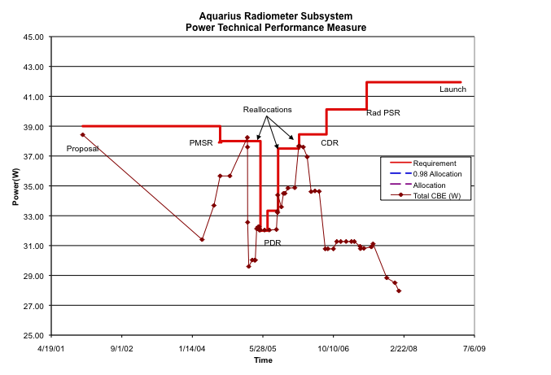
Electrical vs Thermal Dissipation (2)
Example of power history over development
Not uncommon for system to come in under estimates given “stacked” worse-case assumptions
Conservative, yes, but there’s a price to be paid

Slide 37
STOP Analysis
Structural Thermal Optical (STOP) Analysis
Critical function for instruments
By necessity a highly integrated systems activity
Good coordination and documentation a must
Example: JWST
A preliminary STOP analysis was needed to derive requirements for the primary mirror adjustment stages
TVac testing later validated that analysis

Slide 38
Things I’ve Learned In Systems
Most problems are due to poor communication.
Create mechanisms for raising issues/concerns promptly and bring them to closure.
Space missions are easy; people who design, built, test, and operate space missions are hard
Interface tests early and often will save you money.
Don’t count on people reading documents.
It’s the things you aren’t looking at that bite you in the rear.
Discrepancies and disputes are an indicator of a mistake or a misunderstanding. Don’t brush them off—probe into the matter.
You will re-learn some lessons others have already learned—try to keep that to a minimum as best you can.

Slide 39
Things I’ve Learned In Systems
Always look for the things you haven’t thought of, especially during testing.
Perform tests to make sure it will work, not just because someone told you that the test is required.
Test it in the configuration in which you will fly it.
Always ask yourself if your answer makes sense.
Always ask questions—understand why. No matter what you do, you can make better decisions if you understand the situation better.

Slide 40
Summary
Systems engineering is the discipline of:
Breaking a complex need into a series of smaller, related functions
Defining a set of subsystems that can perform those smaller functions
Bringing those subsystems back together into a system that can meet the initial need.
The systems engineering process works best when the systems engineers are in open communication with all of the subsystem teams.
Thermal engineering plays a key part in the development of aerospace systems
Notes:
To solve a complex problem, we must deal with the problem in a way that fits with how we think.
Engineering at any level involves some of this type of thinking—we always break the problem up into more manageable chunks.
Systems engineering typically refers to problems which are so complex that different people must work on the different pieces of the problem.
Specialists handle the details and systems engineers make sure the pieces work together to form something which is more than the sum of its parts.
INCOSE--
System designer decides how to break up system. Requirements owner manages requirements which define system and subsystems. System analyst confirms that the designed system will meet requirements. Val/Ver Engineer makes sure the system does meet requirements. Ops Engineer maintains system through operations and end-of-life. Glue role makes sure things don’t fall through the cracks. CI, TM, IM, PE are fairly obvious. Coordinator facilitates group actions. Last one refers to engineers involved with information technology—formerly maintainers of mainframe computer system.

Slide 41
Backup
GSFC· 2023

Slide 42
Requirement Examples (1)
Don’t use ambiguous terms
The ATLAS laser shall generate laser pulses at approximately 10kHz repetition frequency.
The ATLAS laser shall generate laser pulses at a 10kHz +/- 0.3 kHz repetition frequency
Positively stated
The transmitter shall not allow radiation of the second harmonic to be greater than 20dB.
The transmitter shall suppress radiation of the second harmonic by greater or equal to 20dB.
Keep one thought
The ATLAS laser shall generate laser pulses with a center wavelength of 532 nm +/- 15nm at 10kHz +/- .3kHz repetition frequency.
The ATLAS laser shall emit light at 532nm nm +/- 15nm.
The ATLAS laser shall generate laser pulses at a 10kHz +/- 0.3 kHz repetition frequency.

Slide 43
Requirement Examples (2)
Use consistent terminology
The ATLAS transmitter shall generate laser pulses at a 10kHz +/- 300Hz repetition frequency.
The ATLAS laser shall generate laser pulses at a 10kHz +/- 0.3kHz repetition frequency.
Avoid “people do” statements
The operator shall send stored data to the science team.
The Ground System shall transmit stored data to the science database upon user request.
Avoid implementation specific
The ATLAS laser shall use an intermittent signal disruption to generate laser pulses at a 10kHz +/- 0.3 kHz repetition frequency.
The ATLAS laser shall generate laser pulses at a 10kHz +/- 0.3 kHz repetition frequency.

Slide 44
Be Aware of Your Stakeholders
Testers
Technicians
Operators
Manufacturing
Instrument SE
Observatory
Manager
Branch Management
Spacecraft SE
Designers
Interfacing
Subsystem PDLs
Mission Systems
Engineer
S&MA
Project
Manager
Scientists

Slide 45
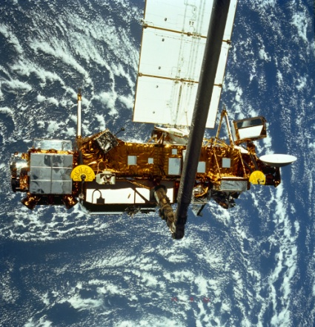
Consider All Lifecycle Phases
Design & Analysis
Manufacturing
Disposal
Assembly
Maintenance
Verification & Test
On-Orbit
Operations
Higher level I&T (e.g., S/C)
Nominal & Off Nominal
Transportation
On-Orbit
Commissioning
Storage
Launch
Pre-Launch Checkout
Include all phases of lifecycle.

Slide 46
Key Issues– Heritage vs New Developments
Using the word “heritage” is probably one of the quickest ways of getting in trouble and starting off the wrong foot when it comes to resource planning.
“In the space business, no two systems can be the same; heritage is imperfect at best and usually less than we think.”
From “Some Things You Always Needed to Know About Systems Engineering but Didn’t Know You Needed to Know”, M.G. Ryschkewitsch, Schneebaum Colloquium GSFC, September 2008
It is more prudent to use prior designs as a starting point for the Requirements and Basis of Estimate. This is very different than bypassing our homework on the basis that “it’s been done before”.
EVERY claim to heritage must be substantiated and presumed not to be until shown otherwise.

Slide 47
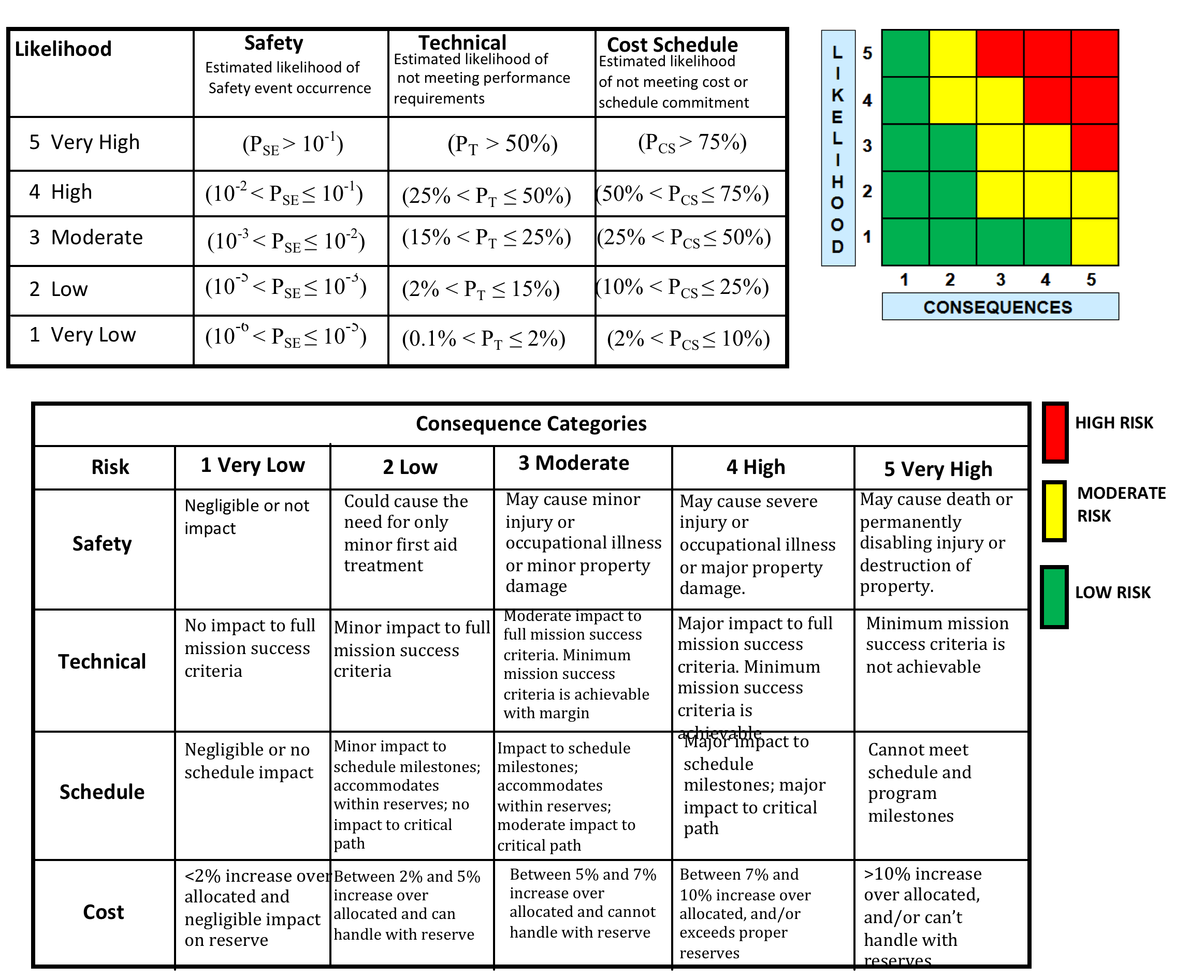
GSFC Risk Scorecard

Slide 48
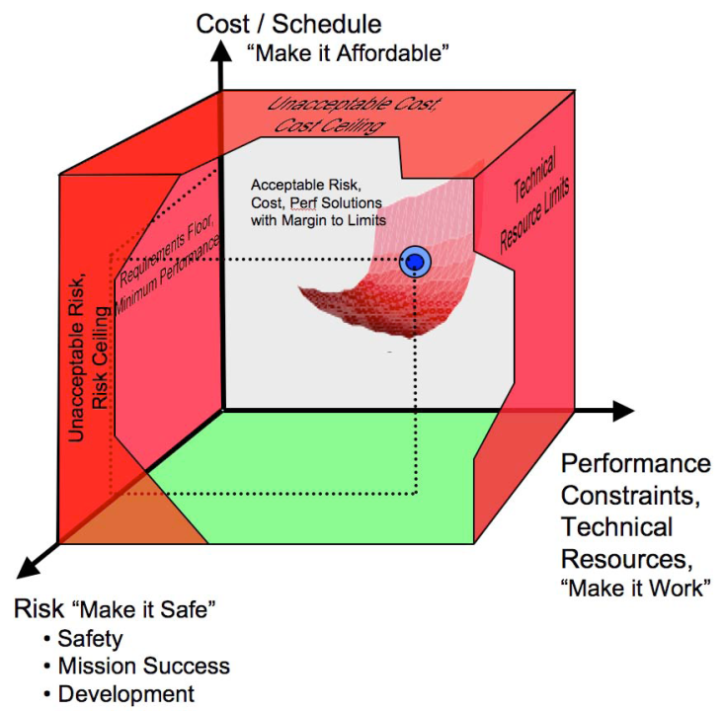
Key Issues – “Good Enough”
The objective is to achieve convergence according to the evaluation criteria.
“Make it work” = technical and performance
“Make it safe and reliable” = risk
“Make it affordable” = cost and schedule.
Overachieving is not necessarily a good thing. As PDL, you need to find the design sweet spot.
Optimization is a SYSTEM issue, not per subsystem
Notes:
“Convergence” of the design is not to be confused with “optimal” design. Optimal implies hitting the bulls-eye when in fact we’re trying to reach a region around the bulls-eye that we consider “good enough”. Another way of looking at it is that each criteria has a “limbo” bar. We’re just trying to get under, i.e., meet the objective, not necessarily to go as low as we can.

Slide 49
Good Enough Example
Example:
TIRS radiator
Cryocooler-based system with many unknowns at the time
Conservative estimate of cyrocooler performance and thermal parasitics led to a rather large radiator with half or more of it blanketed for launch. Not optimized but the right decision for a schedule-constrained project.
How about TIRS2?
It is a lot more cost effective to do an exact repeat of the radiator rather than “optimize” it given its large blanketed area. Again, not optimized but the right decision for a cost-constrained project.
Use of off-the-shelf hardware
LRO over-sized reaction wheels
Developed by GPM
Overkill in performance and not “optimized”
Availability made it best choice for a schedule-constrained project

Slide 50
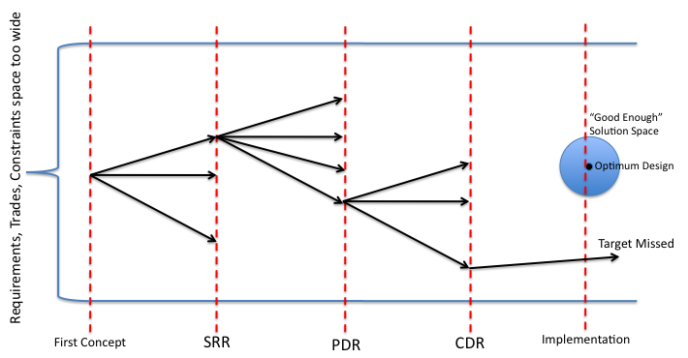
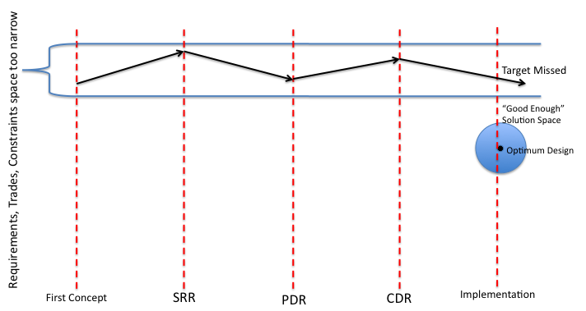
Over or Under Constraining the Solution Space
Under-constrained Solution Space
Usually results in too many options being considered.
Target may be hit or missed.
Potential for large gyrations on the design.
Cost and schedule inefficient.
Over-constrained Solution Space
Perhaps minimal gyrations on the design, which appears cost and schedule efficient, but may never have a chance to hit target.

Slide 51
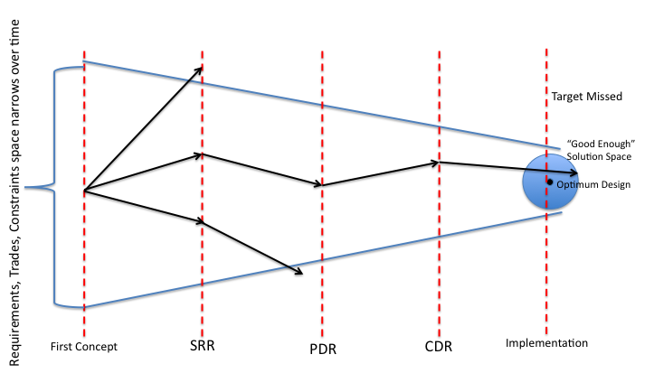
“Optimally” Constraining the Solution Space
Optimally-constrained Solution Space
Reduces gyrations on the design over time, allowing control of cost and schedule while assuring we can hit the target.

Slide 52
Key Issues - Technical Performance Measures
Primary measures: mass, power
Mass is cost!!!
Power generation requires mass, power system components are generally long-lead items.
Other significant measures: data rate, pointing
Data rate impacts memory, processor, downlink (number of ground station contacts, downlink rate, transmitter power)
Pointing impacts type of sensors and actuators, which impacts mass and power
Allocate and track
Notes:
No, this is not a cut and paste error. Mass is the fundamental driver.
It is expensive to get to orbit. 96 GJ for 3000 kg s/c in low earth orbit!
The fundamental driver in the space business is the cost to get into space, so every kilogram is critical.
Spend mass like you spend dollars.

Slide 53
Key Issues - Safehold
Out of power and it is dead.
If it cooks or freezes, it will be dead.
If we can’t talk to it, it might as well be dead.
So, safehold must:
Be power and thermally safe
Allow communication
Be more reliable/robust than normal mode: it is your safety net

Slide 54
Key Issues - Margin
Covers the unknown and the unknowable.
Launches are substantially riskier than flying in an airplane, because rockets have very little margin:
An unexpected event or failure usually means the end of a space mission, while an aircraft can usually get back to the ground safely.
Space missions cannot afford the margin of a commercial airliner—too much energy is required to get to orbit.
Margin costs money, so there is always pressure to reduce margin.
Use good judgment and the experience of others to judge how much margin is appropriate.
Margins must be reasonable and commensurate with mission risk posture.

