Slide 1
A Primer on Planetary Protection for Thermal Engineers
Betsy Pugel, PhD
Code 546/ Contamination, Coatings and Planetary Protection Engineering Branch
Planetary Protection Group Lead, GSFC
Betsy.Pugel@nasa.gov
TFAWS 2023

Slide 2
Today
Planetary Protection Basics
Planetary Protection Requirements
The Intersection of Thermal and Planetary Protection
Flight Project Practicalities

Slide 3
Today
Planetary Protection Basics
Planetary Protection Requirements
The Intersection of Thermal and Planetary Protection
Flight Project Practicalities

Slide 4
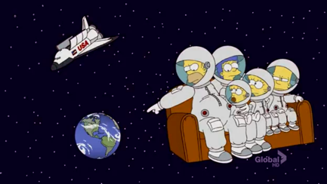
What this talk is (and isn’t)
What this talk is: A fun (hopefully!) and informative way to learn about planetary protection
What this isn’t:
A review of planetary protection policy.
A list of what can or cannot/should or should not be used.

Slide 5
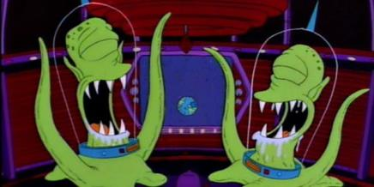
Planetary Protection
NASA missions are required to comply with requirements that protect the science and protect the planet, depending on the mission’s objectives.

Slide 6
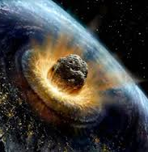

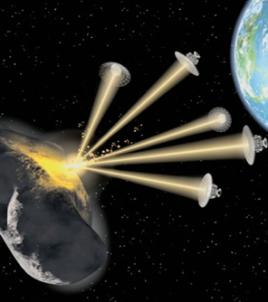
What Planetary Protection isn’t…
It’s not about keeping an eye on the big things...
(asteroids impacting Earth)
Planetary Defense

Slide 7
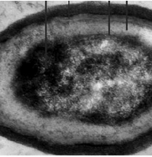
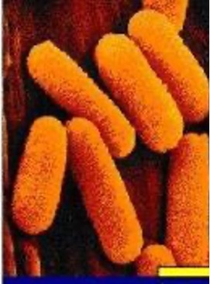

What Planetary Protection is…
It’s about keeping an eye on the little things...
(microbes)

Slide 8
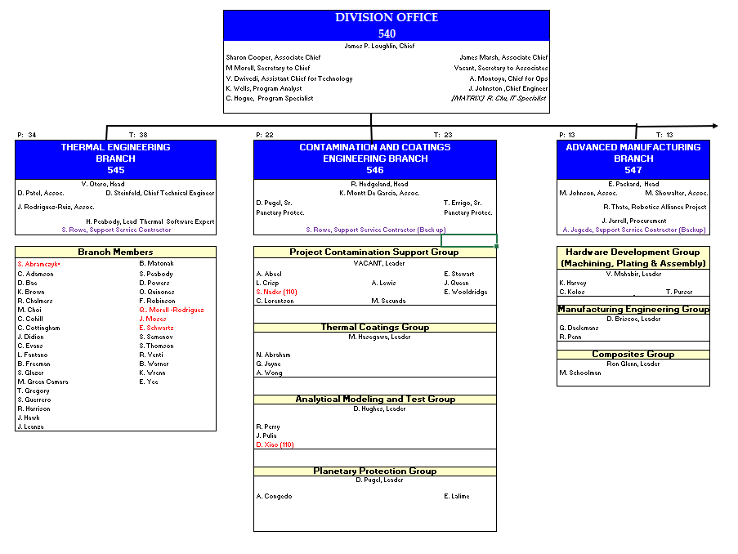
T. Errigo
C. Lorentson
R. Perry

Slide 9

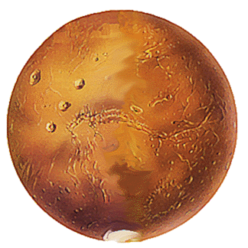
The two components of planetary protection…
FORWARD CONTAMINATION
BACKWARD
CONTAMINATION

Slide 10

FORWARD CONTAMINATION
Keeping opportunities open for future science on other planetary bodies
noise
Ours
Or
Mars?
signal
BACKWARD
CONTAMINATION

Slide 11

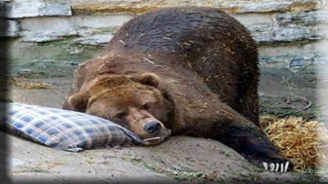
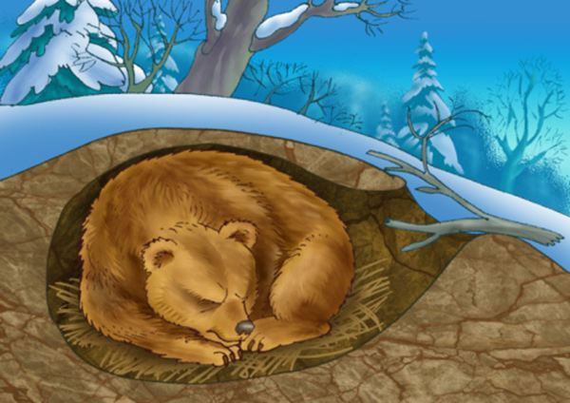
What do we protect other planets from?
The hardiest of the hardy: microbes able to be dormant when the environment was unfavorable and then, emerge from dormancy when conditions were favorable.
These are known as
bacterial endospores
or just
“spores.”

Slide 12
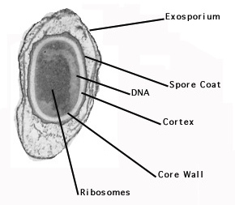
Spores and Bioburden
Endospores, or “spores” are the dormant forms of bacteria, able to withstand adverse environmental pressures and reanimate when the conditions are right.
When the going gets tough, the tough get sporulating.
< 3 microns
Note: these are bacterial spores, not mold spores!

Slide 13
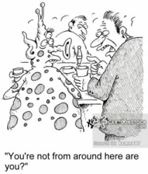

FORWARD CONTAMINATION
Greetings Earthlings!
…Not closing the door on our Earthly civilization when we bring samples back from certain planetary bodies…
BACKWARD
CONTAMINATION

Slide 14
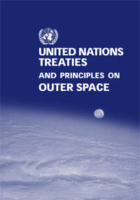
…microbes!
Wait, what?! Why?
Article IX
States Parties to the Treaty shall pursue studies of outer space, including the moon and other celestial bodies, and conduct exploration of them so as to avoid their harmful contamination and also adverse changes in the environment of the Earth resulting from the introduction of extraterrestrial matter and, where necessary, shall adopt appropriate measures for this purpose.
conduct exploration of them so as to avoid their harmful contamination
Notes:
When NASA explores the solar system or returns samples from elsewhere in the solar system, we have to think about microbes as an additional systems engineering variable.
This is for a few reasons.
Science: Signal to noise for life detection
National Policy: NEPA (sample return)
International Policy: Outer space treat
…These are pretty good reasons,…

Slide 15
Today
Planetary Protection Basics
Planetary Protection Requirements
The Intersection of Thermal and Planetary Protection
Flight Project Practicalities

Slide 16


Guiding NASA Policy and Documents
NPD 8020.7
Biological Contamination Control for Outbound and
Inbound Planetary Spacecraft
Roles and Responsibilities
NPR 8715.24
Formerly, NPR 8020.12D
NID 8020.109A
Planetary Protection Provisions for Robotic Extraterrestrial Missions
Categorization and Requirements
NASA-STD-8719.PP
PP Standard
Standard Processes for Bioburden Assaying/Processing
NASA-HDBK-6022
NASA Technical Handbook for the Microbial Examination of Hardware, in revision
Guidance document with engineering information
CALL YOUR
PP ENGINEER!
NID 8715.129
NASA Interim Document- Biological Planetary Protection for Human Missions to Mars
Roadmap for developing PP Requirements for human missions
Don’t worry, your PP Engineer wrangles all of this!
TFAWS 2023 - Planetary Protection - Pugel/GSFC/546

Slide 17
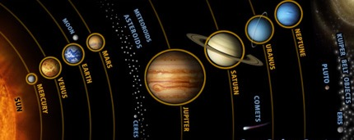

NEPTUNE
MARS
URANUS
EARTH
SATURN
VENUS
MERCURY
TITAN, ENCELADUS
IO
EUROPA
GANYMEDE
JUPITER
CERES
Notes:
Where do we worry about biology? There are only certain spots in our solar system where we really worry--- those are in orange.
The rest of the solar system, planetary protection is concerned about keeping track of organic compounds (potting, epoxy, heatshield material, etc)—so those bodies, we don’t keep track of microbes, like I will talk about today.
There are places where the international community believes that there is the highest chance for life as we know it to exist. We are responsible investigators and so, we track bioburden on spaceflight hardware being sent to the locations marked in orange, which we call Category III or IV missions in NASA speak.

Slide 18
TITAN, ENCELADUS
IO
EUROPA
GANYMEDE
Cat I
Cat II
Cat II
Cat III & IV
Cat I or II
Cat II
Cat II
Cat II
Cat II
Cat II (moon)
Cat II
Cat II, III , IV
Cat IV or Cat III
Planetary Protection Categorization
Notes:
There are places where the international community believes that there is the highest chance for life as we know it to exist. We are responsible investigators and so, we track bioburden on spaceflight hardware being sent to the locations marked in orange, which we call Category III or IV missions in NASA speak.

Slide 19
Categorization
NASA Missions are categorized I – V for Planetary Protection
Categorization Definitions and requirements in NASA Procedural Requirement (NPR)
Categorization frames the range of requirements, implementation ranges and verification approaches and depends upon:
  Target body (moon vs. planet vs. other)
  Mission Objectives (detecting life? Not detecting life?)
  Mission Platform (Orbiter? Lander?)
Categorization Depends On:
  Where you’re going
  How you’re going to get there
  What you plan on doing once you get there
  If you’re going back home
Code 546/Your PP Engineer is tasked to work with a project to generate these requests
and work through requirements development, implementation, and verification.

Slide 20
Categorization Depends On:
  Where you’re going
  How you’re going to get there
  What you plan on doing once you get there
  If you’re going back home
Categorization | Mission Platform | Planetary Target Priority
I | Any | Not of direct interest for understanding the process of chemical evolution or where exploration will not be jeopardized by terrestrial contamination. No protection of such planets is warranted, and no requirements are imposed. Typical Examples: Undifferentiated, metamorphosed asteroids, Io
II | Any | Of significant interest relative to the process of chemical evolution but only a remote chance that contamination by spacecraft could compromise future investigations. Typical Examples: Venus, Moon, Jupiter, Saturn, Uranus, Uranian satellites, Neptune, Comets, Ceres, Carbonaceous Chondrite Asteroids, Ganymede, Titan, Triton, Pluto/Charon,
III | Flyby, Orbiter | Of significant interest relative to the process of chemical evolution and/or the origin of life and for which scientific opinion provides a significant chance that contamination by spacecraft could compromise future investigations. Typical Examples: Mars, Europa, Enceladus
IV | Lander, Probe
V Restricted Earth Return Unrestricted Earth Return | All Earth Return | All Solar System Missions Typical Examples: Restricted = Mars, Europa; Unrestricted: Earth’s Moon, Venus, most asteroids and comets
Notes:
When NASA explores the solar system or returns samples from elsewhere in the solar system, we have to think about microbes as an additional systems engineering variable.
This is for a few reasons.
Science: Signal to noise for life detection
National Policy: NEPA (sample return)
International Policy: Outer space treat
…These are pretty good reasons,…

Slide 21
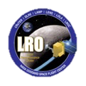











Some Examples from Current and Past Missions
Category I and II
Cat III
Cat IV
Cat V, Unrestricted
Cat V,
Restricted
13 cubesats
Mars Express
*assumed

Slide 22
Secondary Payloads and Instruments
Secondary Payloads (Cubesats/Small Sats) Are independent missions that need to request their own Categorization, separate from the Primary Mission. Secondaries work with the project/mission to “do no harm” to the overall planetary protection compliance of the primary mission. Cubesats may have a less stringent categorization assigned to them compared to the primary, dependent upon trajectories and primary mission risk assessments.
Instruments and Other Payload Elements conform to the Level 1s assigned to the mission/project as defined in the Categorization letter and as flowed to them by the project.

Slide 23
PP Requirements Themes At a Glance: Sorted by Category
Cat | PP Plan | Inventory of bulk organic constituents | Trajectory Biasing | Cleanroom Requirement | Burnup and Breakup Analyses | Subsidiary Plans | Bioassays | Bioburden Reduction | System Sterilization
I
II
III
IV
V
Requirements as listed in the NPR
None
Some
All/Significant

Slide 24
Today
Planetary Protection Basics
Planetary Protection Requirements
The Intersection of Thermal and Planetary Protection
Flight Project Practicalities

Slide 25
MARS
TITAN, ENCELADUS
IO
EUROPA
Cat I
Cat II
Cat II
Cat III & IV
Cat I or II
Cat II
Cat II
Cat II
Cat II
Cat II (moon)
Cat II
Cat II, III , IV
Cat IV or Cat III
Missions where Thermal and Planetary Protection Engineers
are most likely to work together…
Notes:
There are places where the international community believes that there is the highest chance for life as we know it to exist. We are responsible investigators and so, we track bioburden on spaceflight hardware being sent to the locations marked in orange, which we call Category III or IV missions in NASA speak.

Slide 26
Thermal and PP Engineers Join Forces for Category IV MIssions
FORWARD CONTAMINATION
Cat | PP Plan | Inventory of bulk organic constituents | Trajectory Biasing | Cleanroom Requirement | Burnup and Breakup Analyses | Subsidiary Plans | Bioassays | Bioburden Reduction | System Sterilization
I
II
III
IV
V
Requirements as listed in the NPR
None
Some
All/Significant
Microbial Inactivation
Filtration of Blanket Vents/Exhausts
BACKWARD
CONTAMINATION

Slide 27
Category IV Missions: Do we need to thermally inactivate microbes?
Depending on the requirements of the Cat IV mission (Mars, Enceladus, Europa), your planetary protection engineer may talk to you about thermally inactivating microbes before launch.
Dry Heat Microbial Reduction
DHMR
Thermal Inactivation of Microbes
Bioburden Reduction
What? Non-operational bakeout
It could happen at the component, subsystem or system level
When? It could happen prior to integration, as a part of TVAC, as a separate bakeout.
How? It depends on the “What”.

Slide 28



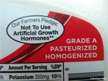
Thermal Inactivation of Microbes
You experience it everyday…
Pasteurization, cooking meat, canned food
These all employ process-based methods for reducing organisms in your food.
How do you know when it’s safe to eat your food?
What temperatures make things safe?
The USDA has developed processes in time and temperature.
Many of these are written in law for preservation of public health

Slide 29
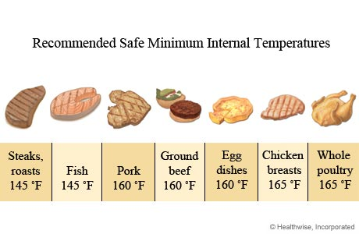
Bioburden Reduction in Your Daily Life
63ºC
71ºC
74ºC
Here, Salmonella (a living organism) is being reduced by an established process
NASA reduces spores by a different established process

Slide 30
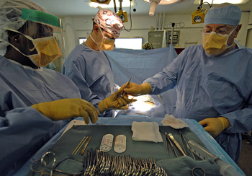
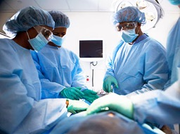

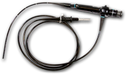
Heat Microbial Reduction
Why do we trust our surgeons?
What makes their tools sterile?
Sterilization of surgical tools, surgical rooms, medical equipment
NIH and CDC have developed processes in time and temperature for sterilization.
Many of these are written in law for preservation of public health

Slide 31
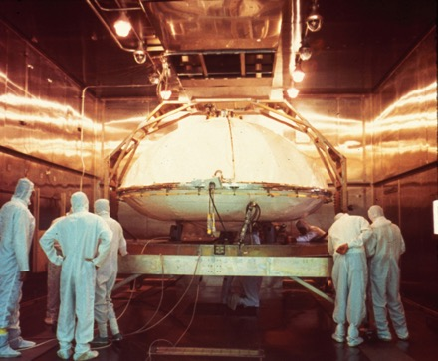
Heat Microbial Reduction
At NASA, we do something similar..
No!
Yes!
http://solarsystem.nasa.gov/galleries/viking-in-the-oven
NASA employs process-based (time and temperature) reduction of microbes. [It’s like cooking a hamburger that’s stainless steel and going to Mars vs. your stomach]
The most common approach is Dry Heat Microbial Reduction (DHMR)

Slide 32
Milk, Chicken, Spacecraft and Medical Equipment

Slide 33

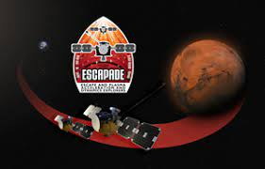
Category IV Missions: Blanket Filtration for vents/exhausts
Depending on the mission requirements
your PPE engineer will work with you
to determine optimal sizing of blanket filters.
< 3 microns

Slide 34
Today
Planetary Protection Basics
Planetary Protection Requirements
The Intersection of Thermal and Planetary Protection
Flight Project Practicalities

Slide 35
General Advice for Thermal Folks Working a PP Mission
Find out who is the PP Lead --- @ GSFC = 546, elsewhere, PP Engineer
If you can’t find out easily, reach out to our branch management (Randy Hedgeland or Tina Montt de Garcia) or me.
Ask the PP Lead about the PP Category:
  Has it been formally categorized (usually, this happens in Phase A/B)?
  If this is a proposal, there will be a pre-proposal informal categorization.
If it’s Category I or II, don’t sweat too much.
  Your planetary protection lead will ask you about materials details/MIUL.
  That’s about it!
If it’s Category III or IV, we’ll be working with you!
  Can we take advantage of TVAC cycles for microbial bakeouts (if needed?)?
  Can we list the PP bakeouts in the ERD and in thermal documents? (that way, no one is surprised!)
RESIST THE TEMPTATION TO LUMP PP with CONTAMINATION CONTROL!
  They have different deliverables, different chains of authority
  They can be different people, depending on the mission complexity!

Slide 36
T. Errigo
C. Lorentson
R. Perry

Slide 37
Keep Our Solar System Weird
Questions?
Contact us!
Betsy.Pugel@nasa.gov
Randy.J.Hedgeland@nasa.gov
Kristina.M.Monttdegarcia@nasa.gov

Slide 38
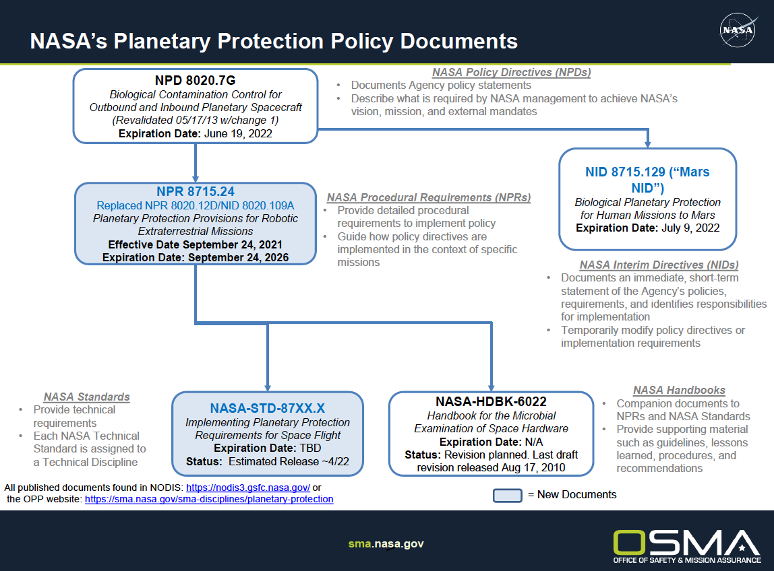

Slide 39
Requirements At a Glance
Cat | PP Plan | Inventory of bulk organic constituents | Trajectory Biasing | Cleanroom Requirement | Burnup and Breakup Analyses | Subsidiary Plans | Bioassays | Bioburden Reduction | System Sterilization
I
II
III
IV
V
Mostly documentation + Cleanroom Assembly
Bioburden-Related Requirements

Slide 40

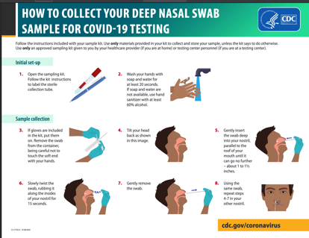
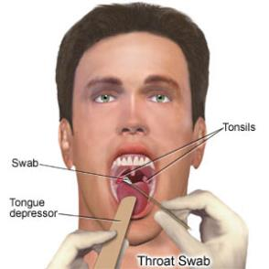
What you already know about Spacecraft Assaying…
Sampling a spacecraft is a bit like your experience with swabbing a nose…though here, we are sampling for bacteria vs. viral material
Processing is very different!
Sampling for COVID-19
(viral)
Sampling for Strep Throat
(bacteria)
NOT CLEARED FOR DISTRIBUTION OUTSIDE CODE 300-Intro to PP

Slide 41
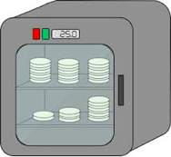
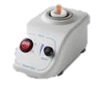










We process swabs and wipes using the NASA Standard Assay
EXTRACT
HEAT SHOCK
PLATE
INCUBATE
outreplicate
NASA Standard Assay | Sonication in water via vortex mixer | Water bath 80ºC | Trypticase Soy Agar (TSA) | Aerobically incubated 32ºC, 72 hours total Inspect in 24 hr intervals
My Pet Spore
Solar System Survivor
Outsporulate
Notes:
If you’ve done a covid test, you’ve sampled with a swab and extracted the viral contents into a vial.
Here’s where things get a little different.
We extract spores and bacteria from swabs and wipes and play survivor island by doing a heat shock step—this selects out for only the spores that can survive that step.

Slide 42

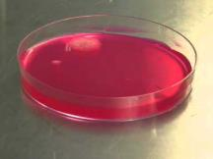
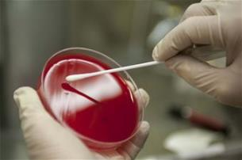
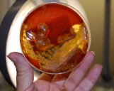

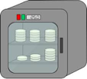
My Pet Spore
(2) See if it grows
Swab extracted sample
onto food
It’s clean!
No growth
Plate
Reclean
or
Conduct Bioburden Reduction Process
Growth
Bring your new pet home
and feed it!
Incubate
Keep feeding it
and keep it warm!

Slide 43
Terminology
microorganism
A microscopic organism, such as a bacterium, virus or fungus, unable to be seen with the naked eye and typically composed of a single cell.
Microbe
A minute organism,
A microorganism
Cell
The basic organizational unit of
an Earth organism; some are composed of many cells, together
Eukaryotes
Spore
BacterIA
Smaller
A dormant form of a bacterial
cell – smaller than the cell itself
Archaea
Virus
Types of organisms: most are single-cell microorganisms, but Eukaryotes can be LARGE and
multicellular and bacteria make films and aggregations
A parasitic entity composed of RNA and/or DNA, and proteins

Slide 44
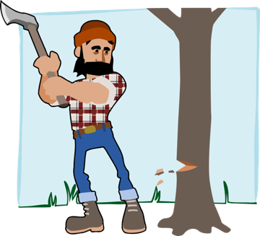

Log Reduction
“Log Reduction” is not about chopping firewood…
START With a known level of spores
You know this level because you’ve sampled and assayed.
SELECT A bioburden process that has been well characterized (e.g. NASA Standard Process)
APPLY that process to your hardware with appropriate level of controls.
END RESULT: a number of logs of reduction in spores.
We know the population reduction due to extensive process development and testing.

Slide 45
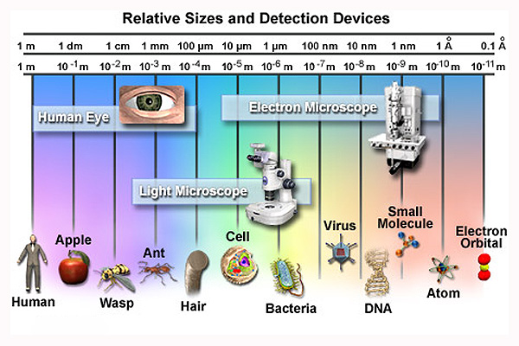
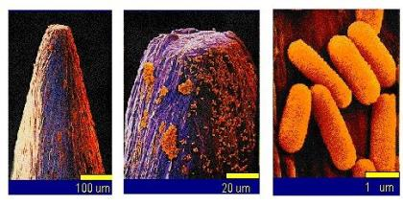
Relative Size Scales of Microbes
Bacteria on the head of a pin
—there are lots there!
—and they are not angels…

Slide 46
Terminology
 | Bacteria | Spore | Virus
Size Range | ~0.2-10 µm | ~2-5 µm | ~100-10 nm
Unique Features | DNA in a circular molecule; cell wall; ribosomes make proteins | Can exist in a state of dormancy for long periods; bacterial machinery in storage | Needs a host; some can persist almost indefinitely in the environment
Examples | Staphylococcus aureus Streptococcus mitis | Bacillus subtilis Anthrax NOT S. mitis | Influenza Ebola Bacteriophage T-4
Endospores are not the same as mold or fungal spores:
Endospores help bacteria withstand harsh conditions
Mold spores and fungal spores are what allow molds and fungi to reproduce

Slide 47
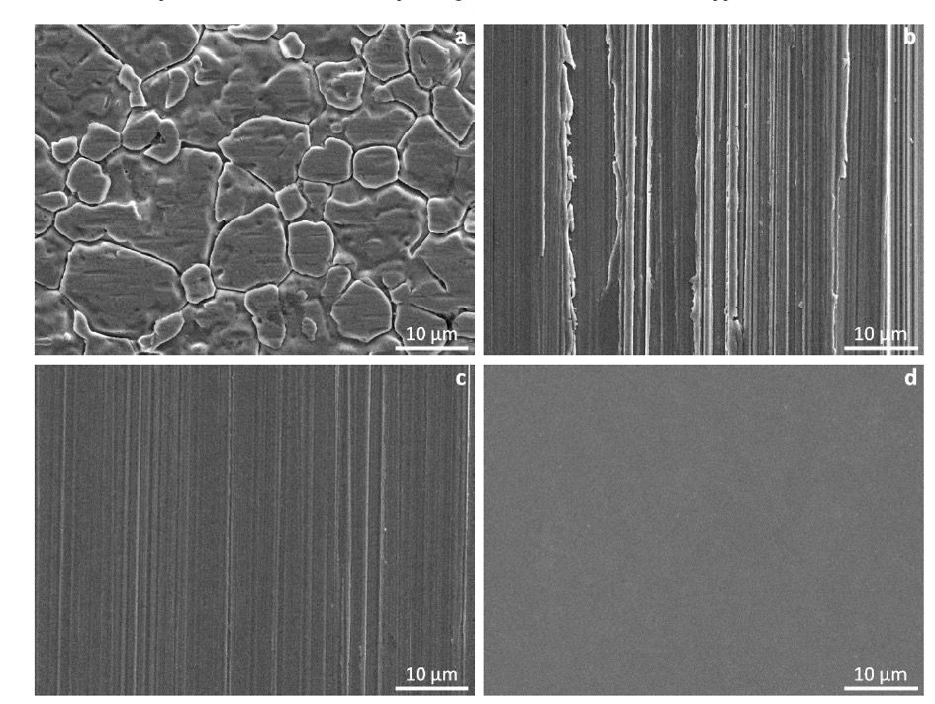
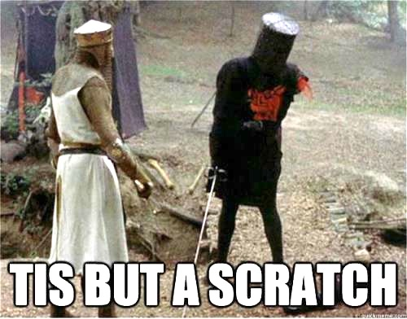

Slide 48
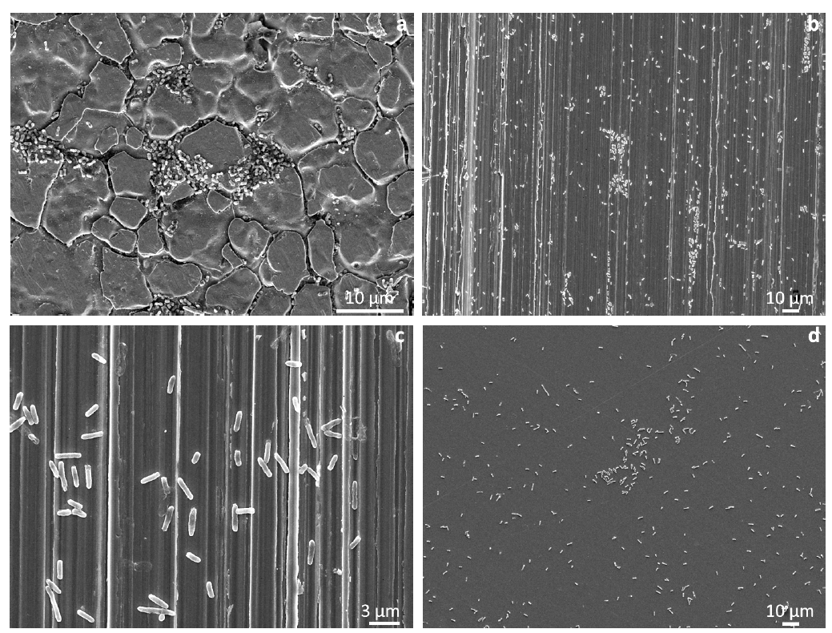

But some call it a home

