Slide 1


Heat Pipes for Space Applications
Sergey Semenov – NASA GSFC
TFAWS Technical Course
Thermal & Fluids Analysis Workshop
TFAWS 2023
August 21-25, 2023
NASA Goddard Space Flight Center
Greenbelt, MD

Slide 2
Outline
Introduction
  Heat Transfer Systems
Constant Conductance Heat Pipes (CCHP)
  Axial Grooved Heat Pipes
  Other Types of CCHPs
Variable Conductance Heat Pipes (VCHP)
Diode Heat Pipes

Slide 3
Heat Transfer Systems
From Wikipedia:
  Heat transfer is a discipline of thermal engineering that concerns the generation, use, conversion, and exchange of thermal energy (heat) between physical systems. Heat transfer is classified into various mechanisms, such as thermal conduction, thermal convection, thermal radiation, and transfer of energy by phase changes…
Heat transfer system is a device (or a system) that transports heat from a heat source to a heat sink.

Slide 4
Heat Transfer by a Two-Phase System
The term Two-Phase System (TPS) refers to a heat transfer system that employs phase change phenomena (such as evaporation and condensation) for heat acquisition and release.
Vapor flow carries heat
to another location (vapor phase)
Evaporation
(Vaporization) of liquid absorbs heat
Heat released by Condensation
Cycle
Liquid phase returns back to the evaporation site
Heat Source
Heat Sink
Closed System

Slide 5
Benefits of Two-Phase Systems
Passive – no external pumping power.
  However, an external power is needed for temperature control, startup and shutdown.
Self regulating – no flow control devices.
  Except pressure regulators for passive temperature control of the LHP temperature.
No moving parts – vibration free.
  Except thermosiphons in gravity field.
High conductance
  Small temperature difference between a heat source and a heat sink.

Slide 6
Types of TPS used in Space Applications
Heat Pipes (HPs):
  Constant Conductance Heat Pipes (CCHPs).
    Axial grooved heat pipes
    Sintered metal powder wick heat pipes
    Heat pipes with a screen wick
    Arterial heat pipes
    Oscillating Heat Pipes (OHP) a.k.a. Pulsating Heat Pipes (PHPs).
  Variable Conductance Heat Pipes (VCHPs).
  Diode Heat Pipes.
Loop Heat Pipes (LHPs) and Capillary Pumped Loops (CPLs).
  The LHPs will be covered in a separate lecture
Note: this is not a complete list of Two-Phase Systems
  Hybrid (Mechanically Assisted) Two-Phase Systems.

Slide 7
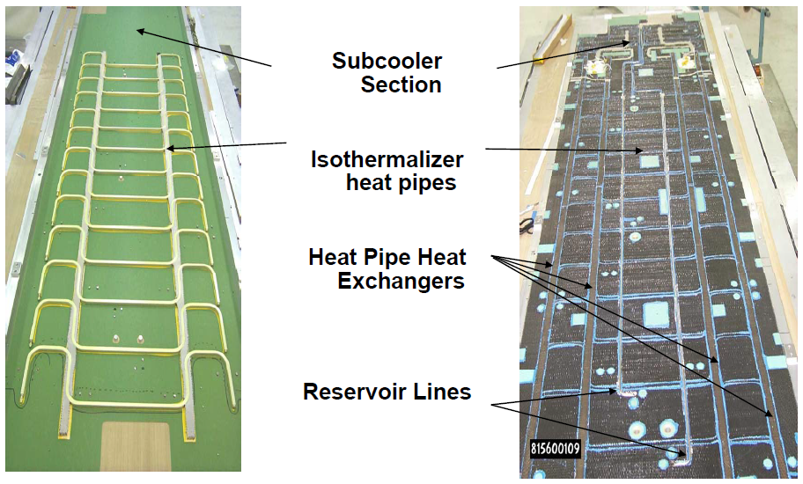
Heat Pipes in Space Applications
Heat pipes are frequently used in space for thermal management.
  Spacecraft radiators may have dozens of embedded heat pipes.
Heat pipe is a heat transfer device which is capable of transporting:
  high rates: up to several kilowatts
  over long distances: up to several meters
  with small temperature difference: on the order of several degrees.
Radiator Assembly – Hubble Space Telescope
Notes:
Heat Pipe is one of the most common two-phase systems utilized in space applications for thermal management.
Heat pipe is the name given to a high performance heat transfer device which can transport heat at high rates and over long distances with a very small temperature difference. It is a two-phase system. The heat transfer in two-phase system employs evaporation and condensation for heat acquisition and release, respectively.

Slide 8
Heat Pipe Definitions
T. P. Cotter, “Theory of Heat Pipes,” 1965
  A heat pipe is a self-contained structure which achieves very high thermal conductance by means of two-phase fluid flow with capillary circulation.
S. W. Chi, “Heat Pipe Theory and Practice, A Sourcebook,” 1976
  The heat pipe, a device for transmitting heat from one location to another over a small temperature gradient, …
P. D. Dunn and D. A. Reay, “Heat Pipes,” 1994
  The heat pipe is a device of very high thermal conductance.
H. Ma, “Oscillating Heat Pipes,” 2015
  The heat pipe is a heat transfer device that effectively utilizes evaporation and condensation to transfer heat over a long distance.
B. Zohuri, “Heat pipe Design and Technology,” 2016
  Heat pipes are two-phase flow heat transfer devices where a process of liquid to vapor and vice versa circulates between evaporator and condenser with high effective thermal conductivity.

Slide 9
Heat Pipe Elements
4. Fill Tube
1. Envelope – sealed container
2. Capillary wick
3. Working fluid
5. End Cup
6. Flanges

Slide 10
Heat Pipe Operation
4. Vapor condenses and gives up the latent heat to the wick surface. The condensate liquid saturates the wick
2. Liquid is vaporized, and the latent heat of vaporization is transferred from the surface of the saturated wick
3. Vapor flows from evaporator to condenser
1. Heat is conducted through the heat pipe wall and liquid saturated wick
5. Heat is conducted through the saturated wick and heat pipe wall
Heat Source
Heat Sink
6. The liquid flows from the condenser to the evaporator through the porous wick by capillary surface-tension pumpung
The primary driving force that causes a heat pipe to operate is an externally applied heat load to the evaporator and a heat removal from the condenser.

Slide 11
Heat Transfer in the Evaporator
1. Uniform Heat Load
2. One-Sided Heat Load
3. Two-Sided Heat Load
Vapor space
Vapor space
Flange
Vapor space
Heat pipe wall
Heat pipe wick – axial grooves
Space applications primarily deal with one-sided and two-sided heat load cases

Slide 12
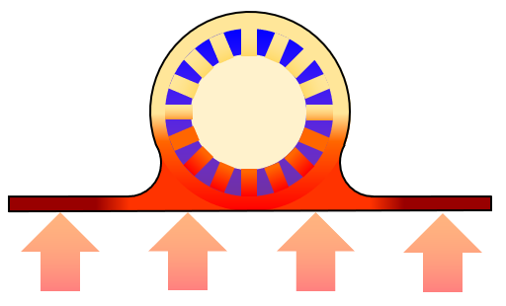



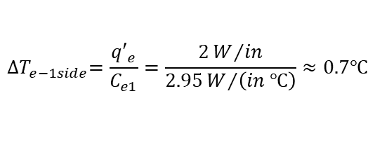



One-Sided Heat Load
$D_{hp}=1/2$ $in$
$$L_{e}=10 in$$
Evaporator Adiabatic Section Condenser
$$T_{oper}=−10℃$$
$$Q_{e}=20 W$$
Calculating the evaporator temperature drop
Find the evaporator conductance per unit length at the operating temperature
Calculate the evaporator heat load per unit length.
Calculate the evaporator temperature drop.
Thus, the temperature difference between the heat loaded surface and vapor space is about 0.7ºC
$$D_{hp}=0.5 in, T_{oper}=−10°C→ C_{e1}=2.95\frac{W}{in ℃}$$
$$Q_{e}=20 W, L_{e}=10 in, {q′}_{e}=\frac{Q_{e}}{L_{e}}=2\frac{W}{in}$$
$${∆T}_{e−1side}=\frac{{q′}_{e}}{C_{e1}}=\frac{2W/{in}}{2.95W/{\left(in ℃\right)}}≈0.7℃$$

Slide 13
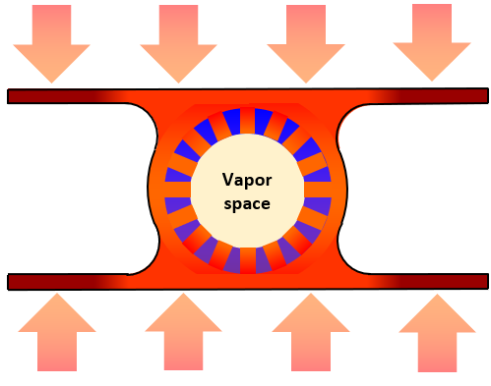


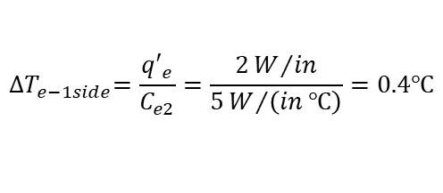



Two-Sided Heat Load
$$L_{e}=10in$$
$$D_{hp}=0.5 in$$
Evaporator Adiabatic Section Condenser
$$T_{oper}=−10℃$$
$$Q_{e}=20 W$$
Calculating the evaporator temperature drop
Find the evaporator conductance per unit length at the operating temperature
Calculate the evaporator heat load per unit length.
Calculate the evaporator temperature drop.
Thus, the temperature difference between the heat loaded surface and vapor space is less than 0.5ºC
$$D_{hp}=0.5 in, T_{oper}=−10℃→ C_{e2}=5\frac{W}{in ℃}$$
$$Q_{e}=20 W, L_{e}=10 in, {q′}_{e}=\frac{Q_{e}}{L_{e}}=2\frac{W}{in}$$
$${∆T}_{e−1side}=\frac{{q′}_{e}}{C_{e2}}=\frac{2W/{in}}{5W/{\left(in ℃\right)}}=0.4℃$$

Slide 14






Evaporation Process
q”, W/m²
$$W_{g}$$
$$W_{f}$$
10³ 10⁴ 10⁵
$$R_{1}$$
I – equilibrium zone
$$T_{g}$$
II – evaporation zone
$$T_{hp}$$
III – meniscus
Variable Typical Value
R₁ – Capillary radius over 10 micrometers
T_{hp} – Wall thickness from 0.3mm to 1mm
T_{g} – Groove depth from 0.3mm to 2mm
W_{f} – Fin thickness from 0.5mm to 1mm
W_{g} – Groove width from 0.4mm to 1mm
$$R_{1}$$
h, m
For ammonia heat pipes the effective heat transfer coefficient in the evaporator ranges from 2,000 W/(m² ∙ K) to 6,000 W/(m² ∙ K).
A value of h_{evap} = 4,000 W/(m² ∙ K) is recommended for preliminary assessments.

Slide 15
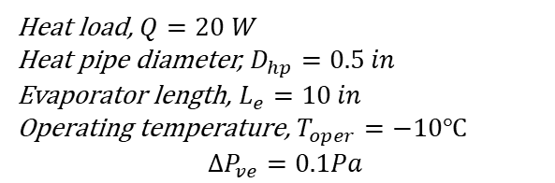

Vapor Flow in the Evaporator
Evaporator
Pressure gradient to accelerate vapor to the axial velocity v
Pressure gradient to overcome frictional drag forces at the wick surface
${∆P}_{ve}={∆P}_{ve}^{inertial}+$ ${∆P}_{ve}^{viscous}=ρv^{2}+\frac{8μ_{v}\dot{m}}{ρπR_{vs}^{4}}\frac{L_{e}}{2}$
Pipe flow with injection
Temperature, ºC
Typically the pressure drop of the vapor flow in the evaporator is very small.
Example:
Heat load, $Q=20 W$
Heat pipe diameter, $D_{hp}=0.5 in$
Evaporator length, $L_{e}=10 in$
Operating temperature, $T_{oper}=−10℃$
$$∆P_{ve}=0.1Pa$$
The inertial component of the pressure drop can be partially recovered in the condenser section when vapor flow deccelerates.

Slide 16

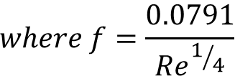

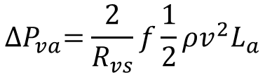
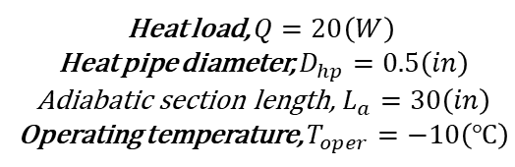
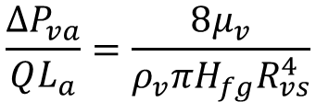
Vapor Flow in the Adiabatic Section
Adiabatic Section
Turbulent (Re > 2100)
Laminar (Re < 2100)
$${∆P}_{va}=\frac{2}{R_{vs}}f\frac{1}{2}ρv^{2}L_{a}$$
$$\frac{∆P_{va}}{QL_{a}}=\frac{8μ_{v}}{ρ_{v}πH_{fg}R_{vs}^{4}}$$
Pipe flow
Fully developed, axial, incompressible
$$where f=\frac{0.0791}{{Re}^{1/4}}$$
In most space applications the vapor flow is laminar.
Example:
Heat load, $Q=20\left(W\right)$
Heat pipe diameter, $D_{hp}=0.5\left(in\right)$
Adiabatic section length, $L_{a}=30\left(in\right)$
Operating temperature, $T_{oper}=−10\left(℃\right)$
From the plot:
$$\frac{∆P_{va}}{QL}=0.0006\frac{Pa}{W in}$$
Thus,
$${∆P}_{va}=0.0006\frac{Pa}{W in}∙30 in∙20W=0.36Pa$$

Slide 17

Vapor Flow in the Condenser
Heat load, $Q=20 W$
Heat pipe diameter, $D_{hp}=0.5 in$
Condenser length, $L_{c}=20 in$
Operating temperature, $T_{oper}=−10℃$
$$∆P_{vc}^{No recovery}=0.12 Pa$$
Condenser
- 60ºC
No pressure recovery
Pipe flow with suction
Full pressure recovery
Pressure gradient to decccelerate vapor stream.
Pressure gradient to overcome frictional drag forces at the wick surface
- 40ºC
-30ºC
-20ºC
${∆P}_{vc}={∆P}_{vc}^{inertial}+$ ${∆P}_{vc}^{viscous}=−ρv^{2}+\frac{8μ_{v}\dot{m}}{ρπR_{vs}^{4}}\frac{L_{c}}{2}$
0.12Pa
-10ºC
Negative – decceleration

Slide 18
Condensation Process
δ_{c} – liquid film thickness
$$W_{g}$$
$$W_{f}$$
$$R_{1}$$
Liquid
The heat transfer coefficient in the condenser affected by the following parameters:
Liquid film thickness, δ_{c}
Fluid properies, such as:
  Latent heat
  Liquid density
  Liquid viscosity
  Surface tension
Groove geometry
Heat flux
Presence of non-condensable gases
$$T_{g}$$
Fin
$$T_{hp}$$
Wall
Variable Typical Value
R₁ – Capillary radius order of centimeters
T_{hp} – Wall thickness from 0.3mm to 1mm
T_{g} – Groove depth from 0.3mm to 2mm
W_{f} – Fin thickness from 0.5mm to 1mm
W_{g} – Groove width from 0.4mm to 1mm
δ_{c} – Liquid film thickness from 5 mkm to 30 mkm
For ammonia heat pipes the effective heat transfer coefficient in the condenser ranges from 2,000 W/(m² ∙ K) to 20,000 W/(m² ∙ K).
A value of h_{cond} = 8,000 W/(m² ∙ K) is recommended for preliminary assessments.

Slide 19






Heat Transfer in the Condenser
$$T_{oper}=−10℃$$
$$D_{hp}=0.5 in$$
$$L_{c}=20 in$$
Calculating the condenser temperature drop
Find the condenser conductance per unit length at the operating temperature
Calculate the condenser heat load per unit length.
Calculate the condenser temperature drop.
Thus, the temperature difference between the heat loaded surface and vapor space is about 0.14ºC
$$D_{hp}=0.5 in, T_{oper}=−10℃→ C_{c}=7\frac{W}{in ℃}$$
$$Q_{c}=20 W, L_{c}=20 in, {q′}_{1}=\frac{Q_{c}}{L_{c}}=1\frac{W}{in}$$
$${∆T}_{c−1side}=\frac{{q′}_{1}}{C_{c}}=\frac{1}{7}≈0.143℃$$

Slide 20
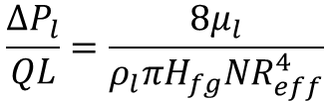

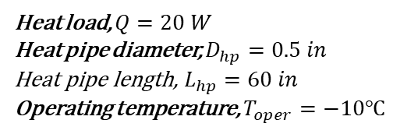

Liquid Flow in the Grooves
The liquid in the grooves flows back to the evaporator by capillary pumping.
The flow is laminar.
Calculating the Liquid Pressure Drop
Find the liquid pressure drop per watt per unit length at the operating temperature for selected heat pipe diameter
Calculate the liquid pressure drop
$$\frac{{∆P}_{l}}{QL}=\frac{8μ_{l}}{ρ_{l}πH_{fg}NR_{eff}^{4}}$$
R_{eff} = 2 · Flow Area / Wetted Perimeter
N – number of grooves
Q – heat load
Heat load, $Q=20 W$
Heat pipe diameter, $D_{hp}=0.5 in$
Heat pipe length, $L_{hp}=60 in$
Operating temperature, $T_{oper}=−10℃$
$$\frac{∆P_{l}}{QL}=0.032 \frac{Pa}{W in}$$
$${∆P}_{l}=0.032\frac{Pa}{W in}∙60in∙20 W=38.4 Pa$$

Slide 21

Gravitational Impact
Axial groove heat pipe operation is affected by gravity
Gravity Assisted
Reflux mode
2. Gravity Neutral
3. Against Gravity
Adverse tilt
Condenser
Evaporator
Condenser
Evaporator
Evaporator
Condenser
Gravity helps liquid to flow back to the evaporator
Gravity impact is minimal
Gravity creates resistance for the liquid flow
The pressure difference due to hydrostatic head of the liquid is equal to:
ΔP_{g} = ρ_{l} g h_{hp} – general formula
where ρ_{l} – the liquid density
g – the gravity acceleration
h_{hp} – the height difference between heat pipe ends
Evap
Evap
h_{hp}
h_{hp}
Cond
Cond
ΔP_{g} = ρ_{l} g L_{hp} sin φ – straight heat pipe formula
where L_{hp} – the heat pipe length
φ – the heat pipe tilt angle
h_{hp}
φ

Slide 22
Pressure Balance in the Heat Pipe
The total pressure drop in a heat pipe is a sum of three components:
  Pressure drop in the vapor flow from the evaporator to the condenser, ΔP_{v}
  Pressure drop in the liquid flow to return liquid back to the evaporator, ΔP_{l}
  The gravitational head, ΔP_{g}
The maximum capillary pumping head (ΔP_{c} )_{max} must be greater than the total pressure drop in the heat pipe.
If this condition is not met, a dry out will occur in the evaporator and heat pipe operation will be ceased.
(ΔP_{c} )_{max} ≥ ΔP_{v} + ΔP_{l} + ΔP_{g}

Slide 23
Pressure Distribution in a Heat Pipe
In most cases vapor pressure drop is much smaller than liquid pressure drop.
Gravity affects the total pressure drop and the heat transport capacity.
Evaporator
Adiabatic Section
Condenser
Vapor
ΔP_{vap}
ΔP_{tot}
ΔP_{cap}
Gravity Assisted
Pressure
0-g
ΔP_{liq}
Against Gravity
Liquid
Location

Slide 24
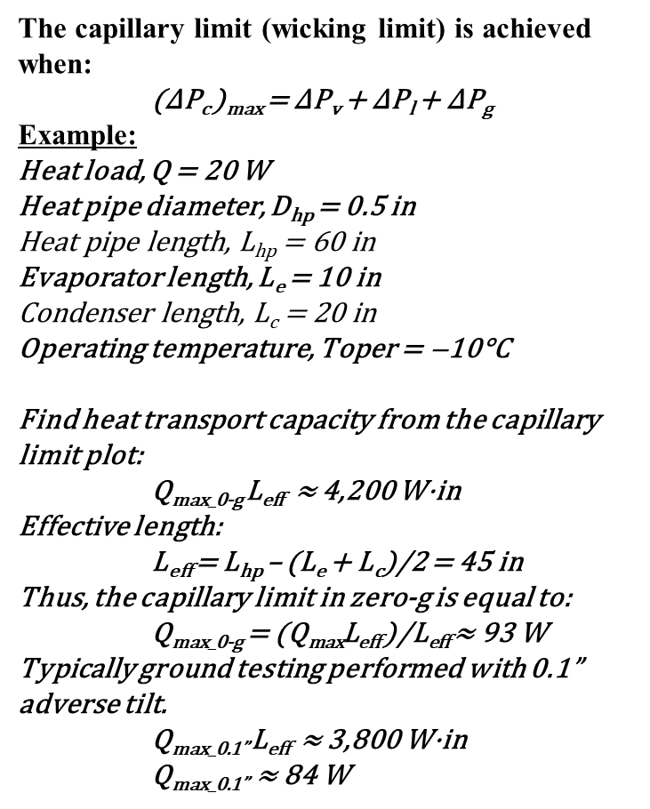
Capillary Limit
The capillary limit (wicking limit) is achieved when:
(ΔP_{c} )_{max} = ΔP_{v} + ΔP_{l} + ΔP_{g}
Example:
Heat load, Q = 20 W
Heat pipe diameter, D_{hp} = 0.5 in
Heat pipe length, L_{hp} = 60 in
Evaporator length, L_{e} = 10 in
Condenser length, L_{c} = 20 in
Operating temperature, Toper = ̶ 10°C
Find heat transport capacity from the capillary limit plot:
Q_{max_0-g} L_{eff} ≈ 4,200 W·in
Effective length:
L_{eff} = L_{hp} – (L_{e} + L_{c})/2 = 45 in
Thus, the capillary limit in zero-g is equal to:
Q_{max_0-g} = (Q_{max}L_{eff} )/L_{eff} ≈ 93 W
Typically ground testing performed with 0.1” adverse tilt.
Q_{max_0.1”} L_{eff} ≈ 3,800 W·in
Q_{max_0.1”} ≈ 84 W

Slide 25
Heat Transport Limits
Heat transport limits:
Capillary limit
Sonic limit
Boiling limit
Entrainment limit
Low pressure limit (Viscous limit)
The heat transport in most cases is limited by capillary pumping pressure.

Slide 26
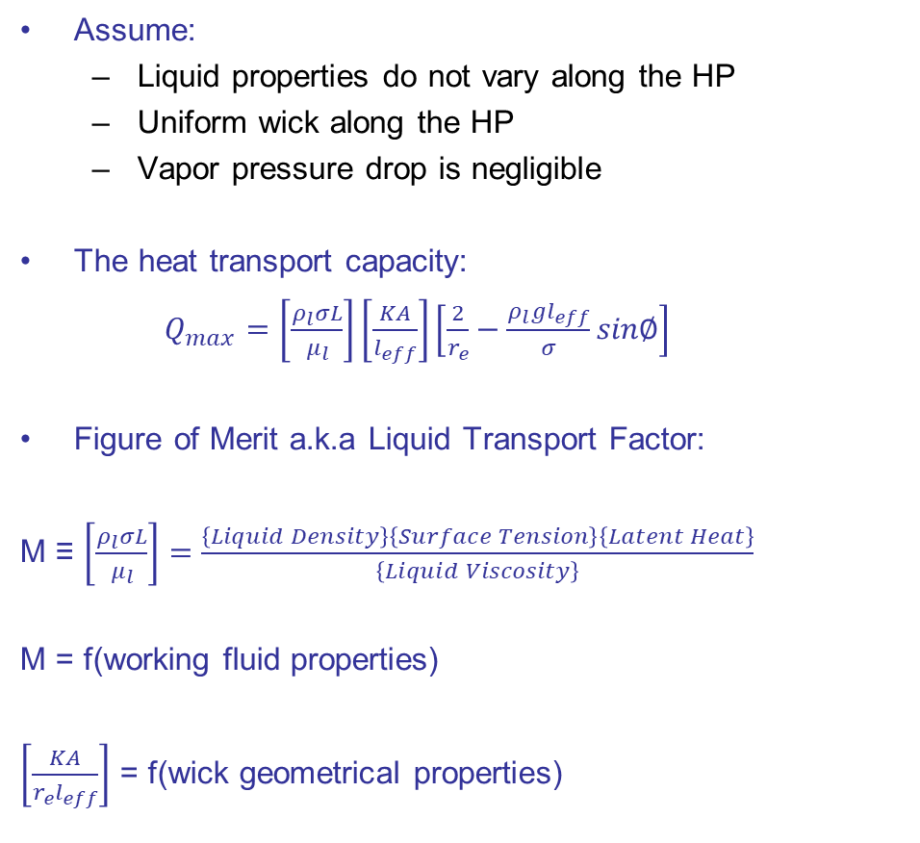
Capillary Limit and Liquid Transport Factor
Higher value → higher power capacity
Assume:
  Liquid properties do not vary along the HP
  Uniform wick along the HP
  Vapor pressure drop is negligible
The heat transport capacity:
$Q_{max}=\left[\frac{ρ_{l}σL}{μ_{l}}\right]\left[\frac{KA}{l_{eff}}\right]\left[\frac{2}{r_{e}}−\frac{ρ_{l}gl_{eff}}{σ}sin∅\right]$
Figure of Merit a.k.a Liquid Transport Factor:
M ≡ $\left[\frac{ρ_{l}σL}{μ_{l}}\right]=\frac{\left\{Liquid Density\right\}\left\{Surface Tension\right\}\left\{Latent Heat\right\}}{\left\{Liquid Viscosity\right\}}$
M = f(working fluid properties)
$\left[\frac{KA}{{r_{e}l}_{eff}}\right]$ = f(wick geometrical properties)

Slide 27
Working Fluids for Two-Phase Systems
Working Fluid | Chemical Formula | Triple Point Temp. |  |  | Critical Temp. |  |  | Critical Pressure
 |  | K | °C | F | K | °C | F | MPa | Atm | PSI
Helium | He | 1.46 | -272 | -457 | 5.19 | -268 | -450 | 0.2 | 2.2 | 33
Hydrogen | H₂ | 13.8 | -259 | -435 | 33.2 | -240 | -400 | 1.3 | 13 | 189
Neon | Ne | 24.6 | -249 | -415 | 44.4 | -229 | -380 | 2.8 | 27 | 400
Oxygen | O₂ | 54.4 | -219 | -362 | 155 | -119 | -181 | 5.1 | 50 | 732
Nitrogen | N₂ | 63.2 | -210 | -346 | 126 | -147 | -233 | 3.4 | 33 | 492
Propylene | C₃H₆ | 86.9 | -186 | -303 | 366 | 92 | 198 | 4.7 | 46 | 677
Ethane | C₂H₆ | 89.9 | -183 | -298 | 305 | 32 | 90 | 4.9 | 48 | 711
Methane | CH₄ | 90.7 | -182 | -296 | 191 | -83 | -117 | 4.6 | 45 | 666
Ethylene | C₂H₄ | 104 | -169 | -272 | 366 | 92 | 198 | 4.7 | 46 | 677
Ethanol | C₂H₅OH | 150 | -123 | -190 | 514 | 241 | 466 | 6.3 | 62 | 914
R134a | CH₂FCF₃ | 170 | -103 | -154 | 101 | -172 | -278 | 4.1 | 40 | 589
Methanol | CH₃OH | 176 | -98 | -144 | 513 | 240 | 464 | 8.1 | 80 | 1175
Acetone | C₃H₆O | 179 | -95 | -138 | 508 | 235 | 455 | 4.8 | 47 | 696
Ammonia | NH₃ | 195 | -78 | -108 | 406 | 132 | 270 | 11 | 111 | 1636
Water | H₂O | 273 | 0.01 | 32 | 647 | 374 | 705 | 22 | 218 | 3200
Potassium | K | 336 | 63 | 146 | 2223 | 1950 | 3542 | 16 | 158 | 2321
Sodium | Na | 371 | 98 | 208 | 2573 | 2300 | 4172 | 35 | 345 | 5076
The operating temperature range is narrower than the saturation temperature range.

Slide 28
Heat of Vaporization
Ammonia and propylene are the most commonly utilized fluids in two-phase thermal control systems for space applications.
  Higher power → ammonia
  Lower minimum operating (survival) temperature → propylene
Triple Point Temperatures
-186℃ -78℃
Critical Temperatures
92℃ 132℃
Ammonia
Propylene

Slide 29
Maximum Heat Flux
The maximum heat flux or the maximum heat load per unit length is affected by:
Heat pipe orientation in 1G.
Evaporator length.
  Lengths of the adiabatic section and condenser also affect the maximum heat flux, but to a lesser extent.
Heat pipe size (outside diameter).
Operating temperature.
Internal geometry.
Fluid charge.
The values in this table are recommended as a starting point.
Parameter | Heat Pipe OD, in
 | 3/8 | 1/2 | 5/8
Max heat load per linear inch (1-sided heat load), W/in | 10 | 13 | 16
Max heat load per linear inch (2-sided heat load), W/in | 13 | 17 | 23

Slide 30
Why Axial Grooved Heat Pipes?
Axial grooved HPs are very popular for space applications due to:
  Simplicity.
  Passive operation.
  Reliability.
  High heat transport capacity.
  High thermal conductance.
  Versatility
  Space flight heritage.

Slide 31
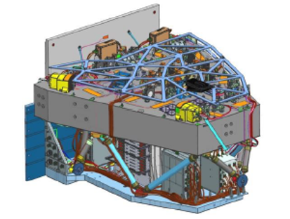
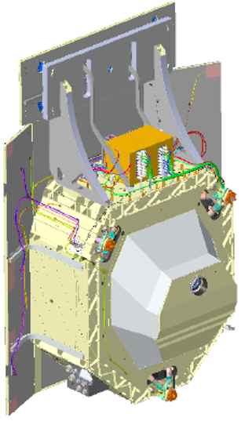
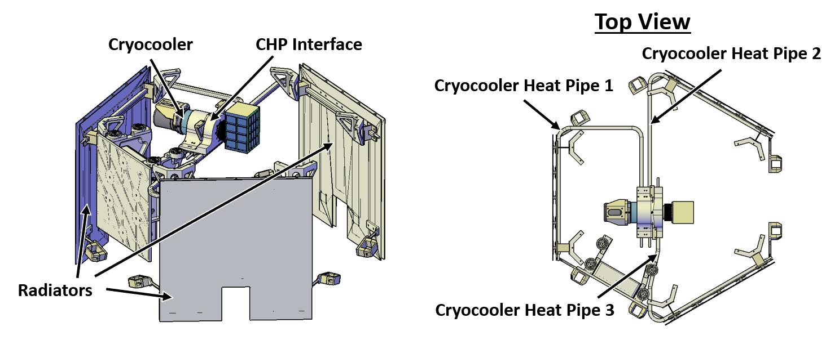
Axial Grooved Heat Pipes in Current Programs
RST WFI
RST CGI
Radiator with embedded CCHPs
Transport CCHPs Connect Pallet and Radiator (not vsible)
Pallet with Embedded CCHPs
COSI SMEX

Slide 32
Constant Conductance Heat Pipes
What is conductance?
  Conductance (thermal conductance) is an engineering term used to characterize the amount of heat transferred by TPS for a given end-to-end temperature drop.
  During steady-state operation conductance is the ratio of heat load to the temperature drop across the heat pipe:
    Q/ΔT = {Heat Load / Temperature Drop}
    Commonly used units [W/K], [W/ºC].
    Commonly used symbol: C = Q/ΔT
    The inverse is called thermal resistance [K/W], [ºC/W].
Constant Conductance means proportionality of heat load and temperature drop
  Doubling Q will result in doubling ΔT.
The CCHP term frequently used to refer to the axial grooved heat pipes and rarely used for the other types of CCHPs.
Temperature Drop,
ΔT (ºC)
Constant Conductance
Heat Load, Q (W)

Slide 33
When to Consider Heat Pipes?
Transport heat from one location to another.
  When solid conductors cannot meet your requirements.
  Example: a spacecraft instrument generates 5W of heat and it is located one meter from the radiator panel.
Provide heat spreading for high heat flux applications.
  Without heat spreading the surface/component would be damaged (melted).
  Example: leading edge of the reentry vehicle.
Create isothermal condition.
  Temperature uniformity provides substantial benefits.
  Example: radiator panel size can be reduced when its temperature is uniform
Note: In many applications heat pipes are used for more than one purpose listed above.

Slide 34
When a Heat Pipe is NOT the Best Choice
Short heat transport distance
  less than 1 inch (< 25 mm)
Solid aluminum or copper (pyrolytic graphite in some cases) “will do the job” or meet all requirements, such as:
  Thermal conductance
  Weight and size
  Price
  Delivery
Other factors could lead to an alternative solution. For example:
  High radiation dose
    HP performance degrades from radiation exposure.
  Freezing of the working fluid could be a problem.
  High temperature survival can be a problem too due to excessive internal pressure
  Wide operating temperature range
    Operating temperature range for each fluid is narrower than saturation temperature range (from freezing to critical temperature)

Slide 35
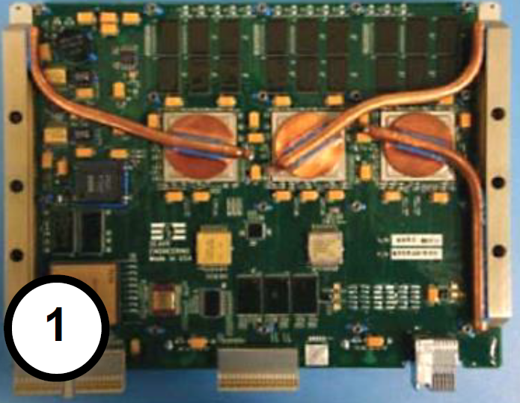
Other Types of CCHPs
CCHPs can be classified by the wick structure and cross-sectional geometry:
  Sintered powder metal wick HPs
    These types of HPs primarily used for terrestrial applications
    Production rate: hundreds of thousands per day!
      vs. tens of thousands per year for the axial grooved HPs.
      The most commonly used materials copper and water.
  Screen wick HPs (see Ref. 1 – 6)
    Screen Wick HPs
  Arterial HPs (see Ref. 1 – 6)
    Arterial HPs
  Hybrid wicks (see Ref. 1 – 6)
    Hybrid Wick HPs
  Oscillating HPs
    Typically do not contain a wick structure
Copper-water CCHPs for space

Slide 36
Copper-Water HPs vs. Aluminum-Ammonia HPs
Parameter | Copper – Water Sintered Powder Wick Heat Pipes | Aluminum – Ammonia Axial Grooved Heat Pipes
Length, mm | from 100 to 500 | from 200 to 2,000
Diameter, mm | from 2 to 25 | from 5 to 20
Maximum Heat Flux, W/cm² | > 100 | < 10
Operating Temperature | from + 30ºC to + 200ºC | from – 60ºC to + 60ºC
Min. Survival Temperature | < – 200ºC | – 77ºC (Ammonia freezing)
Max. Survival Temperature | + 200ºC | + 80ºC (depends on HP OD)
Freezing of the working fluid | Cu/H₂O HPs can survive freezing | Shall be avoided
Freeze-thaw cycling | > 1,650 cycles | N/A
Operation against gravity | up to 400 mm (typically > 200 mm) | < 40 mm (typ. < 20 mm)
Flexing HP during installation | Several mm (depends on HP OD) | Shall be avoided
Boiling tolerance | High | Low
The values are typical for electronics cooling applications.
Some designs may demonstrate performance exceeding the values listed in this table.

Slide 37
Vapor Chambers
A Vapor Chamber (VC) is essentially a heat pipe produced in a 2D or 3D shape/form to accommodate a particular application.
Typically VCs can handle higher heat fluxes than round HPs.
Round Heat Pipe
Flattened Heat Pipe
3D Vapor Chamber
2D Vapor Chamber

Slide 38
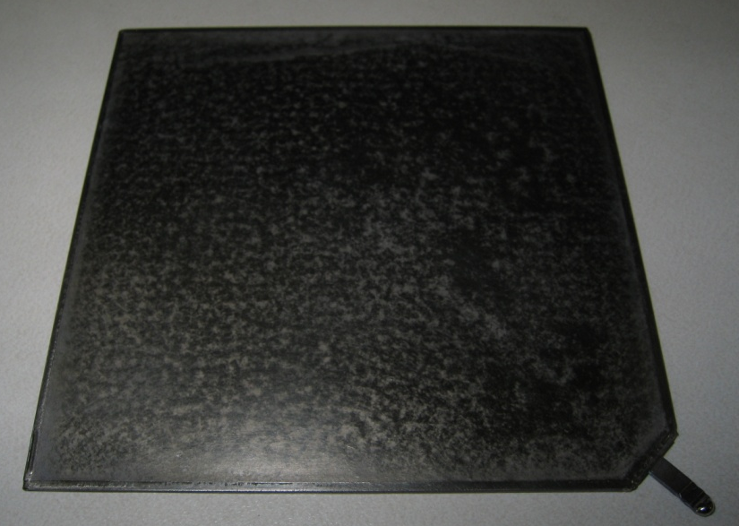
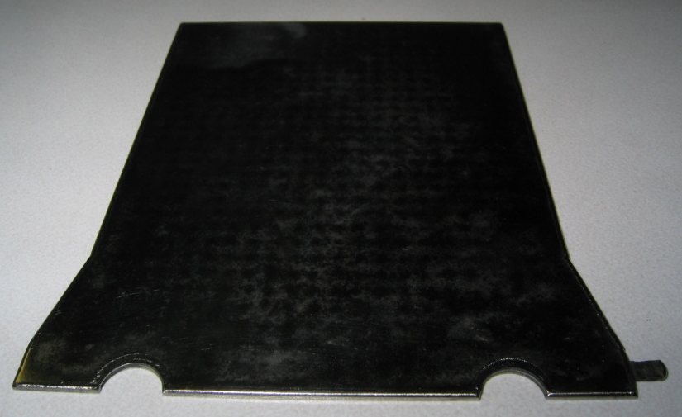
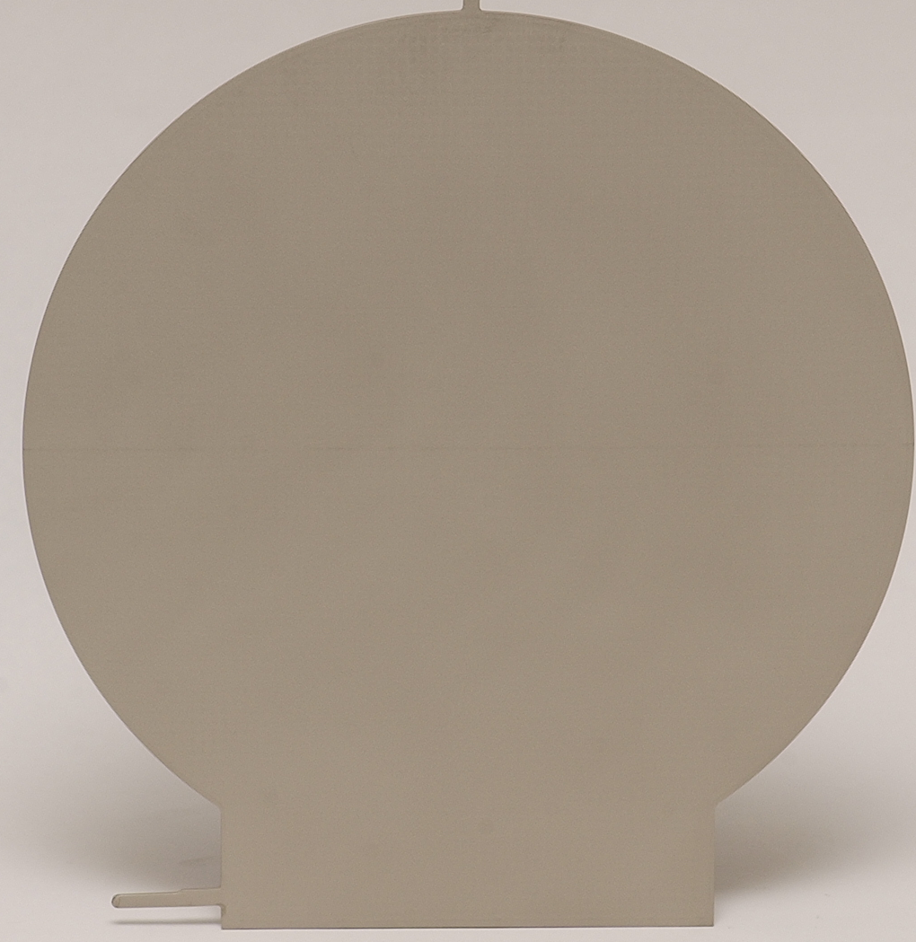
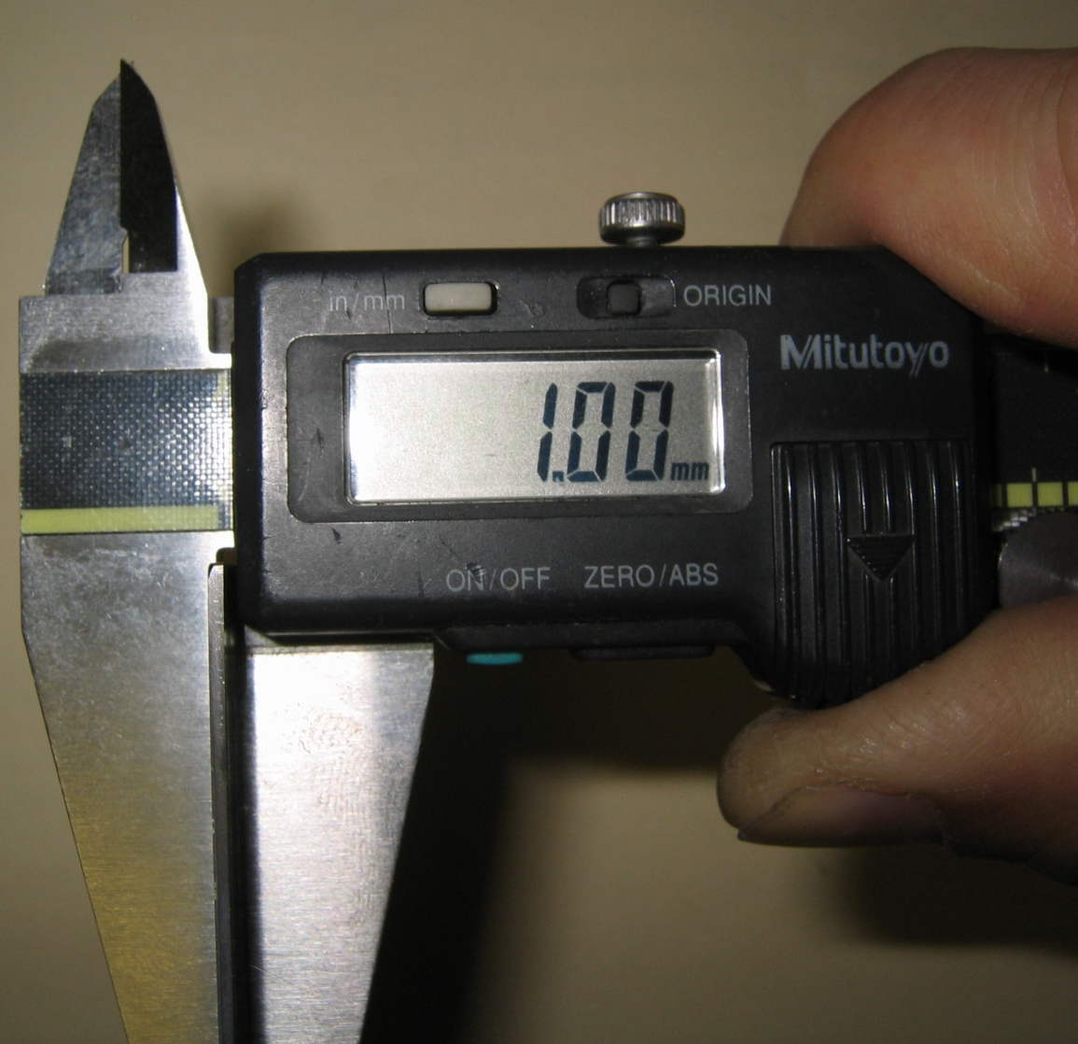
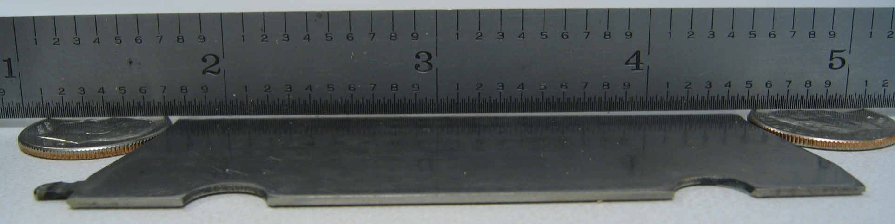
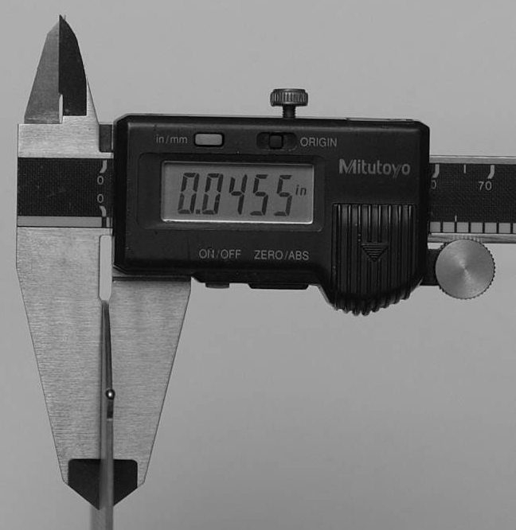
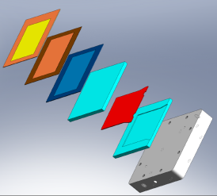
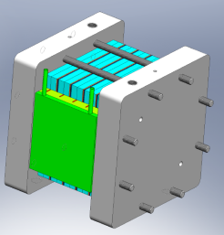
Titanium Vapor Chambers for Space Applications
4” by 4” demo HP 2” by 3” HP for small fuel cell 5.5” diameter Phase I SBIR
Stack of Titanium Vapor Chambers for Fuel Cell Cooling Phase II SBIR
Titanium water heat pipe

Slide 39
Oscillating Heat Pipes
Construction
Typically no wick
Small diameter channels
Partially filled with liquid
Simple construction
Operation
Oscillatory motion of slugs
Non-equilibrium pressure
Pulsating motion of slugs
Heat transfer by convection and phase change
Adiabatic Section
Condenser
Evaporator
Vapor Slugs
Luquid Slugs

Slide 40
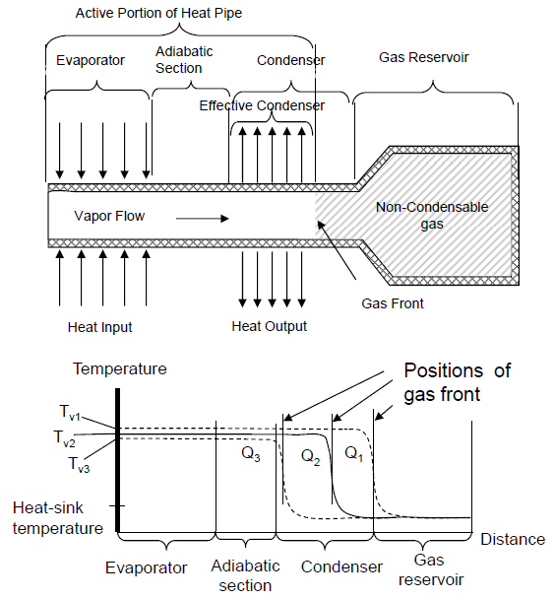
Variable Conductance Heat Pipes (VCHPs)
Q = h_{c}πDL_{c}(T_{v,a} -T_{sink})
L_{c} varies with T_{sink} and Q to keep T_{v,a} constant
h_{c}πDL_{c} = variable conductance
Reservoir size is a function of:
  Range of heat load
  Range of sink temperature
  Temperature control requirement

Slide 41
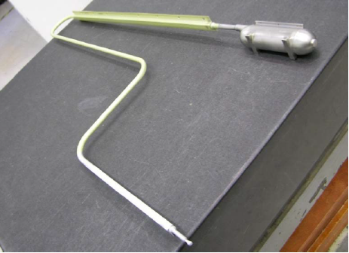
VCHPs
Types of VCHPs
  Passive VCHP
  Feedback-controlled VCHP
    Active control with heaters on reservoir.
  Pressure Controlled HPs (PCHPs)
    Active control of the reservoir volume/size
  Cold gas reservoir VCHPs
  Hot gas reservoir VCHPs
OCO-2 VCHP

Slide 42
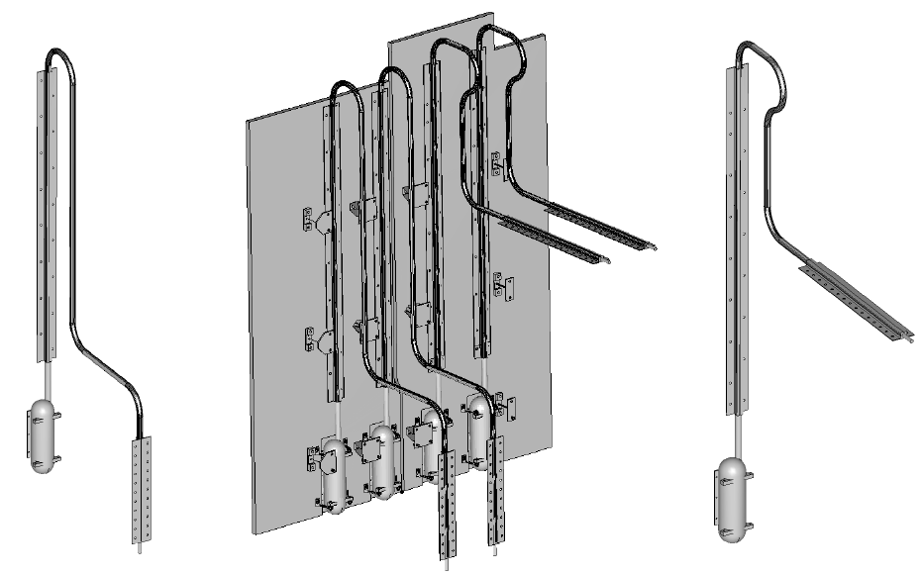
Orbiting Carbon Observatory–2 (OCO-2) VCHPs

Slide 43
Diode Heat Pipes
Diode HPs operate as HPs in one direction only.
  They still transfer heat in the opposite direction due to conduction along HP wall and wick.
The most common diode HPs are:
  Liquid trap diode
  Liquid-blockage diode
  Gas-blockage diode

Slide 44


Liquid Trap Diode
Normal Operation
Saturated Wick
Dry Wick
Reservoir
Evaporator
Condenser
Heat in
Heat out
Heat in
Non-Operating State
Saturated Wick
Dry Wick
Reservoir
“Evaporator”
“Condenser”
Heat out
Heat out
Heat in

Slide 45
Liquid-Blockage Diode
Reservoir
Normal Operation
Saturated Wick
Condenser
Evaporator
Heat out
Heat in
Heat out
Non-Operating State
“Evaporator”
Dry Wick
Reservoir
“Condenser”
Heat in
Liquid Blockage
Heat out
Heat in

Slide 46

Gas-Blockage Diode
Normal Operation
Saturated Wick
Blocking Gas Reservoir
Condenser
Evaporator
Heat out
Heat in
Heat out
Non-Operating State
Empty Reservoir
Evaporator
Reservoir
Condenser
Heat in
Gas Blockage
Heat out
Heat in

Slide 47
More about Heat Pipes
The heat pipe is an isothermalizer.
– A single heat pipe can serve multiple heat sources and/or multiple heat sinks.
– The vapor temperature is nearly isothermal.
The heat pipe can be bent.
– Small degradation in heat transport limit
Although the heat pipe can transport hundreds of watts over many feet of distance, it has a very limited wicking capability, i.e. the total pressure drop it can sustain is small.
– Example: no more than 0.5” adverse elevation using ammonia as the working fluid (< 100 Pa) in one-G environment.
– Ground testing of a heat pipe requires that the heat pipe be placed horizontally with < 0.2” adverse elevation.
When the heat pipe operates under a favorable elevation, liquid puddle may form at the evaporator end.

Slide 48
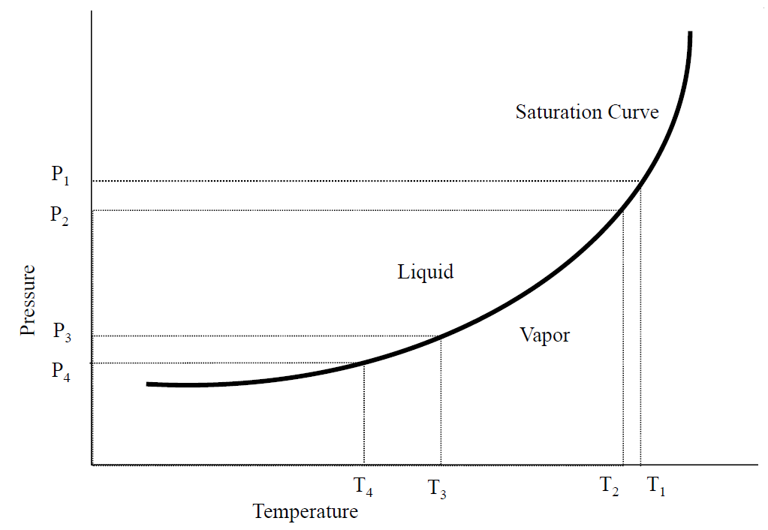
Heat Pipe Temperature Drop vs Operating Temperature
Higher operating temperature → smaller temperature drop and better thermal conductance
Challenges associated with operating a heat pipe near freezing point:
  Large temperature gradient due to:
    Saturation curve is not steep
    Effect of non-condensable gas
  Low vapor pressure
Challenges associated with operating a heat pipe near critical temperature:
  Low surface tension
  Low heat of vaporization

Slide 49
Generic Steps to Determine Heat Pipe
Determine the operating temperature range
Select the working fluid
– Liquid transport factor
– Avoid operation near the freezing poin or the critical temperature of the working fluid.
Select the container material.
– Material compatibility
– Structural strength
Select the wick.
– Material
– Shape
From the thermal requirement, determine the type of heat pipe.
– CCHP, VCHP, Diode HP
Determine the heat pipe diameter and length, and number of heat pipes.
– Temperature drop across the heat pipe
– Temperature gradient requirement
– Some computer models available

Slide 50
Design Cosiderations – 1
Heat pipe theory
Physical, thermal, and mechanical constraints
Material properties
Application requirements
Fabrication, processing, and testing limitations
Reliability and safety

Slide 51
Design Cosiderations – 2
Once the performance requirements and specifications are defined, the design and evaluation process can be initiated.
Three Basic Consideration
– Working fluid
– Wick design
– Container (envelope)
Several options may exist.
The final design usually represents an iteration among various design factors.

Slide 52
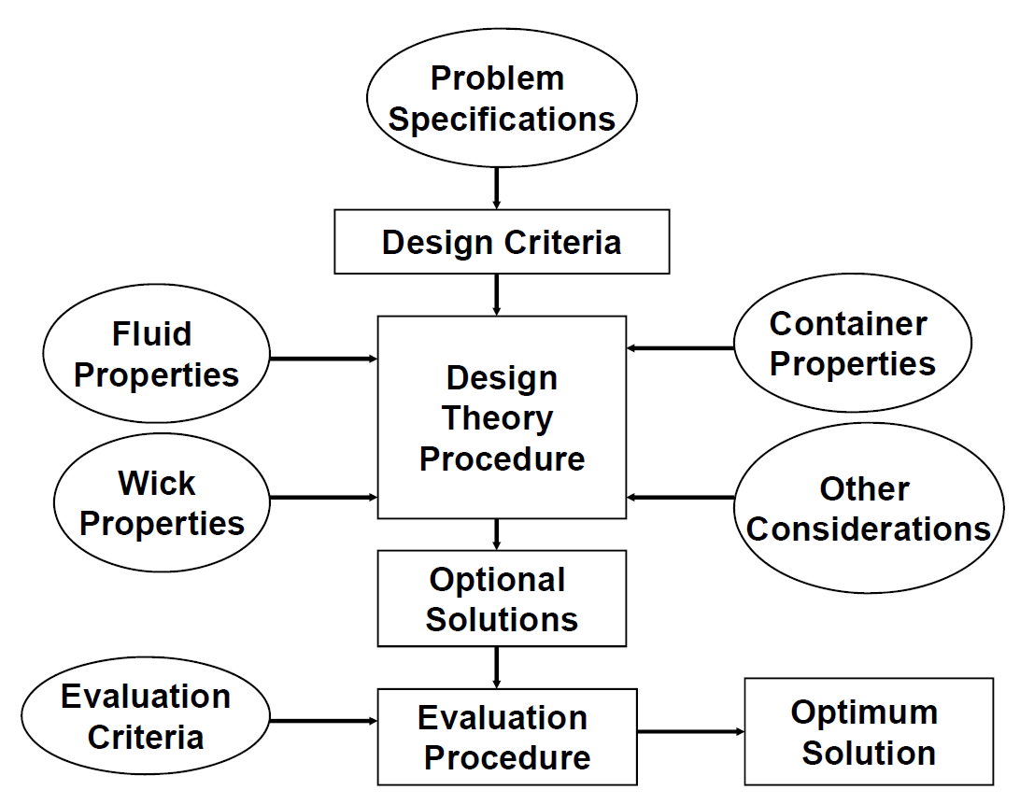
Major Elements of the Heat Pipe Design Process

Slide 53
How Requirements Impact the Design
Requirement | Impact on Design
Operating temperature range | Choice of working fluid; Pressure retention
Thermal load | Heat pipe diameter; No. of heat pipes; Wick design; Choice of working fluid
Transport length | Wick design
Temperature uniformity and overall ΔT | Wick design; Conductive path length trade-off; Heat pipe geometry
Physical requirements | Size, Weight, Structural strength and geometry
Acceptance and qualification testing | “one-G’ operation and “zero-G” correlation
Ground testing | Orientation
Dynamic environment | Operation under accelerating field; Structural integrity
Thermal environment | Pressure retention under non-operating temperatures
Mechanical interfacing | Mounting provisions; Provision for thermal interfacing
Man Rating | Pressure vessel code; Fluid toxicity
Transient behavior | Choice of working fluid; Wick design; Variable conductance type
Reliability | Leak tightness; Material compatibility; Processing control; Redundancy

Slide 54
Working Fluid
Variety of fluid possible - selection determined by applications:
– Operating temperature, capacity, safety, etc.
Must be able to exist as both vapor and liquid at the operating temperature.
– Often best to select a fluid that has its normal boiling point near desired operating temperature.
Use the liquid transport factor as the figure of merit.
Purity of the working fluid is critical (99.999%).
– Impurities reduce performance and may lead to undesirable NCG buildup.
Compatibility with other materials in the heat pipe.
Operating pressure
Wicking capability in body-force field
Liquid thermal conductivity
Vapor phase properties

Slide 55
Operating Temperature Ranges
Cryogenic
– below 120K (< -153ºC)
– Elemental or simple organic compounds
Low Temperature
– 120K to 400K (-153ºC to 127ºC)
– Polar molecules or halocarbons
High Temperature
– over 400K (> 127ºC)
– Liquid metals

Slide 56
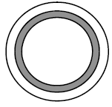
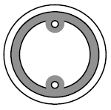


Heat Pipe Wicks
Provides capillary pumping head.
Provides porous media for liquid transport.
Variety of design possibilities exist.
– Axial groove (most common)
– Screen
– Sintered powder
– Arteries
– Composites
Small uniform pore size is desirable.
– Compromise with a goal for high permeability
Screen or sintered metal powder wick
Sintered metal powder wick with arteries
Slab wick
Axial grooves

Slide 57
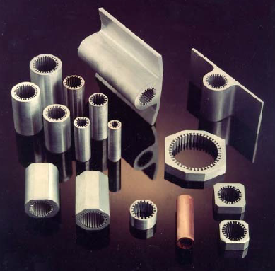
Extrusion Profiles
Features:
Number of grooves:
  8 to 50 typical
Groove shapes:
  Rectangular
  Trapezoidal
  Omega (re-entrant)
Wall thickness
  .016” to .050” typ.
Flanges
  0, 1, 2, 4, 8
0
1
2
4
8

Slide 58
Heat Pipe Envelope Material
Typically a metal tube tightly sealed at both ends
A variety of shapes, sizes, and configurations exist.
Basic design considerations
– Structure integrity and leak tight containment
– Compatibility with working fluid and external environment
– Internal size and geometry for liquid and vapor flow requirements
– External interface with heat sources and sinks
– Fabrication concerns
– Heat transfer concerns

Slide 59
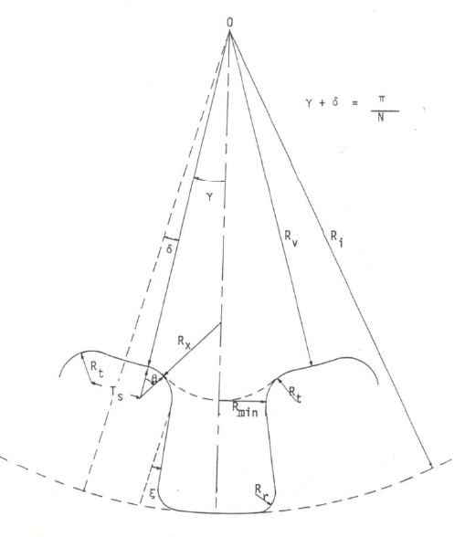

Working Fluid Inventory
Liquid charge must be sufficient to saturate the wick.
  Performance degrades with improper charge.
    Undercharge: reduced heat transport capability
    Overcharge: liquid puddle in the condenser
The optimal inventory will be determined based on operating conditions.

Slide 60
Fabrication and Testing
Cleaning and material compatibility are critical. Must develop and follow tight cleaning procedures.
Proper level of fluid charge is important.
Component and system level tests
– In-process
– Proof pressure
– Burst
– Leak
– Performance - vary tilt to develop performance map
Rigid requirements for space applications
– MIL-STD1522A (USAF)
– NSTS-1700.7B (NASA)

Slide 61
Heat Pipe Selection
Determine the operating temperature range.
Select the working fluid.
Select the wick and container material.
Obtain performance curves for various heat pipes from vendors.
From the thermal requirements, determine the type of heat pipe.
– CCHP, VCHP, Diode HP
Determine the heat pipe diameter, length and number of heat pipes.
– Overall temperature drop from heat source to heat sink
– Temperature gradient requirement
– Temperature uniformity requirement
– Physical constraints – diameter and shape of heat pipes
– Mass constraints
– Design margins
– Cost
Ground test requirement at the instrument and spacecraft level

Slide 62
Heat Pipes with 3D Bents
3-D heat pipes cannot be tested in one-G for its performance verification.
For design qualifications, an equivalent 2-D heat pipe can be made with same number of bends, same degree of bend for each bend, and same segment lengths, and test for its performance.
For acceptance test, the 3-D pipes may be tested in segments.
– Adequate for axially-grooved heat pipes which have uniform grooves.
– Inadequate for slab wick heat pipes.

Slide 63
Dual Bore Heat Pipes
Some reasons to use dual bore heat pipes
– Redundancy
– Reduce heat flux and temperature gradient between the heat source and the heat pipe
– HP can serve as structural member
For qualification test, each bore is charged and tested separately.
For acceptance test, both pipes are tested together – cannot tell whether one of them fails.
For charging, one bore is charged first, then the other.
Performance such as the heat transport, heat flux, thermal conductance, liquid slug and NCG can only be done for both heat pipes on the “average” basis.
Dual bore heat pipes are more difficult to bend.

Slide 64
Ground Testing in Reflux Mode
It may be necessary to test heat pipes in a reflux mode during instrument or spacecraft level testing
Liquid puddle will form at the evaporator which is below the condenser.
Liquid may not boil to generate vapor unless a superheat is exceeded at the evaporator.
To facilitate the ground testing, some concentrated heater can be attached to the evaporator to create a high heat flux, which initiates liquid boiling.

Slide 65
Abbreviations
AGHP – Axial Grooved Heat Pipe
CCHP – Constant Conductance Heat Pipe
CLHP – Cryogenic Loop Heat Pipe
CPL – Capillary Pumped Loop
HEX – Heat Exchanger
HP – Heat Pipe
LEO – Low Earth Orbit
LHP – Loop Heat Pipe
OHP – Oscillating Heat Pipe
PHP – Pulsating Heat Pipes
SC – Spacecraft
TCS – Thermal Control System
TPS – Two-Phase System
TRL – Technical Readiness Level
VC – Vapor Chamber
VCHP – Variable Conductance Heat Pipe

Slide 66
References
Gilmore D. G., Spacecraft Thermal Control Handbook, Volume 1: Fundamental Technologies, 2nd ed. 2002
Chi S. W., Heat pipe theory and practice: a sourcebook, 1976
Reay D. A., Heat pipes : theory, design and applications, 2014
Karam R. D., Satellite thermal control for systems engineers, 1998
Faghri A. Heat pipe science and technology, 2nd edition, 2016
Zohuri B. Heat Pipe Design and Technology: Modern Applications for Practical Thermal Management, 2nd edition, 2016
D. Khrustalev, A. Faghri, “Thermal Characteristics of Conventional and Flat Miniature Axially-Grooved Heat Pipes,” Journal of Heat Transfer, Vol. 117, 1995
D. Khrustalev and A. Faghri, “High Flux Evaporative Mini-Channel Heat Sink With Axial Capillary Grooves,” Journal of Enhanced Heat Transfer, Vol. 3, No 3, 1996
R. Hopkins, A. Faghri, D. Khrustalev, “Flat Miniature Heat Pipes With Micro Capillary Grooves,” Journal of Heat Transfer, Vol. 121, 1999
D. Khrustalev and A. Faghri, “Coupled Liquid and Vapor Flow in Miniature Passages With Micro Grooves,” Journal of Heat Transfer, Vol. 121, 1999
Semenov S. Y., Sizing an Aluminum – Ammonia Axial Grooves Heat Pipe, in Proceedings of 2019 Spacecraft Thermal Control Workshop
Semenov S. Y., Thayer J. G., Gernert N. J., Design Considerations When Using Copper – Water Heat Pipes for Space Applications, in proceedings of 2018 Spacecraft Thermal Control Workshop
Jentung Ku, Capillary Two-Phase Thermal Devices for Space Applications, April 2016
Jentung Ku, Introduction to Loop Heat Pipes, TFAWS, 2015

