Slide 1

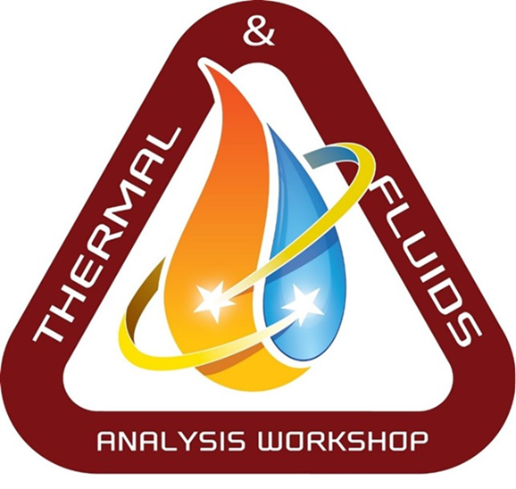
Thermal Hardware Introduction
David Steinfeld
NASA Goddard/ Code 545
TFAWS Passive Thermal Paper Session
Presented By
David Steinfeld
Thermal & Fluids Analysis Workshop
TFAWS 2023
August 21-25, 2023
NASA Goddard Space Flight Center
College Park, MD

Slide 2
David’s Bio
Education:
  Georgia Tech
    1985 Bachelors Degree Mechanical Engineering
  University of Texas, Arlington
    1989 Masters Degree Aerospace Engineering
Employment:
  1985-1999: LTV Aerospace and Defense, Dallas TX
    Space Shuttle Carbon-Carbon Leading Edges Reentry heating
    Space Station (ISS) Radiators (HRS, Photovoltaic, Solar Dynamic)
  1999-Pres: NASA Goddard Space Flight Center, Greenbelt, MD
    Chief Engineer Thermal Engineering Branch
    Worked many space missions, including Hubble Telescope and its servicing missions, Triana, SDO, LRO, MMS, STEREO, LUCY, Landsat-9, ExoMars/MOMA, DAVINCI, Dragonfly/DraMS

Slide 3
Topics
MLI Blanketing Theory 101
MLI blanketing installation
Temperature Measurements
Heaters and Thermostats
Optical coatings (Paints and tapes)
Interface Conductance and Gap fillers
Ordering Flight Hardware
Louvers

Slide 4
MLI Blanketing 101
Thermal Analyst:
“The actual MLI doesn’t look like my Thermal Desktop Model”
Blanket Tech:
“David, can you help me out? The Thermal Analyst
can’t tell me what he wants”

Slide 5
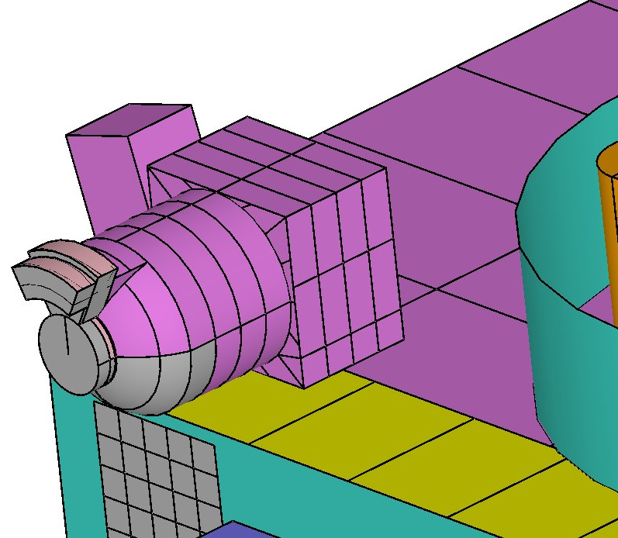
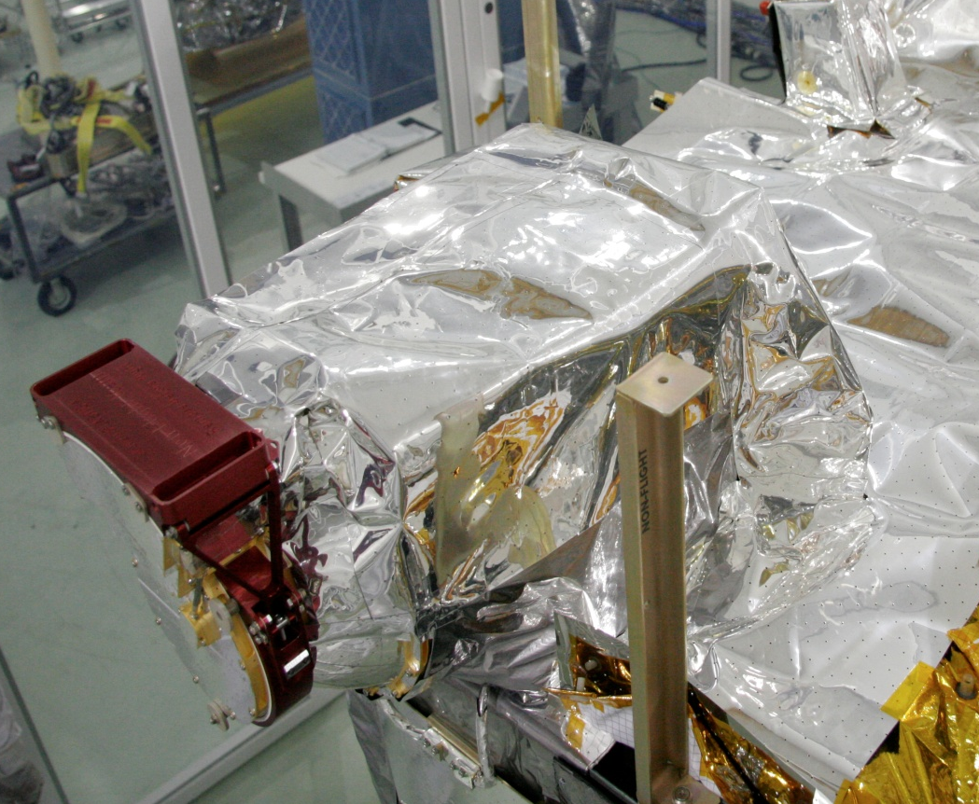
Thermal Model vs. Hardware
STEREO/PLASTIC as an example
Thermal Model
Actual MLI

Slide 6
Actual vs. Theoretical MLI Blanket
Actual MLI
Theoretical MLI

Slide 7
What effects MLI blanket ε*?
Penetrations
Ground Straps
Crinkling
Stitching
Vents
Separator layers
Tightness
Cryogenic Temperatures
Atmospheric pressure

Slide 8
What effects Optical Properties?
Emissivity usually not effected by age (BOL vs. EOL), its already high.
Alpha increases with age (BOL vs. EOL)
  It darkens
Atomic oxygen effects outer layer
  Silver Teflon needs to be 10 mil instead of 5 mil thick in LEO

Slide 9
MLI Layers Touching = Bad
For every 1 ft² blanket covering a 30^{O}C surface:
  Good MLI blanket design = 1.2 watts lost
  Smashed blanket = 38.0 watts lost

Slide 10
Stitching Effects
1 ft wide blanket
SEAM
SEAM

Slide 11
Blankets Vent or Blow Up
Air Pressure on ground
  14.7 psi
  2117 lbs per square foot.
  But pressure in Space = 0 psi.
Blankets go from Ground to Space pressure (or inside T/V chamber)
  Air around MLI goes from 14.7 psi -> 0 in about 120 seconds
MLI Blankets can only handle 0.1 psi (14.4 lbs per square foot)
Venting needed:
  Between MLI layers (or risk blowing up)
  Between MLI and underlying substrate (or risk being blown off surface)
  Eliminate Gas conduction

Slide 12
Generic Launch Pressure
Inside Fairing

Slide 13
Cryogenic Temperatures effect MLI Blankets
Emissivity shifts to the far infrared
at very cold temperatures.

Slide 14
Things Grow and Shrink
Coefficient of Thermal Expansion
  Things grow bigger when hot
  Things shrink when cold
  Aluminum shrinks/grows a lot compared to Kapton
    CTE = 0.000026 in/in ^{O}C
    72 inch Bus Panel, from -20 ^{O}C to +40 ^{O}C grows 1/8”
Blanket Buttons
MLI
Metal

Slide 15
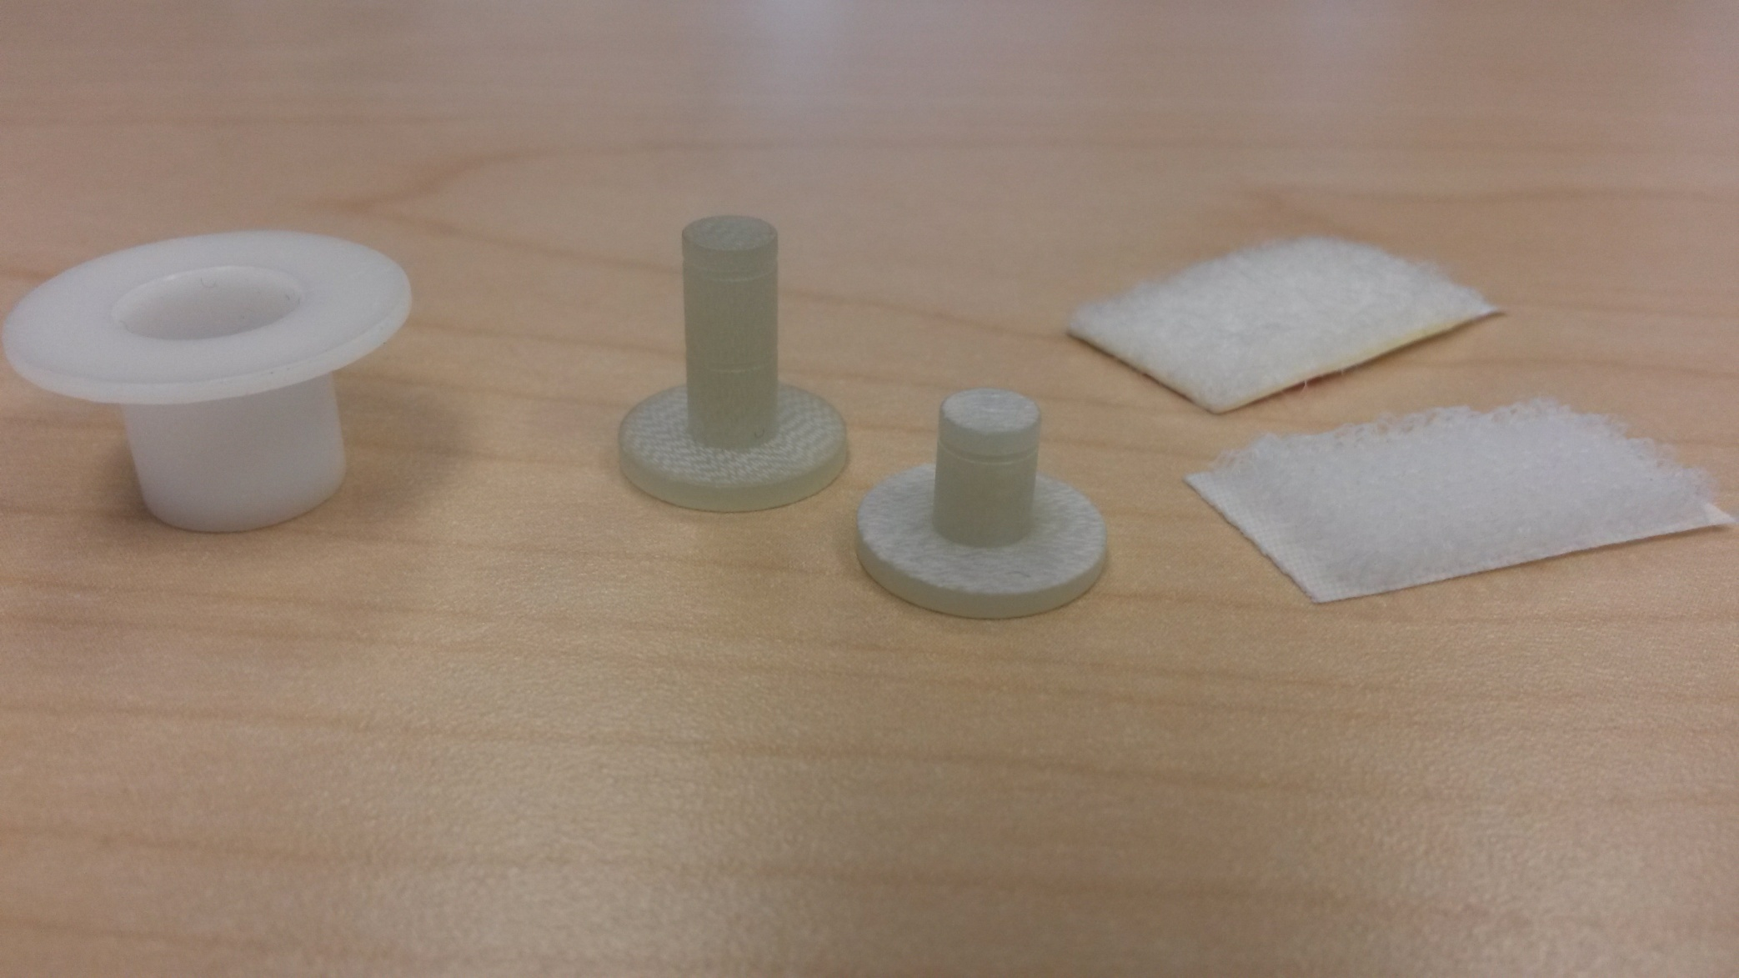
Blanket Buttons, Etc…
Top hat
Blanket buttons
Velcro

Slide 16
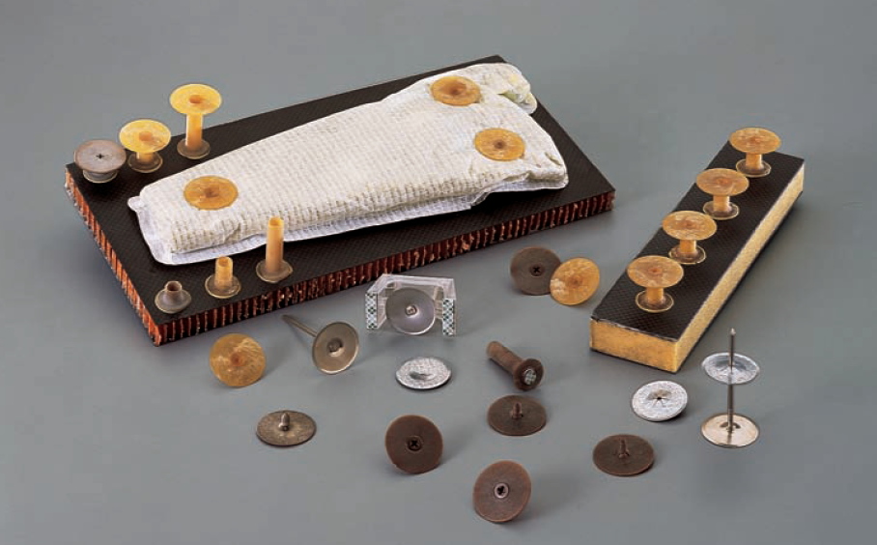
ClickBonds
(For heavier or thicker blankets)

Slide 17
Bonding Thermal Hardware
Thermofoil (Kapton) Heaters
  Under 3.5 w/in²: 3M 966 Acrylic adhesive
  Over 3.5 w/in²: Stycast 2850FT
Thermal Hardware (MLI Buttons, Thermistors, PRTs, Thermostats) bonded with Stycast 2850FT Catalyst 9
  Small bondline, so thermal resistance is low.
Polymerics license required for bonding Flight hardware.
Surface preparation is key to a good bond:
  Clean surfaces
  Abrade surfaces with sandpaper
  Vacuum, then clean surface again
  Hold down with Kapton until epoxy dries overnight.
    Think about how to handle vertical surfaces!

Slide 18
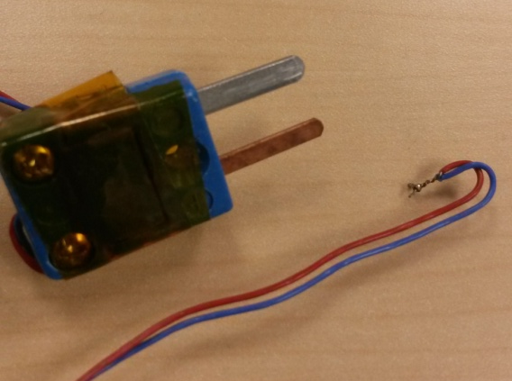
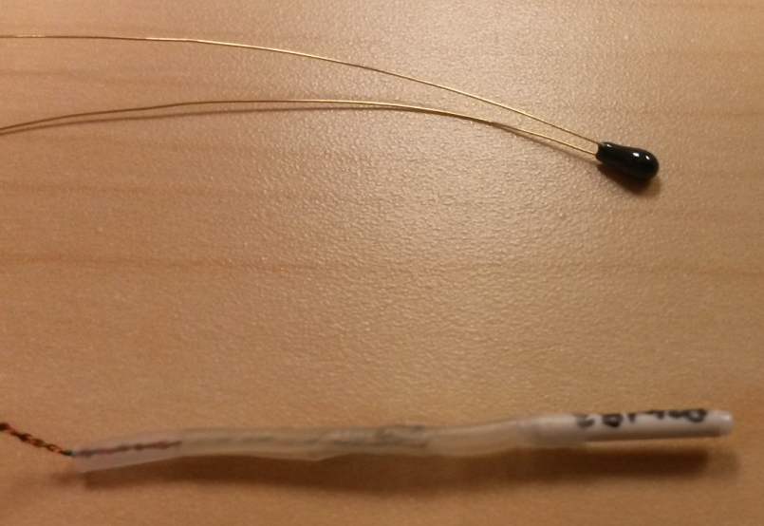
Temperature Measuring Devices
Thermocouple
  Only used for thermal vacuum testing
  Typically bought in a large length spool
    Omega Engineering a good source
  Cut to length, solder the bead
Thermistor
  Resistance of the bead changes with temperature
  Flight units bought from:
    TE Connectivity (Measurement Specialties, Inc)
    QTI (Boise, ID)
PRT
  Used for high or low (cryogenic) temperatures
  Flight units bought from:
    UTC Collins Aerospace (formerly Rosemount)
    QTI (Boise, ID)
Thermocouple
Thermistor
PRT

Slide 19
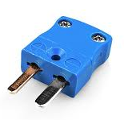
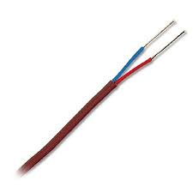
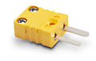
Thermocouples
Used for Thermal vacuum testing
  Not used for Flight, but sometimes may fly…
Two dissimilar metals create a voltage difference
  Seebeck Effect
  Voltage dependent on temperature
Cheap to purchase
Quick to install
  Attached with Aluminum tape
Very long lengths allowed
  75 feet not uncommon
Need complicated (expensive) electronics to read temperature
Different metal combinations:
  Type T (Red + Blue) is normal at Goddard (-200C to +350C)
    Copper-Constantan
  Type K (Red + Yellow) used for higher temps (-200C to +1250C)
    Chromel-Alumel

Slide 20
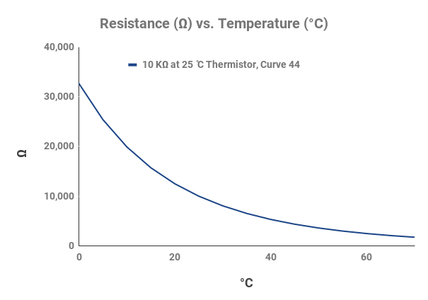
Thermistors
Resistance changes with Temperature
  Metal oxide bead material
Very non-linear response
  Negative slope curve
    NTC (Negative Temperature Coefficient)
  Comes in various resistances
  2252 Ω, 1000 Ω, 5000 Ω, 10,000 Ω, etc…
  Nominal resistance rated @ 25^{O}C
  Temperature range -55C and +90C
    Not to be used on solar arrays or cryogenic applications
    High temp exposure permanently changes resistance of the bead

Slide 21
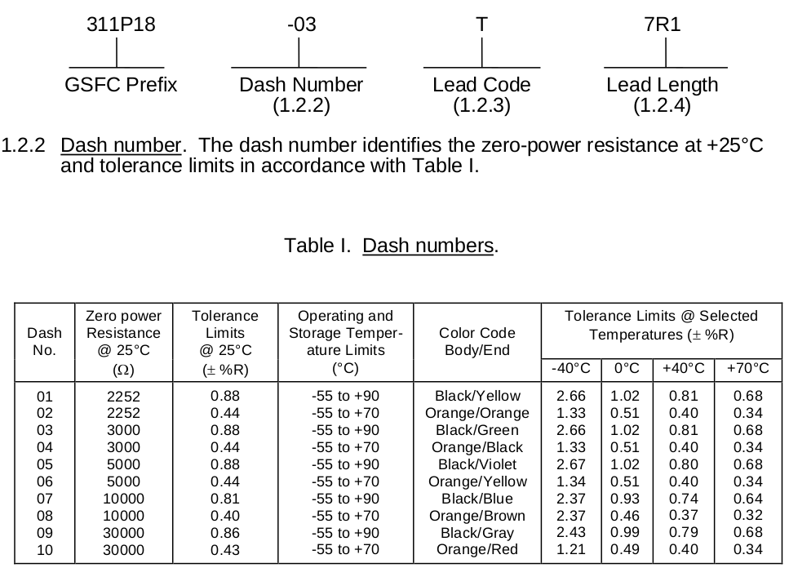
Thermistor Specs
  Thermistors:
    S-311-P-18L: Standard GSFC thermistor
    S311-P-8-827A: QTI surface mount (chip style)

Slide 22
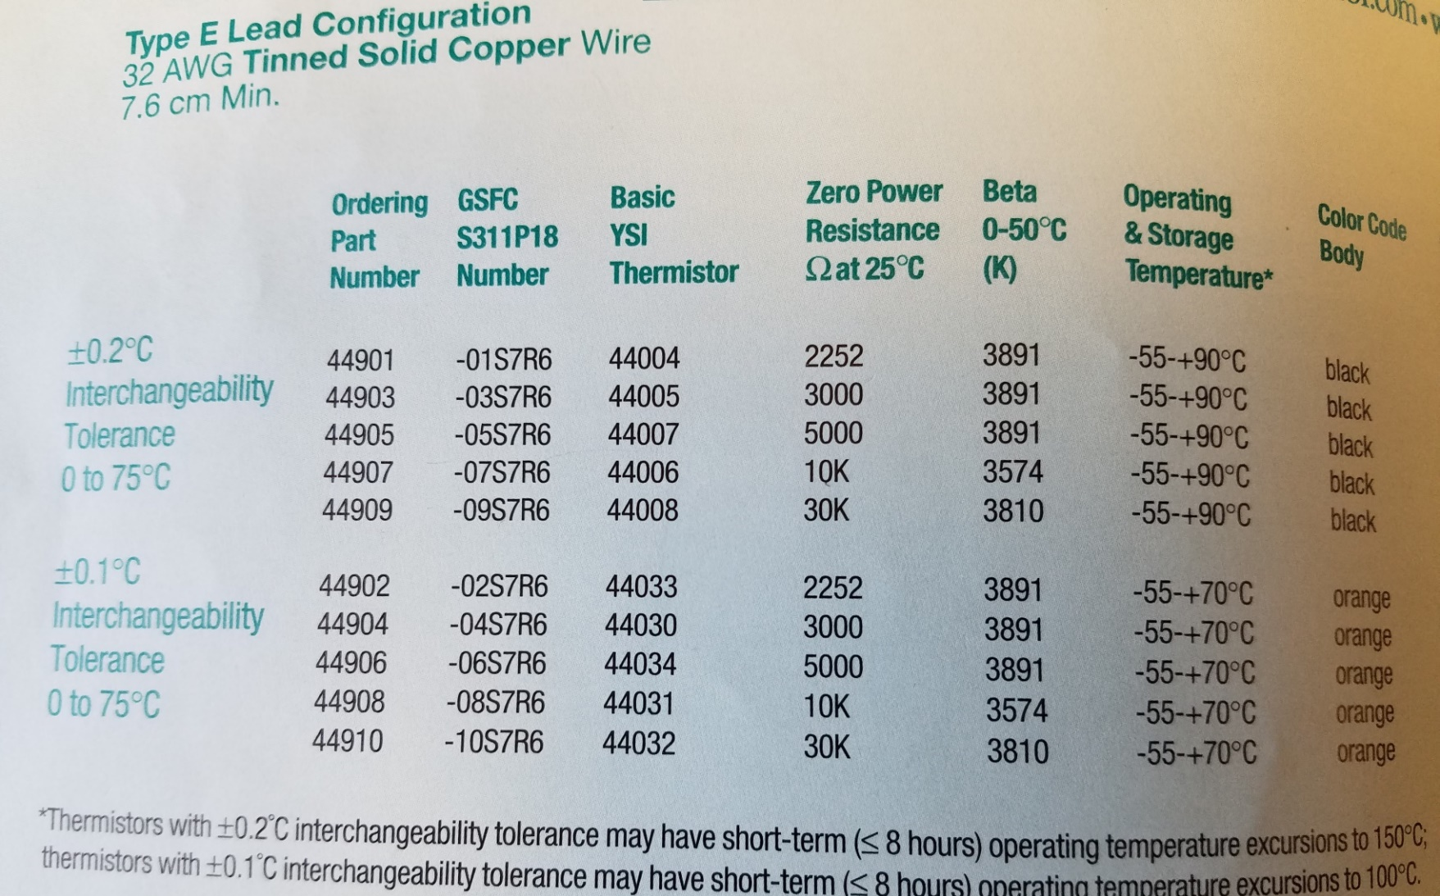
Thermistor Part Number
Correlation between manufacturer number and Goddard number

Slide 23
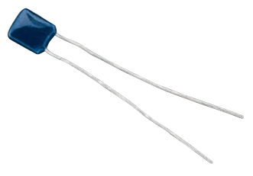
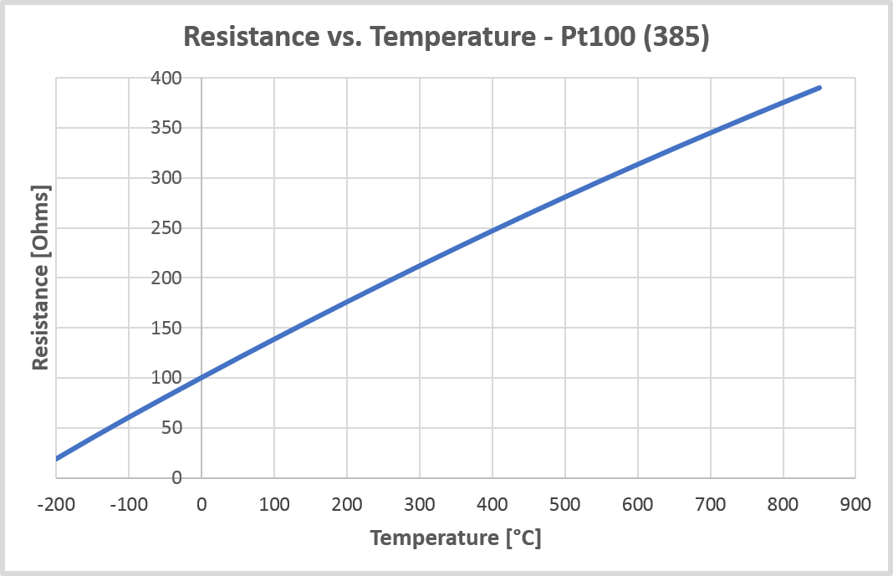
PRTs
Resistance element is Platinum
  Platinum Resistance Thermometer
Positive slope
  PTC (Positive Temperature Coefficient)
Very linear Temperature vs. Resistance curve
Temperature range -269^{O}C to 400^{O}C
  Others capable up to +800^{O}C,
  Nominal resistance rated @ 0^{O}C
4 wire variety enhances accuracy if needed
  Removes resistance of leads.
  Resistances usually 100 Ω

Slide 24

2 PRT Packages
Wire wound
  Cylindrical shape package
  Platinum wire wrapped around a spool
  Not vibration resistant
  More accurate at high/low temps
  10X more expensive than thin film
Thin film deposition
  Rectangular shape package
  Platinum is deposited onto a ceramic substrate
  Better for high vibe loads
  Less accurate at high/low temps
    Temperature change will grow/shrink package; slightly changing resistance due to strain

Slide 25
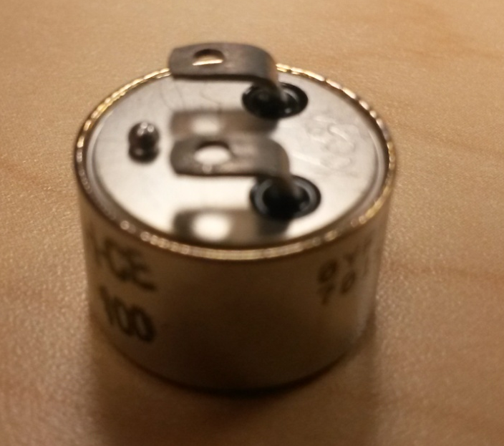
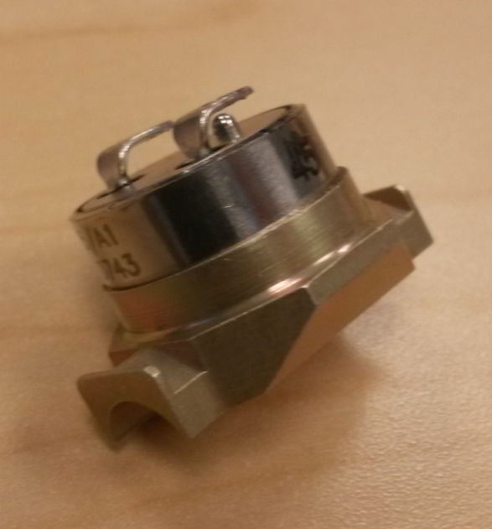
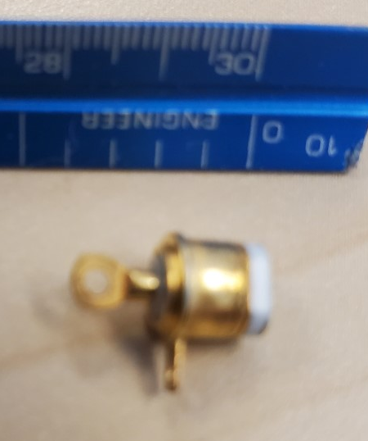
Mechanical Thermostats
Flight qualified vendors: from Honeywell, Sensata, or Comepa
  NASA Goddard S311-641 specifications
  Honeywell Type 700
  Sensata M1, M2, 3BT, 4BT
  Comepa has an ESA Spec which Goddard agreed to allow as a S311 surrogate
Style 701, or M1 (standard)
Style 717 (Prop lines)
Sensata Style 3BT

Slide 26
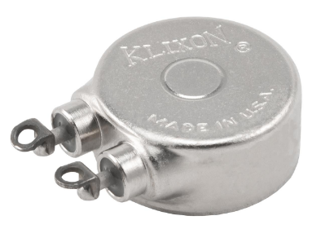
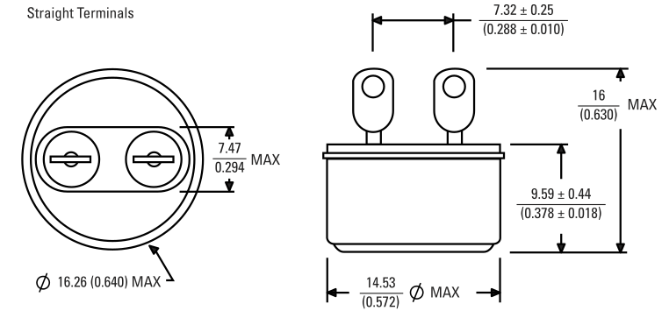
Sensata M1 and M2 Thermostats (1/2” disks)
M1: Large Temp Differential
  20^{O}F (9^{O}C)
-65°F to 550°F (-53.9°C to 287.8°C) close setpoints
5amps @ 30 VDC
  100,000 cycles minimum
M2: Small Temp Differential
  2°F to 5°F (1.1 to 2.8°C)
-40ºF to +235ºF (-40ºC to 112.8ºC) close setpoints
2.0 amperes at 30Vdc, 250,000 cycles
3.0 amperes at 31Vdc, 50,000 cycles

Slide 27
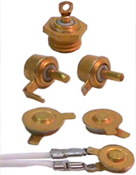
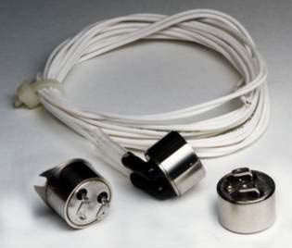
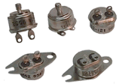
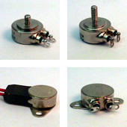
Thermostat Specs for Flight Hardware
  Thermostats:
    NASA S-311-641-XX
      B: General Requirements
      /02: Sensata M2 (narrow differential)
      /03: Honeywell 700 Series (standard t’stat)
      /04: Honeywell 270 Series (High Power, 10amp)
      /05: Sensata M1 (large differential)
      /06: Sensata 4BT (super tiny)
      /07: Sensata 3BT (super tiny)

Slide 28
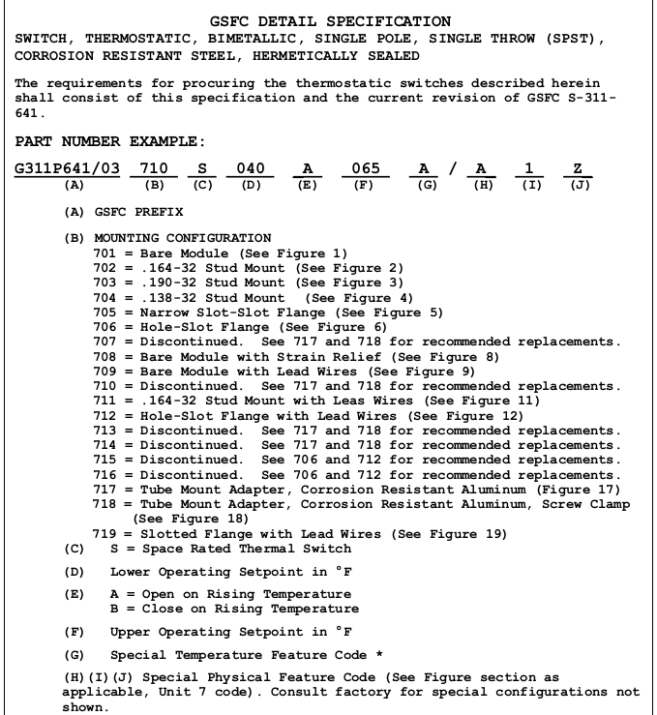
S311-P641/03 Spec

Slide 29
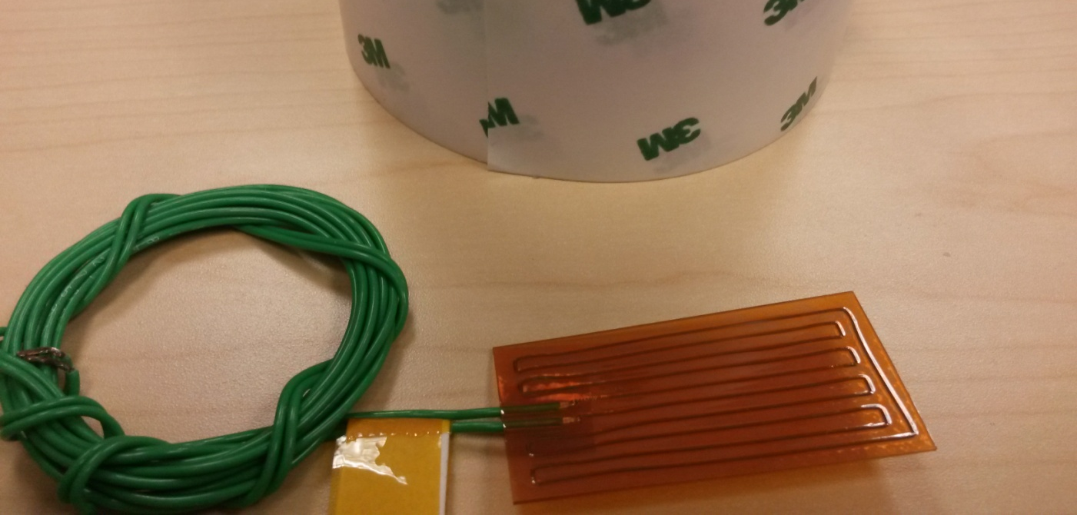
Heaters
Kapton (Polyimide) Thermofoil Heaters
Typically applied with 3M 966 Acrylic Adhesive
  Low outgassing
Kapton material temp limit +150^{O}C (although Minco makes some good to +200^{O}C)
  966 adhesive good to about +130^{O}C (data sheet says +204^{O}C) before outgassing happens
  Bond with Stycast Epoxy if hotter than +130^{O}C, or watt density higher than 3.5 W/in2
Overtaped with 3M 425 aluminum tape to help spread out heat from potential “bubbles”
  Note: Be careful when bonding heaters to cylindrical surfaces with 3M966 (spring-back)

Slide 30
Heater-Thermostat Redundancy
Thermostats 1,2
Heater 1
+
Primary
-
Thermostats 3,4
Heater 2
+
Redundant
-
  Two thermostats wired in series
    To prevent failed “on” condition
  Two heaters wired in parallel
    To prevent failed “off” condition
  Heaters can be ordered with dual-elements
    Cost is about the same as single element
    Remember to order heaters with two color coded wires (to tell circuits apart)

Slide 31
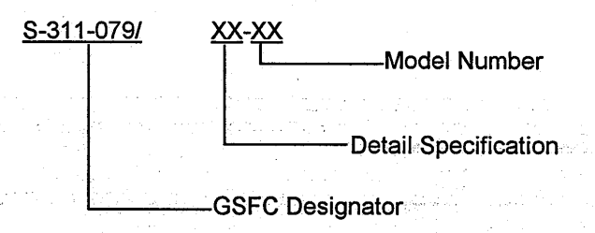
Heater Specs
Heaters:
  Procurement: S-311-P-079
    Order to this spec.
  General Specifications: S-311-P-841
    Tells how the heater should be made

Slide 32
Optical Coatings
Word of Advice: Never call an optical coating “Paint”!
Things that effect Optical coatings:
  Atomic Oxygen*
  UV Radiation*
  Proton-Electron particle Radiation
  Contamination on the surface
  Note: * LEO orbits
Example: Silver Teflon in LEO usually needs 10mil Teflon instead of 5 mil (AO erodes the Teflon)

Slide 33
Optical Coatings, Page 2
Thickness of the coating is key:
  Too thick makes the coating crack
  Too thin effects the emissivity and solar absorptance
Coating Selection
  The Substrate: metal or composite?
  Temperature range:
    Polyurethanes do not do well at hot temperatures. They turn brown.
    Silicates work better when hot but have their own problems.
Coat on flat side of the radiator, not on pocketed side if possible.
Fillets and bolt patterns create 5-10X more time to coat. $$$$
Talk to your Coatings Engineer before you get too far down the path.

Slide 34
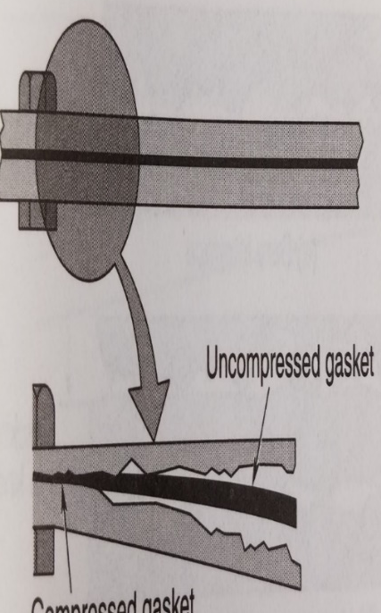
Contact Conductance in a Vacuum:
“Potato Chipping” between bolts
Conduction Highly dependent upon:
Box baseplate thickness
Distance between bolts
Bolt diameter
Bolt Torque
Stiffness of Coldplate/radiator
Overall Dimensions of box.
No Contact

Slide 35
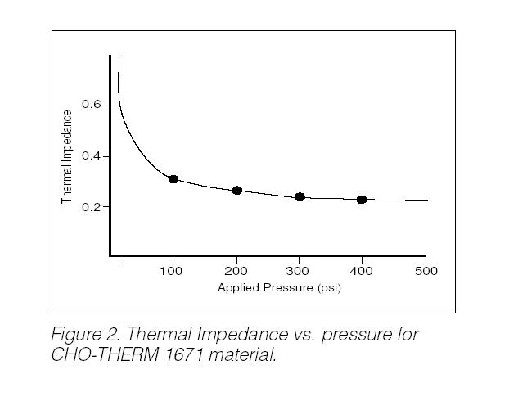
Solid Sheet Thermal Enhancement
Chotherm 1671
  Non electrically conductive
  15 mils thick
Choseal 1285
  Electrically dissipative
  20 mils thick
e-Graf
  5 or 10 mils thick

Slide 36
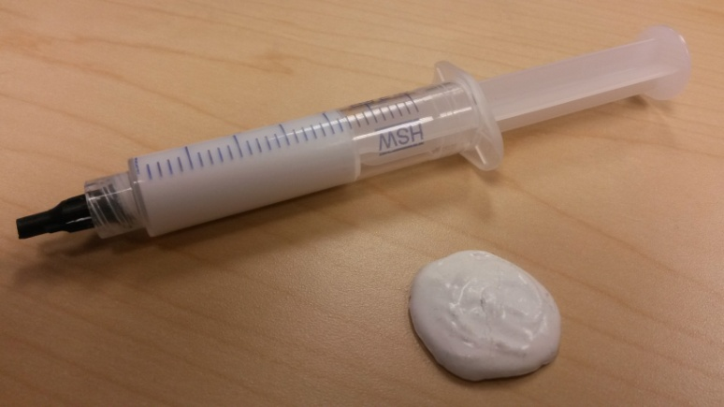
Liquid Thermal Enhancement
Nusil CV-2946
  2-part material which needs to be mixed beforehand and degassed.
  Stored in a freezer or hardens in an hour
  Use Miller-Stephenson MS-143H as a release agent if needed. Teflon particles. Apply 3 layers.
Arathane
  Mixed with 30-40% Boron Nitride increases thermal conductivity.
  Cabasil makes it thick.

Slide 37
Results for an 8” X 8” Ebox
Datasheet G = 1.59 W/in²-C
Datasheet G = 4.35 W/in²-C
Empirical G = 0.10 W/in²-C

Slide 38
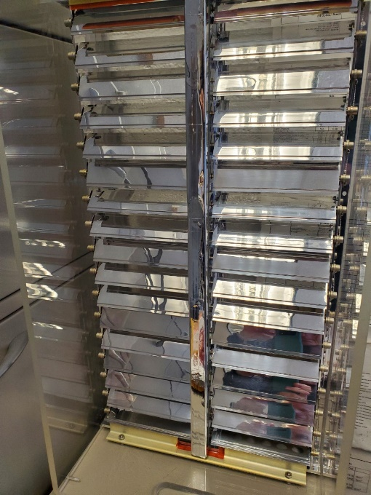
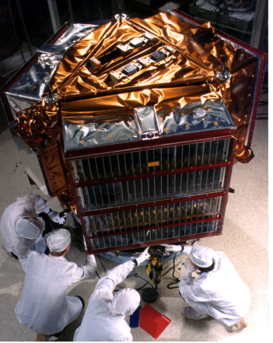
Louvers
Louvers have been used since the 1950’s
  Hundreds/thousands used on satellites
  Not aware of any failures
Thermally activated shutters regulate the structural/electronic equipment temperature
Highly-polished aluminum blades driven by bi-metallic sensors
  Totally passive; No heaters needed
Open when hot. Closed when cold
Typical thermal performance:
  Open ε*=0.70
  Closes ε*=0.09

Slide 39
End of Class
Any last questions?

