Slide 1
TFAWS Thermal Course Session
Notes:
Thank you, David for the introduction
Good afternoon, everyone, I want to thank you all for being here today.
The turnout at TFAWS 2023 has been amazing so far and I’m very excited to be here today.
My name is Elliot Schwartz, I’m a Thermal Engineer at NASA’s G.S.F.C.
Today, I’ll be teaching a course on Thermal Vacuum Testing for Space Applications

Slide 2
Agenda
About me
Importance of thermal vacuum testing
Thermal and vacuum components
Vacuum systems sequence of operation
Contamination control
Common types of tests
Control software and post-processing
Questions

Slide 3
About Me
Thermal Engineer at NASA Goddard since August 2021
Thermal Technology Development and Demonstration (T2D2) Facility
Bachelors: Rowan University, NJ (2016)
Mechanical Engineering
Masters: Rutgers University, NJ (2022)
Mechanical and Aerospace Engineering
HVAC Building Automation Career
Quality Assurance Engineer (2 years)
Service System Specialist (1 year)
Notes:
T2D2 = only lab in the Thermal Engineering branch, thermal vacuum testing & assorted thermal R&D projects

Slide 4
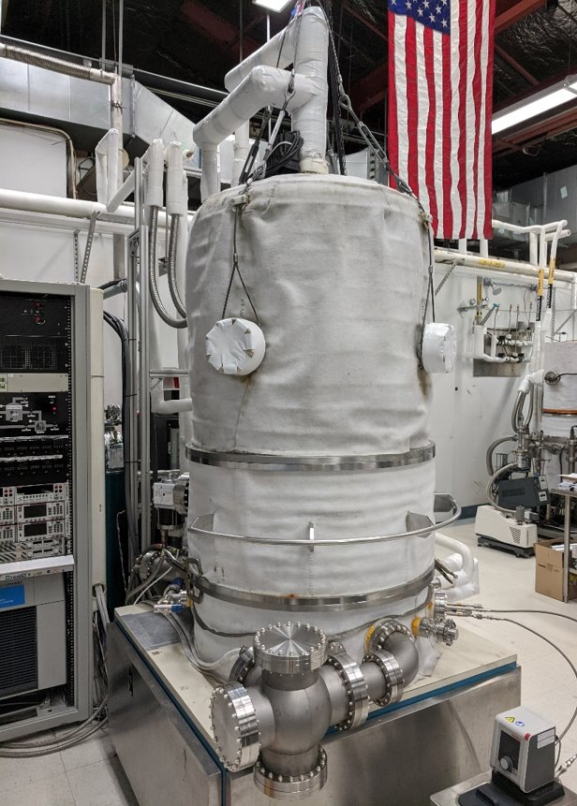
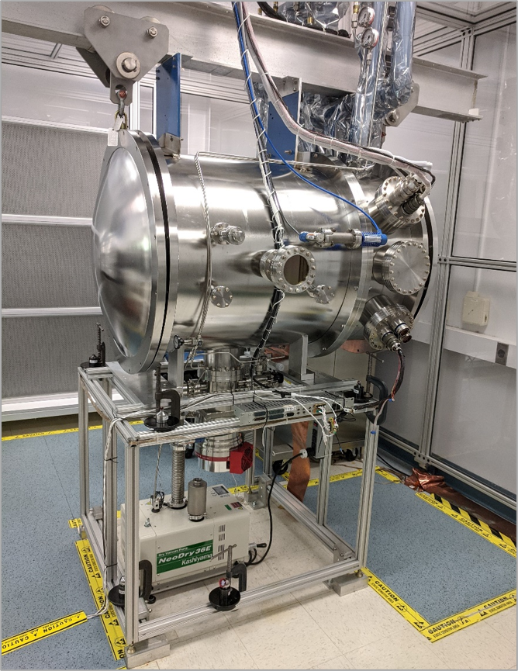
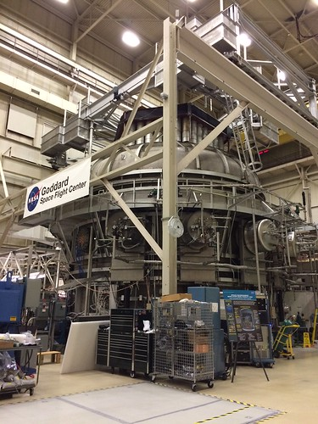
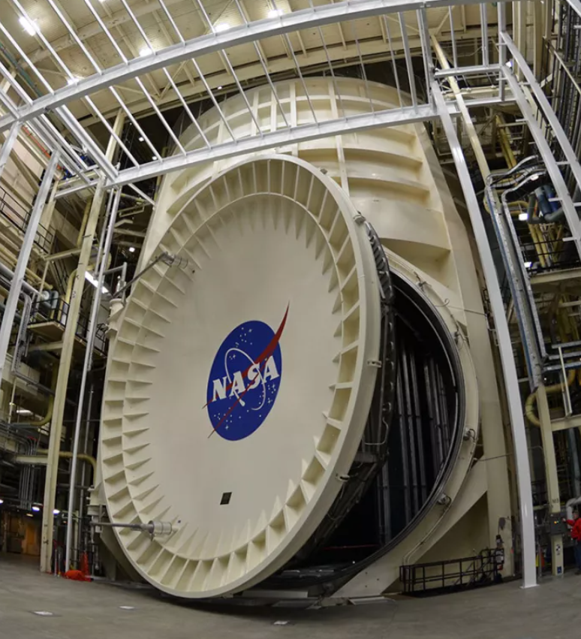
Thermal Vacuum Chambers
Used to simulate the temperature and pressure of a space environment
MDC
(Goddard T2D2)
W: 21“, H: 18“, D: 26"
Dynavac
(Goddard T2D2)
Ø32”, H: 32”- 50”
Space Environment Simulator (Goddard)
Ø27’, H: 40’
Chamber A
(NASA JSC)
Ø55’, H: 90’
Notes:
So, let’s jump right into the topic for today
Thermal Vacuum Chambers are used to simulate the temperature and pressure of an outer space environment
Hardware goes into the chamber, to test if it will operate correctly in outer space
T-VAC chambers come in different shapes and sizes…as you can see for the four photos
***explain photos
All run on the same principles, but I will focus a lot of this course on the chambers in the T2D2 facility
This is more of an introduction course and is not all inclusive of every chamber configuration and size

Slide 5
Importance of T-VAC Testing
Verification of thermal design
Qualifying space hardware, “test as you fly”
Thermal model correlation
Testing hardware temperature limits
Contamination/outgassing analysis
Notes:
Thermal model correlation, lots of thermal analyst in TEB, make thermal model in computer to predict the temperatures of components in space flight, use real life data from T-VAC test to tweak their model and provide better thermal predications.
Temperature limits are tested to make sure the hardware will survive the most extreme temperatures that it could be subjected to during flight.

Slide 6
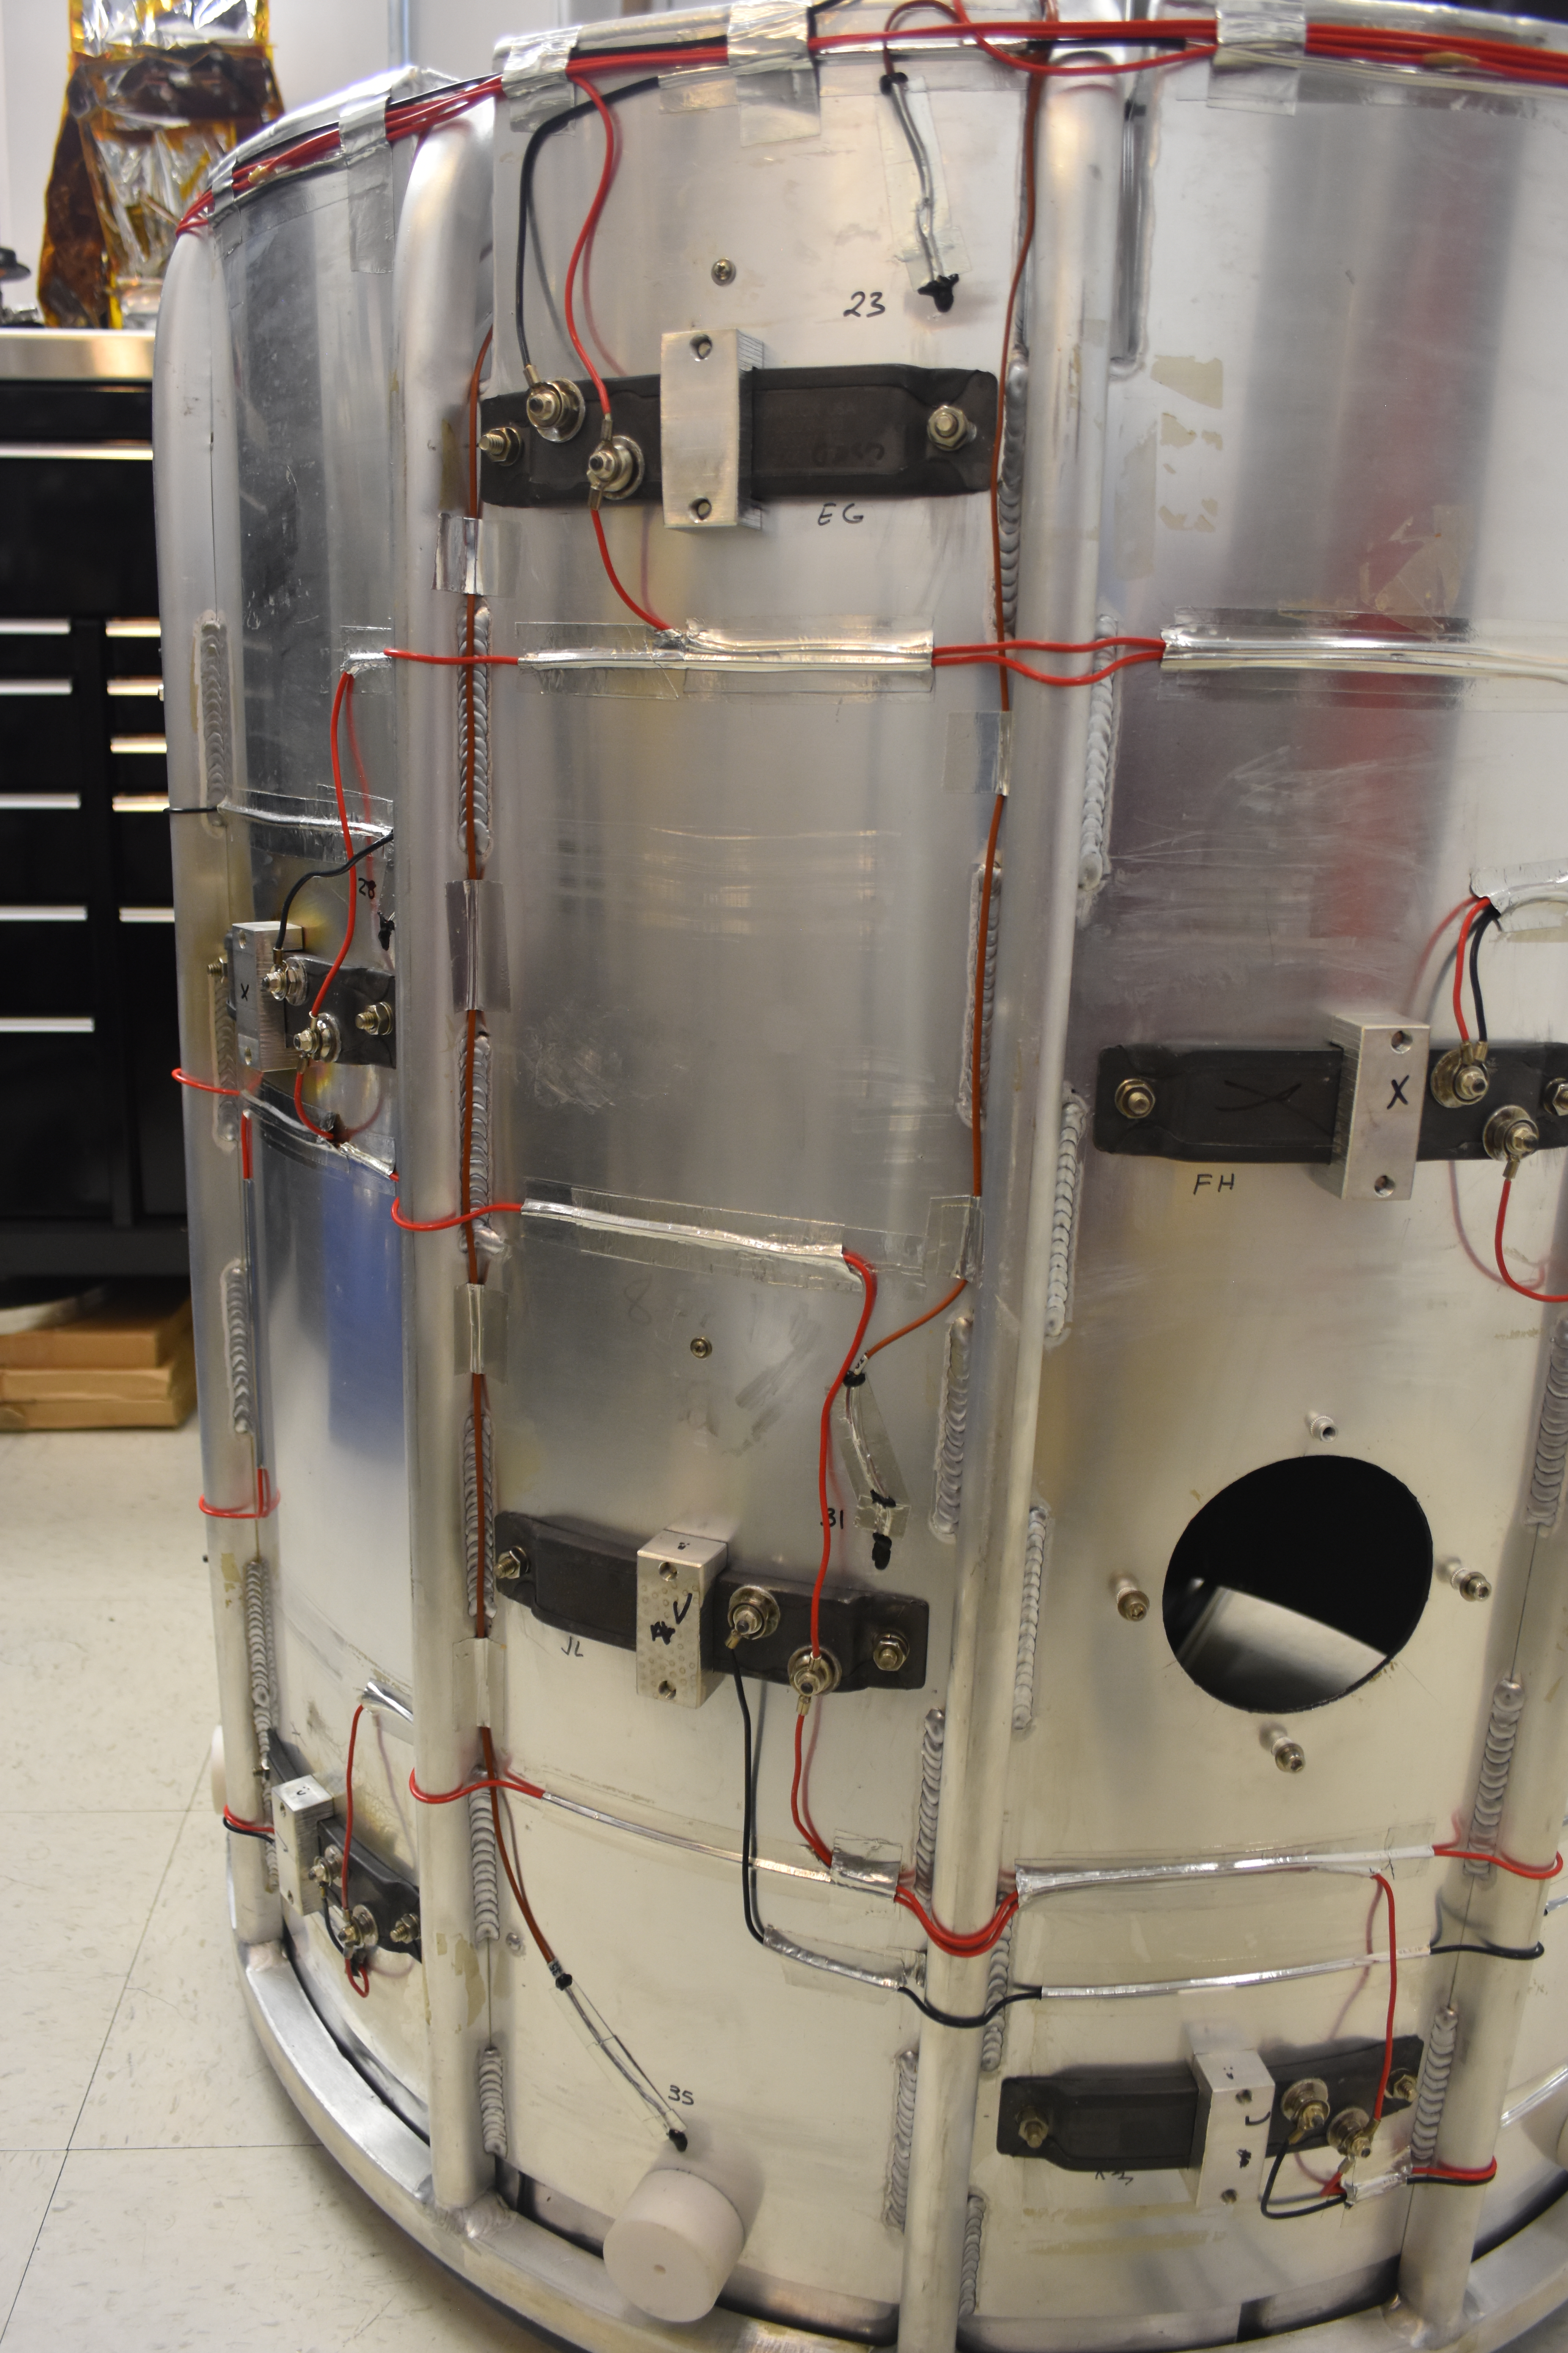
Thermal Elements
Heating: heaters connected to power supplies
T2D2 heating: up to 140 °C (284 °F)
Cooling: liquid nitrogen plumbing or cryocooler
T2D2 cooling:
down to -180 °C (-292 °F) with LN2
down to 4.2 K (-452 °F) with cryocooler
Heaters
LN2 Cooling

Slide 7
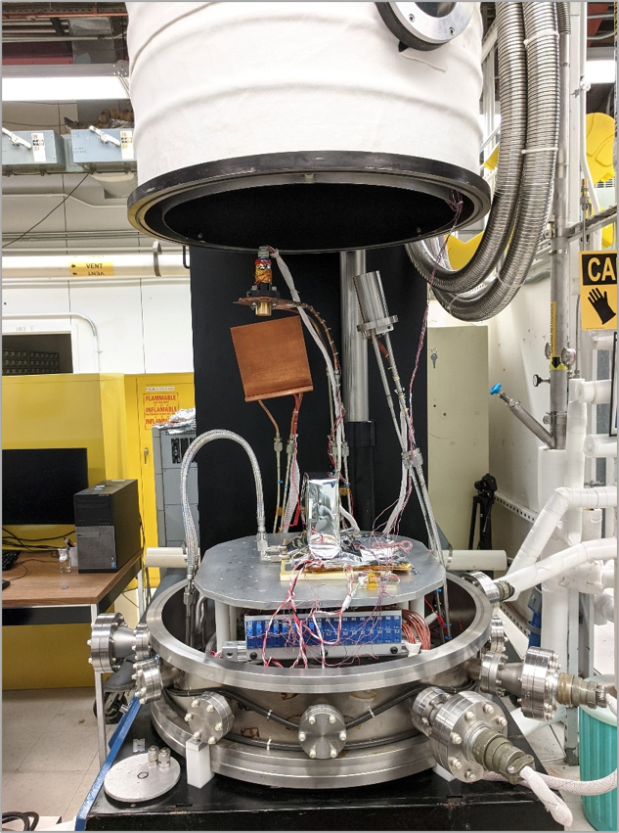
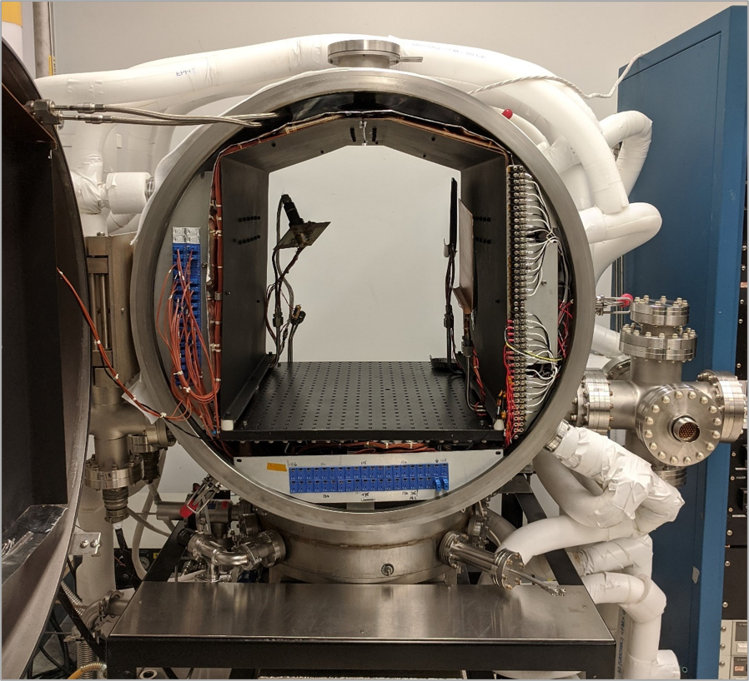
Thermal Zones
Platen = bottom plate
Basewell = chamber bottom
Shroud = radiative walls
Shield = radiative doors
Chamber Shell
Shield
Shroud
Platen
Basewell
7
Notes:
Platen = bare or coated aluminum

Slide 8
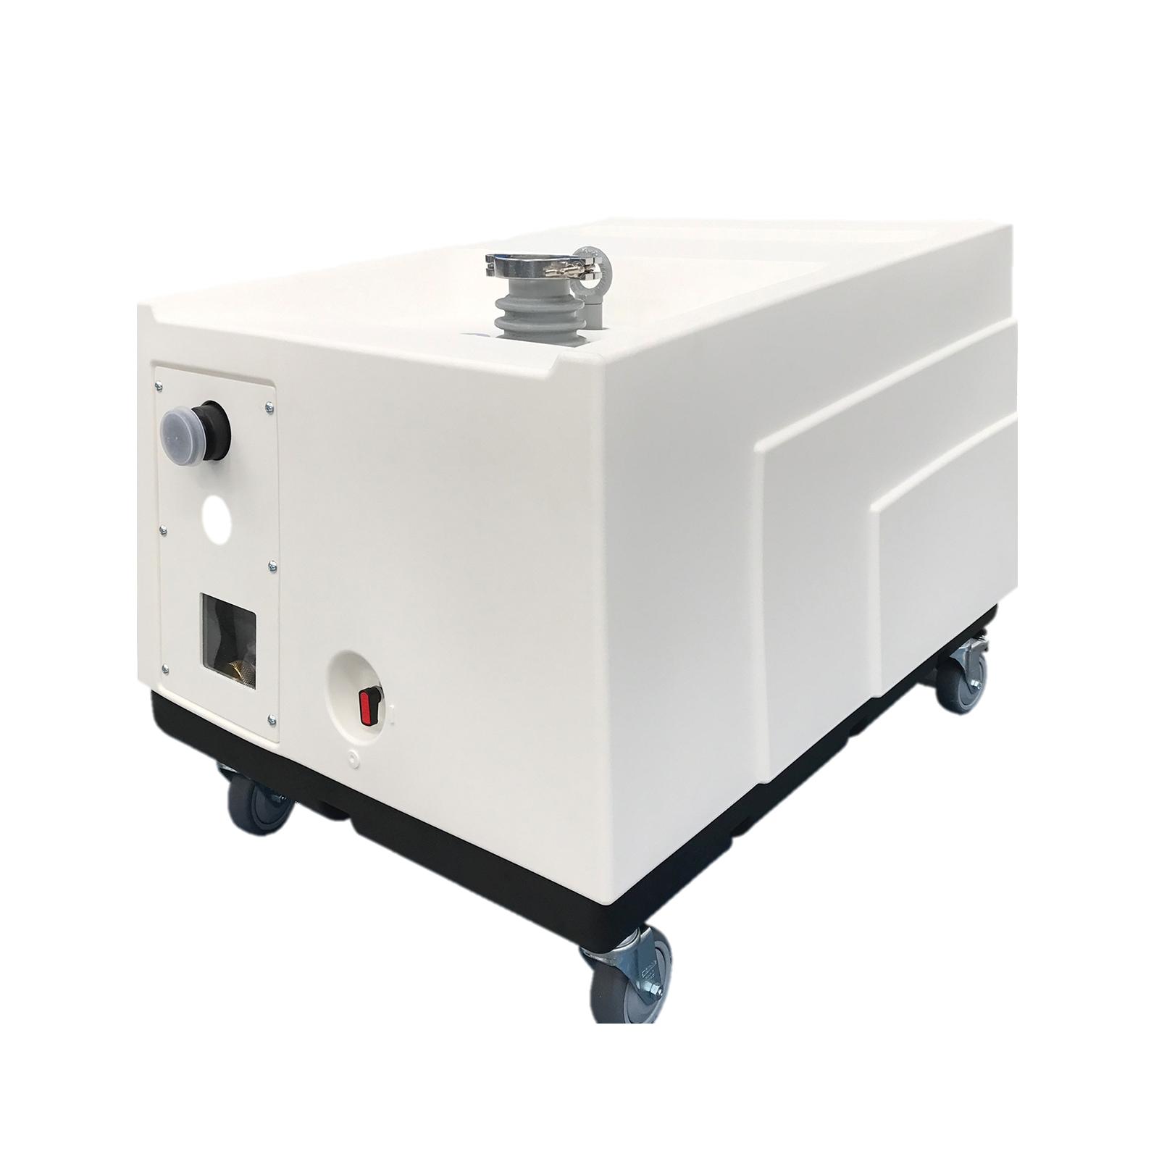
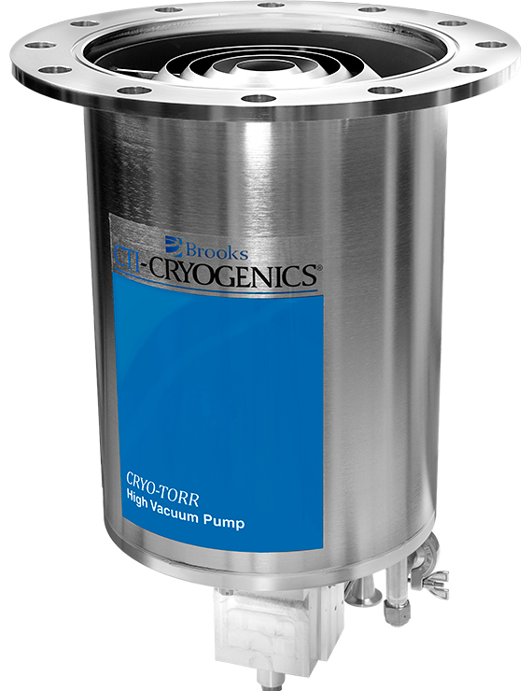
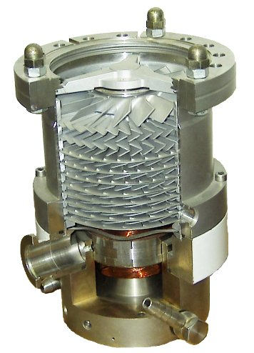
Vacuum Elements
Rough vacuum: 760 Torr (atmospheric) → 1x10⁻³ Torr
High vacuum: 1x10⁻³ Torr → 1x10⁻⁹ Torr
Achieve vacuum: series of pumps and valves
T2D2 vacuum pressures: < 1x10⁻⁷ Torr
Two main classifications of pumps:
T2D2 facility rough vacuum pumps: oil-free multi-stage roots
T2D2 facility high vacuum pumps: cryogenic and turbomolecular
Roughing Pump
Cryo Pump
Turbo Pump
Notes:
That was an introduction to the thermal side of thermal vacuum testing so now it’s time to talk about the vacuum side.
A vacuum is any pressure that is less then atmospheric pressure.
A standard atmosphere at sea level is 760 torr, that we’re experiencing right now, entire atmosphere is pushing down on you
Most of outer space is a hard vacuum which means the pressure is effectively 0 torr
Impossible to get that low of pressure so…
Rough vacuum, 1 millionth that of an atmosphere
High vacuum, 1 trillionth that of an atmosphere
As thermal engineers, achieving a high vacuum is good enough for getting rid of convective heat transfer and is a good representation of how hardware will respond in space.
*READ from “Achieve vacuum: series of pumps and valves”

Slide 9
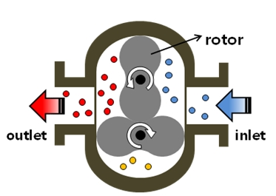
Roughing Pump
Chamber pressure from atmospheric to rough vacuum
760 Torr → 1x10⁻³ Torr
“Through” pump using rotating blades
Works in continuum flow regime
Notes:
Continuum flow, there are so many air molecules in the chamber that they bounce against each other, and the friction helps pull many molecules at a time. The pressure drops rapidly in this kind of flow regime.

Slide 10
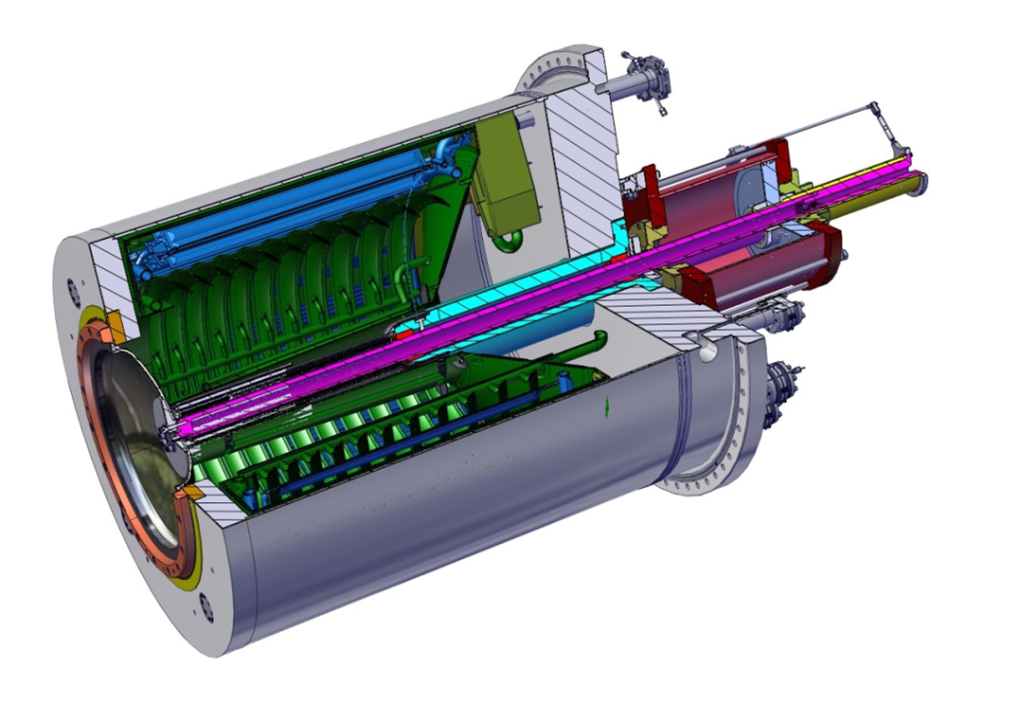
Cryogenic Pump
Chamber pressure from rough vacuum to high/ultra high vacuum
1x10⁻³ Torr → 1x10⁻¹⁰ Torr
“Collection” pump that cools to single digit Kelvin to freeze gases
Works in molecular flow regime
Notes:
Molecular flow is like the DVD screen saver, instead of people cheering when the logo hits the corner, we get to see the chamber pressure decrease which is ALMOST as fun.

Slide 11
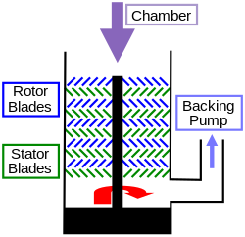
Turbomolecular Pump
Chamber pressure from rough vacuum to high/ultra high vacuum
1x10⁻³ Torr → 1x10⁻¹⁰ Torr
“Through” pump that spins up to 90,000 RPM
Works in molecular flow regime
Notes:
Need roughing pumping to back it up
Outlet of turbo pump goes into the inlet of the roughing pump

Slide 12
Cryo Vs. Turbo Pump
Cryo pumps:
Pros:
Cheaper for same pumping speeds
Cons:
Bad for pumping helium
More power intensive
Compressor required
1-2 Hz mechanical vibration
Regeneration cleaning required
Slow startup
Turbo pumps:
Pros:
Good for pumping helium
Less power intensive
Cons:
Bad for heavy gases like xenon
More expensive for same pumping speeds
Backing roughing pump required
Up to 1500 Hz mechanical vibration
Spinning parts wear out over time
Notes:
Some chambers have both, some large chambers have many of each kinds.
Our lab has one chamber with both, a test needed us to turn off the cryo pump.

Slide 13
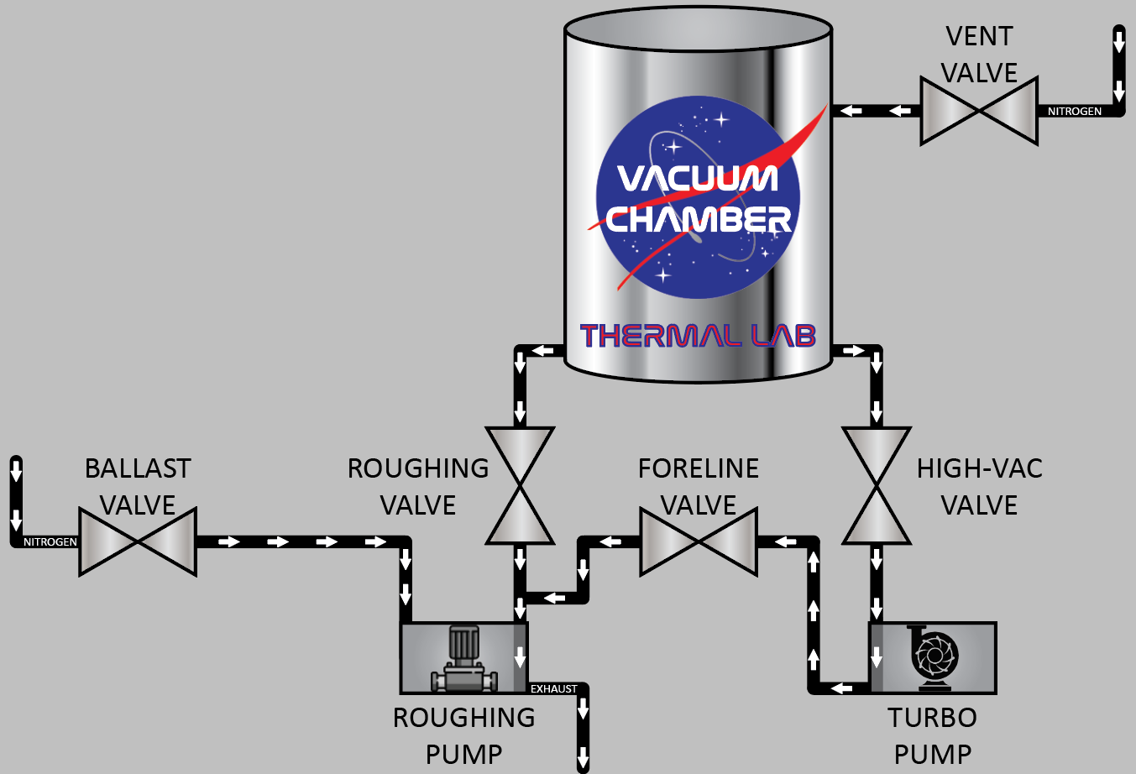
Turbo Pump System
Purge chamber with nitrogen
Connect chamber to roughing pump
Connect chamber to turbo pump
Purge the roughing pump with nitrogen
Connect turbo pump to roughing pump
*not to scale
Notes:
***Explain each valve

Slide 14
Turbo Pump System Animation
*not to scale

Slide 15
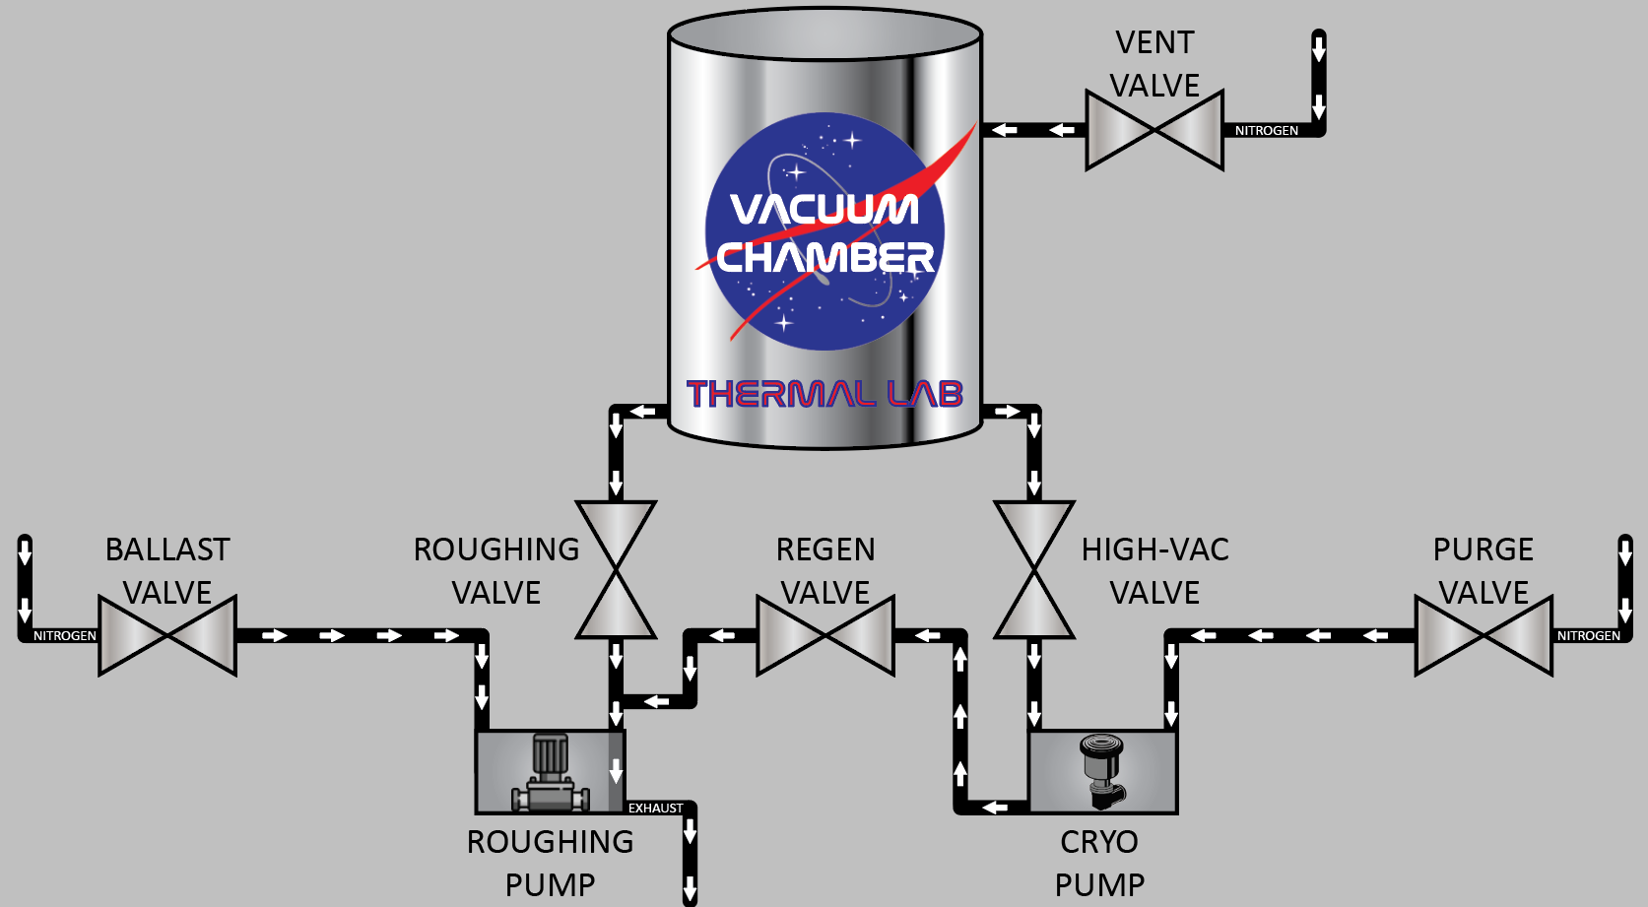
Cryo Pump System
Purge chamber with nitrogen
Connect chamber to roughing pump
Connect chamber to cryo pump
Purge the roughing pump with nitrogen
Connect cryo pump to roughing pump
Fill the cryo pump with nitrogen
*not to scale

Slide 16
Cryo Pump System Animation
*not to scale

Slide 17
Contamination Elements
Determine outgassing rates and cleanliness of sample
Quartz Crystal Microbalance (QCM), Cold Finger, Scavenger Plate, Residual Gas Analyzer (RGA)
Collect samples that can be analyzed later
QCM
Cold Finger
Scavenger Plate
17
Notes:
Define outgassing = Under vacuum the boiling point for all materials decreases.
When under vacuum and subjected to heating all sorts of different materials start to boil off or outgas from hardware inside a thermal vacuum chamber.
Everything from water to oil from machining and fingerprints starts to boil off the hardware.
That is why we always use gloves and clean the hardware before TVAC testing.
The higher the outgassing rate usually means that the hardware is dirty, or a non vacuum compatible material was used.
Most materials would not do well under a vacuum.

Slide 18
Scavenger Plate
A device that freezes contaminants onto its surface.
Typically set to -120 °C to -160 °C to attract contaminants.
Collects outgassed material throughout the entire test.
Isopropyl alcohol (IPA) rinses taken off SP tend to be discolored (yellowish tint).

Slide 19
Cold Finger
Operates in the same way as the scavenger plate (same temperatures).
Operates only near the end of the test.
Collects materials that are still being outgassed from the hardware near the end of the test.
Isopropyl alcohol rinses taken off CF are always cleaner than SP rinses.

Slide 20
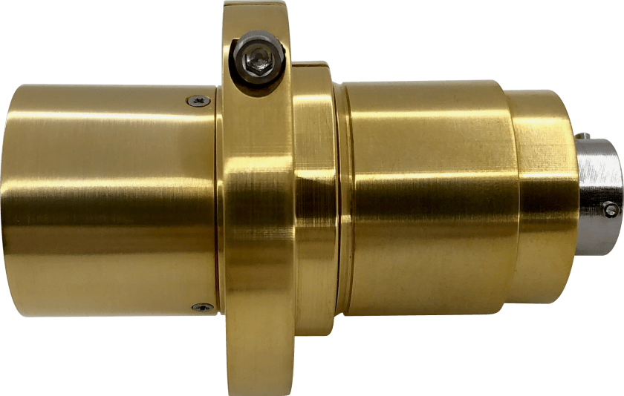
Quartz Crystal Microbalance (QCM)
Determines the real-time outgassing rate of hardware.
Quartz crystal changes oscillation frequency as more material is outgassed.
Delta Frequency (Hz/hr): change in frequency over time, outgassing rate.
Delta Delta Frequency (Hz/hr/hr): change in delta frequency over time, see if the outgassing rate is still decaying.
QCM crystal cooled to around -20 °C to -40 °C.
Placed close to outgassing hardware.

Slide 21
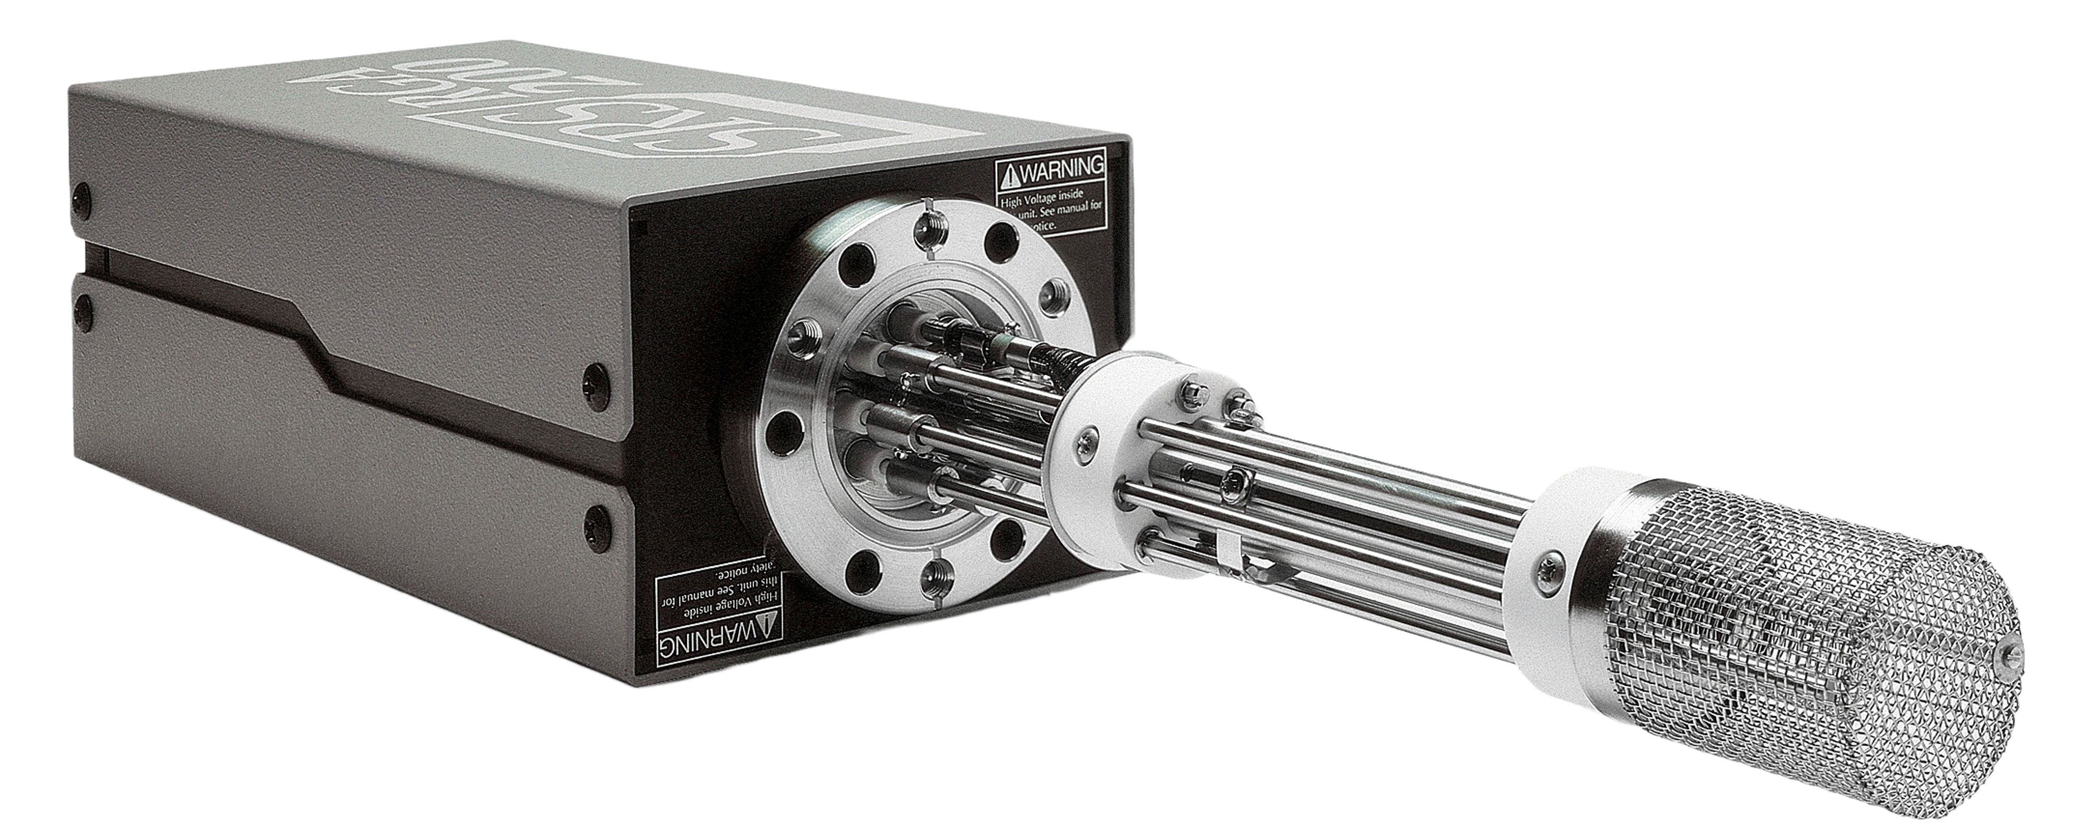
Residual Gas Analyzer (RGA)
Detects small traces of impurities in a vacuum environment down to parts per million resolution
Operates in vacuums down to the 10^-12 torr range
Used to identify which elements and compounds are still present
Gives data about partial pressures as a function of atomic masses
Useful for leak detection using helium or isopropyl alcohol

Slide 22
Common T-VAC Tests
Three typical kinds of thermal vacuum tests:
Bakeout: cleaning hardware by raising its temperature under vacuum
Thermal cycling: subjecting hardware to multiple temperature swings to test for workmanship
Thermal balance: vacuum chamber set to a fixed temperature, hardware reaches thermal equilibrium, used for thermal model correlations

Slide 23
Thermal Vacuum Software
T2D2 Facility LabVIEW software features:
Real time plotting of data
Temperature rate of change control
Real-time rate of change calculations
Automated thermal cycling
Temperature limits and hardware protection
PID loop power control for stable temperature change

Slide 24
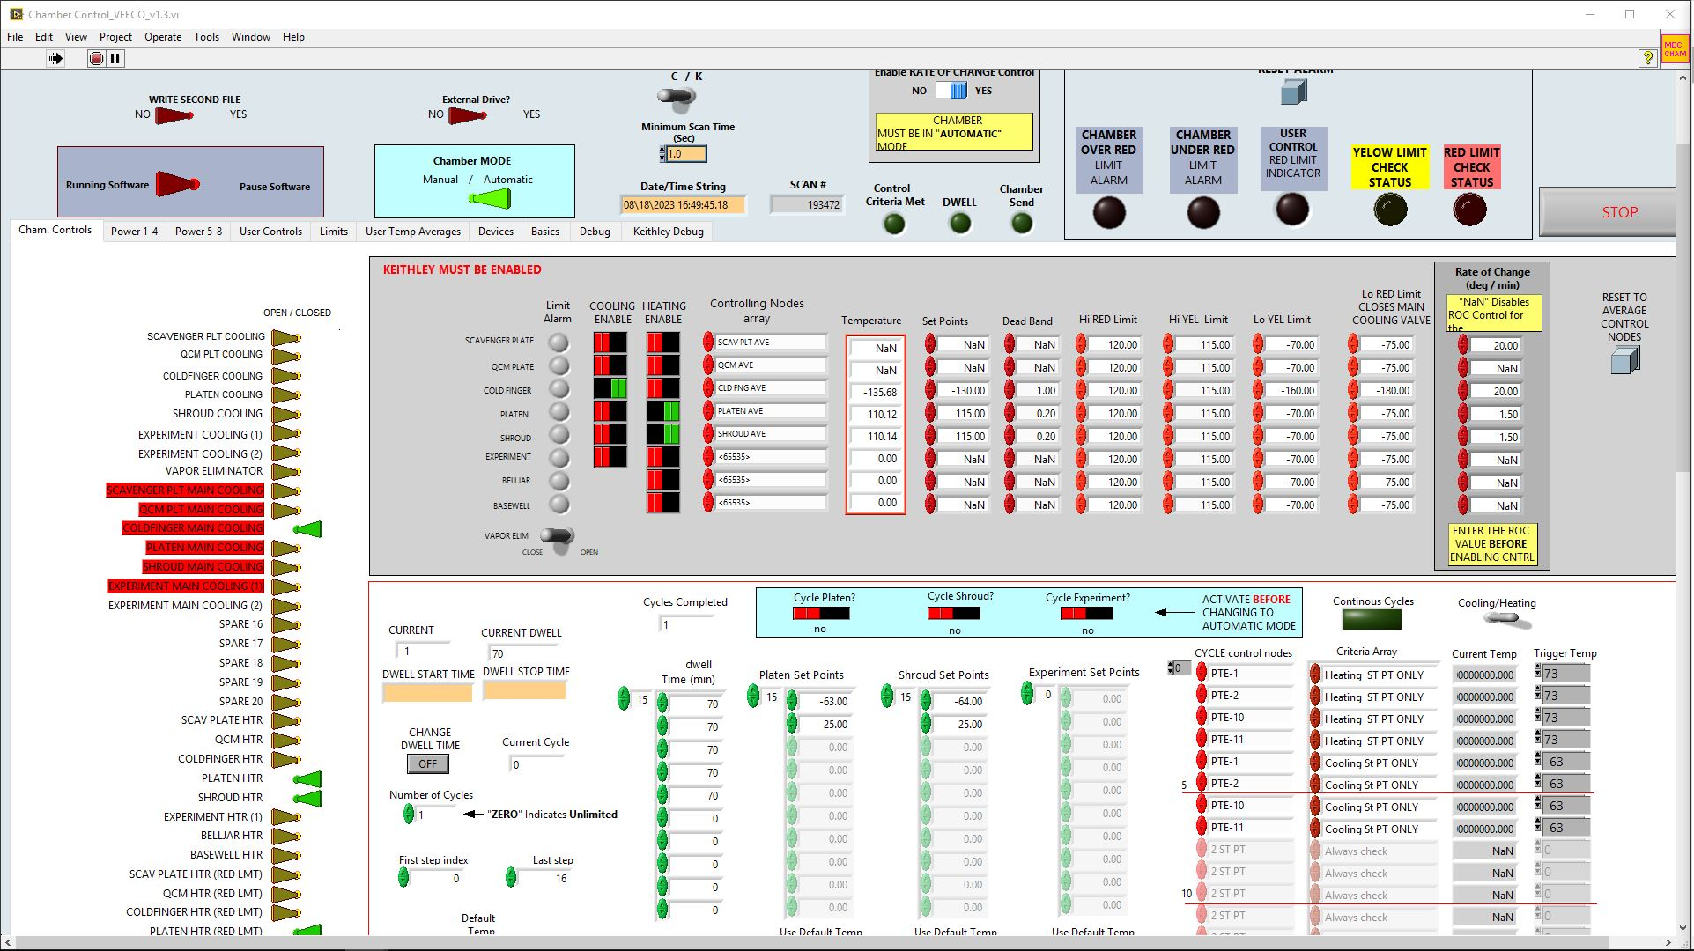

Slide 25
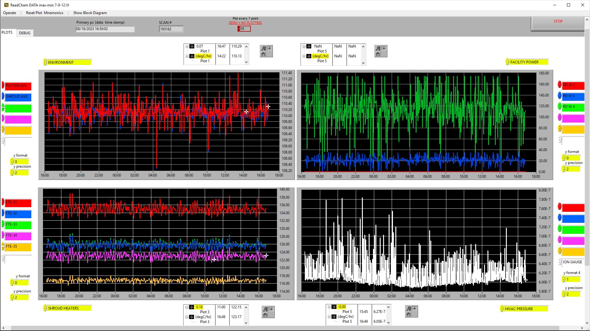

Slide 26
Post Test Data Processing
T2D2 Facility Python script data processing:
Data file consolidation
Data filtering
Payload and facility averaging
Thermal milestone log calculator
Checks for erroneous temperature values
Interpolates data to any time interval

Slide 27
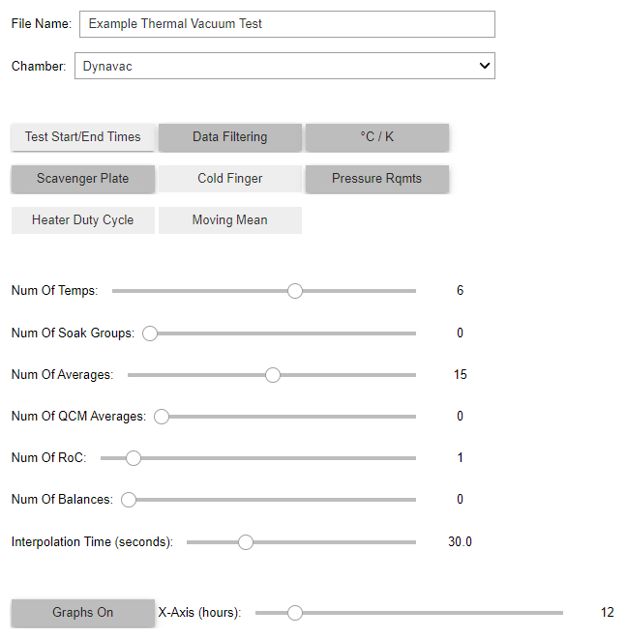

Slide 28
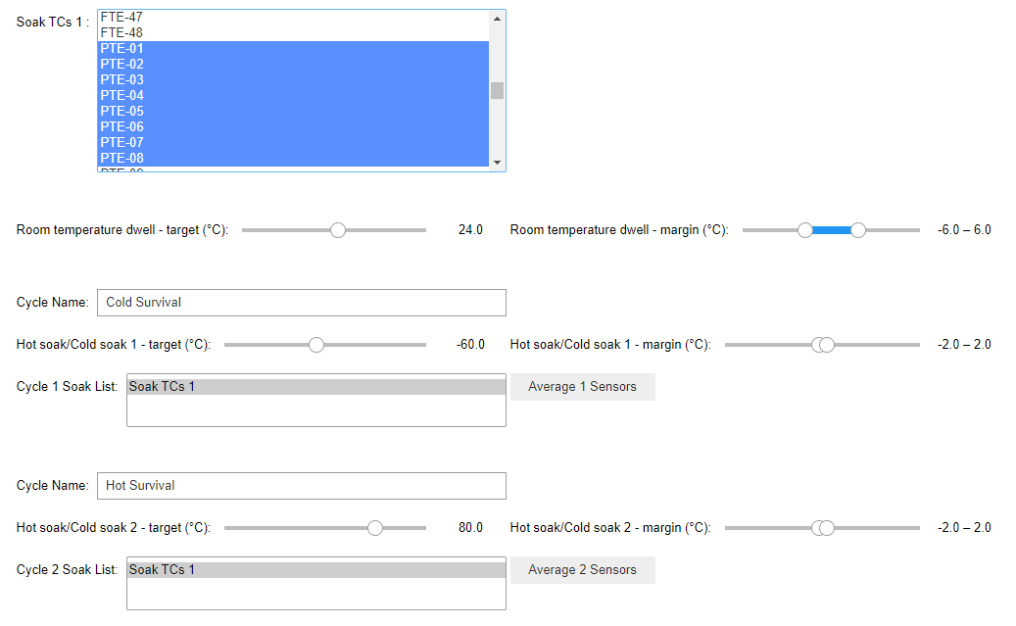

Slide 29
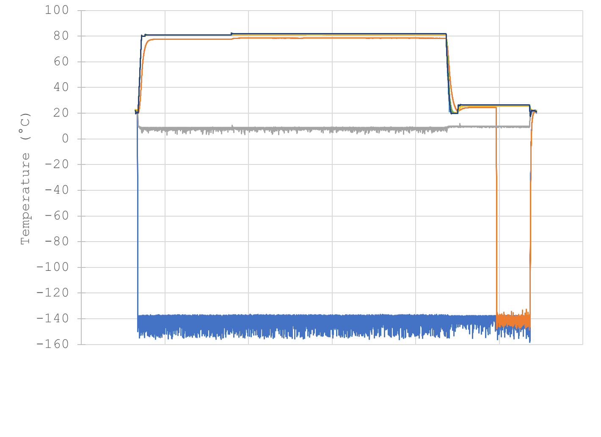
Day 1 00:00
Day 2 00:00
Day 3 00:00
Day 4 00:00
Day 5 00:00
Day 6 00:00
Day 7 00:00

Slide 30
Conclusion
Importance of thermal vacuum testing
Thermal zones, roughing pumping, cryo pump, turbo pump
Vacuum systems sequence of operation
QCM, SP, CF, RGA
Bakeout, thermal cycling, thermal balance tests
LABView control software
Python post-processing script

Slide 31
New Thermal Website
To learn more about Thermal Vacuum testing and Goddard’s Thermal Engineering Branch, check out our newly designed website:
https://thermal.gsfc.nasa.gov/

Slide 32
Questions
Thank you for your attention!
https://thermal.gsfc.nasa.gov/

