Slide 1
Epoxy, Heaters, Sensors and Wiring NASA-GSFC
TFAWS Thermal Instrumentation Paper Session
Presented By Colton Cohill
Thermal & Fluids Analysis Workshop TFAWS 2023 August 21-25, 2023
NASA Goddard Space Flight Center
College Park, MD

Slide 2
About me
Thermal technician at NASA GSFC for the past 7 years.
Supporting Roman Space Telescope (RST) and various flight projects with thermal hardware applications.
Hold certifications for ESD monitoring, J-STD Soldering, Polymerics, Crimp ,Cable and Harnessing.
I do most of my work in our branch thermal lab which consist of installing hardware for various projects into chambers simulating the vacuum pressure in space.
Preparing the tests by interfacing electric heaters, cooling lines, sensors, blankets and communication cables.

Slide 3
4 Different Thermal Hardware Installs
Heaters
3M966 Acrylic Adhesive if watt density is less than 3.5 W/in2
Stycast Epoxy if watt density is greater than 3.5 W/in2
Thermocouples
Usually aluminum tape
Thermostats, Themistors, PRTs
Stycast Epoxy
Nusil under an Ebox
If watt density is so high, solid gap fillers won’t work

Slide 4
Who can do the work?
For Flight hardware, a Polymerics License is REQIRED
Many hours of class
Recertification every 2 years
No Polymerics license, Do not touch Flight Hardware!!!
I have a license ☺

Slide 5
Types of Material
Thermal adhesive transfer tape
966 Pressure Sensitive Adhesive (PSA)- operating temperature
232 ̊c to -40 ̊c (we’ve proved it works down to -40K)
Thermal epoxy bond
Stycast/catalyst 23LV- operating temperature -65 ̊c to 105 ̊c (Room temp. cure, 16 to 24 hours at 25 ̊c)
Stycast/catalyst 11LV- operating temperature -55 ̊c to 155 ̊c (Heat to cure, 8-16 hours at 80 ̊c)
Stycast/catalyst 9LV- operating temperature -40 ̊c to 130 ̊c (Room temp. cure, 16 to 24 hours at 25 ̊c)
Thermal elastomer interface
Nusil CV1-2946- for thermal conductivity wet joint
To cure 7 days minimum at ambient temperature and humidity
Operating temperature -50 ̊c to 250 ̊c
Miller Stephenson- semi-permanent mold release

Slide 6
Heaters
How HEATERS are installed

Slide 7
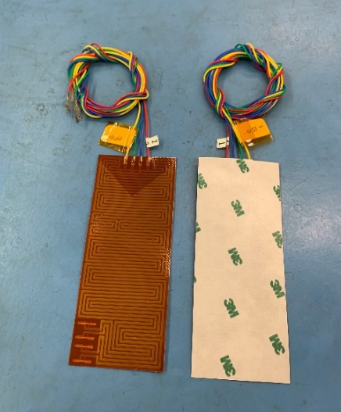
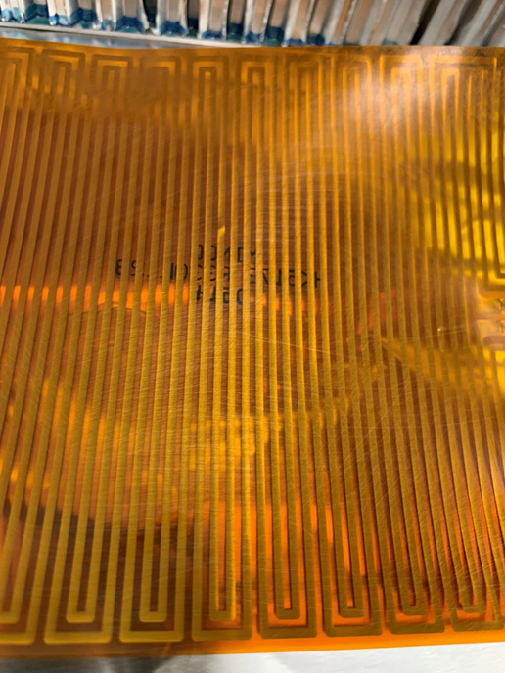
Applying PSA
Abrade your heater with fine grit Scotch-Brite
Frame the bonding area with tape to prevent unintended damage to the surrounding area.
Any surfaces with a coating such as paints must be removed by Abrasion using sandpaper.
Remove the tape framing.
Clean the abraded and surrounding area very carefully with IPA
Allow the hardware to dry.
Apply PSA to the heater and then apply heater the substrate.
Notes:
we mask the location of the with 2 layers of aluminum or Kapton tape leaving 1/8in on each side for a fillet.

Slide 8
Surface preparation for bonding
Frame the bonding area with tape to prevent unintended damage to the surrounding area.
Any surfaces with a coating such as paints must be removed by Abrasion using sandpaper.
After abrasion remove the framing tape.
Clean the abraded and surrounding area very carefully with IPA
Allow the hardware to dry.
Following the work instruction 541-WI

Slide 9
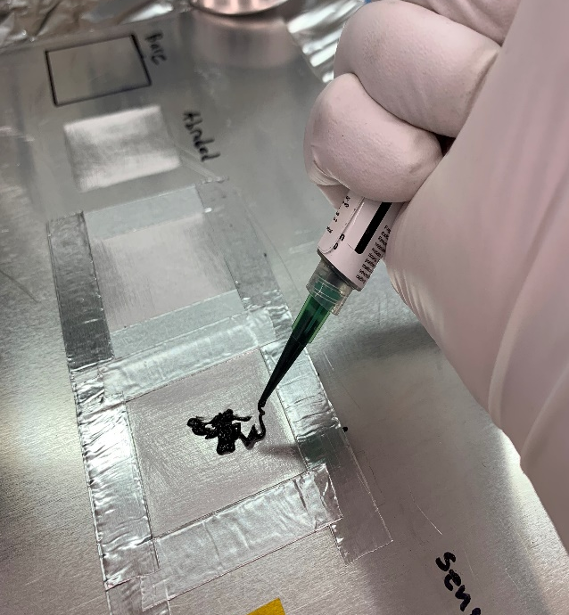
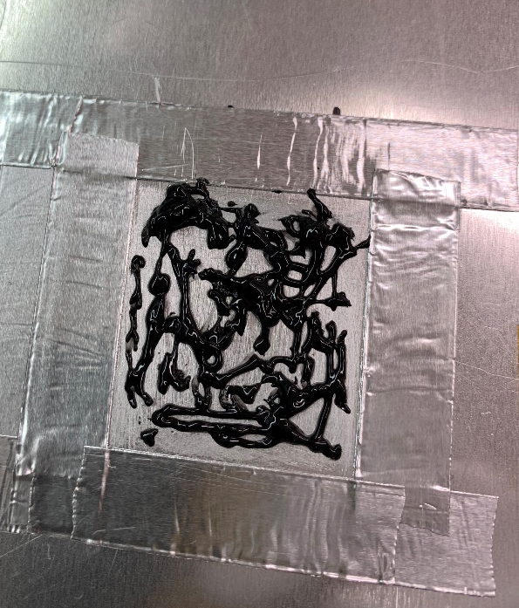
Bond height & Applying Epoxy
Add the desired amount of aluminum tape for the bond height
Add your epoxy and smooth it out using the tape as a guide rail
Separately on a clean surface like a sheet of aluminum foil repeat step for the heater being used
Once both surfaces have been wetted with epoxy they can be joined
Notes:
we mask the location of the with 2 layers of aluminum or Kapton tape leaving 1/8in on each side for a fillet.

Slide 10
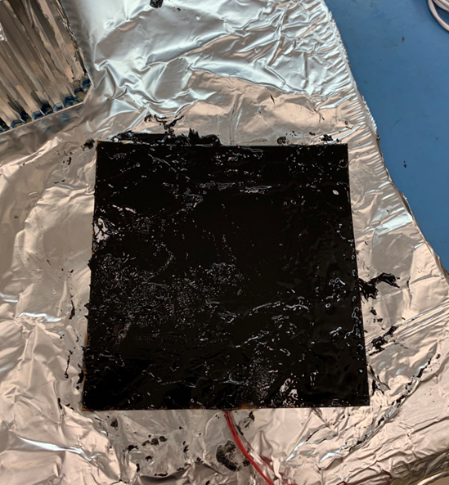
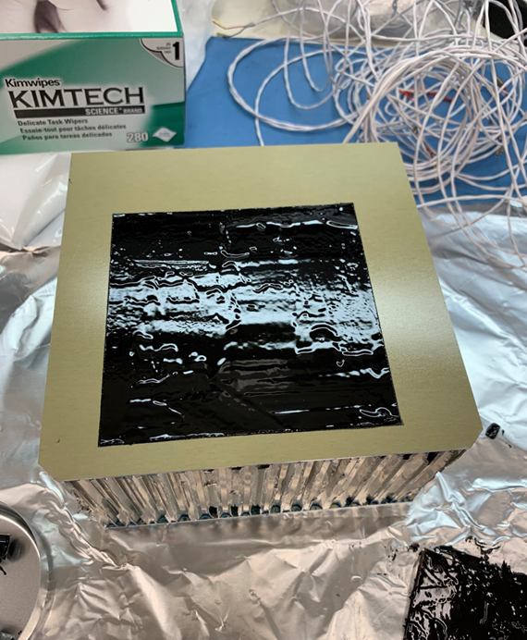
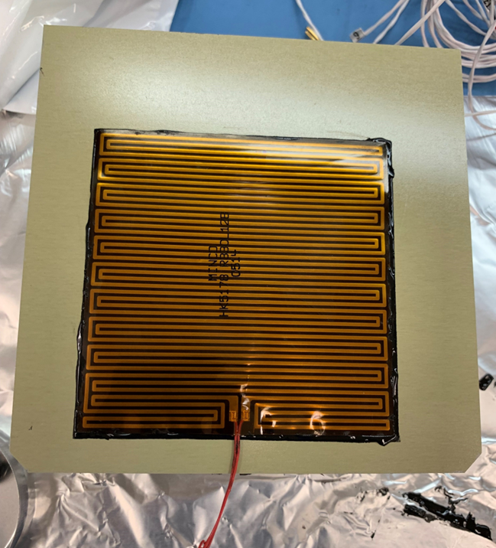
Setting a heater
Once you have a smooth layer on each surface you will want to remove all aluminum tape.
Once the tape has been removed you will place the heater on to the substrate.

Slide 11
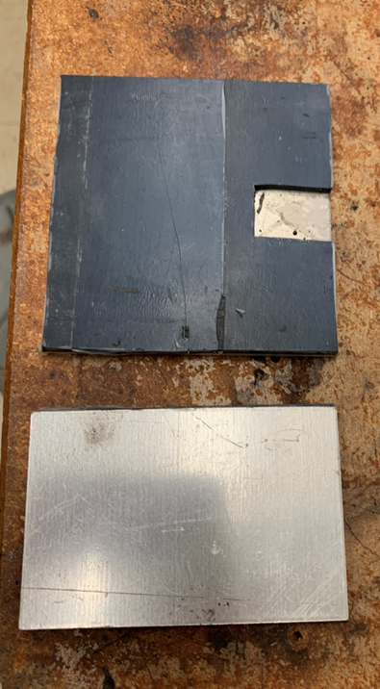
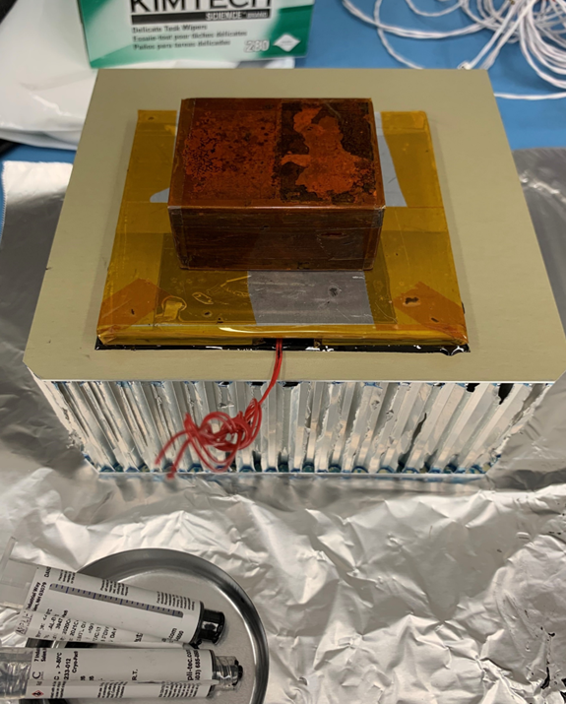
Applying weight
Once you have the heater on the substrate you will add leveling plate.
This plate will be made up of layers.
The first layer will be Teflon tape to hold a rubber pad to a 1/8” aluminum plate and then placing a two-pound weight on top.

Slide 12
Thermocouples
How Themocouples are installed

Slide 13
Thermocouple Installation
Thermocouples are temporary during TVAC testing
Need to stay in place, but removeable after the test
Aluminum Tape (3M425) is standard method
Label T/C bead and miniplug with a vacuum compatible numbers
Bend Thermocouple into a “U” shape
Apply aluminum tape over T/C bead
Burnish Aluminum tape down with a Teflon Stick, etc…

Slide 14
Thermostats, Thermistors, PRTs
How Tstats, thermsitors, PRTs are installed

Slide 15
Applying a Thermistor and PRT
Abrade the location for the sensor and clean with IPA
Add tape to hold the sensor in place while epoxy dries
Add a small bead to the surface under and over the sensor
You can stake the sensor in place with arathane
Notes:
we mask the location of the with 2 layers of aluminum or Kapton tape leaving 1/8in on each side for a fillet.

Slide 16
Eboxes
How Eboxes are installed with Nusil

Slide 17
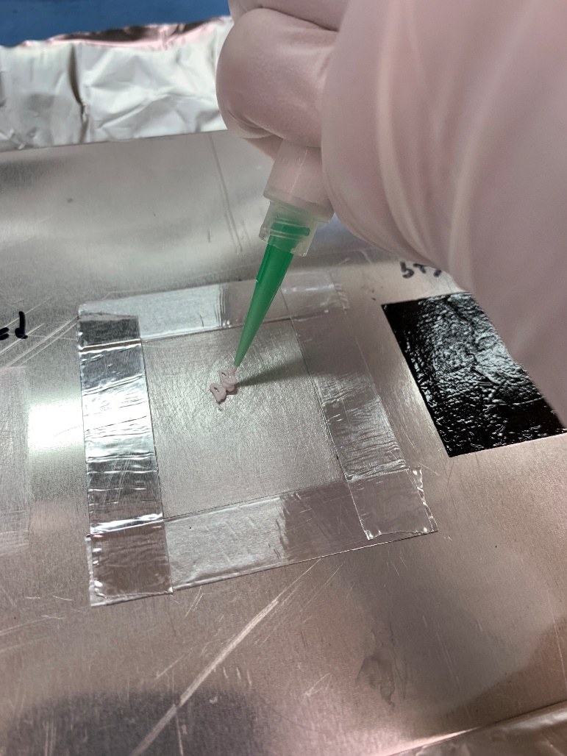
Desired height & Applying Nusil
Clean your mounting surface with IPA and allow to dry.
Add a mold release agent to the Radiator/cold plate
Add the desired amount of aluminum tape for the bond height.
5 mils thick per layer
Add Nusil to the Ebox and smooth it out
Join the electronics box to the mounting surface.
Notes:
we mask the location of the with 2 layers of aluminum or Kapton tape leaving 1/8in on each side for a fillet.

Slide 18
Lessons Learned & Possible Issues
Bonding issues
Accidentally creating bubbles or voids in epoxy.
Bubbles or voids can create hot spots and burn out the heater.
PSA (pressure sensitive adhesive tape) when applied incorrectly can have bubbles or may not fully cover heater surface.
Epoxy can run when applied to a vertical surface, depending on the fluid consistency.
Bonding onto a curved surface can be difficult if a heater is not pre-formed prior to applying.
Heater can spring back
Flight qualified Zip Ties help hold it on if needed.

