Slide 1
Temporary Thermocouple Attachment for Thermal/Vacuum Testing at Non-Extreme Temperatures
Eugene K. Ungar Sarah E. Wright
NASA/Johnson Space Center
Thermal and Fluids Analysis Workshop

Slide 2
Overview
Post-test inspection of a thermal vacuum test article and analysis of test data showed that many test thermocouples had become detached
The Interface Heat Exchanger test article was re-instrumented and the test repeated, yielding much different results
Effort was begun by the NASA Engineering and Safety Center (NESC) to assess and test methods used around the agency to temporarily attach thermocouples
Thermocouple adhesion test will be performed in the near future

Slide 3
Interface Heat Exchanger Test
Thermal/vacuum test was performed to assess the thermal response of an International Space Station Interface Heat Exchanger (IFHX) Orbital Replacement Unit
Qualification unit was instrumented with stick-on type T thermocouples
A layer of Kapton tape was overlaid to secure the junctions
Post-test inspection showed that some of the thermocouples had loosened

Slide 4
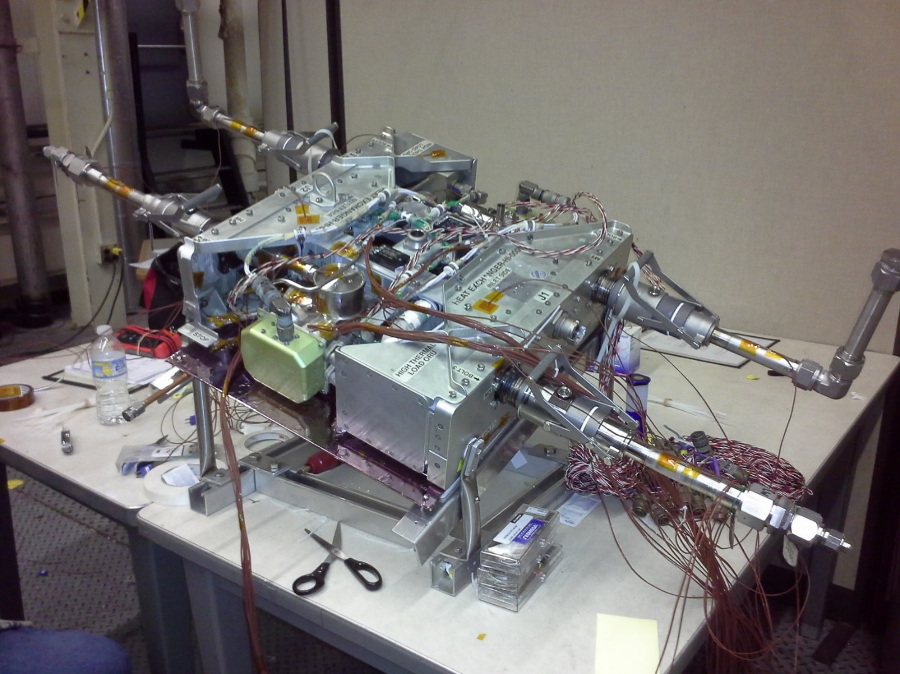
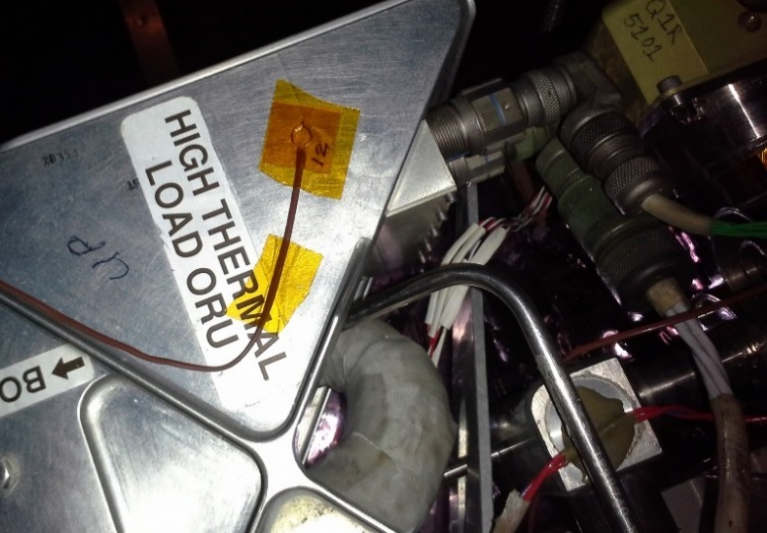
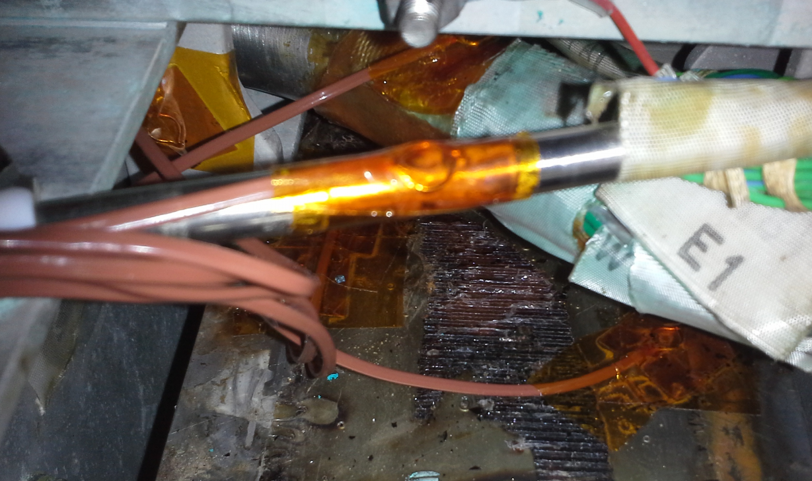
Interface Heat Exchanger Test Set-Up

Slide 5
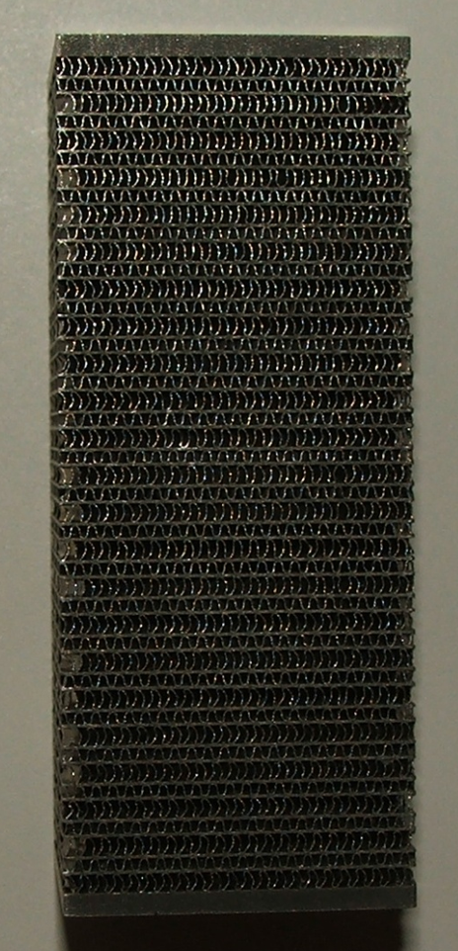
The Heat Exchanger Core
443 mm long, 101 mm wide
63 mm thick
Water Fins are 0.05 mm nickel
NH3 fins are 0.05 CRES 347
Parting sheet is 0.18 mm CRES 347
End sheet is 2.67 mm Inconel 625
23 water passages
Each 1.32 mm high
0.58 mm fin spacing
22 ammonia passages
Each 0.81 mm high
44 fins/inch

Slide 6
Post IFHX Test Assessment
Post-test inspection showed that some of the thermocouples had obviously lifted
When pressed down they felt springy

Slide 7
Post IFHX Test Assessment
Test data indicated a 6.7°C temperature gradient from the top to the bottom of the heat exchanger
bottoms up estimate of effective thermal conductivity is 4 W/m K
300 W/m² by conduction
Cold plate underneath at 20°C with measured ε=0.62
Bottom of heat exchanger with measured ε=0.21
19 W/m² by radiation
Something was clearly wrong
Test article was re-instrumented with epoxied thermocouples and test was rerun
0.5°C temperature gradient from the top to the bottom of the heat exchanger

Slide 8
NESC Canvass
NESC canvassed the centers to identify preferred thermocouple mounting techniques
Johnson Space Center
Commercial 24 ga thermocouples with self-adhesive
On occasion use a bare bead held with Kapton tape
Or sometimes a bare bead held with 3M 425 aluminum tape
Jet Propulsion Laboratory
fabricates 26 ga self-stick thermocouples
Goddard Space Flight Center
Commercial 30 ga thermocouples
Aluminum tape
3M #425
Tape is worked with a wooden stick

Slide 9
NESC Canvass - continued
Kennedy Space Center
Aluminum tape
Either GSA spec tape or 3M #425
Tape is worked with a wooden stick
Langley Research Center
Aluminum tape
3M #425
Tape is worked with a wooden stick
Glenn research Center
no standard
Marshall Space Flight Center
Aluminum tape
Nominally uses 3M #425
Also emphasize strain relief
Either bend TC wire into a U-shape under the tape
Or tape the wire nearby

Slide 10
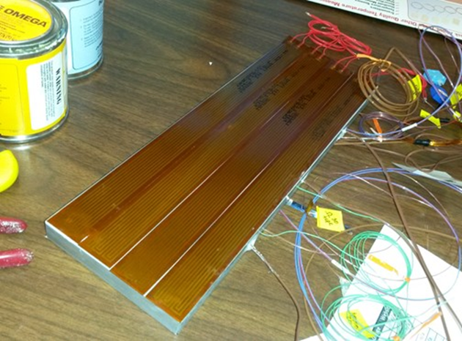
Thermocouple Assessment Test Plan
305 x 101 x 15.9 mm 6061‑T6 aluminum plate suspended in Chamber G
The back side of the plate is covered with four 305 x 25 mm 120 V 120 W Omega Kapton® heaters with pressure sensitive adhesive
The heaters are covered with aluminum tape, then insulated with Nomex felt and Mylar sheet

Slide 11
Thermocouple Assessment Test Plan - continued
Three 24 gauge type T RTK control thermocouples are potted into the plate using Omegabond 101 thermally conductive epoxy
The front surface of the plate is covered with 0.025-mm adhesive-backed aluminized Kapton® film with emissivity of 0.63
The Kapton® was removed from small areas to allow the test thermocouples to be mounted directly to the aluminum surface

Slide 12
Thermocouple Assessment Test Article
1
2
3
6
9
12
16
8
15
14
5
11
13
7
10
4

Slide 13
Thermocouple Assessment Legend
TC # | Gauge | Description
1 | 24 | RDF 26895 in 1/4" hole drilled <1" deep. Potted with Omega Bond thermally conductive epoxy.
2 | 24 | RDF 26895 in 1/4" hole drilled <1" deep. Potted with Omega Bond thermally conductive epoxy.
3 | 24 | RDF 26895 in 1/4" hole drilled <1" deep. Potted with Omega Bond thermally conductive epoxy.
4 | 24 | Omega 5TC-TT-T-24-36 T/C on bare aluminum. Covered with GSA aluminum tape.
5 | 30 | Omega 5TC-TT-T-30-36 3on bare aluminum. Covered with 3M #425 aluminum tape.
6 | 36 | Omega SA1-tl-1M self adhesive thermocouple.
7 | 24 | RDF 26895 placed on bare aluminum. Covered with GSA aluminum tape.
8 | 36 | Omega SA1-tl-1M self adhesive thermocouple.
9 | 26 | JPL-2 thermocouple.
10 | 30 | Omega 5TC-TT-T-30-36 T/C on bare aluminum. Covered with GSA aluminum tape.
11 | 24 | Omega 5TC-TT-T-24-36 T/C on bare aluminum. Covered with 3M #425 aluminum tape.
12 | 24 | RDF 26895 placed on bare aluminum. Covered with 3M #425 aluminum tape.
13 |  | Digisense GH-08519-54 self adhesive thermocouple.
14 | 26 | JPL-5 thermocouple.
15 | 32 | RDF 26895-36 self adhesive thermocouple.
16 | 30 | GSFC 30 gauge with strain relief. Covered with 3M #425 aluminum tape.

Slide 14
Thermocouple Assessment Test Plan
Test Point | Temperature (C) | Notes
Cal 1 | 21 ± 5 | Steady-state at vacuum before coldwalls are applied
1 | 27 ±5 | Temperature drift less than 0.05°C/hr
2 | -9 ±5 | Temperature drift less than 0.05°C/hr
3 | -46 ±5 | Temperature drift less than 0.05°C/hr
4 | -9 ±5 | Temperature drift less than 0.05°C/hr
5 | 27 ±5 | Temperature drift less than 0.05°C/hr
6 | 66 +5/-0 | Temperature drift less than 0.05°C/hr
7 | 27 ±5 | Temperature drift less than 0.05°C/hr
8 | -84 +0/-5 | Temperature drift less than 0.05°C/hr
9 | -46 ±5 | Temperature drift less than 0.05°C/hr
10 | 27 ±5 | Temperature drift less than 0.05°C/hr
11 | 66 +5/-0 | If time allows
12 | -84 +0/-5 | If time allows
Cal 2 | 21 ±5 | Steady-state at vacuum after coldwall heatup

Slide 15
Expected Outcome
We expect to obtain sufficient data to allow us to recommend one or more methods of temporary thermocouple attachment

