Slide 1
Advanced Features of Thermal Desktop/SINDA-FLUINT: I. Interface with Matlab Xiao-Yen Wang II. Using SpaceClaim for Complex Geometries William Fabanich
TFAWS Passive Thermal Paper Session
Presented By Xiao-Yen Wang & William Fabanich
Thermal & Fluids Analysis Workshop TFAWS 2016 August 1-5, 2016
NASA Ames Research Center
Mountain View, CA

Slide 2
Contents
Advanced features of Thermal Desktop/SINDA-FLUINT
Thermal Desktop® (TD) interface with Matlab
SINDA-FLUINT interface with Matlab
Provides great flexibility in using the functionality of Matlab
Use SpaceClaim/TD Direct to incorporate complex geometries into TD.
Demonstration of these advanced features
Lunar Dust thermal model
TD interface with Matlab
Advanced Stirling Radioisotope Generator (ASRG) thermal power model
SINDA-FLUINT interface with Matlab
ASRG thermal power model with SpaceClaim/TD Direct

Slide 3
Interface with Matlab
Part I:
TD and SINDA-FLUINT interface with Matlab
Xiao-Yen Wang
NASA Glenn Research Center

Slide 4
Lunar Dust Project
Lunar Dust Project:
On the Moon, dust can significantly change the optical properties of coating materials (Reference: NASA TM 2008-215492, James Gaier, etc)
For AZ-93, dust lowered emissivity by as much as 16%
For Ag/FEP, dust raised emissivity by as much as 11%.
Tests were performed to determine the optical properties of AZ-93 and Ag/FEP coatings (i.e., emissivity ɛ and solar absorptivity α) under different conditions:
Heating (with a solar simulator) and cooling (in a 30 K coldbox)
The sample disc surface can be pristine, clean, or sub-monolayer dust covered
The time history of temperature of the center of the sample disc was recorded for the length of 500 s to 10,000 s.
Test data is labeled as “cooling curve” and “heating curve” for cooling and heating test conditions (a series of Excel spreadsheets).

Slide 5
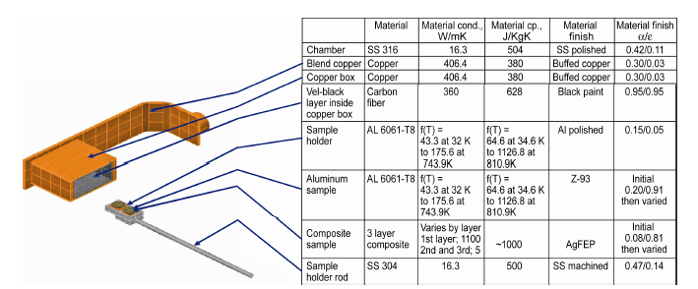
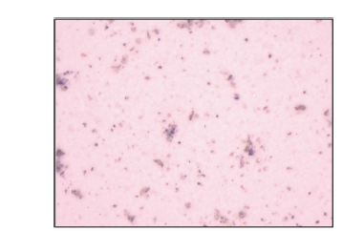
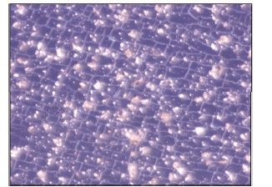
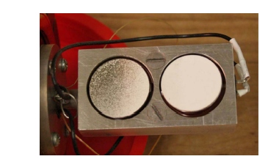
Lunar Dust Test Rig
Reference: NASA TM 2008-215492, James Gaier, etc
Test Rig
Photomicrographs
Sample of dusted disk
AZ-93
Ag/FEP

Slide 6
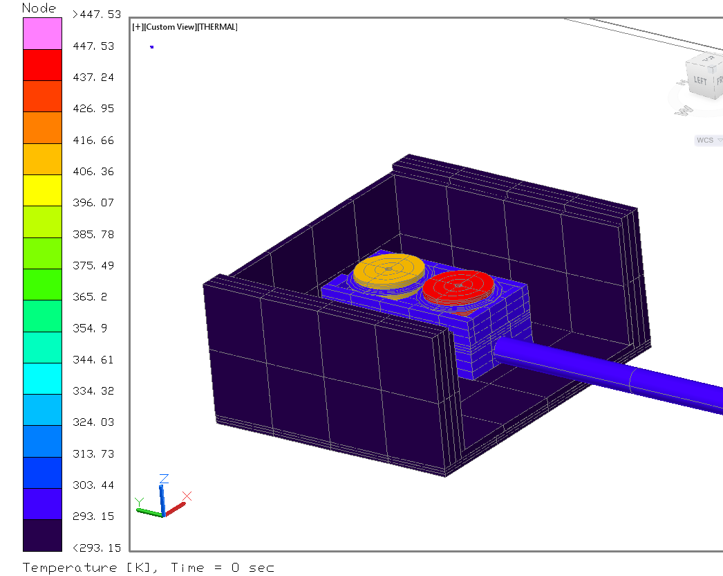
Lunar Dust Thermal Model
Thermal Model for the Lunar Dust Project
Objective was to determine the optical properties of clean and dusted sample discs.
A thermal model of the sample disc in the test rig was built using TD.
Disc temperatures were calculated with TD for assumed values of ɛ and α.
Ag/FEP
AZ-93
Lunar Dust TD thermal model originally built by John Siamidis at GRC
Sample disc inside an enclosure

Slide 7
Lunar Dust Thermal Model
Since the TD model results need to match the test data, an iterative method of varying ɛ and α was used to determine the actual values of ɛ and α.
The differences between model results and test data are defined as:
err1 and err2 < 5.0e-4 is considered the solution is converged.
Matlab was programed to perform these iteration procedures automatically ( read in the Excel sheets, find err1 and err2, update ɛ and α).
This feature saved time and the user’s effort of manually inputting the optical property values.
This feature allowed hundreds of cases to be run in a short time with eliminated input errors.
err1 $=\sum_{t=0}^{t_n}{\left(T_{AZ−93}^{model}−T_{AZ−93}^{test}\right)}$
err2 $=\sum_{t=0}^{t_n}{\left(T_{Ag/FEP}^{model}−T_{Ag/FEP}^{test}\right)}$

Slide 8
Steps need to be performed
For each case, three steps need to be followed:
Step 1: Use Cooling curve to compute ɛ of AZ-93 and Ag/FEP.
Users need to give initial values of ɛ for AZ-93 and Ag/FEP.
Two variables
Step 2: Use Pristine Heating curve to compute lamp power and α of Ag/FEP.
First, define a constant α of Ag/FEP, solve power lamp by checking err1 (AZ-93 curve).
Then With the correct lamp power, solve α of Ag/FEP by checking err2 (Ag/FEP curve). Users also need to define the correct ɛ obtained in Step 1.
Two variables
Step 3: Use Heating curve for "Dust," "Clean," or "Clean2" to compute α of AZ-93 and Ag/FEP by checking err1 and err2. Users also need to define the correct ɛ obtained in Step 1 and lamp power obtained in Step 2.
Two variables
Note that within each step, the iteration procedure will be performed.

Slide 9
Iteration Procedure in Matlab
Give initial values of ɛ and/or α of AZ-93 and Ag/FEP
2) Call TD model to run and get the data of T_{AZ-93} and T_{Ag/FEP}
No
< 5.0E-4
Yes
3) Then compute err1 and err2 (difference between model results and test data)
4)Then output the actual values of ɛ and/or α
Check convergence criteria
(err1 and err2 < 5.0E-4 )
4)Then update ɛ and/or α of AZ-93 and Ag/FEP
9

Slide 10
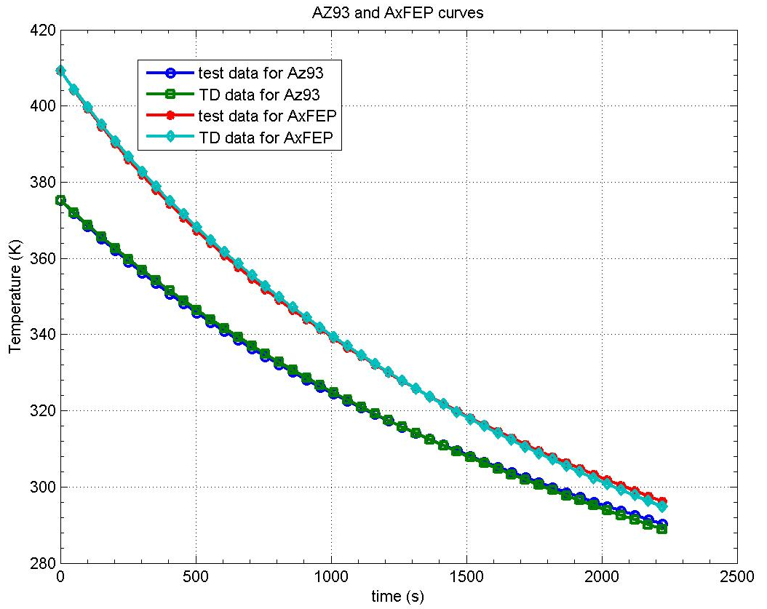
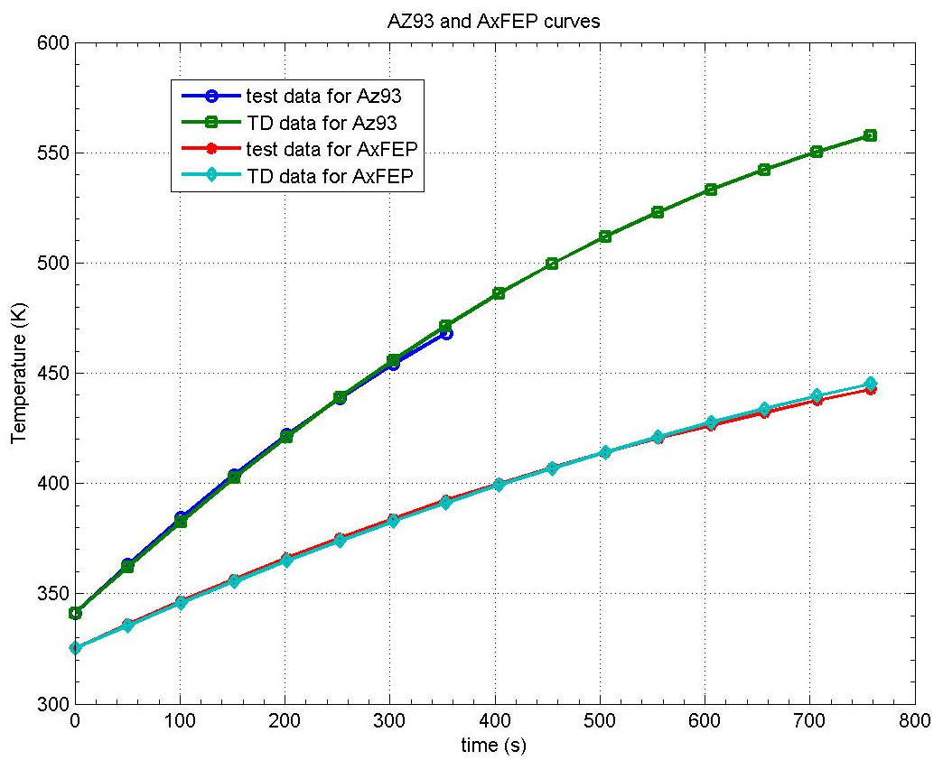
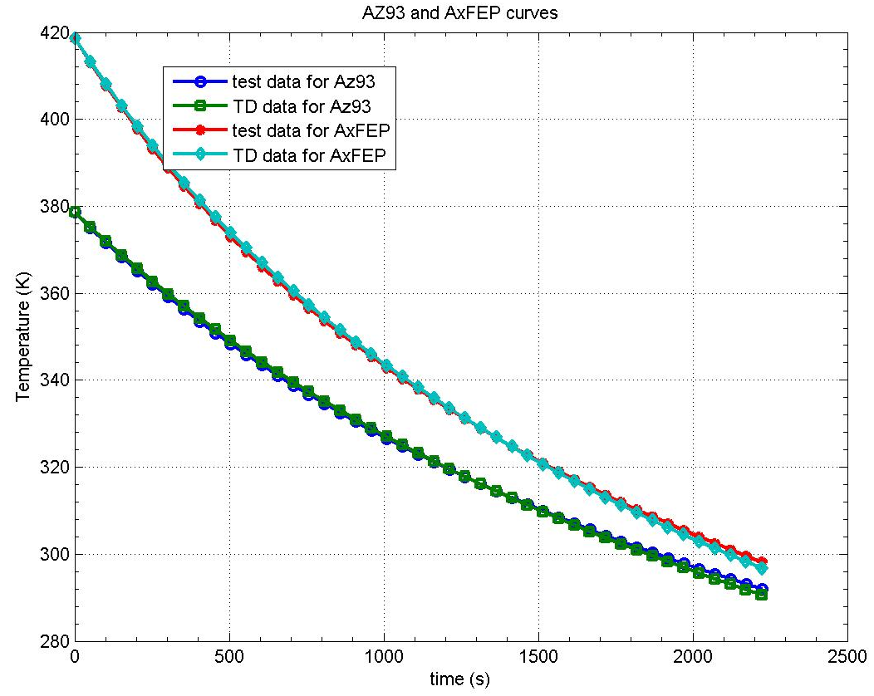
Lunar Dust Thermal Model
Pristine, Heating case
Pristine, cooling case
Dust, Heating case
Dust, cooling case

Slide 11
Lunar Dust Thermal Model
 | Raw Data |  | Sample Condition | Emissivity |  | alpha |  | Lamp Power |  | LTF
Case | AZ-93 | Ag/FEP |  | AZ-93 | Ag/FEP | AZ-93 | Ag/FEP | Factor | Watts | Analyst | Checker
1 | 1008 | 1022 AlFEP | Pristine | 0.750 | 0.750 | 0.147 | 0.1565 | 1 | 17960 | Harpster | Guzik
 |  |  | Dusted | 0.602 | 0.719 | 0.325 | 0.303 | 1 | 17960 | Harpster | Guzik
 |  |  | Cleaned | 0.770 | 0.803 | 0.220 | 0.344 | 1 | 17960 | Harpster | Guzik
2-1 | 1009 | 1026 AlFEP | Pristine | 0.746 | 0.738 | 0.143 | 0.157 | 1 | 18330 | Harpster | Guzik
 |  |  | Dusted | 0.751 | 0.810 | 0.453 | 0.318 | 1 | 18330 | Harpster | Guzik
 |  |  | Cleaned | 0.778 | 0.827 | 0.404 | 0.335 | 1 | 18330 | Harpster | Guzik
2 | 1009 | 1026 AlFEP | Pristine | 0.746 | 0.738 | 0.143 | 0.157 | 1 | 18330 | Harpster | Guzik
 |  |  | Dusted | 0.751 | 0.810 | 0.453 | 0.318 | 1 | 18330 | Harpster | Guzik
 |  |  | Cleaned | 0.778 | 0.827 | 0.409 | 0.339 | 0.99 | 18147 | Harpster | Guzik
3-1 | 1010 | 1027 AlFEP | Pristine | 0.777 | 0.722 | 0.143 | 0.161 | 1 | 17115 | Harpster | Guzik
 |  |  | Dusted | 0.765 | 0.791 | 0.425 | 0.513 | 1 | 17115 | Harpster | Guzik
 |  |  | Cleaned | 0.783 | 0.803 | 0.324 | 0.535 | 1 | 17115 | Harpster | Guzik
3 | 1010 | 1027 AlFEP | Pristine | 0.777 | 0.722 | 0.143 | 0.161 | 1 | 17115 | Harpster | Guzik
 |  |  | Dusted | 0.765 | 0.791 | 0.428 | 0.516 | 0.99 | 16997 | Harpster | Guzik
 |  |  | Cleaned | 0.783 | 0.803 | 0.331 | 0.546 | 0.98 | 16761 | Harpster | Guzik
An example of results summary sheet:
For each case: 4x3 + 1 = 13 variables need to be determined.
We have hundreds cases.

Slide 12
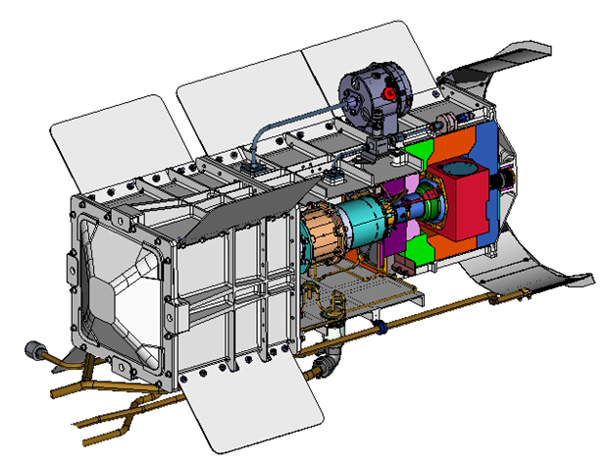
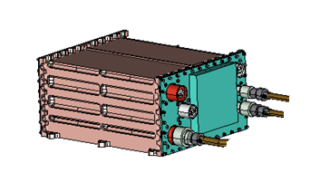
Advanced Stirling Radioisotope Generator
ASRG was developed as a high efficiency (28%-32%) thermal electric power system for multi mission applications
ASRG can reduce the required amount of Pu-238 by a factor of 4 as compared to radioisotope thermoelectric generators (RTG)
Pressure Relief Device (PRD)
ASC (2)
GPHS (2)
GMV (1)
PRD (1)
Housing (1)
Gas Management Valve (GMV)
Heat Source Support
Analog Telemetry to SC
Shunt Dissipator Unit
Thermal Insulation
General purpose heat source (GPHS)
Advanced Stirling convertor(ASC)
AC Power
Piston Position Telemetry
Shunt Power
Overview of ASRG components

Slide 13
ASRG thermal power model
Matlab was used to integrate the 3D ASRG thermal
model in TD/SINDA-FLUINT, ASC model in Sage, and
control strategy of ASC.
ASRG Thermal model in TD/SINDA-FLUINT
Finite Element/Finite Difference Mesh for the geometries
Heat source, insulation blocks, the housing
Radiation/conduction/convection heat transfer and orbital heating
The ASC is a black box in TD/SINDA-FLUINT, but modeled with the
SAGE code, which determines the temperatures and heat flux values
throughout the ASC.
ASC control strategy:
Fix the T_{h} (hot end temperature of ASC)
Fix the A_{p} (piston amplitude of ASC)
Iterations were performed within Matlab to achieve the thermal energy balance between ASRG thermal model and ASC.

Slide 14
Iterative procedure implemented with Matlab
Choose ASC control strategy. Give initial values of R_{6_hot} and Q_{rej}
2) Run the SINDA-FLUINT model to compute T_{h} , T_{c} , and Q_{in}
< 1E-4
No
Yes
7) Run SAGE model to compute
power output at
alternator
3) Use obtained T_{h} , T_{c} , and Q_{in} to update the R_{6_hot} and Q_{rej} by running SAGE model
5) Check convergence criteria (difference < 1E-4)
4) Calculate the difference of R_{6_hot} and Q_{rej} between two iterations
14

Slide 15
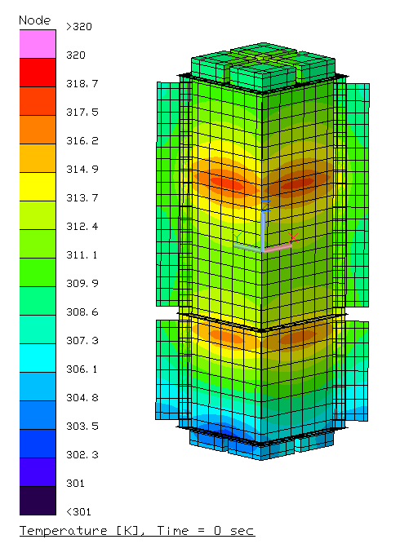
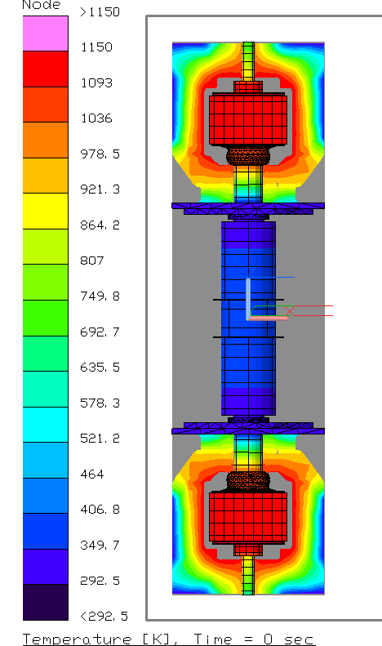
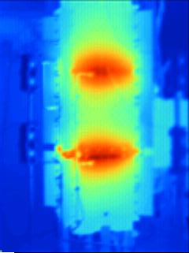
ASRG Thermal Power Model Results
317 K
293 K
forced convection case
ASRG thermal image

Slide 16
SpaceClaim/TD direct
Part II:
SpaceClaim/TD-Direct Application
William Fabanich
NASA Glenn Research Center

Slide 17
ASRG Thermal Power Model
Challenge - ASRG program requirements:
Power prediction => System Level Model
But…also want to track heat flow around GPHS and Stirling engine => High Fidelity Model.
Challenge – Thermal analyst needs to:
Build model that can be run as a system model
Easily run many cases – different environments/operating parameters/etc.
Therefore, need to limit model complexity.
Maintain level of fidelity to meet researchers needs.
Can be difficult with TD primitives.
Solution…SpaceClaim/TD-Direct

Slide 18
ASRG Thermal Power Model
SpaceClaim/TD-Direct
Importing common CAD formats.
Repair and defeaturing/simplification of the geometries.
Generating FE meshes that maintain the needed geometric fidelity.
Creating assemblies that can be re-imported as multiple instances in a TD model.
Example: ASRG Insulation Block
Maintaining a high fidelity geometry of the insulation block around the general purpose heat source (GPHS) was required to characterize the heat loss paths.
The TD model of the ASRG with a finite element mesh generated by SpaceClaim provided an accurate (compared to EU test data) estimate of heat loss through the insulation.

Slide 19
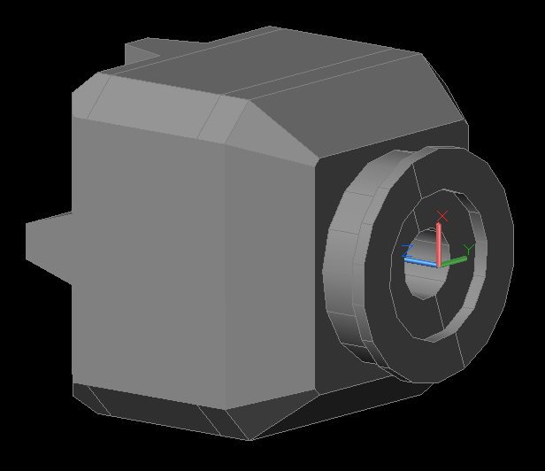
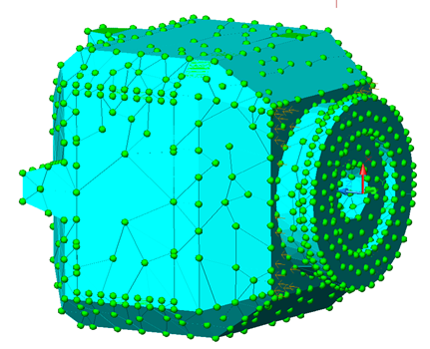
ASRG Thermal Power Model
Interest in a highly detailed model of the internal heat flows necessitated use of SpaceClaim/TD Direct to create FE components from the original CAD.
TD does has a FE native mesher…but…doesn’t have extended features of TD Direct.
At first – ASRG insulation block done with native mesher…
Difficult import – each piece individually.
Original CAD poor quality – (not obvious/hard to repair).
Contactor to/from area nightmare – had to create 76 AutoCad Groups.
Mesh hard to control.
Making a geometry change = starting over.

Slide 20
ASRG Thermal Power Model
ASRG Insulation Block CAD
Done in ProE.
Two Versions:
EU (Engineering Unit)
Flight Unit
EU Insulation
Original CAD - “issues” that Space Claim made easy to fix.
Flight Insulation
SpaceClaim/TD Direct made it easy to update ASRG TD model from EU to Flight insulation.

Slide 21
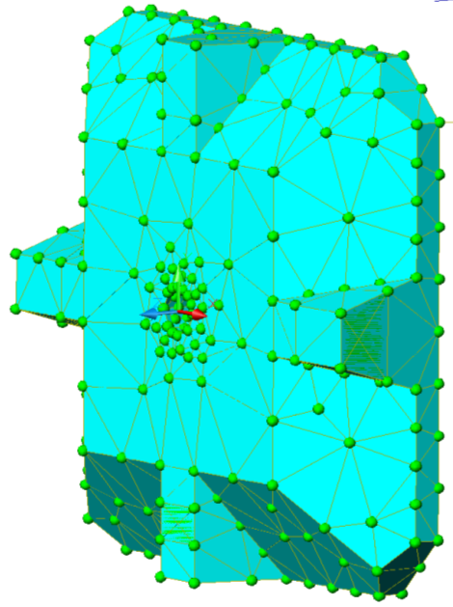
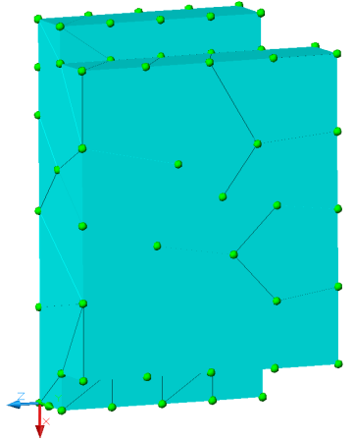
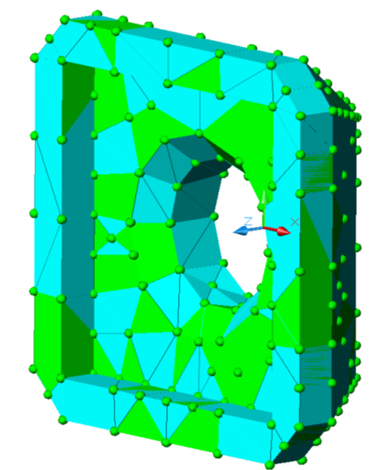
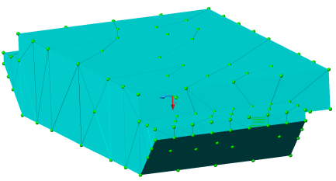
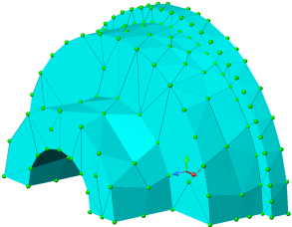
EU Insulation – Meshed w/ native Mesher.
8 pieces per end (5 unique)

Slide 22
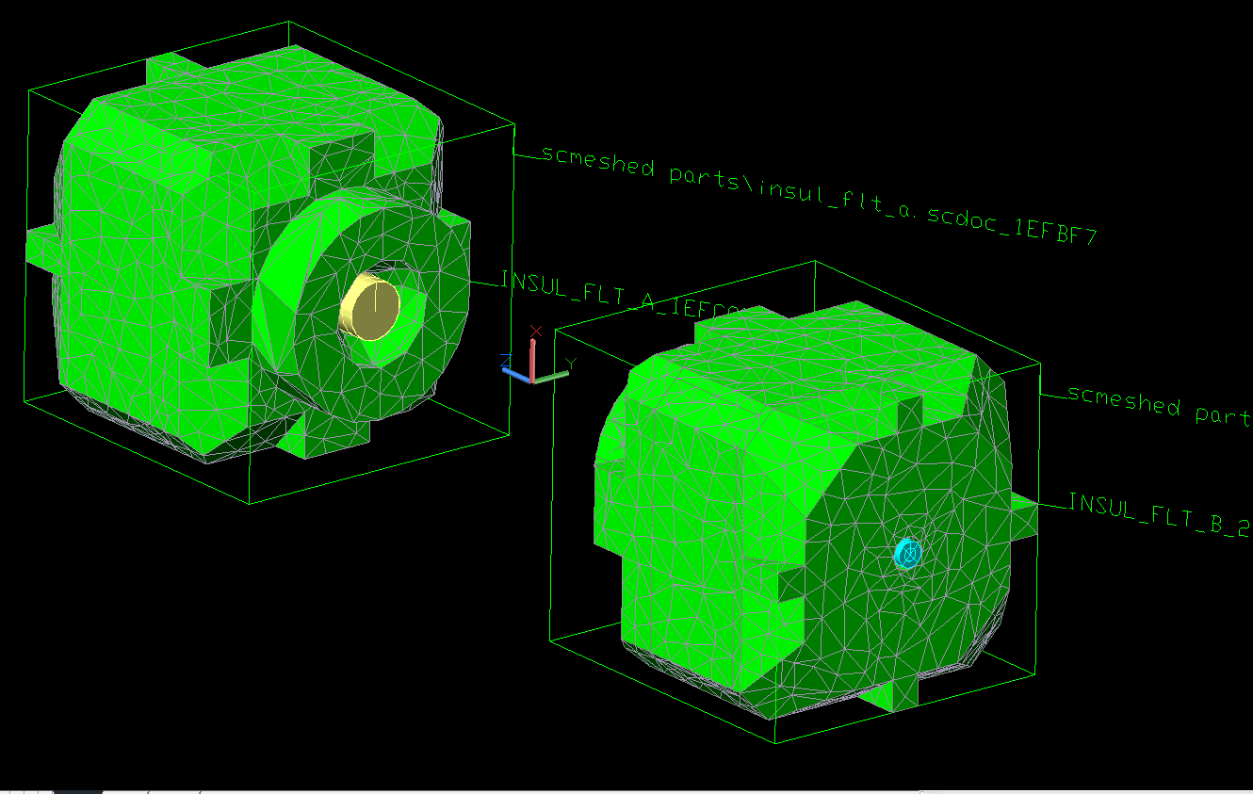
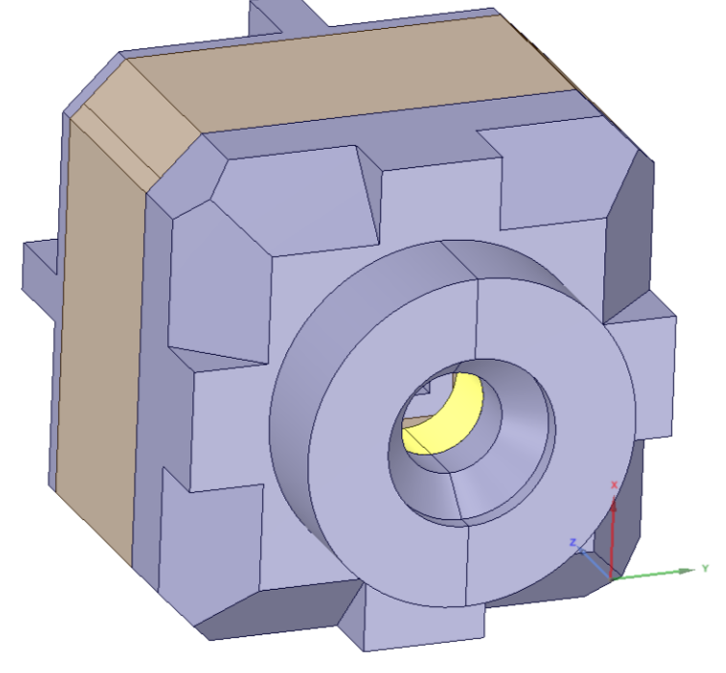
ASRG Thermal Power Model
ASRG Flight Insulation:
Overall dimensions the same – some difference from EU.
Same number of pieces – but some interfaces are different.
SpaceClaim/TD Direct – quick/easy to add thermal and meshing tags – take advantage of existing contactors and RAGs in existing ASRG TD model.
Pieces had directional thermal conductivity – applied material orienter tags.
Two instances of insulation in ASRG model – only need to do work once.

Slide 23
ASRG Thermal Power Model
Special Case
“Engine Out” Scenario
All GPHS heat ends up going through insulation – GPHS at risk of melting.
Insulation “shrinks” – increased thermal conductivity allows increased heat flow to housing.
Investigate effect this has on remaining Stirling performance.
Need to change:
Insulation Block geometry on one side of ASRG model to match shrunken insulation.
Change thermophysical properties for shrunken insulation.

Slide 24
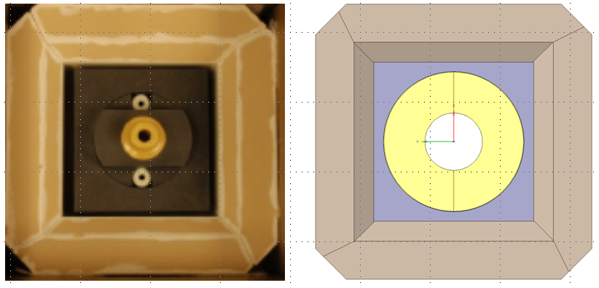
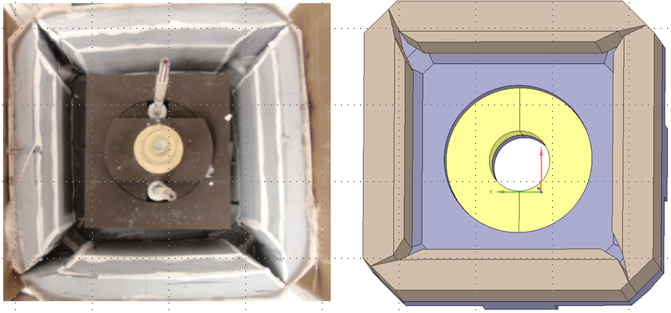
ASRG Thermal Power Model
Before:
After:

Slide 25
ASRG Thermal Power Model
Flight Insulation – Midsection View
(l): Normal Operation; (r) Post Heat-Dump/Shrunk

Slide 26
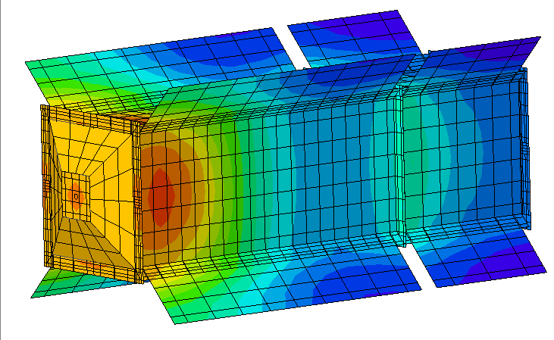
ASRG Thermal Power Model

Slide 27
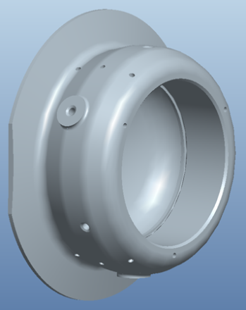
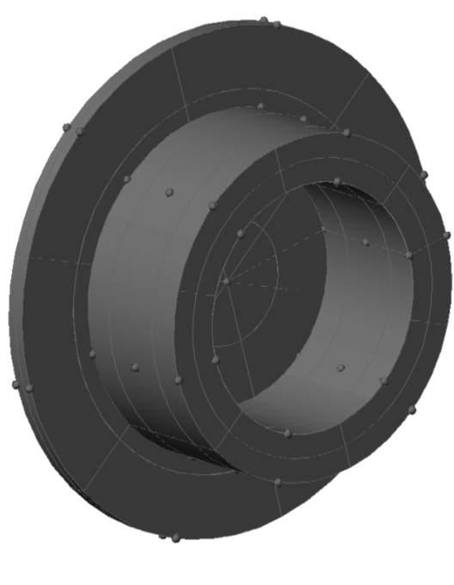
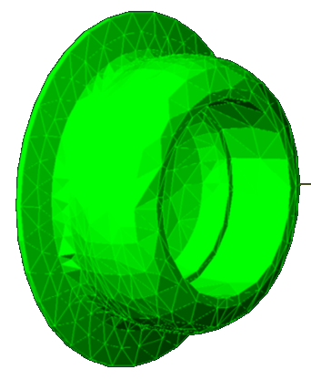
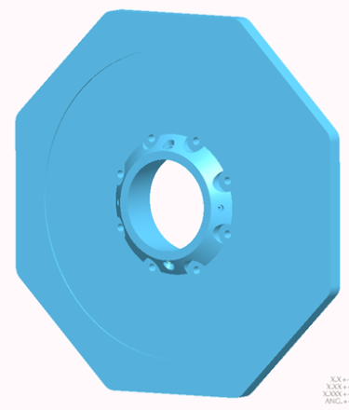
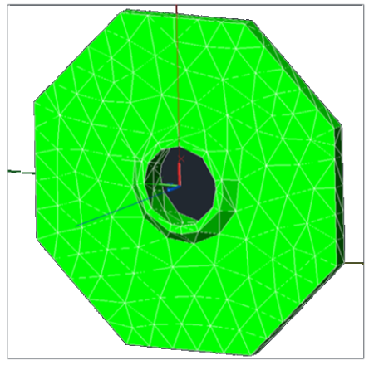
ASRG Thermal Power Model
These geometries were originally (pre- SpaceClaim/TD Direct) modeled with FD primitives (CSAF, heat collector) and TD Mesher (insulation).

Slide 28
SpaceClaim/TD Direct Summary
SpaceClaim/TD Direct advantages:
Gains in speed/ease of import and preparation of geometry.
Tools for import, repair, defeaturing/simplification, and FE meshing.
Ability to update meshes without losing and then having to redefine network elements (e.g. heat loads, contactors).
In some cases, provide more accurate results.
Maintain high geometric fidelity.
Easier to maintain high geometric fidelity while maintaining control over total node/element count.
Also good for easy generation of complex geometries from scratch.
As always…up to analyst to make choices.
Understand limits of tools.
Understand needs of analysis.
Hope to hear about other TD users using this tool – and share their experience and knowledge.
Notes:
1:
Might not produce a better model…but will allow you to produce the same good model quicker.

Slide 29
Summary
Advanced features of Thermal Desktop (w. SpaceClaim/TD Direct) and SINDA-FLUINT have been applied to challenging thermal modeling.
TD/SINDA-FLUINT can interface with Matlab, allowing users to use functionality of Matlab with them. It becomes a very powerful tool for solving complex problems, saves time and reduce errors.
SINDA-FLUINT allows user to control many parameters in the model, which makes SINDA-FLUINT unique and powerful.
SpaceClaim fills the gap for TD to use FEM for complex geometries. TD/SINDA-FLUINT can model primitive and complicated geometries.

Slide 30
Acknowledgements
Great appreciation to George Harpster, James Yuko and Duane Beach at GRC for valuable input reviewing this paper.
Many thanks to John Siamidis for the initial build of the Lunar Dust TD model and Justin Elchert for additional Lunar Dust Matlab/TD case runs. George Harpster leading role in Lunar dust project.
Great appreciation to Douglas Bell at C& R Tech for his valuable help all the time. His patience and willingness to help are always so much appreciated!
Also like thank Tim Panczak, Mark Schmidt, Doug Bell, and Cindy Beer for invaluable assistance in learning and using SpaceClaim/TD Direct.

