Slide 1

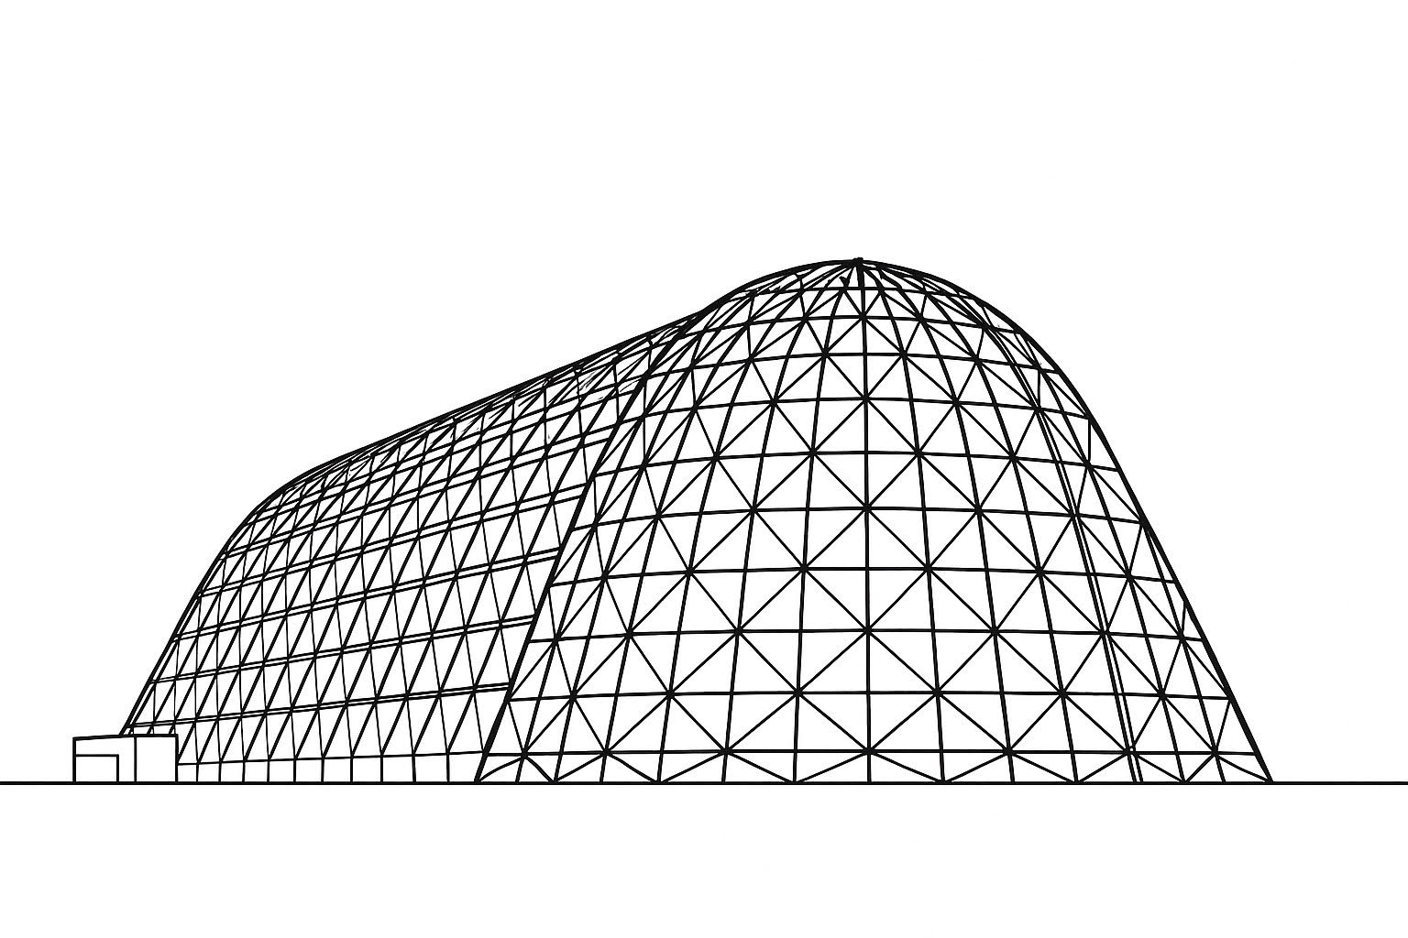

[Presentation Title Presentation Title Presentation Title Presentation Title Presentation Title Presentation Title]
TFAWS 2025 Passive Thermal Technical Session
Replace Passive Thermal with Active Thermal, Aerosciences, Cryogenics, or Interdisciplinary, depending on session topic
Presented by: [your name]
[List of author names]
[List of affiliations]
Thermal & Fluids Analysis Workshop 2025
NASA Ames Research Center
San Jose, CA
August 4-7, 2025

