Slide 1
Lunar Gateway Space Station Thermal Control Systems Overview
TFAWS Short Course
Presented By
Miguel Perez, JETS
Lead Gateway Active Thermal Analyst
Lisa Erickson, NASA JSC
Gateway Active Thermal Analyst
Latham Speasmaker, JETS
HALO Active Thermal Analyst
Christian Thornton, JETS
HALO Active Thermal Analyst
Jonah Smith, JETS
Lead Gateway Passive Thermal Analyst
Lourdes Ibrahim, JETS
Lead Gateway Passive Thermal Systems Engineer
Thermal & Fluids Analysis Workshop TFAWS 2023 August 21-25, 2023
NASA Goddard Space Flight Center
College Park, MD

Slide 2
In Greek mythology, Artemis is the goddess of the Moon and the twin sister of Apollo.
Now, Artemis personifies our path to the Moon as the name of NASA’s campaign to return astronauts, including the first woman and first person of color, to the lunar surface.
Supporting the Artemis Program, the Lunar Gateway Space Station will be a foundational element of NASA’s planned infrastructure on and around the Moon and for deep space travel, along with the Orion spacecraft, Space Launch System (SLS) rocket, Human Landing System (HLS), and the Extra Vehicular Activity (EVA) & Human Surface Mobility (HSM) Programs.

Slide 3
I-III: INITIAL OPERATIONS TO THE MOON

Slide 4
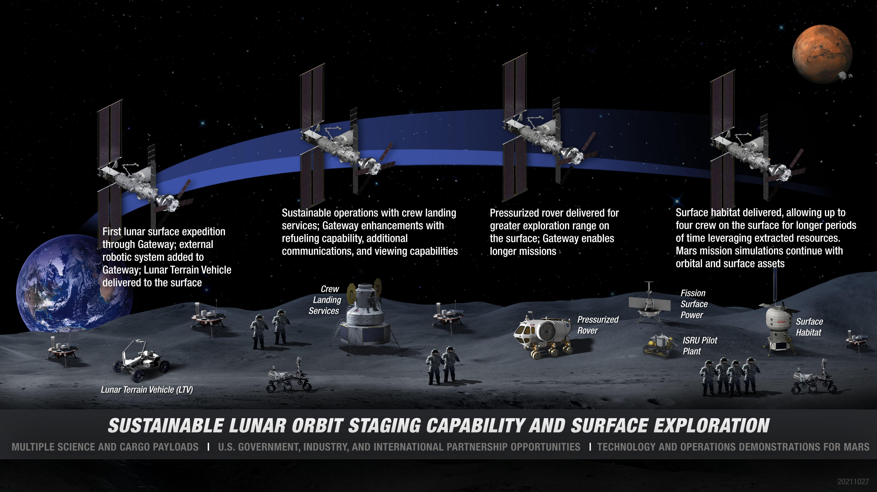
IV-VII+: SUSTAINING MISSIONS TO THE MOON

Slide 5
TIMELINE: SUSTAINING MISSIONS TO THE MOON

Slide 6
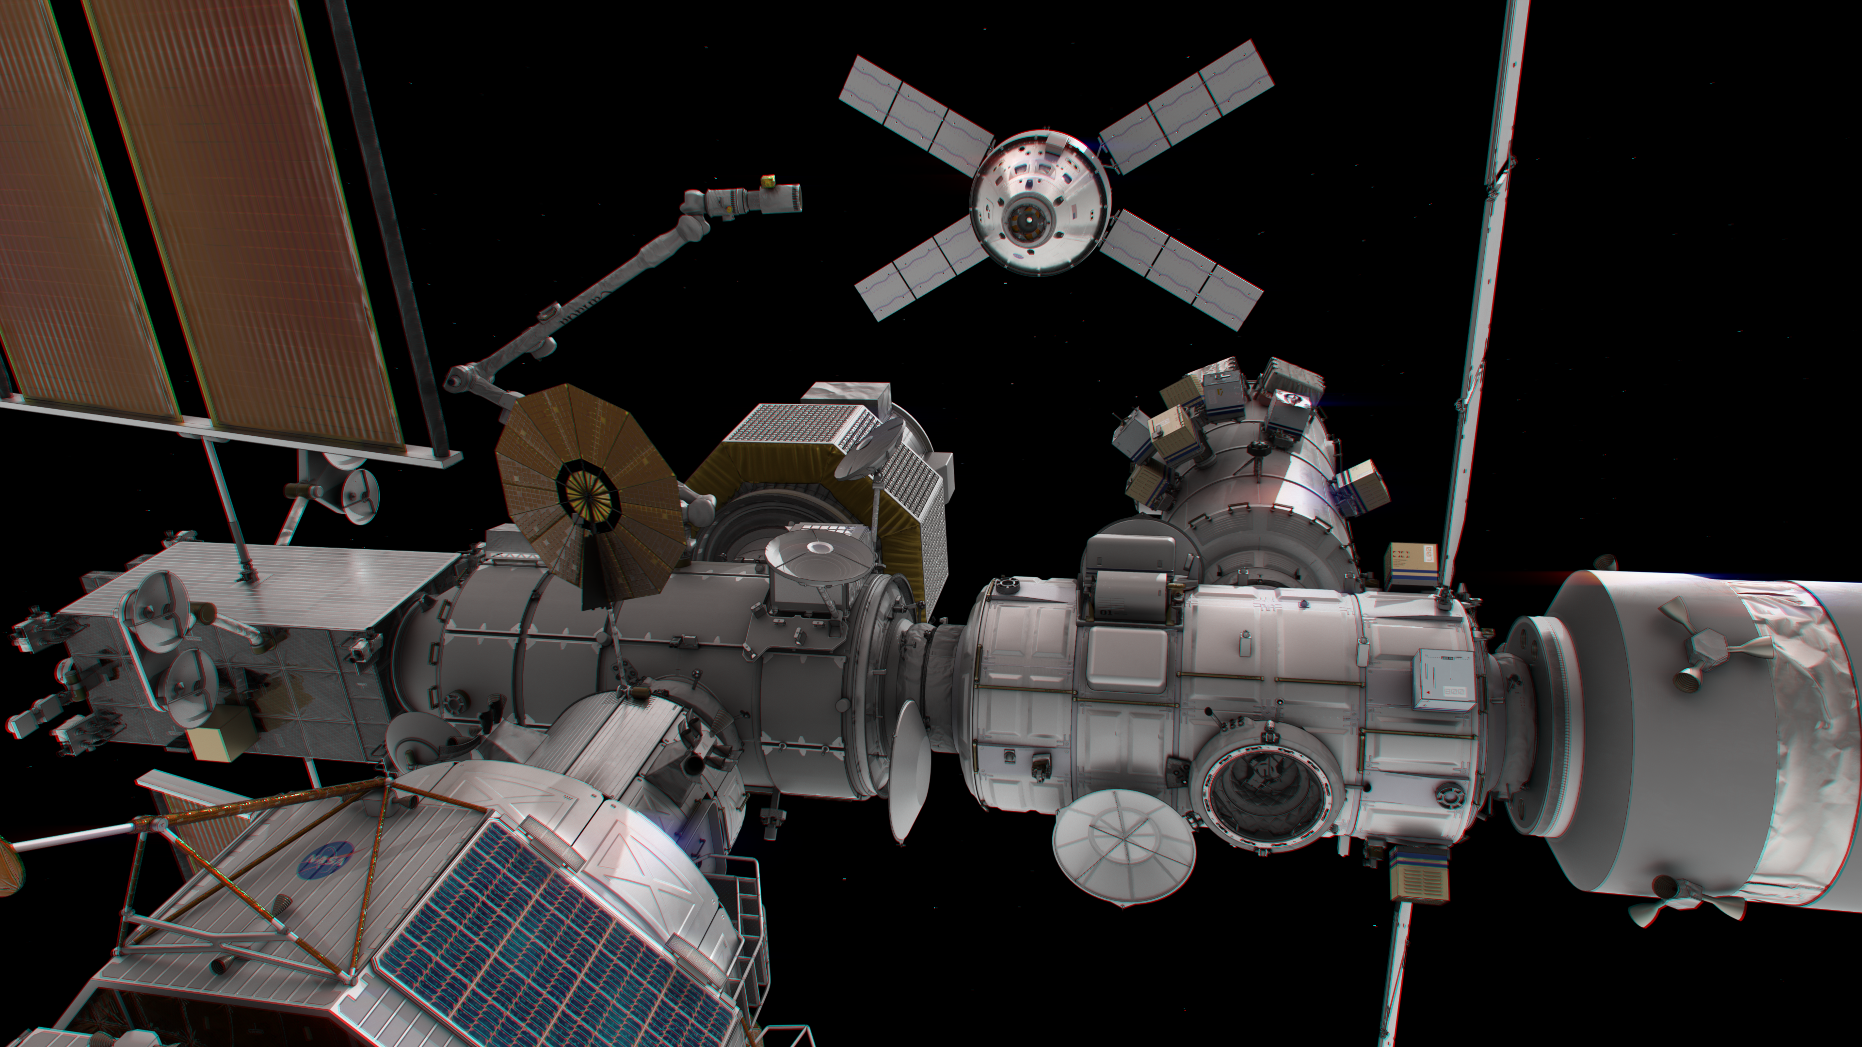
GATEWAY: A FOUNDATION IN DEEP SPACE
Gateway will be a multi-element space station in cis-lunar orbit.
On and around the Moon, we can take reasonable risks, perform groundbreaking science, and prove technologies and mature systems necessary while astronauts are just days away from home.
Notes:
an outpost in lunar orbit that will be a staging point for human and robotic exploration in deep space and will serve as a technology test bed for Mars.

Slide 7
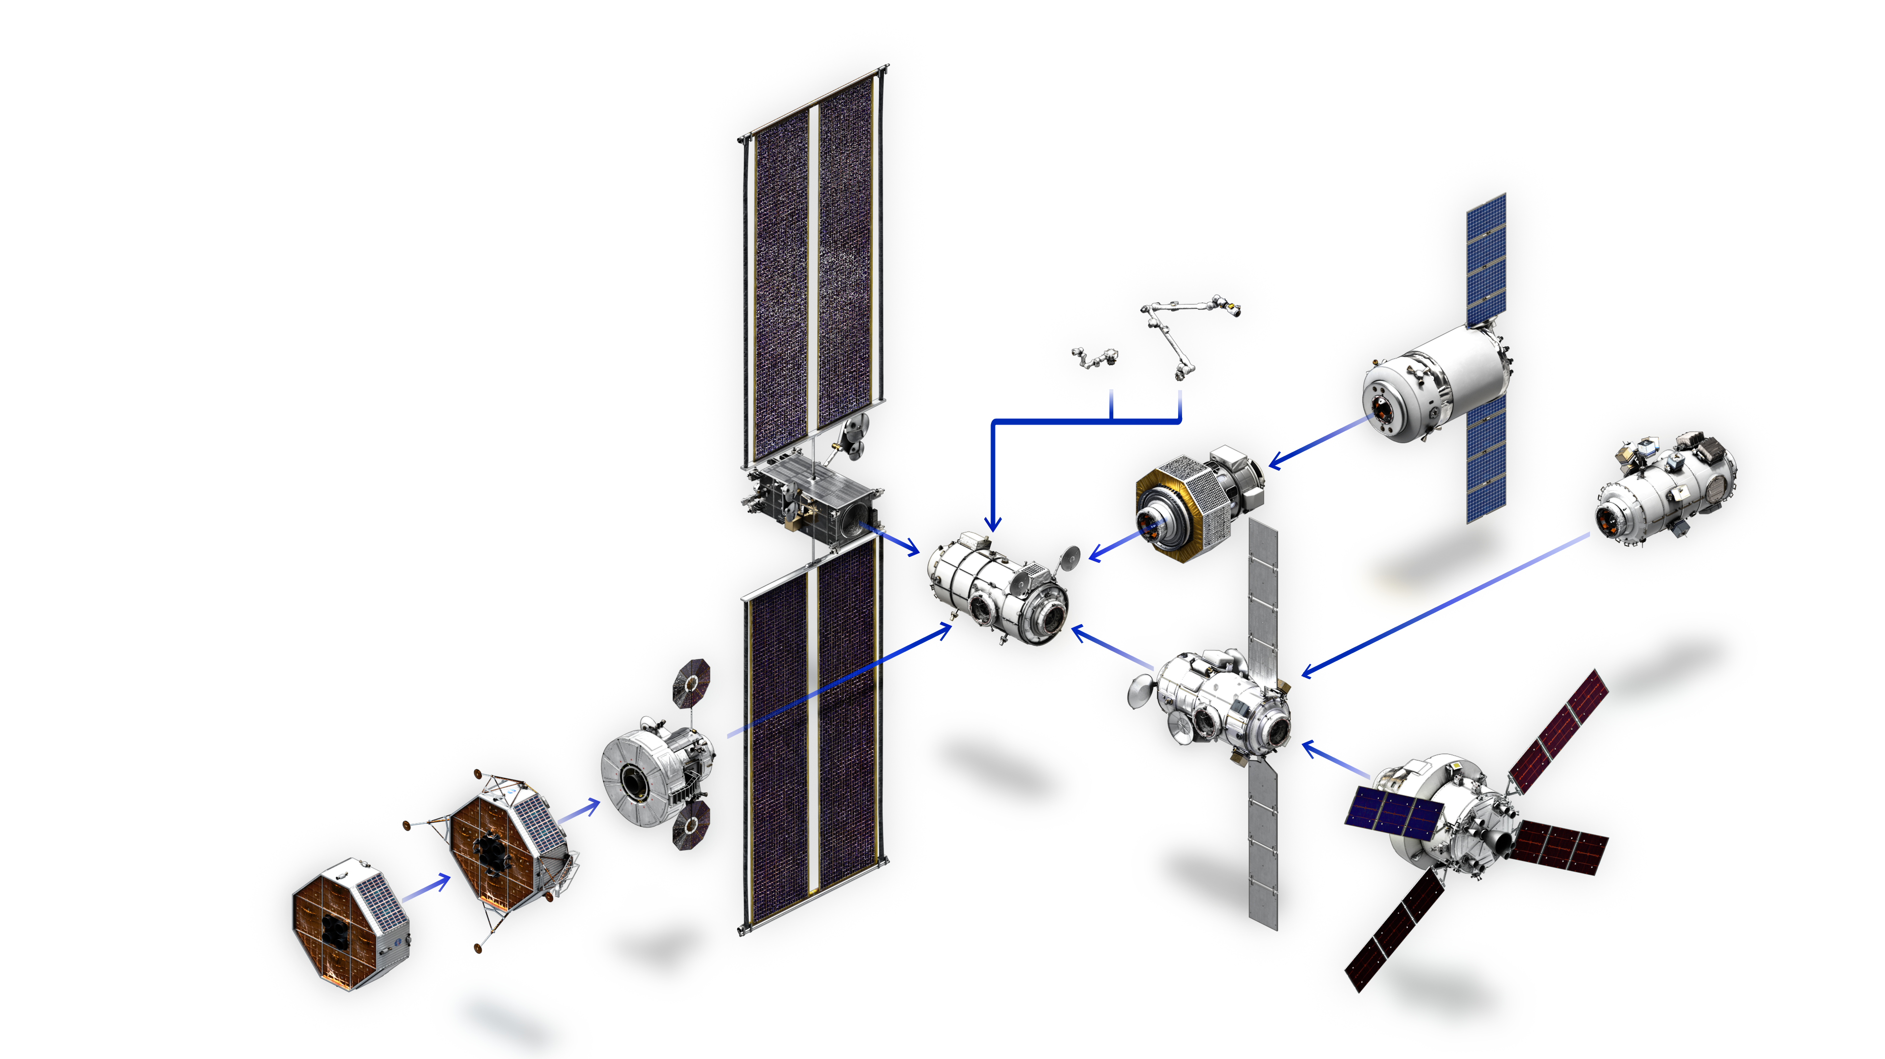
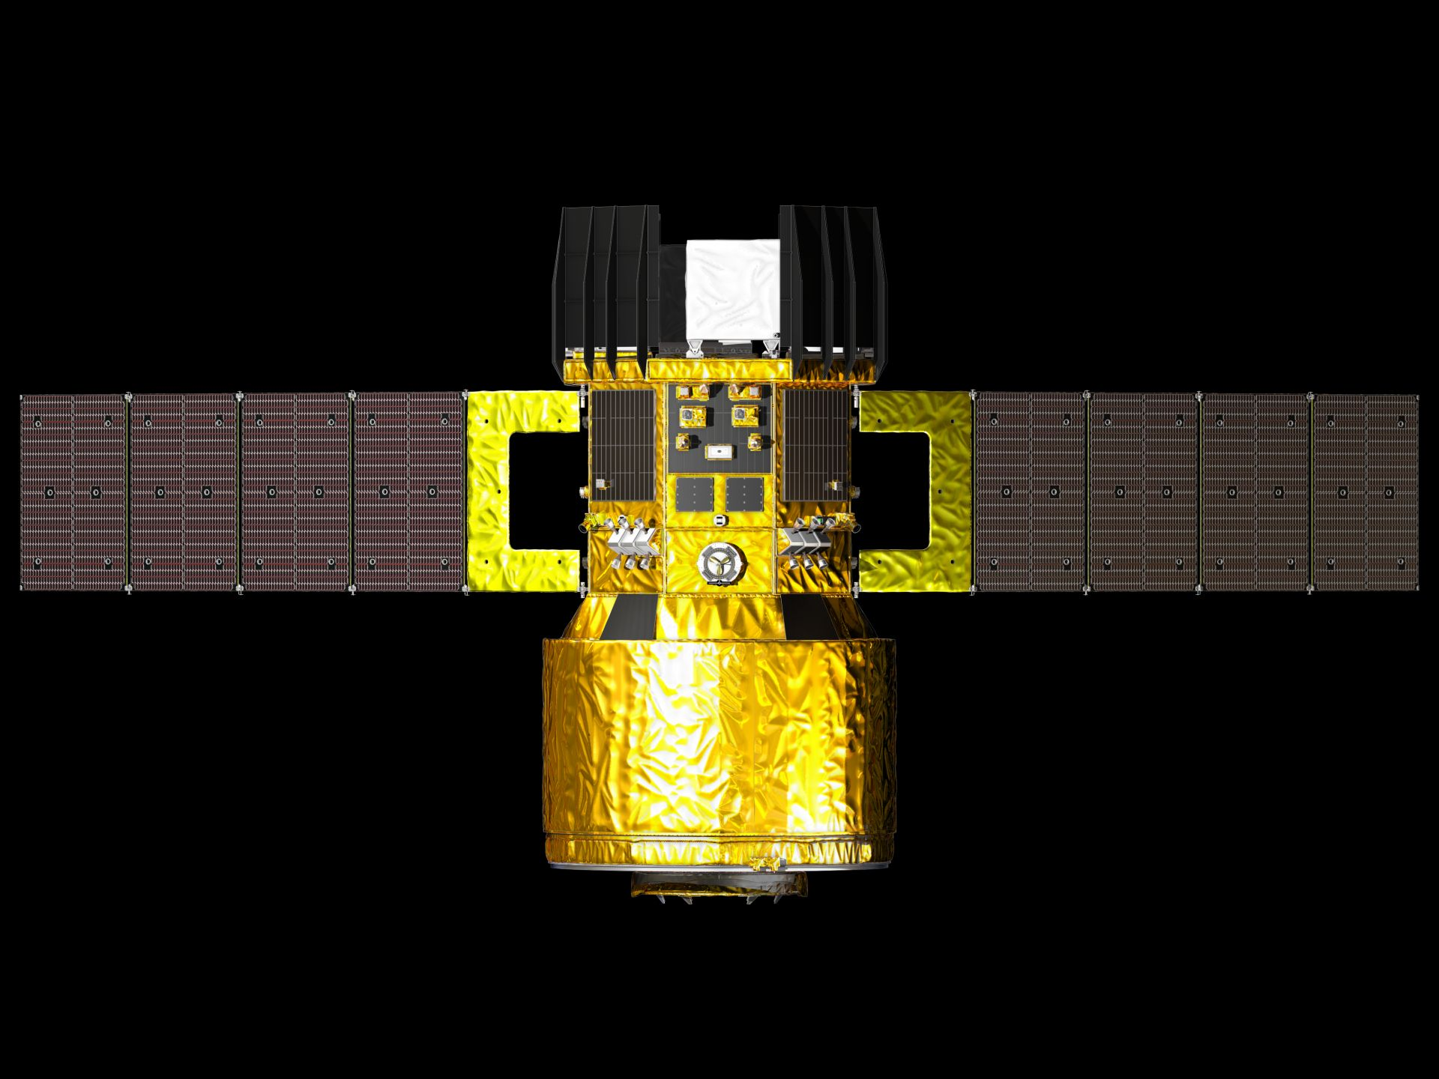
GATEWAY INTEGRATED SPACECRAFT CONFIGURATION
Co-manifested (PPE/HALO)
Launch Vehicle
Gateway External Robotic System (GERS)
Canadarm3
Logistics Modules (LM)
Dragon-XL
Power and Propulsion Element (PPE)
HTV-XG
ESPRIT-Refueler Module (ERM)
Airlock Module (ALM)
Provider TBD
Human Landing System (HLS)
(government reference concept shown)
Habitation and Logistics Outpost (HALO)
International Habitat (I-HAB)
Orion
Notes:
This is an exploded view of the GW station
PPE and HALO will be launched together
Between HALO & IHAB have living quarters
LM provides supplies and scientific experiments
ERM provides refueling
Orion brings astronauts from earth
HLS is for lunar surface ops – this slides shows gov reference
Canada provides the GERS a robotic arm
Airlock provides EVA accessibility for GW

Slide 8
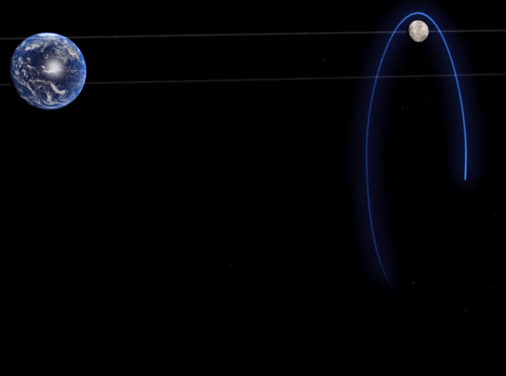
Notes:
A halo orbit has been chosen for the Gateway when it gets into position around the Moon.
Gateway will initially operate in a halo orbit around the Moon called the Near-Rectilinear Halo orbit – one that one that is accessible not only by NASA’s Space Launch System (SLS) and Orion spacecraft for crews and outsized cargo, but also by many existing rockets on the U.S. domestic and international market today.
From this orbit, the Gateway will have a continuous view of Earth, and will be able to support lunar surface tele robotics, including those on the far side.

Slide 9
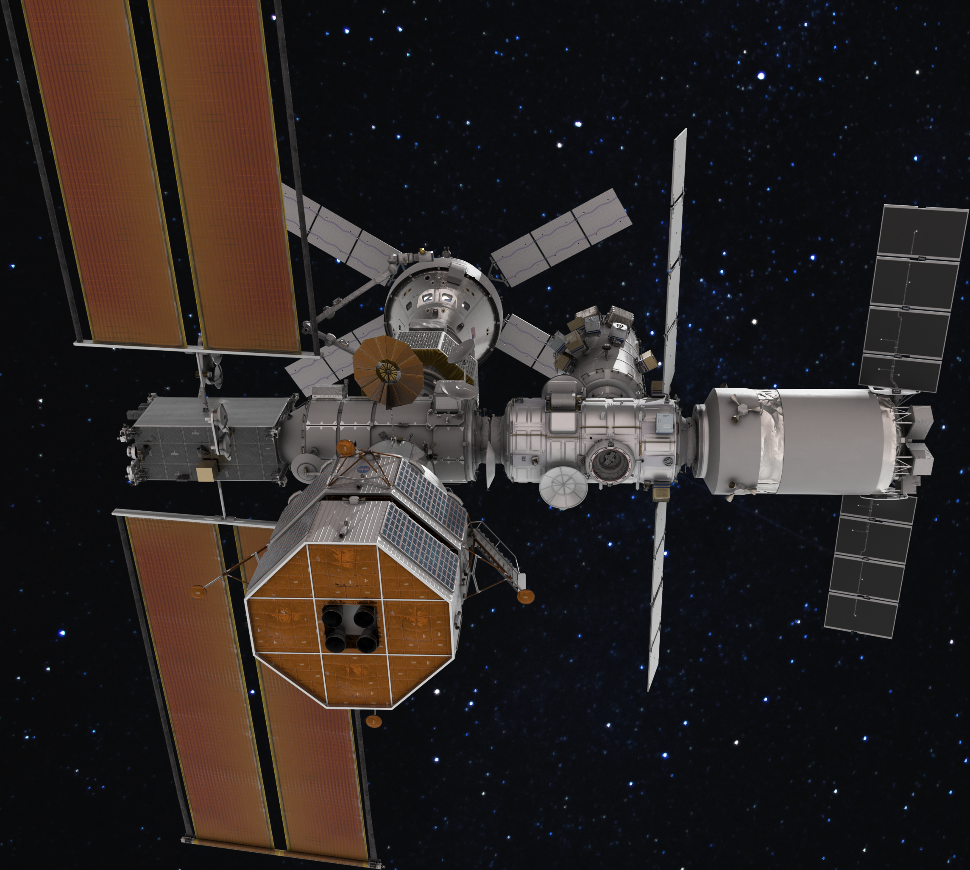
MOON BEFORE MARS
Gateway will serve as a unifying catalyst to equip NASA and its international partners with the knowledge and experience to:
Establish deep space scientific investigations
Support sustained surface access and operations on a different planetary body
Prepare for the complex logistics needed for future crewed missions to Mars.
Notes:
Crew Health and Safety
•Validate capability to execute nominal and contingency physical and behavioral health operations autonomously and with time delay.
•Evaluate effects of the deep space environment on food-related microbes and plants and developing a food system adequate for crew health and performance in support of progressively Earth-independent operations.
Operations
•Learn how to operate an orbiting outpost for astronaut and vehicle rendezvous between orbit and surface.
•Learn how to conduct efficient scientific exploration of a planetary body with new tools and techniques for clean sample collection.
•Use automation, robots and humans to maximize the scientific return.
•Leverage pressurized and unpressurized surface mobility to expand crew reach from landing sites.
•Develop end-to-end dust mitigation processes.
TECHNOLOGY ADVANCEMENT
•Advance propulsion capabilities for deep space travel, as well as planetary ascent and descent vehicles.
•Harvest planetary resources to reduce our supply chain from Earth.
•Design for commonality within systems to increase robustness with reduced logistics needs.
•Evolve space suits with increasing EVA duration and capability.
•Create uninterrupted surface power, resistant to dust and limited sun exposure

Slide 10
Gateway Thermal Control Overview

Slide 11
Thermal Control System (TCS) Architecture Description
The Gateway Thermal Control System (TCS) maintains modules, components, and subsystems (both internal and external) within their temperature limits using both Active (ATCS) and Passive (PTCS) thermal control
ATCS utilizes active components, such as mechanically pumped fluid loops, heat exchangers, cold plates, fluid-pumped radiators, valves, etc. to collect waste heat and transport it via a pumped fluid loop and heat exchangers to external radiators that reject the heat to space
PTCS utilizes passive components, such as multilayer insulation (MLI), thermo-optical coatings, passive (heat pipe) radiators, interface conductance, sun shields, etc. to insulate sensitive components from temperatures swings, add heat with electrical heaters, transfer waste heat to external surfaces with heat pipes, radiate heat to space and absorb heat to the system via external surface thermal materials
Overall TCS performance is driven by the following factors
Crew metabolic loads and internally generated vehicle waste heat
Environmental conditions:
Surrounding 3K deep space temperature sink
Variable solar and planetary heating that changes with:
Vehicle orbit, attitude, orientation, module configuration, orbiting body (Earth vs Moon)
Visiting vehicle induced environments (plume, dust, venting, contamination, etc.)
Notes:
Common question:
Why are components divided as such between PTCS and ATCS?
The way TCS components are divided are due to the organizational structure of JSC engineering divisions such as heaters or pumps.

Slide 12
Gateway TCS Overview
Capability varies by provider
X-strap
Capable
HLS
X-strap Jumper capable
Passive TCS
Optical Solar Reflectors (OSR)
Silver Teflon (AgFEP)
Radiators
Heat Pipes
Heaters
MLI
Controllers
Passive TCS
Heaters
MLI
Internal - PGW
Pumps, Accumulators
cold plates
Heat Exchangers
Flow control valves
Sample, Fill/Drain port
Instrumentation
Controllers
Shell Heaters
External - HFE 7200
Body Mounted Rads
Pumps, Accumulators
Heat Exchangers
cold plates
Flow control valves
Fill/Drain
Instrumentation
Controllers
Heaters, MLI
External - HFE 7200
Deployable OSR Rads
Pumps, Accumulators
Heat Exchangers
cold plates
Flow control valves
Fill/Drain ports
Instrumentation
Controllers
Heaters, MLI
Internal - PGW
Pumps, Accumulators
cold plates
Heat Exchangers
Flow control valves
Sample, Fill/Drain ports
Gas Trap
Instrumentation
Controllers
Shell Heaters
ORION
Internal ATCS -
Propylene Glycol Water Mixture (PGW)
IEA
External ATCS – HFE 7200
PPE
HALO
IHAB
Fuel Transfer Capability (FTC)
ESPRIT-RM XL
X-strap
Capable
Thermal Load Sharing
Habitable Gateway modules (HALO, IHAB, and ALM) can share thermal heat loads via internal loop cross-strapping to modules with higher thermal margins. (both nominally and for contingencies)
TCS TBD
Suit cooling interface
cold plates
Flow control valves
Instrumentation
Controllers
Heaters, MLI
Heaters, MLI
Inter-Module Ventilation
Heaters, MLI
Independent ATCS - TBD
ALM
LM
GW Module with ATCS and PTCS
+Y
GW Module with PTCS
+X
+Z (out of plane)
Notes:
Write out acronyms
OSR: optical solar reflector
AgFEP: silver Teflon.
Delete ThermalEdit contingence load share to add nominal cross strapping
Independence box
Update HLS box to varies by provider

Slide 13
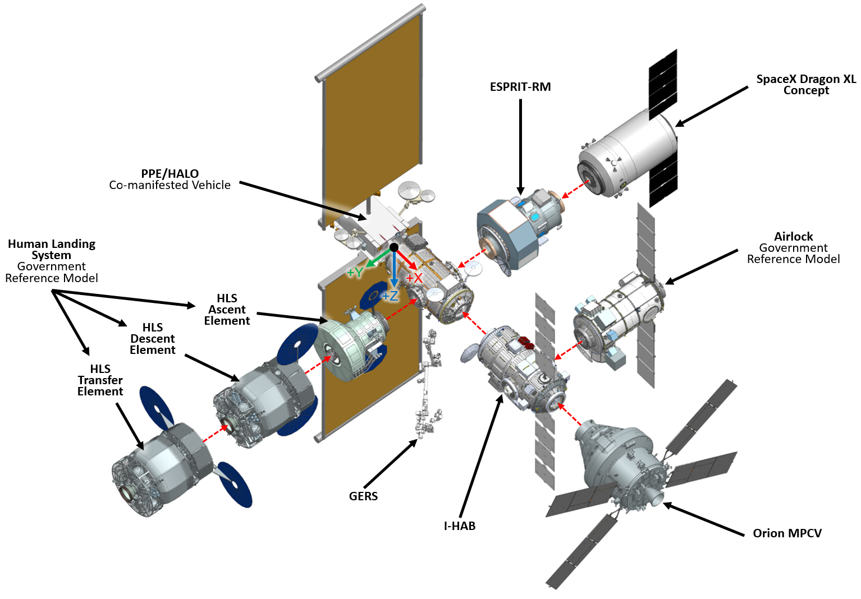
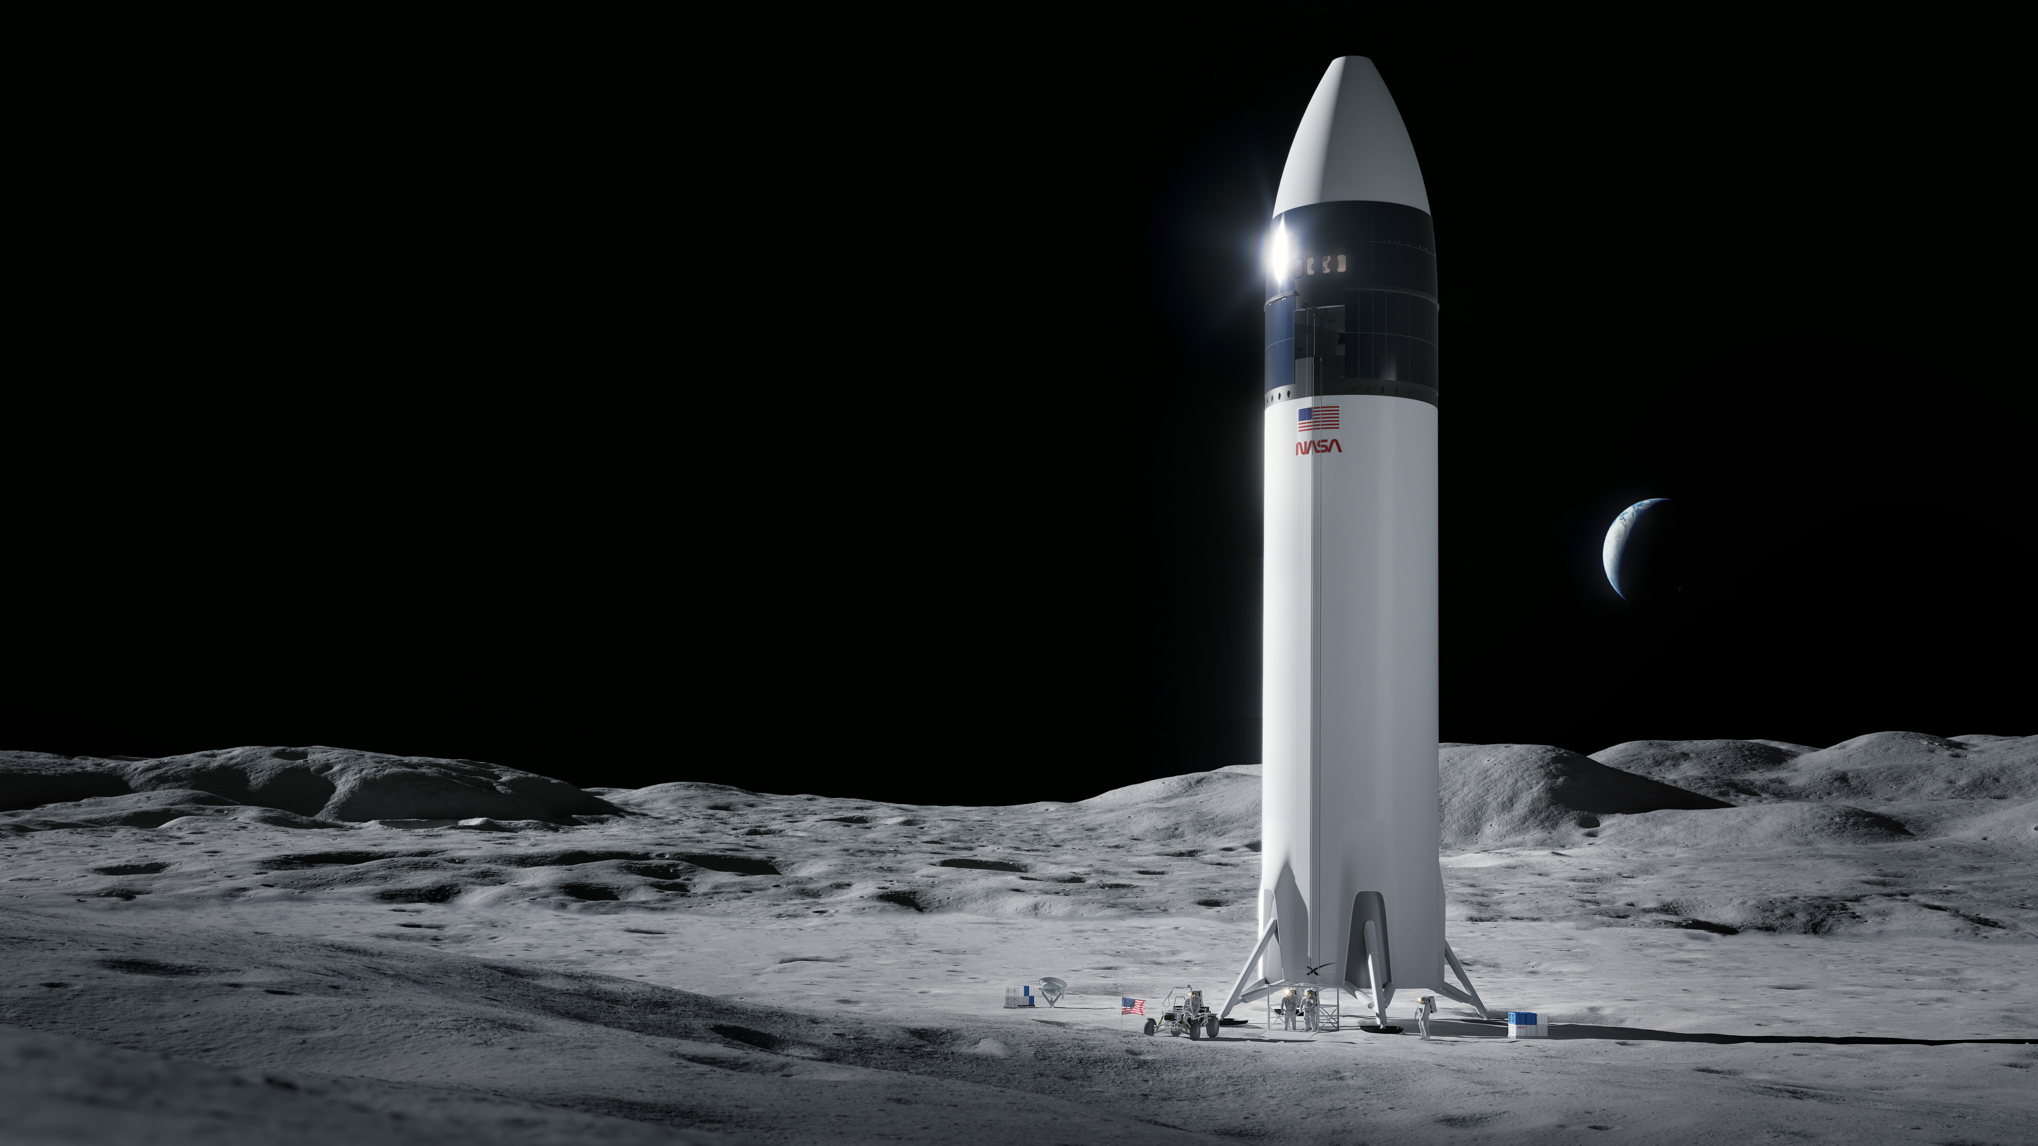
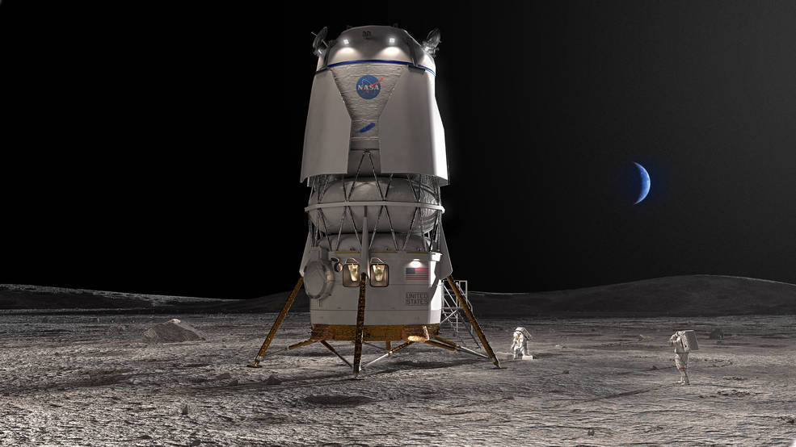
Gateway CAD Models
SpaceX Human Landing System
Blue Origin Human Landing System

Slide 14
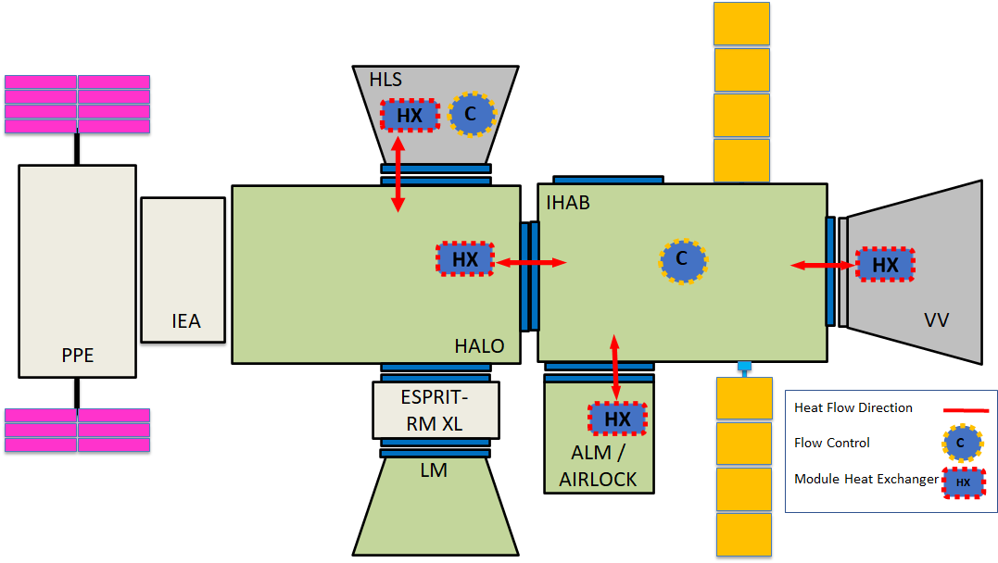
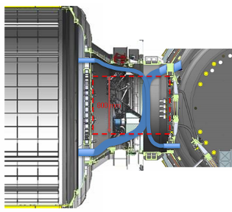
Gateway IATCS Cross-Strap Overview
Thermal cross-strapping allows thermal load sharing capabilities between module internal fluid loops via inter-module heat exchangers (MHX’s) and fluid jumpers routed through docking port vestibules.
Thermal cross-strapping requires crew installation of the jumpers, and then is automatically controlled by the IHAB Module System Manager (MSM)
Heat transfer is modulated via flow control between modules
Bi-directional heat transfer
Fluid jumpers are routed through docking ports between modules for cross-strapping
Notes:
TFAWS Notes:
Placeholder chart for cross strapping
Reword heat rejection to not mention HALO issues since it might not be public knowledge and NG will be at TFAWS
Add bullet about setpoints

Slide 15
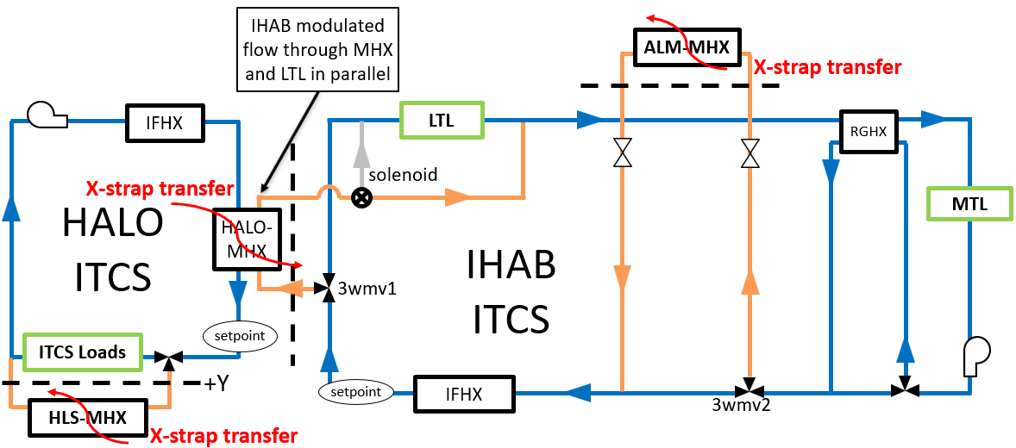
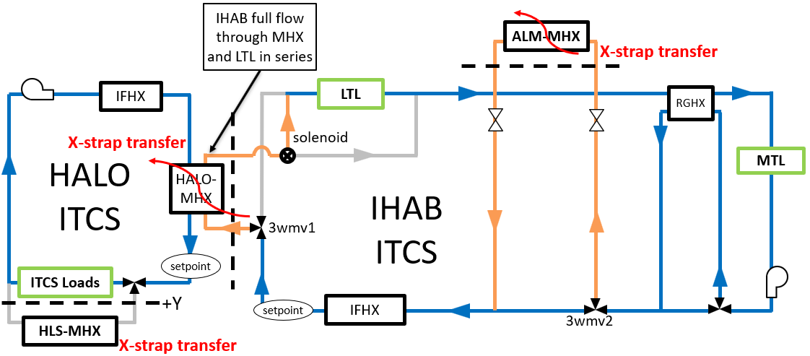
Gateway IATCS Cross-Strap Overview Continued
For the HALO/IHAB interface, alternative MHX locations were considered. Final decision was driven bidirectional functionality.
IHAB ITCS fluid temperature at the MHX is nominally colder than HALO temperatures. (IHAB has a condensing HX downstream vs non-condensing for HALO)
This optimizes HALO-to-IHAB heat transfer (nominal cases), while still protecting for IHAB-to-HALO heat transfer during contingencies
Cross-strapping heat transfer capabilities (HXC’s) are the theoretical loads that can be transferred across an MHX. (thermal bottlenecks)
Driven by heat exchanger performances and fluid boundary conditions
Note: HXC’s do not take into account thermal margins of modules.
Nominal cross-strapping scenarios:
Requirement: 2 kW bidirectional heat transfer between HALO & IHAB
Additional heat transfer (up to the HXC) is possible as available based on thermal margins
ALM serves as supplementary HRC for HALO via IHAB
Contingency cross-strapping scenarios:
During loss of heat rejection capability of any module, cross-strapping allows some thermal load rejection for the faulted module via MHX’s using neighboring module thermal margins
Notional nominal Cross-strapping scenario
Notional IHAB-contingency Cross-strapping scenario

Slide 16
HALO and IHAB Active Thermal Control System Overview

Slide 17
ATCS Architecture Overview - HALO
HALO ITCS: two Propylene-glycol/water (PGW) pumped fluid loops
Fluid temperatures driven by the Noncondensing Cabin HX’s inlet setpoint
Heat exchange with IHAB through the HALO-IHAB MHX
Heat and fluid exchange with HLS through the HALO-HLS MHX
Loads consist of:
HALO Battery Cold Plate loads (within IEA)
HALO Air Revitalization System (HARS) Cabin Heat Exchanger (CHX) airborne loads
Utilization and Avionics Cold Plate loads
HALO ETCS: two 3M Novec hydrofluoroether (HFE-7200) pumped fluid loops
Radiators: 25 body mounted radiator panels
4 Radiator Rings along HALO’s axis running in parallel
Up to 8 panels per ring running circumferentially in series
6 parallel tubes per loop for each radiator panel
AL pipes mounted to AL facesheets
Radiator facesheets painted with white paint coating (high IR emissivity, low solar absorptivity)
Radiator bypass valve controls the amount of cooling provided by radiators
Radiator heat rejection bias based on flow order
Heat rejection is more sensitive to the environmental flux onto the later panels (5-8)
NCHX Inlet Setpoint
Notes:
Heat rejection is more sensitive to the environmental flux onto the later panels
This is because if you see more env. Heat flux on the later panels there’s less chance downstream to radiate that extra heat away.

Slide 18
ATCS Architecture Overview - IHAB
IHAB ITCS: two Propylene-glycol/water (PGW) pumped fluid loops
ITCS loops are not automatically redundant
Actively cooled components are cooled by an individual ITCS loop, but have the capability to be transferred between loops via quick disconnects in failed loop contingencies
Note both ITCS loops flow through a single MHX
Loads consist of Low and Moderate Temperature Loops ( LTL & MTL)
Fluid temperatures are driven by condensing CHX’s inlet setpoint
Setpoint is not internally controlled: ETCS controls fluid temperatures
IHAB ETCS: two 3M Novec HFE-7200 pumped fluid loops
Radiators: 4 deployable radiator panels per wing on IHAB +z axes
AL pipes embedded between two AL facesheets with Optical Solar Reflector coatings (high IR emissivity, low solar absorptivity)
Pipes serpentine through panels in series
Outermost panels have a single face covered in MLI
After deploying, radiator wings articulate to be edge-to-Sun
Regenerative heat exchanger (RGHX) prevents overcooling
Fluid inlet to IFHX setpoint → drives ITCS fluid temperatures
Ongoing considerations to provide cross-tie capabilities to the external loops. Currently, if an ETCS loop fails, the internal loop is also failed due to separate IFHX’s
CHX’s inlet
IHAB Internal Volume
Condensing CHX (x1 per loop)
LTL
RGHX
(x1 per loop)
MTL
HALO
MHX
X-strap solenoid valve
X-strap 3WMV
X-strap 3WMV
IFHX
(x1 per loop)
IFHX inlet controlled setpoint
3
ALM
MHX
4
2
RGHX
(x1 per loop)
1
Radiator
Flow Order:
1
2
4
3

Slide 19
NRHO Orbit, Flight Configurations, and Flight Attitudes

Slide 20
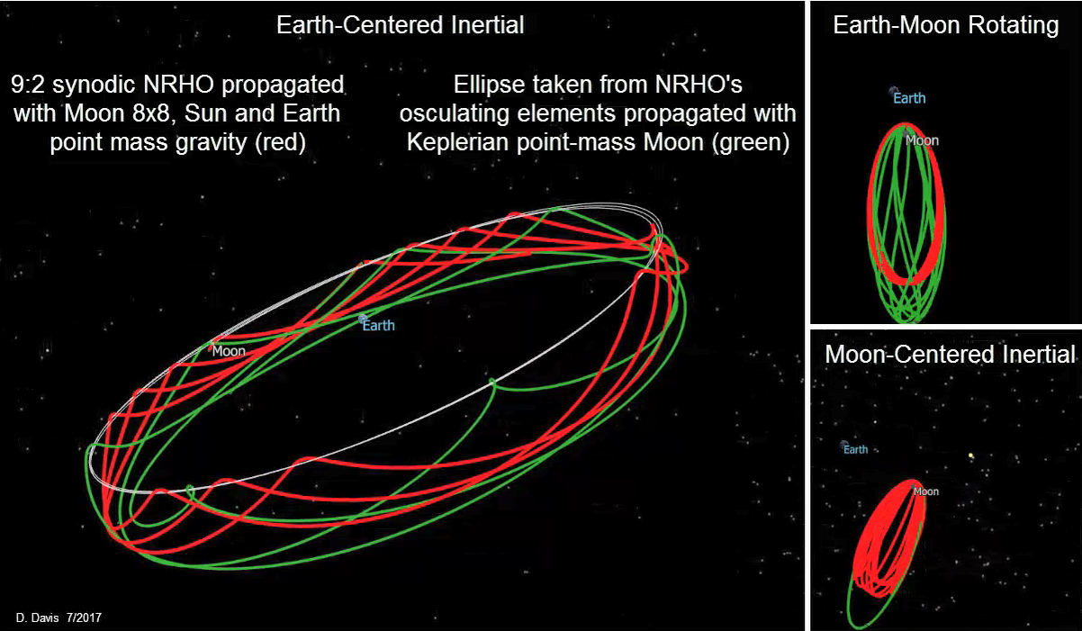
Gateway Orbit – NRHO¹
Gateway’s orbit is a 9:2 Lunar Synodic Resonant L2 Southern Near Rectilinear Halo Orbit (NRHO)
Gateway completes 9 revolutions around the Moon every 2 Lunar months.
Gateway has constant view to Earth, and a solar-inertial attitude (i.e. static solar vector from station reference frame).
This orbit is highly eccentric and non-Keplerian (not elliptical) because it relies on the gravity of both the Moon and the Earth to maintain this unique orbit.
Keplerian orbits typically used in Thermal Desktop (TD) only do a good job modeling NRHO at low altitudes near the Moon, but most of the orbit is spent at very high altitudes. Keplerian approximations of NRHO can misrepresent orbital period by over 24 hours.
Gateway’s closest position to the Moon in its orbit is called “Perilune”, and its furthest position is called “Apolune”
Constant view to Earth
 | Orbital period (days) | Perilune altitude (km) | Apolune altitude (km)
Minimum | 6.26 | 1,458 | 68,267
Mean | 6.56 | 1,629 | 69,363
Maximum | 6.76 | 1,820 | 70,112
Gateway’s NRHO shown in red. Green shows orbit calculation assuming elliptical orbit around Moon. Elliptical assumption does not make a good approximation of NRHO at high altitudes.
Notes:
Ref: Davis, Diane. “9:2 Lunar Synodic Resonant NRHO: Orbital parameters and Ellipse Comparison”. September 3, 2019.

Slide 21
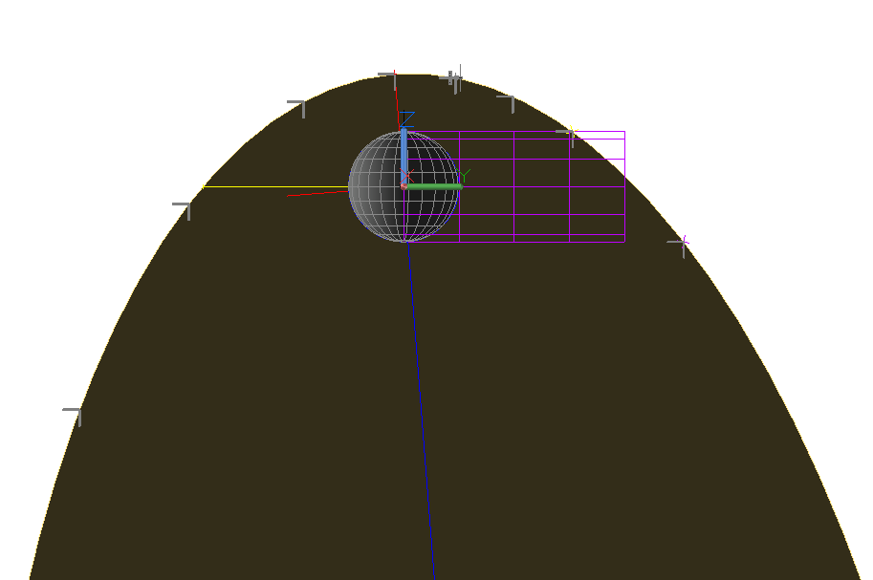
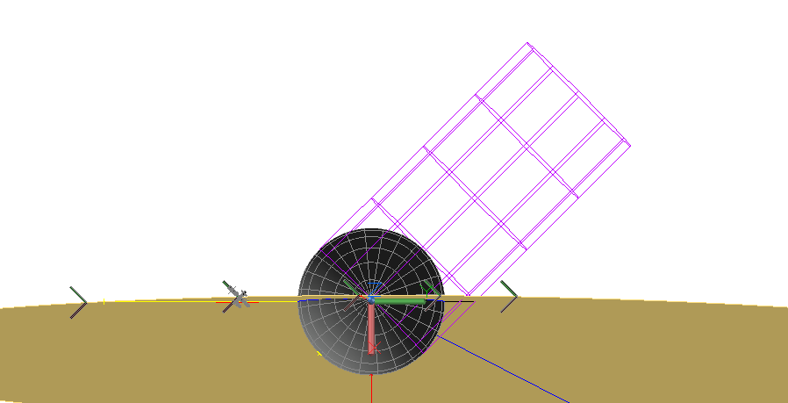
Gateway Orbit – Solar Beta Angle
Solar beta angle (β) is the angle between the normal vector of the satellite’s orbital plane and the vector pointing from the planetary body to the Sun.
For Gateway’s orbit, solar beta angle is much less important than on ISS due to Gateway’s solar inertial attitude, meaning it does not affect direct solar heatloads. However, solar beta angle does affect Lunar IR and Albedo heating rates.
At a solar beta angle of $0°$Gateway passes over the subsolar point of the Moon (point on the Moon directly facing towards the Sun) when passing over the sun-facing side of the Moon, and experiences maximum eclipse duration when passing over the nightside of the Moon ($≤$90 mins).
Gateway can pass over either the nightside or sun-facing side of the Moon first.
At a solar beta angle of ±$90°$, Gateway passes over the line of longitude on the Moon that divides day from night.
Subsolar-Point
Moon’s Shadow
Orbital Plane
β = 0°
View from Orbit Normal
β = 45°
View from North Pole
Moon’s Shadow
Orbital Plane
Subsolar-Point

Slide 22
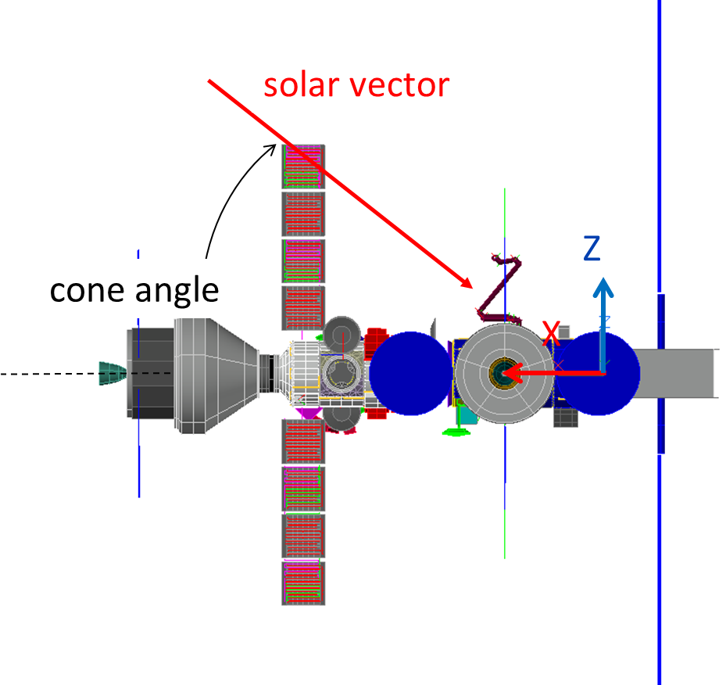
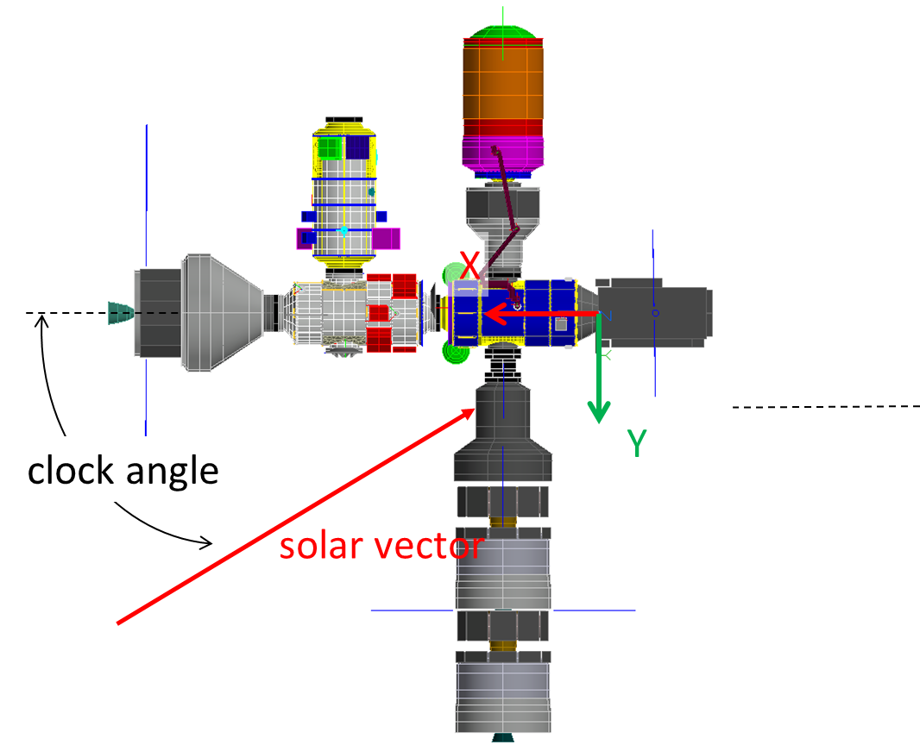
Flight Attitudes and Configurations
Gateway requirements specify that the vehicle shall be able to fly in any solar clock angle with solar cone angles limited between $−10°$to $+10°$
Baseline attitude of clock/cone = 0/0 has the Gateway +x axis facing towards the sun
Solar cone angle pitches the vehicle, exposing ±z surfaces to the sun
Solar clock angle yaws the vehicle, exposing port/starboard/aft surfaces to the sun
Attitude is nominally set to Solar Pressure Equilibrium Attitude (SPEA) to minimize the amount of prop used to maintain orbit/attitude. Deviations occur when:
A visiting-vehicle (VV) is present that has its own attitude restrictions, such as Orion which in steady-state flies within ±$20°$ of tail-to-sun
An Orbital Maintenance Maneuver (OMM) occurs in which Gateway yaws->rolls->yaws into burn attitude. OMMs can occur once per orbit (once every 6.5±0.25 days) but may not be needed each orbit to maintain Gateway within NRHO. OMMs can last over 24 hours.
Crewed OMMs: 3 hours
Uncrewed OMMs: Dependent on stack mass, can last up to 30 hours
Different Gateway manifests impact module thermal environments

Slide 23
NRHO Environment

Slide 24
Environmental Factors Comparison for LEO, GEO, and NRHO²
Most space flight experience is in the LEO and GEO environments
Diagram shows how NRHO compares to LEO and GEO
LEO
NRHO
Lunar Dust
Atomic Oxygen
Orbital debris
Solar wind charged particles
More extreme and wider range of planetary IR
GEO
NRHO
Lunar Dust
Orbital debris
Van Allen Belt Charged Particles
Less frequent and shorter eclipse
More extreme and wider range of planetary IR
UV
Solar wind charged particles
Vacuum
Micro-meteoroids
UV
Vacuum
Micro-meteoroids

Slide 25
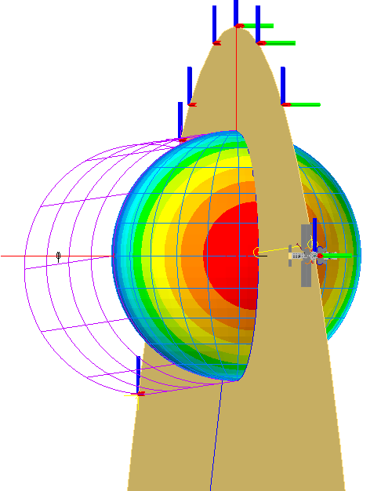
Environmental Heating Rate Sources
Environmental Heating Rates for use in thermal analysis of Gateway were chosen based off of data from the “Cross-Program Design Specification for Natural Environments (DSNE)” [SLS-SPEC-159]³
Gateway experiences 3 sources of environmental heating:
Solar radiation: Heating from the sun in the ultraviolet, visible, and near-infrared light spectra.
Albedo: Sunlight reflected off the Lunar surface back to space.
Lunar IR: Infrared (IR) Radiation emitted by the Lunar surface. Lunar surface absorbs sunlight and re-radiates it back to space. Intensity varies based on temperature of the Lunar surface, which varies based on solar incident angle.
Gateway surfaces radiate heat out to deep-space, modeled as a temperature sink at 3 Kelvin
Lunar IR
Solar Radiation
Sun
Albedo
Notes:
Image from IAC8r1 GITEM, SEI-DM-MAN-001-M-8r1

Slide 26
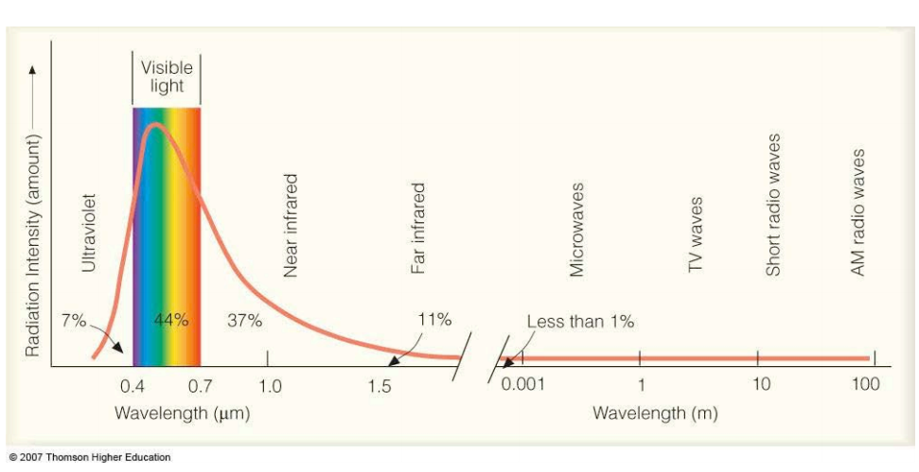
Solar Flux
Solar Flux
Solar flux changes based on distance from the Sun and variations in solar intensity due to the ≈11-year solar cycle.
Since the Moon orbits the Earth, Gateway will experience slightly higher maximum and lower minimum solar fluxes than LEO/GEO satellites.
Minimum solar flux : 1,315±5 W/m²
Mean solar flux: 1,367±5 W/m²
Maximum solar flux: 1,421±5 W/m²
Maximum solar flux is 8% higher than minimum solar flux. About 7% of this variation is seasonal based on the distance from the Earth/Moon to the Sun, and the other 1% is due to variations in the solar cycle.
Solar radiation is mostly in the ultraviolet visible, and near infrared spectra
Notes:
Get better graphic for wavelengths of sunlight and citation for it
References: TIEDS-M and PaTH

Slide 27
Albedo
Albedo
Percentage of sunlight incident to a planet or moon which is reflected back into space.
This source of environmental heating is also in the “solar spectrum”.
Albedo flux incident to Gateway varies based on altitude (further from the Moon = less flux)
Albedo varies between the near side (Earth-facing side) and far side (a.k.a. “dark side”) of the Moon, as well as due to Lunar surface features (e.g., craters, maria, highlands).
The orbit chosen for Gateway is a polar orbit set such that Gateway has a constant view of Earth. Gateway is neither over the near or far side of the Moon, and instead orbits along the line of longitude which separates the two.
Due to Gateway’s high altitude orbit, average values of Albedo were chosen to use for thermal analysis as at any given time Gateway has view to a large percentage of the Lunar surface, minimizing Albedo impacts from terrain variation.
Albedo | Near Side | Far Side
Minimum | 0.07 | 0.10
Average | 0.12 | 0.15
Maximum | 0.20 | 0.20
Notes:
References: TIEDS-M and PaTH

Slide 28
Lunar IR
The nightside of the Moon (side which does not face the Sun) varies between 80 and 120 Kelvin. The Moon’s IR emissivity ($ϵ$) varies between 0.95 and 0.98. These can be used directly in the Stefan-Boltzmann law to define the Lunar IR flux emitted by the night side of the Moon.
$I_{IR,night side}=ϵσ{\left(T_{night}\right)}^{4}$ $σ=5.6704E−8 W/{m^{2}K^{4}}$
Sunlight that is not reflected by the Lunar surface is absorbed as heat, and then re-radiated as Infrared (IR) radiation back to space. This is also called Outgoing Longwave Radiation (OLR).
The amount of solar energy absorbed by the Lunar surface is dependent on Solar Flux ($S_{0}$), Albedo ($\overline{a}$), and Solar Incidence Angle ($i$) which is the angle between the surface normal and the solar vector.
$$\text{Solar} \text{power} \text{absorbed}\text{ =} \left(1−\overline{a}\right)S_{0}\cos\left(i\right)$$
The Lunar IR emitted by the sun-facing side of the Moon is ≈ the solar power absorbed by the surface, but this creates a discontinuity at $i=90°$. The Lunar IR flux emitted by the sun-facing side of the Moon is modeled using the following equation to fix this:
$$I_{IR,sun−facing side}=\left[\left(1−\overline{a}\right)\left(S_{0}\right)−I_{IR,night side}\right]\cos\left(i\right)+I_{IR,night side}$$
It’s important when modeling IR that the vehicle’s view-factor to the entire Moon is considered. Gateway nominally flies at a high altitude where a large percentage of the Moon’s surface can be seen, so the Moon cannot be considered a single temperature.
In Thermal Desktop, this is modeled by inputting a table of flux emitted by the Moon vs. solar incidence angle. Be sure to use the “Subsolar Coordinate System” feature of Thermal Desktop rather than Latitude vs. Longitude.
Notes:
References: TIEDS-M and PaTH

Slide 29
Combined Environmental Heating Rates
Choosing a high value of Albedo maximizes Albedo heating rates but minimizes Lunar IR. Choosing a low value of Albedo minimizes Albedo heating rates and maximizes Lunar IR.
In order to be conservative, an Albedo of 0.12 is used in calculating cold Albedo fluxes while an Albedo of 0.15 is used in calculating cold IR fluxes. Likewise, an Albedo of 0.15 is used for hot Albedo fluxes and 0.12 is used for hot IR fluxes.
Note that the solar flux listed here is the flux incident at Gateway, while the IR flux is the flux emitted by the Moon’s surface at the surface of the Moon. The amount of IR flux that hits Gateway will be much smaller and varies with altitude, as this changes the view-factor between Gateway and the Moon.
Radiators are designed to have high IR emissivity to maximize rejected heat and have low solar absorptivity to minimize absorbed solar/albedo flux. High IR emissivity means that radiators also have high IR absorptivity and are heavily impacted by incident Lunar IR flux.
 | Cold Case Analysis | Hot Case Analysis
Solar Flux [W/m²] | 1310 | 1426
Albedo [unitless] | 0.12 | 0.15
Lunar IR Night Side [W/m²] | 2.206 | 11.522
Lunar IR Sunlit Side [W/m²] | [1111.29 cos(i) + 2.206] | [1243.36 cos(i) + 11.522]
Notes:
References: TIEDS-M and PaTH
Add bullet on Radiator Absorptivity vs. Emissivity

Slide 30
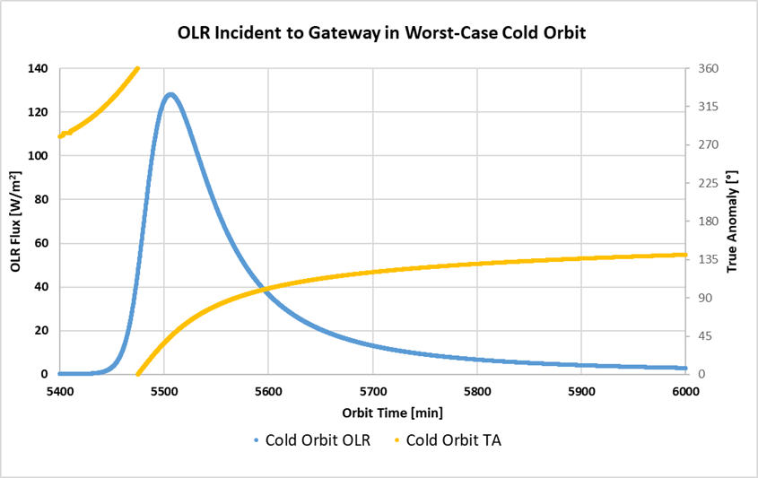
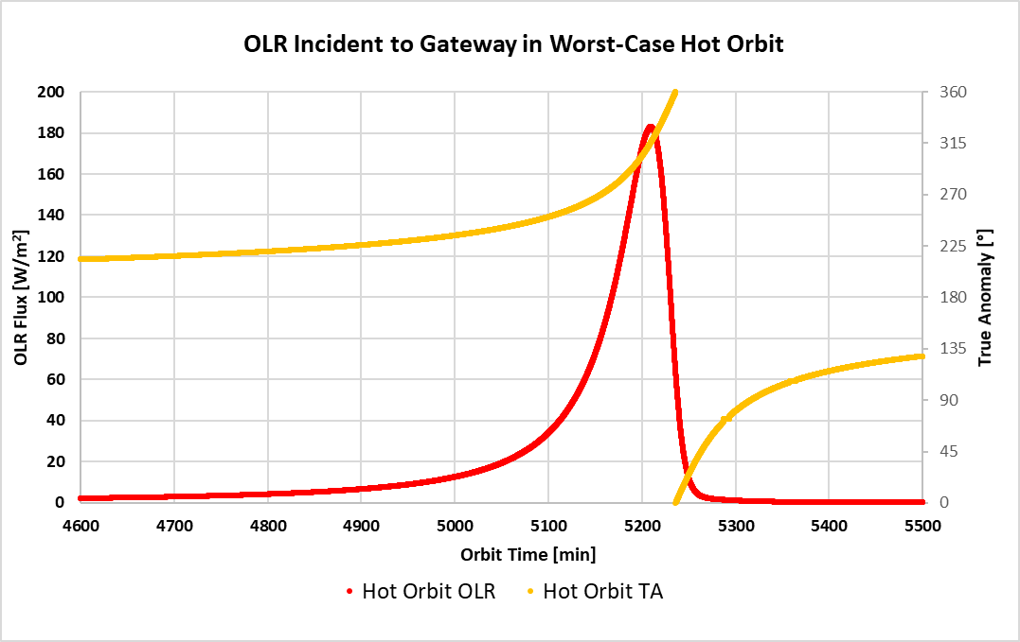
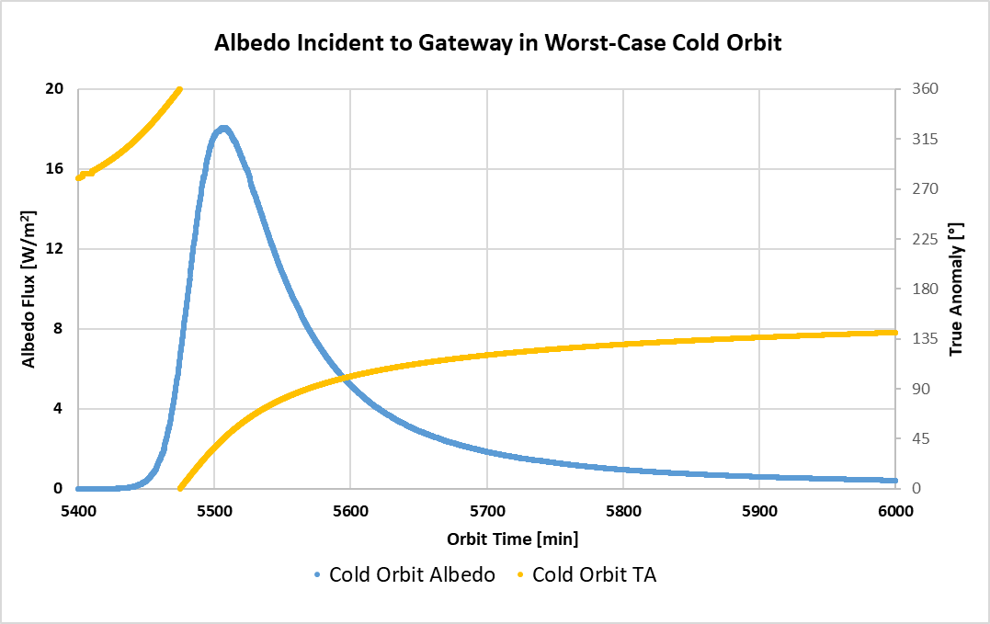
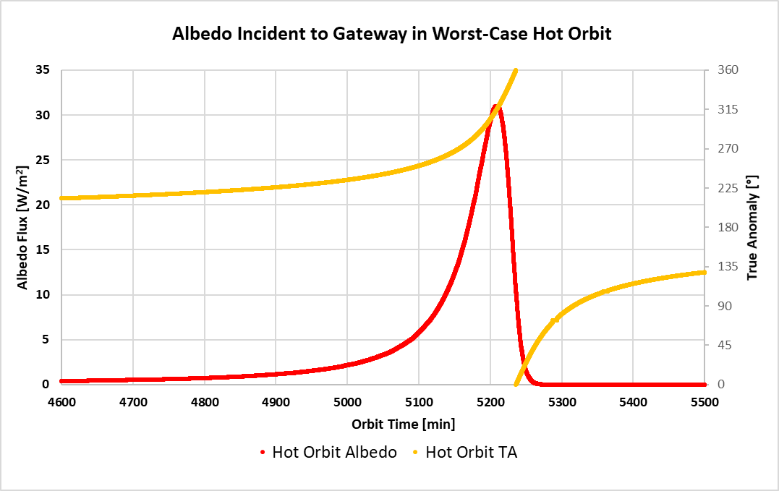
Environmental Heating vs. Time and True Anomaly^{3,4}
Graphs to the right show IR and Albedo fluxes incident to Gateway at a solar beta angle of 0°
IR flux peaks at 183 W/m² and Albedo peaks at 31 W/m², much smaller than the solar flux of 1310 to 1426 W/m²
Lunar IR and Albedo is negligible for most of the 6.5 ± 0.25 day orbital period of Gateway, and only affects Gateway for about 6 hours each orbit.
Solar beta angles away from 0° would have even lower IR and Albedo fluxes than shown here
Cold Case
Hot Case
OLR [W/m²]
OLR [W/m²]
IR Flux Incident to Gateway
Albedo [W/m²]
Albedo [W/m²]
Albedo Flux Incident to Gateway
Notes:
Orbital period is long enough such that Gateway reaches thermal steady-state without influence of Lunar IR/Albedo.
Graphs from Gateway Passive Thermal Handbook SEI-DM-HAND-001

Slide 31
Gateway vs. ISS Environmental Heating⁵
ISS flight attitude assumed to vary between 150 – 270 nm, and Earth radius 3444 nm. This gives ISS a view factor between 0.86 to 0.92 to the Earth for a nadir surface.
Earth OLR varies between 206 to 286 W/m², multiply by view factor to get values in table.
Earth Albedo varies 0.2 to 0.4. Multiply by solar flux and view factor to get maximum value in table.
 | Gateway | ISS
Solar Flux [W/m²] | 1310 – 1426 | 1321 – 1423
Albedo Incident to Spacecraft [W/m²] | 0 – 31 | 0 – 523
OLR Incident to Spacecraft [W/m²] | 0 – 183 | 177 – 263
Maximum Eclipse Duration [min] | 90 | 37
Orbital Period [hours] | 150 – 162 | 1.50 – 1.58
Notes:
JSC 66617

Slide 32
Thermal Models

Slide 33
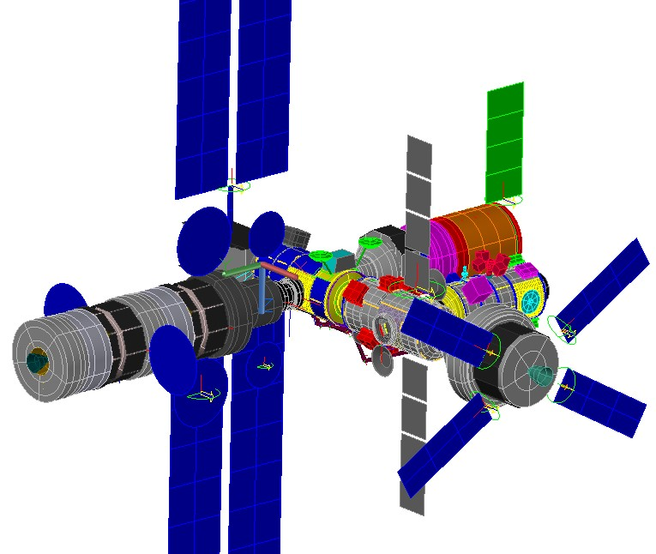
Gateway Integrated Thermal Environment Model (GITEM)⁶
Gateway Integrated Thermal Environment Model (GITEM)
The GITEM is a simplified non-proprietary Thermal Desktop model of the entire Gateway station for Gateway participants to perform thermal analysis on their hardware.
The GITEM is updated each Gateway Integrated Analysis Cycle (IAC) based on latest CAD, thermal design, and Con-Ops.
The GITEM includes orbital heating rate data for worst-case hot and cold analysis, and steady-state apolune analysis.
Thermal Induced Environment Databook and Simulation Manual (TIEDS-M)
Model documentation and user-guide for the GITEM.
Documents Gateway induced thermal environment definition for Gateway participants to use when assessing radiative heat transfer from element to element.
Optical Properties, Solar Absorptivity, Beginning of Life (BOL), End of Life (EOL)
GITEM Geometry
Notes:
Edit to add more about how GITEM works rather than talking about IACs
Reference: L2 PDR Gateway Dr. Laurie Carrillo
Add the general use of the GITEM

Slide 34
Gateway CAD Models
SpaceX Human Landing System
Blue Origin Human Landing System
Notes:
This is the cad that we take and convert 2 the non-proprioritary versions used in the GITEM.

Slide 35
GITEM Model Integration Process⁷
Simplified thermal models provided by module, element, and visiting vehicle vendors where available; otherwise, they are built by NASA using a government reference design.
Simplified representations of more detailed models of each module are used. The simplified model requirements are:
< 600 nodes and < 600 surfaces
No FloCAD (fluid representations are modelled using 1-way conductor networks)
Non-proprietary
The simplified models are integrated together using Thermal Desktop’s xREF to provide module geometry for the parent model GITEM.
This methodology allows the simplified model stand-in to be removed (via xREF) and replaced with a more detailed model.
Detailed models can be integrated into GITEM which provides the radiation and shadowing impacts and temperature boundaries from other modules.
Simplified and detailed models/data are developed by vendors and provided to NASA
GITEM is created as a parent model using all simplified models
Vendors and NASA analysis teams replace the relevant simplified submodel with a detailed version for analysis

Slide 36
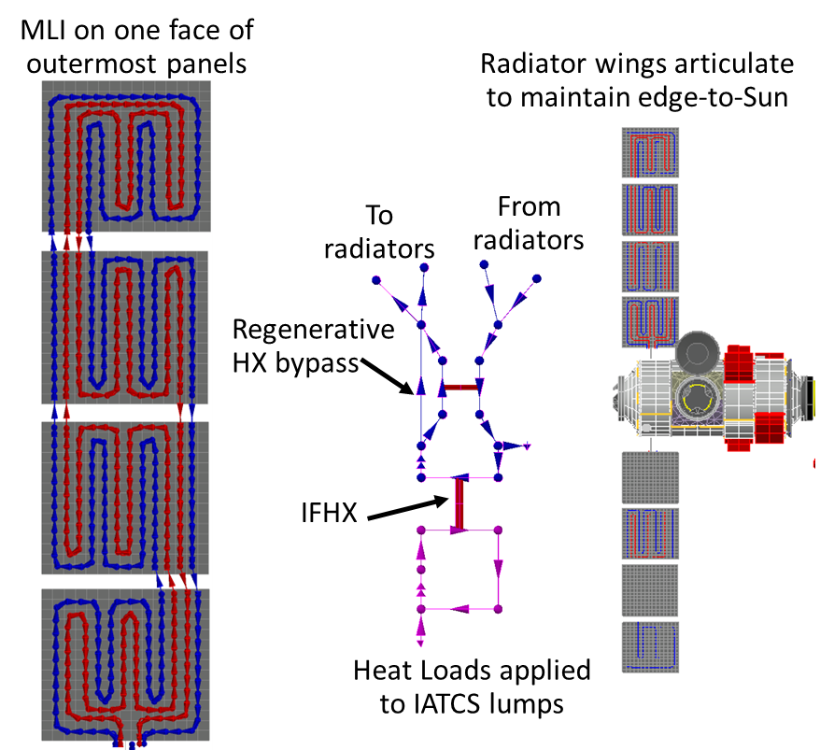
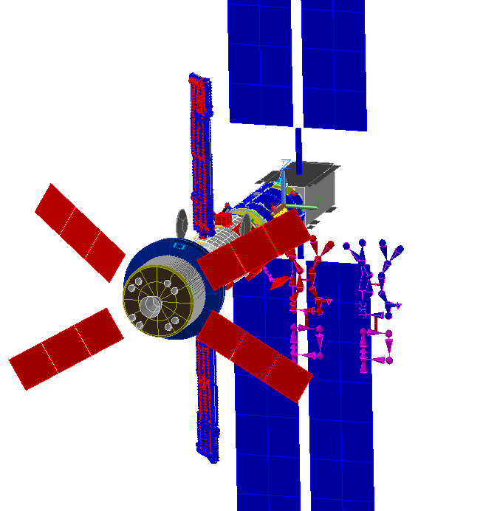
ATCS Analysis and Testing – Active TCS Fluid Models
The ATCS Fluid Models (AFMs) are Thermal Desktop and FloCAD models that represent the HALO and IHAB Active Thermal Control Subsystems individually. Each AFM contains:
A geometric portion (plumbing and radiators) and a schematic portion
IATCS and EATCS fluid loops modelled using FloCAD (pipes in the geometric portion of the model, lumps and paths in the schematic portion)
Boundary heat loads directly on the IATCS fluid loop
With options to instead apply heat loads to cold plates instead to capture thermal mass as their design matures
External radiators with plumbing modelled
Heat transfer between ITCS fluid → interface heat exchangers → ETCS fluid → piping → discretized radiators
Flow control valves and associated PI control software for ETCS setpoint control modelled using SINDA
Fluids and radiators thermal mass for transient analysis
Do not contain: coldplate & component thermal masses, air temperatures or ECLSS impacts
The AFMs are integrated into the GITEM to provide a radiation environment (environmental heating and geometric view factors).
The models are intended to predict the heat rejection capability and critical fluid temperatures of the EATCS subsystems to support Gateway-level and module-level design trades and to serve as a comparison of the vendor/IP analyses.
The baseline models are updated as necessary to match the vendor design and results are compared to the vendor detailed models.
IHAB AFM Example
AFMs are built using Thermal Desktop & SINDA
Inputs: Vendor data and models, heritage data
SINDA flow control, cases solution iteration
AFMs are integrated into GITEM by replacing the corresponding module sub-model with the AFM
Fluid temperatures are outputted from model. Postprocessing is performed on output files.
Notes:
.

Slide 37
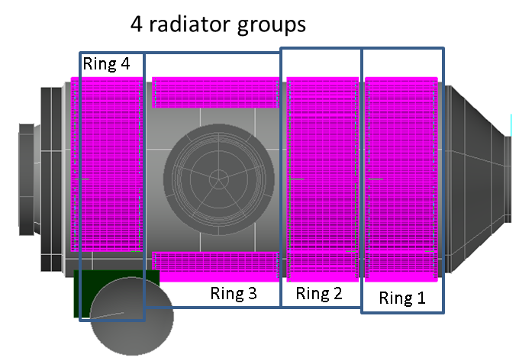
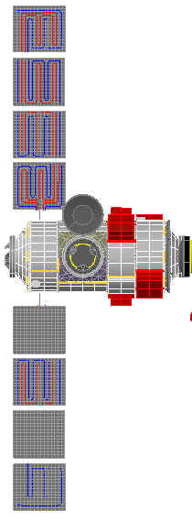
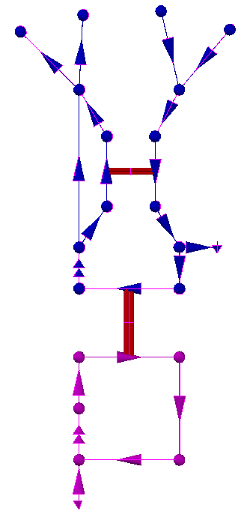
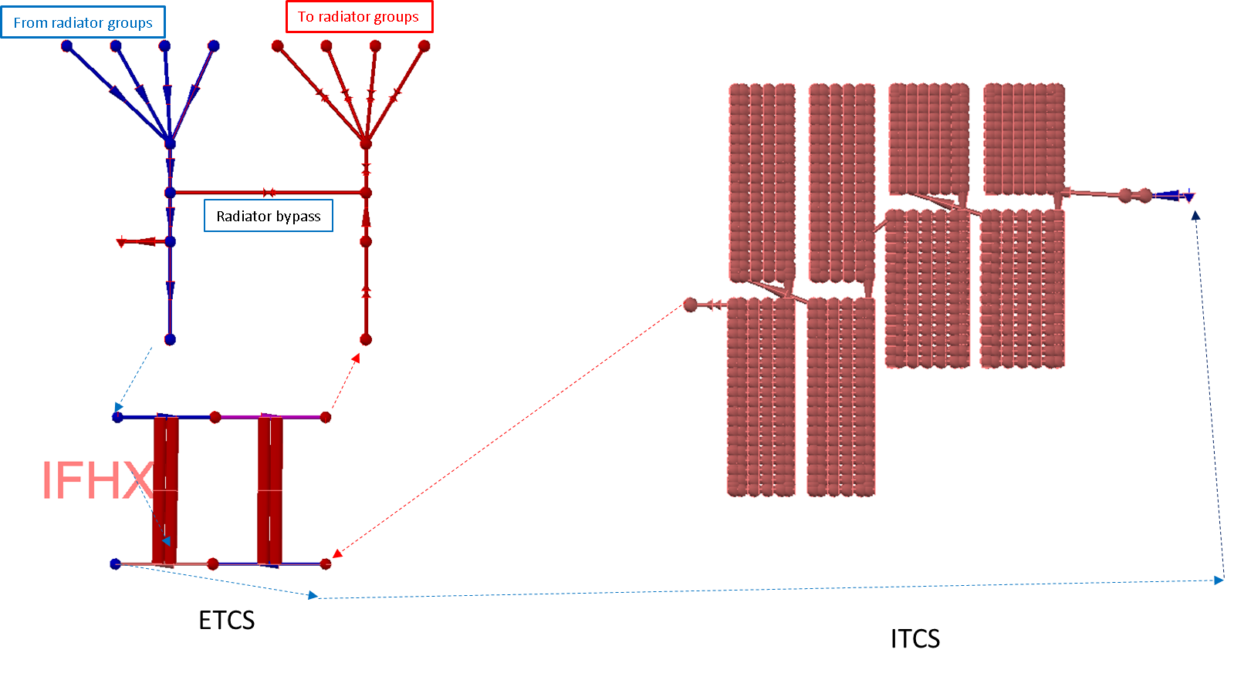
ATCS Analysis and Testing – Active TCS Fluid Models Schematics
HALO AFM
(showing 1 EATCS loop)
For both models, SINDA logic blocks are used to represent the EATCS temperature control modulating valves
For HALO, this is achieved by a radiator flow bypass
For IHAB, this is achieved using a regenerative HX
IHAB AFM
(showing 1 EATCS loop)
MLI on one face of outermost panels
Radiator wings articulate to maintain edge-to-Sun
To radiators
From radiators
Regenerative HX bypass
From Radiator groups
To Radiator groups
4 paths to/from groups in parallel
2 IFHX’s in series per loop
Radiator bypass
IFHX
Heat Loads applied to cold plates
Heat Loads applied to IATCS lumps
ETCS
ITCS
Notes:
SINDA logic-blocks

Slide 38
Passive Thermal Control

Slide 39
Heater Architecture

Slide 40
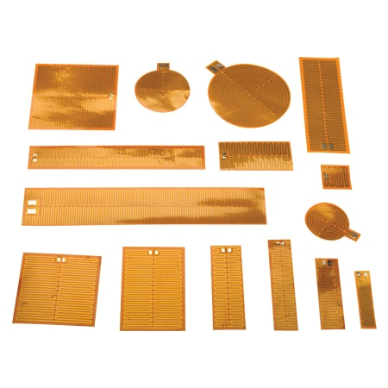
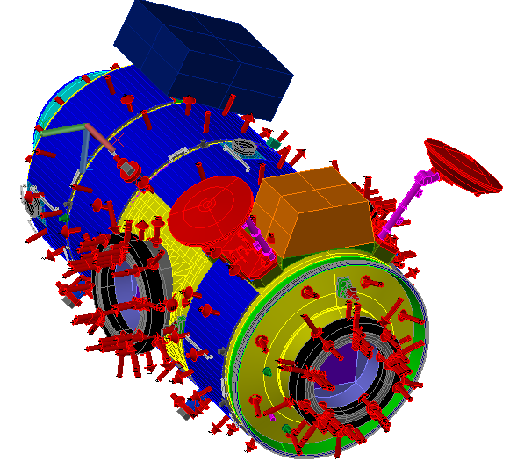
Gateway Heater Architecture
Each Gateway module and element will have its own independent heater architecture which includes shell heaters, radiator heaters (if applicable), docking system heaters (if applicable), heaters for powered down avionics, and heaters for other external components.
Radiator heaters are needed to keep radiator fluid above -70°C for transit but are not typically needed in NRHO.
To prevent condensation shell heater setpoints are +5°C above the dewpoint.
Dewpoint is dependent on crewed and uncrewed mission phases.
Shell heater architecture is designed using thermal analysis and parameters explained in the next slide.
To allow for setpoint changes during different phases of mission, computer-controlled software is used to manage and control each individual heater architecture.
Computer controlled software is ideal for unmanned long duration missions.
The shell heater control hardware needed for a computer-controlled system includes programmable switch controllers, temperature sensors (RTDs or thermistors), fuses, and relays.
Example of modeled heater architecture to the right. Working HALO Thermal Model with Heater Zones
Heater architecture provided by Northup-Grumman.
NASA Gateway baseline is assumed until heater architecture is provided by the module or element owner.
Heater zones on the shell are arranged in rings.
Heaters and RTDs are represented as red arrows.
Kapton Polyimide Film Heaters
HALO Thermal Model used during heater analysis. Heaters and RTDS are represented as red arrows
Notes:
10 degrees C is the crewed dewpoint and add extra 5 to get inner wall temperatures
13 degrees C during exercise
Dewpoint is lower uncrewed

Slide 41
How to Design Shell Heater Architecture
Heater Architecture Analysis and Parameters | Heater Architecture Design Approach
Makeup energy analysis calculates the make-up heater power required to maintain the inner wall temperatures during the worst cold cases. There are no other external heat loads included during this analysis, the inner wall temperature setpoints is the only variable being assessed. The make-up energy values for the worst case of each section is then used to develop heater zoning. | Use a detailed thermal math model to create a boundary node model. Hold shell nodes to the inner wall temperature setpoint, solve for the power input required to maintain that temperature. The inner wall temperature should be based on dew point limits to protect against condensation. Make up energy values should be found for each portion of the spacecraft i.e., walls, forward/aft cones, all ports, etc. Assess uncrewed, crewed, and transit phases
The detailed heater analysis sizes heaters and creates heater zones that maintain all temperature limits during worst-case cold environments. Watt density should be considered to ensure heater sizes and heater zones do not damage structure. This is an iterative analysis that will take trial and error to find the best option. | Heaters are sized and heater zones are created by running parametric studies done with a simplified thermal model (<600 nodes and surfaces) in the worst-case cold environment with the appropriate mission attitudes and spacecraft configurations. Temperature gradients across different portions of the shell can help to identify the best way to zone heaters.
Watt density is also considered while sizing heaters and protects against damage to the structure and the heater itself. | It is best practice to select a watt density below 3.5 W/in². A higher watt density can be used if heaters are mounted to thick substrates with high conductivity. For higher watt-density consider the impact of heater burnout to the design. Gateway adopted the same watt density used on the ISS, 3 W/in².
Heater power budget analysis verifies heaters can maintain temperatures within the minimum, nominal, and maximum power settings for the overall system. Duty cycle should be included with heater power draw. | A simplified thermal model is used in minimum, nominal, and maximum power settings with the nominal environment of the orbit. The nominal environment should be defined with parameters that the spacecraft will be subjected to for a majority of the mission’s orbit.
Duty Cycle is an input to analysis as a margin to protect against undersized heaters. | Duty cycle for heater architecture is determine by measuring the percentage of time that a heater zone is on. Gateway followed ISS guidelines, applying a duty cycle no more than 70%. To lower duty cycle consider increasing heater power.
Notes:
10 degrees C is the dewpoint and add extra 5 to get inner wall temperatures
13 degrees C during exercise
Dewpoint is lower uncrewed

Slide 42
Material Properties and Optical Coatings

Slide 43
Passive Thermal Control - External Surface Material Properties
Infrared emittance (ε) and solar absorptance (α) are optical properties of external surfaces that impact the radiative heat transfer to and from the environment.
Optics are material and surface coating dependent.
SEI-DM-HAND-001 Gateway Passive Thermal Handbook (GW PaTH) includes a Material Matrix with thermal surface materials and their BOL and EOL optical properties which can be used as a starting point in Gateway thermal analysis.
Each external thermal surface function has a desired range of optical properties.
Radiators
Designed to radiate IR to space and minimize solar heating
High emissivity and low absorptivity are desired
Gateway material options that meet these optics include white paint, optical solar reflectors (OSRs), silver Teflon, etc.
Multi-layer Insulation (MLI)
Designed to reduce all types of heat transfer from one side of the blanket to the other
A low solar absorptivity to emissivity ratio is desired for the MLI external layer
MLI external layer options for Gateway include Aluminized Kapton, Black Kapton (plain, Stamet, or Germanium), Astroquartz, Beta Cloth, Titanium, etc.

Slide 44
Gateway External Surface Material Selection and End of Life Optics
Gateway has several requirements that impact surface material selection and End of Life optics such as:
Plume impingement heat loads from Visiting Vehicle docking
Electrical Dissipation
Contamination from venting, material outgassing, and ion sputtering from electric propulsion (EP) on PPE
Particulate release from neighboring modules and/or visiting vehicles
Lunar Dust
EVA Kick Loads
Touch Temperatures
Notes:
Material outgassing

Slide 45
PTCS Analysis & Testing - Degradation to Optical Properties
End-of-life (EOL) thermal performance is impacted by degradation of optical properties that include IR emittance and solar absorptance. The design is driven by the degraded EOL optical properties.
Impacts from environmental exposure over mission lifetime:
Increased solar absorptance
Reduces radiator heat rejection capability
Increases external surface temperature maximums
Emissivity is not significantly affected, except for by lunar dust which may have an impact
Comparison of three orbital environments LEO, GEO, and NRHO can be seen to the right, refer to slide 24.
Transit to NRHO requires passage through LEO and GEO which will result in degraded properties upon arrival to NRHO
Van Allen Belts, which intersect with GEO, account for majority of degradation from charged particles. Solar wind is much less severe than the Van Allen Belts.
The transit path is module dependent.
At the beginning of Gateway there was little known on how to assess degradation and End of Life Optics. Since then, Gateway has performed analyses and testing to fill in the knowledge gaps.
Orbit Environmental Factor Comparison
LEO
NRHO
Lunar Dust
Atomic Oxygen
Orbital debris
Solar wind charged particles
UV
Vacuum
Plume
MM
GEO
NRHO
Lunar Dust
Orbital debris
Van Allen Belt Charged Particles
UV
Solar wind charged particles
Vacuum
Plume
MM

Slide 46
PTCS Analysis & Testing - Charged Particle/Solar Wind/UV Testing
Parameter | Method | Definition
Equivalent Solar Hours (ESH) | Analysis | ESH is the amount of UV radiation that reaches a surfaces due to direct and reflected solar loads. This number is an input into UV/Charged Particles Testing and Molecular Contamination + UV analysis.
UV/Charged Particles | Test | Exposure of certain Gateway materials to expected proton and electron fluence as well as UV exposure up to 5000 ESH (Near UV and Vacuum UV). The test is done at the Solar Wind Test Facility at Goddard Space Flight Center.
Molecular Contamination + UV | Analysis | Degradation due to the combined effect of surface molecular contamination and solar ultraviolet (UV) / vacuum ultraviolet (VUV) radiation is determined by analysis based on a heritage ISS semi-empirical model. This analysis is performed by the Jet Propulsion Lab Contamination Control Engineering team in collaboration with L2 Gateway Induced Environments.
Lunar Dust | Analysis | Lunar dust can impact thermo-optical properties of Gateway surfaces which effects thermal performance especially radiator functionality. Lunar dust percent area coverage (PAC) estimates how much dust can be expected on Gateway surfaces. PAC values are pulled from analysis by Gateway SE&I. The percent area coverage was correlated to an increase in absorptivity using the law of mixtures.
Contamination Sputtering | Test | Gateway contamination includes ion sputtering from PPE thrusters that causes optical degradation. Redeposit of sputtered material during transit is included in current assessment for all the Co-Manifested Vehicle (CMV) surfaces. Testing at NASA Glenn Research Center by Sharon Miller is done to determine optical degradation due to sputtered material. Contamination from sputtering will primarily occur during transit and is expected to be minimal during NRHO operations.
 | Analysis | Analysis is performed to determine how thick contaminant layer is on CMV surfaces. This analysis is done at NASA Glenn Research Center by John Yim.
Integration of Degradation Factors | Analysis | Delta absorptivity degradation from all contamination sources are calculated and integrated to find EOL properties for surfaces, as well as BOO for CMV. Integration of these factors is done in such a way to minimize over estimation of degradation.
Notes:
When talking about how EOL properties were calculated we can mention the testing and analysis that was completed
We don’t need to go as in depth as this slide to talk about testing
ESH analysis was done by the Gateway PTCS team at JSC to understand the amount of UV radiation
UV/Charged Particles are particularly important because PPE and HALO spend a significant time in the Van Allen belt’s charged particle environment

Slide 47
Specularity Analysis

Slide 48
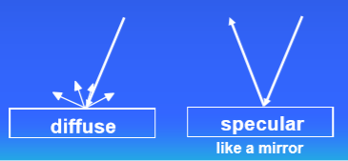
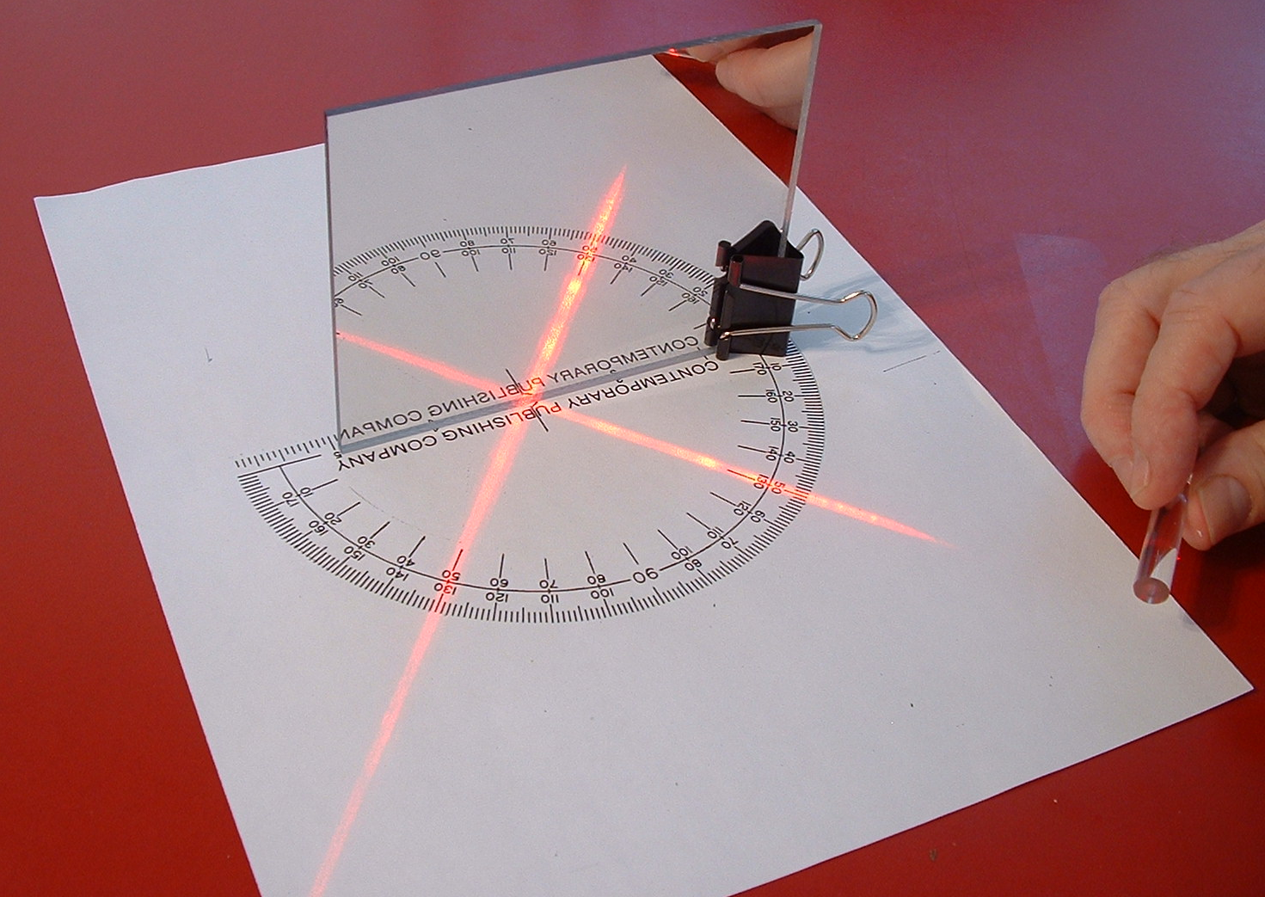
Specularity Background ⁸
What is specularity?
Fraction of reflected energy that is reflected in a non-diffuse manner
For an opaque surface:
$1 –α= ρ_{total}$
$ρ_{total}$ = $ρ_{diffuse}$ + $ρ_{specular}$
$\% Specularity =\frac{ρ_{specular}}{ρ_{total}}$
Why do we care about specularity?
Thermal
Specularity could impact heat rejection, create hotspots or impact thermal performance.
EVA
Specularity could induce glint as well as create focused heat on suits – overheating.
Power
Specularity could affect solar array performance.
Notes:
Add some pictures

Slide 49
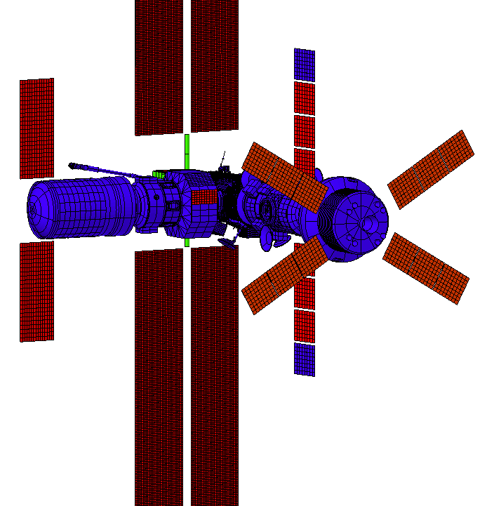
Gateway Specularity Analysis Methodology ⁸
Identify critical locations on Gateway that will be affected by specularity.
Refine nodalization of simplified thermal models that include optical properties for surface coatings, solar values, IR wavelengths, and specularity values for materials.
Run cases to confirm locations of specular reflection and confirm attitudes in which the reflections occur.
Plot Absorbed reflected solar flux.
Note, that absorbed flux is relative to the absorptivity value of the receiving surface. If the absorptivity increases, so does the absorbed flux.
Analyze thermal performance impacts to critical locations.
*Specular surfaces colored red

Slide 50
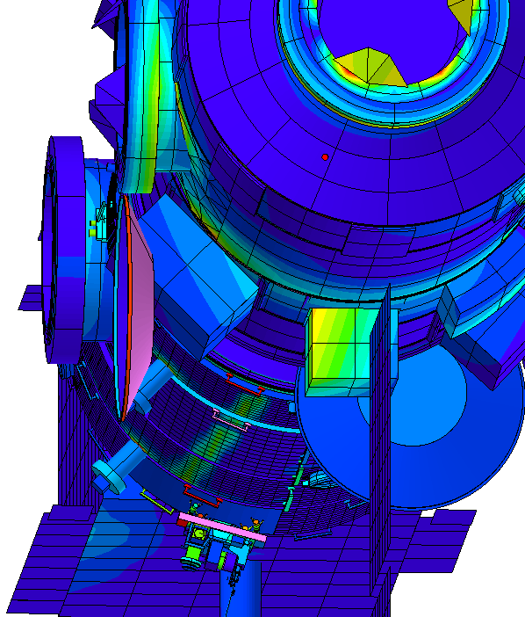
Gateway Example: Reflections onto HALO ⁸
Ex Case 1: Conf. 5 pitch 10º yaw -3.74º
Case Study | Receiver of Reflection | Source of Reflection | Configuration | Attitudes
HALO - 1 | HALO radiators | IHAB radiator | 3-31 | Yaw 5° to -5° Pitch >5°
HALO Body Mounted Radiators were identified as a critical location.
The specular analysis identified the IHAB radiator as a source of specular reflections onto HALO radiators.
Further thermal analysis verified that HALO radiator performance was not affected by IHAB radiator specular reflections.
*view from sun

Slide 51
Gateway Specularity Analyses Conclusion⁸
Gateway will fly in many different attitudes which means there are numerous scenarios to run with a variety of impacted hardware for each scenario.
Highly specular surfaces will create concentrated reflected flux onto neighboring modules.
As a result of specularity analysis, PPE solar arrays are being certified to meet temperature exceedances from specular reflections
Specular reflections onto solar panels can cause an increase in current and an instantaneous effect on downstream hardware.
Higher absorptivity will increase the amount of absorbed reflected flux.
Areas of impact will change with respect to geometry and configuration changes.
Solar-inertial attitudes result in static specular reflections that do not change over time unless attitudes are changed.

Slide 52
Active Thermal Control System

Slide 53
Heat Rejection Analysis

Slide 54
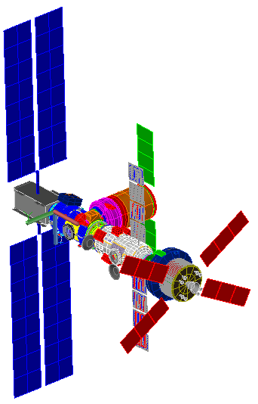
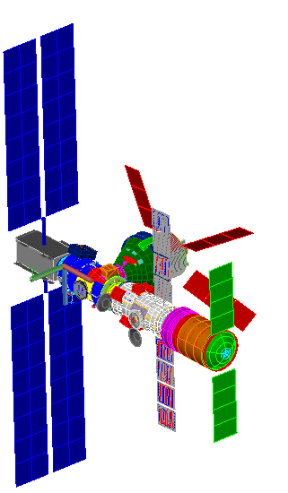
ATCS Analysis – Heat Rejection Capability
Both the HALO and IHAB AFM’s use a similar methodology to predict the module’s heat rejection capabilities (HRC):
AFM’s are integrated into the GITEM to provide the thermal environments
Note: GITEM has geometric representations of all Gateway modules that are replaced as needed when using the AFM. For example, the HALO geometric model in GITEM is replaced with the ATCS HALO model for the HALO AFM.
Cases are set up to bound all possible radiation environments:
Manifests (stack-ups): About ~30 unique stack-ups each analysis cycle. View factors from other modules impact the radiator’s sink environment. Shading and solar reflection from other modules can occur.
AFM’s cases are ran using all unique manifests
Vehicle attitude: Vehicle attitude impacts the incident solar flux on HALO BMR’s as well as the sink environment caused by other surface’s reflections on radiators.
For analysis, solar clock angles (rotations about the +Z-axis) are discretized from 0˚–360˚ in equal increments (typically 22.5˚)
Solar cone angles (angle above the xy-plane) are discretized from -5˚ to 5˚
Orbital environment: NRHO is split between Apolune and Perilune Pass
Apolune environments are modelled using steady-state analyses considering only solar environmental heating NRHO orbit is approximated using a Keplerian orbit in Thermal Desktop
Solar Beta angles (orbit plane rotations about the north ecliptic pole) are discretized from -90˚ to 90˚
Different Gateway manifests impact module thermal sink environments
Solar flux angles impact radiator heating (directly and via reflections)
NRHO split into two regions for thermal analysis:
Perilune Pass
(transient analysis with solar and lunar heating)
Apolune (modelled steady-state with only solar heating)

Slide 55
ATCS Analysis – Heat Rejection Capability: Logic
Set Heat Load applied to an initial guess HRC
IHAB schematic
IHAB steady-state case example:
Initial guess: 12.5 kW
In order to capture maximum heat rejection for a case, overcooling controls are disabled
(fluid flows fully through radiators as would be expected at HRC)
To radiators
From radiators
Heat Load Guess [kW] | Error ΔT [˚C]
12.50 | 6.08
11.25 | 0.58
11.12 | 0.10
11.09 | -0.03
Run Steady State at a low heat load (to initialize)
Timeo = Orbit Start, Timend = Orbit Stop
100% of fluid flows through bypass (no overcooling should occur when heat load applied = HRC)
Run Transient
Timeo = Orbit Start, Timend = Orbit Stop
IFHX return Temperature
After 12.5 kW heat load error is 6.08˚C. The heat load is reduced to 11.25 kW and the case is reiterated.
After +2 cases are run (i>1), a linear approximation is created and used to “guess” the HRC until the return temperature is within 0.1˚c of the setpoint.
Any heat load greater would be beyond the system capabilities (higher return temperature)
Any heat load lower would leave system margin (additional heat load could be applied before system breaks)
11.09 kW is the HRC
Save for iteration i:
guess HRC & maximum T_IFHX_return
ΔT = |T_IFHX_return – T_IFHX_return_setpoint |
IFHX
If ΔT > 0.1 and i > 1:
guess HRC = predicted HRC at Target IFHX return T via linear interpolation from previous 2 runs
If ΔT > 0.1 and i < 2:
guess HRC = previous guess HRC – constant*(Δ)
ITCS
Heat Load applied to IATCS lumps
If ΔT < 0.1 :
HRC = guess HRC

Slide 56
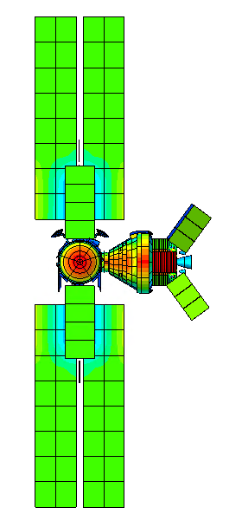
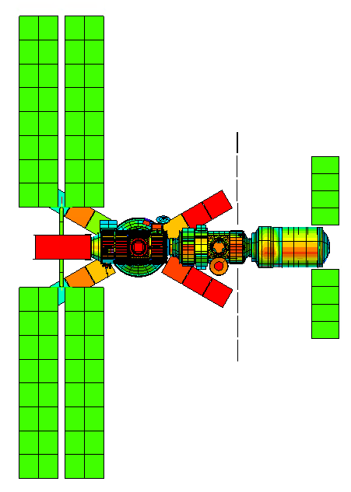
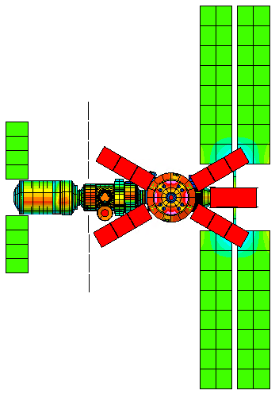
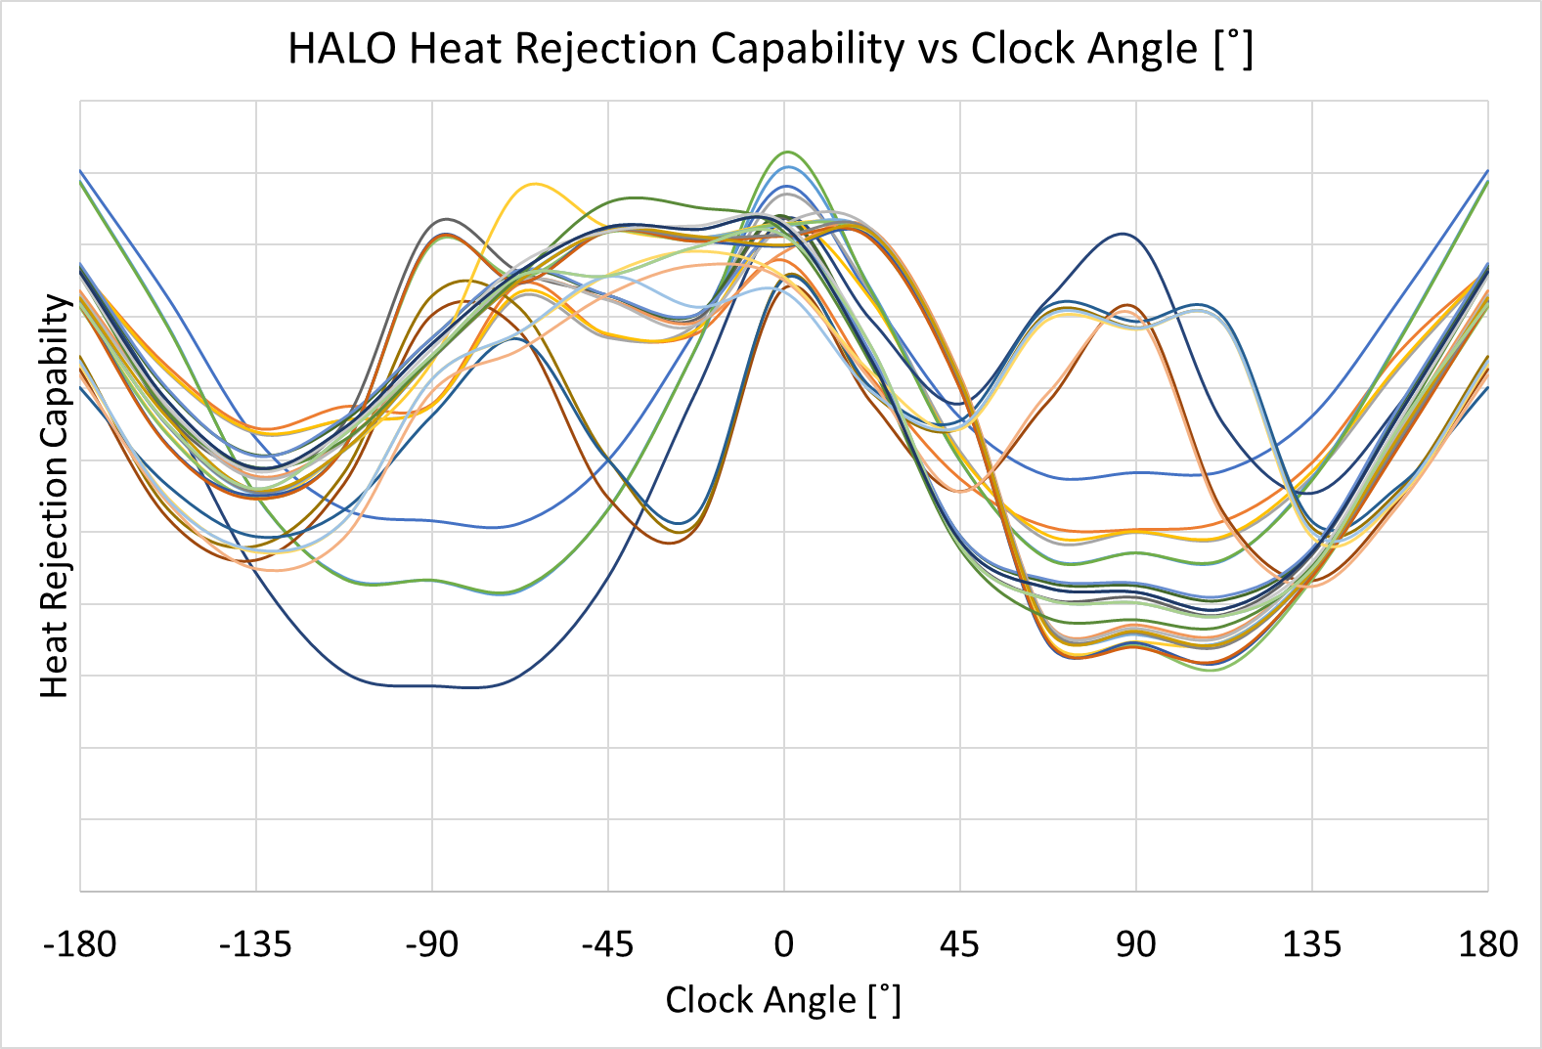
ATCS Analysis – HALO Heat Rejection Capability Results
Example HRC analysis: Apolune
Predict HRC for expected clock & cone angles, and manifests, at each environment.
Calculations are at steady-state (no time/mass impacts).
Plot HRC vs. clock angle for each manifest:
HRC is best when HALO’s radiators do not see sun.
Incident Solar Flux - View from Sun (HALO/PPE, IHAB, Orion, ALM)
Clock 0
Clock 90
Clock -90
HRC is high because HALO radiators see space
HRC is low because ½ of HALO radiators see sun
HRC is high because Orion shades HALO radiators
Notes:
For halo: Highlight high (+/-90) clock angles and show pics of sun views to illustrate why HRC dips there, and discuss shadowing for manifests when vehicle dock to those ports
The example Manifest here is from IAC9 config 9. Everything is present but HLS
The HRC at 0 and -90 are simar because Orion blocks the sun from hitting most of the HALO radiators.
But at 90 the HRC is roughly cut in half because about half of the HALO radiators sees the sun

Slide 57
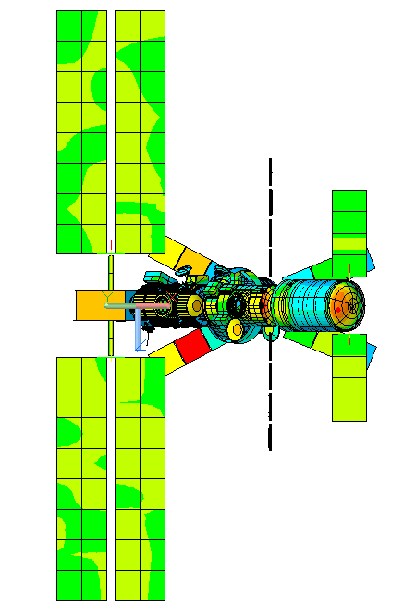
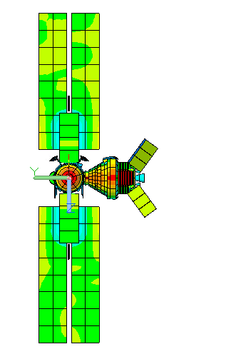
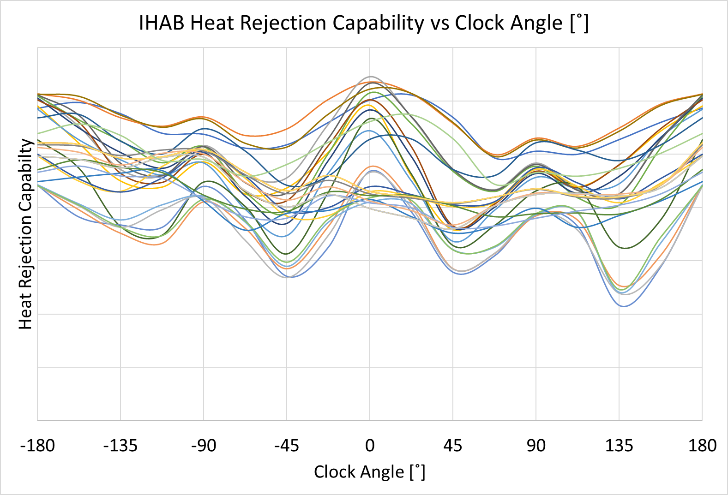
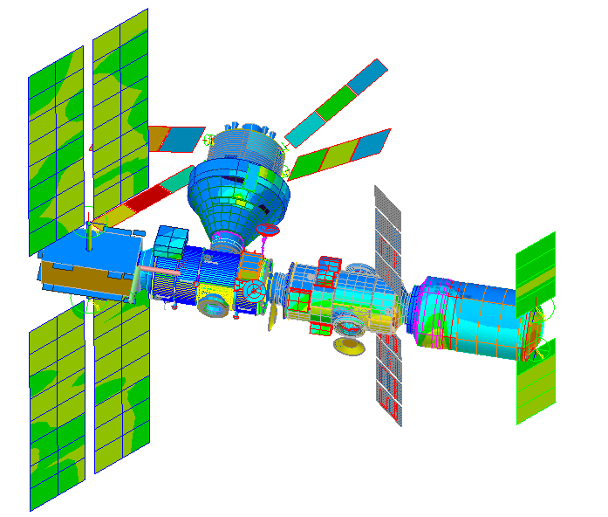
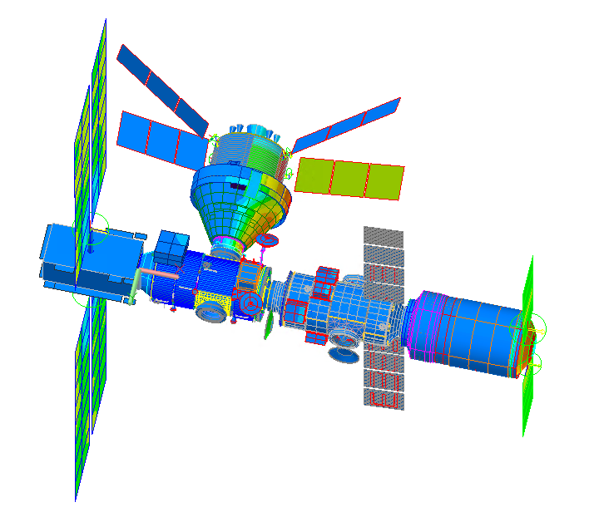
ATCS Analysis – IHAB Heat Rejection Capability Results
Example HRC analysis: Apolune
Predict HRC for expected clock & cone angles, and manifests, at each environment.
Calculations are at steady-state (no time/mass impacts).
Plot HRC vs. clock angle for each manifest:
Since IHAB’s radiators are always edge to sun, its HRC is mostly driven by its view to nearby solar arrays and their temperatures.
Incident Solar Flux (HALO/PPE, IHAB, Orion, ALM)
Clock 45
Clock 0
Smallest view to PPE & LM solar arrays
View from Sun
View from Sun
Largest view to PPE & LM solar arrays
Sun
Sun
Notes:
This is from the IHAB HRC model config 9
Incident solar flux (scale is from 0 to 1426 W/m^2)
Note that view to solar arrays is impacted by proximity (angle between IHAB radiators to solar arrays is always 90deg).

Slide 58
Turndown Analysis

Slide 59
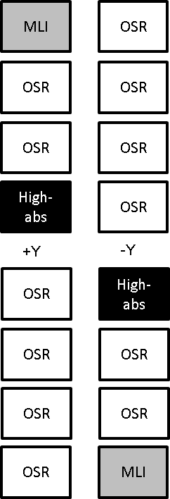
ATCS Analysis – Turndown Analysis
IHAB radiators operate in extreme high and low heat load scenarios and thus require a high turndown ratio (high-side heat load / low-side heat load). IHAB nominally has sufficient hot-side margin but has negative margins on the cold-side.
IHAB target turndown ratio: ~8:1 overall (including transit), and ~3:1 during deployed
IHAB has positive hot-side margins, but negative cold-side margins
Hot cases: Docking cases with radiators feathered towards Sun, crewed cases with heat load shed from HALO to IHAB, and lunar flyby’s (perilune pass regions of NRHO)
Cold cases: Transit scenarios from LEO to NRHO (stowed radiators), and uncrewed NRHO phases
Design options in consideration to solve cold-case negative margins:
Implementation of MLI on the outermost radiator faces during the transit (stowed) scenarios or implementation of heater architecture for the radiators
Use of high solar absorptivity coatings on IHAB radiators along with radiator rotations to capture solar heating as necessary when radiators are deployed
Views From Sun:
Radiator Coatings
IHAB radiator angle = 0˚
IHAB radiator angle = 90˚
Solar flux: sin(0)=0
Solar flux: sin(90)=1
Problem | Solutions considered | Rationale | Impacts
Transit (stowed) towed phase freezing concerns | Implementation of MLI on the outermost radiator faces during stowed phases Increase power allocation + radiator heater architecture | MLI: Decreases heat leak to space during stowed phases Heaters: Increases load applied to radiators | MLI: mass, loss of HRC Heaters: design/implementation of architecture, increased power allocation
Low heat loads available during cold deployed phases | Use of high solar absorptivity coatings on IHAB radiators along with radiator rotations to capture solar heating as necessary | Since IHAB radiators articulate to be edge-to-Sun during nominal cases, rotating to face the Sun can capture solar flux | Software implementation Increased actuation for IHAB radiators Loss of some HRC

Slide 60
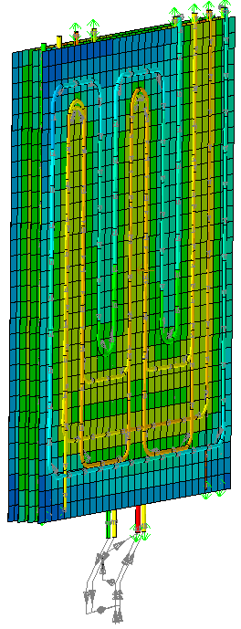
ATCS Analysis – Turndown Analysis Continued
For turndown analyses, the AFM is used with modified SINDA iteration logic.
The heat load is iterated until both of the following success criteria are met:
1) Return temperature is above the minimum setpoint
2) All EATCS fluid lump temperatures are above the minimum allowable fluid temperature
For transit phases, the radiator geometry in the AFM is also modified to represent the panels in their stowed configuration
Turndown analysis for the stowed radiator during transit phases provides estimates on the heater power required to protect fluid temperature.
“If the MLI is removed, how much heater power would be required to protect fluid temperatures during transit scenarios?”
For deployed cold phases, the AFM with modified iteration logic is used to determine the minimum loads required on the EATCS during nominal NRHO cold cases
High-absorptivity coatings along with radiator rotations was shown to improve cold cases without significantly impacting hot cases. Radiators are rotated as necessary to capture solar flux (see chart at right)
Results show the heat load that can be supported by each design at varying IHAB radiator angles.
Note: the minimum allowable heat load that can be support occurs at IHAB radiator angles of 90˚ (perpendicular to solar flux)
Stowed Radiator TD Model
Views From Sun:
Outermost panel uses a “space” sink temperature. MLI covers the outermost panel
IHAB radiator angle = 0˚
IHAB radiator angle = 90˚
Solar flux: sin(0)=0
Solar flux: sin(90)=1
Goal minimum heat load: < X kW.
Design points above this (in red) fail turndown analysis
Notes:
Try to generalize trend of Minimum heat load required vs. IHAB radiator angle. Maybe take off y-axis?

Slide 61
Cross Strapping

Slide 62
Thermal Cross Strapping Architecture: HALO-to-IHAB
For both nominal and contingency HALO-to-IHAB cases, cross-strapping is used to cool HALO fluid temperature to its setpoint.
On HALO, MHX is downstream of IFHX and upstream of its ITCS components as a supplemental heat rejection component.
On IHAB, MHX is in parallel with the Low Temperature Loop.
Notional nominal Cross-strapping scenario
Notes:
This section is about cross strapping analysis:
[This slide: defines cross strapping, outlines ITCS loops and key components ] 1:20
As Miguel mentioned earlier.
GW uses a cross-strapping architecture to transfer heat from HALO to IHAB.
This means that HALO and IHAB’s internal fluid loops are connected with a heat exchanger
This architecture enables HALO to meet its temperature setpoint at more GW configurations.
Here we have a notional sketch of the HALO and IHAB internal fluid loops depicting a nominal cross-strapping scenario.
The module heat exchanger between HALO and IHAB is marked HALO-MHX.
The boxes marked IFHX’s are the heat exchangers that reject heat to each module’s external thermal control system.
Why MHX on the inside: can still connect modules in case a ETCS fails.
The HALO loop has a MHX that could be used to pick up heat from another vehicle (e.g., HLS)
And the IHAB loop has an MHX that could be used to reject heat to the air-lock module
The IHAB loop also has a low temperature section marked LTL (for low temperature loop)
and mid-temperature section marked MTL (for mid-temperature loop)

Slide 63
Thermal Cross Strapping Architecture: HALO-to-IHAB
For both nominal and contingency HALO-to-IHAB cases, cross-strapping is used to cool HALO fluid temperature to its setpoint.
On HALO, MHX is downstream of IFHX and upstream of its ITCS components as a supplemental heat rejection component.
On IHAB, MHX is in parallel with the Low Temperature Loop.
HALO fluid temperature at IFHX exit is greater than its setpoint
Notional nominal Cross-strapping scenario
IHAB MHX 3-way mixing valve PID:
Process variable: HALO MHX exit temperature
Control variable: IHAB flowrate to MHX
IHAB flow is split between MHX and LTL in parallel
Excess heat on HALO is rejected to IHAB via MHX
Heated fluid on IHAB is directed downstream of LTL by the solenoid valve
IHAB rejects the excess heat
Notes:
[This slide: outlines the nominal cross strapping scenario.] 1:20
This slides shows a notional nominal cross-strapping scenario:
In the HALO ITCS, the fluid picks up heat and is pumped through the IFHX in order to reject heat to HALO’s external loop.
When IFHX’s exit temperature is above HALO’s set point than, excess heat needs to be rejected to IHAB.
On the IHAB side, a 3-way missing valve and PID controller controls the flow rate directed to the MHX.
The PID controller adjusts its control variable (the IHAB flowrate to the MHX) until its process variable (the HALO MHX exit temperature) hits its goal.
Fluid entering the 3-way mixing valve is either sent to the MHX or to IHAB’s low temperature loop.
IHAB’s low temperature loop’s setpoint is maintained by directing warm fluid exiting the MHX downstream of the LTL.
Then fluid flows through the regen heat exchanger to pick up any heat needed to maintain IHAB’s mid-temperature loop’s setpoint.
If the ALM is present than another 3way mixing valve and MHX enables IHAB to reject heat to the ALM.

Slide 64
Thermal Cross Strapping Architecture: HALO-to-IHAB
Theoretical heat transfer capability (HXC) is based on maximum flowrate available from IHAB.
Per requirements, IHAB should be capable of accepting 2 kW from HALO nominally.
Additional heat load can be transferred from HALO to IHAB if:
Heat transferred is within HXC
IHAB & ALM have available thermal margins
Notional nominal Cross-strapping scenario
Notes:
[This slide: conveys limitation in heat rejected through the MHX]
Because the flow in IHAB is split between 1) the flow that goes to the HALO-MHX then to the mid-temperature loop
And 2) the flow that bypasses the HALO-MHX and goes to the low temperature loop
The theoretical max heat transfer from HALO to IHAB is based on the max flow available form IHAB
IHAB is required to be nominally be capable of accepting 2kW from HALO
So at 2kW from HALO to IHAB, the warm flow exiting the MHX will not cause the MTL to exceed it’s inlet setpoint
- Scenarios where >2kW from HALO to IHAB may be allowed if at these configurations IHAB or IHAB + ALM have excess heat rejection capability (able to reject >2kW from HALO)
We’ve predicted HRC HR
This plow shows trend
The amount of heat transfer increases with increased flow through the MHX
In a loop failure case, the MHX UA drops and the HTC drops.

Slide 65
Thermal Cross Strapping Architecture: IHAB-to-HALO
As a contingency scenario, IHAB-to-HALO heat transfer cases occur when IHAB rejects heat to HALO via the HALO/IHAB-MHX.
On HALO, MHX is downstream of IFHX and upstream of its ITCS components as an additional heat load.
On IHAB, MHX is downstream of the IFHX and upstream of the LTL as a supplemental heat rejection component.
Heat Transfer capability depends on the minimum HALO IFHX temperature possible.
HXC may also be increased by allowing elevated setpoint temperatures during contingencies.
IHAB fluid temperature at IFHX exit is greater than its setpoint
3wmv starts flowing to HALO (full flow-through MHX, unless oversharing occurs)
Notional IHAB-contingency Cross-strapping scenario
HALO reduces IFHX temperature to accept heat from IHAB
(possible option to adjust flowrate to accept increased heat loads)
HALO accepts heat from MHX and its fluid temperature increases up to CHX inlet setpoint
(higher temperatures may be allowed during contingencies)
Cooled fluid on IHAB is directed towards the LTL inlet on IHAB by the solenoid valve
HALO rejects some excess heat from IHAB
Notes:
[This slide: describes a contingency cross strapping scenario]
Another potential cross strapping scenario is a contingency case where IHAB would need to reject heat to HALO.
In this case the MHX acts as an additional heat load in HALO’s fluid loop
so the amount of heat that IHAB can transfer to HALO depends on HALO’s minimum allowable IFHX outlet temperature and HALO allowed setpoint.
The 3way mixing valve would start at full flow on the IHAB side unless HALO’s MHX outlet is too high.
One option for a contingency scenario is to enable HALO’s MHX exit to be slightly greater than it’s nominal setpoint.
As opposed to the nominal scenario now the MHX outlet is directed to IHAB’s LTL instead of passed it.

Slide 66
Thermal Cross Strapping Architecture IHAB-to-ALM
ALM ITCS architecture and design is not known
Instead, the following assumptions are made:
ALM ITCS conditions are parametrized as inputs for the heat transfer capability between IHAB/ALM:
ALM fluid inlet temperature to MHX
ALM fluid maximum exit temperature allowed from MHX
ALM flowrate through the MHX
IHAB inlet temperature to the MHX is also parametrized.
Results:
Heat transfer capability is mapped as a function of the ALM inlet variables and IHAB inlet temperature assumption.
Results can provide guidance on ALM interface requirements based on goal heat transfer capabilities.
As ALM design matures, HXC is can be better defined.
Notional IHAB-contingency Cross-strapping scenario
IHAB-to-ALM HXC [W] vs ALM flowrate to MHX [lbm/hr]
Notes:
[This slide: talks about heat that can be rejected to the ALM]
The last possible GW cross-strapping scenario that we’ll talk about is from IHAB to the air lock module
Since air lock module’s ITCS design is not known we’ve estimated heat transfer capability across the ALM-module heat exchanger parametrically
We parameterized ALM’s MHX inlet temperature, max allowed exit temperature and flow rate
We also parameterized IHAB’s inlet temperature
This work was done to gauge possible ALM capabilities and IHAB to ALM interface requirements.

Slide 67
Gateway Thermal Challenges

Slide 68
Docking Challenges
Delta interface temperatures between docking surfaces
Unless the docking vehicle is side to sun, one port is shaded and other is in sunlight
HALO side to sun
Feathering
View from Sun - Feathered
View from Sun - nominal
Positive IHAB radiator feather direction
30°
70°
Solar flux vector and docking vehicle direction

Slide 69
Gateway Challenge: Lunar Dust
Lunar dust impacts have not been thoroughly studied but preliminary results indicate even a small amount of lunar dust can significantly degrade thermal performance.
HLS will be landing on the surface of the moon and will bring back lunar dust that can potentially transfer to Gateway through docking vibrations and electrostatic charge differences between HLS and Gateway.
Lunar Dust Analysis:
Lunar dust percent area coverage (PAC) estimates how much dust can be expected on Gateway surfaces. PAC values are pulled from the GOLDMAP analysis by Ron Lee at NASA JSC.
Lunar Dust Testing:
Gathered optical property measurements of various Lunar Dust simulants in collaboration with Purdue University.
Published poster “Thermo-optical Properties of Lunar Dust Simulants,” by Abby Zinecker and Brittany Spivey (2023 Lunar and Planetary Science Convention).
Vibration testing is done at JSC to understand how lunar dust adheres to certain Gateway surfaces under vibration loads.
Lunar Dust Level Sensor and Effect on Surfaces (LDES) deposit dust onto coupons of a few different materials and measure the heat rejection capability to back calculate effective emittance under various dust loads.
LDES testing and analysis is done in collaboration with other Artemis programs at NASA JSC by Katy Hurlbert.

Slide 70
Gateway Challenge: Multiple Design Schedules
Each Gateway module undergoes the design cycle in nonconcurrent schedules
Each contractor and agency involved in the design and manufacturing of the gateway components has their own design and review processes and schedule
This poses a challenge with ever evolving designs as each component goes through its design reviews
Other Artemis programs have a separate design cycle
Orion is already built and has heritage requirements that drive Gateway design
HLS PDR
LM SRR
One module is in SRR while another is in CDR
Modules that all need to interface and work together are in different stages of design review
PPE CDR
HALO CDR
IHAB PDR
ALM SRR

Slide 71
Gateway Challenge: Inefficient Heat Rejection
Body Mounted Radiators (HALO):
At the mercy of the Vehicle orientation and configuration when it comes to radiator view to sun, moon, and space
Limited in radiating area based on the size of the vehicle and other external components on the module, such as docks, external pump packages, robotic interfaces, and external experiment platforms
Deployable Radiators (IHAB):
Can turn out of the sun and are above and below the docking plane
Can add or remove panels as a module’s design heatload changes
Along with solar arrays, greater plume load issues due to the torque applied to the arrays, so docking procedures can require feathering that limits their effectiveness
Radiator Optical Properties:
Heat Rejection effectiveness degrades over the course of Gateway’s 15-year mission due to:
Extended travel through the Van Allen Belts (HALO)
UV degradation
Sputtering deposition from PPE Solar Electric Propulsion (SEP) thrusters
Potential lunar dust deposition

Slide 72
Gateway Challenge: Inefficient Heat Rejection
Cross Strapping Limitations:
Difference in fluid temperatures drive heat transfer:
Nominally HALO ITCS setpoint is warmer than IHAB ITCS setpoint, so HALO providing heat rejection for IHAB requires reducing the HALO fluid setpoint temperature
Colder fluid setpoint temperatures reduces radiator temperatures that in turn reduce radiator heat rejection effectiveness
HALO IMHX is upstream of HALO HARS, so HALO IMHX can only pick up enough heat from IHAB to not reduce HALO’s Cabin Heat Exchanger operation
IHAB flow through HALO IMHX and HALO flow through HLS IMHX is limited by the amount of flow that can bypass IHAB’s LTLs and HALO’s coldplates
Some scenarios (such as Orbital Maintenance Maneuvers and Docking) where multiple modules have reduced heat rejection simultaneously (HALO side to sun and IHAB radiators feathered for Orion docking) which limits the ability for Cross strapping between modules

Slide 73
Gateway Challenge: Plume Heating
Relative to the ISS, Gateway is a much more compact space station. Most surfaces are expected to experience the maximum plume heating loads from docking visiting vehicles shown in the table below:
The max plume heating loads have posed challenges to thermal performance by causing external MLI materials to exceed their temperature limits.
Heritage Black Kapton MLI blankets that are commonly used in GEO cannot withstand Gateway plume heating loads.
The Gateway Passive Thermal Team created an MLI Model to analyze plume impingement loads onto sample MLI stack ups for various modules and elements on Gateway.
To learn more about MLI Modeling see the TFAWS 2023 presentation “Using Thermal Desktop to Model the Effects of Plume Heating on MLI,” by Abby Zinecker and Brandon Hoffmann.
Gateway is interested in testing sample MLI under simulated plume heating loads to understand the impact to material properties.
Plumee(s) are defined as Gateway modules or elements within plume impingement environments.
Gateway Plumee Plume Impingement Heating Requirements from GP 10040 Gateway Loads Data Book Revision A

Slide 74
Questions

Slide 75
References
D. Davis, 9:2 Lunar Synodic Resonant NRHO: Orbital parameters and Ellipse Comparison. September 3, 2019.
S. Bhakta, L. Carrillo, L2 TCS PDR Outbrief, Gateway Program Control Board, March 7, 2022.
Cross-Program Design Specification for Natural Environments (DSNE), Rev. F. SLS-SPEC-159, National Aeronautics and Space Administration May 8, 2019
D. Davis, White Paper: Gateway Destination Orbit Model: A Continuous 15 Year NRHO Reference Trajectory, August 20, 2019.
L. Carrillo, D. Farner, and C. Preston, ISS Payload Thermal Environments. NASA Thermal and Fluids Analysis Workshop. August 3, 2015.
J. Smith, Gateway Thermal Induced Environment Databook and Simulation Manual (TIEDS-M). SEI-DM-MAN-001-8r1. December 8, 2022.
L. Ibrahim, Gateway Thermal Control System Modeling and Simulation Plan SEI-DM-MAN-002, July 2022.
B. Spivey, AP-927 IAC9 Specularity Assessment. Gateway Integrated Spacecraft Performance Working Group, May 17, 2023.
D. Gilmore, Spacecraft Thermal Control Handbook, Volume I: Fundamental Technologies. Washington, DC: American Institute of Aeronautics and Astronautics, Inc., 2002.

Slide 76
Backup

Slide 77
Gateway CAD Models
ERM
GERS
SpaceX
Dragon XL Concept
ALM
Orion
IHAB
HALO
PPE
HLS
Government Reference
Notes:
Arrays with cylinder on the underbelly is ALM
Re-paste LM from TIEDS-M because it is missing solar arrays
Google image of HLS for space x and also put reference
Make the picture to scale for size comparison

Slide 78
ATCS
HRC: Logic showing iteration method?
And also sample HRC plots for HALO and IHAB to show general HRC vs attitude relation
Turndown: logic showing iteration based on both parameters

Slide 79
NRHO K
NRHO Keplerian Orbit
Perilune
Perilune Pass
Apolune (can model with a basic orbit with 0 IR flux)
Notes:
NRHO92_Keplerian_HOT_Picture

