Slide 1
Thermal Modeling and Test Correlation for SWOT Loop Heat Pipe Evan Shea Orbital ATK
TFAWS Passive Thermal Paper Session
Presented By Evan Shea
Thermal & Fluids Analysis Workshop TFAWS 2016 August 1-5, 2016
NASA Ames Research Center
Mountain View, CA
Orbital ATK IPWG Approval 657, Unlimited Release

Slide 2
Overview and Objective
Overview
Characterizing the transient behavior of a loop heat pipe (LHP) is difficult to do accurately. This poses a design challenge when a LHP is required to operate in a situation where transient performance is the limiting design case.
The Surface Water Ocean Topography (SWOT) mission, managed by JPL, presents a need for a LHP that can maintain a tight payload temperature stability during fast radiator transients (0.05C/min of the payload)
For SWOT a benchtop LHP was tested by JPL to characterize its ability to maintain the stability requirements, and then a Thermal Desktop model was developed and correlated to this test data.
Objective
Use SWOT as a working example to discuss a method for creating simple transient LHP models in TD and Sinda/Fluent
Review the initial results of the SWOT benchtop model
Discuss advantages of using early benchtop testing/modeling to demonstrate LHP transient performance.

Slide 3
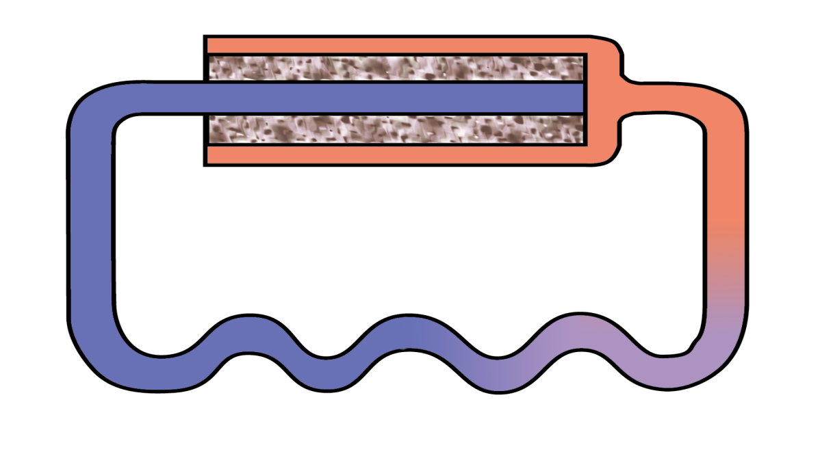
Loop Heat Pipe Background
Compensation Chamber
Heat In
Wick
Liquid
Hot Vapor
Heat Rejected Out
Heat is applied to the evaporator which contains the primary wick which is saturated with liquid
Vapor is generated at the evaporator and then travels to the condenser
In the condenser the vapor condenses transferring heat to the radiator surface
Liquid exits the condenser where it returns to the evaporator
Excess liquid is stored in the reservoir which is connected to the evaporator by a secondary wick

Slide 4
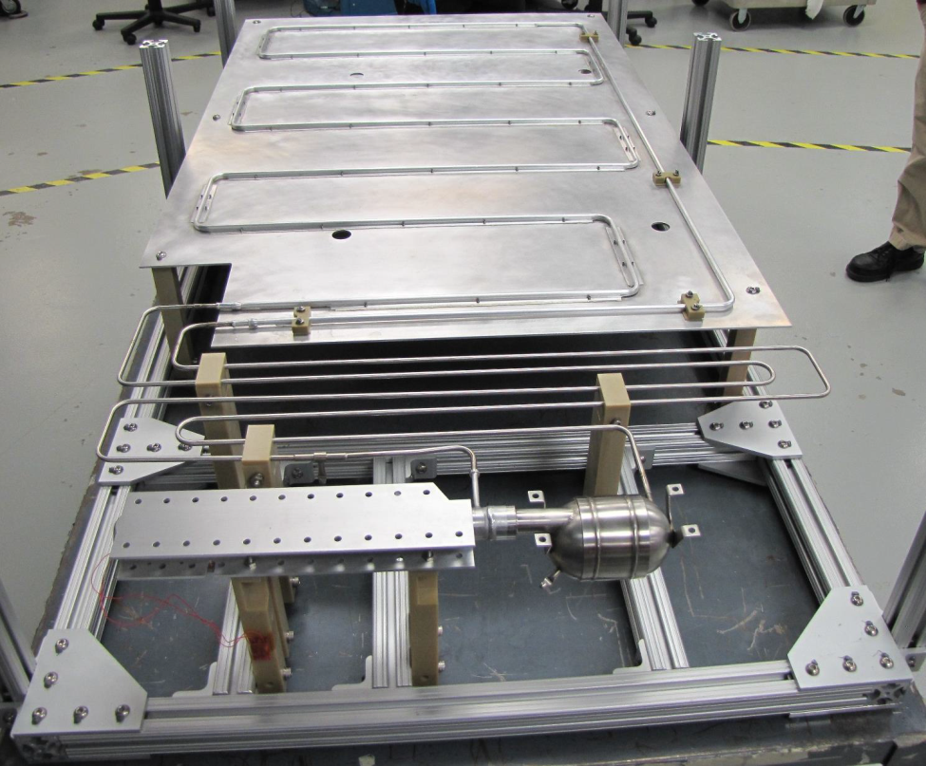
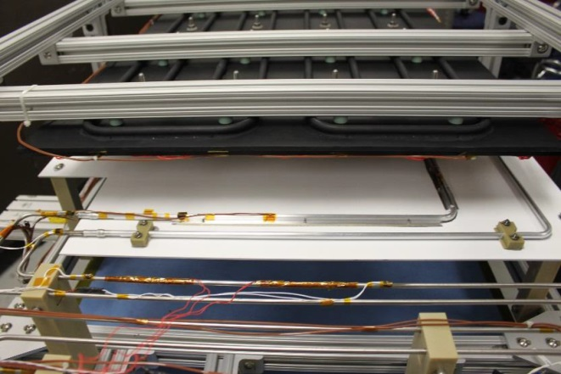
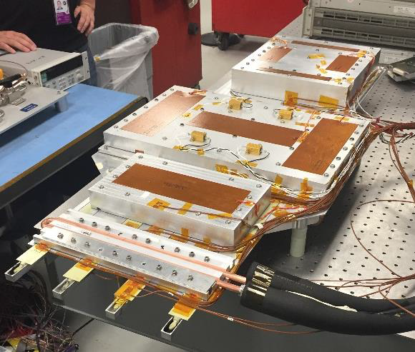
SWOT Benchtop LHP System
Condenser
Sink
Thermal Mass 1
Test Pallet
Evaporator
Reservoir
Thermal Mass 2
All images on this slide courtesy of NASA/JPL-Caltech
Thermal Mass 3
Benchtop system consists of LHP system, a convective cold sink, and a Test Pallet
Test Pallet consists of 4 heat pipes embedded in an aluminum base with 3 thermal masses simulating instruments. All 3 thermal masses have heaters
4 Heat Pipes
LHP Evaporator Interface

Slide 5
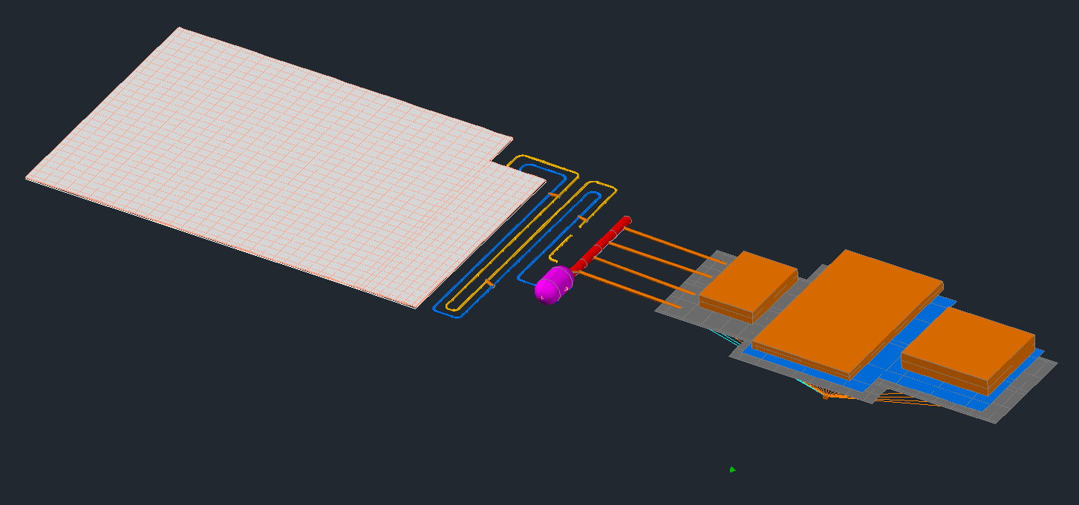
Model Geometry
Generating model geometry is the first step.
Majority of the model is simple pipe and surface/solid geometry.
Evaporator and Reservoir
Evaporator and reservoir were modeled with simplified geometry due to the system level nature of this model
Evaporator/Reservoir fluid modeling performed with CAPPMP
Heat Pipe
Heat pipe structure is not modeled, instead their mass is accounted in the Test Pallet base
Working Fluid
Propylene is the working fluid. C&R tech property files were used on the model
Transport
Lines
Condenser Lines
Heat Pipes
Evaporator
Radiator
Test Pallet
Evap/Test Pallet Interface
Reservoir

Slide 6
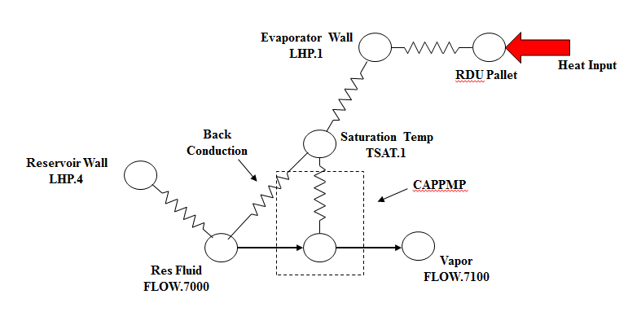
Thermal Model Schematic
Evaporator is modeled as 4 nodes
Evaporator nodes are connected to a node representing LHP saturation temperature.
Evaporator conductance was correlated from test data
Reservoir
Reservoir fluid is modeled as a single tank lump.
This lump is also connected to the saturation node by a conductor representing wick back conduction.
Back conduction was correlated from test data
FLOW.7100
This lump represents the 100% vapor output from the primary wick.
CAPPMP Junction
CAPPMP is a built in capillary pump submodel that is used to model the primary wick
CAPPMP connects the Reservoir node with the vapor outlet
This subroutine takes heat input (in this case through the saturation node) and creates the appropriate vapor generation from the res.

Slide 7
CAPPMP Notes
Primary CAPPMP inputs
Capillary Flow Conductance (CFC)
This is the permeability of the primary wick. For SWOT wick test data was used
Capillary Ratio (RC)
This is the pore size/radius. This was left as zero for this model to improve stability and runtime
CAPPMP can be temperamental to use and is easy to crash or have inefficient runs
Setting the RC to 0 keeps the CAPPMP from depriming prematurely or in unrealistic situations.
A Wick iface can be used to help the stability of the CAPPMP, but it was not used in this model
CAPPMP is directional so the reservoir and vapor lumps must be placed in the correct order

Slide 8
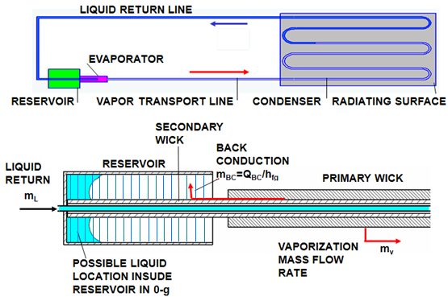
Back Conduction
Back conduction is the heat flow rate that occurs between the saturated vapor in the evaporator to the reservoir.
Back conduction has a heavy influence on the amount of subcooling the loop requires to operate
This model uses the classical definition of back conduction
$$Q_{BC}=\frac{C_{wick}∆P_{v−r}}{{dP}/{{dT}_{sat}}}$$
The back conduction conductor must be programmed in Sinda to recalculate at every iteration of the run as it is a function of the pressure drop in the loop and the pressure/temperature saturation curve
Back conduction can be heavily influenced by the design and manufacturing of the evaporator and so must be correlated with test data to insure accuracy. A correction factor is used in the SWOT model for the correlation

Slide 9
Heat Pipe Model
4 Constant Conductance Heat Pipes were used in the test pallet to act as a thermal spreader
Heat pipes were modeled as conductors attached to an arithmetic node that represents the internal vapor of the heat pipe
Evaporator and condenser conductance's determined from previous testing done at OA facilities
This method assumes that the vapor is isothermal and does not experience any heat loss
This modeling method was chosen because the heat pipes simply being used as spreaders, and their exact behavior is not a point of interest

Slide 10
SWOT Test Overview
Test Performed by JPL
Start Up
Long duration steady state with 200W on the test pallet
Sink transient (8C/min for ~3 minutes)
Shutdown
Testing was performed at ambient conditions using a convective/radiative sink
Only the steady state and sink transient were used in model correlation
The model is not designed to demonstrate start up or shut down operations
Sink transient is designed to test the temperature stability of the interface of thermal mass 1 and 2 to the test pallet.
Data presented in this slide references: Somawardhana, Ruwan. “Thermal Stability Testing of Two-Phase Thermal Control Hardware for the Surface Water Ocean Topography Mission”. International Conference on Environmental Systems (ICES). 2016

Slide 11
Correlation Parameters
Primary Correlated Values
Evaporator Conductance
Back Conduction
Sink to Radiator Conductance
Interface Conductance
Measured Property Values
Wick Permeability
Wick Pore Size (this is used for Sinda calculations that do not directly affect the model)
Heat Pipe Conductance

Slide 12
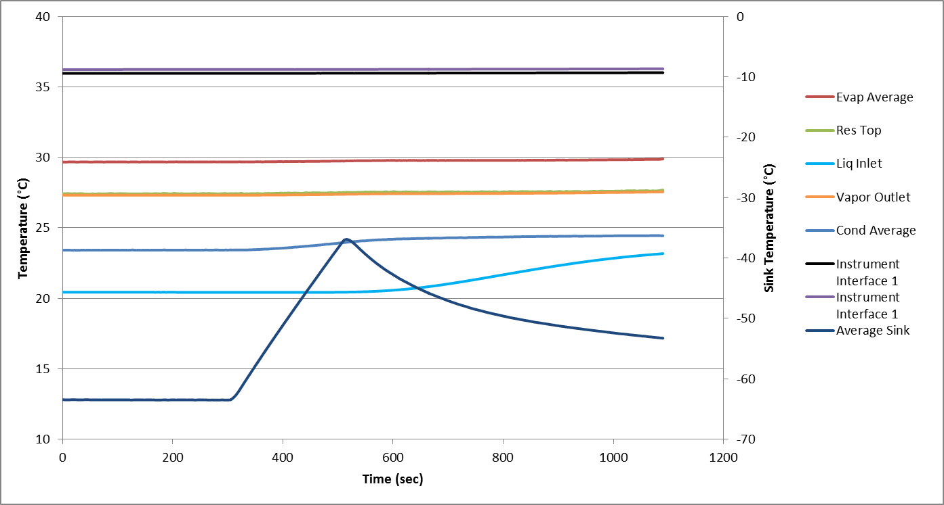
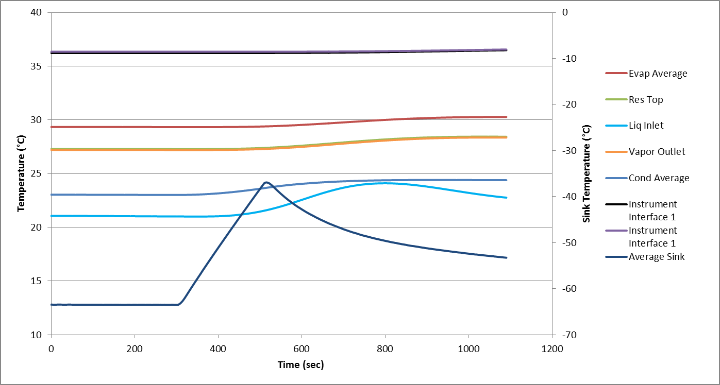
Sink Transient
JPL Test Data
200W is applied to the test pallet throughout test
Transient is preceded by long steady state at -63C sink
Sink ramp rate is ~8C/min for 3 minutes
Sink temperature is graphed on secondary axis
Primary interest is in the stability of the Instrument Interface temperature
Model Data
Data presented in this slide references: Somawardhana, Ruwan. “Thermal Stability Testing of Two-Phase Thermal Control Hardware for the Surface Water Ocean Topography Mission”. International Conference on Environmental Systems (ICES). 2016

Slide 13
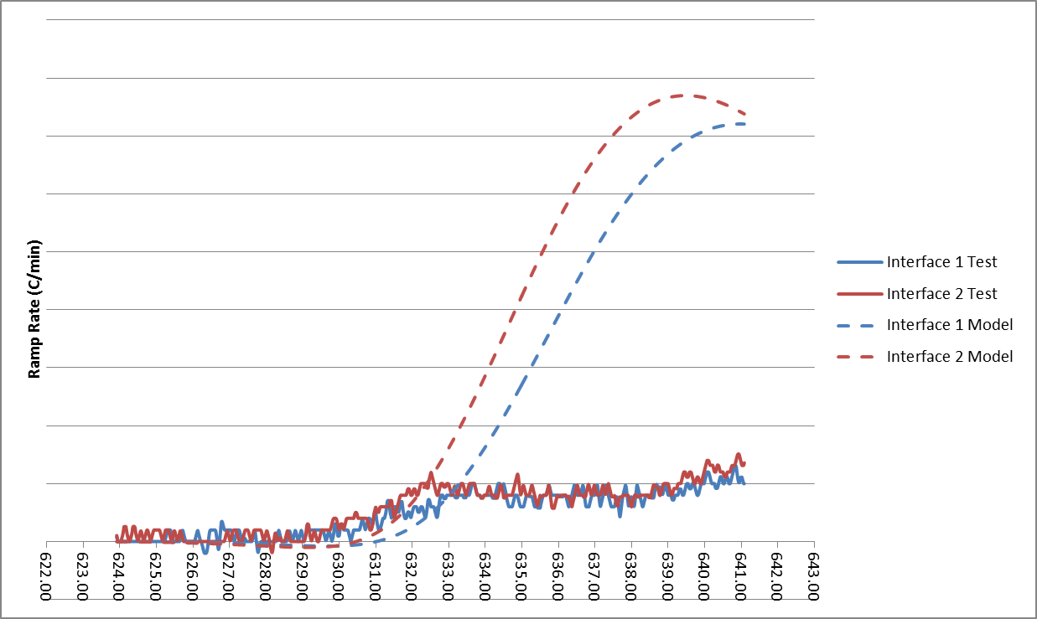
Thermal Pallet Stability
Initial rate of change of the model synchs up well with the test data
After initial transient response, the test system stabilizes while the model overshoots before beginning to recover
Model prediction still meets required interface stability

Slide 14
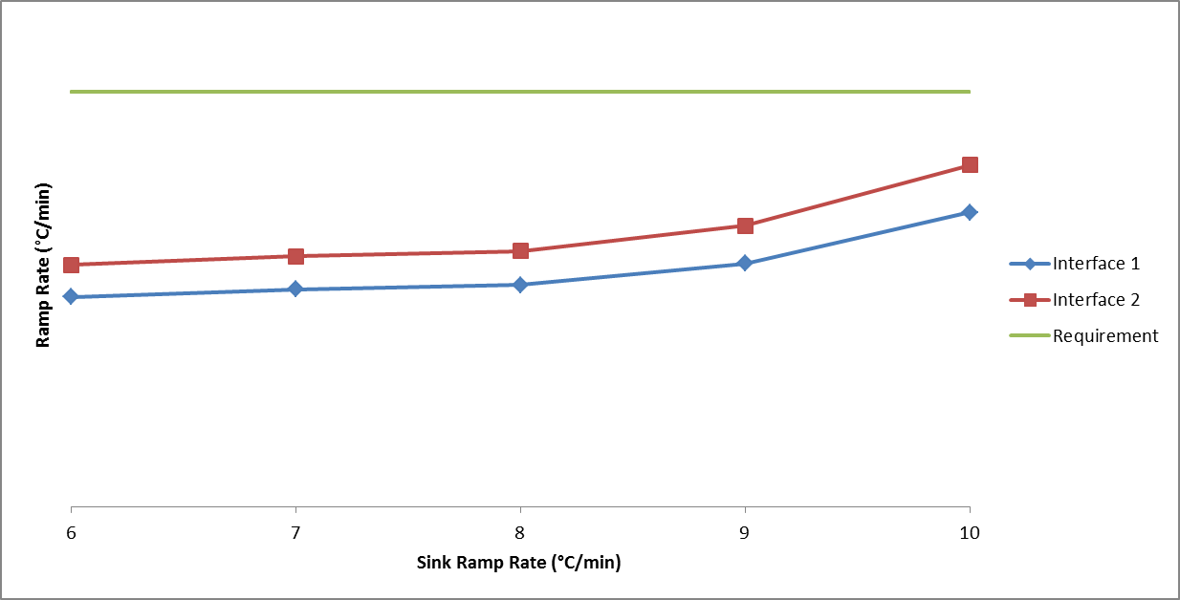
Model Stability Sensitivity
Requirement = .05C/min
Model shows relatively small effects of ramp rate on stability
Above 8C/min there seems to be an exponential degradation in interface stability

Slide 15
Model Limitations
Model does not include the secondary wick
Model does physically model the secondary wick. Sinda code can be added to calculate secondary wick performance needs, but was not needed for this application
CAPPMP implementation is relatively “dumb”
The CAPPMP model does not determine when dryout occurs. Sinda code is added to track the pressure drop within the loop. Pressure performance must be checked after the run is complete
Not designed to model Start Up and Shut Down transient cases
Correlation is rough
Testing was not done with model correlation in mind and was limited in scope.
Testing was done in an ambient environment adding more uncontrolled parasitics
Conduction between the sink and radiator is done with a linear conductor due to difficulty in obtaining accurate convection correlation
Model is relatively simple
The model is relatively simple and will not take into account more complicated phenomenon

Slide 16
Conclusion
Conclusion
The as correlated model shows good correlation with test data and can provide reasonable transient predictions.
The correlated evaporator model can be adapted to evaluate new condenser designs and routing
This will provide more accurate results then an uncorrelated model
A simple testbed LHP verifies the SWOT program’s transient performance requirements can be met by this LHP design and a thermal model to help finalize designs.
Future Work
Update the current SWOT model with variations in condenser design
Model and correlate the final SWOT LHP designs

Slide 17
Questions
Acknowledgements
Michael Nikitkin (Orbital ATK) for providing technical and moral support
Ruwan Somawardhana, SWOT Payload Thermal Lead, NASA Jet Propulsion Laboratory, California Institute of Technology - Technical Monitor

Slide 18
References
Khrustalev, D. “Modeling Transient Operation of Loop Heat Pipes using Thermal Desktop”. Thermal & Fluids Analysis Workshop (TFAWS) 2007
Kim Wrenn, Ed Kroliczek, and Dave Wolf. “Secondary Wick Limitations on LHP Operations”. International Two-Phase Thermal Control Technology Workshop 2001
Somawardhana, Ruwan. “Thermal Stability Testing of Two-Phase Thermal Control Hardware for the Surface Water Ocean Topography Mission”. International Conference on Environmental Systems (ICES). 2016
C&R Technologies. User’s Manual Sinda/Fluint Version 5.7. Boulder: CRTECH, 2014
Khrustalev, Dmitry. “Advances in Transient Modeling of Loop Heat Pipe Systems with Multiple Components”, Space, Propulsion & Energy Sciences International Forum (SPESIF) 2010, Laurel, MD, Applied Physics Laboratory, March 18-20, 2010
Cullimore, Brent and Bauman, Jane, Steady State and Transient Loop Heat Pipe Modeling : International Conference on Environmental Systems (ICES), 2000, SAE 2000-01-2316

