Slide 1


Reduced-Order Modeling for Rapid Thermal Analysis and Evaluation of Spacecraft
TFAWS Interdisciplinary Paper Session
Derek Hengeveld
Senior Engineer | LoadPath
dhengeveld@loadpath.com
Thermal & Fluids Analysis Workshop
TFAWS 2016
August 1-5, 2016
NASA Ames Research Center
Mountain View, CA

Slide 2
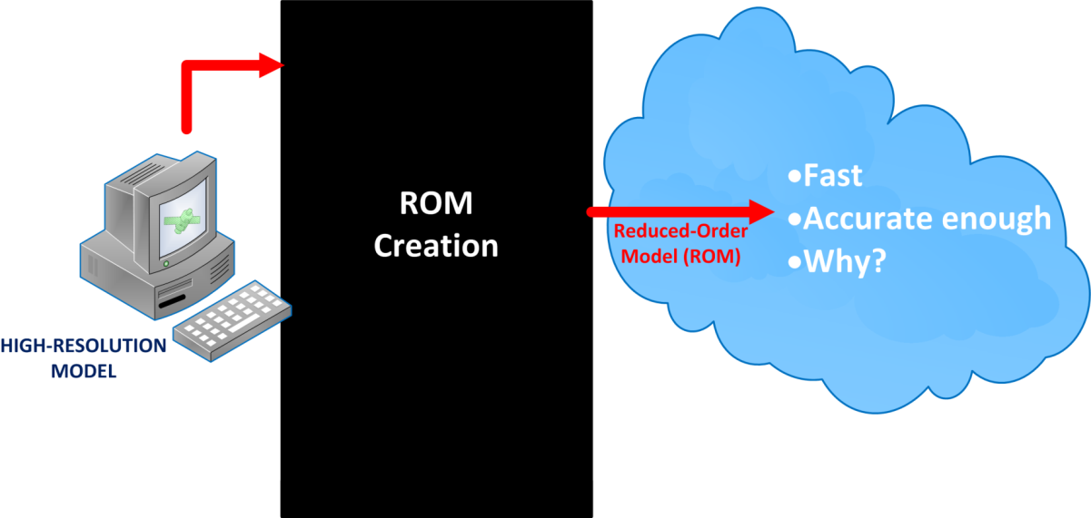
Reduced-Order Modeling
Lowers computational expense of a model
Approximates the original model

Slide 3
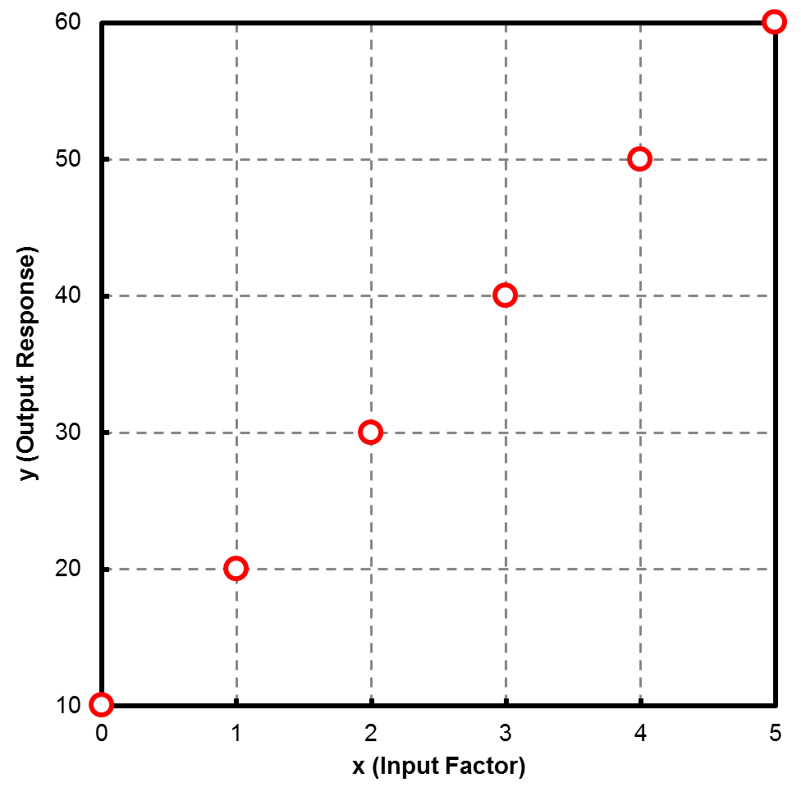
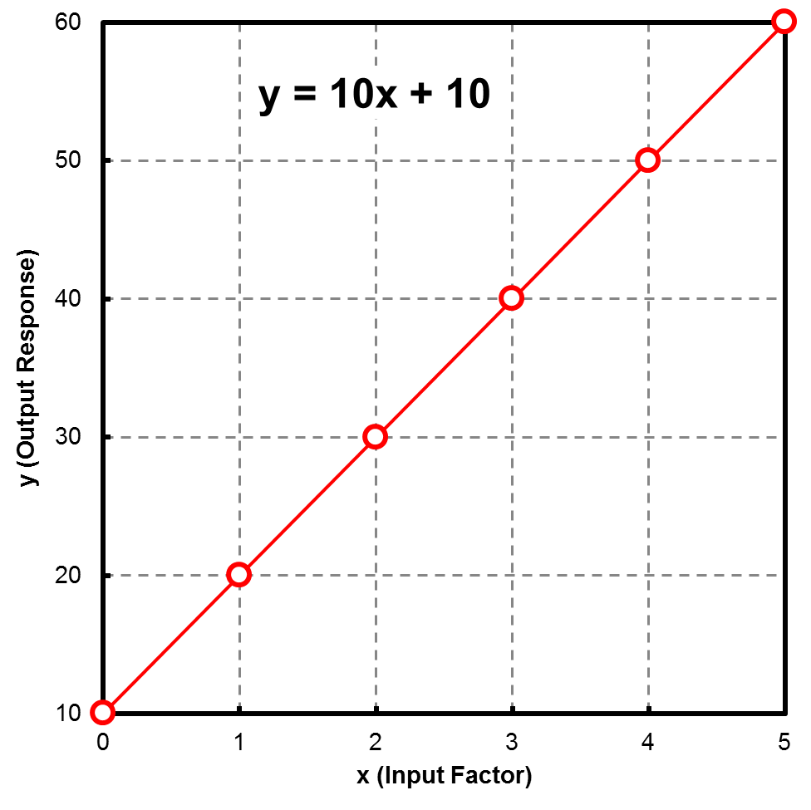
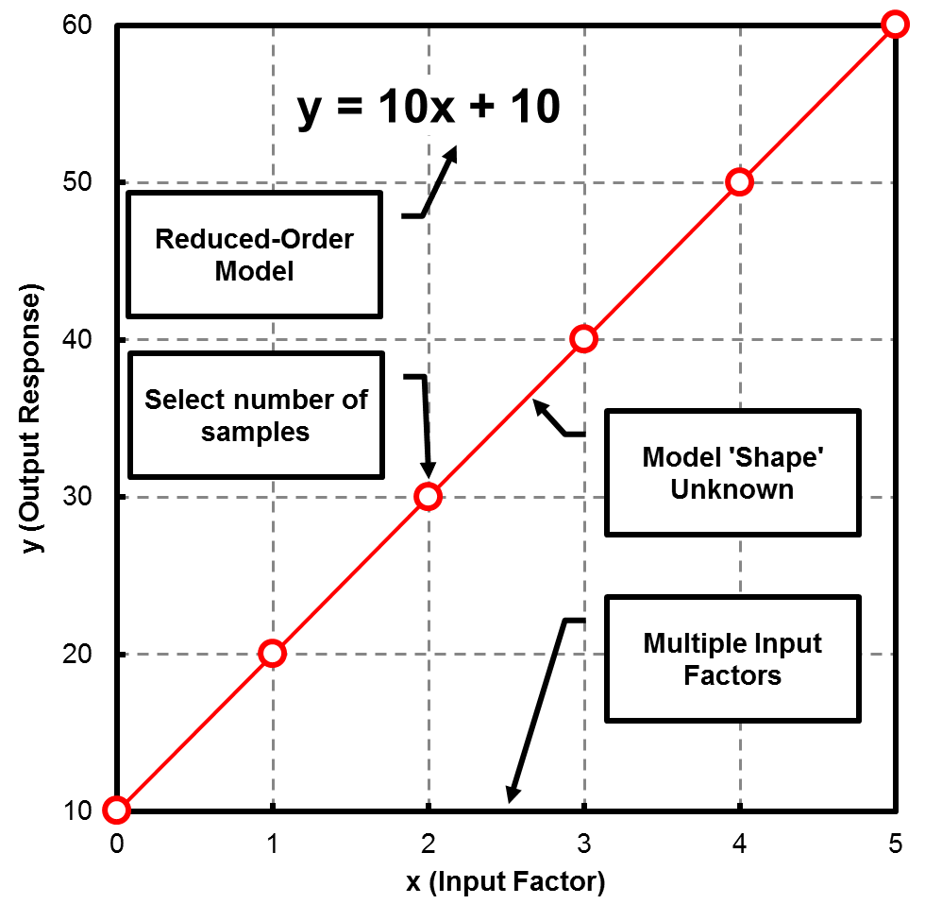
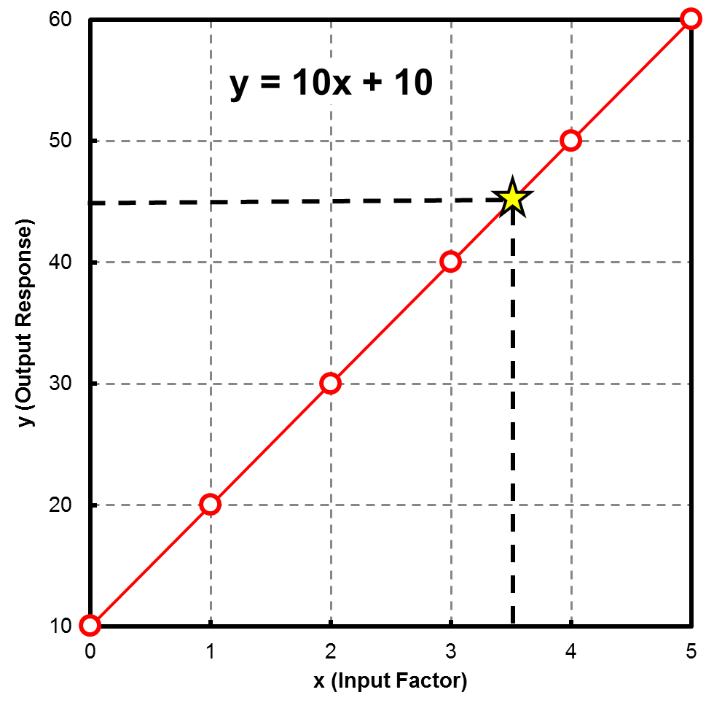
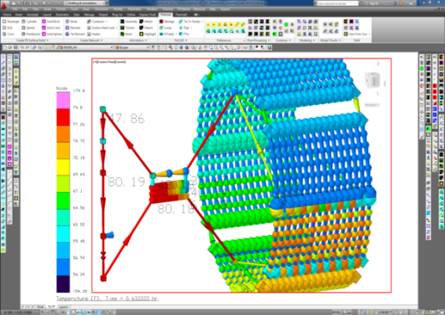
Reduced-Order Modeling
Sampling then data fitting

Slide 4
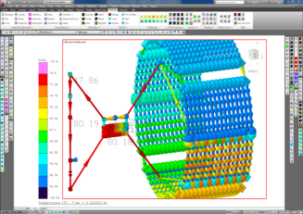
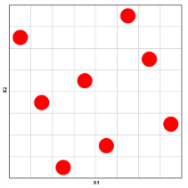
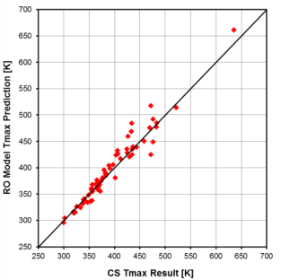
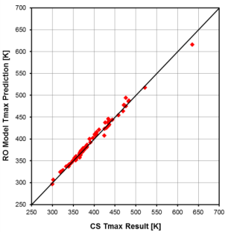
Overview
Approach
  Based on sample of computer simulations
  Capture effects between sampling points
Advantages
  Fast computations
  Useable by ‘non-trained’ personnel
Disadvantages
  Captures a limited set of possible variables
  ROM creation time
High resolution model
Select sample points
(Input Factors)
Run model at sampling points
(monitor Output Responses)
Develop ROM
(Input Factors to Output Responses)
Test ROM
(ROM versus Computer Simulations)
Impact of sample number

Slide 5
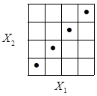
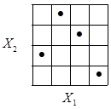
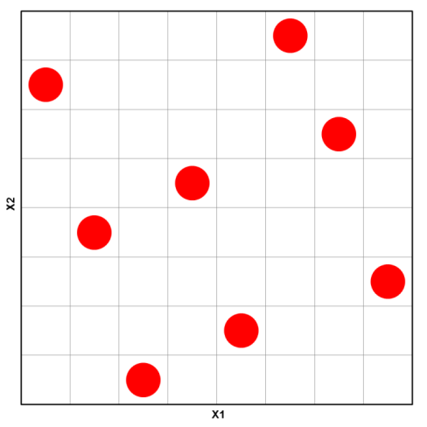
Sampling
Latin Hypercube Sampling
  A method for efficiently filling a design space
  The range of each Input Factor (e.g. X) is divided into N intervals
    N = number of samples
    Each interval is used only once
  Maximize the minimum distance between points
  Using pseudo-Maximin Method
    Maximize the minimum distance between sampling points
N = 4
2 factors | 8 sampling points

Slide 6
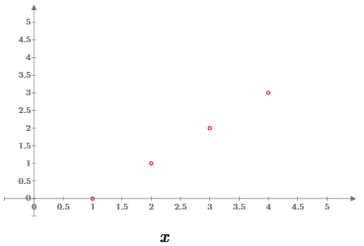
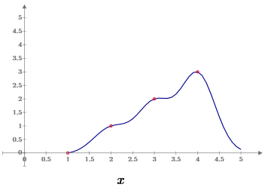

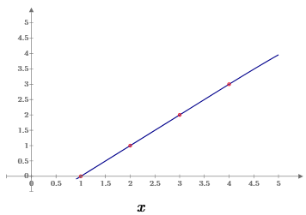
Data Fitting
Gaussian Process model
  Relatively new (1996)
  Does not impose a specific model structure
    E.g. ‘f(x) = mx + c’ not needed
    Can fit a wide-range of data without prior knowledge of ‘shape’
  Based on training data
    E.g. simulation results
    Resulting covariance matrix populated using function (e.g. squared exponential)
    Optimized hyperparameters needed
  Can fit data exactly
    Useful for computer simulations
  Provide confidence intervals
Training Data
l = 0.4
l = 4

Slide 7
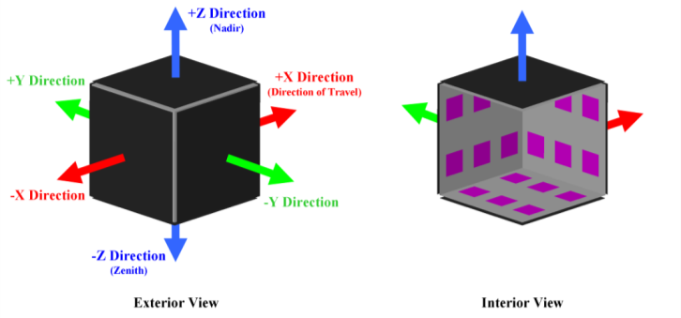
Initial Work
Evaluated approach using nominal satellite design
  1.0 x 1.0 x 1.0 m cubic satellite
  Honeycomb construction
  Body-mounted radiators
Input factors (11 total)
  3 categorical (orbit/heat pipe/optimized placement)
  8 continuous
Output responses (3 total)
  Maximum orbital temperature
  Minimum orbital temperature
  Maximum temperature difference

Slide 8
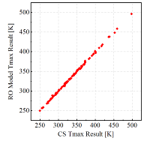
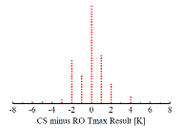
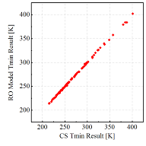
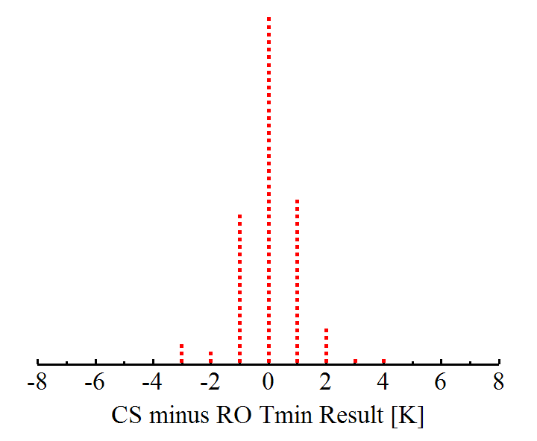
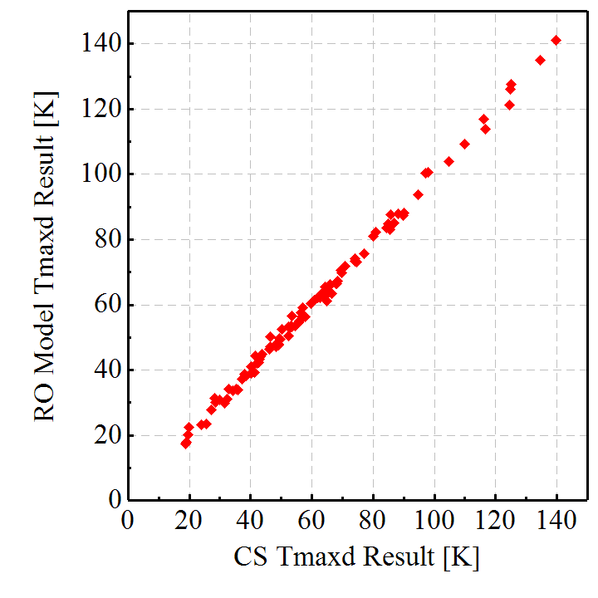
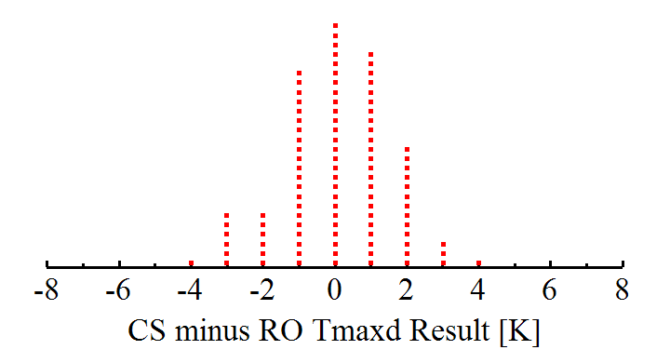
Initial Work
Reduced-order model was developed
  Utilized Latin Hypercube / Gaussian Process
  ROM evaluated at 100 random test points
  ROM versus computer simulation (CS) results
    ROM provides good performance (i.e. dotplot results)
    Mean value near 0 K
    Standard deviations are acceptable

Slide 9
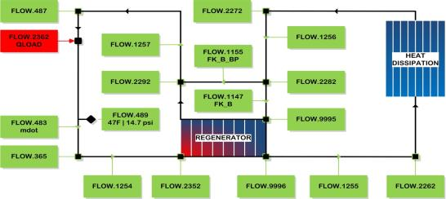
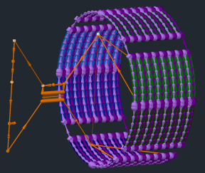
NASA ROM
Orion Crew Exploration Vehicle (CEV)
  External fluid loop
  Heat rejection system (radiators)
  Control setpoint (FLOW.487)
Results
  CS results compared to ROM
    Residual mean (trueness)
    Standard deviation (precision)
  Temperature: 1.6 K max residual mean and 5.0 K standard deviation
  Power: 0.2 W max residual mean and 1.93 W standard deviation
  Did poor job of replicating output responses with discontinuities (e.g. time to steady-state)

Slide 10
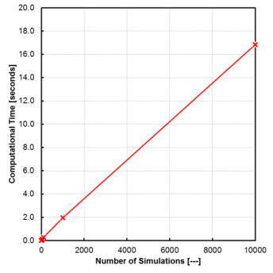
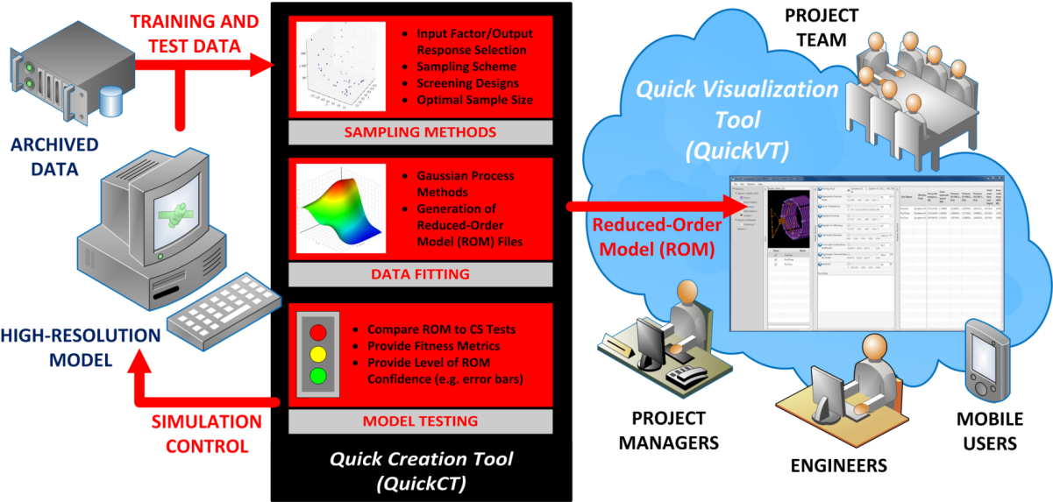
Quick Analysis Tools
QuickCT and QuickVT
  Create and use ROMs
  Semi-automated
  User-friendly
  Fast
  Accurate enough

Slide 11
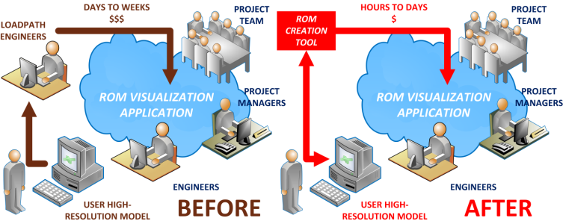
Quick Analysis Tools - Creation Tool
Quick Creation Tool (QuickCT)
  Semi-automated process for creating a ROM
  Step-by-step process
  C# based tool
  Currently built for Thermal Desktop

Slide 12
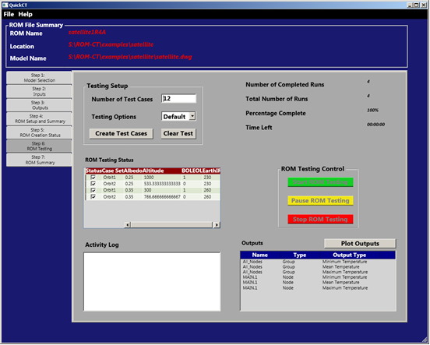
Quick Analysis Tools - Creation Tool
ROM Creation
Step-by-step instruction

Slide 13
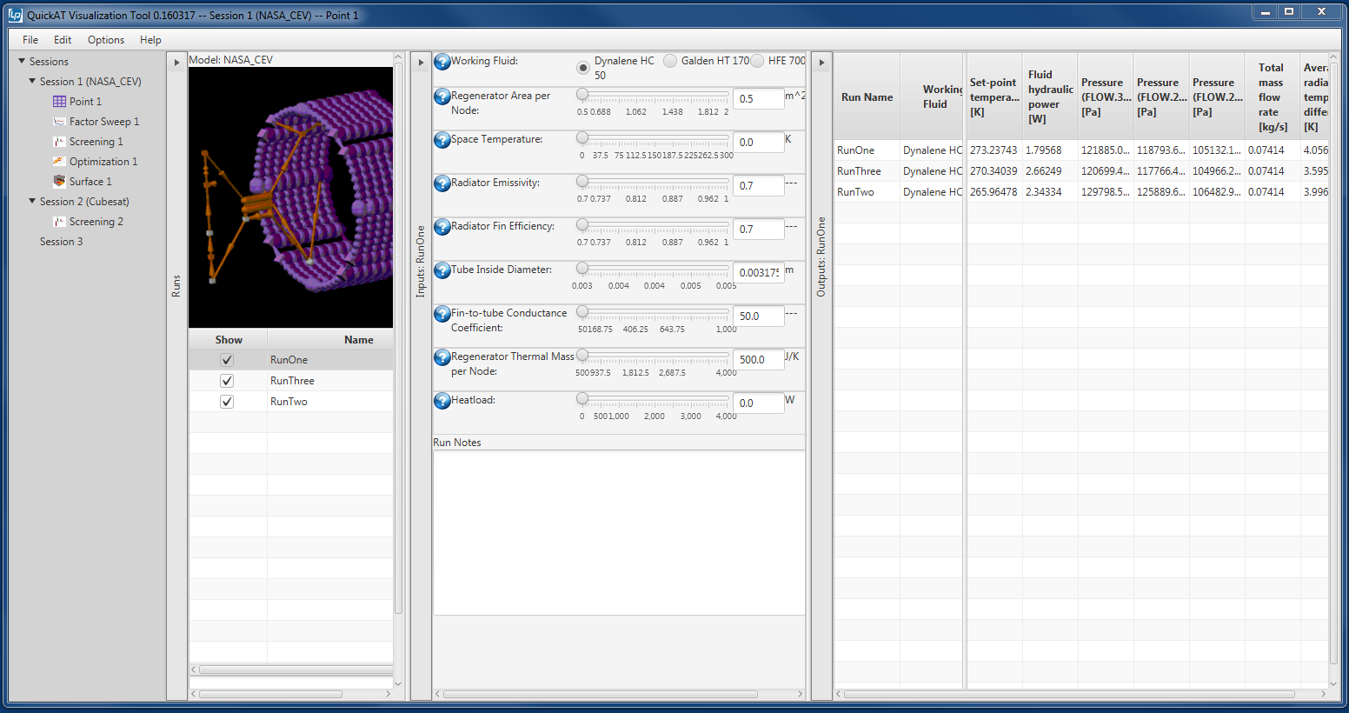
Quick Analysis Tools - Visualization
Quick Visualization Tool
  Java based tool that ‘visualizes’ a ROM
Session Manager
Work between database of ROMs
Run Manager
Multiple analyses per session
Input Factors
Dependent on ROM
Analysis (e.g. point analysis)
Visually links input factors to output responses

Slide 14
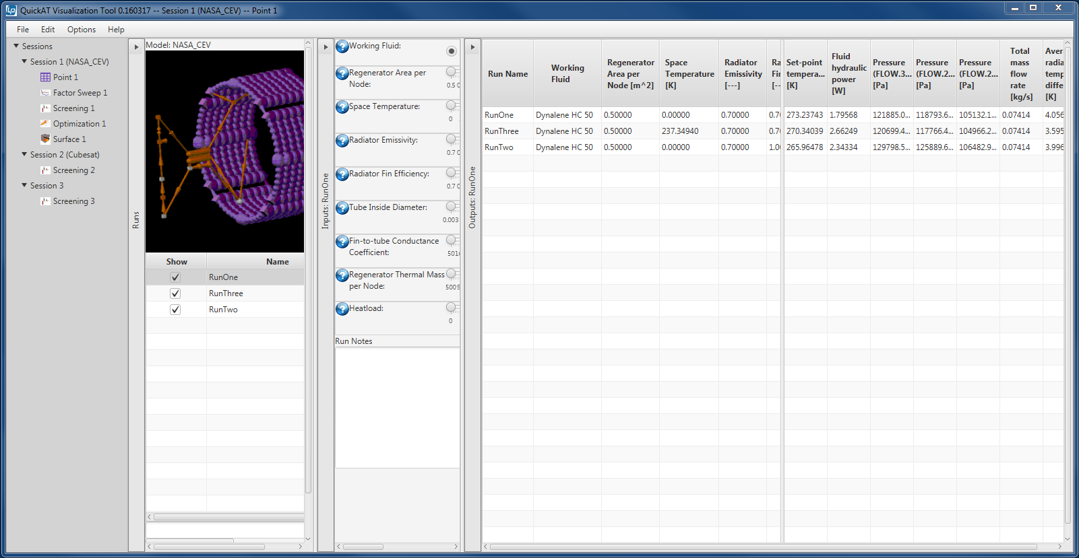
Quick Analysis Tools - Visualization
Point Analysis
  Table approach for evaluating individual (i.e. point) analyses
  ‘Excel’ like

Slide 15
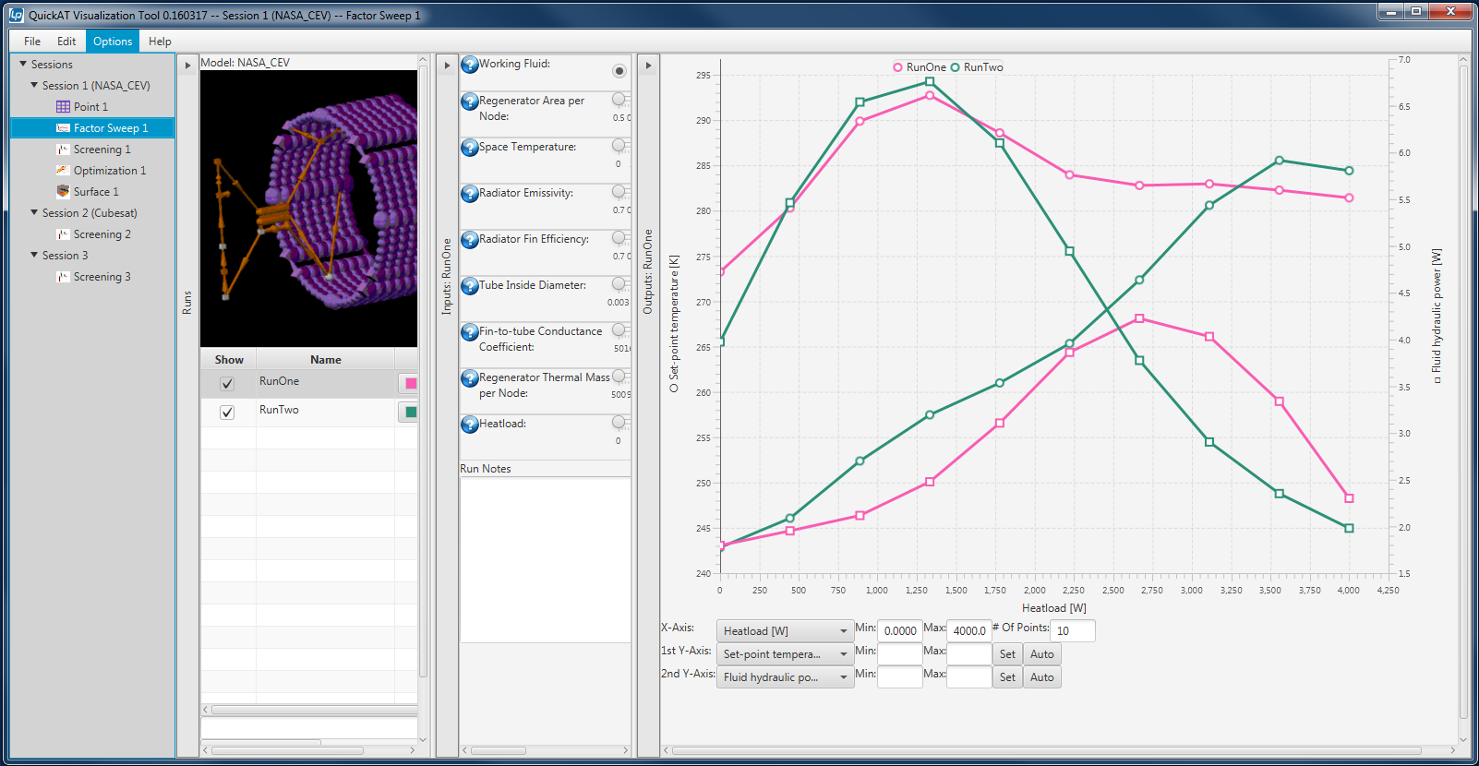
Quick Analysis Tools - Visualization
Factor Sweep
  Plot of 1-2 output responses versus a single input factor range
  2D graph

Slide 16
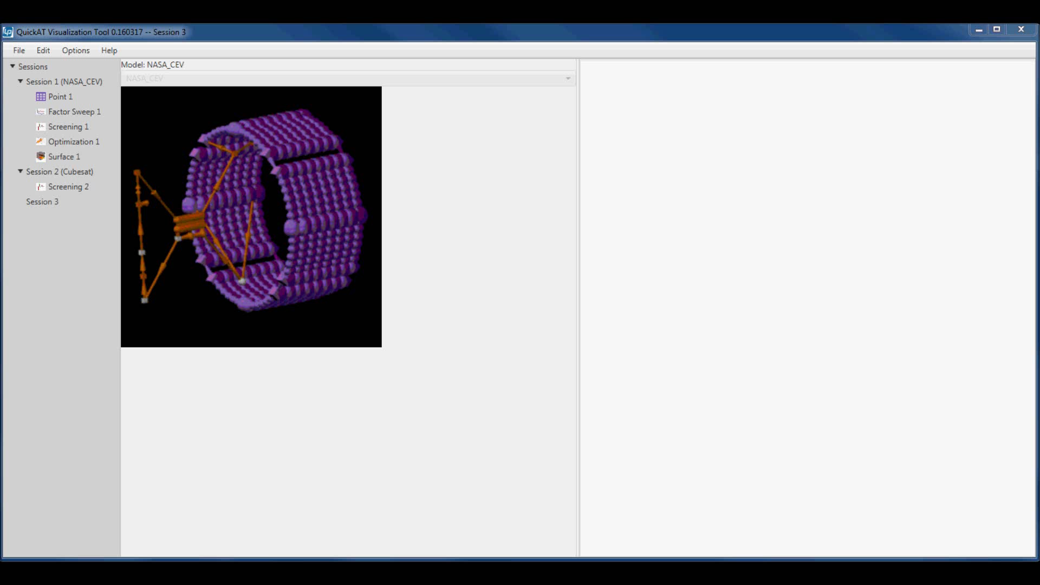
Quick Analysis Tools - Visualization
Screening analysis
  What input factors are most important for a given output response?
  2^{N} simulations (computationally expensive)

Slide 17
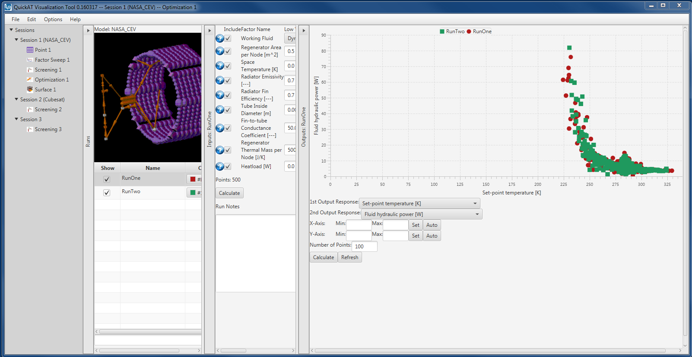
Quick Analysis Tools - Visualization
3D Plots (1 output response versus 2 input factors)
Optimization
  Monte-carlo optimization approach
  Pareto front can be visualized

Slide 18
Path Forward
Beta test QuickAT
  QuickCT and QuickVT
Quick CT
  Additional sampling/data fitting features
  Develop for other data sources/platforms
Quick VT
  Additional analysis capabilities
  Add uncertainty to results

