Slide 1
MHK Turbine Theoretical Design Bryan Szloh & Annie Poluse Cleveland State University
TFAWS Interdisciplinary Paper Session
Presented By Bryan Szloh
Thermal & Fluids Analysis Workshop TFAWS 2020 August 18-20, 2020
Virtual Conference

Slide 2
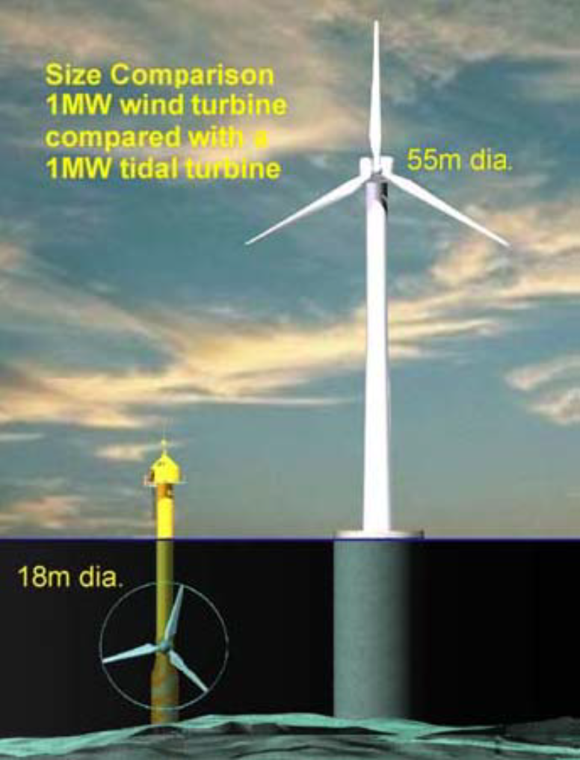
Terminology
Marine Hydro Kinetic (MHK) Turbine Terminology
Cavitation- rapid changes in pressure in a fluid that cause vaporization and the formation of cavities or bubbles.
Cause surface erosion when bubbles collapse
Efficiency loss in MHK turbines
To be avoided in design!
Flow Separation- fluid flow becomes detached from the surface of the object due to an adverse pressure gradient thus forming eddies and vortices
Usually occurs when cavitation occurs
To be avoided in design!
Tip Speed Ratio (TSR)- ratio of tangential speed of the blade and the actual fluid velocity
Horizontal Axis Turbine- tidal current turbine where tidal currents flow parallel to the axis of rotation of the rotor
Similar to wind turbines
Most Common
AKA: HATCT Horizontal Axis Tidal Current Turbine

Slide 3
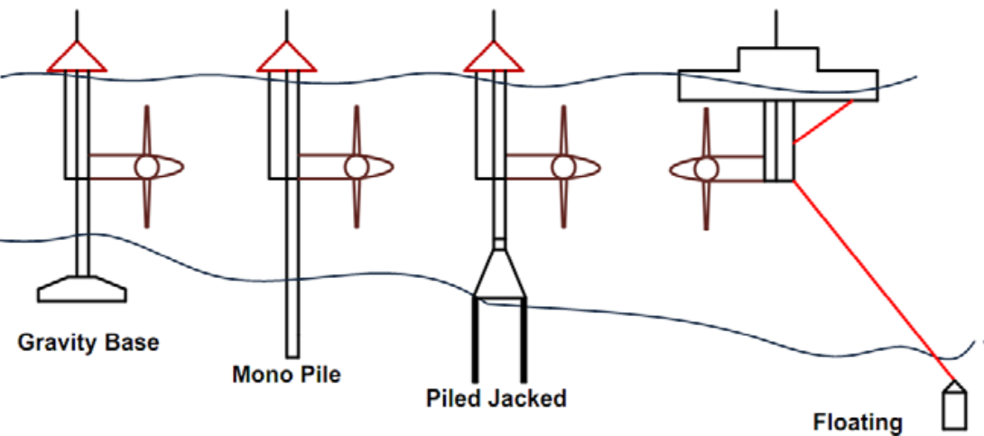
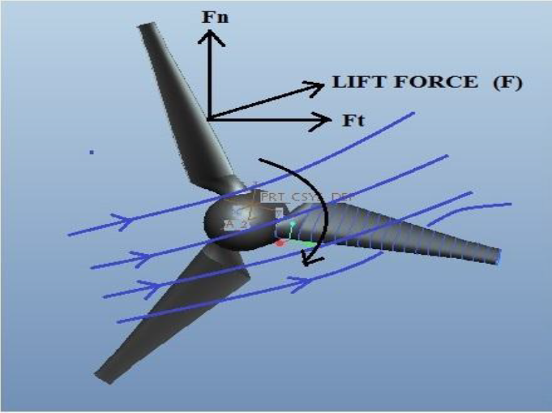
Design Selection Criteria
Floating design selected
Location
Oahu Coast
About 100 km
Location Criteria
Current velocities needed to be between 1 and 3 m/s
Faster than 3 m/s could lead to cavitation
Less than 1 m/s would not produce enough power
Turbine Concept chosen
Horizontal Axis Turbine
Most common
Least complex design
Avoid cavitation and flow separation
Tip velocity < 7 m/s for cavitation avoidance

Slide 4
Equations Provided in Literature Used in Calculation
Tip Speed Ratio: TSR = ωR/V
Where TSP = Tip Speed Ratio (dimensionless), ω = rotation speed (rad/sec), R = Radius of blades from center (m) , V = current velocity (m/s)
Convert rad/sec to rev/min: by multiplying by 30/$π$
Power coefficient: C_{p} = P/½ρAV³
Where c_{p} = Power Coefficient (dimensionless), P = Power (watts), ρ = sea water density (kg/m³), A = swept Area of the rotor where $A=πr^{2}$(m²) , V = current velocity (m/s)
Reynolds Number: Re = ρDV/µ
Where Re = Reynolds Number (dimensionless), ρ = sea water density (kg/m³), D = Diameter of blades (m) , V = current velocity (m/s), µ = Dynamic Viscosity (Pa-s)

Slide 5
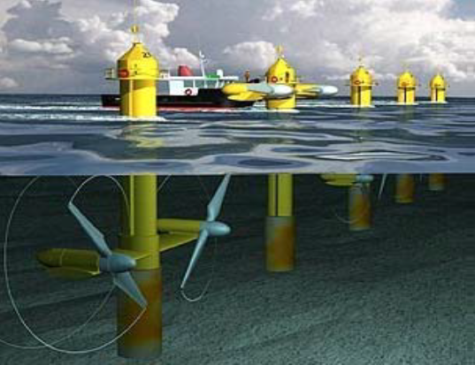
Input / Data Sources
Location Depth:
About 4,500 m deep (average)
Google Maps Elevation
Current Velocity:
1.9 m/s (assuming late November)
Coastal Observation Research and Developing Center
Location:
100 km off Honolulu Coast
latitude 20.6, longitude -158.4
Coastal Observation Research and Developing Center
Water Density:
1025 kg/m³
NOAA (National Oceanic and Atmospheric Administration)
ncei.info@noaa.gov National Centers for Environmental Information (NCEI) (Andrew Allegra)
“A good estimate of density at the ocean's surface is 1025 kilogram per cubic meter, and specific gravity is therefore 1.025”
Water Viscosity (dynamic):
1.13(10⁻³) Pa-s
Matches density provided by NOAA from literature
Blade tip to tip Diameter:
18 m (9 m Radius from center)
Blade dimensions provided from test turbine
Tip Speed Ratio (TSR)
4.4 (chosen from AeroDyn output)
Avoids cavitation
Material of blades
Aluminum alloy
Smooth finish to avoid cavitation
Corrosion resistance
Blade type
NACA 63-8xx airfoil
5 degree set angle
From literature

Slide 6
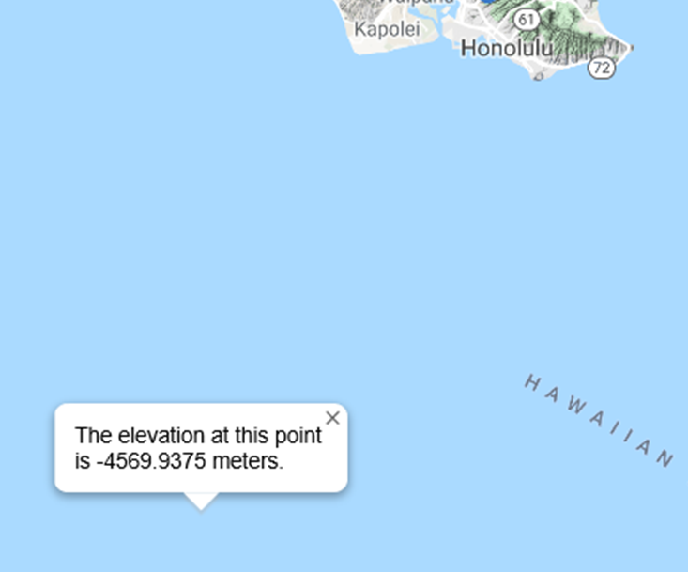
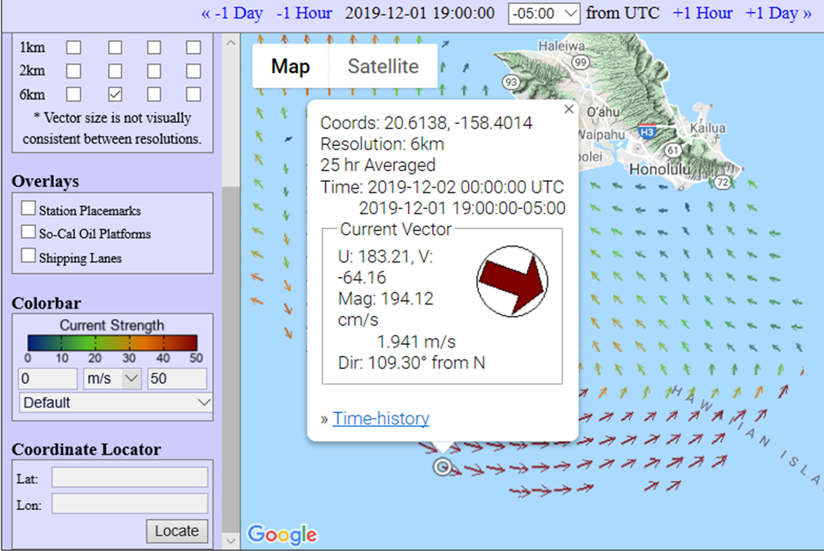
Proposed Location
Current Velocity & Location from Coastal Observation Research and Developing Center
Depth approximation from Google Maps Elevation

Slide 7
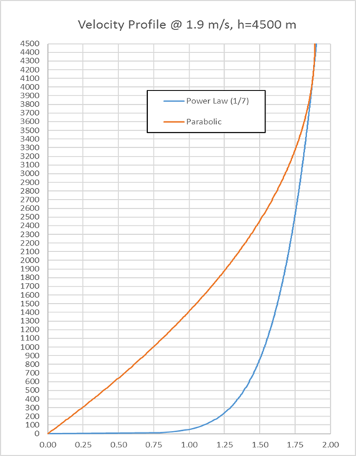
Theoretical Velocity Profile @ Location
Power Law
$$U\left(h\right)=1.615{\left[\frac{h}{(0.32)(4500)}\right]}^{\frac{1}{7}}$$
The 1/7 power law was used and a bed roughness value of 0.32 was assumed which corresponds to a typical value used in shelf-sea oceanographic research
Parabolic
$$U\left(h\right)=0.00042\left[\frac{h^{2}}{4500}−2h\right]$$
Usually used for air, shown for comparison purposes

Slide 8
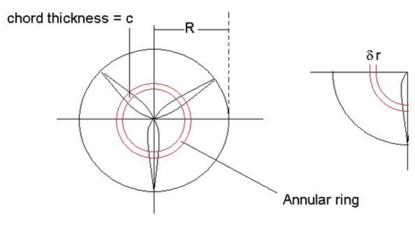
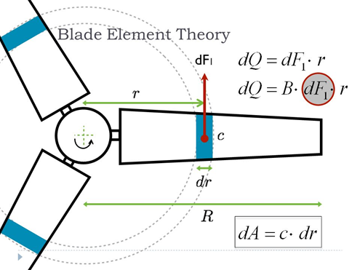
Blade Element Momentum Theory (BEM)
Analytical model that iterates between:
Momentum Theory - used to derive axial and circumferential inflow factors
Blade Element Theory – used to model the section drag and torque
Originally published by Glauert in 1935.
Blade is divided into elements along the length and 2D aerodynamic forces and moments are calculated at nodes (one node per element) as distributed loads per unit length using an annular control volume.
Loads are integrated over the blade length to approximate 3D loads over the entire blade.
Assumptions: Uniform and steady inflow over the annular elements, zero flow along the blade length, annular CV’s independent of each other
Positives: BEM theory models are fast and efficient, thus a large number of trials can be run before the use of higher cost computational tools.
Negatives: Not suitable for accurate estimation of wake effects, complex 3D flow or dynamic stall, and chordwise loading.

Slide 9
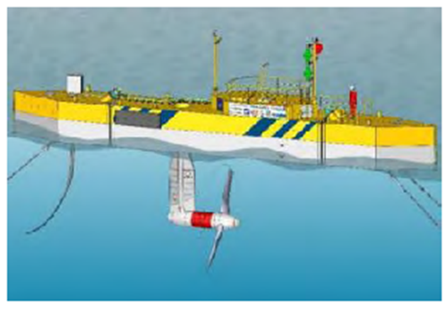
AeroDyn software
Free BEM theory software from NREL (National Renewable Energy Laboratory) website
Run in Matlab
Requires 4 input files
Main driver file
Primary input file
Blade geometry file (can use airfoil design software like XFOIL)
Airfoil data file (angle of attack, pressure forces, etc. designed in XFOIL)
XFOIL – program that uses 2D panel code to derive lift and drag coefficients for blade elements
Generate a Ct and Cp vs. TSR curve for a turbine and can perform a cavitation check at each node for each TSR iteration step.
Included file of 0.8m diameter, 3 bladed turbine that was designed and tested in a cavitation tunnel in a paper by Bahaj, Batten, and McCann.

Slide 10
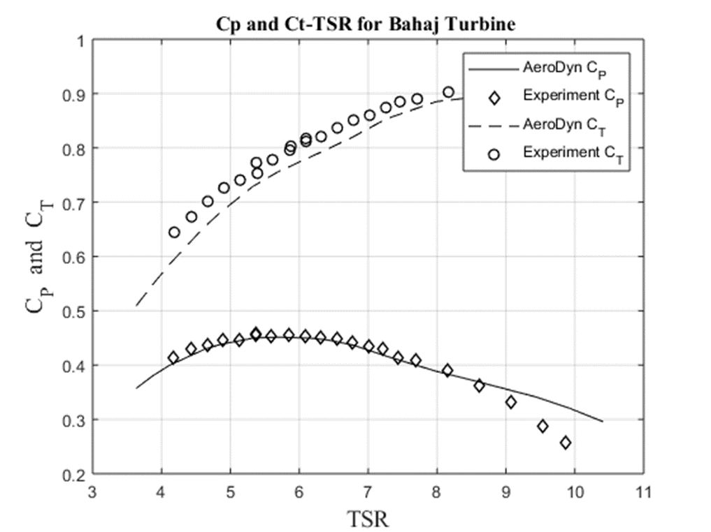
Calculation Process for Design
AeroDyn calculations were compared with test data
Plot of Cp and Ct vs. TSR was generated for both sets of data
Choose an appropriate TSR that will avoid cavitation but maximize Cp
Found TSR = 4.8425 at
Cp = 0.4377
Used TSR and Cp to determine
Estimated power generated
Turbine RPM
Reynolds number also calculated in case needed
$C_{p}$ = 0.4377
TSR = 4.8425

Slide 11
Calculations and Comparative Results
Bahaj, Batten & McCann and other Sources claim to get 1000 KW Power using:
18m to 20m Diameter
2.5 m/s current velocity
Calculations using our site’s location:
V = 1.9 m/s; D = 18m
Calculations using given velocity from
Bahaj, Batten & McCann: V = 2.5m/s; D=18m
Re = ρDV/µ = 31022124
ω = (TSP)V/R = 8.87 Rev/min
From c_{p} vs TSR graph, c_{p} ~0.4377
A = $πD$² /4 = 254.47 m
P = ½ c_{p}ρAV³ = 391.5 kW
This is enough to power about 98 homes, assuming each home consumes about 4 KW (literature says 3-5KW)
Re = ρDV/µ = 40818584
ω = (TSP)V/R = 11.67 Rev/min
From c_{p} vs TSR graph, c_{p} ~0.4377
A = $πD$² /4 = 254.47 m
P = ½ c_{p}ρAV³ = 891.9 kW
This is enough to power about 223 homes, assuming each home consumes 4 KW

Slide 12
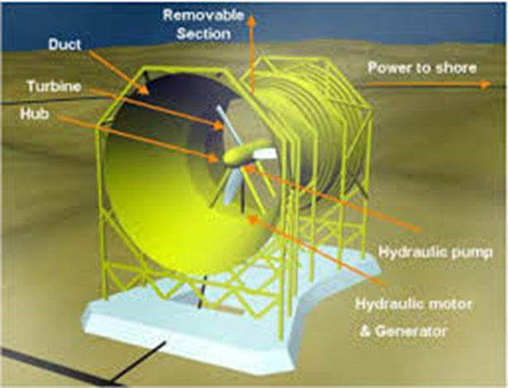
Using a duct with an MHK turbine
What does a duct do?
Acts as a nozzle, increasing the velocity to obtain more power from fluid stream:
$V_{2}$ = $V_{1}\frac{A_{1}}{A_{2}}$
$P_{2}$ = $P_{1}$+ $\frac{1}{2}$ ρ($V_{1}^{2}$-$V_{2}^{2}$)
Bernoulli analysis shows that increasing the velocity will decrease the pressure at the duct exit or turbine inlet.
Decreasing the duct exit pressure could result in a decrease in the cavitation number (increase cavitation).
Cavitation is much more likely in turbines located near the water surface than turbines located on the ocean floor, therefore we chose NOT to use a duct in our design.
Cavitation Number
$σ_{c}$ = $\frac{\left(P_{atm}+ ρgH\right)− P_{v}}{0.5ρU^{2}}$

Slide 13
Environmental Considerations
How will turbine affect wildlife and ocean floor?
Study by Zhang et al used a 1:100 scale axial flow turbine in a tank with live fish ranging in size from 3 to 4.2 cm long.
The results showed that no fish were observed to contact or collide with the turbine in the experiment
Study done by Romero-Gomez and Richmond used a computer simulation of a 3 bladed turbine with a radius of 2.44 m and fish ranging from 100 to 760 mm in length.
Showed a low mortality rate (< 4%) which is consistent with previous experimental observations
Results seem to indicate that an axial flow turbine would have little to no affect on fish in the area, however, consideration needs to be taken for other wildlife.
Floating configuration would keep the turbine far from the ocean floor where the wake might cause sediment to be disturbed.

Slide 14
Environmental Considerations (cont’d)
Elimination of potential leak paths
Use of cartridge seal on turbine shaft would effectively isolate the inside of the nacelle from the ocean water
Beam et al describes the design of an axial flow turbine PTO that uses a cartridge seal that can last up to 20 years
Use of sealed bearings
Tian et al describes an axial flow turbine that uses sealed bearings along with a magnetic coupling to isolate the PTO from the ocean water
Reduction of noise generated by turbine
Use of helical rather than spur gears to reduce gear noise, however this may result in a slight decrease in transmitted power.
Again, make sure cavitation is avoided as this will also cause unnecessary noise

Slide 15
Suggestions for Further Investigation
Design of floating platform
Wosnik et al describes the design of a floating platform that is used to test scale models of axial flow turbines
Platform stability needs to be considered so as to avoid any unnecessary oscillation that could affect the turbine efficiency
Look at buoyancy of platform and take into account weight of electrical cabling and mooring cabling
Design of method to fix platform to ocean floor and mooring
Need to assess the type of rock on the ocean floor so that a specific type of mooring can be designed
Drag force from platform and thrust from turbine need to be accounted for
Use of a breakaway mechanism in cabling
Golightly describes several methods of platform design and ocean floor mooring/anchoring in a presentation for offshore wind energy.

Slide 16
Suggestions for Further Investigation
Design of gearbox, generator and controller
Beam et al describes the design of an axial flow turbine PTO
Design or specify a gearbox that uses helical gears.
Need to develop a Transfer Function model of a controller, generator, and gearbox for the turbine, run simulation in Matlab.
Design of cooling system
Beam et al describes a closed loop internal cooling system
Can research other methods of cooling that use the water as a heat sink for the heat generated by the gear box and control system components
Electrical system, cabling, and connection to grid
Li et al describes the design of an electrical system to transfer the power from the turbine to the grid
Two subsystems: a collection subsystem that transmits from the turbine to a collection point and a transmission subsystem that transmits the power from collection point to onshore grid tie-in.

Slide 17
Suggestions for Further Investigation
Stress (FEA) analysis of stresses on turbine blades
Turbine design software HarpOpt (NREL website) will evaluate the stresses on the turbine blades
Pressure data from a BEM analysis can be used as an input file to a commercial FEA package and used to analyze the stresses on the turbine blades
Mohammed et al used a panel method to perform a hydrodynamic analysis of the Bahaj turbine to obtain the blade pressures and used this as an input for an FEA study
Final power output estimation
Domenech et al describes a method of assessing a practical value of energy extraction from a turbine based on systems engineering model.
Maintenance considerations
Use of sensors to monitor turbine condition
Consider blade fouling and how to control this
How accessible is the turbine for maintenance?

Slide 18
Conclusion
Summary of turbine design
We hope that this paper will serve as a contribution to another potential MHK turbine site in the United States and to help Hawaii in identifying and implementing another clean and economical energy source.
Turbine outer diameter | 18 | m
Theoretical power output | 392 | kW
Blade profile | NACA 63-8xx | -
Number of blades | 3
Set angle | 5 | degrees
Mounting | Floating platform type
Blade Material | Aluminum alloy

