Slide 1
Heat Rejection Analysis Process for Early Thermal Assessment
Alanna Koser
August 20, 2020

Slide 2
Overview
Introduction
Analysis Description
Model Setup
Using the Results
Summary

Slide 3
Introduction
Goals
  Answer the question: How much power can the bus reject if all available, unblocked structure is used as radiator area?
  Allows comparison of total spacecraft and individual panel capability vs heat load
  Provide early identification of likely thermal problems
  Provide early inputs on desired spacecraft bus component locations and approximate heater power needs without needing to build a detailed thermal model
Method has been successfully used for…
  Both LEO and GEO environments
  Buses in the size range of ~a few feet in each dimension
    Different bus sizes may require a different bulk temperature for the bus (30°C is used here)
Limitations of the Method
  Does NOT predict component temperature
  Method inherently assumes perfect heat-spreading
    Indicator of what’s possible, but may need heat pipes, heat straps, and / or heat spreaders to achieve it
    Design decisions made based on these results should be considered preliminary
  Spacecraft is held at a bulk-average temperature that does NOT account for spacecraft gradients or orbital swings

Slide 4
Analysis Description
Hold panels at bulk-average temperature of 30°C with boundary nodes
  Heat rejection capability = power required to hold that temperature
  Why so low?: Bulk-average temperature does NOT account for spacecraft gradients or orbital swings
    Components generally hotter than radiator
    Cooler sections of radiator have less heat rejection capability
    Batteries have narrower limits than other components
    My experience is assuming 30°C tends to lead to better results in the detailed model
Heater power ballpark estimate
  Hot Case: Add MLI such that heat rejection capability = (total contingency heat load)*1.25
  Cold Case: Hold panels at bulk-average temperature of 0°C
    Heater power = power required to hold that temperature - CBE heat load
    Check against one-node model calculation

Slide 5
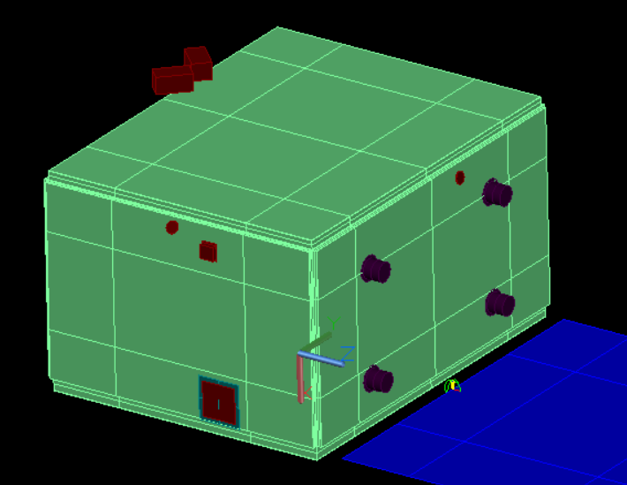
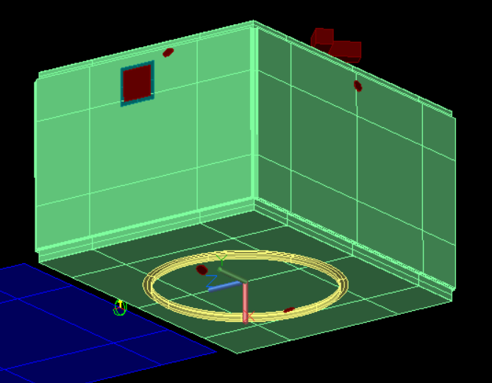
Model Setup
Low-Fidelity
  Example has 272 nodes, 5262 conductors
All external components modeled to account for radiator blockage and view factors to the environment
  The example model uses generic external components
No internal components modeled
As usual, stack hot-biasing environments, optical properties, etc. for the hot case, and cold biasing environments, optical properties, etc. for the cold case
Use boundary nodes on the internal structure faces to hold the bus at a bulk-average temperature
  Example uses FD Solids with 2 nodes through the thickness, with only the inner-facing nodes as boundary nodes
    Thermal Desktop applies environmental heating rates as a heat load on the external nodes
    If boundary nodes are external, heating rates will need to be subtracted out
PL (payload) deck
+Z
-Y
+Y
-Z
LV (launch vehicle) Panel

Slide 6
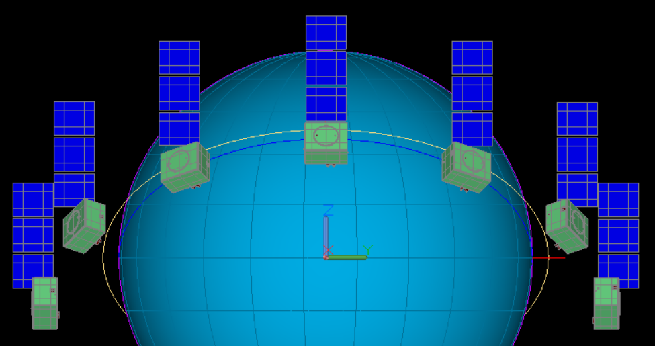
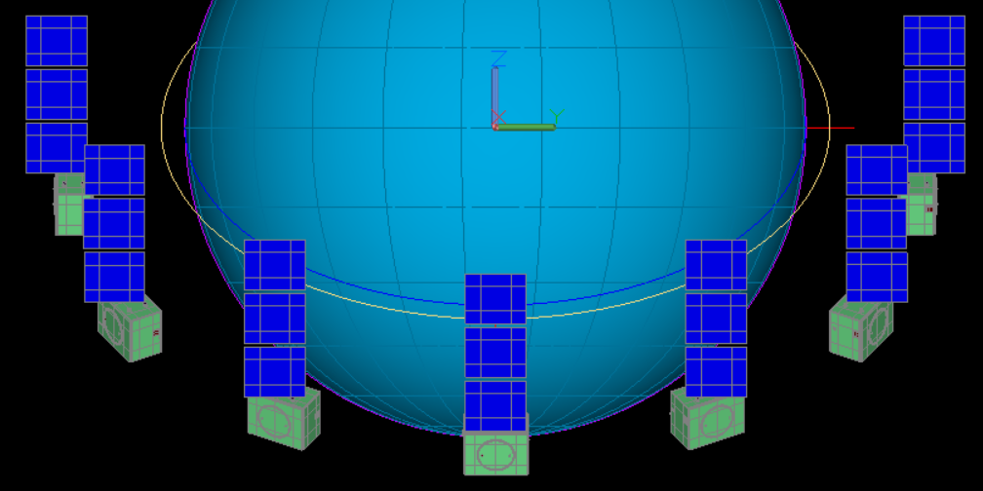
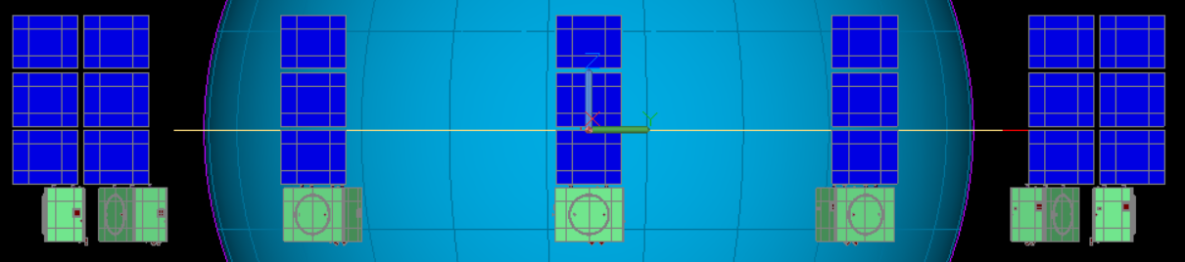
Using the Results: Heat Rejection Capability
View From Sun
Case 1: All panels have sufficient heat rejection capability
Case 2: Total heat load is too high for the bus to handle
  Additional radiator area may need to be added
  May need to look at creative solutions to increase heat rejection capability or lower the heat load
Case 3: Some panels have a higher heat load than they can handle, but the overall bus capability is sufficient
  Problems areas can likely be mitigated with heat straps or pipes
A negative value indicates that environmental inputs are higher than the radiation to deep space
Beta = -35°
Panel capability
Beta = +35°
Internal bus dissipation
Beta = 0°

Slide 7
Using the Results: Heater Power Approximation
Approximate MLI coverage applied such that heat rejection capability = (total contingency heat load)*1.25
Heater power = power required to hold 0°C temperature - CBE heat load
  Estimated 24 W orbit-average heater power required
Note that max heater power will be at least 1.25x the orbit-average value, likely more once individual heaters are sized

Slide 8
Method Validation
Table shows a comparison of the results of the low-fidelity heat rejection model, the high-fidelity traditional model, and the 1-node model calculation from SMAD V3
  All agree very well with each other in terms of radiator requirements
  Do not agree as well for heater power, but heat rejection model is conservative and provides a rough early approximation

Slide 9
Summary
SNC has developed a standard method to quickly assess a proposed bus configuration
This method has been used successfully during proposals and early phases of a program to provide early identification of likely thermal problems and provide early inputs on desired spacecraft bus component locations and approximate heater power needs without needing to build a detailed thermal model

