Slide 1
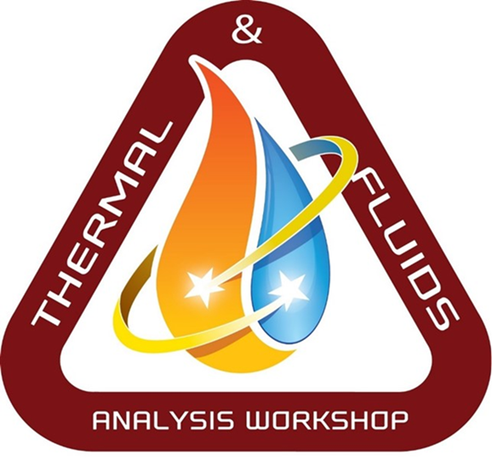
SIMILARITY OF TWO-PHASE CYCLE STABILITY BETWEEN GROUND-BASED INCLINATION AND PARABOLIC FLIGHT EXPERIMENTS
TFAWS Active Thermal Paper Session
Leon P. M. Brendel¹*, Stephen L. Caskey², James E. Braun¹, Eckhard A. Groll¹ ¹Ray W. Herrick Laboratories, School of Mechanical Engineering, Purdue University West Lafayette, 47907-2099, USA ²Air Squared, Inc. 510 Burbank St, Broomfield, CO 80020, USA
Presented By Leon Brendel
Thermal & Fluids Analysis
Workshop TFAWS 2021 August 24-26, 2021
Virtual Conference

Slide 2
Outline
Thermal gravitational scaling/Similarity
Test rig and available data
Results
Encouraging
Discouraging
Discussion & Conclusions

Slide 3
Vapor compression cycle
Most frequently used cooling cycle
Continuous boiling and condensation
Note for later: Mass flow rate
Evaporation temperature
Condensation temperature

Slide 4
Thermal gravitational scaling
“Holy grail” of thermal system design for space applications
Many propositions, almost no results
Reduce cost, increase confidence
Leverage dimensionless numbers
$≠$ Gravity independence
Model
Prototype

Slide 5
Outline
Thermal gravitational scaling/Similarity
Test rig and available data
Results
Encouraging
Discouraging
Discussion & Conclusions

Slide 6
Experiments
Inclination testing (ground-based)
Parabolic flight testing
https://www.bbc.com/future/article/20180206-the-flight-that-brings-space-weightlessness-to-earth
Can inclination testing approximate the effects that parabolas have on a vapor compression cycle?

Slide 7
Gravity perturbations
Inclination testing (ground-based)
Parabolic flight testing
Fluids: R134a, R1234ze(E)
Fluids: R134a
Pick angles to represent gravity levels
Match timing of parabolic flights

Slide 8
Datasets
Three sets of data:
Parabolic flights testing / R134a
Inclination testing / R134a
Inclination testing / R1234ze(E)

Slide 9
Outline
Thermal gravitational scaling/Similarity
Test rig and available data
Results
Encouraging
Discouraging
Discussion & Conclusions

Slide 10
Instability measure
For temperatures:
$$Instabilty=max −min$$
For mass flow rate:
$$Instabilty=\frac{max −min}{average}$$
(Absolute)
(Relative)

Slide 11
Encouraging results (1)
Overlap of inclination and parabolic flight data
$$We_{4}=\frac{G^{2}D}{ρ_{x}σ}$$

Slide 12
Encouraging results (2)
Very good overlap of different fluids

Slide 13
Discouraging results (1)
Discrepancy among fluids for low Weber numbers

Slide 14
Discouraging results (2)
Different trends for condensation temperature

Slide 15
Outline
Thermal gravitational scaling/Similarity
Test rig and available data
Results
Encouraging
Discouraging
Discussion & Conclusions

Slide 16
Discussion
Academically very interesting!
Robust tools possible?
Tools necessary?
Start (continue?) simple
https://inhabitat.com/unearthed-art-offers-a-glimpse-at-nasas-vision-for-life-after-earth/nasa-space-colony-10/

Slide 17
Conclusions
No future for thermal gravitational scaling without systematic research of significant volume
Superiority of design tools over experience and increased safety margins unclear
Wildly interesting field of research
Potential deepening of two-phase flow understanding

Slide 18
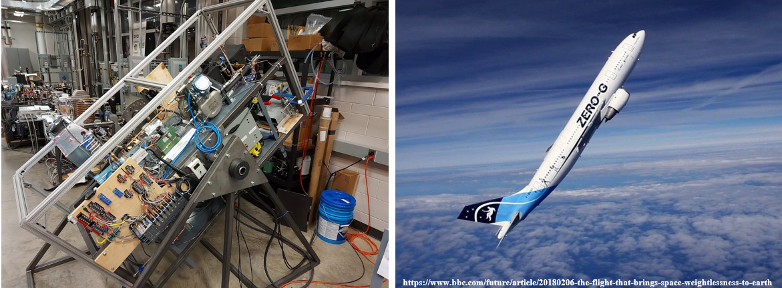
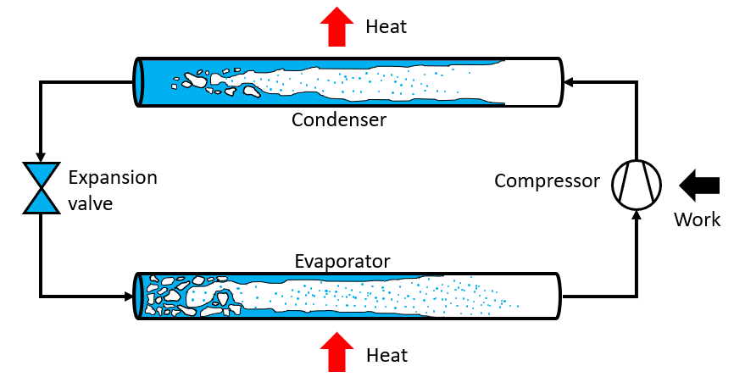
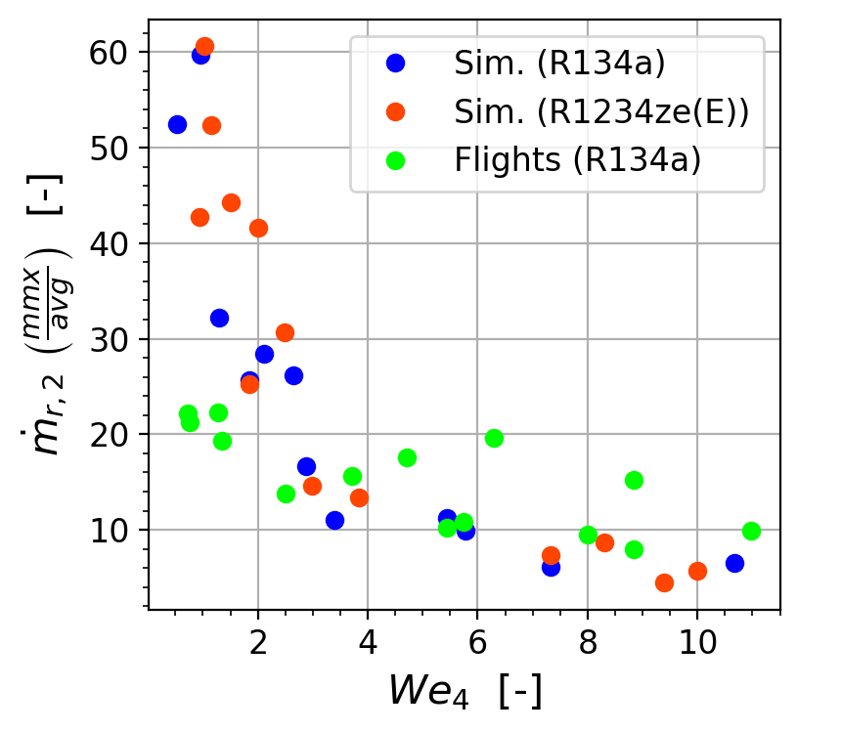
Thank you !!!
Please ask your questions or send an email to:
brendel@purdue.edu

