Slide 1

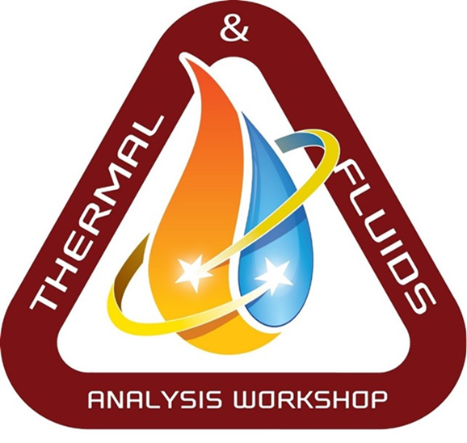
Conceptual Thermal Control System Design for a Lunar Surface Habitat
Greg Schunk, Stephanie Babiak and Dawn Naville
Thermal Analysis and Control Branch/MSFC
&
Brian Evans
Jacobs Space Exploration Group/ESSCA
TFAWS Active Thermal Paper Session
Presented By
Greg Schunk
Thermal & Fluids Analysis Workshop
TFAWS 2021
August 24-26, 2021
Virtual Conference

Slide 2
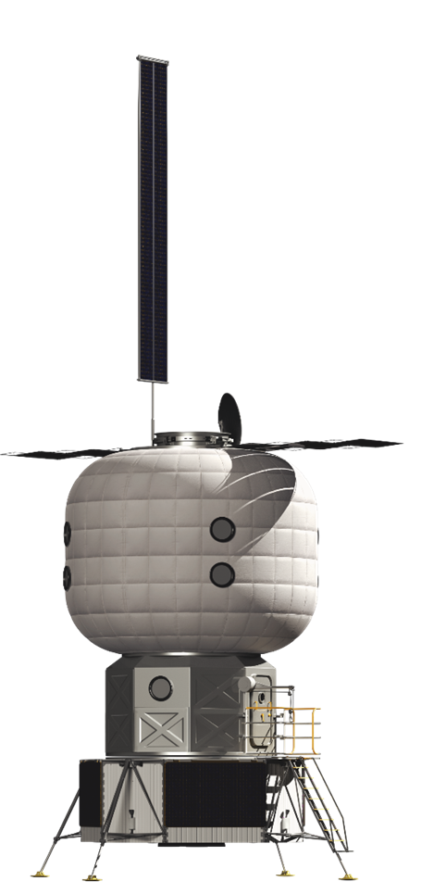
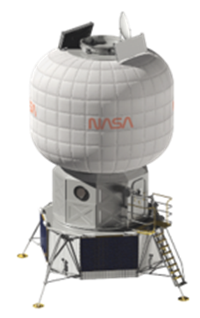
Overview
The NASA Next Space Technologies for Exploration Partnerships (NextSTEP) Broad Area Announcement (BAA) for Habitation (Appendix A) was released in April 2016, with a focus on developing a habitation capability in cis-lunar space through multiple commercial partnerships.
As part of an overall habitation formulation strategy, NASA has developed a Lunar Surface Habitat (SH) Reference Architecture.
A Thermal Control System (TCS) conceptual design for the SH based on the government design reference is presented with a focus on thermal radiator design, Survive-the-Night considerations and growth potential.

Slide 3
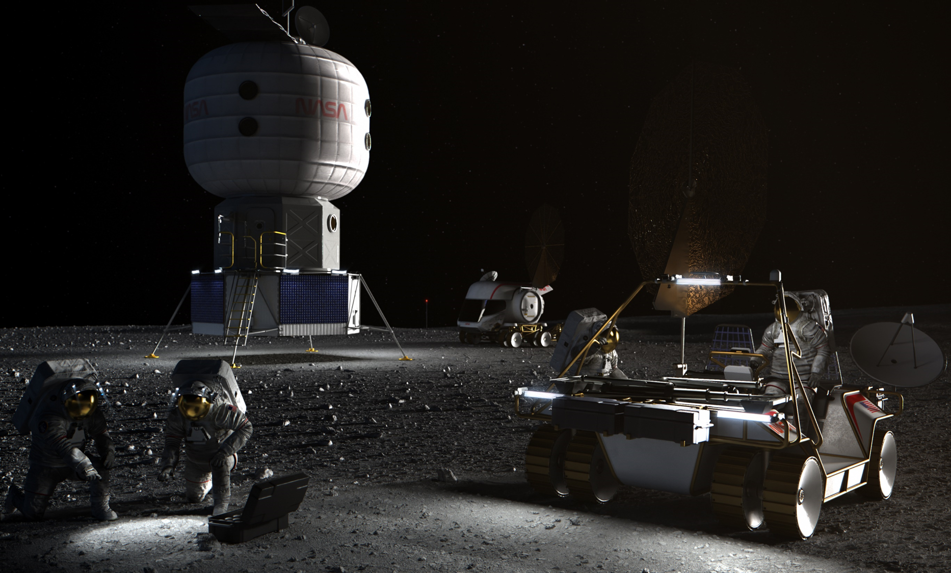
Lunar Surface Habitat Architecture Reference
Crew: | 2-4
Power: | 15 kW
Night Power: | 2 kW
Eclipse: | 100 hours
Pressure: | 10.2 psia
Lifetime: | 15 years
Mission Duration: | 30-60 days
Mass: | 12 mT
Habitable Volume: | 175 m³
Location: | Lunar South Pole

Slide 4
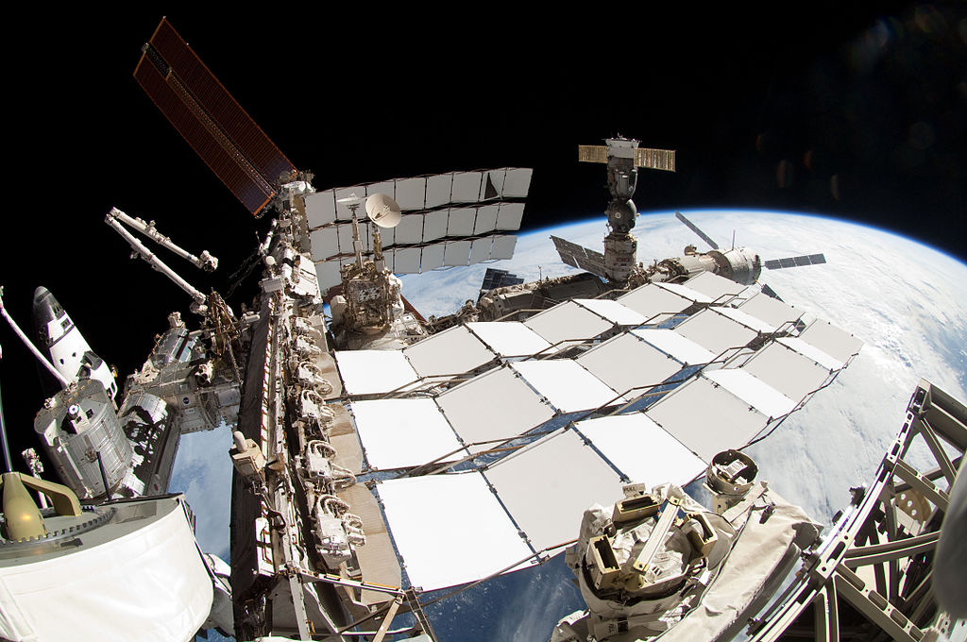
Surface Habitat ATCS Description
The Surface Habitat (SH) Thermal Control System (TCS) is designed to reject 15 kWt of heat under peak summertime conditions at the Lunar South Pole with 48 m² of radiator surface area (double sided). The two-sided deployable thermal radiators are derived from the International Space Station (ISS) design utilizing a honeycomb core.
The TCS has two loops with HFE 7200 as the working fluid externally and a 60/40 water/propylene glycol mixture as the internal fluid.
The internal TCS loop is subdivided to provide both low and moderate temperature service analogous to the ISS ATCS. The low temperature service is intended primarily for ECLSS (e.g. condensing heat exchanger) as well as any payloads that may require it.
Heritage hardware is utilized where possible.
ISS HRS Radiator
X-38 Sublimator

Slide 5
Conceptual Surface Habitat Thermal Control System
Internal ATCS parsed into low and moderate temperature loops.
An external recuperator is added to thermally manage (i.e. minimize) parasitic heat loss during Survive-the-Night.
Thermal
Radiator
#1
HFE 7200
External Pump
Package
Thermal
Radiator
#2
Mixing
Valve
External
Cold-Plates
Recuperator
LTL
Interface
Heat
Exchanger
Vent
MTL
Interface
Heat
Exchanger
From Airlock
Sublimator
Internal Pump
Package
Cond
Hx
Mixing
Valve
Mixing
Valve
Low Temp
Loads
Regenerative
Heat
Exchanger
Moderate Temp
Loads
To Airlock
Propylene Glycol/Water

Slide 6
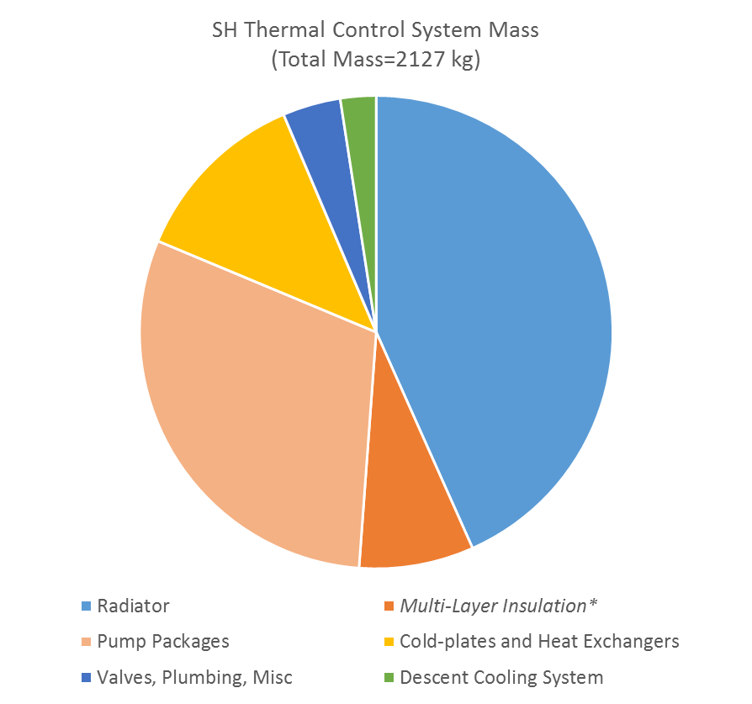
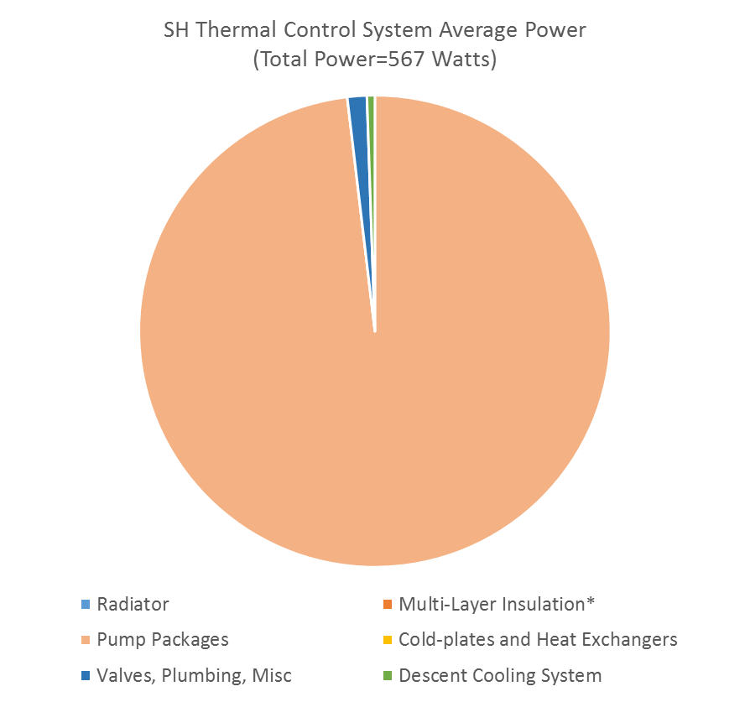
Surface Habitat TCS Resource Estimates
Primary drivers for mass and power are the thermal radiators and circulating fluid pump packages. Internal volume for TCS < 1 m³.
MLI included for reference but is generally considered part of the SH inflatable structure. Outer beta cloth covering not included but surface optical properties are a factor in thermal heat leak in to and out of the habitat.

Slide 7
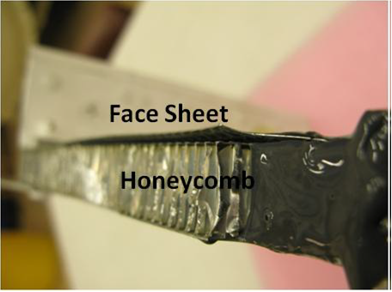
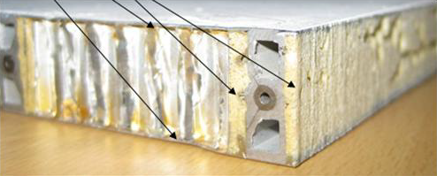
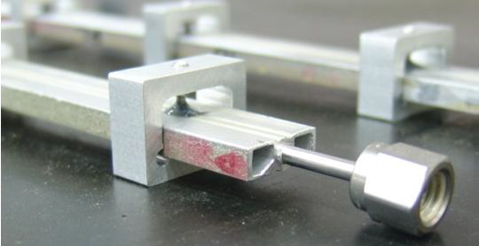
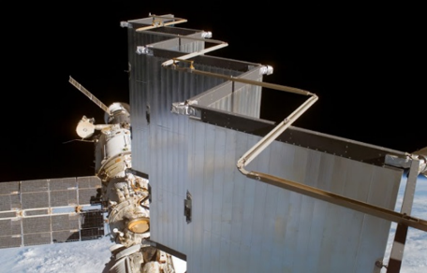
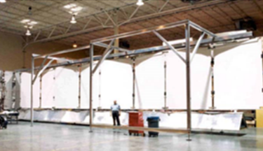
Surface Habitat Thermal Radiator Design
Inconel/Stainless Steel Tube
Aluminum Face-sheet (0.015”)
Based on ISS deployable radiator design with modifications.
Coolant tube diameter layout and geometry modified to support single phase HFE 7200 instead of single phase Ammonia.
Aluminum face-sheet thickness increased from 0.010” to 0.015” for performance improvement.
Four panels per side (~3 x 2m) needed for total area of 48 m² in SH application.
Aluminum
Honeycomb
~1.00’’
Conductive Bracket/Saddle
Cross Section
ISS Deployed
Bracket Assembly
Test Orientation

Slide 8
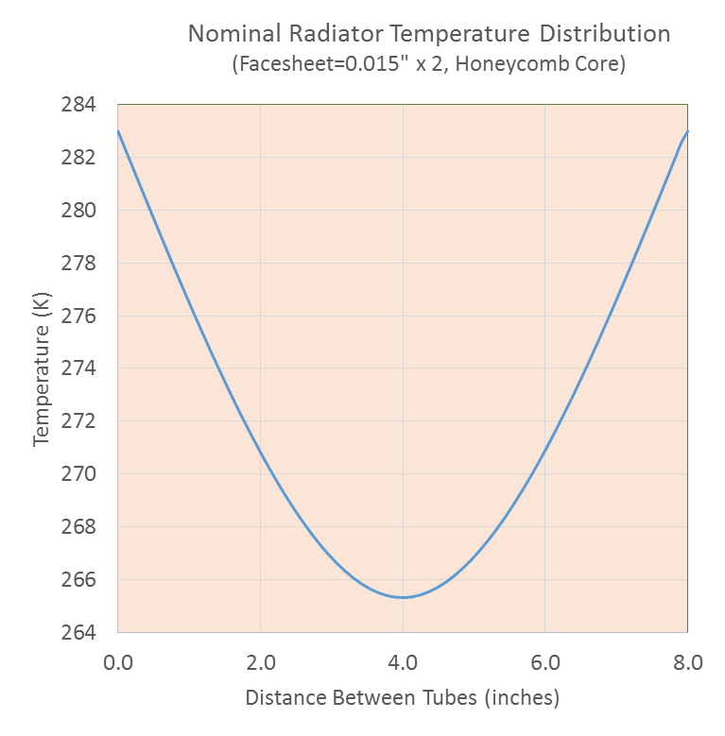
Thermal Radiator Panel Design
8”
Manifold
Out
3m
In
2m
Fluid enters the radiator via a manifold that splits the flow into 10 tubes. A balance between the spacing of the tubes and radiator fin efficiency is desired.
8”
At 8” spacing with a nominal fluid temperature of 283K and 0.015” aluminum face-sheets, the predicted temperature profile is shown with an estimated fin efficiency of 85.5%.

Slide 9
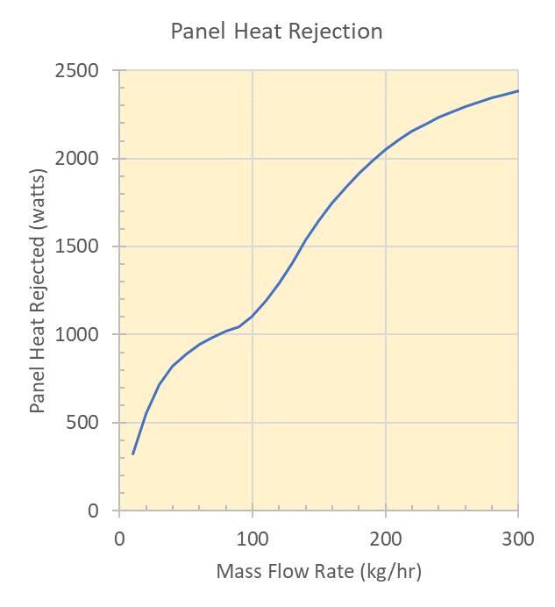
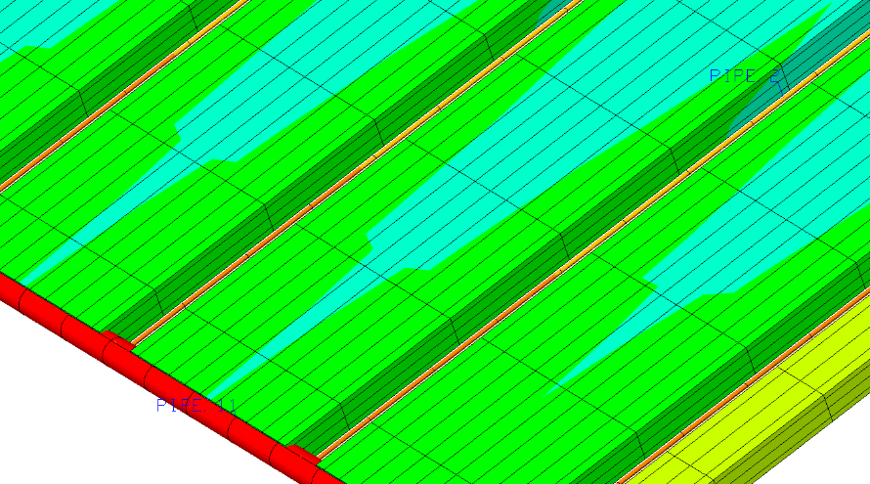
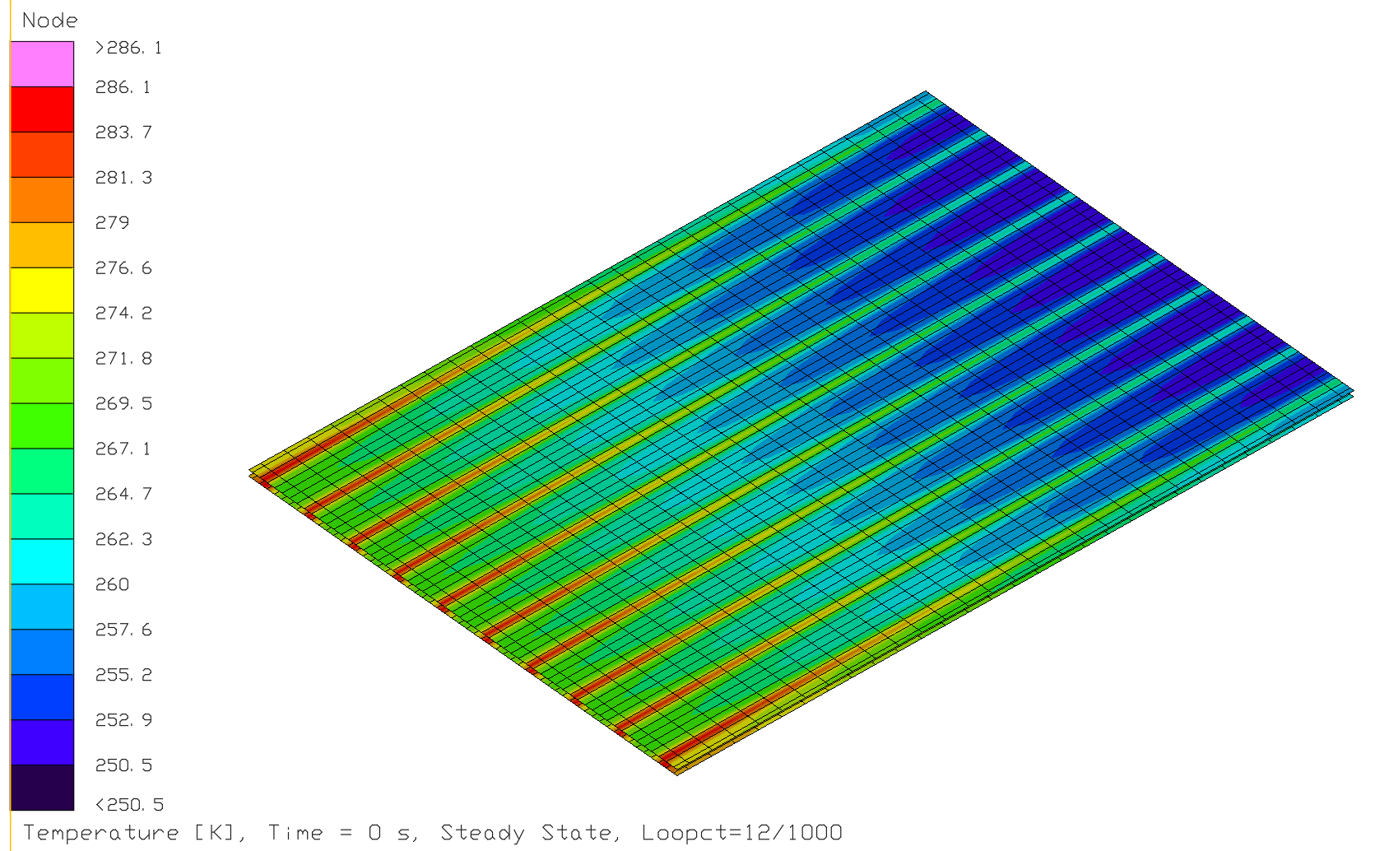
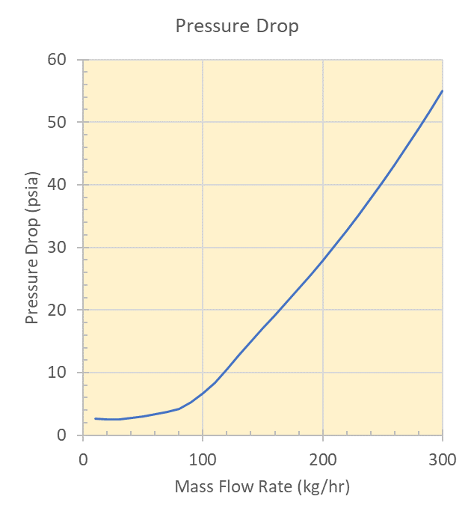
Detailed Thermal Radiator Panel Model
Flow Tubes (1/16”)
Honeycomb
Manifold
Upper and Lower Face Sheets
Out
In

Slide 10
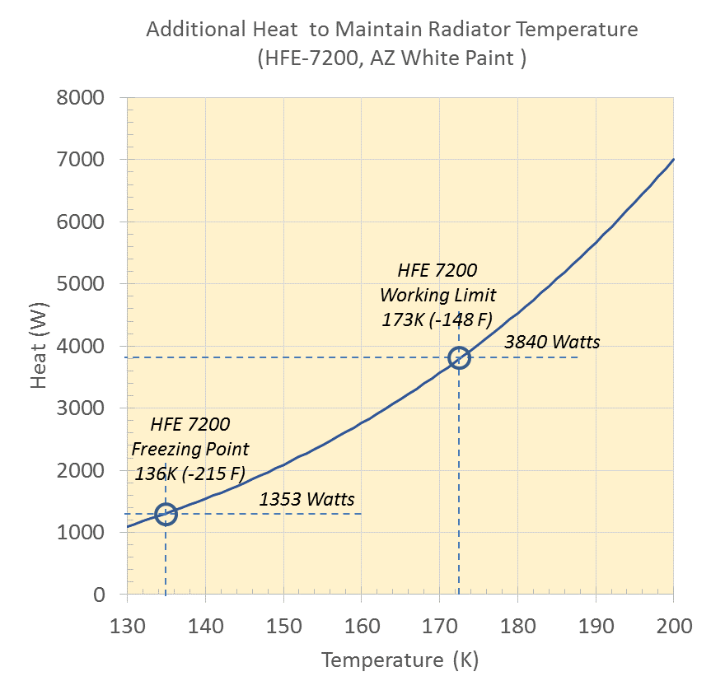
Surface Habitat Survive-the-Night
A 100-hour eclipse is possible at the Lunar South Pole. Additional heat will be needed to maintain the SH inflatable volume and thermal radiators above minimum temperature limits during the dormant Survive-the-Night scenario.
Survive-the-Night may vary in duration and with partial illumination.
To maintain the SH at minimum temperature would require 1550 watts to offset the heat leak through the inflatable volume.
The radiator fluid (HFE 7200) has a lower working temperature limit of -100ºC (-148ºF) and a freezing point of -137ºC (-215ºF).
To maintain the radiators just above the working or freezing temperature limits would require nearly continuous heat of at least 3840 or 1353 watts, respectively.
For the fluid working limit, the un-mitigated (i.e. no counter-measures) total energy required would be 540 kWh for the 100 hour Survive-the-Night scenario.
Mitigation strategies to reduce the power requirement, including energy storage, preconditioning the SH (warm) and stowing or reconfiguring the radiators, are under consideration

Slide 11
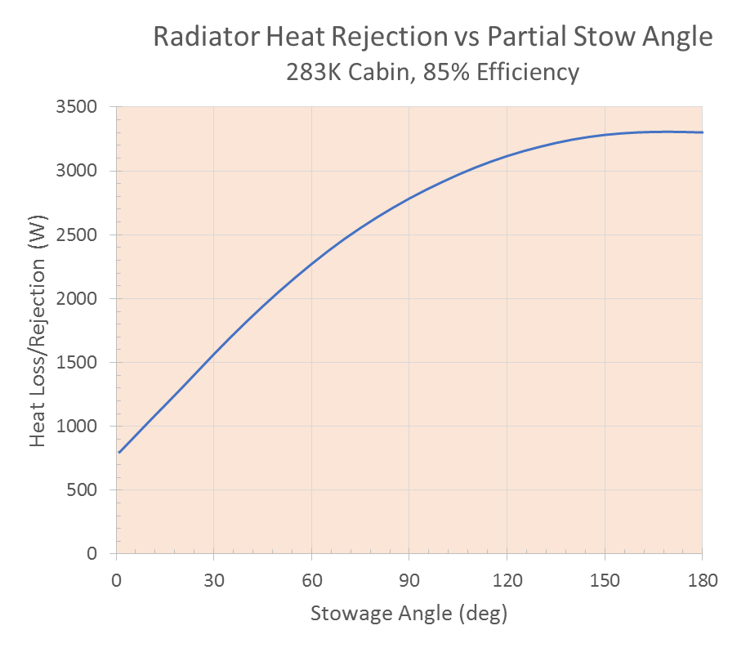
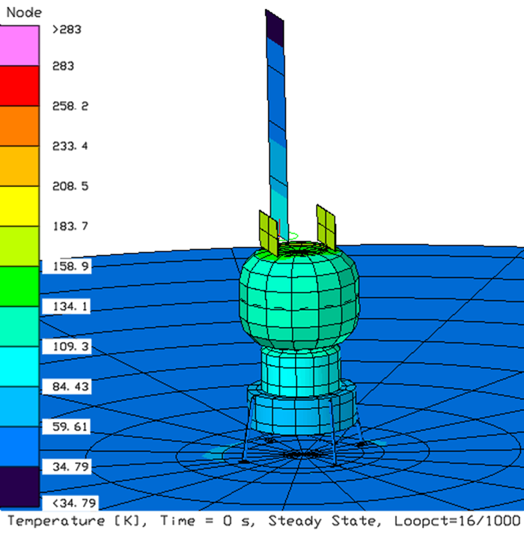
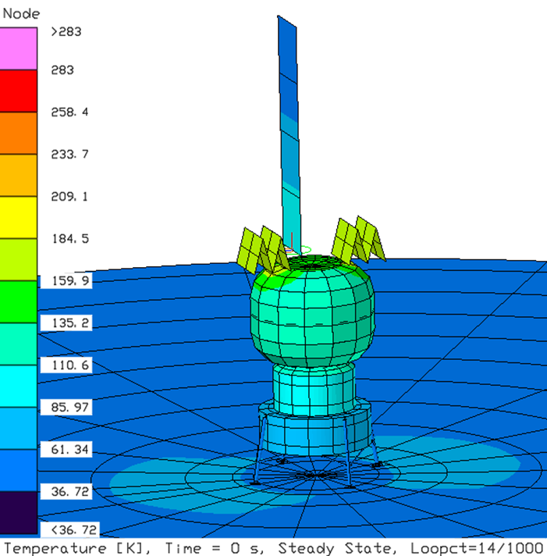
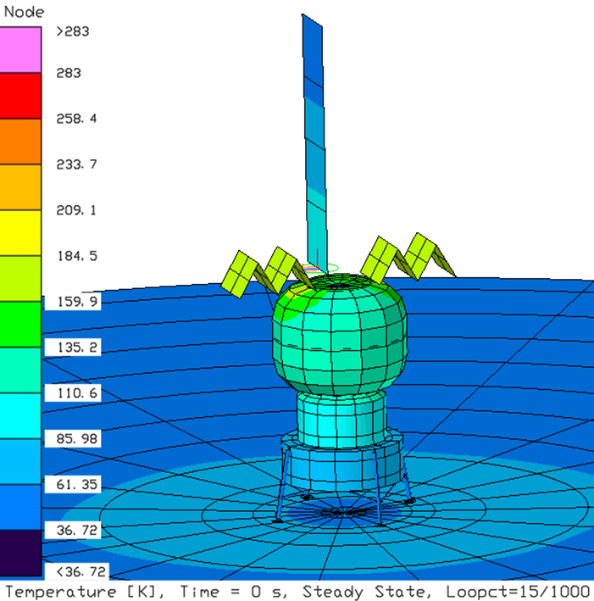
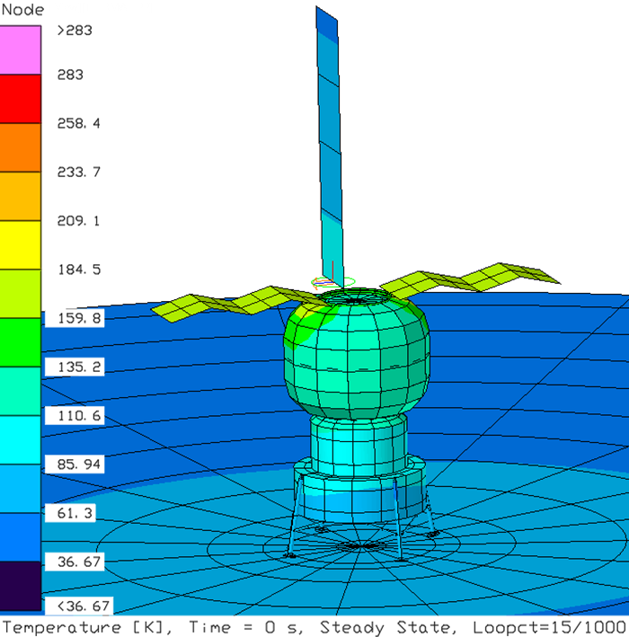
Mitigation Strategy: Retractable Radiators
α=0°
α=30°
α
α=60°
α=150°
Stowing the thermal radiators for Survive-the-Night could greatly reduce energy storage requirements. Heat leak from the Surface Habitat is fixed.

Slide 12
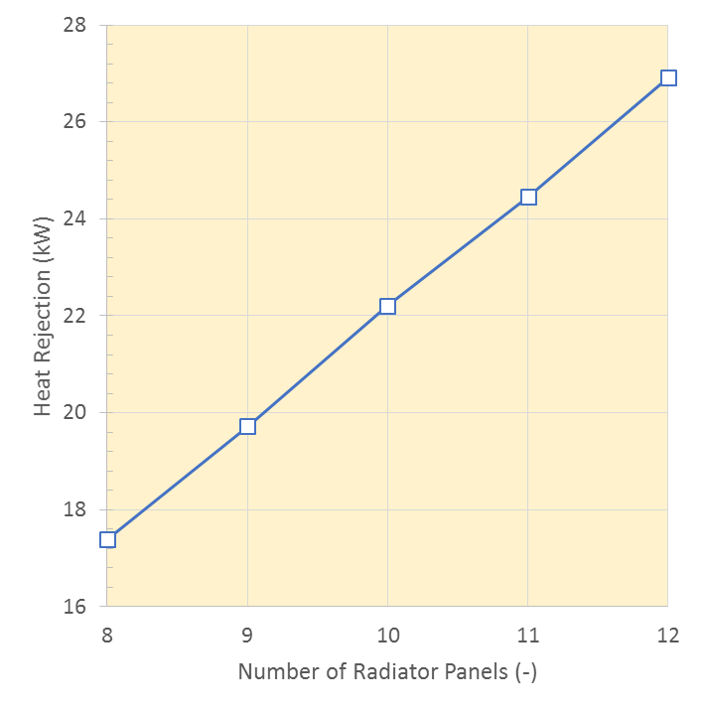
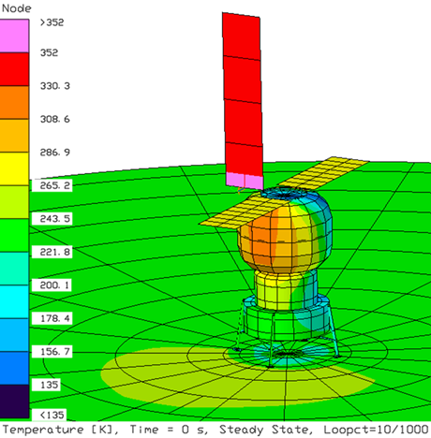
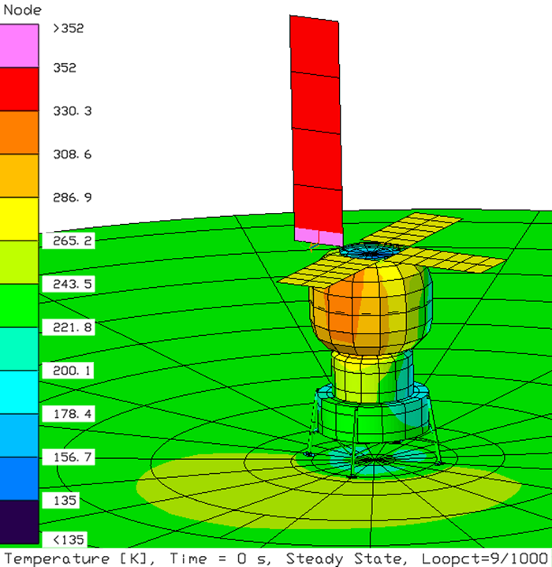
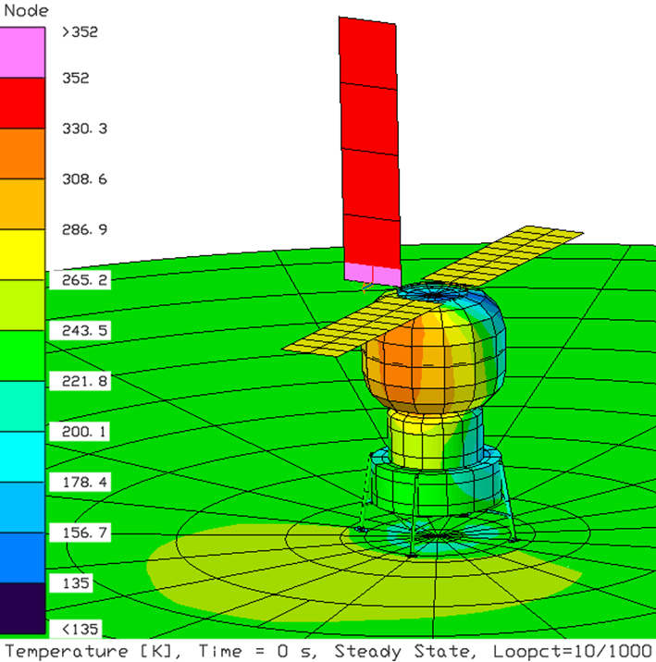
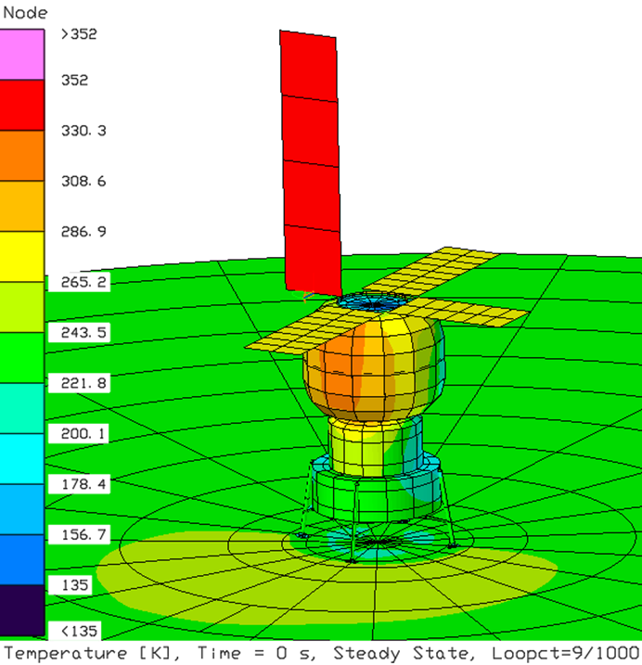
Surface Habitat Heat Rejection and Growth Scenarios
Number of Radiator Panels Required vs Heat Rejection
Radiator Temperature 283K, 85% Efficiency
Baseline
8 Panel (4-4)
9 Panel
(3-3-3)
4-4
10 Panel
(5-5)
11 Panel
(4-3-4)
3-3-3
5-5
4-3-4
4-4-4
Results are for Primary Landing Site, a Lunar Ground Temperature 217K (-70ºF) and Worst-Case Orientation.

Slide 13
Thermal/Power Growth Sensitivity
Normalized Thermal Radiator and
Photovoltaic Panel Mass vs Electrical Power
Thermal Radiator
Photovoltaic Array

Slide 14
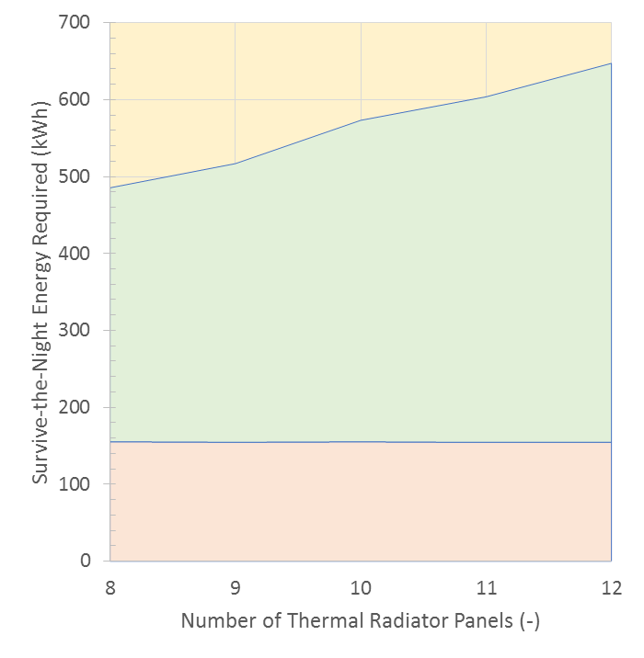
Survive the Night Considerations for Growth
Thermal Energy needed to
Maintain Habitat
Total Regenerative Fuel Cell Mass Needed to Thermally maintain Habitat*
Parasitic Thermal Radiator Loss
2H₂O ⬄ O₂ + 2H₂
Habitat Heat Leakage
Hardware Mass
Thermal can utilize both electrical energy and waste heat from fuel cells. Fuel cells nominally produce 400 kWe/kg with 243 kWt/kg of waste heat at 62.2% efficiency.
*Ian Jakupca, NASA Glenn Research Center, Overview of Regenerative Fuel Cell Technologies for Space Applications, 29 July 2020

Slide 15
Overall Thermal/Power Growth Sensitivity
Total Radiator/Photovoltaic/Fuel Cell
Mass vs Electrical Power
Regenerative Fuel Cell (RFC) provides energy needed to support a 100 hour Survive-the-Night Scenario for a given thermal radiator size.
Habitat heat leak does not vary with electrical power sizing and is approximately a constant 1550 watts during the eclipse.
RFC electrical power and waste heat are utilized to maintain habitat and prevent radiator freezing during the Survive-the-Night scenario.
Additional Electrical Power System (EPS) mass may be required to scale up peripheral distribution components for increased power requirements.
Fuel Cell Logistics (H₂/O₂)
Regenerative Fuel Cell Mass
Thermal Radiator Mass
Photovoltaic Mass

Slide 16
Summary
A TCS Reference Architecture for a 30-day Surface Habitat mission to the Lunar South Pole is presented.
TCS and energy storage needs may be minimized through Survive-the-Night mitigation strategies.
Additional thermal radiator capacity is needed to accommodate EPS growth. With the current TCS deployable radiator design, approximately 400 kg per 10 kWe is needed for the radiator panels.
  Some additional TCS pump power will also be required to accommodate larger heat dissipation.
Fixed re-generable fuel cell mass impacts for Survive-the-Night appear to be slight with increasing radiator size. The amount of water or oxygen/hydrogen required for Survive-the-Night energy storage will grow with increased radiator size (approximately 130 kg per 10 kWe).
Future plans are to continue refinement of the SH ATCS concept with detailed thermal modeling to provide performance predictions and support trade studies.

Slide 17
Nomenclature
ATCS | Active Thermal Control System
BAA | Broad Area Announcement
ε | infrared emittance
ECLSS | Environmental Control and Life Support System
EPS | Electrical Power System
HFE | Hydro-Fluoro-Ether
HRS | Heat Rejection System
ISS | International Space Station
K | Degree Kelvin
kg | kilogram
kW | kilowatt
kWe | kilowatt-electric
kWh | kilowatt-hour
kWt | kilowatt-thermal
MLI | Multi-Layer Insulation
mT | Metric Ton (1000 kg)
NextSTEP | Next Space Technologies for Exploration Partnerships
psia | pounds per square inch absolute
SH | Surface Habitat
TCS | Thermal Control System

