Slide 1


Europa Clipper Thermal Subsystem Overview
EC Thermal Subsystem Team
Jet Propulsion Laboratory, California Institute of Technology
TFAWS Active Thermal Paper Session
Presented By
Hared Ochoa
Thermal & Fluids Analysis Workshop
TFAWS 2021
August 24-26, 2021
Virtual Conference

Slide 2
Outline
Europa Clipper Mission Overview
Flight System Walkthrough
Thermal Subsystem Overview
  Active HRS System
  Passive Thermal Control
Key Challenges
  Inner Cruise Safety
  Launch
  Pump Considerations
Summary and Conclusion
Q&A

Slide 3
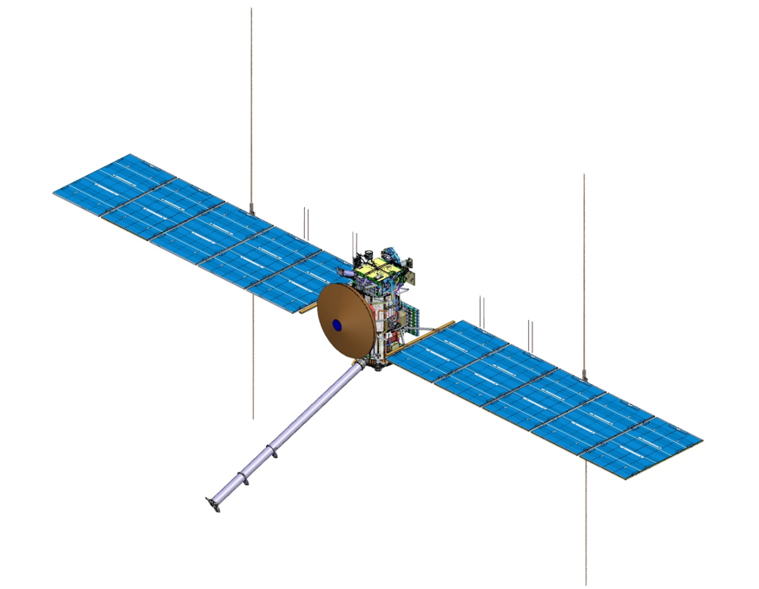
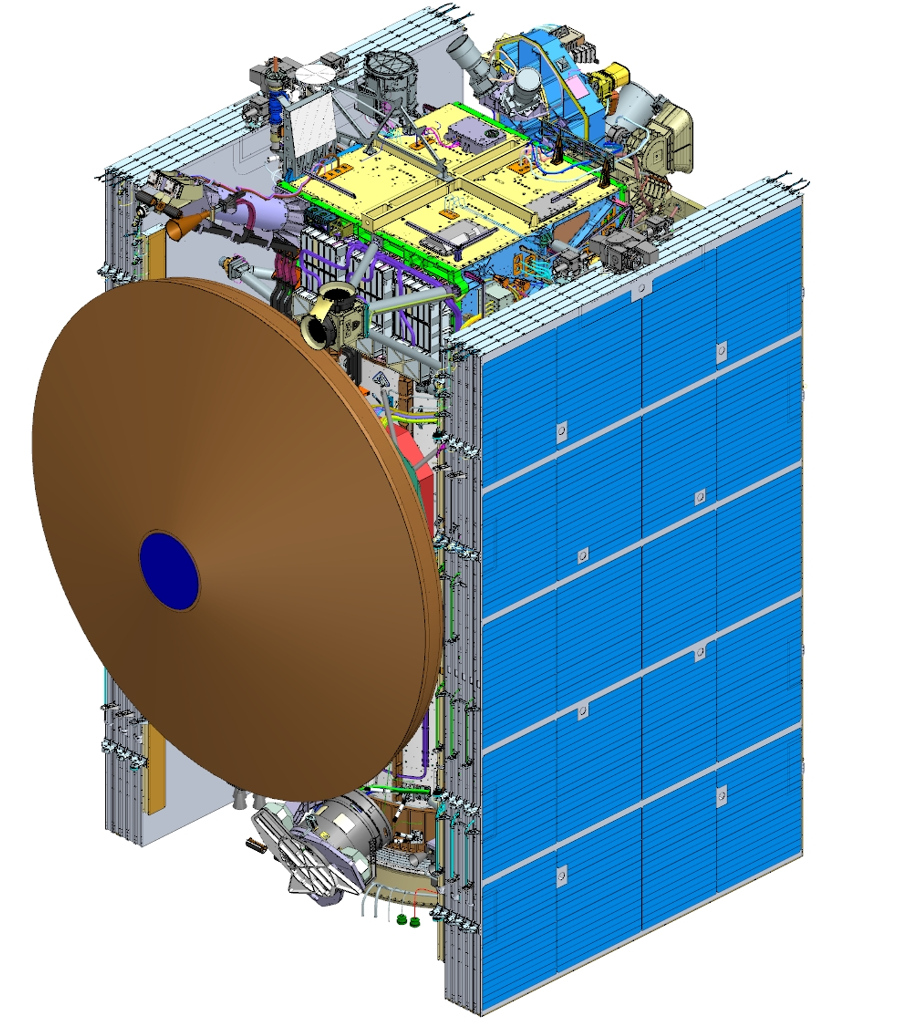
Europa Clipper Mission Overview
Launch Date: 2024
Launch Vehicle: Falcon Heavy
5.5 year cruise, Mars Earth Gravity Assist (MEGA) Trajectory
  Min Sun Range: 0.82 AU
  Max Sun Range: 5.6 AU
3 year Jovian Tour
  Multiple flyby encounters of Europa
  9.2 hour Eclipse
~100m² Solar Array
  >700W
9 science instruments
4m
17m
31m

Slide 4
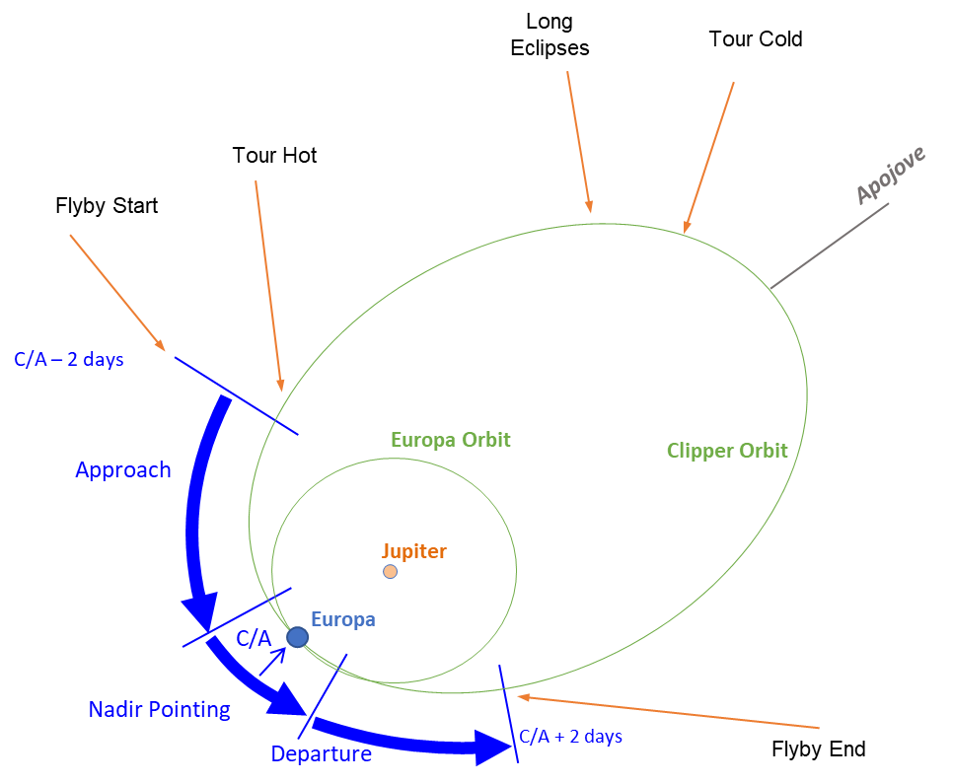
Mission Trajectory and Environments
Cruise Phase
Tour Phase
blank
blank
5.5 year tour
  Closest distance to sun: 0.82AU
  Furthest distance from sun: 5.6 AU
EGA and MGA
  Flyby environments are not driving
Minimal spacecraft operations:
  Trajectory correction maneuvers
  Data downlink/uplink
  Instrument checkouts/calibrations
  Deployments
14 day Orbit around Jupiter
  Long Eclipses only near Apojove
  Most of Science during Flyby window
Flyby Window is Four Days
  +/-2 days from Closest Approach
  Majority of science operations occur in this window
Minimal Science Occurs outside of Flyby:
  PIMS Instrument
  MASPEX Apojove science
  Magnetometer
  Data downlink/uplink, recharge of batteries
  Long Eclipses 9.2 hour long

Slide 5
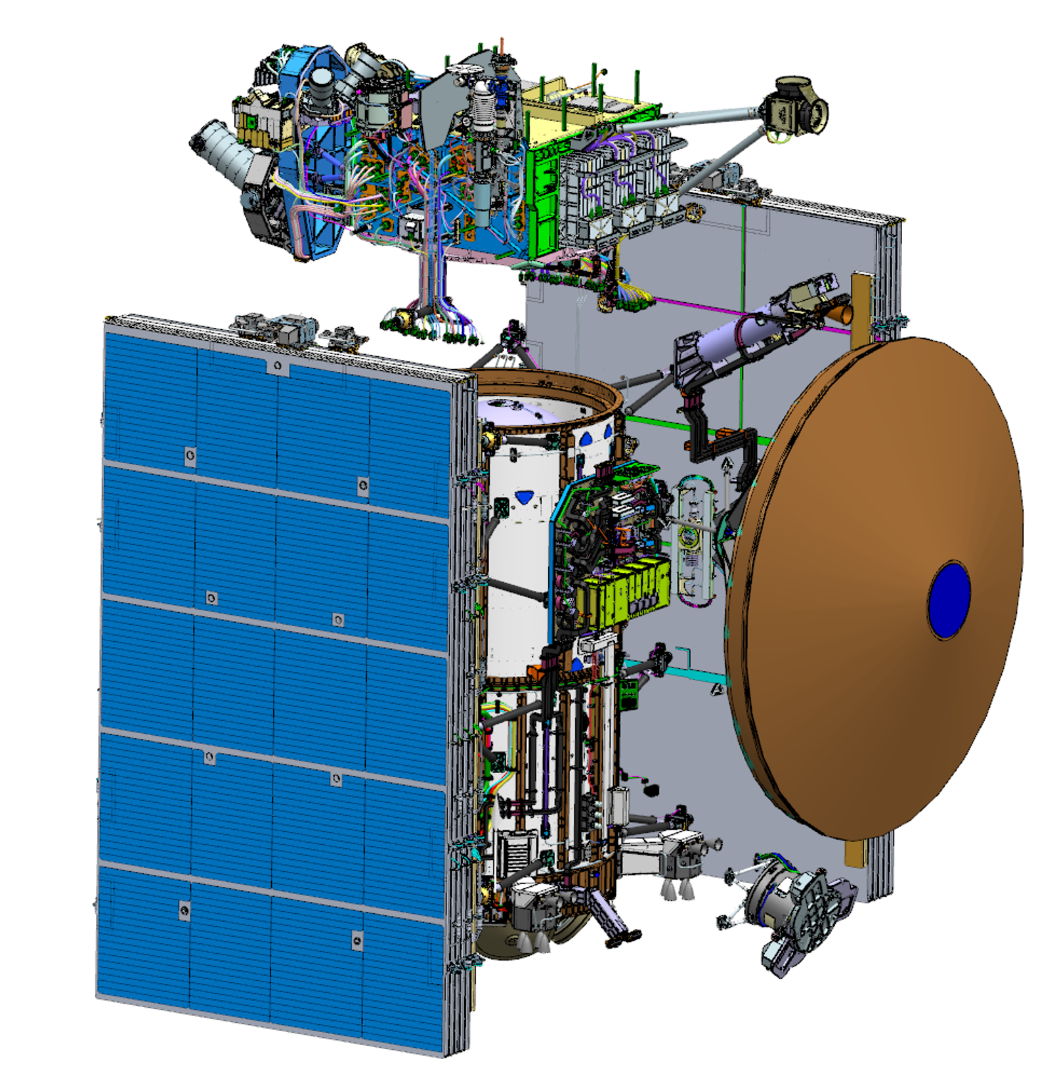
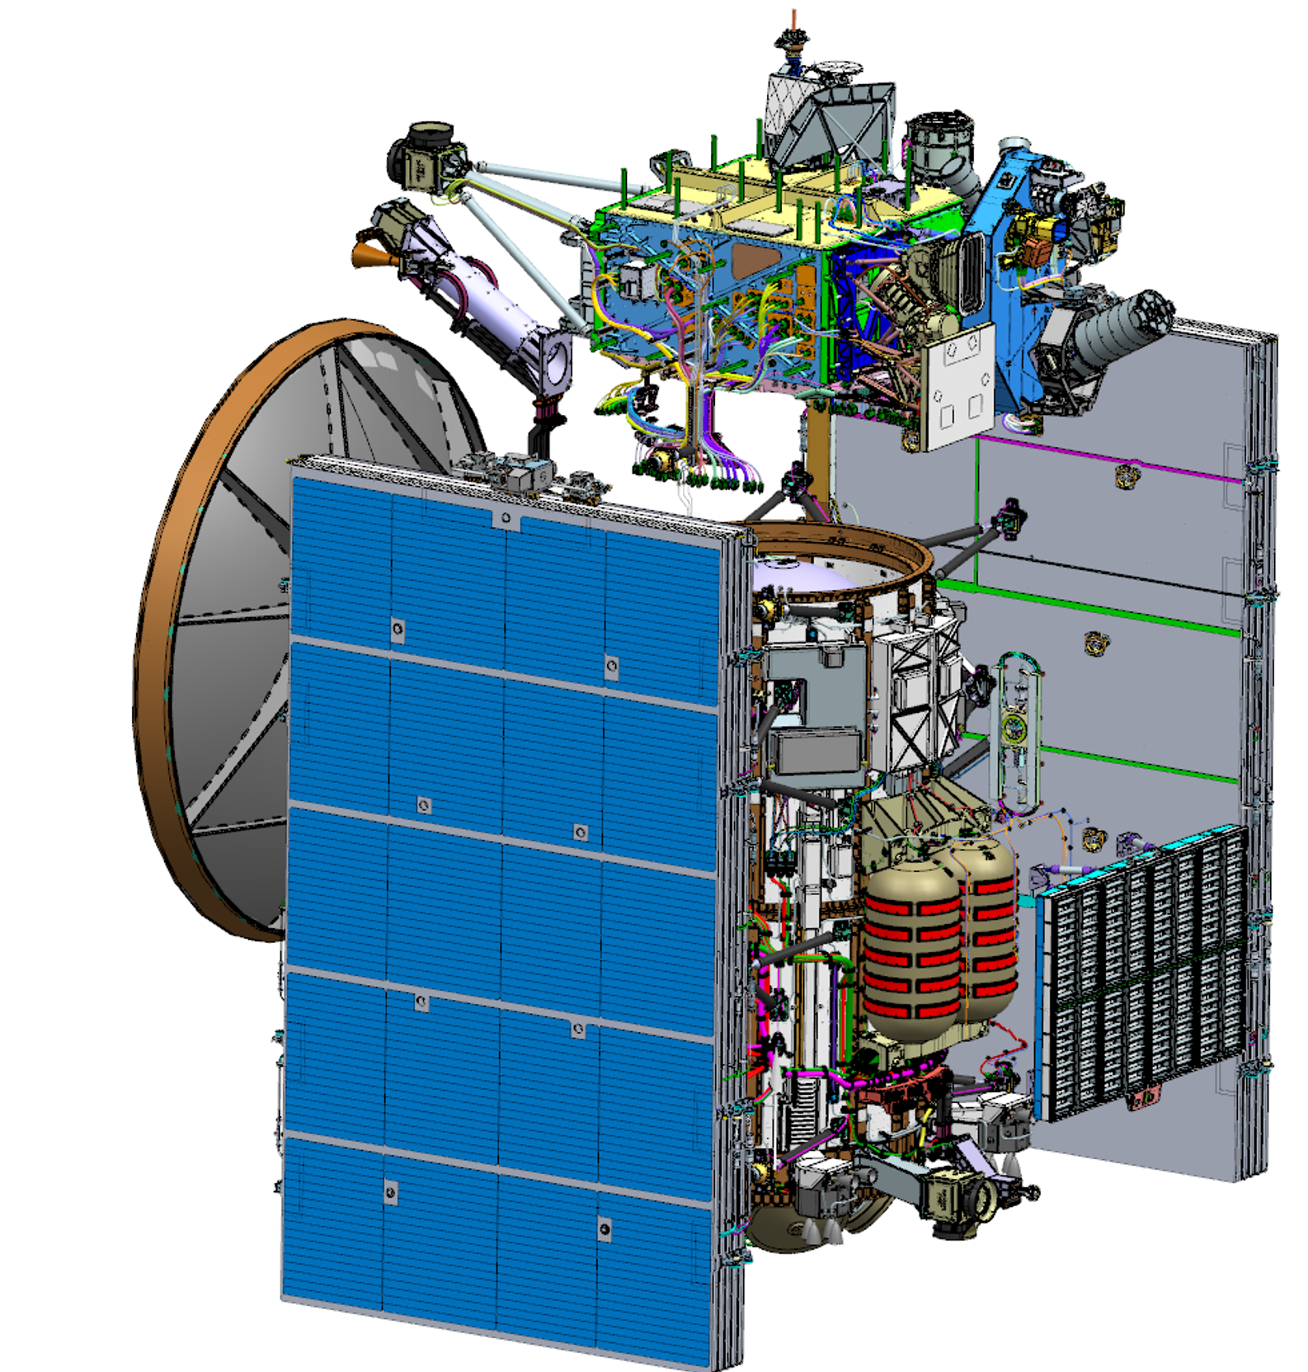
Flight System
Avionics Vault Module (Red)
  Instrument/Spacecraft E-boxes, batteries
  MASPEX, MISE, SUDA, PIMS Upper
Propulsion Module (Purple)
  Prop tanks x2, press tanks x2, Rocket Engine Modules (REM) x 4
  SA wings and HRS radiator, RHB
  ECM, PIMS Lower, REASON
RF Module (Orange)
  3m Diameter HGA, LGA, FBA, MGA
  RF Panel and mini-vault housing electronics
Nadir Platform (Green)
  Star Trackers
  EIS NAC/WAC, E-THEMIS, UVS

Slide 6
Thermal Subsystem
Architecture Goal: Optimize/Minimize Power use
Active HRS Control for Vault and Prop Module
  CFC 11 Mechanically pumped fluid loop system (6 pumps total, 1 pump operation)
  Reclaim waste heat from vault/RF electronics
  Distribute heat to propulsion system
  Provide supplemental heat via Replacement Heater Block, RHB
  Reject excess heat via HRS Radiator
  Louvers on Radiator modulate heat loss during low power/cold environments
Thermal Isolation and Passive Thermal Control for other assemblies
  Thermally Isolate large appendages and instruments
  FSW controlled heaters for Star Trackers, sun sensors, SA gimbal, pressurant tanks
  MLI covers all spacecraft components
  Use of Sunshades (HGA, Vault sunshade, separation ring sunshade)

Slide 7
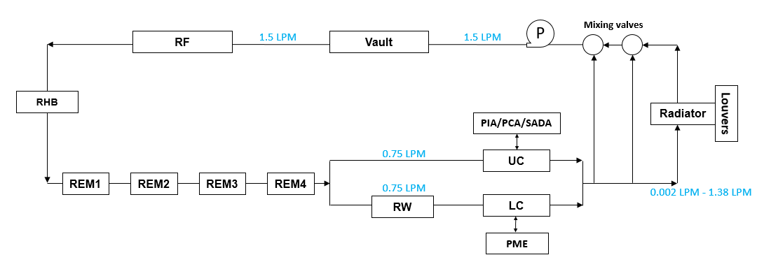
HRS Block Diagram
Net heat into liquid loop dependent on component operating mode and thermal environment
Mixing Valves, passive temp dependent actuation, shut flow to radiator when fluid is cold
Louvers reduces lost heat in cold cases to minimize heater power
Replacement Heater Block (RHB) adds heat to loop
0.9 LPM
0.9 LPM
Vault/RF Plate
Hardware:
-20°C to 50°C
0.45 LPM
0.45 LPM
0.001- 0.88 LPM
Prop Hardware:
0°C to 35°C
Primary heat rejection path
CFC 11 nominally flowing at 0.9 lpm (1 pump operating)
Full flow at Vault, RF , RHB, REMs
Split flow at PM Upper Cylinder (UC), Lower Cylinder (LC), and RW (Reaction Wheel cone)
  Orifice to be used for flow balance
Pump Packages located inside vault assembly (next slide)
Net heat out of prop module varies dependent on thermal environment

Slide 8
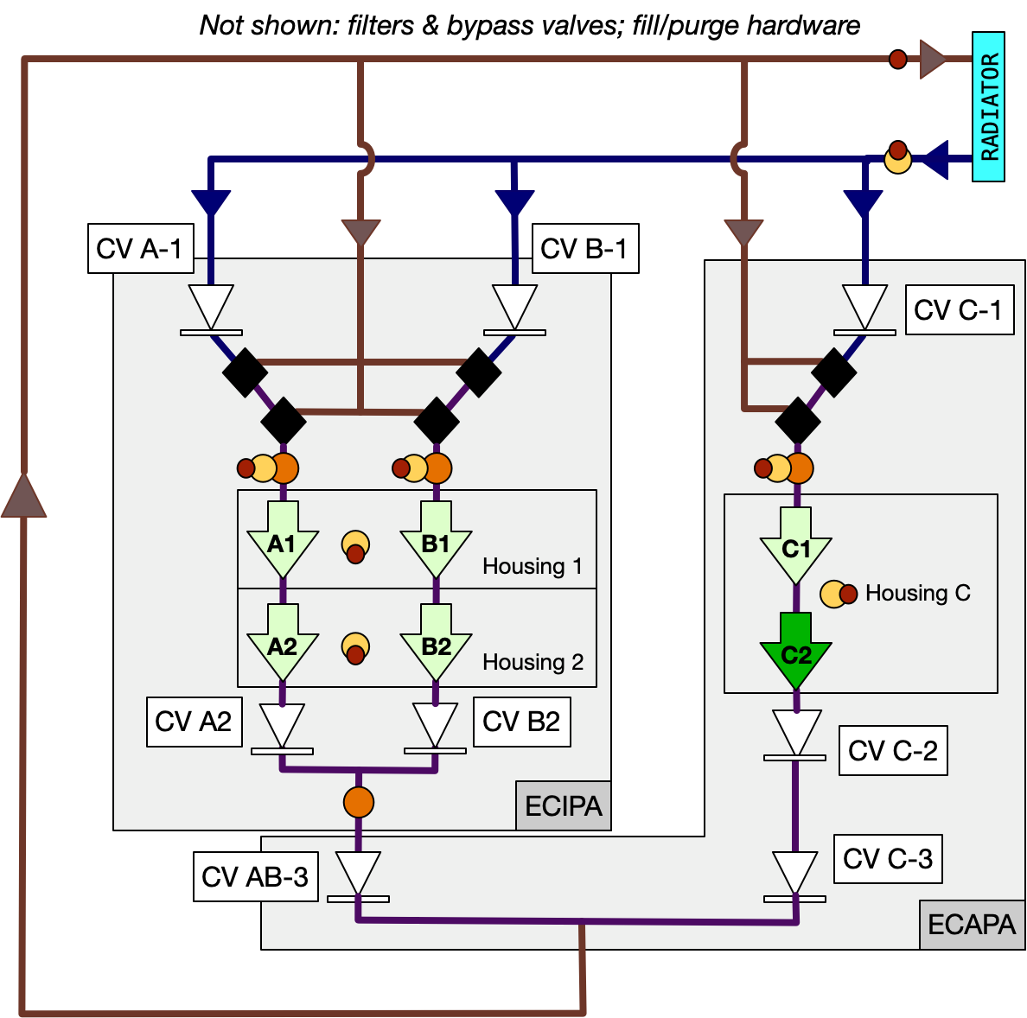
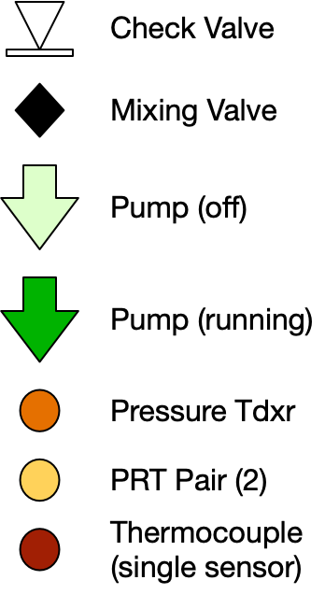
Pump Assy Block Diagram
Pump assembly in vault:
  ECIPA (Europa Clipper Integrated Pump Assembly): 4 pumps, 4 mixing valves
  ECAPA (Europa Clipper Auxiliary Pump Assembly): 2 pumps, 2 mixing valves
  TPEA (Thermal Pump Electronics Assemblies) x 2
  Nominal thermal control viable with 1 pump operation
  Total of 6 pumps (3 legs) used for redundancy and increased life capability

Slide 9
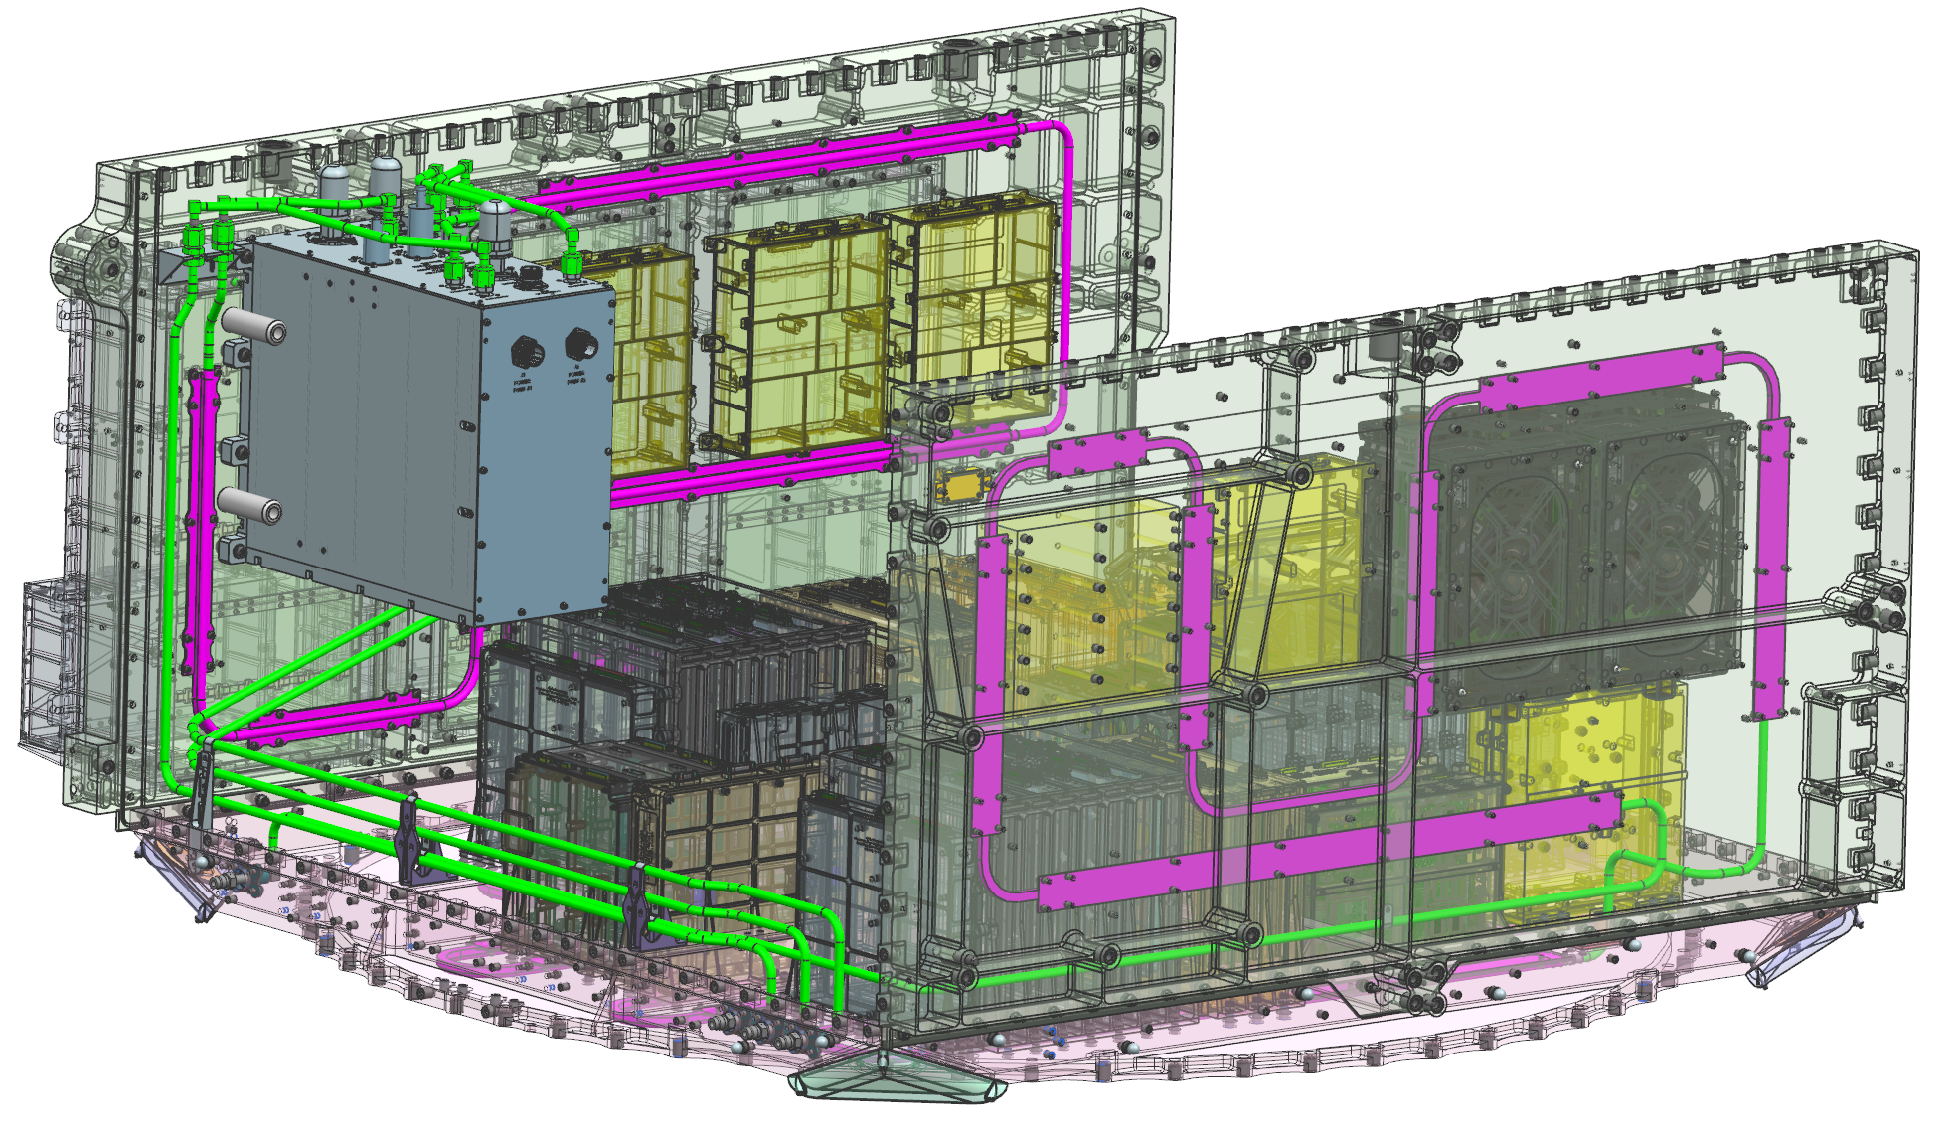
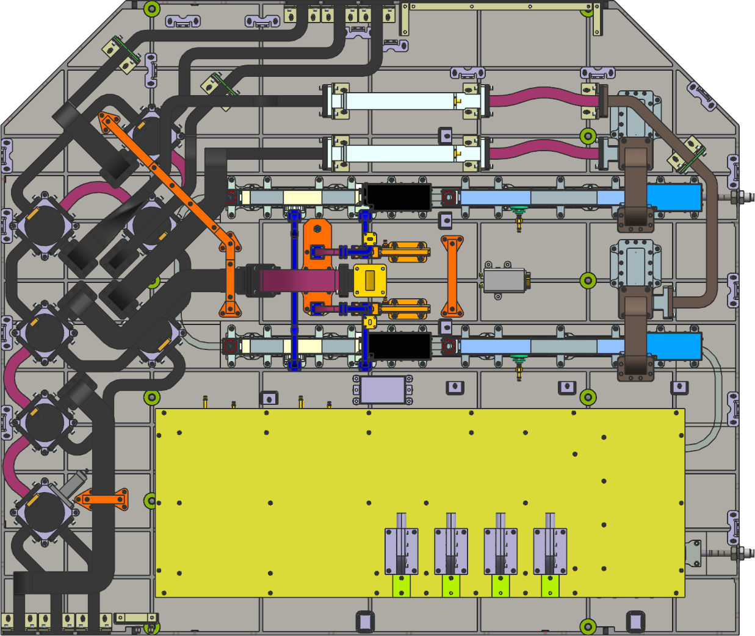
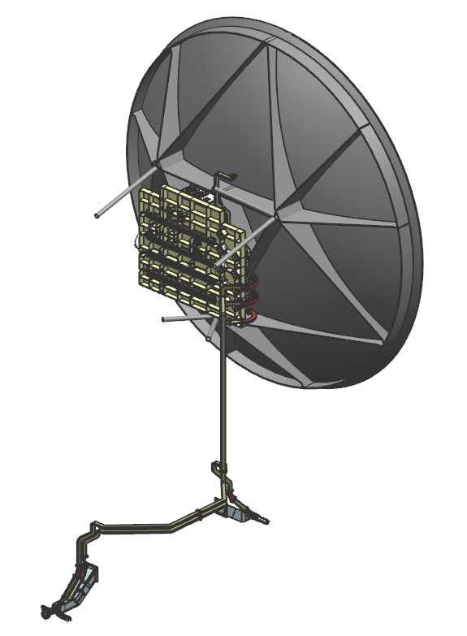
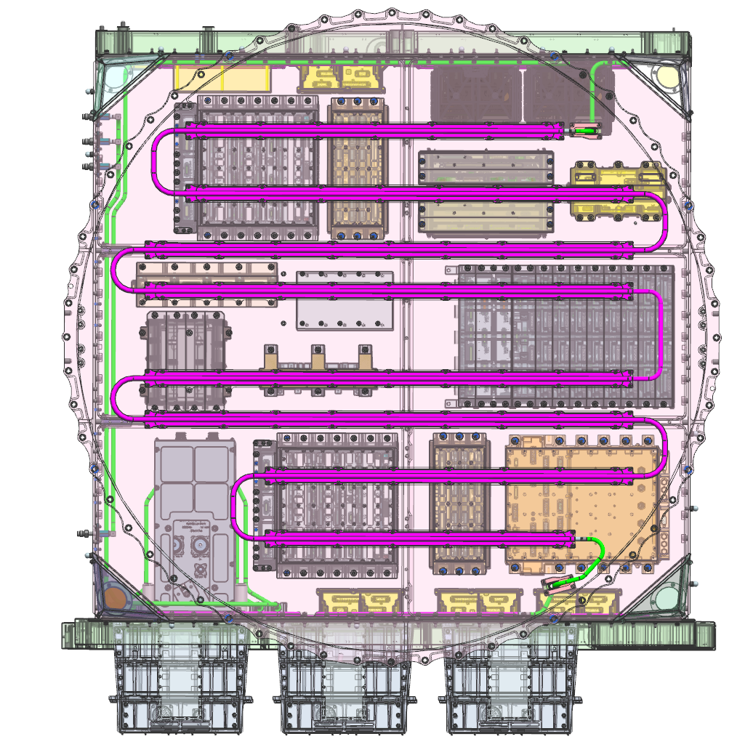
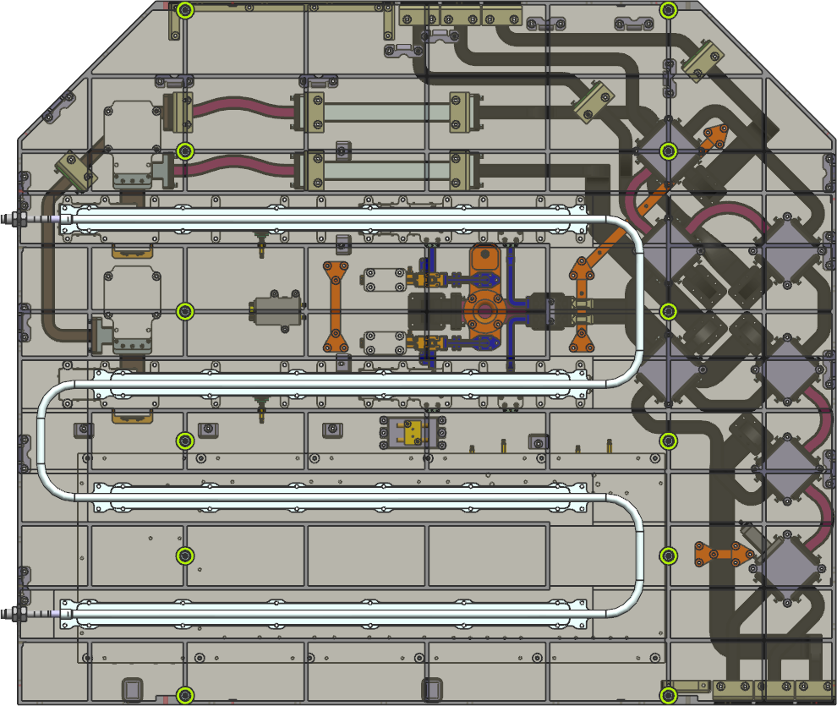
Vault and RF Module HRS
Vault Assy
RF Panel
-Y Panel
Ka Band &
X-Band TWTAs
Aux
pump
+Y Panel
Mini Vault with Radios
-Z Panel
HRS tubing picks up heat from vault to transfer to prop module (+Y, -Z, -Y panels)
  Highest dissipating components on –Z panel
  No HRS on +Z, -X, +X panels (low power). But all panels strongly coupled
Fluid directly downstream of pump provides best thermal control
  First component is batteries with tightest AFT (0C to 30C)
  Most components in vault and RF panel are -20°C to 50°C AFT
RF Panel immediately downstream of vault assembly
  Heat harvested form radios/TWTAs

Slide 10
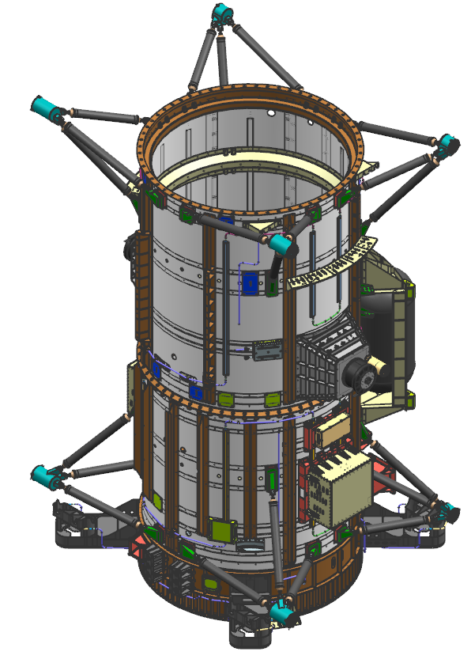
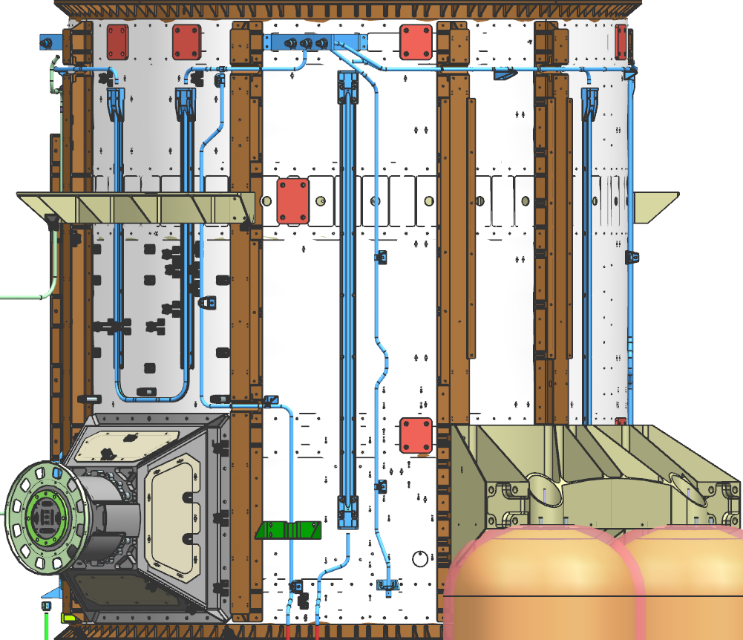
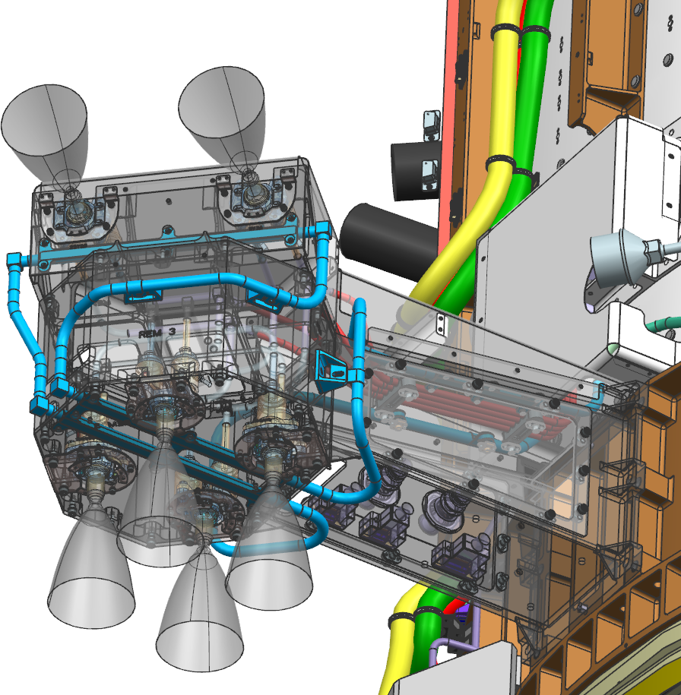
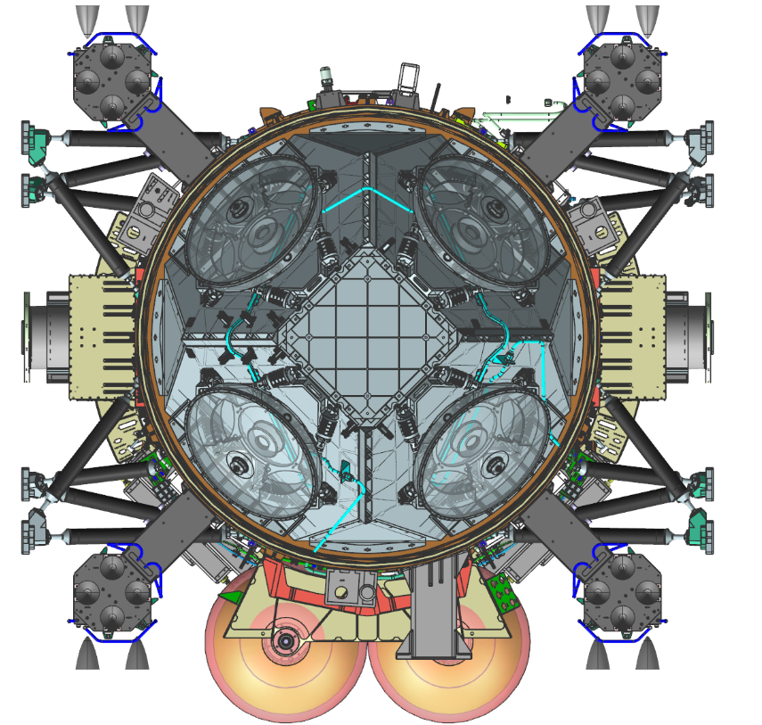
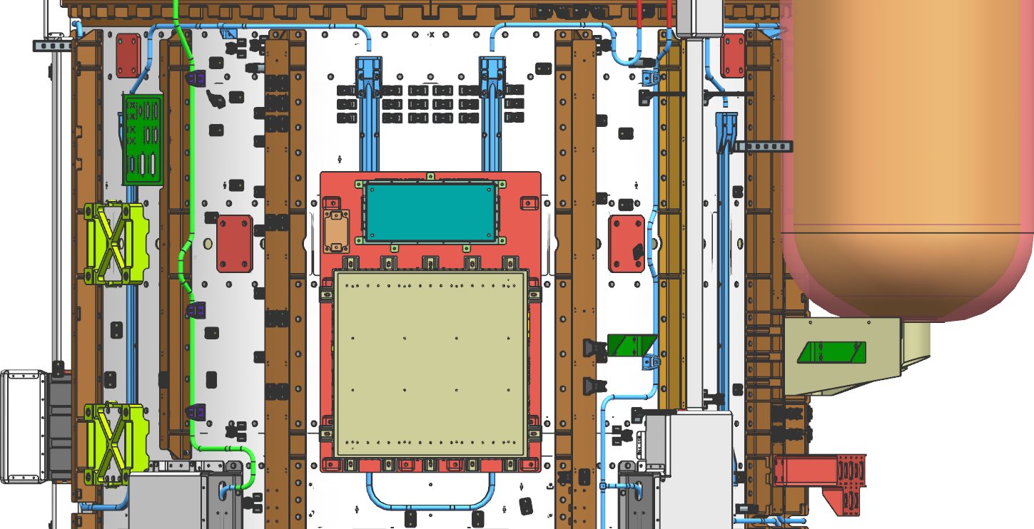
Prop Module HRS
Upper Cylinder
Propulsion module uses a “warm cocoon” to maintain temperatures
Most components are radiatively and conductively tied to the PM structure to utilize the stable HRS temperature
Prop lines are routed inside the prop cylinder, as much as possible Prop lines external to PM cylinder under aluminum shields
Ox and fuel pressurant tanks are thermally isolated and blanketed FSW controlled heaters
REM
Wheel Units Pyramid
Lower Cylinder
24 rocket engines are conductively tied to the 4 Rocket Engine Modules (REM)
Only region in HRS where stainless steel d-tubes are implemented
Flow splits downstream of REMs

Slide 11
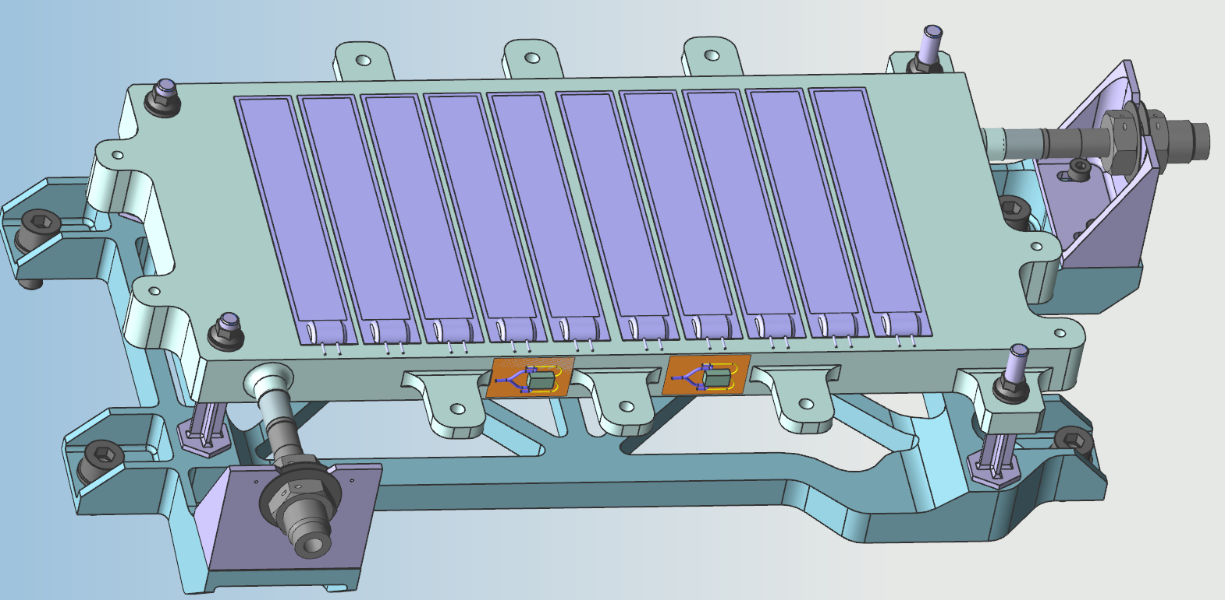
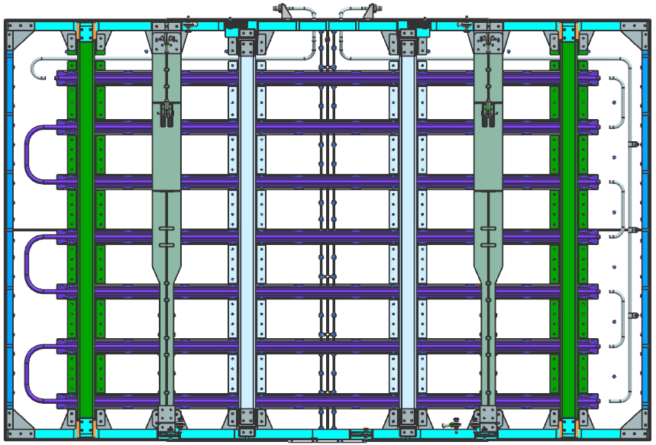
RHB and Radiator
RHB
Radiator
Heater
Fluid out
PRT
0.28 m
Fluid out
0.13 m
1.08 m
Titanium fitting bracket
Aluminum bracket to interface PM cylinder
Titanium thermal isolators
1.68 m
Fluid in
Fluid in
Aluminum heat exchanger plate, friction stir weld by maxQ
18 W/K assuming 0.9 lpm flow rate
20 Kapton self-magnetic cancelling film heaters. 16 reserved as primary
>204W capability at min bus voltage (assuming primary). <6.5 W/in²
Thermally isolated from PM structure
Z93C55 white painted 1 mm thick aluminum panel (locally 2 mm thick under the flanges)
~10 meters length of HRS flanged tubing is installed on non-space viewing side of panel
8 full set louver assemblies installed onto space viewing side of the panel to reduce heat loss in cold environments
FSW controlled heater to maintain radiator above CFC-11 Freeze temperature
Titanium struts provide mechanical support and thermal isolation from pressurant tank bracket

Slide 12
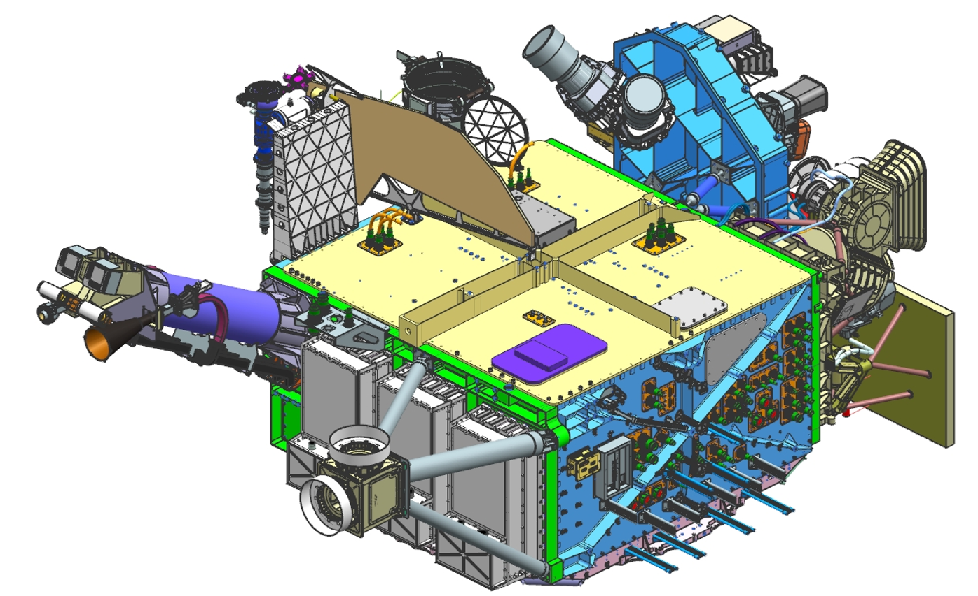
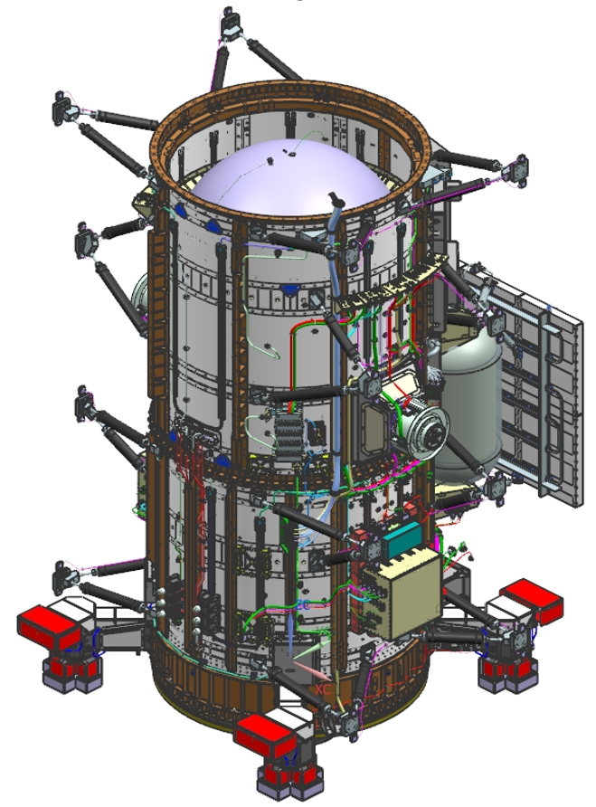
Non-HRS Heater Control
Nadir deck
FSW controlled Kapton film heaters across several non-HRS controlled spacecraft components
Components using heater control
  Pressurant tanks (op heater & pre-fire heaters)
  Pressurant tank ox lines
  SADAs
  DSS (sun sensors)
  Nadir Platform
Instrument sensors also employ heater control
SRUs
DSS
Press Tanks
& lines
SADA
DSS

Slide 13
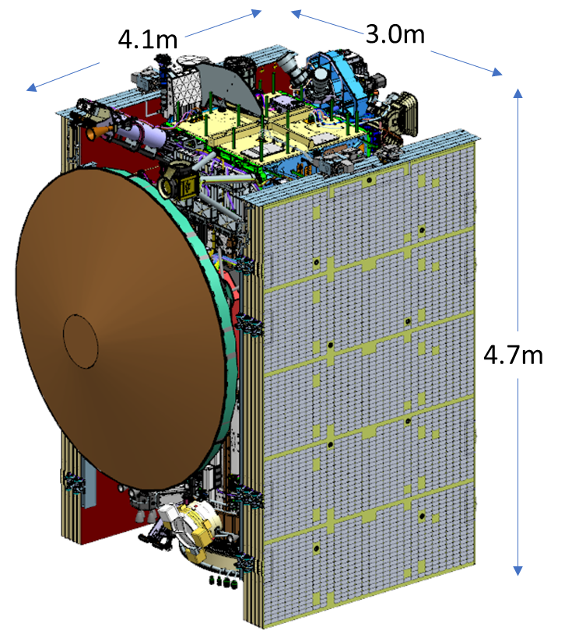
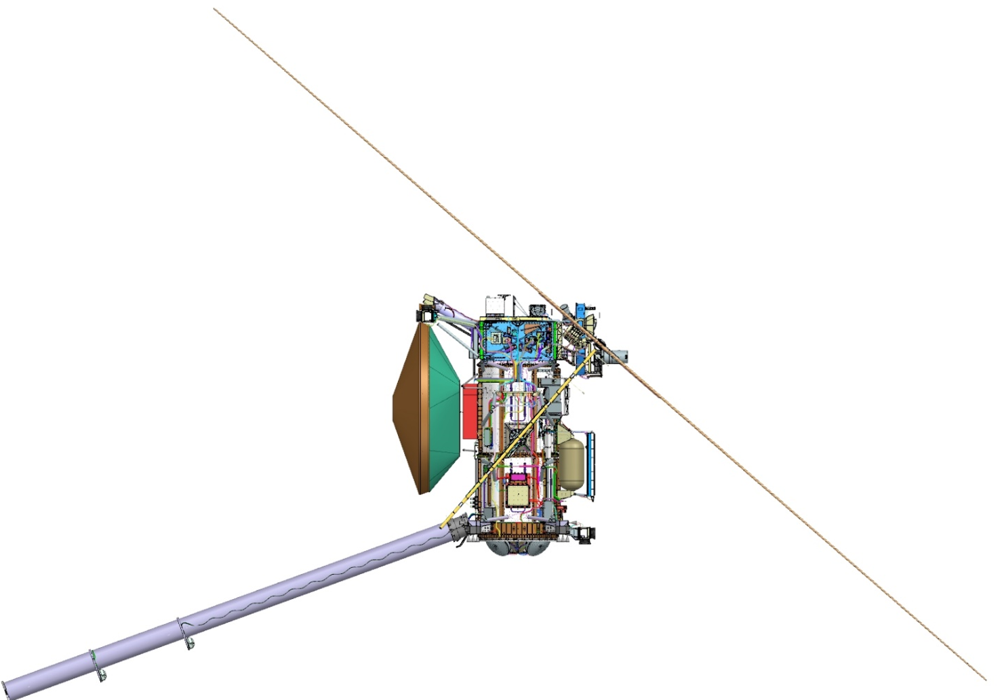
Sunshades and Inner Cruise Safety
Several Sunshades to shadow sensitive elements during inner cruise:
  HGA used to cover Prop Module
  Vault Sunshade and MISE sunshade for instruments
  Separation Ring Sunshade on lower portion of PM
Inner Cruise Attitude Constraints:
  HGA boresight to sun
  SA normal to sun >41 deg
  Limit off-pointing to <60 minutes
  Limit instrument operations
  Limit RWA/Ka Band usage <1AU
Sun Shades on SC
HGA radome
SA normal to sun at >41deg
Within 5 deg for cruise

Slide 14
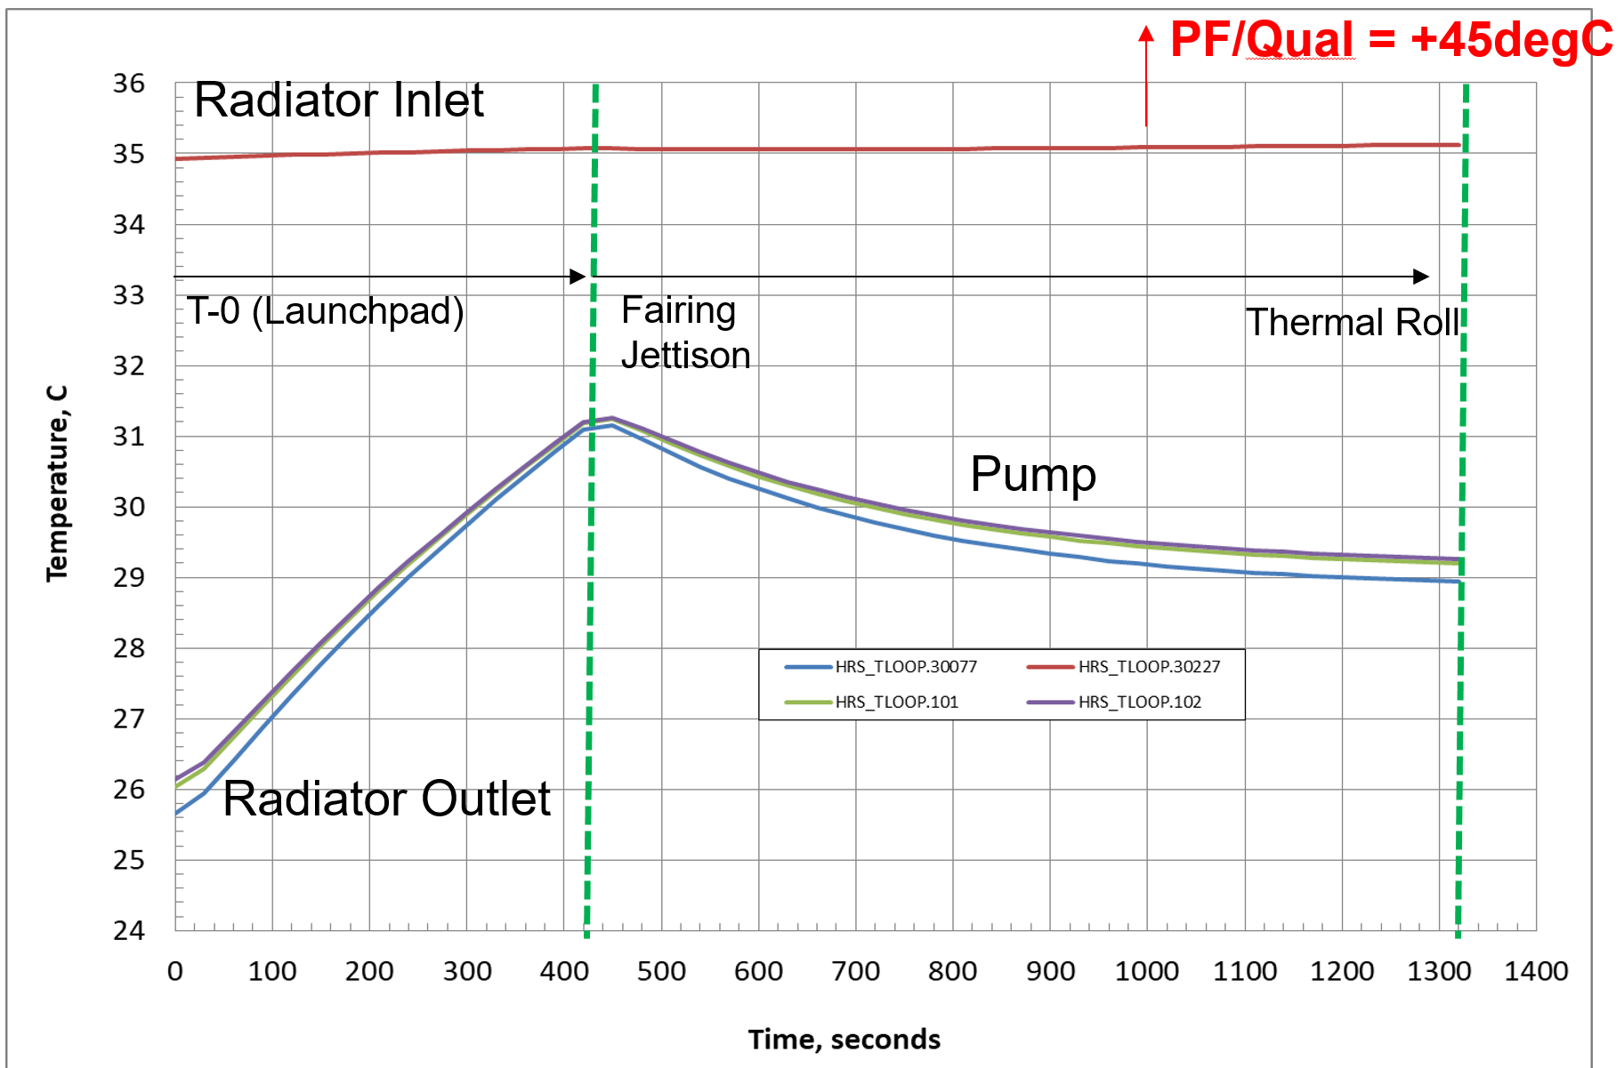
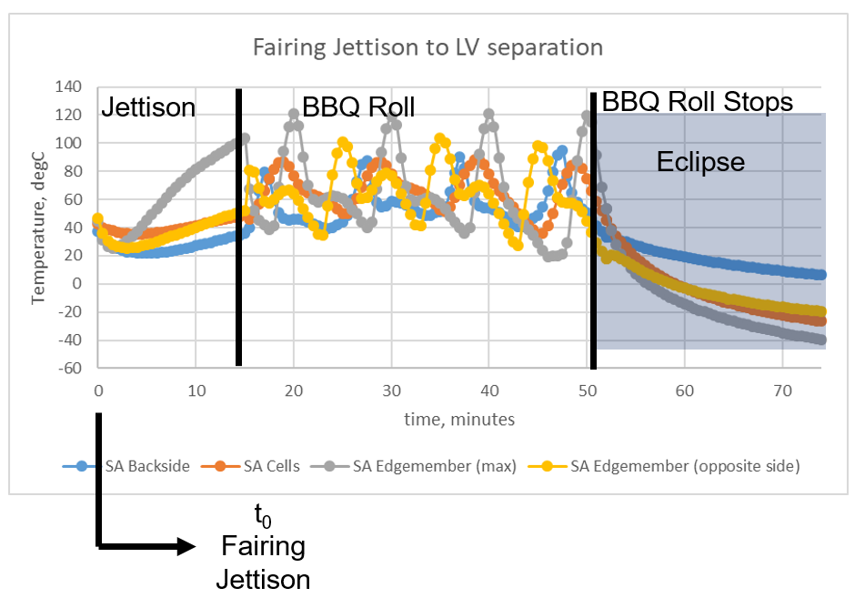
Launch Environment
Effective insulation of spacecraft and warm thermal environment inside fairing creates a challenge for heat rejection
  Directed flow (h>35/W/m²-C) on the radiator during Launchpad operations
  Thermal roll during parking orbit phase
  Radiator pointed away from Sun during LV separation
  Higher temperature limits for Battery and Pump asssy required for this scenario
Solar Array thermal control
  SA conditioning via BBQ roll about s/c z-axis to modulate temperatures
  Assessing final 6 DOF trajectories

Slide 15
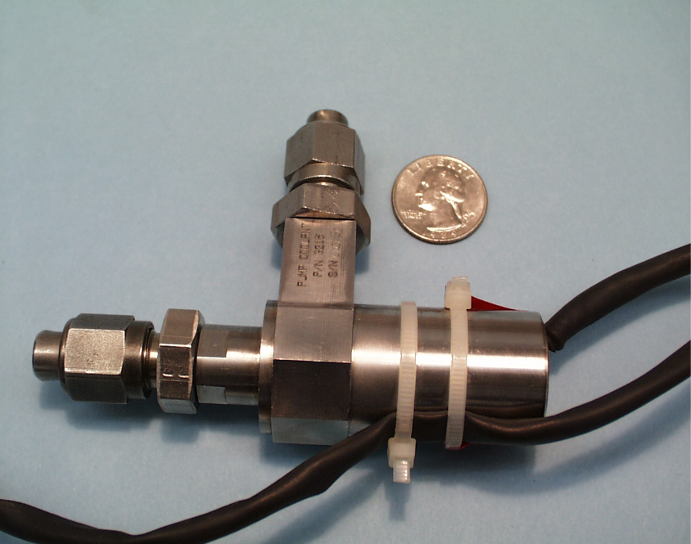
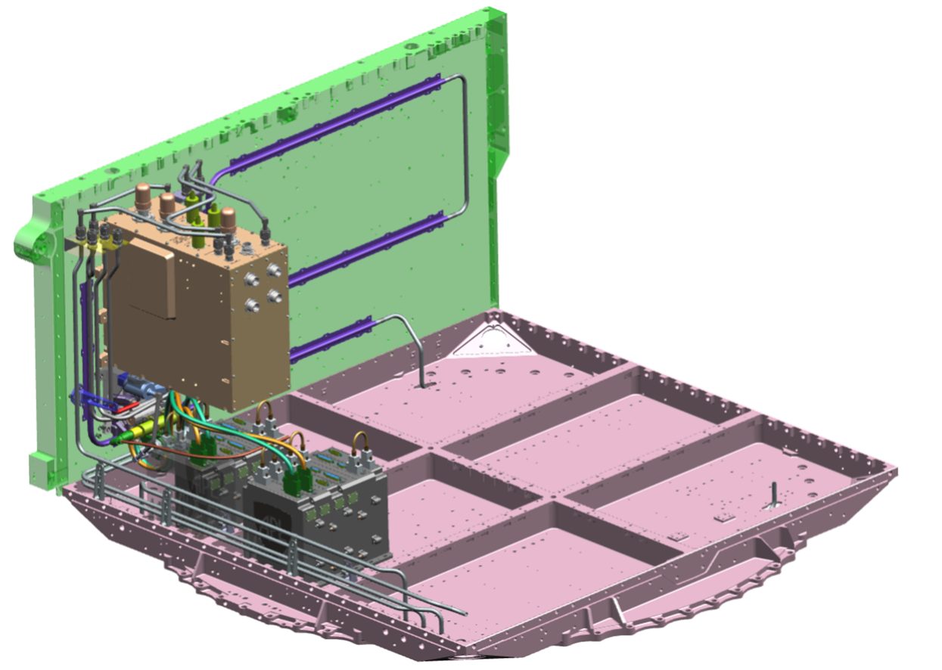
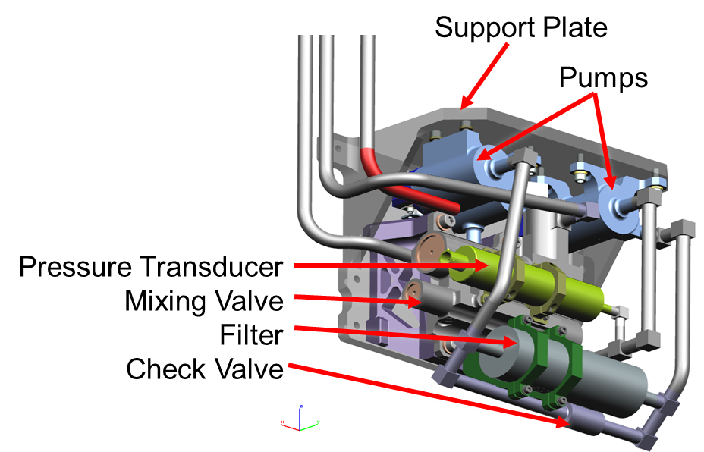
Pump Configuration Update
MSL and M2020 heritage pumps were used for 3 year mission life applications
With Europa Clipper, and a 12 year mission life, an assessment on long term pump operation was done
JPL ground testing experience justifies four year minimum pump life
6 pump architecture: if we lose an entire string, we still likely have 16 years of pump life
1 additional string was added to design during detailed design phase: ECAPA
ECAPA

Slide 16
Summary and Conclusion
Europa Clipper Spacecraft Thermal Design employs active and passive thermal control to deliver an efficient and low power subsystem
HRS system effectively redistributes waste heat from avionics (dissipation inside vault) to the Prop Module
  The RHB adds additional power to the loop in case the vault dissipation is not high enough to balance the heat loss through the PM blankets
  The mixing valve directs hot fluid from the PM to the radiator to reject to space
  Louvers are used to reduce large (constant) heat loss from radiator since not needed in cold case
  All components on the loop are thermally coupled and benefit from large thermal capacitance of the loop
Passive control for non-HRS items:
  Components not on the loop are individually heated
  HGA and sunshades minimize heat absorbed by spacecraft
  MLI (Stamet outer coating) insulates from heat loads at 0.65AU and heat loss at 5.6AU
Key Challenges in Detailed Design phase have been addressed:
  Launch Hot Environment driving scenarios for pump, battery, and solar array
  Pump lifetime considerations led to a reconfiguration in pump packaging
Near term future work:
  Hardware implementation in progress
    Some concerns with heater workmanship
  Confirmation on Launch Vehicle capabilities and detailed trajectory design
  System Thermal Vacuum testing planning
    Key Decisions on inclusion of SA assembly/sub-assembly, boom etc.

Slide 17
Acknowledgements
Anthony Paris
Frank Kelly
Bruce Williams (APL)
AJ Mastropietro
Tyler Schmidt
Razmig Kandilian
Mike Underhill
Collier Miers
Brian Carroll
Emma Nelson
Nickolas Emis
Entire HRS implementation team
Pump electronics team
Jenny Hua
Howard Tseng (GSFC)
EC Team

