Slide 1
Tank Sizing Analysis for the Reduced Gravity Cryogenic Transfer Receiver Tank Erin M. Tesny, Daniel M. Hauser, Jason W. Hartwig NASA Glenn Research Center, Cleveland, OH, USA
TFAWS Cryothermal Paper Session
Presented By Erin Tesny
Thermal & Fluids Analysis Workshop TFAWS 2021 August 24-26, 2021
Virtual Conference

Slide 2
Overview
Tank Chilldown Background
Modeling Overview
Tank descriptions
Charge/Hold/Vent procedure
Results
Conclusions
Future Work

Slide 3
Background
Understanding fluid behavior in microgravity is essential to further development of in-space cryogenic systems
No current published data on tank chilldown in microgravity
Reduced Gravity Cryogenic Transfer (RGCT) project is designed to investigate tank chilldown in a microgravity environment onboard a parabolic flight
1 parabolic flight consists of 25 parabolas, 60s each
Current study: what is appropriate tank size to complete chill down during 1 flight given 3 possible different chilldown scenarios?
Goal is to chill down the tank wall to some target temperature by the end of the flight

Slide 4
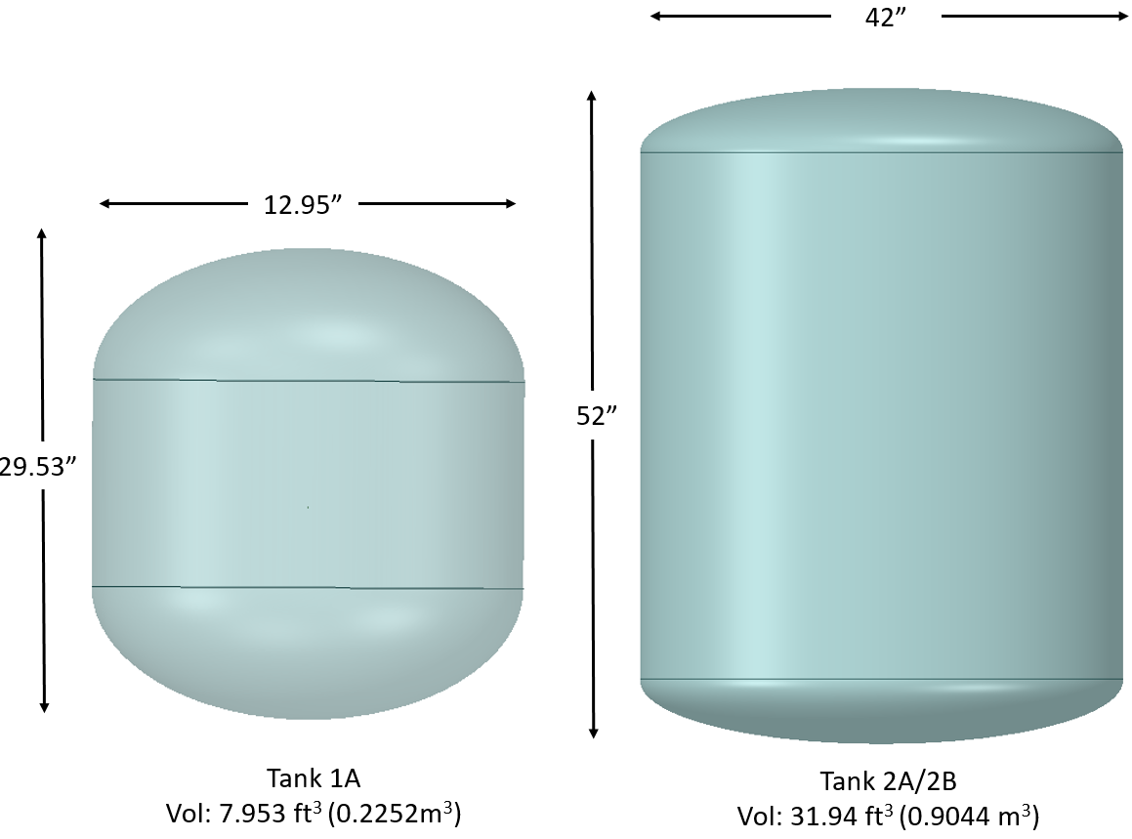
Tank Descriptions
Tank Parameters to investigate:
Small vs. Large Tank Volume
Thin vs. Thick-walled
Tank | Description | Dry Mass (kg) | Internal Volume (m³) | MEOP (psia) | Wall Thickness (in)
1A | Lower Limit | 30.2 | 0.225 | 50 | 3/16”
2A | Upper Limit | 79.0 | 0.904 | 64.3 | 3/16”
2B | Upper Limit, Thick-Walled | 158.2 | 0.904 | 330 | 3/8”

Slide 5
Modeling Approach
Thermal Desktop, multi-node model
Working Fluid: nitrogen
Tank wall material: Aluminum 2219
Fluid in tank is modeled as twin lumps (liquid + vapor)
Bottom fill dip tube injector with top vent
Monitoring liquid temperature, pressure, and average tank wall temperature

Slide 6
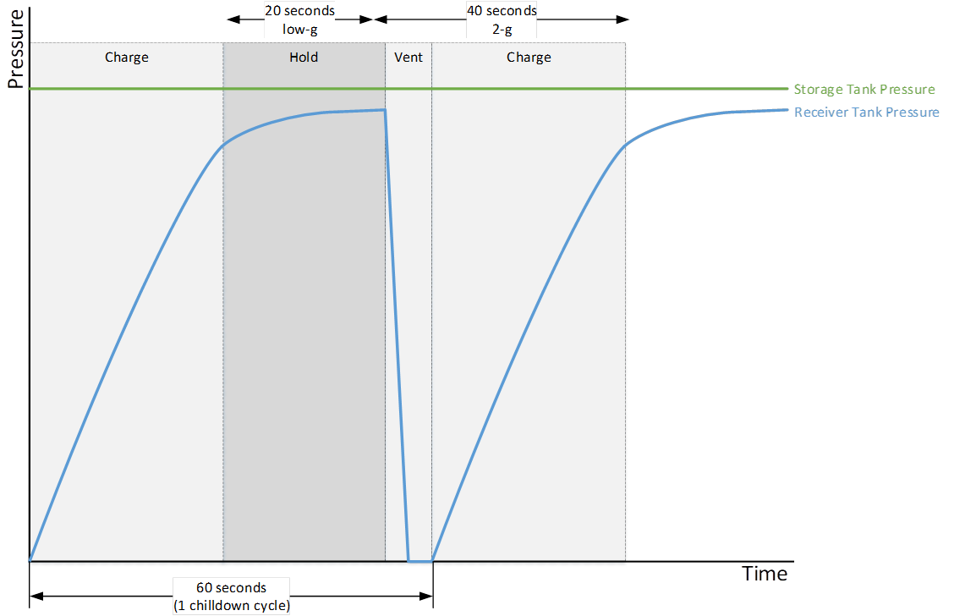
Charge/Hold/Vent Procedure
Charge/Hold/Vent (C/H/V) Chilldown:
Charge: Supply Valve Open/Vent Valve Closed
Hold: Supply Valve Closed/Vent Valve Closed
Vent: Supply Valve Closed/ Vent Valve Open
Pattern is repeated once every 60s (or once per 1 parabola)

Slide 7
Different Chilldown Scenarios
Case No. | Parasitic Heat Load? | Flow Rate (gps) | Operation
1 | No | 100 | Charge: 20s/ Hold: 25s / Vent: 20s
2 | Yes | 100 | Charge: 20s/ Hold: 25s / Vent: 20s
3 | Yes | 50 | Charge: 20s/ Hold: 25s / Vent: 20s
4 | Yes | 100 | Charge: 17s/ Hold: 73s / Vent: 30s

Slide 8
Tank 1A Results

Slide 9
Tank 1A Results (Cont’d)

Slide 10
Tank 1A Results (Cont’d)

Slide 11
Tank 1A Results Summary
 | Propellant Used (kg) | Propellant Vented (kg) | Final Average Wall Temp (K) | Time (s)
Case 2 | 36.5 | 27.3 | 99.0 | 1500
Case 3 | 18.5 | 15.5 | 184.0 | 1500
Case 4 | 21.8 | 15.5 | 167.9 | 1500

Slide 12
Efficiency Parameters
Propellant Efficiency$= \frac{Mass Transfered−Mass Vented}{Mass Transfered}$
Thermal Eff. $=1−\frac{Mass Vented × hvap}{Tank Wall Mass × Specific Heat × Change in Temperature of Tank Wall}$
$$∆T Factor=T_{Wall,final}− T_{sat, inlet}$$

Slide 13
Results: Large vs. Small Tank
Tank | Propellant Efficiency
 |  | Case 3 | Case 4
 | Case 2
1A | 41.5% | 20.6% | 42.3%
2A | 25.2% | 16.2% | 28.9%
Thermal Efficiency
 | Case 3 | Case 4
Case 2
43.8% | 43.3% | 48.0%
61.0% | 60.6% | 65.7%
Delta T Factor (K)
 | Case 3 | Case 4
Case 2
10 | 23.3 | 38.3
21.8 | 106.8 | 80.7
Case 3 has lowest propellant/thermal efficiency for both tanks
Tank 1A has similar propellant thermal/efficiency whereas Tank 2A has significantly higher thermal efficiency
Delta T factor is most important parameter in determining if tank can be successfully filled after chilldown
Tank 1A always has lower Delta T Factor than 2A
Case 2 always has lower Delta T Factor than Case 4

Slide 14
Results: Thin vs. Thick-Walled Tank
Tank | Propellant Efficiency
 |  | Case 3 | Case 4
 | Case 2
2A | 25.2% | 16.2% | 28.9%
2B | 19.4% | 14.0% | 26.2%
Thermal Efficiency
 | Case 3 | Case 4
Case 2
61.0% | 60.6% | 65.7%
62.3% | 61.7% | 67.0%
Delta T Factor (K)
 | Case 3 | Case 4
Case 2
21.8 | 106.8 | 80.7
107.2 | 157.7 | 148.2
Case 3 has again lowest propellant/thermal efficiency for both tanks
Both tanks have similar propellant/thermal efficiencies
Delta T factor is most important parameter in determining if tank can be successfully filled after chilldown
Tank 2A has lower Delta T factor than Tank 2B for all cases

Slide 15
Conclusions
For parabolic flight pattern, the recommended tank size for an elliptical dome tank is closer to the size of Tank 1A (0.225 m³) rather than Tank 2A (0.904 m³)
Thin-walled tank (3/16”) has higher propellant and thermal efficiency than thick-walled tank (3/8”)
Thin-walled tank similar in size to Tank 1A is recommended for parabolic flight chilldown
Case 2 chilldown procedure (Charge: 20s/ Hold: 25s / Vent: 20s with a 100gps flow rate) recommended for this tank size

Slide 16
Future Work
Further narrow down tank size and wall thickness
Test rig size
Maximize efficiency parameters
Use of other injectors besides dip tube for chilldown

