Slide 1

Modeling of Evaporation in Cryogenic Fuels Without Tuning Coefficients
Ayaaz Yasin and Kishan Bellur
August 2024
Thermal and Fluids Analysis Workshop

Slide 2




Motivation: Space Fuel
Deep-space exploration missions … will require storage of cryogens for well over a year. This technical challenge must be overcome if humans are ever to explore destinations beyond the Moon.
$$\dot{m}$$
$$\dot{Q}$$
Propellant storage and transfer is a game-changing technology for a wide range of applications because it enables long-duration, high-thrust, high-ΔV missions for large payloads and crew.
- NASA Space Technology Roadmaps and Priorities
National Research Council. (2012)

Slide 3
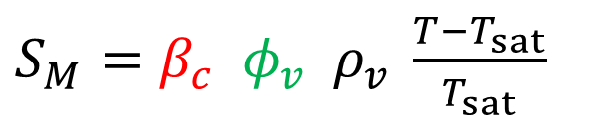
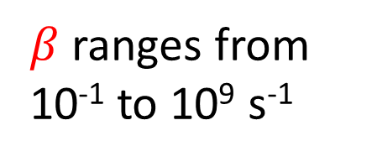
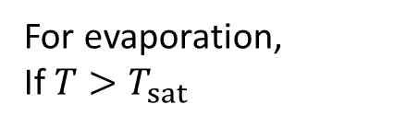
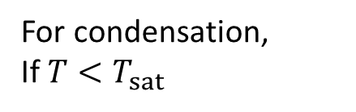
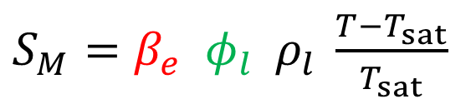
Motivation: Lee’s Model
$S_{M}=β_{c} φ_{v} ρ_{v} \frac{T−T_{sat}}{T_{sat}}$
For condensation,
If $T<T_{sat}$
$β$ ranges from 10⁻¹ to 10⁹ s⁻¹
Tuning Coefficient
Volume Fraction
10 orders of magnitude!
$S_{M}=β_{e} φ_{l} ρ_{l} \frac{T−T_{sat}}{T_{sat}}$
For evaporation,
If $T>T_{sat}$
Lee. Technical Report Los Alamos National Lab. (1979)

Slide 4
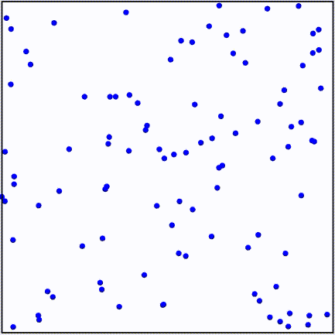
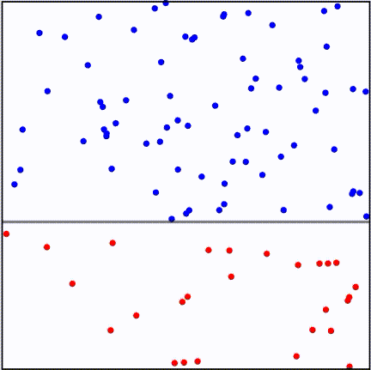
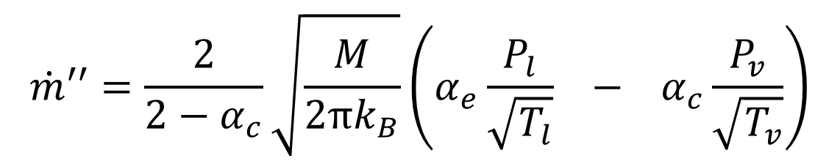
Kinetic Theory of Phase Change
$$\dot{m}′′=\frac{2}{2−α_{c}}\sqrt{\frac{M}{2πk_{B}}}\left(α_{e}\frac{P_{l}}{\sqrt{T_{l}}} − α_{c}\frac{P_{v}}{\sqrt{T_{v}}}\right)$$
Vapor
evaporation
condensation
Interface
Saturated Liquid
Hertz. Ann. Phys. (1882)
Knudsen. Ann. Phys. (1915)
Schrage. (1953)

Slide 5
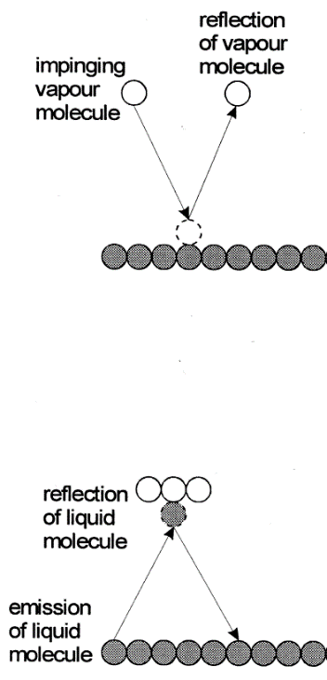
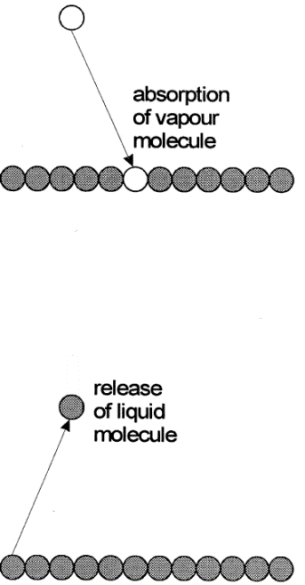
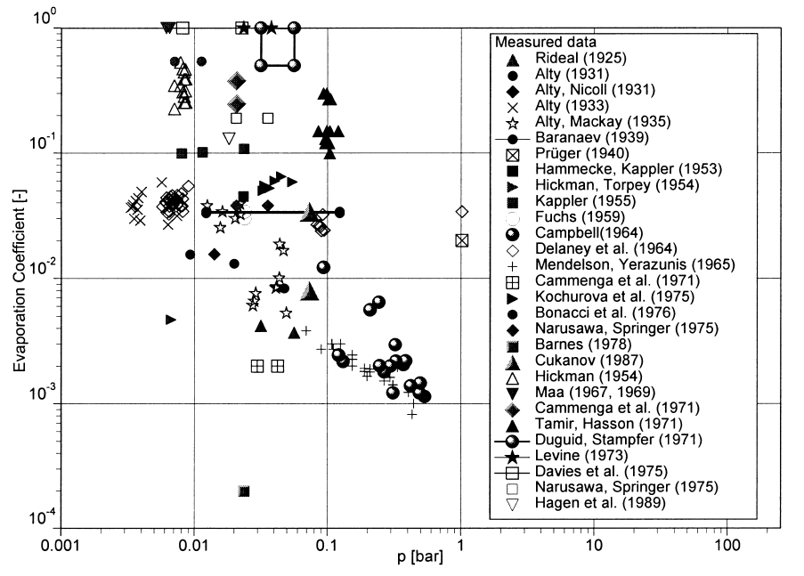
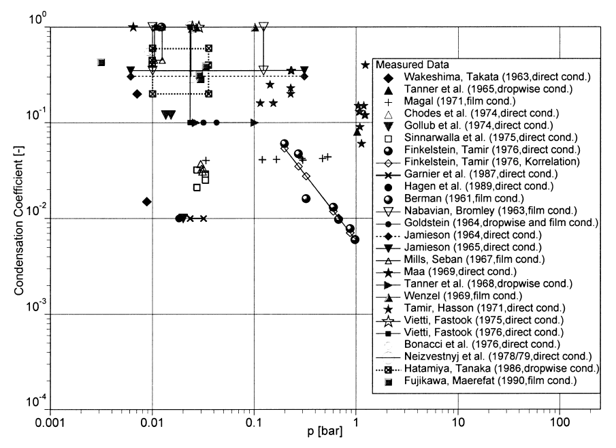
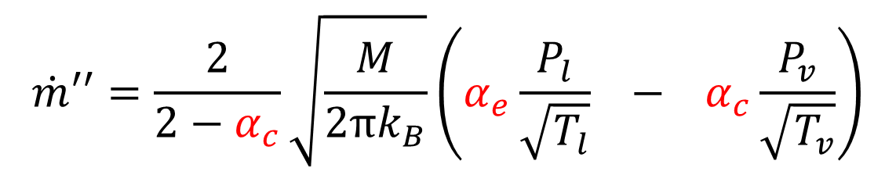

Accommodation Coefficient(s)
$$\dot{m}′′=\frac{2}{2−α_{c}}\sqrt{\frac{M}{2πk_{B}}}\left(α_{e}\frac{P_{l}}{\sqrt{T_{l}}} − α_{c}\frac{P_{v}}{\sqrt{T_{v}}}\right)$$
Evaporation Coefficient (-)
Condensation Coefficient (-)
Pressure [bar]
$$α_{e}=α_{c} ?$$
Pressure [bar]
Schrage. (1953)
Marek and Straub. Int. J. Heat Mass Trans. (2001)

Slide 6
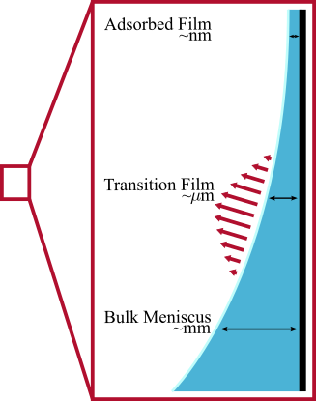
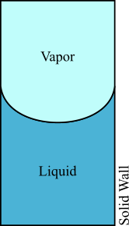
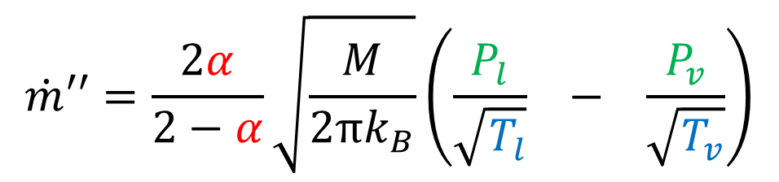
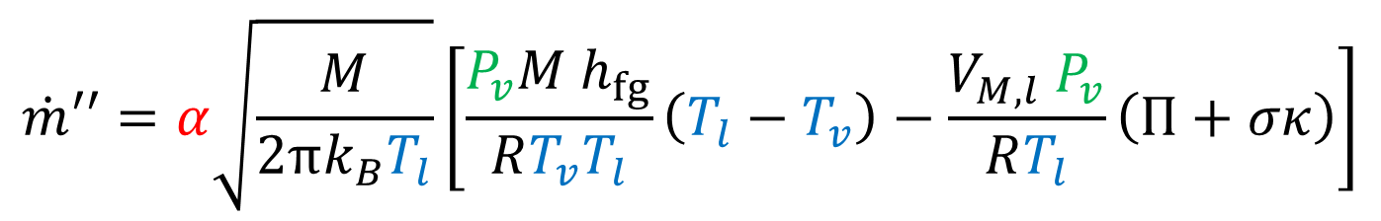
Curved Interfaces
$$\dot{m}′′=\frac{2α}{2−α}\sqrt{\frac{M}{2πk_{B}}}\left(\frac{P_{l}}{\sqrt{T_{l}}} − \frac{P_{v}}{\sqrt{T_{v}}}\right)$$
Schrage
Planar Interfaces
evaporation
condensation
disjoining pressure
surface tension
interface
curvature
$$\dot{m}′′=α\sqrt{\frac{M}{2πk_{B}T_{l}}}\left[\frac{P_{v}M h_{fg}}{RT_{v}T_{l}}\left(T_{l}−T_{v}\right)−\frac{V_{M, l} P_{v}}{RT_{l}}\left(Π+σκ\right)\right]$$
Wayner
Curved Interfaces
temperature contribution
pressure contribution
Schrage. (1953)
Wayner. Colloids Surf. (1991)

Slide 7
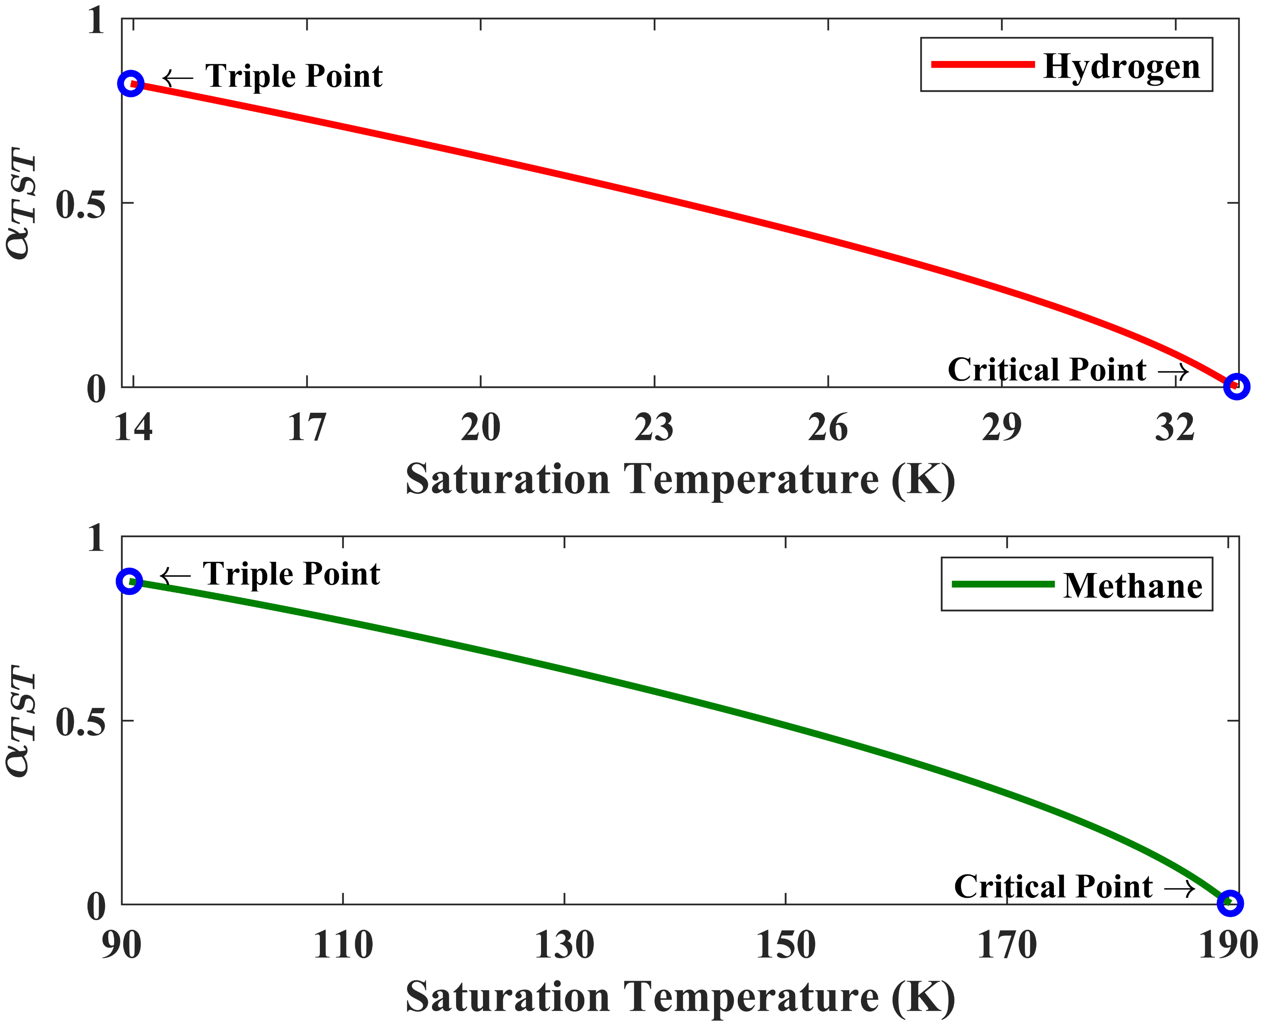
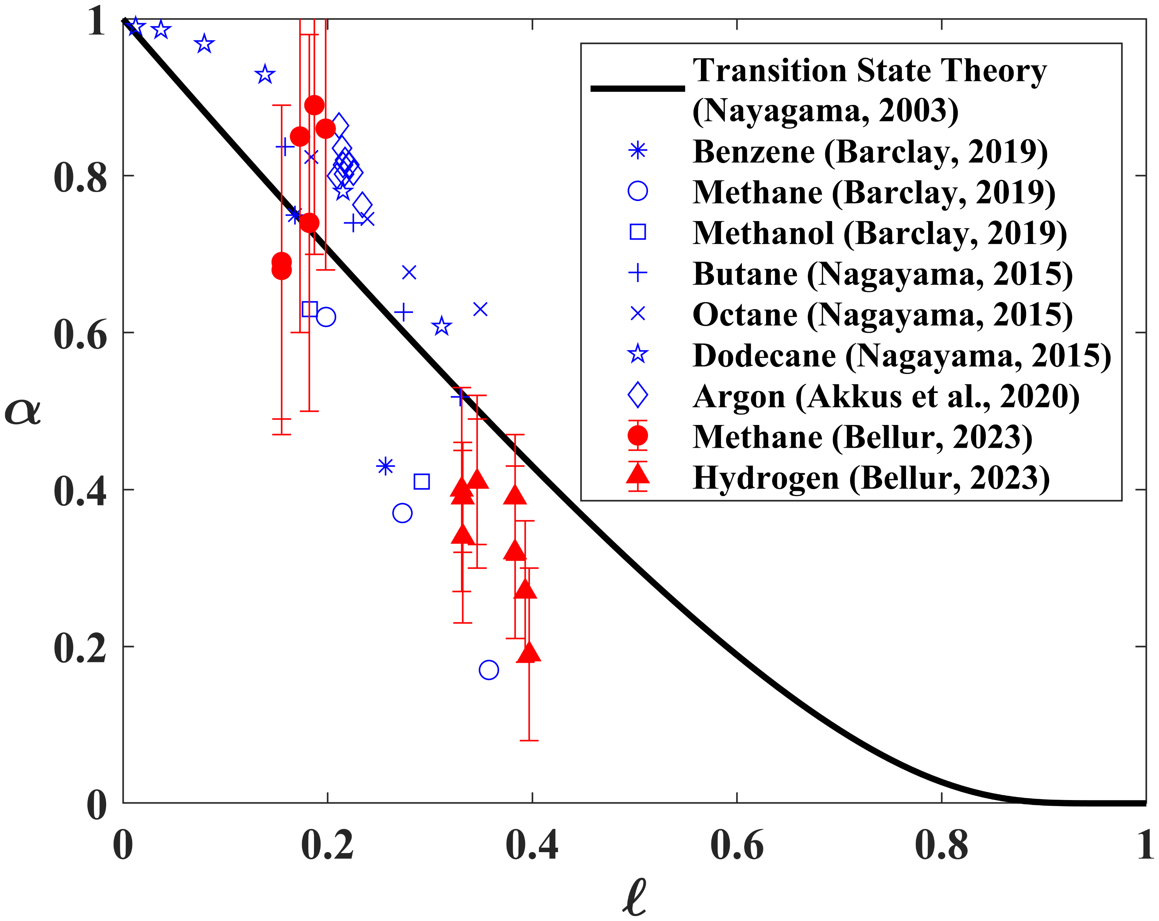

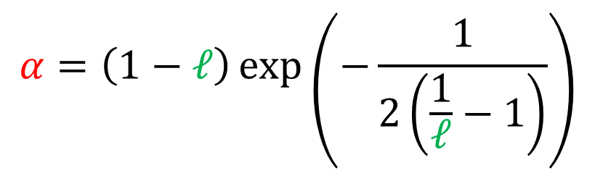

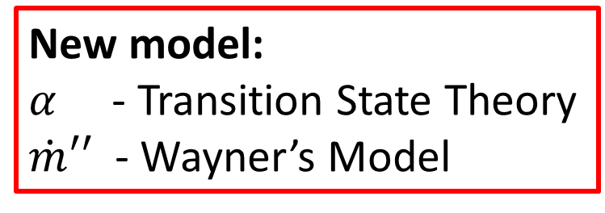


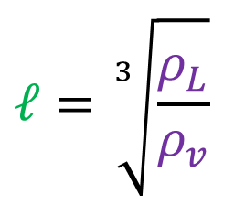
Transition State Theory
$$α=\left(1−ℓ\right)\exp\left(−\frac{1}{2\left(\frac{1}{ℓ}−1\right)}\right)$$
$$α$$
$$ℓ=\sqrt[3]{\frac{ρ_{L}}{ρ_{v}}}$$
$$α$$
$$α$$
Molecular Dynamics
Experiments
New model:
$α$ - Transition State Theory
$\dot{m}′′$ - Wayner’s Model
$$ℓ$$
Nagayama and Tsuruta. J. Chem. Phys. (2003)

Slide 8
How do we validate the new model?

Slide 9
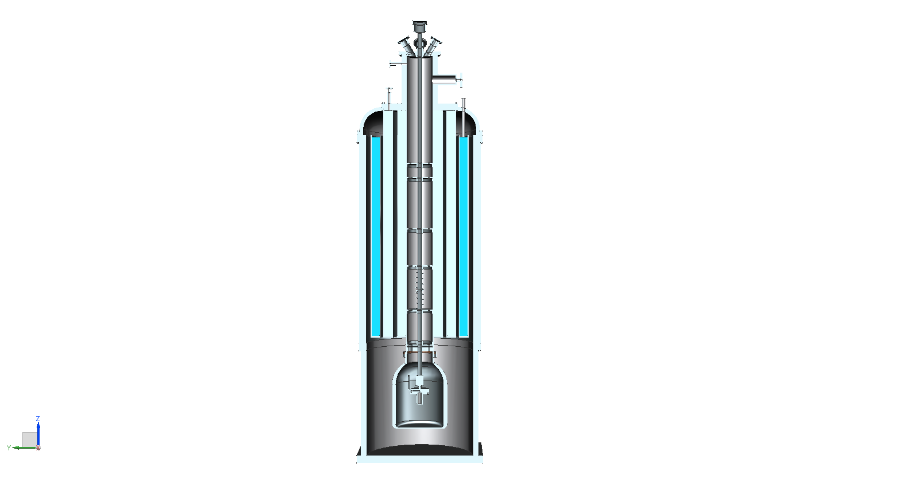
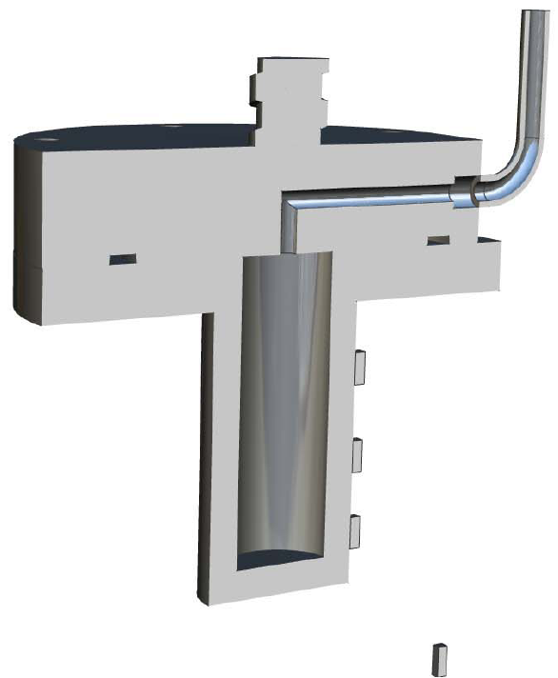
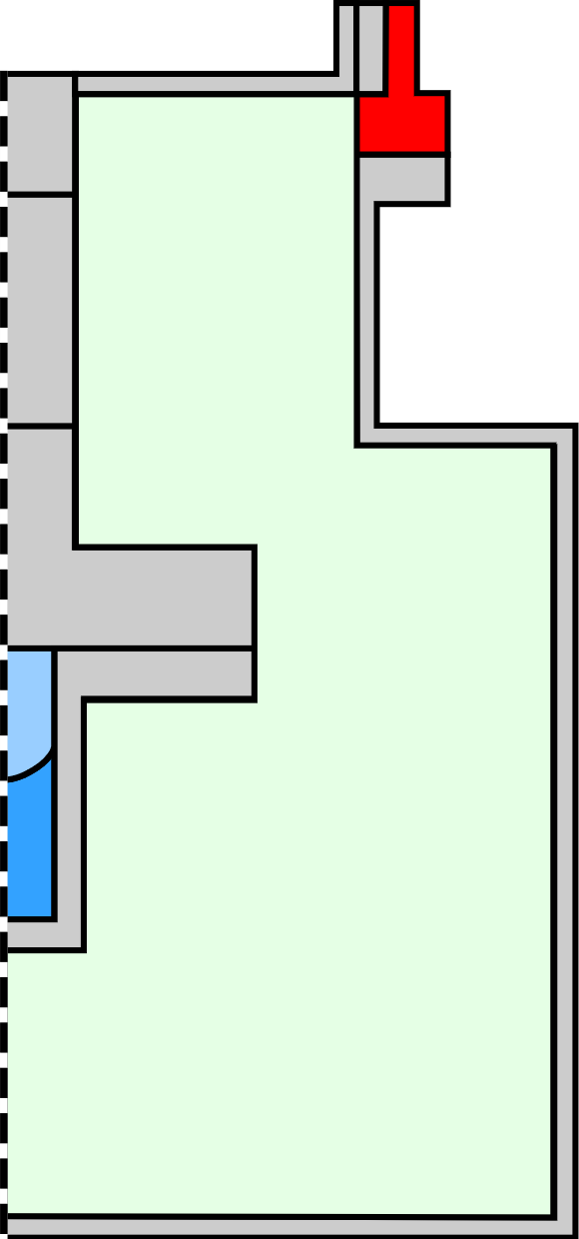
Cryo-Neutron Experiments
Test cell
Wall
Baffle
Heater
Holder
Sensor
Flange
Hydrogen/
Methane
Test Cell
Helium Bath
Bellur et al. Cryogenics. (2022)

Slide 10
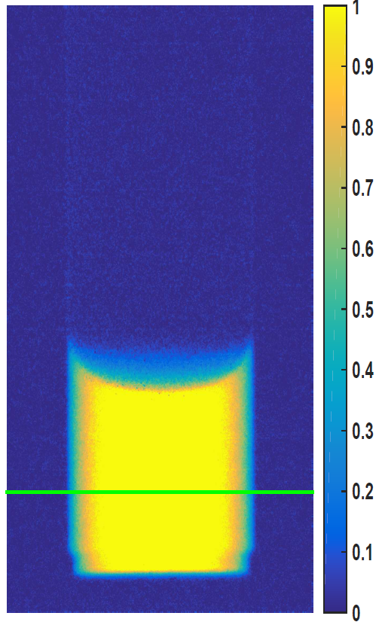
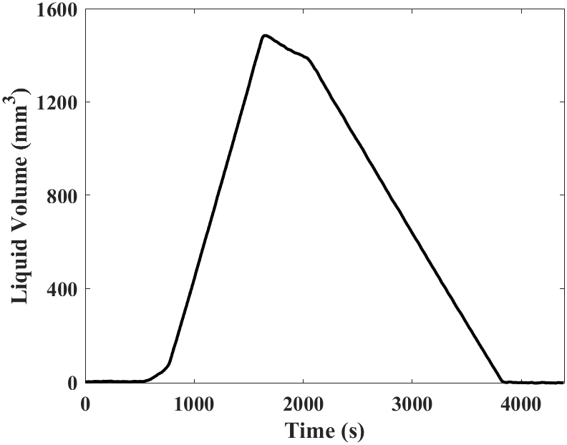
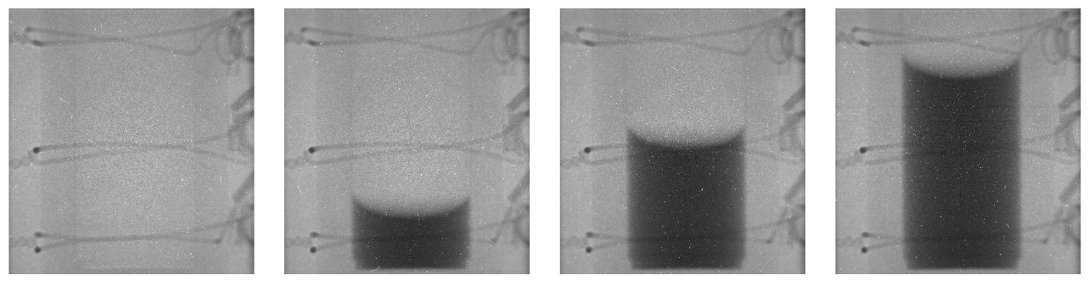
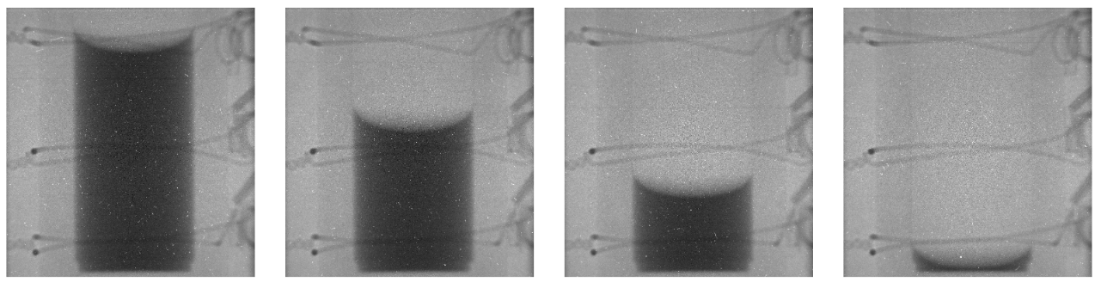
Cryo-Neutron Experiments
Test cell
Heater
Condensation
Hydrogen/
Methane
Helium Bath
Evaporation
Bellur et al. Cryogenics. (2022)
Bellur et al. J. Flow Vis. Image Pro. (2016)

Slide 11
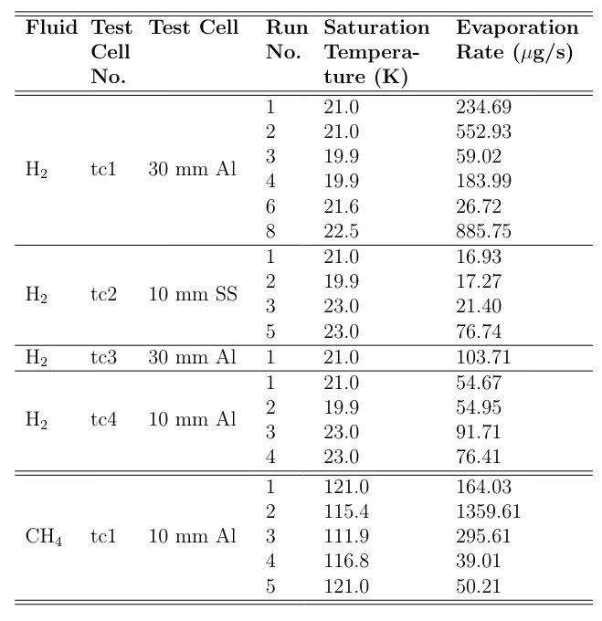
Cryo-Neutron Experiments
Randomly
Selected for Validation
Bellur et al. Data in Brief. (2022)

Slide 12

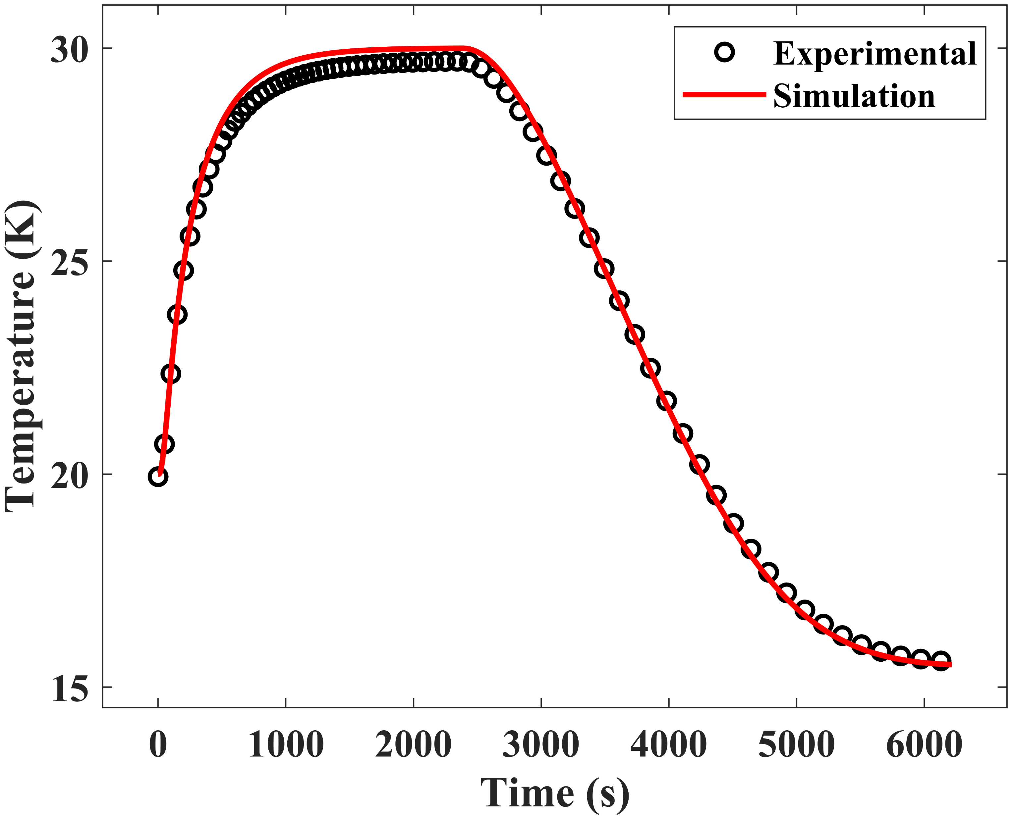
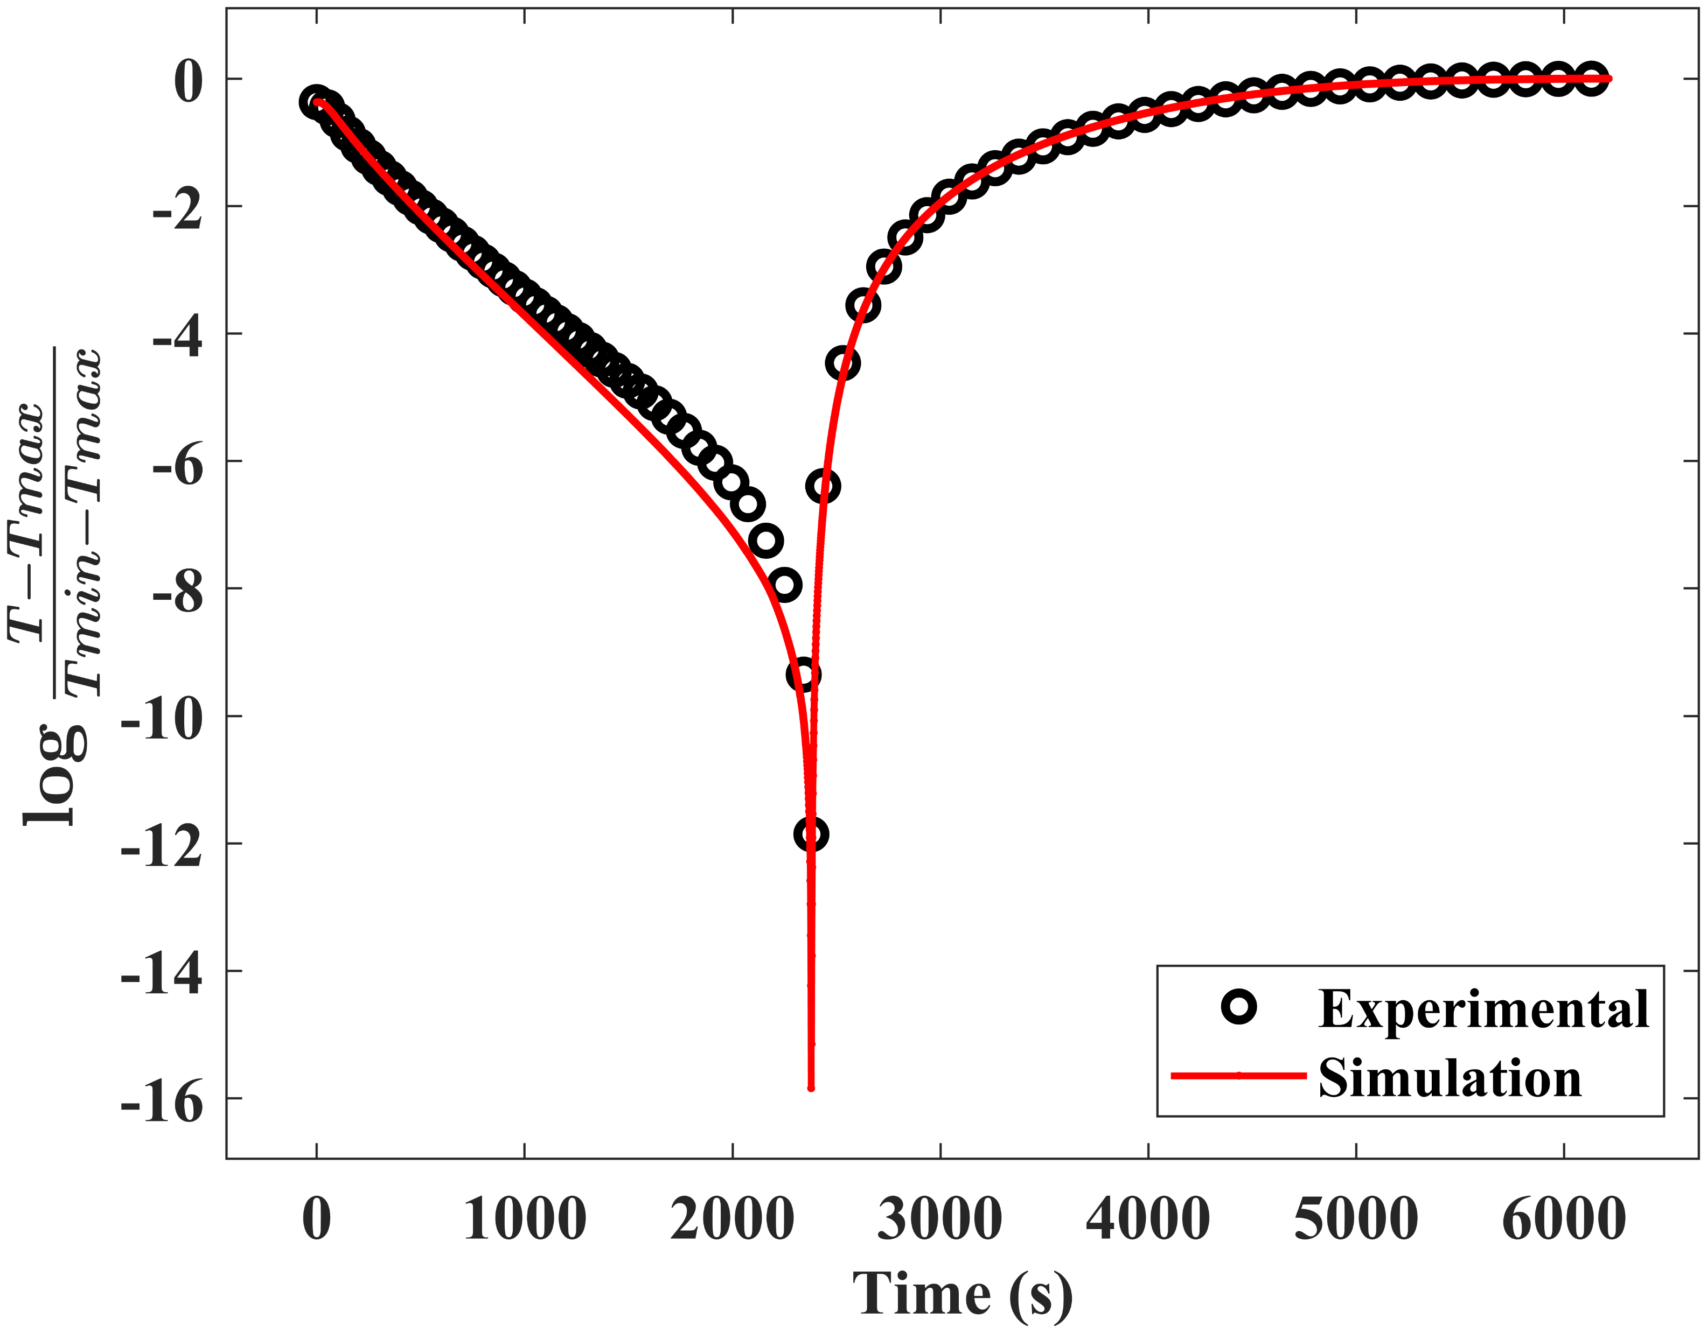

Computational Setup: Dry Test Simulations
Heater
Bellur et al. Cryogenics. (2018)

Slide 13


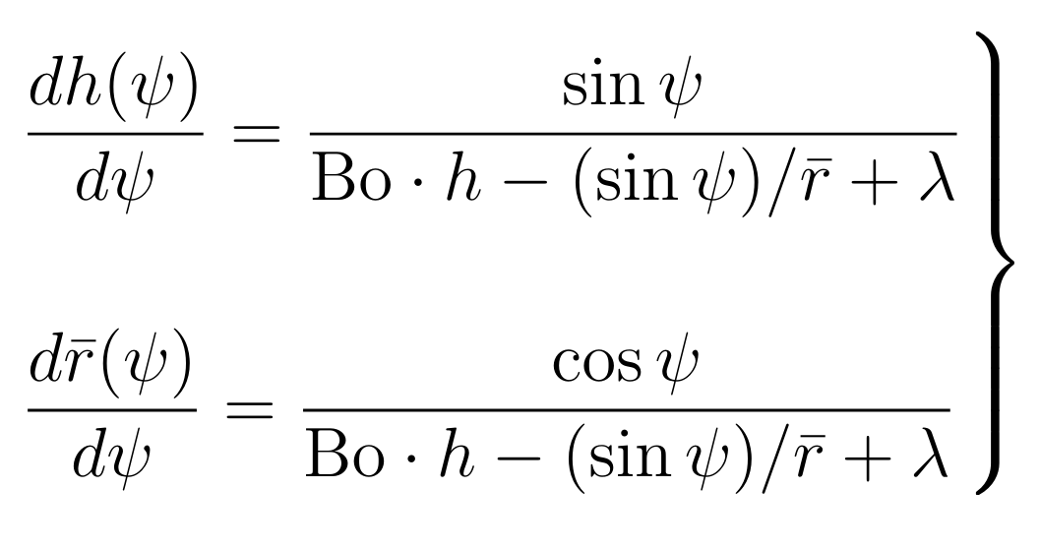
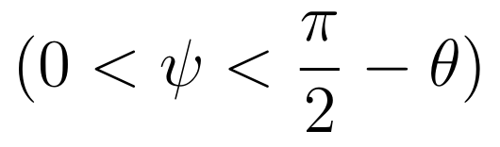
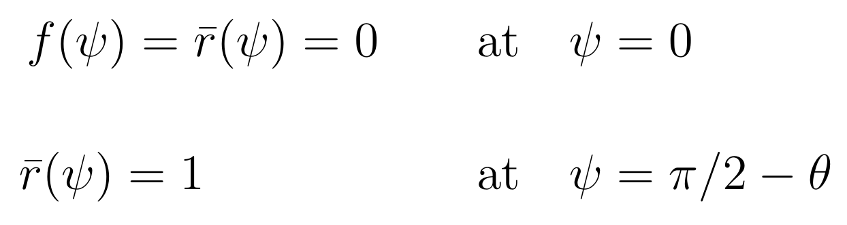
Computational Setup: Meniscus Shape
Heater
Cutoff
10 µm
Hydrogen/
Methane
Boundary Conditions
Helium Bath
Concus. J. Fluid Mech. (1968)
Bellur et al. J. Flow Vis. Image Pro. (2016)

Slide 14
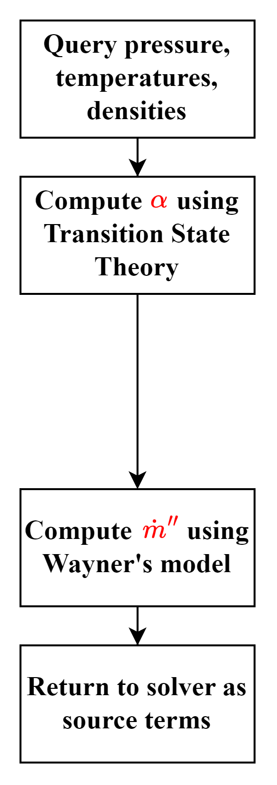
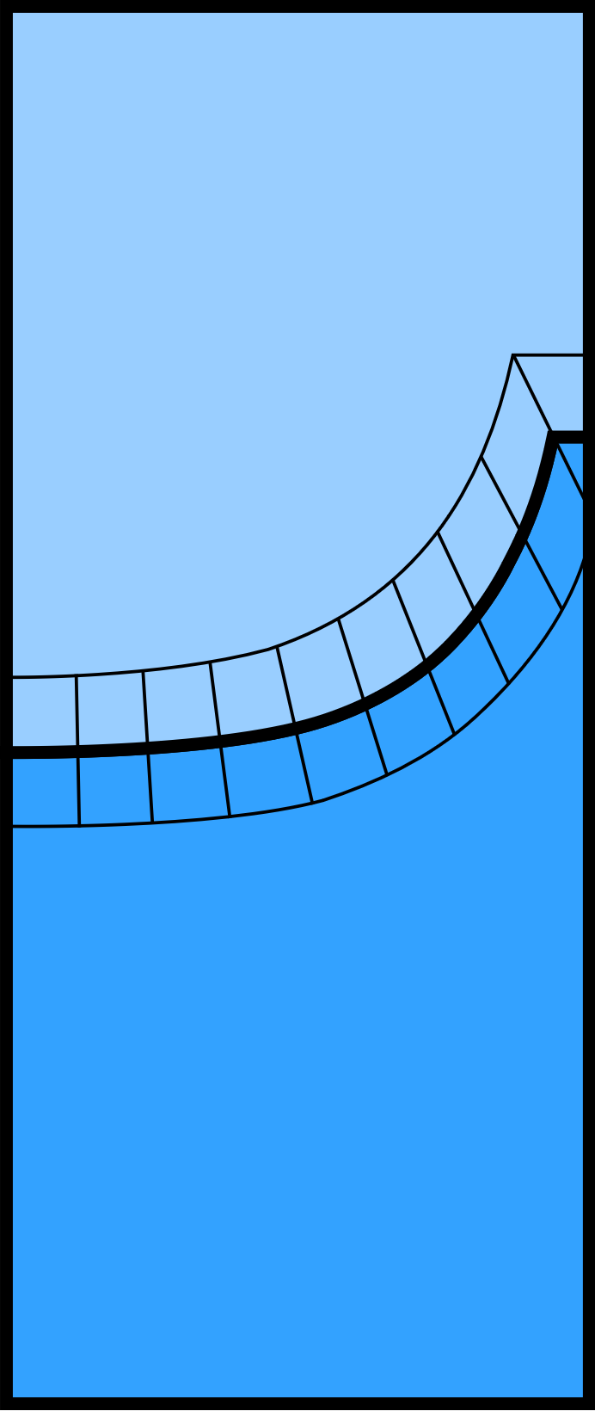
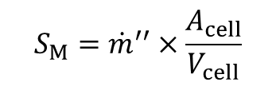




Computational Routine
$$V_{cell}$$
Heater
$$A_{cell}$$
20 µm mesh cells
Mass source
$$S_{M}={\dot{m}}^{′′}×\frac{A_{cell}}{V_{cell}}$$
Hydrogen/
Methane
Latent heat sink
$$S_{LH}=h_{fg}×S_{M}$$
Helium Bath
Heat balance
$$S_{HB}=−S_{M}⋅c_{p}⋅\left(T_{ref}−T_{sat}\right)$$

Slide 15
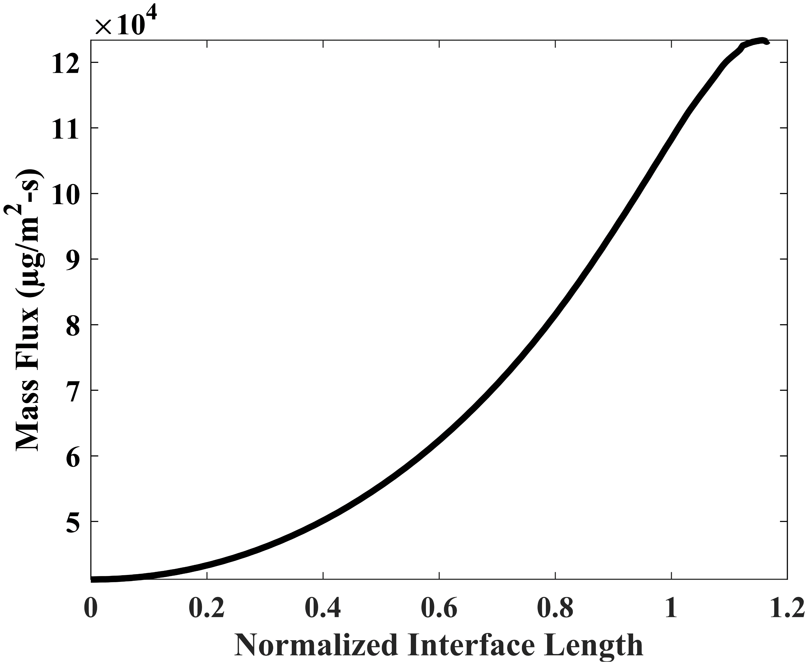
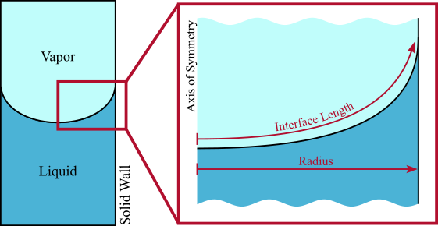
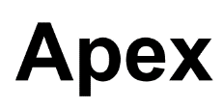
Results

Slide 16
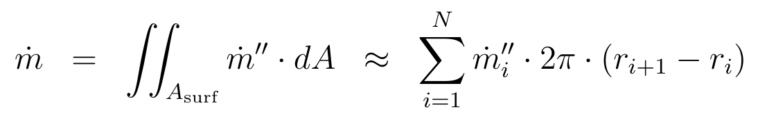
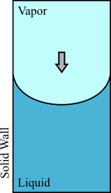
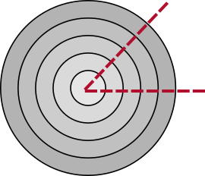
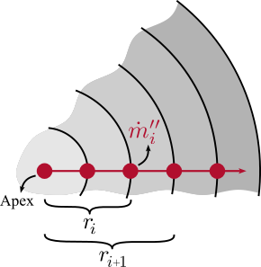
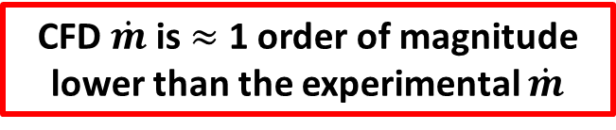
Analysis: Surface Integration
CFD $\dot{m}$ is $≈$ 1 order of magnitude lower than the experimental $\dot{m}$

Slide 17
disjoining pressure
surface tension
interface
curvature
$$\dot{m}′′=α\sqrt{\frac{M}{2πk_{B}T_{l}}}\left[\frac{P_{v}M h_{fg}}{RT_{v}T_{l}}\left(T_{l}−T_{v}\right)−\frac{V_{M, l} P_{v}}{RT_{l}}\left(Π+σκ\right)\right]$$
Wayner
Curved Interfaces
temperature contribution
pressure contribution
Wayner. Colloids Surf. (1991)

Slide 18
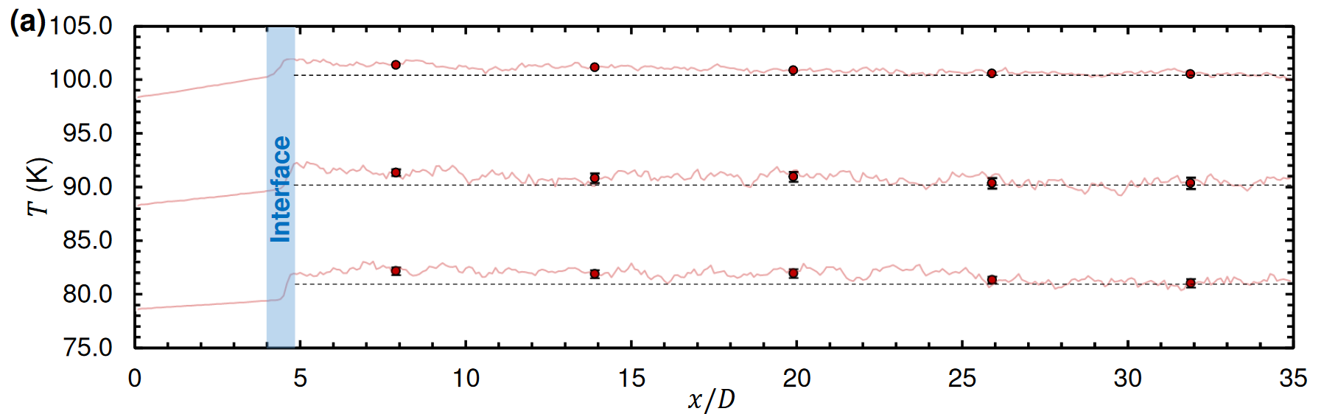
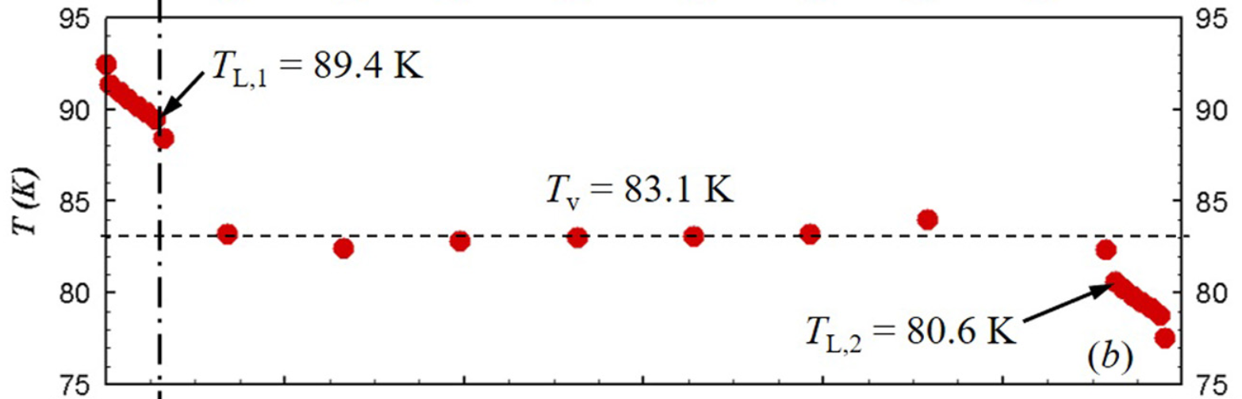

Sub-grid Vapor Temperature
1 mean free path
Condensation
Condensation
Evaporation
Akkus et al. Nanosc. Microsc. Therm. (2020)
Liang et al. Int. J. Heat Mass Trans. (2017)

Slide 19
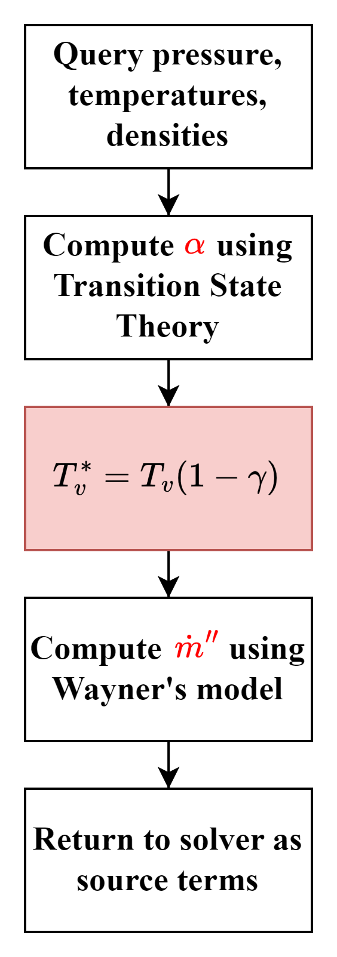
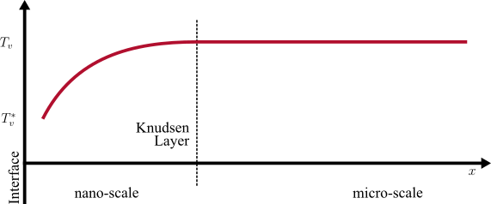
Computational Routine: Introducing $γ$

Slide 20

Results: Tuning $γ$

Slide 21
But is $γ$ predictable?

Slide 22

Results: Predicting $γ$

Slide 23

Results: Predicting $γ$

Slide 24

Results: Predicting $γ$

Slide 25

Results: Predicting $γ$

Slide 26





Conclusion
Wayner
$$\dot{m}′′=α\sqrt{\frac{M}{2π k_{B }T_{l}}}\left[\frac{P_{v}M h_{fg}}{RT_{v}\left(1−γ\right)T_{l}}\left(T_{l}−T_{v}\left(1−γ\right)\right)−\frac{V_{M, l}{ P}_{v}}{RT_{l }}\left(Π+σκ\right)\right]$$
Gamma
$$γ=a⋅\frac{{\dot{m}}^{′′}}{M} + b$$
$$a=2.0155×{10}^{−3}$$
$$b=8.6555×{10}^{−5}$$
Wayner. Colloids Surf. (1991)

Slide 27

Validation

Slide 28

Validation

Slide 29


Summary
Future Work
A kinetic-theory-based coefficient-free CFD model of evaporation is proposed.
The model is shown to be numerically stable.
New parameter $γ$ is introduced to predict interfacial vapor temperature.
$γ$ is shown to be predictable.
Include a thin-film model.
Find $γ$ relation for condensation.
Expand the CFD setup to be compatible with interface capturing methods.

Slide 30
Questions/Comments?
Ayaaz Yasin
yasinaz@mail.uc.edu
Kishan Bellur
bellurkn@ucmail.uc.edu

Slide 31
Appendix Slides

Slide 32



Hertz-Knudsen-Schrage
Hertz (1882)
Derived from Kinetic Theory, based of experiments with Mercury.
$$\dot{m}′′=\sqrt{\frac{M}{2πk_{B}}}\left(\frac{P_{l}}{\sqrt{T_{l}}} − \frac{P_{v}}{\sqrt{T_{v}}}\right)$$
Knudsen (1915)
Added accommodation coefficients to account for over-prediction of mass flux.
$$\dot{m}′′=\sqrt{\frac{M}{2πk_{B}}}\left(α_{e}\frac{P_{l}}{\sqrt{T_{l}}} − α_{c}\frac{P_{v}}{\sqrt{T_{v}}}\right)$$
Schrage (1953)
Accounted from macroscopic drift in vapor molecules.
$$\dot{m}′′=\frac{2}{2−α_{c}}\sqrt{\frac{M}{2πk_{B}}}\left(α_{e}\frac{P_{l}}{\sqrt{T_{l}}} − α_{c}\frac{P_{v}}{\sqrt{T_{v}}}\right)$$
Hertz. Ann. Phys. (1882)
Knudsen. Ann. Phys. (1915)
Schrage. (1953)

Slide 33



Mass Flux Sensitivity to $γ$
$$\dot{m}′′=α\sqrt{\frac{M}{2π k_{B }T_{l}}}\left[\frac{P_{v}M h_{fg}}{RT_{v}\left(1−γ\right)T_{l}}\left(T_{l}−T_{v}\left(1−γ\right)\right)−\frac{V_{M, l}{ P}_{v}}{RT_{l }}\left(Π+σκ\right)\right]$$

Slide 34

Capillary and Disjoining Pressures
Ball. (2012)

Slide 35



Test Cell Dimensions
H2 test cell 2 - 10 mm SS
H2 test cell 4 - 10 mm Al
CH4 test cell 1 - 10 mm Al
H2 test cell 1 - 30 mm Al
H2 test cell 3 - 30 mm Al

Slide 36



Solution to Concus’ ODEs
Initial Conditions $f\left(ψ\right)=\overline{r}\left(ψ\right)=0 at ψ=0$
Boundary Conditions $\overline{r}\left(ψ\right)=1 at ψ=\frac{π}{2}−θ$
$$λ_{n+1}=λ_{n}−\frac{r−1}{∂r/∂λ_{n}}$$
$$Bo=\frac{ρ g L^{2}}{σ}$$
surface
tension
Concus. J. Fluid Mech. (1968)
Bellur et al. J. Flow Vis. Image Pro. (2016)

Slide 37



Issues with Phase Change Modeling
$$\dot{m}′′=\frac{2}{2−α_{c}}\sqrt{\frac{M}{2πk_{B}}}\left(α_{e}\frac{P_{L}}{\sqrt{T_{L}}}−α_{c}\frac{P_{v}}{\sqrt{T_{v}}}\right)$$
$$α_{c}$$
Condensation
$$α_{e}$$
Evaporation
Marek and Straub. Int. J. Heat Mass Trans. (2001)

Slide 38








Determining Coefficients
Start
Guess
$T_{i}$, $α_{c}$, $β$
$$β=\frac{α_{e}}{α_{c}}$$
$$\dot{m}′′$$
No
$α$, $β$
Converged?
Yes
End
$β =0.986$
$α_{c}=0.760$
From Transition State Theory
$α_{c}=$0.779
Chakrabarti and Bellur. (2023). [unpublished]

Slide 39

Domain Validation
4
3
2
1

Slide 40


Experimental Data
Bellur et al. Data in Brief. (2022)

Slide 41



Young-Laplace Equation
Augmented
Young-Laplace Equation
surface
tension
mean surface curvature
disjoining
pressure
$$P_{v}−P_{l}=2⋅σ⋅H=P_{cap}$$
$$P_{v}−P_{l}=P_{cap}+Π$$
capillary pressure
$$P_{v}−P_{l}=σ⋅\left(\frac{1}{R_{1}}+\frac{1}{R_{2}}\right)$$
radii of curvature

Slide 42


Slide 43


Slide 44


Slide 45



Slide 46


Slide 47


