Slide 1
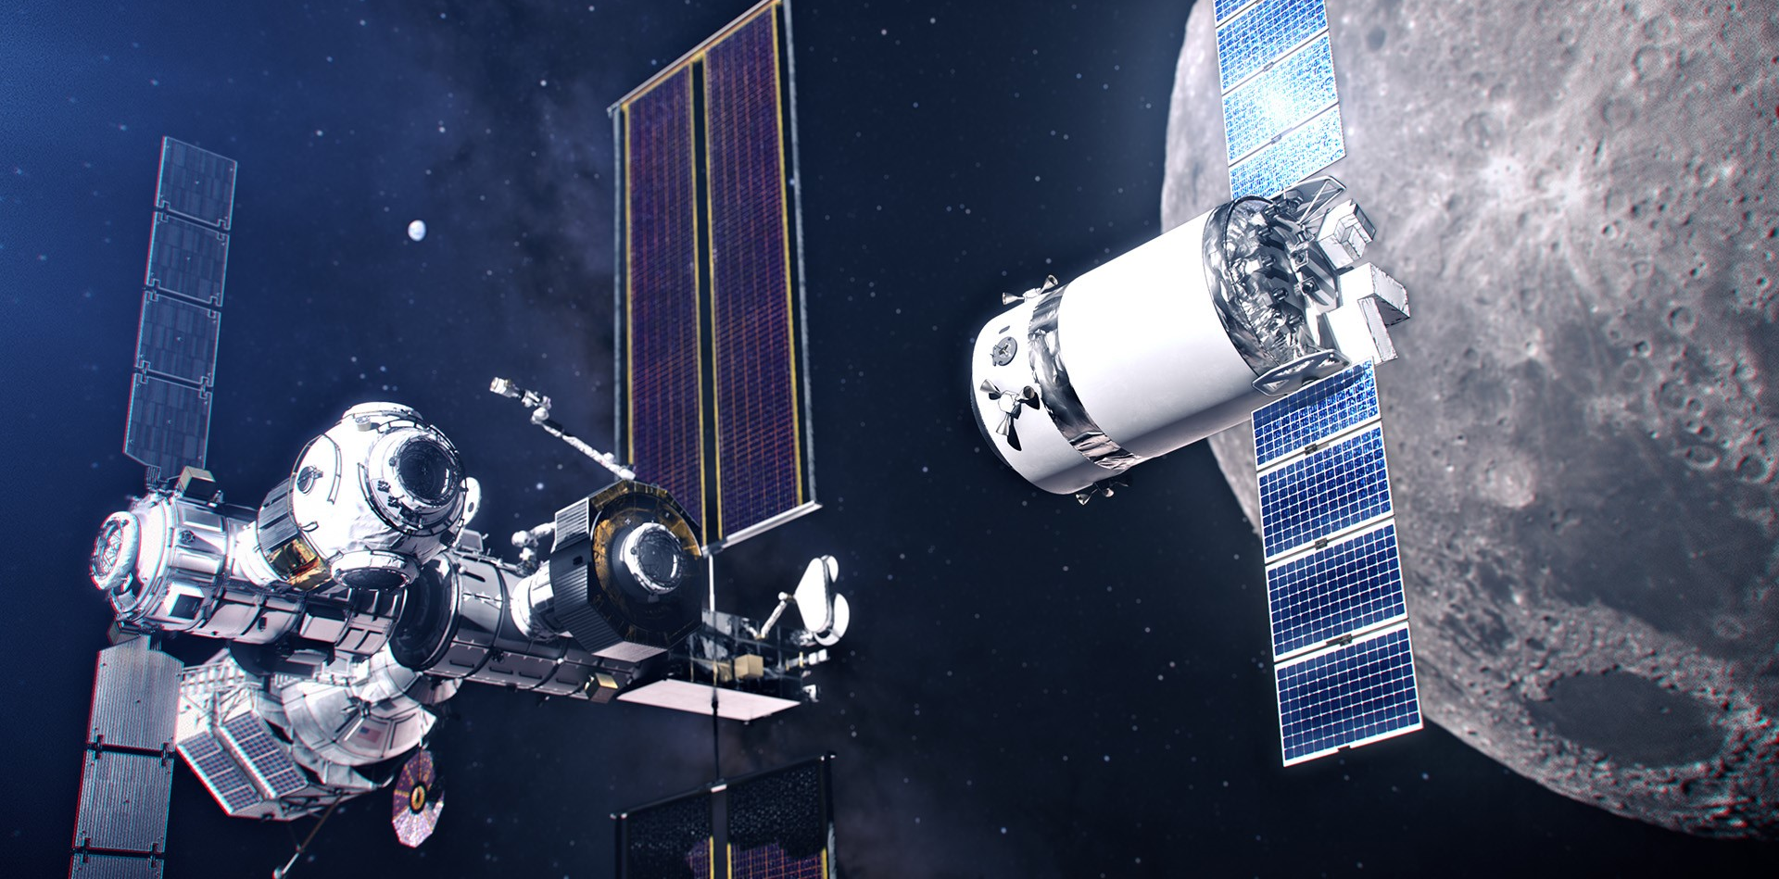
Hydrophobicity of Cryogenic Fluids for Fuel Transfer in Space Applications
Martin Rosales
Eduardo J. Bidot-Lopez
Matthew Wittal
Intern, NASA Deep Space Logistics
Intern, NASA Deep Space Logistics
GN&C Engineer, NASA Deep Space Logistics

Slide 2
Background and Motivation
Fuel flow is important for rocket performance
Increasing fuel flow can increase performance/efficiency
Inducing a hydrophobic surface on the interior surfaces of the fuel tanks/fuel lines
Reduces friction
Increases flow rate

Slide 3
Cryogenics
Behavior of materials at very low temperatures
~<-100°C
Space is inherently cryogenic
Cryogenic fluids are commonly used as spacecraft fuel
Usually diatomic
Nonpolar

Slide 4
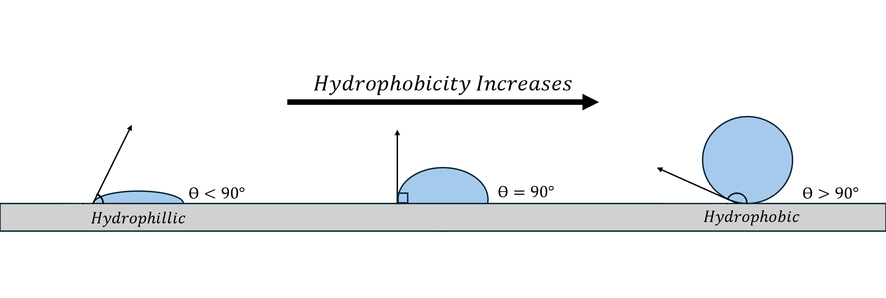
Hydrophobicity

Slide 5
Methods of Hydrophobicity
Physical
Surface quality
Can be applied to various materials and/or surfaces
Chemical
Polarity
Opposite polarities repel, being “hydrophobic”
Inherent property of substances
Repels

Slide 6
Assumptions
Determine hydrophobic properties at cryogenic temperatures
Etched wafer testing
Preliminary chemical coating testing
Determine if chemical hydrophobicity remains constant with different states of matter
Determine if this hydrophobicity remains constant at cryogenic temperatures

Slide 7
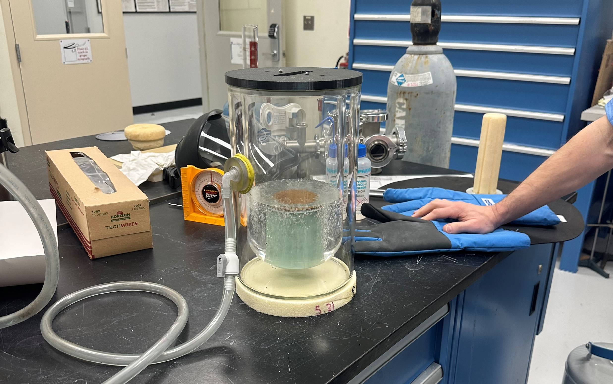
Testing Apparatus

Slide 8
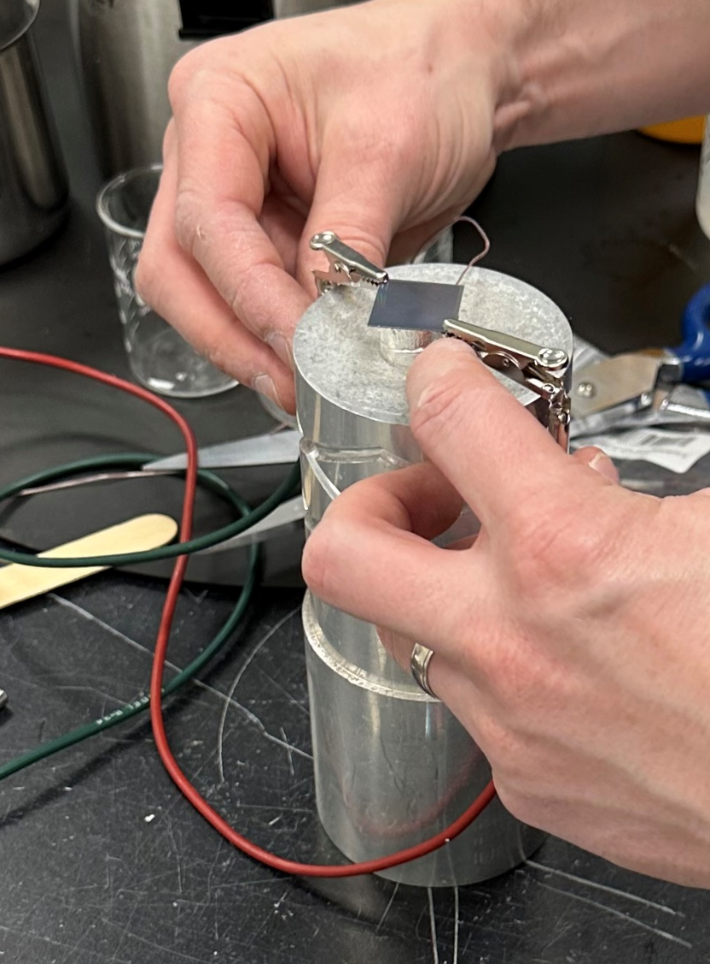
Testing Procedures
Pour over cryogenic fluid to reduce the temperature of the wafer
Allow for the boil off to expose wafer
Wafer should be the same temperature as the cryogenic fluid
Use dropper and drop cryogenic fluid on wafer (at cryogenic temperatures)

Slide 9
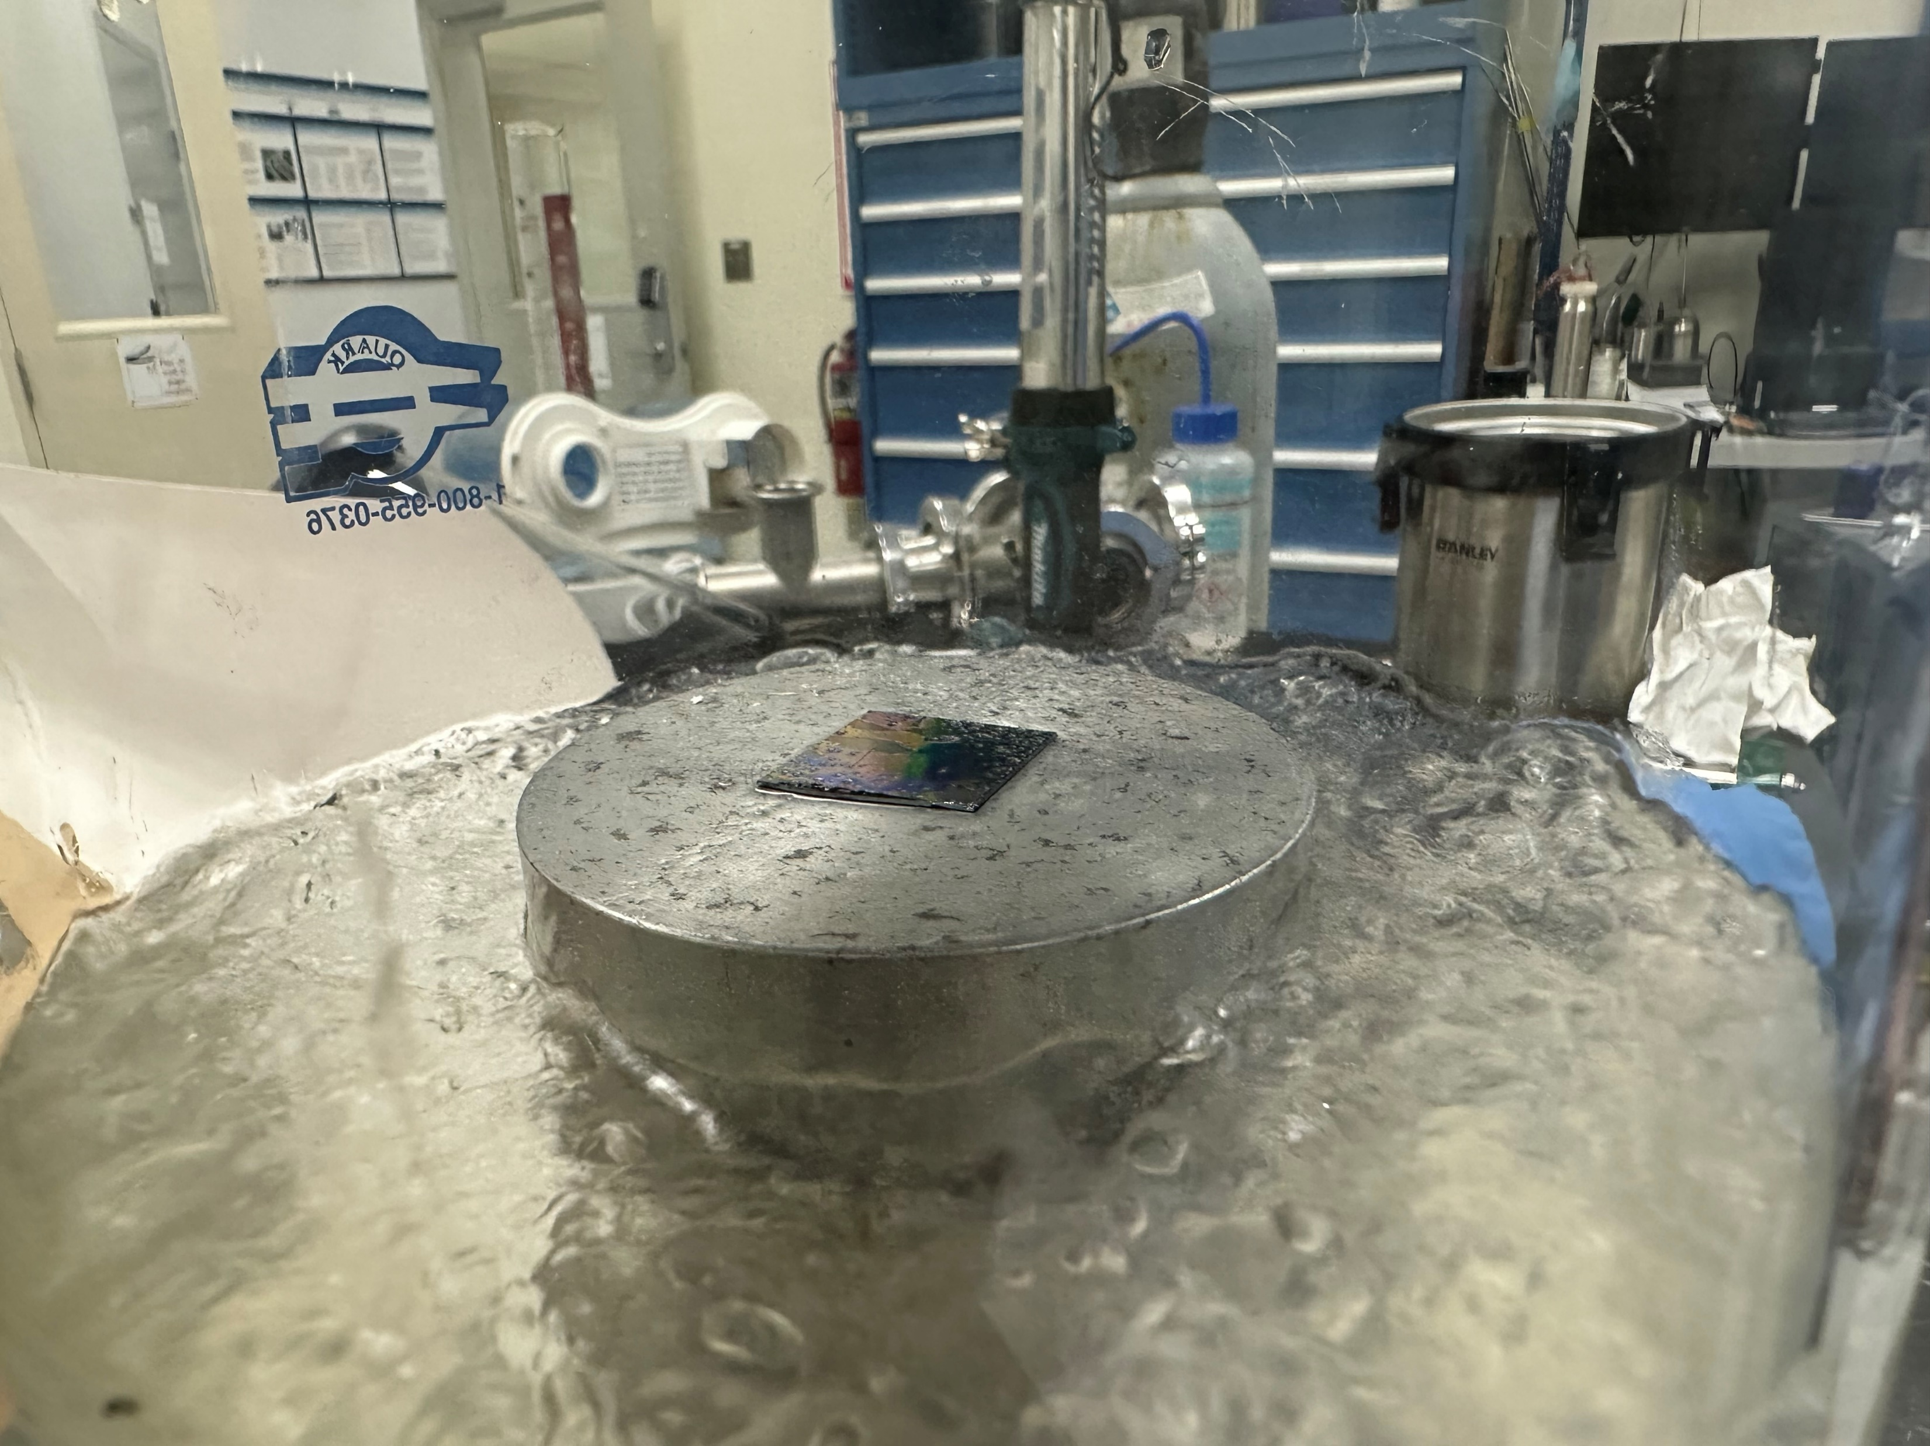
Etched Wafer Testing Results
Tested LN2 & LAr
LAr > LN2
Other cryogenic fluids pose unique issues
LH2
LOx
Minimal wetting angle
Mostly hydrophilic

Slide 10
Preliminary Chemical Results
Solid nonpolar substance, liquid polar substance
Tested at room temperature
Extremely hydrophobic
Hydrophobic properties remained constant with different states of matter

Slide 11
Discussions
Etched wafer still has promise, depends on properties of the etch
Depth
Width
Pattern
Chemical has greater promise
Solid lipid and water used
Polar repels nonpolar regardless of state of matter
Lithium stearate

Slide 12
Future Work
Etched Wafer
Alternate etching patterns
Alternate materials
Chemical testing
Advancing chemical testing to lithium stearate and cryogenic fluids
Coat surface with lithium stearate and replicate etched wafer testing procedures
Alternate coatings
Induced Current
An alternating current across the surface could induce hydrophobicity

Slide 13
Thank you! Questions?
Contact:
Martin M. B. Rosales | Matthew Wittal
martinmbrosales@gmail.com | matthew.m.wittal@nasa.gov
Key References:
J. Narbutt, “Chapter 4 - fundamentals of solvent extraction of metal ions,” in Liquid-Phase Extraction (C. F. Poole, ed.), Handbooks in Separation Science, pp. 121–155, Elsevier, 2020.
A. Y. Vorobyev and C. Guo, “Multifunctional surfaces produced by femtosecond laser pulses,” Journal of Applied Physics, vol. 117, p. 033103, 01 2015.
P. P. Madeira, G. Todorov, V. N. Uversky, and B. Y. Zaslavsky, “Solvent polarity and hydrophobicity of solutes are two sides of the same coin,” Biochemical and Biophysical Research Communications, vol. 701, p. 149600, 2024.
B. Zohuri, “Chapter 1 - cryogenic technologies,” in Physics of Cryogenics (B. Zohuri, ed.), pp. 1–51, Elsevier, 2018.
G. Klesse, S. J. Tucker, and M. S. P. Sansom, “Electric field induced wetting of a hydrophobic gate in a model nanopore based on the 5-ht3 receptor channel,” ACS Nano, vol. 14, no. 8, pp. 10480–10491, 2020. PMID: 32673478.

