Slide 1


Validation of Computational Fluid Dynamics Model for Pressurized Expulsion of Liquid Methane using Non-Condensable Pressurant
Nelson Longmire, GRC/LTF [HX5, LLC]
Dan Hauser, GRC/LTF
TFAWS Cryogenics Paper Session
Presented By
Nelson Longmire
Thermal & Fluids Analysis Workshop
TFAWS 2024
August 26-30, 2024
NASA Glenn Research Center
Cleveland, OH

Slide 2
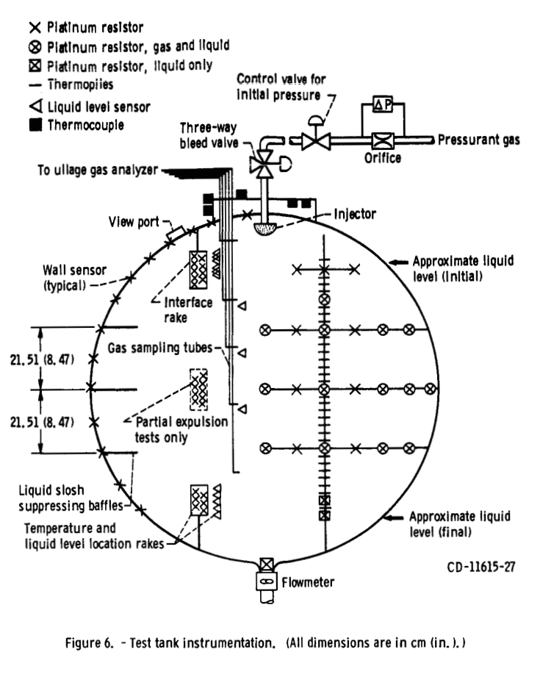
K-site pressurized expulsion of LCH4
  Tests were conducted which liquid methane is expelled from a 1.52 m diameter spherical aluminum tank while pressurant is added to the top of the tank to keep the tank at a certain pressure
  Different species of pressurant were tested
    Helium, hydrogen, and methane
  Tested with a static tank and while shaking the tank to induce slosh
  Tank included wall temperature sensors, a rake of temperature sensors inside of the tank, and 5 gas sampling tubes
  The focus of this study was to simulate cases using helium as the pressurant gas to validate the non-condensable gas model in commercial CFD solver Flow3D

Slide 3
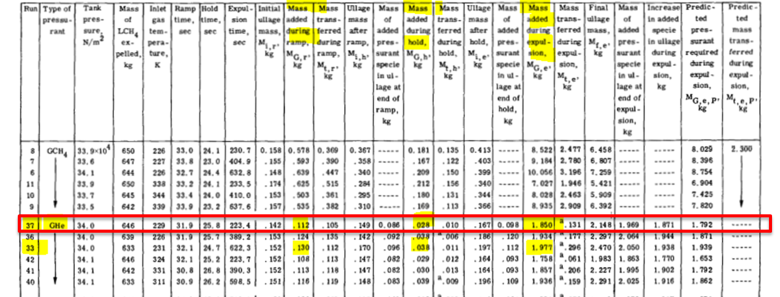
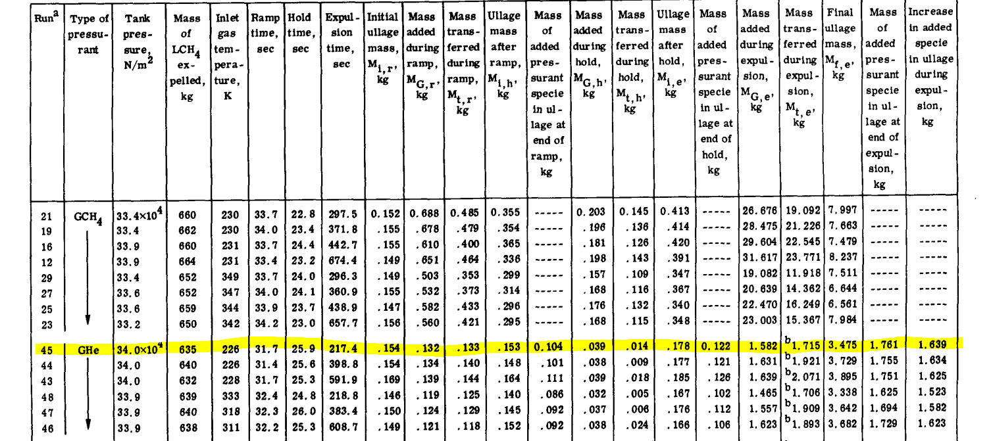
K-site liquid methane expulsion tests
Used Flow3D to simulate run 37 (static expulsion and run 45 (sloshing expulsion)
Expulsion of LCH4 at 112.5 K
Helium was used as the pressurant gas
Simulated ramp and expulsion portions of experiments (skipped hold portion)
Compared amount of pressurant added during expulsion, wall temperatures, ullage temperatures, and ullage concentration at the end of expulsion

Slide 4
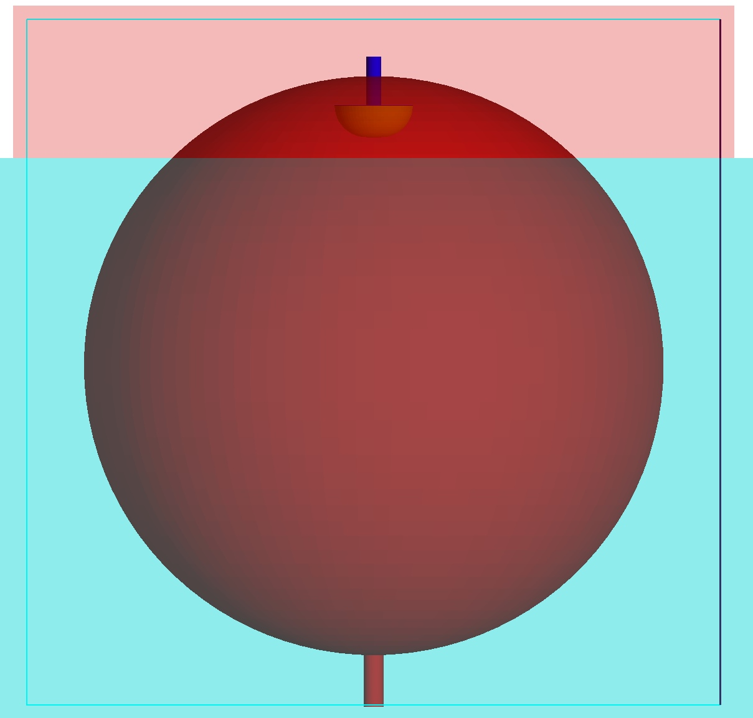
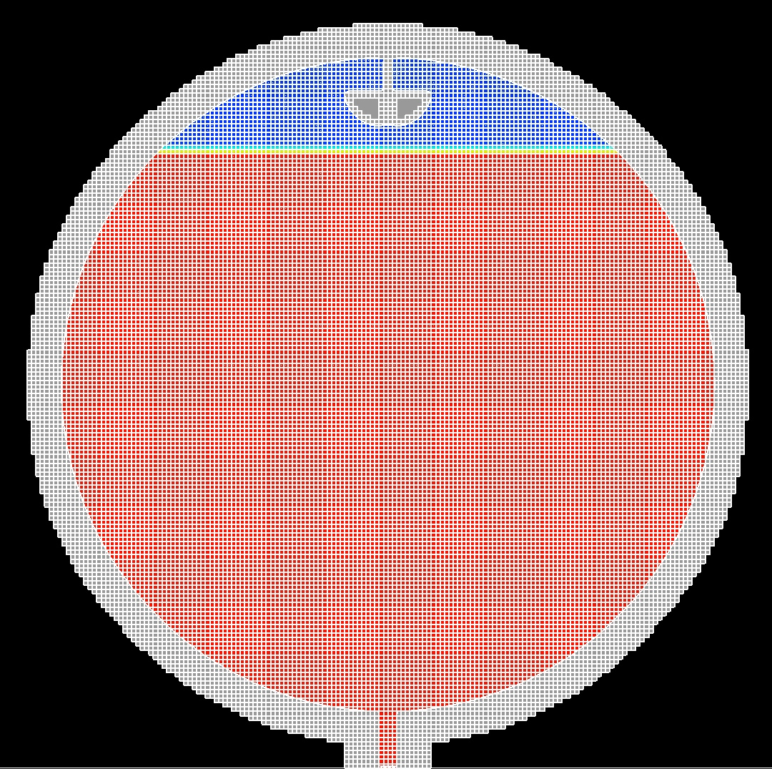


CFD geometry
A 3D CAD model of the k-site tank was imported into Flow3D (1.52 m spherical tank)
Diffuser was modeled as a hemisphere at the top of the tank
  Defined as a mass source that added He pressurant at 226 K to keep tank pressure at 3.4 bar for the extent of the expulsion
Tank had no baffles for the runs that were examined
Cell size of 0.01 m was used (5.7 million cells)
Tank walls in the experiment were 7.62 mm but due to the split cell meshing Flow3D uses it would be impossible to efficiently mesh that wall thickness
  Instead, a wall thickness of 76.2 mm was used but the total thermal mass of the experimental walls was matched in the simulation by scaling the heat capacity of the wall using a ration between the experimental wall thickness and the scaled wall thickness
Diffuser
Outlet
$$c_{p,w,scaled}=\frac{c_{p,w}}{C}$$
$$C=\frac{t_{w,scaled}}{t_{w}}$$

Slide 5
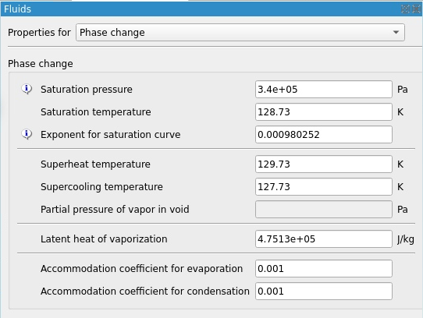
CFD set up
Used commercial CFD code Flow3D
3D VOF solver
K-w turbulence model
Included surface tension
  Contact angle: 1 degree
Included heat and mass transfer
  Accommodation coefficient: 1e-3
Used Flow3D non-condensable gas model to model helium pressurant
Assumptions:
  Used constant liquid fluid properties (LCH4 at 112.5 K)
  Used compressible ideal gas for ullage
  The walls had constant Aluminum 2219 properties at Tsat (128.73 K)
  At start of the ramp the ullage and wall temps were initialized at Tsat
  Flow rate of diffuser was unknown, so diffuser was set to have a flow rate of 0.009 kg/s and was turned off and on to keep pressure at target pressure of 3.4 bar

Slide 6
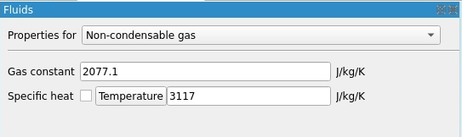

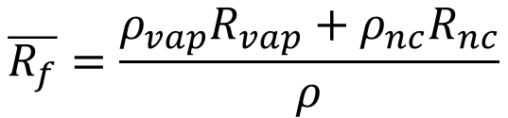
Flow3D non-condensable gas model
Flow3D has a non condensable gas model which allows the gaseous phase to be a mixture of vapor and non-condensable gas
  In this case, the vapor is methane, and the non-condensable gas is helium
The mixture gas constant is calculated as a density weighted average of the gas constants of the vapor and the non-condensable gas
Then the pressure is computed using that mixture gas constant
A specific heat is specified for both the non-condensable gas and vapor
However, a singular viscosity and thermal conductivity is set for the non-condensable and vapor
  These properties can vary by temperature but not mixture
$$\overline{R_{f}}=\frac{ρ_{vap}R_{vap}+ρ_{nc}R_{nc}}{ρ}$$
$$P=\overline{R_{f}}ρT$$

Slide 7
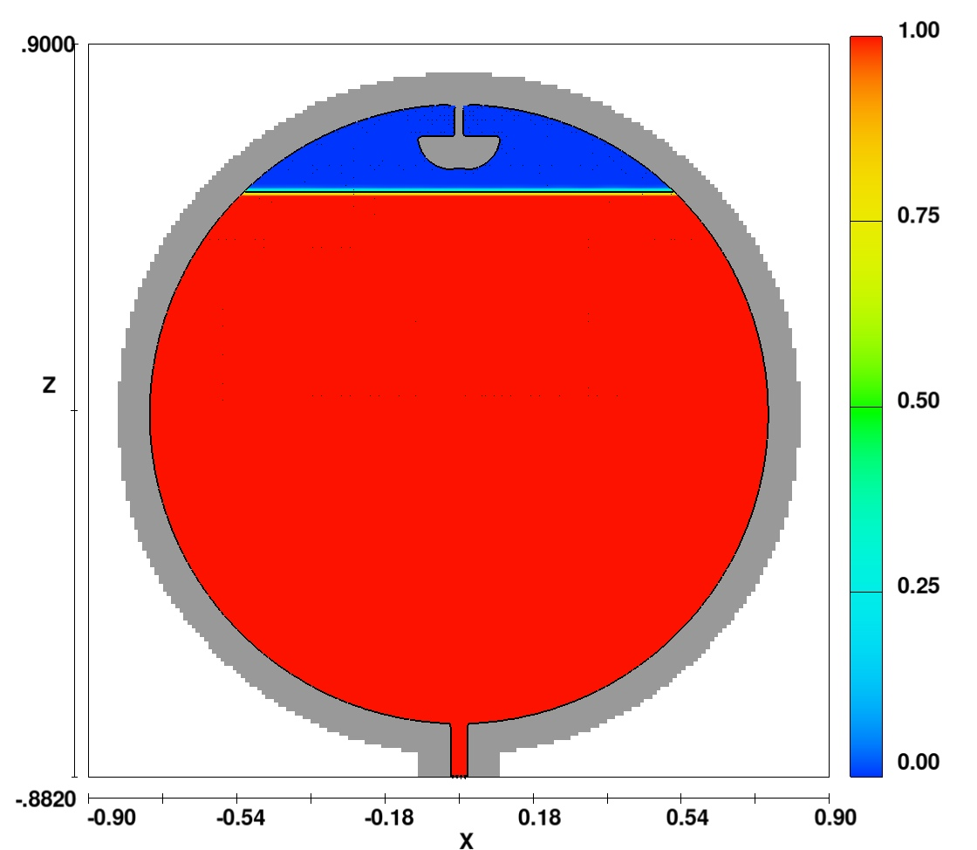
Initialization and boundary conditions for static expulsion (Run 37)
For Ramp:
  Duration: 31.9 s
  Fill level: 95%
  Pressure: 1 bar
  Liquid temp: 112.5 K
  Ullage and wall temp: 128.73 K
  Ullage concentration: 100% gCH4
  He pressurant at 226 K added to raise tank pressure to 3.41 bar
For expulsion:
  Duration: 223.4 s
  Flow field from end of ramp was used as initialization for expulsion
  Fill level: 95%
  Pressure: 3.41 bar
    Held constant by adding He pressurant
  Drain rate: 2.89 kg/s
  Tank was static so no sloshing during expulsion

Slide 8
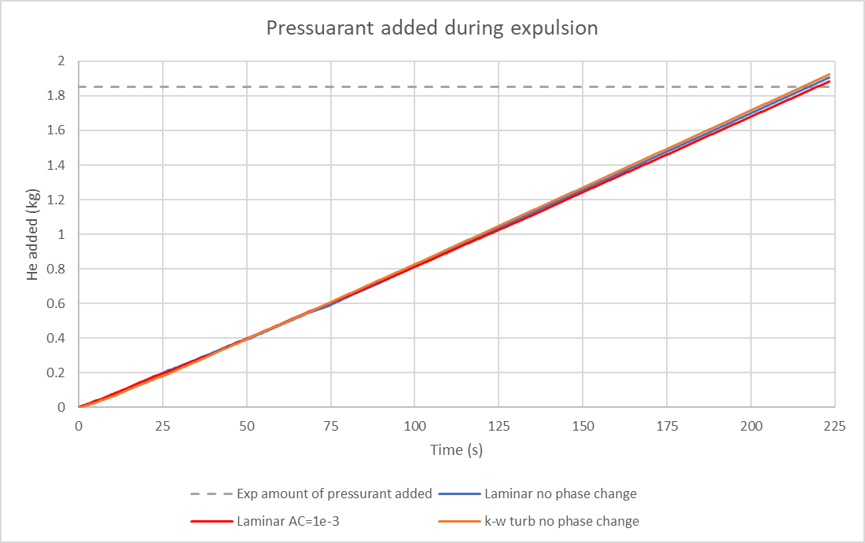
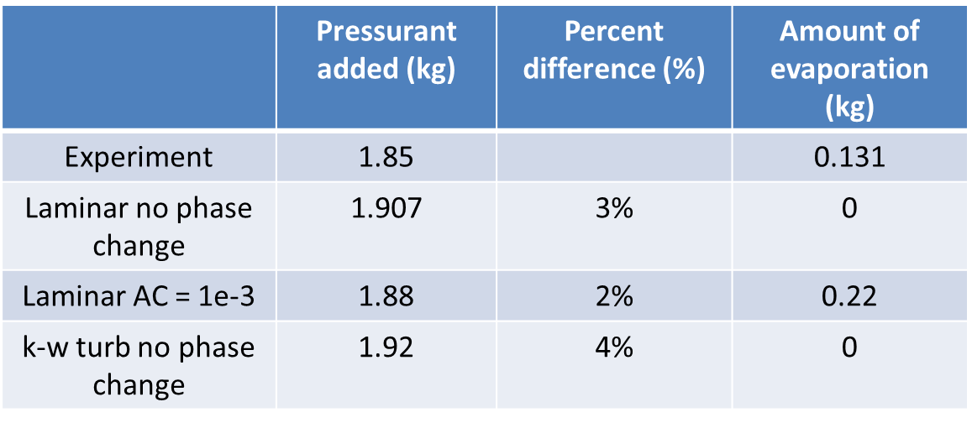
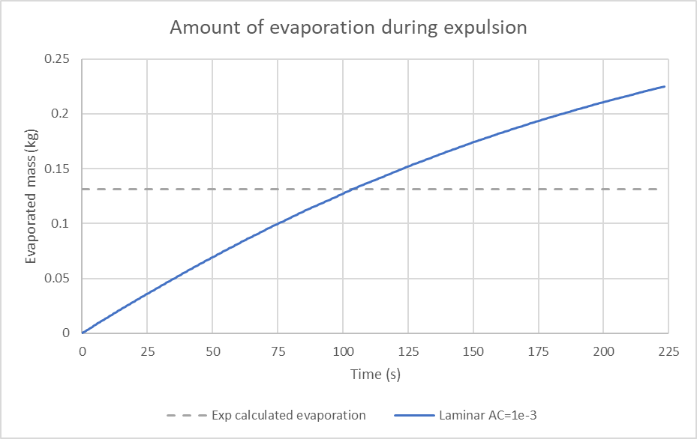
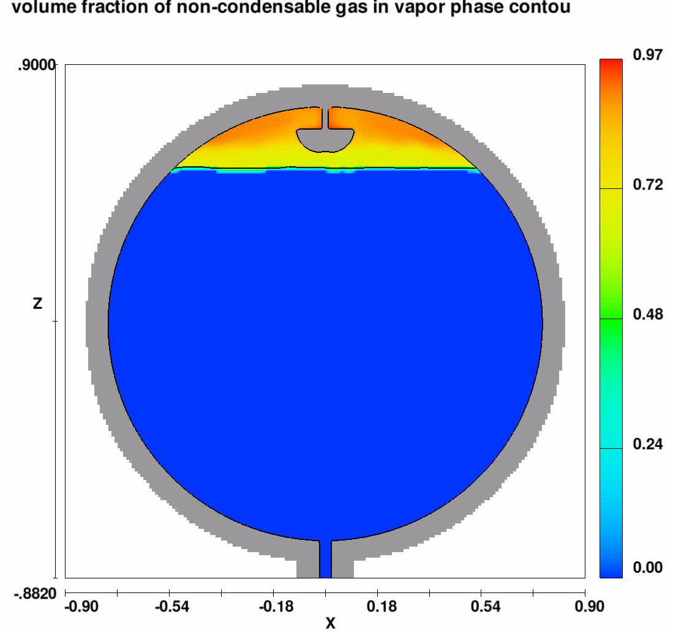
Run 37 predicted pressurant mass vs experimentally required
Flow3D predicts the amount of He pressurant required during the expulsion within 5% of the experiment
For the static case only a small amount of evaporation occurred during the experiment
Including phase change does not have large effect on the amount of pressurant added because very little evaporation occurred

Slide 9
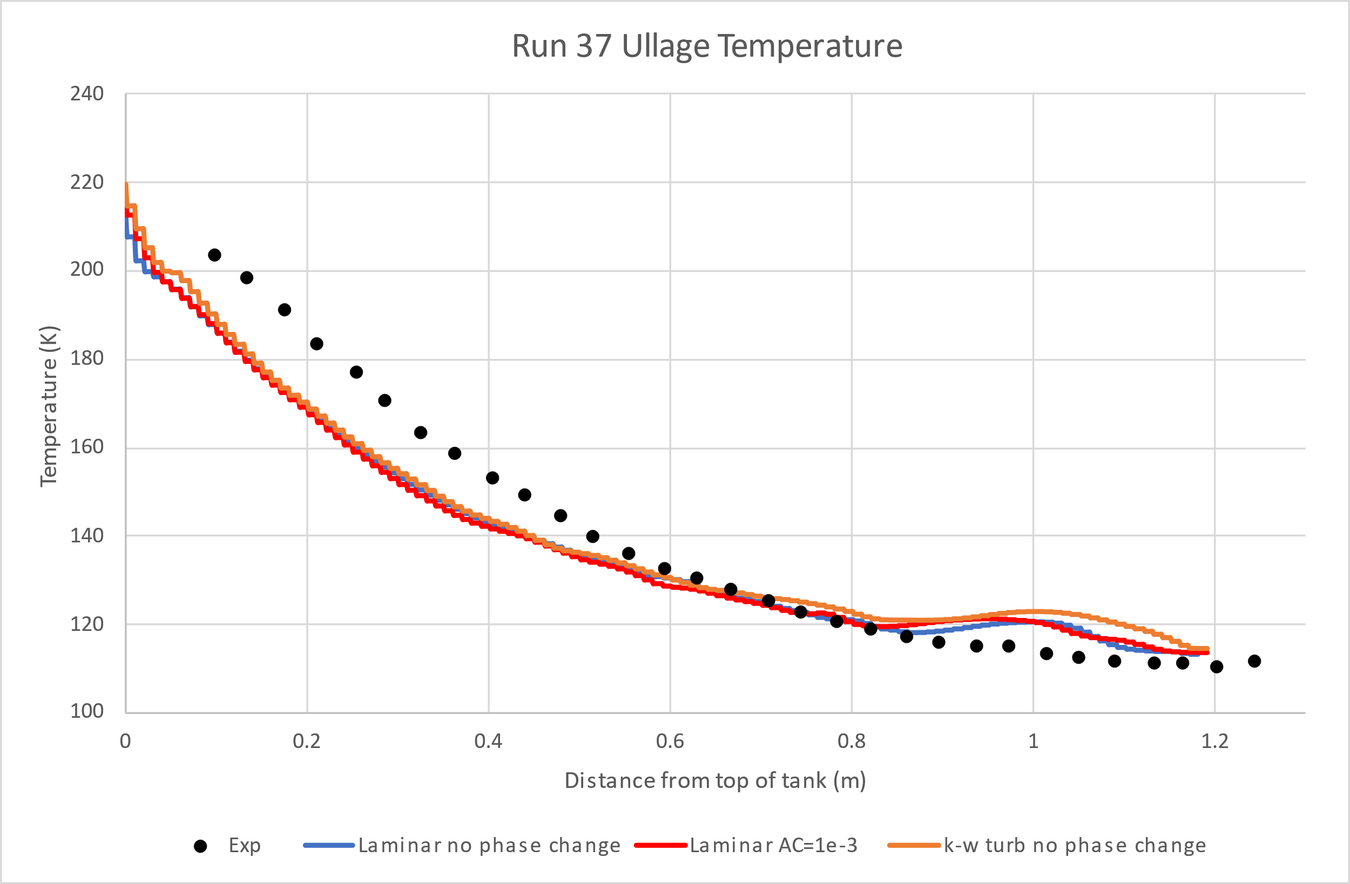
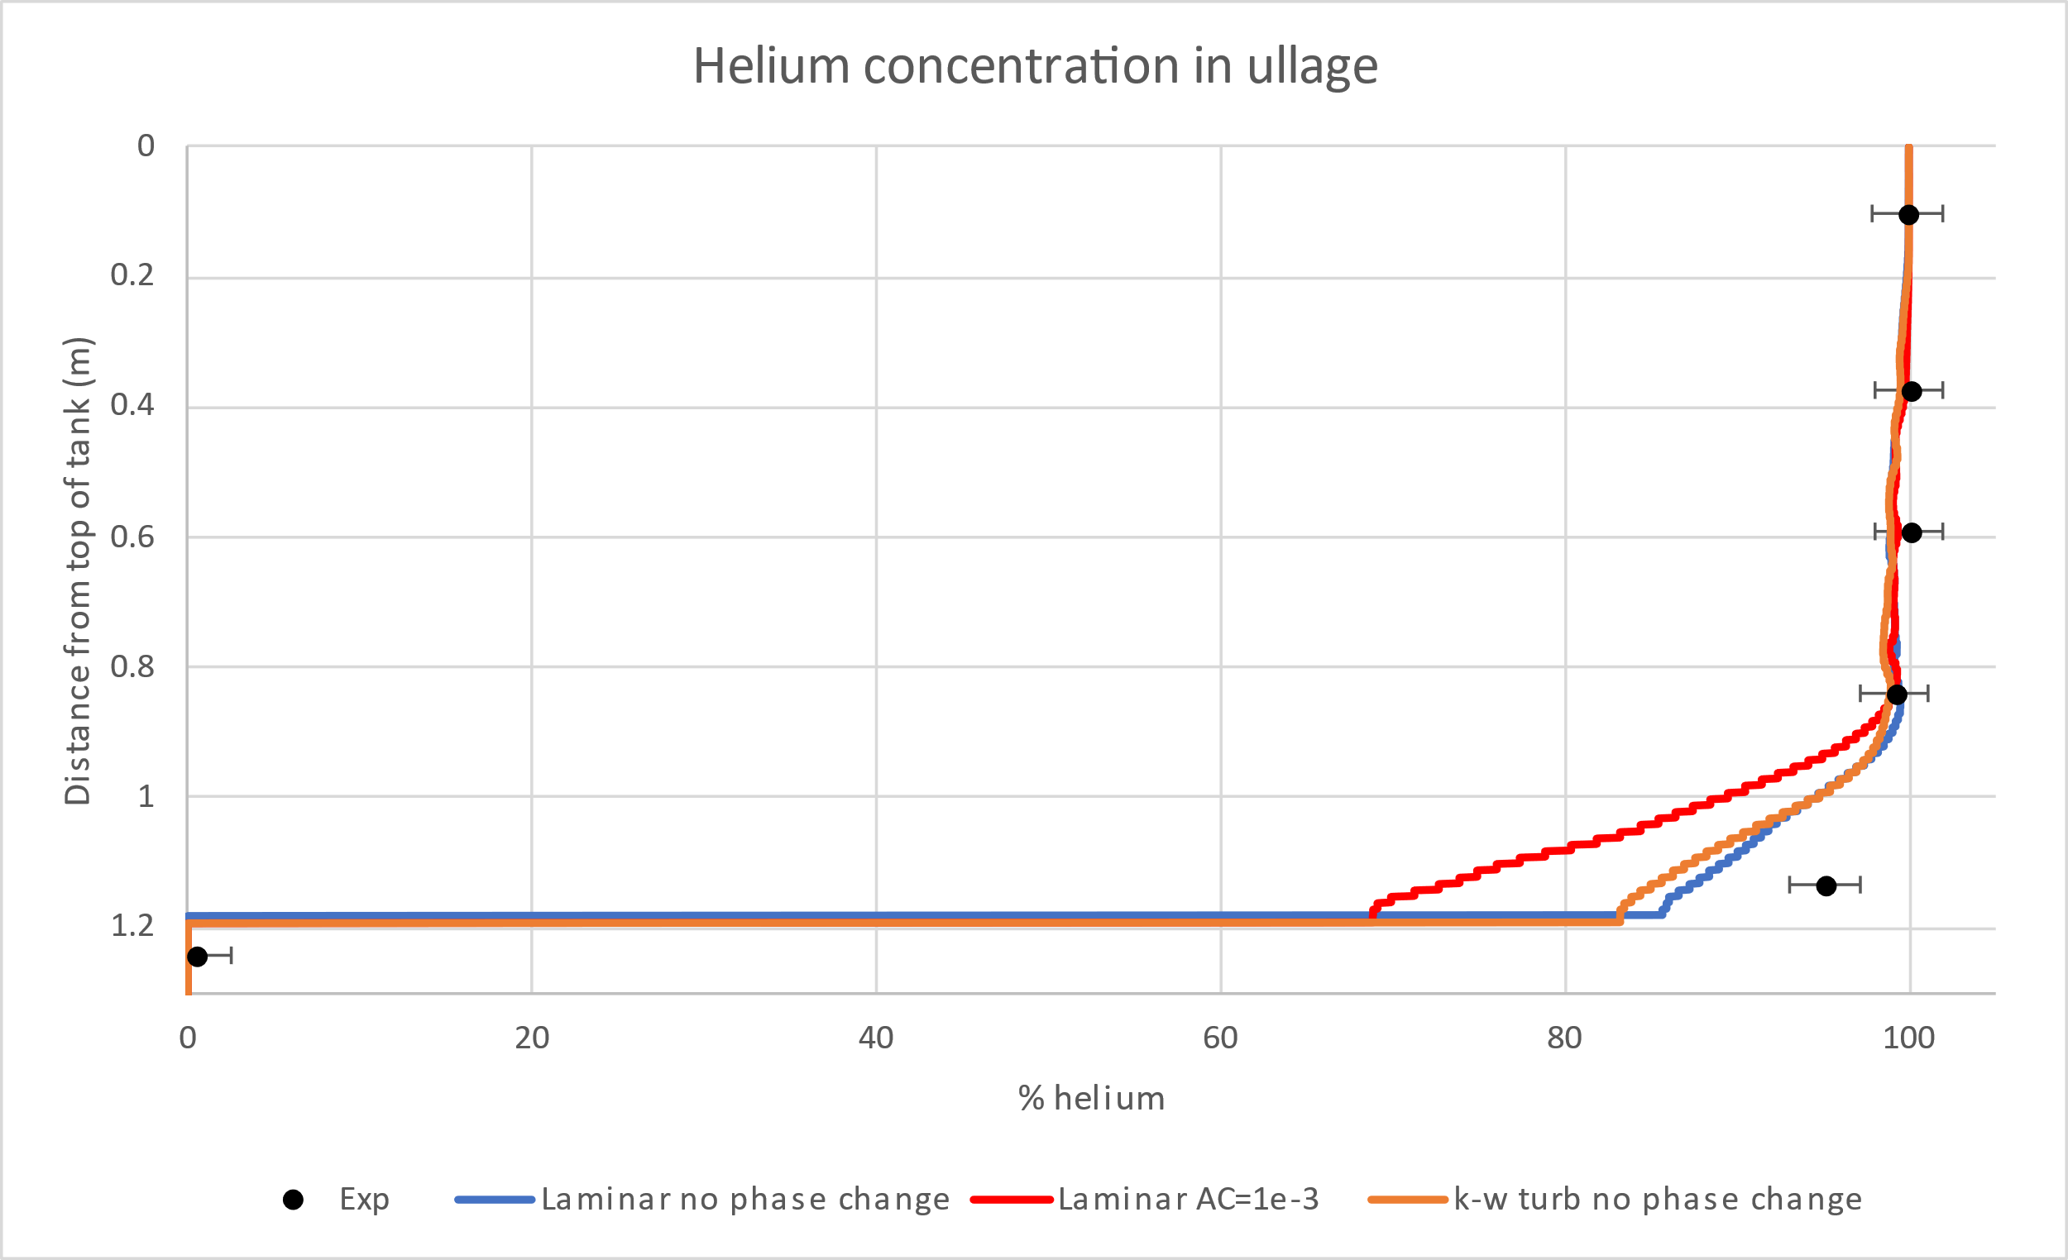
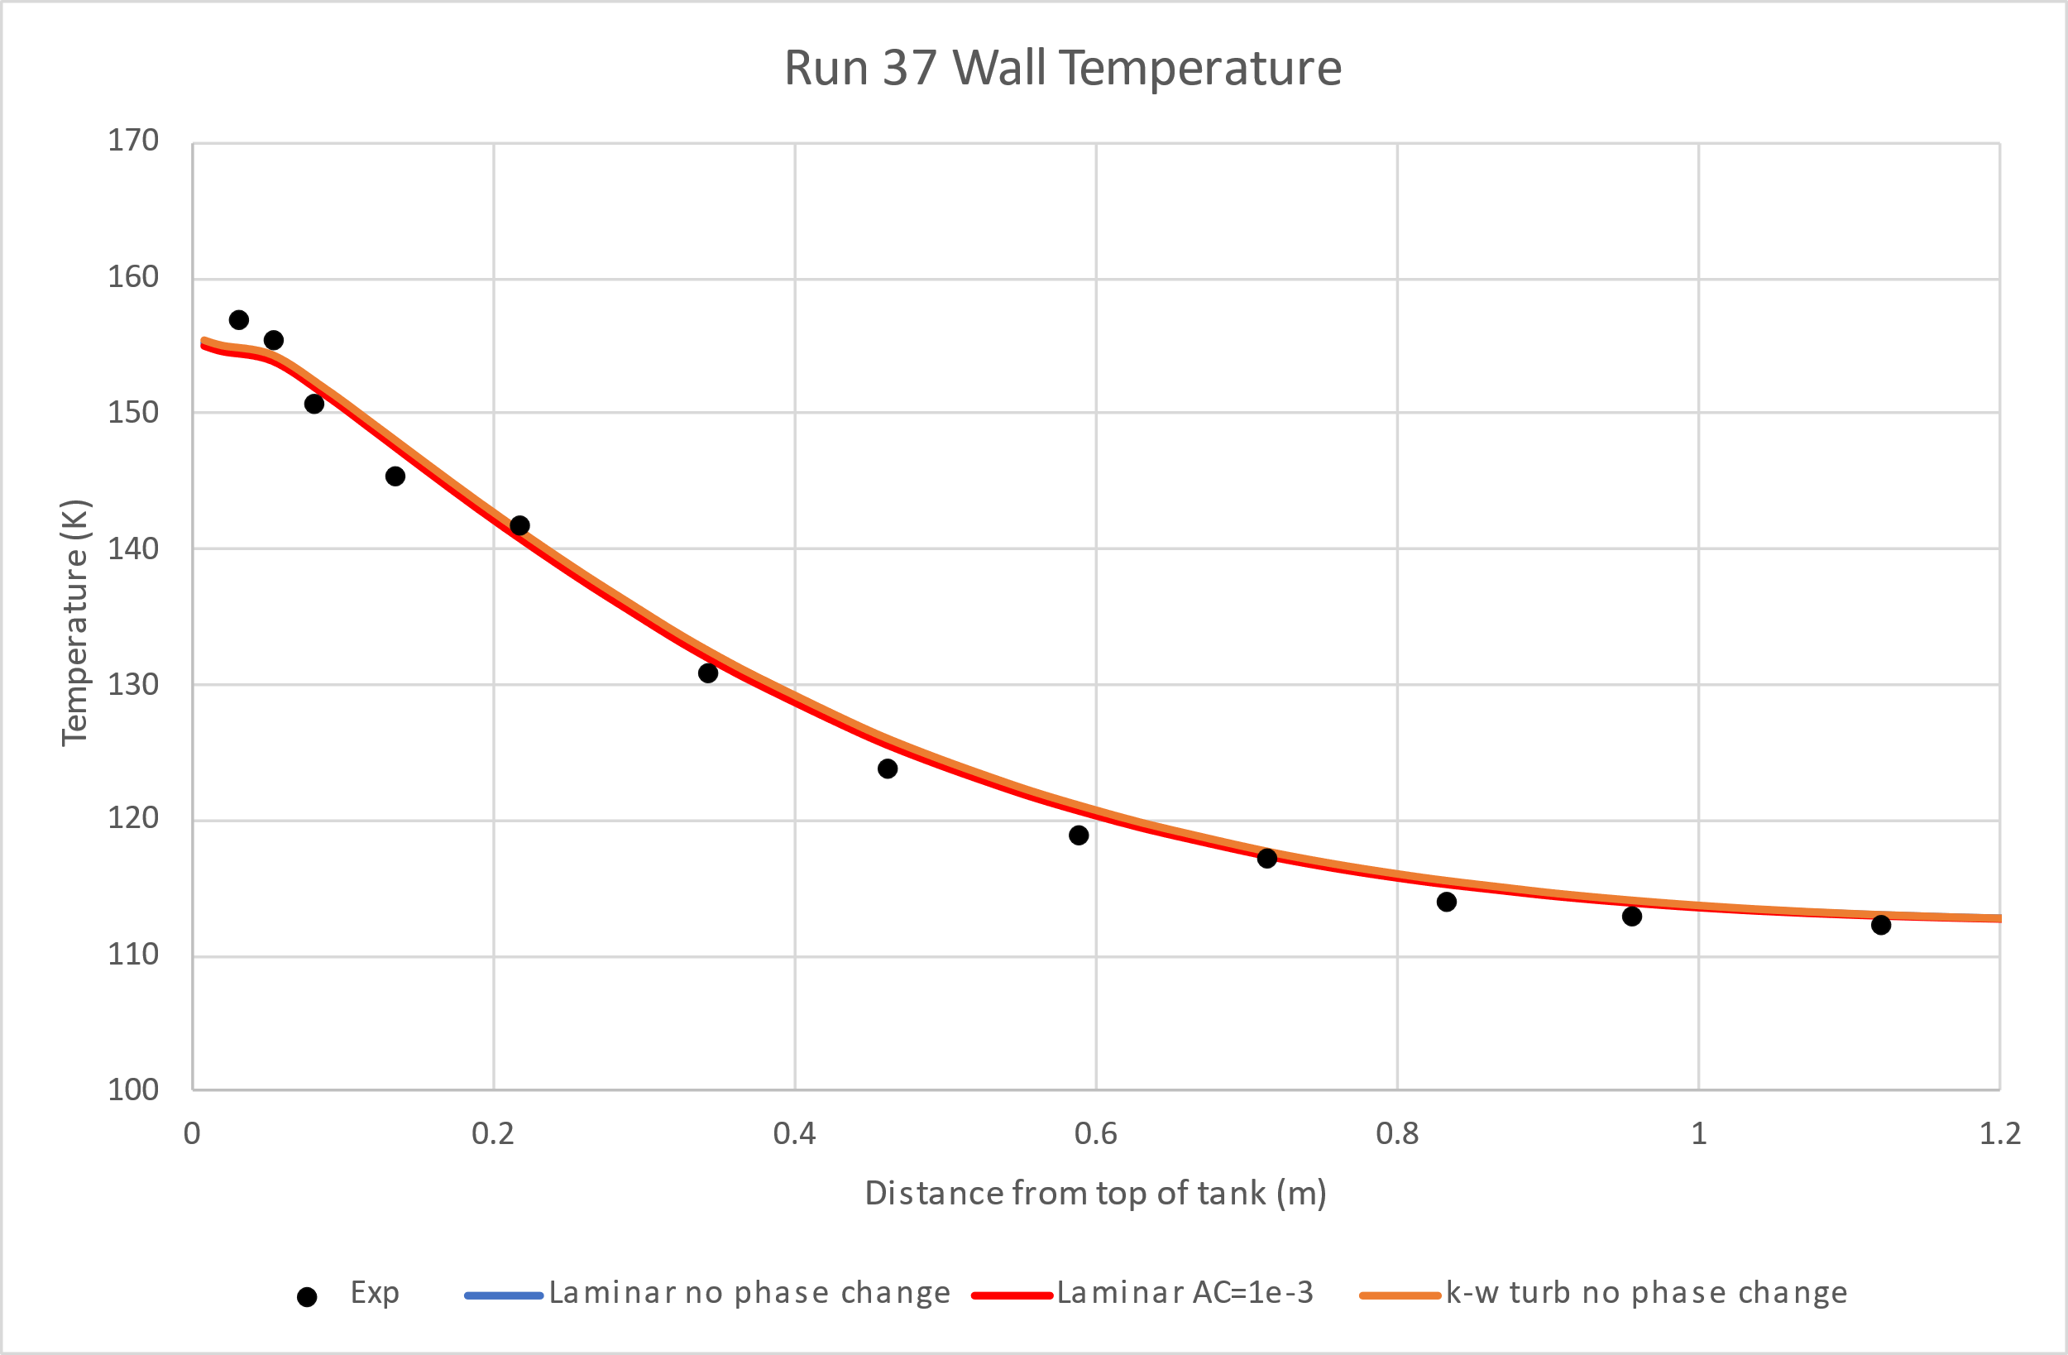
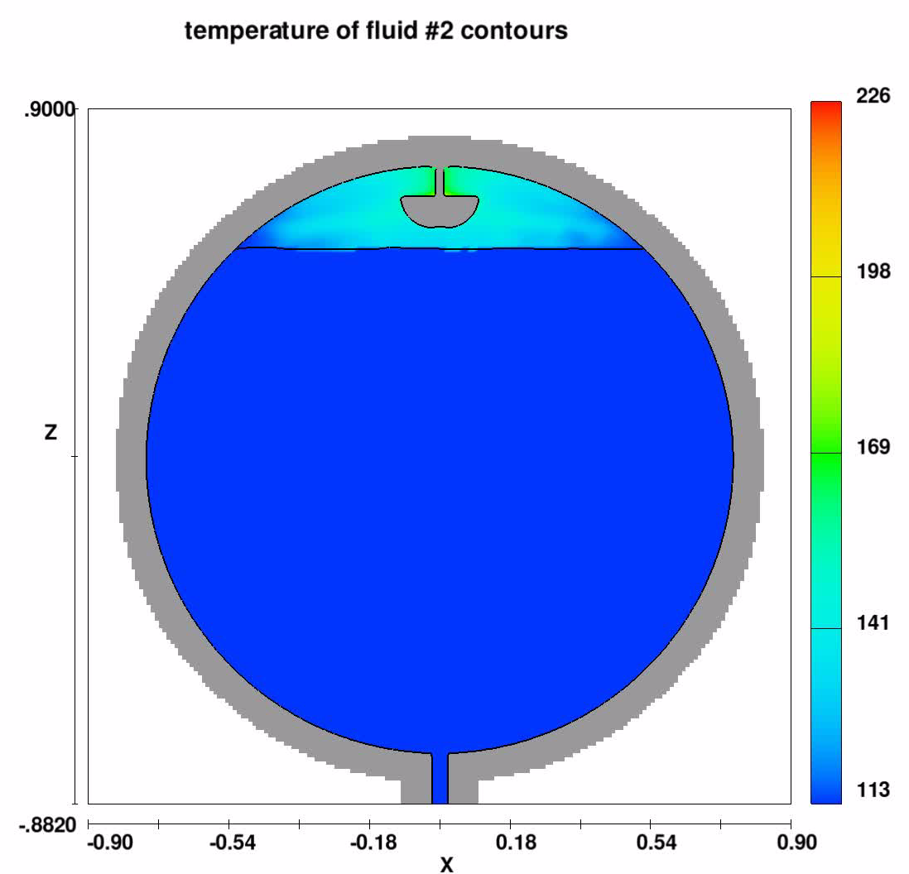
Run 37 predicted temperatures and ullage concentration vs experimentally measured
Flow3D predicts the wall temperature very close to the experimentally measured wall temperature
The ullage temperature near the top of the tank is slightly underpredicted and is slightly overpredicted it near the interface
The prediction of the helium concentration in the ullage matches well with the experiment but overpredicts the amount methane vapor near the interface

Slide 10
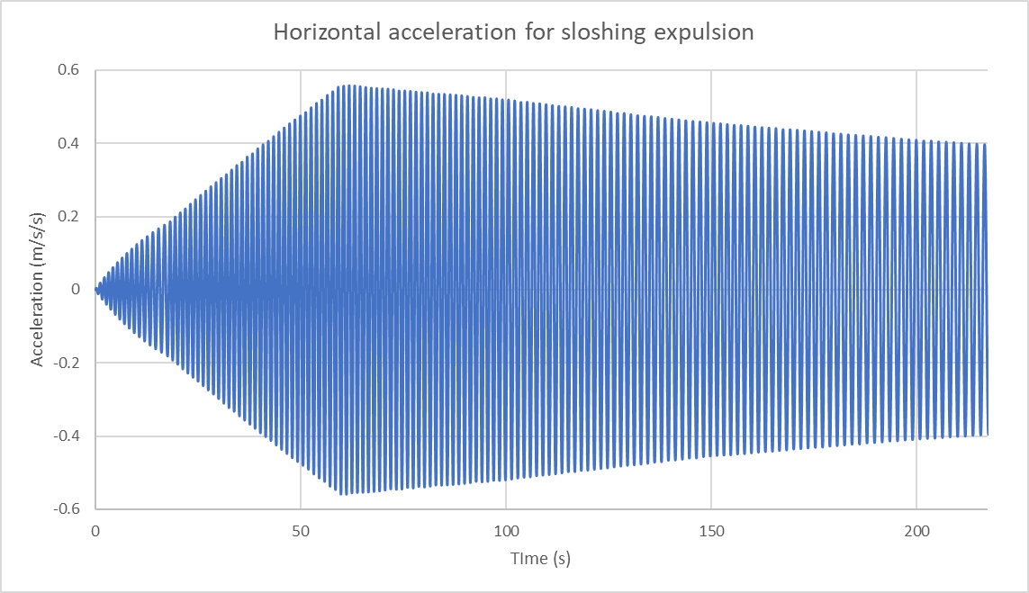
Initialization and boundary conditions for sloshing expulsion (Run 45)
For Ramp:
  Duration: 31.7 s
  Fill level: 95%
  Pressure: 1 bar
  Liquid temp: 112.5 K
  Ullage and wall temp: 128.73 K
  Ullage concentration: 100% gCH4
  He pressurant at 226 K added to raise tank pressure to 3.41 bar
For expulsion:
  Duration: 217.4 s
  Flow field from end of ramp was used as initialization for expulsion
  Fill level: 95%
  Pressure: 3.41 bar
    Held constant by adding He pressurant
  Drain rate: 2.92 kg/s
  Tank was accelerated back and forth side to side to induce sloshing and mimic how tank was shaken in experiment

Slide 11
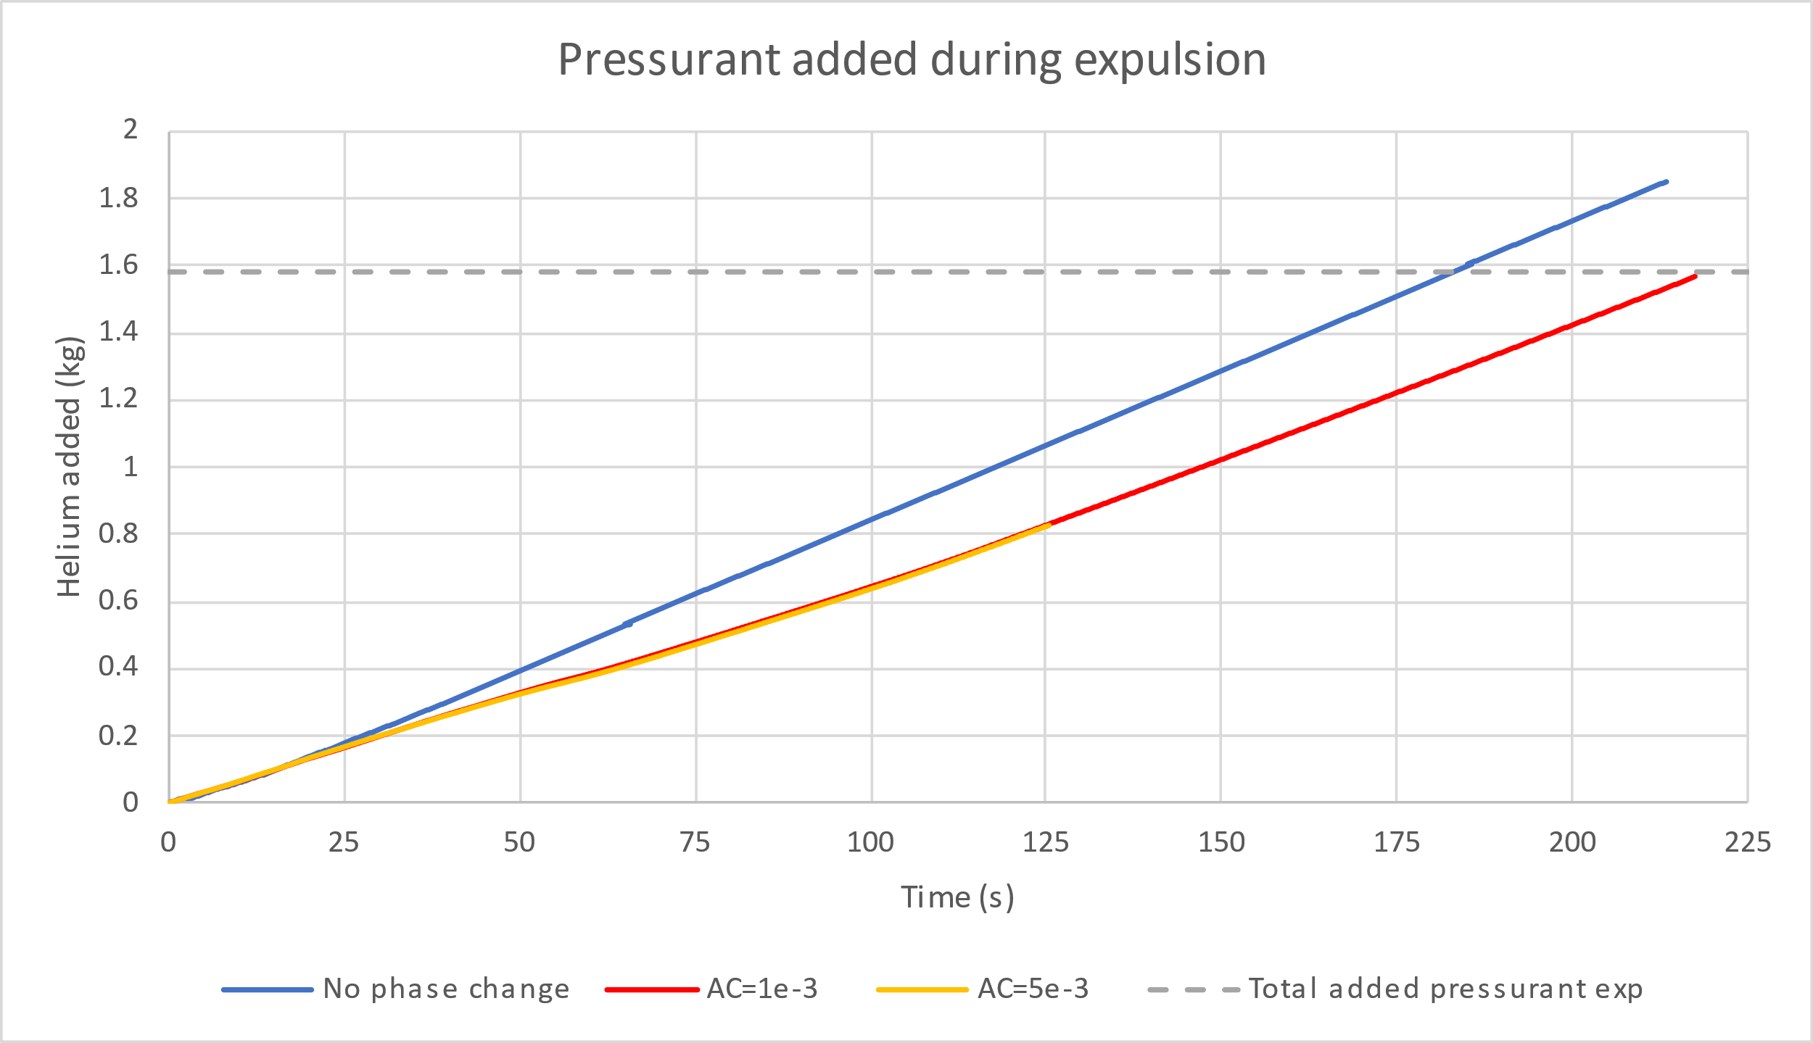
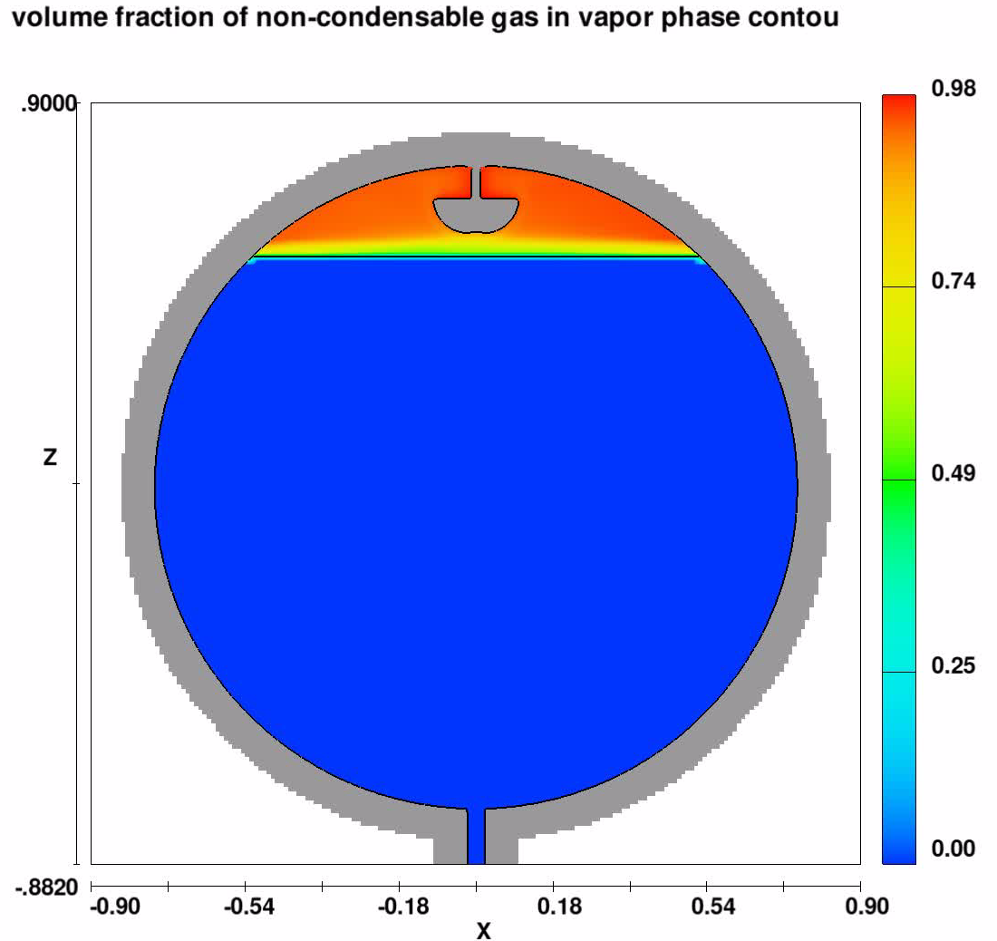
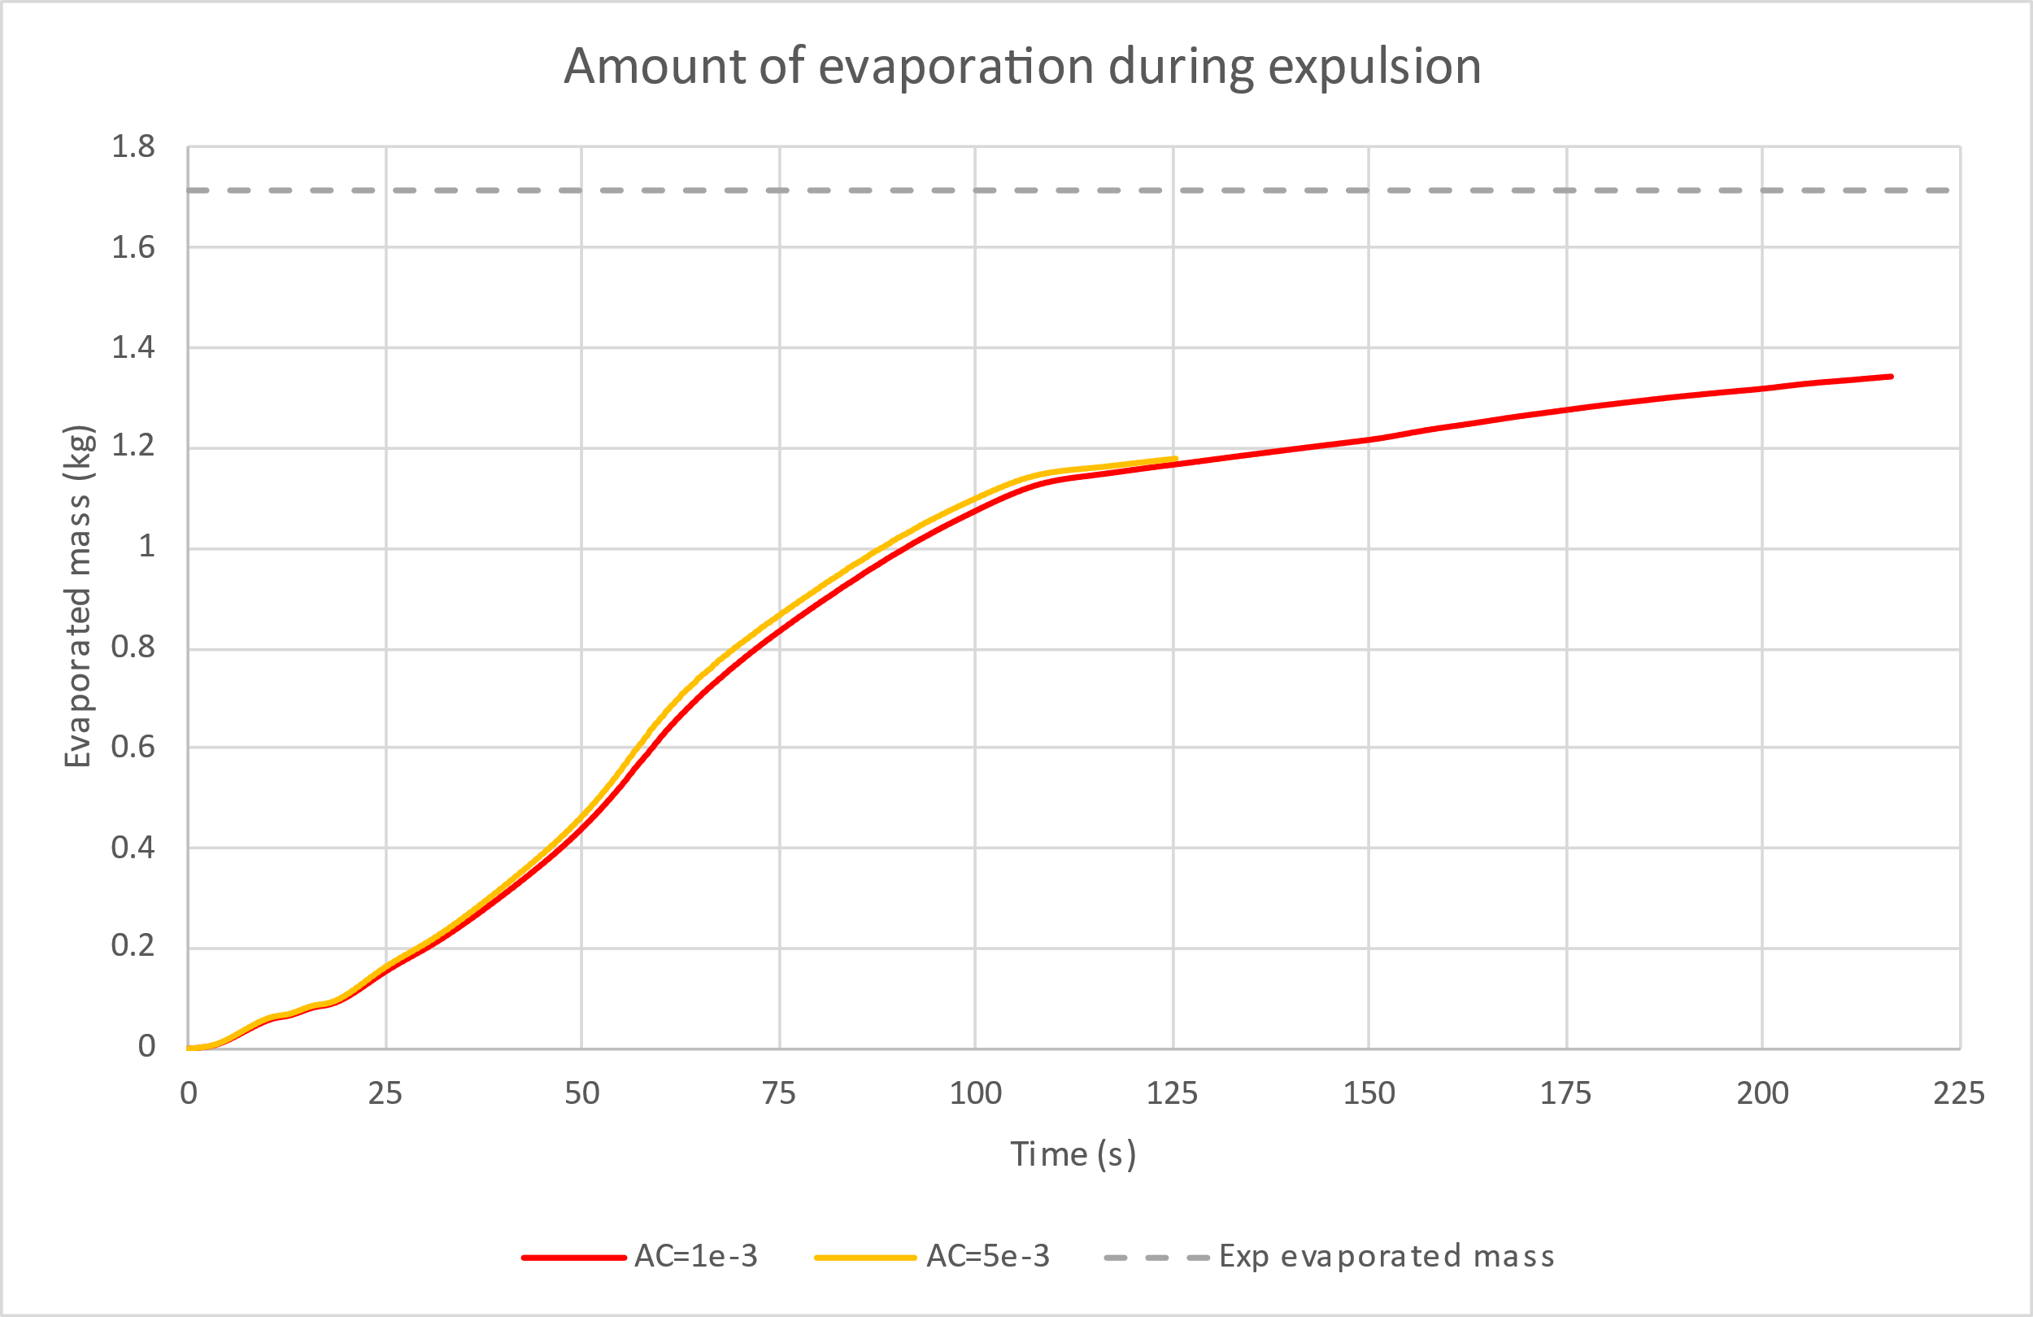
Run 45 predicted pressurant mass vs experimentally required
 | Pressurant added (kg) | % difference from experiment | Amount of evaporation (kg)
Experiment | 1.582 | 0% | 1.715
No phase change | 1.887 | 19% | 0
AC = 1e-3 | 1.56 | 1% | 1.344
Amount of added pressurant is over predicted by Flow3D when phase change is not included
When phase change is included the evaporation causes a reduction in the amount of added pressurant required and matches the experiment well
The predicted amount of evaporation in Flow3D is less than the amount of evaporation calculated in the experiment
Very little difference when using a higher accommodation coefficient

Slide 12
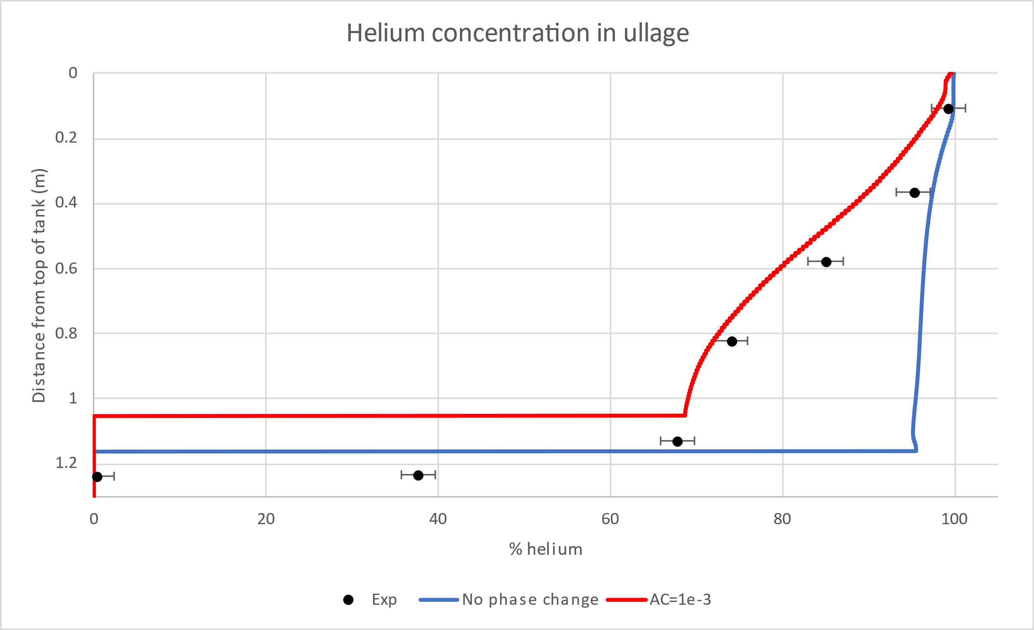
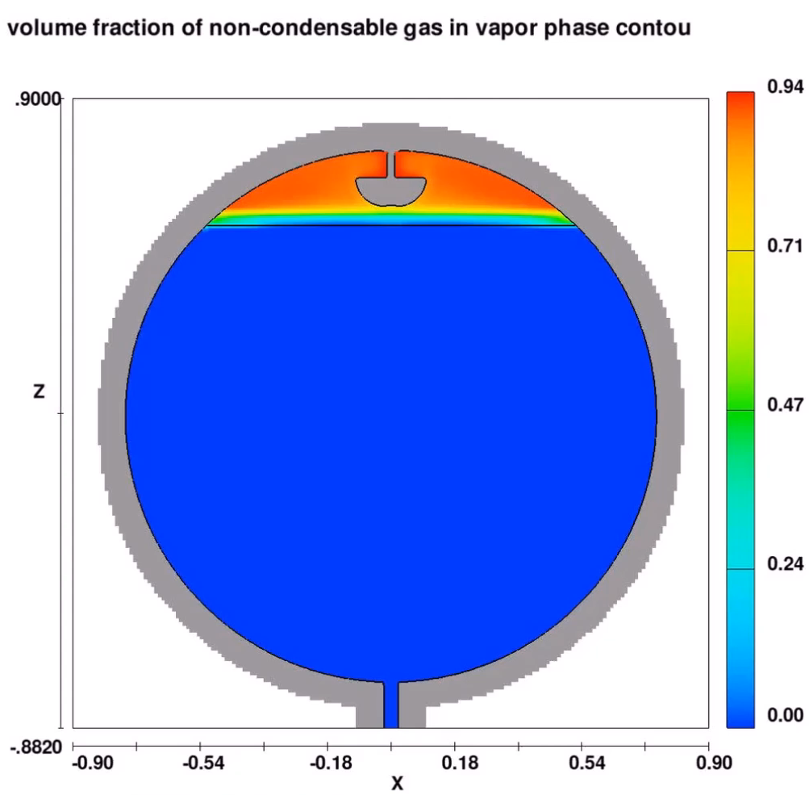
Run 45 predicted helium concentration in ullage vs experimentally measured
No phase change
With phase change
The plot compares the He concentration in the ullage at the end of the expulsion
The case without phase change does not match the experiment as Flow3D predicts almost 100% concentration of helium in the ullage as no evaporation was occurring
The case with phase change prediction is much closer to the exp due to the evaporation which added more methane to the ullage

Slide 13
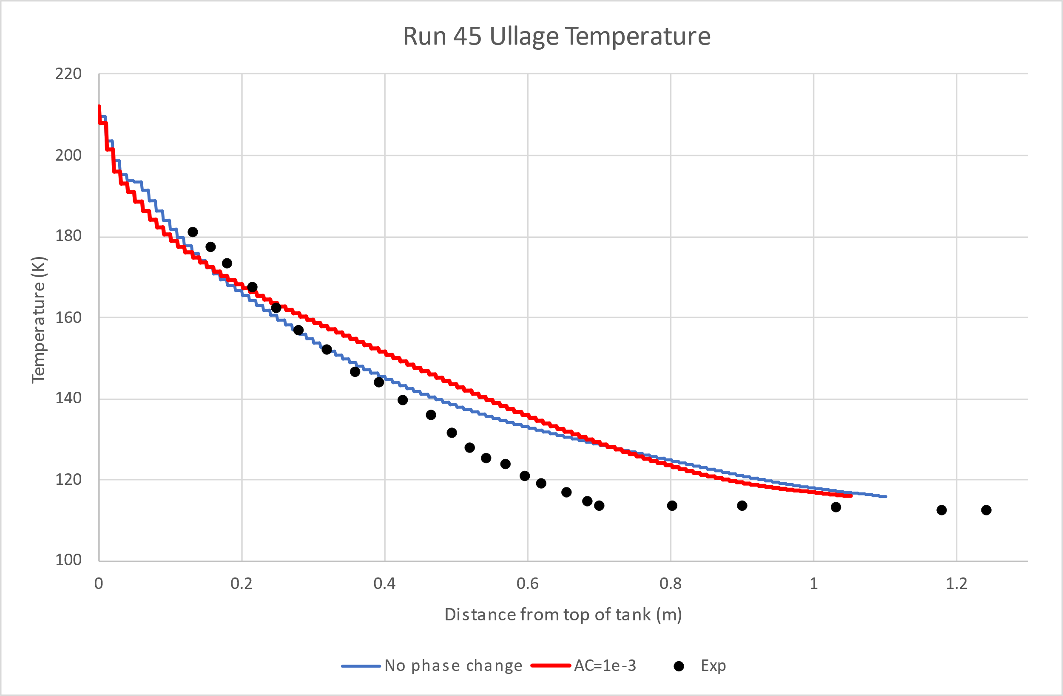
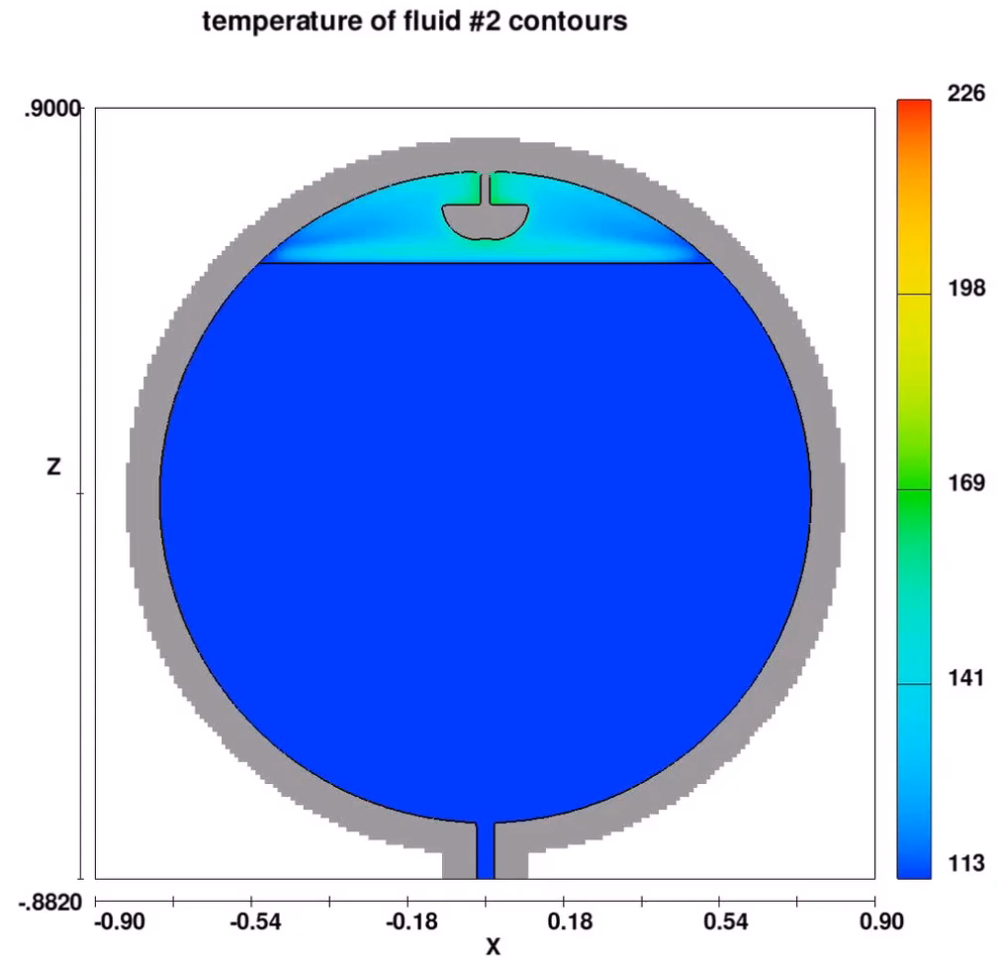
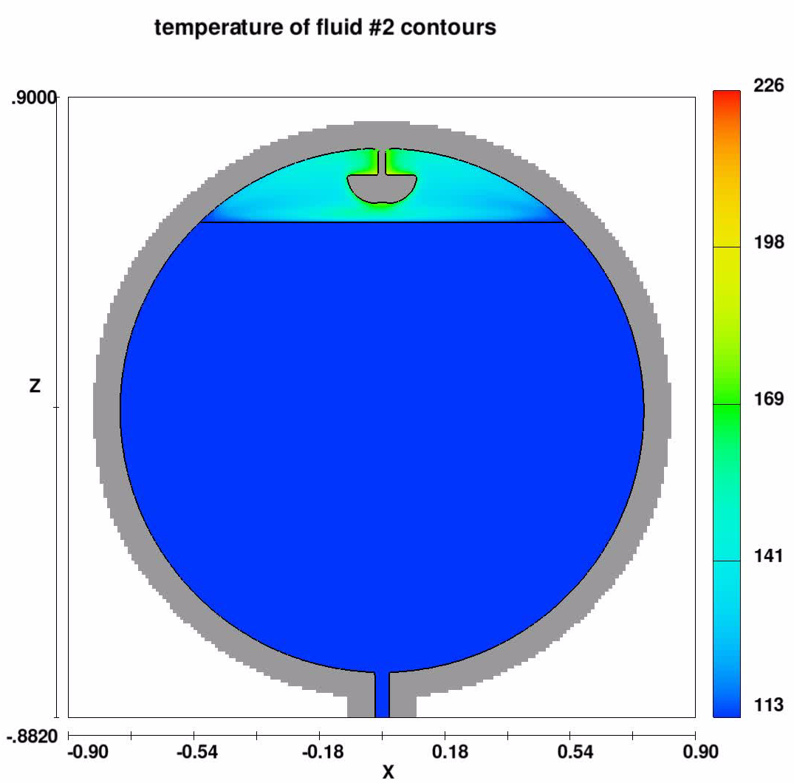
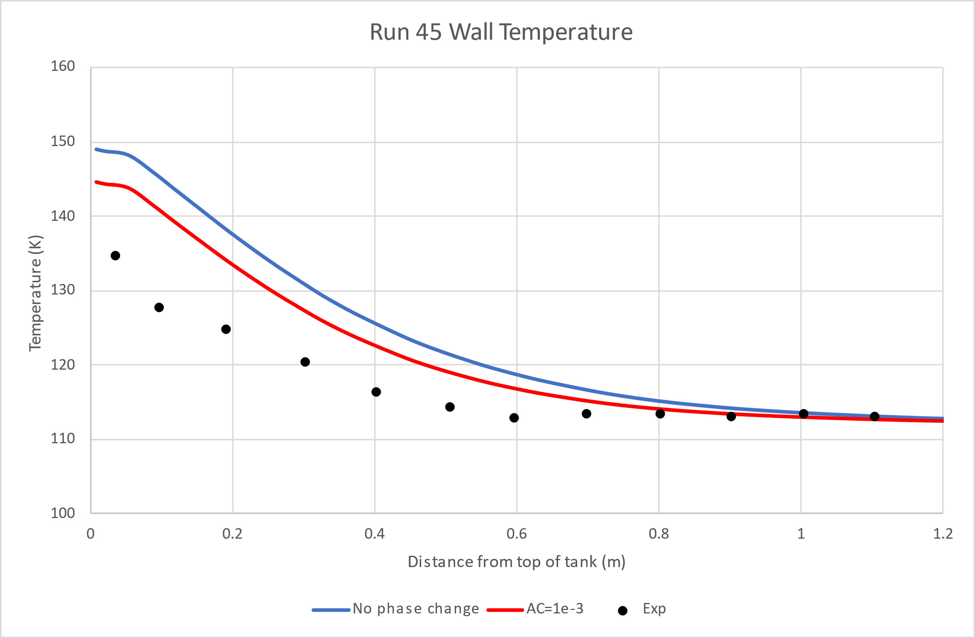
Run 45 predicted temperature in ullage and wall vs experimentally measured
No phase change
With phase change
Comparison of the ullage and wall temperature of the tank at the end of the expulsion
No large difference between case with and without phase change
Flow3D predicts a hotter ullage and hotter walls compared to the experiment
There are few factors that may be causing this offset
  Flow3D only allows to set one thermal conductivity for both the vapor and non condensable gas
    He and gaseous CH4 have a thermal conductivity difference by about a factor of 10
  The k-w turbulence model maybe affecting the ullage temperatures

Slide 14
Conclusions
Flow3D with the non-condensable model predicted amount of pressurant required during the expulsion to high accuracy within 1-2% of what experimented reported
  Flow3D predicts slightly different wall temperatures and ullage temperatures at the end of the expulsion when compared to the experiment
    Discrepancy is due to limitation of non-condensable model allowing only a single thermal conductivity to be specified for both the vapor and non-condensable gas
When including phase change Flow3D predicts evaporation of methane at the liquid vapor interface which reflects what was observed in experimental data
  Without sloshing there is less interaction with the helium which results in lower amounts of evaporation when compared to the sloshing case, and Flow3D’s prediction of evaporation for the two different cases reflected this
Including phase change also improves accuracy of Flow3D predictions of pressurant required and the ullage concentration at the end of the expulsion when compared to the experiment

Slide 15
References
  DeWitt, R. L., & McIntire, T. O. (1974). Pressurant requirements for discharge of liquid methane from a 1.52-meter-(5-ft-) diameter spherical tank under both static and slosh conditions. NASA. Washington D.C.: NASA.
  FLOW-3D® Version 2022R2 Users Manual (2023). FLOW-3D [Computer software]. Santa Fe, NM: Flow Science, Inc

