Slide 1


A Method for Reduction of Radiation Networks for Simplification of Thermal Modeling and Analysis Michael Saeger, ATA Engineering
TFAWS Passive Thermal Paper Session
Presented By
Michael Saeger
Thermal & Fluids Analysis Workshop TFAWS 2024 August 26-30, 2024
NASA Glenn Research Center
Cleveland, OH

Slide 2
Introduction
Thermal models tend to have relatively few elements compared to other analysis types such as stress and CFD. In models that include heat transfer by radiation, low element count is typically made necessary by the large number of radiation conductors required to simulate radiative heat flows between elements.
Consequently, thermal engineers often spend a great deal of time and effort simplifying geometry, remeshing, and otherwise manipulating models to achieve low element count.
This presentation will focus on an alternate way of dealing with radiation modeling. Instead of painstakingly defeaturing geometry and making coarse thermal meshes to keep conductor counts and runtimes under control, a method of radiation reduction will be presented in which simplifying operations are performed on networks of conductors rather than on geometry and elements.

Slide 3
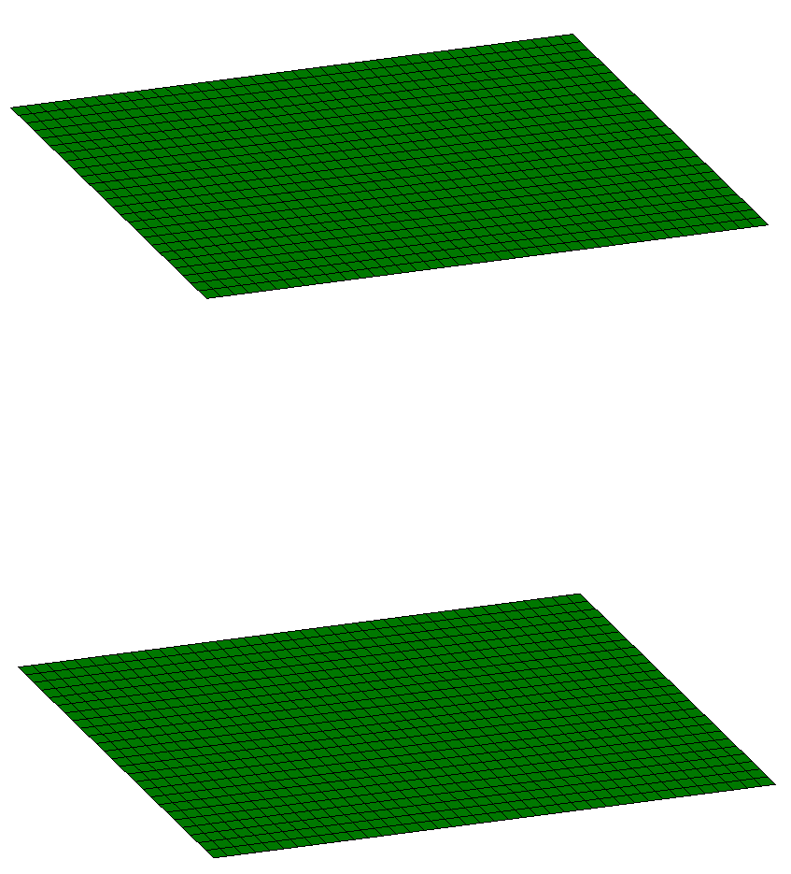
Radiation Model Size Considerations
Once radiation is included in a thermal model, there is a radiative conductor between every surface element and every other surface element that it sees.
The number of radiative conductors can get very big very quickly, leading to long run times and/or run failure due to exceeding memory limitations.
1000 elements
1,000,000 CONDUCTORS
1000 elements

Slide 4
How to Deal With Radiation (the Usual Way)
IMPORT
GEOMETRY
SIMPLIFY/REBUILD GEOMETRY
MESH
GEOMETRY AS COARSELY AS POSSIBLE
IMPORT
STRUCTURAL FEM
MANIPULATE AND COMBINE ELEMENTS TO REDUCE MESH DRASTICALLY
RUN
THERMAL SOLVER

Slide 5
How to Deal With Radiation (Using Reduction)
IMPORT
GEOMETRY
SIMPLIFY GEOMETRY
WHERE FEASIBLE
RUN
THERMAL SOLVER
MESH GEOMETRY WITH REASONABLE NUMBER OF ELEMENTS
IMPORT
STRUCTURAL FEM
MAKE MESH COARSER IN AREAS WITH EXCESSIVE ELEMENT DENSITY
RUN RADIATION REDUCTION

Slide 6
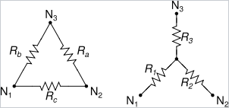
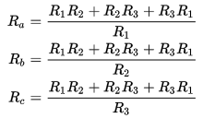
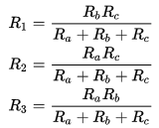
Radiation Reduction Method: Δ-Y Transform
Model Reductions are based on an extension of the well-known Δ-Y transform:

Slide 7
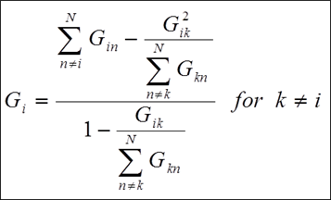
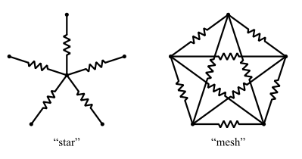
Radiation Reduction Method: Star-Mesh Transform
The (less well-known) extension of the Δ-Y transform is the star-mesh transform:
All stars whose conductance sum is nonzero can be transformed into a mesh. This equation is always valid.
In general, meshes cannot be transformed into a star; however, for those that can, this equation is valid.

Slide 8
Radiation Reduction Method: Parallel Plates
Consider two parallel plates:
All conductors are from side A to side B.
Any star transformation produces conductors from every element to every other element which means A-A and B-B as well as A-B.
A
B
A
B
A
B

Slide 9
Radiation Reduction Method: Parallel Plates
Use counter-acting stars:
Cancel the unwanted A-A and B-B conductors with negative-valued stars.
From the equation, only an appropriate scale factor on the negative conductors is needed and the cancellation will be exact.
Gi’ = -c x Gi so that Gij’ = -Gij
A
B
A
B

Slide 10
Radiation Reduction Method: Generalized Past Parallel Plates
Each element has both a positive conductor and a negative one:
Selection of elements and grouping is very important.

Slide 11
Radiation Reduction Method: mesh→star Transform Accuracy
The mesh-to-star transformation typically is not very accurate.
This equation tends to give a result that is fairly close to the best possible choice for Gi, but even with the best possible Gi, agreement with the original mesh is still usually rather poor.
Nonetheless, stars use far fewer conductors, so many of them can be used to approximate a mesh while still reducing the overall conductor count.

Slide 12
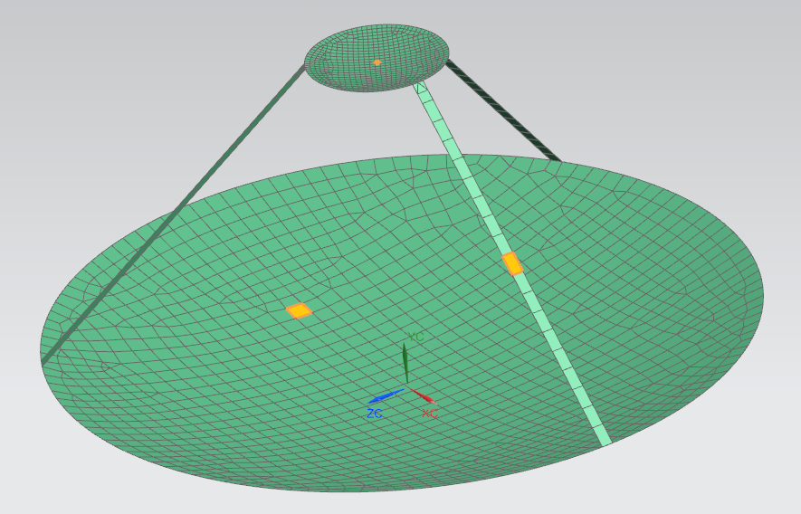
Radiation Reduction Example Model
Secondary Reflector Element 1789
Support Strut Element 2048
Primary Reflector Element 212
Reflector is placed in a highly elliptical orbit facing the Earth

Slide 13
Slide Title
The thermal response of the antenna was studied for three radiation cases:
Full Radiation
Solve the thermal model with all radiation conductors included
Number of radiation conductors: 2093124
Total number of conductors: 2113720
Reduced Radiation
Reduce the radiation network and solve the thermal model with the reduced network
Number of radiation conductors: 50148
Total number of conductors: 70744
No Internal Radiation
Remove all radiation between antenna surfaces but retain radiation to space
Number of radiation conductors: 8455
Total number of conductors: 29051

Slide 14
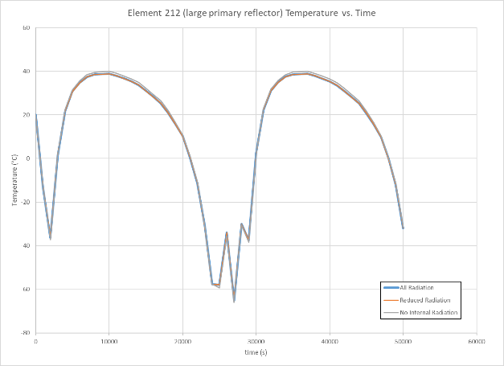
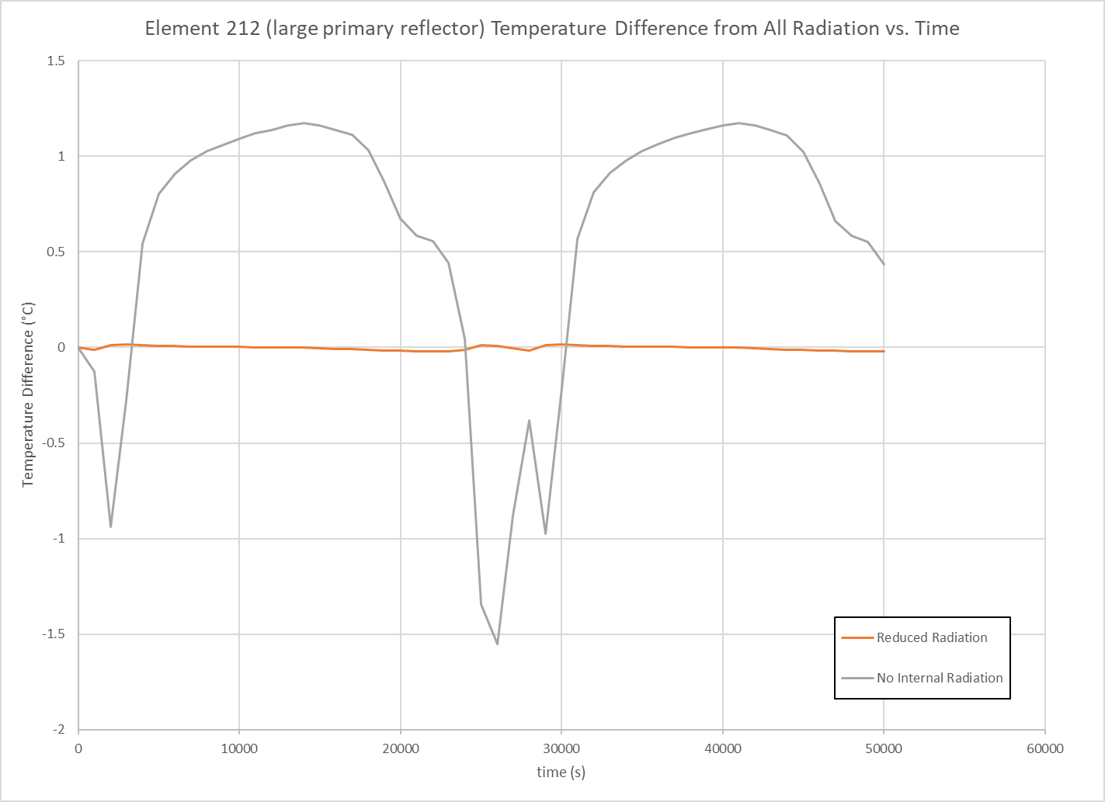
Radiation Reduction Example Primary Reflector Results
Temperature history comparison for primary reflector element 212

Slide 15
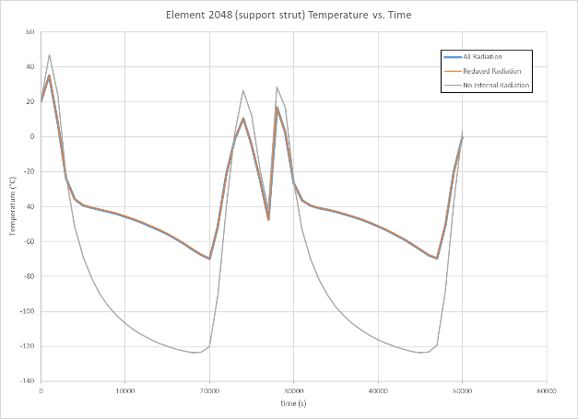
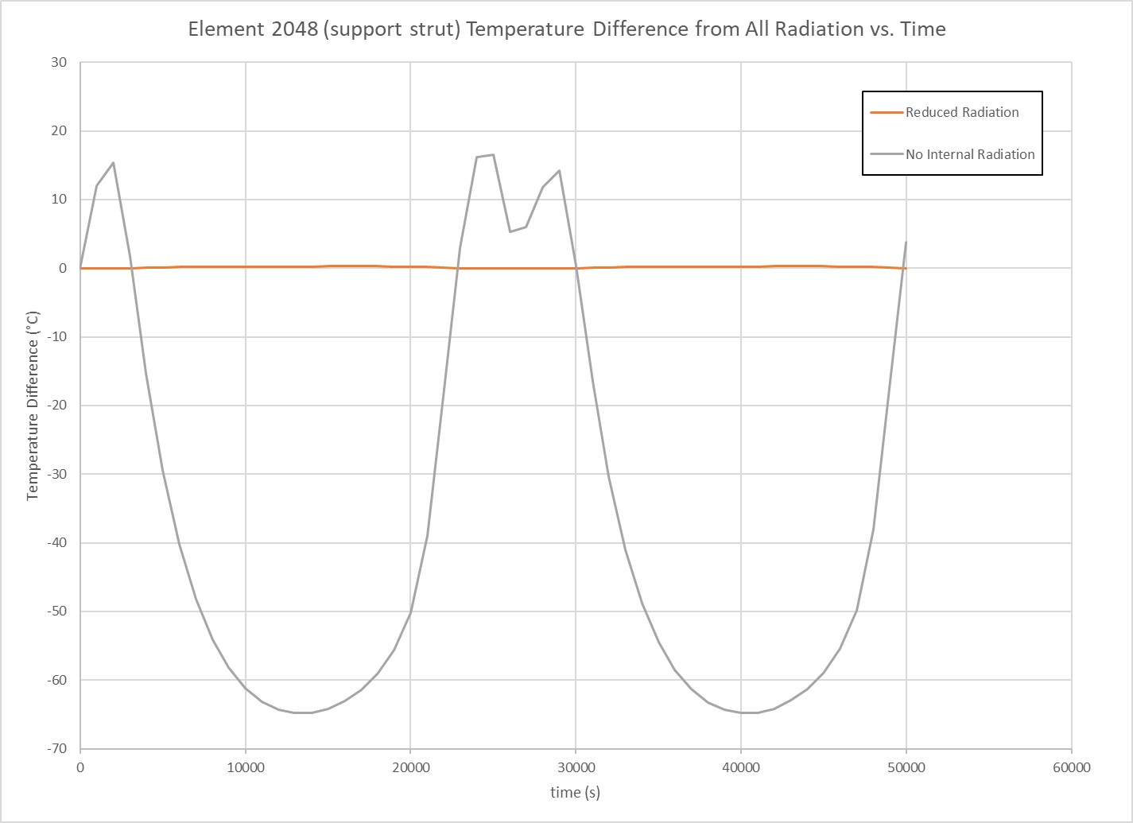
Radiation Reduction Example Support Strut Results
Temperature history comparison for support strut element 2048

Slide 16
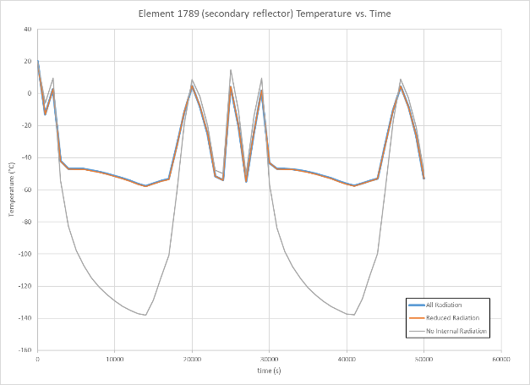
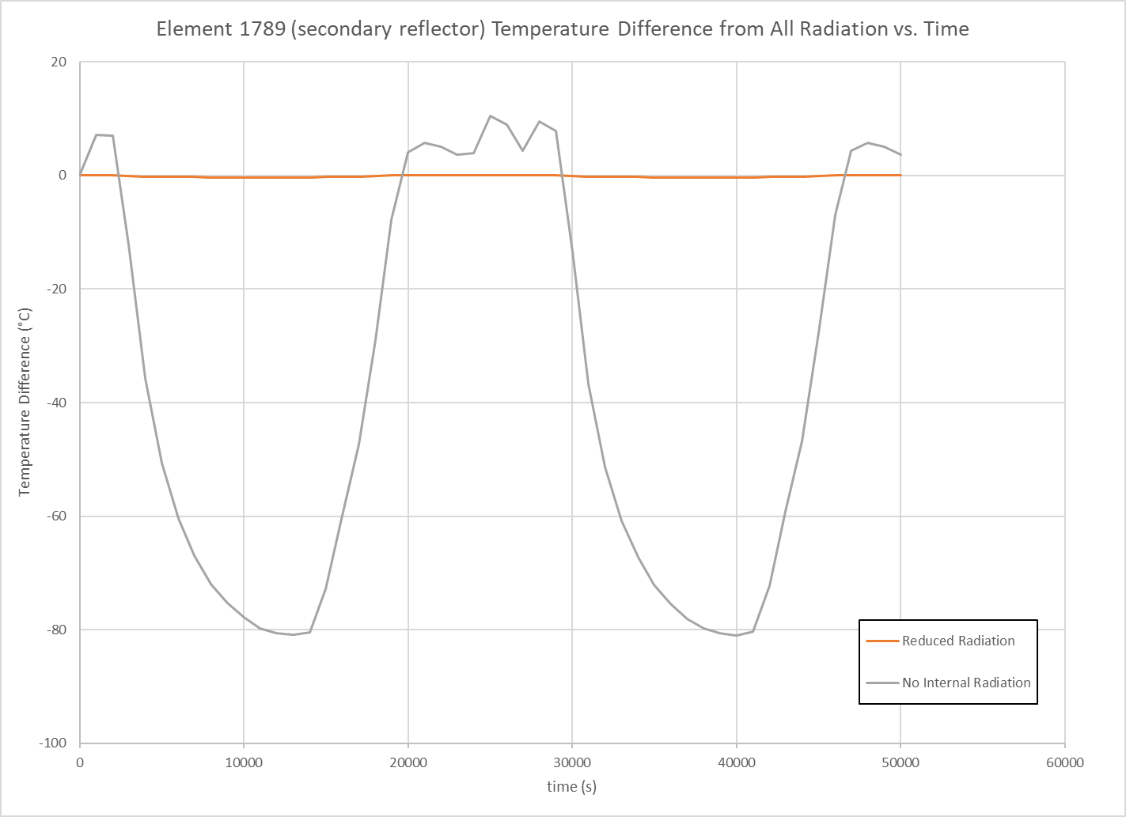
Radiation Reduction Example Secondary Reflector Results
Temperature history comparison for secondary reflector element 1789

Slide 17
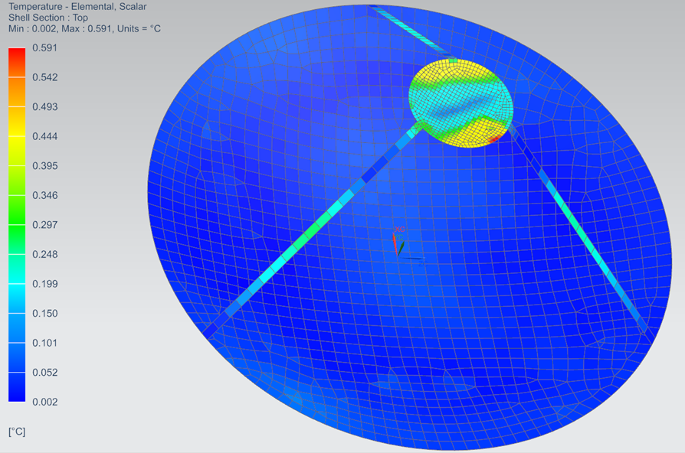
Radiation Reduction Example Maximum Discrepancy
The largest discrepancy between Full Radiation and Reduced Radiation across all simulation times is:

Slide 18
Conclusions
A method for approximating large radiation conductor networks with significantly smaller radiation conductor networks has been presented. Use of this method on a simple example model has demonstrated good agreement between original and reduced models, with the later containing only 2.4% as many radiation conductors.
Potential benefits include:
Faster thermal model development time
Less computer resources needed to perform a thermal simulation
Faster transient thermal simulation run time
Capability to solve larger thermal models
Simple way to create low-conductor, system-level model of a component directly from its detailed, component-level model
Quick trade studies

