Slide 1


Numerical Analysis of Thermal Shielding for Lunar Surface Habitat Design
Matt Buckley, Eymon Lan, and Shanbin Shi
Rensselaer Polytechnic Institute
TFAWS Passive Thermal Paper Session
Presented By
Matt Buckley
Thermal & Fluids Analysis Workshop
TFAWS 2024
August 26-30, 2024
NASA Glenn Research Center
Cleveland, OH

Slide 2
Contents
Background
Research objective
Technical approach
Problem description
Mathematical models
Numerical implementation
Results
Conclusions
Future work

Slide 3
Background
Motivation
  Pursuing long-duration human presence on the Moon is paramount for advancing scientific exploration
  In-situ resource utilization is critical to minimize launch mass from Earth
  Harsh lunar environments including extreme temperatures fluctuations from about -133℃ to 120℃ necessitating innovative solutions for habitat construction
  Lunar regolith found to be an excellent insulator
Numerical challenges
  Transient thermal analysis is a challenge due to lunar temperature fluctuations and lengthy day cycles
  Low thermal diffusivity of lunar regolith
  Lumped assumption of conducting material not appropriate since Bi >> 0.1

Slide 4
Research Objectives
Develop a model to conduct transient thermal analysis of prototypical habitat utilizing in-situ resources
  Approximate the transient heat transfer and find the internal temperature change
  Determine optimal regolith wall thickness for lunar habitat construction
  Estimate energy requirements for maintaining habitable conditions within prototypical lunar habitat

Slide 5
Technical Approach
Conduct literature review on lunar surface conditions and long duration space travel
Develop an in house MATLAB code for numerical analysis of heat transfer through a regolith wall
Conduct transient thermal analysis to account for lunar surface temperature variations across multiple lunar day cycles with a simplified model
Modify assumptions to make the analysis more accurate
Optimize the wall thickness based on quasi-steady heating requirements

Slide 6
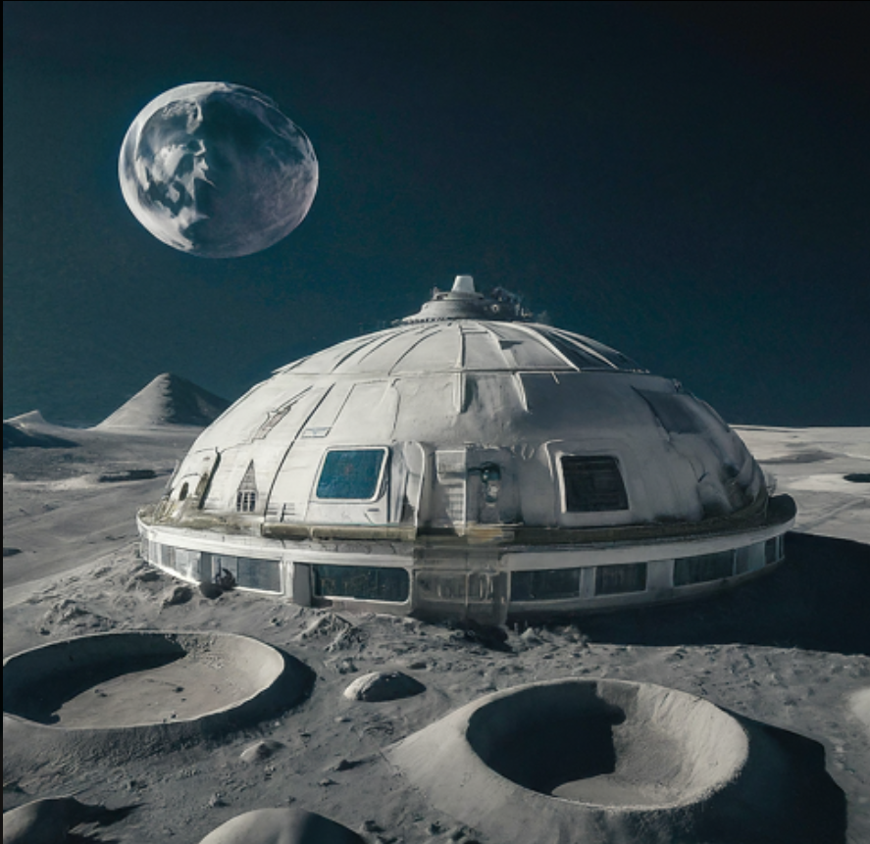
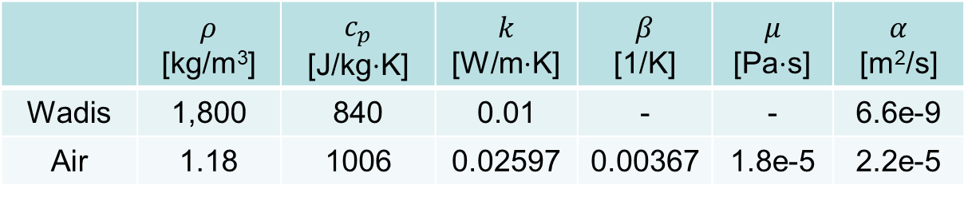
Problem Description
Long lunar day cycles and large surface temperature fluctuations make transient heat transfer analysis difficult.
Thermal requirements for a prototypical lunar habitat need to consider environmental heat transfer
  Solar radiation
  Radiation to vacuum of space
 | $ρ$ [kg/m³] | $c_{p}$ [J/kg$⋅$K] | $$k$$ [W/m$⋅$K] | $$β$$ [1/K] | $$μ$$ [Pa$⋅$s] | $$α$$ [m²/s]
Wadis | 1,800 | 840 | 0.01 | - | - | 6.6e-9
Air | 1.18 | 1006 | 0.02597 | 0.00367 | 1.8e-5 | 2.2e-5
R. Balasubramaniam et al., “Analysis of Solar-Heated Thermal Wadis to Support Extended-Duration Lunar Exploration,” Proceedings of 47th AIAA Aerospace Sciences Meeting, January 5-8, 2009, Orlando, Florida, USA.

Slide 7
Assumptions
1D heat transfer
No heat generation
Consider only incoming solar radiation and radiation out to vacuum of space
Internal natural convection
Internal environment treated as lumped
Constant material properties
Notes:
Wadis is a modified lunar regolith material

Slide 8
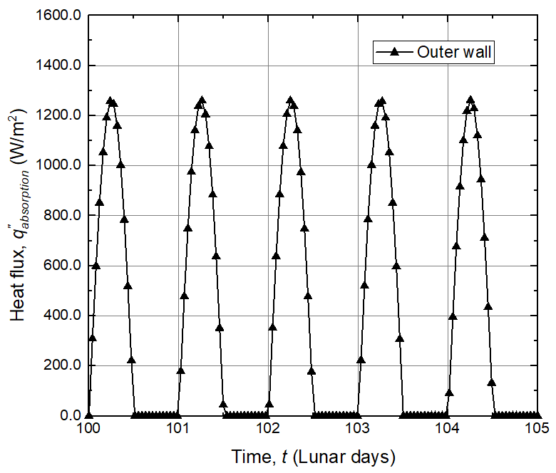
Mathematical Models
4
3
2
1
Natural convection
Conduction
Radiation
Solar radiation heat flux
R.B. Malla and K.M. Brown, “Determination of Temperature Variabtion on Lunar Surface and Subsurface for Habitat Analysis and Design,” Acta Astronautica, 107, pp. 196-207, 2015.

Slide 9
Mathematical Models (Cont’d)
4
3
2
1
Natural convection
Conduction
Radiation
T. Bergman et.al, Fundamentals of Heat and Mass Transfer, 8th Edition
Notes:
Boundary node temperature defined at the wall interface.

Slide 10
Mathematical Models (Cont’d)
4
3
2
1
Natural convection
Conduction
Radiation
S.W. Churchill, and H.H.S. Chu, “Correlating Equations for Laminar and Turbulent Free Convection From a Vertical Plate,” Int. J. Heat Mass Transfer, 18, pp. 1323-1329, 1975.

Slide 11
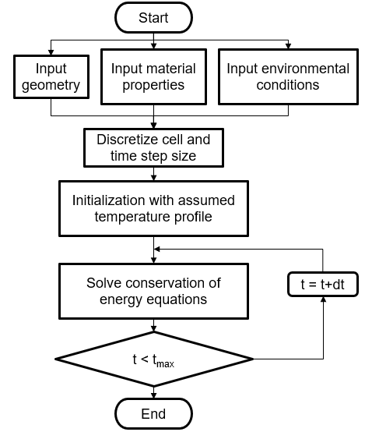
Numerical Implementation
Numerical tool: MATLAB
  In house code using finite difference method
Time step size: 1 second
Cell size: 0.2 mm
Stability and convergence criteria for explicit scheme
  Internal conduction nodes
  External boundary nodes
T. Bergman et.al, Fundamentals of Heat and Mass Transfer, 8th Edition

Slide 12
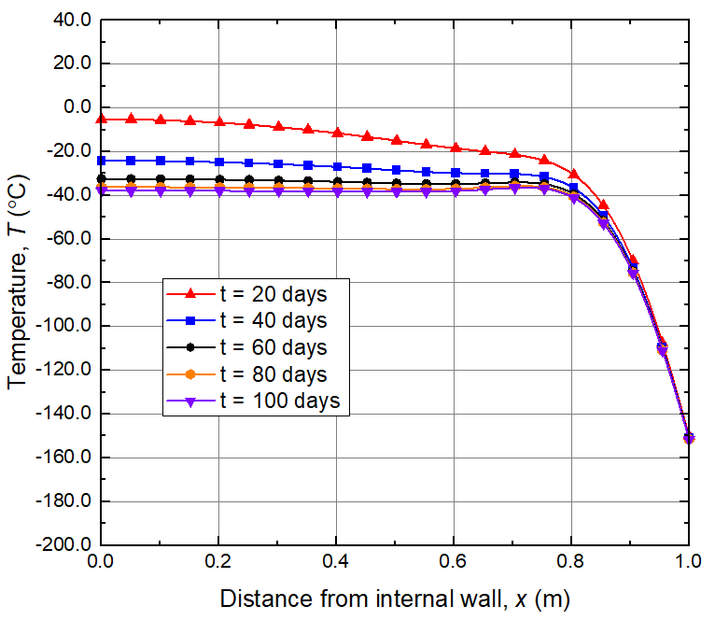
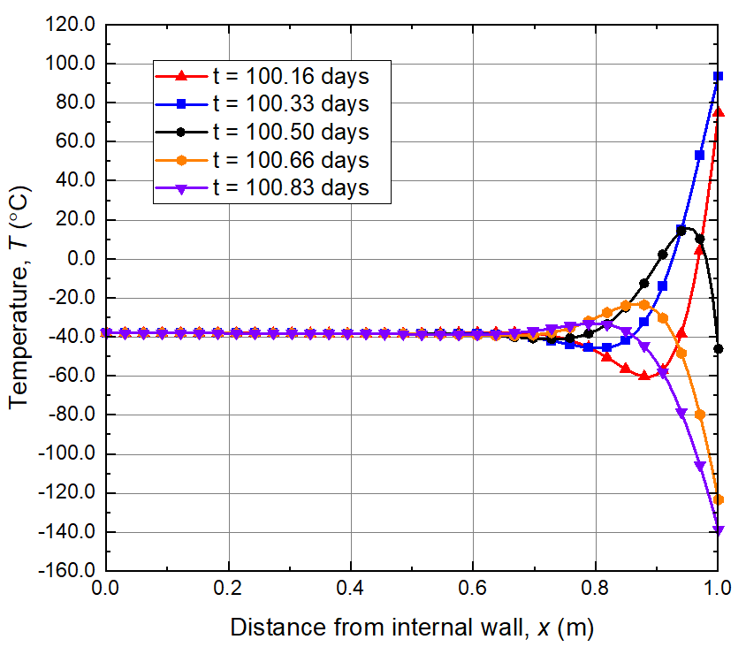
Results
Case 1: Without temperature control
  Considering inner ambient air heat storage term
4
3
2
1
Natural convection
Conduction
Radiation
Wall thickness
t = 1 meter
Wall temperature at quasi-steady state during night time
Wall temperature profile along the wall at different instantaneous times

Slide 13
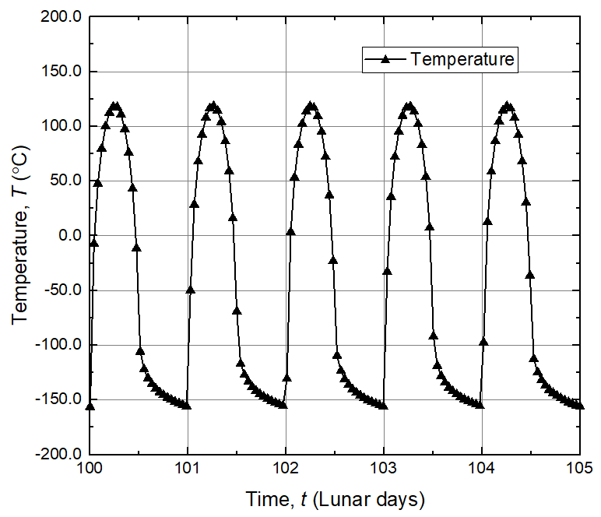
Results (Cont’d)
Case 1: Without temperature control
  Considering inner ambient air heat storage term
4
3
2
1
Natural convection
Conduction
Radiation
Wall thickness
t = 1 meter
Outer wall temperature at quasi-steady state

Slide 14
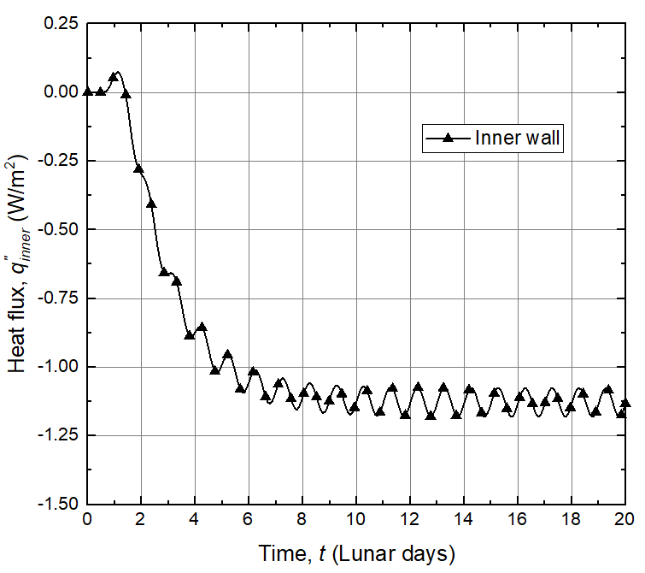
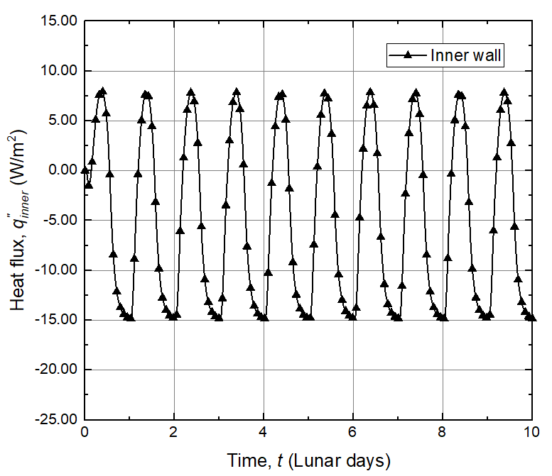
Results (Cont’d)
Case 2: Thermal requirements for different wall thicknesses
  Environment temperature maintained at 20℃
4
3
2
1
Natural convection
Conduction
Radiation
-5.07 W/m²
-1.125 W/m²
Inner wall heat flux for 0.5 m thickness
Inner wall heat flux for 0.1 m thickness

Slide 15
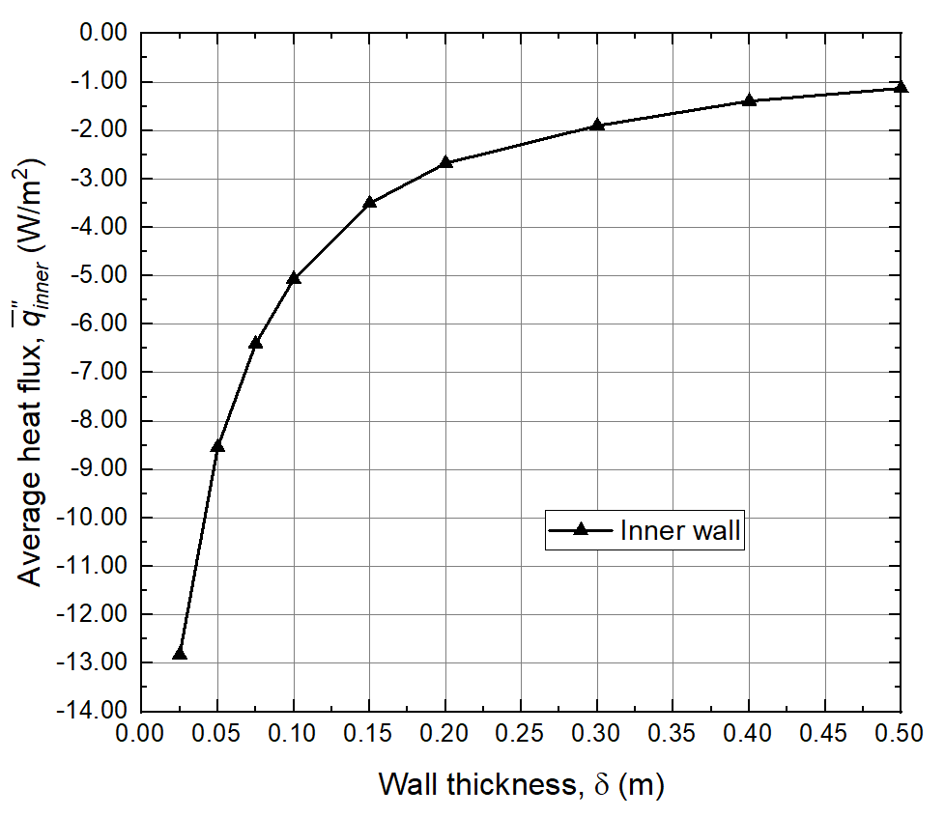
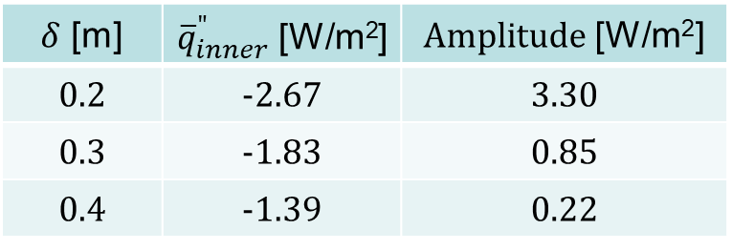
Results (Cont’d)
Case 2: Thermal requirements for different wall thicknesses
  Assuming ambient living environment temperature maintained at 20℃
  Floor area = 78.54 m²
  Wall area = 157.1 m²
$δ$ [m] | ${\overline{q}}_{inner}^{"}$ [W/m²] | $Amplitude$ [W/m²]
0.2 | -2.67 | 3.30
0.3 | -1.83 | 0.85
0.4 | -1.39 | 0.22
E. Krecke et.al, “Connection of Solar and Near Surface Geothermal Energy in Isomax Technology”, Central Europe towards Sustainable Building Conference, September 24-26, Prague, Czech Republic, 2007.
Notes:
10-20W/sqr foot area.
Normal household in winter loses 6.93 W/m²

Slide 16
Results (Cont’d)
Case 3: Considering floor effects
  Assuming ambient living environment temperature maintained at 20℃
  0.3 meters below the floor the temperature of the soil is constant at -18.35℃
  The habitat loses 1.271 W/m² through the floor
R.B. Malla and K.M. Brown, “Determination of Temperature Variation on Lunar Surface and Subsurface for Habitat Analysis and Design,” Acta Astronautica, 107, pp. 196-207, 2015.
E. Radziemska and W.M. Lewandowski, Applied Energy, 68, 347, 2001.

Slide 17
Conclusions
An inhouse MATLAB code was developed to conduct transient thermal analysis of prototypical lunar habitat using regolith as the wall material
Without thermal management systems the habitat loses heat to the environment throughout the lunar day and night cycles resulting in an internal temperature of -40℃
Wall thickness parametric study show that a reduction in wall thickness result in an exponential increase in average heat loss to environment with larger amplitudes
  This implies an exponentially greater heating requirement and necessitates a PID thermostat that alternates between cooling and heating configurations
A thickness of 0.3 m wall thickness was recommended to minimize the internal heat flux fluctuations necessitating a consistent heater output of 387 W to maintain comfortable temperatures of 20℃

Slide 18
Future Work
MATLAB code development for spherical coordinates
Consideration of composite materials for habitat wall
Implementation of heat generation terms to account for heating/cooling requirements
Include solar reflection from the surrounding environment for the heat flux boundary condition

Slide 19
Thank You
and
Questions?

