Slide 1


Variable Emissivity Materials for Thermal Radiators: Modeling and Applications
TFAWS Passive Thermal Paper Session (TFAWS2024-PT-40)
Presented By
Dr. Derek Hengeveld, Redwire
Thermal & Fluids Analysis Workshop
TFAWS 2024
August 26-30, 2024
NASA Glenn Research Center
Cleveland, OH

Slide 2
Overview
Variable Emissivity Materials (VEMs)
VEM Thermal Modeling
VEM Applications
SPIRRAL

Slide 3
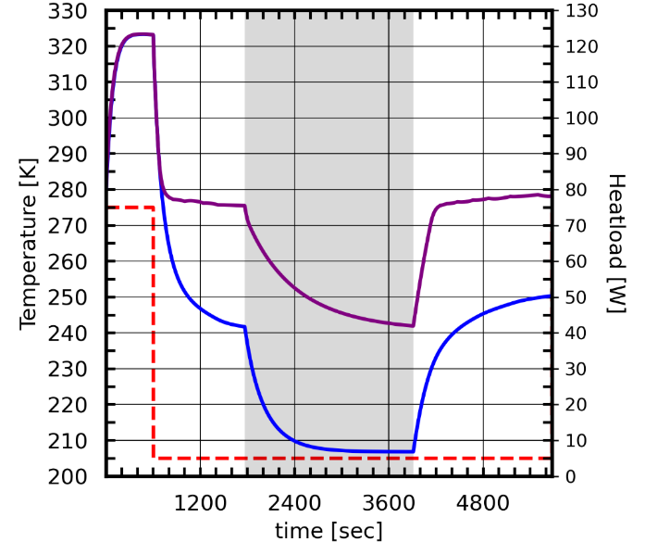
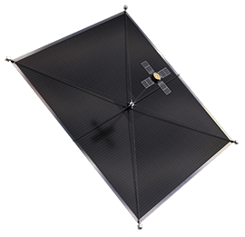

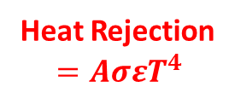
Variable Emissivity Materials (VEMs)
The Problem
Eclipse
Spacecraft (S/C) radiators are sized for hot conditions
Existing fixed emissivity materials (FEM) let S/C get too cold without heaters
VEM ε = 0.2 to 0.8
SPIRRAL is bringing to fruition the holy grail of space thermal control: VEMs.
Heat Rejection
$$=AσεT^{4}$$
30°C savings
ε = 0.8
The
Solution
VEM Value Proposition
Thermochromic Variable Emissivity Materials (VEMs)
IR emissivity (ε) passively changes in response to temperature
Holy grail of S/C thermal for past 30+ yrs
Simulated exemplary spacecraft in LEO with/without VEM
Hardware that would have gone to -65°C in eclipse goes to -30°C with VEMs
ThinSats of the future will achieve even better savings
VEMs would also provide 3-4x less heater demand

Slide 4

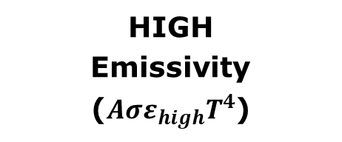
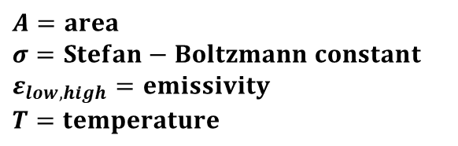
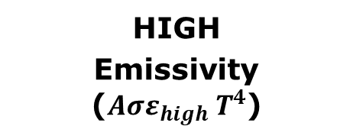
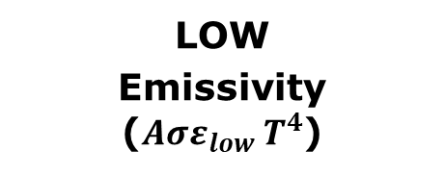
Variable Emissivity Materials (VEMs)
VEM
Traditional
HIGH
Emissivity
($Aσε_{high}T^{4}$)
LOW
Emissivity ($Aσε_{low}{ T}^{4}$)
HIGH
Emissivity ($Aσε_{high}{ T}^{4}$)
High ε is critical for heat rejection
Albedo
S/C
S/C
S/C
Eclipse
Direct
Solar
Earth
IR
Earth
IR
Internal Heat
Reduced
heater requirements
Increased
heater
requirements
$$A=area$$
$$σ=Stefan−Boltzmann constant$$
$$ε_{low,high}=emissivity$$
$$T=temperature$$

Slide 5
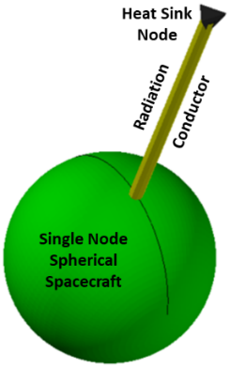
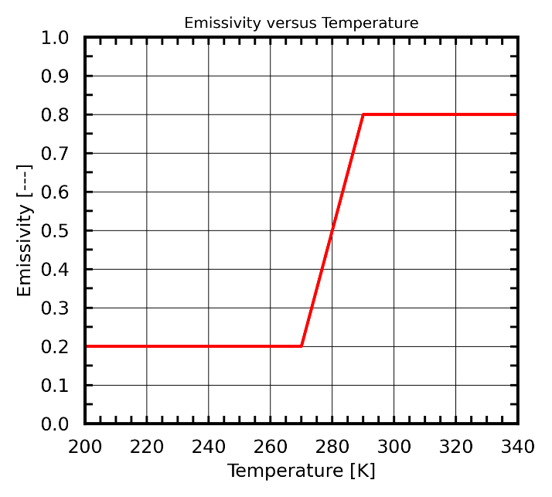
VEM Thermal Modeling
Traditional thermal modeling tools (Thermal Desktop®) assume fixed optical properties (ε = constant).
How to handle VEMs; ε = f(T)?
Three methods developed to handle VEMs
Radiation conductor (with and without Dynamic SINDA)
  Node-to-surface conductor with temperature dependent optical property. Inexpensive and simple but limited.
Radiation Database
  Pre-run radiation jobs across temperature bands. Not as versatile but less expensive than Dynamic SINDA.
  Do all the computationally expensive ray tracing ahead of time. Requires additional logic/code.
Radiation conductor
Radiation Database Bands
2023 ICES/TFAWS – Hengeveld and Allison - Novel Methods for Modeling Thermochromic Variable Emissivity Surfaces

Slide 6
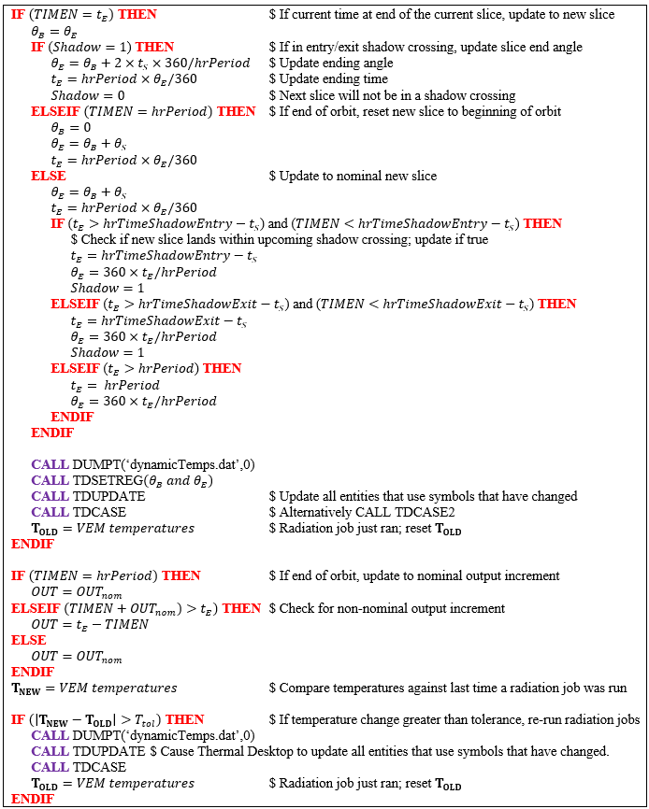
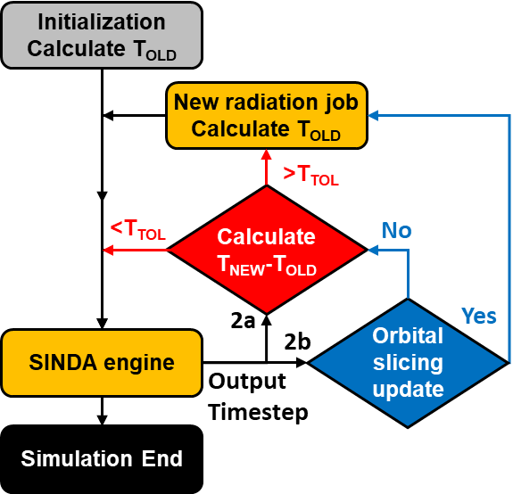
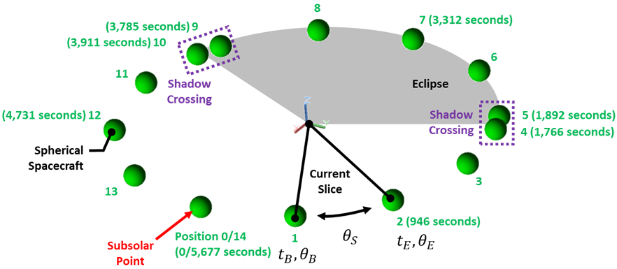
VEM Thermal Modeling
Dynamic SINDA
(with and without orbital slicing)
  Leverages Dynamic SINDA
  Temperature-dependent optical property
  Periodically pause current SINDA solution, update radiation jobs (e.g., Radk and Heating Rates), then resume
    Based on VEM temperatures
Most versatile method but can be computationally expensive
Pseudocode
Dynamic
SINDA
Method

Slide 7
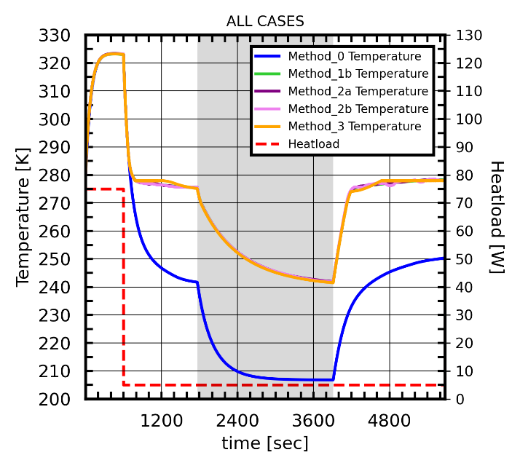
VEM Thermal Modeling
All methods were compared
  Good agreement with one another; +/-1.5°C
  Some differences. Likely a result of temperature band resolution and differences in orbital positions
Dynamic SINDA
  Used to evaluate to applications; CubeSat and ThinSat
Method | Description | Application | Computational Cost
1a | Radiation Conductor (without Dynamic SINDA) | Single VEM surface without spacecraft IR (emissivity-dependent) environmental heating | Low (10 seconds)
1b | Radiation Conductor (with Dynamic SINDA every 2 seconds) | Single VEM surface with spacecraft IR (emissivity-dependent) environmental heating | Extremely High (2,196 seconds)
2a | Dynamic SINDA (without orbital slicing) | Any number of VEM surfaces; any heating environment | High (162 seconds)
2b | Dynamic SINDA (with orbital slicing) | Any number of VEM surfaces; any heating environment | Medium-High (146 seconds)
3 | Radiation Database | Single VEM surface with emissivity-dependent environmental heating | Medium-Low (20 seconds)

Slide 8
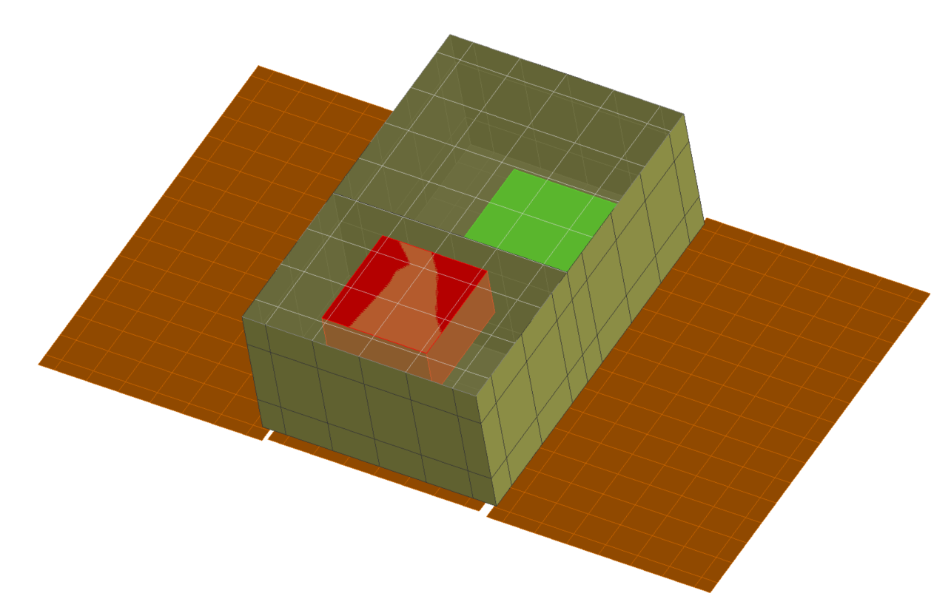
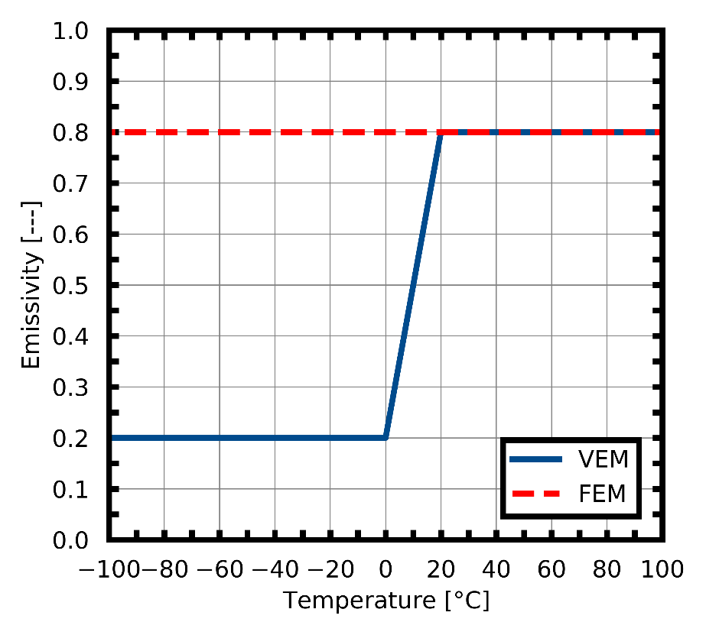
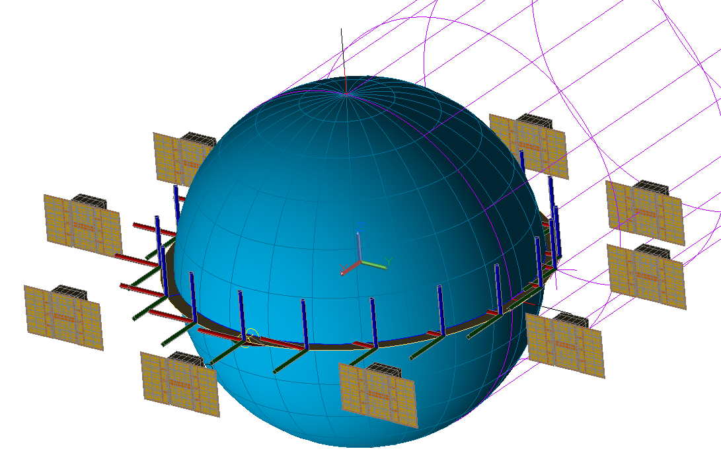
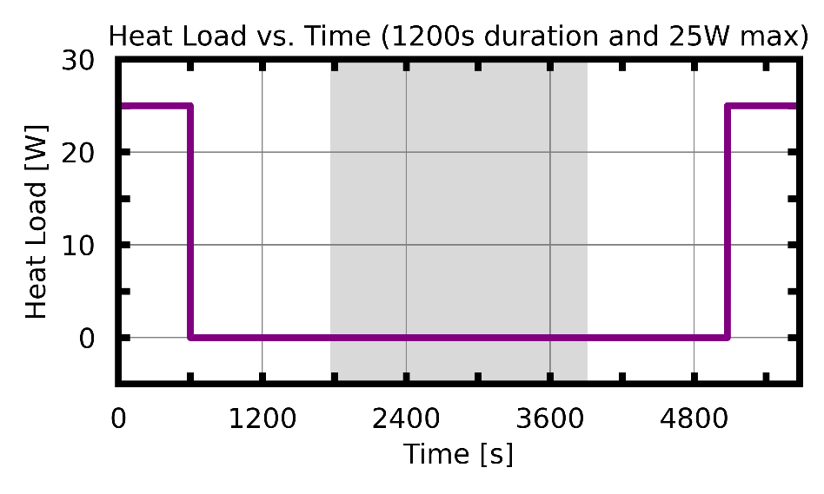
VEM Applications: CubeSat
6U CubeSat
  500 km, β= 0°, circular orbit, sun-pointing solar array
Payload (P/L) Heat Load
  Off and 25W max
Range of operational durations/duty-cycles
  Payload protected with 10W heater (-3°C on; 0°C off)
Exterior surfaces coated with either FEM or VEM
  VEM is 5 surfaces; FEM is 3 surfaces (to reduce
  heater energy requirements)
Payload
ε = VEM/FEM
α = 0.2
Solar
Panel
6U CubeSat
Thermal Desktop Model
Example emissivity vs. temperature
Eclipse

Slide 9
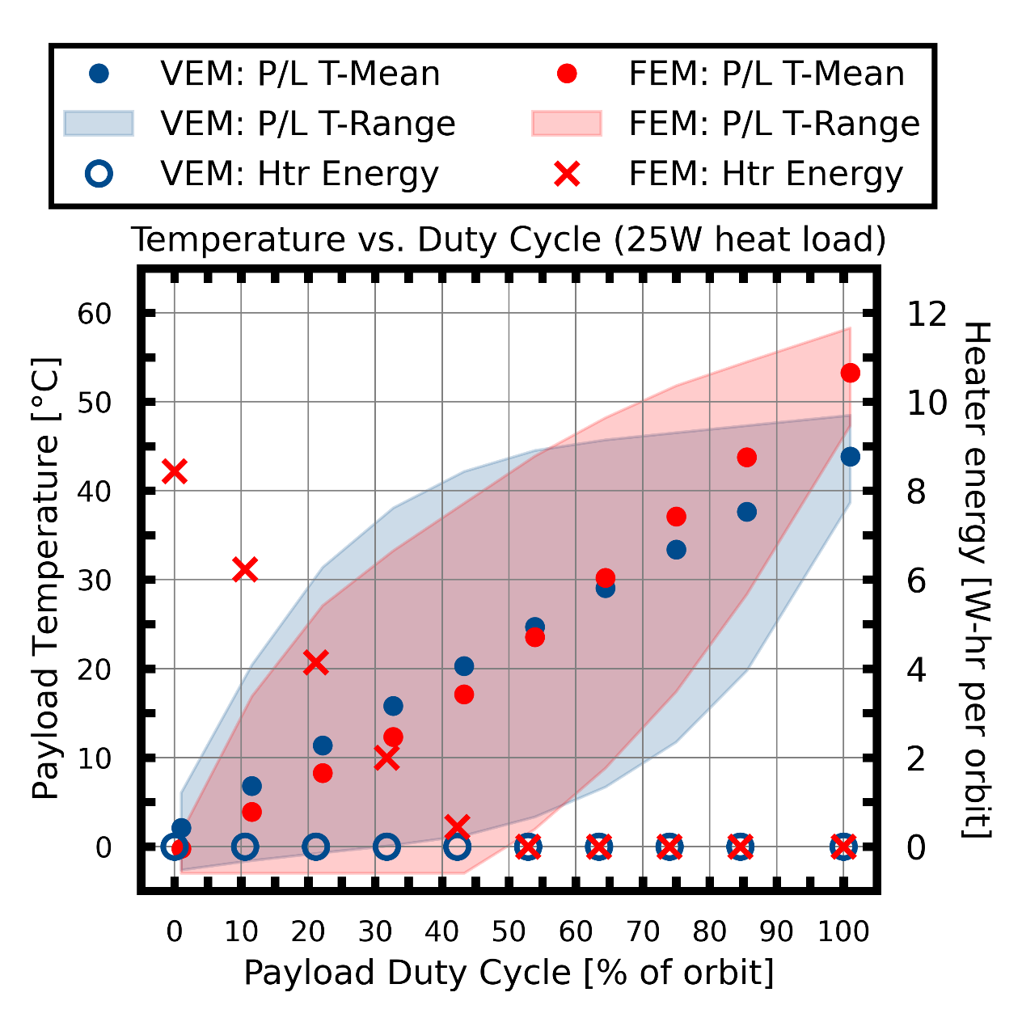
VEM Applications: CubeSat
VEMs provide reduction in required heater energy at low duty cycles
  6 W-hr per orbit (FEM) vs. 0 W-hr per orbit (VEM) at 0% duty cycle (off)
VEM payload runs cooler at higher duty cycles
  Result of high ε radiator surface and more radiating area
  VEMs provide a one-size-fits-most approach
Plot of payload temperature versus duty cycle for VEM/FEM designs

Slide 10
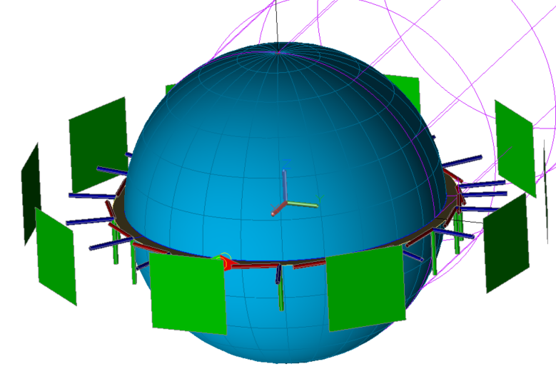
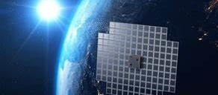
VEM Applications: ThinSat
Nadir pointing Thinsat
Large, thin satellites
Thermal Desktop® model
  500 km, β = 0°, circular orbit
  20 kg, 3 node model; 1x1 m Thinsat (1 cm thick)
Payload/Thinsat (P/L) Heat Load
  0 W/m² to 2,000 W/m²; 600 second transient profile
  1,000 W/m² cold-protection from 0 to 5°C
Exterior surfaces coated with FEM or VEM
  Same thermo-optical properties as CubeSat application
  Same radiator area for both
Example emissivity vs. temperature
AST BlueWalker 3
(ast-science.com)

Slide 11
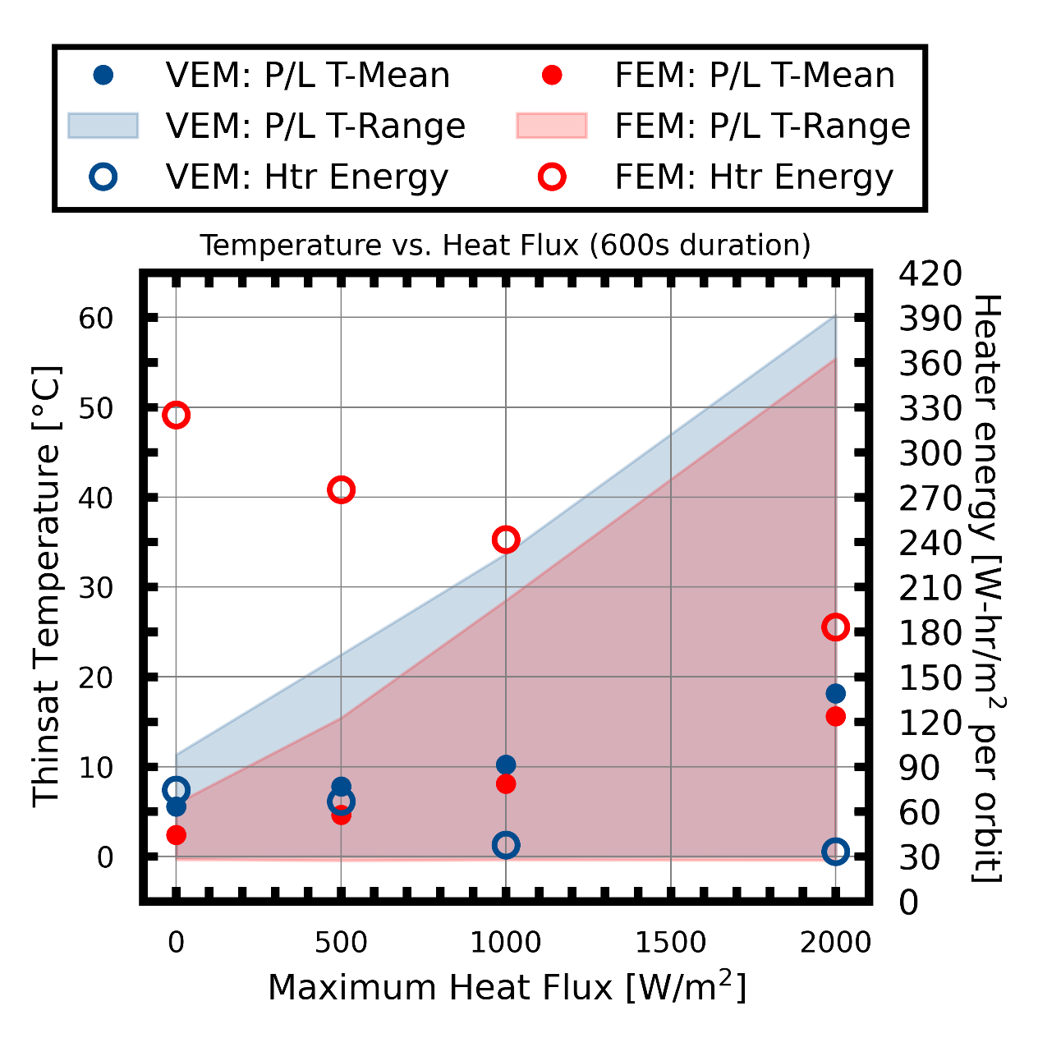
VEM Applications: ThinSat
VEMs provide reduction in required heater energy
  330 W-hr/m²/orbit (FEM)
    ~90% more than available body mount solar array (SA) generation; would require deployable SA solution
  84 W-hr/m²/orbit (VEM)
    Would not require deployable SA solution
  For given heat load, VEMs (notional) run warmer than FEM
    Result of lower orbital averaged ε
VEM advantages
  Simple, no-moving parts
  Scalable and robust
  Little size, mass, depth
  Simple AI&T
  Reduced/elimination of heater power demand
75% reduction in required heater power (211 W/m² to 53 W/m² )
Plot of payload temperature versus max heat flux for VEM/FEM designs
Notes:
Solar Energy Generated ~= 1400 W/m2 x 0.25 x 0.32 x 5676 / 3600 = 176 W-hr per orbit
0.25 = approximate solar array conversion efficiency
0.32 = approximate average cos(theta) over entire orbit
5676 = orbital period in seconds
3600 = seconds/hr

Slide 12
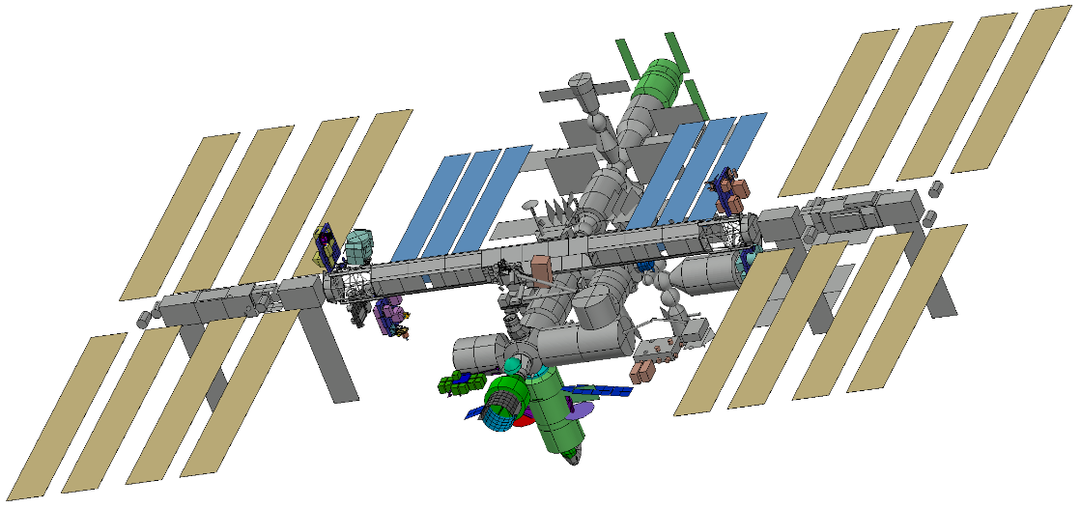
SPIRRAL
Space Power IR Regulation and Assessment of Lifetime (SPIRRAL)
  Measures VEM IR emissivity (ε) and solar absorptivity (α) throughout 1 yr ISS mission
  Determine space effects on VEMs
SPIRRAL consists of
  18 active ‘sites’ (13 VEMs + 5 control samples); power and temperature controlled
  Plus, space effects sensors and passive area
Typically, ε and α are constant vs temperature; not for SPIRRAL!
How do we measure VEM ε and α?
  Testing: Ground and Spaceflight calorimetry
  Thermal modeling
  Data analysis
ISS Thermal Model showing SPIRRAL location
Controls
(constant ε and α)
5 total
VEMs
13 total
UV/AO
sensors
Passive
Sample area
Rendering of ISS SPIRRAL Experiment

Slide 13
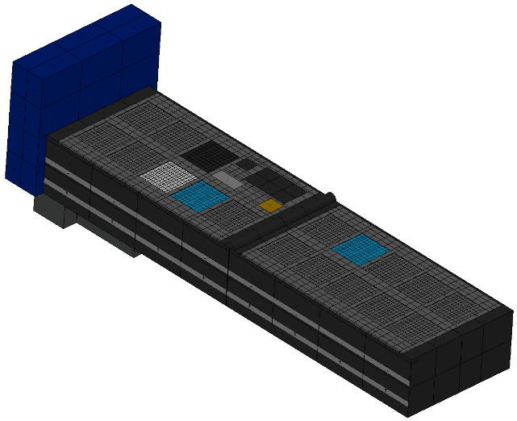
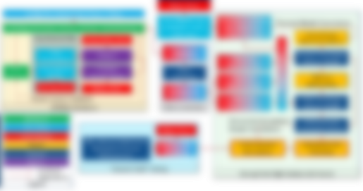
SPIRRAL
Experiment Design and Techniques
Provides highest signal-to-noise data
Thermal Modeling
Constrains realm of the possible; filters for best data sources & methods
Data Analysis
Provides high-confidence flight TOPs results. Manages highly noisy thermal data.
SPIRRAL is Targeting industry standard TOP measurement of +/- 3 basis points 1-sigma standard uncertainty, industry standard spec for spacecraft finishes. The ultimate goal of SPIRRAL is to enable tech transition of VEMs.

Slide 14
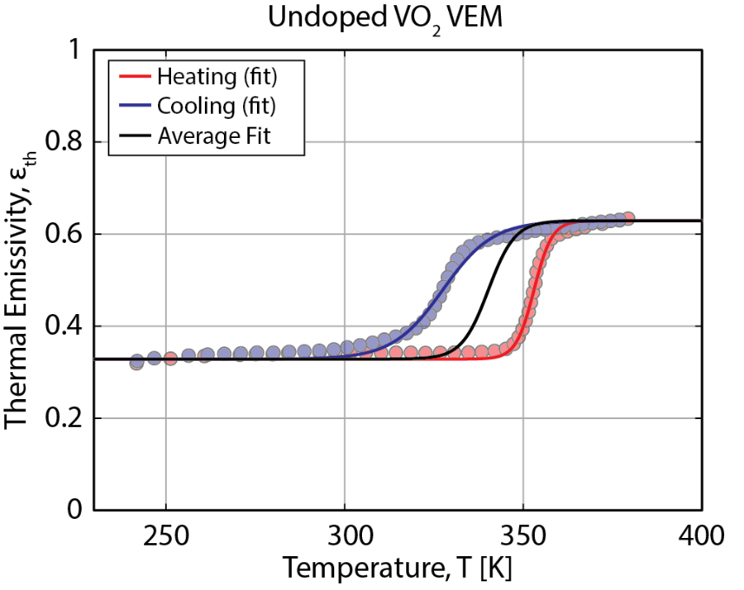
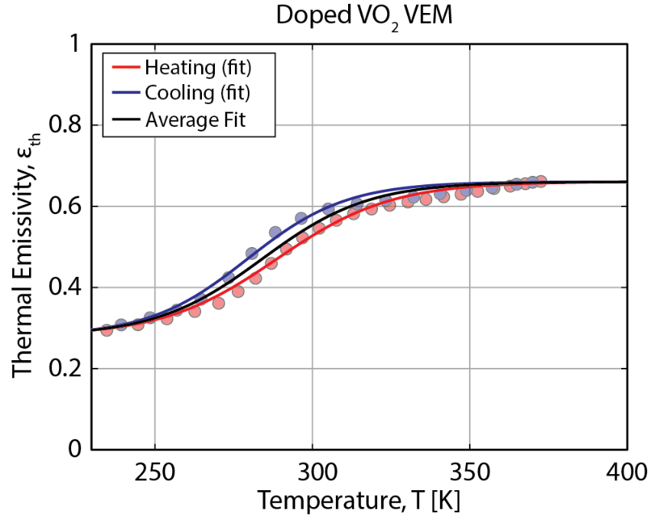

SPIRRAL: VEM Characterization - Logistic Model
Logistic model
  Captures both the asymptotic and transition characteristics of VEMs
Full thermal emissivity characteristics
  Suggests a more comprehensive set of key performance parameters used to design, optimize, characterize, and model VEMs used for spacecraft thermal control.
Asymptotic Emissivity (Hot)
Asymptotic Emissivity (Cold)
$$ε_{th}\left(T\right)=ε_{th,c}+\frac{ε_{th,h}−ε_{th,c}}{1+e^{−k\left(T−T^{∗}\right)}}$$
Transition Rate
Midpoint Transition Temperature
2024 AIAA SciTech - Barako - Variable Emissivity Thermal Radiators: Methods and Models for Characterizing Thermochromic Infrared Surfaces

Slide 15
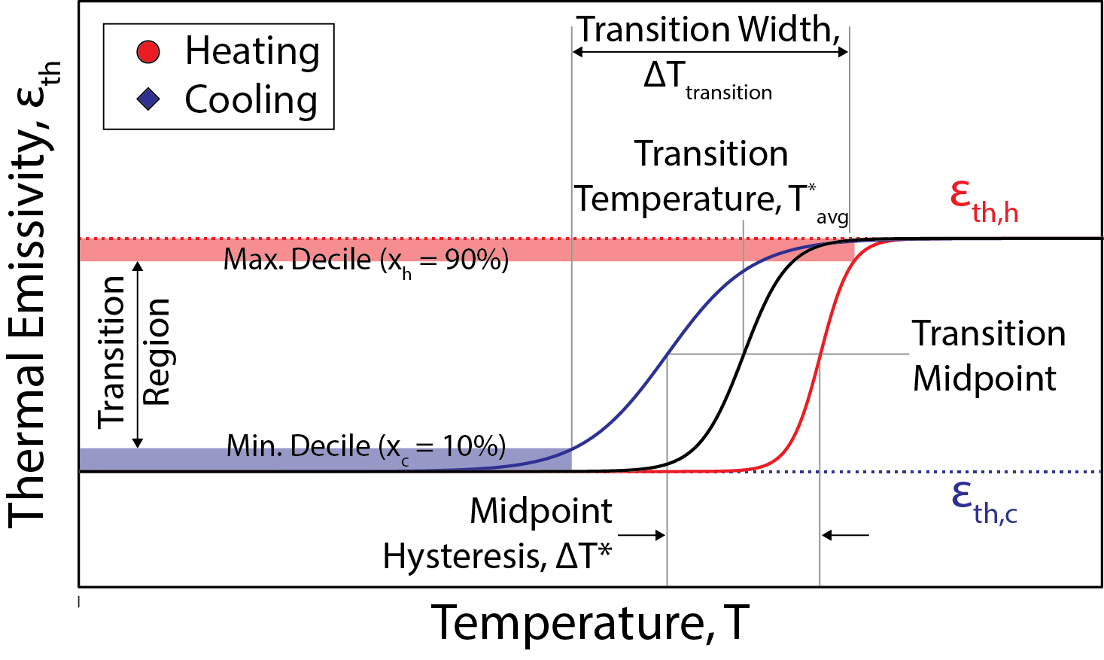
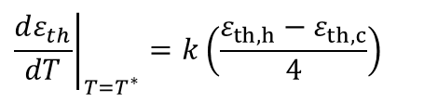

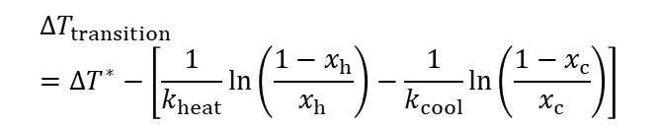

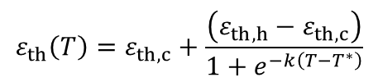
SPIRRAL: VEM Characterization - Logistic Model
Variable Thermal Emissivity
$$ε_{th}\left(T\right)=ε_{th,c}+\frac{\left(ε_{th,h}−ε_{th,c}\right)}{1+e^{−k\left(T−T^{∗}\right)}}$$
Transition Temperature
$$T_{avg}^{∗}=\frac{T_{heat}^{∗}−T_{cool}^{∗}}{2}$$
Hot threshold, x_{h} = 90% (maximum decile)
Cold threshold, x_{c} = 10% (minimum decile)
Transition Width
$${ΔT}_{transition}={ΔT}^{∗}−\left[\frac{1}{k_{heat}}\ln\left(\frac{1−x_{h}}{x_{h}}\right)−\frac{1}{k_{cool}}\ln\left(\frac{1−x_{c}}{x_{c}}\right)\right]$$
Transition Rate
$${\left.\frac{dε_{th}}{dT}\right|}_{T=T^{∗}}=k\left(\frac{ε_{th,h}−ε_{th,c}}{4}\right)$$
Hysteresis
$${ΔT}^{∗}=T_{heat}^{∗}−T_{cool}^{∗}$$

Slide 16
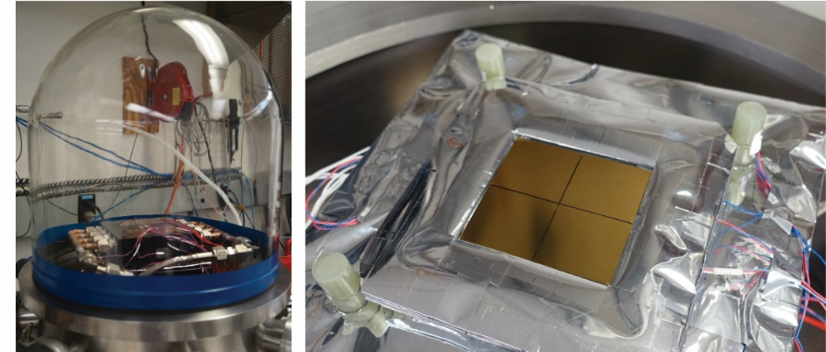


SPIRRAL: VEM Measurement - Ground Calorimetry
Direct Measurement of Thermal Emissivity
  Calorimetry used to measure radiative heat flux emitted from a surface as a function of surface temperature
  Yields complete temperature-dependent thermal emissivity.
Calibrating Heat Losses
  Combined multimodal heat losses (i.e. all of the energy not radiated from the sample surface) calculated by performing calorimetry on reference samples of stable, constant thermal emissivity and only depends on sample temperature.
Steady State Energy Balance
$$Q_{in}=Q_{rad}\left(T\right)+Q_{loss}\left(T\right)$$
Input Power
Heat Loss
$${Q_{rad}\left(T\right)=ε}_{th,ref}σ\left(T^{4}−T_{0}^{4}\right)$$
2024 AIAA SciTech - Barako - Variable Emissivity Thermal Radiators: Methods and Models for Characterizing Thermochromic Infrared Surfaces
TFAWS 2024 – August 26-30, 2024
DISTRIBUTION A: Approved for public release: distribution is unlimited. Public Affairs release approval AFRL20244211

Slide 17

SPIRRAL: VEM Measurement - Ground Calorimetry
Similar challenges to ground calorimetry…
  Control heat loss (conductive and radiative)
  Measurement knowledge imperfect (i.e., uncertainty); poor signal-to-noise ratio (SNR)
  Good experiment design critical for successful calorimetry
  Non-isothermality in both space & time
…but with space environment
  Transient thermal loads (e.g., SAP, IR from adjacent surfaces, reflections)
  Must know thermal backloading before you can calculate VEM TOPs W/calorimetry
    Use multiple control tiles with well-known thermo-optical coatings
    Solve control tile energy balance equation for IR backloading
Transient environmental
loading (short- and long-wave)
Variable Emissivity Material
Wiring heat loss
Heater
Applied
Heat
Load
Surface heat
loss
Mounting heat loss
Conductive/Radiative
Heat Flow
Energy Balance Model
$$Emissivity=\frac{Net Heat Load}{Surface Area∗Constant∗Temperature4}$$
$${\dot{Q}}_{h,t}+ε_{t}{\dot{Q}}_{IR}+α_{t}{\dot{Q}}_{solar}−{σA}_{t}ε_{t}T_{t,n}^{4}−{\dot{Q}}_{loss}={\dot{Q}}_{net}$$
$$\left[\begin{matrix}ε_{C1,t} & α_{C1,t} \\ ε_{C2,t} & α_{C2,t}\end{matrix}\right]\left[\begin{matrix}{\dot{Q}}_{IR} \\ {\dot{Q}}_{solar}\end{matrix}\right]=\left[\begin{matrix}{\dot{Q}}_{C1, net}+{\dot{Q}}_{C1,loss}+{σA}_{C1,t}ε_{C1,t}T_{C1,t,n}^{4}−{\dot{Q}}_{C1,h,t} \\ {\dot{Q}}_{C2, net}+{\dot{Q}}_{C2,loss}+{σA}_{C2,t}ε_{C2,t}T_{C2,t,n}^{4}−{\dot{Q}}_{C2,h,t}\end{matrix}\right]$$
2024 AIAA SciTech - Foster - Variable Emissivity Radiator Coatings: Introduction to Characterizing Infrared Surfaces in Space
TFAWS 2024 – August 26-30, 2024
DISTRIBUTION A: Approved for public release: distribution is unlimited. Public Affairs release approval AFRL20244211

Slide 18
VEMs in the literature
Journal of Thermophysics and Heat Transfer
  Evaluating Variable-Emissivity Surfaces for Radiative Thermal Control; Michael Barako et al.
2023 Spacecraft Thermal Control Workshop
  Air Force Research Laboratory Tech Roadmap; Dr. Valerie Lawdensky
52nd International Conference of Environmental Systems (2023)
  Novel Methods for modeling thermochromic variable emissivity surface; Derek Hengeveld and Jon Allison
  Testing and Evaluation of Spacecraft Thermal Isolators for SmallSats; Isaac Foster, Trevor Bird, Derek Hengeveld, and Steven Lockyer
2023 Thermal-Fluids Analysis Workshop
  Novel Methods for modeling thermochromic variable emissivity surface; Derek Hengeveld
AIAA SciTech 2024: Special Session on Variable Emissivity Materials
  Jon Allison: Variable Emissivity Materials: The Natural Solution to the Future of Spacecraft Thermal Regulation
  Derek Hengeveld: Modeling and Application of Thermochromic Variable Emissivity Materials
  Trevor Bird: Thermal Characterization of Bolted Interfaces for Variable Emissivity Materials
  Isaac Foster: Assessment of In-Space Calorimetry of Thermochromic Variable Emissivity Materials
  NGC/NRL: Variable Emissivity Thermal Radiators: Methods and Models for Characterizing Thermochromic Infrared Surfaces

Slide 19

This work is in support of the Space Solar Power Incremental Demonstrations and Research Project (SSPIDR) program and Space Power InfraRed Regulation and Analysis of Lifetime (SPIRRAL) experiment by the Air Force Research Laboratory, Space Vehicles Directorate, Kirtland AFB, NM (AFRL/RV). The views expressed are those of the author and do not necessarily reflect the official policy or position of the Department of the Air Force, the Department of Defense, or the U.S. government.

