Slide 1
TFAWS Passive Thermal Paper Session
Passive Thermal Control for High Power Electronics Boxes
Andrew Kraus
ARKA GROUP, L.P
100 Wooster Heights Road
Danbury, CT 06810-7509
Telephone (203) 797-5000
CAGE No. 8LAC5
©2024 ARKA Group, L.P. All rights reserved.
Trademarks used herein are owned by ARKA Group, L.P.

Slide 2
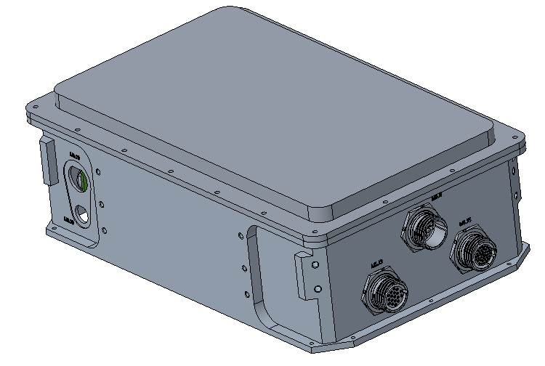
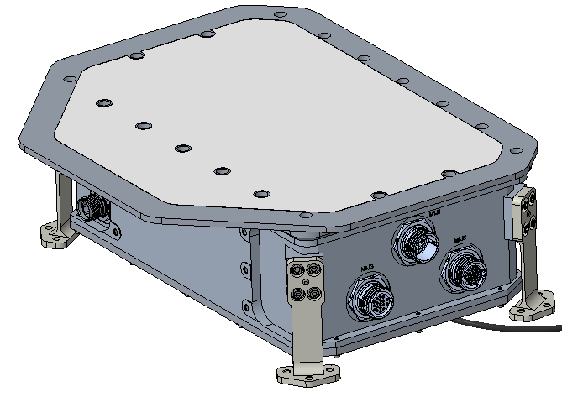
Background
Densely packed electronics box for space application
Select few high-power components with low operational range (85°C)
Requirement for operation with +71°C average enclosure temperature
Heat rejection though conduction and radiation
Design Iterations

Slide 3
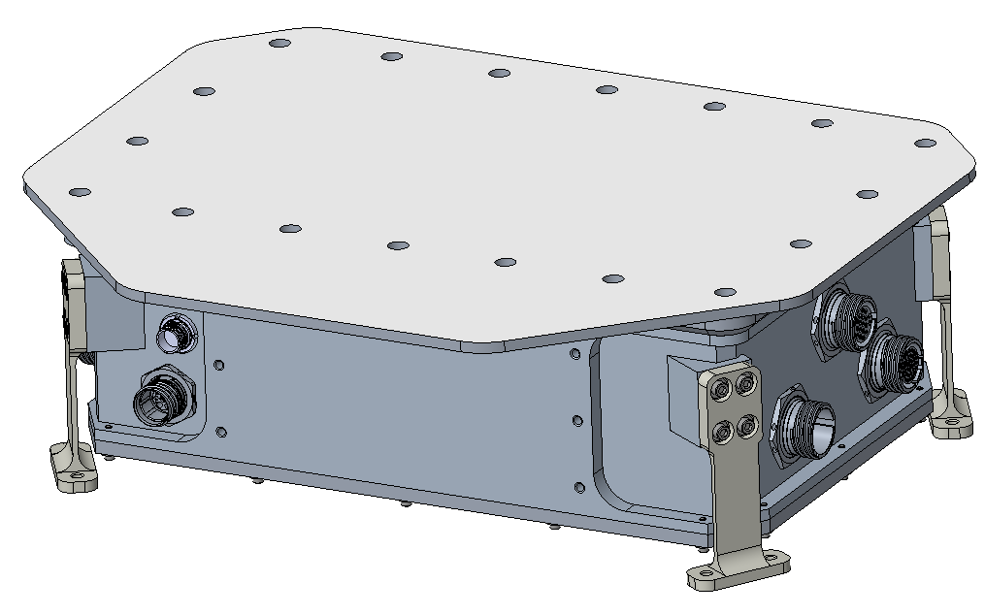
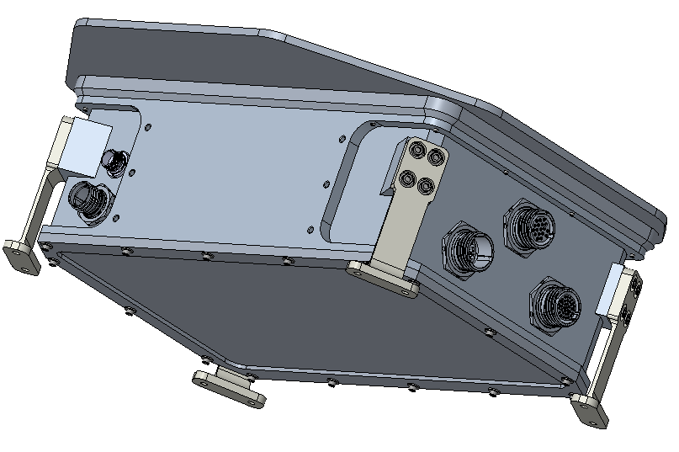
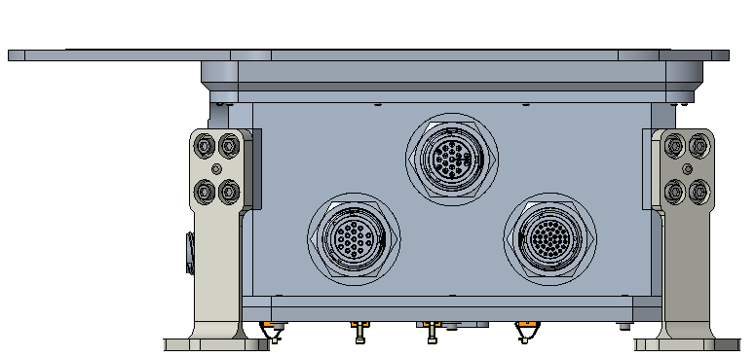
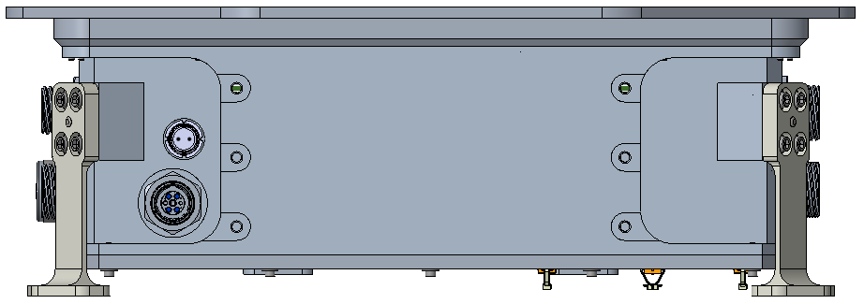
Initial Design
Top Cover/Radiator
Aluminum enclosure electronics box containing 2 boards
Roughly 0.8 ft³ Volume
Top cover converted to FOSR Silver 5mil FEP for first analysis
Titanium flexures to host
Flexures To Host
Bottom Cover
15”
12”
5”

Slide 4
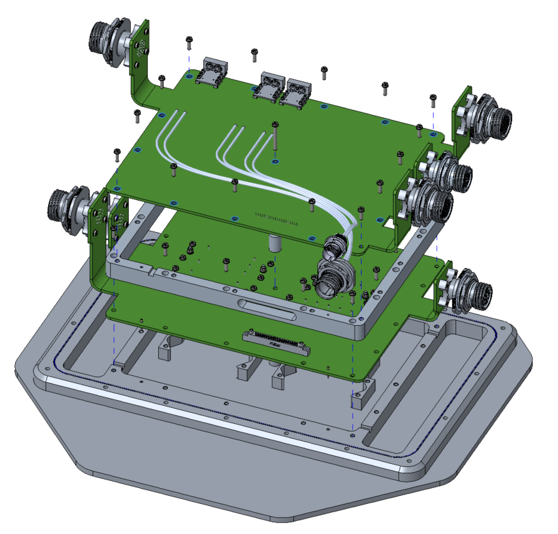
Initial Design
High Power Components
Aluminum enclosure electronics box containing 2 boards
Steady State Power
  ~20 W
  ~1000 components
High Power Components dissipated ~1.5 W each WC
Board 1
Board 2

Slide 5
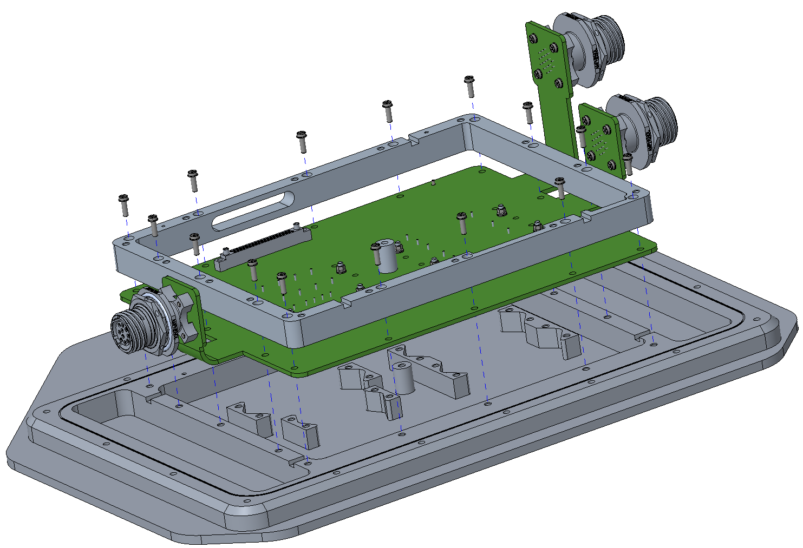
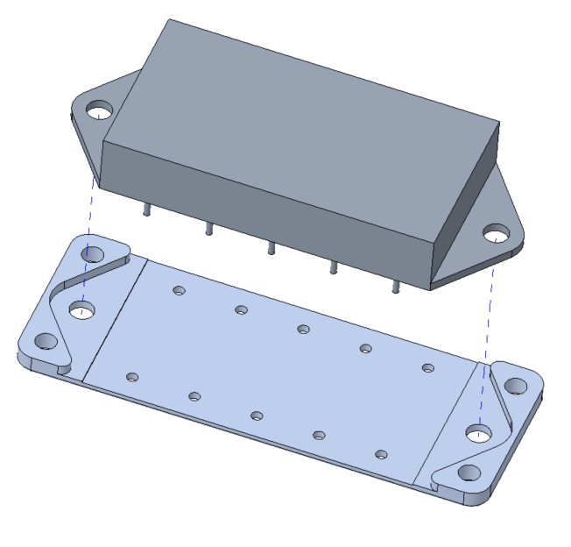
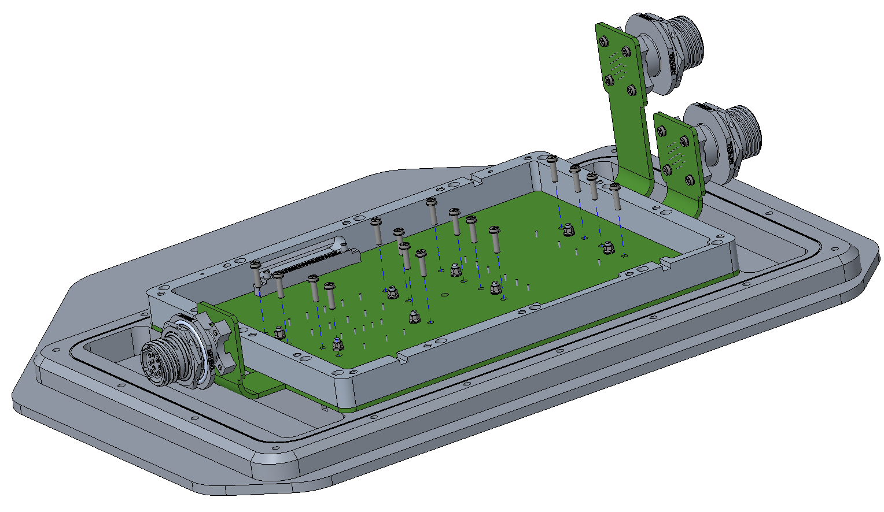
Initial Design
High power converters tied directly to radiator/lid via fasteners
Heat passes from Board 1 through carrier and Board 2 to radiator
Board 2
Board 1 Heat
Converter/Filter heat sink

Slide 6
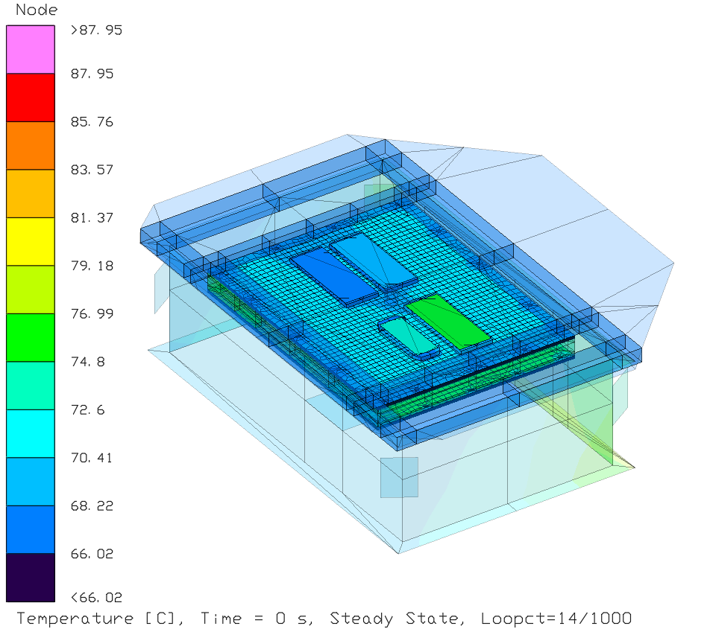
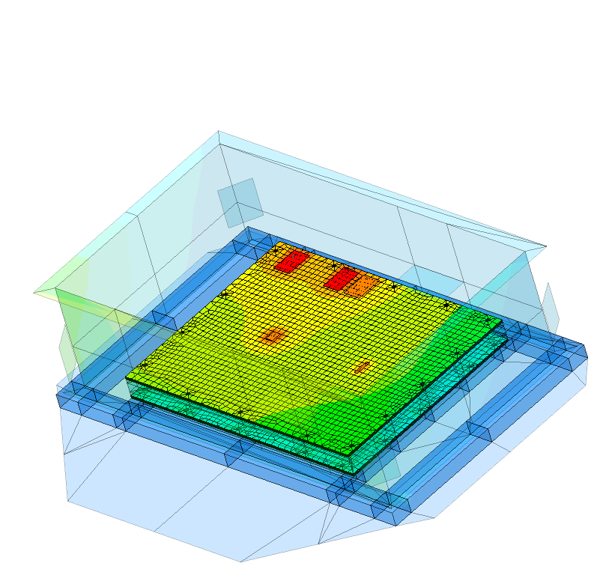
Preliminary Results
Model run in steady state conditions
Radiation turned on
~70% of the power on top 9 dissipating components
High power components on Board 1 over operating limits (+85°C Rating)
High power components on Board 2 showed to be non-issue
(+105°C Rating)
Other components add realizable heat

Slide 7
Design Review
High Power Components
Board 1
High power components need isolation from each other and to better shed heat to environment
Components are lacking information
  Testing required to fill gaps
Board 2

Slide 8
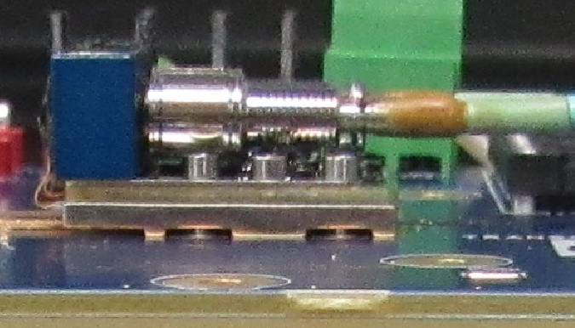
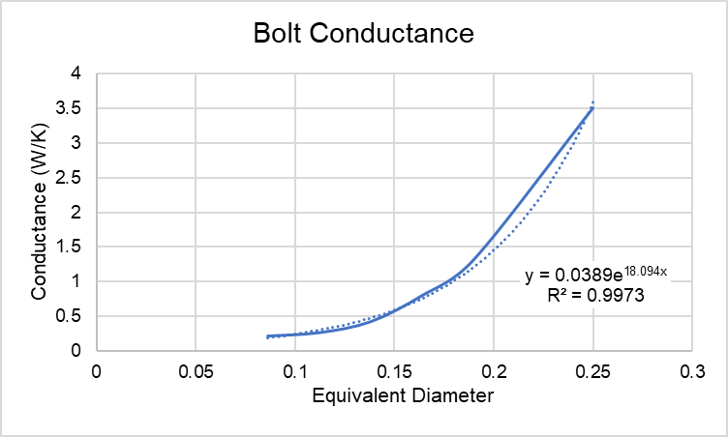
Problem Component Definition
Transceivers use QTY 4 0-80 Fasteners to mount to board
  Prelim analysis used a linearized assumption from bolt conductance table (David Gilmore’s Spacecraft Thermal Control Handbook)
Mounting rails are not in contact around fasteners
  Conductance path assumption is not accurate/predicable

Slide 9
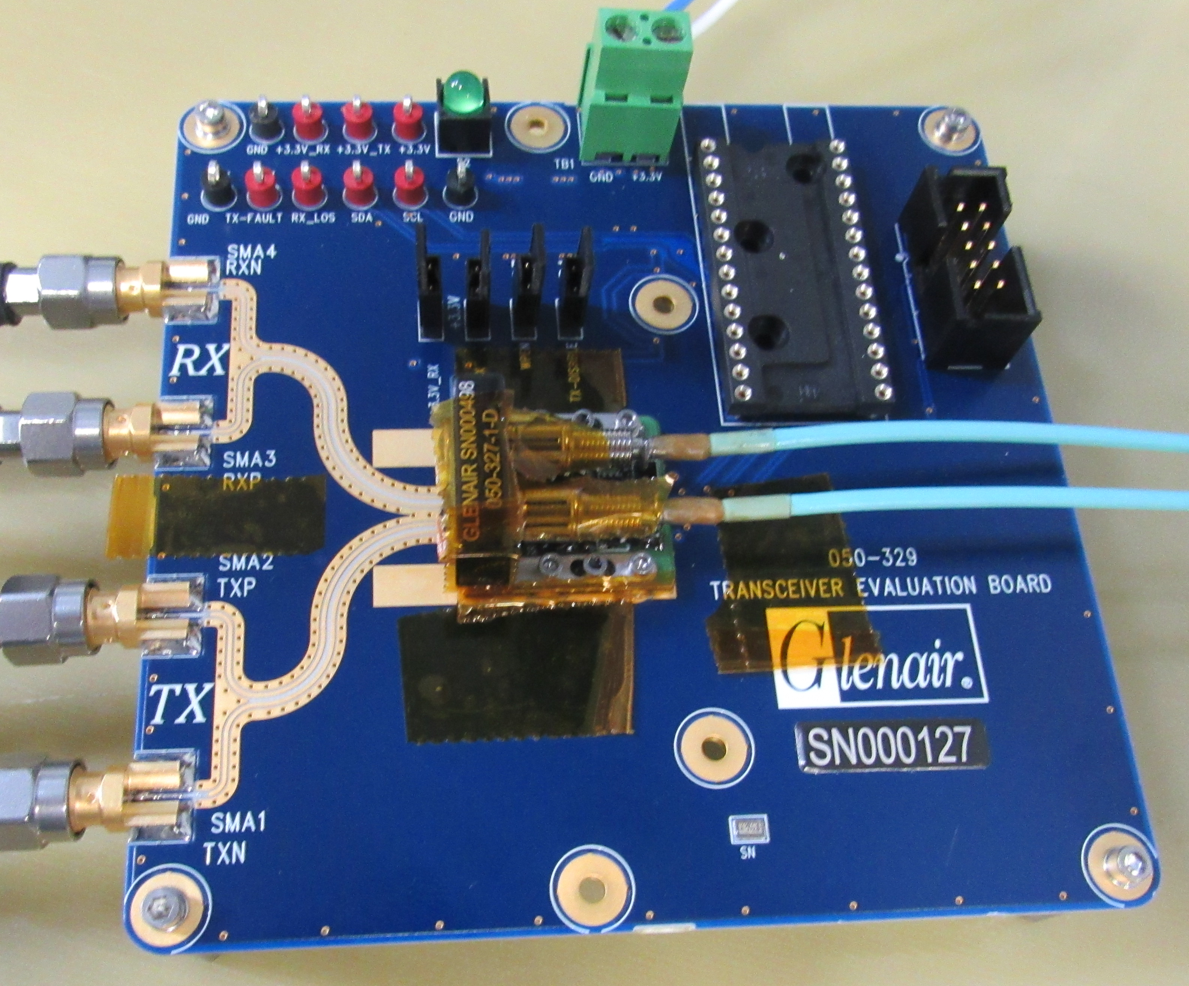
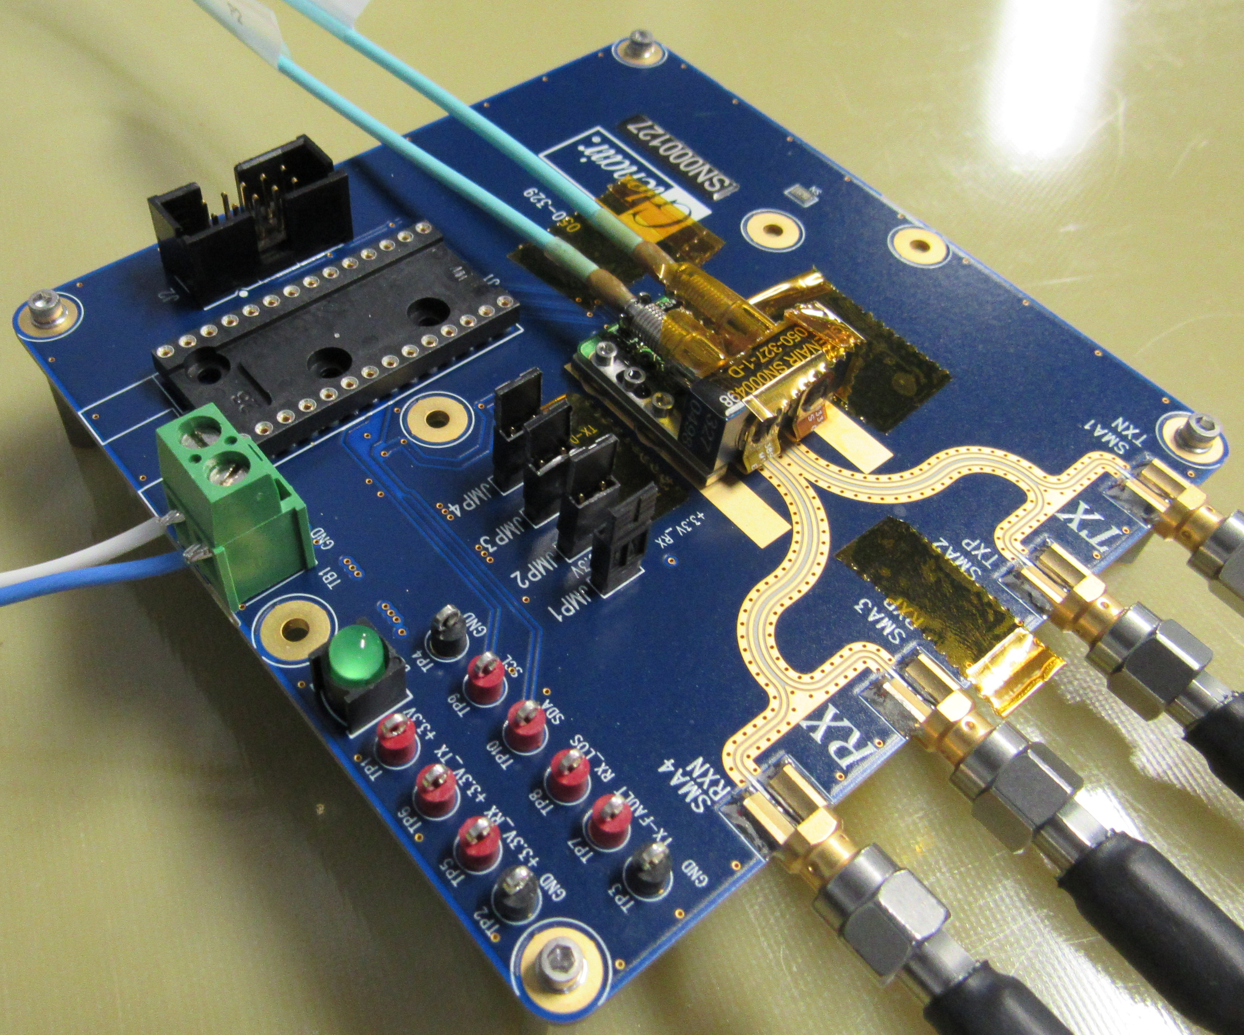
Problem Component Testing
Kapton tape of known emissivity used to create continuity for IR camera measurements
Component powered on for over 1.5 hours as shown in free convection state to ensure soaked condition is met
Data taken with IR camera of various spots to gather local board temp and component temp

Slide 10
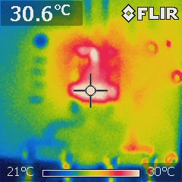
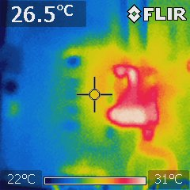
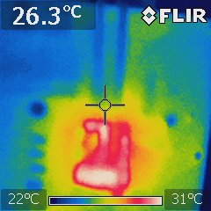
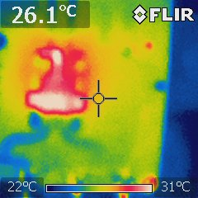
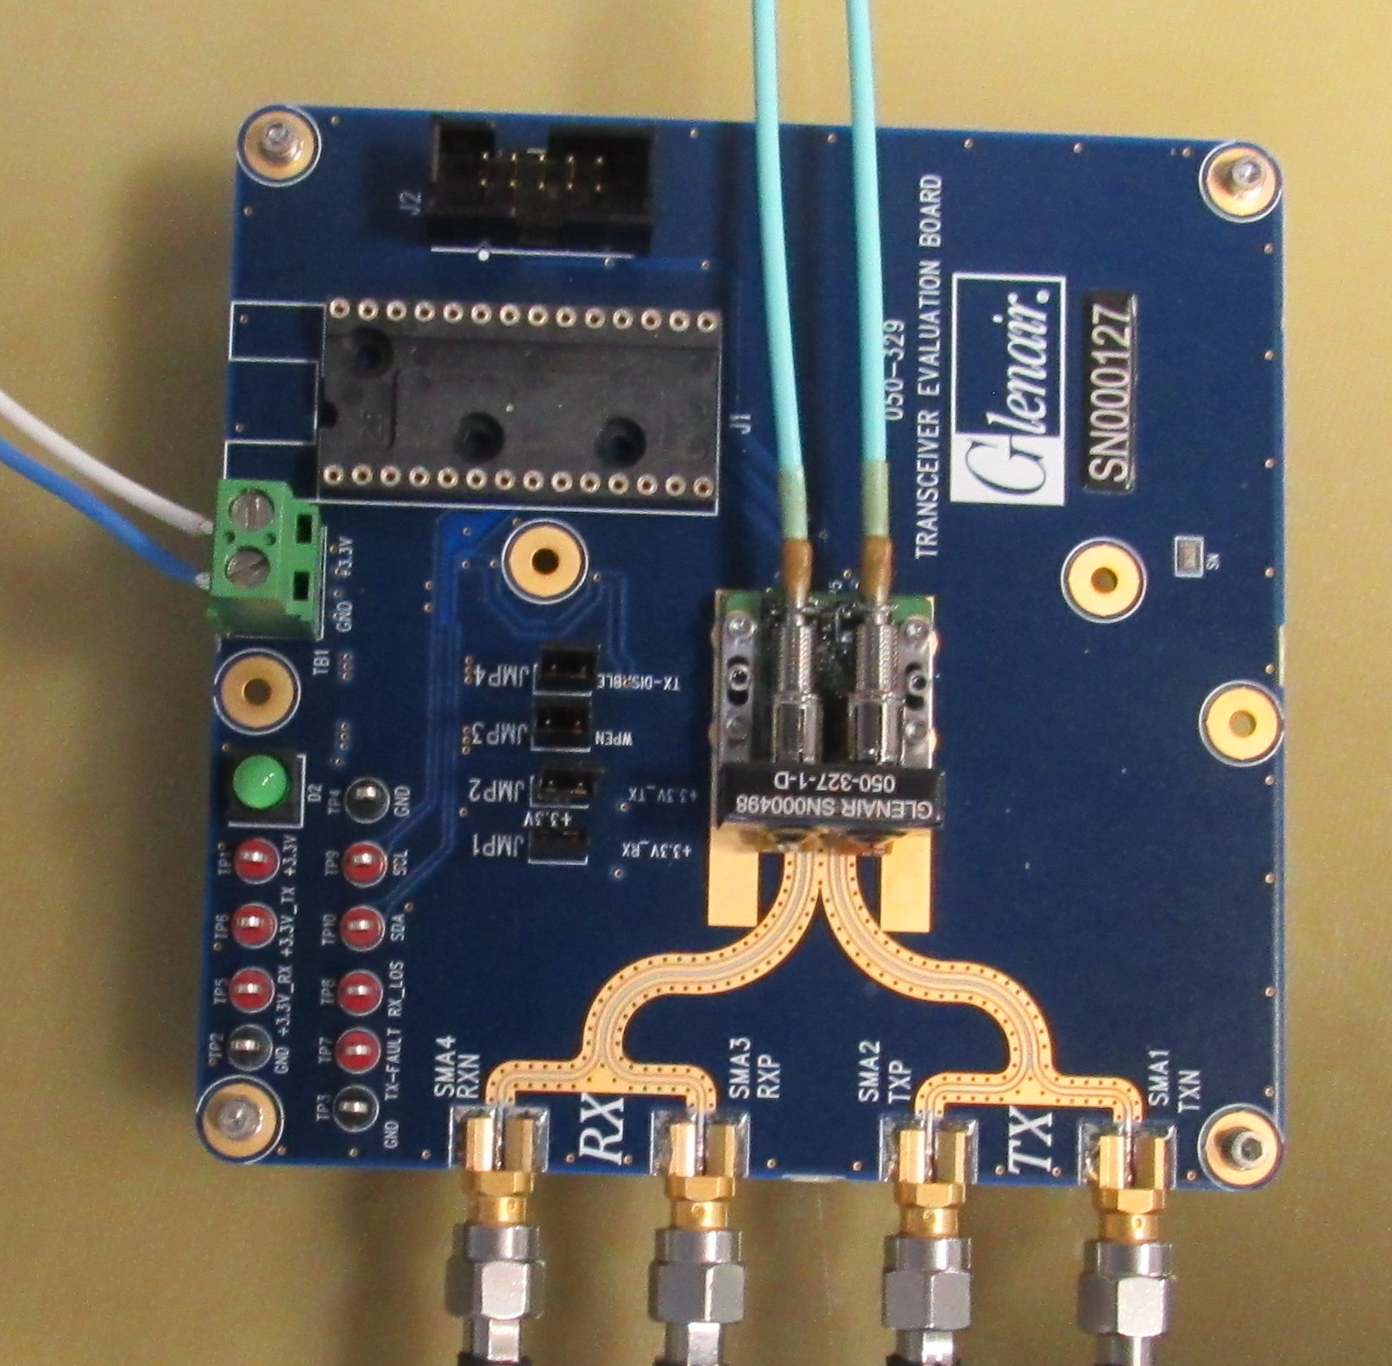
Problem Component Testing
Top Case View, T_{C}
Board Left View, T_{B}
Board Top View, T_{B}
Board Right View, T_{B}
V = 3.34V
I= 0.24A
P = 0.80W
Givens:
T_{C} = 30.6°C (303.75°K)
T_{B} was averaged = 26.3°C (299.45°K)
T_{A} was measured via thermocouple = 20°C (293.15°K)
ε = 0.900
A_{Component} = 0.000961 m²
σ = 5.67E-8 W/(m²K⁴)
h_{c} = 12.12 W/(m²C)
Old Ø_{CB} = 8.696 C/W (STCH)
New Ø_{CB} = 6.903 C/W
Correlation removes ~2°C of model conservatism

Slide 11
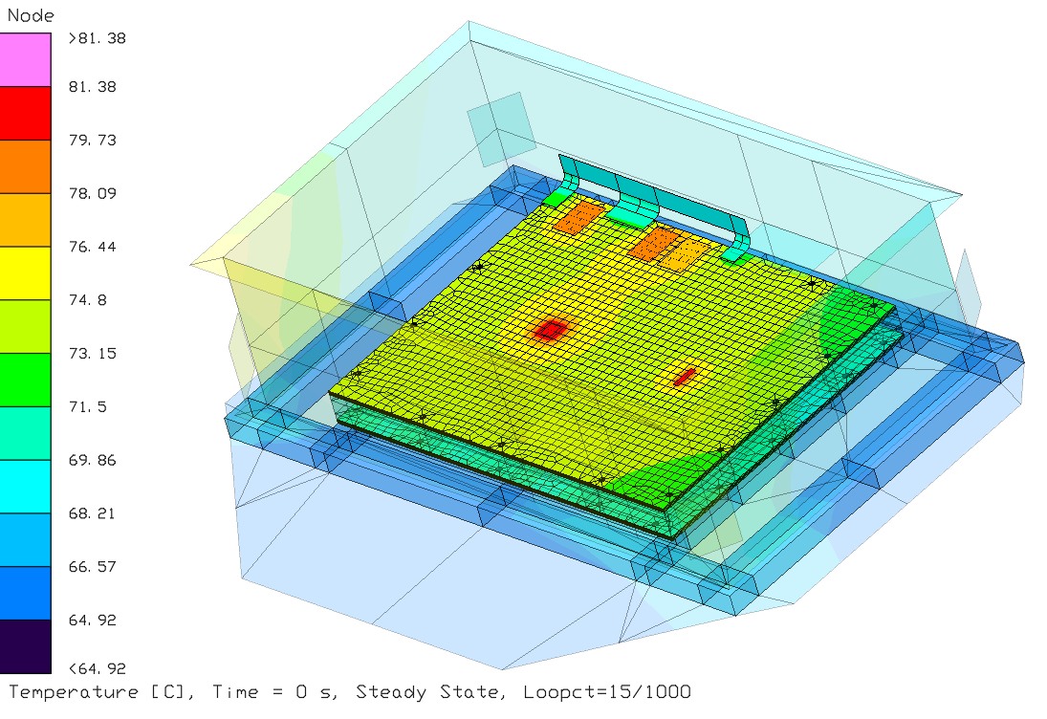
Initial Modification
Conductive tie between other high-power components still exists
Problem:
  Average Board 1 temperature is +78°C
    Heat must be removed from board to allow for compliance
Solution:
  Adding heat strap to board directly ties board to walls of enclosure
  Average Board 1 temperature is now +74°C
Path Forward:
  Modify component placement
  Locate other easy sources to further remove heat

Slide 12
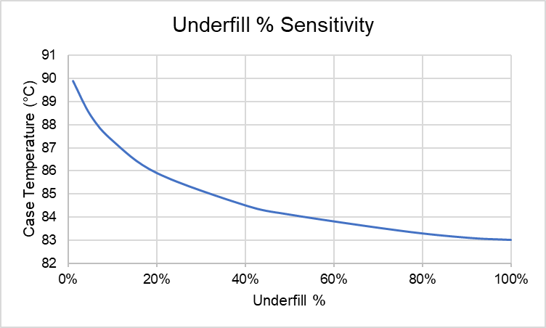
Other Sources of Heat Removal
Black anodize interior of enclosure
  Result: 0.7°C decrease in average board temperature
  Higher cost, lower reward
Gap pads added under components
  Over 5°C drop

Slide 13
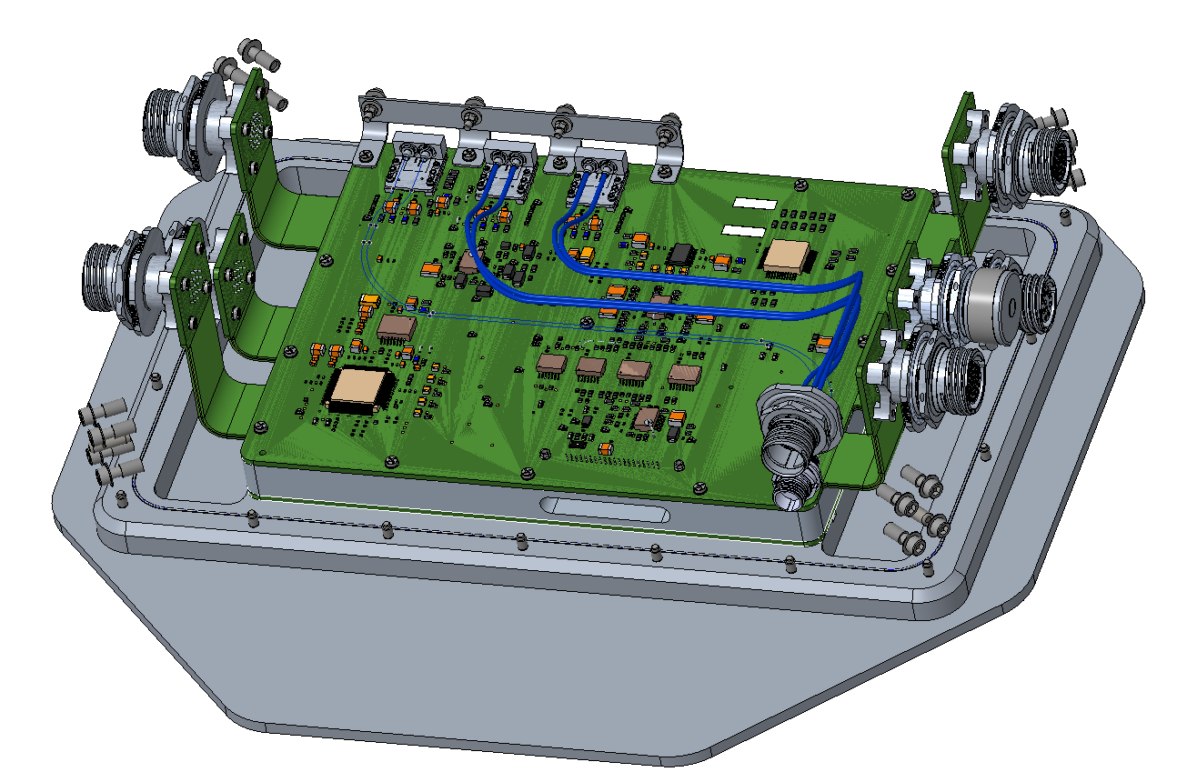
Final Design Modifications
Heat strap to enclosure
High power components are separated via bolted contacts to CCA carrier and to heat strap
Auxiliary high-power components moved to secondary side of board

Slide 14
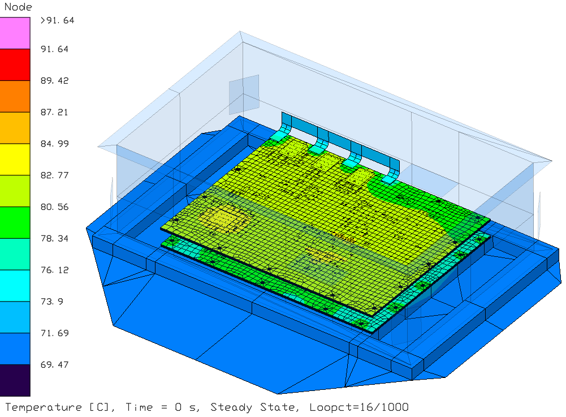
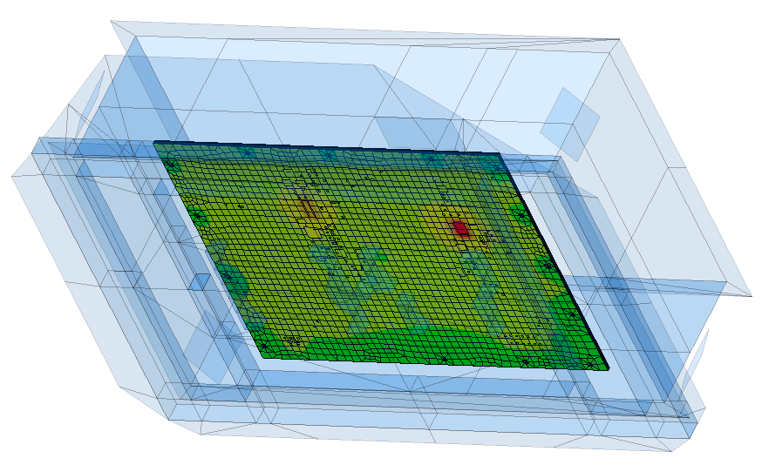
Final Design Results
Conclusions:
Passive heat transfer solutions effectively reduce CCA temperature
  Strategic component placement, conductive ties to boundary conditions and underfill
Collaborative efforts between thermal engineering and mechanical designers reduces program risk
In bounding cases, isolated CCAs can have an average temperature significantly higher than enclosure temperatures
Critical component temperature compliant (<85°C)
Other components moved to secondary side

Slide 15
Thank you! Questions?
Contact Information:
Andrew Kraus
akraus@arka.org

