Slide 1


L’Ralph Early On-Orbit Thermal Performance and Investigation of the Colder-than-Expected Cryoradiator
TFAWS24-PT-45
Daniel Bae, NASA GSFC 545
Owen Warner, NASA GSFC 545 OSTEM Intern
Juan Rodriguez-Ruiz, NASA GSFC 545
TFAWS Passive Thermal Paper Session
Presented By
Daniel Bae
Thermal & Fluids Analysis Workshop
TFAWS 2024
August 26-30, 2024
NASA Glenn Research Center
Cleveland, OH

Slide 2
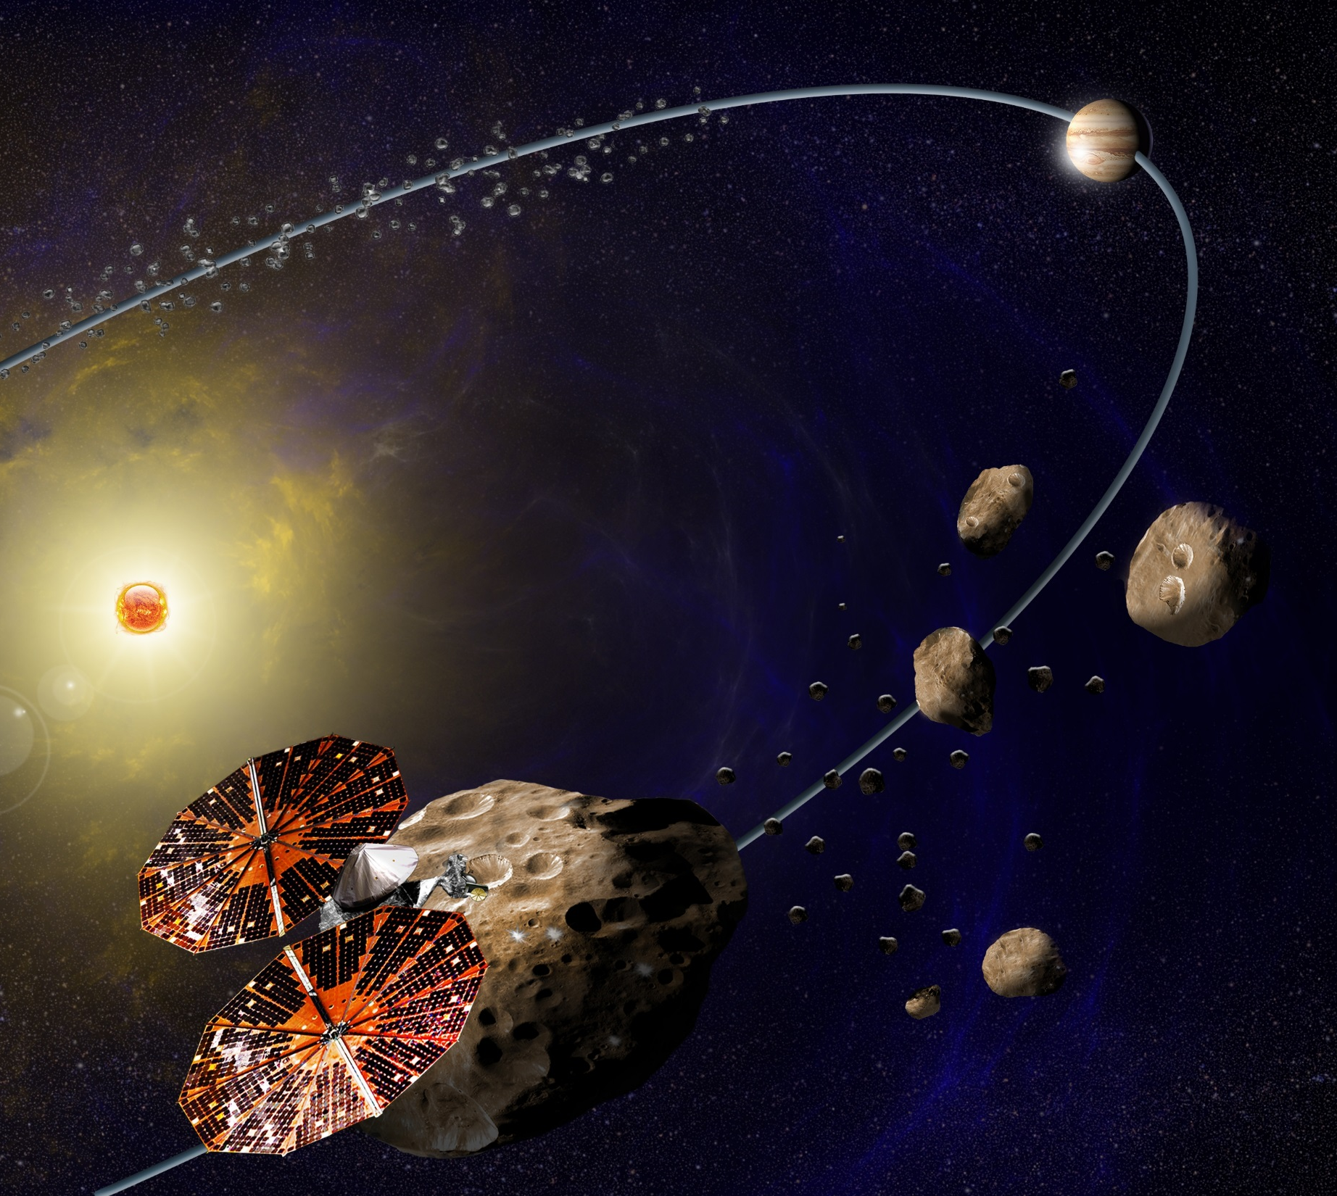
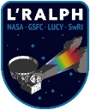
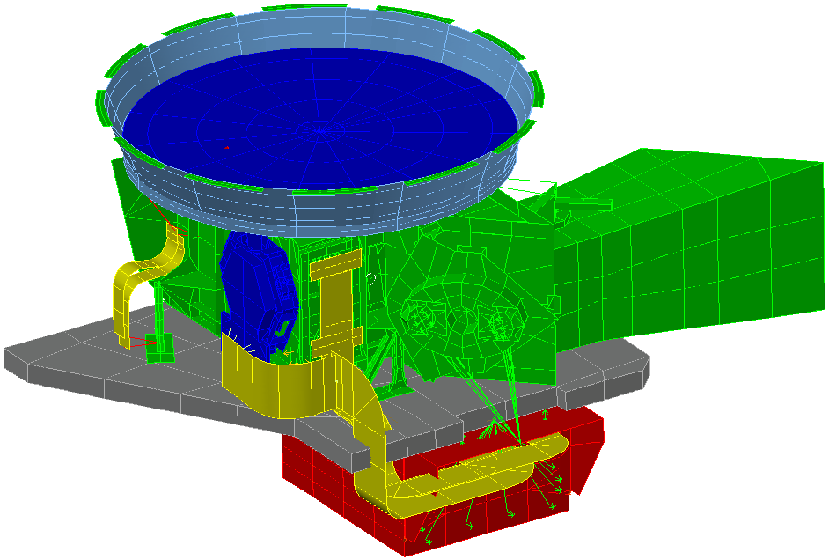
Lucy
The first space mission to explore a population of small bodies known as the Trojan asteroids, which orbit the Sun “in front of” and “behind” the gas giant Jupiter. The Trojan Asteroids are leftovers from the early days of our solar system, effectively the fossils of planet formation. Lucy launched on October 16th, 2021
L’Ralph
GSFC in-house instrument on Lucy with two detectors: The visible wavelength multicolor imager (MVIC) and the infrared Linear Etalon Imaging Spectral Array (LEISA), which is passively cooled to 100K. Image below shows temperature zones
Cryosystem $≈$ 100 K
Telescope Detector Assembly (TDA)
TDA $≈$ 170 K
LEISA Detector
IPP $≈$ 245 K
Instrument Pointing Platform (IPP)
Main Electronics Box (MEB)
MEB $≈$ 290 K
Notes:
Lucy will be the first space mission to study the Trojan asteroids associated with Jupiter. It was also launched last year. The L’Ralph instrument on Lucy employs two detectors: The visible wavelength multicolor imager and the infrared Linear Etalon Imaging Spectral Array, which is passively cooled to 100K. The temperature zones of the L’Ralph instrument are shown in the bottom right figure. The coldest cryosystem zone maintained at 100K, while the Telescope Detector Assembly, labeled as TDA is at 170K, the Instrument Pointing Platform - IPP at 245K and the Main Electronics Box - MEB is at 290K.

Slide 3
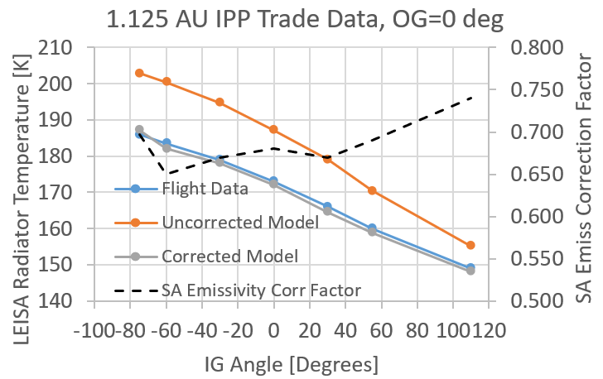
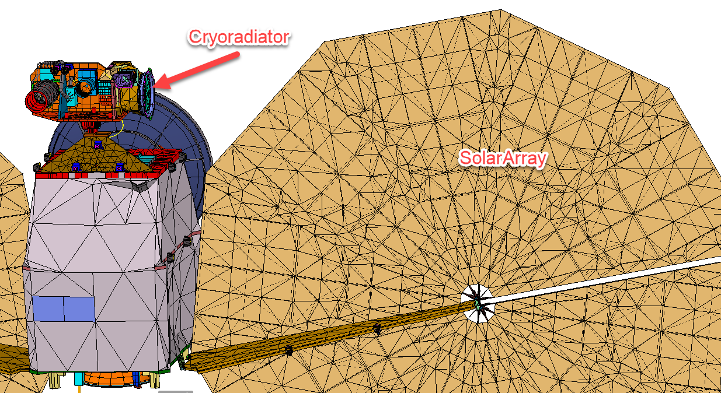
L’Ralph Early (<2 AU) On-Orbit Thermal Performance
Cryosystem was showing significantly cooler temperatures
To better understand the thermal performance, instrument pointing platform (IPP) was set at different angles
At low AU, radiative loading from solar array to the cryoradiator dominates the heat flow (>90% of heat input)
  Cryoradiator has a good view to the backside of the solar array backside

Slide 4
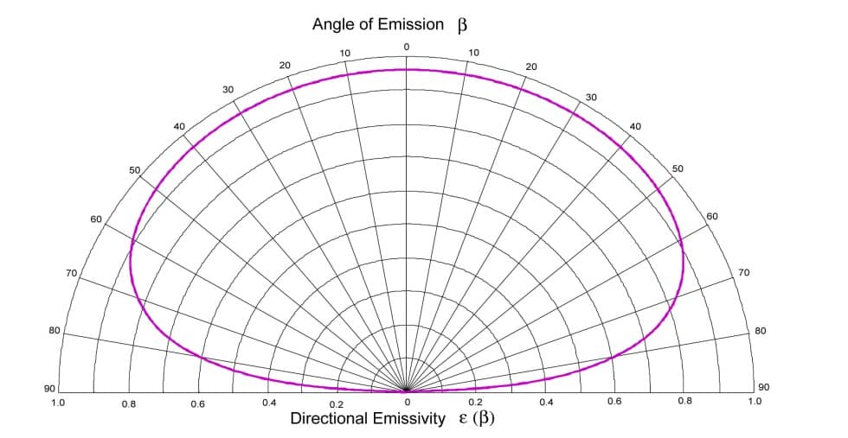
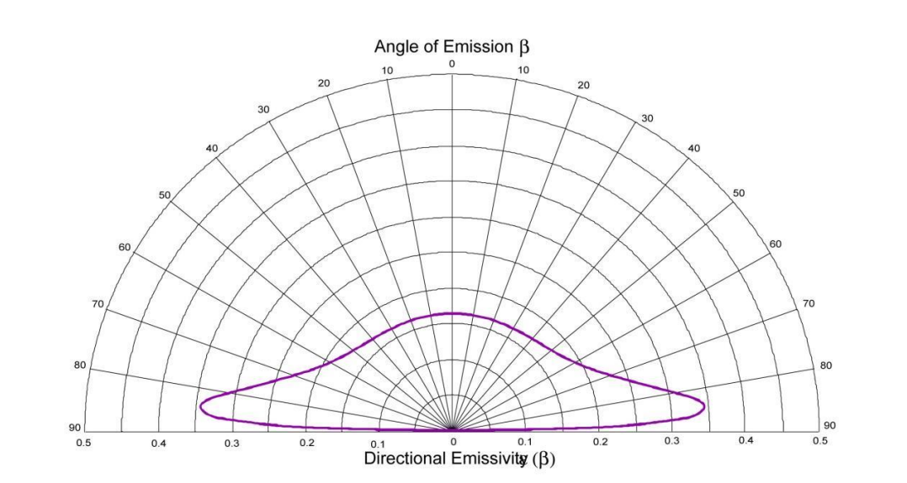
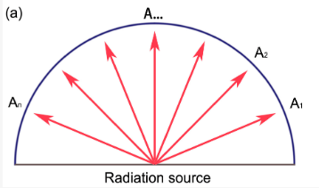
Why is This Happening?
The main theory:
  Directional emissivity curve might have a significant impact
    Cryoradiator has a sharp viewing angle to the solar array, where significant brightness reduction can happen based on the directional emissivity behavior
In the model, Thermal Desktop assumes Lambertian directional emissivity
Solar array directional emissivity may not be Lambertian causing the difference in temperature
Unfortunately, we could NOT test this on ground; solar array is too big and we could not set up a ground test in such a way that would have captured the radiative coupling between L’Ralph and the solar array
Lambertian means that the brightness of the object will remain constant regardless of the viewing angle
Directional emissivity plots from NASA/TP–2005–212792, Kauder, L., “Spacecraft Thermal Control Coatings References”

Slide 5
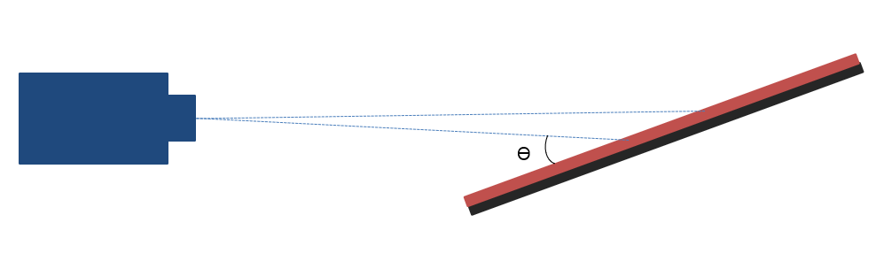
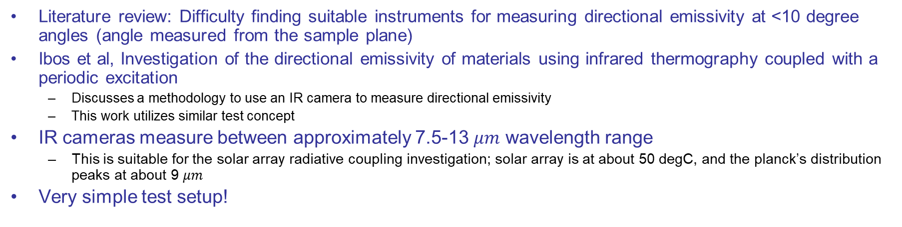
Directional Emissivity Measurement using the IR Camera
Literature review: Difficulty finding suitable instruments for measuring directional emissivity at <10 degree angles (angle measured from the sample plane)
Ibos et al, Investigation of the directional emissivity of materials using infrared thermography coupled with a periodic excitation
  Discusses a methodology to use an IR camera to measure directional emissivity
  This work utilizes similar test concept
IR cameras measure between approximately 7.5-13 $μm$ wavelength range
  This is suitable for the solar array radiative coupling investigation; solar array is at about 50 degC, and the planck’s distribution peaks at about 9 $μm$
Very simple test setup!
IR Camera
Rotational Stage
Vertical Translational Stage
Horizontal Translational Stage

Slide 6
Testing Methodology
IR Camera’s absolute temperature measurement can be inaccurate due to many unknown/unquantifiable sources of heat input
Use relative measurement (Delta Method) to cancel out a lot of the errors!
  In addition to canceling unwanted sources of radiation, the delta method also decreases experimental uncertainty
  Delta Method
  Absolute Temperature
  This is because we don’t have to rely on an absolute temperature calibration, which is more likely to have uncertainties
  This Y intercept can be wrong

Slide 7



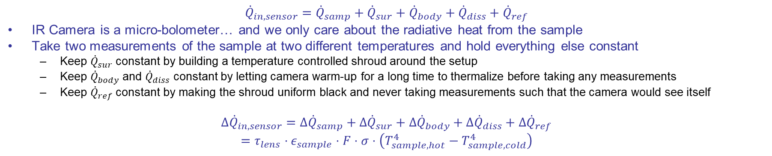


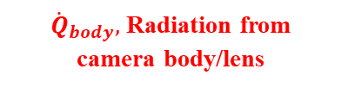



IR Camera Energy Balance
$${\dot{Q}}_{in, sensor}={\dot{Q}}_{samp}+{\dot{Q}}_{sur}+{\dot{Q}}_{body}+{\dot{Q}}_{diss}+{\dot{Q}}_{ref}$$
IR Camera is a micro-bolometer… and we only care about the radiative heat from the sample
Take two measurements of the sample at two different temperatures and hold everything else constant
  Keep ${\dot{Q}}_{sur}$ constant by building a temperature controlled shroud around the setup
  Keep ${\dot{Q}}_{body}$ and ${\dot{Q}}_{diss}$ constant by letting camera warm-up for a long time to thermalize before taking any measurements
  Keep ${\dot{Q}}_{ref}$ constant by making the shroud uniform black and never taking measurements such that the camera would see itself
$$Δ{\dot{Q}}_{in, sensor}=Δ{\dot{Q}}_{samp}+Δ{\dot{Q}}_{sur}+Δ{\dot{Q}}_{body}+Δ{\dot{Q}}_{diss}+Δ{\dot{Q}}_{ref}$$
$$=τ_{lens}⋅ε_{sample}⋅F⋅σ⋅\left(T_{sample,hot}^{4}−T_{sample,cold}^{4}\right)$$
$0$
$0$
$0$
$0$
IR Camera Body with Electronics
${\dot{Q}}_{ref},$Reflected radiation off of sample
Sample
How would the camera process this?
${\dot{Q}}_{diss},$self heating from the electronics
${\dot{Q}}_{samp},$Radiation from sample
IR Sensors
Lens
${\dot{Q}}_{sur},$Radiation from air/surroundings
${\dot{Q}}_{body},$Radiation from camera body/lens

Slide 8

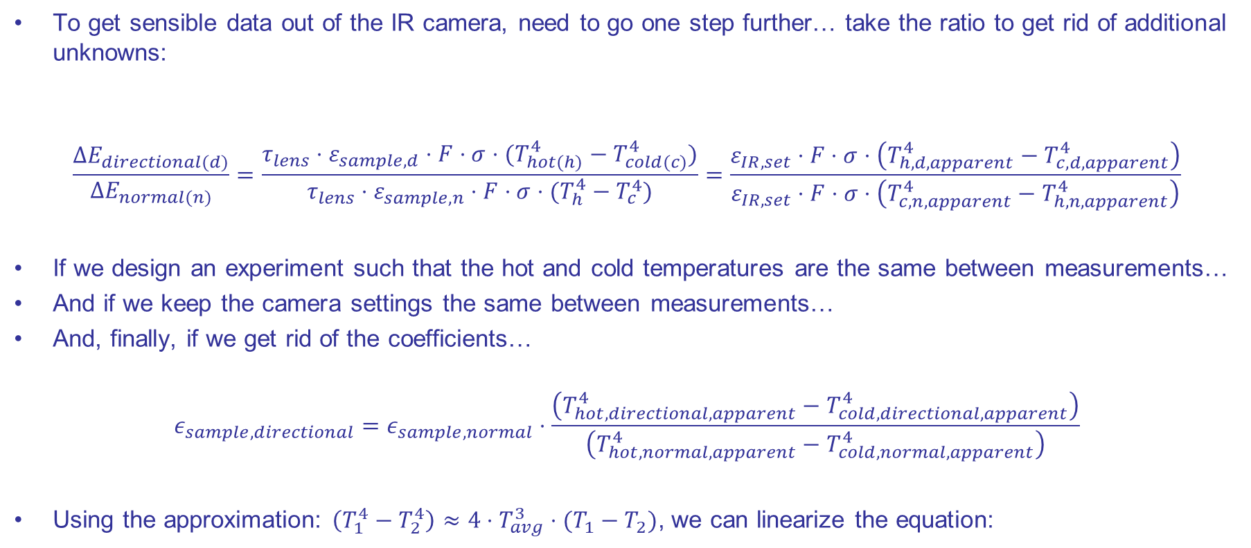
IR Camera Internal Data Processing
To get sensible data out of the IR camera, need to go one step further… take the ratio to get rid of additional unknowns:
$$\frac{∆E_{directional(d)}}{∆E_{normal(n)}}=\frac{τ_{lens}⋅ε_{sample,d}⋅F⋅σ⋅(T_{hot(h)}^{4}−T_{cold(c)}^{4})}{τ_{lens}⋅ε_{sample,n}⋅F⋅σ⋅(T_{h}^{4}−T_{c}^{4})}=\frac{ε_{IR,set}⋅F⋅σ⋅\left(T_{h,d,apparent}^{4}−T_{c,d,apparent}^{4}\right)}{ε_{IR,set}⋅F⋅σ⋅\left(T_{c,n,apparent}^{4}−T_{h,n,apparent}^{4}\right)}$$
If we design an experiment such that the hot and cold temperatures are the same between measurements…
And if we keep the camera settings the same between measurements…
And, finally, if we get rid of the coefficients…
$$ε_{sample,directional}=ε_{sample,normal}⋅\frac{\left(T_{hot,directional,apparent}^{4}−T_{cold,directional,apparent}^{4}\right)}{\left(T_{hot,normal,apparent}^{4}−T_{cold,normal,apparent}^{4}\right)}$$
Using the approximation: $\left(T_{1}^{4}−T_{2}^{4}\right)≈4⋅T_{avg}^{3}⋅(T_{1}−T_{2})$, we can linearize the equation:
Real change in energy received by the camera
Processing of the Radiation Received by the Camera
$$ε_{s,d}=\frac{ε_{s,n}\left(∆T_{a,d}\right)}{\left(∆T_{a,n}\right)}$$
Note that we still need the normal emissivity value, which we used an in-house instrument to measure

Slide 9
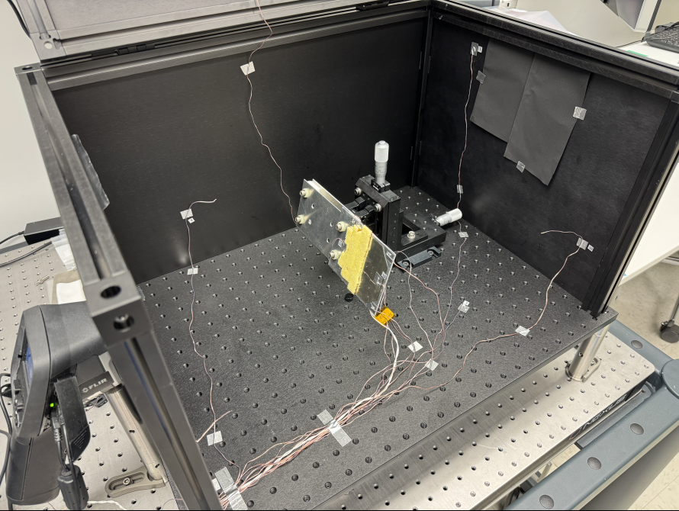
Test Setup
Rotation and Translation Stages
IR camera
Optical enclosure and Z307 to provide a uniform reflecting surface
Solar Array Sample (Backside)
Thermocouples read the temperature of the air, enclosure, IR camera, and sample
-

Slide 10
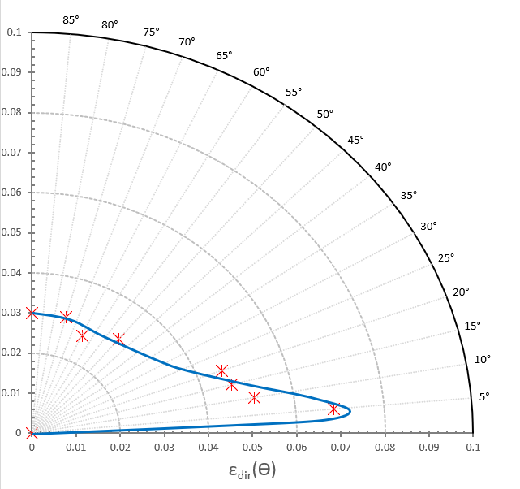
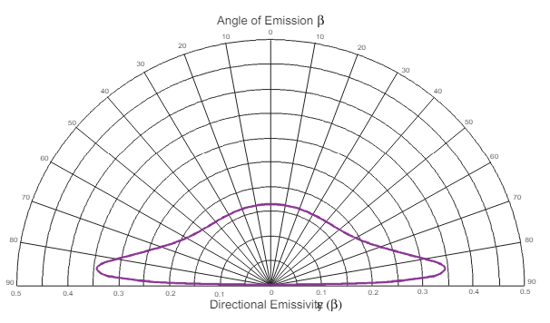
Test Results: Aluminum
  Measured Directional Emissivity Curve using the IR camera method
  Theoretical directional emissivity curve of a conductor

Slide 11
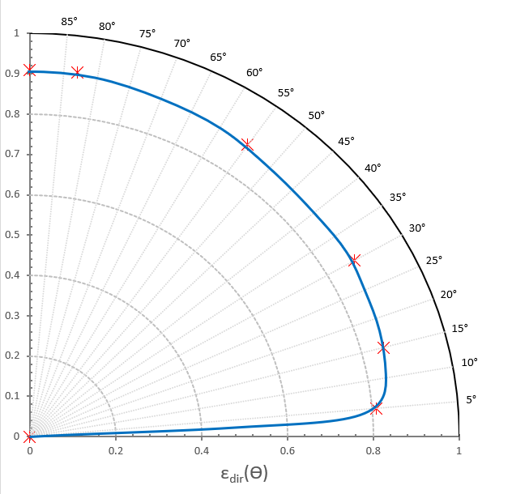
Test Results: Z307
  Test results from Z307 are consistent with a very diffuse, high emissivity di-electric material
IR Camera measurement methodology and data processing works!

Slide 12
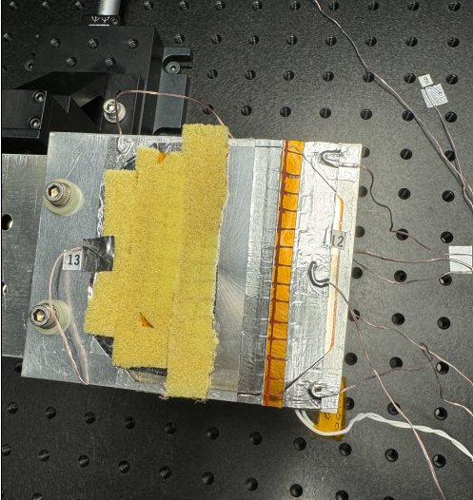
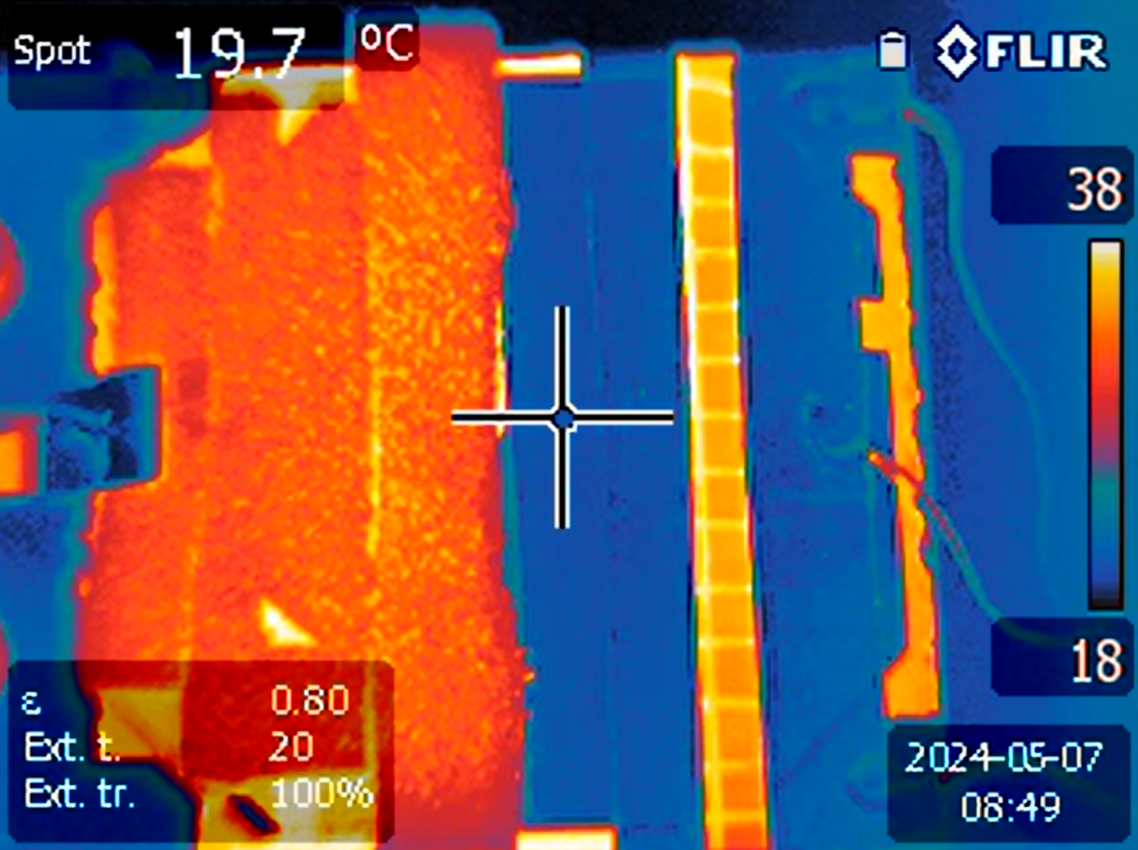
Solar Array Sample (Backside)
  Solar Cell
  Kapton/Scrim
  Foam

Slide 13
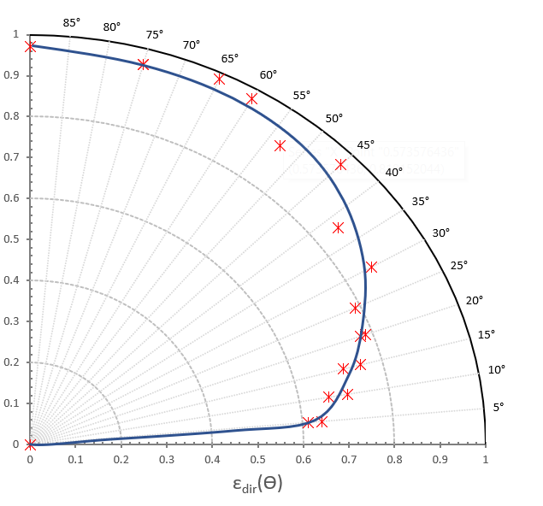
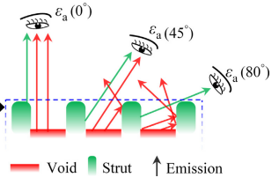
Test Results: Foam
Experimental data agrees with literature review; significant drop off due to topology
  Emissivity drops off significantly after 40°
  Consistent with the directional emissivity hypothesis
Figure taken from Li et al., 2018, “Tomography-based analysis of apparent directional spectral emissivity
of high-porosity nickel foams”

Slide 14
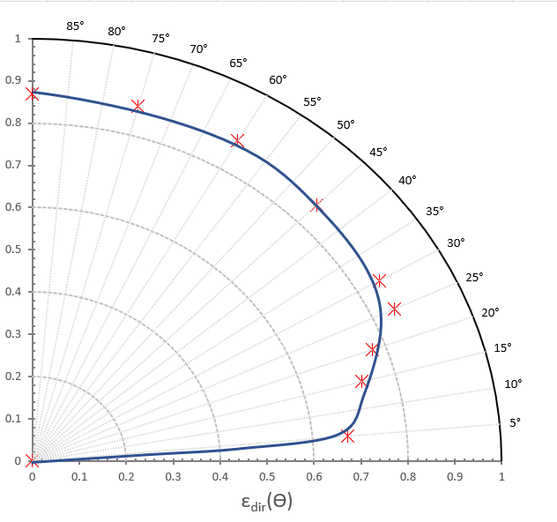
Test Results: Kapton
  Kapton/Scrim also experiences a drop of emissivity at glancing angles

Slide 15
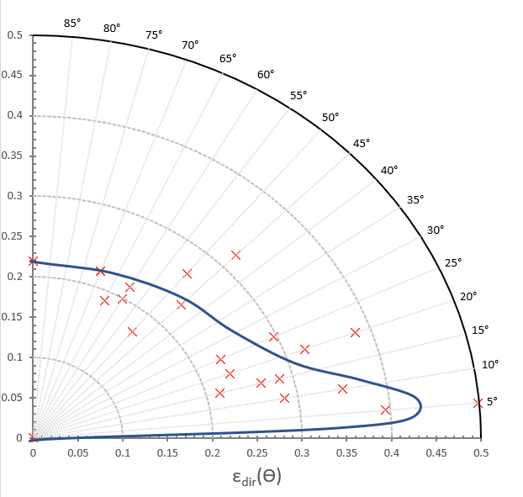
Test Results: Backside of the Solar Cell
  Data from the solar cell is inconclusive and scattered, unknown environmental factors caused two trials to not agree. Needs further investigation
  Emissivity increases at glancing angles
  The solar cell has much lower emissivity than the foam and Kapton, so it’s energy contribution to the cryo-radiator is less

Slide 16
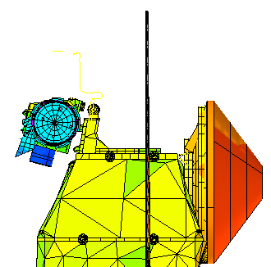
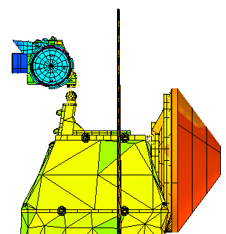
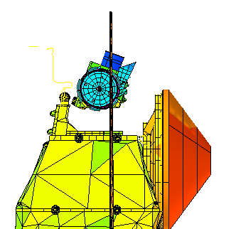
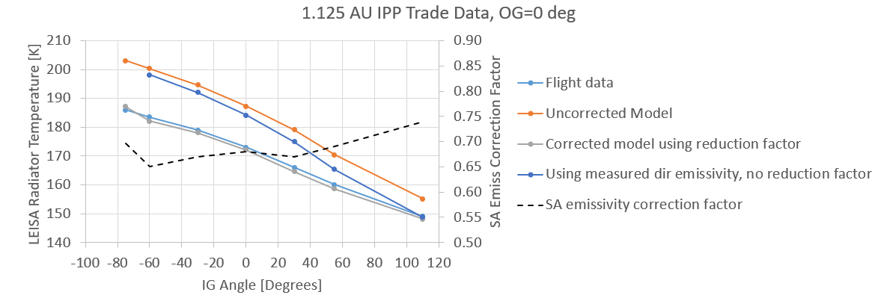
Directional Emissivity Impact on L’Ralph Thermal Predicts
Inputted directional emissivity curve into the L’Ralph TD model to see its impact on the thermal model predicts
  Used area weighted averaging of the three backside surfaces to generate effective directional emissivity curve
Unfortunately, directional emissivity only partially explains the cooler temperature that we see on flight
Thankfully, at >5 AU, the radiative coupling between the solar array and the cryoradiator drops off by >10x, so for L’Ralph’s science, the reduced radiative coupling should not cause significant impact
-75 deg
0 deg
110 deg
SA
Cryorad
More glancing angle between the solar array and the cryoradiator

Slide 17
Conclusion
Successful directional emissivity measurement system (for limited spectral range) was developed with very little cost
Significant emissivity drop off at glancing angles is confirmed… however, this only partially explains the cooler temperature
  Lesson learned: Try and do your best to mimic flight like environment, especially for cryogenic instrument; radiative heat load from the solar array was the only thermal heat source we could not verify via ground testing

Slide 18
Acknowledgements
Huge thank you to Owen Warner, our OSTEM summer intern, for doing amazing work!
Huge thank you to the L’Ralph team for performing custom on-orbit IPP maneuvers for us, and for providing funds

