Slide 1
Wall model for simulation of high-enthalpy hypersonic flows
Robyn L. Macdonald
Assistant Professor
Aerospace Engineering Sciences
University of Colorado Boulder
August 4, 2025
2025 Thermal & Fluids Analysis Workshop
NASA Ames Research Center
NASA Grant: 80NSSC23K1500

Slide 2



Research Team
Robyn L. Macdonald
Principal Investigator
Joshua Camp
Graduate Research Assistant
Jackson Simon
Undergraduate Research Assistant
Notes:
Add Joey Schulz as research collaborator

Slide 3
Outline
Motivation & Background
Research Objectives
Wall-model Formulation
Results
Summary & Acknowledgments

Slide 4
Outline
Motivation & Background
Research Objectives
Wall-model Formulation
Results
Summary & Acknowledgments

Slide 5
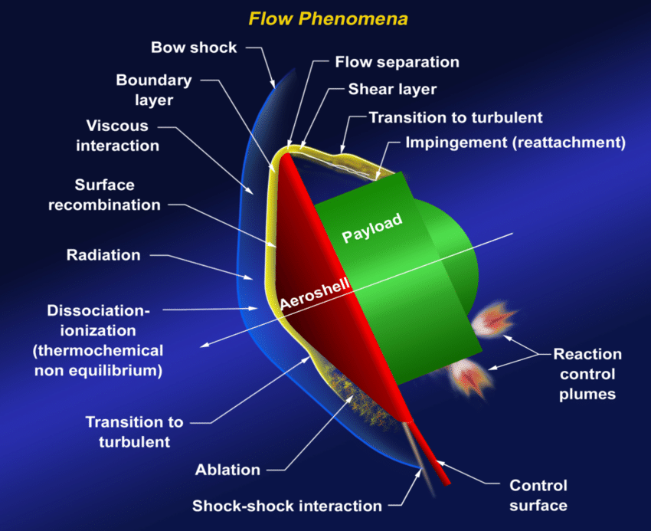
Modeling and Predicting Hypersonic Entry Systems
Modeling and predicting entry systems requires physical models for a variety of physics:
Thermochemistry (gas-phase and gas-surface); radiation; transition and turbulence; …
Coupled simulations become complex and computationally intensive as the physics model fidelity is increased.
Significant advances to high-fidelity physics modeling have been made in both gas-phase chemistry modeling (quantum mechanics informed models) and turbulence modeling (DNS).
Coupling remains elusive…
Credit: NASA

Slide 6
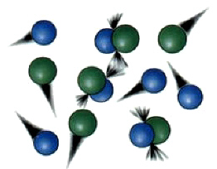
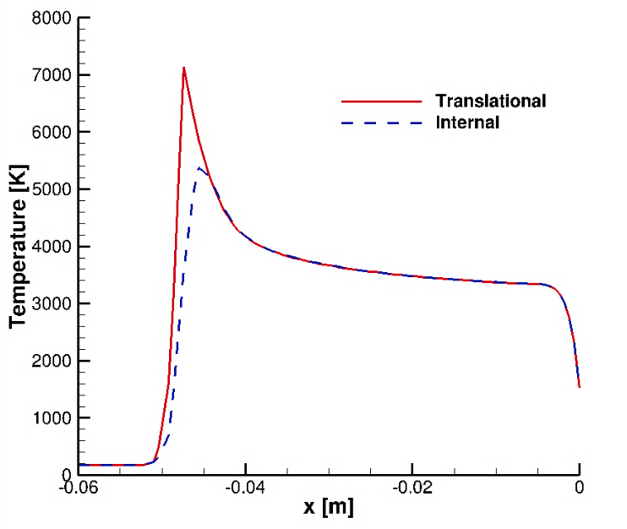
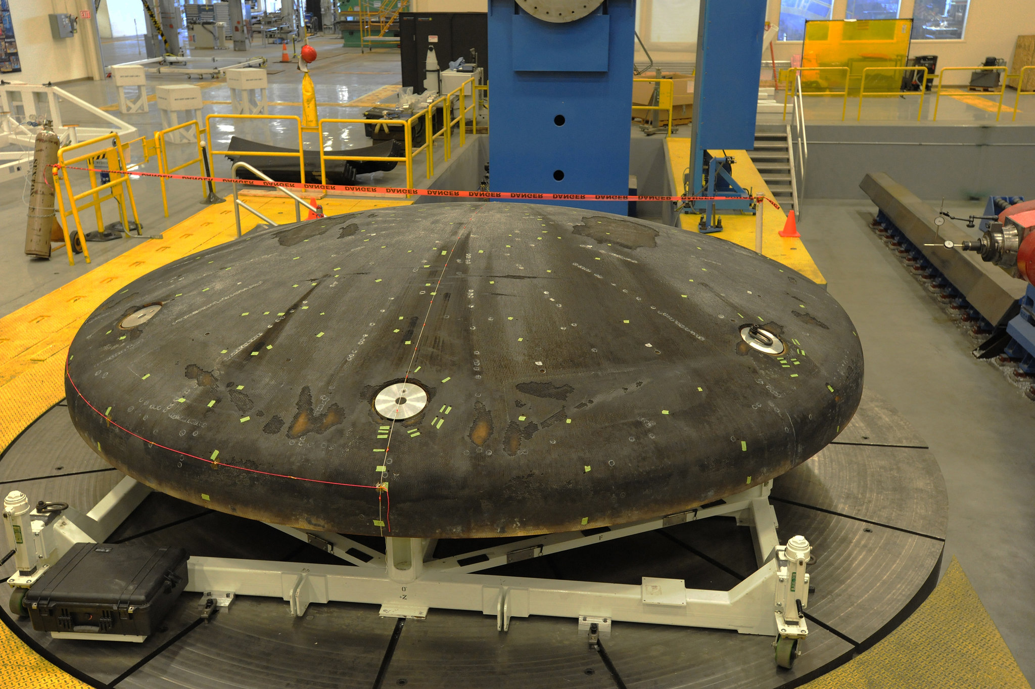
High Enthalpy Effects for Hypersonic Flows
Effects which must be modeled in high-enthalpy flows can include:
Gas-phase chemistry: dissociation, ionization, …
Gas-surface chemistry: ablation, blowing, pyrolysis gases…
Thermal-nonequilibrium: multiple temperatures needed to describe the gas
Radiation: impacts the energy balance in the gas
Viscous and transport phenomena
Coupling these with turbulent and transitional flows is not trivial.
Significant effort has been made to develop models for these phenomena and couple with CFD solvers.
Gas phase collisions (Credit: Wikipedia)
Thermal non-equilibrium
Orion Heat Shield (Credit: NASA)

Slide 7
Turbulence Modeling Approaches
Reynolds Averaged Navier-Stokes (RANS) | Large Eddy Simulation (LES) | Direct Numerical Simulation (DNS)
Solve governing equations for averaged quantities; model fluctuations. | Solve governing equations for large eddies; model small eddies (subgrid-scale modeling). | Solve governing equations for all scales of turbulence.
Pros: Computationally cheap/efficient for model design | Pros: More accurate than RANS; possible for some larger/higher Reynolds flows where DNS is impossible | Pros: Provides the “true” answer
Cons: Models for hypersonic flows are not well understood/developed; lots of modeling assumptions. | Cons: Some subgrid-scale terms are not well understood; becomes expensive for wall bounded flows. | Cons: Extremely expensive; coupling in other physics can be prohibitive; generally limited to simple geometries.

Slide 8
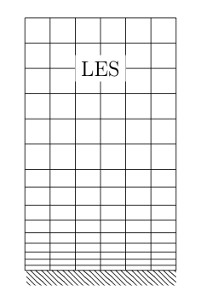
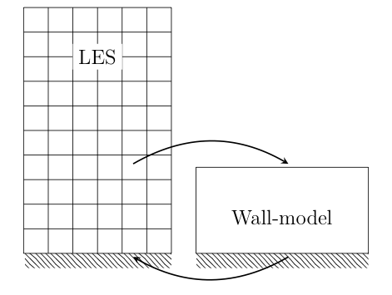

Wall Modeled Large Eddy Simulation
Wall models can enable LES simulations of high-Reynolds number flows near solid boundaries
Wall modeled LES (WMLES) uses an intentionally under-resolved LES grid
Solves a simplified set of equations on an auxiliary wall grid and updates the boundary condition.
Simplified equations could be algebraic, ODEs, or PDEs
Many cells required near wall;
Small time-steps required by CFL condition
Wall-resolved LES
There is currently no wall-model which accounts for thermo-chemical non-equilibrium effects relevant for high-enthalpy hypersonic flows!
Cheaper LES grid;
Time step requirement is relaxed due to larger cells
Wall-modeled LES

Slide 9
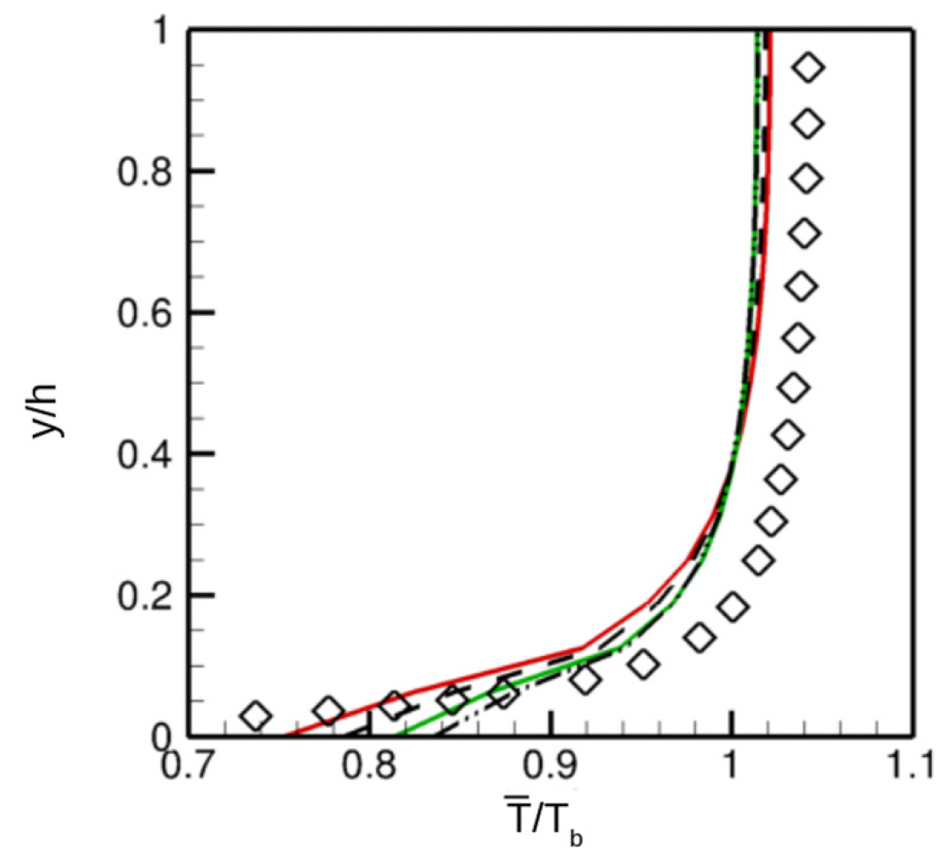
Past work on hypersonic boundary layers (DNS & LES)
Highlighting here work on hypersonic boundary layers with significant wall heat transfer:
Zhang et al, JTHT, 2018 – DNS study of wall temperature effects on hypersonic boundary layers
Iyer & Malik, PRF, 2019 – Investigating wall scaling for wall-modeled LES in cold wall boundary layers
Muto et al, IJHMT, 2019 – LES wall model for reacting turbulent flows with heat transfer (combustion)
Yang et al, AIAAJ, 2018 – LES wall model for boundary layer flows with significant wall heat transfer
Griffin et al, PNAS, 2021 – velocity transformations for compressible flows with and without heat transfer
Others…
Zhang et al, JTHT, 2018
Iyer & Malik,
Phys. Rev. Fluids. 2019

Slide 10
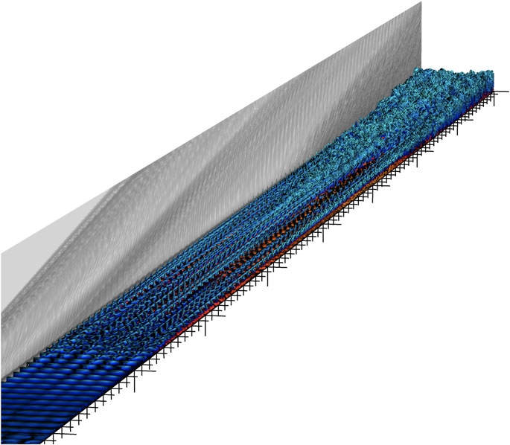
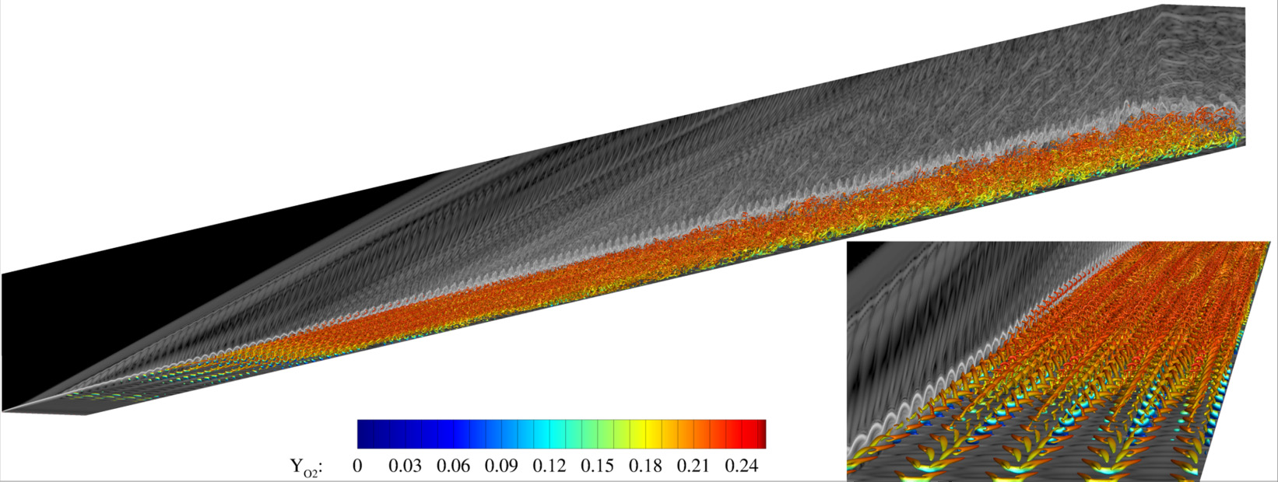

DNS of Hypersonic Flows with High-Enthalpy Effects
Duan & Martin, JFM, 2011
DNS of reacting flat plate boundary layer at Mach 3 – 10
No vibrational energy equation but 5-species air chemistry
Di Renzo & Urzay, JFM 2021
DNS of reacting flat plate boundary layer at Mach 10
No vibrational energy equation but 5-species air chemistry
Passiatore et al, PRF, 2021
DNS of reacting flat plate boundary layer at Mach 10
No vibrational energy equation but 5-species air chemistry
Passiatore et al, JFM, 2022
DNS of reacting flat plate boundary layer at Mach 12.5
Includes vibrational energy equation and 5-species air
Di Renzo & Urzay, JFM 2021
Passiatore et al, JFM, 2022
Passiatore et al, PRF, 2021

Slide 11
Outline
Motivation & Background
Research Objectives
Wall-model Formulation
Results
Summary & Acknowledgments

Slide 12
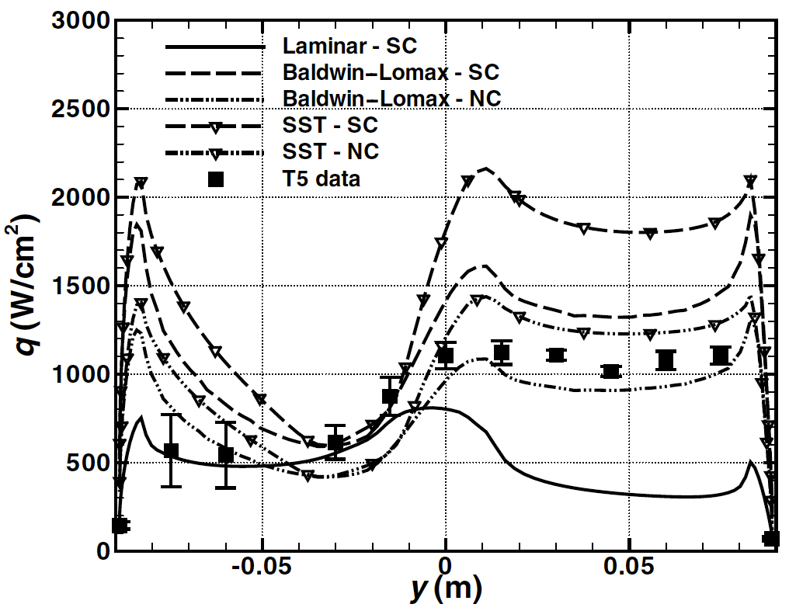
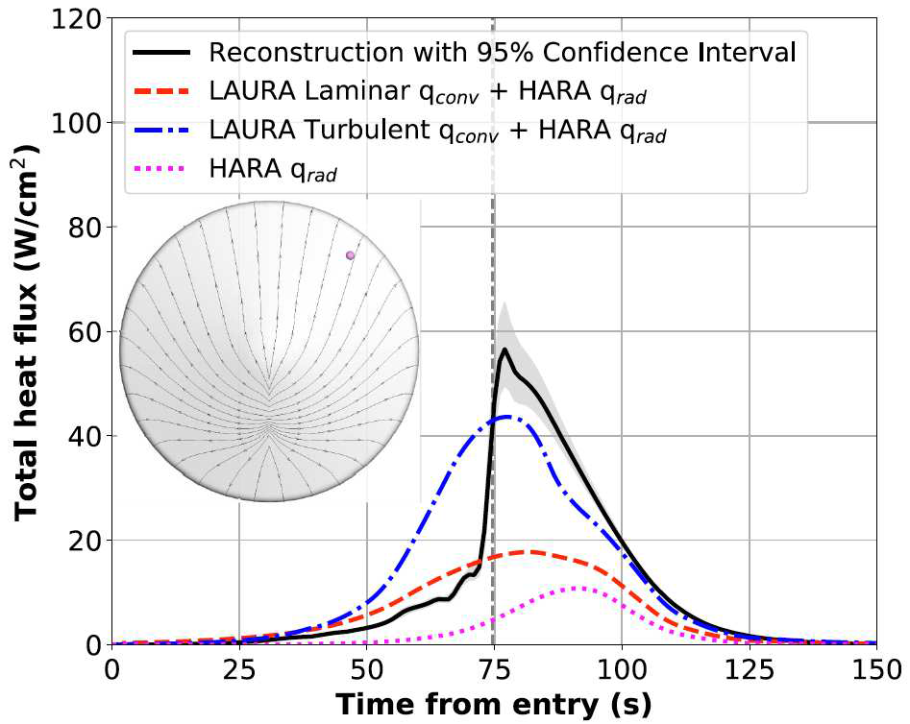
Current State-of-the-Art
Wright et al, JTHT, 2006.
Scale-resolved simulations of high-enthalpy hypersonic flows:
DNS or LES of simplified geometries such as flat plates
LES models (both sub-grid scale and wall-models) are largely undeveloped/untested for hypersonic high-enthalpy flows
Design/production level simulations of high-enthalpy hypersonic flows:
Rely on RANS models which are chosen based on agreement with ground test experiments
Unquantified uncertainty in RANS models
RANS models were generally not designed to predict hypersonic flows
Edquist et al, JSR, 2023
Passiatore et al, JFM, 2022

Slide 13
Research Objective
The objective of this work is to construct a LES wall-model capable of capturing NASA relevant thermo-chemical non-equilibrium phenomena

Slide 14
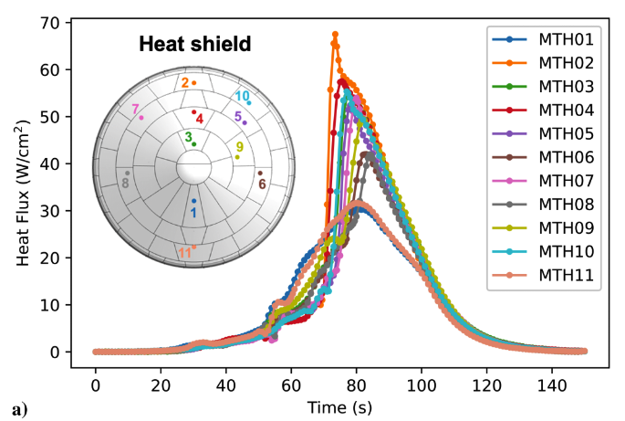
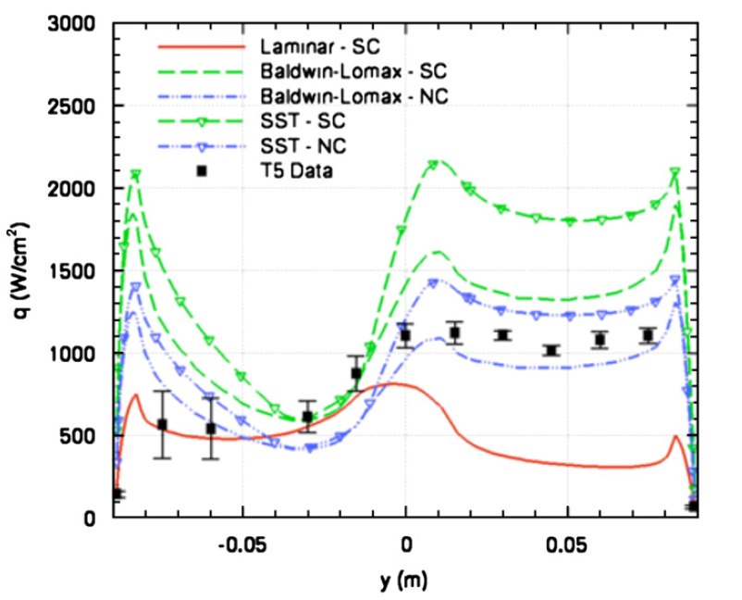
Innovations & Potential Impacts
Innovation: Enable scale-resolved simulations of full-scale entry vehicles accounting for high-enthalpy phenomena.
Potential Impact 1: Improved post-flight reconstruction; reduced uncertainty in atmospheric entry physics models.
Potential Impact 2: Improved RANS models with better understanding of the physics from scale-resolved simulations.
Mars 2020 MEDLI2 Heat Flux Data
Alpert et al, JSR, 2023
Comparison of RANS models on MSL model
Hollis and Borrelli, PAS, 2012

Slide 15
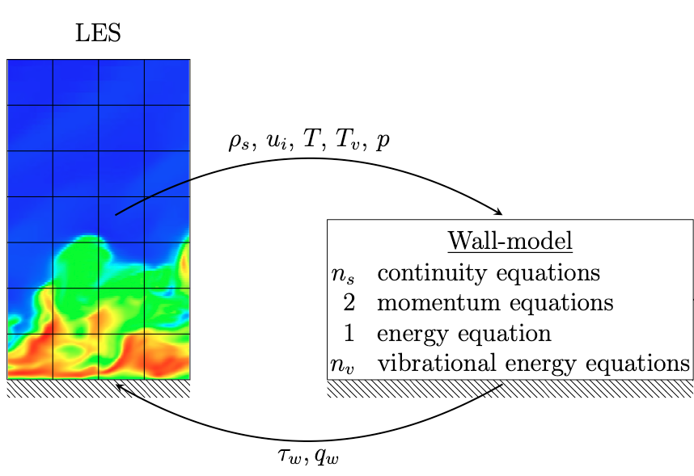

Approach
Develop thermo-chemical non-equilibrium wall model for LES.
Implement into stand-alone code for testing.
Compare stand-alone wall model code with results of RANS simulations for verification.
Implement into US3D Plugin.
Compare WMLES results from US3D plugin with WRLES results from US3D for verification/validation.
Compare WMLES results from US3D plugin with experimental data from T5/MSL
Passiatore et al, PRF, 2021
Wright et al, JTHT, 2006.

Slide 16
Outline
Motivation & Background
Research Objectives
Wall-model Formulation
Results
Summary & Acknowledgments

Slide 17
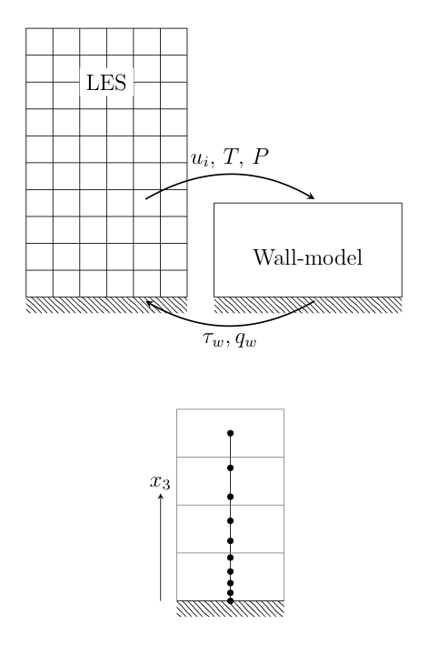
Standard Equilibrium ODE Based Wall Model
Solve a reduced set of RANS equations in the wall normal direction:
Boundary conditions are taken from the probe point and from the wall.
Wall shear stress and heat flux are passed back to the LES solver.
Kawai and Larsson, Physics of Fluids, 2012. Komives, PhD Thesis, University of Minnesota, 2016.

Slide 18
Two-Temperature Wall Model

Slide 19
Two-Temperature Governing Equations
Starting from the two-temperature model implemented in many hypersonic CFD codes:
For now we neglect the effects associated with ionized flows.
Gnoffo, NASA TR, 1989.

Slide 20
Two-Temperature Wall Model
Assume: no gradients in spanwise/streamwise directions; no inertial terms; zero pressure gradient.
System of coupled ODEs:
Urzay & Di Renzo, CTR, 2020.
Notes:
\begin{array}{rl}
\dfrac{d}{dx_3}\left[ \left(\rho D_{s} + \dfrac{\mu_t}{Sc_t} \right)\dfrac{dy_s}{dx_3} \right] & = - \dot{\omega}_s, \quad s = 1, \ldots, N_s \\
& \\
\dfrac{d}{dx_3}\left[ \left(\mu + \mu_t \right) \dfrac{du_{||}}{dx_3}\right] & = 0 \\
& \\
\dfrac{d}{dx_3}\left[ \left(\mu + \mu_t \right) u_{||} \dfrac{du_{||}}{dx_3} + \left(\kappa + \dfrac{c_p\mu_t}{Pr_t} \right) \dfrac{dT}{dx_3}\right] + \dfrac{d}{dx_3}\left[ \kappa_v \dfrac{dT_v}{dx_3}\right] + \dfrac{d}{dx_3}\left[ \sum\limits_{s = 1}^{N_s} \rho h_s D_{s} \dfrac{dy_s}{dx_3} \right] & = 0 \\
& \\
\dfrac{d}{dx_3}\left[ \kappa_v \dfrac{dT_v}{dx_3}\right] + \dfrac{d}{dx_3}\left[ \dfrac{\mu_t}{Pr_t} \dfrac{d e_v}{dx_3} \right] + \dfrac{d}{dx_3}\left[ \sum\limits_{s = 1}^{N_s} \rho h_{v,s} D_{s} \dfrac{dy_s}{dx_3} \right] & = -Q_{v-t} + \sum\limits_{s=1}^{N_s} \dot{\omega}_s \hat{D}_s
\end{array}

Slide 21
Numerical Implementation
We are solving for variables y_{s}, u||, T_{v}, and T
We solve using a second-order central finite difference scheme with an inner-loop/outer-loop structure
Notes:
\scriptsize
\begin{array}{rl}
\dfrac{d}{dx_3}\left[ \left(\mu + \mu_t \right) \dfrac{du_{||}}{dx_3}\right] & = 0 \\
& \\
\dfrac{d}{dx_3}\left[ \left(\rho D_{sp} + \dfrac{\mu_t}{Sc_t} \right)\dfrac{dy_s}{dx_3} \right] & = - \left.\dot{\omega}_s\right|^{k-1} \\
& \\
\dfrac{d}{dx_3}\left[ \left( \kappa_v + \dfrac{\mu_t}{Pr_t} \dfrac{d e_v}{dT_v}\right) \dfrac{d T_v}{dx_3}\right] & = - \left.\dfrac{d}{dx_3}\left[ \left( \kappa_v + \dfrac{\mu_t}{Pr_t} \dfrac{d e_v}{dT_v}\right) \dfrac{d T_v}{dx_3}\right]\right|^{k-1} - \left.\dfrac{d}{dx_3}\left[ \sum\limits_s \rho h_{v,s} D_{sp} \dfrac{dy_s}{dx_3} \right]\right|^{k-1} - \left.Q_{v-t}\right|^{k-1} + \left.\sum\limits_s \dot{\omega}_s \hat{D}_s\right|^{k-1} \\
& \\
\dfrac{d}{dx_3}\left[ \left(\kappa + \dfrac{c_p\mu_t}{Pr_t} \right) \dfrac{dT}{dx_3}\right] & = - \left.\dfrac{d}{dx_3}\left[\left(\mu + \mu_t \right) u_{||} \dfrac{du_{||}}{dx_3}\right]\right|^{k-1} - \left.\dfrac{d}{dx_3}\left[ \kappa_v \dfrac{dT_v}{dx_3}\right]\right|^{k-1} - \left.\dfrac{d}{dx_3}\left[ \sum\limits_s \rho h_s D_{sp} \dfrac{dy_s}{dx_3} \right]\right|^{k-1}
\end{array}

Slide 22
Discretized System
Express each independent variable as the sum of the variable and change from the previous iteration:
Using finite differences, write the energy equation in terms of previous iteration temperature (k-1) and temperature update for the current step (k)
We can re-arrange this into a simple tri-diagonal matrix system for the temperature update:
Notes:
Might remove - backup

Slide 23
Numerical Implementation (Wall-model equations)
Initialize wall-grid and initial solution
Calculate thermodynamic properties (𝜇, 𝜇_{t}, 𝜅, 𝜅_{t}, c_{p}, …)
Calculate RHS source term
Repeat for each variable
Inner-loop
Outer-loop
Solve for solution variable
Sync density with equation of state
Check for convergence of wall shear/heat flux/wall temperature/species concentrations
No
Yes
Pass wall shear/heat flux/wall temperature back to CFD solver

Slide 24
Stand-alone Wall Model Code
# Number of wall points (nyw)
nyw = 200
# Inner/outer loop iterations
ninner = 3
nouter = 100
# Convergence criteria
tol = 1.d-8
# Relaxation parameter
womega = 0.5
# Height of the probe point (SI units)
yp = 0.000792d0
# Number of species (ns)
ns = 2
# Number of vibrational modes (nv)
nv = 1
# Wall temperature boundary condition (wallbc_temp) and guess/value (adiabatic/isothermal)
# 1 – adiabatic; 2 - isothermal
wallbc_temp = 1
Tw = 2000.d0
Tvw = 2000.d0
# Wall chemistry boundary condition (wallbc_chem)
# 1 - fully catalytic; 2 - non-catalytic
wallbc_chem = 2
wallbc_ys = 0.9 0.1
# DPLR GasProps path
thermochem_dplr = /projects/roma6120/workspace/...
# Probe point properties (u,v,T,Tv,rhos,p) – SI units
u = 3100.46d0
v = 0.d0
T = 3804.21d0
Tv = 3804.56d0
p = 28233.59d0
ys = 0.66d0 0.34d0
Sample input file
Two-temperature reacting wall model is implemented into a stand-alone piece of code.
Specify boundary conditions (wall and probe point).
Call DPLR Gas Property module to evaluate:
Diffusion coefficients
Species mass source terms
Vibrational energy loss due to chemical reactions
VT relaxation term
Thermodynamic model
Solves the boundary value problem using a tri-diagonal matrix algorithm.
Convenient for testing and debugging.

Slide 25
Outline
Motivation & Background
Research Objectives
Wall-model Formulation
Results
Summary & Acknowledgments

Slide 26
Verification of the Two-Temperature Wall model
To verify implementation of the proposed wall-model we compare against RANS.
Future validation efforts will make use of DNS data.
Start with a simple zero-pressure gradient boundary layer (eliminates possible pressure gradient or inertial effects).
Use RANS simulations to extract boundary conditions to test stand-alone wall model code.
Compare RANS near wall solution with wall model.
Passiatore et al, JFM, 2022
Notes:
Add freestream/boundary conditions from the RANS cases.
Add details on models/inputs to US3D

Slide 27
RANS Test Cases
Inflow specified with compressible Blasius boundary layer with only diatomic molecules (N₂ or O₂)*.
Freestream conditions are:
Extract profiles at various stations to see the effect of the inflow condition.
Select a station far downstream for comparing with wall-model.
All results are plotted in semi-local units.
*Future work will improve the inflow condition for all simulations with a reacting boundary layer solver
Notes:
Add boundary layer profiles
Add domain schematic

Slide 28
Isothermal Wall RANS (Nitrogen)
Lines darken moving downstream
Notes:
Plot of properties at different streamwise locations in RANS cases

Slide 29
Isothermal Wall RANS (Oxygen)
Lines darken moving downstream
Notes:
Plot of properties at different streamwise locations in RANS cases

Slide 30
Adiabatic Wall RANS (Nitrogen)
Lines darken moving downstream
Notes:
Plot of properties at different streamwise locations in RANS cases

Slide 31
Adiabatic Wall RANS (Oxygen)
Lines darken moving downstream
Notes:
Plot of properties at different streamwise locations in RANS cases

Slide 32
Comparing the Wall Model to RANS
In order to compare the wall model with the RANS data we select a point well within the log layer.
Identify the log layer by transforming velocity using the Van Driest transform and plotting in inner units.
Around x₃⁺ = 30 for the cases considered.
Take values of u, T, T_{v}, and y_{s} from this point as the input to the wall model.
Van Driest transformed velocity for oxygen adiabatic case
Notes:
Plot of properties at different streamwise locations in RANS cases

Slide 33
RANS vs. Wall Model - Nitrogen isothermal
Excellent agreement between RANS and wall model for velocity and temperatures
Notes:
Nitrogen adiabatic

Slide 34
RANS vs. Wall Model - Nitrogen isothermal
Very good agreement between RANS and wall model for gas composition
Notes:
Nitrogen adiabatic

Slide 35
RANS vs. Wall Model - Oxygen isothermal
Excellent agreement between RANS and wall model for velocity and temperatures
Notes:
Nitrogen adiabatic

Slide 36
RANS vs. Wall Model - Oxygen isothermal
Very good agreement between RANS and wall model for gas composition
Notes:
Nitrogen adiabatic

Slide 37
Isothermal walls convergence
Converges very quickly and could be further improved with a better initial guess
Notes:
Nitrogen adiabatic

Slide 38
Wall boundary conditions (isothermal)
Generally good agreement between wall boundary conditions predicted by RANS and wall model.
Small discrepancies in near wall temperature behavior drive errors in the vibrational temperature.
 | Nitrogen |  |  | Oxygen
 | WM | RANS | % Difference | WM | RANS | % Difference
y_{O}/y_{N} [-] | 0.00009 | 0.00009 | 0.1 | 0.1016 | 0.1013 | 0.2
𝜏_{w} [Pa] | 1190.0 | 1097.4 | 8.1 | 1226.4 | 1134.8 | 7.8
q_{w} [W/cm²] | 313.6 | 293.1 | 6.8 | 252.4 | 269.8 | 6.6
q_{v,w} [W/cm²] | 23.8 | 21.5 | 10.1 | 32.2 | 29.5 | 8.7
Notes:
Nitrogen adiabatic

Slide 39
RANS vs. Wall Model - Nitrogen adiabatic
Differences arise between wall model and RANS for adiabatic wall cases.
Near wall temperature profiles are quite different.
Notes:
Nitrogen adiabatic

Slide 40
RANS vs. Wall Model - Nitrogen adiabatic
Large differences in gas composition near wall
Notes:
Nitrogen adiabatic

Slide 41
RANS vs. Wall Model - Oxygen adiabatic
Differences arise between wall model and RANS for adiabatic wall cases.
Near wall temperature profiles are quite different.
Notes:
Nitrogen adiabatic

Slide 42
RANS vs. Wall Model - Oxygen adiabatic
Large differences in gas composition near wall
Notes:
Nitrogen adiabatic

Slide 43
Adiabatic walls convergence
Convergence of adiabatic wall cases is much slower.
May be related to the higher amount of dissociation in these cases.
Notes:
Nitrogen adiabatic

Slide 44
Wall boundary conditions (adiabatic)
Agreement between wall model and RANS is reasonable for wall shear and temperatures.
Large differences in composition near the wall require further investigation…
 | Nitrogen |  |  | Oxygen
 | WM | RANS | % Difference | WM | RANS | % Difference
y_{O}/y_{N} [-] | 0.2241 | 0.14233 | 44.6 | 0.3778 | 0.445814 | 16.5
𝜏_{w} [Pa] | 920.91 | 958.17 | 4.0 | 954.27 | 1021.21 | 6.8
T_{w} [K] | 9394.20 | 9044.39 | 3.8 | 4919.66 | 4637.83 | 5.9
T_{v,w} [K] | 9298.79 | 8863.87 | 4.8 | 4887.10 | 4639.1 | 5.2
Notes:
Nitrogen adiabatic

Slide 45
Outline
Motivation & Background
Research Objectives
Wall-model Formulation
Results
Summary & Acknowledgments

Slide 46
Summary and Next Steps
Developed the model formulation for an ODE based thermo-chemical non-equilibrium wall model.
Implemented and partially verified the thermo-chemical non-equilibrium wall model in stand-alone code with DPLR thermochemistry routines.
Agreement with RANS is acceptable for isothermal wall cases.
Further work is needed to identify sources of error in adiabatic wall cases.
Currently developing a locally self similar boundary layer solver for a reacting one-temperature system to initialize WM/WR LES cases.
Currently porting stand-alone wall model code capability into US3D plugin.

Slide 47

Acknowledgments
University of Colorado Boulder
Joshua Camp (GRA)
Jackson Simon (UGRA)
NASA Ames
Michael Barnhardt
Joey Schulz
Jeff Hill
Amal Sahai
University of Minnesota
Graham Candler
Pramod Subbareddy
Tyler Hendrickson
Virtus Aero – Providing access to US3D
This work is funded by the NASA Early Career Faculty Grant
(NASA Grant: 80NSSC23K1500)

