Slide 1
Dragonfly: Entry, Descent, and Landing
Thermal Environment and Analysis Approach
TFAWS 2025; Session: Aero III – 01
Presenter: Evan Cosentino, Lander TD Model Lead, evan.cosentino@jhuapl.edu
Authors: Evan Cosentino, Kurt Gonter, Hui Liu, Bruce Williams, Jane He
Johns Hopkins Applied Physics Laboratory

Slide 2
Outline
System Overview
EDL Description
Thermal Analysis
Summary

Slide 3
1. System Overview
Dragonfly Mission & Thermal Control

Slide 4
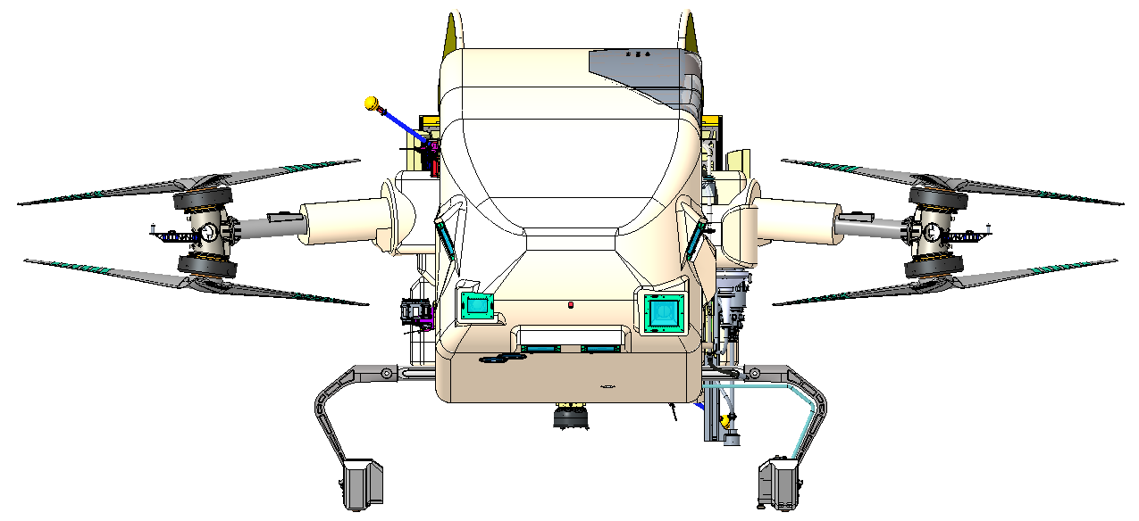
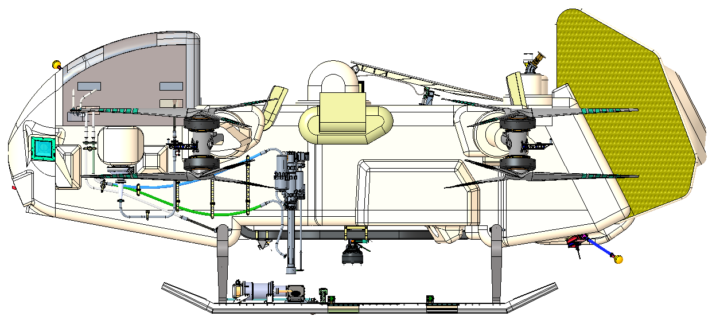
Dragonfly & Mission Overview
3.8 m
Dragonfly is a NASA New Frontiers mission to Titan, Saturn’s moon, with the goal of discovering and studying prebiotic chemistry on the surface
Titan has a dense, cryogenic atmosphere with a surface pressure of 1.5atm of nitrogen at -186°C
The Lander is relocatable rotorcraft, with all thermal & electrical energy coming from a radioisotope thermoelectric generator (RTG)
  995 kg
  Solimide foam covering Al honeycomb fuselage, rotor arms, and legs for thermal control and aerodynamic shaping
  MMRTG similar to MSL/Mars 2020, with shorter fins and larger cooling tubes
  134 Ahr battery capable of extended flights
1.3 m
1.6 m
0.5 m
0.9 m
MMRTG
(inside can)
4.0 m

Slide 5
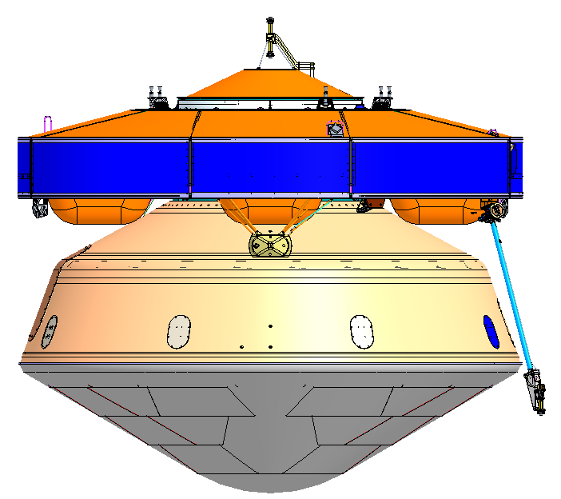
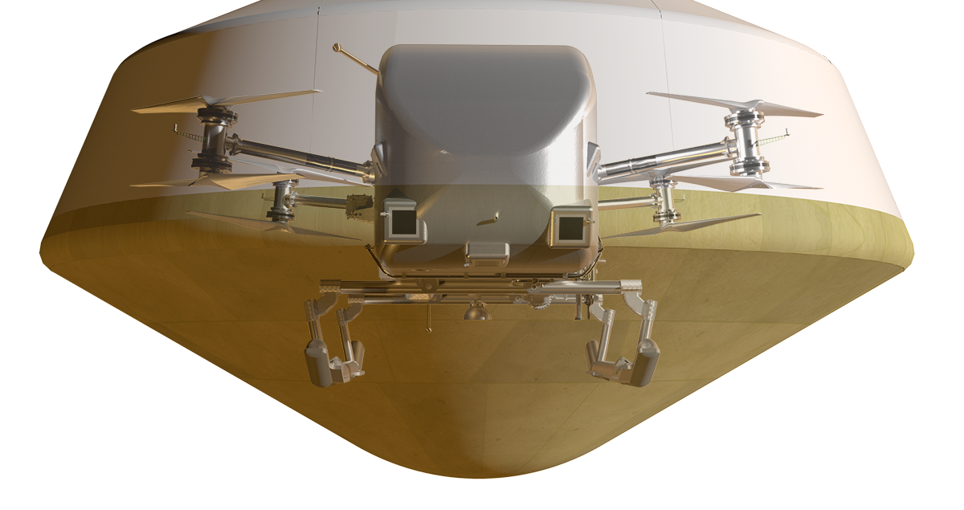
Spacecraft & Thermal Design Overview
Three primary spacecraft elements:
Cruise Stage (CS)
  Radiators, Propulsion, etc.
Entry Assembly (EA)
  Heatshield (HS)
  Backshell (BS)
    Parachutes
    Common Fluid Loop (CFL) Hardware
    Phase Change Material (PCM)
Lander:
  Lander Fans
  Battery & MMRTG
Radiators
Cruise Stage
CFL Pumps & PCM (Cruise TCS)
Backshell
Entry Assembly
Lander
Heatshield
Lander Fan
(Surface TCS)

Slide 6
2. EDL Description
EDL Timeline, Environment, and Lander Thermal Interfaces

Slide 7



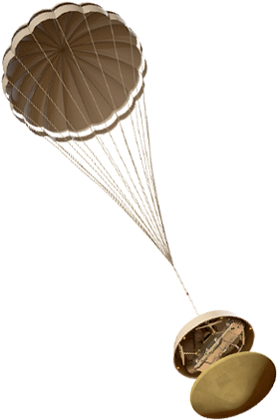

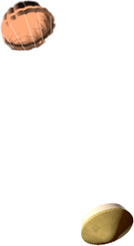
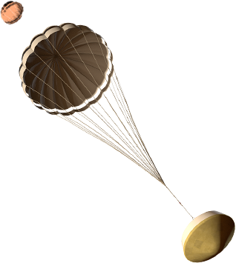
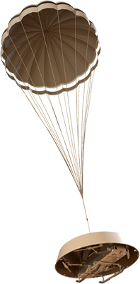
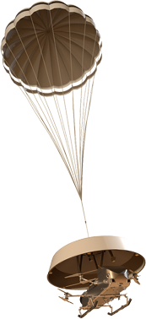

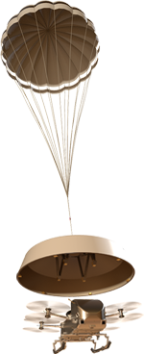




Wake up; E-190 min
Cut thermal loop; E-16 min
Entry Descent and Landing (EDL) at Titan
Cruise Stage Separation; E–10 min
Entry Interface (1270 km); E=0
Peak heating
245 km; E+234 s
Peak deceleration
220 km; E+246 s
108 min Descent under drogue
Drogue deployment
143 km; E+383 s
Main chute deployment
4.8 km; E+114 min
Heatshield separation
4.4 km; E+116 min
CFL-Fan swap
2.5 km; E+128 min
1.2 atm
Lander Pose
2.1 km; E+130 min
Entry prep (3.2 hours)
Entry & Heating (7 minutes)
Descent & Gradual Cooldown (2 hours)
Flight Prep & Rapid Cooldown (20 minutes)
First Flight and Landing (15 minutes)
Despin
2.0 km; E+131 min
Lidar Ground Lock
1.8 km; E+132 min
Lander Separation
1.0 km; E+137 min; 2.9 m/s
1.45 atm
Transition to Powered Flight
Release + 1 s
Radiators
PCM
Fan Circulated Atmosphere
Surface
TCS
Vacuum
1.5 Atm

Slide 8
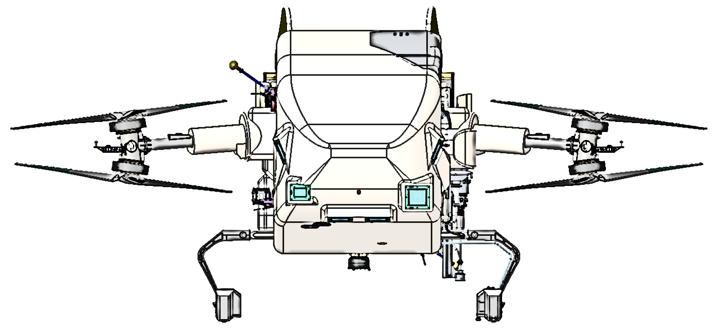
Lander Thermal Interfaces
Heatshield
  Rapidly increases to +150°C from atmospheric drag/effects
  Slowly cools until release
Backshell
  Lags heatshield, until HS release
Convective Environment
  EA fills with ambient atmosphere throughout the descent
  Internal EA atmosphere warmed by EA and Lander surfaces
CFL
  Temperature rises rapidly due to loss of cruise stage (PCM only) until HS separation
Backshell
PCM
Aeroshell
Ambient
Heatshield

Slide 9
3. Thermal Analysis
Challenges, Motivation, and Approach

Slide 10
EDL Analysis: Challenges & Motivation
EDL is a combination of three sequential “worst case” thermal scenarios
  A cruise case with a loss of CFL conditioning
  A non-flight, atmospheric case with exposed surfaces and air infiltration
  A flight case, where the lander starts from a preheated state
  None of these scenarios close in steady state
This is bounding hot and/or cold case for many components
  Cold bounding for some internal components during descent
  Hot bounding for external components during descent
  Hot bounding for internal components during flight
Lander has to be fully operational at release
No reference mission
EDL is a Test As You Fly Exception (TAYFE)
  Will not be simulated by a chamber on Earth
Notes:
Precedent

Slide 11
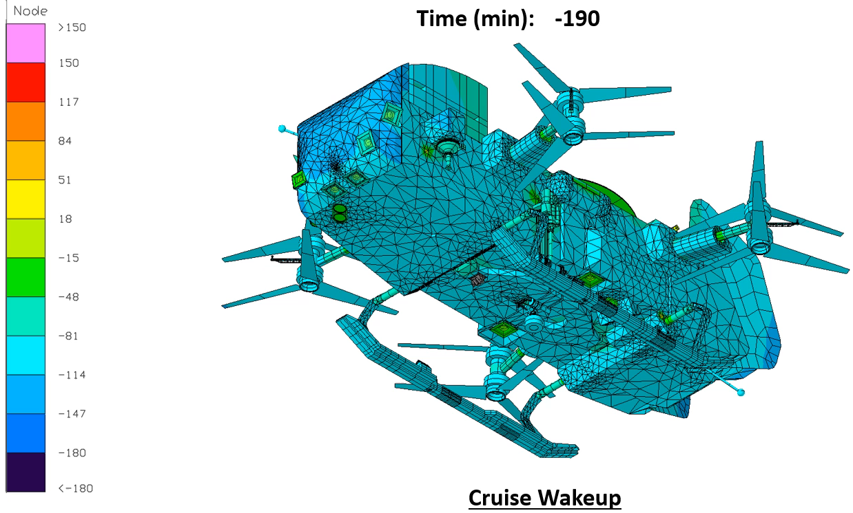
Entry & Descent – External Contour Plot, Hot Case

Slide 12
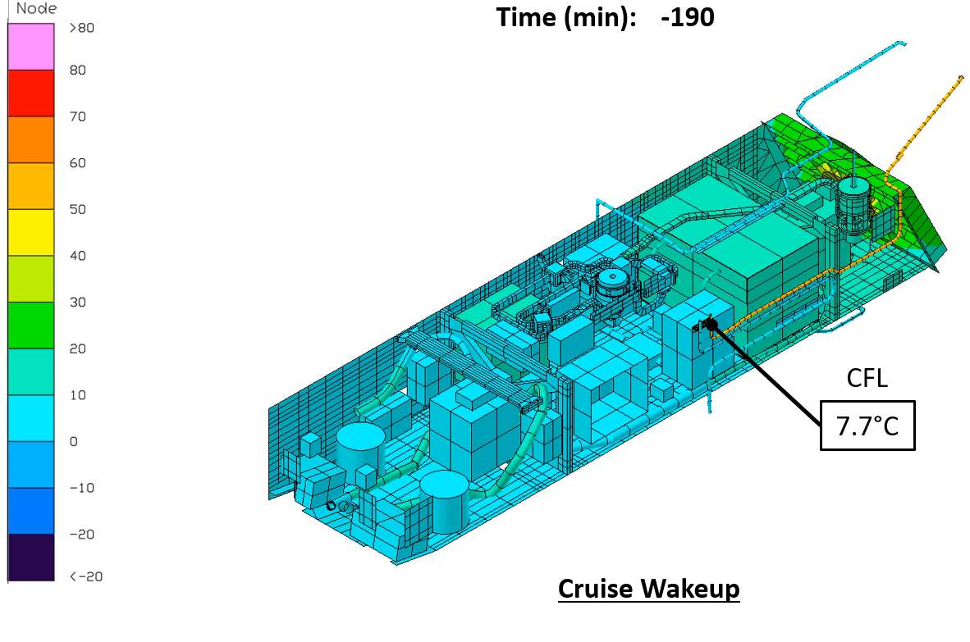
Entry & Descent – Internal Contour Plot, Hot Case

Slide 13
Uncertainty Reduction
Transient analysis has inherent uncertainty
Traditional pathways to reduce uncertainty are unavailable for Dragonfly
  Assume steady state, rely on heritage, test campaign, etc.
Dragonfly has a few aspects that enable another approach:
  Designed for sustained operation at both endpoints
  Thermally isolated from external environment
  Relies on battery thermal mass to survive short flight transients
Hypothesis: Dragonfly has enough thermal mass and isolation to survive the EDL transient
How can we test this hypothesis, with low uncertainty in the results?

Slide 14
Analysis Approach
General Approach: Move towards physical limits for boundary conditions
Hot Bias: Radiation Only
Convection is removed entirely from the simulation
  All heat transfer is radiation or conduction
Effect from initial heat pulse is maximized, while cooldown is minimized
Convection-based local heat spreading is eliminated
Lander can reject significantly less heat to the environment
Cold Bias: Direct Titan Exposure
Convection is maximized throughout the simulation
  Lander is exposed directly to Titan atmosphere
Effect from initial heat pulse is minimized, and cooldown is maximized
Convection driven local heat spreading is exacerbated
Lander can reject additional heat to the environment

Slide 15
Bounding Hot Case: Radiation Only
External: Passive Component
MGA Antenna
Internal: Passive Component
Integral Panel Heatpipe
Internal: Active Component
TWTA
OFF
Limited ability to dissipate heat
OFF
No cooling at fan activation
No cold shock at HS release
System thermal mass high enough to keep avionics below reasonable upper limits

Slide 16
Bounding Cold Case: Direct Titan Exposure
External: Passive Component
MGA Antenna
Internal: Passive Component
Integral Panel Heatpipe
Internal: Active Component
TWTA
Early and severe cold shock
OFF
OFF
System thermal mass high enough to keep avionics above reasonable lower limits
Notes:
Configuration Differences

Slide 17
4. Summary

Slide 18
Summary
Through these two analyses, the Dragonfly Lander is shown to be robust over the given timeframe
Uncertainty is somewhat reduced:
  Components have estimated “physical” limits based on the bounding analyses performed
  External environment is less important than initially thought
However, much uncertainty remains:
  System: ConOps, trajectory, power states
  Modeling: nodalization, convection scaling, general practice etc.
To account for this we expanded our thermal margin past typical APL standards for spacecraft
Future work will focus on reducing uncertainty during Lander EDL is focused on refining convection parameters as we continue to anchor the Thermal Desktop and CFD model
04 August 2025

Slide 20
Backup

Slide 21
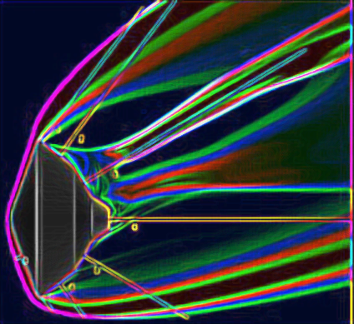
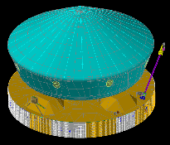
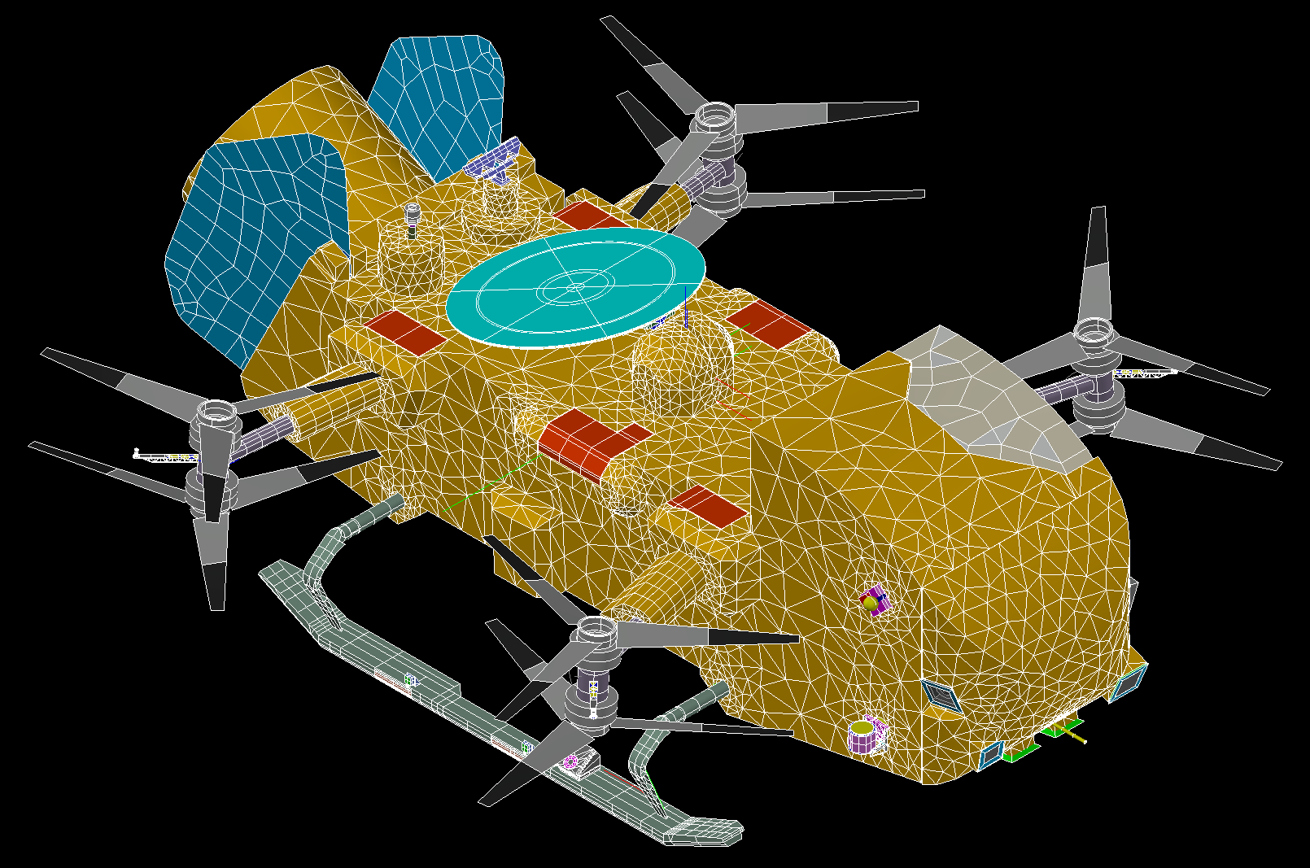
EDL Thermal Analysis Overview
APL
  Lander Thermal Desktop (TD) model
    Primary Tool
  Lander CFD model
    Supplemental Tool
    Airflow focused
      Convective coefficient
      Aeroshell air
      Pressure filling
LM
  EDLA Thermal Desktop (TD) model
  Cruise Thermal Desktop (TD) model
  Spacecraft Thermal Desktop (TD) model
NASA AMES
  Trajectory & aerodynamic heating data
NASA Ames
Lockheed Martin
Atmospheric Profile
Aero-heating Fluxes
Atmospheric
Profile
JHU APL
EA Temperatures

Slide 22
The Titan EDL Environment
Ambient Pressure
Ambient pressure steadily increases throughout EDL
Little lag between EA, Lander and atmosphere
Cruise-Surface TCS swap occurs at 1.2 atm
Ambient Temperature
Ambient temperature around -100°C at entry
Minimum of -202°C occurs at low pressure
HS release occurs within 5°C of surface temperature
Flight Prep
1 atm
Flight Prep

Slide 23
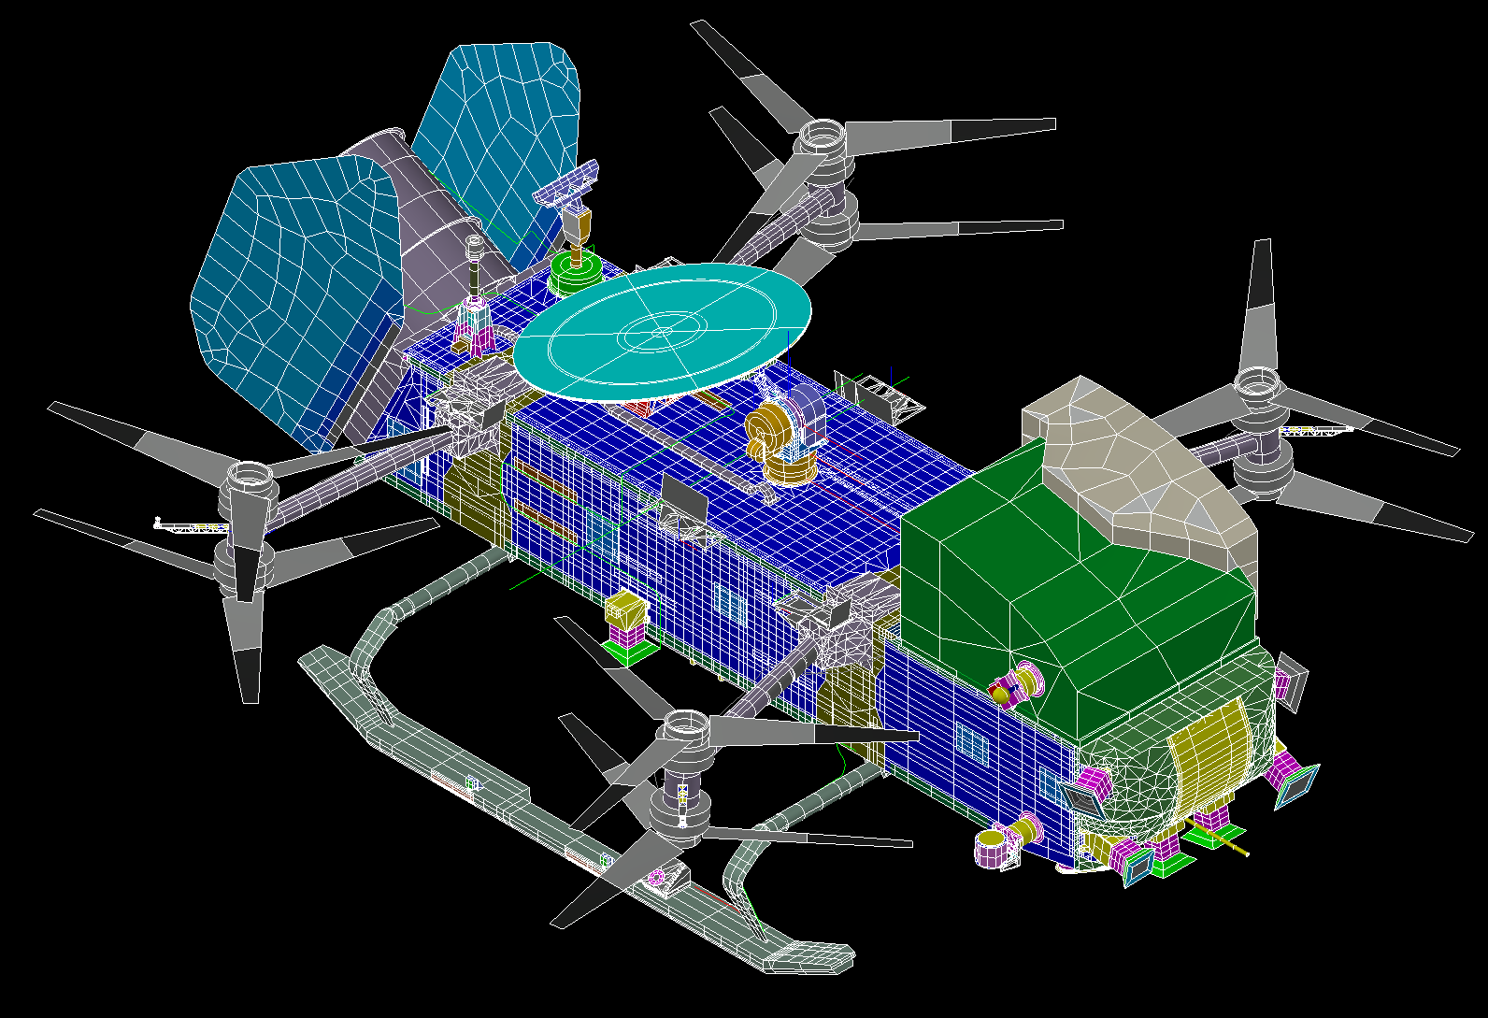
TD Model Overview: Thermal Interfaces
Convection
  External convection increases after heatshield release and flight
  Internal convection bounded low value validated by CFD
  Both scale with pressure
Radiation
  Lander views EA assembly, then Titan atmosphere
Backshell Group
Heatshield Group
Notes:
Maybe delete?

Slide 24
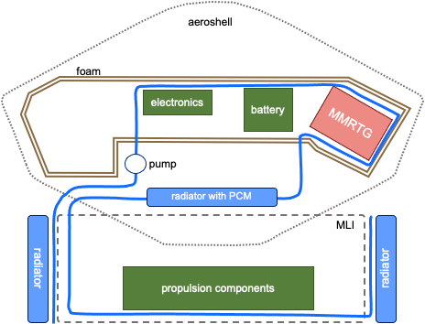
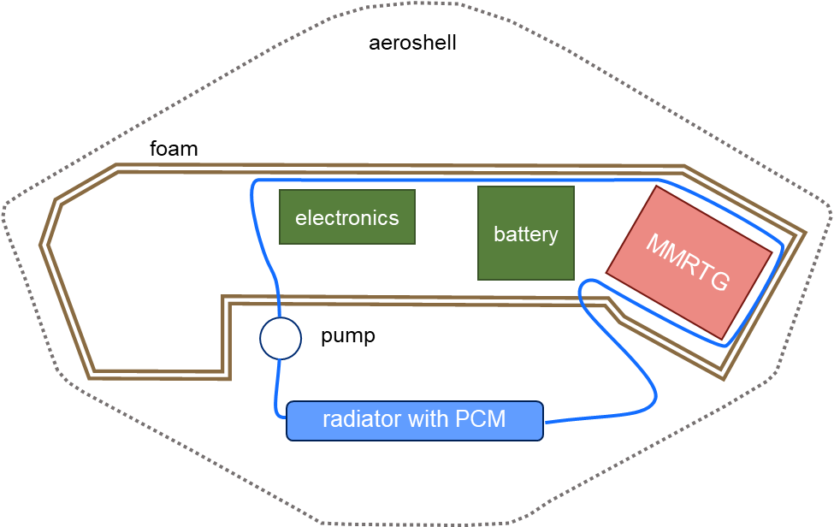
Cruise Thermal Control System
The Common Fluid Loop (CFL) regulates component temperature during cruise:
Refrigerant (R-245fa) is circulated through the cruise stage, backshell interface plate, and lander
Heat pipes couple critical lander components to the CFL
During cruise, heat is rejected through a series of large cruise radiators
During entry, heat is stored by a block of phase change material inside of the backshell
Cruise CFL Configuration
Entry CFL Configuration

Slide 25
Surface Thermal Control System
The lander fan & thermal trim device (TTD) regulate component temperature during atmospheric operations:
The fan blows warm air through the duct system
The air is conditioned as it travels though the duct system
The conditioned air regulates component temperature as it circulates through the lander body
The air passes by the MMRTG, warming again
4
1
3
2

