Slide 1

Modular Trajectory Analysis Tool for Skip-Out and Aerocapture Maneuvers Bohdan Wesely, NASA ARC, Aerodyne Industries LLC. Periklis Papadopoulos, SJSU Aerospace Engineering Paul Wercinski, NASA ARC

Slide 2
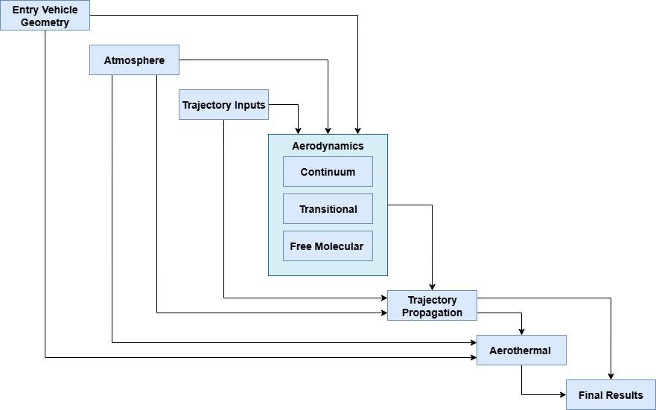
Project Overview
Project was completed for an M.S. in Aerospace Engineering at SJSU.
A 3DOF trajectory simulation was developed to study multi-pass aerocapture as an orbit insertion technique.
Initial goal was to compare with traditional, “single-pass” aerocapture.
Written entirely in MATLAB utilizing modern object-oriented programming techniques.
While various trajectory software tools already exist, programming a simulation from scratch re-enforces fundamental EDL relevant concepts. The most valuable takeaway from this project has been the learning experience.

Slide 3
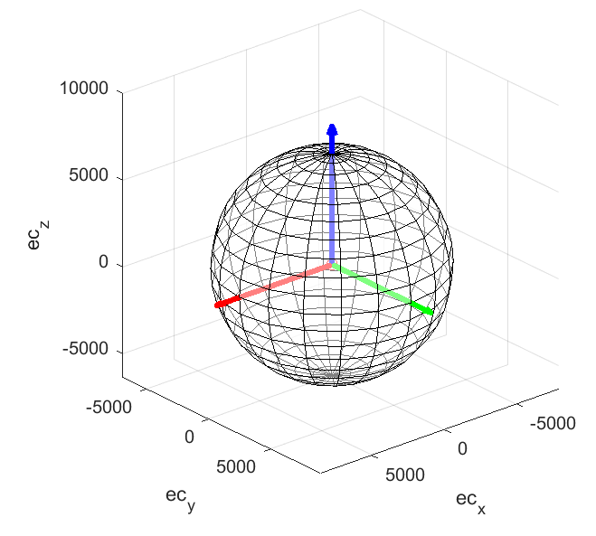


Orbital Mechanics
Cartesian, equatorial reference frame (ECI) was chosen.
2-body, J2 gravity model, no other perturbing body forces on vehicle.
Program utilizes a patched conic method to stitch together trajectory segments and supports three different physics types, coast, atmospheric flight, and propulsive maneuvers.
3DOF, vehicle modeled as a point mass, no rigid body or attitude dynamics.
Solver utilizes a Runge Kutta 4/5th order variable step integrator to solve the equations of motion.
Widely used technique for trajectory propagation
$$F_{g}=\frac{Gm_{1}m_{2}}{r^{2}}$$
$$\begin{aligned}r=\left[\begin{matrix}X ec_{x} \\ Y ec_{y} \\ Z ec_{z}\end{matrix}\right] \#\end{aligned}$$
$$\begin{aligned}μ=GM \#\end{aligned}$$
$$\begin{aligned}\ddot{r}=\frac{μ}{r^{3}}r \#\end{aligned}$$
$$\ddot{r}=\frac{μ}{r^{3}}r+\frac{F\dot{r}}{mr}$$
Newton’s Universal Law of Gravitation
Position Vector
Gravitational Constant Definition
2-body Equation of Motion
Equation of Motion for Propulsive Maneuvers

Slide 4
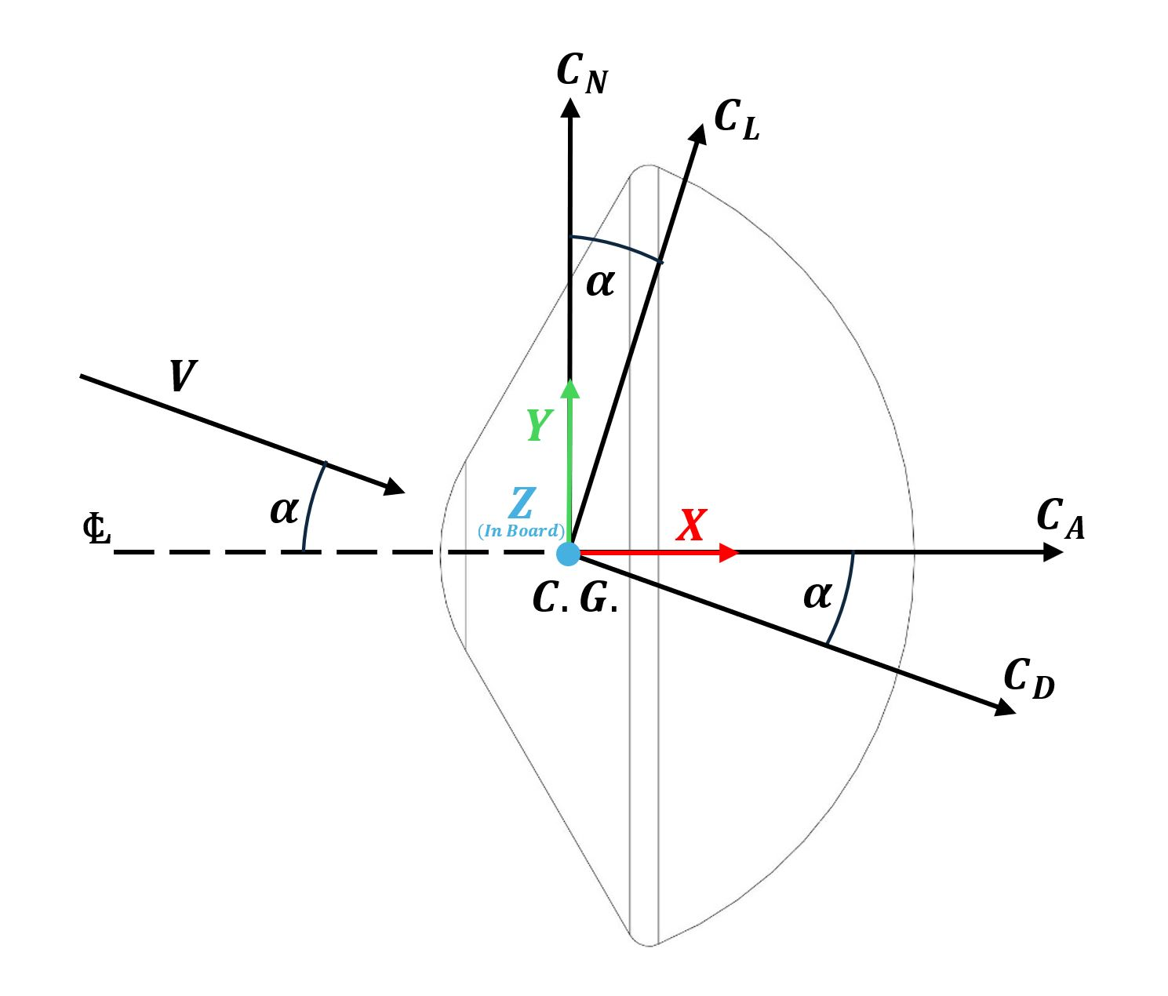
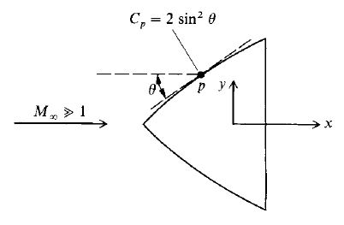

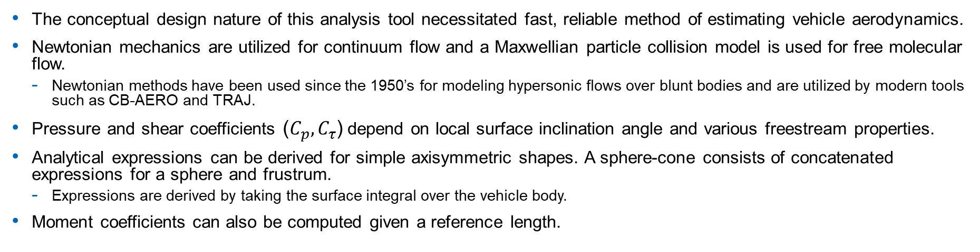

Aerodynamics Modeling
The conceptual design nature of this analysis tool necessitated fast, reliable method of estimating vehicle aerodynamics.
Newtonian mechanics are utilized for continuum flow and a Maxwellian particle collision model is used for free molecular flow.
Newtonian methods have been used since the 1950’s for modeling hypersonic flows over blunt bodies and are utilized by modern tools such as CB-AERO and TRAJ.
Pressure and shear coefficients (${C_{p},C}_{τ}$) depend on local surface inclination angle and various freestream properties.
Analytical expressions can be derived for simple axisymmetric shapes. A sphere-cone consists of concatenated expressions for a sphere and frustrum.
Expressions are derived by taking the surface integral over the vehicle body.
Moment coefficients can also be computed given a reference length.
$$\begin{aligned}\left[\begin{aligned}&C_{A} \\ &C_{N} \\ &C_{S}\end{aligned}\right]=\frac{1}{A_{\text{ref} }}\iint_{S}{ }C_{p}\left[\begin{aligned}n^{T}\hat{x} \\ n^{T}\hat{y} \\ n^{T}\hat{z}\end{aligned}\right]dA\#\end{aligned}$$
Continuum
$$C_{p}=C_{p_{max}}\sin^{2}{θ}$$
$$\begin{aligned}\left[\begin{aligned}C_{A} \\ C_{S} \\ C_{N}\end{aligned}\right]=\frac{1}{A_{ref}}\iint_{S}{ }{(C}_{p}\hat{n}+C_{τ}\hat{t}) dA\end{aligned}$$
Free Molecular

Slide 5
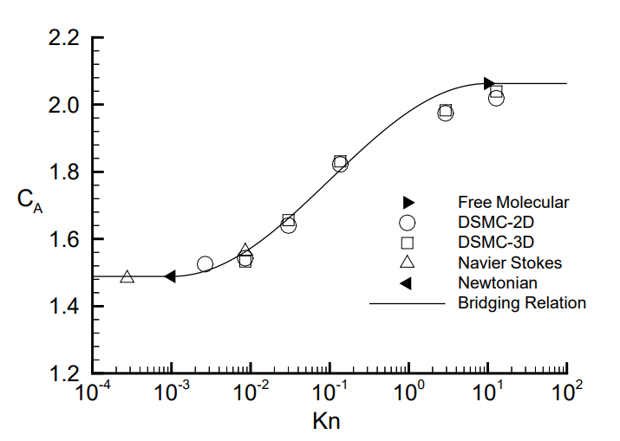

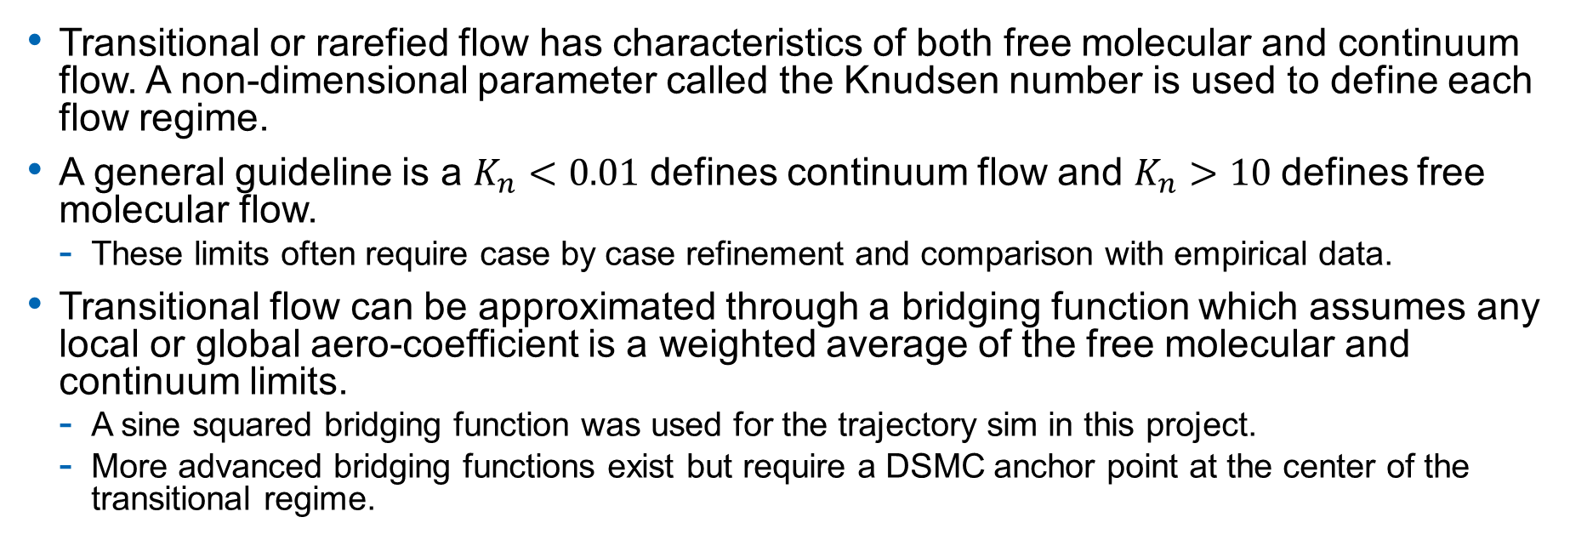

Transitional Aerodynamics
Transitional or rarefied flow has characteristics of both free molecular and continuum flow. A non-dimensional parameter called the Knudsen number is used to define each flow regime.
A general guideline is a $K_{n}<0.01$defines continuum flow and $K_{n}>10$defines free molecular flow.
These limits often require case by case refinement and comparison with empirical data.
Transitional flow can be approximated through a bridging function which assumes any local or global aero-coefficient is a weighted average of the free molecular and continuum limits.
A sine squared bridging function was used for the trajectory sim in this project.
More advanced bridging functions exist but require a DSMC anchor point at the center of the transitional regime.
$$K_{n}=\frac{λ}{L}$$
$$C_{tr}={P_{b}C}_{fm}+\left(1−P_{b}\right)C_{cont}$$
Knudsen Number
$$P_{b}=\sin^{2}{ψ}$$
$$λ=\frac{k_{b}T}{\sqrt{2}πd^{2}p}$$
$$ψ=π\left(a_{1}+a_{2}log10K_{n_{∞}}\right)$$
Mean Free Path
Sine Squared Bridging Function Formulation

Slide 6
Atmospheric Modeling
The NASA developed Global Atmospheric Reference Model (GRAM) is an engineering design tool that can compute planetary atmospheric conditions utilizing ephemeris calculations and a host of empirical data.
Supported Planets
Earth, Mars, Venus, Jupiter, Uranus, Neptune, Titan (SaturnGRAM in development)
Key GRAM implementation details
GRAM model queried at each trajectory time step for maximum accuracy
Temporal, spatial variations and winds are modeled within GRAM
Atmospheric uncertainties and perturbations are supported through Monte Carlo runs
Constant vehicle orientation, 3DOF, no GNC modeling or uncertainties at this point

Slide 7


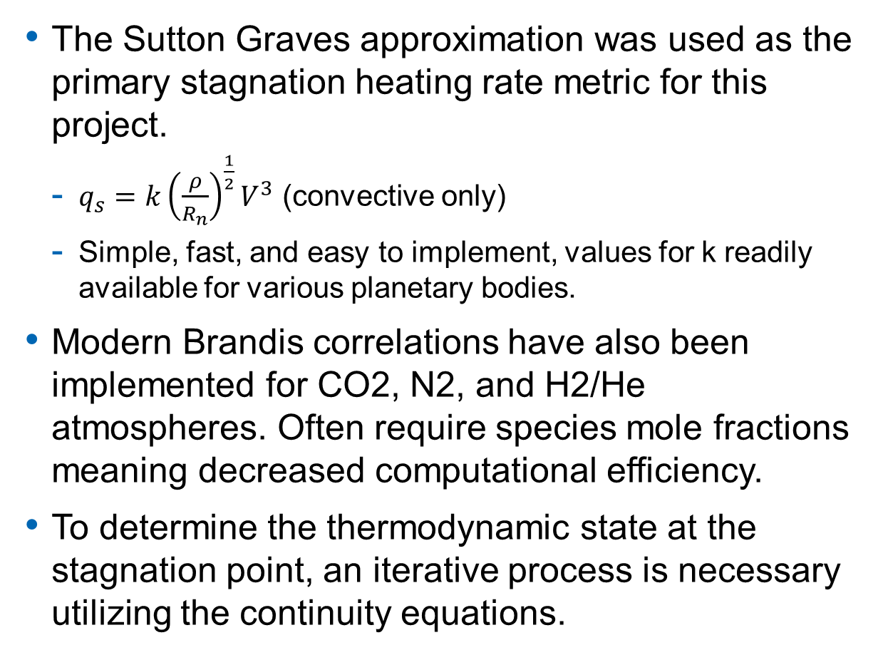



Aerothermal Modeling
The Sutton Graves approximation was used as the primary stagnation heating rate metric for this project.
$q_{s}=k{\left(\frac{ρ}{R_{n}}\right)}^{\frac{1}{2}}V^{3}$ (convective only)
Simple, fast, and easy to implement, values for k readily available for various planetary bodies.
Modern Brandis correlations have also been implemented for CO2, N2, and H2/He atmospheres. Often require species mole fractions meaning decreased computational efficiency.
To determine the thermodynamic state at the stagnation point, an iterative process is necessary utilizing the continuity equations.
$$p_{2}=p_{1}+ρ_{1}u_{1}^{2}\left(1−\frac{ρ_{1}}{ρ_{2}}\right)$$
Shock relations (solved iteratively)
$$h_{2}=h_{1}+\frac{u_{1}^{2}}{2}\left[1−{\left(\frac{ρ_{1}}{ρ_{2}}\right)}^{2}\right]$$
$$\begin{aligned}G_{i}=H_{i}−TS_{i}\end{aligned}$$
$$\begin{aligned}ΔG^{p=1}≡\sum_{i}{ }v_{i}G_{i}^{p_{i}=1}\#\end{aligned}$$
$$\begin{aligned}\prod_{i}{ }p_{i}^{v_{i}}=e^{−\frac{ΔG^{p=1}}{ℛT}}\#\end{aligned}$$
Thermochemical Equilibrium Calculations
$$K_{p}\left(T\right)=\prod_{i}{ }p_{i}^{v_{i}}$$
$$\begin{aligned}p_{t}=\sum_{i}{p_{i} }\#\end{aligned}$$
$$\begin{aligned}h=\sum_{i}{ }c_{i}h_{i}=\sum_{i}{ }η_{i}H_{i}\#\end{aligned}$$

Slide 8
Aerothermal Modeling
The chemical equilibrium calculation is computationally tedious and is employed in the industry standard, NASA developed CEA software.
The trajectory tool as part of this project utilizes symbolic math to reduce the set of non-linear partial pressure equations for fast convergence.
The NASA ARC TS developed TRAJ code will pre-generate a thermodynamic Mollier diagram for efficiency.
In many cases, the isentropic pressure ratio (Raleigh-Pitot formula) is a good enough approximation.
The trajectory program supports Monte Carlo runs which can generate a normal distribution of aero heating environments based on trajectory and GRAM atmospheric dispersions.
P1 = 1 Pa
T1 = 216.4 K
0.79 mole N2
0.21 mole O2

Slide 9
Uncertainty Modeling
A Monte Carlo Analysis was run for a small Venus entry vehicle to test the perturbation capabilities in GRAM.
5000 runs were completed in around 13 mins on a 12-core i9 machine, parallelization possible but not utilized.
Potential use as a margin policy if 3σ edge case aerothermal environments are fed into a material response program.
Pressure, temperature and species mole fraction dispersions are not yet supported for VenusGRAM.
Monte Carlo Test Case
Number of Runs | 5000
Julian Date | 2460809 (14-May-2025)
Mass | 17 kg
Cone Half Angle | 45°
Diameter | 0.43 m
Nose Radius | 0.118 m
Mean: 1513 W/cm^2
3σ: 208 W/cm^2
Mean: 1.292e5 Pa
3σ: 2.173e4 Pa
Dispersions
Parameter | Mean | Variance
Velocity | 11 km/s | 1σ=0.05 km/s
EFPA | -10° | 1σ=0.1°
Longitude | 130° | No Dispersion
Latitude | 20° | No Dispersion
Azimuth | 91° | No Dispersion
Winds | GRAM | GRAM 3σ
Density | GRAM | GRAM 3σ
Move to Backup

Slide 10
Trajectory Sample Cases

Slide 11
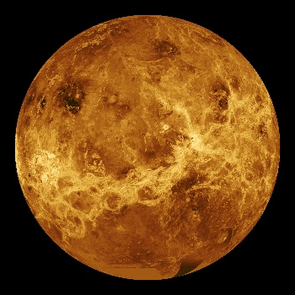
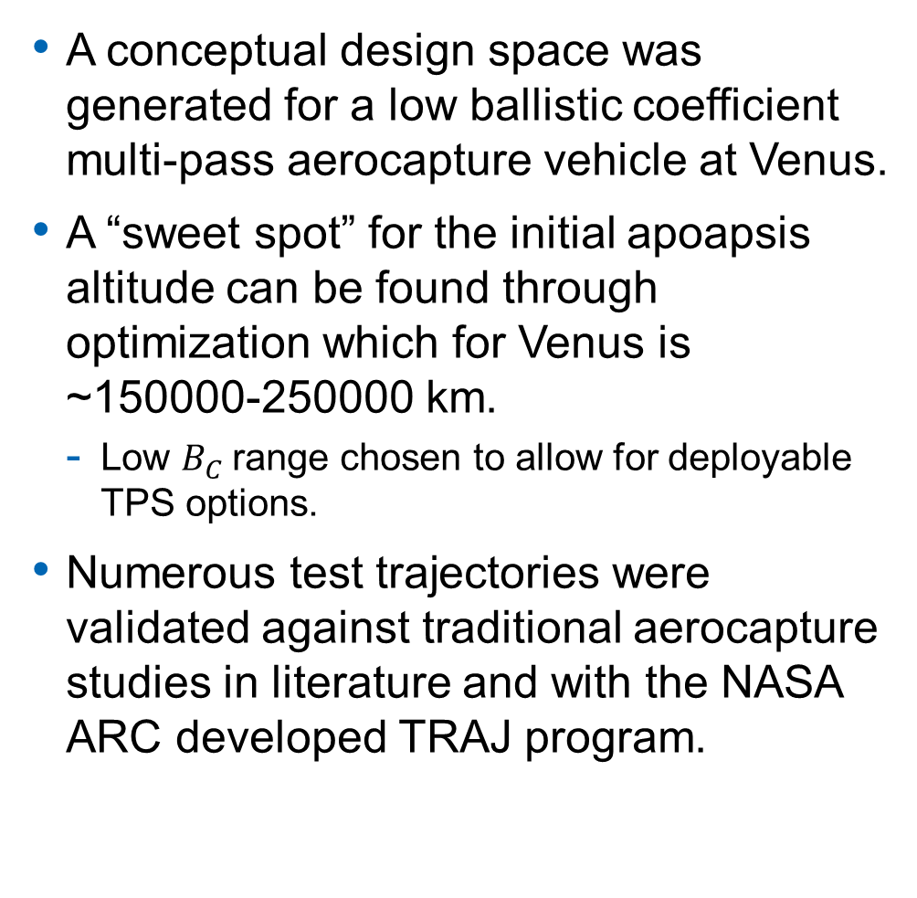
Multi-Pass Aerocapture at Venus
A conceptual design space was generated for a low ballistic coefficient multi-pass aerocapture vehicle at Venus.
A “sweet spot” for the initial apoapsis altitude can be found through optimization which for Venus is ~150000-250000 km.
Low $B_{C}$range chosen to allow for deployable TPS options.
Numerous test trajectories were validated against traditional aerocapture studies in literature and with the NASA ARC developed TRAJ program.
Initial orbit apoapsis is 175000 km
Vehicle diameter varied from 2-4 m
Nose radius is ¼ the vehicle diameter
70° Sphere Cone
α=10°/-10°
0°Lat, 170°Long, 150 km
Heating can vary by ~5-7% depending on entry long/lat and JD
Primary Venus Validation Reference:
Lugo, R. A., Dutta, S., Matz, D., Johnson, B. J., Pensado, A. R., Roelke, E., Aguirre, J. T., and Powell, R., “Performance Analysis of SMALLSAT Aerocapture at Venus,” AIAA SCITECH 2023 Forum, Jan. 23–27, 2023, National Harbor, MD. https://doi.org/10.2514/6.2023-0878

Slide 12
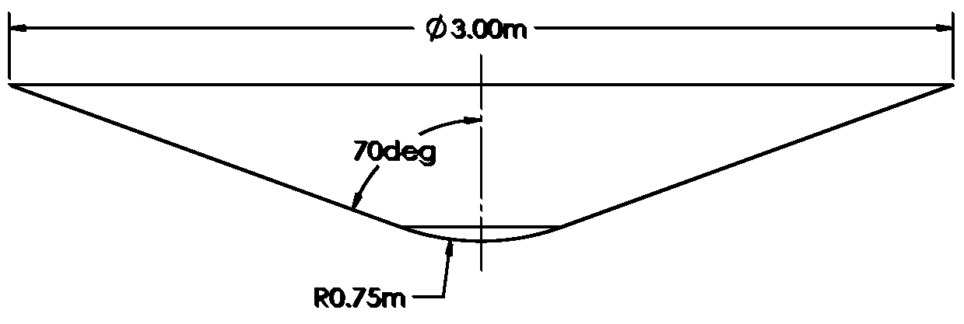
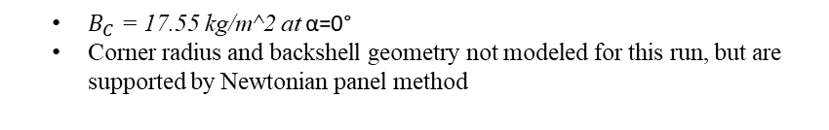
Multi-Pass Aerocapture at Venus
500 km final target science orbit, 4 total atmospheric entries.
A mission planning routine determines the optimal number of atmospheric passes and TCM’s to reach the final target orbit.
The multi-pass offers a narrower range of aerothermal environments that are more benign than the single pass.
A future study might include a Monte Carlo analysis to determine whether a multi-pass approach is less sensitive to atmospheric or trajectory uncertainties.
Single Pass, Large Design Range
Multi Pass, Smaller Design Range
$B_{C}$ = 17.55 kg/m^2 at α=0°
Corner radius and backshell geometry not modeled for this run, but are supported by Newtonian panel method

Slide 13
Summary and Next Steps
A Novel EDL mission design tool has been developed that has the capability to study a wide range of entry problems to assess viability.
The program can optimize and simulate small propulsive maneuvers and con-ops for complex orbital insertion methods such as multi-pass aerocapture.
A stretch goal for this software tool would be to model interplanetary transfers and directly couple aspects like the launch window, launch vehicle, and gravity assists to the aerothermal and entry environment at the destination.
Some technical short-term improvements
N-body
SPICE integration
Translation to Python/C++
Expanded comparison with TRAJ, additional comparisons with other tools such as POST2, GENESIS,
6DOF, mass properties, stability
Expanded radiative heating correlations

Slide 14
Acknowledgements
Paul Wercinski, NASA mentor, NASA ARC, Entry Vehicles and Systems Branch
For countless guidance and technical assistance throughout this project.
Periklis Papadopoulos, SJSU Advisor
For valuable advice and feedback for this project and throughout my M.S. degree.
David Hash, Mairead Stackpoole, Ethiraj Venkatapathy, Todd White, NASA ARC, Entry Systems Division
For valuable feedback and technical insight during rehearsal presentation.

Slide 15
Questions?

Slide 16
Backup
Backup

Slide 17
Why?
A variety of trajectory simulation software exist such as POST, GENESIS, FAST, etc.
Copernicus and several other tools exist for interplanetary mission design and maneuver optimization.
Most importantly, programming a physics simulation from scratch re-enforces fundamental mathematics knowledge, modeling, and programming techniques that are all relevant to EDL and space systems in general.
Also, building a completely new codebase/architecture is rare, legacy programs are often used for 20+ years. While they can be continuously updated, there are often fundamental limitations and out of date implementations that remain.
Bloating out an architecture by adding modules, wrappers, and libraries while leaving original source untouched can lead to lower readability, original authors often retire or move on.
At its core, 2-body gravitational mechanics isn’t that difficult to simulate in a modern development environment like MATLAB or Julia.
Additional fidelity and physics can easily be added without starting over or throwing off the existing models.
While traditional aerocapture has been simulated numerous times in literature, a simulation combining multiple atmospheric entries, propulsive maneuvers, and trajectory optimizations is not as common.

Slide 18
Multi-Pass Aerocapture at Venus
Several planetary bodies were evaluated for the benefits of a multi-pass approach.
Uranus and Neptune, while popular for traditional aerocapture, aren’t applicable for a multi-pass apoapsis reduction due to the presence of natural satellites for free down-pumping maneuvers and limited science at ultra low orbits.
The Uranus moon Titania orbits at ~550,000 km, which is near the ΔV limit of a bonded elliptical orbit.
Venus has no natural satellite and has ample science objectives in low (~500 km) orbits. The trajectory tool was used to explore the feasibility of a small-sat, multi-pass aerocapture mission.
A weighting function was used to evaluate the optimal aerocapture post-exit altitude based on stagnation heating rate and orbital period.

Slide 19

Multi-Pass Aerocapture at Venus
One of the drawbacks of a multi-pass approach is increased mission duration.
Orbital period varies non-linearly with apoapsis altitude.
Shaving off less ΔV will produce a milder aerothermal environment but also a higher apoapsis and longer orbital period.
A “sweet spot” can be found through optimization which for Venus is an apoapsis of ~150000-250000 km.
Using this data, a conceptual design space can be generated for a low ballistic coefficient aerocapture vehicle at Venus targeting a 500 km science orbit.
Initial orbit apoapsis is 175000 km
Vehicle diameter varied from 2-4 m
Nose radius is ¼ the vehicle diameter
70° Sphere Cone
α=10°/-10°
0°Lat, 170°Long, 150 km
Heating can vary by ~5-7% depending on entry long/lat and JD
Low $B_{C}$ range chosen to allow for deployable TPS options
Primary Venus Validation Reference:
Lugo, R. A., Dutta, S., Matz, D., Johnson, B. J., Pensado, A. R., Roelke, E., Aguirre, J. T., and Powell, R., “Performance Analysis of SMALLSAT Aerocapture at Venus,” AIAA SCITECH 2023 Forum, Jan. 23–27, 2023, National Harbor, MD. https://doi.org/10.2514/6.2023-0878

Slide 20
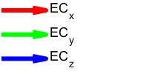
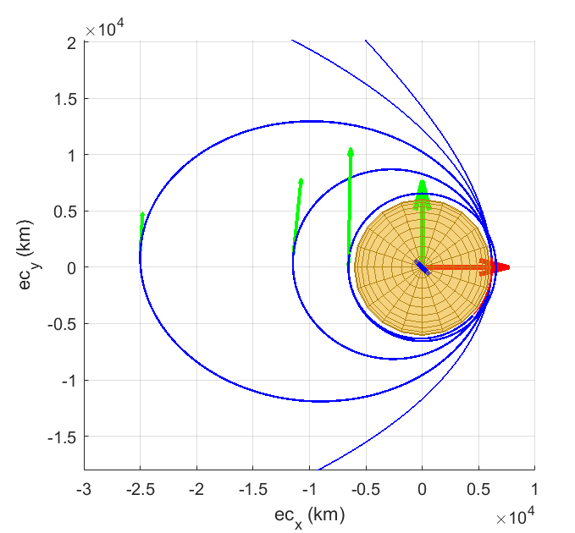
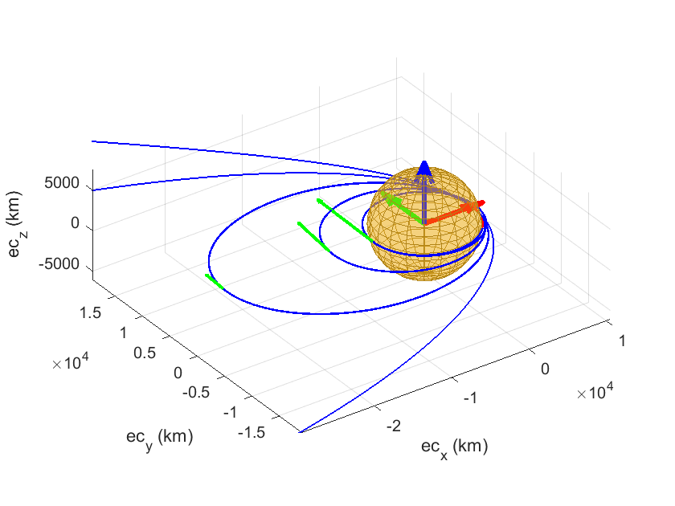
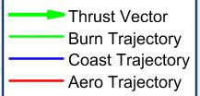
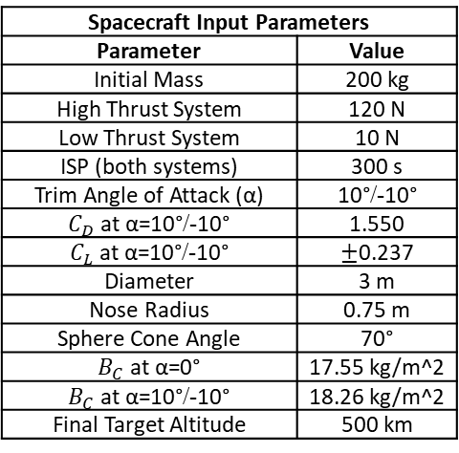
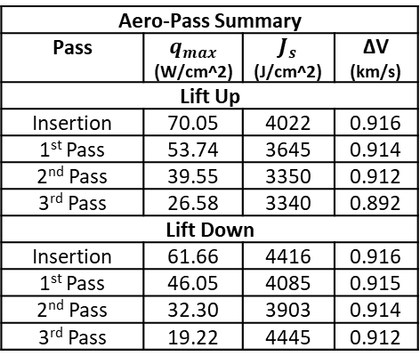
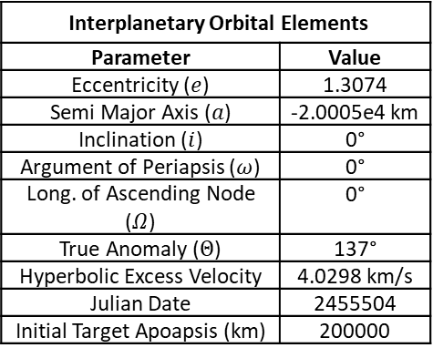
Venus Multi-Pass Additional Results
Maneuvers Summary
Maneuver | Duration (s) | ΔV (m/s)
Lift Up
Interplanetary TCM | 10.49 | 0.525
1st Periapsis Adjust | 0.128 | 0.006
2nd Periapsis Adjust | 2.000 | 0.100
3rd Periapsis Adjust | 10.15 | 0.507
Final Periapsis Raise | 190.0 | 116.3
Lift Down
Interplanetary TCM | 12.17 | 0.610
1st Periapsis Adjust | 0.194 | 0.010
2nd Periapsis Adjust | 2.141 | 0.110
3rd Periapsis Adjust | 8.137 | 0.407
Final Periapsis Raise | 177.1 | 108.2
Totals | Lift Up | Lift Down
Mission Duration (days) | 5.461 | 5.468
Maneuvers ΔV (m/s) | 117.4 | 109.4
Propellant Usage (kg) | 7.832 | 7.304
Spacecraft Input Parameters
Parameter | Value
Initial Mass | 200 kg
High Thrust System | 120 N
Low Thrust System | 10 N
ISP (both systems) | 300 s
Trim Angle of Attack (α) | 10°/-10°
$C_{D}$ at α=10°/-10° | 1.550
$C_{L}$ at α=10°/-10° | $±$0.237
Diameter | 3 m
Nose Radius | 0.75 m
Sphere Cone Angle | 70°
$B_{C}$ at α=0° | 17.55 kg/m^2
$B_{C}$ at α=10°/-10° | 18.26 kg/m^2
Final Target Altitude | 500 km
Interplanetary Orbital Elements
Parameter | Value
Eccentricity ($e$) | 1.3074
Semi Major Axis ($a$) | -2.0005e4 km
Inclination ($i$) | 0°
Argument of Periapsis ($ω$) | 0°
Long. of Ascending Node ($Ω$) | 0°
True Anomaly ($Θ$) | 137°
Hyperbolic Excess Velocity | 4.0298 km/s
Julian Date | 2455504
Initial Target Apoapsis (km) | 200000
Aero-Pass Summary
Pass | $q_{max}$ (W/cm^2) | $J_{s}$ (J/cm^2) | ΔV (km/s)
Lift Up
Insertion | 70.05 | 4022 | 0.916
1st Pass | 53.74 | 3645 | 0.914
2nd Pass | 39.55 | 3350 | 0.912
3rd Pass | 26.58 | 3340 | 0.892
Lift Down
Insertion | 61.66 | 4416 | 0.916
1st Pass | 46.05 | 4085 | 0.915
2nd Pass | 32.30 | 3903 | 0.914
3rd Pass | 19.22 | 4445 | 0.912
Figure 6.15 Venus Deployable TPS Additional Trajectory Views

Slide 21
Multi-Pass Aerocapture at Venus
An adaptive mission planning module was developed for the trajectory program that determines the optimal number of atmospheric passes to reach the final target orbit.
The program balances the ΔV of each pass with the bounding initial orbital insertion
Periapsis correction maneuvers are optimized and executed after each pass
A final periapsis raise maneuver is executed after the final target apoapsis is achieved.
Single Pass, Large Design Range
Multi Pass, Smaller Design Range

Slide 22
Peak Heating and Orbital Period Tradeoff
1 m diameter, 0.25 m nose radius
BC = 138 kg/m^2
60° Sphere Cone
11 km/s Venus entry
Figure 6.5 Peak Stag. Heat Flux to Orbital Period Tradeoff

Slide 23
Monte Carlo Test Case Additional Details
Mean: 2.4325e+04 J/cm^2
3σ: 2.8471e+03 J/cm^2

Slide 24
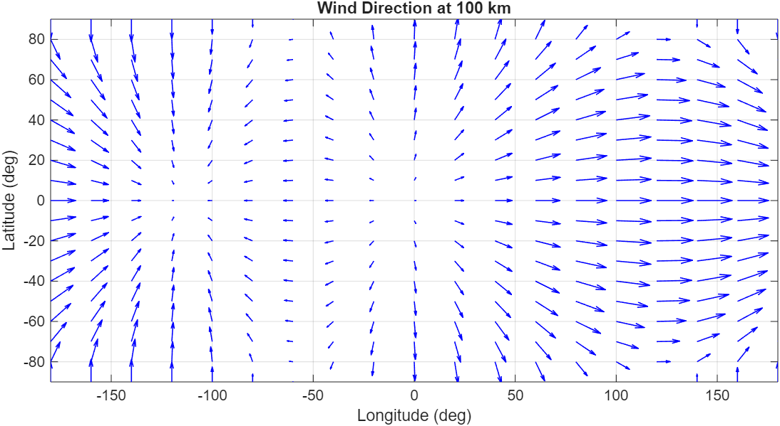
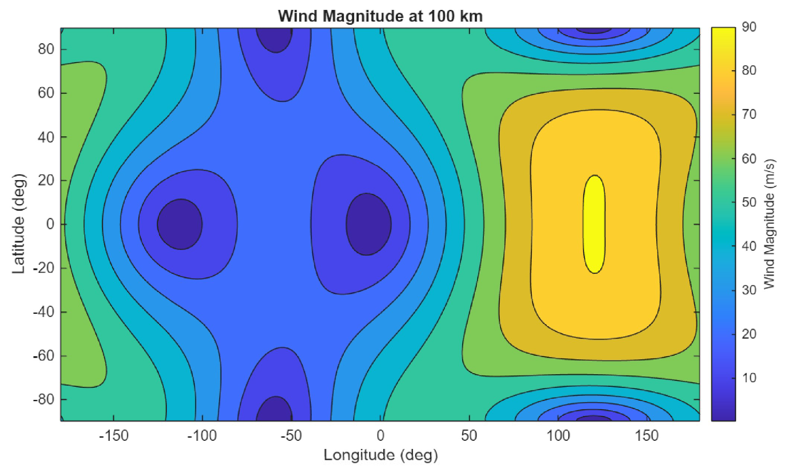

Atmospheric Modeling
Venusian winds modeled within GRAM were studied in detail.
The winds on Venus are significant at higher altitudes (<200 m/s) and are faster than the planet’s rotation.
GRAM outputs winds in three components, north to south (nsw), east to west (eww), and vertical (vw) in the east, north, zenith (ENZ) frame.
A great deal of time was spent in reference frame conversion handing and efficiency for this project (QXx is the ENZ to ECI conv. Matrix).
$$\begin{aligned}&v_{rel}=V_{eci}−\left[\begin{matrix}0 \\ 0 \\ ω\end{matrix}\right] × R_{eci}−Q_{Xx}\left[\begin{matrix}−eww \\ −nsw \\ vw\end{matrix}\right] \#\end{aligned}$$
Coriolis Effect
Winds
Venusian Wind Magnitude and Direction (JD 2459138)

Slide 25
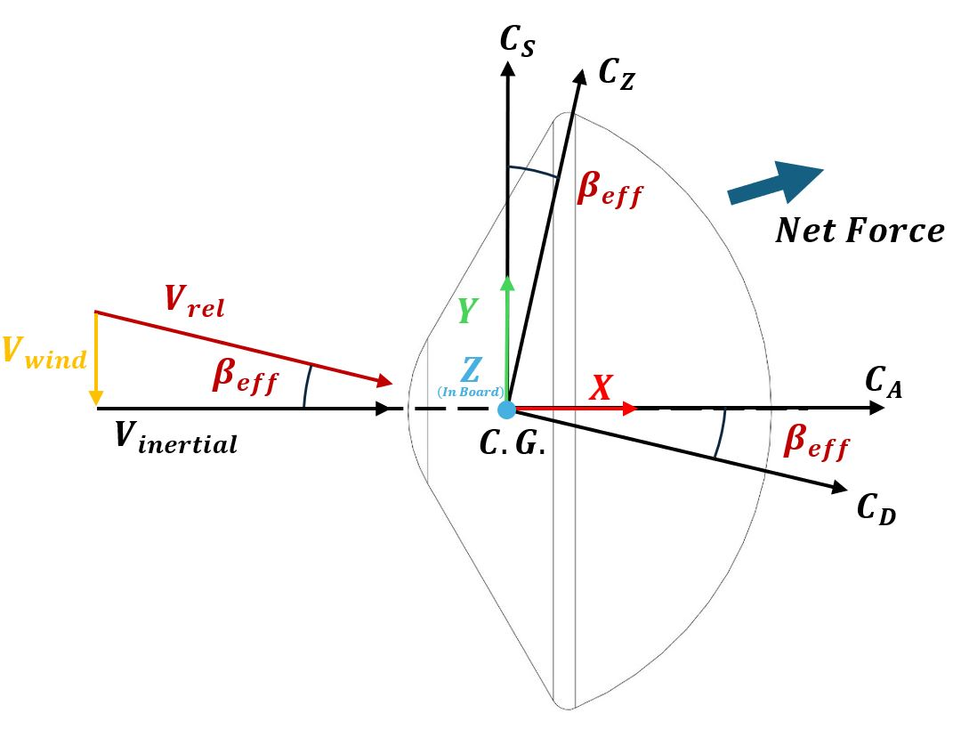
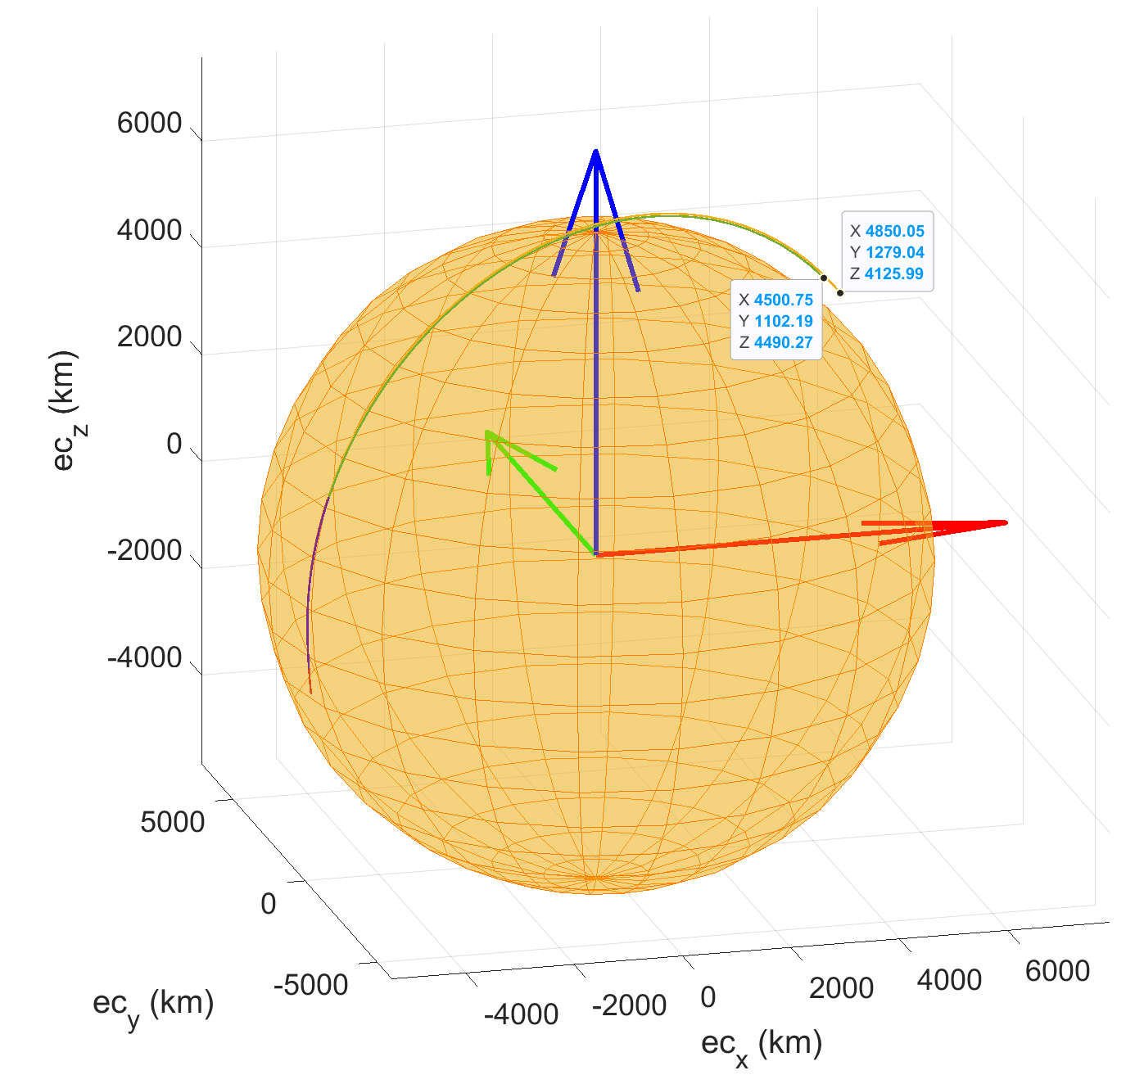
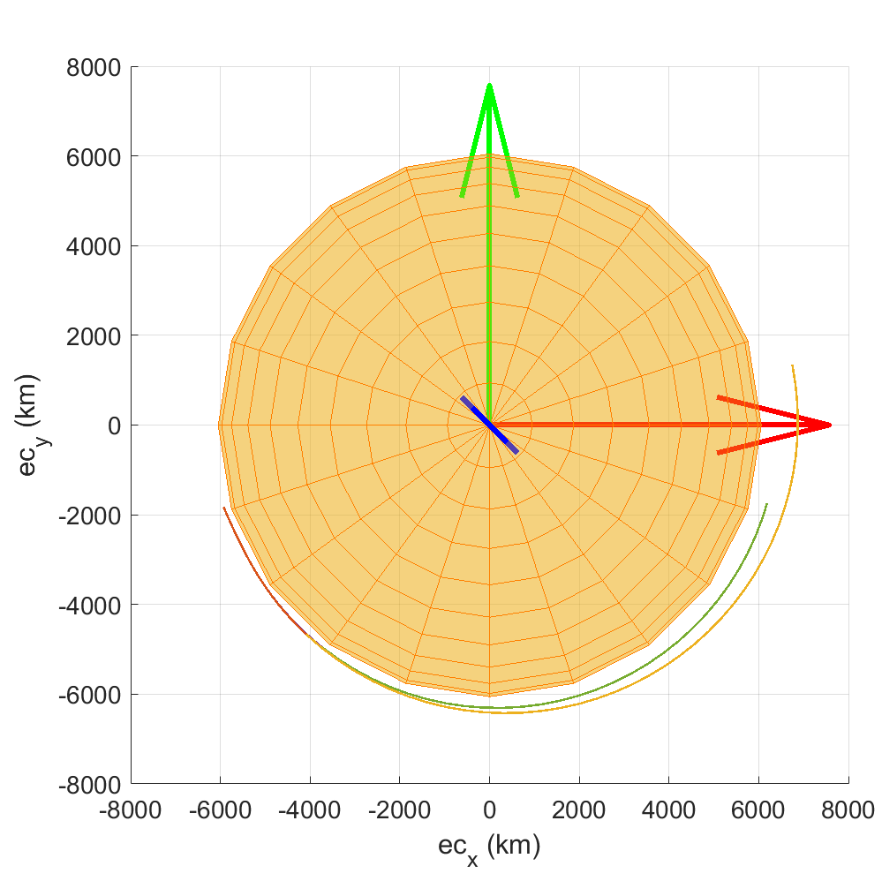


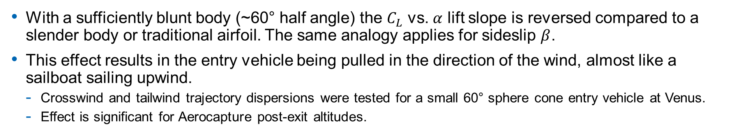
Atmospheric Modeling
With a sufficiently blunt body (~60° half angle) the $C_{L}$ vs. $α$ lift slope is reversed compared to a slender body or traditional airfoil. The same analogy applies for sideslip $β$.
This effect results in the entry vehicle being pulled in the direction of the wind, almost like a sailboat sailing upwind.
Crosswind and tailwind trajectory dispersions were tested for a small 60° sphere cone entry vehicle at Venus.
Effect is significant for Aerocapture post-exit altitudes.
Polar Orbit
V = 11/km/s, Alt = 150 km, Fpa = -5.61°
Final Azimuth (Winds): 173.257°
Final Azimuth (No Winds): 174.242°
Equatorial Orbit
V = 11/km/s, Alt = 150 km, Fpa = -5.61°
Final Altitude (Winds): 828.1516 km
Final Altitude (No Winds): 375.0636 km

Slide 26
Atmospheric Modeling
Long: 225, lat: 60, Date: 2020, 5, 12, 16, 0, 0.0

Slide 27
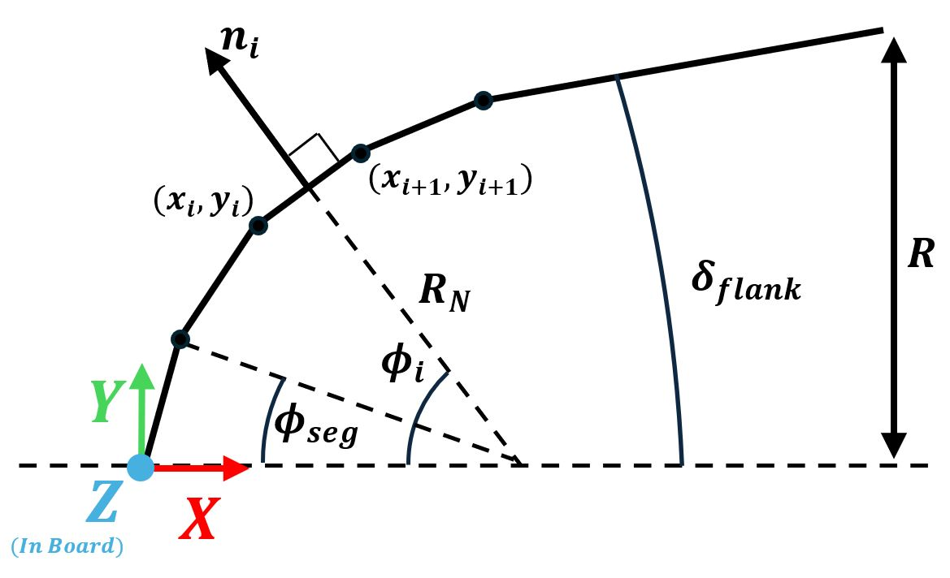
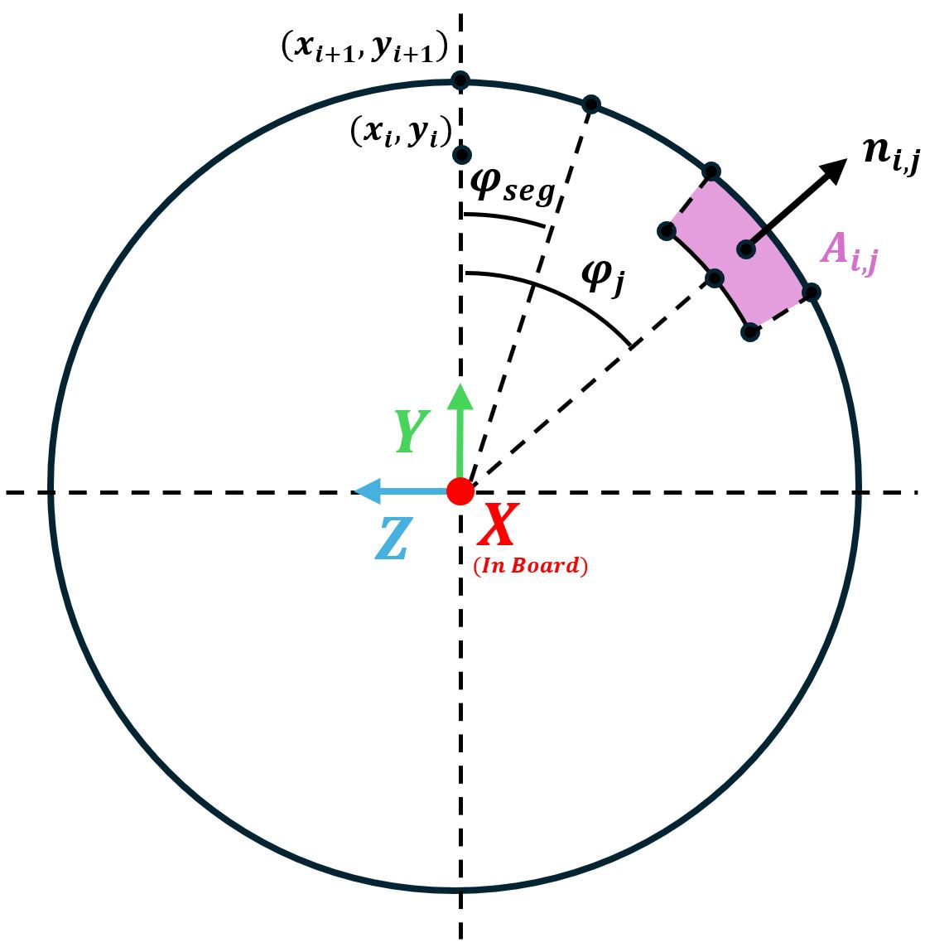
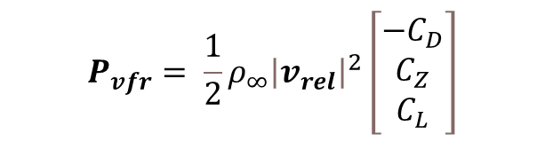


Gridding Methods
Both the free molecular and continuum aerodynamics depend on the local inclination angle of the vehicle surface.
Analytical expressions exist for simple shapes, however for this project a CB-AERO style grid generator was developed to allow for more complex geometries in the future.
The coefficients form an expression for the perturbing acceleration vector due to aero forces. This is a simple addition to the equations of motion, additional perturbations due to spherical harmonics or solar radiation pressure can also be added.
$$\left[\begin{aligned}&C_{D} \\ &{−C}_{L} \\ &C_{Z}\end{aligned}\right]=\frac{C_{p_{max}}}{A_{ref}}\sum_{i=2}^{N_{seg}}{\sum_{j=2}^{M_{seg}}{{{(N}_{i,j}\hat{x})}^{2}\left[\begin{aligned}N_{i,j}\hat{x} \\ N_{i,j}\hat{y} \\ N_{i,j}\hat{z}\end{aligned}\right]A_{i,j}}}$$
$$sinθ=\frac{V_{∞}}{\left|V_{∞}\right|}∙n=N_{i,j}\hat{x}$$
$$P_{vfr}= \frac{1}{2}ρ_{∞}{\left|v_{rel}\right|}^{2}\left[\begin{matrix}−C_{D} \\ C_{Z} \\ C_{L}\end{matrix}\right]$$
$$\ddot{r}=\frac{μ}{r^{3}}r+P$$
Perturbing acceleration vector, coordinate transformation from relative velocity frame (VFR) to ECI frame not shown here for simplicity
Blunt Body Side View Discretization
Nose View Discretization

Slide 28
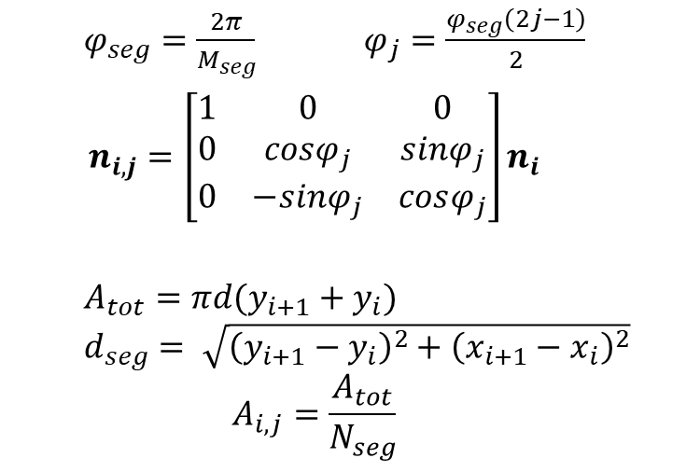
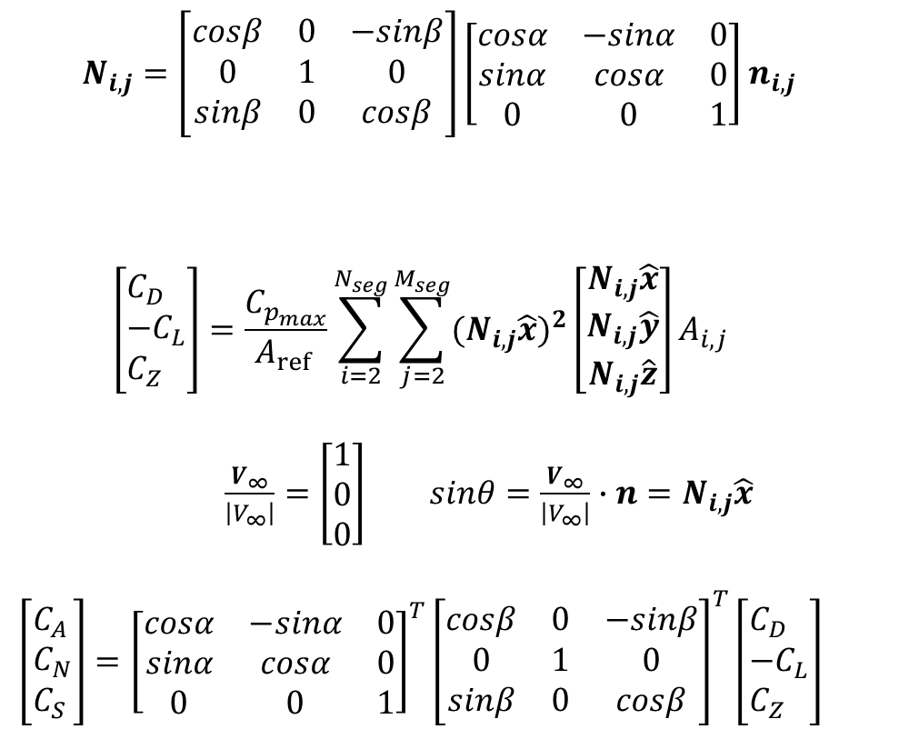
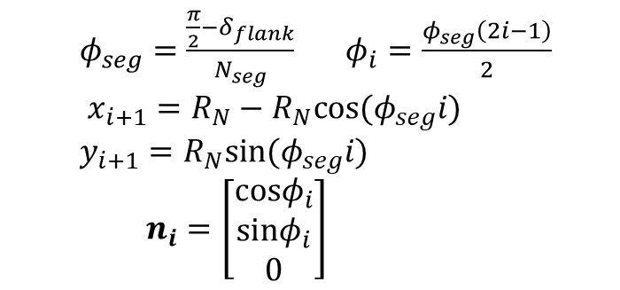
Panel/Grid Method Expanded Relations
$$\begin{aligned}N_{i,j}=\left[\begin{matrix}cosβ & 0 & −sinβ \\ 0 & 1 & 0 \\ sinβ & 0 & cosβ\end{matrix}\right]\left[\begin{matrix}cosα & −sinα & 0 \\ sinα & cosα & 0 \\ 0 & 0 & 1\end{matrix}\right]n_{i,j}\#\end{aligned}$$
$$\begin{aligned}\left[\begin{aligned}&C_{D} \\ &{−C}_{L} \\ &C_{Z}\end{aligned}\right]=\frac{C_{p_{max}}}{A_{ref }}\sum_{i=2}^{N_{seg}}{\sum_{j=2}^{M_{seg}}{{{(N}_{i,j}\hat{x})}^{2}\left[\begin{aligned}N_{i,j}\hat{x} \\ N_{i,j}\hat{y} \\ N_{i,j}\hat{z}\end{aligned}\right]A_{i,j}}}\end{aligned}$$
$\frac{V_{∞}}{\left|V_{∞}\right|}=\left[\begin{aligned}1 \\ 0 \\ 0\end{aligned}\right]$ $sinθ=\frac{V_{∞}}{\left|V_{∞}\right|}∙n=N_{i,j}\hat{x}$
$$\begin{aligned}\left[\begin{aligned}&C_{A} \\ &C_{N} \\ &C_{S}\end{aligned}\right]={\left[\begin{matrix}cosα & −sinα & 0 \\ sinα & cosα & 0 \\ 0 & 0 & 1\end{matrix}\right]}^{T}{\left[\begin{matrix}cosβ & 0 & −sinβ \\ 0 & 1 & 0 \\ sinβ & 0 & cosβ\end{matrix}\right]}^{T}\left[\begin{aligned}&C_{D} \\ &{−C}_{L} \\ &C_{Z}\end{aligned}\right]\#\end{aligned}$$
$φ_{seg}=\frac{\frac{π}{2}−δ_{flank}}{N_{seg}}$ $φ_{i}=\frac{φ_{seg}\left(2i−1\right)}{2}$ $x_{i+1}=R_{N}−R_{N}cos⁡(φ_{seg}i)$ $y_{i+1}=R_{N}sin(φ_{seg}i)$
$n_{i}=\left[\begin{aligned}cosφ_{i} \\ sinφ_{i} \\ 0\end{aligned}\right]$
Radial Segment Expressions
$φ_{seg}=\frac{2π}{M_{seg}}$ $φ_{j}=\frac{φ_{seg}\left(2j−1\right)}{2}$
$$n_{i,j}=\left[\begin{matrix}1 & 0 & 0 \\ 0 & cosφ_{j} & sinφ_{j} \\ 0 & −sinφ_{j} & cosφ_{j}\end{matrix}\right]n_{i}$$
$A_{tot}=πd(y_{i+1}+y_{i})$
$d_{seg}= \sqrt{{\left(y_{i+1}−y_{i}\right)}^{2}+{\left(x_{i+1}−x_{i}\right)}^{2}}$
$$A_{i,j}=\frac{A_{tot}}{N_{seg}}$$
Circumferential Segment Expressions

Slide 29

Free Molecular Flow Expressions
$C_{p}=\frac{1}{s^{2}}\left[\left(\frac{2−σ_{N}}{\sqrt{π}} s\sin\left(θ\right)+\frac{σ_{N}}{2}\sqrt{\frac{T_{W}}{T_{∞}}}\right)e^{−{\left(s\sin\left(θ\right)\right)}^{2}}+\left\{\left(2−σ_{N}\right){\left(s\sin\left(θ\right)\right)}^{2}+\frac{1}{2}+\frac{σ_{N}}{2}\sqrt{\frac{πT_{W}}{T_{∞}}}s\sin\left(θ\right)\right\}(1+erf⁡(s\sin\left(θ\right))\right]$
$C_{τ}=\frac{σ_{N}\cos\left(θ\right)}{s\sqrt{π}}\left[e^{−{\left(s\sin\left(θ\right)\right)}^{2}}+\sqrt{π}s\sin\left(θ\right)(1+\operatorname{erf}\left(s\sin\left(θ\right)\right))\right]$
$s=\frac{V_{∞}}{\sqrt{2RT_{∞}}}$

Slide 30


Panel/Gridding Method Convergence
$$C_{N}$$
$$C_{A}$$
Figure 9.5 Normal Force vs. Number of Divisions (60° sphere cone)
Figure 9.6 Axial Force vs. Number of Divisions (60° sphere cone)

Slide 31


Panel/Gridding Method Convergence
$$C_{S}$$
$$C_{A}$$
Figure 9.7 Side Force Convergence (60° sphere cone)
Figure 9.8 Axial Force vs. Number of Divisions (25° sphere cone)

Slide 32
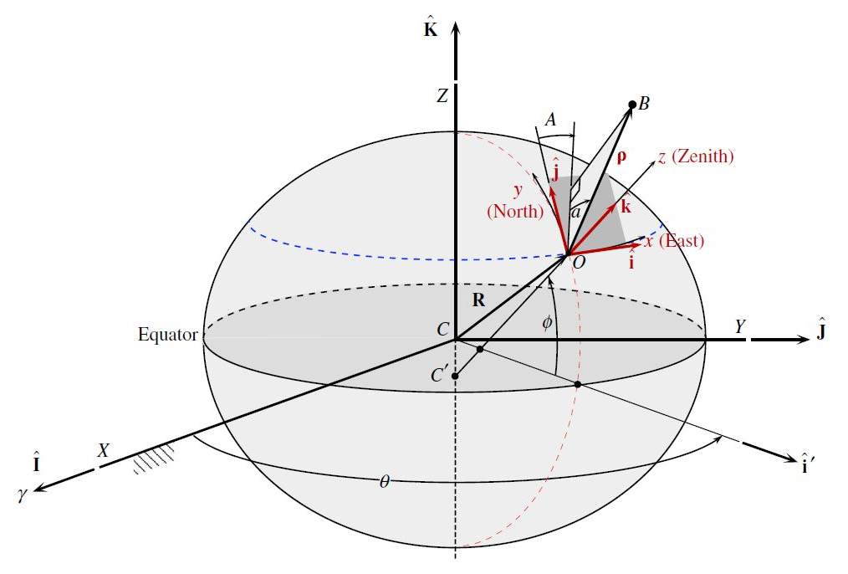
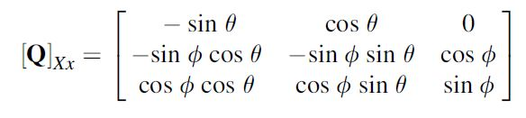
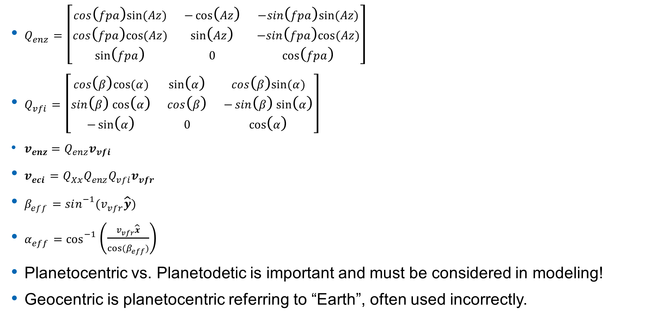
Reference Frames Overview
$Q_{enz}=\left[\begin{matrix}cos\left(fpa\right)sin⁡(Az) & −\cos\left(Az\right) & −sin\left(fpa\right)sin⁡(Az) \\ cos\left(fpa\right)cos⁡(Az) & \sin\left(Az\right) & −sin\left(fpa\right)cos⁡(Az) \\ \sin\left(fpa\right) & 0 & \cos\left(fpa\right)\end{matrix}\right]$
$Q_{vfi}=\left[\begin{matrix}cos\left(β\right)cos⁡(α) & \sin\left(α\right) & cos\left(β\right)sin⁡(α) \\ \sin\left(β\right)\cos\left(α\right) & cos\left(β\right) & −\sin\left(β\right)\sin\left(α\right) \\ −\sin\left(α\right) & 0 & \cos\left(α\right)\end{matrix}\right]$
$v_{enz}=Q_{enz}v_{vfi}$
$v_{eci}={Q_{Xx}Q}_{enz}Q_{vfi}v_{vfr}$
$β_{eff}=sin^{−1}{{(v}_{vfr}\hat{y}})$
$α_{eff}=\cos^{−1}\left(\frac{v_{vfr}\hat{x}}{{cos⁡(β}_{eff})}\right)$
Planetocentric vs. Planetodetic is important and must be considered in modeling!
Geocentric is planetocentric referring to “Earth”, often used incorrectly.
Figure 4.16 ENZ and ECI Reference Frames [22]

Slide 33
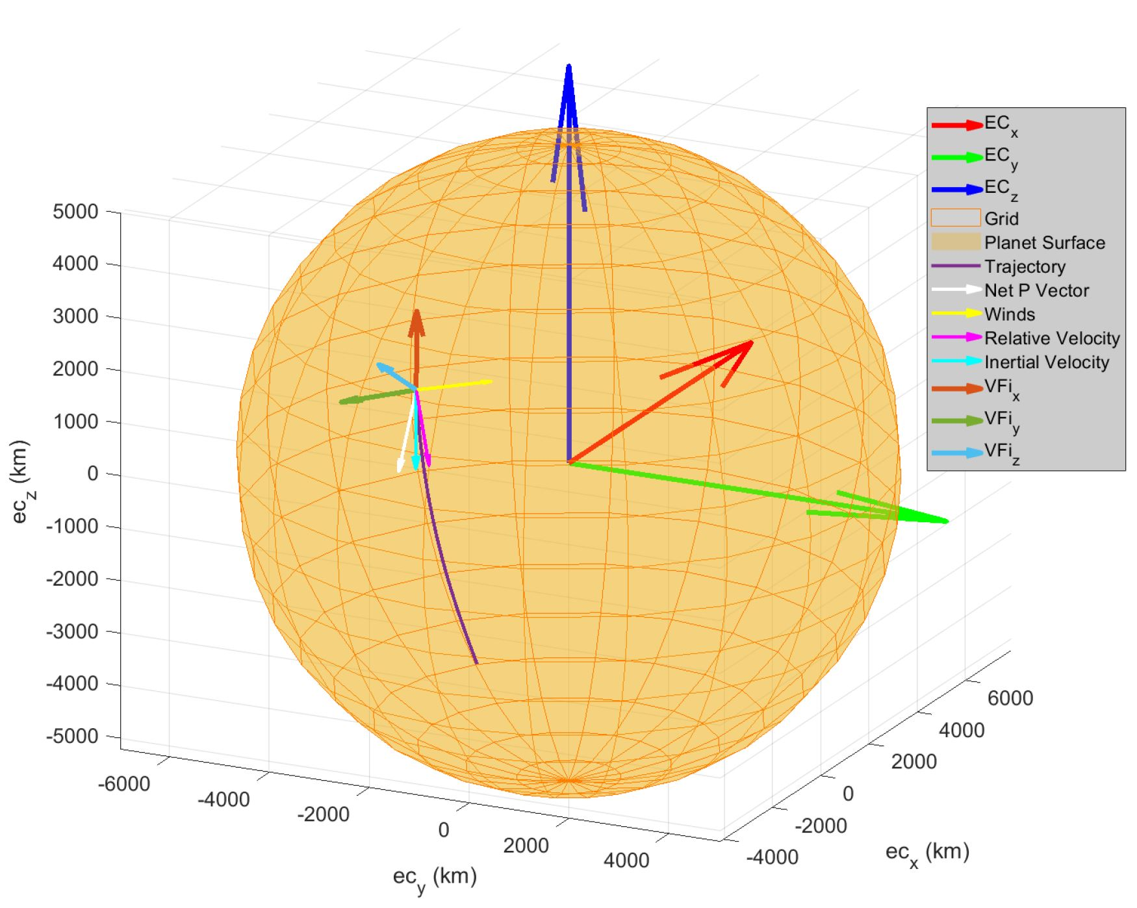

Reference Frames Overview
$v_{rel}=V_{eci}−\left[\begin{matrix}0 \\ 0 \\ ω\end{matrix}\right] × R_{eci}−Q_{Xx}\left[\begin{matrix}−eww \\ −nsw \\ vw\end{matrix}\right]$
$P_{vfr}= \frac{1}{2}ρ_{∞}{\left|v_{rel}\right|}^{2}\left[\begin{matrix}−C_{D} \\ C_{Z} \\ C_{L}\end{matrix}\right]$
$P_{eci}={Q_{Xx}Q}_{enz}Q_{vfi}P_{vfr}$
$\ddot{r}=\frac{μ}{r^{3}}r+P_{eci}$
Coriolis Effect
Winds
Figure 4.18 Inertial Velocity Frame and Forces on Entry Vehicle

Slide 34
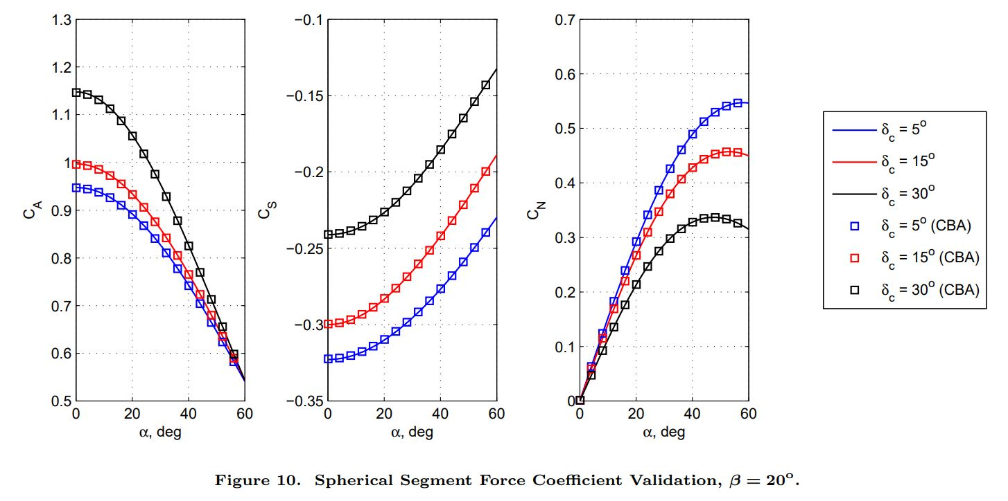
Validations of Newtonian Panel Method
Grant, M., and Braun, R., “Analytic hypersonic aerodynamics for conceptual design of entry vehicles,” 48th AIAA Aerospace Sciences Meeting Including the New Horizons Forum and Aerospace Exposition, Jan. 4-7, 2010, Orlando, FL. https://doi.org/10.2514/6.2010-1212

Slide 35
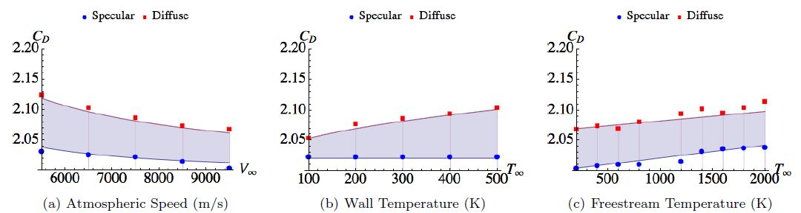
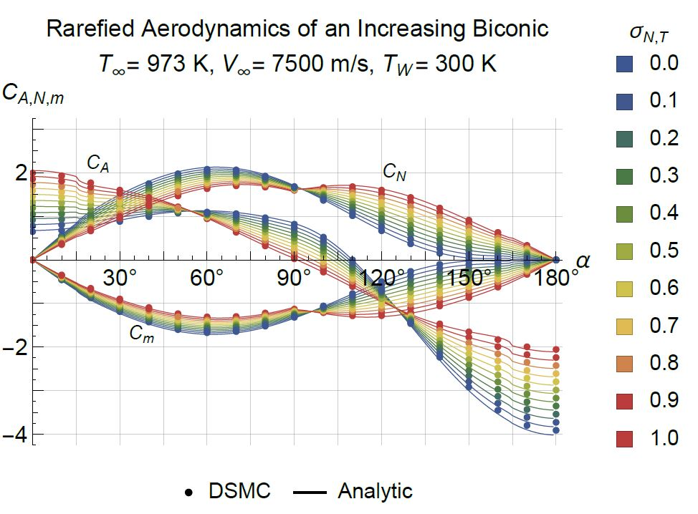
Validations of Free Molecular Panel Method
Figure 9.11 Sphere Drag Coefficient Validation Results
Figure 9.10 Sphere Drag Coefficient Results from [32]
Kenneth A. Hart, Kyle R. Simonis, Bradley A. Steinfeldt, and Robert D. Braun. “Analytic Free-Molecular Aerodynamics for Rapid Propagation of Resident Space Objects,” Journal of Spacecraft and Rockets 2018 55:1, 27-36 https://doi.org/10.2514/1.A33606
Kenneth A. Hart, Soumyo Dutta, Kyle Simonis, Bradley A. Steinfeldt and Robert D. Braun. "Analytically-derived Aerodynamic Force and Moment Coefficients of Resident Space Objects in Free-Molecular Flow," AIAA 2014-0728. AIAA Atmospheric Flight Mechanics Conference, January 13-17, National Harbor, Maryland, USA 2014. https://doi.org/10.2514/6.2014-0728
Figure 9.14 Increasing Bi-conic Results from [33]

Slide 36
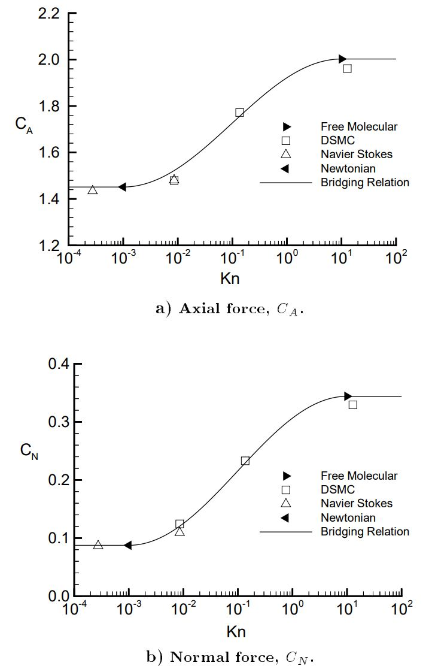
Validations of Free Molecular Panel Method
Figure 9.20 Validation with [36] at α=0°
Richard G. Wilmoth, Robert A. Mitcheltree, and James N. Moss, “Low-Density Aerodynamics of the Stardust Sample Return Capsule, ” Journal of Spacecraft and Rockets 1999 36:3, 436-44. https://doi.org/10.2514/2.3464
Figure 9.19 Validation with [36] at α=10°

Slide 37
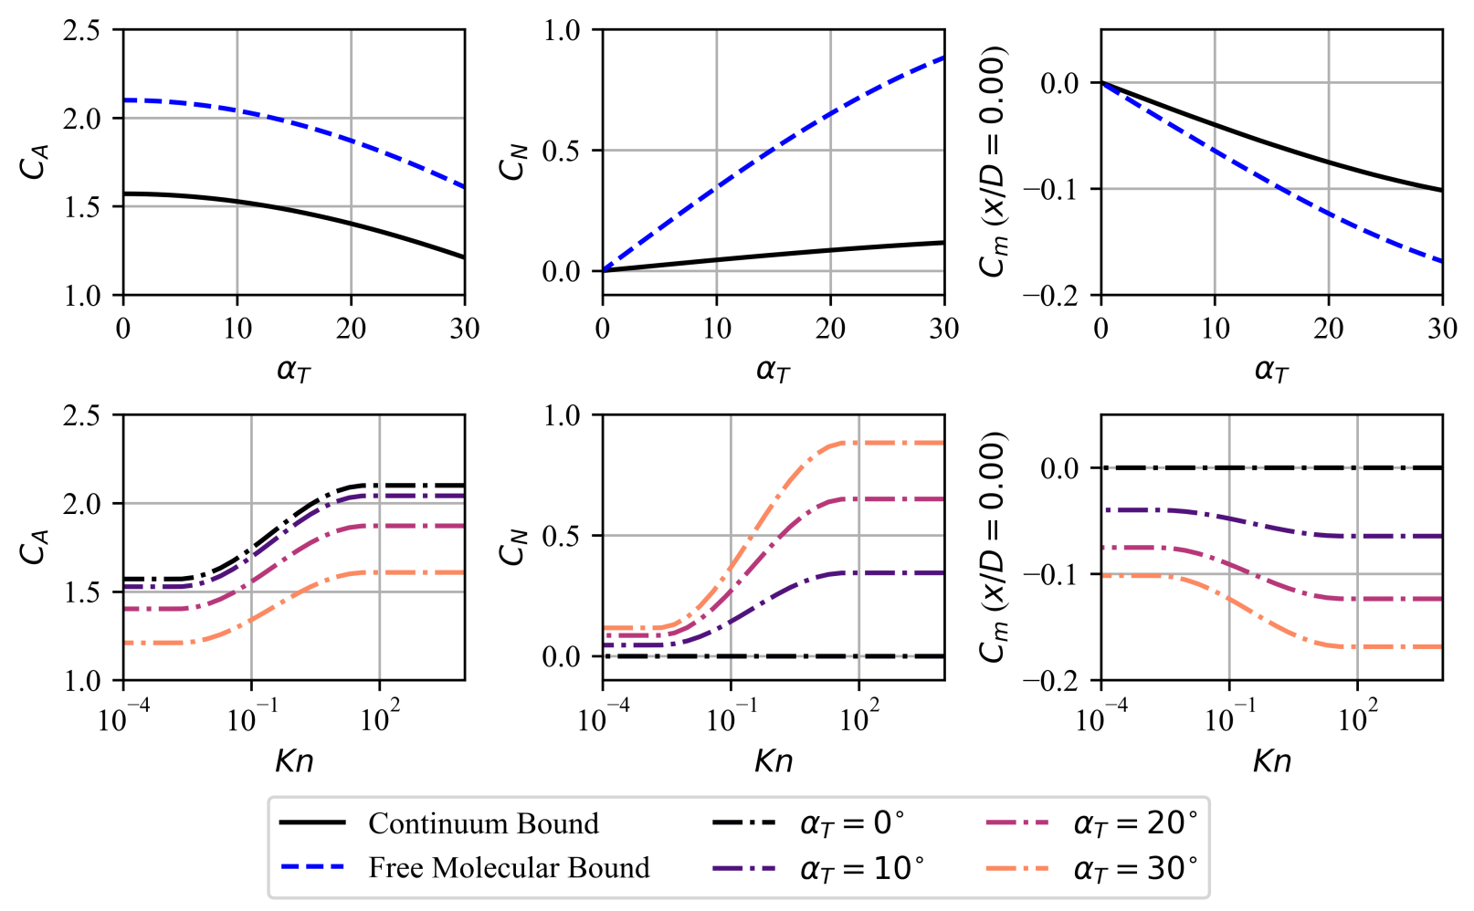
Validations of Free Molecular Panel Method
Shellabarger, E., Scoggins, J. B., Hinkle, A. D., Dutta, S., Deshmukh, R., Patel, M., and Agam, S., “Aerodynamic Implications of Aerocapture Systems for Uranus Orbiters,” AIAA SCITECH 2024 Forum, Jan. 8-12, 2024, Orlando, FL. https://doi.org/10.2514/6.2024-0950

Slide 38
Trajectory Validations with TRAJ
°
°
°
°
°
°

Slide 39
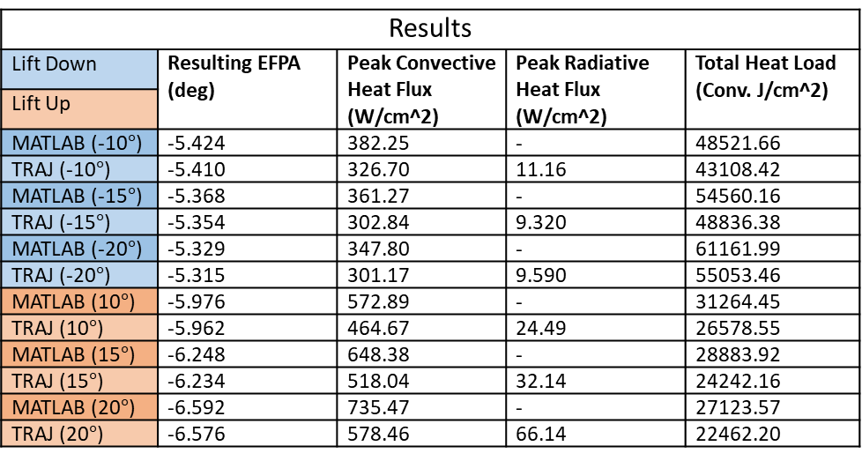
Trajectory Validations with TRAJ
Aerocapture Trajectory at Venus
Velocity | 11 km/s
Azimuth/Heading | -90°
Longitude | 305.61606°
Latitude | 5.170641°
Julian Date | 2456755
Mass | 150 kg
Cone Half Angle | 60°
Diameter | 1 m
Nose Radius | 0.25 m
Target Apoapsis | 500 km
Results
Lift Down | Resulting EFPA (deg) | Peak Convective Heat Flux (W/cm^2) | Peak Radiative Heat Flux (W/cm^2) | Total Heat Load (Conv. J/cm^2)
Lift Up
MATLAB (-10$°$) | -5.424 | 382.25 | - | 48521.66
TRAJ (-10$°$) | -5.410 | 326.70 | 11.16 | 43108.42
MATLAB (-15$°$) | -5.368 | 361.27 | - | 54560.16
TRAJ (-15$°$) | -5.354 | 302.84 | 9.320 | 48836.38
MATLAB (-20$°$) | -5.329 | 347.80 | - | 61161.99
TRAJ (-20$°$) | -5.315 | 301.17 | 9.590 | 55053.46
MATLAB (10$°$) | -5.976 | 572.89 | - | 31264.45
TRAJ (10$°$) | -5.962 | 464.67 | 24.49 | 26578.55
MATLAB (15$°$) | -6.248 | 648.38 | - | 28883.92
TRAJ (15$°$) | -6.234 | 518.04 | 32.14 | 24242.16
MATLAB (20$°$) | -6.592 | 735.47 | - | 27123.57
TRAJ (20$°$) | -6.576 | 578.46 | 66.14 | 22462.20
Shellabarger, E., Scoggins, J. B., Hinkle, A. D., Dutta, S., Deshmukh, R., Patel, M., and Agam, S., “Aerodynamic Implications of Aerocapture Systems for Uranus Orbiters,” AIAA SCITECH 2024 Forum, Jan. 8-12, 2024, Orlando, FL. https://doi.org/10.2514/6.2024-0950

Slide 40
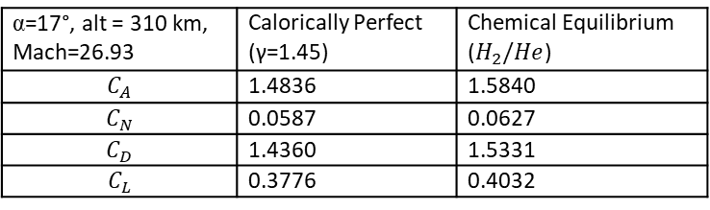
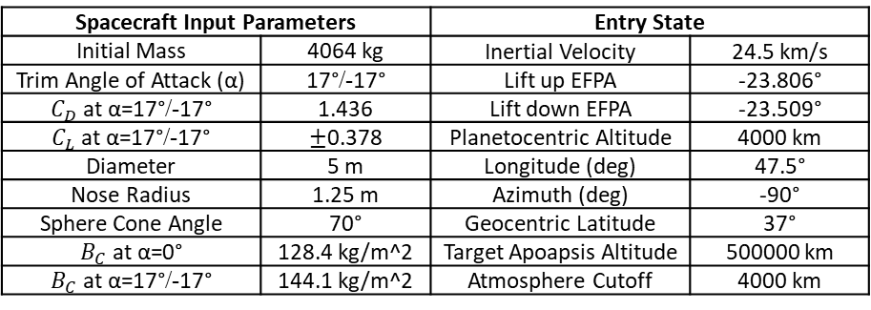
Uranus Aerocapture Analysis
Spacecraft Input Parameters |  | Entry State
Initial Mass | 4064 kg | Inertial Velocity | 24.5 km/s
Trim Angle of Attack (α) | 17°/-17° | Lift up EFPA | -23.806°
$C_{D}$ at α=17°/-17° | 1.436 | Lift down EFPA | -23.509°
$C_{L}$ at α=17°/-17° | $±$0.378 | Planetocentric Altitude | 4000 km
Diameter | 5 m | Longitude (deg) | 47.5°
Nose Radius | 1.25 m | Azimuth (deg) | -90°
Sphere Cone Angle | 70° | Geocentric Latitude | 37°
$B_{C}$ at α=0° | 128.4 kg/m^2 | Target Apoapsis Altitude | 500000 km
$B_{C}$ at α=17°/-17° | 144.1 kg/m^2 | Atmosphere Cutoff | 4000 km
Vehicle diameter varied from 4-6 m
Nose radius is ¼ the vehicle diameter
70° Sphere Cone
α=0°
37° Lat, 47.5° Long
JD = 2466659
α=17°, alt = 310 km, Mach=26.93 | Calorically Perfect (γ=1.45) | Chemical Equilibrium ($H_{2}/He$)
$$C_{A}$$ | 1.4836 | 1.5840
$$C_{N}$$ | 0.0587 | 0.0627
$$C_{D}$$ | 1.4360 | 1.5331
$$C_{L}$$ | 0.3776 | 0.4032

Slide 41
Uranus Aerocapture Analysis

Slide 42
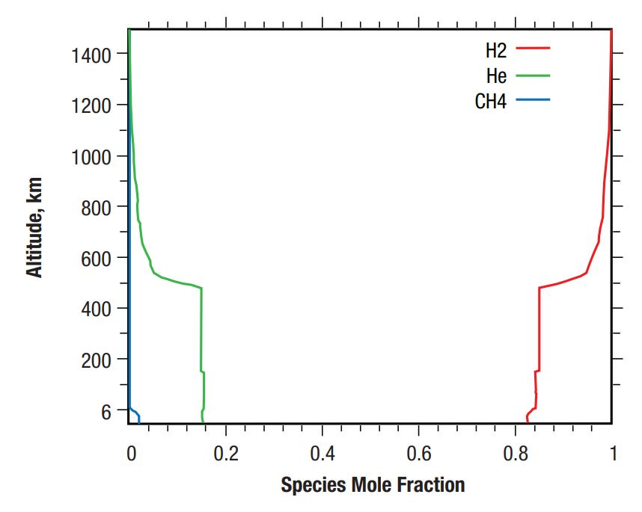
Uranus Aerocapture Analysis

Slide 43

Uranus Aerocapture Analysis
Lift Down
Lift Up

Slide 44

CEA Thermodynamic Lookups
$\frac{C_{P}^{o}(T)}{ℛ}=a_{1}T^{−2}+a_{2}T^{−1}+a_{3}+a_{4}T+a_{5}T^{2}+a_{6}T^{3}+a_{7}T^{4}$
$\frac{H_{T}^{o}(T)}{ℛT}={−a}_{1}T^{−2}+\frac{a_{2}lnT}{T}+a_{3}+\frac{a_{4}}{2}T+\frac{a_{5}}{3}T^{2}+\frac{a_{6}}{4}T^{3}+\frac{a_{7}}{5}T^{4}+\frac{b_{1}}{T}$
$\frac{S_{T}^{o}(T)}{ℛ}=−\frac{a_{1}T^{−2}}{2}−a_{2}T^{−1}+a_{3}lnT+a_{4}T+\frac{a_{5}}{2}T^{2}+\frac{a_{6}}{3}T^{3}+\frac{a_{7}}{4}T^{4}+b_{2}$
McBride, B. J., Zehe, M. J., and Gordon, S., “NASA Glenn coefficients for calculating thermodynamic properties of individual species,” NASA/TP—2002-211556, John H. Glenn Research Center at Lewis Field, 2002.

Slide 45

Chemistry Symbolic Math Overview (N2/O2)
$N_{2}⇌2N$ $O_{2}⇌2O$ $O+N⇌NO$
$K_{p1}=\frac{P_{N}^{2}}{P_{N_{2}}}$
$K_{p2}=\frac{P_{O}^{2}}{P_{O_{2}}}$
$K_{p3}=\frac{P_{N}P_{O}}{P_{NO}}$
$p_{t}=P_{N_{2}}+P_{O_{2}}+P_{N}+P_{O}+P_{NO}$
$MR=\frac{2P_{N_{2}}+P_{N}+P_{NO}}{2P_{O_{2}}+P_{O}+P_{NO}}$
$P_{N_{2}}=f(K_{p1},P_{N})$
$P_{O_{2}}=f(K_{p2},P_{O})$
$P_{NO}=f(K_{p3},P_{N},P_{O})$

Slide 46

Chemistry Symbolic Math Overview (N2/O2)
$P_{t}=f\left(K_{p1},K_{p2},K_{p3},P_{N},P_{O}\right)$
$P_{O}=f\left(K_{p1},K_{p2},K_{p3},P_{N},P_{t}\right)$
$f_{P_{N}}=f\left(K_{p1},K_{p2},K_{p3},P_{N},P_{t},MR\right)$ (solve iteratively for P_N)
$\sum_{i=1}^{NG}{X_{i}a_{ei}=0}$ (additional constraint for ionization)

Slide 47

Chemistry Model Validation (N2/O2)
Anderson, John D. Hypersonic and High Temperature Gas Dynamics. 2nd ed., American Institute of Aeronautics and Astronautics, 1801 Alexander Bell Drive, Reston, VA. 2006.
Conditions at 1 atm, Textbook: Fig 11.12, P.541)

Slide 48
Chemistry Model Validation with CEA
P1 = 1 Pa
T1 = 216.4 K
0.79 mole N2
0.21 mole O2
Conditions at 1 atm, Textbook: Fig 11.12, P.541)

