Slide 1

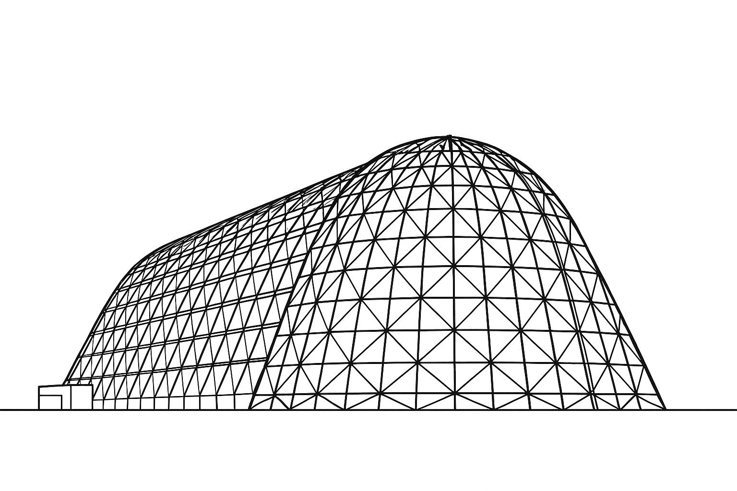


Preliminary Thermal Design of Airborne EO/IR Pods and Bays Based on CONOPS and Flight Envelope
TFAWS25-ID-03-04
TFAWS 2025 Aerosciences Technical Session
Presented by: Mark Whittum, P.E.
Mark Whittum, P.E.
Principal Mechanical Engineer
Raytheon Company
Thermal & Fluids Analysis Workshop 2025
NASA Ames Research Center
San Jose, CA
August 4-7, 2025
TFAWS 2025 - August 4-7, 2025
© 2025 Raytheon Company.
All rights reserved.

Slide 2
Summary
Airborne Electro-optical and Infrared (EO/IR) pods and bays are used extensively in sensing, national security, and surveillance applications
  Literally and figuratively, the environment in which they are operated is changing
A wider variety of platforms, greater power dissipations, variations in Concepts of Operations (CONOPS), and the need for faster design cycles
  These factors drive the need for prompt conceptual development of the thermal management system early in the proposal / design period
Selection of available thermal options frequently depends on limited available platform information, ambiguous requirements, and competing design goals
This presentation will demonstrate approaches to thermal modeling and design of EO/IR pods and bays that will permit rapid evaluation of design options while in the proposal and preliminary design stages
  Using basic flight mechanics, thermodynamics, reduced order modeling methods, and knowledge of applicable environments
©2025 Raytheon Company. All rights reserved.
TFAWS 2025 - August 4-7, 2025

Slide 3
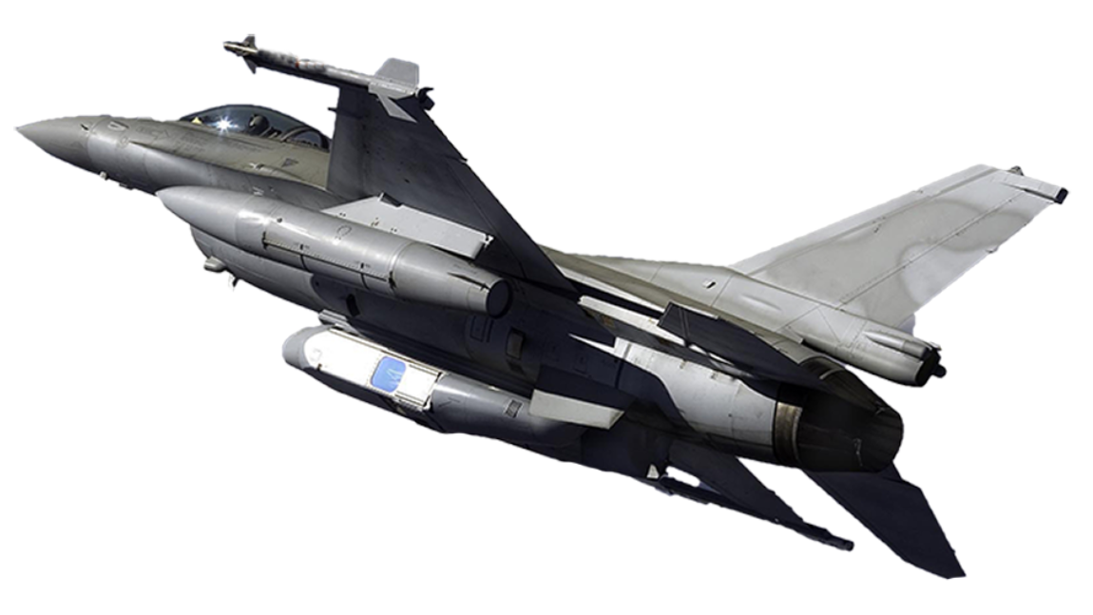
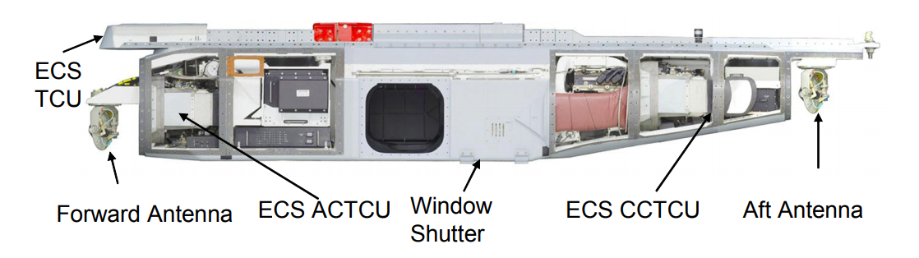
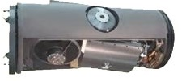
Current State: Fast Jet Electronics Pods
DB110 / MS110 sensor pods made by Intelligent Sensing in Westford, MA
  Flying on fast jet platforms (F15, F16)
  15’ long, 2000lb
Thermal Management
  Vapor Cycle Machines / ECS (active refrigeration)
  ECS: Environmental Control System
  Liquid cooling system
Thermal system capable of preconditioning and cooling at high speed
Hybrid liquid / air cooled chassis
Conduction cooled chassis
Liquid cooled chassis
Sensor bay
ECS – liquid chiller
ECS – air conditioner
Window
Air cooled sensor 340W / 346lb (internal)
photos, models & graphs used by permission of Raytheon
©2025 Raytheon Company. All rights reserved.
TFAWS 2025 - August 4-7, 2025

Slide 4
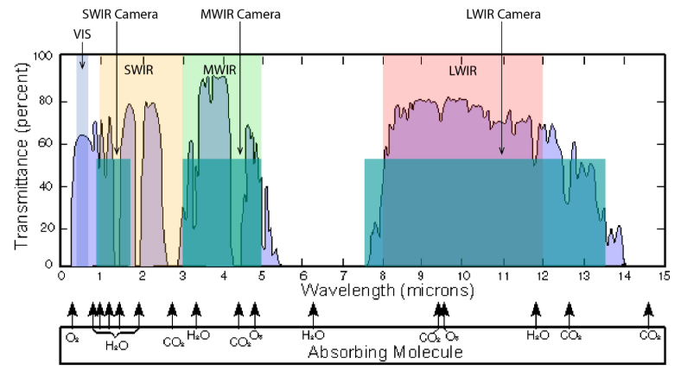
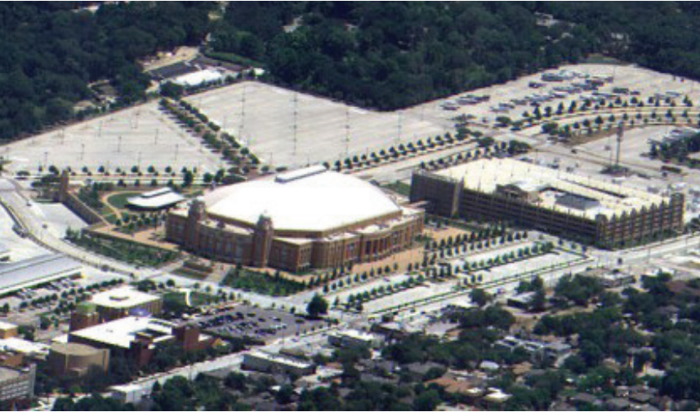
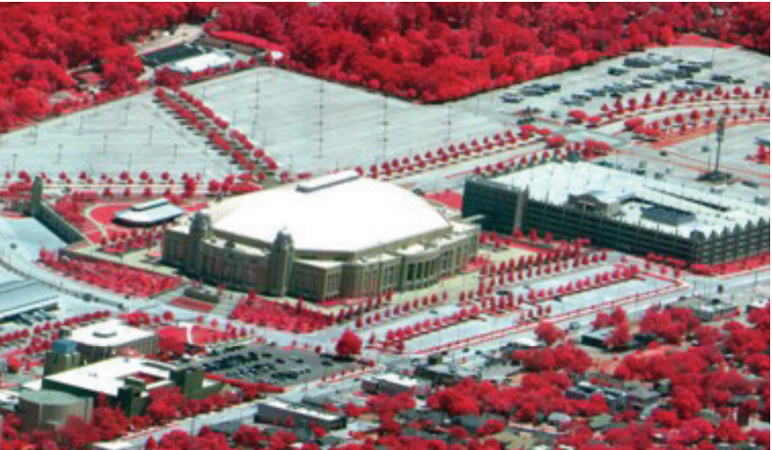
EO / IR Imaging Systems
Airborne EO/IR pods are used extensively for reconnaissance
Electro-Optical (EO) sensors sense visible light
  Dark current “noise” increases with temperature for EO sensors – thermal management critical
Infrared (IR) sensors sense light in the Infrared range
  Includes reflected light (SWIR) and thermal energy (MWIR, LWIR)
  Some IR sensors need cryogenic cooling (can be a thermal management challenge)
  Others IR sensors are uncooled but perform better at lower ambient temperatures
Reference: Gabriel C. Birch, Bryana L. Woo, “Counter Unmanned Aerial Systems Testing: Evaluation of VIS, SWIR, MWIR, and LWIR passive imagers”, SANDIA REPORT: SAND2017-0921, January 2017
All images publicly available from RTX at:
https://prd-sc102-cdn.rtx.com/raytheon/-/media/ray/m/ms-110-mq9-data-sheet.pdf?rev=59670987ce6e422e9439f8b6b33a2d19&hash=4D4109C8BC2AE5783DC61DD7142A036E
photos, models & graphs used by permission of Raytheon
©2025 Raytheon Company. All rights reserved.
TFAWS 2025 - August 4-7, 2025

Slide 5
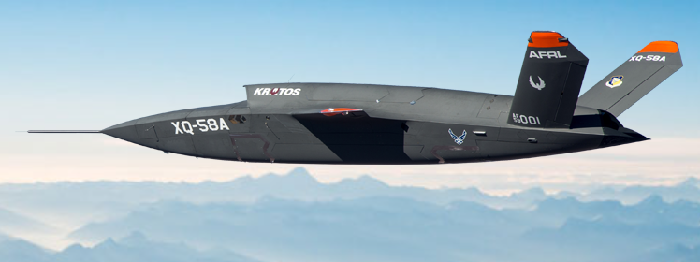
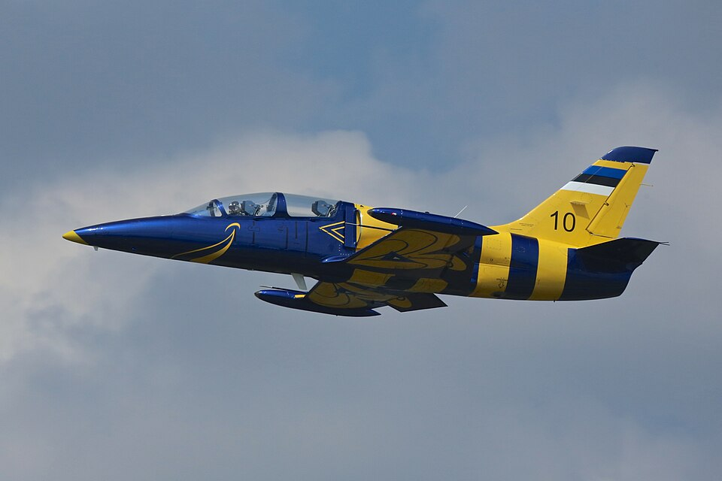
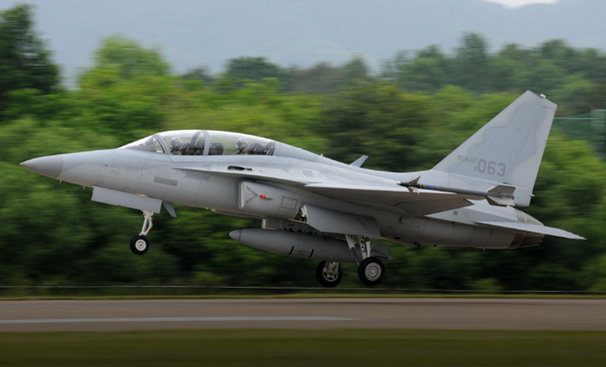
Future State Platforms
Lower performance, lower cost, possibly “attritable”
  Kratos XQ-58A
  TA-50 Golden Eagle
  L-39 Albatros
Smaller external store capability
  Diameter of 15”-18” vs. 27”-33”
Air Force photo by Senior Airman Joshua Hoskins
Photo by ROKAF
File:Light Combat FA-50 Fighting Eagle.jpg - Wikimedia Commons
By Ronnie Macdonald from Chelmsford and Largs, United Kingdom
https://commons.wikimedia.org/wiki/File:Aero_Vodochody_L-39C_Albatros_04_(14708086935).jpg
Deed - Attribution 2.0 Generic - Creative Commons
Deed - Attribution 2.0 Generic - Creative Commons
TFAWS 2025 - August 4-7, 2025

Slide 6
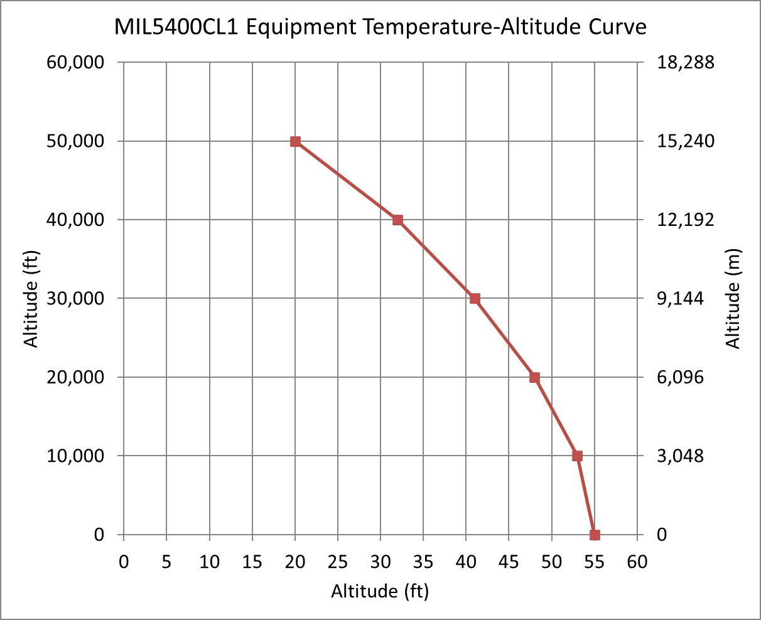
Bay Internal Temperature Limit - Typical
Airborne electronics typically operate with internal bay air supply temperature per MIL5400
  0kft: +55 ° C
  50kft: +20°C
  Derated over altitude due to reduced air density
Equipment thermal ratings exceeded by highest ram temperatures require “active cooling”
+20C / 50Kft
+55C / 0Kft
Temperature (degC)
©2025 Raytheon Company. All rights reserved.
TFAWS 2025 - August 4-7, 2025

Slide 7
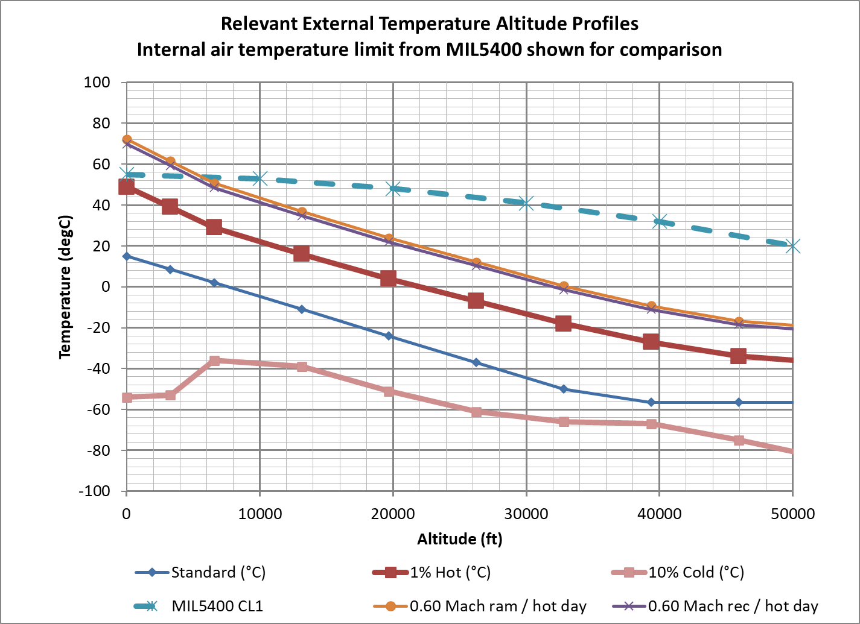
Typical External Thermal Environments
MIL-HDBK-310 1% Hot Day
  +49°C on the ground
MIL-HDBK-310 10% Cold Day
  -54 ° C on the ground
Ram temperature
  T_{ram}=T_{amb}*(1+0.20*M²)
Recovery temperature
  T_{rec}=T_{amb}*(1+0.18*M²)
Air at ram / recovery temperature is the “ultimate heat sink” for our equipment – very hot even at high subsonic speed
©2025 Raytheon Company. All rights reserved.
TFAWS 2025 - August 4-7, 2025

Slide 8

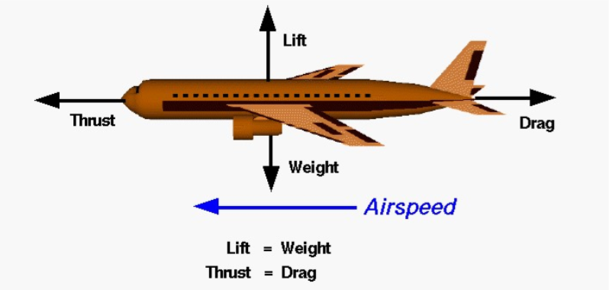



Flight Mechanics / Envelope - determine
Determine operating envelope for a platform using available performance information and equations of flight mechanics
  In absence of complete platform information from airframer
Need following data to start with
  Wing area S and span l
    Aspect ratio AR = l²/S
  Sea level thrust T or power P
  Max level flight speed V for a given altitude and weight
Assume thrust or power scale by density ratio over altitude
  For propeller aircraft use T = P*V
Assume induced drag factor K=1/(π*AR*0.8)
Determine zero lift drag coefficient C_{D0} from preceding
Knowing C_{D0} and K, determine high and low speed C_{L} over altitude
Finally, calculate V and Mach for entire flight envelope
Graphic from NASA Glenn Flight Research Center
Determine lift coefficient for high-speed side of envelope
Determine lift coefficient for low-speed side of envelope, corresponding to maximum endurance
TFAWS 2025 - August 4-7, 2025
©2025 Raytheon Company. All rights reserved.

Slide 9
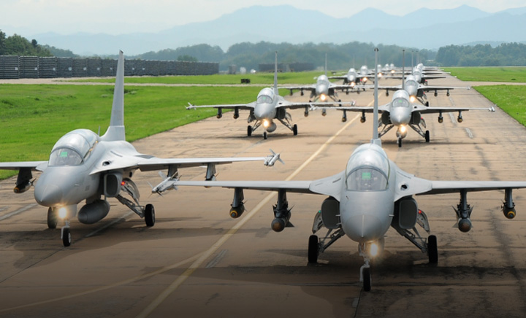
Flight Mechanics / Envelope: TA-50 Light Attack Aircraft
All data from Janes
Dimensions
  Wing area: 23.7m² (255.0ft²)
  Wingspan: 9.45m (31ft)
Weights
  Empty: 6,480kg (14,285lb)
  Max T-O: 9,339kg (20,589lb) [clean]
  Max T-O 12,383kg (27,300lb) [with external stores]
Thrust:
  17,700lb (with afterburner)
  11,950lb (no afterburner)
Max operating speed:
  815 kt (1,509 km/h; 938 mph)
Service ceiling:
  14,935 m (49,000 ft)
Assumptions at max speed point
  30,000ft
  Clean configuration 17,437lb
Photo by ROKAF (2011)
https://en.m.wikipedia.org/wiki/File:TA-50-_Group_Display_in_ROKAF_Airbase.jpg
Deed - Attribution 2.0 Generic - Creative Commons
Clean zero lift drag coefficient C_{D0}= 0.030
  Increased to 0.045 to account for 5 hard points with ΔC_{D0}=0.003 each
Induced drag coefficient K=0.0208
Calculated envelope for 20,793lb
TFAWS 2025 - August 4-7, 2025

Slide 10
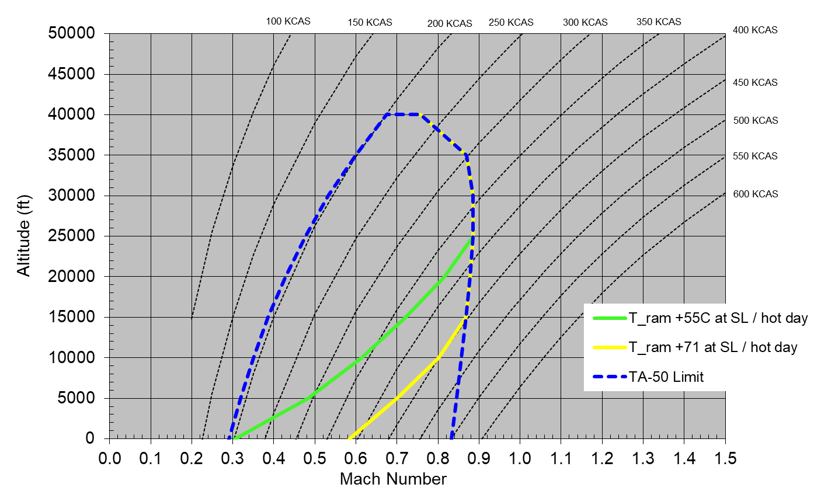
Estimated Thermal Flight Envelope – Ram Air Cooling
KCAS = Knots Calibrated Airspeed
Estimated TA-50 Envelope
Ram air + rugged components sufficient
Plot of estimated TA-50 envelope
Thermal limitations of direct ram air cooling shown
Additional ram air disadvantages
  Contamination
  Condensation
  No ground cooling
Ram air, extended rugged, PCM / active cooling required
(extended zone for possible high-speed dash)
Ram air + extended rugged components sufficient
TFAWS 2025 - August 4-7, 2025
©2025 Raytheon Company. All rights reserved.

Slide 11
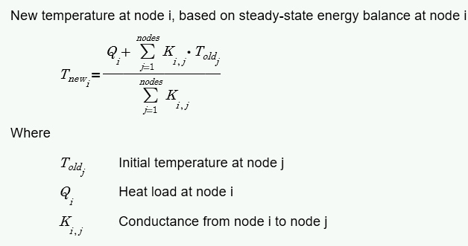
Schematic of Sensor Bay – Network Thermal Model
18” dia x 36” long Sensor Bay
K₁₂ = ( K_{comp} * A_{skin} ) / t_{skin}
K₂₃ = h_{film} * A_{skin}
K₃₄ = h_{film} * A_{win}
K₁₄ = ( K_{Cleartran} * A_{win} ) / t_{win}
Net bay heat (thermal load and any heating / cooling)
Adiabatic
wall
q_{bay}
Sensor
100W
3
Adiabatic
wall
Bay air
2
3
Internal convection to window
Internal convection to skin
2
4
Recovery temp
1
4
1
Skin
0.1” Carbon Fiber Epoxy OR
1” Divinycell insulation
Cleartran Window
200in2 x 0.5in
Hot cases: Fix q_{bay}=100W and T_{bay}= MIL5400, solve for Mach
Cold cases: Fix Mach = low speed envelope and T_{bay}= 0C, solve for q_{bay}
TFAWS 2025 - August 4-7, 2025
©2025 Raytheon Company. All rights reserved.

Slide 12
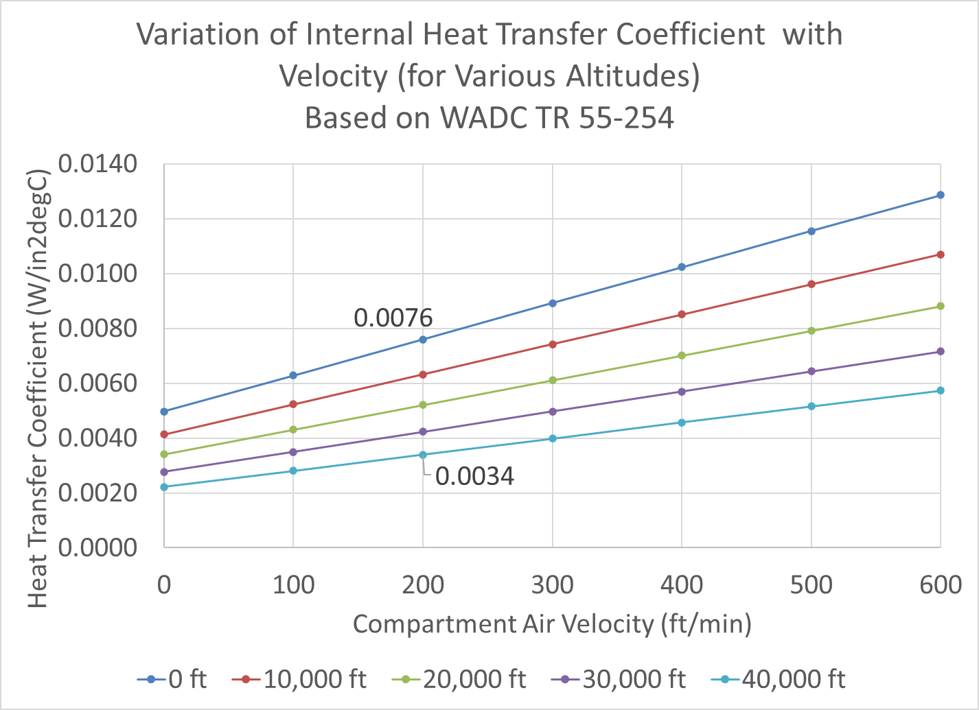
Heat Transfer by Convection (Internal to Bay)
A common way to estimate the convective film coefficient for internal aircraft bays is from Wright Air Development Center report WADC TR 55-254
It provides a relationship between film coefficient, ambient air density, and bulk air velocity in a bay
  h_{film} = (1.45 + 0.23 V)*σ^{0.5}
Where:
  h_{film} is the film coefficient (BTU/hr/ft²°R)
  V is air velocity in ft/s
  σ is the air density ratio with respect to sea level
Assume 200lfm internal flow rate – from experience
TFAWS 2025 - August 4-7, 2025
©2025 Raytheon Company. All rights reserved.

Slide 13
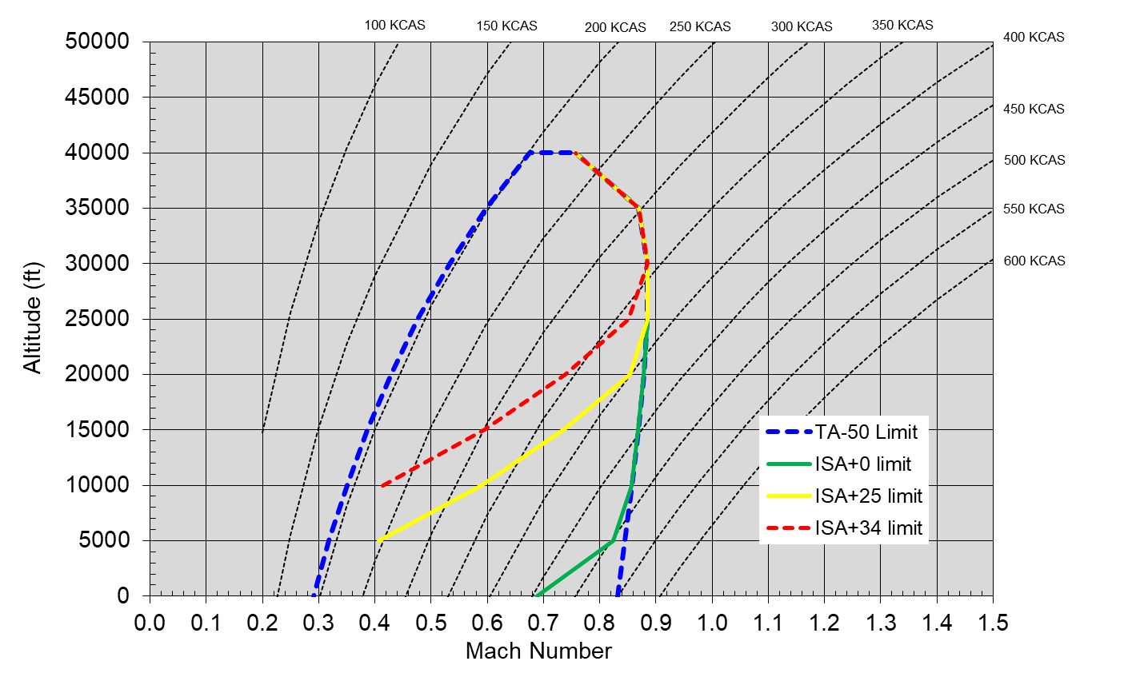
Estimated Thermal Flight Envelope – No ECS
KCAS = Knots Calibrated Airspeed
Can fly here on all days
No ECS
Uninsulated
Limited envelope
More limited than ram air, since sensor bay is sealed
Can fly here on more days
Can’t fly here except on cold days
Can fly here on most days

Slide 14
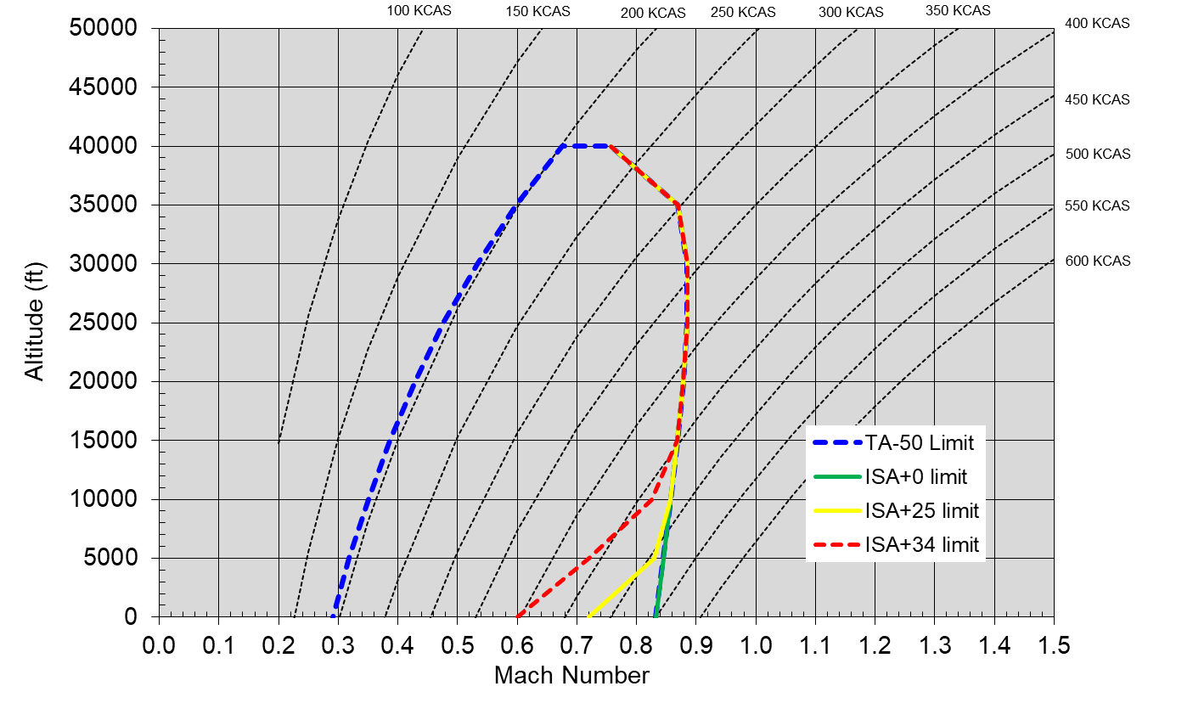
Estimated Thermal Flight Envelope – With ECS
KCAS = Knots Calibrated Airspeed
Can fly here on all days
TEC based ECS
  176W Q_{max}
  42C T_{max}
Insulated pod
Greatly expanded envelope
Greater complexity
Can fly here on more days
Can fly here on most days

Slide 15
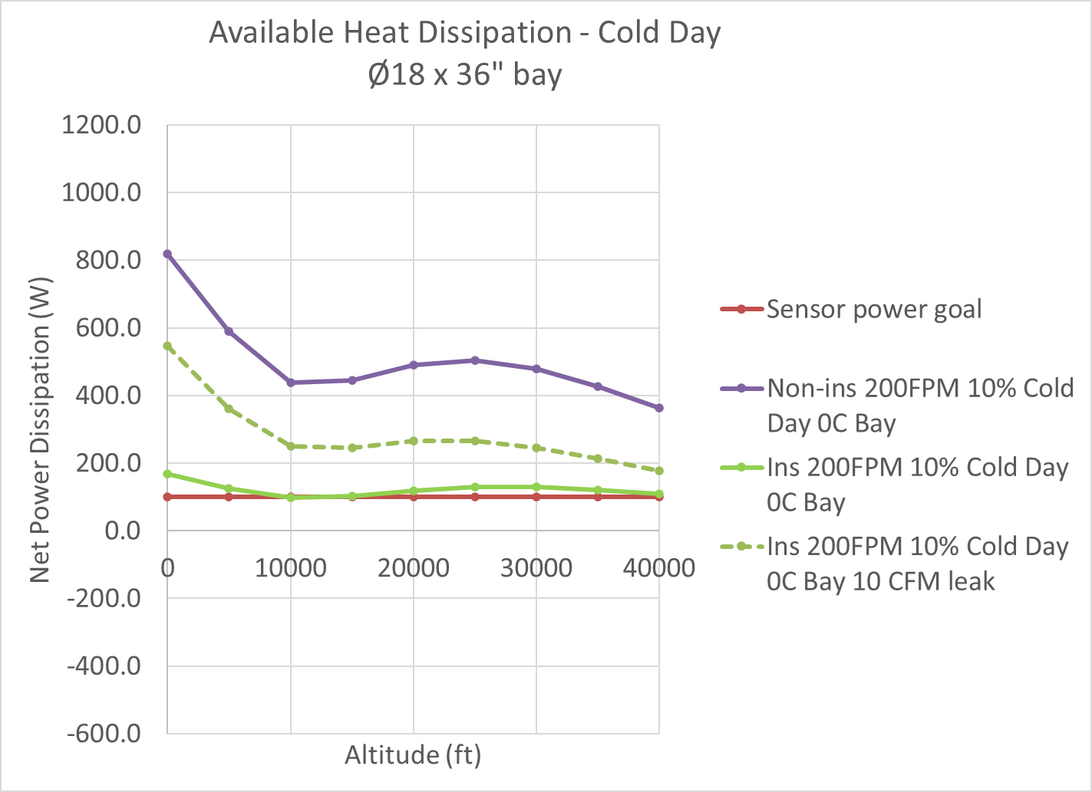
Sensor Bay Heat Transfer – Insulated / Non-insulated
Insulated and non-insulated pod
200LFM internal flow rate
Insulation greatly reduces required heating on cold day
A 10CFM leak will add 100-500W of required heating on a cold day!
TFAWS 2025 - August 4-7, 2025
©2025 Raytheon Company. All rights reserved.

Slide 16
Sensor Bay Sensor Bay Heat Transfer – Comments (1/2)
Cooling a sealed sensor bay presents many challenges
  Sensors may have a more limited temperature range than electronics
  Sealed means direct ram air cooling not possible
  Even small amounts of leakage can cause 100’s of watts of heat loss at cold
  Cooling options are highly dependent on aircraft flight envelope
    Lower altitude (<10kft) / higher speeds (>0.6Mach) will dramatically increase heat load
  Internal bay fans can be used to stir up the air and promote heat transfer
Some levers that can be pulled
  Accept a more limited temperature-altitude environment
  Low altitude airspeed limit
  More robust components
  Limited duty cycle / high speed dashes only at low altitude
TFAWS 2025 - August 4-7, 2025
©2025 Raytheon Company. All rights reserved.

Slide 17
Sensor Bay Sensor Bay Heat Transfer – Comments (2/2)
Decision to include insulation or not will depend on
  How leak tight the bay can be made
  The power dissipation of the sensor
  The available cooling options from the platform (or ECS)
  Required envelope
Typically, the bay will run colder than expected
  Insulation may not be required, but more aircraft power may be
Ground operations will require a further level of analysis
  Is preconditioning required for operation, and over what period of time
  What ground resources will be available – cooling carts, controlled hangar?
  Will the pod be exposed to direct sunlight
TFAWS 2025 - August 4-7, 2025
©2025 Raytheon Company. All rights reserved.

Slide 18
Conclusions
Smaller, lower-cost / lower performance platforms will be more relevant in the future
Large complex electronics pods with vapor cycle machine ECSs will become less relevant
Thermal management of future sensor systems in the low altitude / high transonic Mach regime will present severe challenges
Intent of this presentation was to:
  Demonstrate a method for understanding the flight envelope and its thermal implications over in the temperature-altitude environment
  Start to map out possible thermal management options
  Leverage existing capabilities to develop a notional cooling system design for a high-power density system operating at low altitude / high transonic Mach numbers
TFAWS 2025 - August 4-7, 2025
©2025 Raytheon Company. All rights reserved.

Slide 19
Reference Slides
TFAWS 2025 - August 4-7, 2025
©2025 Raytheon Company. All rights reserved.

Slide 20
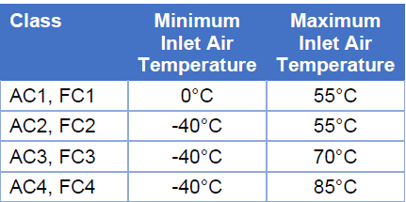
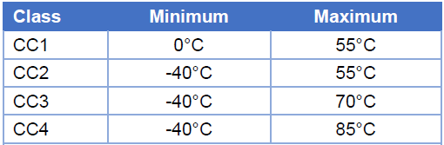
Typical Thermal Ratings for Equipment
From ANSI/VITA 47.0-2019, Construction, Safety, and Quality for Plug-In Modules Standard
Module Interface temperature (e.g., card edge, not component / chip temperature)
  VITA: VMEbus International Trade Association (standards group for electronics)
  Air temperatures are for sea level pressure
Forced Air Cooled
Conduction Cooled
“Rugged”
“Extended Rugged”
TFAWS 2025 - August 4-7, 2025
©2025 Raytheon Company. All rights reserved.

Slide 21
Bay Internal Temperature Limit (Typical)
Table below shows the ambient cooling air temperature, pressure, and density over altitude per MIL-HDBK-5400
Density ratio σ is a measure of how much cooling air is available at altitude
  Many heat transfer / temperature rise relationships correlate to the inverse of the sqrt of the density ratio
Measure of relative temperature rise
TFAWS 2025 - August 4-7, 2025
©2025 Raytheon Company. All rights reserved.

Slide 22
Cooling Modes –the design space
Optimal cooling mode(s) can be selected based on critical regime of flight
Cooling Option | Advantages | Disadvantages | Maturity | Comment / Applicability
Vapor Cycle Machine (ECS) | Active cooling - can cool below ram air temp | Expensive, heavy, custom, not reliable | High | Complexity, size and cost a problem
Thermo-Electric Coolers | Active cooling - can cool below ram air temp | Mechanically simple, but not efficient | High | For use preconditioning before flight or for higher Mach / lower altitude flight, particularly useful for EO sensor
Ram air cooling (with optimized heat sinks / heat exchangers) | Always available in flight | Not available on ground, too hot at higher Mach | High / medium | Could be used for sealed electronics boxes where condensation not an issue, not for sensor
Liquid cooling | Effective at cooling higher power electronics | Mechanically complex, multiple components | High | Complexity, size and cost a problem
Heat pipe (oscillating or otherwise) | Can move heat over large distance at small temperature difference | - | Medium / low | May be needed for high power components / boxes
Phase Change Materials (PCMs) | Can remove / store heat using material latent heat | Only for transient events | Medium | For use preconditioning before flight or for high-speed dashes
Thermal Interface Materials (TIMs) | Reduce temperature rise at interfaces | - | High / medium | Will need
Extended ruggedized components | Greater flexibility in environment | Greater expense / reduced availability | High / medium | For regimes of flight where +71C interface isn't sufficient, use +85C rated modules
TFAWS 2025 - August 4-7, 2025
©2025 Raytheon Company. All rights reserved.

Slide 23
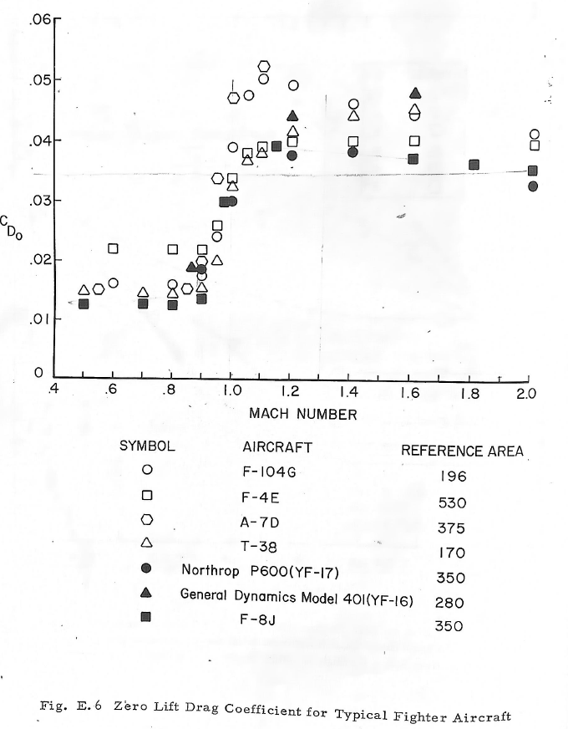
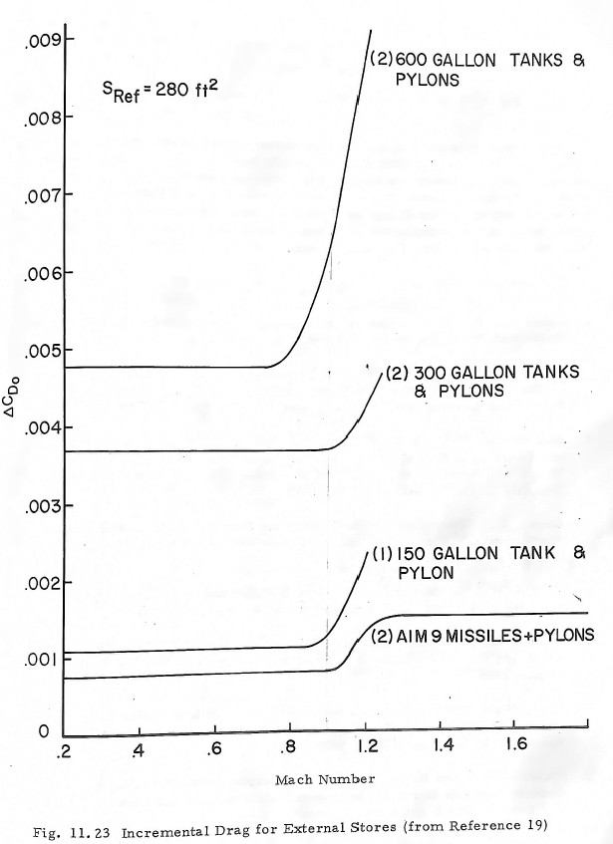
Check Results for Aerodynamic Parameters
Plots from Nicolai, “Fundamentals of Aircraft Design”
TFAWS 2025 - August 4-7, 2025

Slide 24
Relevant Material Properties for ROM Model
Material - Solid | Specific Heat C_{p} |  | Density ρ |  | Conductivity, K |  | Source
 | kJ/kg°C | BTU/lb °R | kg/m³ | lb/in³ | W/m°C | BTU/hr/ft °R
Aluminum 2024-T3 | 0.88 | 0.21 | 2768 | 0.100 | 123 | 71 | MMPDS-17
Carbon Fiber Epoxy (Cytec T300 3 k/977-2 PW) | 0.90 | 0.22 | 1569 | 0.057 | 0.6 | 0.4 | Joven et al, 2018
Foam Insulation (Divinycell H160) | 1.60 | 0.39 | 160 | 0.0058 | 0.04 | 0.02 | DIAB
Cleartran (Zinc Sulfide) | 0.52 | 0.12 | 4090 | 0.148 | 27.2 | 15.7 | Rohm and Haas
TFAWS 2025 - August 4-7, 2025
©2025 Raytheon Company. All rights reserved.

Slide 25








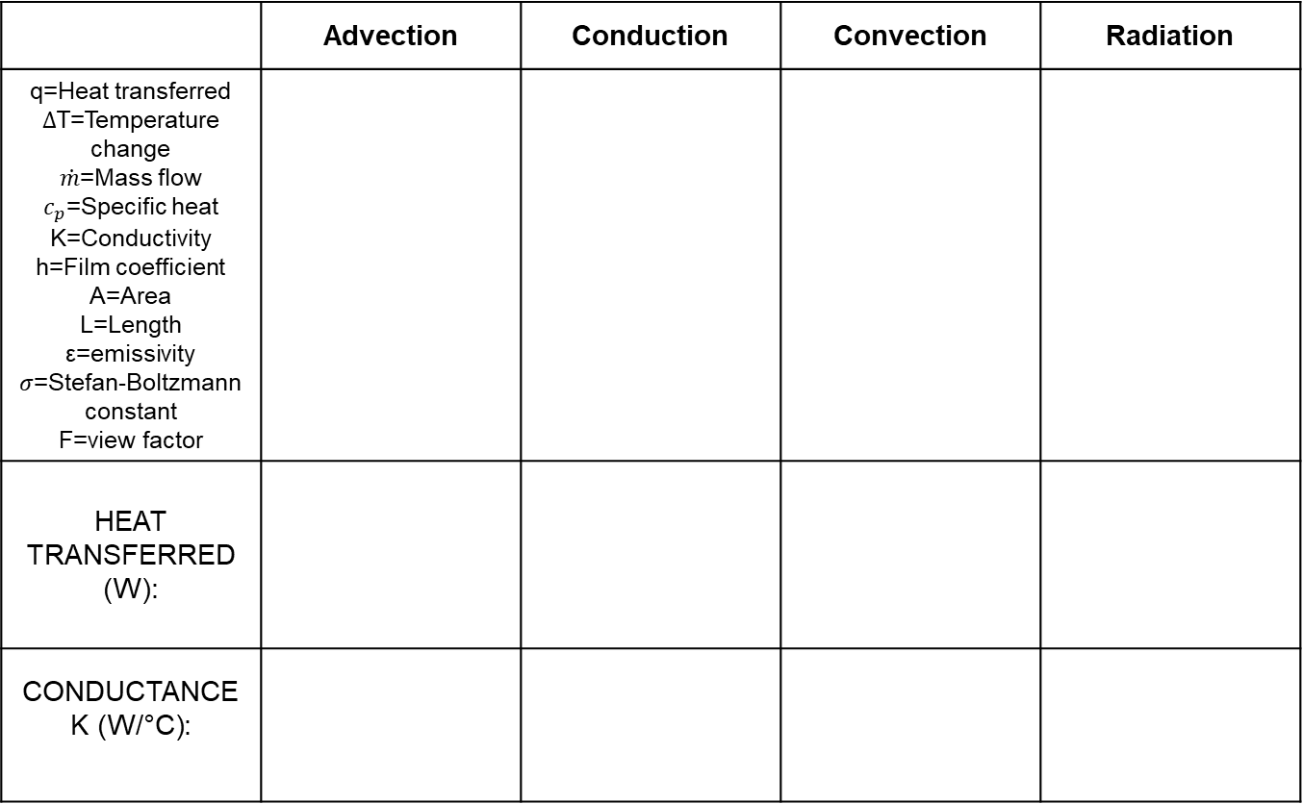


Fundamental Modes of Heat transfer
 | Advection | Conduction | Convection | Radiation
q=Heat transferred $∆$T=Temperature change $\dot{m}$=Mass flow $c_{p}$=Specific heat K=Conductivity h=Film coefficient A=Area L=Length ε=emissivity $σ$=Stefan-Boltzmann constant F=view factor
HEAT TRANSFERRED (W):
CONDUCTANCE K (W/°C):
T₂
ε₂
A₂
f₂₁
T_{fluid}
q
ΔT
q
Convection is critical mode
Conduction relevant for pod skins
Advection relevant for leakage
Radiation relevant on-ground mainly
Other mode to consider: contact resistance (temperature rise across a clamped surface)
ΔT
q
T_{hi}
T_{lo}
T_{surf}
$$\dot{m}$$
ΔT
q
h
k
A
T_{in}
ΔT
T_{out}
A
L
T₁
ε₁
f₁₂
A₁
$$q=\frac{kA}{L}∆T$$
$$q=σεf_{12}A_{1}∗$$
$$(T_{1}^{4}−T_{2}^{4})$$
$$q=\dot{m}c_{p}∆T$$
$$q=hA∆T$$
$$q≈4σε_{1}A_{1}{T_{avg}}^{3}∆T$$
$$\dot{m}c_{p}$$
$$\frac{kA}{L}$$
$$4σε_{1}A_{1}{T_{avg}}^{3}$$
$$hA$$
Resistance R
= 1/K (°C/W)
Not bilateral!
TFAWS 2025 - August 4-7, 2025
©2025 Raytheon Company. All rights reserved.

Slide 26
Thermal Networks
Thermal network analysis is an extremely powerful tool for analyzing thermal problems with multiple heat paths and heat dissipation sources
Computer based modeling programs such as SINDA are network analysis programs and create a complex series of conductors based on geometry
Excel works well too…
TFAWS 2025 - August 4-7, 2025
©2025 Raytheon Company. All rights reserved.

Slide 27
Ram Air Cooling - Comments
Venting electronics bays to ambient / ram conditions may be sufficient to provide cooling to electronics boxes (not sensors!) above ~15Kft, with limitations and risks
Limitations
  Doesn’t provide any cooling on ground
  On extremely cold days, bay temperature may drop to below -40°C
  Applies to air cooled equipment – high power equipment may need dedicated ram flow (not venting) or liquid coolant
Risks
  Water / contaminant ingress
  Condensation: on descent from altitude to a warm airport, it will rain in the bay
Mitigations
  Ram air gate to seal bay at cold combined with heaters may be required to maintain bay temperature
  All electronics must be at least rugged / industrial grade, and withstand condensing humidity
  Drain holes / baffles / guides may be required to direct condensation
TFAWS 2025 - August 4-7, 2025
©2025 Raytheon Company. All rights reserved.

Slide 28
Cooling (and Heating) a Sensor Bay – Assumptions (1/2)
Ø18” x 36” long bay – approximate size of small drop tank
  Max EO/IR sensor power dissipation for this volume would be approximately 100W
Simple model of sealed electronics bay with window
  Ignore end caps and aircraft attachment
  Skin temperature is at adiabatic wall temperature (recovery temperature)
Use estimated TA-50 Mach / flight envelope
  Investigate envelope restrictions at lower altitude due to high recovery temperature
Fix bay temperature to MIL5400CL1 (hot day), 0°C (cold day)
  Corresponds to more sensitive electronics / sensor
Assume 0.1” thick composite pod / bay with 0.6W/m*K conductivity
  Run cases with 1.00” thick Divinycell insulation with 0.04W/m*K conductivity
TFAWS 2025 - August 4-7, 2025
©2025 Raytheon Company. All rights reserved.

Slide 29
Cooling (and Heating) a Sensor Bay – Assumptions (2/2)
Cleartran window 0.5in thick and 200in² area
  Cleartran conductivity 27.2W/m*K
Assume internal convection film coefficient per WADC correlation
  Experiment with various internal flow rates, from 0CFM to 200CFM
Typically, a sensor bay would be sealed, to prevent ingress of moisture that could lead to condensation on optics
  This means a pressure relief valve and desiccant system is required
  Initially assume no leakage, then assess impact of leakage
Fix q_{bay} =100W for hot cases and solve for Mach
Solve for q_{bay} for cold cases (to determine required heating)
Implement active cooling using TEC assembly
  176W max Q / 42C max ΔT
  Would require external ram scoop / HX
TFAWS 2025 - August 4-7, 2025
©2025 Raytheon Company. All rights reserved.

Slide 30
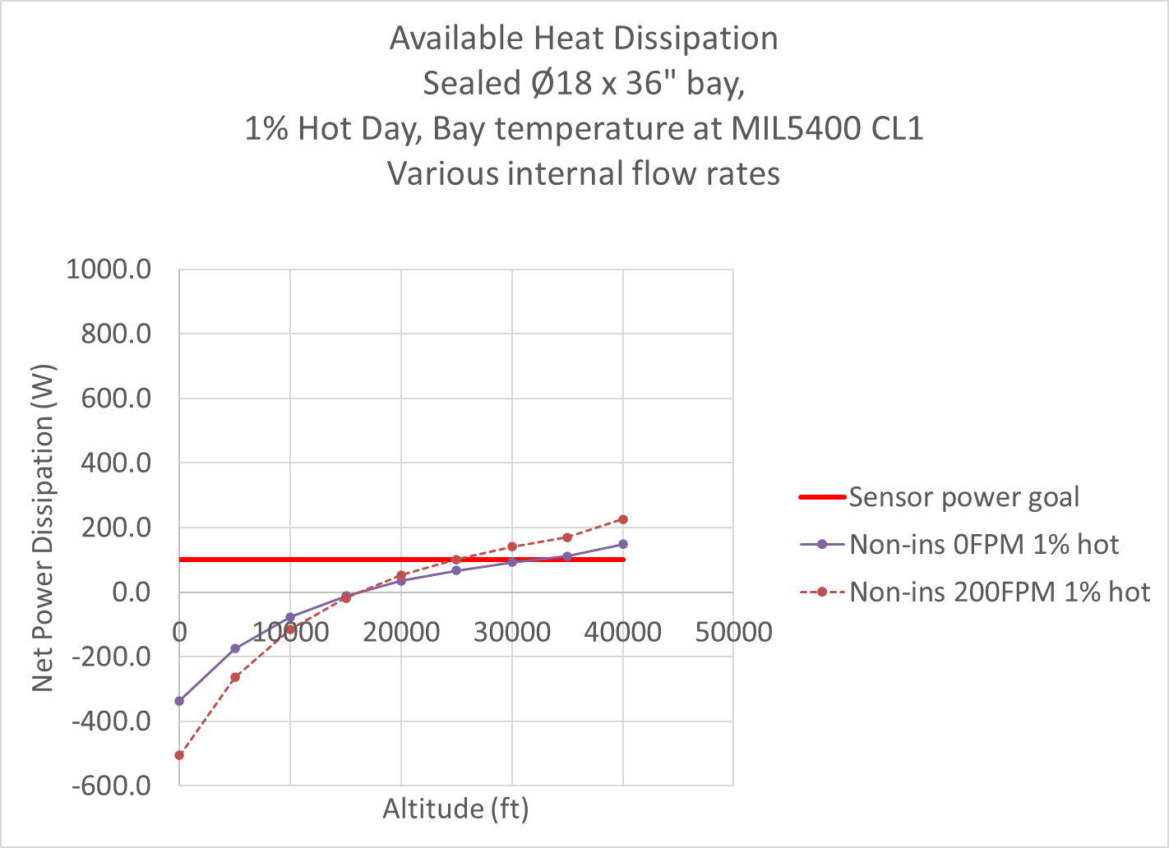
Sensor Bay Heat Transfer – Internal Flow Rate
Non-insulated pod
Variable internal flow rate
Combined heating (cooling) / sensor power required on a hot day is between -300 to -500W at low altitude and 150 to 280W at high altitude
Active cooling required up to approx. 20kft even for a very low power sensor (<50W)
Assume 200fpm internal bay flow rate for further modeling
TFAWS 2025 - August 4-7, 2025
©2025 Raytheon Company. All rights reserved.

