Slide 1


Validating CFD Predictions of a Mach 10 Wake
National Aeronautics and Space Administration
Clark Pederson
Aerothermodynamics Branch
NASA Langley Research Center
August 5th, 2025

Slide 2
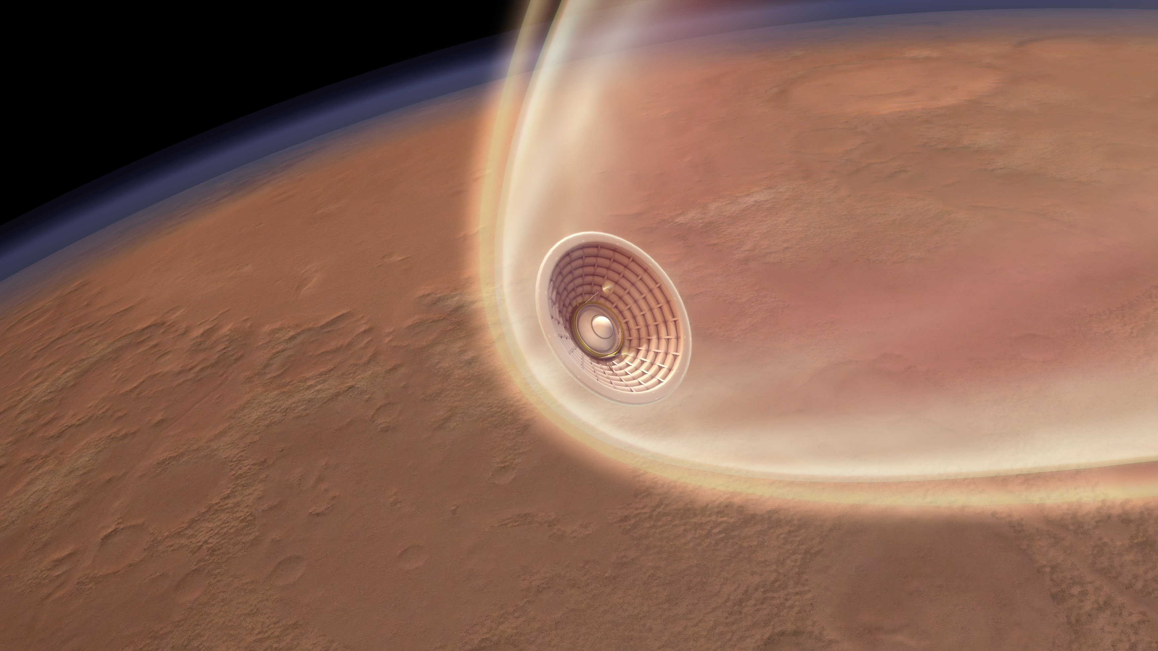
Motivation
Human missions to Mars will require larger payloads than past Mars missions.
  Previous robotic missions landed masses of about 1 ton
  Human missions will require 26-36 tons
Hypersonic Inflatable Aerodynamic Decelerators (HIADs) are an emerging technology that could fill the gap.
HIADs could also be used for re-entry of large payloads, such as rocket engines

Slide 3
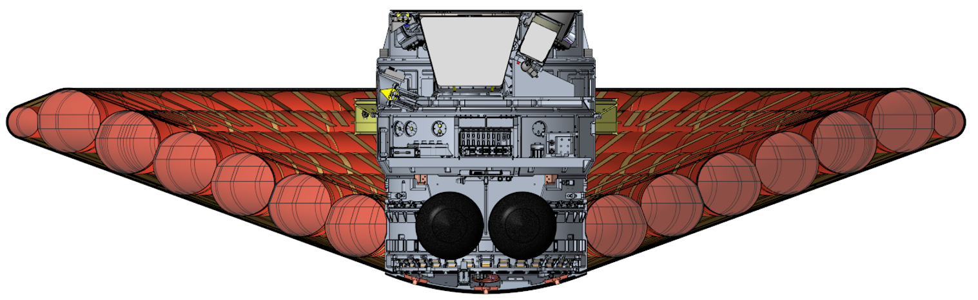
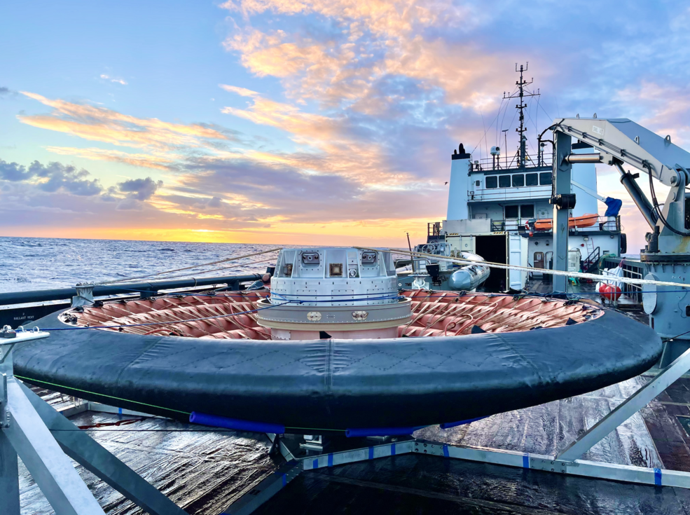
LOFTID: A Successful Flight Demonstration
A Low-Earth Orbit Flight Test of an Inflatable Decelerator (LOFTID) was successfully completed on November 10th, 2022.
The unconventional backside of the vehicle presents new challenges.
  The exposed toroids and straps have minimal thermal protection.
  The payload sits in a large concave section.
Mission success requires accurate predictions of the aerodynamics and heating on this unusual flight geometry.
Future HIAD applications will have larger diameters and faster entry velocities, which will decrease the margin for error.
Cross-Section of the LOFTID vehicle
Photo of the recovered LOFTID vehicle after the successful flight demonstration. Source: NASA

Slide 4
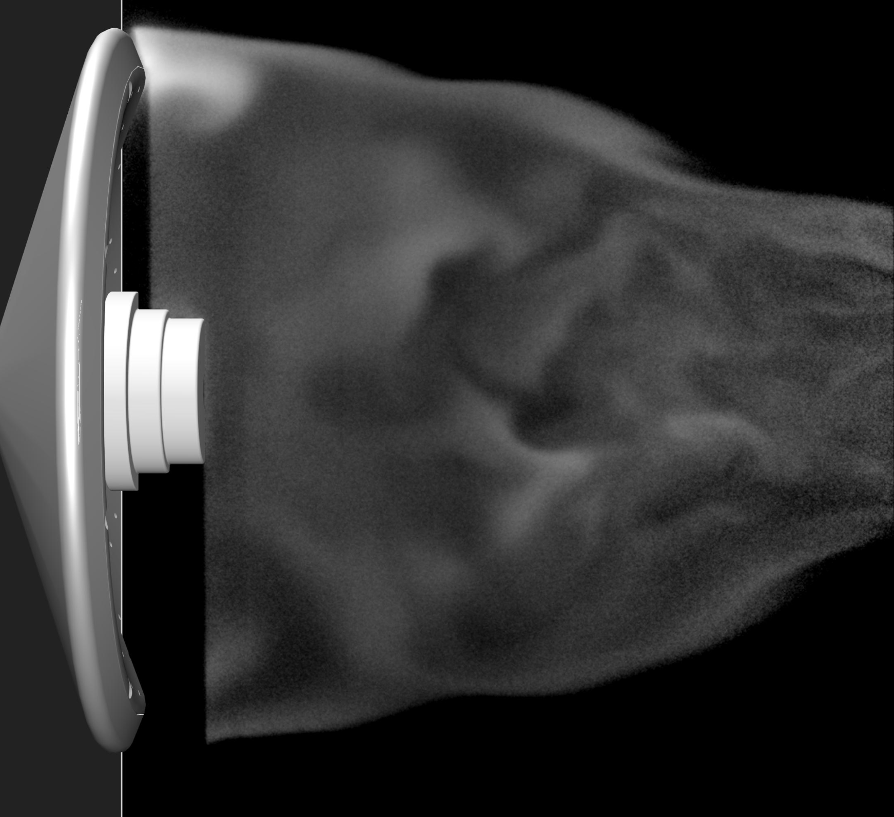
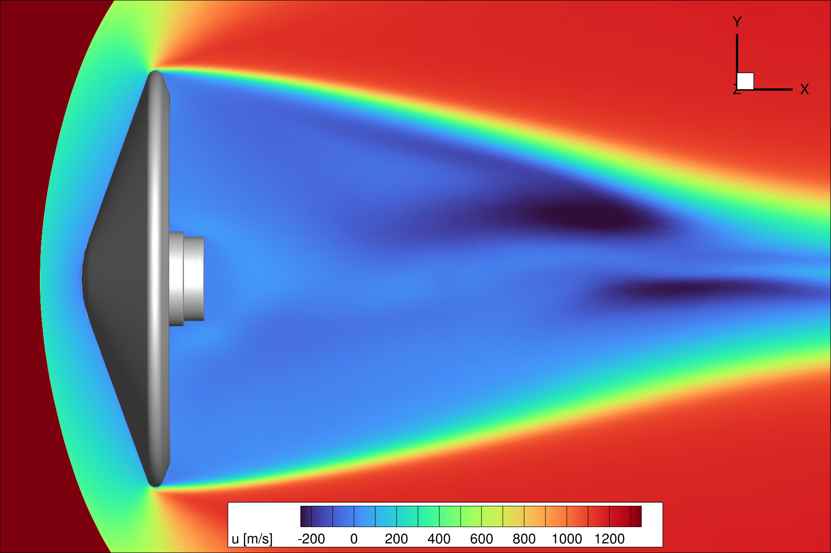
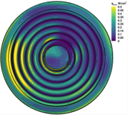
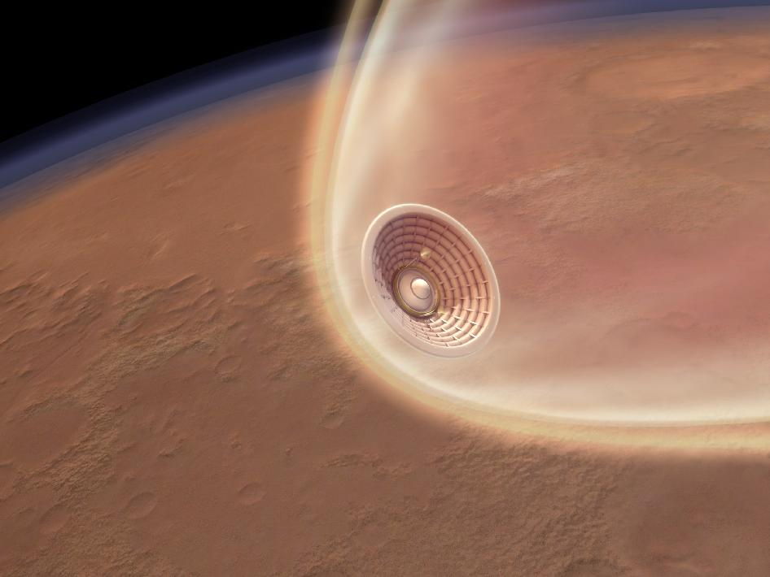
Role Of CFD Validation Experiments
Wind Tunnel
Experiments
CFD Validation
CFD Predictions
Bolder, More Ambitious Missions
Sometimes, projects are interested in quantities that are only indirectly linked to model accuracy.
Other quantities of interest, such as wake velocity, depend more directly on model accuracy.

Slide 5
Quick Summary of the Experiment

Slide 6
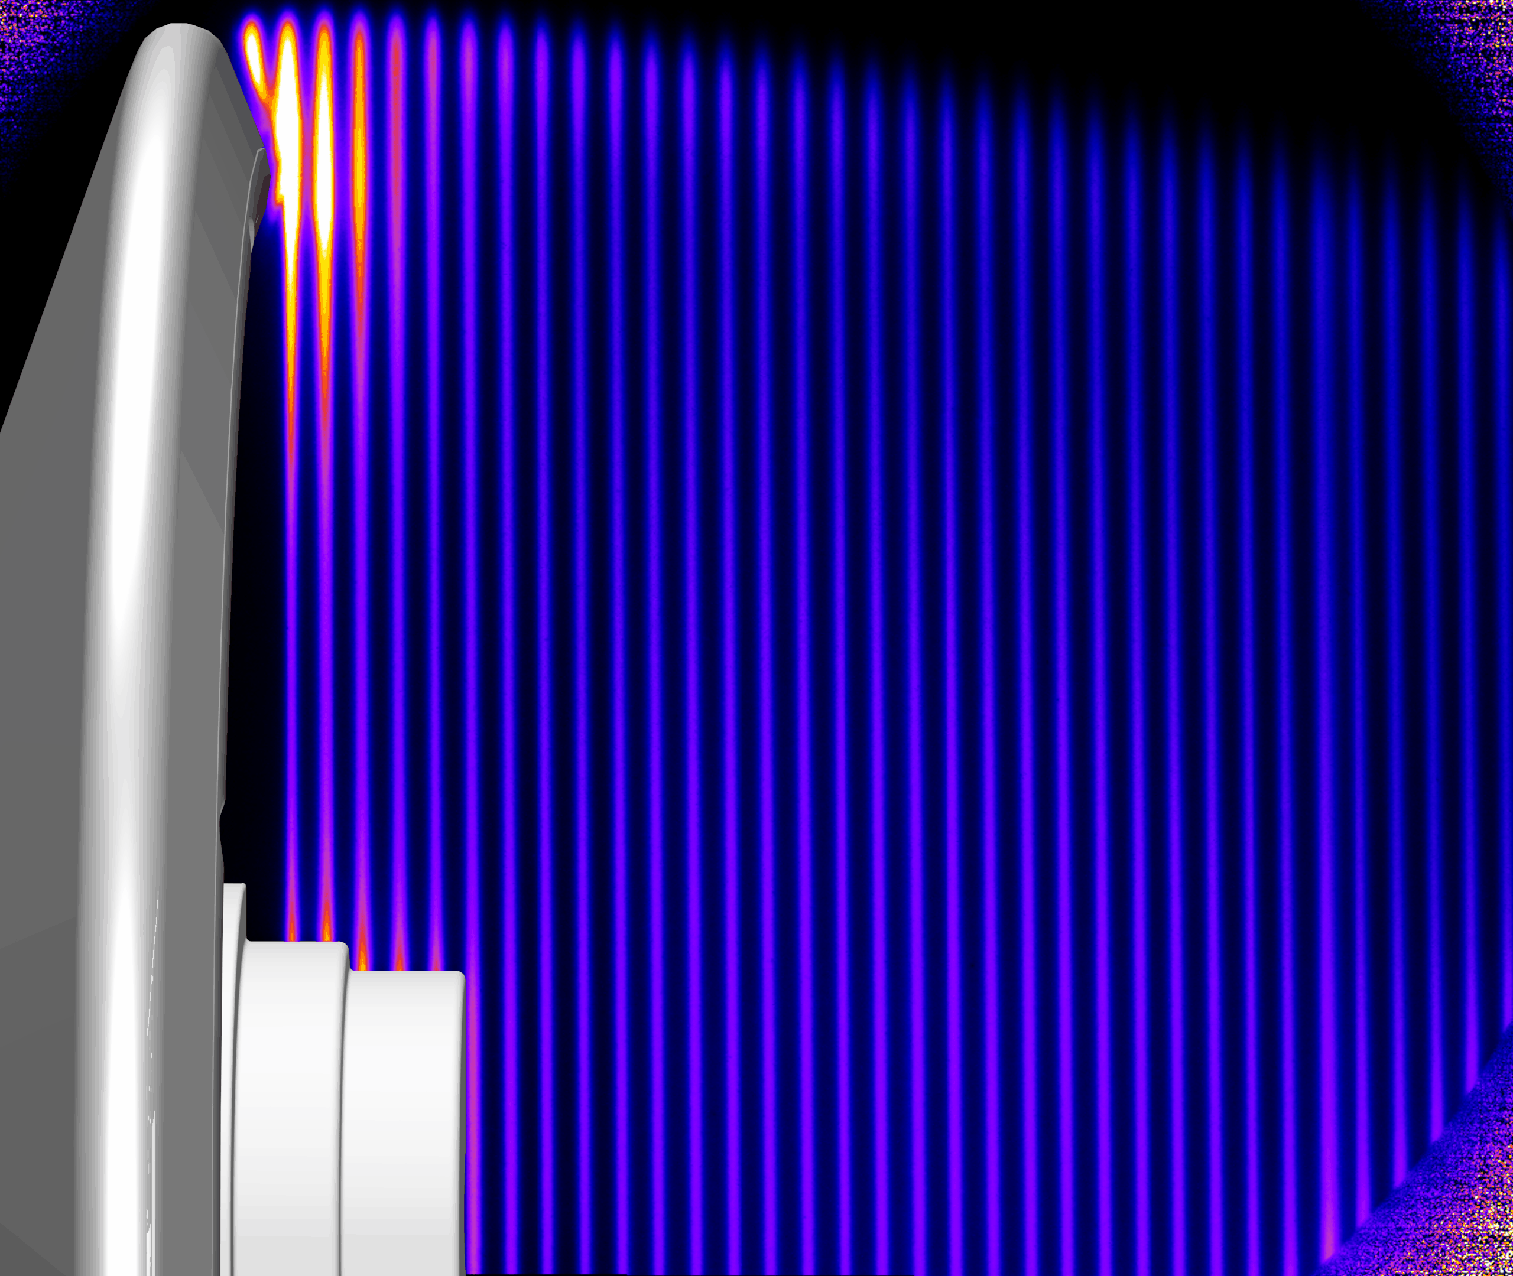
PLIF Wake Flow Experiments
Experiments were performed in the 31-inch, Mach 10 Air Tunnel, which is part of the Langley Aerothermodynamics Laboratory at the NASA Langley Research Center
  Documented by Rodrigues et al. [1]
Velocities were measured using planar laser-induced florescence (PLIF).
  The wake was seeded with nitric oxide (NO) from small holes located on the aft side of the model.
  A 10 Hz, pulsed, tunable UV laser was split into 75 laser beams near the test section using a diffractive optical element.
  The laser excites the nitric oxide (NO) molecules.
  By recording two successive images approximately 500 ns apart, velocity is determined from the displacement of the fluorescence.
Tested a range from Re_{D} = 2.5x10⁵ to 8.9x10⁵
[1] Rodrigues, N. S. et al. “FLEET and PLIF Velocimetry within a Mach 10 Hypersonic Air Flow,” AIAA SciTech 2024 Forum, 2024. https://doi.org/10.2514/6.2024-2323.
Example of snapshots captured during NO PLIF. Images provided by Neil Rodrigues.

Slide 7
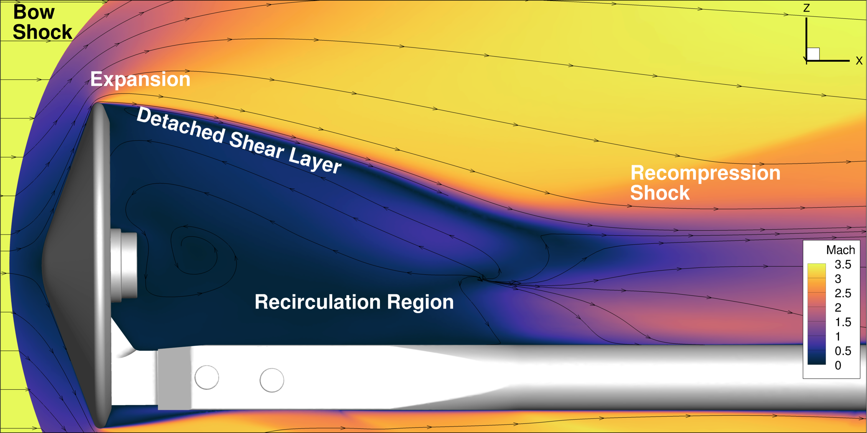
Overview of the Flow Physics

Slide 8
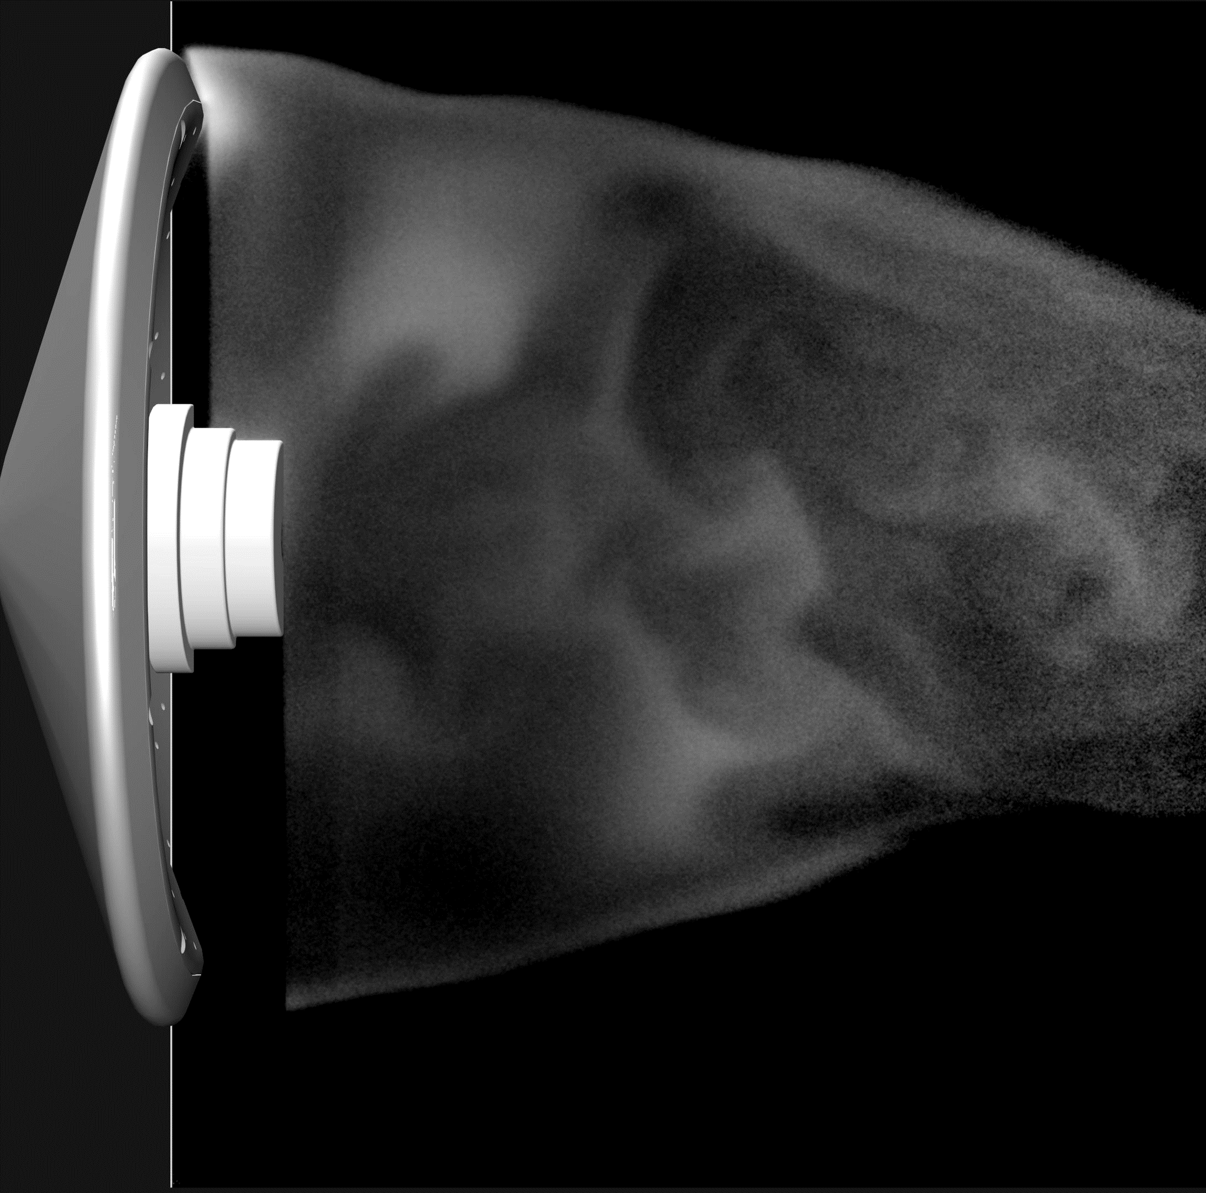
Modeling Challenges
Wake unsteadiness is weak
  Compressibility effects limit the growth of Kelvin-Helmholtz instabilities
  The wake is relatively low Reynolds number (turbulent production is weak)
  The sting damps some of the large-scale unsteadiness in the wake [2]
Both the sting and payload have an effect on the wake.
  This motivated the use of unstructured meshes
[2] Stack, C., et al. “Influence of Blunt-Body Base Protuberances on Near-Wake Unsteadiness.” ICCFD11. https://doi.org/10.2172/2003980.
Wake visualization for the highest Reynolds number. Color represents the logarithm of the intensity from the camera images. Images provided by Neil Rodrigues.

Slide 9
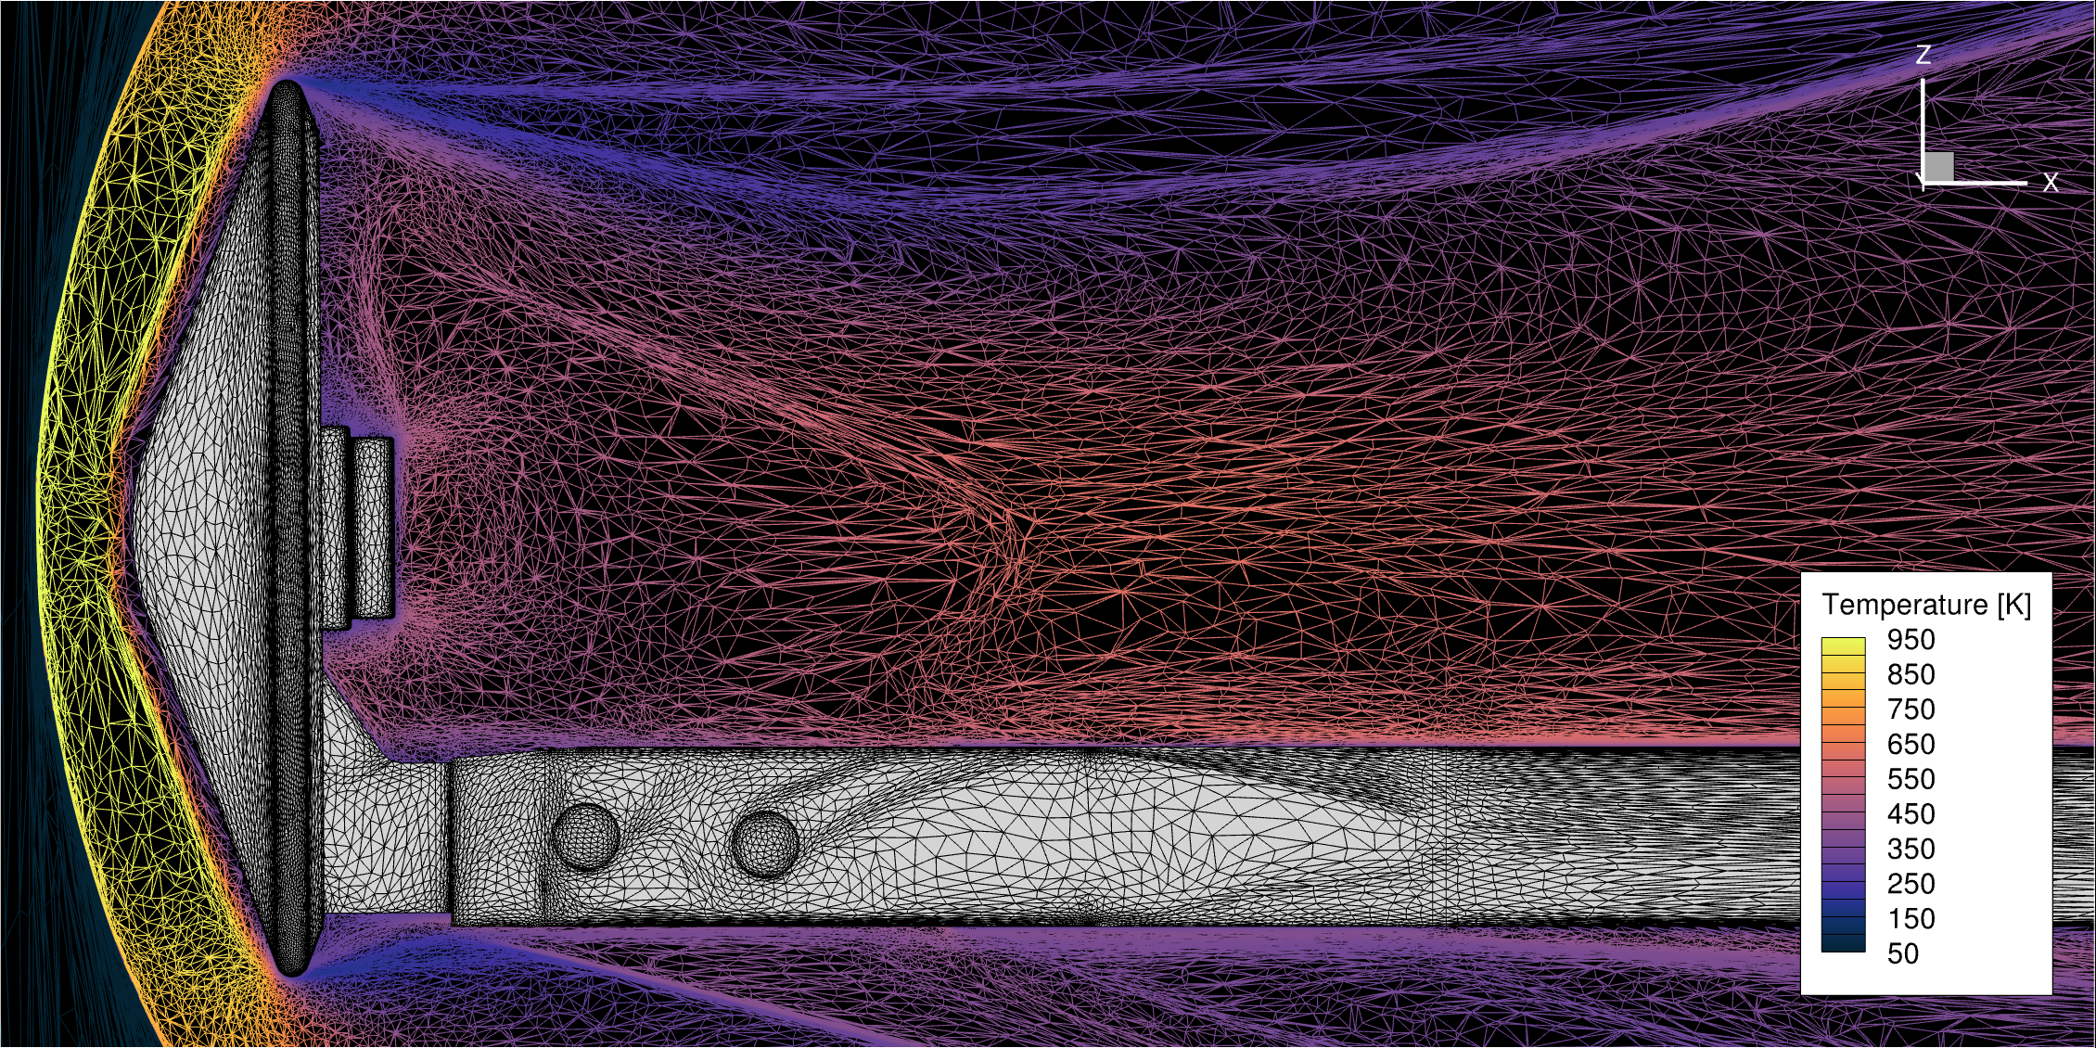
Computational Setup
Compared two different finite-volume CFD solvers
  HyperSolve
  FUN3D
Sketch-to-Solution was used to construct and adapt the unstructured mesh.
Examined both steady RANS and unsteady DDES
A slice through the symmetry plane of an adapted mesh, generated using Sketch-to-Solution. The conditions correspond to the Re_{D} = 2.5 x 10⁵ case. The mesh is colored by the temperature to show the flow features to which grid is adapted.

Slide 10
Comparing CFD With Experiment

Slide 11
Comparison of RANS and DDES
Comparison of the CFD and experimental mean velocity fields at the lowest Reynolds number, Re_{D} = 2.5x10⁵. The zero-velocity contour line is labeled.

Slide 12
Comparison of RANS and DDES
Comparison of the CFD and experimental mean velocity fields at the highest Reynolds number, Re_{D} = 8.9x10⁵.

Slide 13
Comparison of RANS and DDES
(a) Re_{D} = 2.5x10⁵
(b) Re_{D} = 8.9x10⁵
The axial velocity along the centerline of the model, predicted using various turbulence models, for (a)
the lower Reynolds number and (b) the higher Reynolds number cases.

Slide 14
Comparison of HyperSolve and FUN3D
Comparison of the CFD and experimental mean velocity fields at the highest Reynolds number, Re_{D} = 8.9x10⁵. HyperSolve and FUN3D agree well for both steady and unsteady cases.

Slide 15
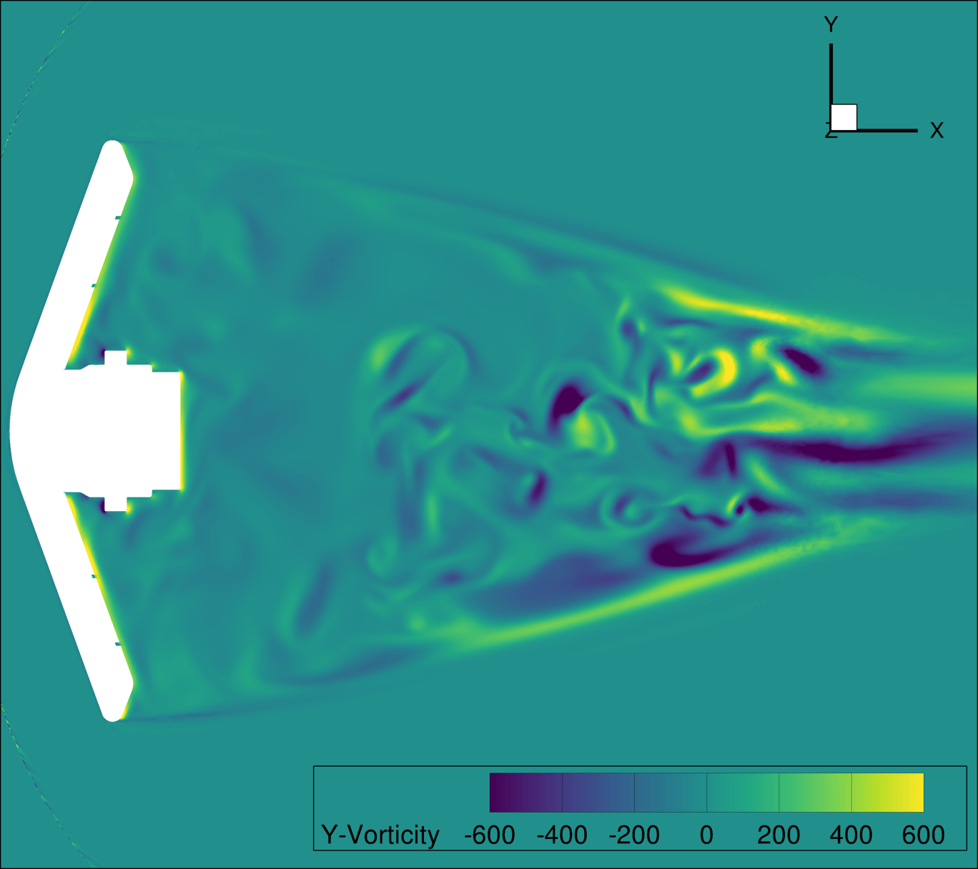
Conclusions
Wake velocities were measured in a Mach 10 flow using PLIF
As demonstrated in previous studies, the RANS models greatly overpredicted the magnitude of the reverse velocity in the separated wake
DDES did better in predicting the qualitative nature of the wake
  Peak reverse velocity was predicted to within 5% of the freestream velocity
  DDES over-predicts the length of the separation bubble
  DDES also predicts too thin of a shear layer
Comparisons between FUN3D and HyperSolve showed good agreement
Future research should focus on improved hybrid RANS/LES models and wall-modeled LES, with an emphasis on low Reynolds number wakes
These lessons will be used in the LOFTID post-flight deep dive and future HIAD flight projects.

Slide 16
Backup Slides

Slide 17
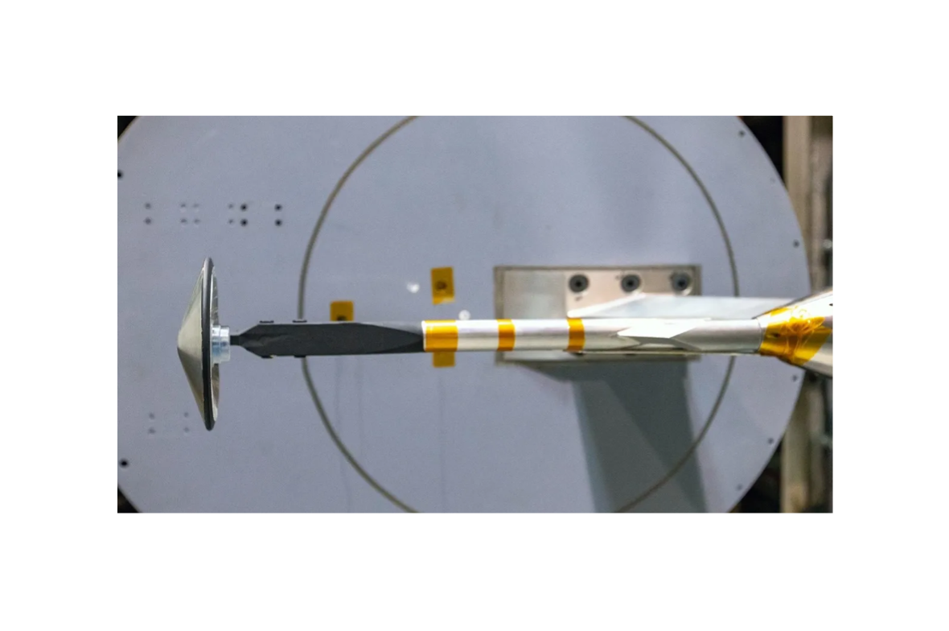
Experimental Setup and Conditions
Case | Re_{D,∞} | M∞ | M∞ [kg/m³] | u∞ [m/s] | T∞ [K]
Low Re | 2.51 x 10⁵ | 9.68 | 4.68 x 10⁻³ | 1385 | 50.9
Mid Re | 5.03 x 10⁵ | 9.81 | 9.13 x 10⁻³ | 1386 | 49.7
High Re | 8.93 x 10⁵ | 9.91 | 1.58 x 10⁻² | 1387 | 48.7

Slide 18
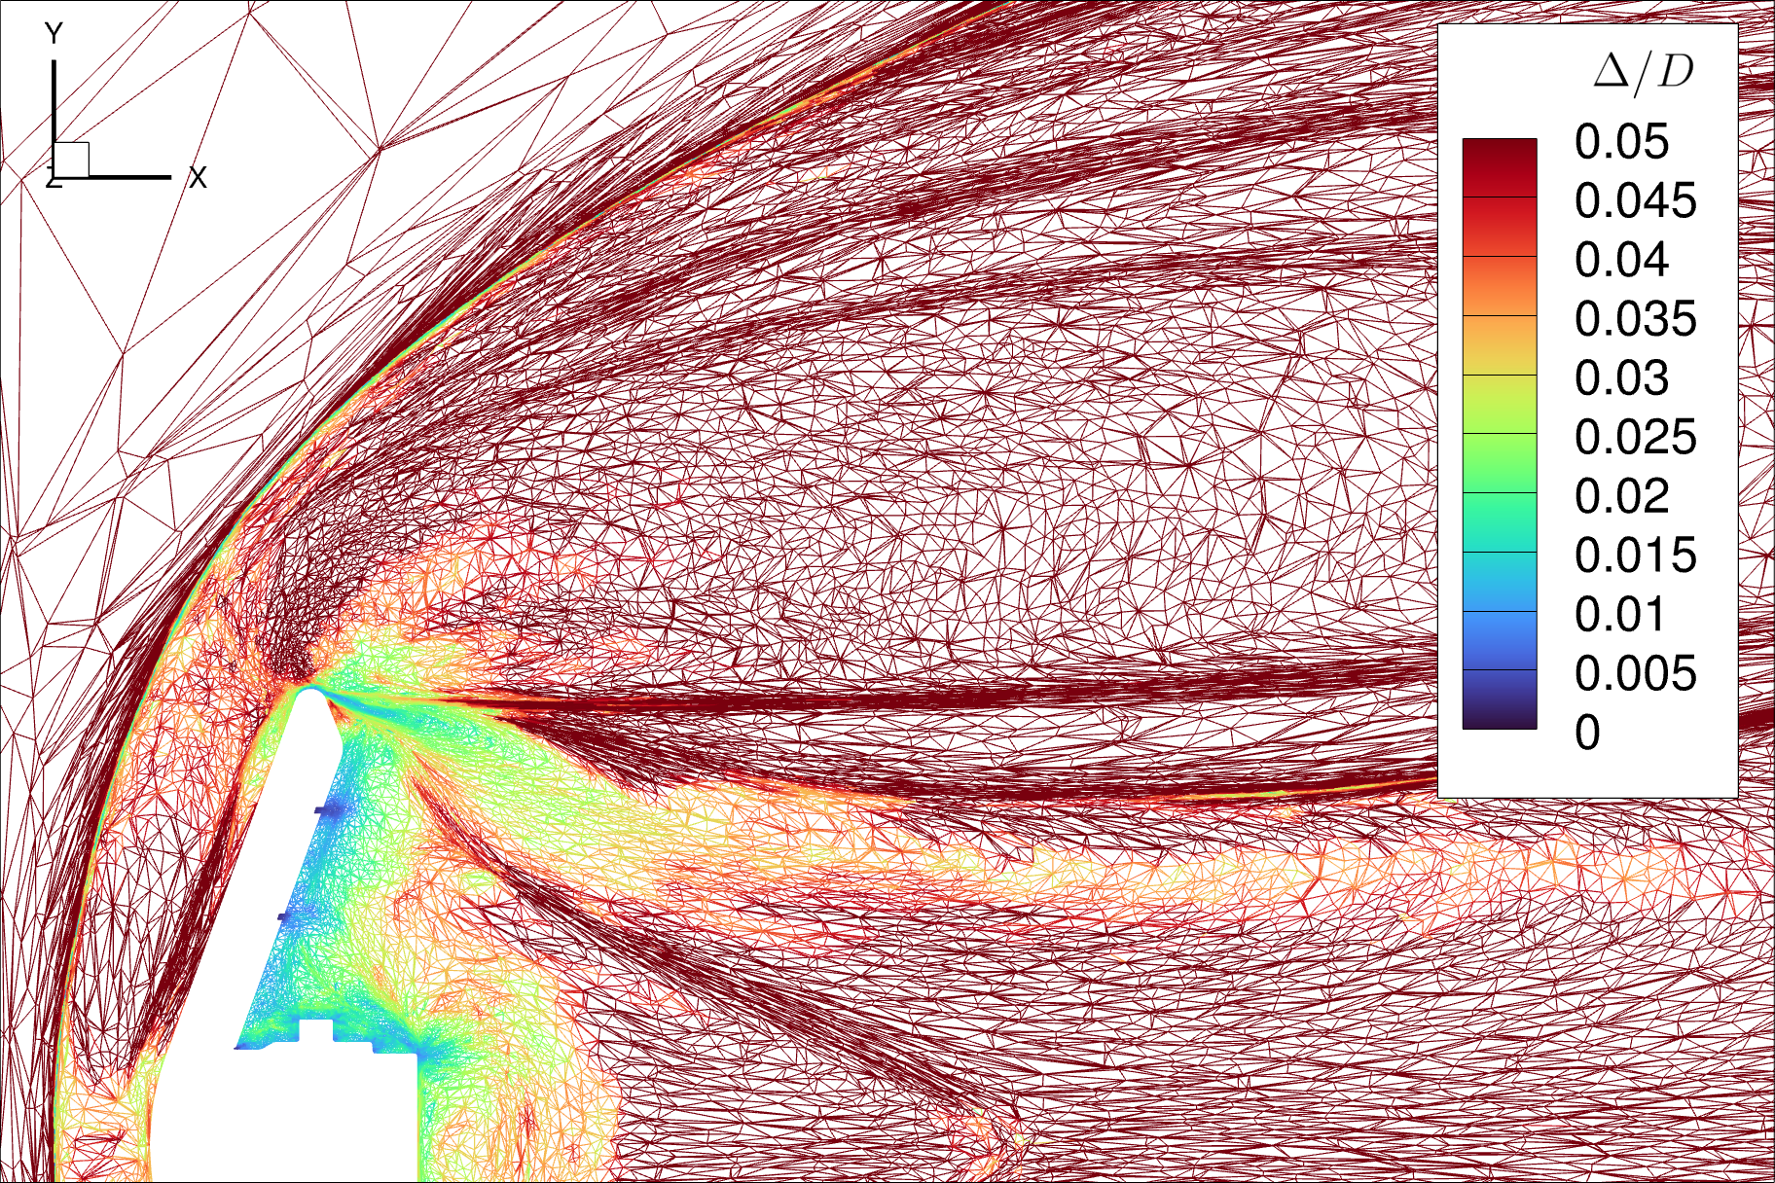
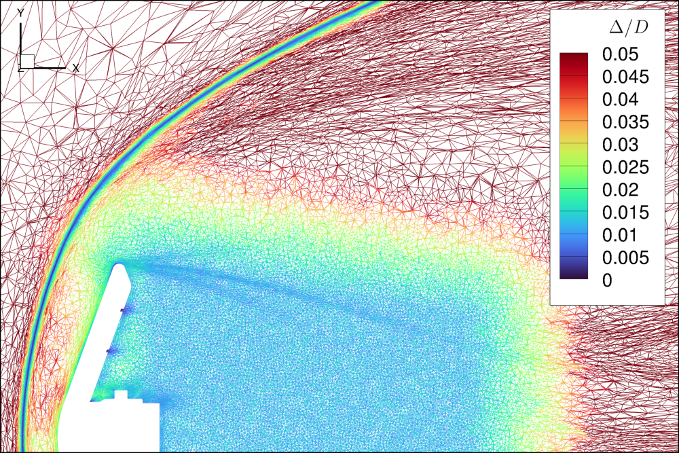
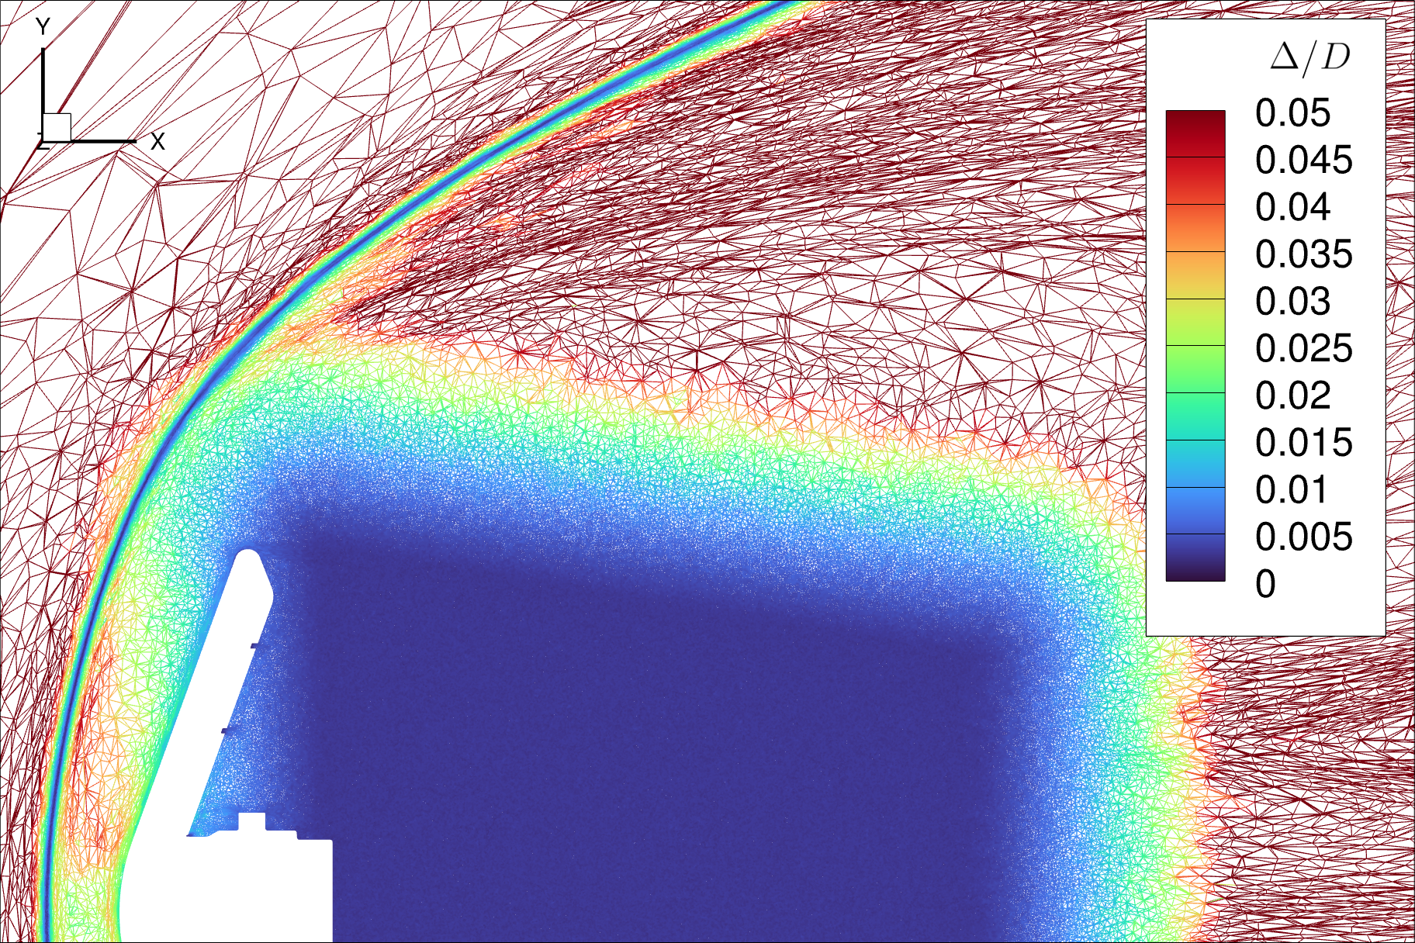
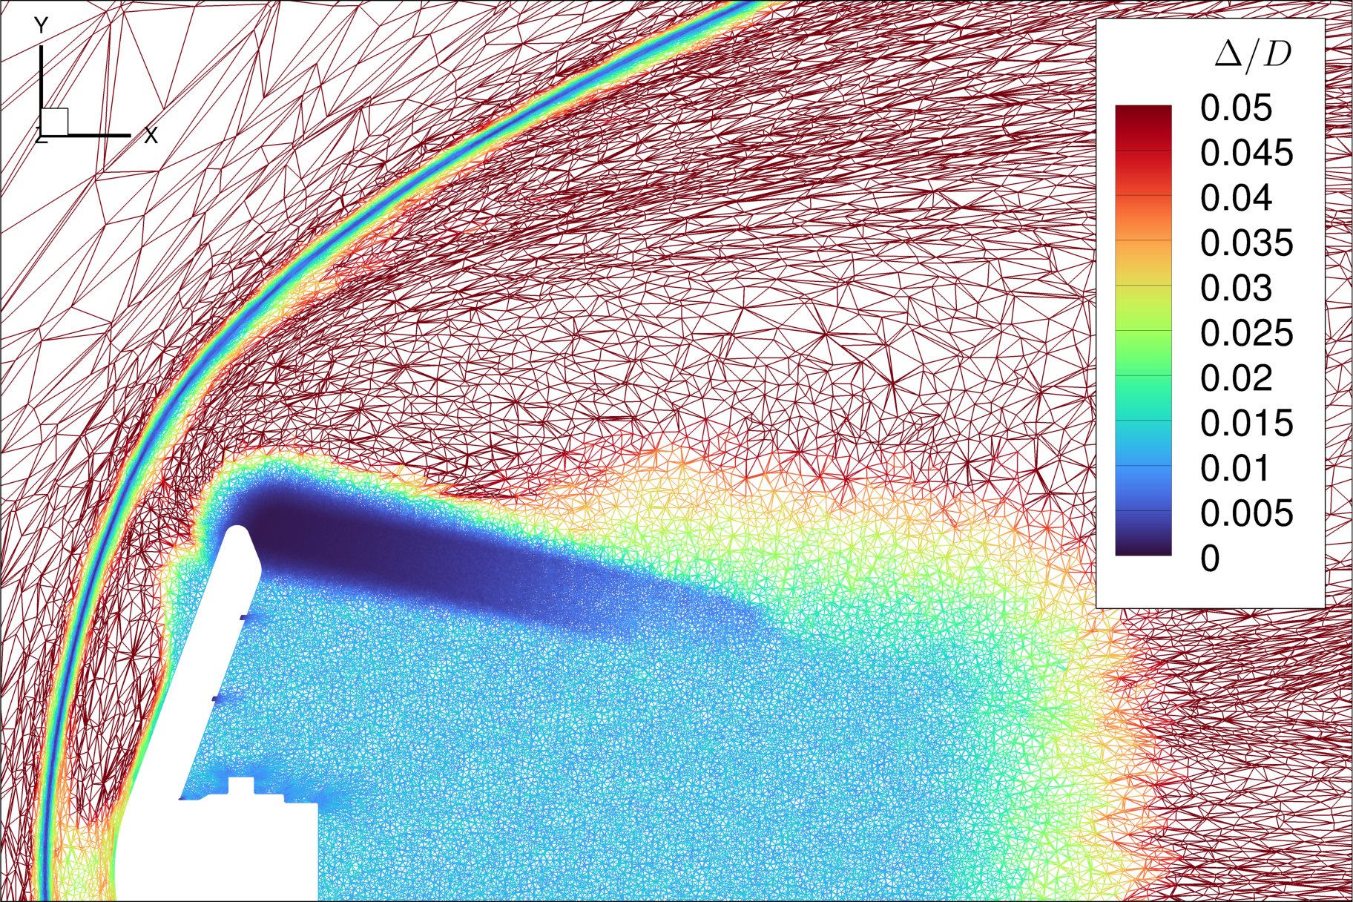
Examples of Meshes
In the wake,
Δ/D ≅ 1%
RANS mesh
Coarse DDES mesh
In the wake,
Δ/D ≅ 0.25%
Fine DDES mesh
DDES mesh with shoulder refinement

Slide 19
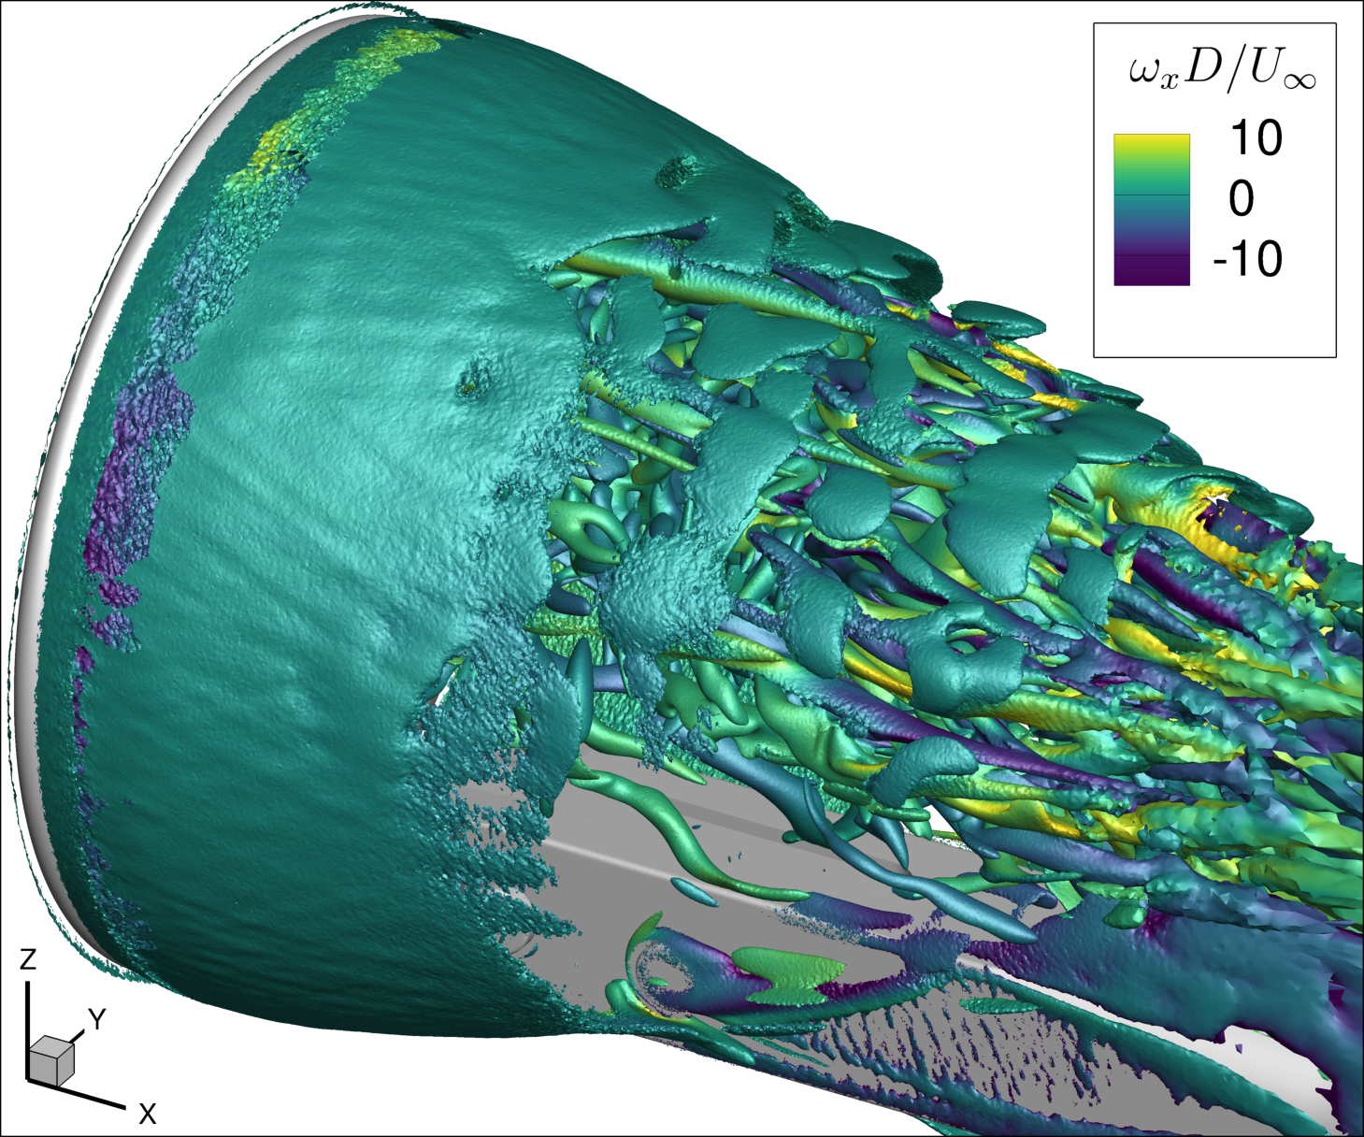
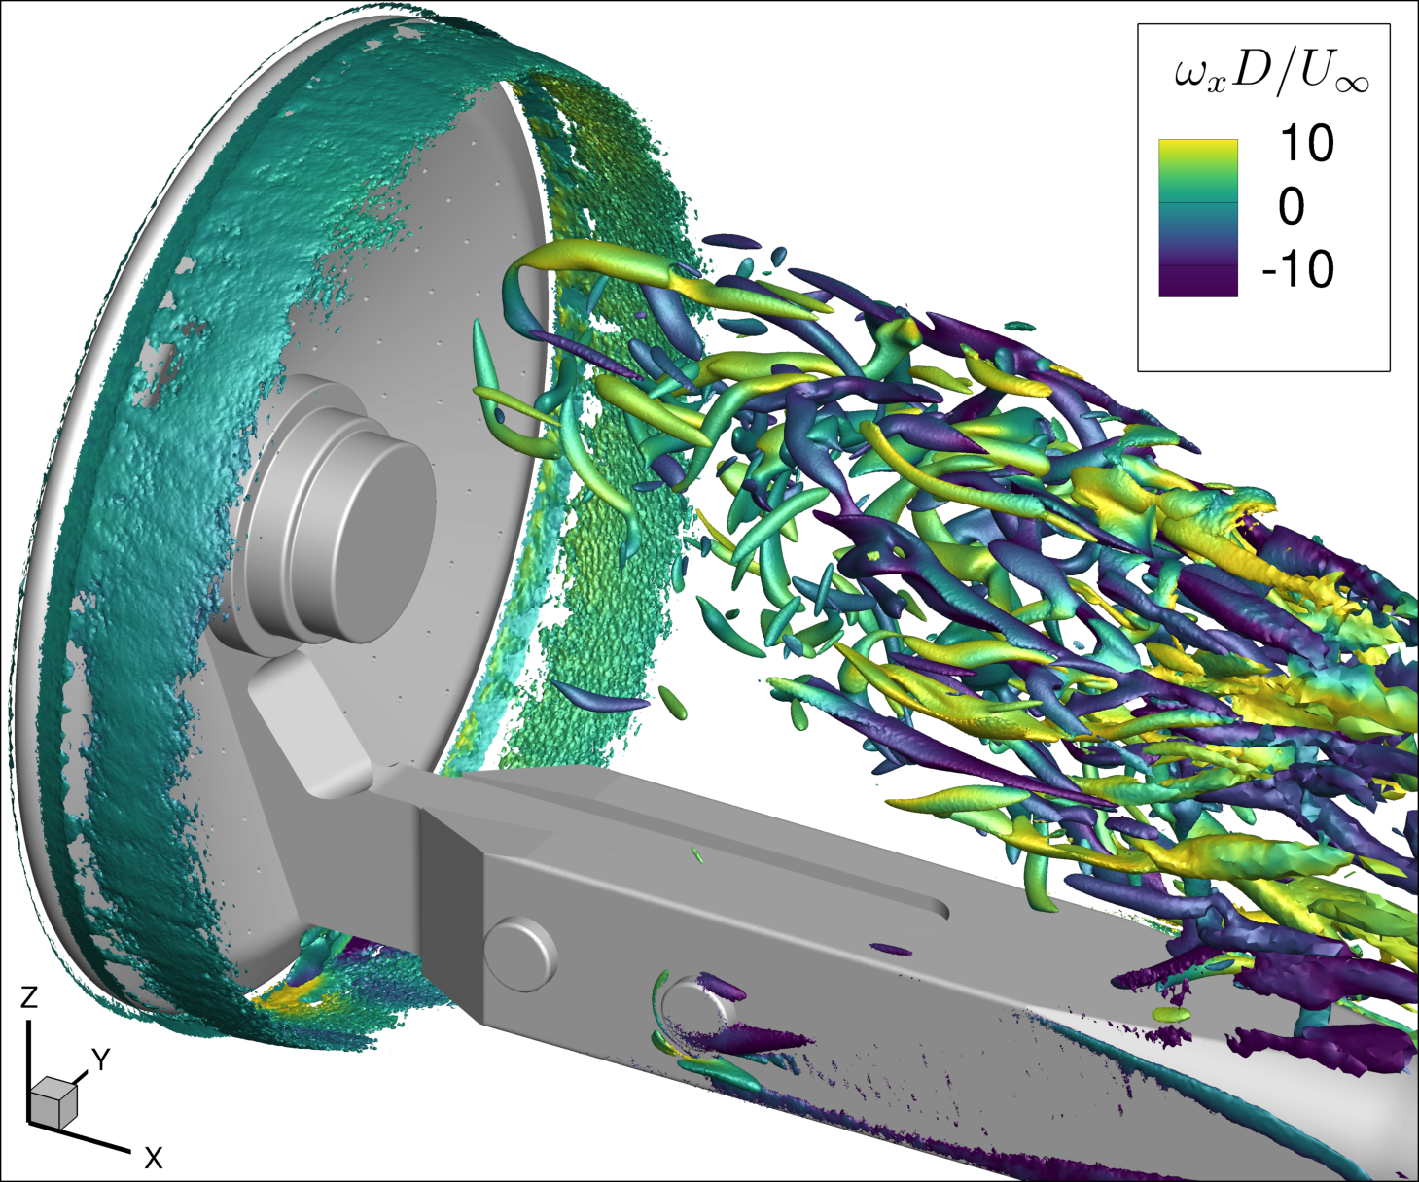
Q-Criterion

