Slide 1

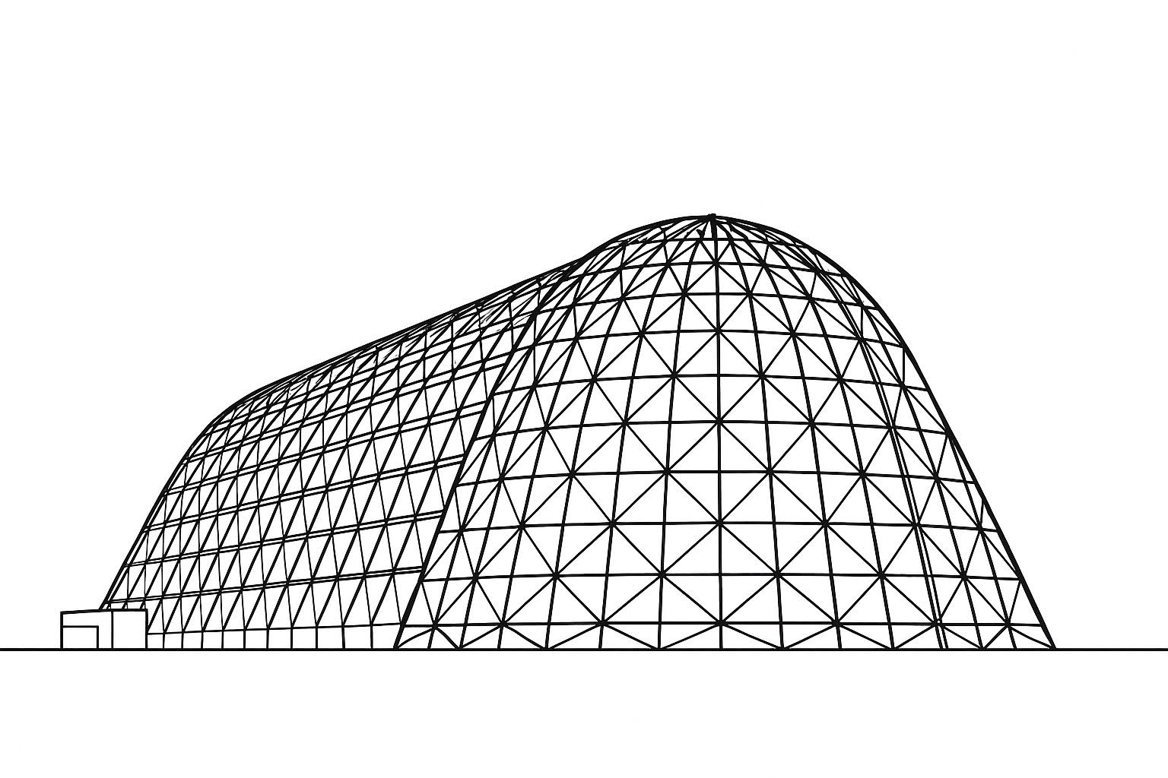

Transport-Equations-Based Transition Models for Three-Dimensional High-Speed Flows
TFAWS 2025 Aerosciences Technical Session
Presented by: Ethan Vogel
Ethan A. Vogel and Meelan M. Choudhari
NASA Langley Research Center
Thermal & Fluids Analysis Workshop 2025
NASA Ames Research Center
San Jose, CA
August 4-7, 2025

Slide 2
Introduction
Laminar-turbulent transition represents a major source of uncertainty in aeroheating predictions for hypersonic flight systems
Transition prediction via transport-equations-based models (transition models) is a mainstay of subsonic aerodynamic analysis
For hypersonics, transport-equations-based models are much less mature
Various extensions to “subsonic” models have been suggested, but often limited to single-code implementations that are not widely available
Insufficient evaluation across wide range of Mach numbers and disturbance environments

Slide 3
Objectives
Present the initial implementation of the SA-(h)AFT transport-based transition model in OVERFLOW
Utilize LST comparisons to evaluate the AFT model’s ability to predict crossflow-induced transition
Also assess crossflow transition for the SST-𝛾 and SST-𝛾-𝜈_{L} models that have been previously studied for 1st and 2nd mode cases
Evaluate all 3 models against experimental test cases with crossflow instabilities in supersonic/hypersonic flow

Slide 4
Outline
Introduction
Objectives
Transition model and solver parameters
Evaluation of SA - (h)AFT for 1st and 2nd mode cases
Description of semi-infinite swept wing for analysis of crossflow
Computational setup
LST results
Comparison of LST and (h)AFT N-factors for semi-infinite swept wing
Assessment of other transition models
Assessment of all models against experimental test cases
Conclusions

Slide 5
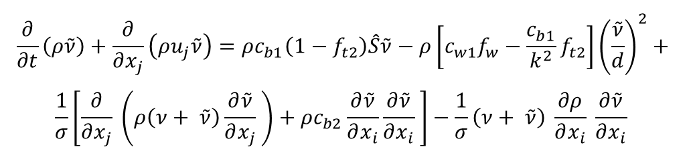
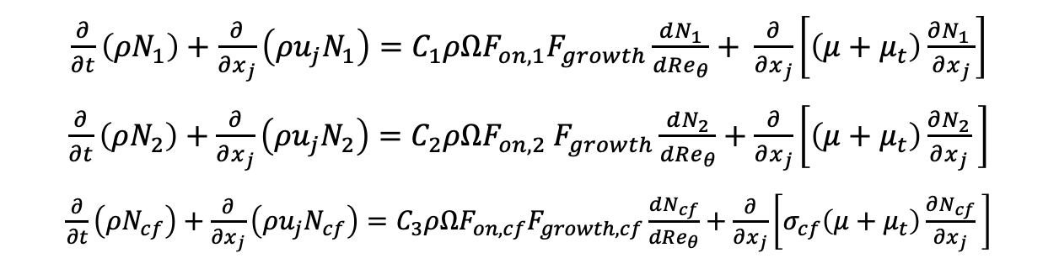

SA-AFT inspired by SST-AFT model of Liu et al. (2023)
Extension of Coder and Maughmer (2014) AFT model to hypersonic flows
Tracks N-factor for 1st, 2nd, and crossflow modes individually
Critical N-factor estimated by modified Mack’s correlation
Limits applicability for 2nd mode
Includes and algebraic correlation to supplement 2nd mode transport
Coupled to SA turbulence model
Novel capability for high-speed flows
$$\frac{∂}{∂t}\left(ρ\tilde{ν}\right)+\frac{∂}{∂x_{j}}\left(ρu_{j}\tilde{ν}\right)=ρc_{b1}\left(1−f_{t2}\right)\hat{S}\tilde{ν}−ρ\left[c_{w1}f_{w}−\frac{c_{b1}}{k^{2}}f_{t2}\right]{\left(\frac{\tilde{ν}}{d}\right)}^{2}+$$
$$\frac{1}{σ}\left[\frac{∂}{∂x_{j}} \left(ρ\left(ν+ \tilde{ν}\right)\frac{∂\tilde{ν}}{∂x_{j}} \right)+ρc_{b2}\frac{∂\tilde{ν}}{∂x_{i}}\frac{∂\tilde{ν}}{∂x_{i}} \right]−\frac{1}{σ}\left(ν+ \tilde{ν}\right) \frac{∂ρ}{∂x_{i}} \frac{∂\tilde{ν}}{∂x_{i}}$$
$$f_{t2}=c_{t3}\left\{1−\exp\left[\tilde{γ}\right]\right\}$$
$$γ=ln\left(tanh\left[5∙\max\left(N_{1,2,cf}−N_{1,2,cf}^{c} ∙F_{turb},0\right)\right]\right)$$
$\frac{∂}{∂t}\left(ρN_{1}\right)+\frac{∂}{∂x_{j}}\left(ρu_{j}N_{1}\right)=C_{1}ρΩF_{on,1}F_{growth}\frac{dN_{1}}{dRe_{θ}}+ \frac{∂}{∂x_{j}}\left[\left(μ+μ_{t}\right)\frac{∂N_{1} }{∂x_{j}}\right]$
$\frac{∂}{∂t}\left(ρN_{2}\right)+\frac{∂}{∂x_{j}}\left(ρu_{j}N_{2}\right)=C_{2}ρΩF_{on,2} F_{growth}\frac{dN_{2}}{dRe_{θ}}+\frac{∂}{∂x_{j}}\left[\left(μ+μ_{t}\right)\frac{∂N_{2}}{∂x_{j}} \right]$
$\frac{∂}{∂t}\left(ρN_{cf}\right)+\frac{∂}{∂x_{j}}\left(ρu_{j}N_{cf}\right)=C_{3}ρΩF_{on,cf}F_{growth,cf}\frac{dN_{cf}}{dRe_{θ}}+\frac{∂}{∂x_{j}}\left[σ_{cf}\left(μ+μ_{t}\right)\frac{∂N_{cf}}{∂x_{j}} \right]$

Slide 6
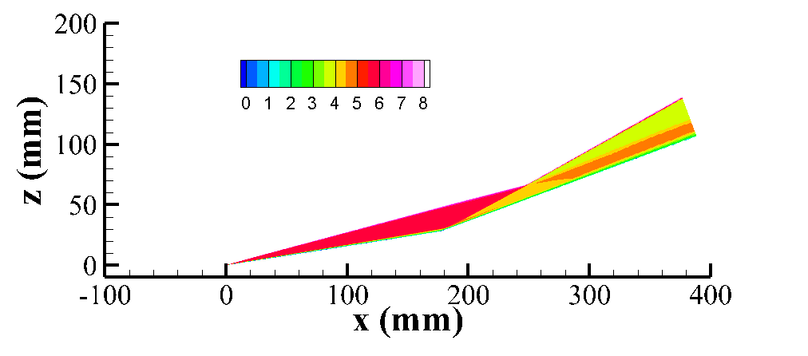
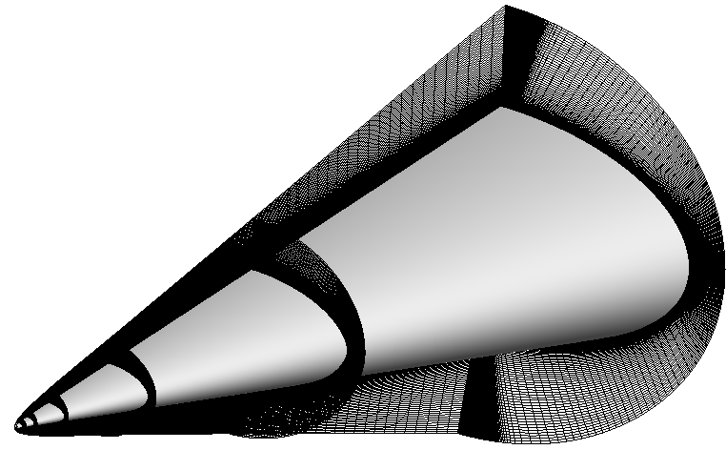
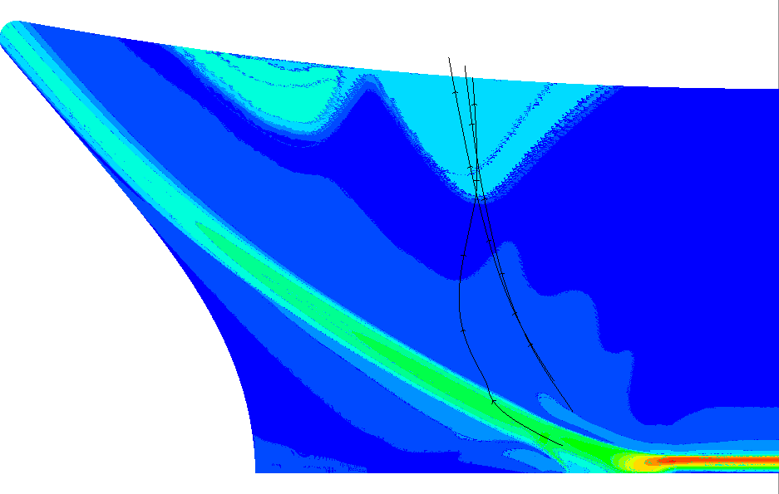
OVERFLOW Structured RANS Solver
OVERFLOW 2.3e+2.4 modified to include all three transition models
SA-AFT + two other previously-studied models
Use HLLE++, van Albada limiter, and SSOR for transition models
Reduced time step for turbulence + transition models
Improves numerical stability
QCR and turbulence
sustaining terms not used
Compression Corner
BOLT
HIFiRE-5
Examples of meshes/results for various OVERFLOW-based analysis of hypersonic transitional flows

Slide 7
Outline
Introduction
Objectives
Transition model and solver parameters
Evaluation of SA - AFT for 1st and 2nd mode cases
Description of semi-infinite swept wing for analysis of crossflow
Computational setup
LST results
Comparison of LST and AFT N-factors for semi-infinite swept wing
Assessment of other transition models
Assessment of all models against experimental test cases
Conclusions

Slide 8
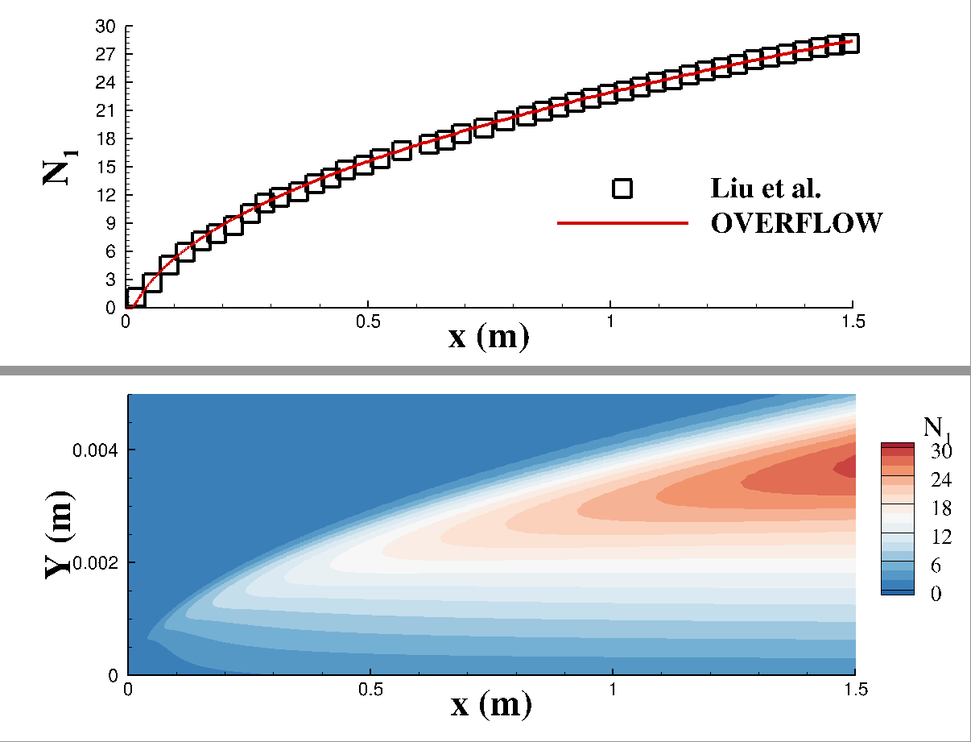


Evaluation of SA-AFT Model for 1st Mode
SST-𝛾 and SST-𝛾-𝜈_{L} models have been previously studied and evaluated in detail for 1st and 2nd mode cases
AFT implementation is a recent addition
AFT 1st and 2nd mode trained against large database of flat plate cases
Present AFT Implementation combines features from several updates to the baseline model
Result is novel approach
SA compatibility is most significant introduction
Flat Plate; M = 2.0, T͚ = 100 K; T_{w} = 300 K; Re ͚ = 1e7 /m
$$∞$$
$$∞$$
Contours of N₁ field variable

Slide 9
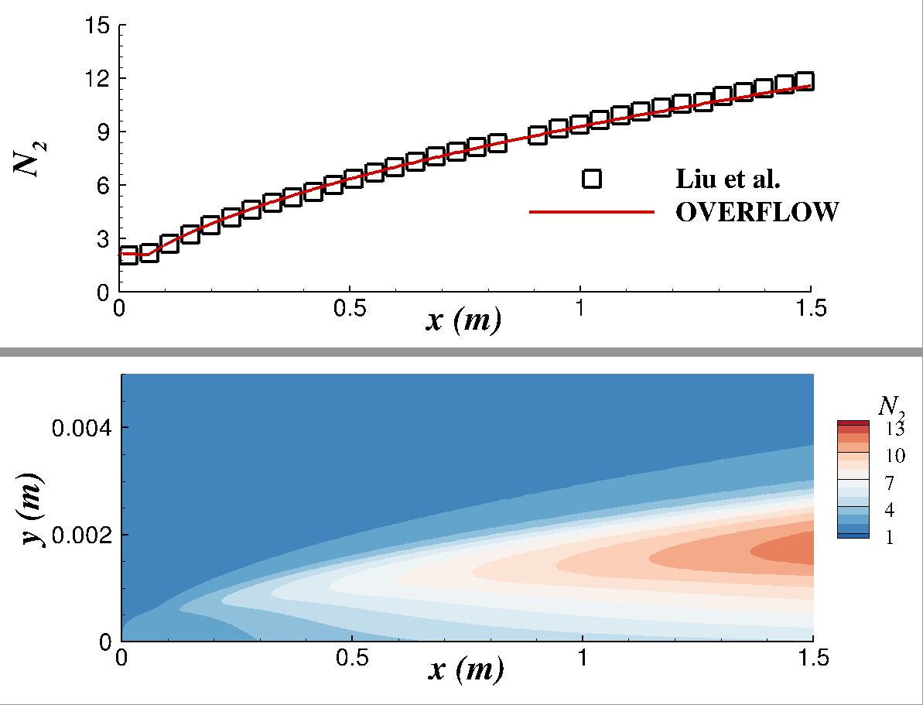

Evaluation of SA-AFT Model for 2nd Mode
N-factor envelope agrees well with Liu et al. (2023) results for flat plate cases
Limiter functions necessary for numerical stability, but not described in presentation of model
Algebraic auxiliary function for 2nd mode cases necessary for flat plate cases
Included in AFT formulation of Liu et al.
Prone to overprediction of N₂ for complex flows
Flat Plate; M = 7.0, T͚ = 100 K; T_{w} = 300 K; Re ͚ = 1e7 /m
$$∞$$
$$∞$$
$$N_{2}$$
Contours of N₂ field variable

Slide 10
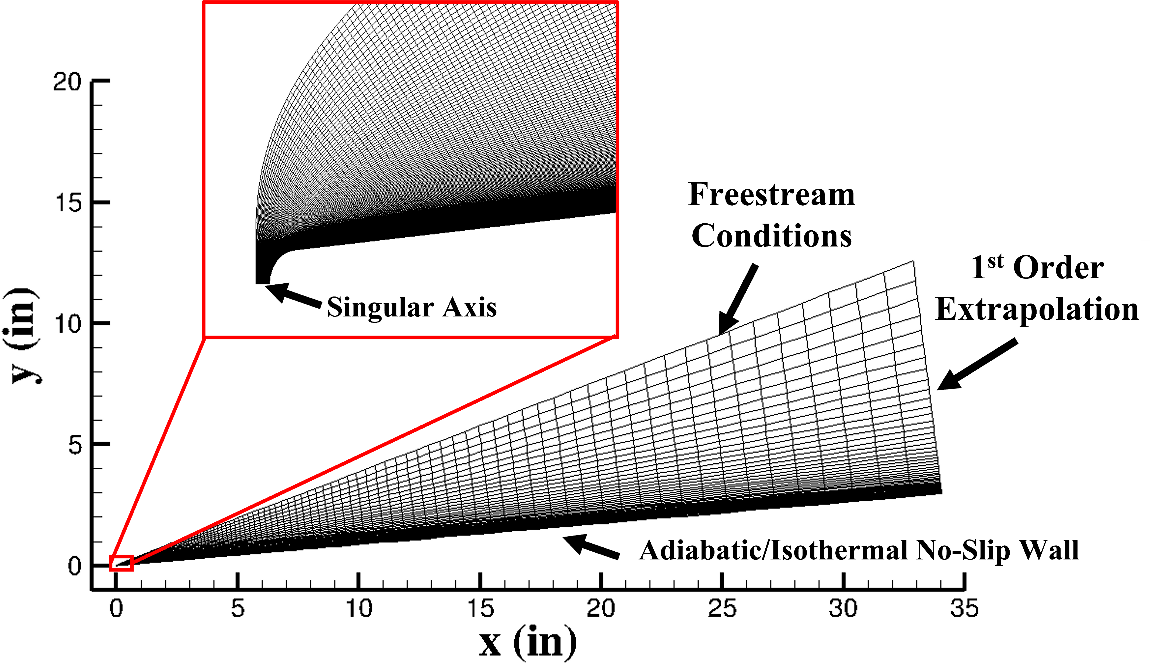
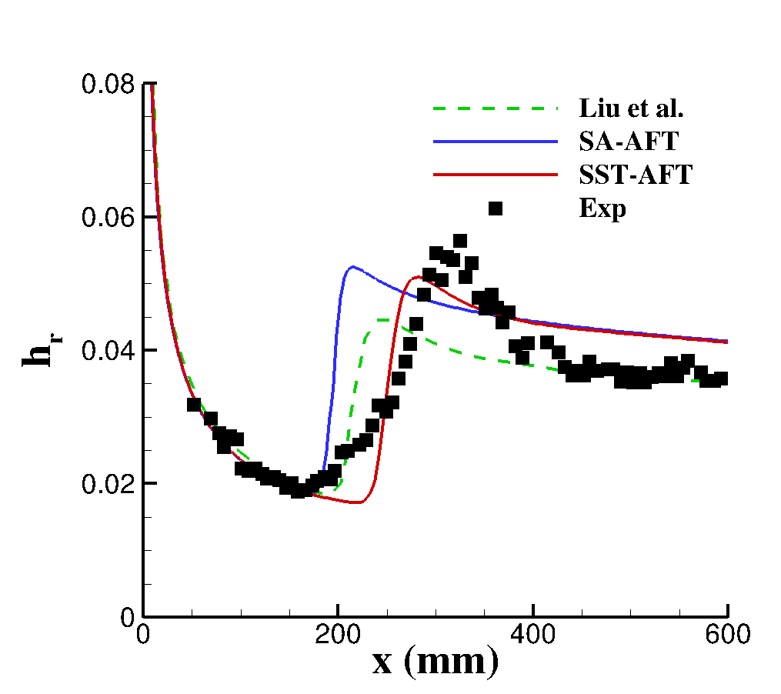
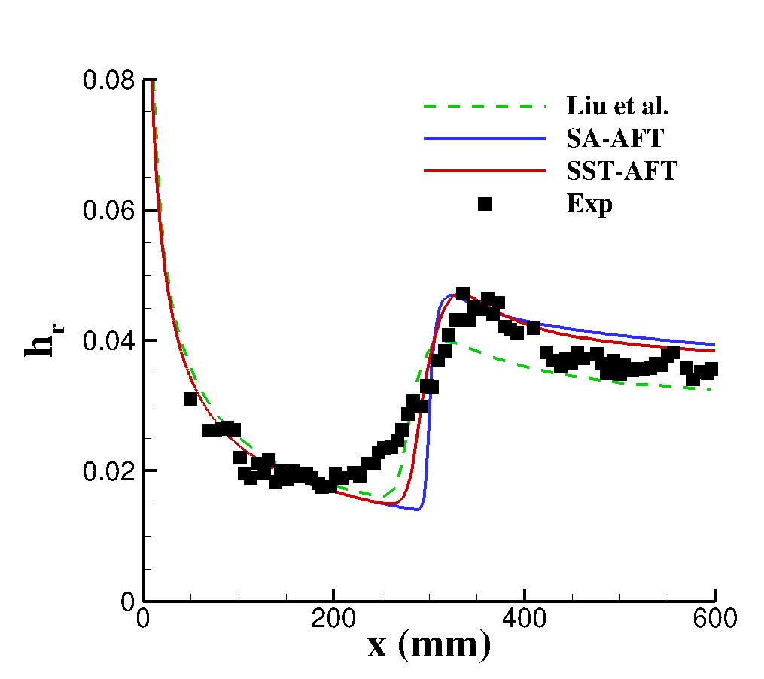
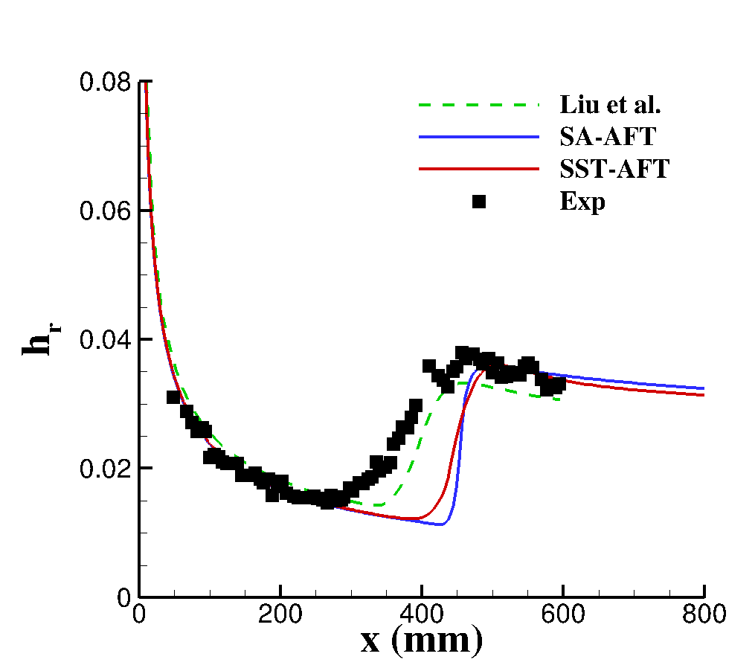



2nd Mode Transition Evaluation of SA-AFT Model Against Experiment
Agreement with measured transition locations is similar to previous findings for SST-𝛾 and SST-𝛾-𝜈_{L} models
Differences in transition locations likely attributed to intermittency modeling rather than N-factor modeling
SA and SST implementations use same source terms
Transition source terms independent of turbulence model
Mach 6 straight cone of Horvath et al. (2002)
Re ͚ = 1.77e7 /m
Re ͚ = 1.41e7 /m
Re ͚ = 1.05e7 /m
$$∞$$
$$∞$$
$$∞$$

Slide 11
Outline
Introduction
Objectives
Transition model and solver parameters
Evaluation of SA - (h)AFT for 1st and 2nd mode cases
Description of semi-infinite swept wing for analysis of crossflow
Computational setup
LST results
Comparison of LST and (h)AFT N-factors for semi-infinite swept wing
Assessment of other transition models
Assessment of all models against experimental test cases
Conclusions

Slide 12
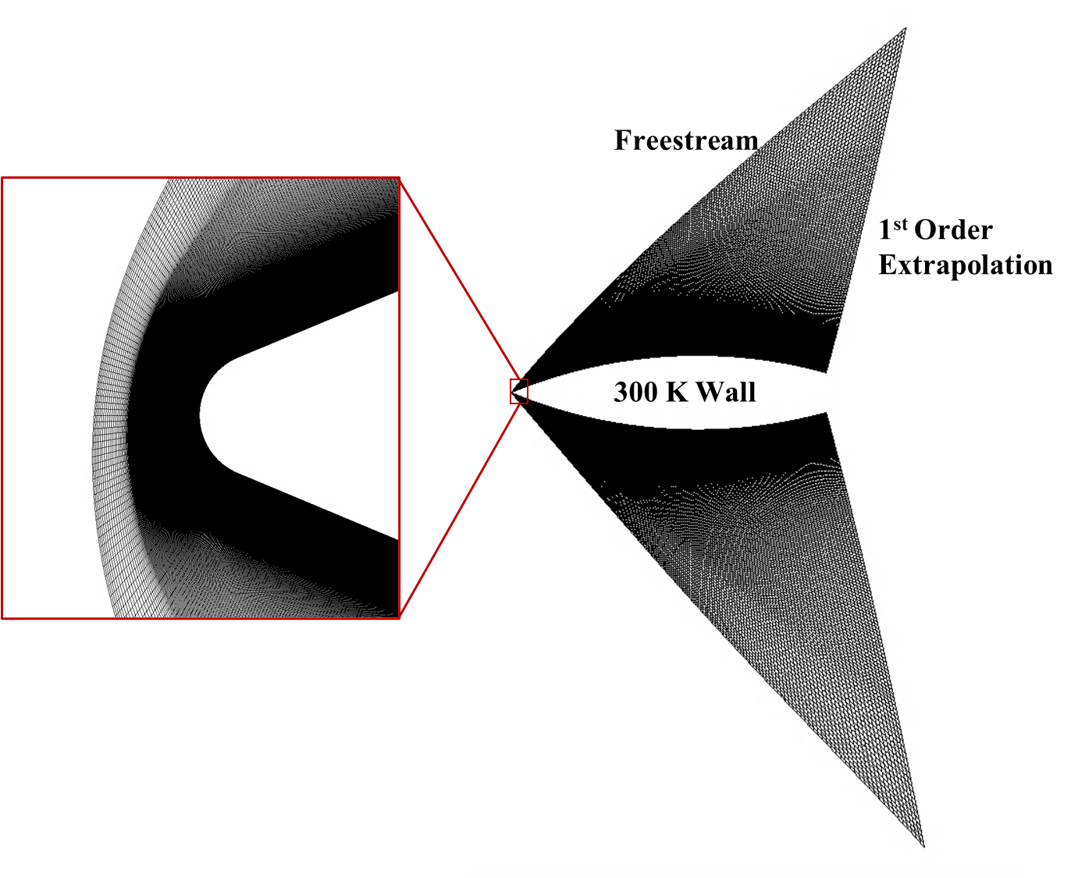
Semi-Infinite Swept Wing Parametric Study
For 1st and 2nd mode dominated transition, significant database of experimental configurations
AFT 1st and 2nd mode trained against large database
Implementation can be validated against parametric LST studies
No similar database for crossflow
Developing crossflow databases is challenging
Non-canonical, 3D flows
Experimental complexity
Must develop our own “unit problem” for crossflow

Slide 13
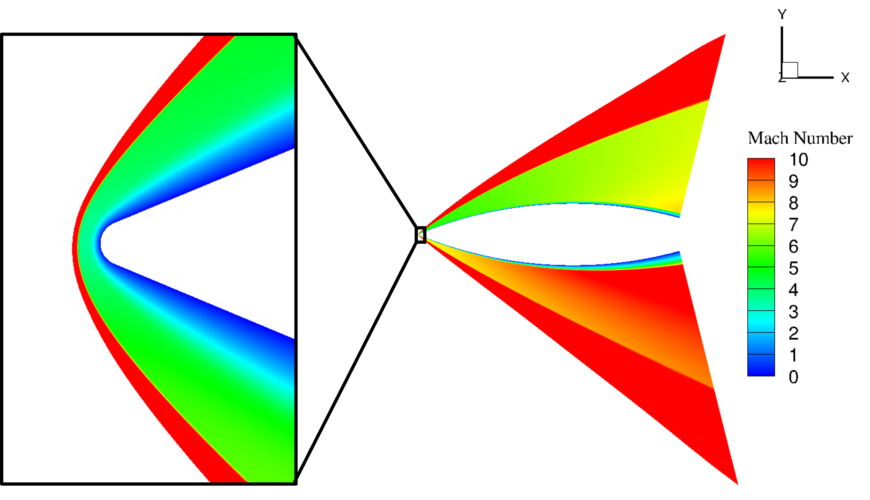
Semi-Infinite Swept Wing Parametric Study
Semi-infinite swept wing is introduced as a canonical configuration for evaluating crossflow N-factor predictions
Studied by Kline et al. (2018) for stability analysis of nonequilibrium flows
Allows for parametric analysis and validation against LST
AFT models stability N-factor
N-factor at transition locations studied for other models

Slide 14
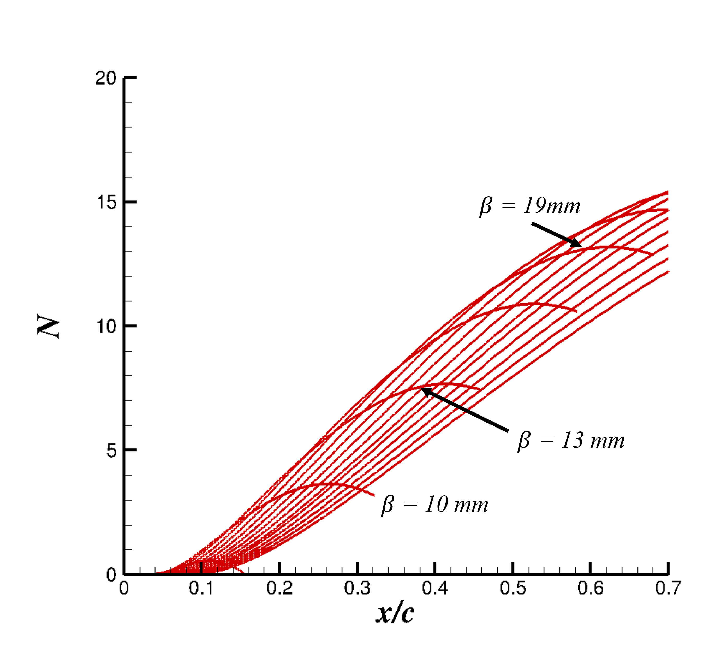
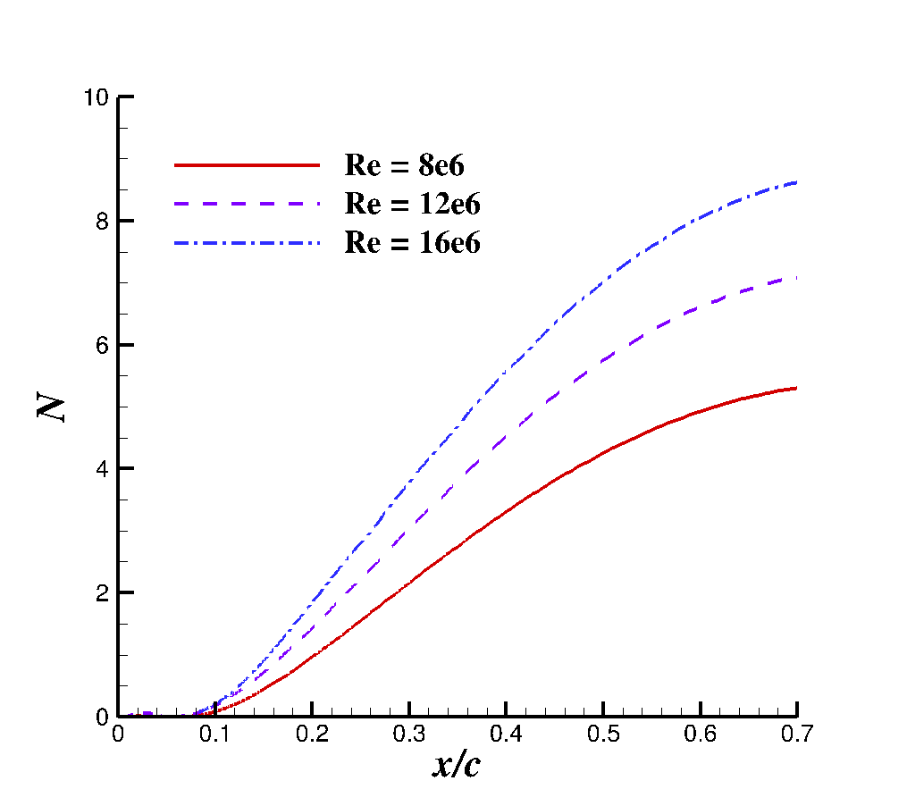
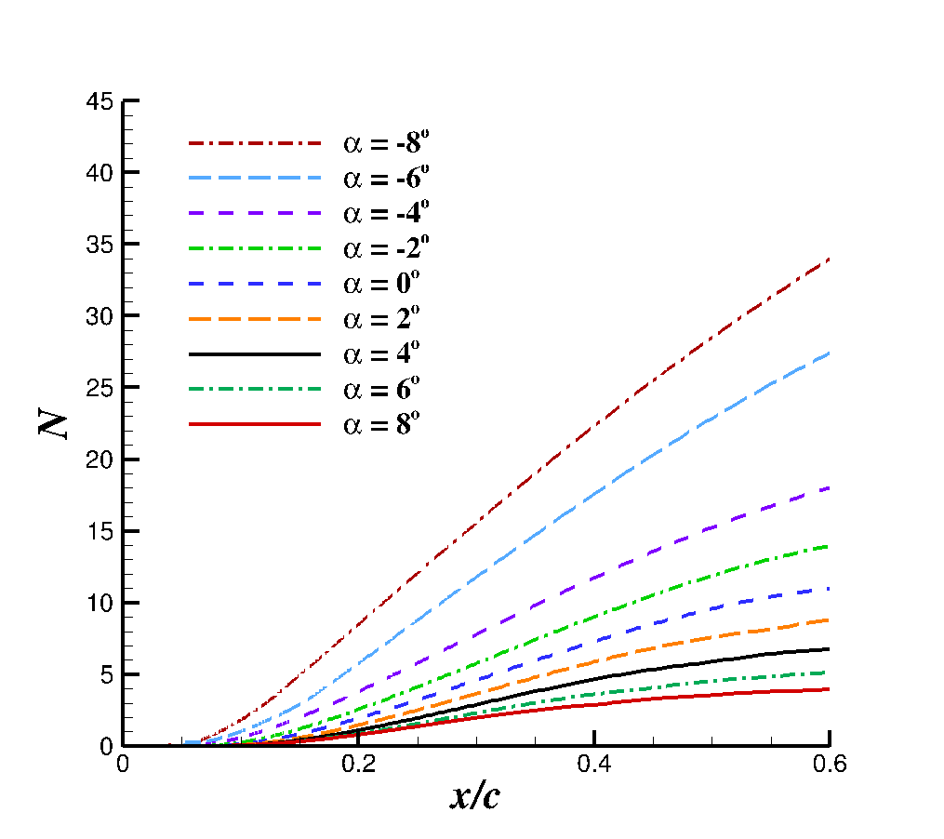
Semi-Infinite Swept Wing LST Results Summary
Swept airfoil database generated for 3 Mach numbers, 3 Reynolds numbers, and 5 angles-of-attack
Meshes generated via VULCAN-CFD’s shock adaptation utility
Larger database developed for calibration purposes
Representative cases presented here
M = 10, Re = 12e6, 𝛼 = −4˚
M = 6, 𝛼 = −4˚, vary Re
M = 6, Re = 12e6, vary 𝛼

Slide 15
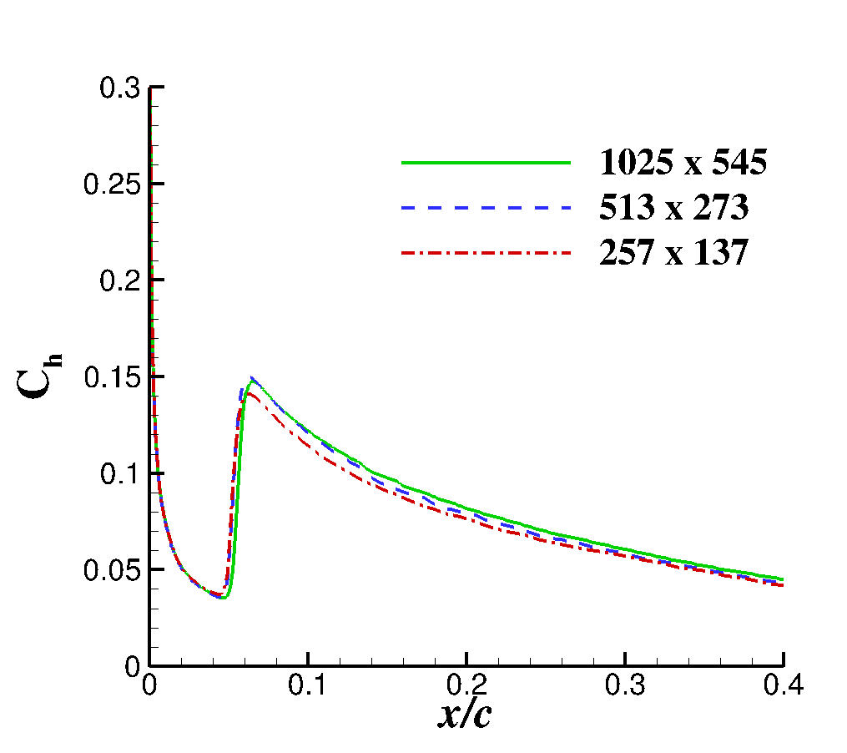
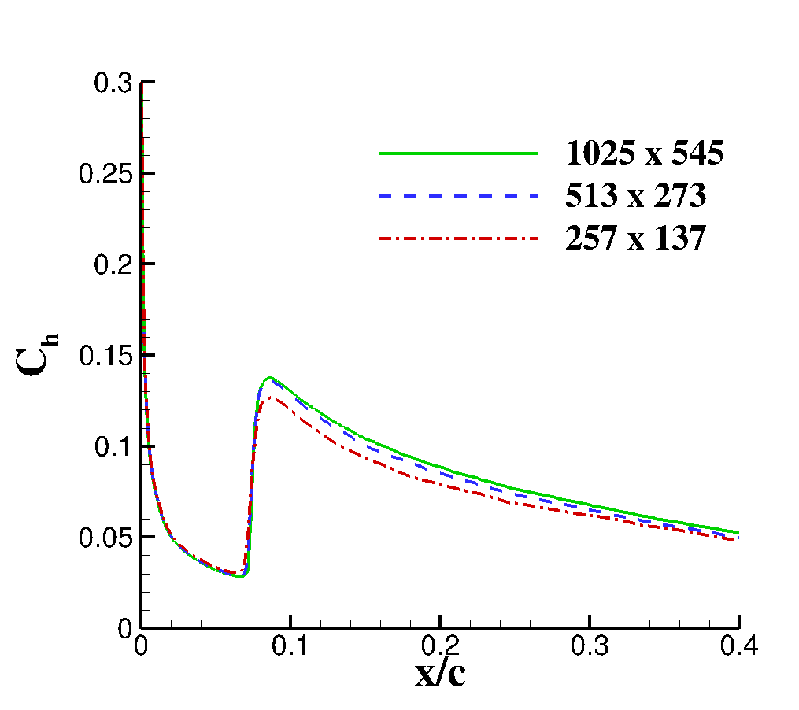
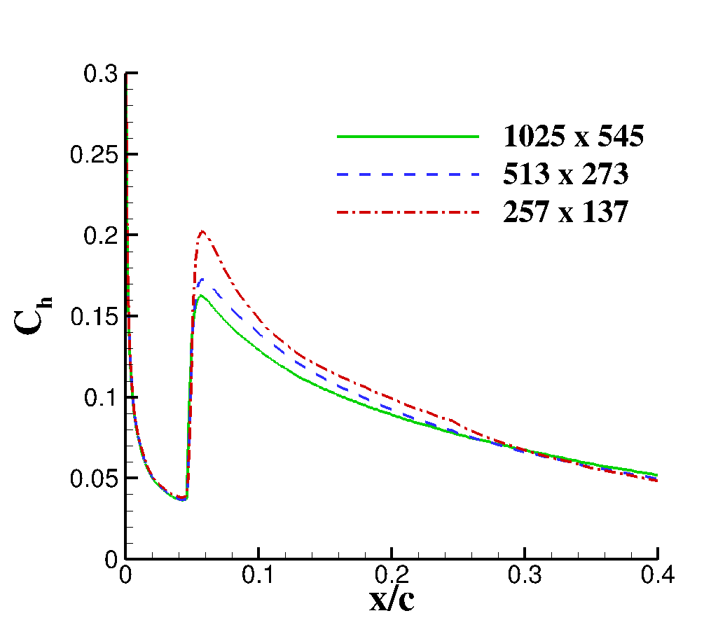
Mesh Convergence of All Models for Mach 6 Semi-Infinite Wing
Grid convergence characteristics of the SST-𝛾 and SST-𝛾-𝜈_{L} models have been documented previously
SA-(h)AFT model appears to have stricter mesh requirements
Investigating ways to reduce grid sensitivity
Appropriate conventions and limiters tend to increase robustness
SST-𝛾
SST-𝛾-𝜈_{L}
SA-(h)AFT
M = 6.0; α = -4˚; Re = 12e6

Slide 16
Outline
Introduction
Objectives
Transition model and solver parameters
Evaluation of SA - (h)AFT for 1st and 2nd mode cases
Description of semi-infinite swept wing for analysis of crossflow
Computational setup
LST results
Comparison of LST and (h)AFT N-factors for semi-infinite swept wing
Assessment of other transition models
Assessment of all models against experimental test cases
Conclusions

Slide 17
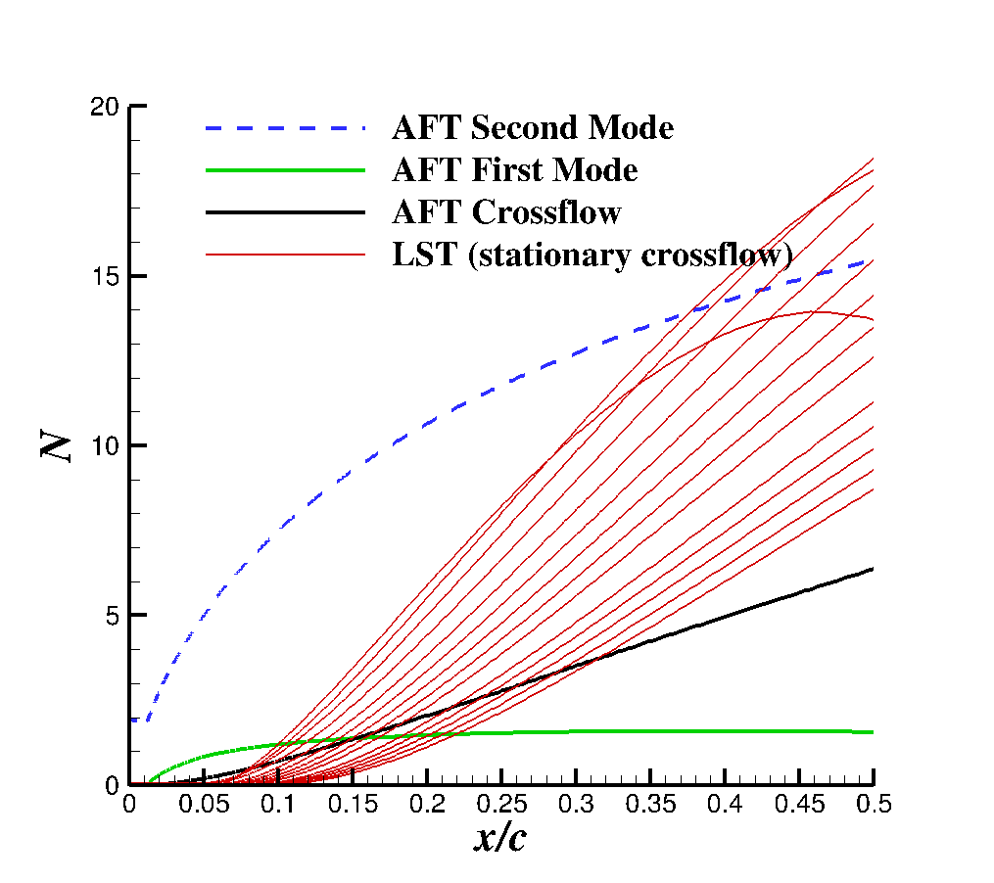
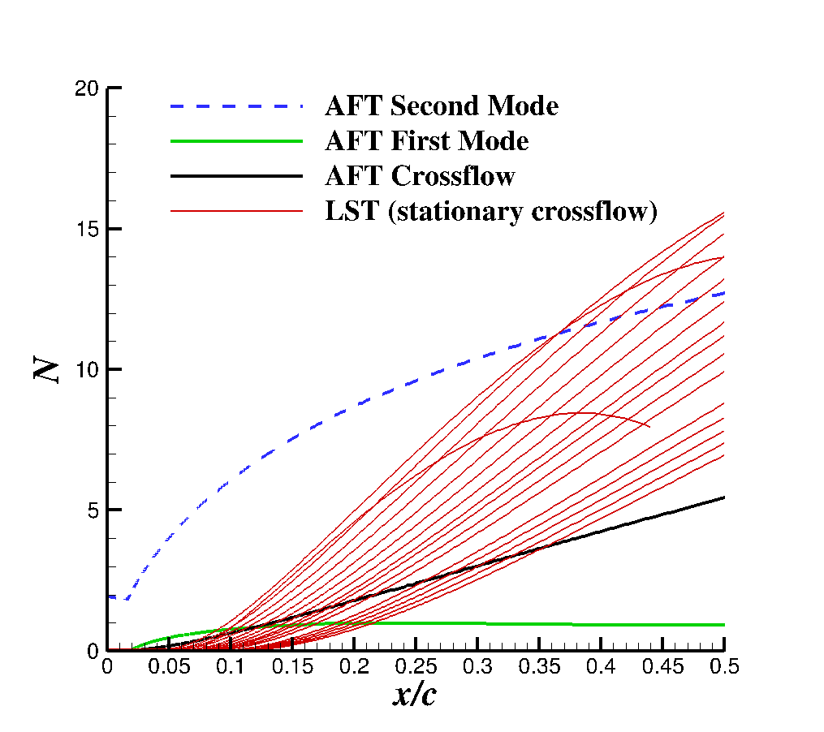
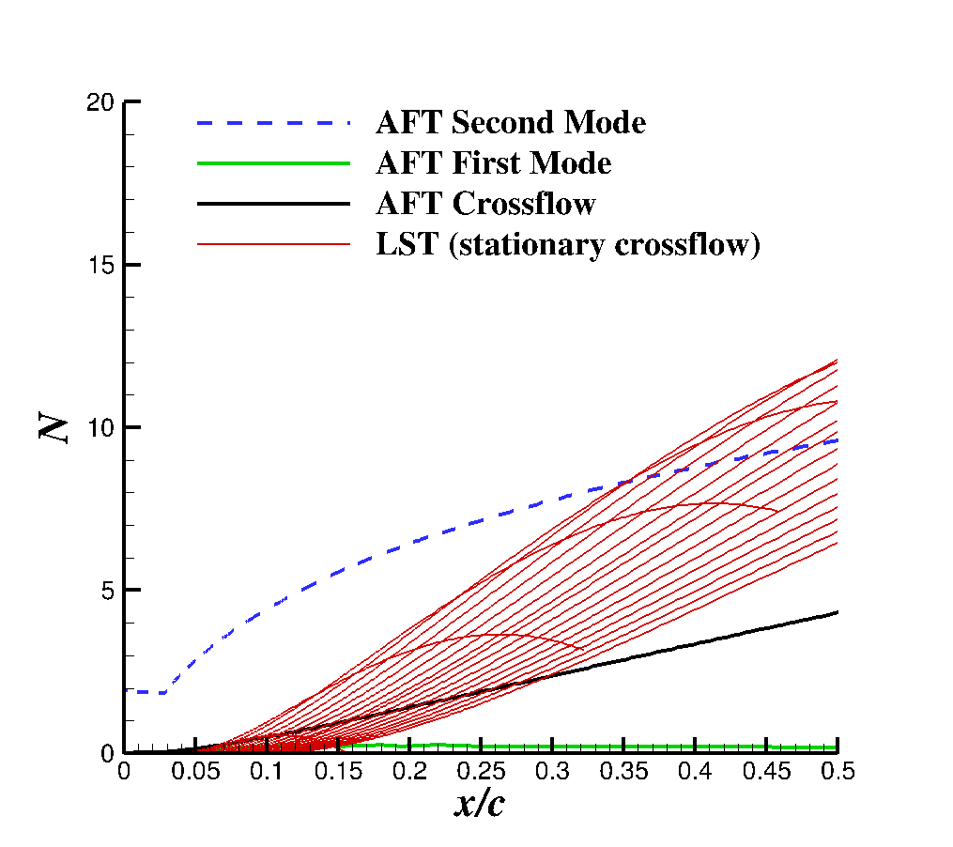
SA-AFT Comparison to LST for M = 6.0; α = -4˚
(h)AFT model tends to significantly underpredict the amplification of crossflow instabilities
Algebraic supplement function to 2nd mode equation leads to large growth of N₂
Trends across Reynolds number (and AoA) are correct, but overall magnitude is lower than LST predicts
Re = 16e6
Re = 12e6
Re = 8e6

Slide 18
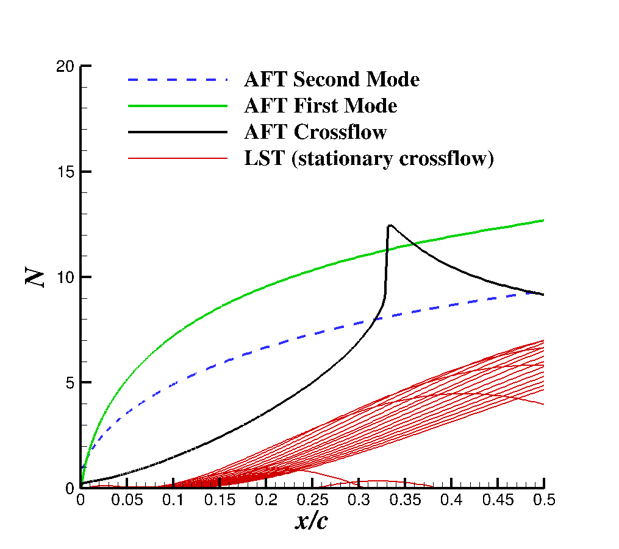
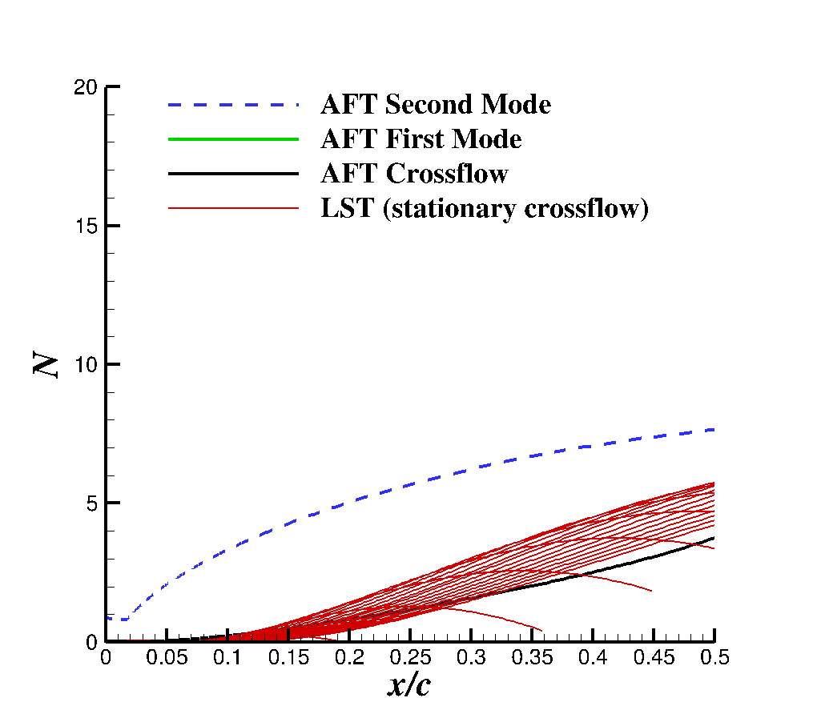
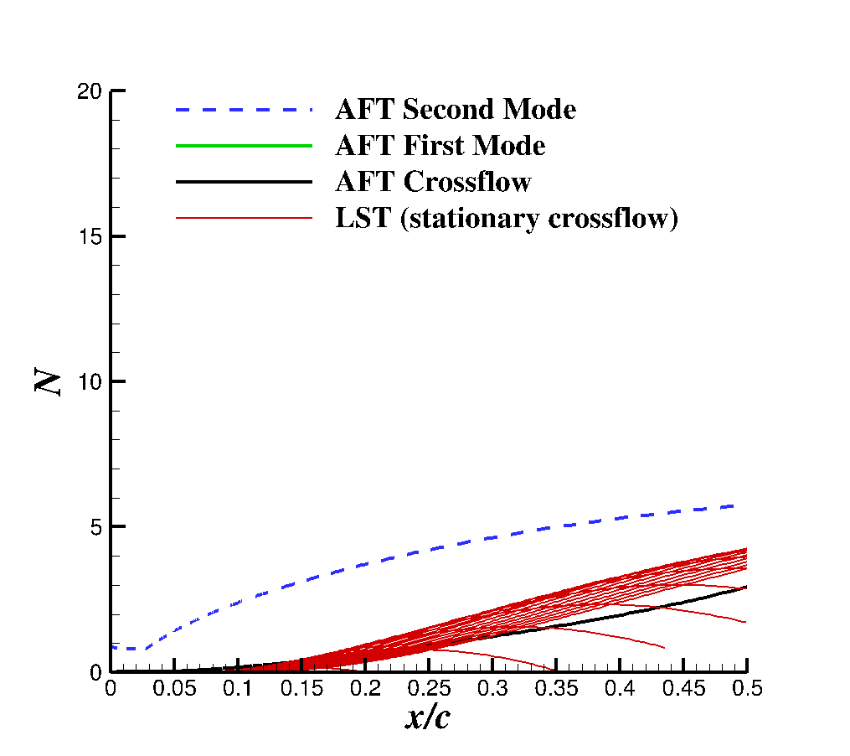
SA-AFT Comparison to LST for M = 10.0; α = -4˚
At higher Mach/Reynolds numbers, numerical instability becomes a factor
Limiter functions required in model, but not described by Liu et al.
Details of implementations are often not fully provided
Fine-tuning of these limiters important for future work
Re = 16e6
Re = 12e6
Re = 8e6

Slide 19
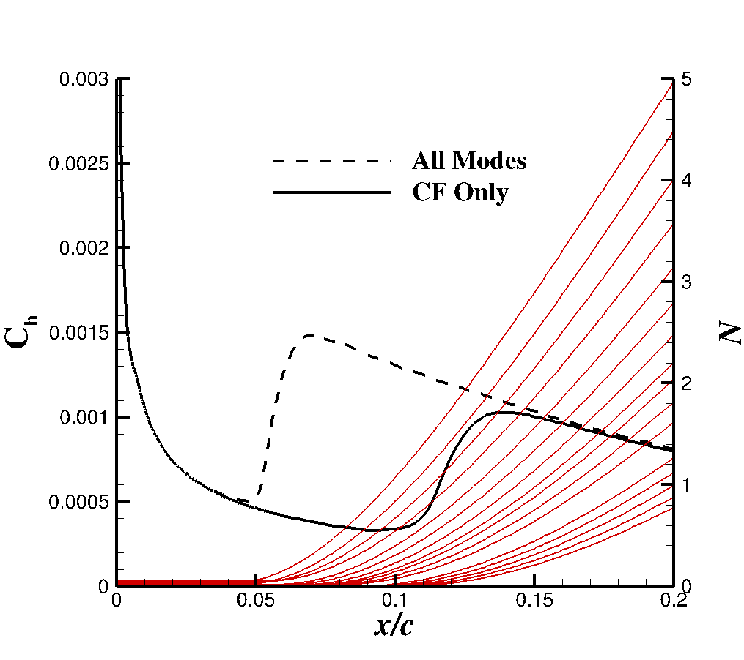
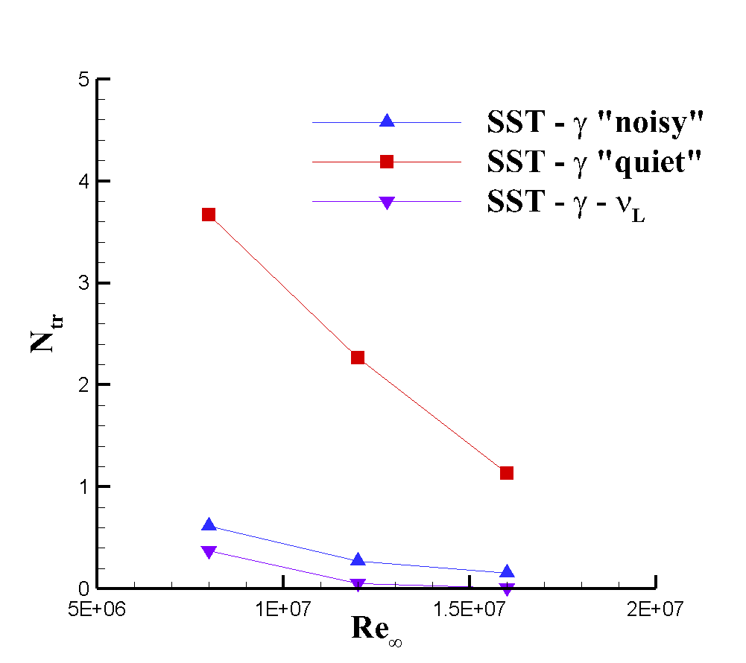
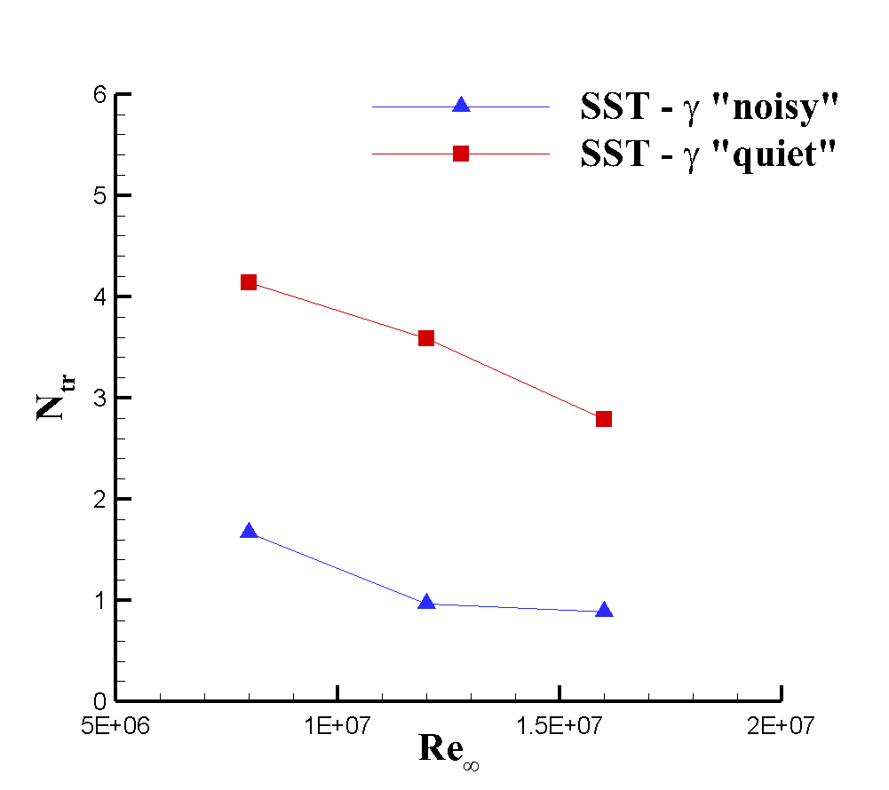
SST-𝛾 & SST-𝛾-𝜈_{L} Comparison to LST for M = 6, M = 10; α = -4˚
The SST-based models do not provide an N-factor to compare directly
Can still find an equivalent transition N-factor
From HIFiRE-5 quiet crossflow transition expected around N=10
Significantly lower for both models in all cases, even with flight-like freestream turbulence
SST-𝛾 evaluated with streamwise correlation deactivated
SST-𝛾-𝜈_{L} difficult to evaluate fairly
M = 6.0
M = 10.0

Slide 20
Outline
Introduction
Objectives
Transition model and solver parameters
Evaluation of SA - (h)AFT for 1st and 2nd mode cases
Description of semi-infinite swept wing for analysis of crossflow
Computational setup
LST results
Comparison of LST and (h)AFT N-factors for semi-infinite swept wing
Assessment of other transition models
Assessment of all models against experimental test cases
Conclusions

Slide 21
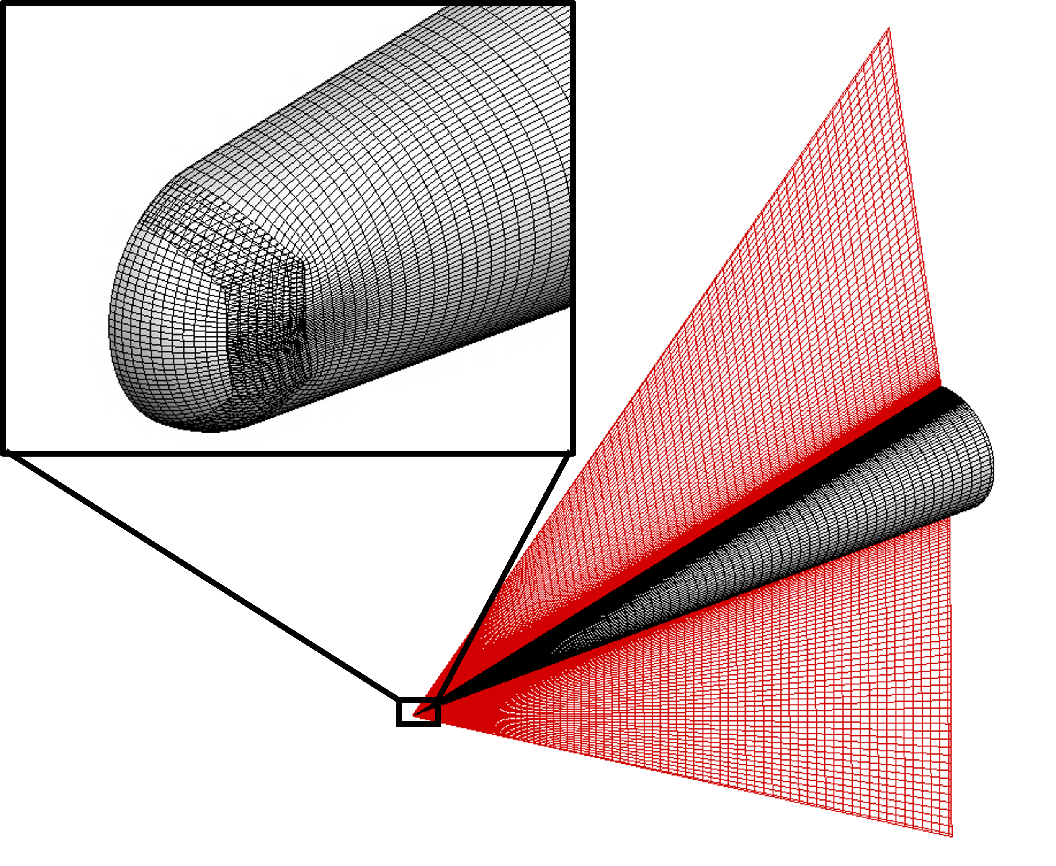
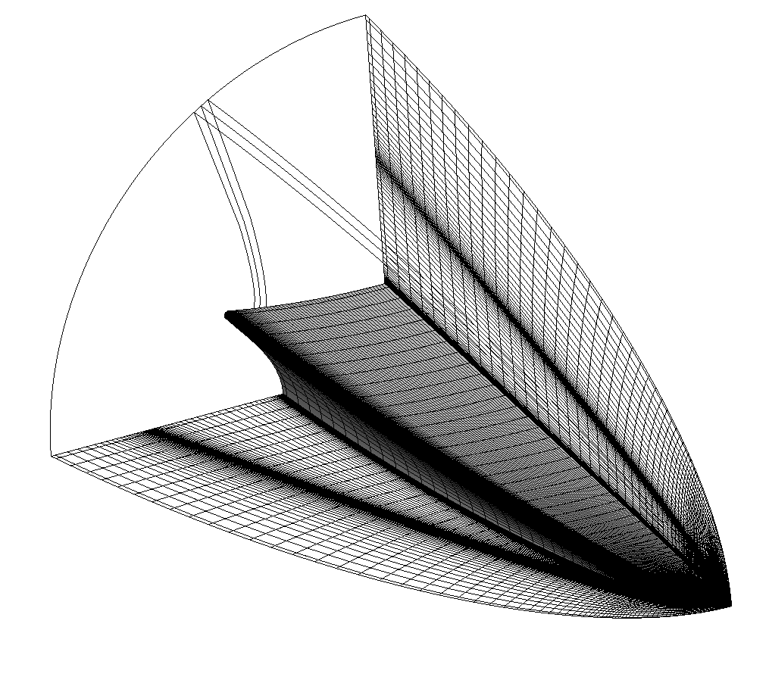
Experimental Test Cases with Crossflow Instabilities
Airfoil study suggests AFT model overestimates 1st, 2nd mode and underestimates crossflow for some cases
Must evaluate these findings with experimental reference
Interactions between modes, non-uniform crossflow growth, etc.
BOLT geometry in CUBRC LENS facility and Mach 2 cone from Fuji Heavy Industries wind tunnel
Mach 2 cone considers 1st mode and crossflow
BOLT considers 1st, 2nd, and crossflow modes
Meshes used for experimental comparison cases

Slide 22
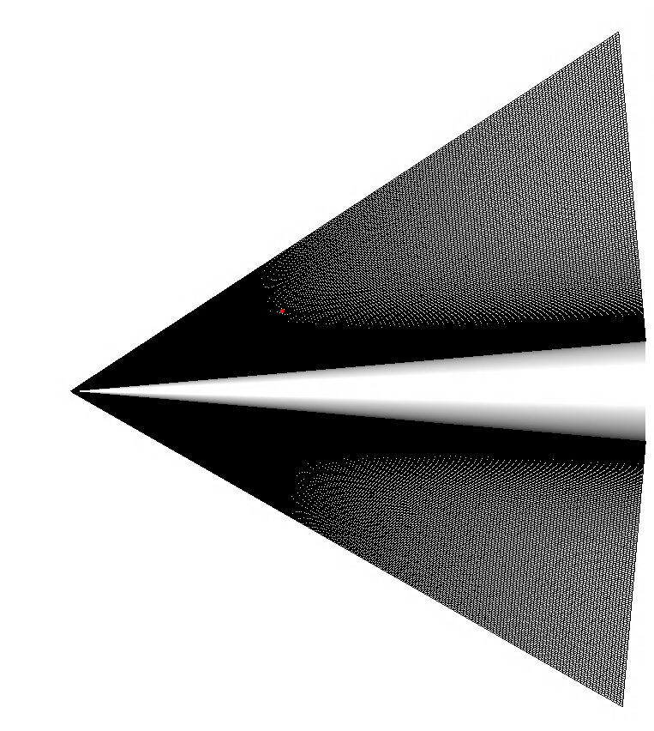
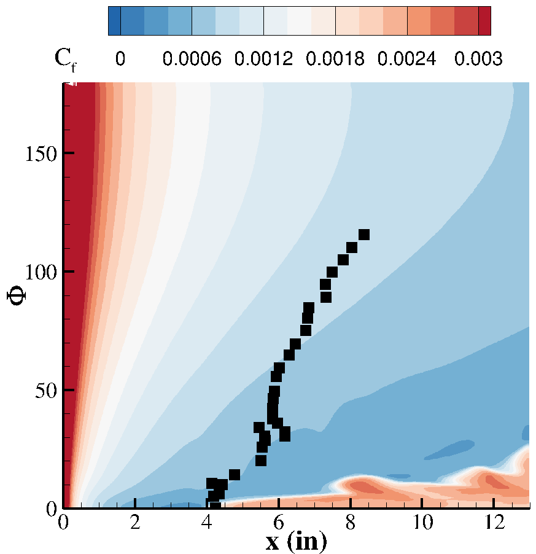
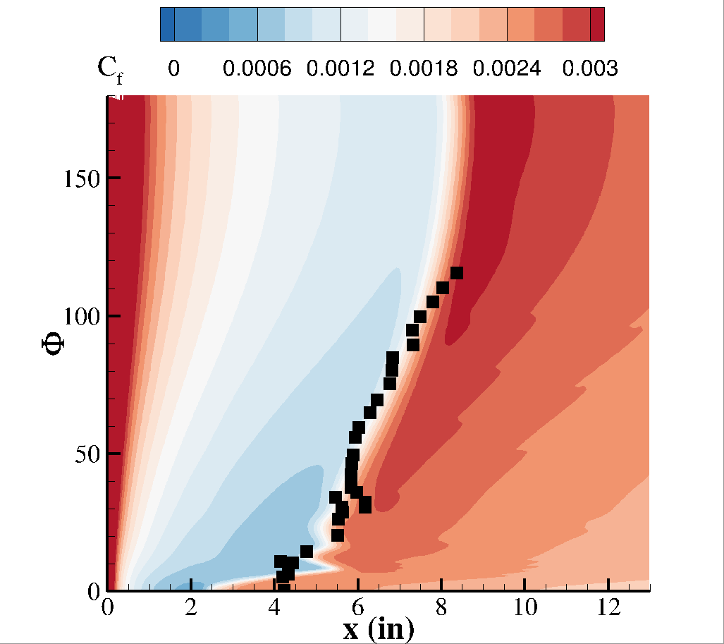
SST-𝛾-𝜈_{L} Crossflow Calibration
SST-𝛾-𝜈_{L} model has known calibration idiosyncrasies
Utilizing physically observed value of freestream turbulence is inconsistent with model calibration from Qiao et al.
Using a “tuned” value gets good agreement with experiments
This value is not consistent with the other models
Model recalibration is planned
JAXA 5˚ Half-Angle Cone
M∞ = 2.0, 𝛼 = 2˚
T∞ = 165 K, Re∞ = 12.2 × 10⁶ m⁻¹
“Unrolled” 5˚ Cone
Tokugawa et al. (2015)
Simulated with “true” value of Tu∞
Simulated with “tuned” value of Tu∞

Slide 23
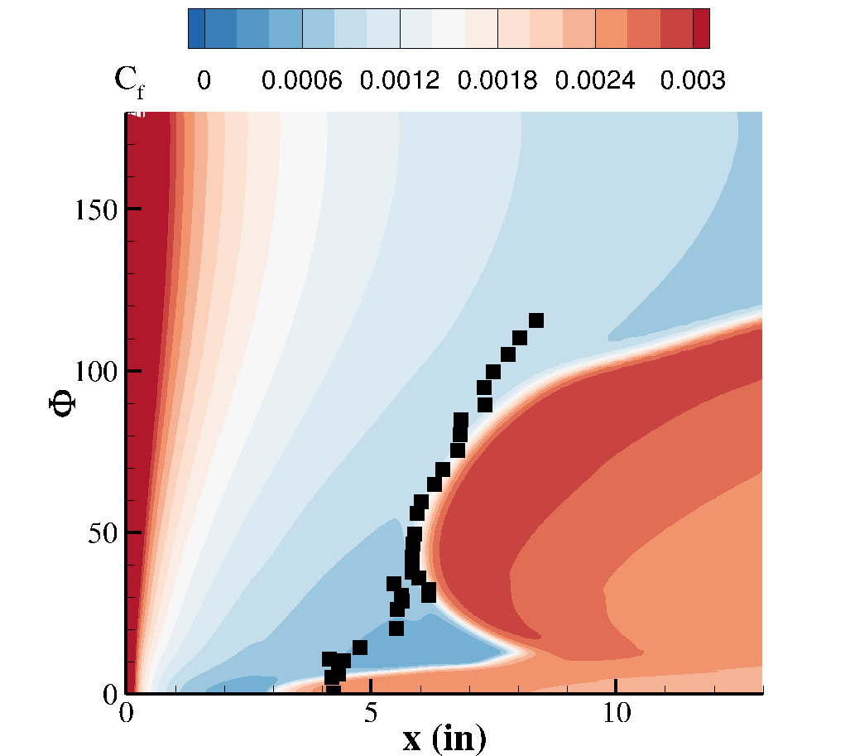
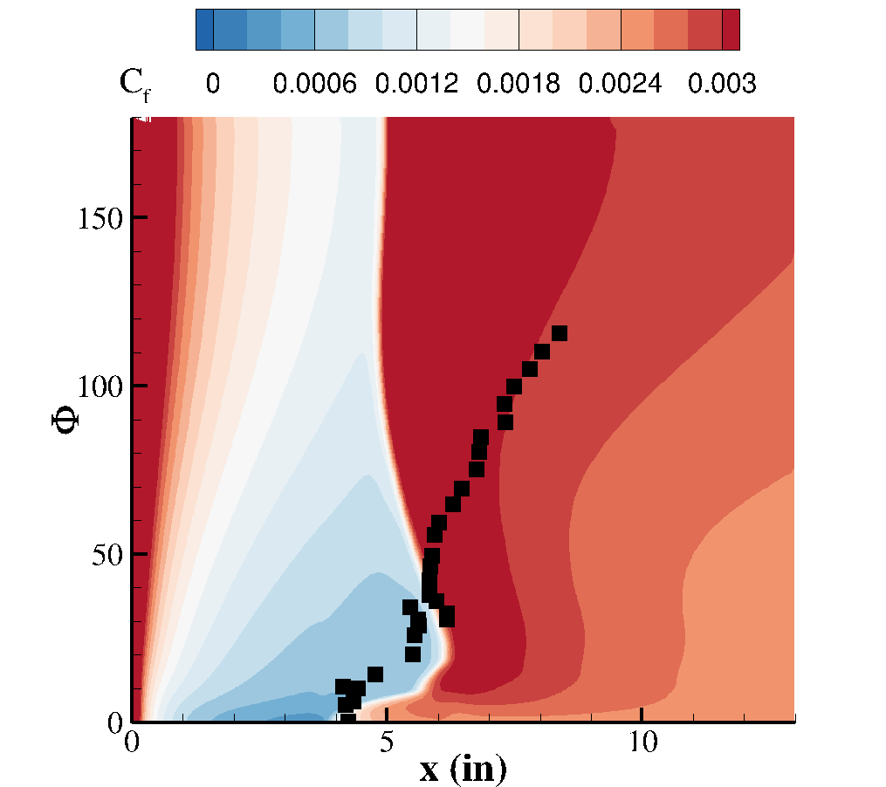
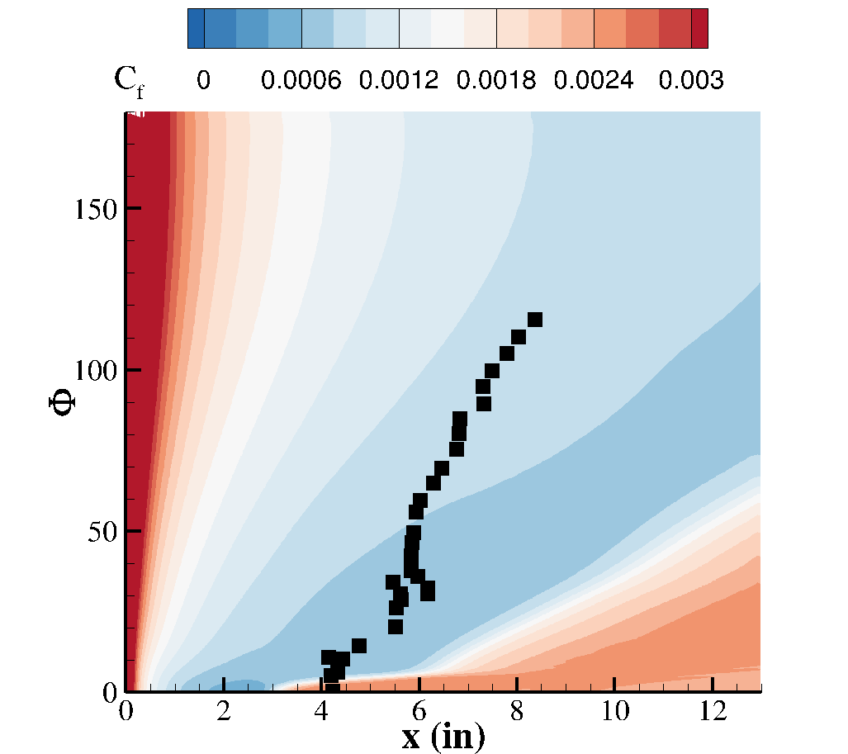
Evaluation of All Models for JAXA Mach 2 Cone
SST-𝛾 model agrees well with measured transition front in most of leeward region
Wedge near symmetry plane where 1st mode and crossflow regions intersect
SST-𝛾-𝜈_{L} model performs well across the transition zone
Required “tuned” value of turbulence intensity
AFT model predicts early transition
overpredicts growth of 1st mode in windward region
Crossflow N-factor not dominant term
SST-LM does poorly for most of the body
SST-𝛾
SST-𝛾-𝜈_{L}
SA-(h)AFT
SST-LM

Slide 24
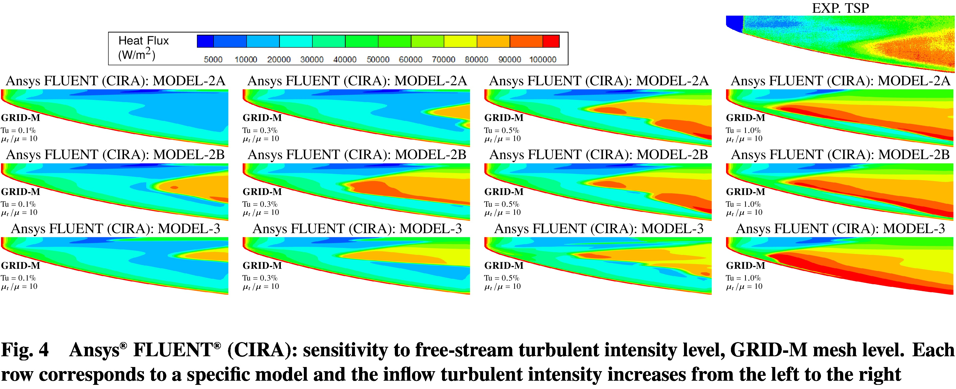
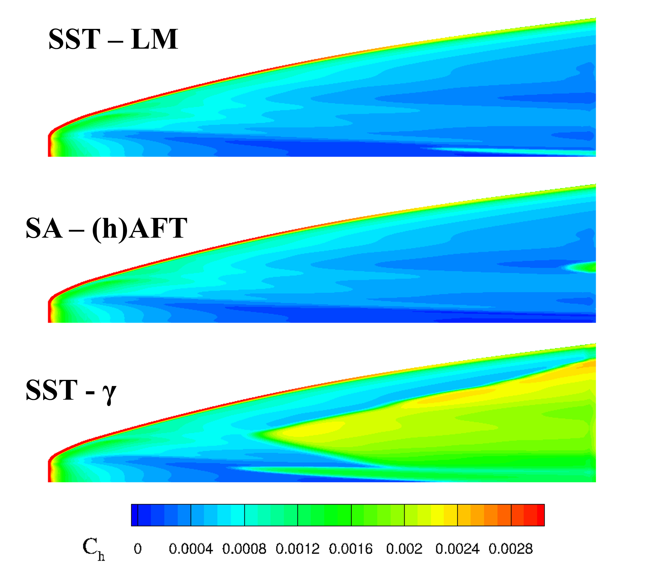
Evaluation of All Models for BOLT Ground Test
BOLT Geometry, M∞ = 5.17, T∞ = 178 K, and Re∞ = 3.9 × 10⁶ m⁻¹
Full scale model in CUBRC LENS facility
SST-𝛾-𝜈_{L} model does not converge for this case
With auxiliary 2nd mode term disabled, SA-AFT predicts transition downstream of experimental location
With that relationship it predicts a fully turbulent frustum
SST-𝛾 performs the best for this case
Reasonable agreement with appropriate freestream inputs
Transition slightly upstream of experiment
Exp TSP provided by Berridge et al. (2018)

Slide 25
Outline
Introduction
Objectives
Transition model and solver parameters
Evaluation of SA - (h)AFT for 1st and 2nd mode cases
Description of semi-infinite swept wing for analysis of crossflow
Computational setup
LST results
Comparison of LST and (h)AFT N-factors for semi-infinite swept wing
Assessment of other transition models
Assessment of all models against experimental test cases
Conclusions

Slide 26
Conclusions
SA-based hypersonic AFT model has been implemented in OVERFLOW
Refinements ongoing
Multiple transport-based transition models have been evaluated for their performance in predicting transition in 3D hypersonic flows
Langtry-Menter model does not predict either experimental transition front well
Hypersonics-focused models can provide better predictions than low-speed models, but several improvements still necessary
Numerical robustness
Agreement with hydrodynamic stability theory
Definition of freestream parameters and calibration
Model calibration as well as additional model refinements based on current findings are underway
Additional focus on model verification and implementation into other NASA codes (FUN3D)

Slide 27
References
Liu, Z., Lu, Y., Li, J., and Yan, C., “Local Correlation-Based Transition Model for High-Speed Flows,” AIAA Journal, Vol. 60, No. 3, 2022, pp. 1365–1381. https://doi.org/10.2514/1.J060994.
Qiao, L., Xu, J., Bai, J., and Zhang, Y., “Fully Local Transition Closure Model for Hypersonic Boundary Layers Considering Crossflow Effects,” AIAA Journal, Vol. 59, No. 5, 2021. https://doi.org/10.2514/1.J059765.
Liu, Z., Lu, Y., and Yan, C., “Amplification factor transport transition model for high-speed flows,” Computers and Fluids, Vol. 265, 2023, p. 106023. https://doi.org/https://doi.org/10.1016/j.compfluid.2023.106023.
Liu, Z., Lu, Y., Xiao, F., and Yan, C., “Further Developments to a Local Correlation-Based Transition Model for HypersonicFlows,” AIAA Journal, Vol. 60, No. 6, 2022, pp. 3909–3916. https://doi.org/10.2514/1.J061585.
Vogel, E. A., Venkatachari, B. S., and Choudhari, M., “Evaluation of the SST-and SST-𝛾-models for transition in high-speed boundary layers,” International Journal of Heat and Mass Transfer, Vol. 246, 2025, p. 127006. https://doi.org/https://doi.org/10.1016/j.ĳheatmasstransfer.2025.127006.

Slide 28
Acknowledgements
This research is sponsored by the NASA Hypersonic Technology Project (HTP)
Computations included in this work were utilized the LaRC K midrange supercomputing cluster.
Visualization of the BOLT ground test experiment is included with permission from Bradley Wheaton and Dennis Berridge

Slide 29
Backup/Supplemental Slides

Slide 30

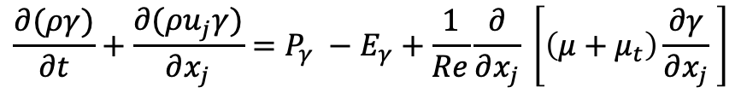
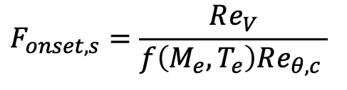
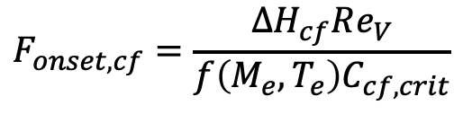

SST-𝛾 model of Liu et al. (2022)
Extends the logic of Langtry-Menter transition model to hypersonics-relevant instabilities
Transition mechanisms involving 1st− and 2nd−mode instabilities are grouped together in streamwise onset function
Simplified implementation, but questions of physical validity
“Streamwise” and crossflow functions compete with one another
$$\frac{∂(ργ)}{∂t}+\frac{∂(ρu_{j}γ)}{∂x_{j}}=P_{γ} −E_{γ}+\frac{1}{Re}\frac{∂}{∂x_{j}} \left[\left(μ+μ_{t}\right)\frac{∂γ}{∂x_{j}} \right]$$
$$P_{γ}=C_{1} ρ F_{onset} γ(1 −γ)$$
$F_{onset}=max(F_{onset, s} , F_{onset,cf})$
$$F_{onset,cf}=\frac{ΔH_{cf}Re_{V}}{f\left(M_{e},T_{e}\right)C_{cf,crit}}$$
$$F_{onset,s}=\frac{Re_{V}}{f\left(M_{e},T_{e}\right)Re_{θ,c} }$$

Slide 31
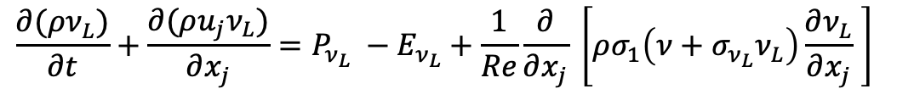
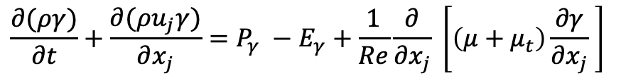

SST-𝛾-𝜈_{L} model of Qiao et al. (2021)
Extension of work by Warren and Hassan (1998), Papp and Dash (2002)
Transition predicted based on “laminar eddy viscosity”
Measure of fluctuation kinetic energy in the pre-transition laminar boundary layer
All modes (1st, 2nd, and crossflow) contribute additively to transition
Difficult to study any in isolation
Known calibration challenges
$$\frac{∂(ργ)}{∂t}+\frac{∂(ρu_{j}γ)}{∂x_{j}}=P_{γ} −E_{γ}+\frac{1}{Re}\frac{∂}{∂x_{j}} \left[\left(μ+μ_{t}\right)\frac{∂γ}{∂x_{j}} \right]$$
$$P_{γ}=ρC_{1}F_{onset}\left(1−γ\right)−\ln{{\left(1−γ\right)}^{\frac{1}{3}}S}$$
$$\frac{∂(ρν_{L})}{∂t}+\frac{∂(ρu_{j}ν_{L})}{∂x_{j}}=P_{ν_{L}} −E_{ν_{L}}+\frac{1}{Re}\frac{∂}{∂x_{j}} \left[ρσ_{1}\left(ν+σ_{ν_{L}}ν_{L}\right)\frac{∂ν_{L}}{∂x_{j}} \right]$$
$$P_{ν_{L}= }C_{μ} ρ τ_{L} S^{2}$$
$$τ_{L}=τ_{1}+τ_{2}+τ_{cf}$$

Slide 32
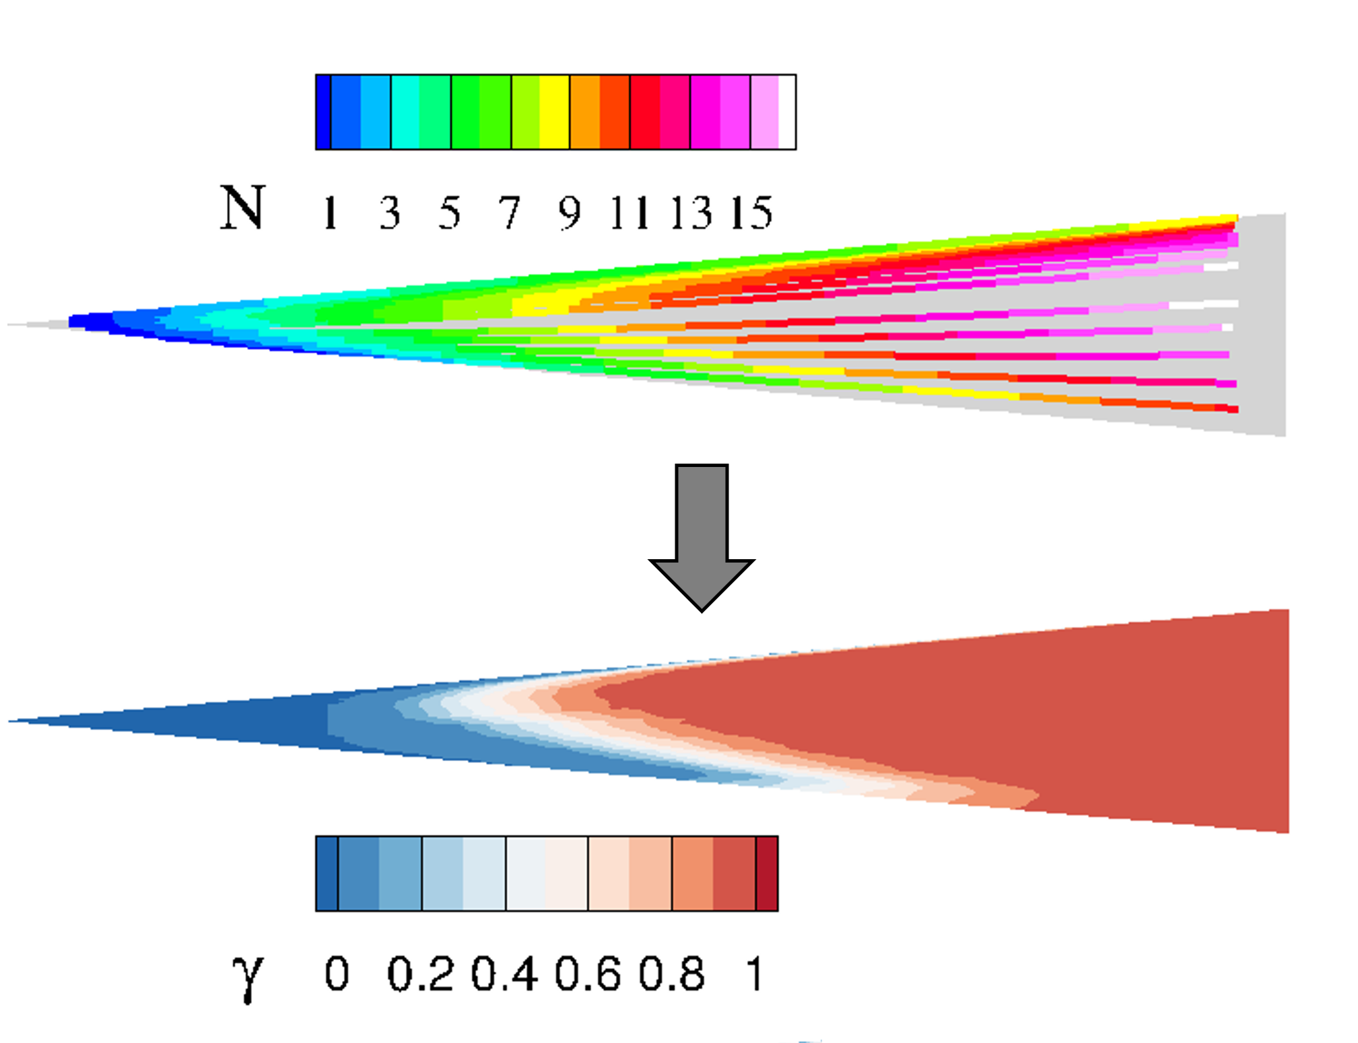
Other Transition Modeling Activities a LaRC
LASTRAC-OVERFLOW coupling provides another avenue for transition prediction without additional transport equations
Capabilities developed for coupled solver are generally AFT-compatible
Compatible with OVERFLOW and FUN3D
Parallel efforts in low-speed and transonic transition prediction
Tuning, evaluation, extension, and development of novel transport-based transition models
Transition identification via coupled LST for JAXA Mach 2 Cone

Slide 33
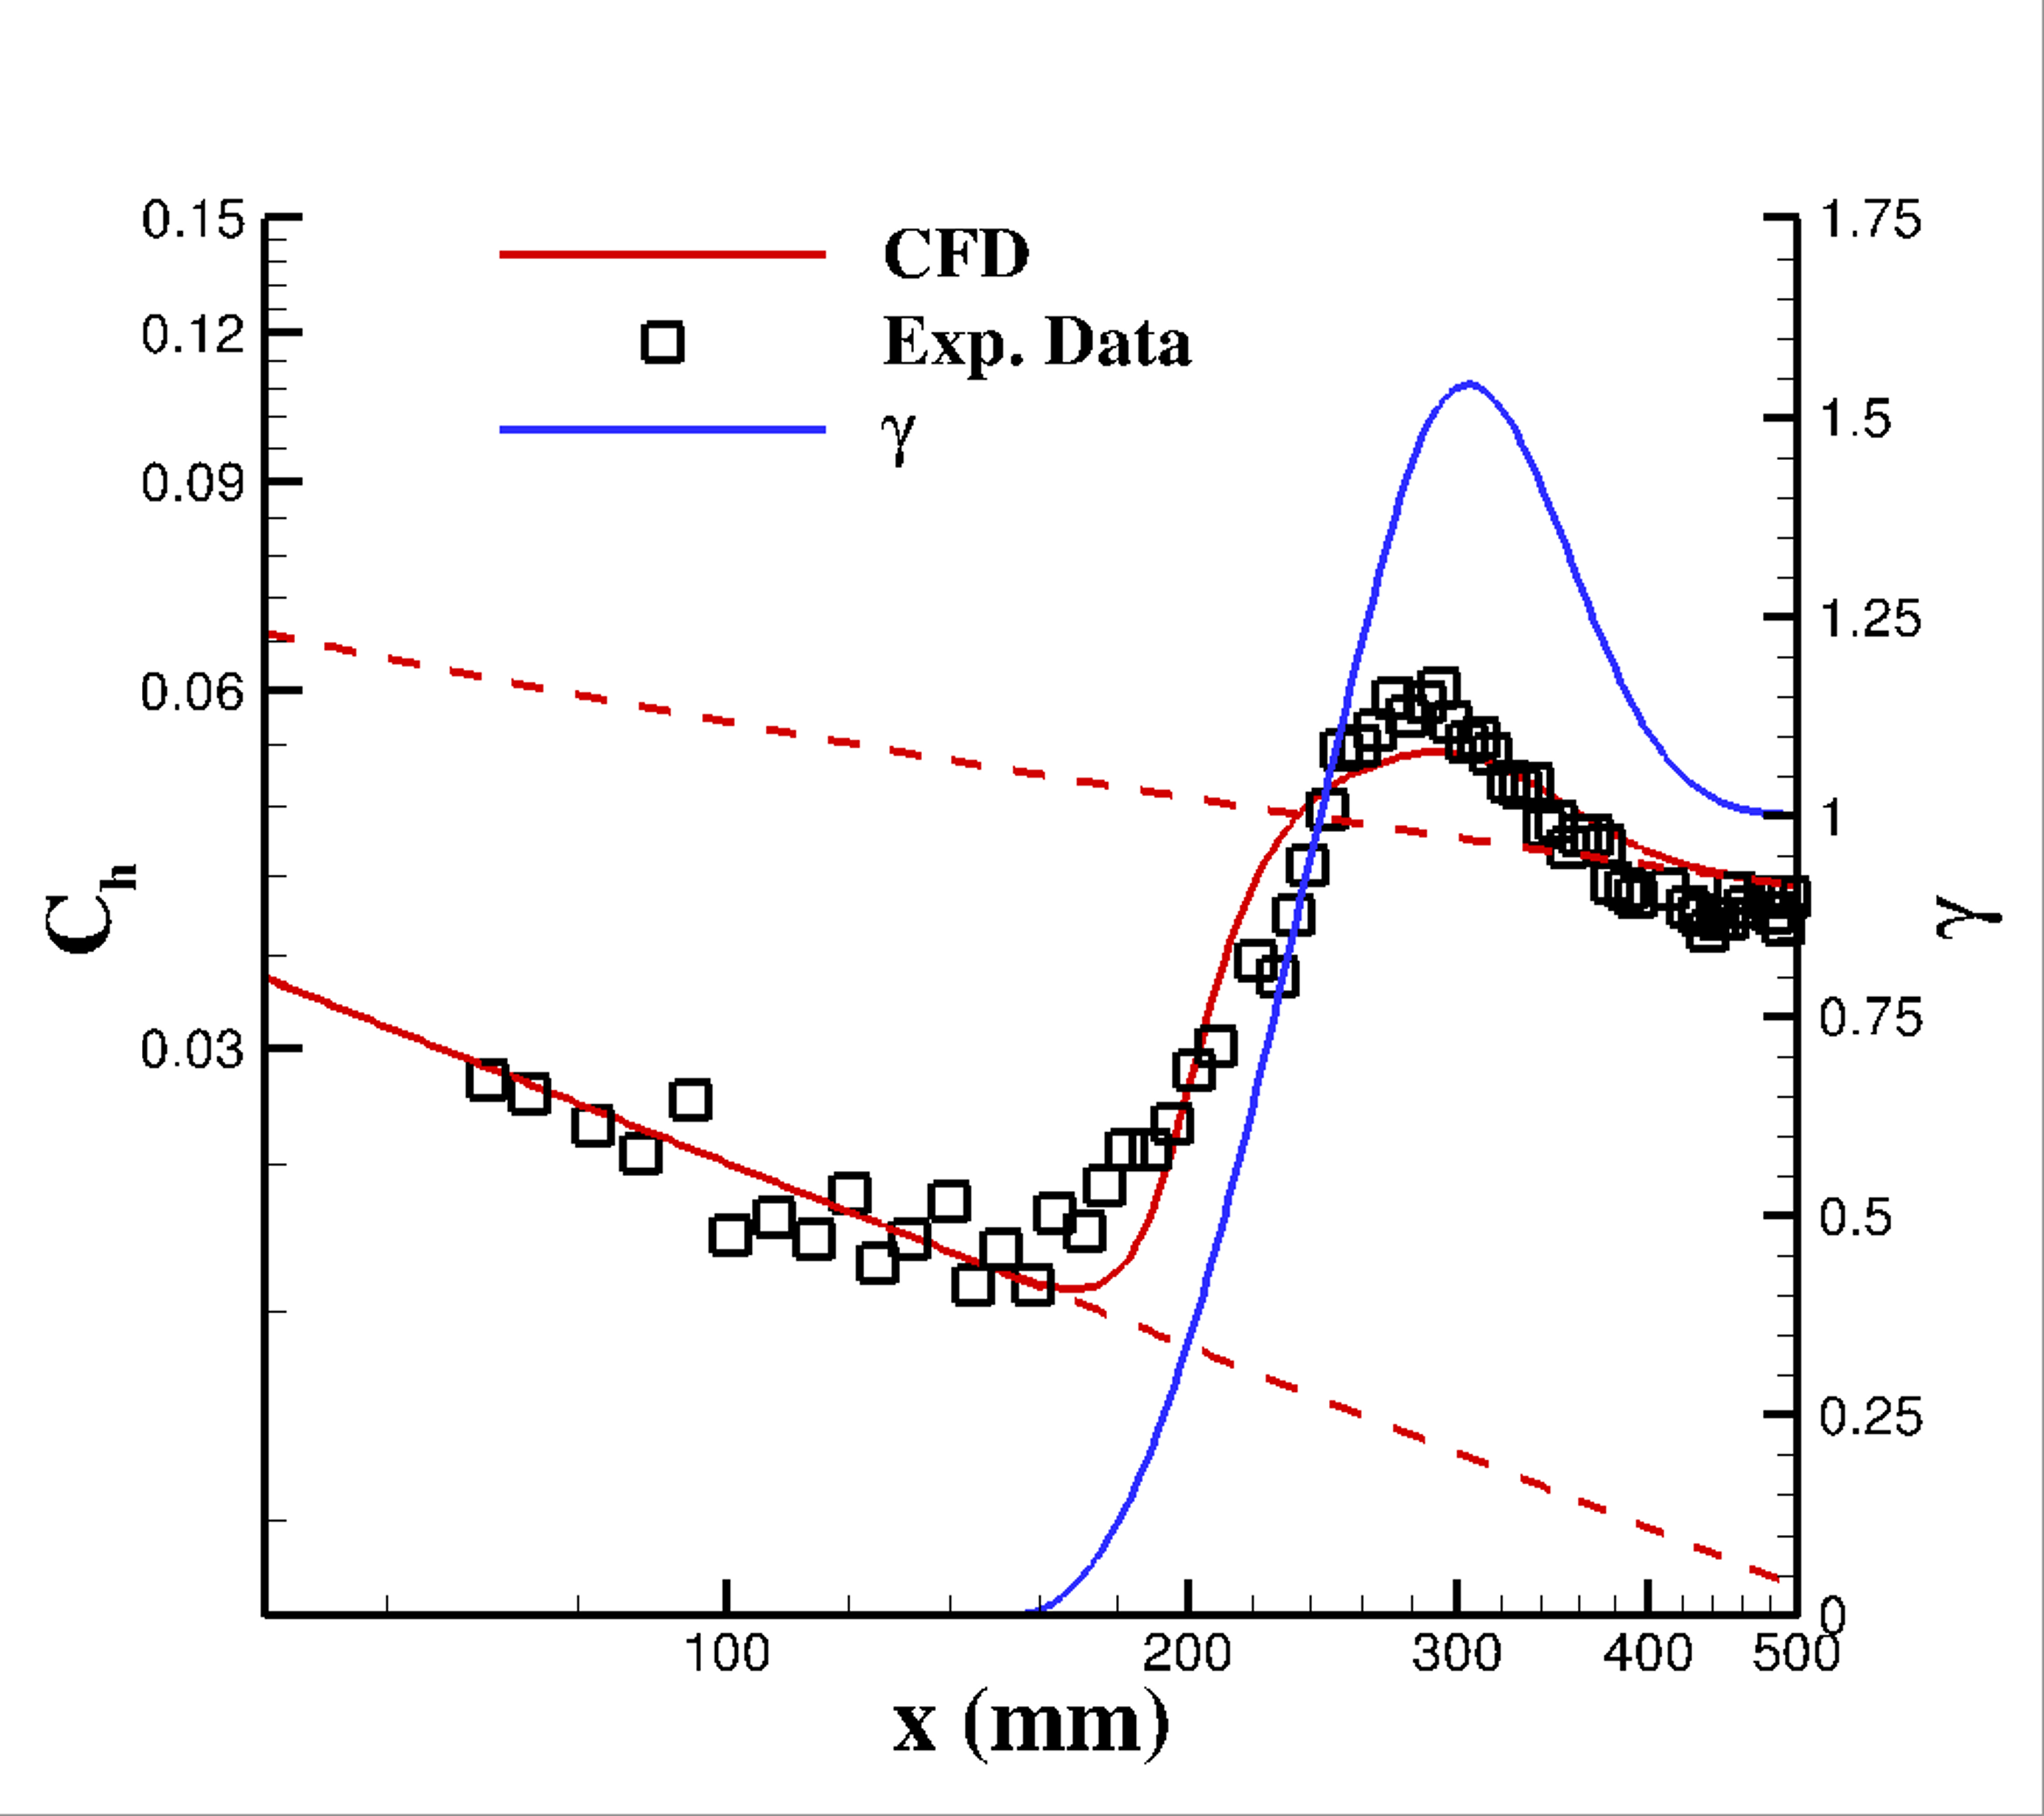
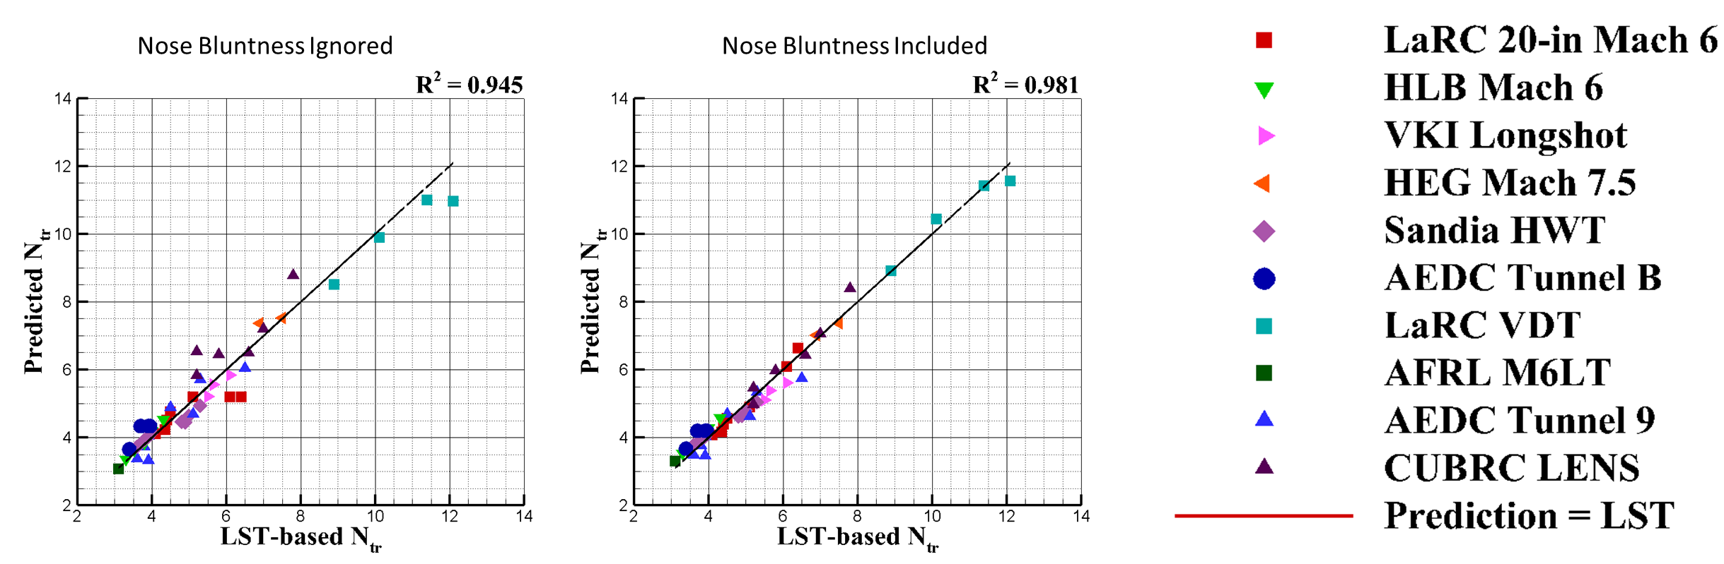
Other Transition Modeling Activities a LaRC
Critical N-factor correlation for 2nd mode
Expand applicability of AFT to additional cases
Improved intermittency modeling
Allow for the capturing of “overshoot” of turbulent heat flux at transition
Mach 6 Cone
Tuned intermittency to capture overshoot
Critical N-factor for transition onset

