Slide 1

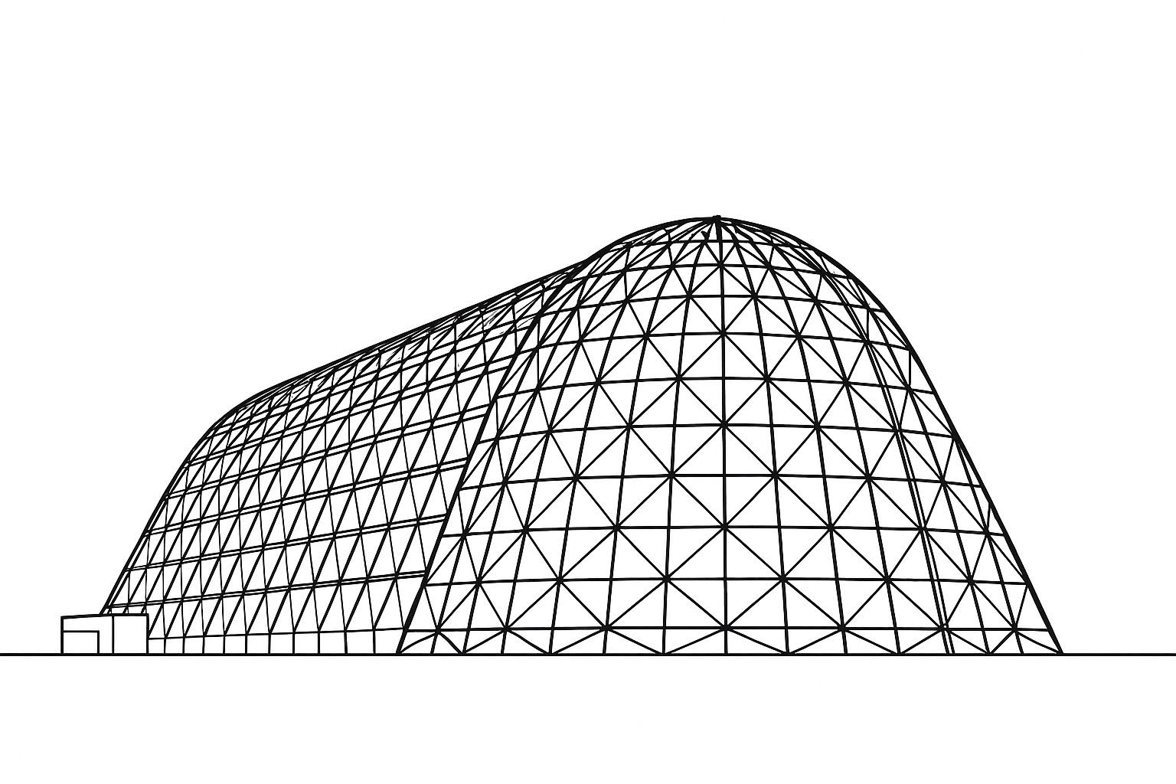

A Reimagining of the DPLR Code
TFAWS 2025 Aerosciences Technical Session
Presented by: Josh Finkbeiner
Dr. Joshua R. Finkbeiner
NASA Glenn Research Center
Thermal & Fluids Analysis Workshop 2025
NASA Ames Research Center
San Jose, CA
August 4-7, 2025

Slide 2
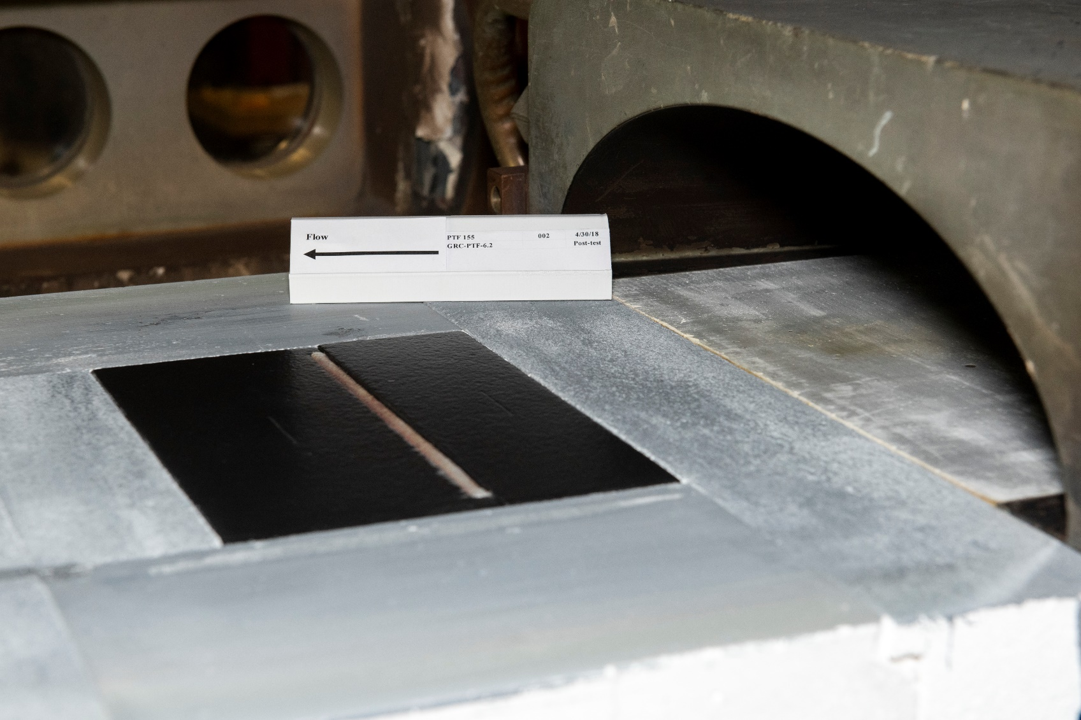
Motivation
Model laminar-to-turbulent transition in the NASA Ames Panel Test Facility
Develop/validate heat transfer models for high-temperature seals
Thermal boundary conditions for seal ingestion
Enthalpy profiles
Gokcen and Alluni (2013) determined that transition occurs within PTF nozzle
Finkbeiner (2021) identified likely location of transition in PTF nozzle
Transition occurs in vicinity of upstream edge of the boundary conditioning plate
Became basis for Ph.D. dissertation
High-temperature seal test article installed in PTF
Flow
High-temperature seal test article
Refractory frame
Semi-elliptical PTF nozzle exit

Slide 3
Description of the DPLR CFD Code
What is DPLR? See Tang (2016)
Ames-developed hypersonic continuum structured CFD code
Massively parallel Data Parallel Line Relaxation (DPLR) solver
Nonequilibrium gas dynamics models
High-speed Earth and planetary entry
Hypersonic heating
Laminar or RANS turbulence models
NASA Software of the Year (2007)
Supported numerous flight projects (Orbiter, Orion, Mars rovers, etc.)
Significant heritage in modeling arc jet flows

Slide 4
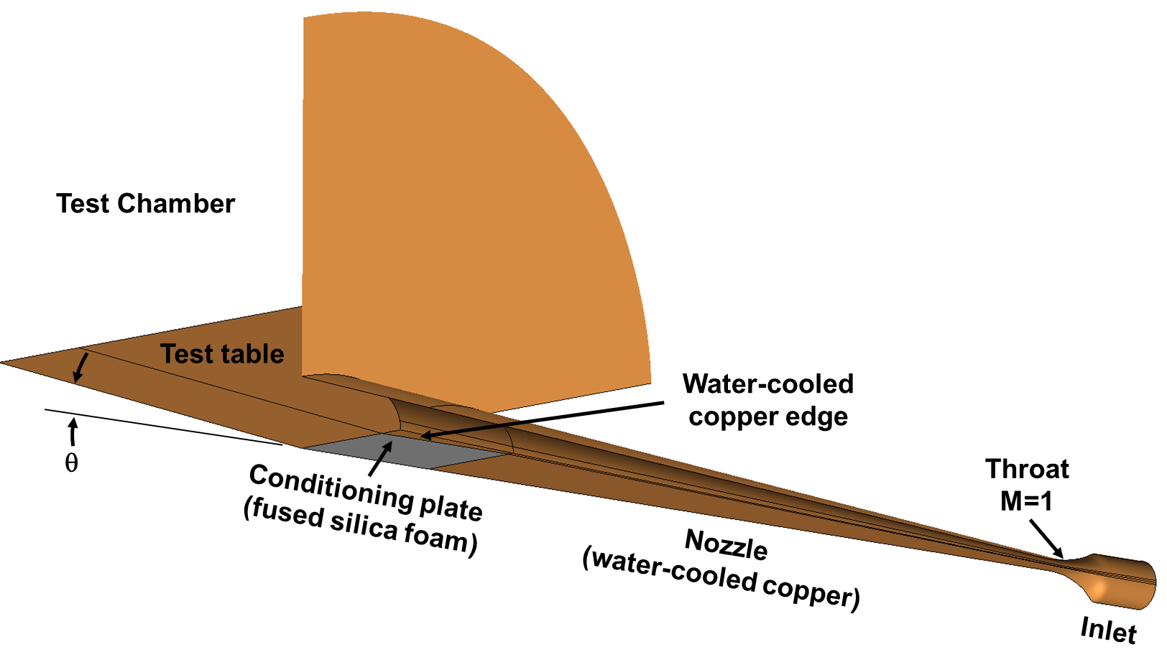

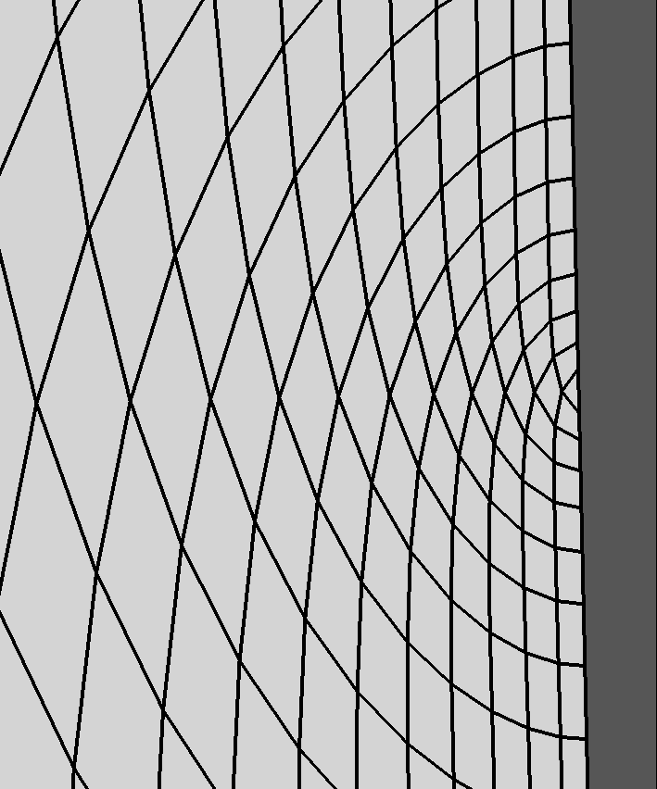
Panel Test Facility CFD Domain
Flow
Water-cooled wall / radiative equilibrium insulator
Water-cooled edge
Flow
Note: Slide is animated

Slide 5
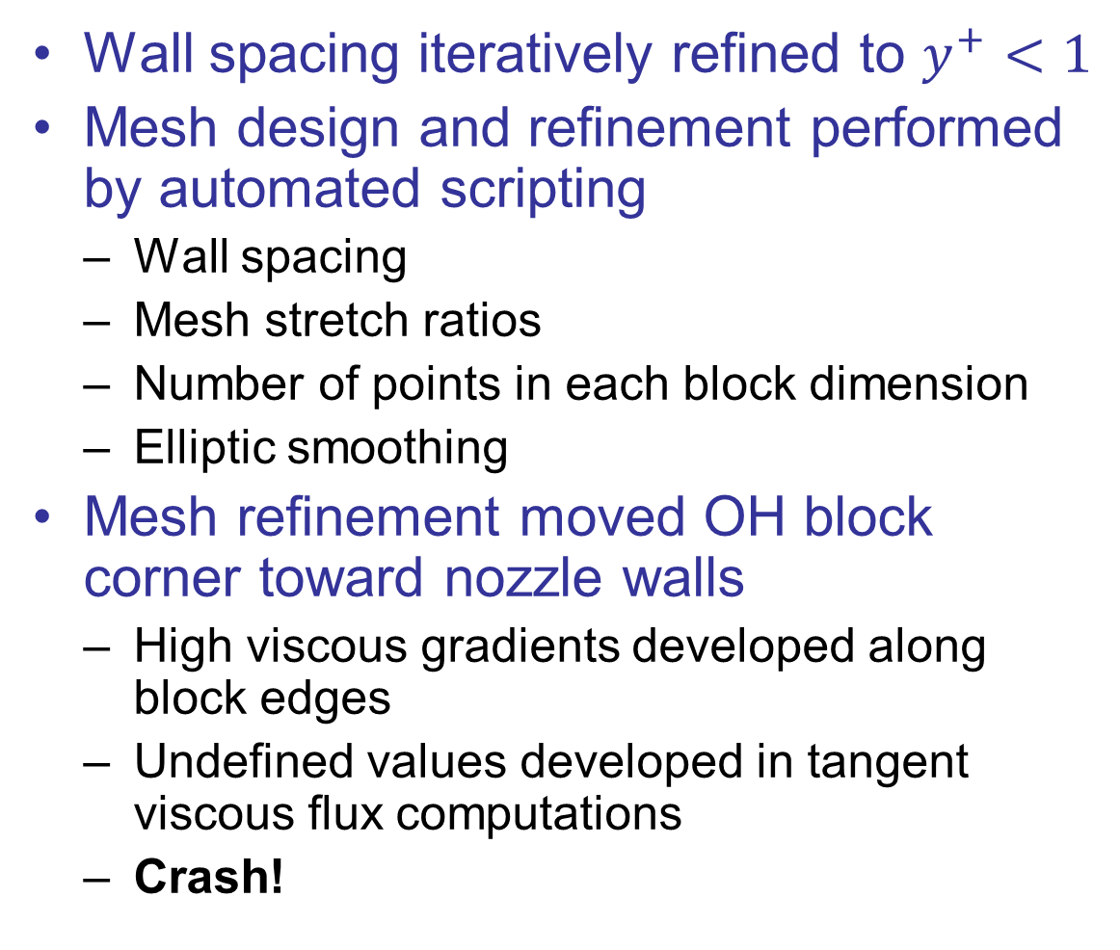
Instabilities Developed During Mesh Refinement
Wall spacing iteratively refined to $y^{+}<1$
Mesh design and refinement performed by automated scripting
Wall spacing
Mesh stretch ratios
Number of points in each block dimension
Elliptic smoothing
Mesh refinement moved OH block corner toward nozzle walls
High viscous gradients developed along block edges
Undefined values developed in tangent viscous flux computations
Crash!

Slide 6
DPLR Reimplementation History
Started modifying the DPLR code in 2014
Identified and corrected numerical instabilities
Added transition modeling capability (e.g., SST-γ-Re_{θ})
Improved robustness of build system
DPLR can be difficult to read
Officially Fortran 90 but more closely aligned with Fortran 77
Data dependencies are difficult to trace
Fortran 90 modules used for global variables but not code
No intent statements
2014 federal furlough required DPLR work stoppage…
…but, an enrolled Ph.D. student could reorganize the code without violating the Federal Anti-Deficiency Act…

Slide 7
Summary of DPLR Code Reimplementation
Utilized Fortran 2008 conventions (modules, derived types, etc.)
Removed duplicate code – “Don’t Repeat Yourself” [Hunt (2000)]
2D and 3D solvers combined into a single universal solver
Code organized into modules, Modules organized into libraries, etc.
Incorporated standard numerical libraries (e.g., LAPACK)
Corrected tangential viscous gradients at edge/corner ghost cells
Implemented kd-tree to accelerate:
Computation of distance to nearest wall
Preprocessor interface detection
Implemented lagged communications across DPLR line boundaries
Reorganized turbulence model subsystem into modular library
Accelerated Jacobian computations by storing modal internal energies
Corrected MUSCL stencil implementation near viscous walls
Added mass flux-based subsonic nozzle inlet boundary condition
Added subsonic nozzle initial condition to accelerate solutions

Slide 8
Finite Volume Method
Solution assumed piecewise constant
Flow properties stored at cell centers
Solution updates derived from interpolated values at face centers
Coupled system of algebraic equations
Inviscid fluxes computed from left and right face-centered properties (vector)
Viscous fluxes computed from face-centered property gradients (tensor)
Time integration scheme
Explicit: face-centered interpolations derived from current values
Implicit: face-centered interpolations derived from future values

Slide 9
Multiblock Domain Decomposition
CPU 1
CPU 2
CPU 3
Block 1
Block 2
CPU 4
Viscous corner
CPU 5

Slide 10
Ghost Cells and Boundary Conditions
Farfield
boundary condition
CPU 3
Ghost cells
from CPU 3
CPU 1
Ghost cells
from CPU 1
CPU 2
CPU 4
Ghost cells
from CPU 4
Corner ghost cell
from CPU 5
(not implemented)
Corner ghost cell
from CPU 1
CPU 5
Viscous wall
implicit boundary condition

Slide 11
O-H Mesh MPI Communication
Decompose
O-grid
O-grid
H-grid (corner)
H-grid (corner)

Slide 12
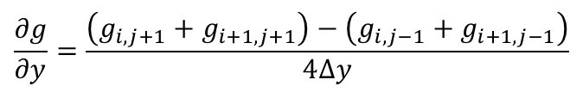


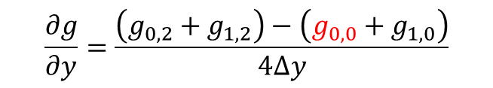
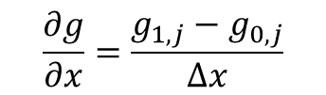









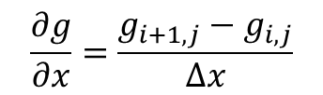

Viscous Flux Computation in Domain Corners
Normal gradients
Tangent gradients
$$\frac{∂g}{∂x}=\frac{g_{i+1,j}−g_{i,j}}{∆x}$$
$$\frac{∂g}{∂y}=\frac{\left(g_{i,j+1}+g_{i+1,j+1}\right)−\left(g_{i,j−1}+g_{i+1,j−1}\right)}{4∆y}$$
Well-posed throughout domain interior
$$g_{1,0}$$
Well-posed throughout domain interior
$$g_{0,0}$$
$$g_{i,j−1}$$
$$g_{i+1,j−1}$$
$$g_{1,2}$$
$$g_{i,j}$$
$$g_{i+1,j}$$
Boundary normal gradients
$$g_{0,2}$$
$$g_{1,2}$$
$$g_{0,2}$$
Edge tangent gradients
$$\frac{∂g}{∂x}=\frac{g_{1,j}−g_{0,j}}{∆x}$$
$$\frac{∂g}{∂y}=\frac{\left(g_{0,2}+g_{1,2}\right)−\left(g_{0,0}+g_{1,0}\right)}{4∆y}$$
$$g_{i,j+1}$$
$$g_{i+1,j+1}$$
Well-posed along all boundaries
Straightforward extension of domain stencil
Cells (0,2) and (1,0) specified by boundary conditions
Cell (0,0) is undefined
Caused instability as wall spacing was reduced

Slide 13



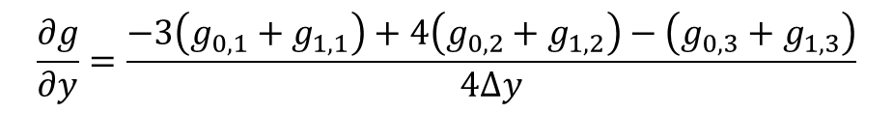



One-Sided Viscous Flux Stencils
Applied one-sided finite differences
Benefits
Avoids referencing edge ghost cells and maintains numerical stability
Retains second-order accuracy
Halves number of MPI communications
Removes hierarchical corner boundary condition logic
$$\frac{∂g}{∂y}=\frac{−3\left(g_{0,1}+g_{1,1}\right)+4\left(g_{0,2}+g_{1,2}\right)−\left(g_{0,3}+g_{1,3}\right)}{4∆y}$$
$$g_{0,1}$$
$$g_{1,1}$$
$$g_{0,2}$$
$$g_{1,2}$$
$$g_{0,3}$$
$$g_{1,3}$$

Slide 14
Comparisons
DPLR 3.05 included example configuration cases
Desktop-scale
Mixture of dimensionalities, model specifications, etc.
2D 2mm-diameter hemisphere in Mach 11 air
6-species air
2-temperature model (stat. mech)

Slide 15
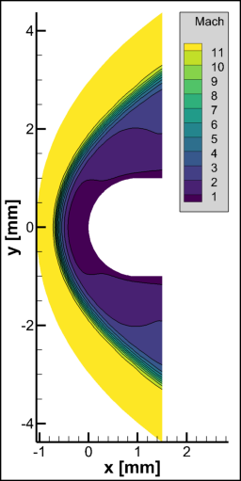

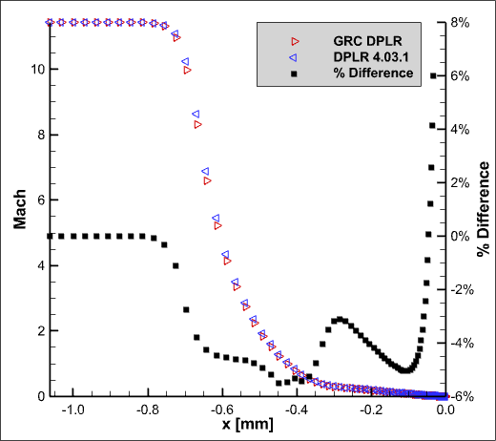

2D Cylinder Comparison (DPLR 3.05 example)
DPLR 4.03.1
GRC DPLR
Mach number distributions along $y=0$

Slide 16
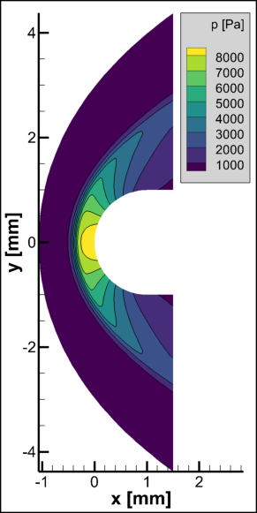

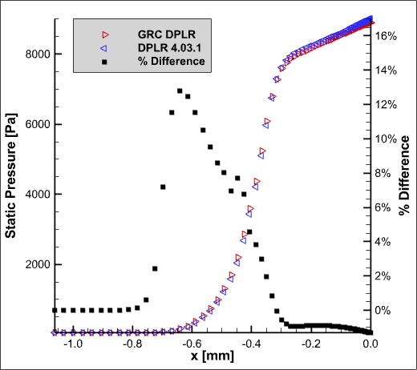

2D Cylinder Comparison (DPLR 3.05 example)
DPLR 4.03.1
GRC DPLR
Static pressure distributions along $y=0$

Slide 17
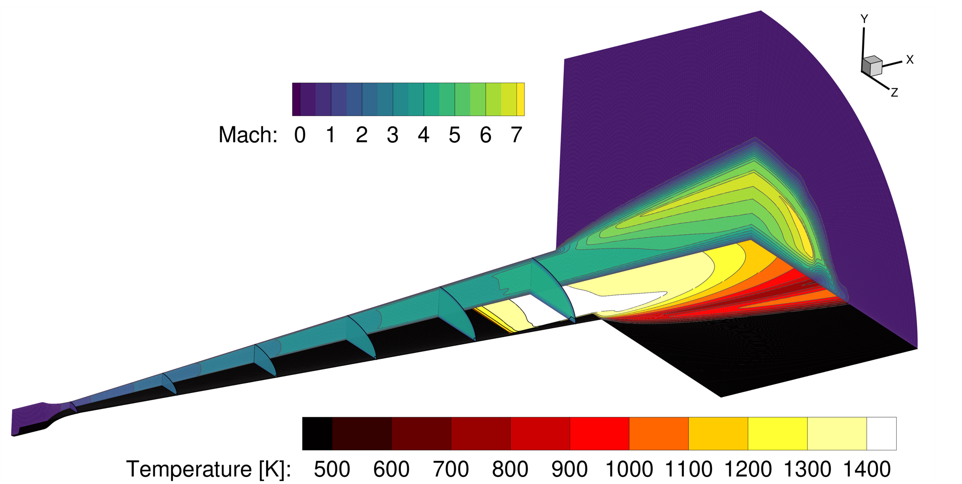
Success
Example laminar-to-turbulent DPLR solution of the NASA Ames Panel Test Facility Nozzle

Slide 18
Reimplementation of DPLR Not Intended as Criticism
“It should be emphasized that the original DPLR software is an excellent analysis tool that has been a cornerstone of modern aerothermal analysis at NASA. The rewrite of this software should not be viewed as a criticism of the original authors of DPLR; rather, it should be seen as a distillation of their original ideas into a more approachable and understandable form. The improved readability and organization of the rewritten code potentially allows the concepts included in the original DPLR code to become even more influential in the CFD community.” [Finkbeiner (2025)]

Slide 19
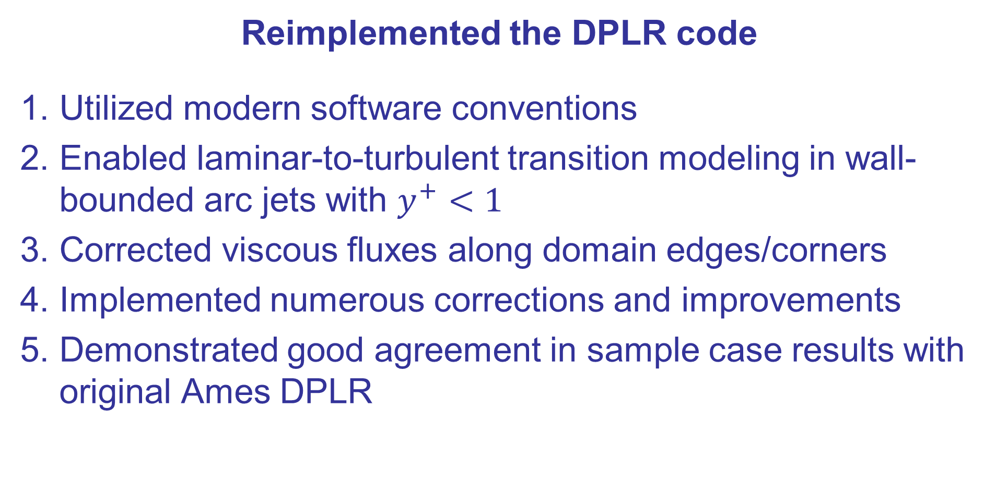
Summary
Reimplemented the DPLR code
Utilized modern software conventions
Enabled laminar-to-turbulent transition modeling in wall-bounded arc jets with $y^{+}<1$
Corrected viscous fluxes along domain edges/corners
Implemented numerous corrections and improvements
Demonstrated good agreement in sample case results with original Ames DPLR

Slide 20
References
Gökçen, Tahir, and Antonella I. Alunni. “On Laminar-to-Turbulent Transition of Arc-Jet Flow in the NASA Panel Test Facility.” Journal of Thermophysics and Heat Transfer 27, no. 3 (July 2013): 549–62. https://doi.org/10.2514/1.T3984.
Finkbeiner, Joshua R. “Modeling Laminar-to-Turbulent Transition in the Panel Test Facility Arcjet.” Journal of Thermophysics and Heat Transfer 35, no. 2 (April 2021): 386–401. https://doi.org/10.2514/1.T6098.
Tang, Chun Y. “Introduction to DPLR.” Thermal & Fluids Analysis Workshop. NASA Ames Research Center, 2016. https://ntrs.nasa.gov/citations/20160010056.
McBride, Bonnie J., Michael J. Zehe, and Sanford Gordon. “NASA Glenn Coefficients for Calculating Thermodynamic Properties of Individual Species.” NASA Technical Paper. Cleveland, OH: NASA Glenn Research Center, September 1, 2002. https://ntrs.nasa.gov/citations/20020085330.
Langtry, Robin B., and Florian R. Menter. “Correlation-Based Transition Modeling for Unstructured Parallelized Computational Fluid Dynamics Codes.” AIAA Journal 47, no. 12 (December 2009): 2894–2906. https://doi.org/10.2514/1.42362.
Finkbeiner, Joshua R. “Modeling Laminar-to-Turbulent Transition in the Panel Test Facility Arcjet.” Ph.D. Dissertation, Purdue University, 2025.
Hunt, Andrew, and David Thomas. The Pragmatic Programmer: From Journeyman to Master. USA: Addison-Wesley Longman Publishing Co., Inc., 2000.

Slide 21
Introduction
New implementation of the DPLR code
Motivation: Laminar-to-turbulent transition modeling in wall-bounded arc jets
Description of DPLR code
Challenges encountered while modeling arc jet flows
Reimplementation of the code
Case study: Corrections to viscous fluxes along domain edges/corners
Comparisons of sample case results

Slide 22
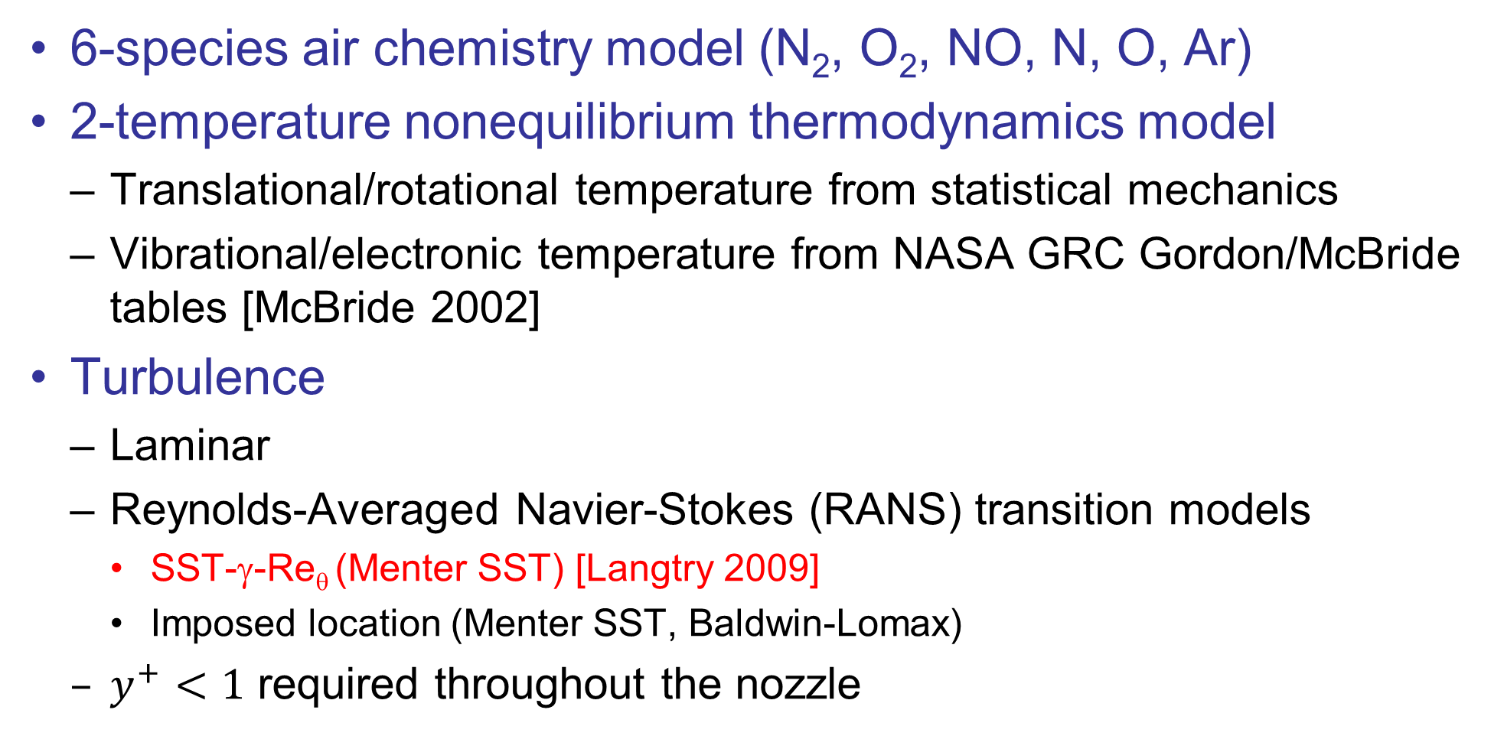
Panel Test Facility DPLR Model
6-species air chemistry model (N₂, O₂, NO, N, O, Ar)
2-temperature nonequilibrium thermodynamics model
Translational/rotational temperature from statistical mechanics
Vibrational/electronic temperature from NASA GRC Gordon/McBride tables [McBride 2002]
Turbulence
Laminar
Reynolds-Averaged Navier-Stokes (RANS) transition models
SST-γ-Re_{θ} (Menter SST) [Langtry 2009]
Imposed location (Menter SST, Baldwin-Lomax)
$y^{+}<1$ required throughout the nozzle
Notes:
Mention that this was a heavily-modified version of the DPLR code – more details in the writeup (or ask questions)
The Gordon/McBride tables were easier to implement in the inlet boundary condition

Slide 23
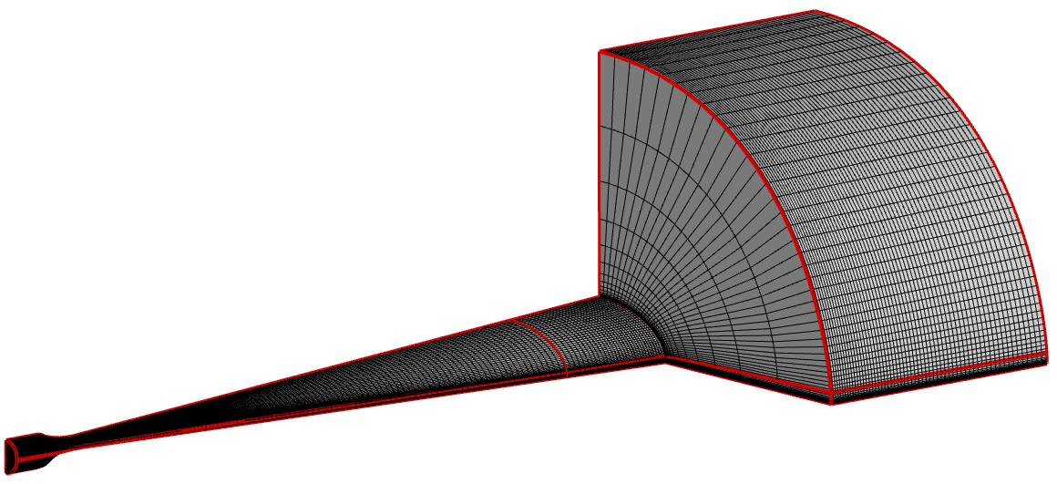
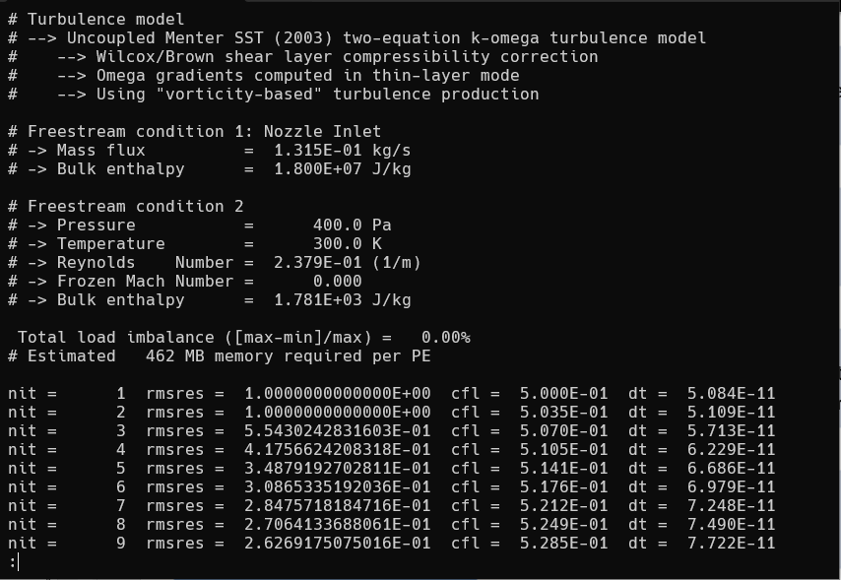

DPLR CFD Workflow
Mesh Generation
Model geometry (CAD)
Check mesh quality
CFD Preprocessing
Discretize domain volume into a mesh
Populate initial guess
Decompose mesh for parallel processing
CFD Solution
Upload, queue, wait for resources
Download results and check for completion
CFD Postprocessing
Compute primitive variables
Generate plots
Check solution “sanity”
Iterate the solution until steady-state
Detect multi-block interfaces
23

Slide 24
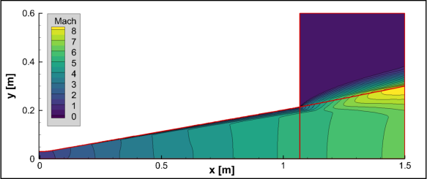
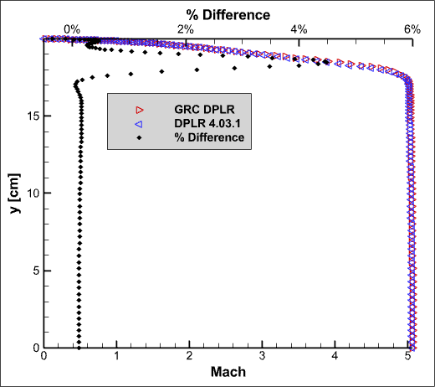
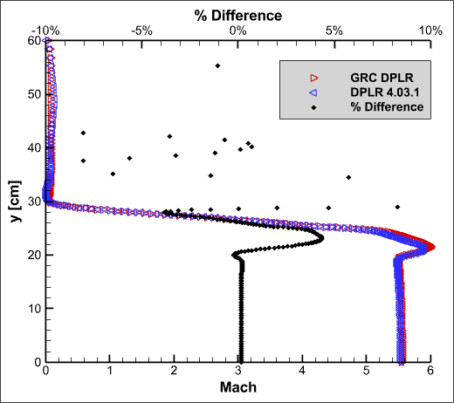



IHF Nozzle Comparison (DPLR 3.05 example)
DPLR 4.03.1
$$x=1\text{m}$$
GRC DPLR
$$x=1.2\text{m}$$

Slide 25
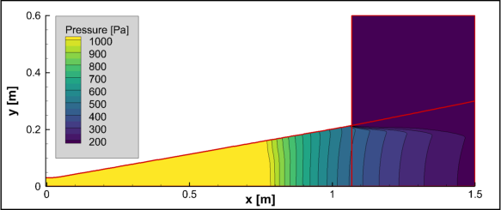
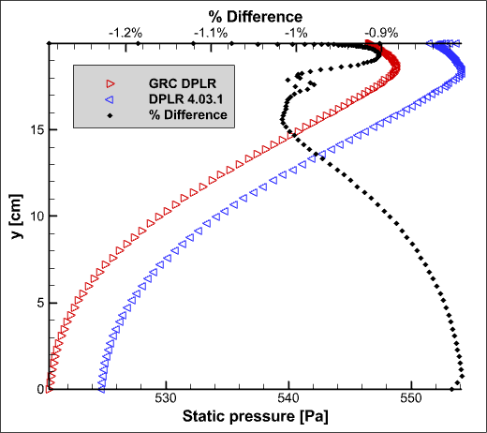
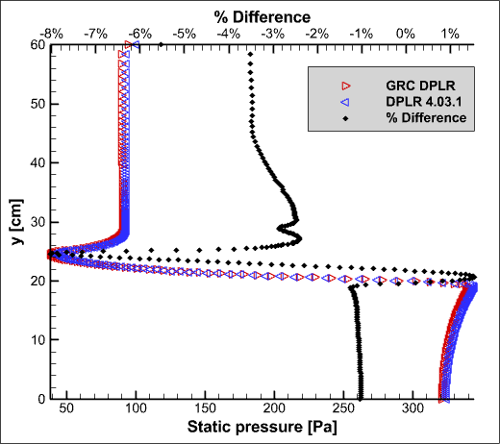



IHF Nozzle Comparison (DPLR 3.05 example)
DPLR 4.03.1
$$x=1.2\text{m}$$
GRC DPLR
$$x=1\text{m}$$

