Slide 1
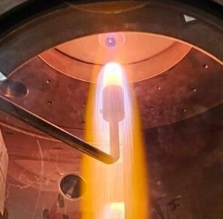




Boundary Layer Characterization around Graphite Samples in Microwave Nitrogen-Methane Plasmas
Dan Fries*, William L. Young*, Kate B. Rhoads*, Savio Poovathingal*, Alexandre Martin*
Stefan Löhle**
NASA TFAWS Aero-VI-03 ∙ August 5th , 2025 ∙ San-Jose, CA
*University of Kentucky
**University of Stuttgart

Slide 2
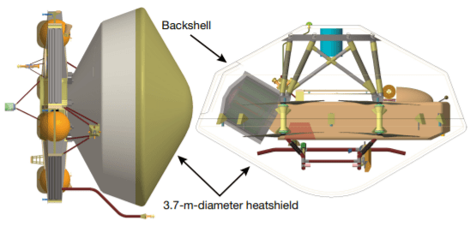
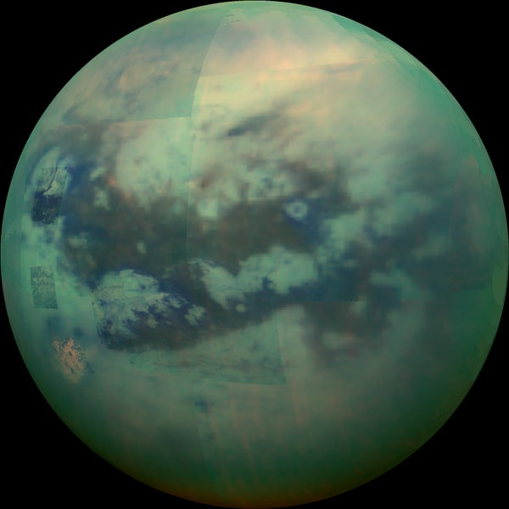
Introduction & Motivation
NASA, JPL-Caltech and University of Arizona
NASA Dragonfly mission will explore the Saturn moon Titan in great detail.
A safe entry into Titan’s atmosphere is critical
Atmosphere is mostly nitrogen and methane [1]
Cassini-Huygens is the only existing flight data set for this kind of atmosphere [2]
Ground tests are needed to understand the reentry-environment better and to reliably predict radiative heat transfer and dominant chemical pathways
Data will be used to validate and improve modeling tools for Dragonfly and other missions [3]
Source: NASA
Source: NASA, JPL-Caltech and University of Arizona
Objectives:
Perform material tests in 98.5% N₂ + 1.5% CH₄ high-enthalpy gas mixtures
Spectroscopic characterization of the radiative environment
Description and validation of gas-material interaction models
[1] Nixon, “The composition and chemistry of titan’s Atmosphere”, ACS Earth Space Chem. (2024).
[2] Johnston and Brandis, "Analysis of Huygens Entry Observation to Inform Titan Shock-Layer Radiation Models." J. Thermophysics and Heat Transfer (2022).
[3] Brandis et al., “Mitigating dragonfly TPS design risks through improved aerothermal environments”, 2024 IPPW (2024).

Slide 3
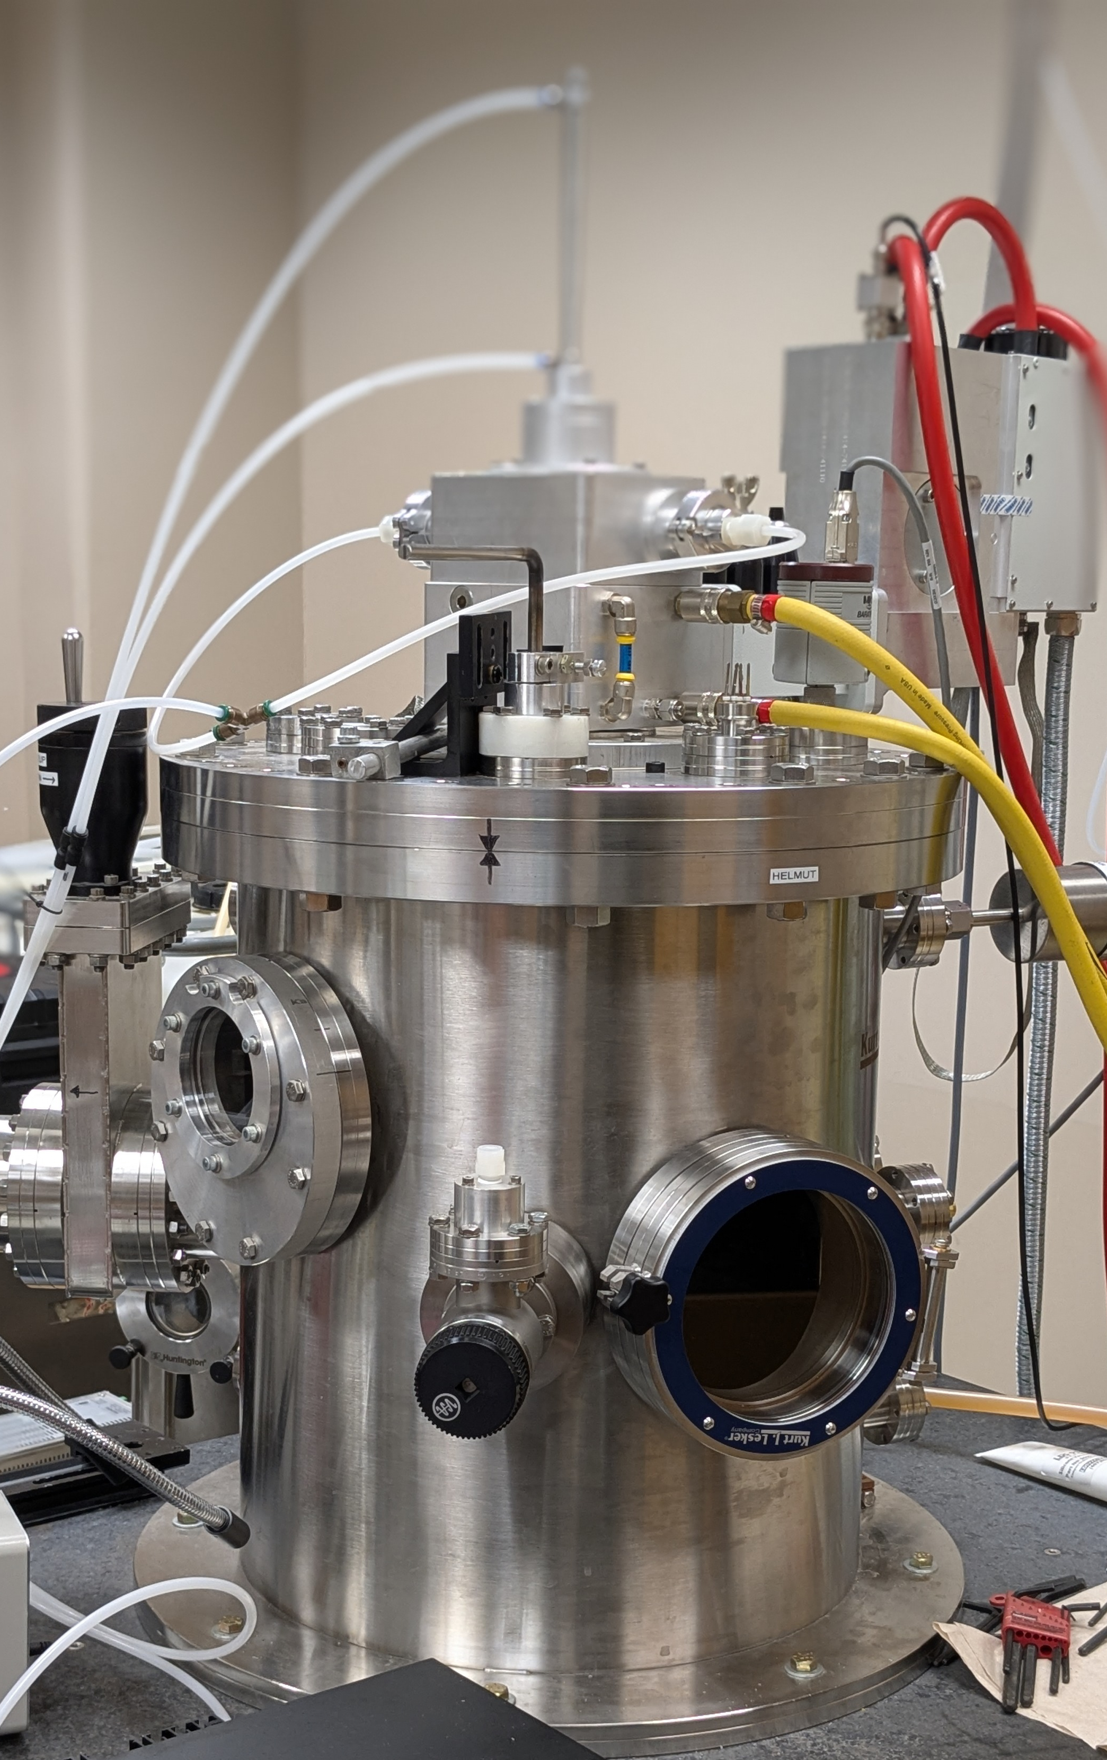
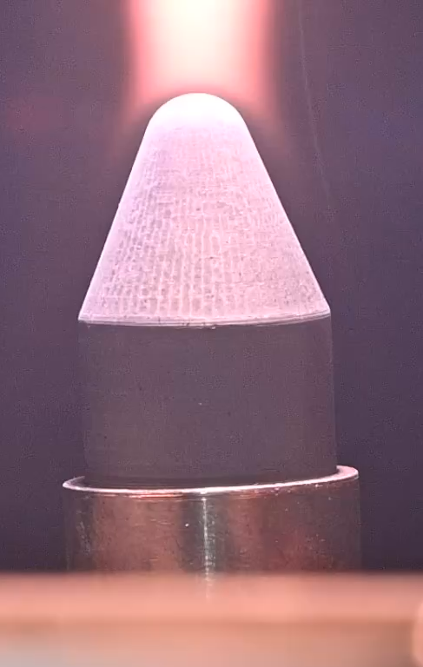
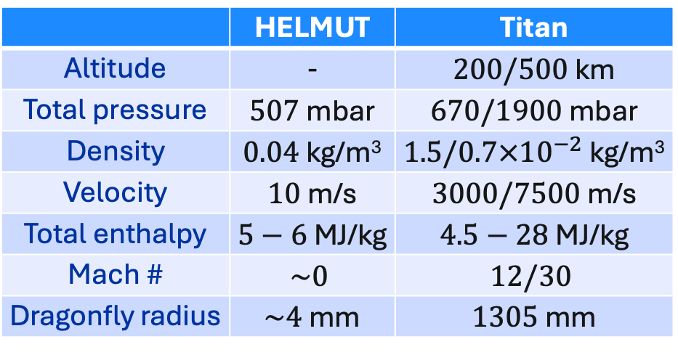
Experimental Setup & Methodology
Local Heat Transfer Simulation Methodology to identify relevant geometries and flow conditions [1]
HELMUT
POCO graphite sample
 | HELMUT | Titan
Altitude | - | $200/500$ km
Total pressure | $507$ mbar | $670/1900$ mbar
Density | $0.04$ kg/m³ | $1.5/0.7×{10}^{−2}$ kg/m³
Velocity | $10$ m/s | $3000/7500$ m/s
Total enthalpy | $5−6$ MJ/kg | $4.5−28$ MJ/kg
Mach # | $$\sim 0$$ | $$12/30$$
Dragonfly radius | $\sim 4$ mm | $1305$ mm
UK High-Enthalpy Multi-User Test (HELMUT) Facility: microwave plasma, variable pressure
Use solid POCO graphite as representative material
[1] Kolesnikov, "The concept of local simulation for stagnation point heat transfer in hypersonic flows-applications and validation." 21st Aerodynamic Measurement Technology and Ground Testing Conference (2000).

Slide 4
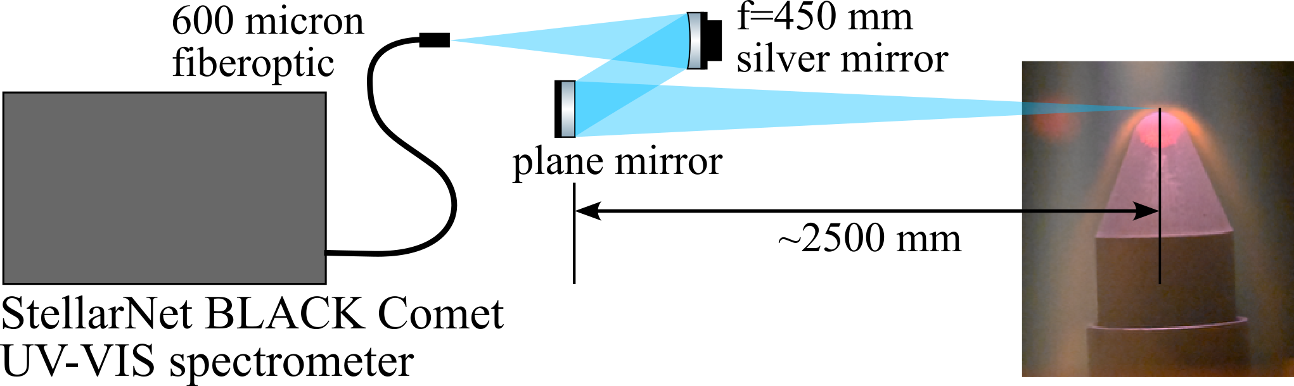
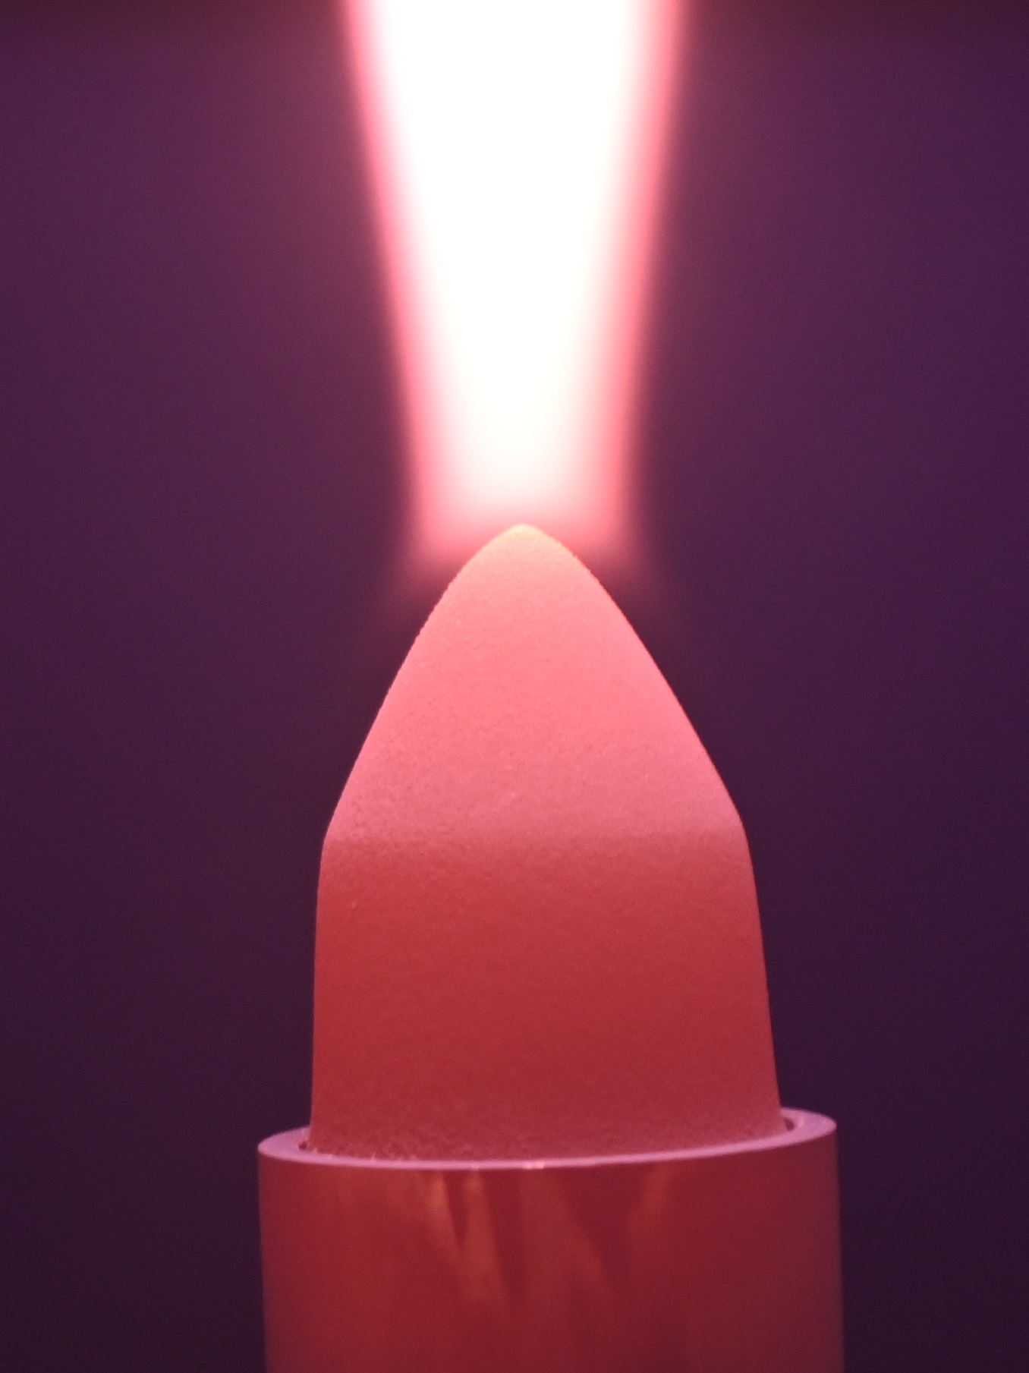
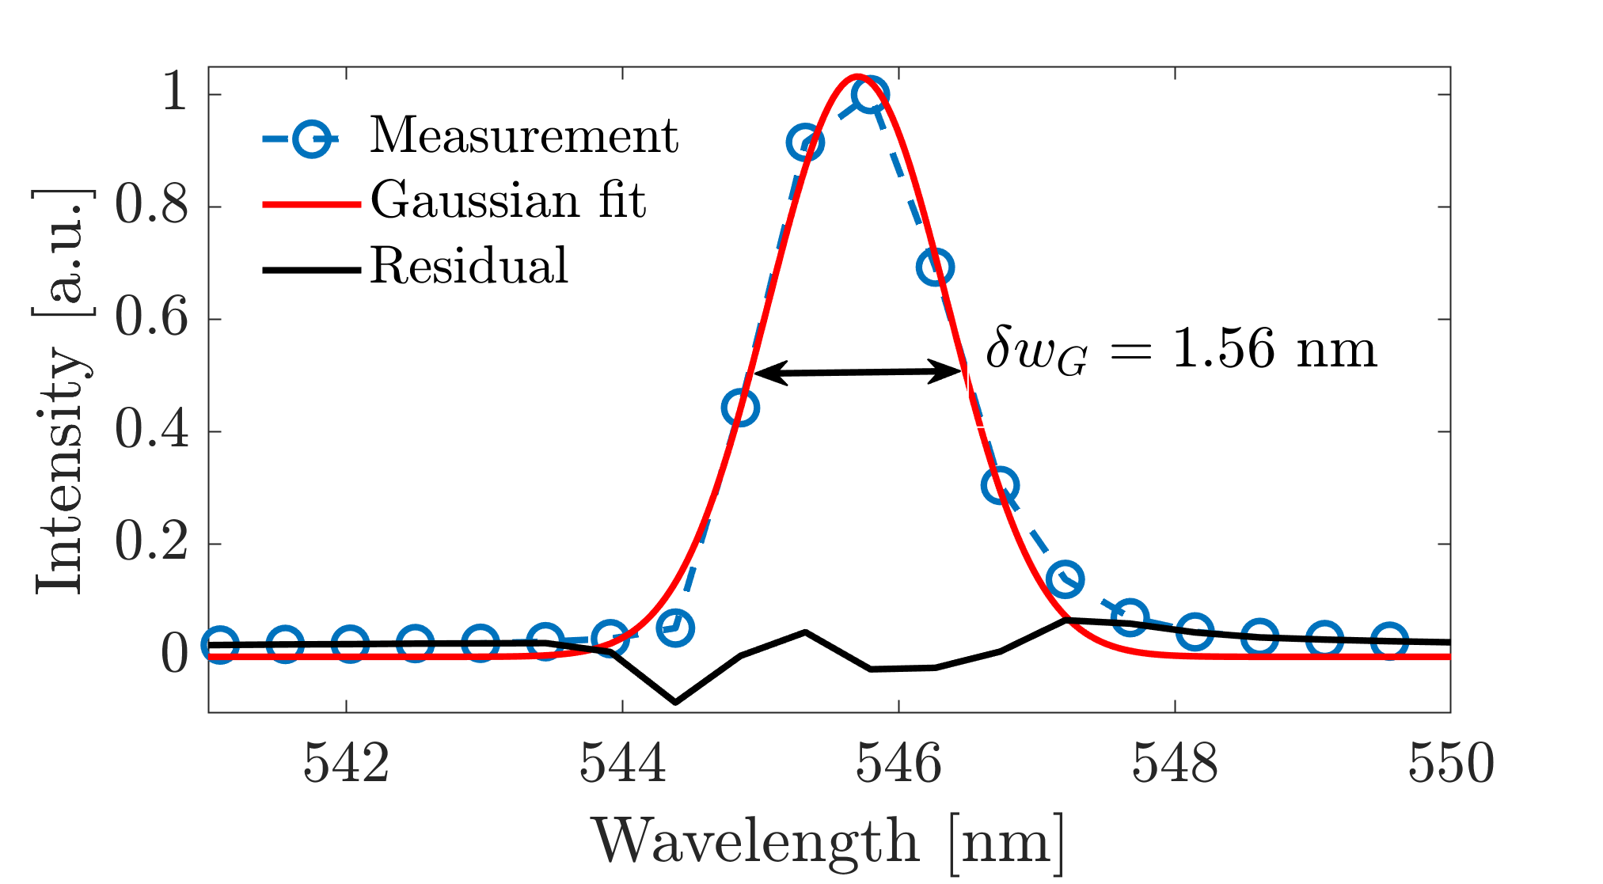
Experimental Setup & Methodology
Broadband low-resolution spectroscopy diagnostic
Measurement radius at focus $\sim 1.5$ mm, $ΔΩ∼4.8×{10}^{−4}$ sr → approximate line-of-sight
Targeting laser from the spectroscopy system
Instrument function
Calibrated with tungsten-halogen and deuterium radiance standard
Looking through strong CN radiation in gas phase

Slide 5
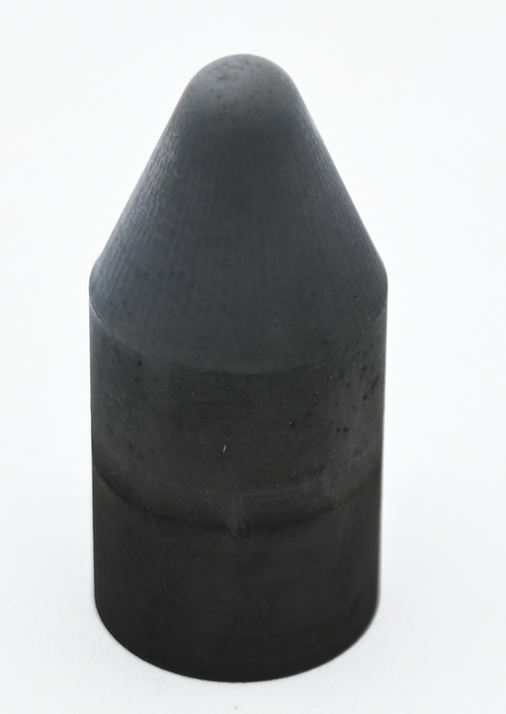
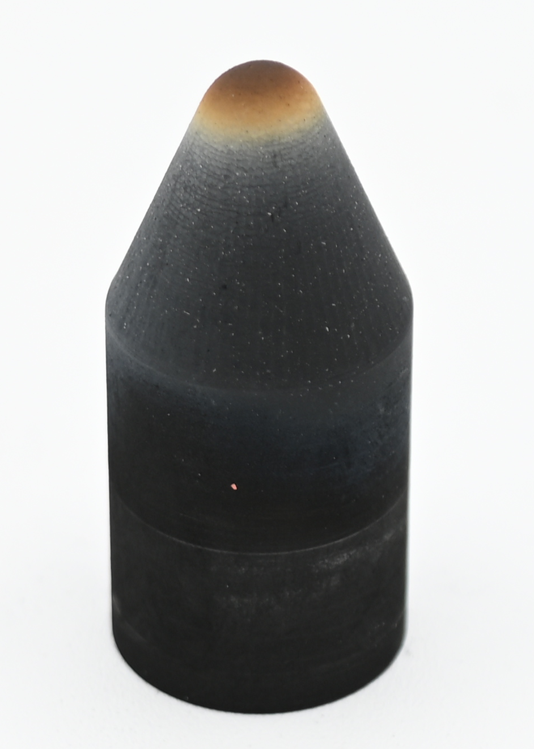
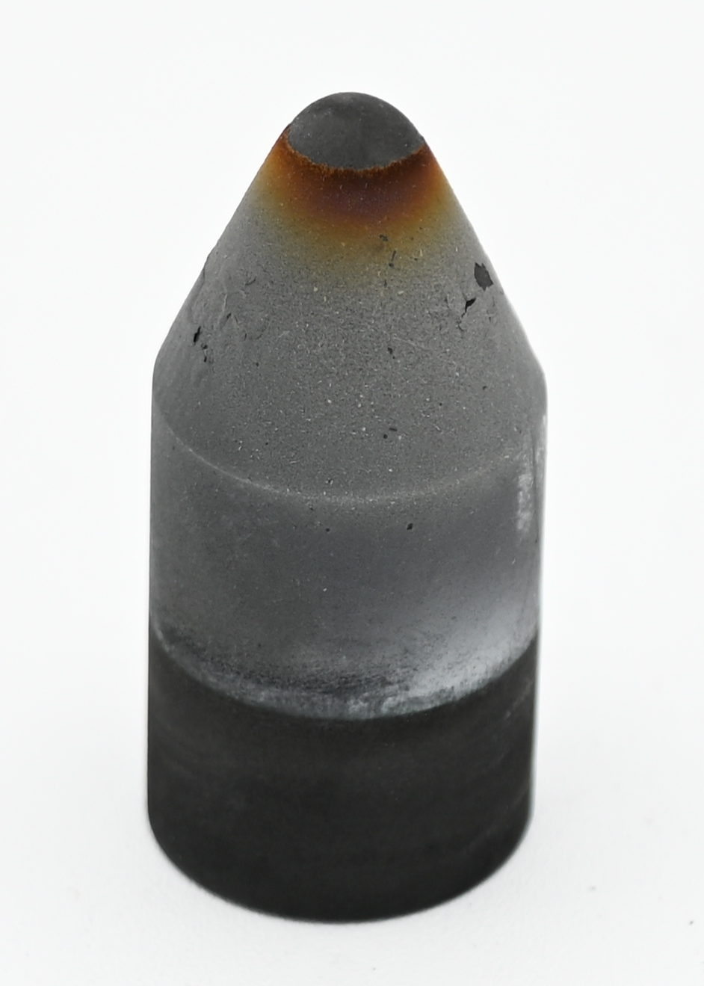

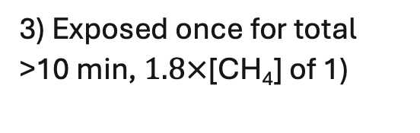
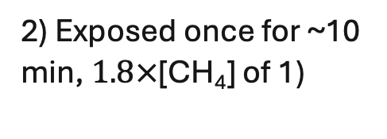
POCO Samples Exposed to Plasma Stream
During test
Post test
Delaminated tip
pure N₂
N₂+CH₄
1
2
3
1) Exposed once for ~5 min, [CH₄] nominal
2) Exposed once for ~10 min, $1.8×$[CH₄] of 1)
Violet glow close to surface → CN
CN in bulk plasma
3) Exposed once for total >10 min, $1.8×$[CH₄] of 1)
→ Not oxidation dominated

Slide 6
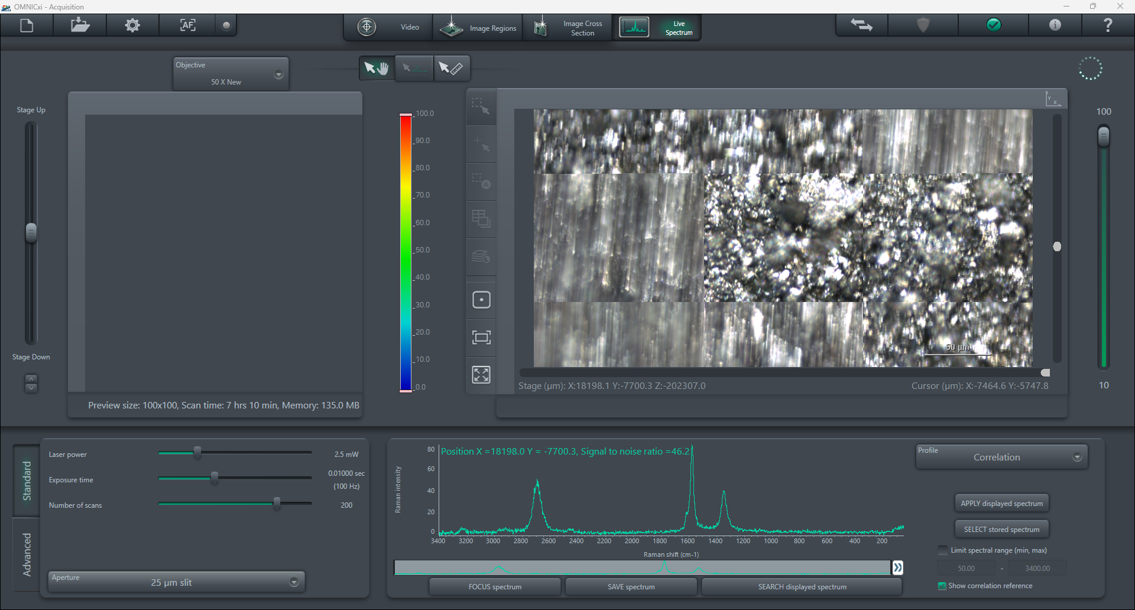
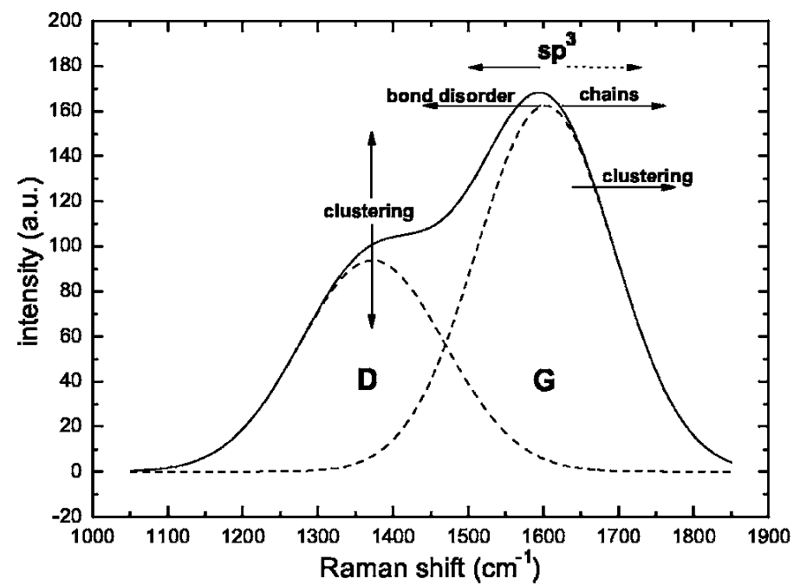

Post Exposure Analysis – Raman Spectroscopy
50 $\text{μm}$
1
2
3
Reference surface
→ Pure graphite
G*
D*
G
D
Peaks indicative of both
crystalline graphite: G, D*, G*
disordered graphite: D, high-energy shoulder at G
→broadening of G and increase in D suggest additional defects, amorphization, and more strain
D* and G* are harmonics of D and G mode
Hong and Winter. "Micro-Raman spectroscopy on a-C: H nanoparticles." Journal of applied physics 98.12 (2005).
Thanks to Michael Hovish (UK) from The Hovish Research Lab for the sample analysis data

Slide 7
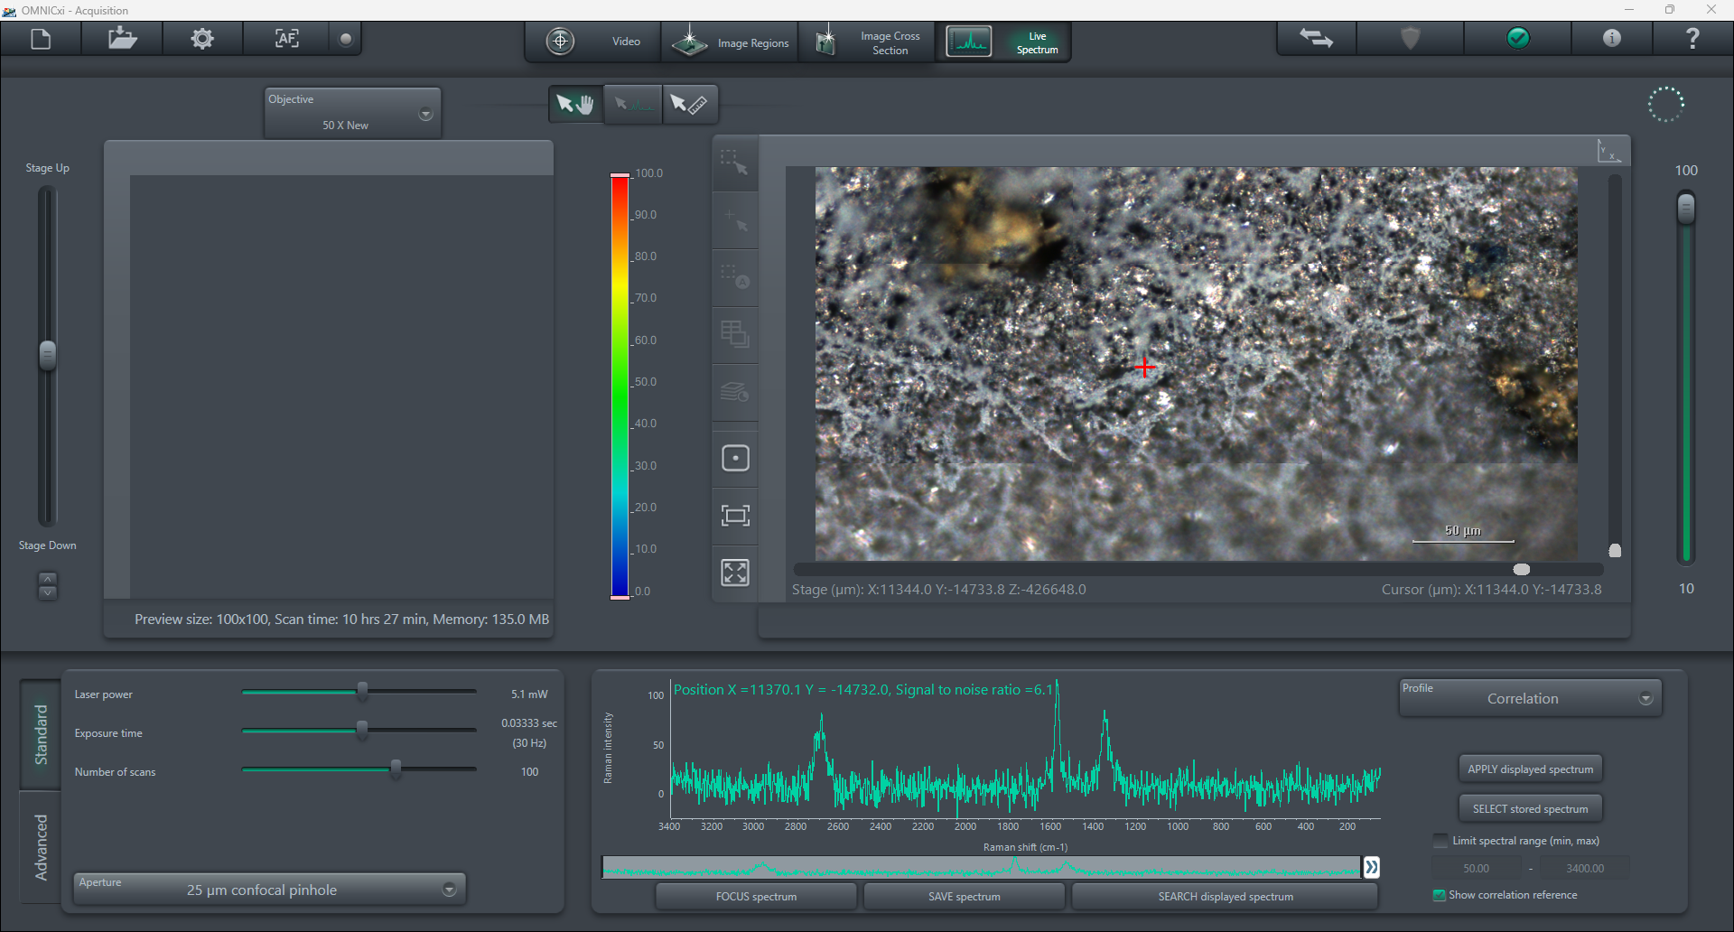
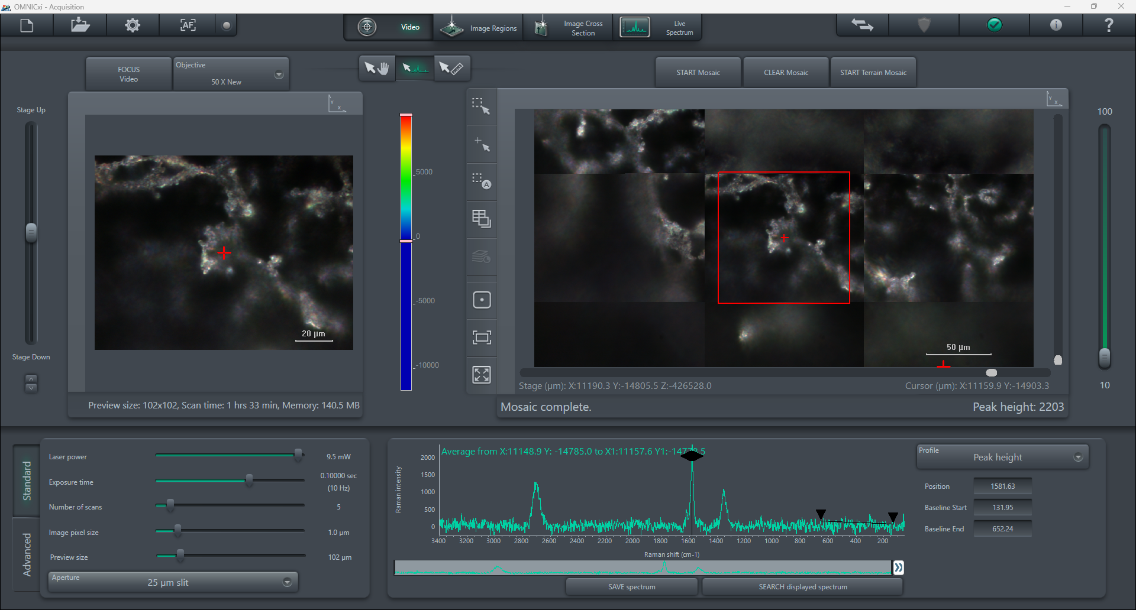


Post Exposure Analysis – Raman Spectroscopy
Reference surface
1
2
3
100 $\text{μm}$
CN?
At nominal [CH₄] and lowest exposure duration → some amorphization
Graphite structure still recognizable
Features of CN_{x}?
100 $\text{μm}$
Thanks to Michael Hovish (UK) from The Hovish Research Lab for the sample analysis data

Slide 8
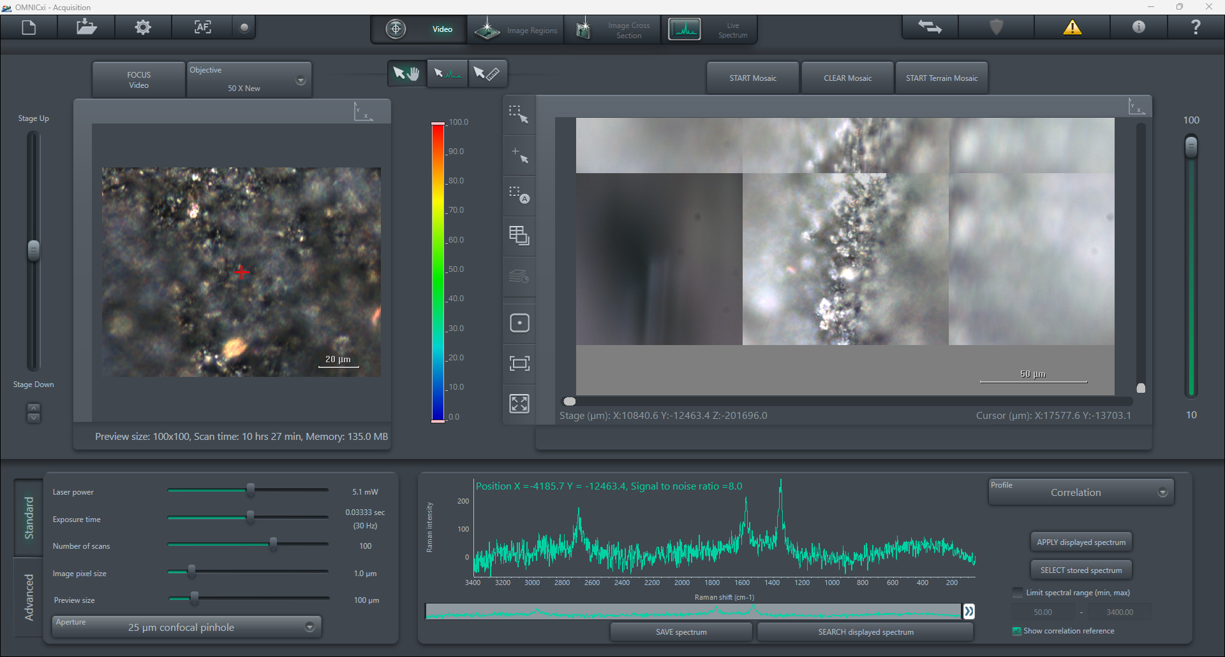
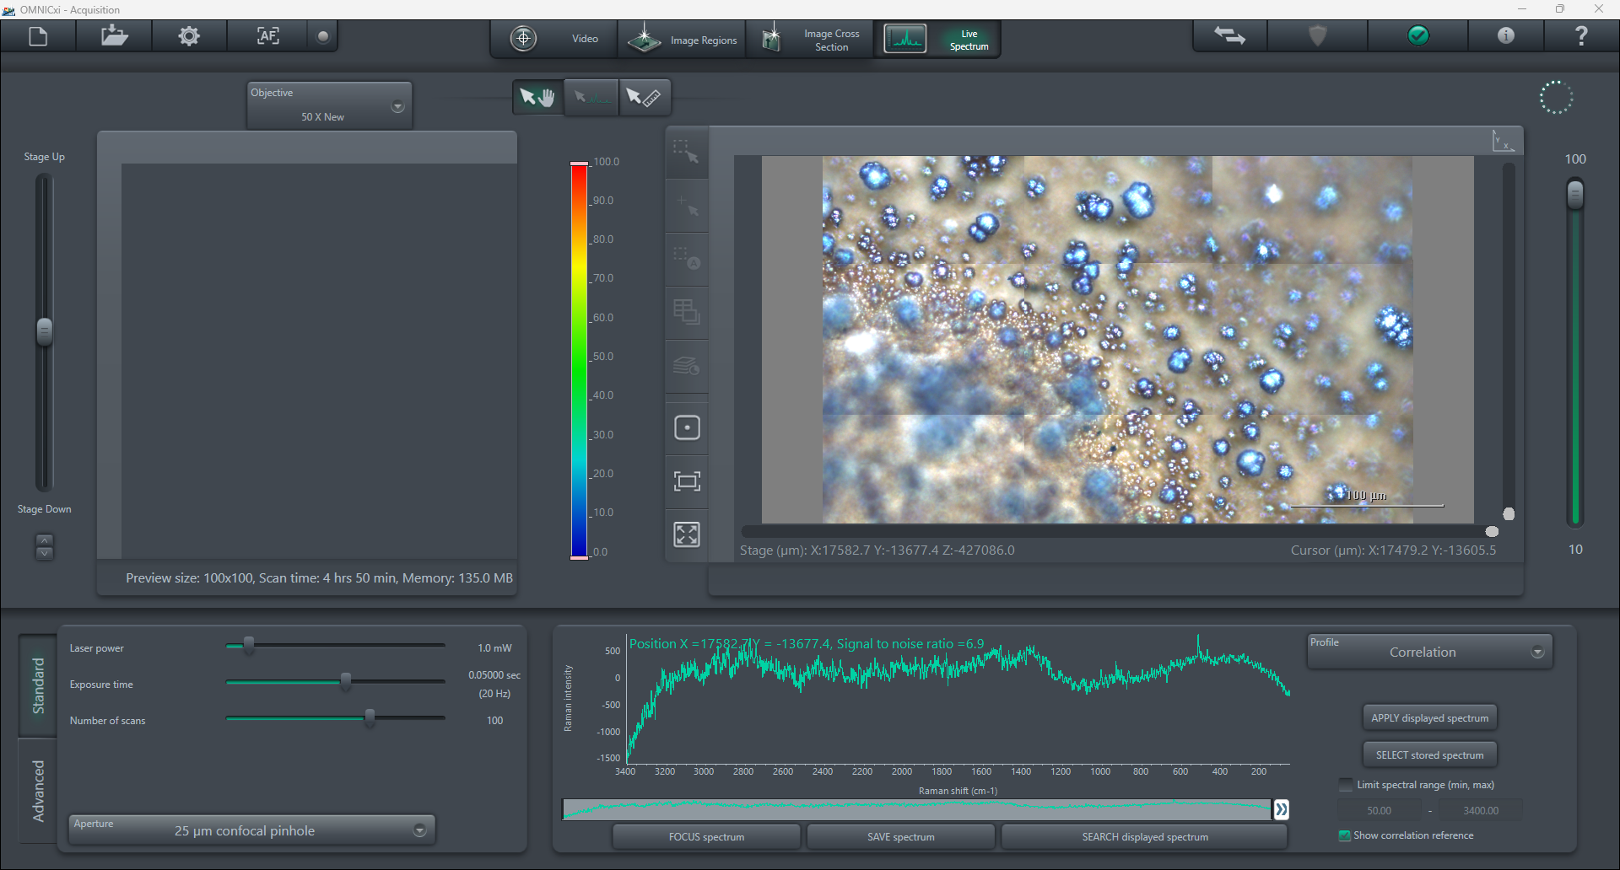
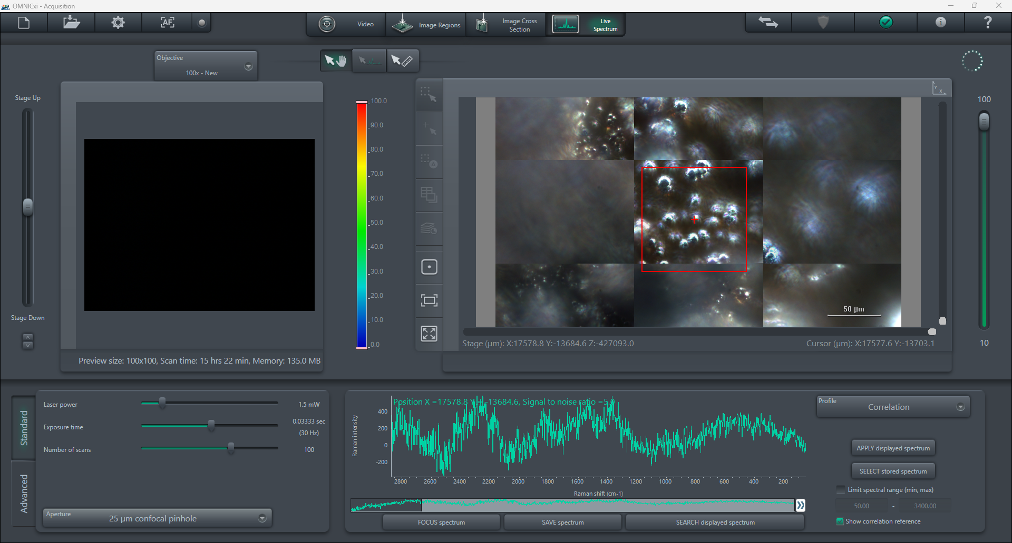



Post Exposure Analysis – Raman Spectroscopy
Reference surface
1
2
3
50 $\text{μm}$
100 $\text{μm}$
Brown area contains “nodule” or “glassy” looking structures → vitrification?
Amorphization stronger at stagnation point and after longer exposure in higher CH₄ concentration
50 $\text{μm}$
CN?
Thanks to Michael Hovish (UK) from The Hovish Research Lab for the sample analysis data

Slide 9
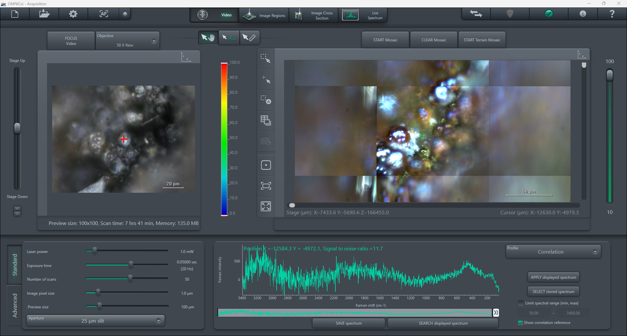
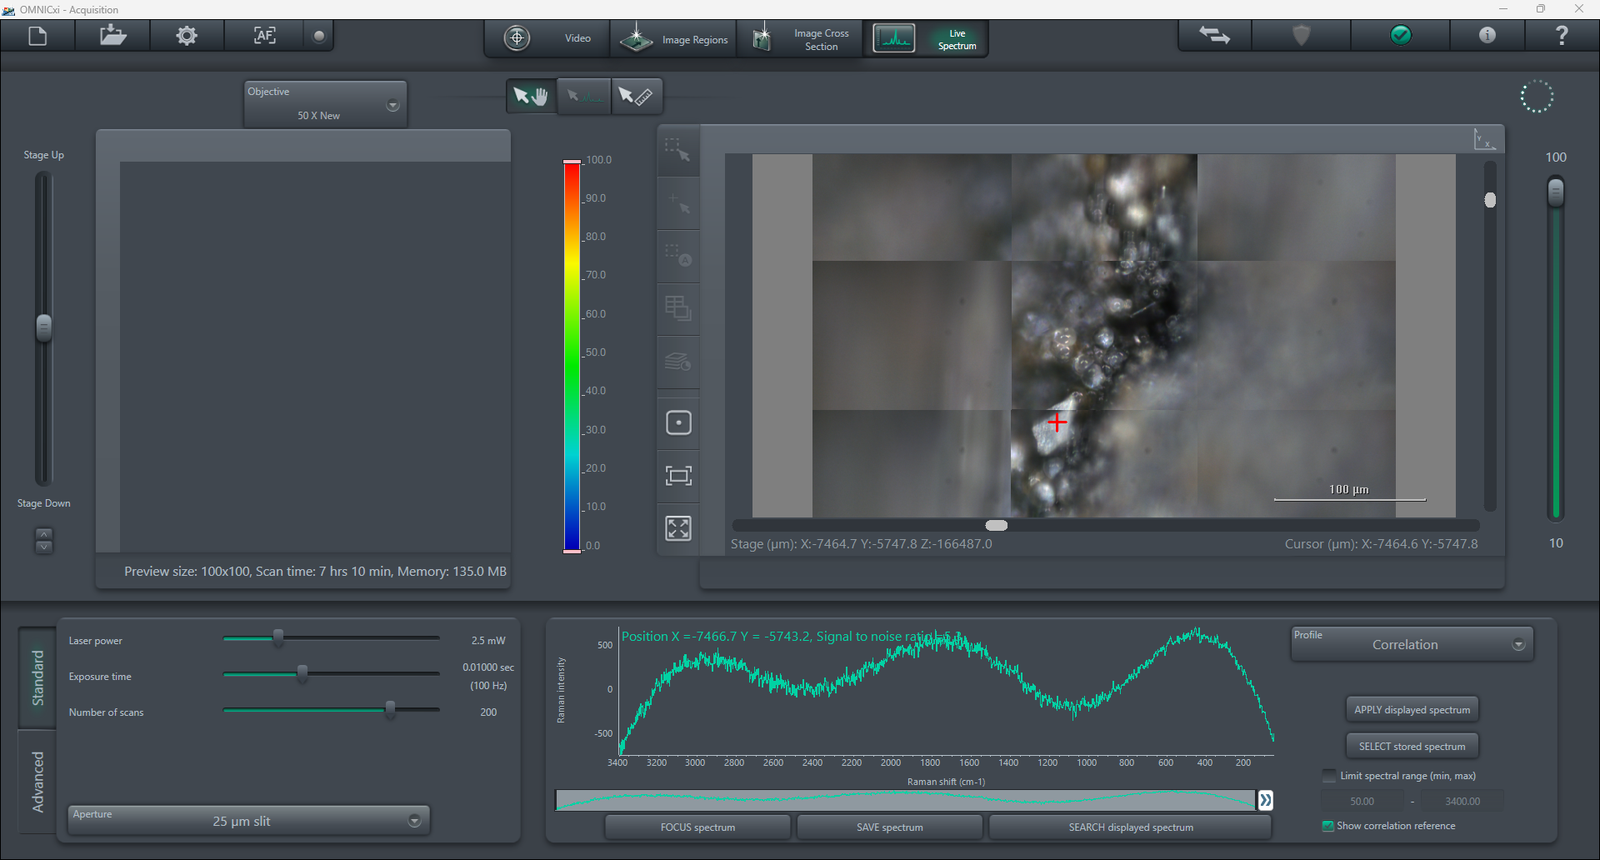


Post Exposure Analysis – Raman Spectroscopy
Reference surface
1
2
3
50 $\text{μm}$
100 $\text{μm}$
Amorphization has progressed even further near stagnation point
Loss of Raman signal due to increase in fluorescence: amorphous carbon, nitrogen-doped carbon, CN_{x}, organic groups
Thanks to Michael Hovish (UK) from The Hovish Research Lab for the sample analysis data

Slide 10
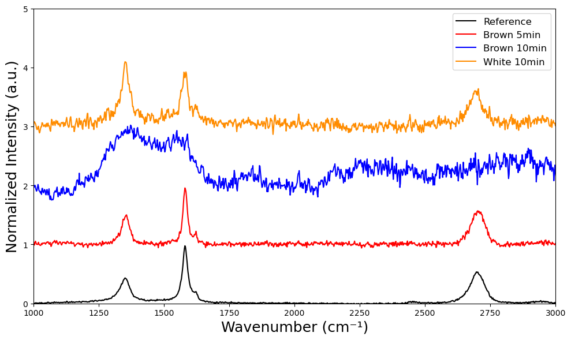
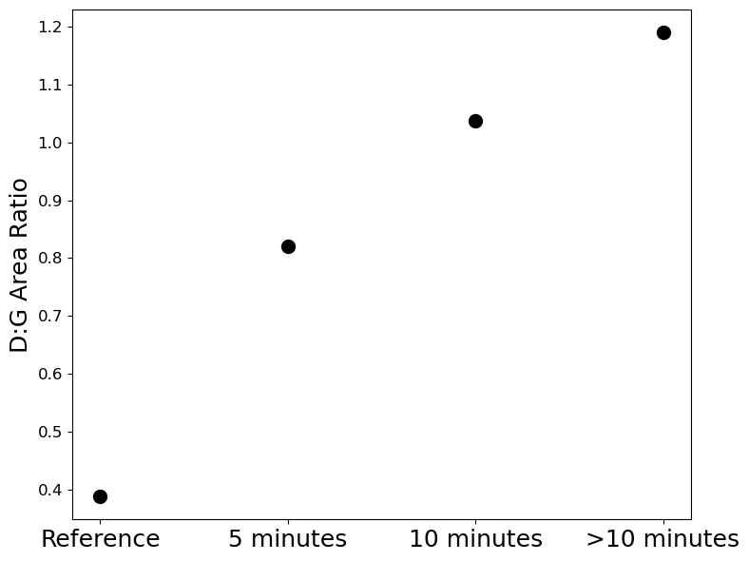
Post Exposure Analysis – Summary
G
D
D*
Brown
White
White
Ref.
increase in disorder
The increase in D:G Area is indicative of increased defect density
The increase in D peak strength is indicative of increased strain
The increase in peak width for both D and G is indicative of amorphization
Increase in disorder and amorphization of graphite due to accumulating defects with exposure time.
Regions exposed to highest heat flux (stagnation point) “degrade” faster: reduced thermal conduction?
Thanks to Michael Hovish (UK) from The Hovish Research Lab for the sample analysis data

Slide 11
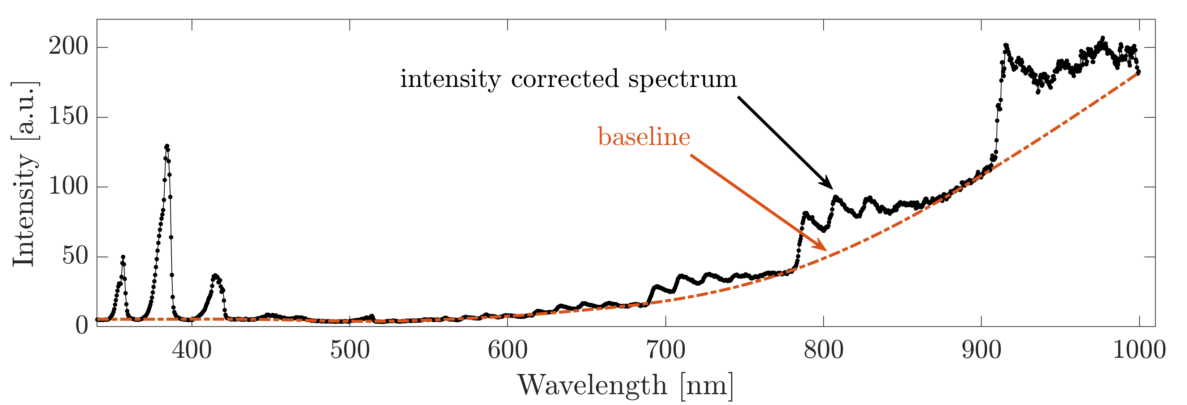
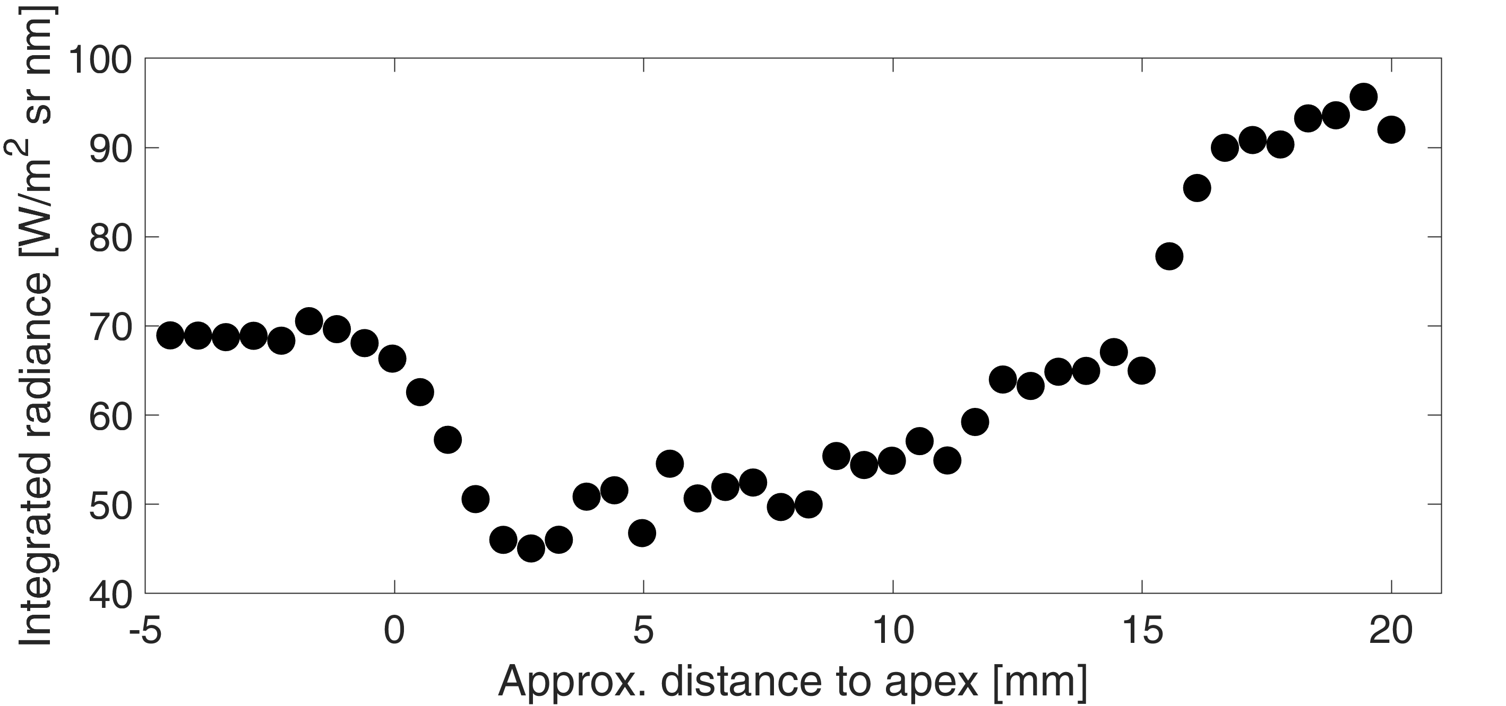
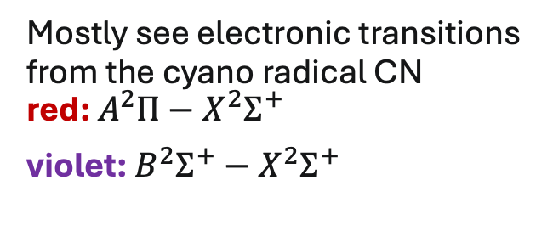
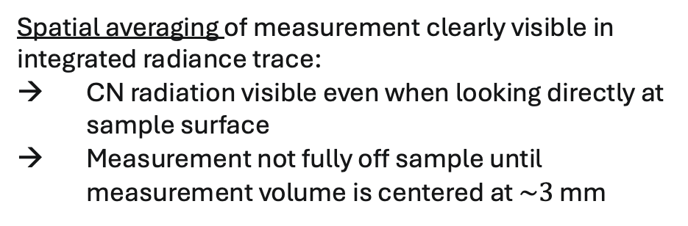
Spectroscopy Data
Mostly see electronic transitions from the cyano radical CN red: $A^{2}Π−X^{2}Σ^{+}$
violet: $B^{2}Σ^{+}−X^{2}Σ^{+}$
CN red
CN violet
Baseline identified using asymmetrically re-weighted least-squares algorithm [1]
CN violet saturated
Spatial averaging of measurement clearly visible in integrated radiance trace:
CN radiation visible even when looking directly at sample surface
Measurement not fully off sample until measurement volume is centered at $\sim 3$ mm
Data points evaluated
[1] Baek et al. "Baseline correction using asymmetrically reweighted penalized least squares smoothing." Analyst (2015).

Slide 12
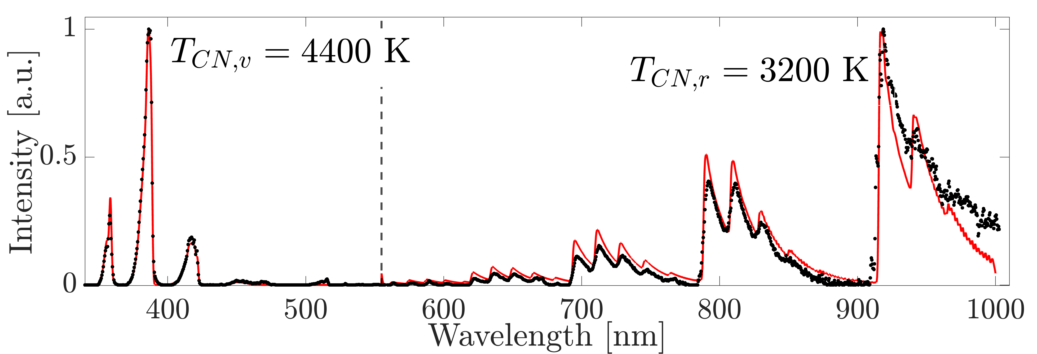
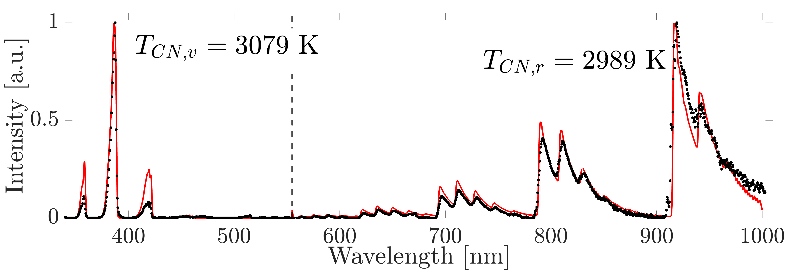
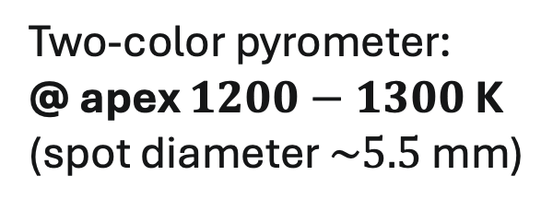
Spectroscopy Data
Fits to CN red and violet system using NASA NEQAIR 15.3:
@1.6 mm
Two-color pyrometer: @ apex $1200−1300$ K (spot diameter $\sim 5.5$ mm)
fit separately
CN violet indicates higher temperature near sample
Higher CN temperatures near sample
Higher degree of nonequilibrium between CN red and violet system
@2.7 mm
fit
measurement

Slide 13
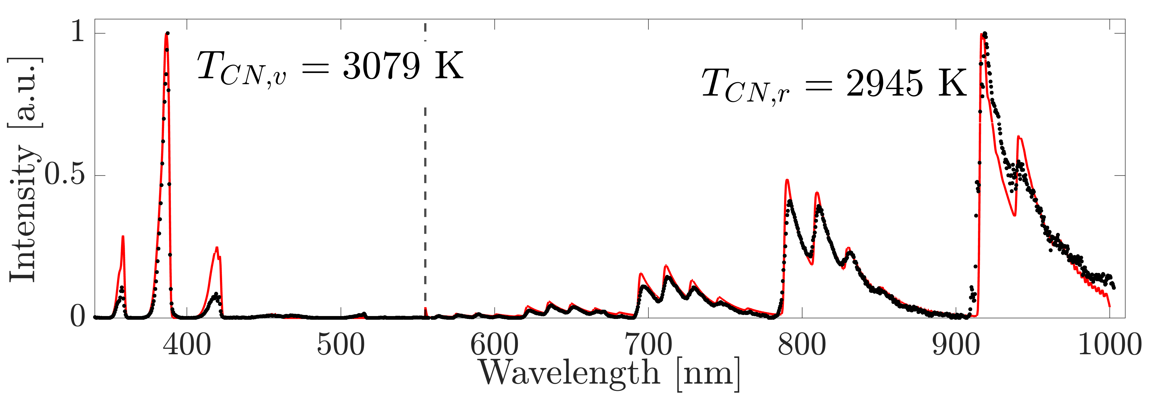
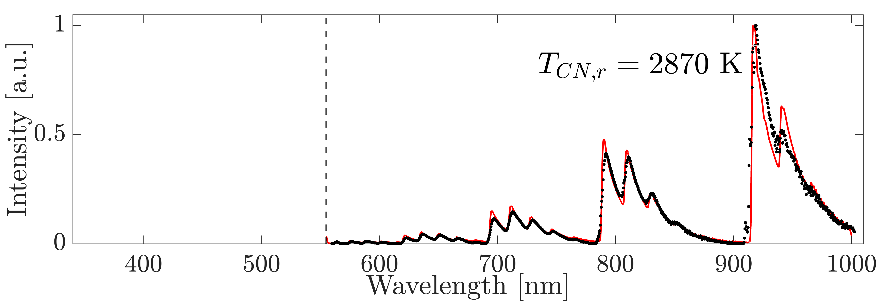

Spectroscopy Data
Fits to CN red and violet system using NASA NEQAIR 15.3:
@6.1 mm
In freestream: CN red and violet temperatures comparable
Inferred CN red temperature drops in freestream, but integrated radiance increases
misfit on CN violet
@20.0 mm
@11.6 mm

Slide 14
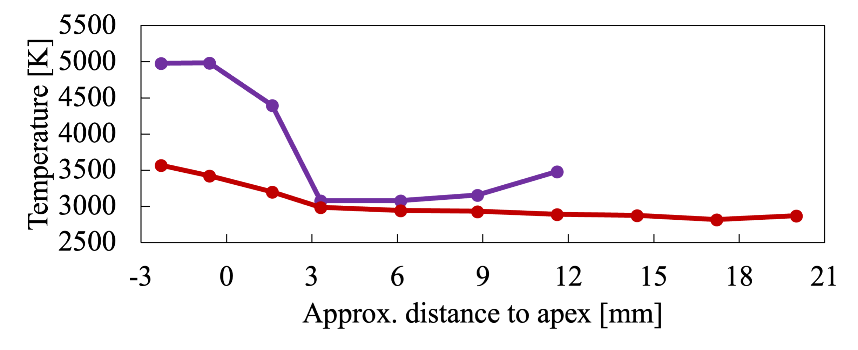
Conclusions
Electronically excited vibrational temperature
Nonequilibrium and CN temperature →influence of surface radiation, line-of-sight, chemistry, misfit, soot component?
Amorphization of carbon suggests changes in material properties
Lowest measured temperature >> surface temperature
Noticeable difference in CN red and violet measuring against sample
Clearer conclusions require higher spatial and spectral resolution for both CN red and violet → ideally measure N₂ separately

Slide 15
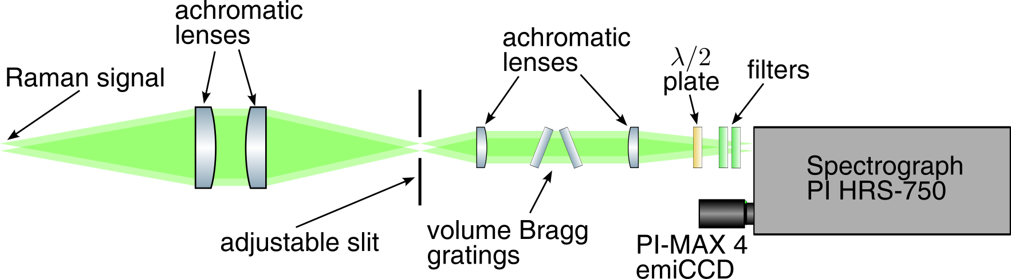
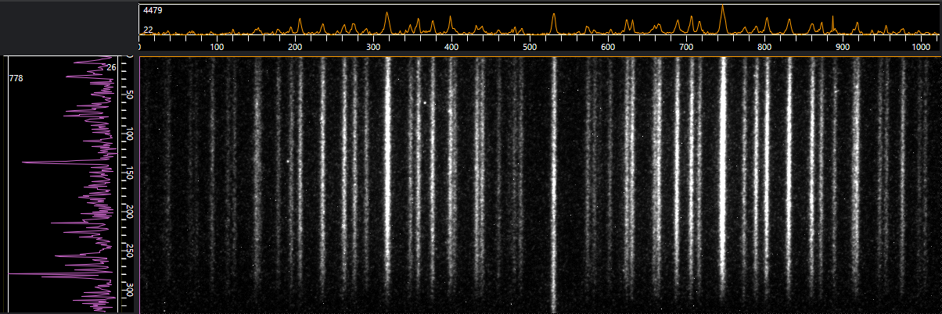
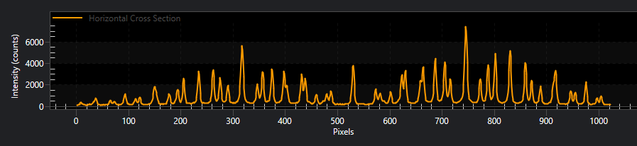
Future Work
Detailed inflow conditions
Abel inverted measurements with imaging spectrometer for higher spectral and spatial resolution
Raman measurements for detailed spatially resolved measurements of rotational and vibrational states
Compare results to existing CN mechanisms and spectroscopy models
Profilometry and XPS on samples to understand graphite processing further
Preliminary 1D-Raman in ambient air → signal scaling suggests measurement possible <1/10 atmosphere

