Slide 1
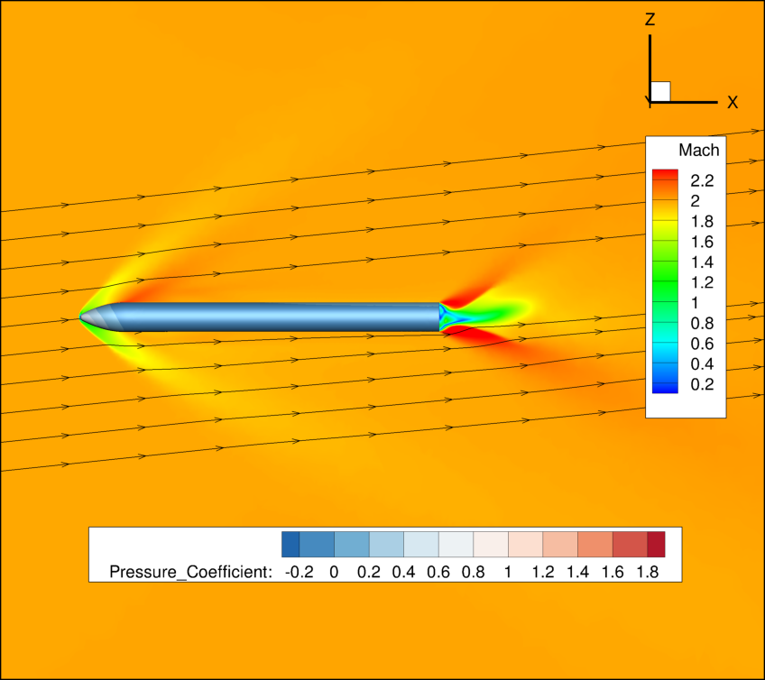


Formulation of an Uncertainty Analysis Methodology for Computational Fluid Dynamics of External Flows over Launch Vehicles
Avery White and Kyle Hanquist: The University of Arizona
Paul Schallhorn and Michael Harris: NASA Kennedy Space Center
Michael Elmore: a.i. solutions, Inc.
TFAWS 2025
6 August 2025

Slide 2
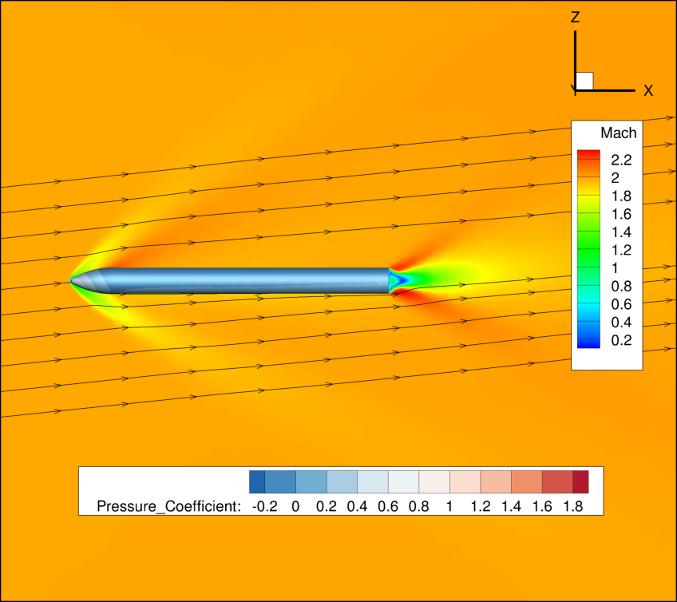
Overview
Motivation and Background
Uncertainty Quantification Methods
Uncertainty Analysis
Test Case Description
Results
Future Work

Slide 3
Motivation and Background

Slide 4
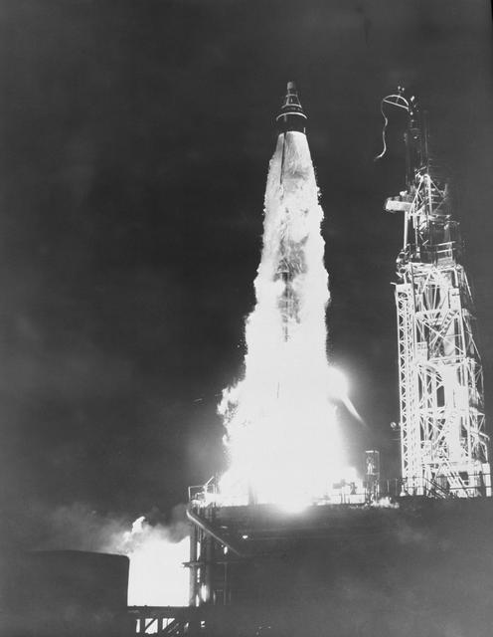
Motivation
Launch vehicles face various harsh conditions throughout the takeoff sequence and often carry delicate and costly payloads
Ground tests provide valuable information but are often expensive
  Difficult to test the entire launch sequence – data points must be carefully chosen
Computational fluid dynamics (CFD) is used to supplement these ground tests and provide preliminary information
As with any measurement, CFD comes with inherent uncertainty
This work introduces a methodology for quantifying the uncertainty in CFD of launch vehicles without the existence of experimental data
Image from NASA

Slide 5
Uncertainty Quantification

Slide 6
Uncertainty Quantification Methods
Methods for calculating uncertainty can be broken down into a few categories:
  Non-probabilistic methods – interval analysis, sensitivity derivatives, fuzzy logic
    Great for small problems, easily implemented
    Not good for large problems, do not provide enough accuracy for aerospace applications
  Probabilistic methods – statistical or non-statistical methods
    Monte Carlo methods – any method that utilizes sequences of random numbers to perform the simulation
      Converges to the exact solution as the number of samples goes to infinity
      Computationally expensive, slow convergence
    Moment methods – Taylor series expansion
      Easily expanded to multiple input parameters, not computationally expensive
      Assumes the mean takes the form of a normal distribution
    Stochastic differential equation methods – add stochastic variables to the deterministic equations
      Can provide more information about higher moments, less computationally expensive than Monte Carlo methods
      Mainly used for structural mechanics problems
For this work, we are using moment methods
  First moment is the mean
  Second moment is the variance

Slide 7
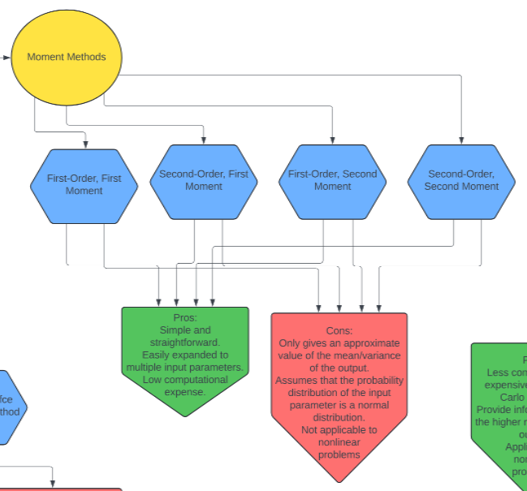
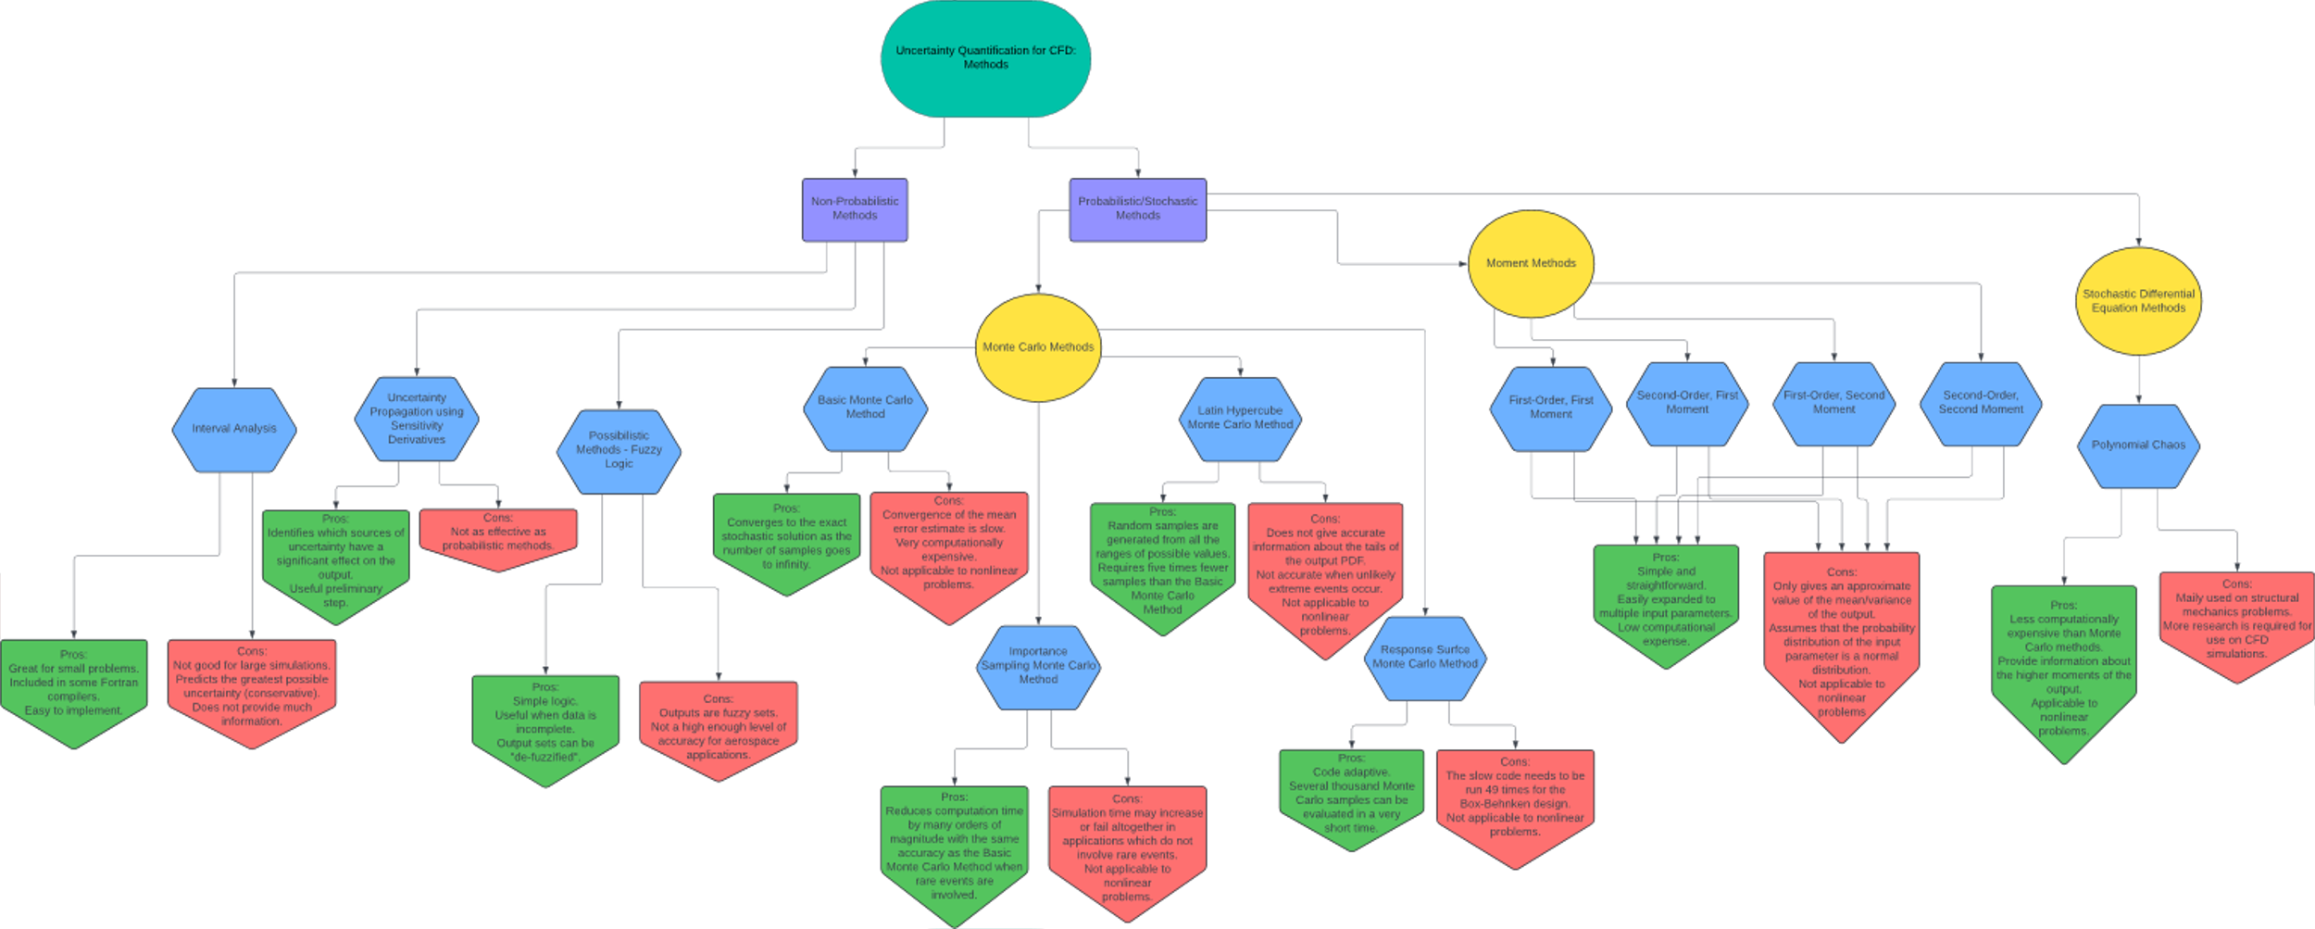


Uncertainty Quantification Methods

Slide 8
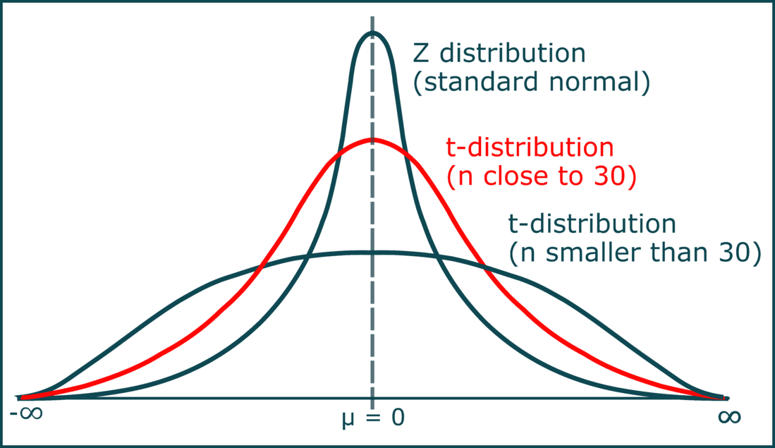
Adapting the Method of Moments
First order first moment and second order first moment methods involve using a Taylor series expansion about the mean value of a dataset
In order to avoid the assumption that the probability distribution is a normal distribution, a coverage factor is introduced which comes from Student's t-distribution
  This is often used in experimental uncertainty calculations in which limited data is present
  The coverage factor is based on the number of simulations completed for each configuration

Slide 9
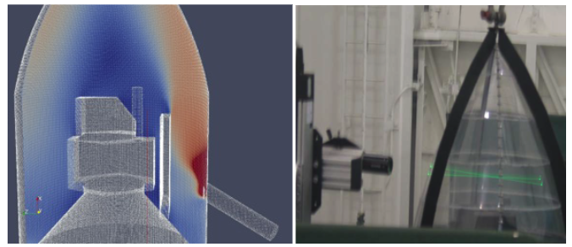
Adapting Other Methodologies
Using methodology developed by Coleman and Steele for experimental approaches on uncertainty quantification
Using methodology developed by Groves for computational fluid dynamics on internal flows
  Payload fairing spacecraft environmental control systems
  Low speed, incompressible flows
Image from Groves et. Al. [1]
[1] Groves, C. E., Ilie, M., and Schallhorn, P., “Computational Fluid Dynamics Uncertainty Analysis for Payload Fairing Spacecraft
Environmental Control Systems,” 52nd Aerospace Sciences Meeting, AIAA Paper 2014-0440, National Harbor, Maryland,
2014. https://doi.org/10.2514/6.2014-0440.

Slide 10
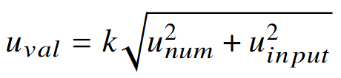

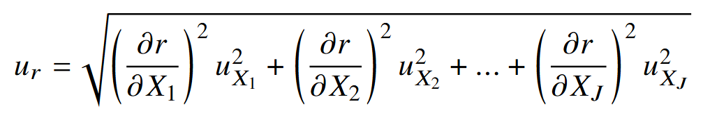
Uncertainty Analysis - First Order First Moment
The total uncertainty can be found from the numerical (aleatory) uncertainty and the input (epistemic) uncertainty:
For this preliminary work, we will ignore the numerical uncertainty and focus on expanding the uncertainty from the input parameters
For some CFD output, r, being a function of J inputs:
The combined standard uncertainty is given by:
With the uncertainty from the input parameter being the average value of the result
What happens if the input parameter is also based on a set of parameters?

Slide 11

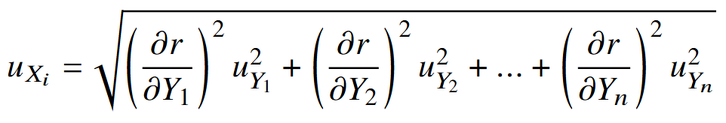
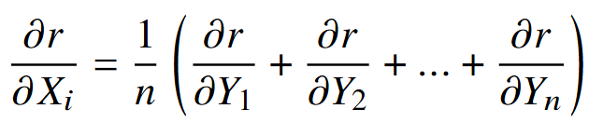
Uncertainty Analysis - Second Order First Moment
If the input parameters are also based on their own variable parameters, use second order method
If the input parameter, X, is a function of Y additional parameters,
The uncertainty contribution from that input parameter can be written as:
With partial derivatives calculated as follows:

Slide 12
Test Case Description

Slide 13
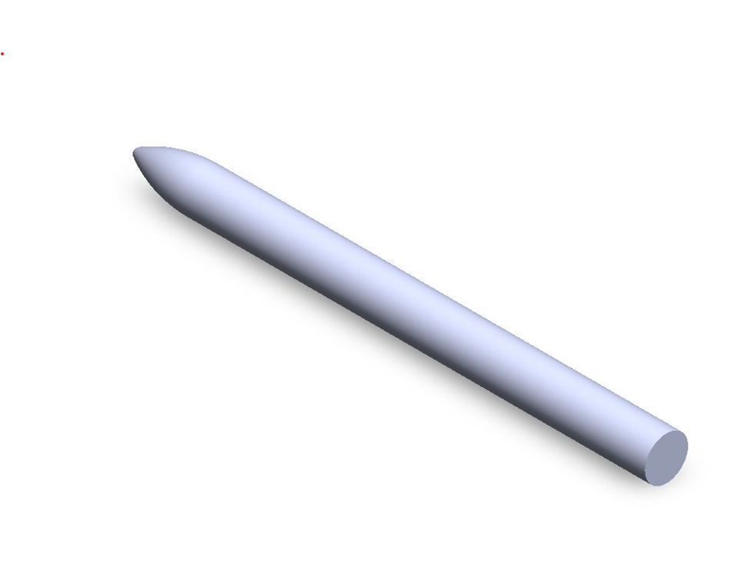
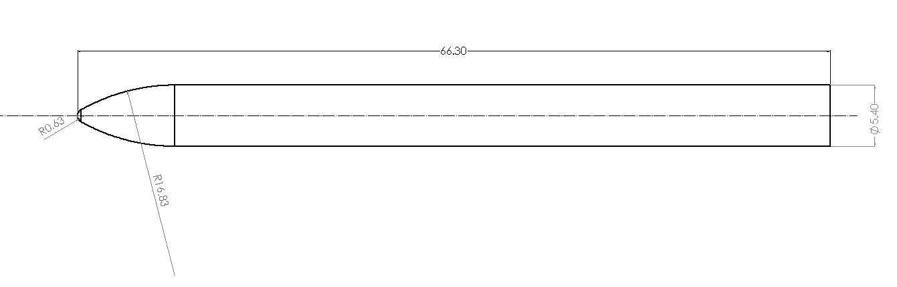
Test Case Description
A simple test case was constructed using a generic launch vehicle with a spherically blunted tangent ogive nose cone

Slide 14
Mesh Description
Five meshes were constructed using Pointwise's T-Rex technique
  Source with constant cell spacing was used to control coarseness
  Boundary layer was captured using a first cell spacing of 1E-4 and a growth rate of 1.1
  Ten vehicle lengths were included behind the vehicle to capture wake effects
Mesh Number | Source Radius | Source Length | Source Cell Size | Number of Cells
1 | 5 | 75 | 0.5 | 5,006,420
2 | 5 | 75 | 0.1 | 30,177,456
3 | 10 | 75 | 0.5 | 5,663,259
4 | 5 | 100 | 0.5 | 5,076,091
5 | 5 | 100 | 0.1 | 41,972,093

Slide 15
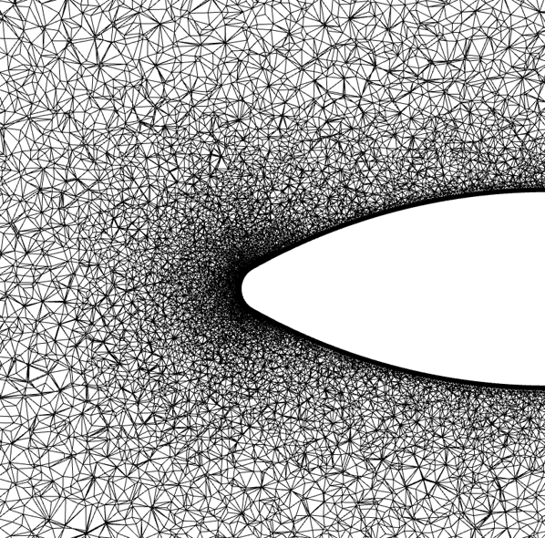
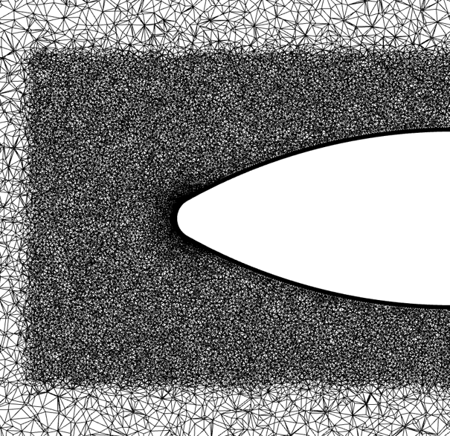
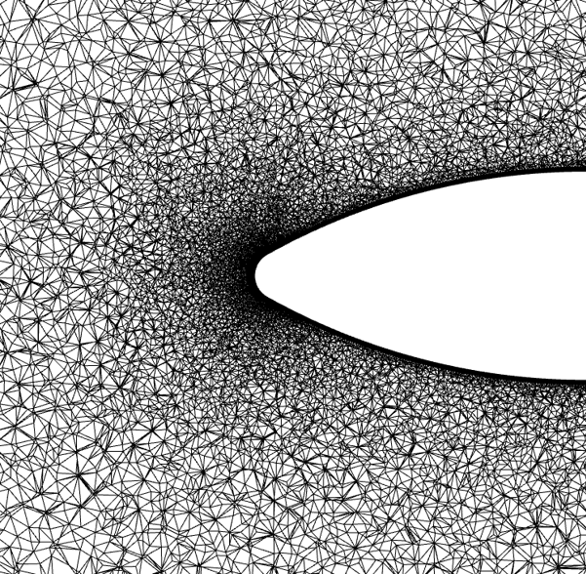
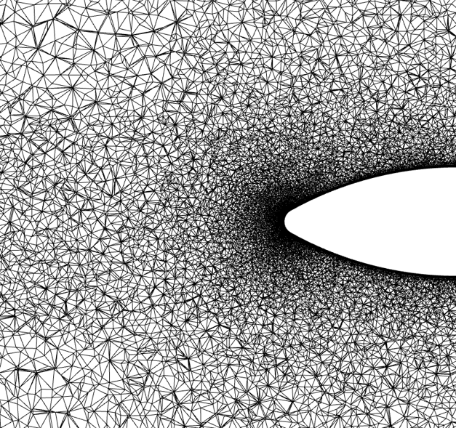
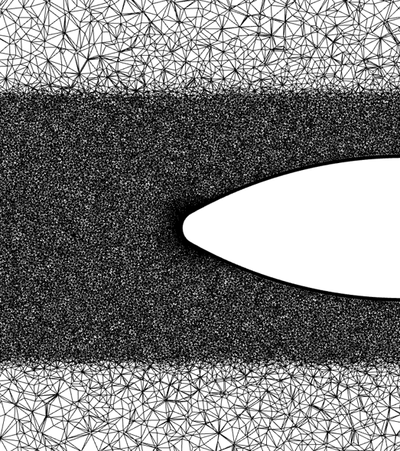
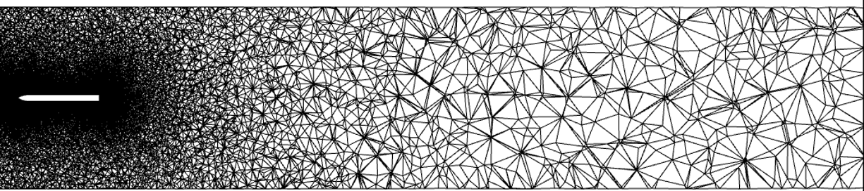
Mesh Description
Mesh 1
Mesh 2
Mesh 3
Mesh 4
Mesh 5
Mesh 1 Full

Slide 16
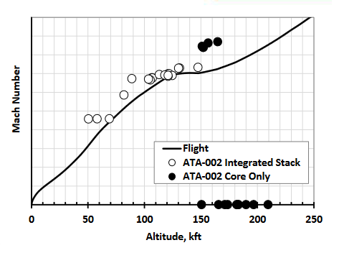
Input Parameters
Mach 2.0 was chosen as an initial starting point
Corresponding altitude of ~30,000 ft
1976 Standard Atmosphere was used to calculate freestream pressure and temperature
Image from Defrene et. Al. [2]
[2] Dufrene, A., MacLean, M., Holden, M., Mehta, M., and Seaford, M., “Space Launch System Base Heating Test: Experimental
Operations and Results,” , Jan. 2016. URL https://web.archive.org/web/20190429090136id_/https://ntrs.nasa.gov/archive/nasa/casi.ntrs.nasa.gov/20160001817.pdf.

Slide 17
Input Parameters
A total of 10 cases were run for each configuration, this gives us a coverage factor of 1.833
Mesh 1, Mach 2.0, with the Shear Stress Transport turbulence model was used as the baseline case for the analysis
The same mesh was used for both turbulence models – possibly introducing more error
  This is common practice for many CFD users
 |  |  | Configuration
Case Number | Parameter |  | 0 Degrees AoA | 6 Degrees AoA
1 | Mesh | Mesh 1 | 1 | 1
2 |  | Mesh 2 | 2 | 2
3 |  | Mesh 3 | 3 | 3
4 |  | Mesh 4 | 4 | 4
5 |  | Mesh 5 | 5 | 5
6 | Boundary Condition | Mach - 5% | 6 | 6
7 |  | Mach +/- 0% | 7 | 7
8 |  | Mach + 5% | 8 | 8
9 | Turbulence Model | Spalart-Allmaras | 9 | 9
10 |  | Shear Stress Transport | 10 | 10

Slide 18
Results

Slide 19
Results
The aerodynamic coefficients are output by the CFD solver upon completion
  CL is the lift coefficient
  CD is the drag coefficient
  CMX is the rolling moment coefficient
  CMY is the pitching moment coefficient
  CMZ is the yawing moment coefficient
 | Mesh 2 | Mach Baseline
 | Angle of Attack | 0 degrees | 6 degrees
Shear Stress Transport | CL | 0.000154 | 0.030719
 | CD | 0.037881 | 0.041893
 | CMx | 0.000001 | 0.000002
 | CMy | -0.004990 | -0.495014
 | CMz | -0.002349 | -0.000902
 | Mesh 3 | Mach Baseline
 | Angle of Attack | 0 degrees | 6 degrees
Shear Stress Transport | CL | 0.001029 | 0.063555
 | CD | 0.039892 | 0.047398
 | CMx | 0.000002 | 0.000005
 | CMy | 0.001806 | -1.780981
 | CMz | -0.004219 | -0.002216
 | Mesh 1 | Mach - 5% |  | Mach Baseline |  | Mach + 5%
 | Angle of Attack | 0 degrees | 6 degrees | 0 degrees | 6 degrees | 0 degrees | 6 degrees
Spalart-Allmaras | CL |  |  | -0.001168 | 0.054496
 | CD |  |  | 0.040206 | 0.046212
 | CMx |  |  | 0.000001 | 0.000004
 | CMy |  |  | 0.030040 | -1.526265
 | CMz |  |  | 0.002632 | 0.001183
Shear Stress Transport | CL | 0.000428 | 0.069069 | 0.000564 | 0.067977 | 0.001171 | 0.066865
 | CD | 0.043195 | 0.049761 | 0.041294 | 0.047937 | 0.039244 | 0.046229
 | CMx | 0.000002 | 0.000005 | 0.000002 | 0.000005 | 0.000002 | 0.000005
 | CMy | -0.024661 | -2.069780 | -0.025681 | -2.016400 | -0.029003 | -1.964558
 | CMz | 0.007575 | -0.004533 | 0.005838 | -0.005253 | -0.000787 | -0.005864
Baseline Case Values
 | Mesh 4 | Mach Baseline
 | Angle of Attack | 0 degrees | 6 degrees
Shear Stress Transport | CL | 0.001522 | 0.067774
 | CD | 0.040540 | 0.048020
 | CMx | 0.000001 | 0.000005
 | CMy | -0.025546 | -2.008672
 | CMz | -0.004545 | -0.002233
 | Mesh 5 | Mach Baseline
 | Angle of Attack | 0 degrees | 6 degrees
Shear Stress Transport | CL | -0.000028 | 0.063930
 | CD | 0.036864 | 0.039971
 | CMx | 0.000001 | 0.000003
 | CMy | 0.001062 | 0.681614
 | CMz | -0.000123 | 0.002436

Slide 20
Results
Uncertainty was calculated using the equations presented previously and is presented as a raw value and as a percentage of the baseline value for each coefficient
Total Uncertainty
 | 0 degrees | 6 degrees
CL | 2.75E-06 | 1.82E-04
CD | 4.16E-06 | 3.97E-06
CMx | 9.17E-13 | 9.17E-13
CMy | 2.85E-03 | 5.05E+00
CMz | 6.81E-05 | 3.80E-05
Normalized Uncertainty
 | 0 degrees | 6 degrees
CL | 0.49% | 0.27%
CD | 0.01% | 0.01%
CMx | 0.00% | 0.00%
CMy | 11.08% | 250.58%
CMz | 1.17% | 0.72%

Slide 21
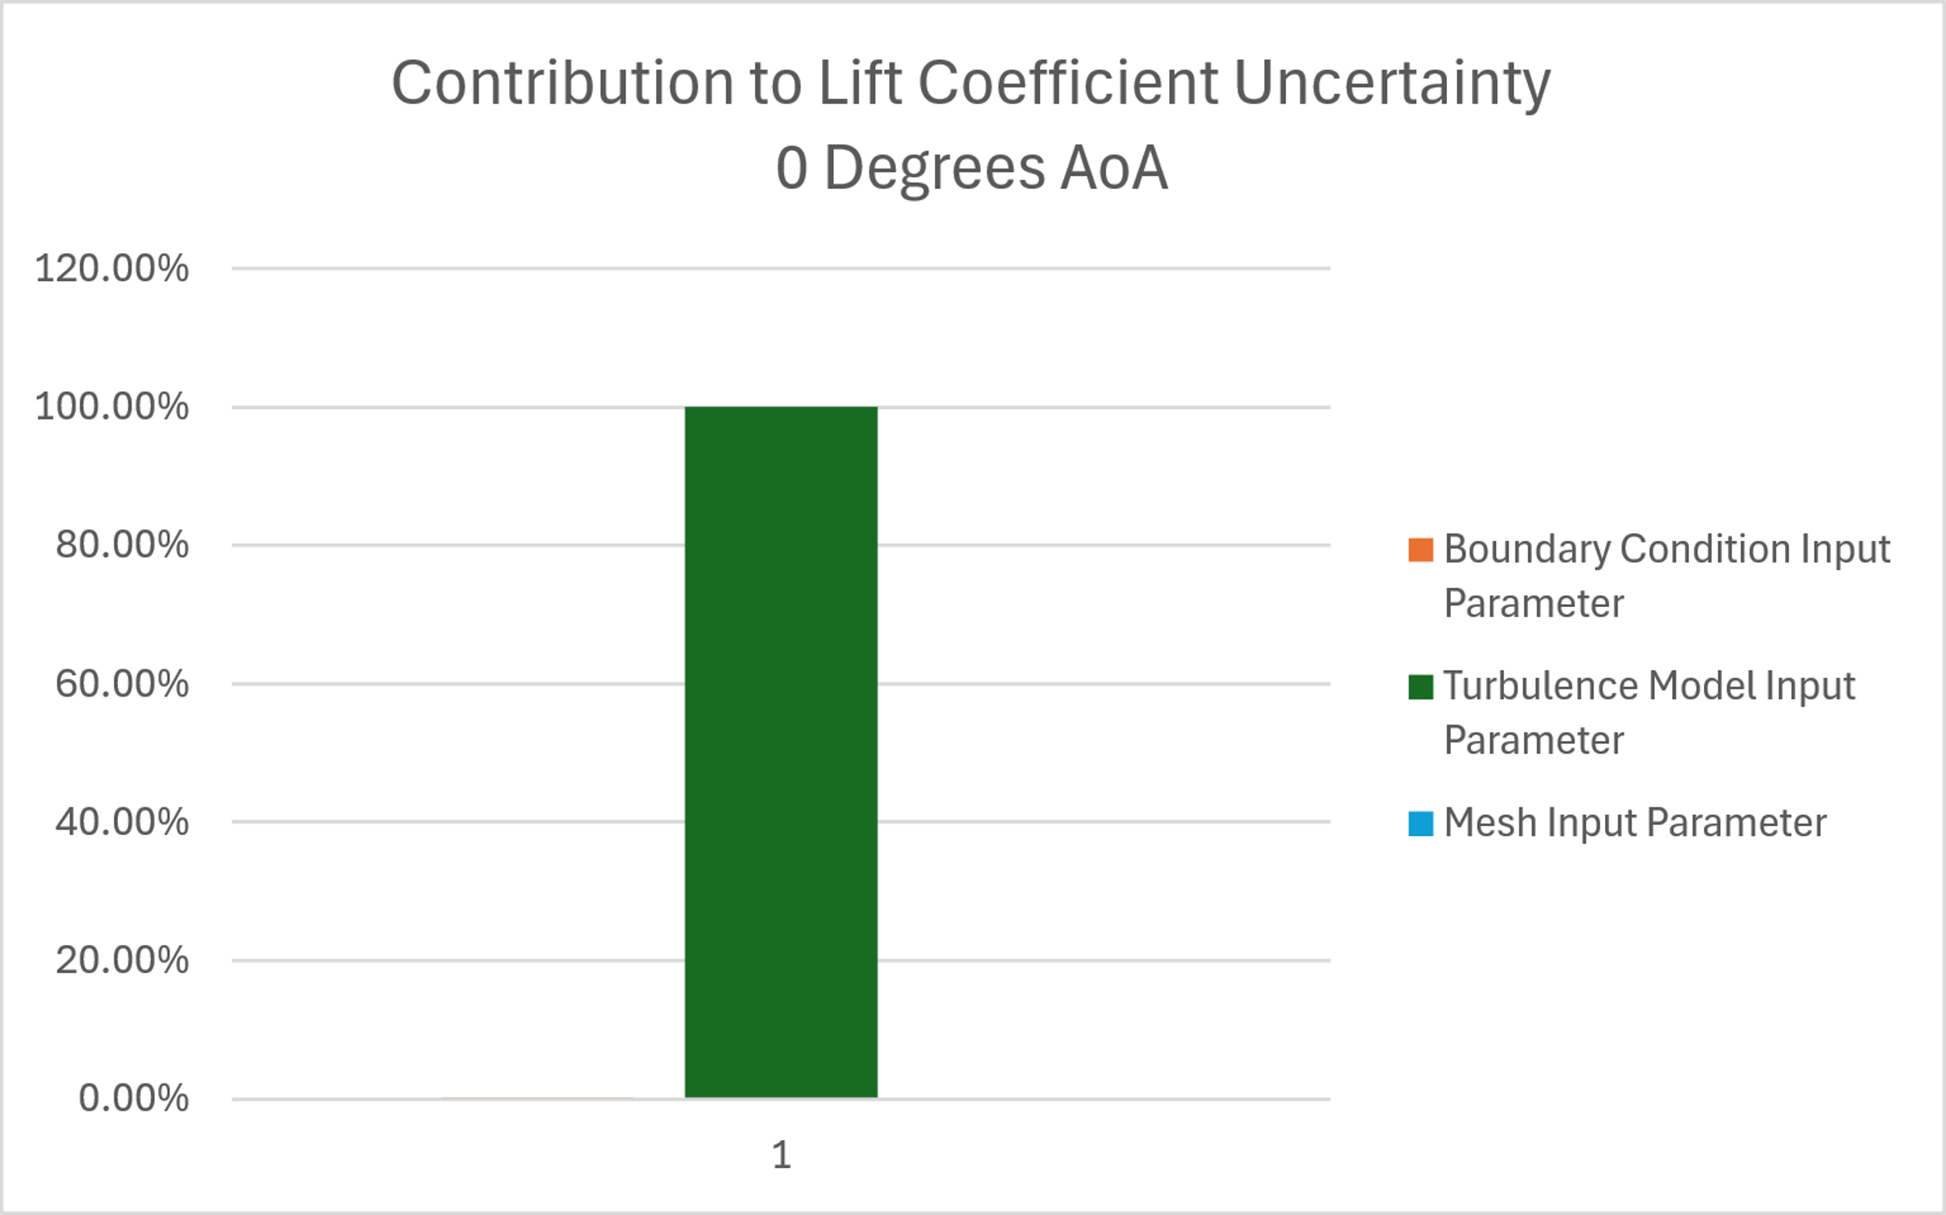
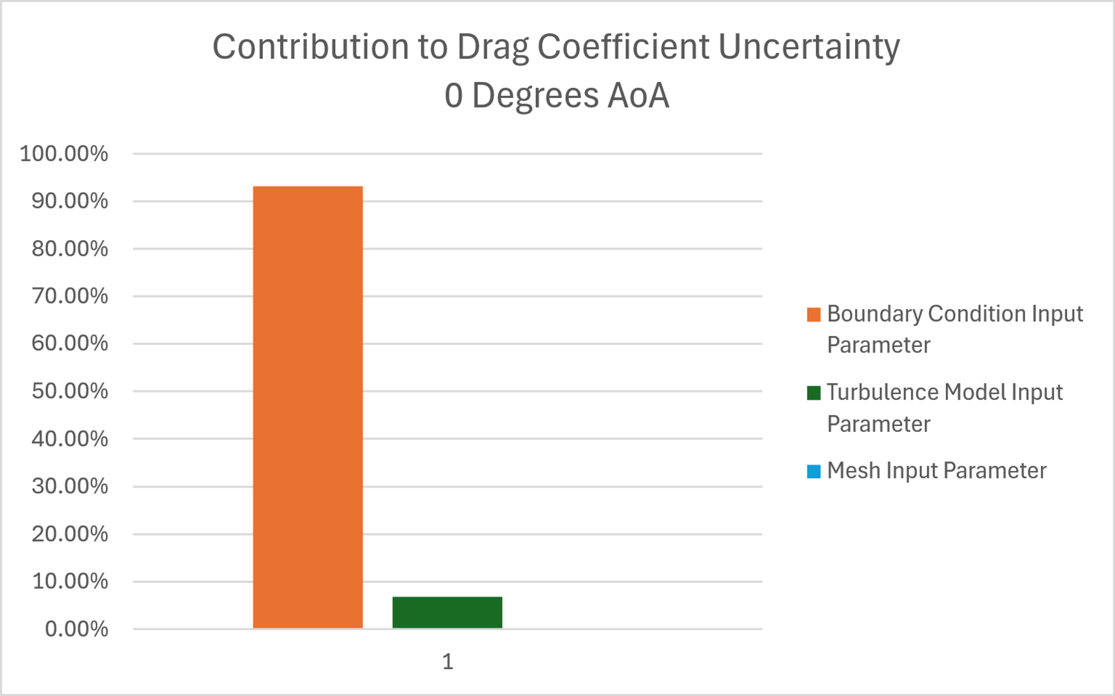
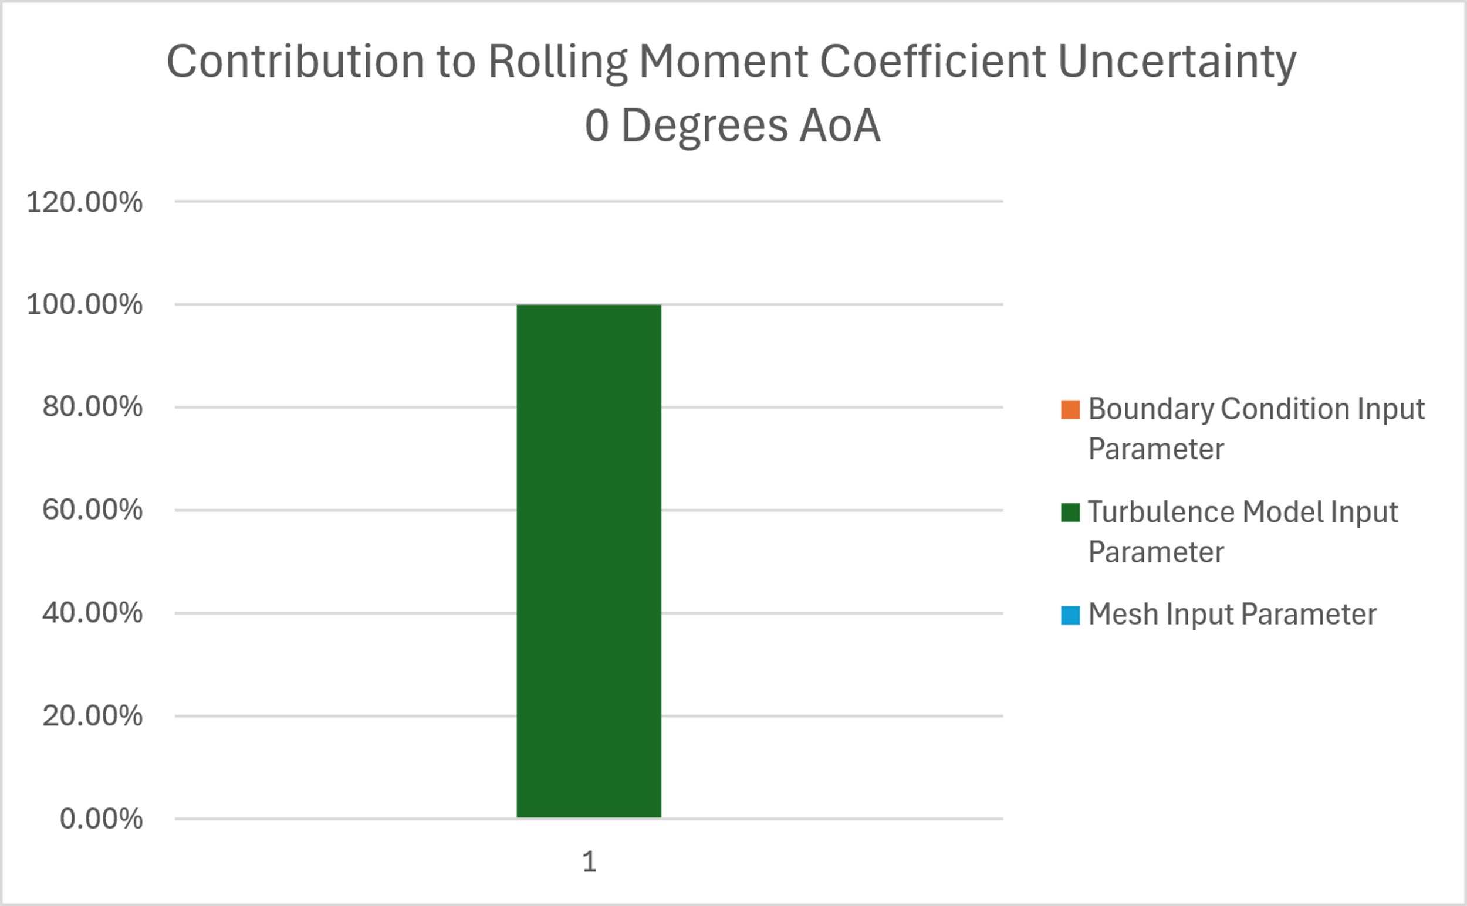
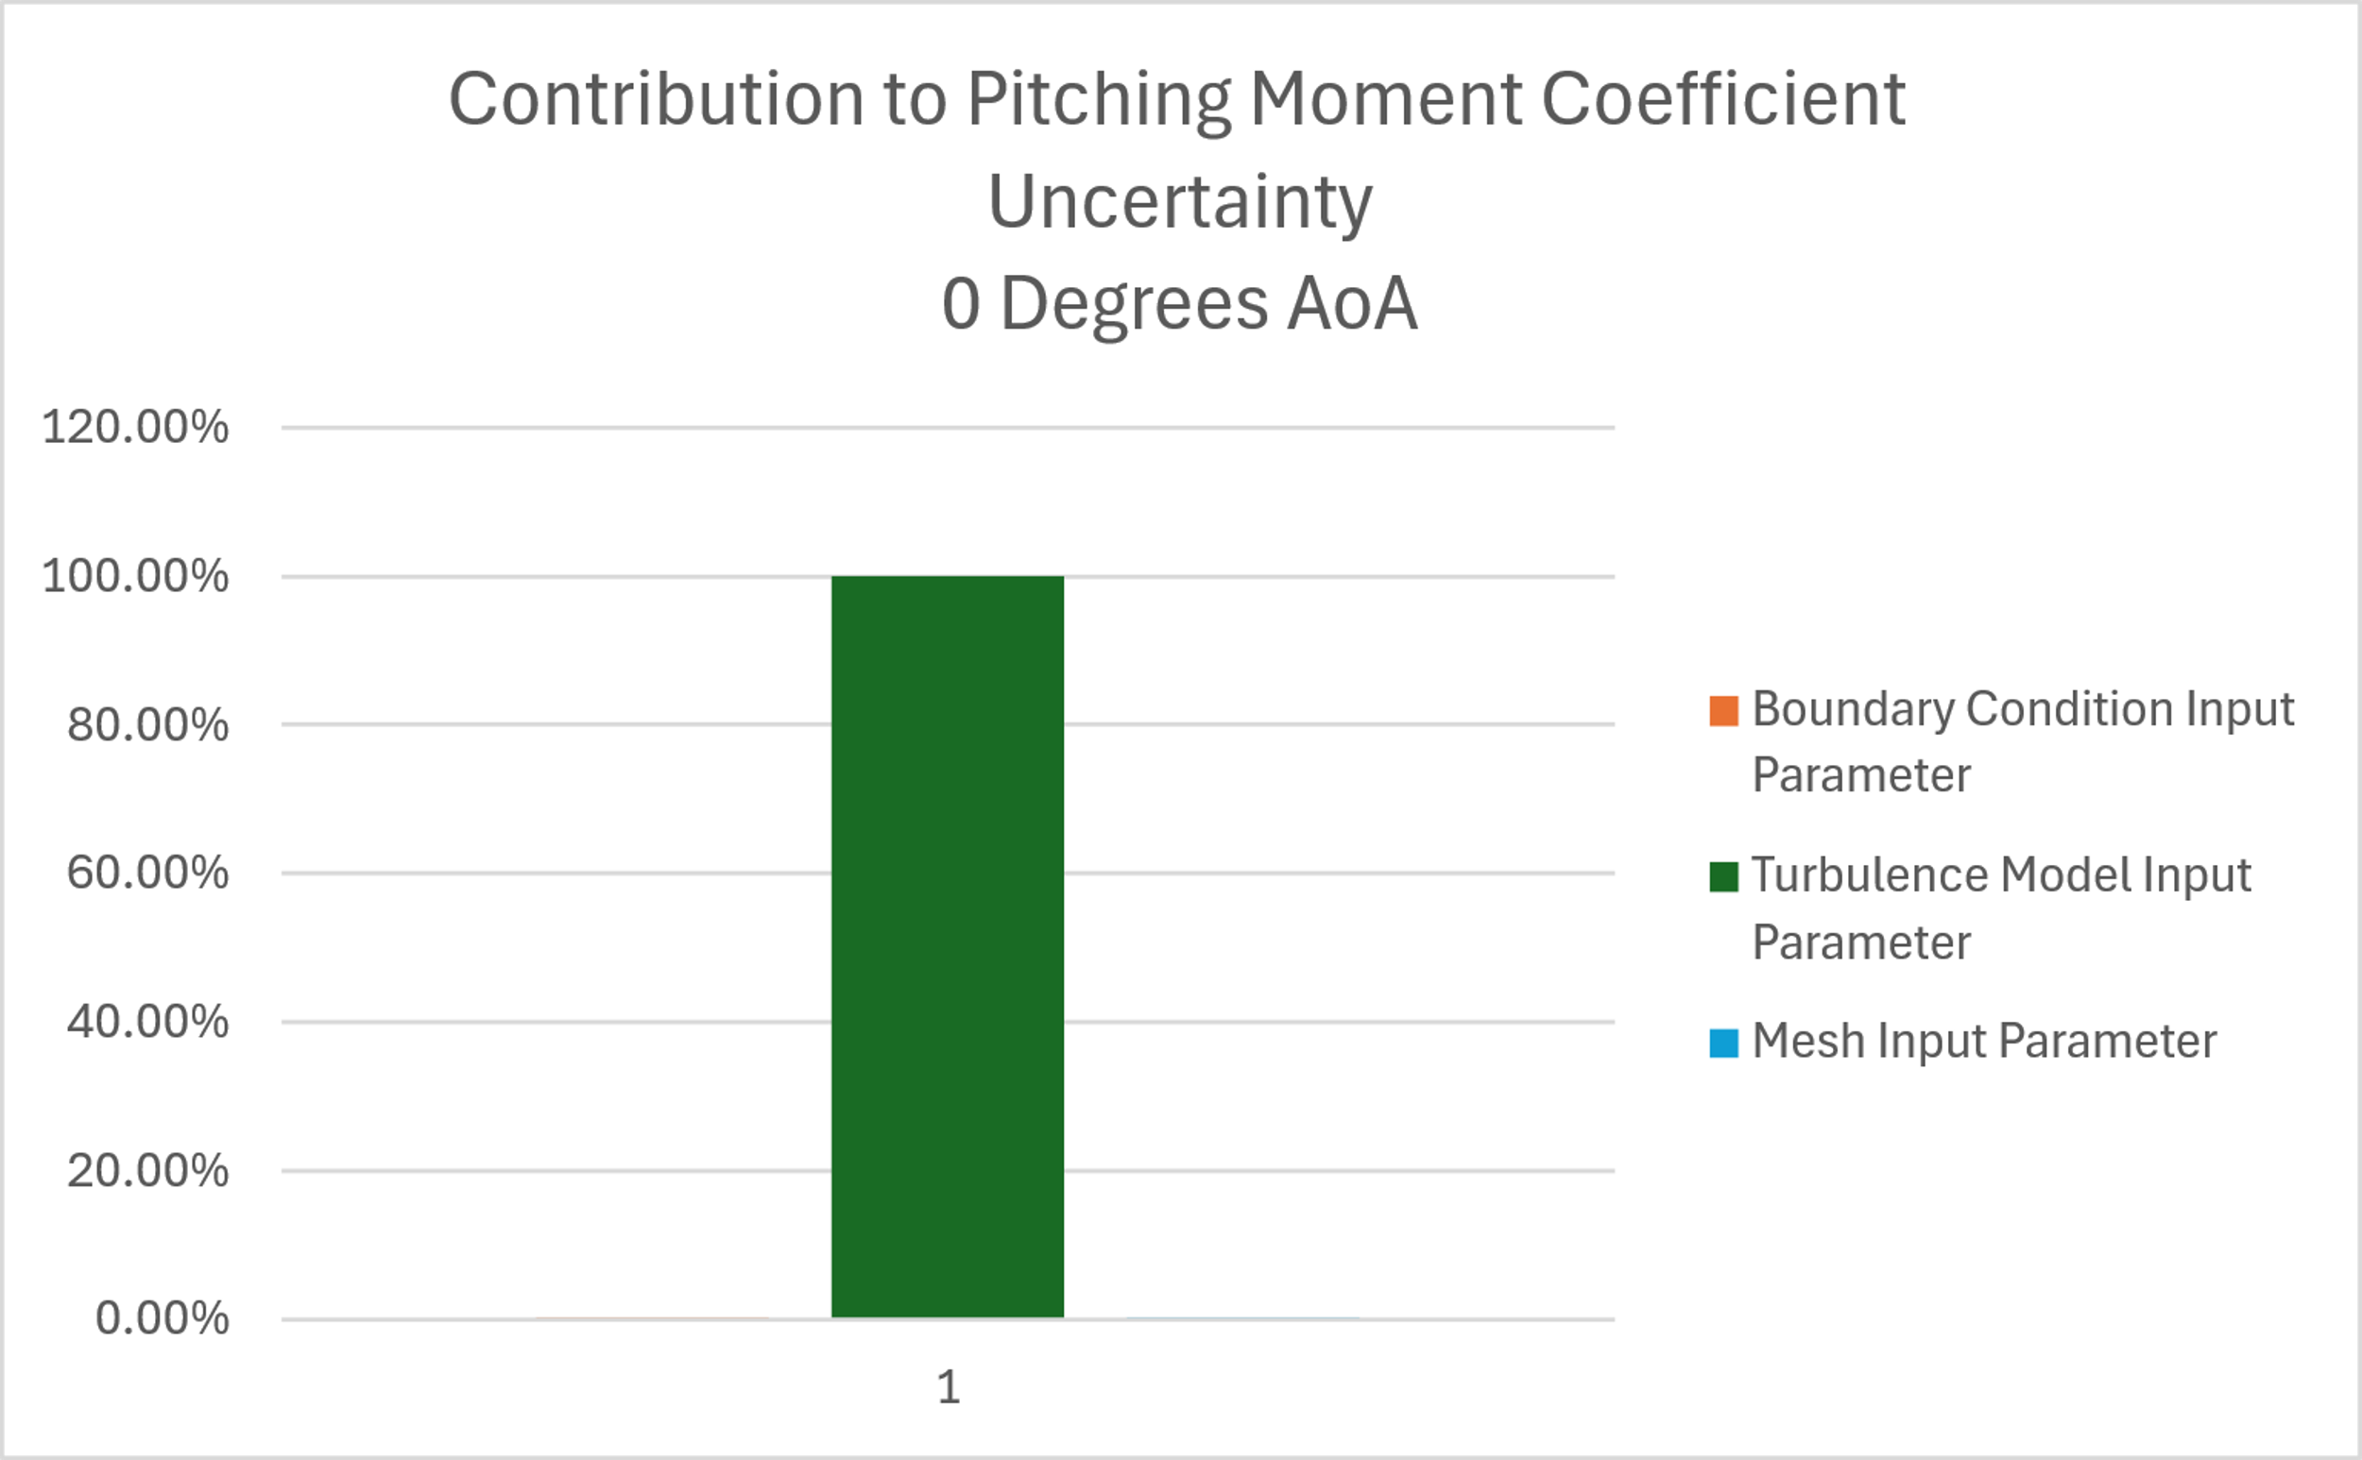
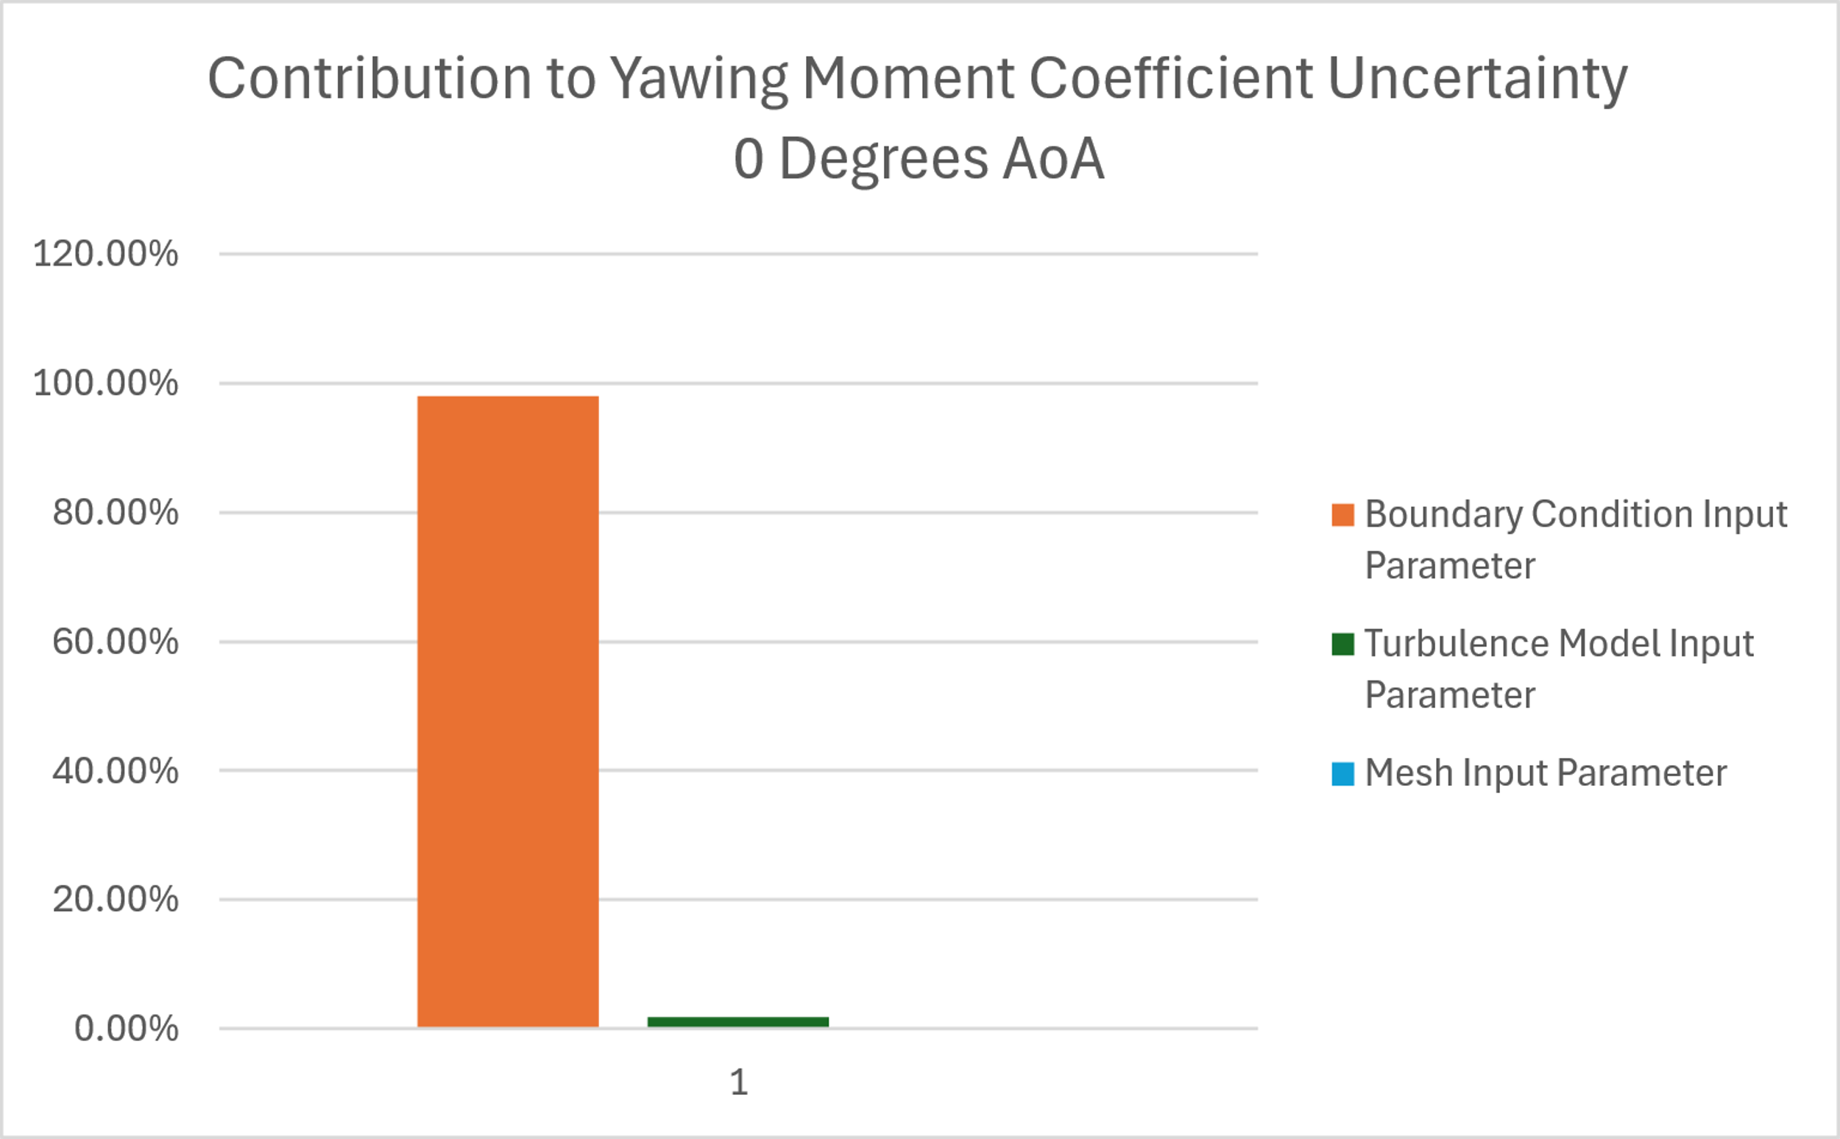
Results
The contribution from each input parameter was calculated from the total uncertainty and is presented as a percentage of the total uncertainty

Slide 22
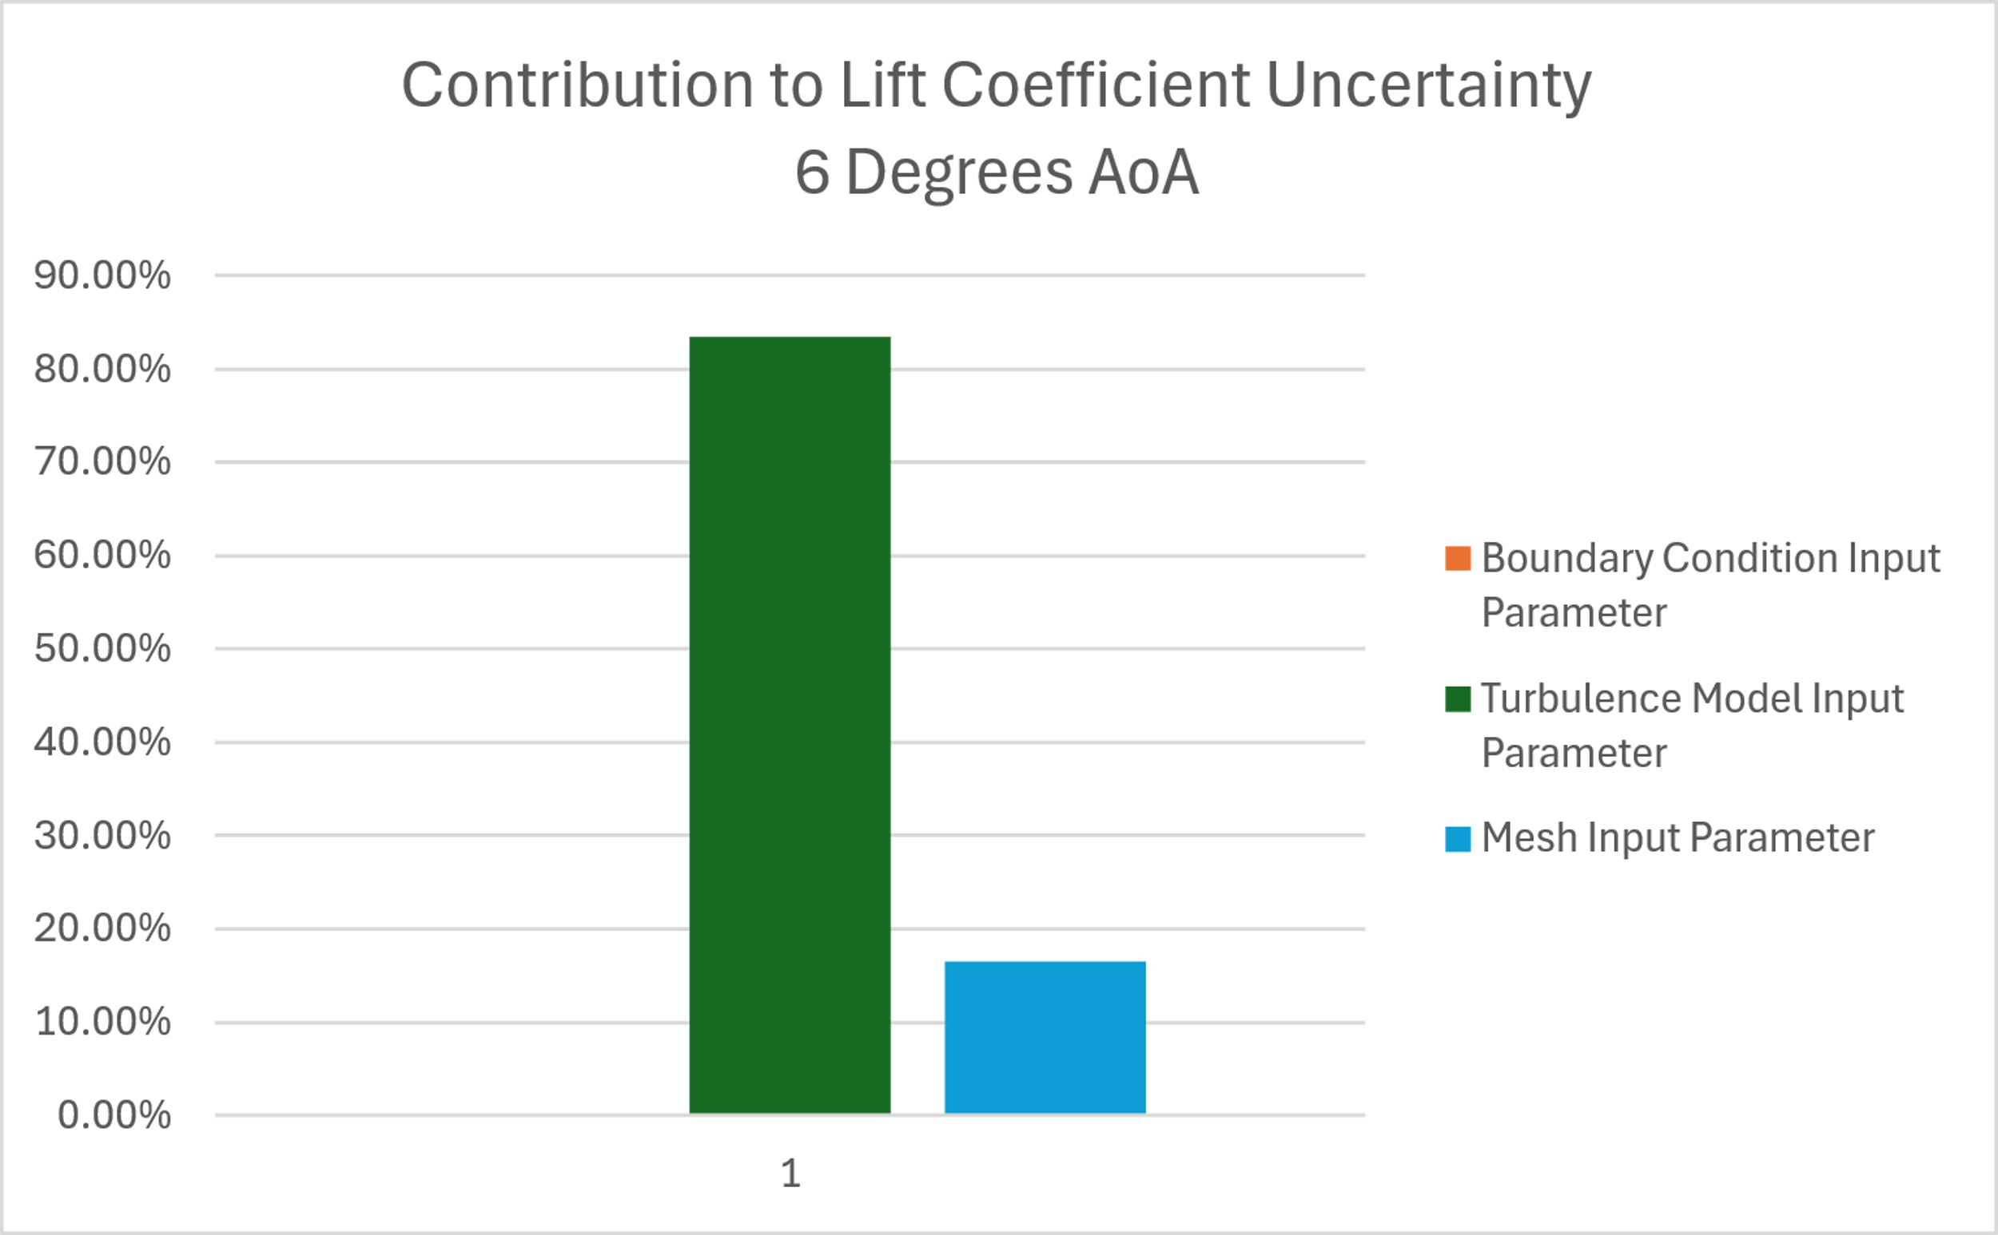
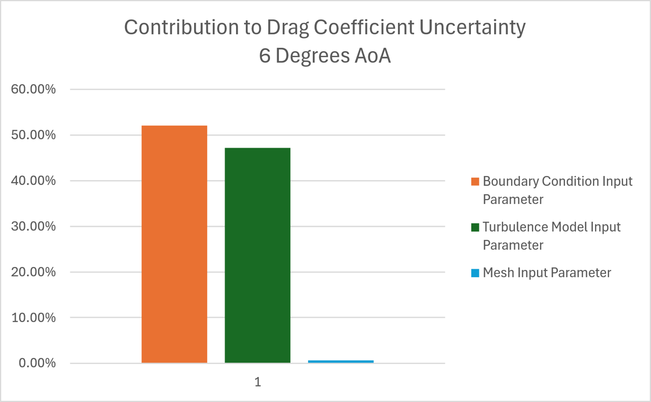

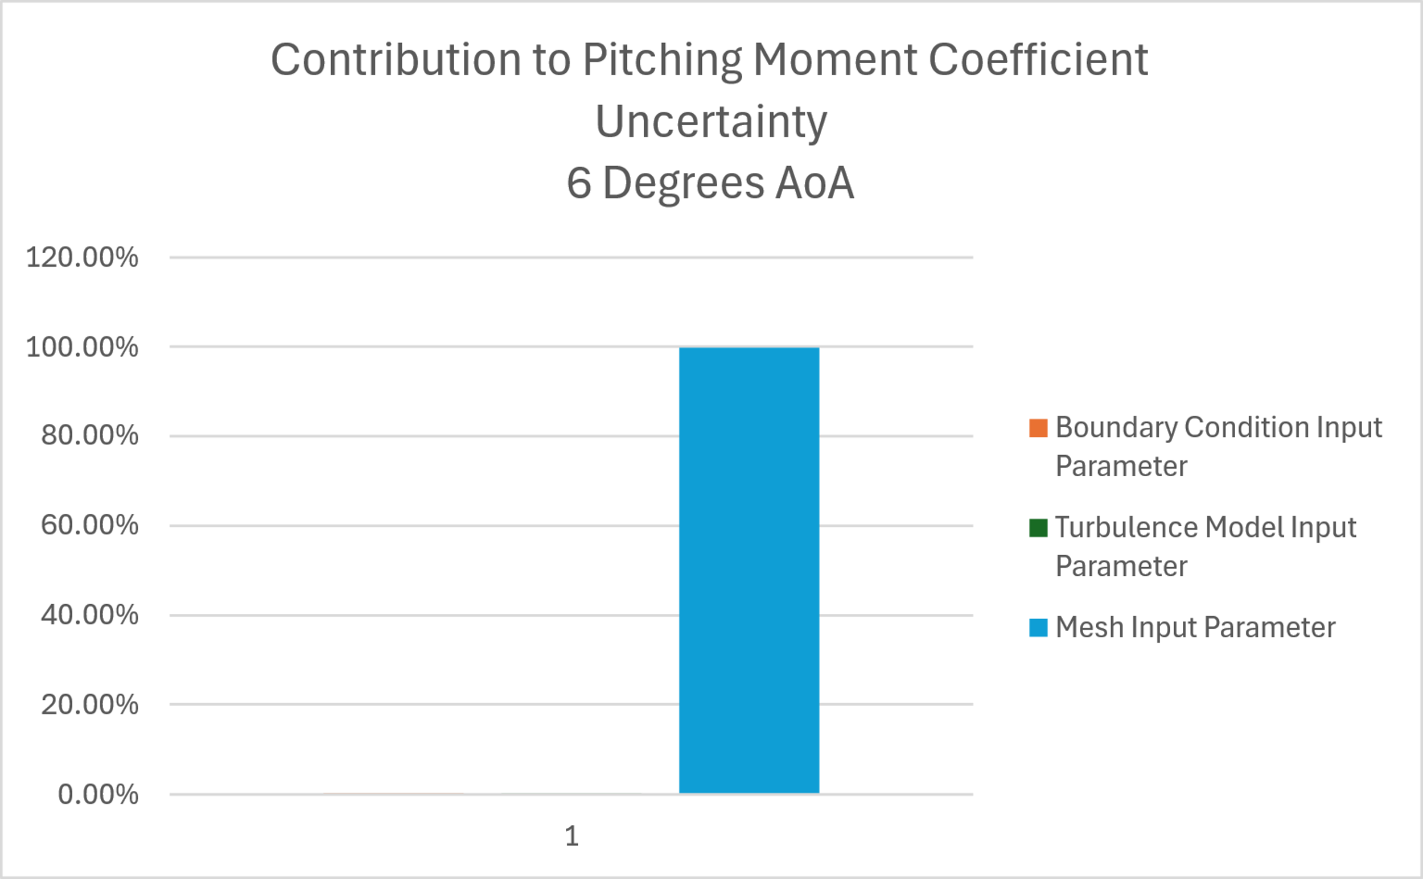

Results
6° configuration:

Slide 23
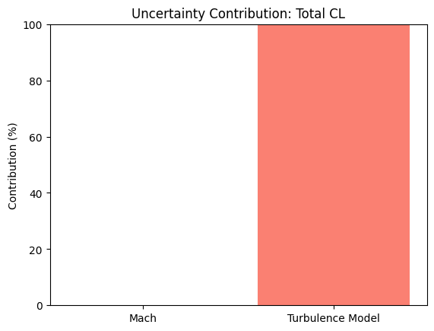
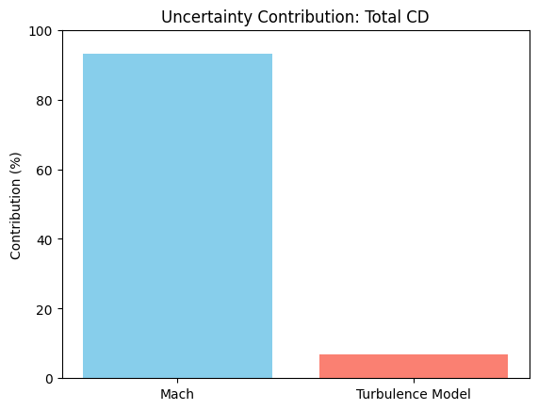


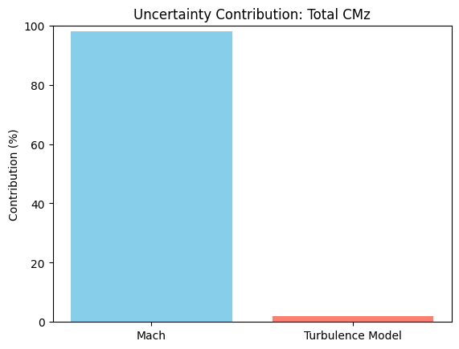
CFD Wrapper
A preliminary wrapper was programmed in python to work with SU2
  Two scripts:
    First script takes in a configuration file for SU2 and a slurm file for the HPC
      Generates dataset and submits to HPC automatically
    Second script calculates uncertainties and outputs values in tabular format and charts as shown previously

Slide 24
Future Directions and Conclusions

Slide 25
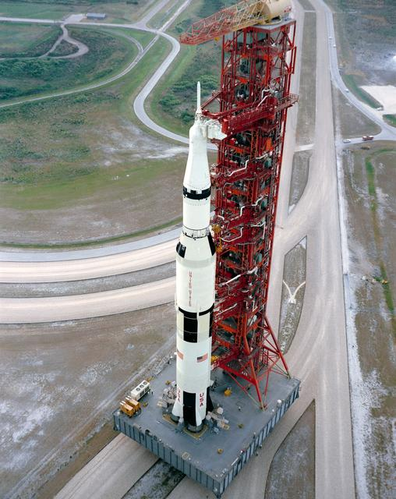
Conclusions
Created a framework to calculate uncertainty in aerodynamic coefficients without the use of experimental data
Each input parameter contributed to the total uncertainty in some capacity
The highest uncertainty was seen in the pitching moment coefficient at 6° angle of attack
  Contribution was almost entirely from the mesh component
    Meshing is important and it will be worthwhile to spend more time getting higher quality meshes in the future
The contributions were different for the different configurations
Image from NASA
Notes:
Now we have a hammer, got to find some nails

Slide 26
Future Work
Create structured meshes for future test cases
Develop the wrapper to include more input parameters
Validate methodology against models where experimental data exists
Include numerical uncertainty in final value
Expand the input parameters to include others such as:
  Wall functions – on/off
  Surface roughness
  Additional boundary conditions – altitude, freestream pressure and temperature
Expand the output quantities of interest to include lineloads
  Primary quantity of interest in launch vehicle tests

Slide 27
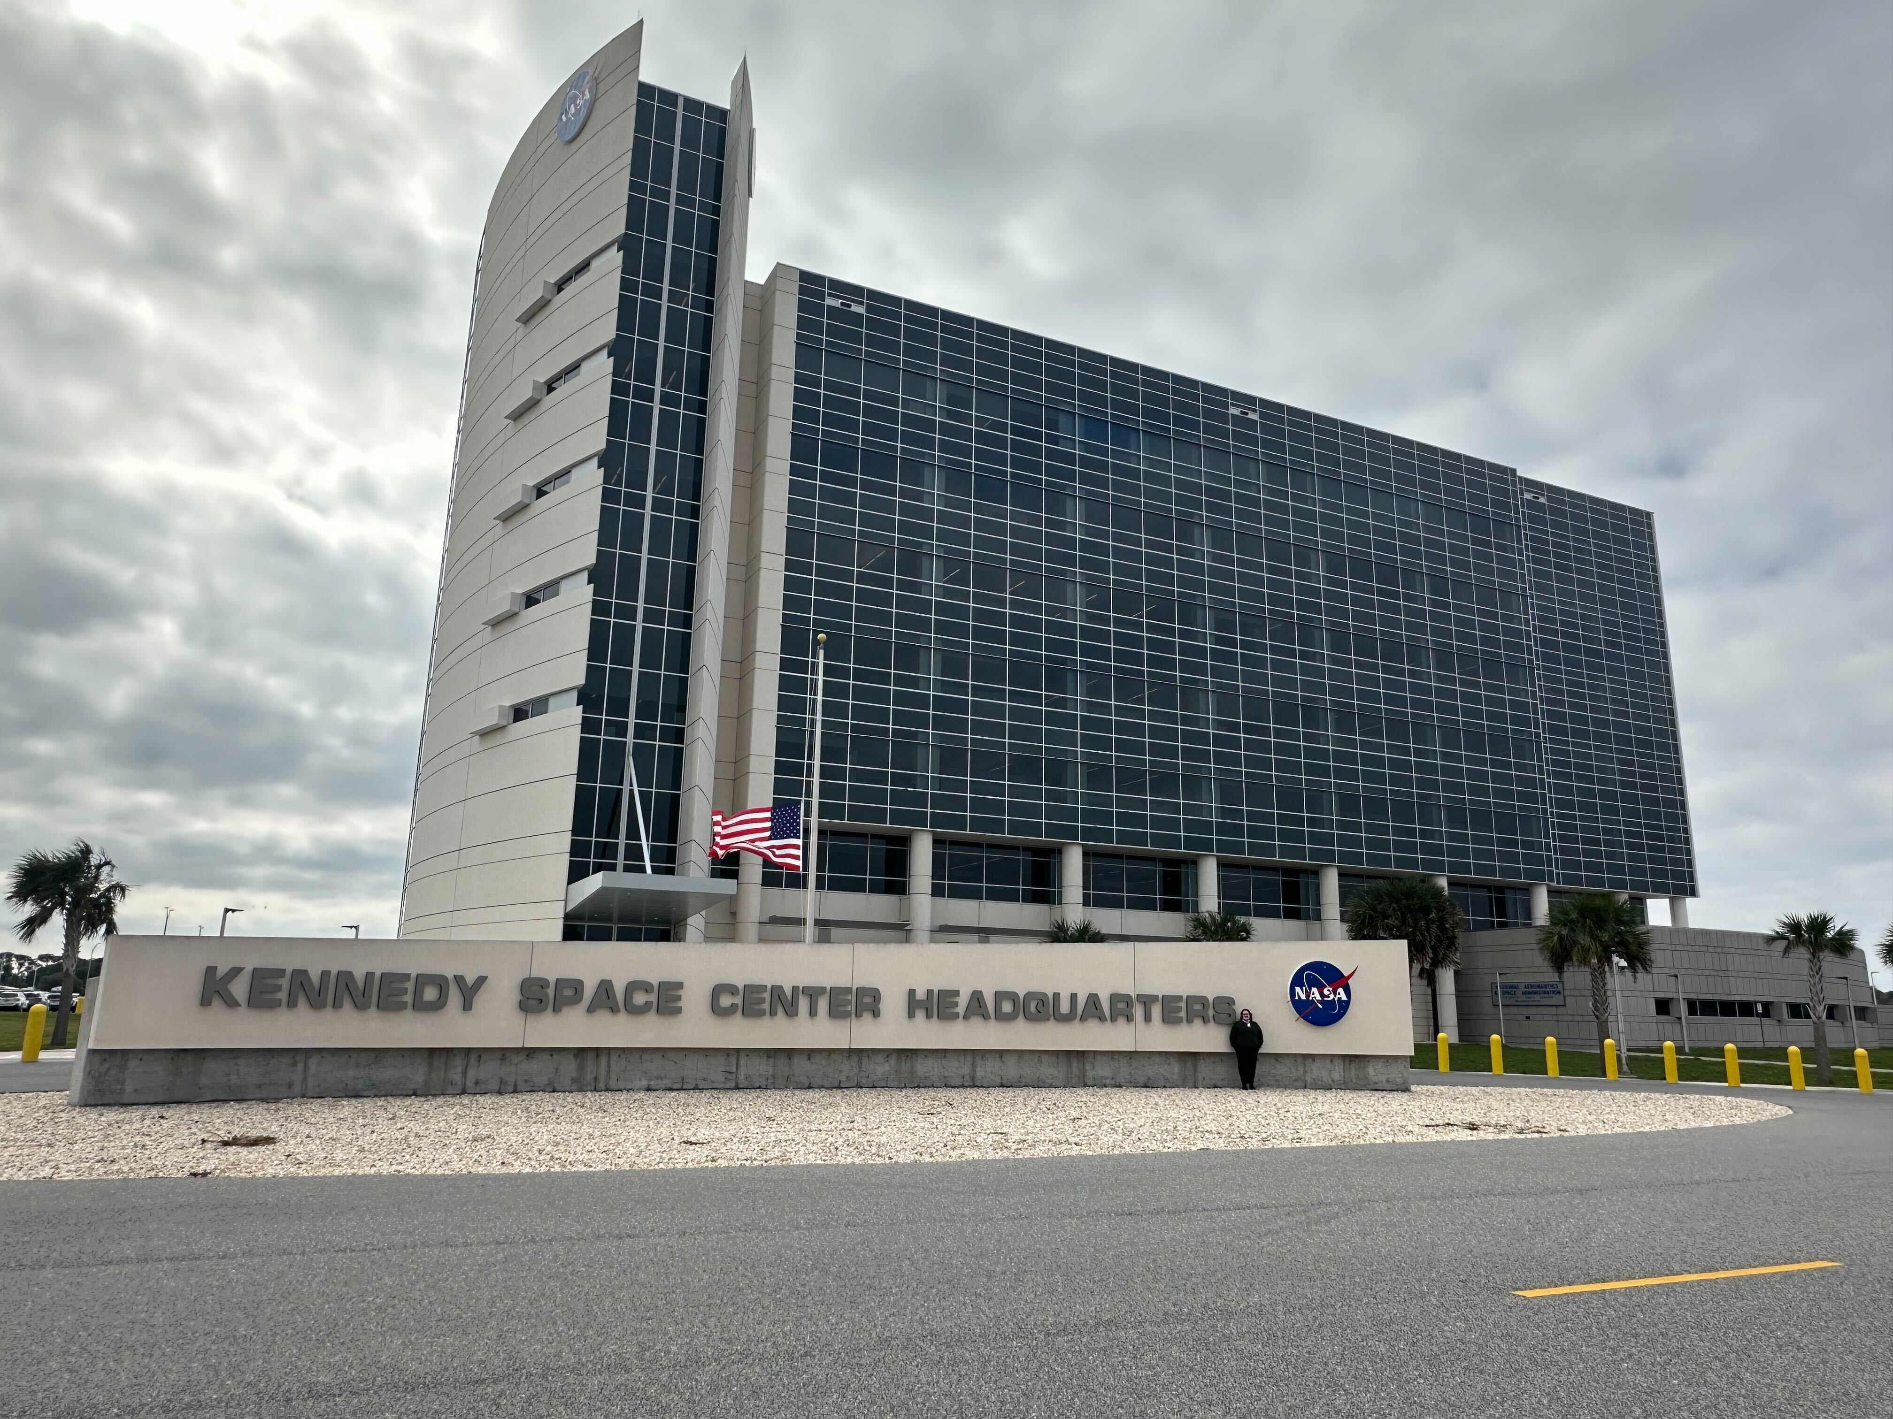
Acknowledgements
This work is supported by the NASA Launch Services Program via the Expendable Launch Vehicle Integrated Support (ELVIS) 3 contract, operated by a.i. solutions inc.
Thank you to Paul Schallhorn, Michael Harris, Michael Elmore, and Scott Clark
This research was supported in part through computational resources and services provided by the University of Arizona's Research Data Center (RDC)

Slide 28

Questions/discussion
chanl.arizona.edu
stockdaleavery@arizona.edu
Hanquist@arizona.edu

Slide 29
Backup slides

