Slide 1

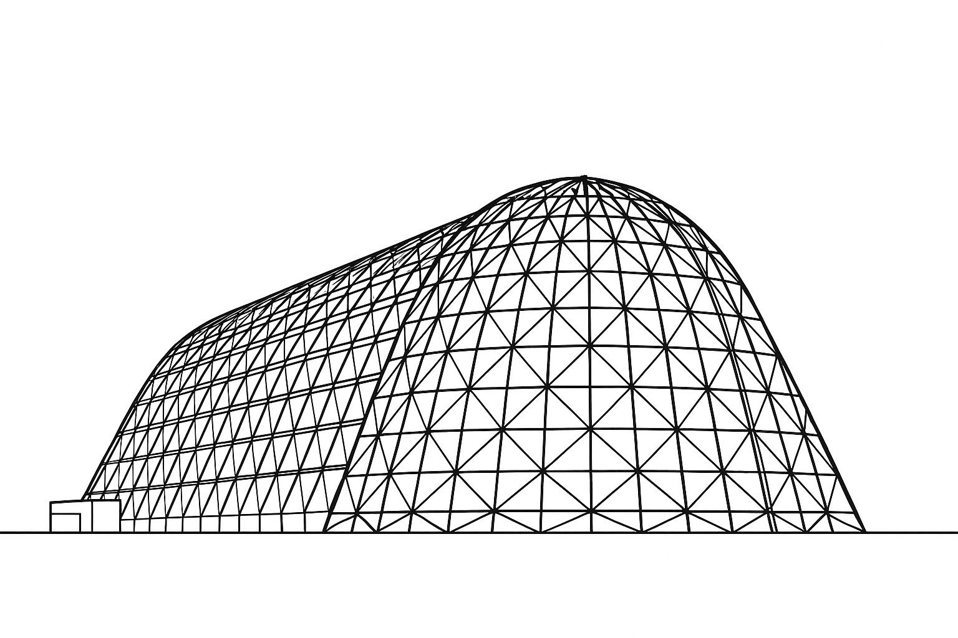


Modeling of Superheated Bubble Condensation in Subcooled Liquid for Liquid Hydrogen Boil-Off Gas Management
TFAWS 2025 Cryogenics Technical Session
Presented by: Mahmood H. Alqefl, PhD
mahmood.alqefl@zeroavia.com
Mahmood H. Alqefl, Gurjap Singh, Parker Bryant
Thermal & Fluids Analysis Workshop 2025
NASA Ames Research Center
San Jose, CA
August 4-7, 2025

Slide 2
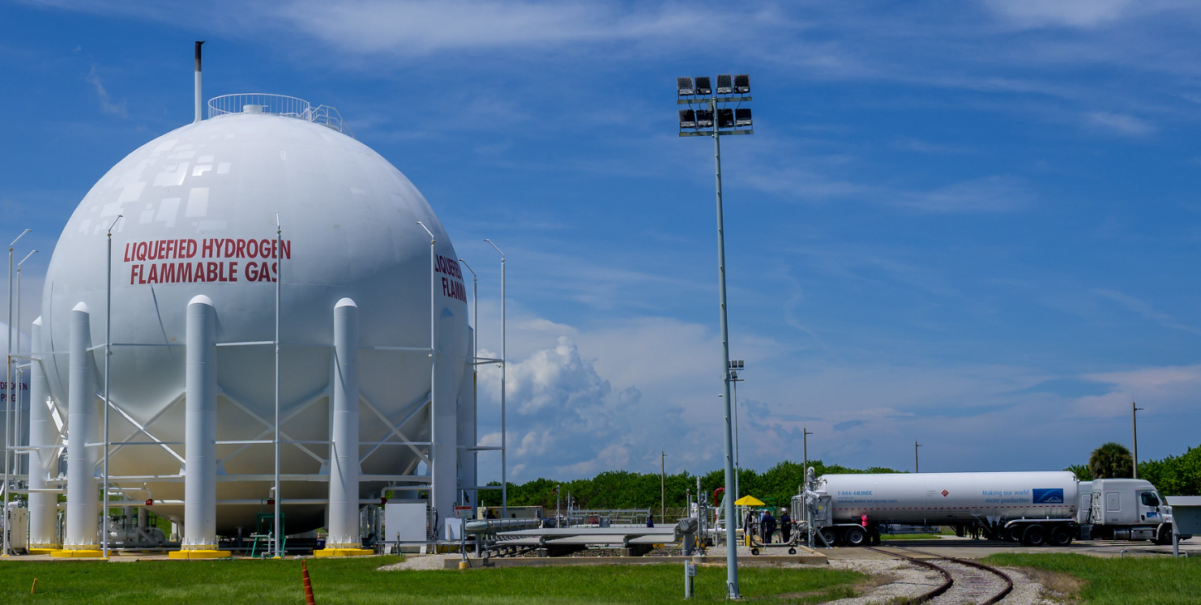
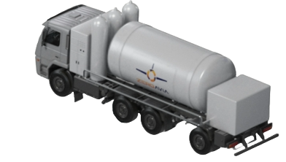
Motivation: Zero-Boil-Off Liquid Hydrogen Refueling
 | Standard Trailer | LH2 Aircraft Refueler Requirement
Road Rating | US DOT (pressure limitation) | US DOT (pressure limitation)
Fill rate | 35 kg/min | >40kg/min (up to 80 kg/min)
Receiving tank | Vents before filling | No venting
Trailer tank | Vents after filling | No venting
System power | N/A (not needed) | Fuel Cell
Trailer LH2 capacity | 4000 kg | 3000 kg
Standard LH2Trailer refilling NASA tanks
ZA LH2 aircraft refueler being developed in CA
Image source: NASA
Zero-Boil-Off LH2 transport & refueling is key for enabling hydrogen aviation

Slide 3
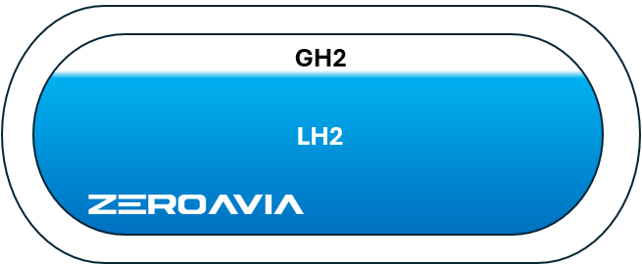

Motivation: Superheated Boil-off Gas Injection in Subcooled LH2
ZA Refueling System
*Not all subsystems are shown
Refueling Tank
Aircraft Tank
T = 20 - 28K
Direct Contact
Condensation (DCC)
GH2
(up to 300 K when empty)
Injector array design?
GH2 flowrate?
Understanding the interaction of superheated GH2 bubbles in subcooled LH2 helps us adequately design the injectors and understand the operation limits

Slide 4
Methodology and Key Assumption
Method:
Transient, reduced-order, first-principles based model
Real gas properties updated every time step using NIST Refprop
Finite-difference method constructed on MATLAB
Forward Euler time stepping scheme
Key Assumptions:
Axisymmetric model around the hole axis
Single bubble physics, i.e., no bubble-to-bubble interaction
No coalescence occur if space between bubbles are 2 diameters
Bubble is hemispherical at t=0
Hydrogen is at low energy state (parahydrogen) throughout (no ortho-para calculation)

Slide 5
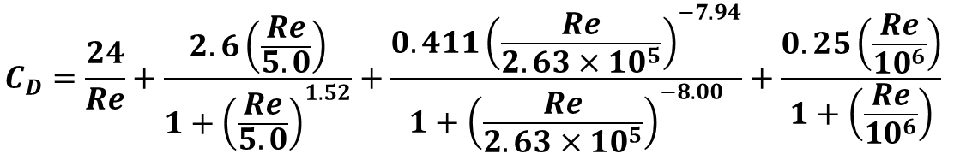
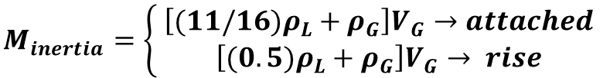








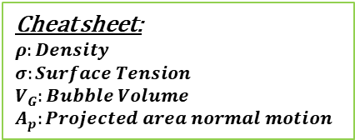
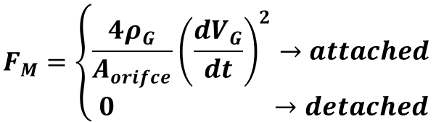


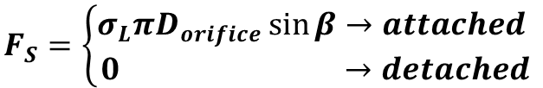
Force Balance
$$\frac{{d (M}_{inertia}u_{G})}{dt}=F_{b}+F_{M}−F_{D}−F_{S}$$
$$\frac{{d (M}_{inertia}u_{G})}{dt}$$
*no-slip
Stagnant Liquid
$$F_{b}=\left(ρ_{L}−ρ_{G}\right)gV_{G}$$
$$F_{D}=\frac{1}{2}C_{D}ρ_{L}u_{G}^{2}A_{p}$$
Liquid Film
$$F_{M}=\left\{\begin{aligned}\frac{4ρ_{G}}{A_{orifce}}{\left(\frac{dV_{G}}{dt}\right)}^{2}→attached \\ 0 →detached\end{aligned}\right.$$
$$u_{G}$$
$$F_{S}=\left\{\begin{aligned}σ_{L}πD_{orifice}\sin{β}→attached \\ 0 →detached\end{aligned}\right.$$
$$F_{b}$$
$$F_{D}$$
Bubble
$$C_{D}=\frac{24}{Re}+\frac{2.6\left(\frac{Re}{5.0}\right)}{1+{\left(\frac{Re}{5.0}\right)}^{1.52}}+\frac{0.411{\left(\frac{Re}{2.63×10^{5}}\right)}^{−7.94}}{1+{\left(\frac{Re}{2.63×10^{5}}\right)}^{−8.00}}+\frac{0.25\left(\frac{Re}{10^{6}}\right)}{1+\left(\frac{Re}{10^{6}}\right)}$$
$$F_{m}$$
$$F_{s}$$
$β$
t>0
(Morrison, 2013)
$$M_{inertia}=\left\{\begin{aligned} \left[(11/16)ρ_{L}+ρ_{G}\right]V_{G}→attached \\ \left[(0.5)ρ_{L}+ρ_{G}\right]V_{G}→ rise\end{aligned}\right.$$
(Brennen, 2005)
Cheat sheet:
$$ρ:Density$$
$$σ:Surface Tension$$
$$V_{G}:Bubble Volume$$
$$A_{p}:Projected area normal motion$$
Bubble inertia is calculated each time step

Slide 6

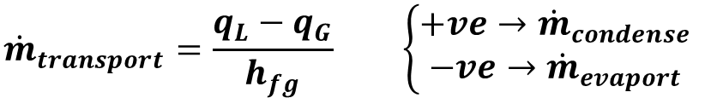




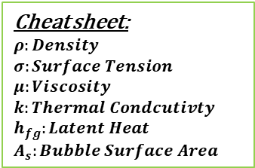






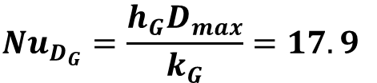

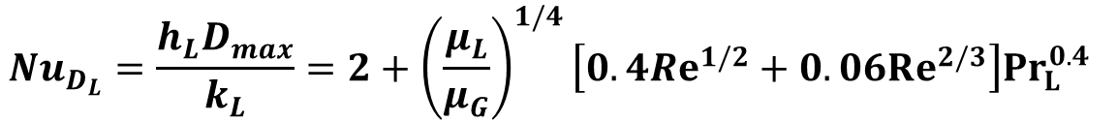

Energy Balance
Stagnant Liquid
Heat transfer:
$$u_{G}$$
$$q_{G}=h_{G}A_{s}\left(T_{G}−T_{sat}\right)$$
$$q_{L}=h_{L}A_{s}\left(T_{sat}−T_{L}\right)$$
$$T_{L}$$
Heat-mass balance across bubble boundary:
$$Nu_{D_{L}}$$
$$Nu_{D_{G}}$$
$$q_{L}$$
$${\dot{m}}_{transport}=\frac{q_{L}−q_{G}}{h_{fg}} \left\{\begin{aligned}+ve→{\dot{m}}_{condense} \\ −ve→{\dot{m}}_{evaport}\end{aligned}\right.$$
$$D_{max}$$
$$q_{G}$$
$$T_{Sat}$$
$$T_{G}$$
Convection inside a sphere bubble:
Bubble
$$Nu_{D_{G}}=\frac{h_{G}D_{max}}{k_{G}}=17.9$$
(Koring-Brink, 1950)
$${\dot{m}}_{condense} h_{fg}$$
Convection around a moving sphere:
Cheat sheet:
$$ρ:Density$$
$$σ:Surface Tension$$
$$μ:Viscosity$$
$$k:Thermal Condcutivty$$
$$h_{fg}:Latent Heat$$
$$A_{s}:Bubble Surface Area$$
$$Nu_{D_{L}}=\frac{h_{L}D_{max}}{k_{L}}=2+{\left(\frac{μ_{L}}{μ_{G}}\right)}^{1/4}\left[0.4Re^{1/2}+0.06Re^{2/3}\right]Pr_{L}^{0.4}$$
(Whitaker, 1972)
$$Re=\frac{ρ_{L}u_{G}D_{max}}{μ_{L}}$$
Heat and mass transfer across the bubble surface are calculated each time step

Slide 7
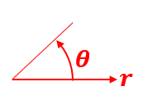
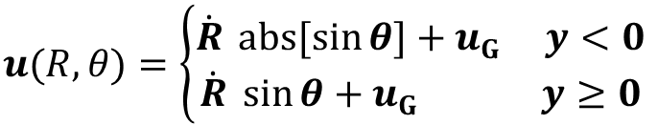






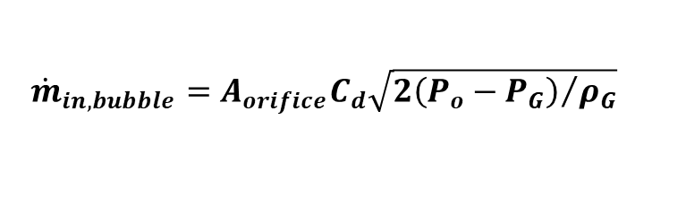






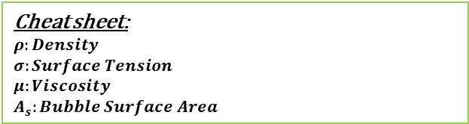
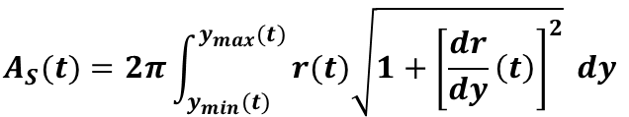













Bubble Shape and Mass Balance
(Sources: Brennen, 2005 ;Zima & Marsik, 2001 ; Martin et al, 2006)
Spherical frame of reference
$$y$$
cylindrical domain
Modified Rayleigh –Plesset Equation, solved in spherical reference frame:
Moving in:
$$t=0$$
$$\frac{P_{G}−P_{L}}{ρ_{L}}=R \ddot{R}+\frac{3}{2}{\dot{R}}^{2}+\frac{4μ_{L}}{ρ_{L}R}\dot{R}+\frac{2G}{ρ_{G}}\dot{R}+\frac{R}{ρ_{L}}\dot{G}+\frac{2σ}{ρ_{L}R}, G=\frac{{\dot{m}}_{transport}}{A_{s}}$$
$$y$$
$$u(R,θ)$$
$$P_{L}$$
$$y_{o}$$
$$v(R,θ)$$
$$u_{G}$$
$$R$$
condensation/evaporation
$$P_{G}$$
$$θ$$
$$r$$
$$u(R,θ)=\left\{\begin{aligned}\dot{R} abs[sin{θ}]+u_{G} y<0 \\ &\dot{R} \sin{θ}+u_{G} y≥0\end{aligned}\right.$$
$$r_{o}$$
$$y(t)=y_{t−dt}+udt$$
$${\dot{m}}_{in,bubble}$$
$$v(R,θ)=\dot{R} \cos{θ}$$
$$r(t)=r_{t−dt}+vdt$$
$$P_{o}$$
$$V_{o}$$
$$A_{S}(t)=2π\int_{y_{min}(t)}^{y_{max}(t)}{r(t)\sqrt{1+{\left[\frac{dr}{dy}\left(t\right)\right]}^{2}} dy}$$
t=0
$$V_{G}(t)=π\int_{y_{min}(t)}^{y_{max}(t)}{{[r(t)]}^{2} dy}$$
$${\dot{m}}_{in}$$
$$T_{G_{o}}$$
$${\dot{m}}_{in,bubble}=A_{orifice}C_{d}\sqrt{{2\left(P_{o}−P_{G}\right)}/{ρ_{G}}}$$
$${\dot{m}}_{in,bubble}=0, y_{min}≥0$$
$$P_{o}=f\left(V_{o},T_{G_{o}},{[\dot{m}}_{in}−{\dot{m}}_{in,bubble}]\right)$$
Cheat sheet:
$$ρ:Density$$
$$σ:Surface Tension$$
$$μ:Viscosity$$
$$A_{s}:Bubble Surface Area$$
$${M_{bubble}(t)={M_{bubble}}_{(t−dt)}+(\dot{m}}_{in,bubble}−{\dot{m}}_{transport} )dt$$
$$V_{o}:Chamber Volume$$
$$V_{G}:Bubble Volume$$
$$T_{G_{o}}:Inlet Gas Temprature$$
$$A_{orifice}:Orfice Area$$

Slide 8
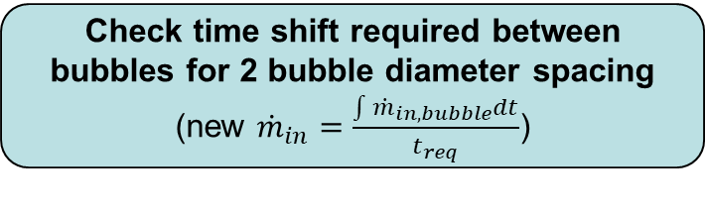



Solver Flowchart
Inputs
Hole geometry, Liquid temperature, Gas Temperature, Ullage Pressure, Liquid Height
Guess ${\dot{m}}_{in}$
Update ${\dot{m}}_{in}$
At t=0, bubble is semi-sphere attached to hole
Initialize parameters
Bubble coordinates, Temperatures, Pressures, Bubble centroid acceleration, Bubble surface acceleration, heat/mass transfer
Check time shift required between bubbles for 2 bubble diameter spacing (new ${\dot{m}}_{in}=\frac{\int{{\dot{m}}_{in,bubble}dt}}{t_{req}}$)
Time step
Is guess ${\dot{m}}_{in}≈{new \dot{m}}_{in}$?
No
Update Parameters
(Euler integration with fixed dt)
Yes
Did bubble reach surface or saturation Temperature?
Converged!
No
Yes

Slide 9
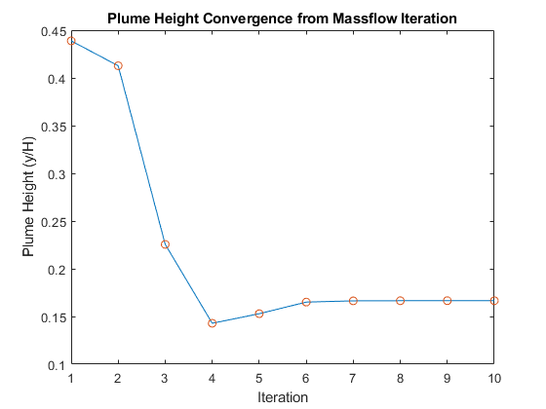
Sample Convergence
Convergence is boosted using a multiplier for the difference between guessed and calculated mass flowrate.
Typically takes less than 8 iterations

Slide 10
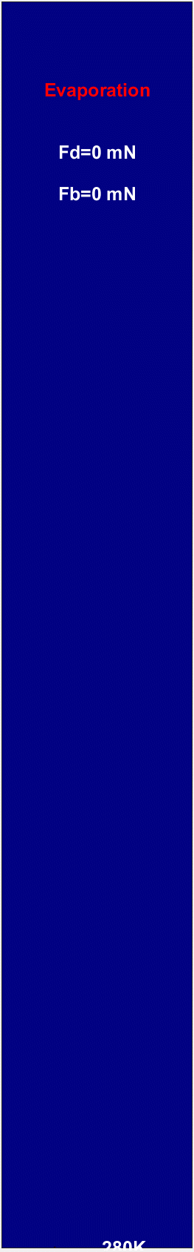

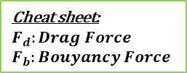
Sample Result Animation
*Not real time
Fluid: Para-Hydrogen
Ullage Pressure: 4 barA
Liquid Temperature: 20 K
Gas Temperature: 280 K
Ullage
2.2 meter
*Much Slower Animation
Bubble Rise
(Shown is bubble temperature)
Ullage
Bubble Growth and Detachment
Cheat sheet:
$$F_{d}:Drag Force$$
$$F_{b}:Bouyancy Force$$

Slide 11
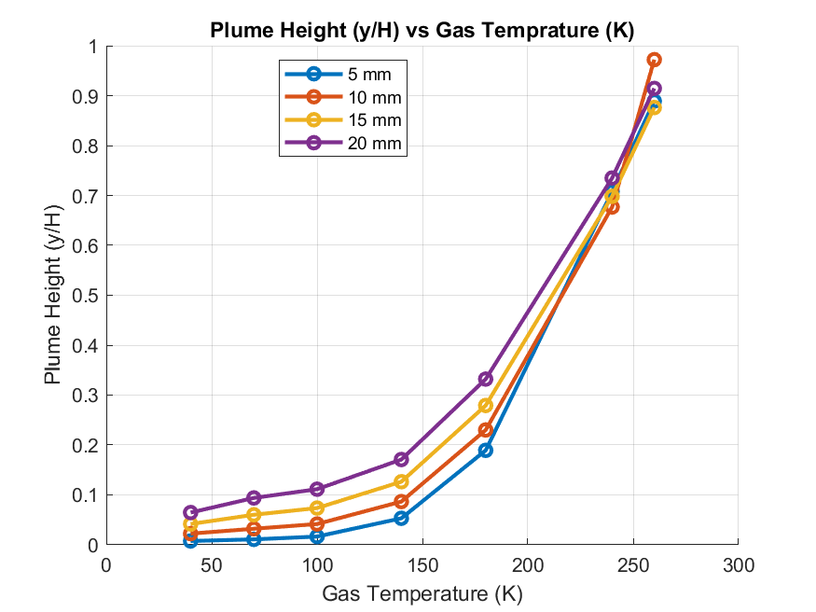
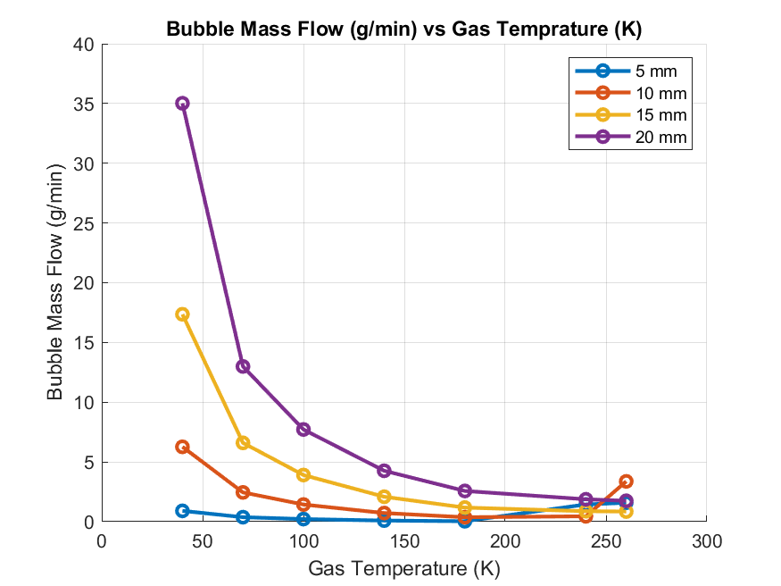
Plume Height and Max Flow
Fluid: Para-Hydrogen
Liquid Temperature: 21 K
Ullage Pressure: 4 barA
Max Height (H): 2.2 meters
At high temperatures, the evaporation from the bubble dominates, reducing the influence of injector diameter

Slide 12
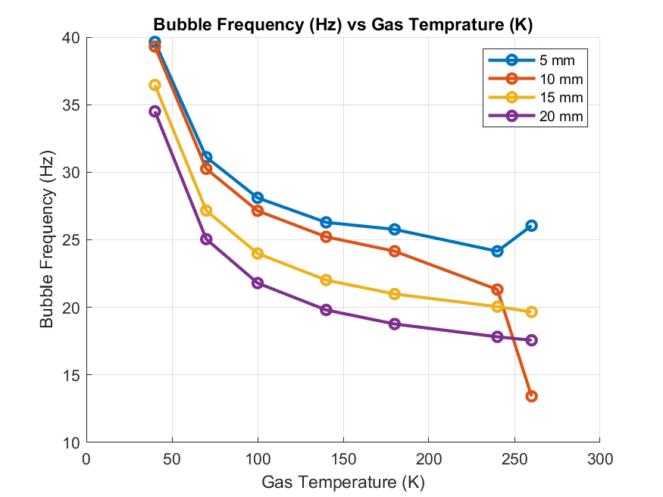
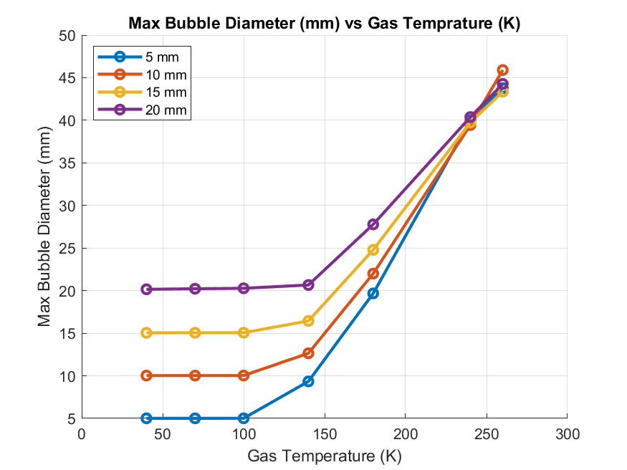
Bubble Frequency and Maximum Diameter
Fluid: Para-Hydrogen
Liquid Temperature: 21 K
Ullage Pressure: 4 barA
Max Height (H): 2.2 meters
Bubble size follows injector hole size until 100 K, then increases

Slide 13
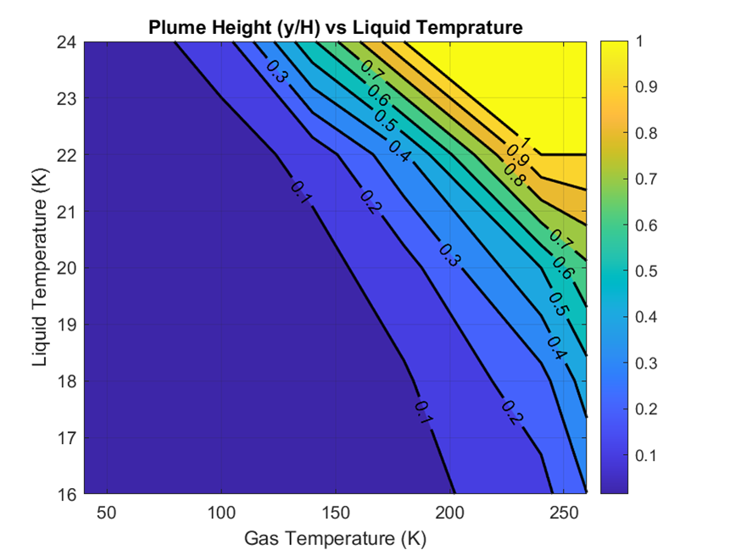
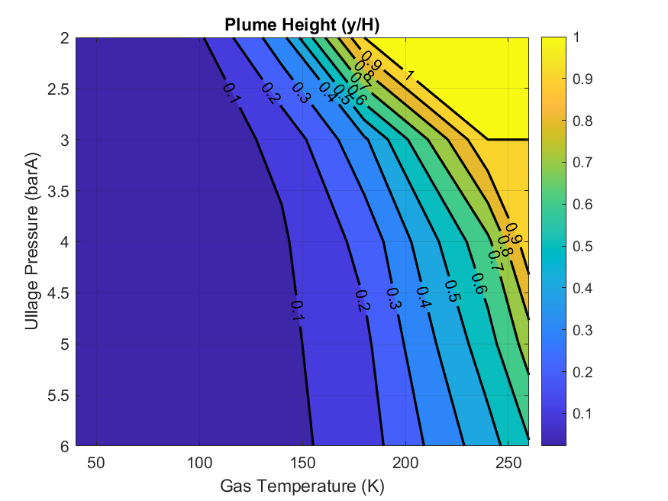
Plume Height vs Subcool
Fluid: Para-Hydrogen
Ullage Pressure: 4 barA
Max Height (H): 2.2 meters
Hole Diameter: constant
Fluid: Para-Hydrogen
Liquid Temperature: 21 K
Max Height (H): 2.2 meters
Hole Diameter: constant
Reducing liquid temperature has a stronger impact on condensation compared to increasing pressure

Slide 14
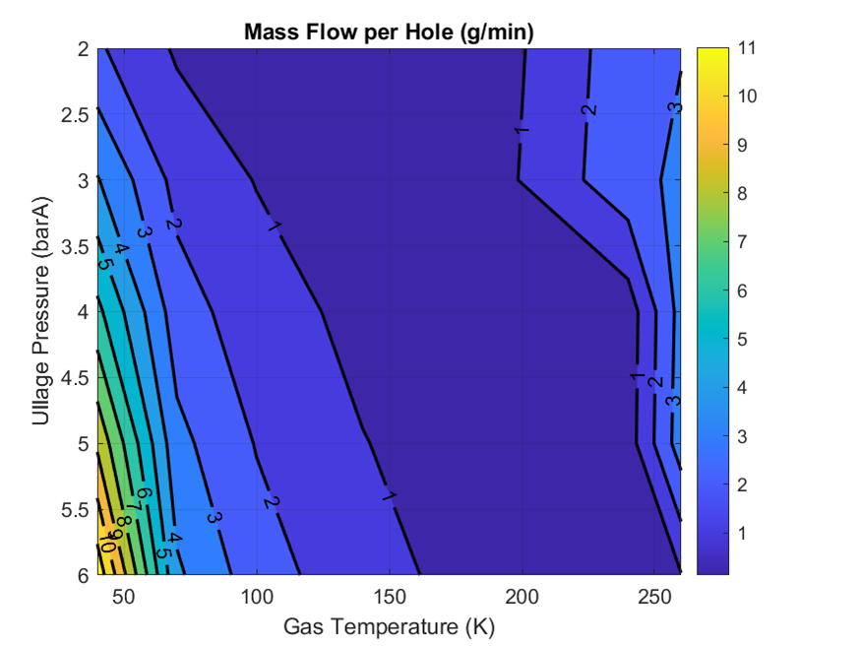
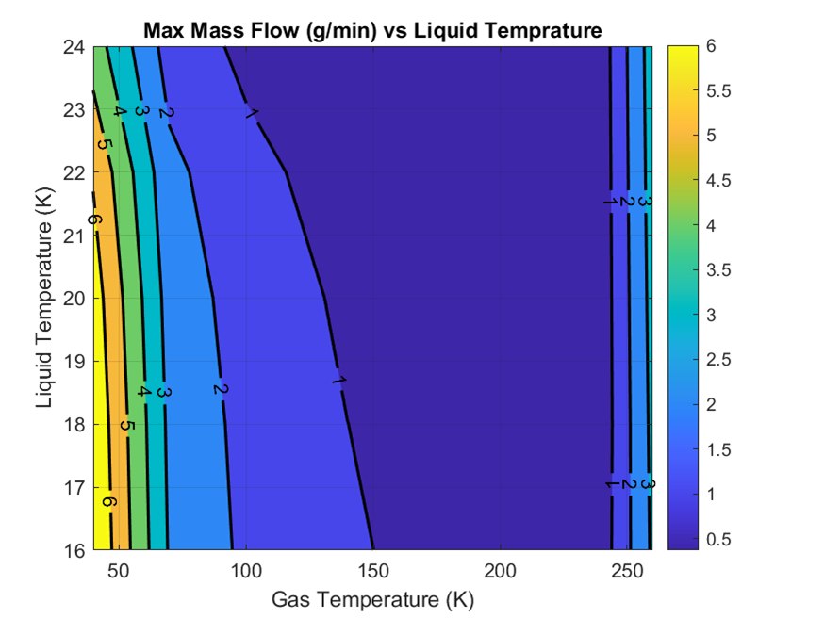
Max Flow vs Subcool
Fluid: Para-Hydrogen
Ullage Pressure: 4 barA
Max Height (H): 2.2 meters
Hole Diameter: constant
Fluid: Para-Hydrogen
Liquid Temperature: 21 K
Max Height (H): 2.2 meters
Hole Diameter: constant
High mass flow is possible due to high density at low temperature --- and due to large bubble size at high temperature

Slide 15
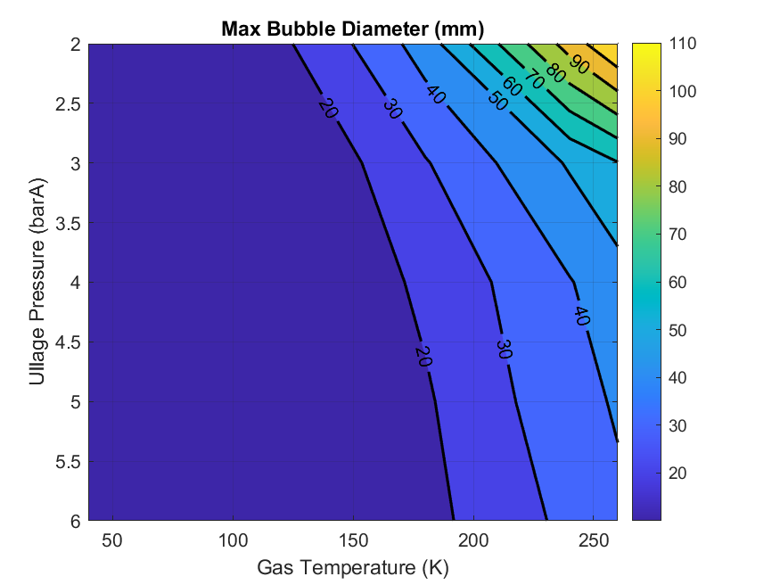
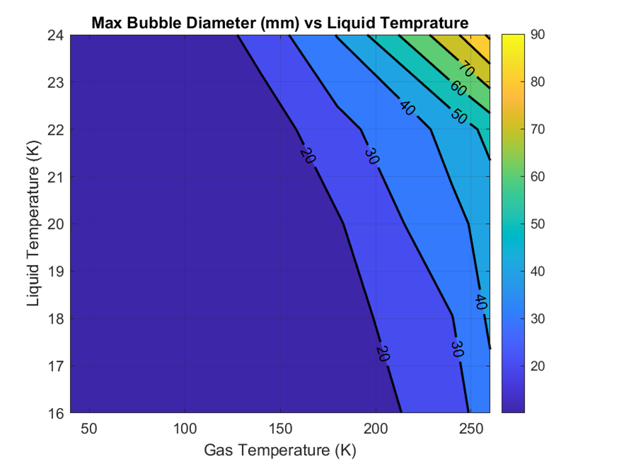
Maximum Bubble Diameter vs Subcool
Fluid: Para-Hydrogen
Ullage Pressure: 4 barA
Max Height (H): 2.2 meters
Hole Diameter: constant
Fluid: Para-Hydrogen
Liquid Temperature: 21 K
Max Height (H): 2.2 meters
Hole Diameter: constant
Ensuring low max bubble size allows for more injectors in the tank more total BOG flow

Slide 16
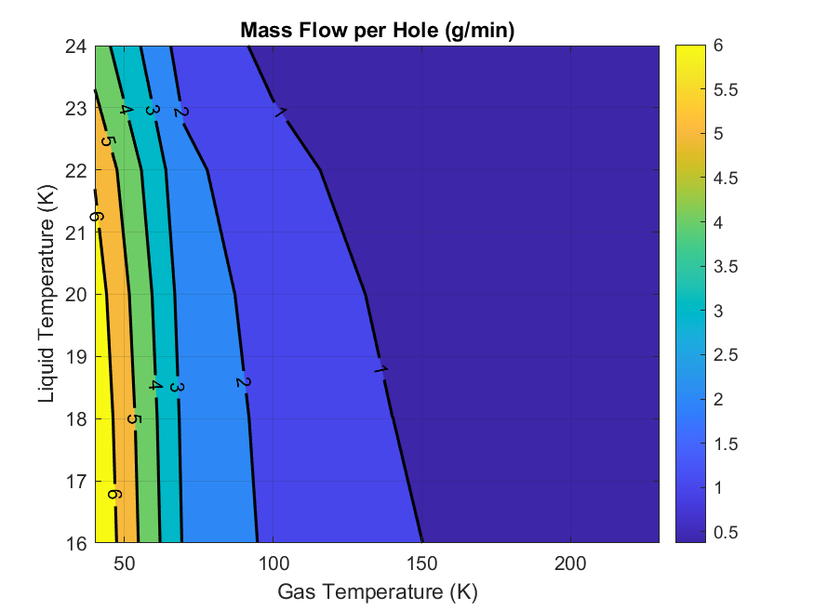
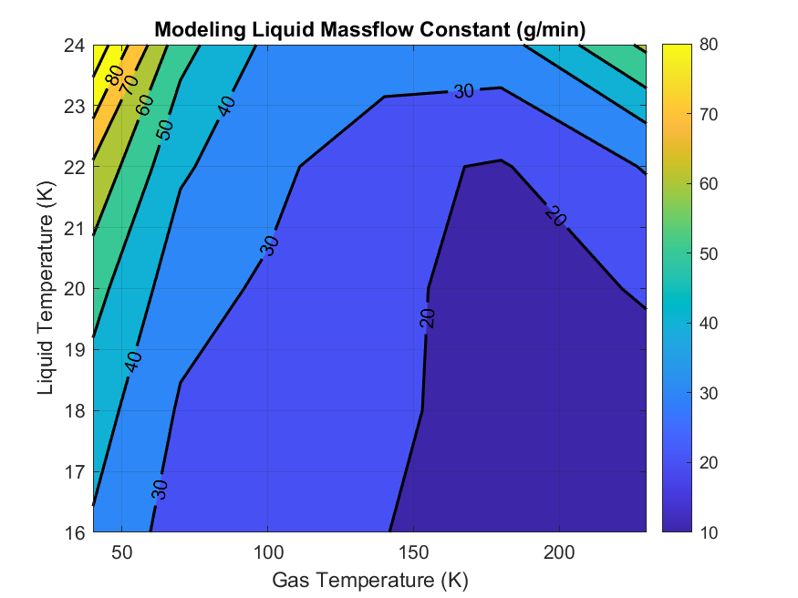


Incorporation of BOG capture in system model
Included here for completion, but the sensitivity is low, so can be neglected
For every time step:
$${\dot{m}}_{model−constant}=f(T_{Gas},T_{liquid},P_{tank})$$
Energy from BOG is mixed with a portion of tank liquid mass:
$${\left( {\dot{m}}_{BOG}+ {\dot{m}}_{model−constant}\right)h}_{mix}={\dot{m}}_{BOG}h_{Gas}+{\dot{m}}_{model−constant}h_{Liq}$$
At tank pressure, if mixed state is:
$${\dot{m}}_{model−constant}={\dot{m}}_{BOG_{max}}\frac{h_{Gas}−h_{sat}}{h_{sat}−h_{Liq}}$$
All gas:
Add to ullage node
All liquid:
Add to liquid node
Mixture:
Distribute to liquid and ullage based on mass fraction
Continue computing energy and mass balance for the nodes of the tank as usual
Cheat sheet:
$BOG:$ Boil-off-Gas

Slide 17
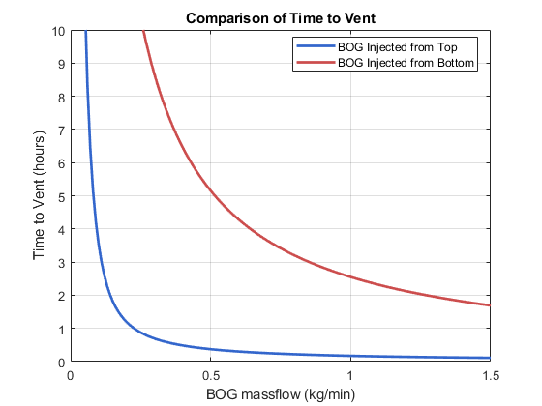
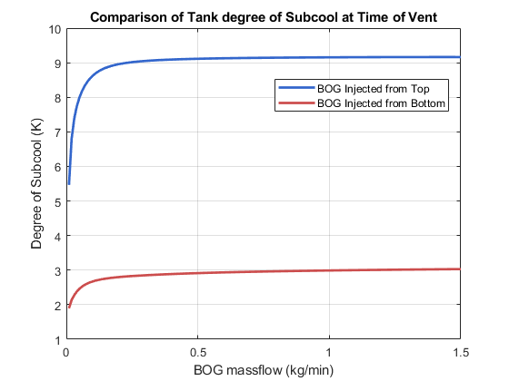
Effects of BOG Injection into Liquid
Fluid: Para-Hydrogen
Initial Tank Pressure: 1 barA
Initial Tank Temperature: Saturated
BOG temperature: 100 K
BOG into ullage
BOG injected into liquid
BOG injected into liquid
BOG into ullage
BOG injection through bubbles in liquid greatly increases BOG consumption flowrate into refueler

Slide 18
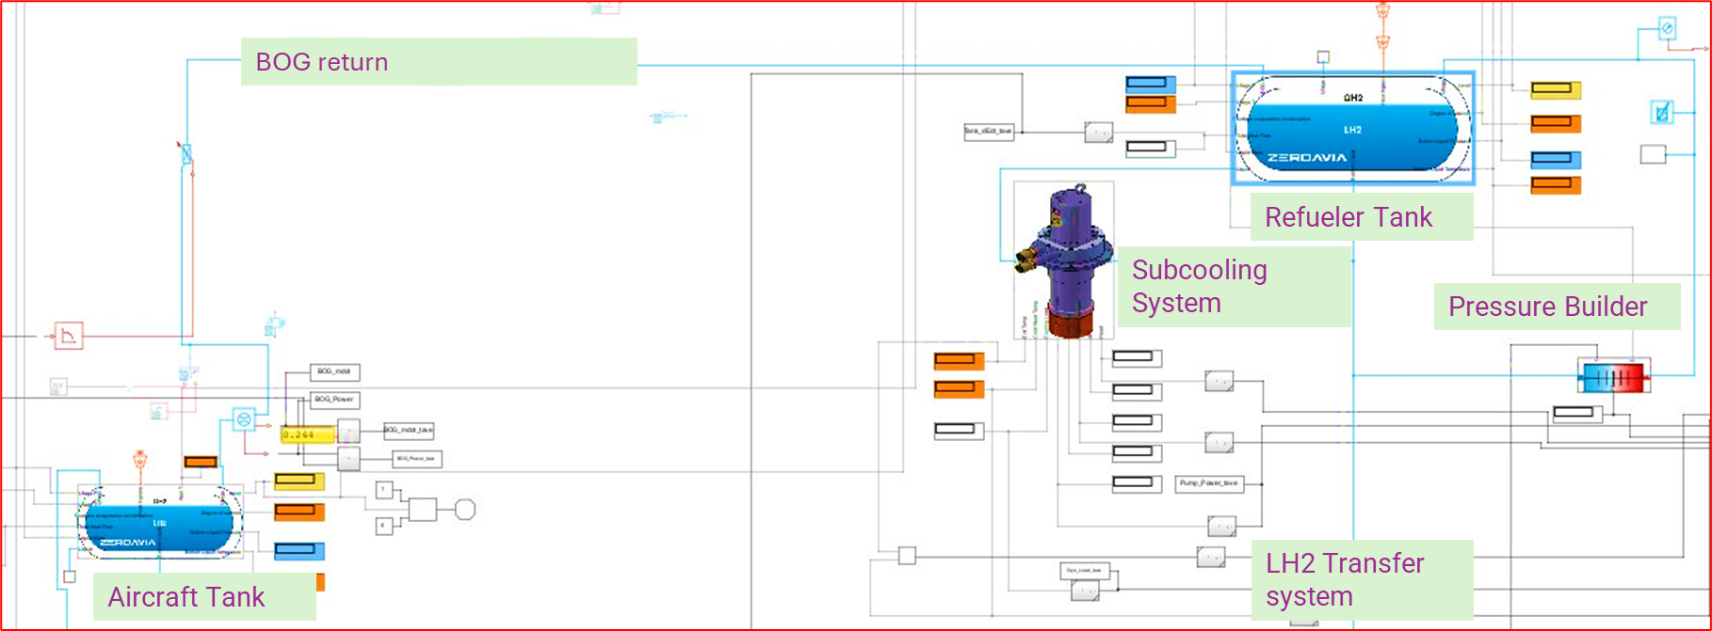
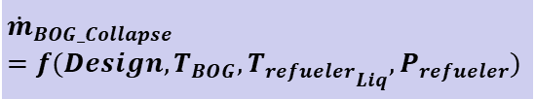
Zero-Boil-off Refueling: System Model
$${\dot{m}}_{BOG_Collapse}=f(Design, T_{BOG}, {T_{refueler}}_{Liq}, P_{refueler})$$
In-house model developed with some custom components
Matlab Simulink/Simscape is utilized
Solved with variable timestep
Model Highlights:
Model includes subcooling system to reduce liquid temperature
Ullage and liquid temperatures in the tank are solved separately, with heat and mass transfer across the boundary (2 volume nodes and 2 tank wall nodes)
BOG injection, Heat ingress into the tanks and lines, pressure loss due to flex hoses
LH2 Transfer, BOG return and pressure builder control systems are included

Slide 19
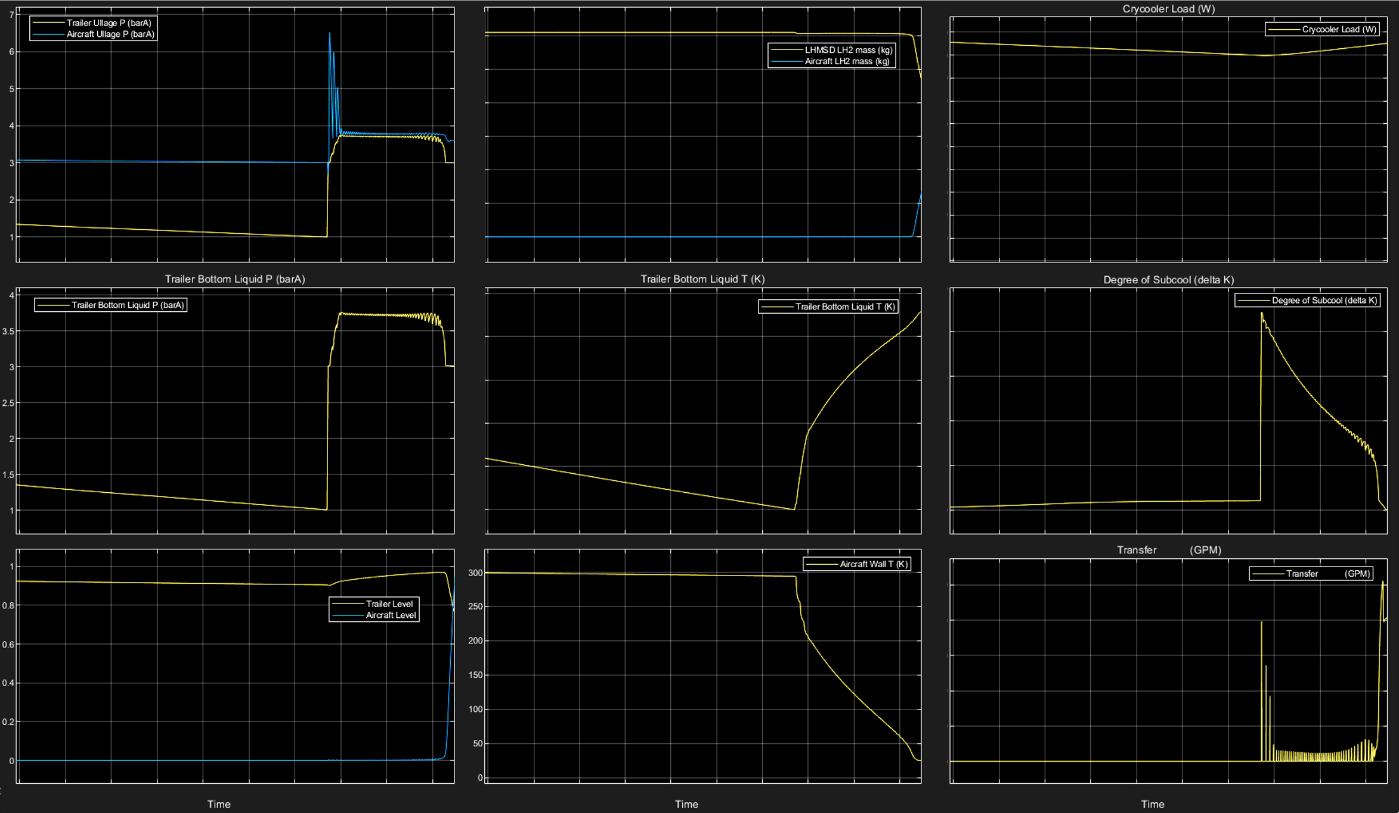
Zero-Boil-off Refueling: System-Level Simulation Results
No Venting
high
high
MAWP=7.9 barA
low
0
high
high
low
Refueller preconditioning
0
high
Aircraft tank chill down
Refueler flow to aircraft is controlled
Aircraft Refuel
0

Slide 20
Modeling Lessons Learned
Modeling heat transfer as total resistance between the bubble and the liquid underestimates the bubble plume height, as it neglects the bubble mass increase due to evaporation
Without iterating to solve for inlet flow, the simulation is sensitive to initial inlet flowrate
Accurate virtual mass and Nusselt number are important
More work is needed to understand the dynamics of multiple bubbles and the effects of cyclic chamber pressure
Higher fidelity CFD and experiments are needed to validate and further adjust modeling parameters for bubble detachment and heat transfer

Slide 21
Conclusions
Plume height: insensitive to bubble injection diameter
Injector diameter increase: boosts maximum massflow at low temperatures, minimal impact at high temperatures
Maximum bubble diameter: key for designing spacing between injector holes; exceeds injector diameter at high temperatures
BOG capture: enhanced by subcooling; lowering liquid temperature is more effective than raising ullage pressure
System modeling: submerged injector limits pressure increase, enables no venting for aircraft tanks at ambient conditions
ZeroAvia Zero Boil Off Refueler development is made possible, in part, with California Energy Commission support through the Gas Research and Development Program grant PIR-23-006

Slide 22
Q&A
Thank You Corresponding author: mahmood.alqefl@zeroavia.com

