Slide 1

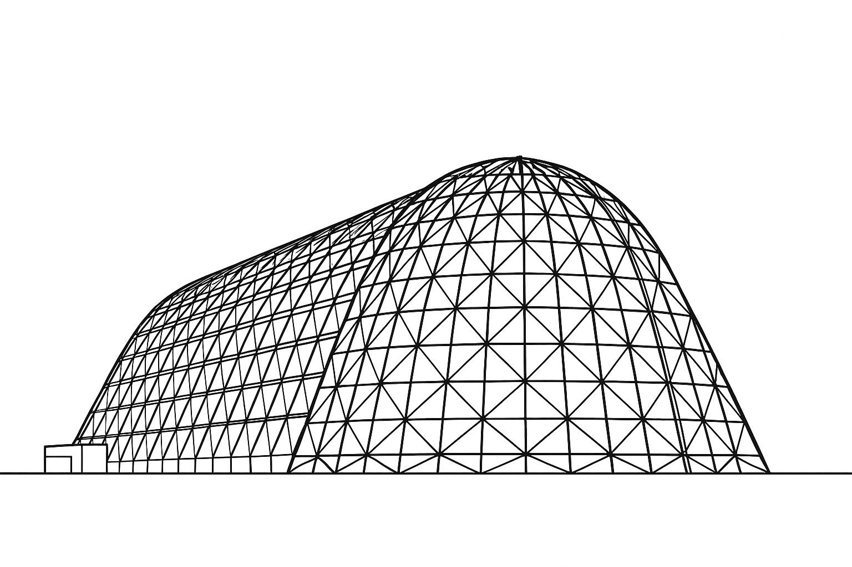



Modeling Complex Cryogenic Tank Thermodynamics with Simple Spreadsheet Tools
TFAWS 2025 Cryogenics Technical Session
Presented by: Mark A Wollen
Mark Wollen, IES
Thermal & Fluids Analysis Workshop 2025
NASA Ames Research Center
San Jose, CA
August 4-7, 2025
Cryo1-03 Wed 11:10
& Course session Mon 3:30

Slide 2
Modeling Complex Cryogenic Tank Thermodynamics with Simple Spreadsheet Tools
TFAWS 2025 Cryogenics Technical Session
Not all that complex!
Nothing magic about cryogens
Applies to hot tanks (e.g. boilers) equally well
Presented by: Mark A Wollen
Mark Wollen, IES
Thermal & Fluids Analysis Workshop 2025
NASA Ames Research Center
San Jose, CA
August 4-7, 2025

Slide 3
Course Agenda
What do we want to get from a tank thermodynamics model? (5 min?)
Description of the thermodynamics problem (15 min?)
  Mass and energy balances, etc
  Understanding various thermal and mass diffusion coefficients, boiling models, etc.
Description and demonstration of the spreadsheet tool (15 min?)
  Simple tank fill, drain, effects of heat load, pressurization, vent, etc.
Modeling some trickier stuff (10 min?)
  Disturbance of tank contents – mixing, splashing, sloshing, quenching
  Bubbler pressurization theory (optional)
A hands-on demonstration (15-20 min?)
  Validating the tool with a coffee machine boiler
  Fee espresso to volunteers or those who answer the most questions right (time permitting)
Workbook and Excel Macro VBAs are Unrestricted*, Free Open Source Software – See me if you’d like a copy
* Gov’t personnel and civil servants responsible for assessing legal installation or use on gov’t furnished equipment

Slide 4
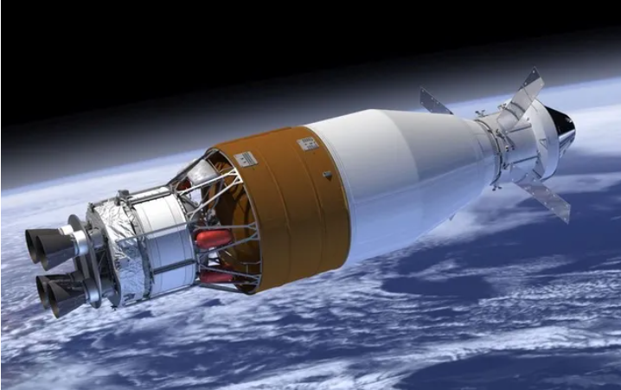
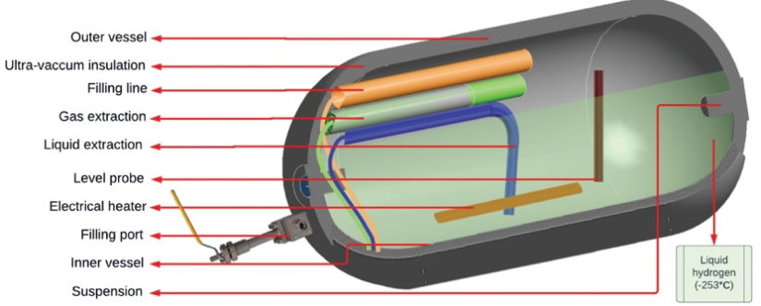
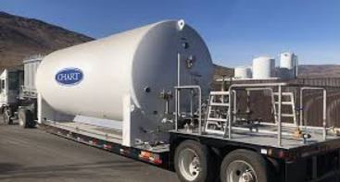
What do we want from a tank thermodynamics model?
Tank conditions of interest
  Liquid conditions - saturated or subcooled
  Ullage gas in tank – may be hot or near liquid temperature, contains vapor phase as well as (possibly) a non-condensable pressurant gas
  Tank walls have non-trivial heat capacity (stored energy)
Operations of interest:
  Filling, draining, venting, pressurizing, heat load (to liquid and ullage)
  Disturbance to tank contents: 1) quenching of hot tank walls, 2) mixing of liquid and ullage
Things we want to quantify:
  Pressure rise rate due to heat load if tank locked up
  Pressurant gas needed to expel (and subcool) liquid
  Pressure excursions due to tank disturbances
  Other?

Slide 5
Choosing an appropriate modeling approach
Model options
  Equilibrium liquid and ullage, or no liquid/ullage interaction (too simple)
  Full two-phase CFD simulation (exceedingly complex and computationally intensive)
  “Pancake” models (multiple vertical liquid, ullage, and tank-wall nodes)
Simplest model that captures all the physics to first order consists of 4 nodes:
  Single ullage node
  Single liquid node
  Wall node associated with ullage
  Wall node associated with liquid
The 4 node model is a “classic” approach, implemented in Fortran in 1960s - 70s, and probably prior to that with “human” computers
Great for understanding the critical physical principles at work, performing preliminary design studies, can be fairly accurate with proper “tuning”

Slide 6
Some preliminaries - understanding nomenclature
Typical Nomenclature:
Convection coeff for the ullage
Temperature of the ullage wall node
$${\dot{Q}}_{wall ull−ull}=γ_{ull}A_{ull w}\left(T_{w ull}−T_{ull}\right)$$
Temperature of the ullage node
Heat flow from ullage wall node to ullage node
Area for the ullage wall
M liq = Mass of liquid in tank
E liq = Energy of liquid in tank
T liq = Temperature of liquid in tank
Rho liq = Density of liquid (funct of T liq)
P liq vp = Liquid vapor pressure (function of T liq)
M vap = Mass of vapor phase in tank
E vap = Energy of vapor phase in tank
M gas = Mass of non-condensible gas in tank
E gas = Energy of non-condensible gas in tank
T ull = Temperature of ullage in tank
V tank = Volume of entire tank
V liq = Volume of tank occupied by liquid
V ull = Volume of tank occupied by gas
When in plain text format, rather than equation format:
Note, typically:
  H, h – used for enthalpies, kW, kW/kg
  γ – used for convection coefficient

Slide 7



































Tank Thermodynamics Modeling (liquid/ullage/wall node model)
Venting:
Ullage pressurization relationships:
$${\dot{H}}_{ull vent}=\left({\dot{m}}_{gas vent}c_{p gas}+{\dot{m}}_{vap vent}c_{p vap}\right)T_{ull}$$
${\dot{m}}_{ull press}={\dot{m}}_{g press}$+ ${\dot{m}}_{v press}$
${\dot{m}}_{ull vent}={\dot{m}}_{gas vent}$+ ${\dot{m}}_{vap vent}$
Note: Enclosed dashed regions show boundary flow or movement prior to incrementing time
$${\dot{H}}_{gas press}={\dot{m}}_{gas press}c_{p gas}T_{gas press}$$
$${\dot{H}}_{vap press}={\dot{m}}_{vap press}c_{p vap}T_{vap press}$$
$$T_{w ull}$$
$$P_{ull}=P_{gas}+P_{vap}$$
Ullage CV boundary
$$V_{ull}$$
Liquid/vapor boundary mass and energy balance:
$${\dot{Q}}_{wall ull−ull}$$
$${\dot{H}}_{ull−liq}=\left\{\begin{aligned}{\dot{m}}_{vap ull−liq}c_{p vap}T_{ull},{\dot{m}}_{ull−liq }>0 \\ {\dot{m}}_{vap ull−liq}c_{p vap}T_{liq},{\dot{m}}_{ull−liq }<0\end{aligned}\right.$$
Wall energies:
$${\dot{Q}}_{env−wall ull}$$
$${\dot{Q}}_{ull−liq }$$
$${\dot{m}}_{ull−liq }$$
$$E_{wall ull}=m_{wall ull}c_{v wall}T_{wall ull}$$
Moving CV boundary
$$∆E_{ull}=−P_{ull}∆V_{ull}$$
(PV work terms)
$$E_{wall liq}=m_{wall liq}c_{v wall}T_{wall liq}$$
$$T_{w liq}$$
$$∆E_{liq}=−P_{ull}∆V_{liq}$$
Liquid CV boundary
$${\dot{Q}}_{env−wall liq}$$
$$V_{liq}$$
Liquid vaporized and added to ullage due to bubbler:
$${\dot{Q}}_{env−wall ull}=γ_{env}A_{ull w}\left(T_{env}−T_{w ull}\right)$$
$${\dot{Q}}_{wall liq−liq }$$
$${\dot{m}}_{vap bub}={\dot{m}}_{gas bub}\frac{P_{sat}}{P_{ull}−P_{sat}}∙\frac{R_{gas}}{{ZR}_{vap}}$$
$${\dot{Q}}_{env −wall liq}=γ_{env}A_{liq w}\left(T_{env}−T_{w liq}\right)$$
$$P_{sat}=P_{sat}\left(T_{liq}\right)$$
$${\dot{Q}}_{wall ull−ull}=γ_{ull}A_{ull w}\left(T_{w ull}−T_{ull}\right)$$
$${\dot{m}}_{gas bub}$$
Enthalpy added to liquid due ${\dot{m}}_{gas bub}$:
$${\dot{Q}}_{wall liq−liq}=γ_{liq}A_{liq w}\left(T_{w liq}−T_{liq}\right)$$
$${\dot{H}}_{liq bub}={\dot{m}}_{gas bub}c_{p gas}T_{gas bub}$$
$${\dot{Q}}_{supp liq}$$
Enthalpy leaving liquid to ullage due ${\dot{m}}_{gas bub}$:
Supplemental heating:
$${\dot{H}}_{liq−ull bub g}={\dot{m}}_{gas bub}c_{p gas}T_{liq}$$
Liquid or two phase inflow:
$${\dot{m}}_{liq in}$$
Enthalpy leaving liquid due to ${\dot{m}}_{vap bub}$*:
* - Different due to different liquid and vapor energy reference levels
$${\dot{m}}_{liq out}$$
$${\dot{H}}_{liq out bub v}={\dot{m}}_{vap bub}h_{fg }$$
$${\dot{H}}_{liq in}={\dot{m}}_{liq in}\left[\left(1−X\right)c_{v liq}\left(T_{liq in}−T_{nbp}\right) +\left(1−X\right)\frac{P_{ull}}{ρ_{liq}\left(T_{liq in}\right)}+Χh_{fg}\right]$$
Enthalpy entering ullage due to ${\dot{m}}_{vap bub}$*:
Liquid outflow:
$${\dot{H}}_{liq out}={\dot{m}}_{liq out}\left[c_{v liq}\left(T_{liq in}−T_{nbp}\right)+\frac{P_{ull}}{ρ_{liq}\left(T_{liq}\right)}\right]$$
$${\dot{H}}_{ull in bub v}={\dot{m}}_{vap bub}c_{p vap }T_{liq}$$

Slide 8










Basic thermodynamic and tank equations
Ideal gas equations, with compressibility factor for the condensable vapor phase
Energy relationships assume constant specific heats and heat of vaporization
Liquid saturation pressure is function of temperature
Primary thermodynamics relationships:
Volume relationships, and related PV work:
$$P_{gas}=\frac{m_{gas} R_{gas} T_{ull} }{V_{ull}}$$
$$V_{tank}=V_{tank nom}+\frac{∂V}{∂T}\left(T_{wall ave}−T_{nom}\right)+\frac{∂V}{∂P}\left(P_{ull}−P_{nom}\right)$$
$$P_{vap}=\frac{m_{vap} {ZR}_{vap} T_{ull} }{V_{ull}}$$
$$V_{liq}=\frac{m_{liq} }{ρ_{liq}\left(T_{liq}\right)}$$
$$T_{liq}−T_{nbp}=\frac{E_{liq}}{{m_{liq}c}_{v liq}}$$
$$V_{ull}=V_{tank}−V_{liq}$$
Work done by (or energy removed from) liquid due to change in liquid volume:
$$T_{nbp}=$$
Normal boiling point for liquid
$$∆E_{liq}=−P_{ull}∆V_{liq}$$
$$T_{ull}=\frac{E_{ull}}{{m_{vap}c}_{v vap}+{m_{gas}c}_{v gas}}$$
Work done by (or energy removed from) ullage due to change in ullage volume:
$$P_{sat}=P_{sat}\left(T_{liq}\right)$$
Typically 2nd or 3rd order polynomial
$$∆E_{ull}=−P_{ull}∆V_{ull}$$

Slide 9















Wall heat transfer and thermodynamics modeling
Wall boundary mass and energy transfer:
Energy equations for wall nodes:
$$E_{wall ull}=m_{wall ull}c_{v wall}T_{wall ull}$$
$$m_{w ull}$$
$$∆t$$
$$m_{w ull}+∆m_{w}$$
$$E_{wall liq}=m_{wall liq}c_{v wall}T_{wall liq}$$
$$E_{w ull}+∆m_{w}c_{pw}T_{w liq}$$
$$m_{w liq}$$
Falling
$$m_{w liq}−∆m_{w}$$
Heat transfer equations for wall nodes:
$$E_{w liq}−∆m_{w}c_{pw}T_{w liq}$$
$${\dot{Q}}_{env−wall ull}=γ_{env}A_{ull w}\left(T_{env}−T_{w ull}\right)$$
$${\dot{Q}}_{env −wall liq}=γ_{env}A_{liq w}\left(T_{env}−T_{w liq}\right)$$
$${\dot{Q}}_{wall ull−ull}=γ_{ull}A_{ull w}\left(T_{w ull}−T_{ull}\right)$$
$$∆t$$
$$m_{w ull}−∆m_{w}$$
$${\dot{Q}}_{wall liq−liq}=γ_{liq}A_{liq w}\left(T_{w liq}−T_{liq}\right)$$
$$m_{w ull}$$
$$E_{w ull}−∆m_{w}c_{pw}T_{w ull}$$
Rising
$${\dot{Q}}_{wall ull−wall liq}=k_{wall}{\left(\frac{A_{x}}{L}\right)}_{w}\left(T_{w ull}−T_{w liq}\right)$$
$$m_{w liq}$$
$$m_{w liq}+∆m_{w}$$
Where:
  γ and k are wall convection coefficients and thermal conductivity
  L ~ ½ distance separating wall nodes (?)
  A_{x} = tank wall cross sectional area
$$E_{w liq}+∆m_{w}c_{pw}T_{w ull}$$
Wall
Liquid

Slide 10



Mass and energy Balance Relationships
Iterative mass balance relationships (5):
$$\frac{dM}{dt}=\sum{{\dot{m}}_{in}−{\dot{m}}_{out}}$$
Liquid:
$$M_{liq t+∆t}=M_{liq t}+\left\{{\dot{m}}_{liq in}−{\dot{m}}_{liq out}+{\dot{m}}_{ull−liq}−{\dot{m}}_{vap bub}−{\dot{m}}_{boiling}\right\}∙∆t$$
Ullage (non-condensable gas):
$$M_{gas t+∆t}=M_{gas t}+\left\{{\dot{m}}_{gas press}−{\dot{m}}_{gas vent}+{\dot{m}}_{gas bub}\right\}∙∆t$$
Ullage (condensable vapor):
$$M_{vap t+∆t}=M_{vap t}+\left\{{\dot{m}}_{vap press}−{\dot{m}}_{vap vent}+{\dot{m}}_{vap bub}−{\dot{m}}_{ull−liq}+{\dot{m}}_{boiling}\right\}∙∆t$$
Tank wall regions (2):
$$M_{wall liq t+∆t}=M_{wall liq t}−∆m_{w}$$
$$M_{wall ull t+∆t}=M_{wall ull t}+∆m_{w}$$
Iterative energy balance relationships (4):
$$\frac{dE}{dt}=\frac{d\left(M∙e\right)}{dt}=\sum{{\dot{m}}_{in}h_{in}−{\dot{m}}_{out}h_{out}+\dot{Q}}$$
Liquid:
$$E_{liq t+∆t}=E_{liq t}+\left\{{\dot{H}}_{liq in}−{\dot{H}}_{liq out}+{\dot{H}}_{ull−liq}+{\dot{Q}}_{liq wall−liq}+{\dot{Q}}_{ull−liq}−{\dot{H}}_{boiling}\right\}∙∆t−P_{ull}∆V_{liq}$$
Ullage:
$$E_{ull t+∆t}=E_{ull t}+\left\{{\dot{H}}_{gas press}+{\dot{H}}_{vap press}+{\dot{H}}_{gas bub}+{\dot{H}}_{vap bub}−{\dot{H}}_{ull−liq}+{\dot{Q}}_{ull wall−ull}−{\dot{Q}}_{ull−liq}+{\dot{H}}_{boiling}\right\}∙∆t−P_{ull}∆V_{ull}$$
Tank wall regions (2):
$$E_{wall liq t+∆t}=E_{wall liq t}−∆m_{w}+\left\{{\dot{Q}}_{env−liq wall}+{\dot{Q}}_{ull wall−liq wall}−{\dot{Q}}_{liq wall−liq}\right\}∙∆t$$
$$E_{wall ull t+∆t}=E_{wall ull t}+∆m_{w}+\left\{{\dot{Q}}_{env−ull wall}−{\dot{Q}}_{ull wall−liq wall}−{\dot{Q}}_{ull wall−ull}\right\}∙∆t$$
Basically, a big explicit time-iterative bookkeeping effort
  Explicit implies no sub-iterations – state at t+Δt is directly calculated from known conditions at t

Slide 11
Selection of rate-governing coefficients
Successful use of the model depends on proper choices of the various convection, thermal and mass diffusion, and conduction coefficients that regulate the heat and mass transfer under various conditions
A few examples follow…

Slide 12











Choosing an outer wall convection coefficient
External wall convection coefficient :
Nusselt number:
$$Nu=\frac{hl}{k}$$
$${\dot{Q}}_{env−wall ull}=γ_{env}A_{ull w}\left(T_{env}−T_{w ull}\right)$$
$$Gr=\frac{gβ∆Tl^{3}}{ν}$$
Grashof number:
$${\dot{Q}}_{env −wall liq}=γ_{env}A_{liq w}\left(T_{env}−T_{w liq}\right)$$
Prandtl number:
$$Pr=\frac{μc_{p}}{k}$$
Some classic Nusselt number correlations and results
Property eval temp:
$$T_{f}=\frac{T_{amb}+T_{wall}}{2}$$
For free convection on a vertical cylinder, use, for example, Ref 1:
$$Nu=0.1{\left(Gr Pr\right)}^{1/3}$$
$$h≈2−4 \frac{W}{m^{2}k}$$
Generally similar process and results for selecting reasonable convection coefficients inside tank
If trying to match a known operational tank or system, can “tune up” coefficients from data
For forced convection (wind) on a vertical cylinder:
$Nu=0023{Re}^{0.8}$ ${Pr}^{0.3}$
$$h≈5−20 \frac{W}{m^{2}k}$$
If frost forms on outside of tank, creating insulating layer:
Can add insulation term, or knock down h:
$$h≈1 \frac{W}{m^{2}k}$$
For forced convection (ascent, moderate Mach) on a vertical cylinder:
Ref 1 – Holman, J.P., Heat Transfer
$Nu=0023{Re}^{0.8}$ ${Pr}^{0.3}$
$$h≈{100}^{′}s \frac{W}{m^{2}k}$$

Slide 13





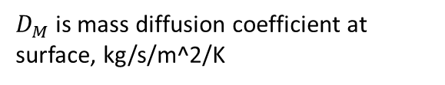

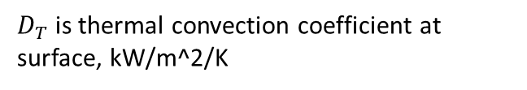

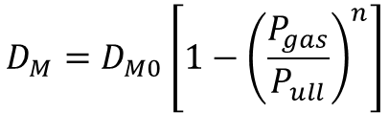

Thermal and mass diffusion relationships at liquid-ullage interface
Thermal and mass diffusion relationships at liquid-vapor interface:
Boiling mass transfer relationship, liquid to ullage:
$${\dot{Q}}_{ull−liq }=D_{T}A_{x}\left(T_{ull}−T_{liq}\right)$$
$${\dot{m}}_{liq−ull boiling }=D_{B0}m_{liq}e^{D_{B1}\left[P_{sat}\left(T_{liq}\right)−P_{ull}\right]}$$
$D_{T}$is thermal convection coefficient at surface, kW/m^2/K
$D_{B0}$is constant with units 1/s (“scaling” constant)
$${\dot{m}}_{ull−liq }=D_{M}A_{x}\left(P_{vap}−P_{sat}\left(T_{liq}\right)\right)$$
$D_{B1}$is constant with units 1/bar (“knee sharpness” constant)
$D_{M}$is mass diffusion coefficient at surface, kg/s/m^2/K
Enthalpy entering ullage due to ${\dot{m}}_{liq−ull boiling}$*:
$$D_{M}=D_{M0}\left[1−{\left(\frac{P_{gas}}{P_{ull}}\right)}^{n}\right]$$
$${\dot{H}}_{ull in boiling}={\dot{m}}_{ liq−ull}c_{p vap}T_{liq}$$
Enthalpy leaving liquid due to ${\dot{m}}_{liq−ull boiling}$*:
$${\dot{H}}_{liq out boiling}={\dot{m}}_{liq−ull boiling }h_{fg }$$
Enthalpy leaving ullage due to ${\dot{m}}_{ull−liq}$*:
$${\dot{H}}_{ull−liq}=\left\{\begin{aligned}{\dot{m}}_{ ull−liq}c_{p vap}T_{ull},{\dot{m}}_{ull−liq }>0 \\ {\dot{m}}_{ ull−liq}c_{p vap}T_{liq},{\dot{m}}_{ull−liq }<0\end{aligned}\right.$$
Enthalpy entering liquid due to ${\dot{m}}_{ull−liq}$*:
$${\dot{H}}_{ull−liq}={\dot{m}}_{ull−liq }h_{fg }+\left\{\begin{aligned}{\dot{m}}_{ ull−liq}c_{p vap}\left(T_{ull}−T_{liq}\right),{\dot{m}}_{ull−liq }>0 \\ 0,{ \dot{m}}_{ull−liq }<0\end{aligned}\right.$$

Slide 14
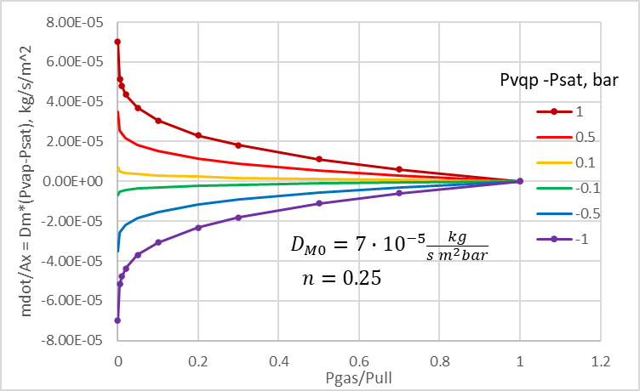



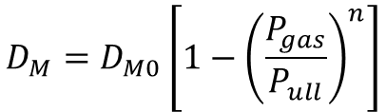



Choosing coefficients for mass diffusion at liquid-vapor surface
Mass diffusion assumed driven by difference between ullage vapor partial pressure and bulk liquid saturation pressure:
$$P_{vap}$$
$$P_{sat}$$
$${\dot{m}}_{ull−liq }=D_{M}A_{x}\left(P_{vap}−P_{sat}\left(T_{liq}\right)\right)$$
Mass diffusion slowed by presence of non-condensable gas:
$$D_{M}=D_{M0}\left[1−{\left(\frac{P_{gas}}{P_{ull}}\right)}^{n}\right]$$
Where D_{M0} is mass diffusion coefficient in absence of non-condensable gas
This approach is highly empirical approximation, due to bulk properties nature of liquid and ullage, but it can work surprisingly well for condensation
  For evaporation, perhaps gas interference effect should be adjusted or turned off
Typical value range for many fluids and calm surface:
$$D_{M0}=3∙{10}^{−5} to 3∙{10}^{−4}\frac{kg}{{s m}^{2}bar}$$
$$n=0.25$$
If disturbed/fragmented surface
$$D_{M0}≈0.01 to>1 \frac{kg}{{s m}^{2}bar}$$
is possible (due to greatly enhanced surface area)

Slide 15
















Ullage heat transfer and stratification considerations
Heat flow into ullage (typical cryogenic tank)
Heat flow out of ullage (typical boiler tank)
Vertical temp distribution
Vertical temp distribution
$$T_{w ull}$$
$$T_{w ull}$$
$$T_{ull}$$
Liquid temp
$${\dot{Q}}_{wall ull−ull}$$
Liquid temp
Wall temp
$$T_{ull}$$
Wall temp
$${\dot{Q}}_{env−wall ull}$$
$${\dot{Q}}_{wall ull−ull}$$
$${\dot{Q}}_{env−wall ull}$$
$${\dot{Q}}_{ull−liq}$$
$${\dot{Q}}_{ull−liq}$$
Warm vapor rises to top
Convection inhibited
Cooled vapor sinks or condenses along wall
Heated (and added) vapor rises from liquid
Strong convection
In absence of venting, ullage gas rapidly stratifies and becomes (on average) much warmer than liquid
Ullage gas temperature tends to track liquid temperature
$γ_{ull},D_{T},D_{M0},⟹small$er values
$$γ_{ull},D_{T},D_{M0},⟹larger values$$
$${\dot{Q}}_{wall ull−ull}=γ_{ull}A_{ull w}\left(T_{w ull}−T_{ull}\right)$$
$${\dot{m}}_{ull−liq }=D_{M}A_{x}\left(P_{vap}−P_{sat}\left(T_{liq}\right)\right)$$
$$D_{M}=D_{M0}\left[1−{\left(\frac{P_{gas}}{P_{ull}}\right)}^{n}\right]$$
$${\dot{Q}}_{ull−liq }=D_{T}A_{x}\left(T_{ull}−T_{iq}\right)$$

Slide 16
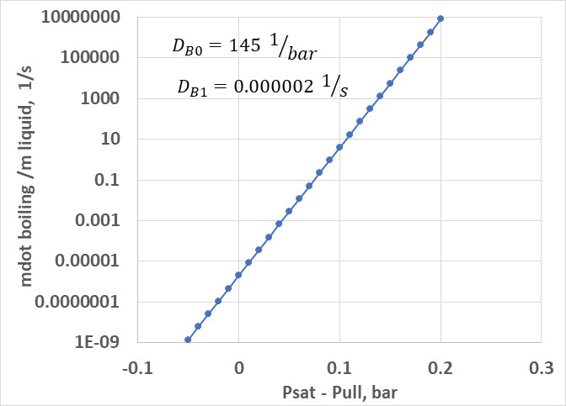
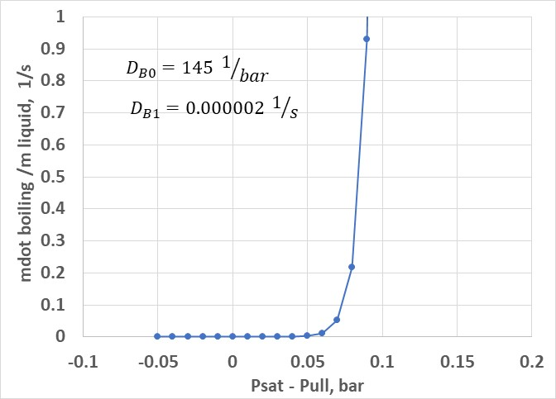
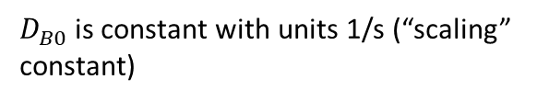
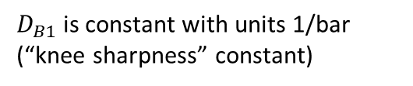
Explanation of boiling model
Objective is to capture basic boiling characteristics such that algorithm runs in a stable manner
Empirical boiling mass transfer relationship, liquid to ullage:
$${\dot{m}}_{liq−ull boiling }=D_{B0}m_{liq}e^{D_{B1}\left[P_{sat}\left(T_{liq}\right)−P_{ull}\right]}$$
Boiling rate is proportional to mass of liquid in tank
Exponential cutoff characteristic (penalty function)
$D_{B0}$is constant with units 1/s (“scaling” constant)
Rapid increase if P_{sat} > P_{ull}
$D_{B1}$is constant with units 1/bar (“knee sharpness” constant)
Negligible boiling if P_{sat} < P_{ull}

Slide 17







What about tank disturbances (Mixes and Quenches)
Mixing of liquid with ullage
  Liquid sprays or splashes into ullage
Quenching of walls
    Liquid sloshes or wicks up walls
Will usually drop tank pressure
Will usually raise tank pressure
$$T_{w ull}$$
$$T_{w ull}$$
$${\dot{m}}_{ull−liq }$$
$$T_{ull}$$
$$T_{ull}$$
$${\dot{m}}_{ull−liq }=D_{M}A_{x}\left(P_{vap}−P_{sat}\left(T_{liq}\right)\right)$$
$${\dot{Q}}_{wall ull−wall liq}$$
$${\dot{Q}}_{ull−liq}$$
$${\dot{Q}}_{wall ull−wall liq}=k_{wall}{\left(\frac{A_{x}}{L}\right)}_{w}\left(T_{w ull}−T_{w liq}\right)$$
$${\dot{Q}}_{ull−liq }=D_{T}A_{x}\left(T_{ull}−T_{iq}\right)$$
Consequence
  High heat and mass transfer between liquid and ullage
  Ullage and liquid reach equilibrium in limit
Consequence
  High heat transfer between ullage wall and liquid
  Possible boiling
  Ullage walls quenched to liquid temperature in limit
$$Set D_{T},D_{M} high$$
$$Set L very low (or k_{wall} artificially high)$$
Can explicitly solve equations for mix and quench limits, but…
  Easier to brute-force solutions by driving up appropriate convection, conduction, and diffusion coefficients
  This also provides some transient behavior modeling, if test data available to aid in coefficient selection
In real world, various combinations of these two events are likely to occur

Slide 18
Description of spreadsheet tools
Implementation of 4 node model in spreadsheets with VBA macros

Slide 19
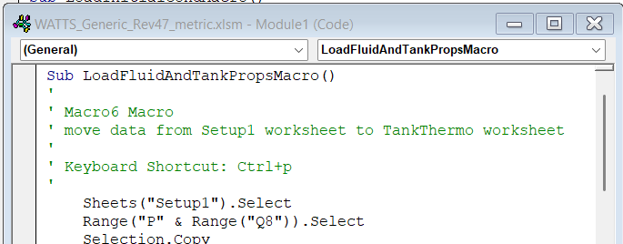
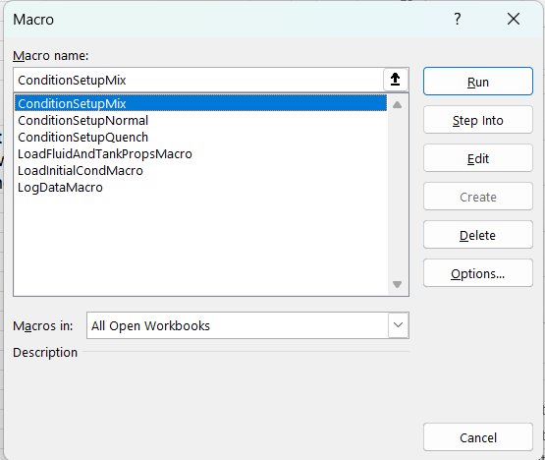
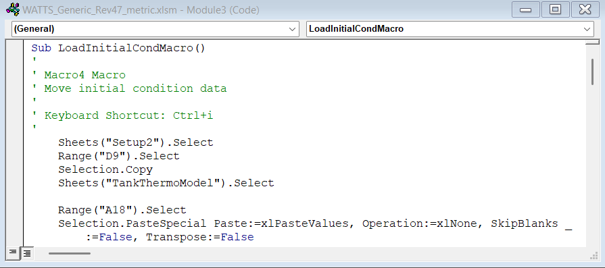
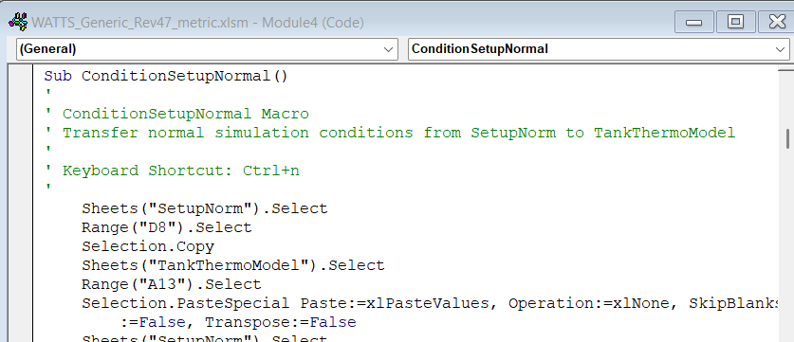
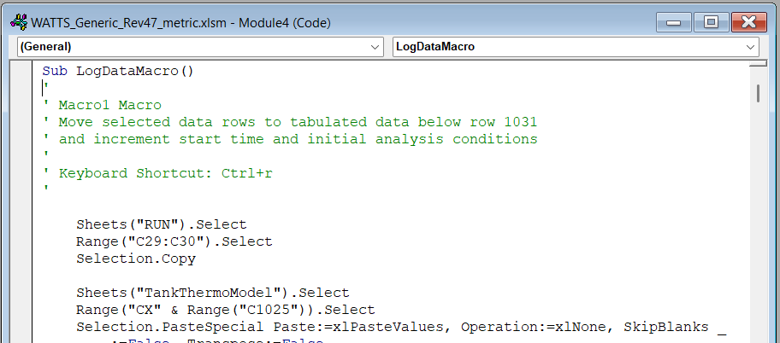
Macros summary (1 of 2)
Six macros to drive analysis operations
  Move condition data to appropriate locations
  Increment analysis intervals and log data

Slide 20
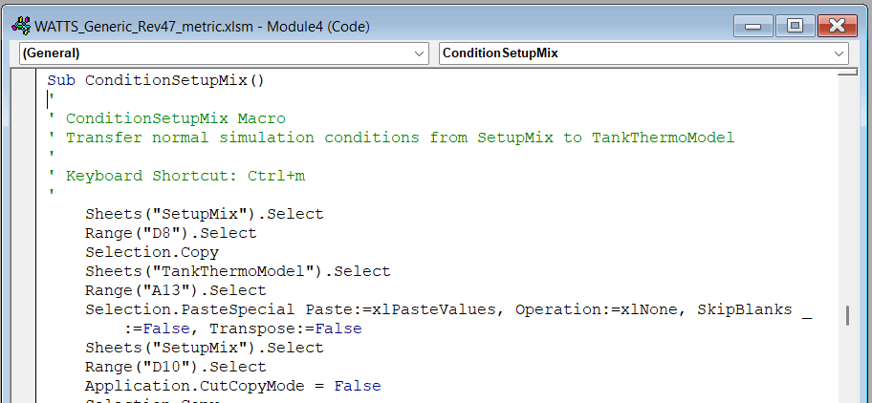
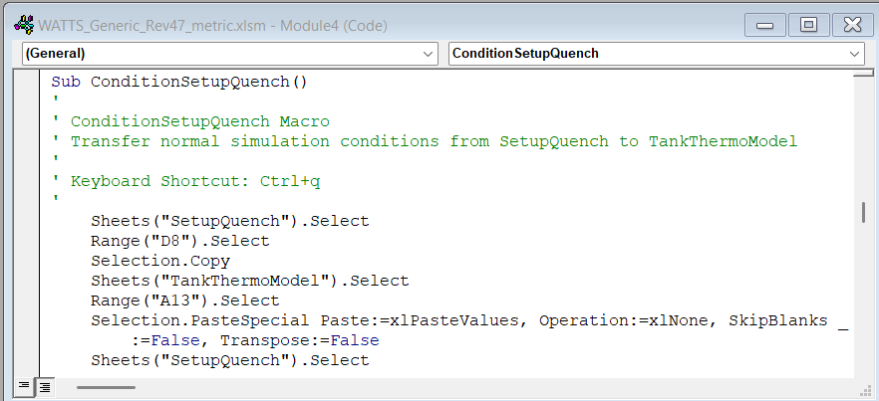
Macros summary (2 of 2)
Dedicated macros to set up for a “Mix” or “Quench” simulation
Equivalent to “Normal” setup, but using different modeling conditions

Slide 21
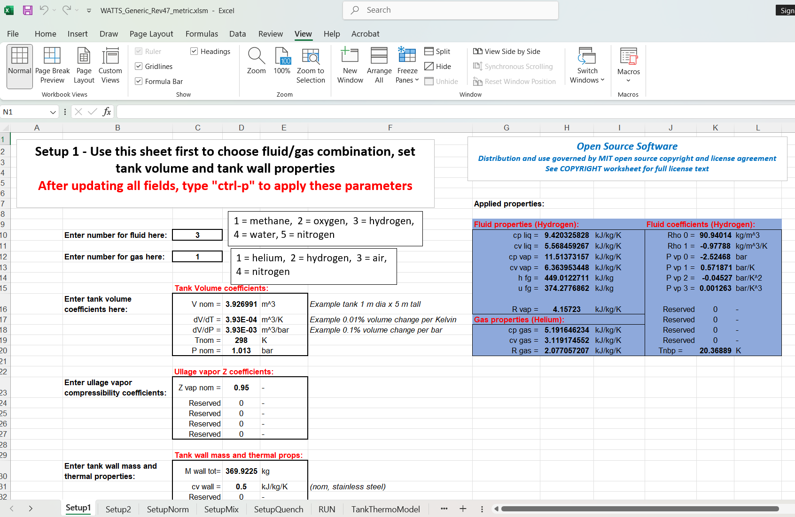
Worksheets – Setup1
Work through Worksheets left to right
“Setup1” is for fluid selections and tank parameters

Slide 22
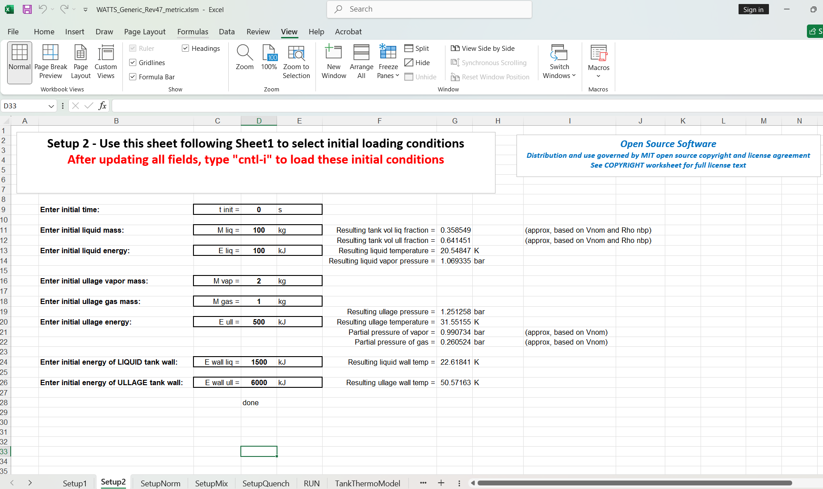
Worksheets – Setup2
“Setup2” is for setting initial conditions, and initializing analysis

Slide 23
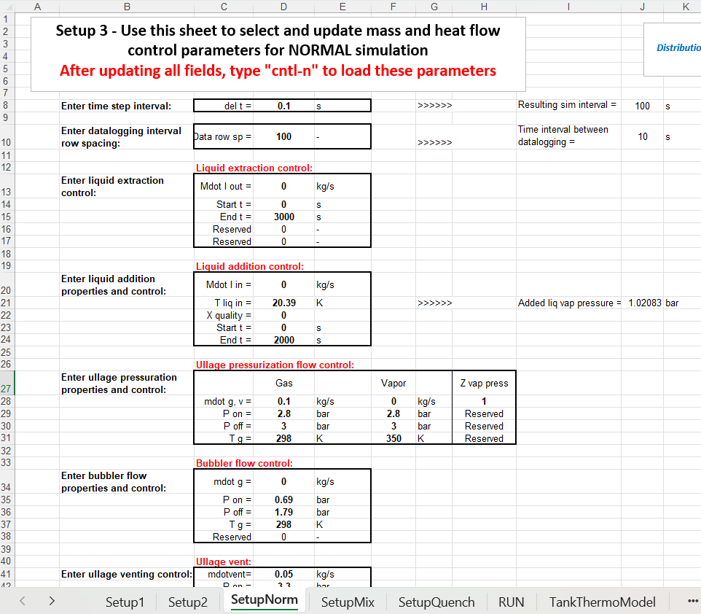
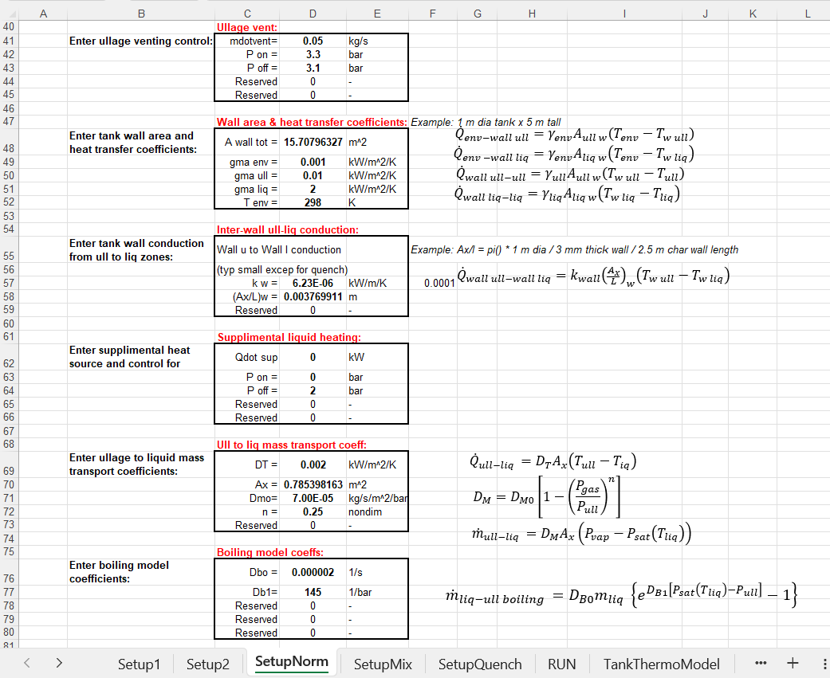
Worksheets – SetupNorm
“SetupNorm” sets:
  Thermal and mass diffusion coefficients
  Gas and liquid flow control
  Supplemental heating
“SetupMix” and “SetupQuench” are essentially identical to “SetupNorm”

Slide 24
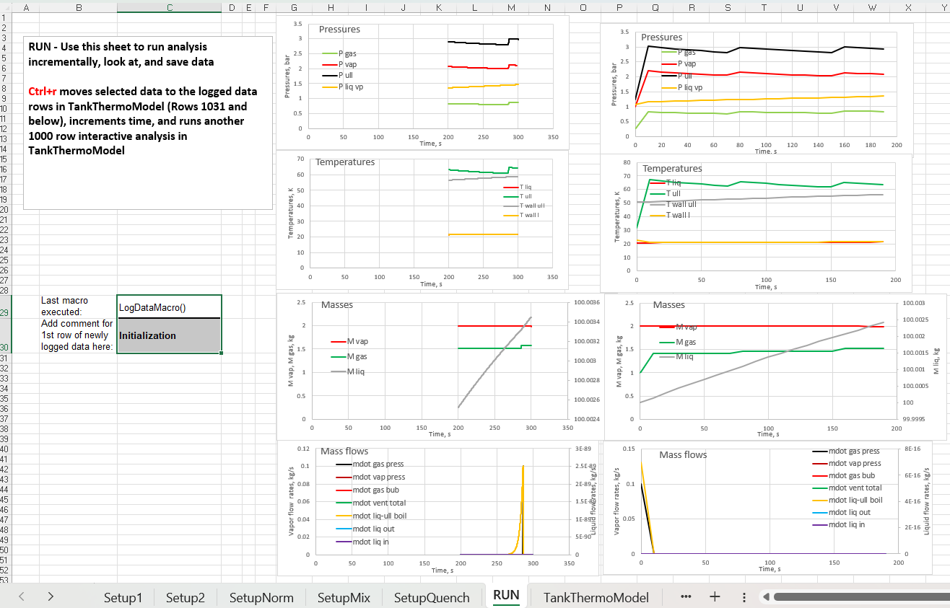
Worksheets – Run
Pressures
Temperatures
Masses
“Run” is where data is displayed and time step execution is controlled
Mass flows
Results of last analysis interval
Cumulative results (logged data)

Slide 25
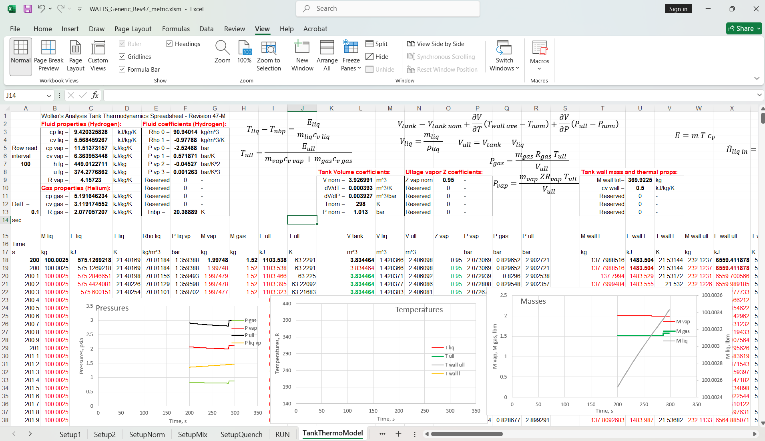
Worksheets – TankThermoModel
This is the Worksheet where all the calculations occur
~ 80 columns
~ 1050 rows

Slide 26
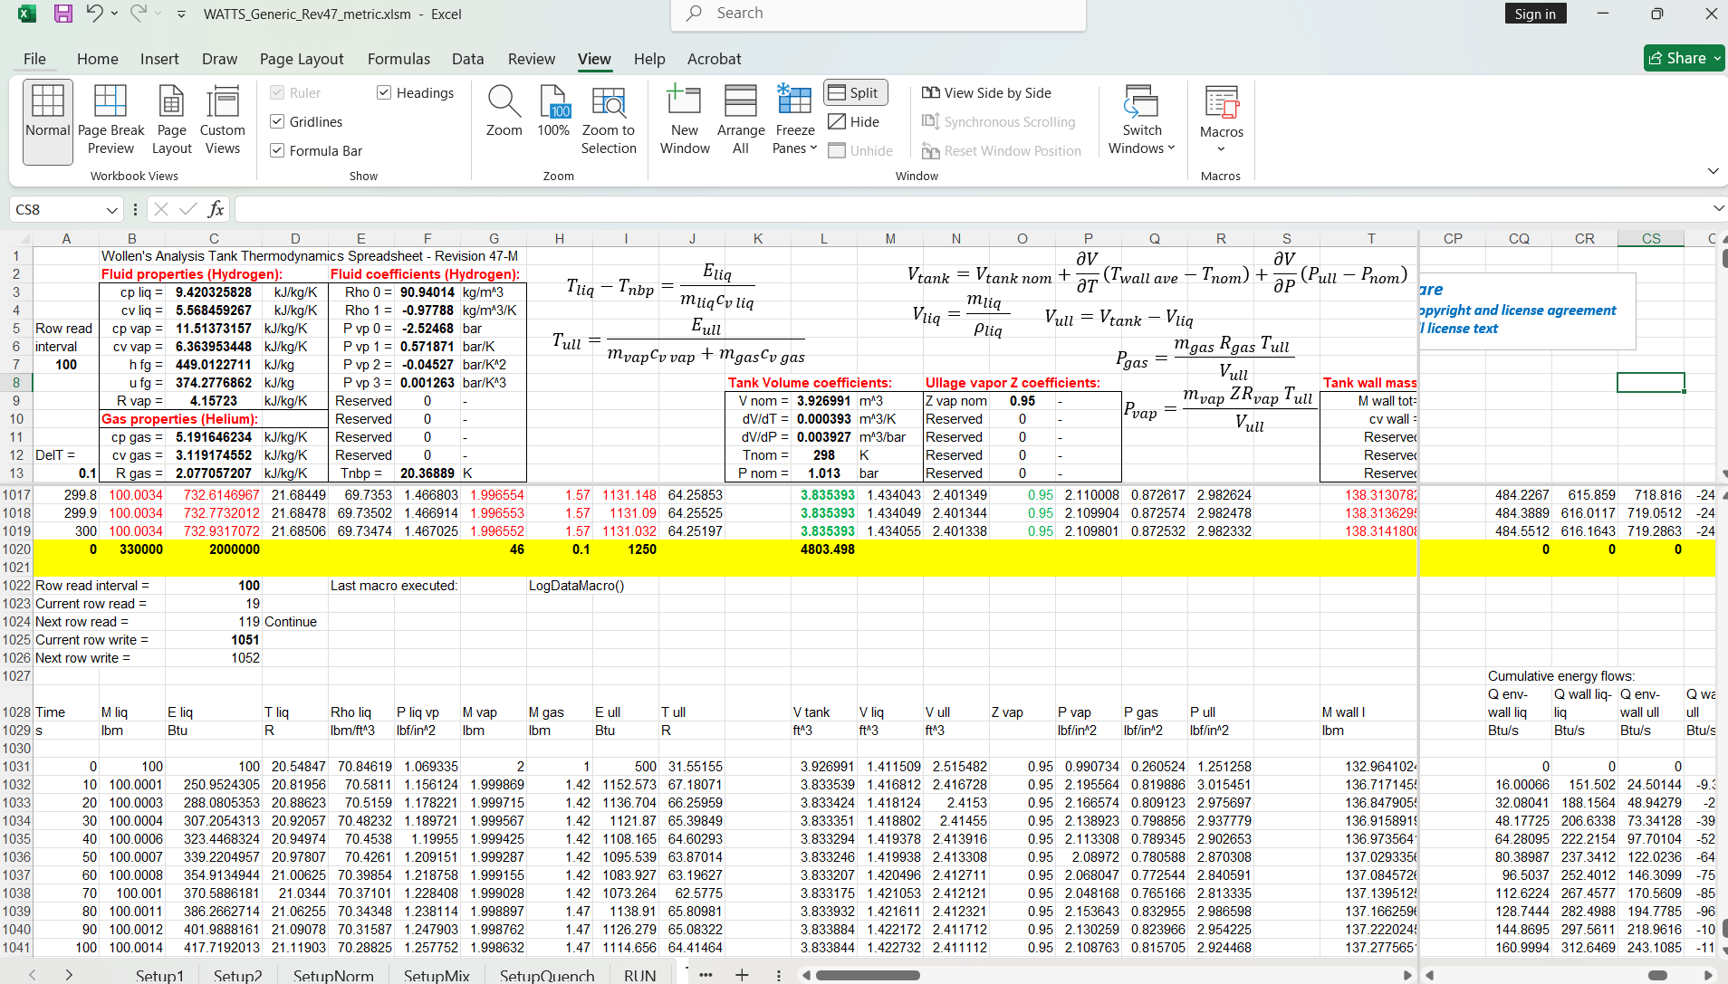
Worksheets – TankThermoModel
Row 1022 and on is where logged data is recorded
All masses, energies, temps, press, flows, etc logged at specified intervals (10 sec in this example)

Slide 27
Analysis demonstration (optional)
Perform real time analysis demonstration of tank loading, pressurization, outflow with heating (i.e., ascent), and mix/quench disturbance for a hydrogen tank

Slide 28
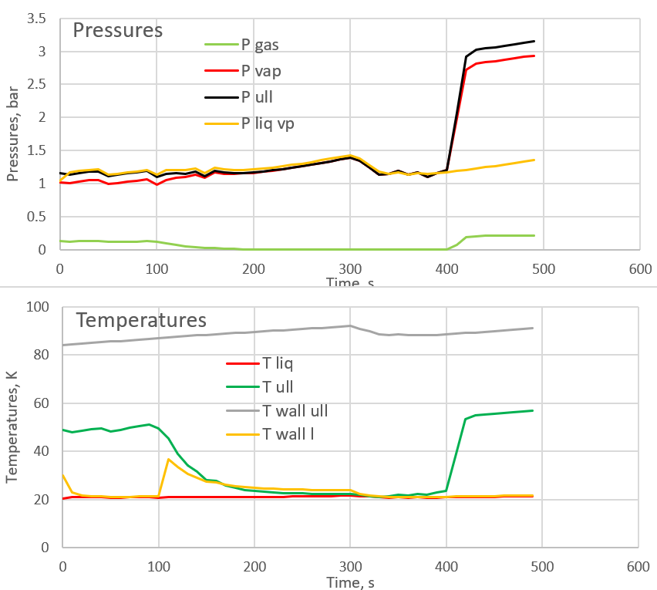
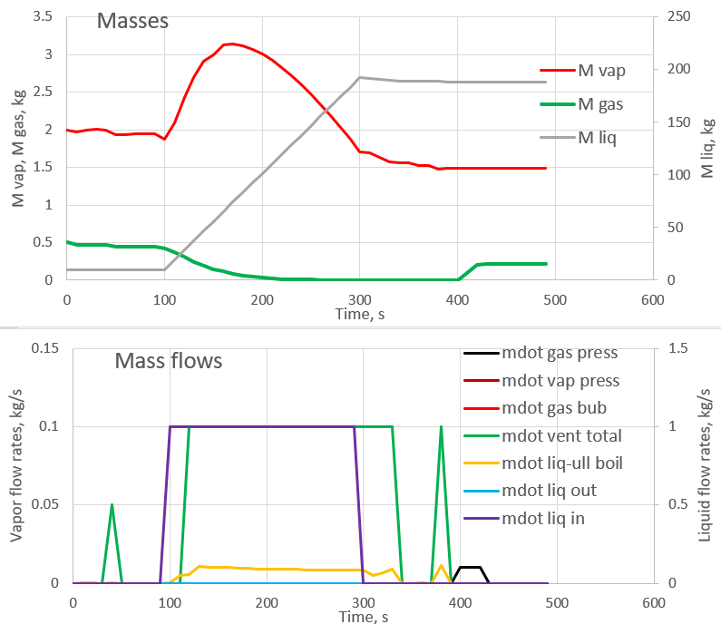
Example simulation – Hydrogen tank loading and press’n
Loading
He, 298 K
Loading, 1 kg/s
He, 298 K
Press’n
Heat leakage
Press’n

Slide 29
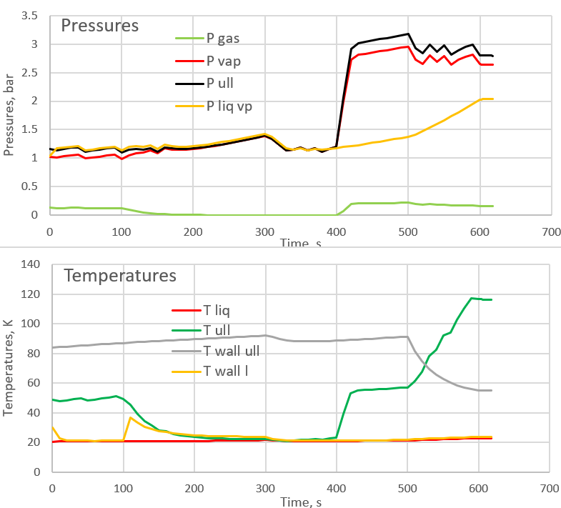
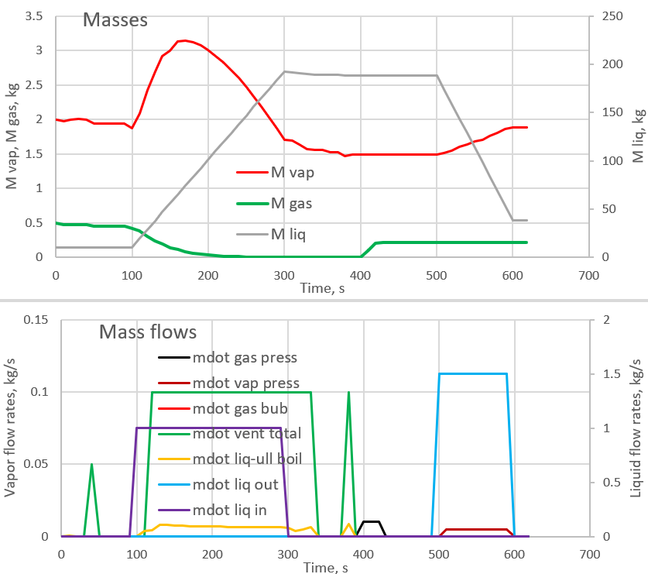
Example simulation – Hydrogen tank outflow/ascent
Liquid outflow
MECO/undisturbed
Liquid outflow, 1.5 kg/s
MECO/undisturbed
H2 ullage press, 0.005 lbm/s, 350 R
1x
3x heating
Liq vap press rise
Due to env heating
Cold liq wall being added to warm ull wall
Liquid evaporating into ullage as temperature rises

Slide 30
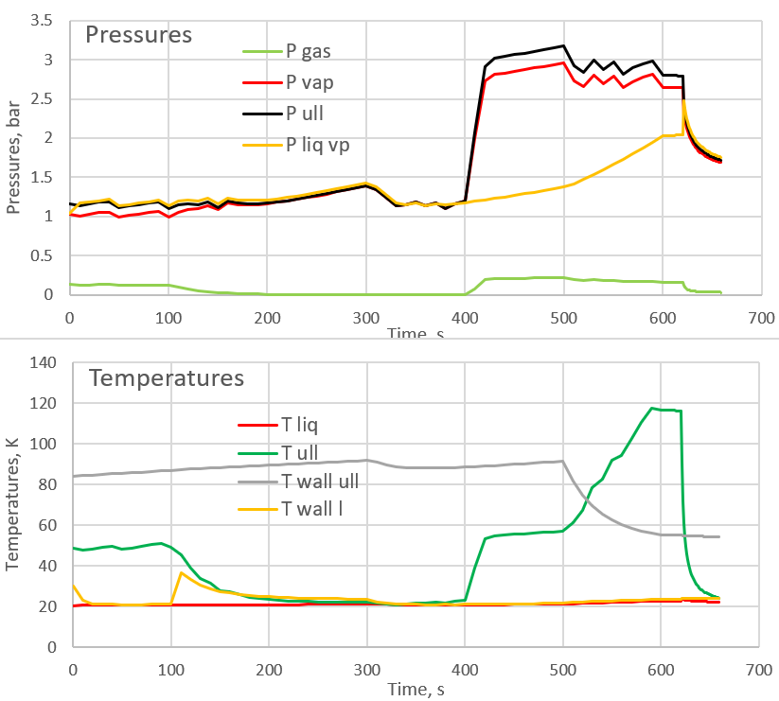
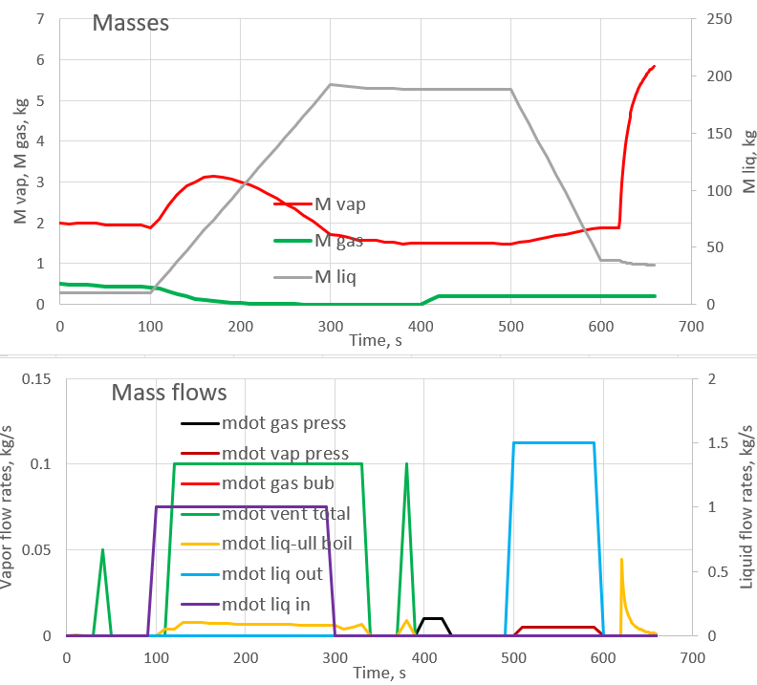
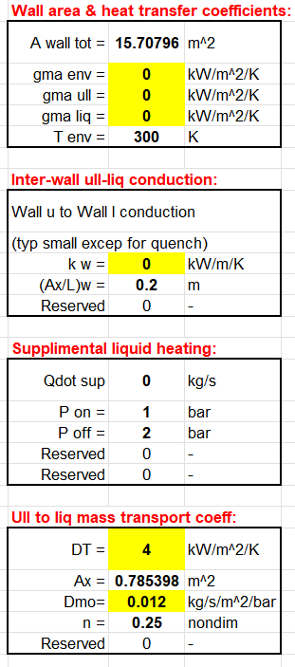
Example simulation – Hydrogen tank post-outflow MIX
MIX (liq-ullage mix)
MIX (liq-ullage mix)
Pressure collapses
~4 kg vap add’n to ull
Liquid saturates
Ullage chills
Liquid boils

Slide 31
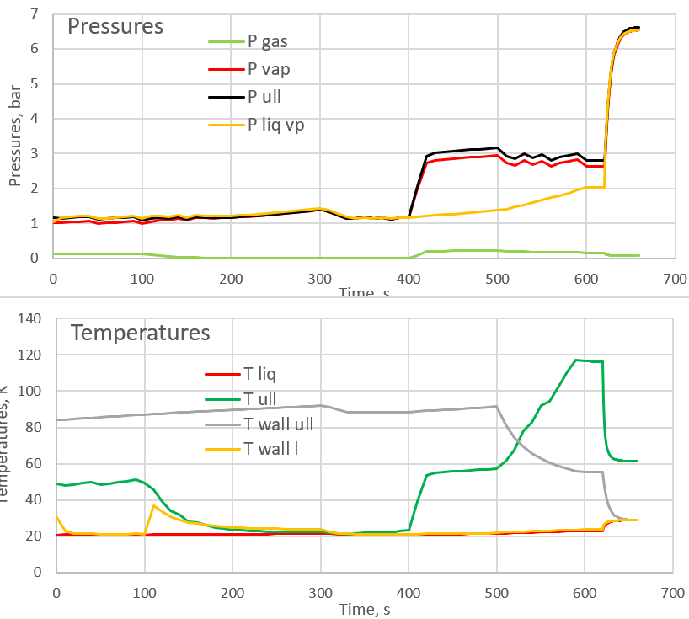
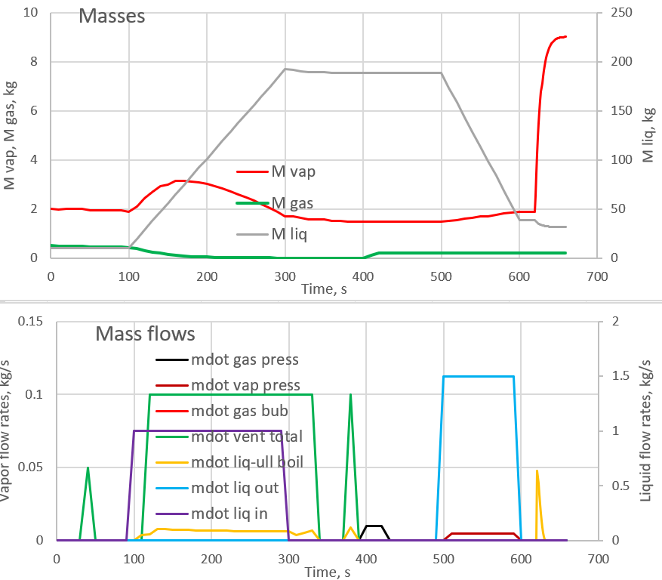
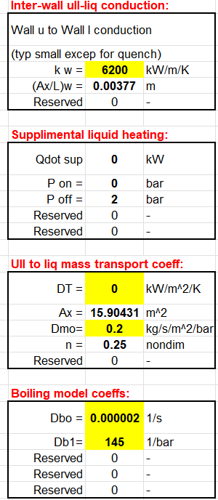
Example simulation – Hydrogen tank post-outflow QUENCH
QUENCH (Liquid quenches tank walls)
QUENCH (Liquid quenches tank walls)
Liquid saturates pressure spikes
~7 kg vap add’n to ull
Ullage cools
Liquid boils
Ullage wall chills

Slide 32
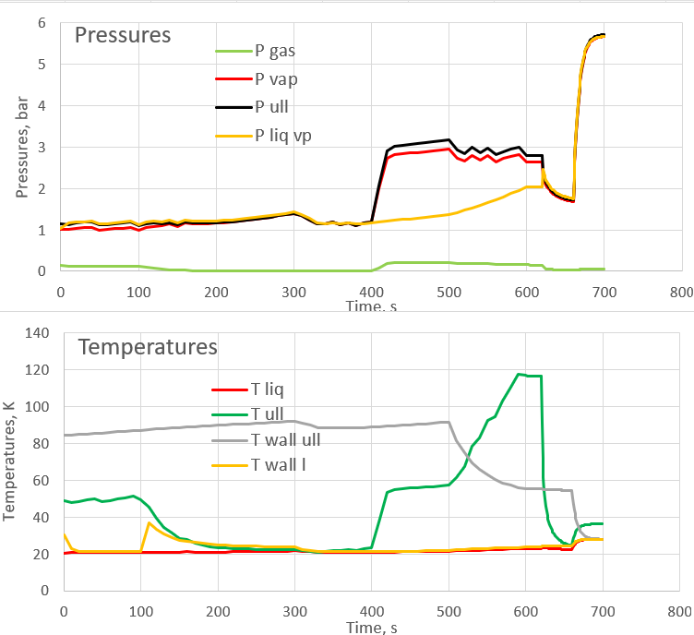
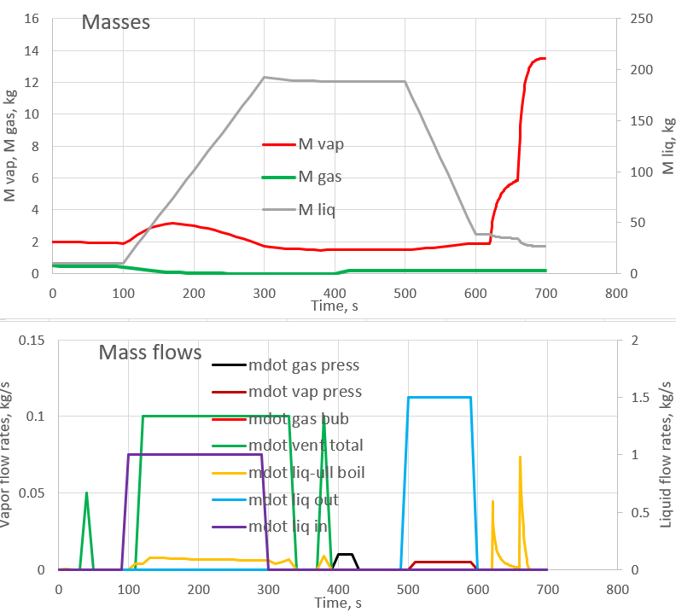
Example simulation – Post-outflow MIX-QUENCH
QUENCH
QUENCH
MIX
MIX
Liquid saturates on mix, pressure spikes on quench
~11 kg vap add’n to ull
Liquid boils
Temps all approaching equilibrium
Question – What about a QUENCH-MIX rather than a MIX-QUENCH?

Slide 33
Possible future enhancements and improvements
Lacks an ullage wall condensation model
  Generally not needed for cryogens, but would improve simulation for boilers
Time steps are fixed and manually set
  Automatic time step selection could speed up execution and avoid some initial work, but might add its own problems
Tank geometry and wall model refinements
  Currently simple cylindrical shape for area-volume-height
  Dynamically adjusting length scale for intra-wall heat transfer would improve wall conduction simulation
Lacks adsorption of non-condensable gas in liquid
  Can be of importance with hydrogen-helium or water-air combinations

Slide 34
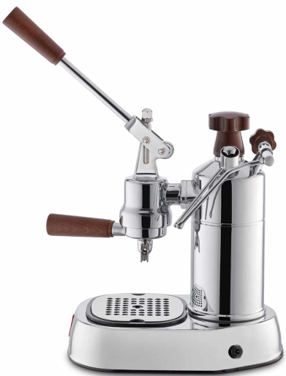
A practical example and algorithm validation
Espresso machine boiler
T
Ullage and liquid thermocouples
T
Ullage pressure
Ullage vent (frother)
P
Liquid outflow (to coffee basket)
Heat LOSS through walls
1 liter boiler
Stainless steel
2.2 kg boiler mass
Pwr meter
Bare (chrome) walls
950 W heating element
Thermal control feedback
Heat addition
to liquid (950W)

Slide 35
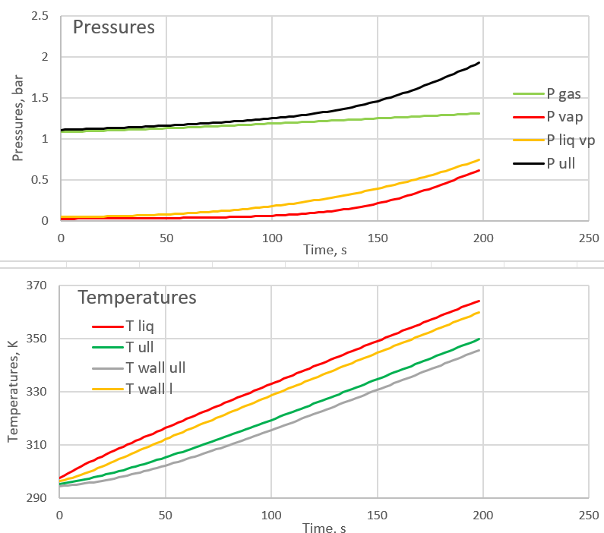
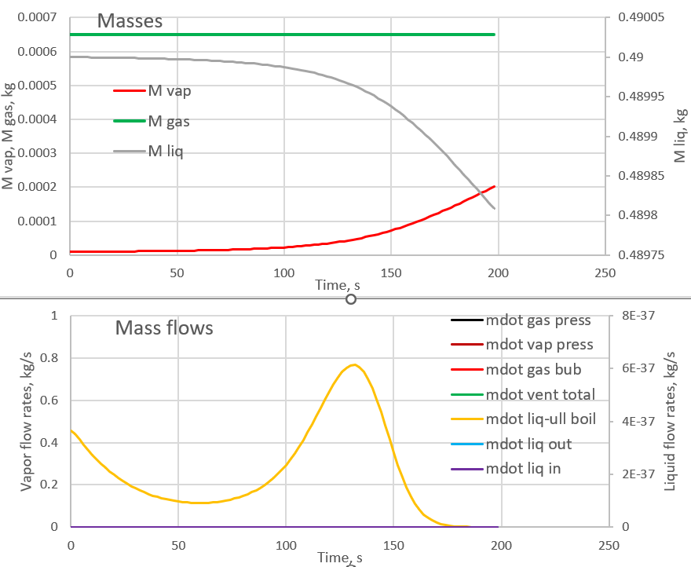
Boiler through 200 seconds
What’s going to happen when we vent?
Approaching vent level
Liquid evaporating into ullage as temperature rises

Slide 36
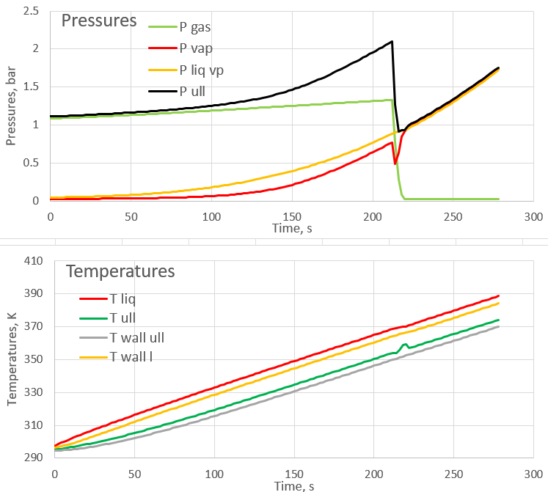
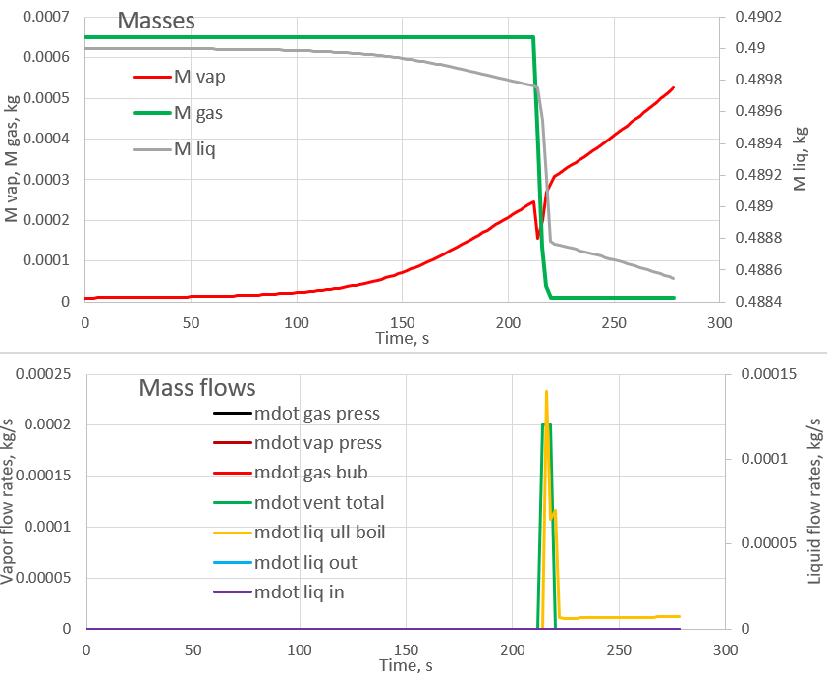
Boiler through 280 seconds
Approaching second venting – what’s going to happen now?
Ullage venting
Ullage venting
Non-condensable gas vented off
Boiling kicks-in as P_{ull} drops to P_{sat}
T_{ull} perturbation due to venting

Slide 37
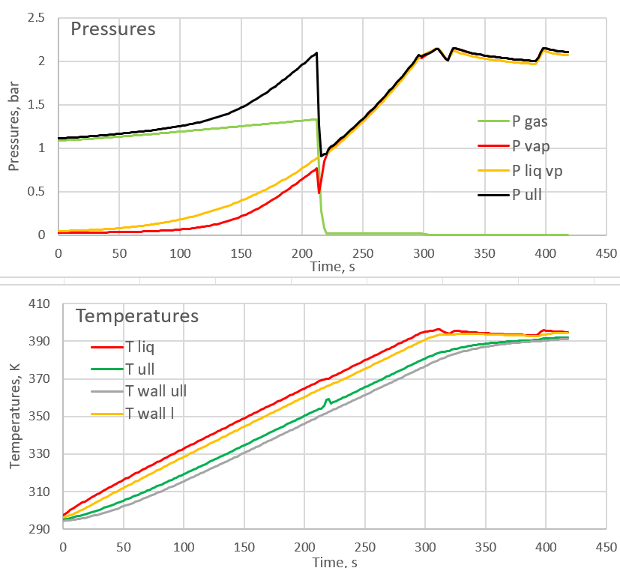
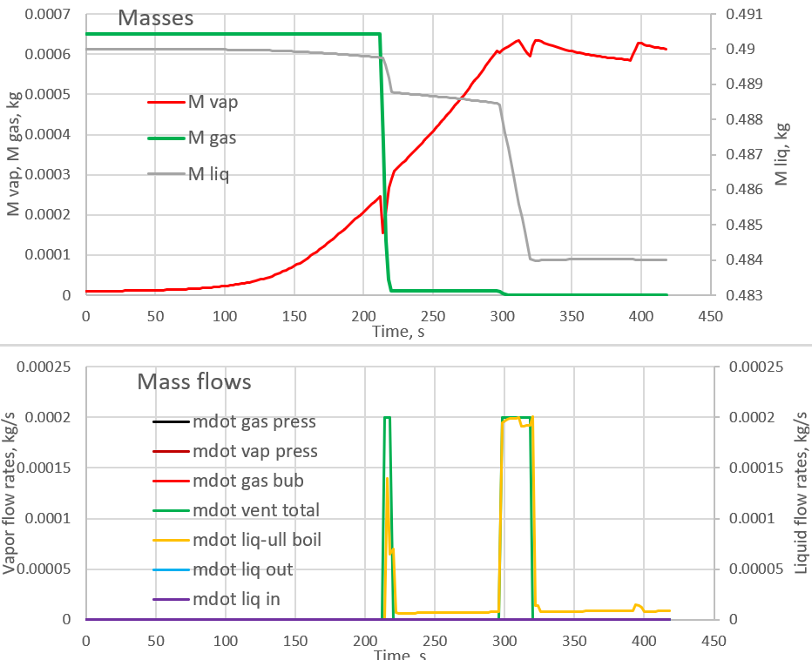
Boiler through 420 seconds
Ullage venting
Heater cycling
Ullage venting
Heater cycling

Slide 38
End of presentation
Questions?
Time for coffee break?

