Slide 1

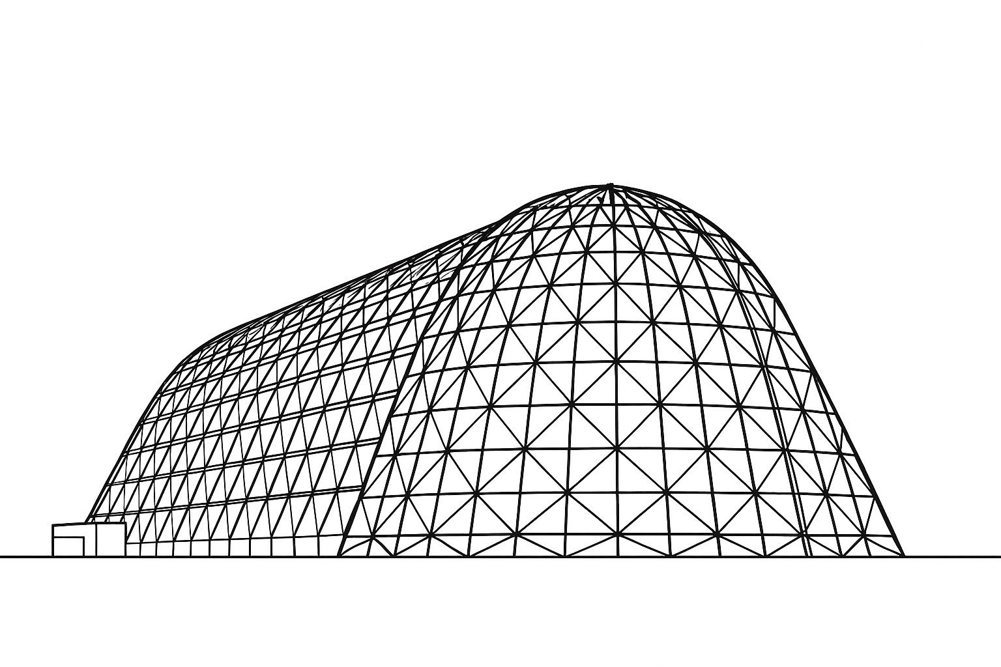

Hydrophobicity of Surface Coatings for Cryogenic Liquid Storage and Transfer in Microgravity Environments
TFAWS 2025 Cryogenics Technical Session
Presented by: Ethan Paulsen
Matthew Wittal, Richard Zhang, Mai Harrison
University of North Texas, NASA
Thermal & Fluids Analysis Workshop 2025
NASA Ames Research Center
San Jose, CA
August 4-7, 2025

Slide 2
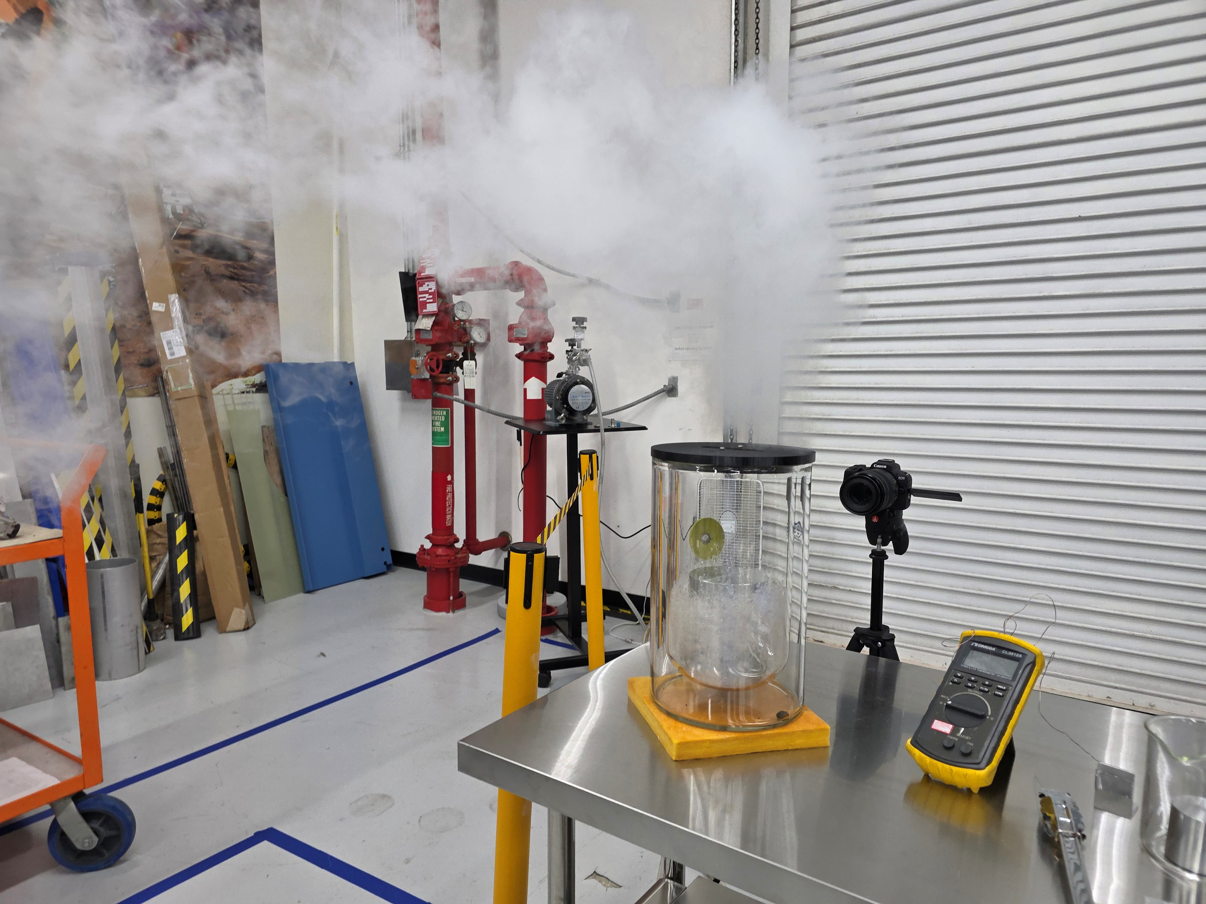
Outline
Introduction
Methodology
  Samples
  Initial Setup
New Setup
  Problems
Results
  Samples 1-3: SU-8
  Samples 4-6: Copper with/without greases
  Conclusion
Future Efforts

Slide 3
Introduction
Microgravity imposes limitations on fuel transfer
  Surface adhesion decreases efficiency of contemporary fuel storage systems
Alterations to systems have cascading changes
  Introducing a new component requires room, weight, and safety considerations
  Most changes introduce a variety of failure risks independent of other changes
  Maneuvers to reduce adherence can be incredibly dangerous
Goal: A simple, risk-free design that is generalizable
  No charged components or current
  No volatile/reactive components
  Properties that translate across cryogenic fuels
  Minimal design changes
Proposal: Make a surface that is generally cryophobic

Slide 4
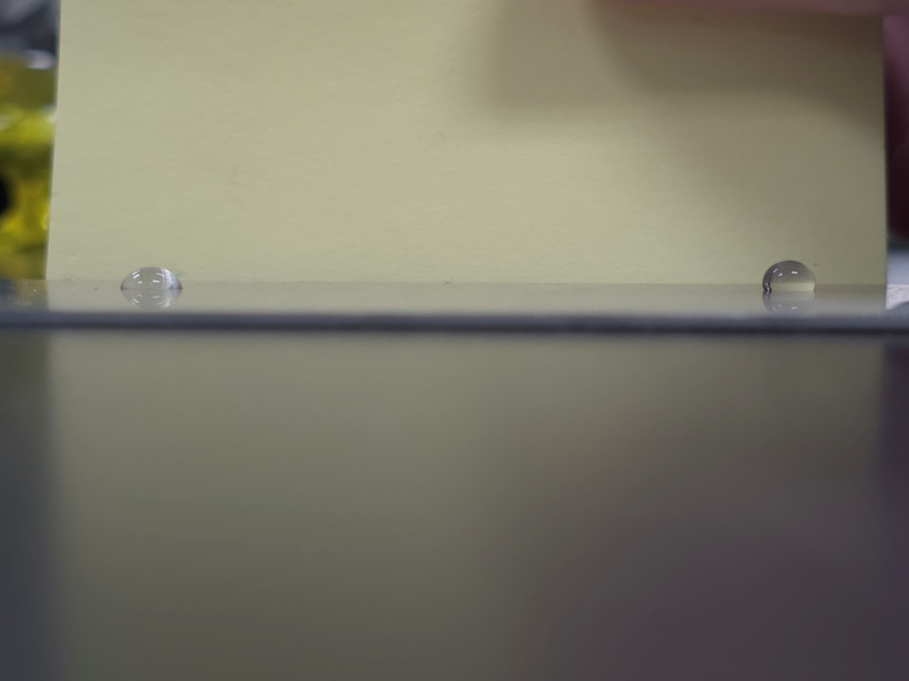
Methodology
Initial testing aimed at establishing experimental setup and benchmark
  Few published work on this topic
  Benchtop setup designed for proof-of-concept testing
Using goniometry to determine surface-fluid interaction
  Canon EOS R50
    1920x1080, 120 fps video
    6000x4000 images
  Measure contact angle of cryogen droplets
Water On Steel
Water On Krytox Coated Steel

Slide 5
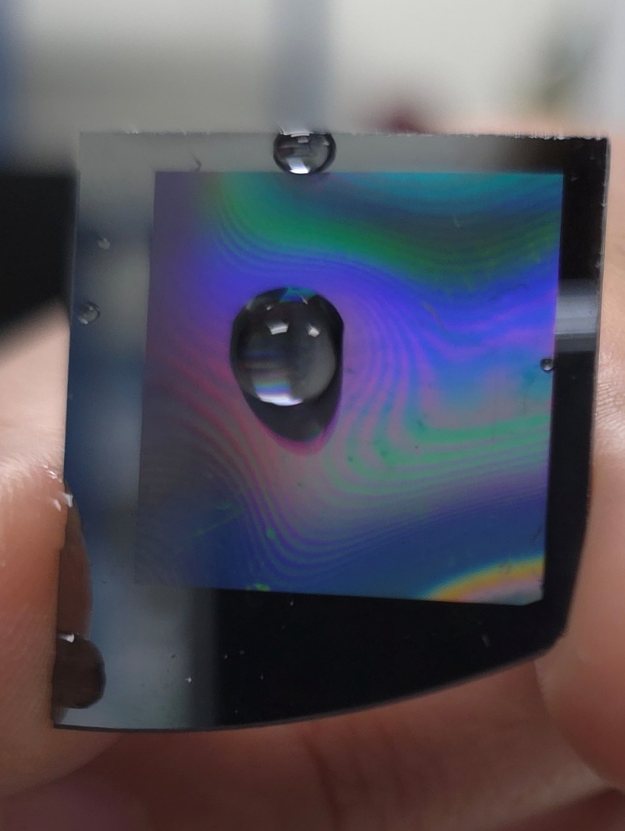
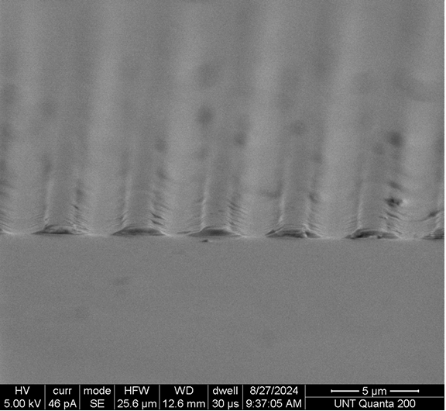
Samples
Starting with known and available samples
  SU-8 photoresist applied in a hydrophobic pattern
    Selected for it’s inert and robust state once patterned
  Copper sheet cut to 1x1” squares
    Bare copper
    Krytox 240AC coating
    Apiezon N coating

Slide 6
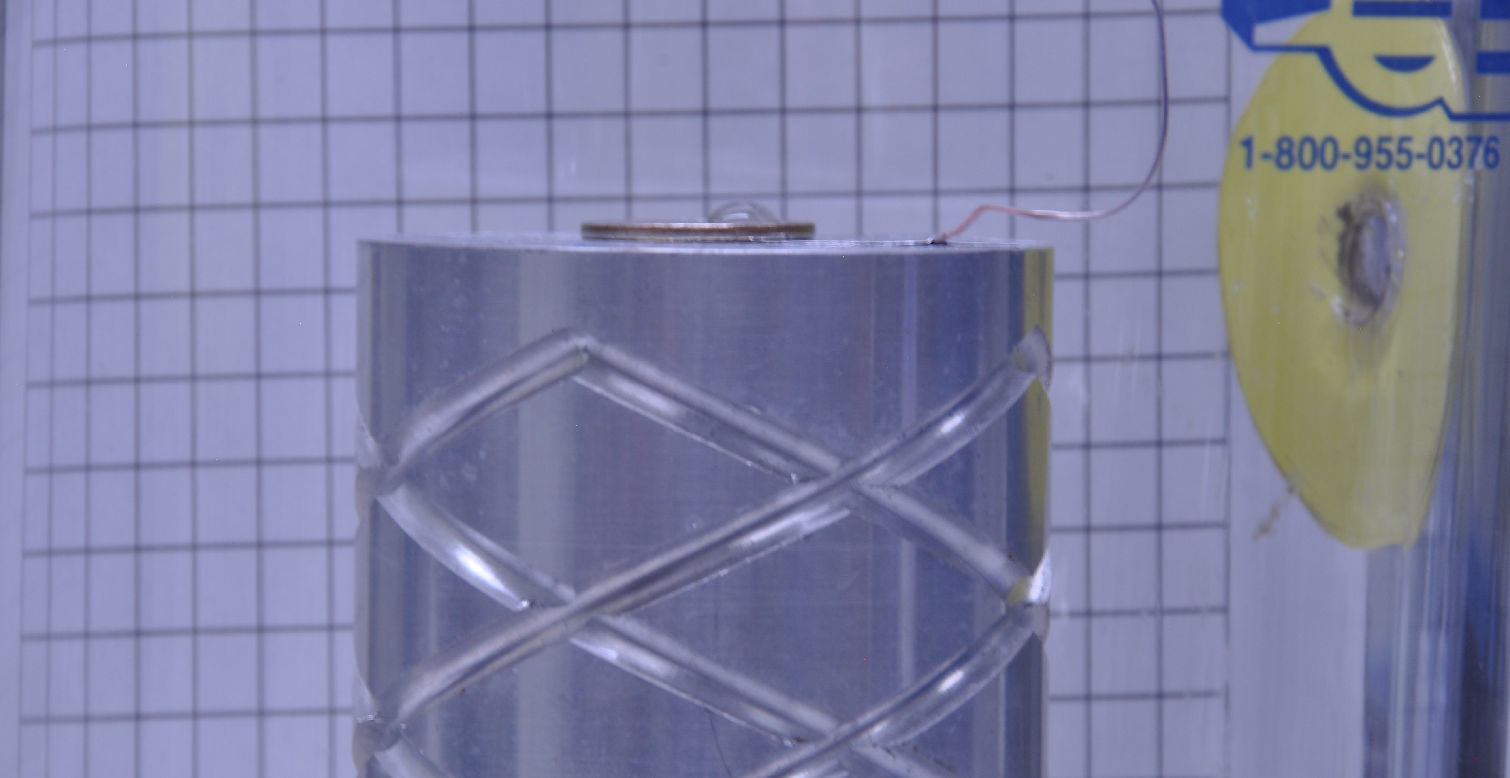
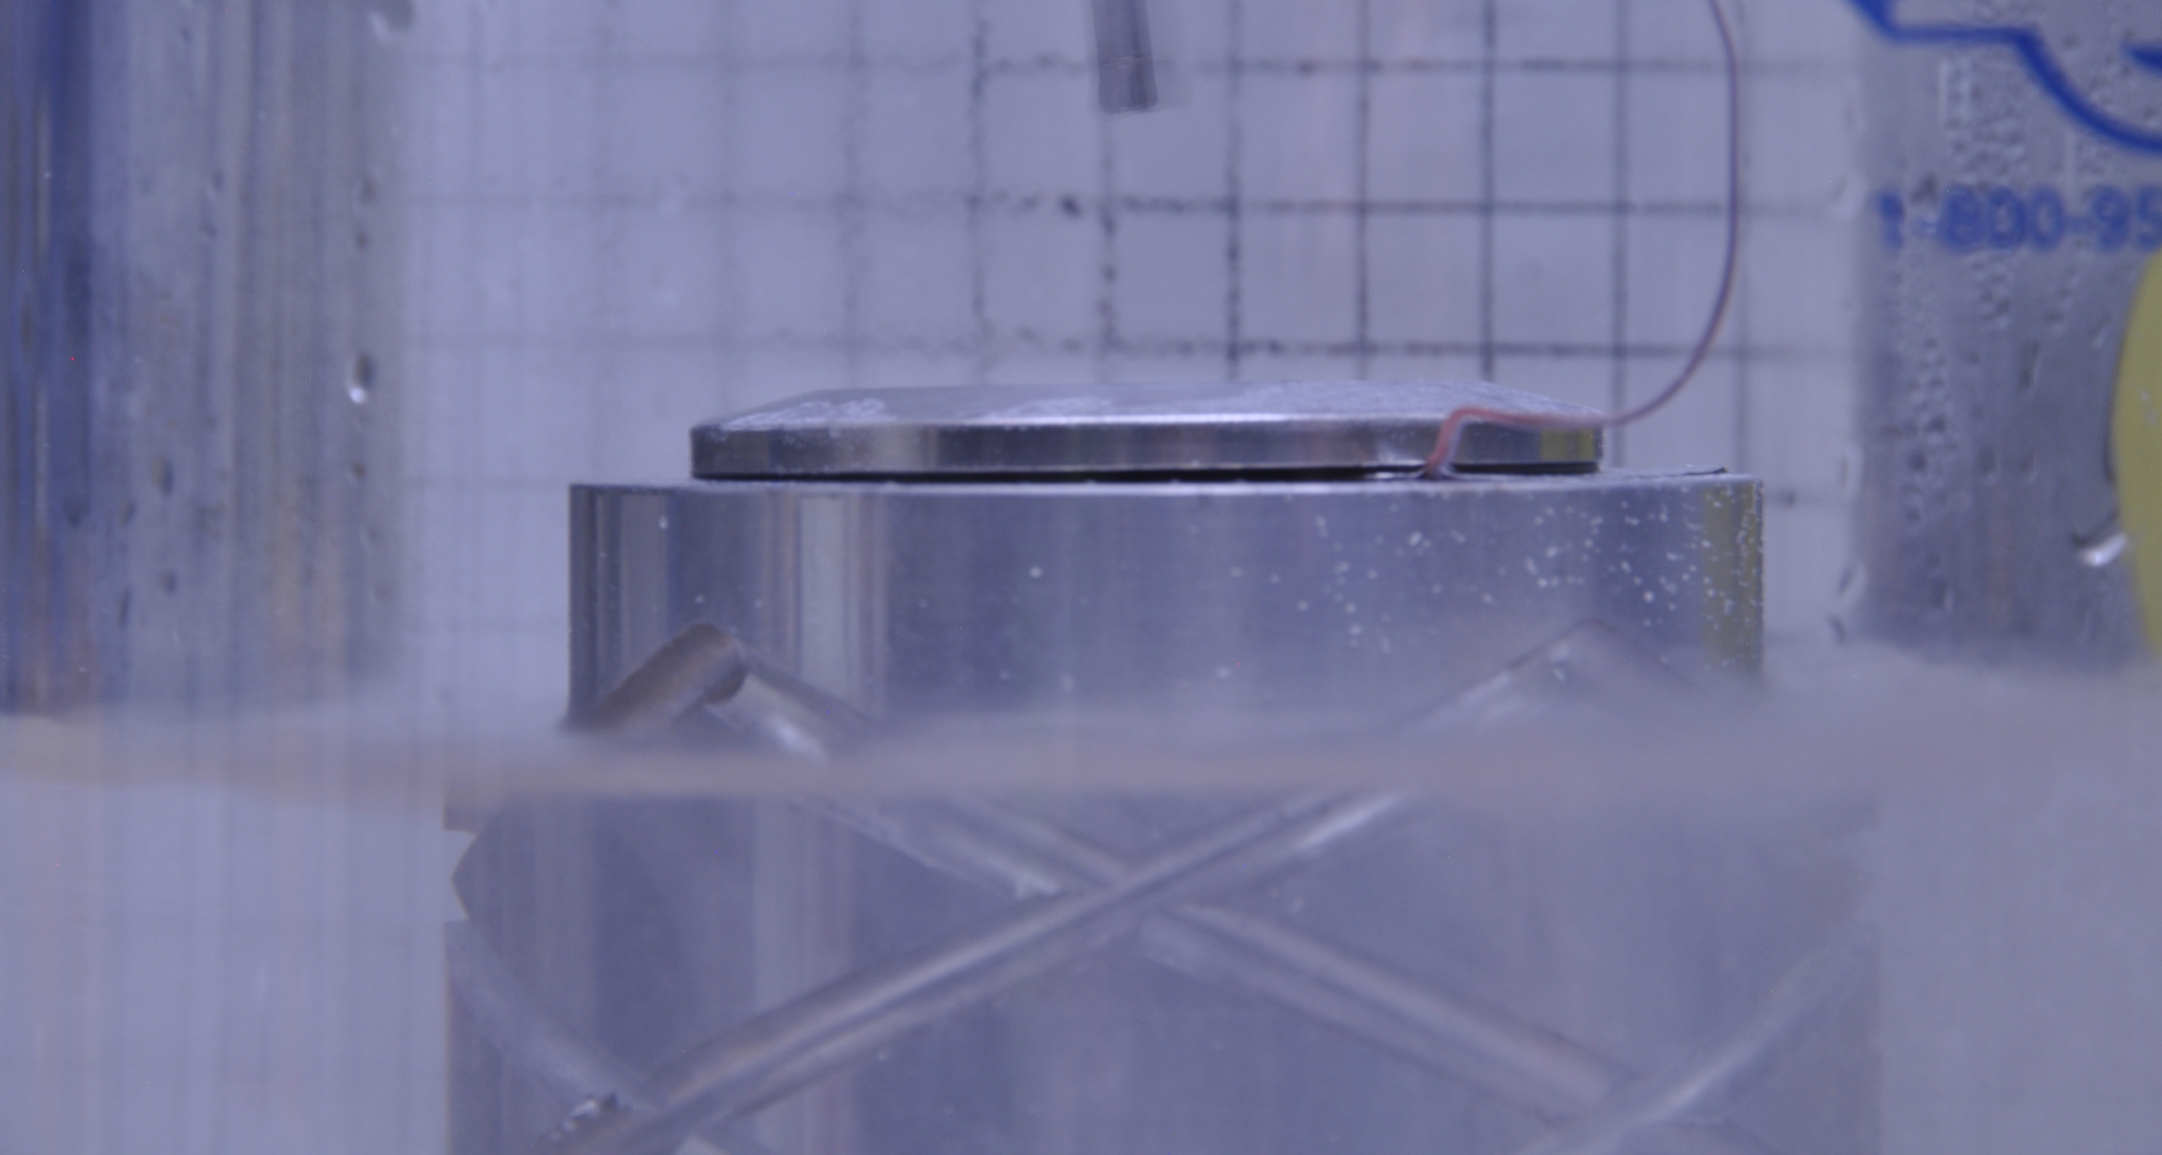
Initial Setup
Previous tests performed by Nicholas Harden
Provided undesirable results for myriad reasons
  LN2 has extremely low surface tension
  Initial setup resulted in moisture buildup on vacuum jacketed beaker
Though disappointing, liquid oxygen was planned for use in subsequent tests
  Change to LOx might address surface tension issue

Slide 7
Initial Setup
Vacuum Jacketed Beaker
Test Droplet
Sample
LN2
To Pump
Aluminum Stand
TFAWS 2025 – August 4-7, 2025

Slide 8
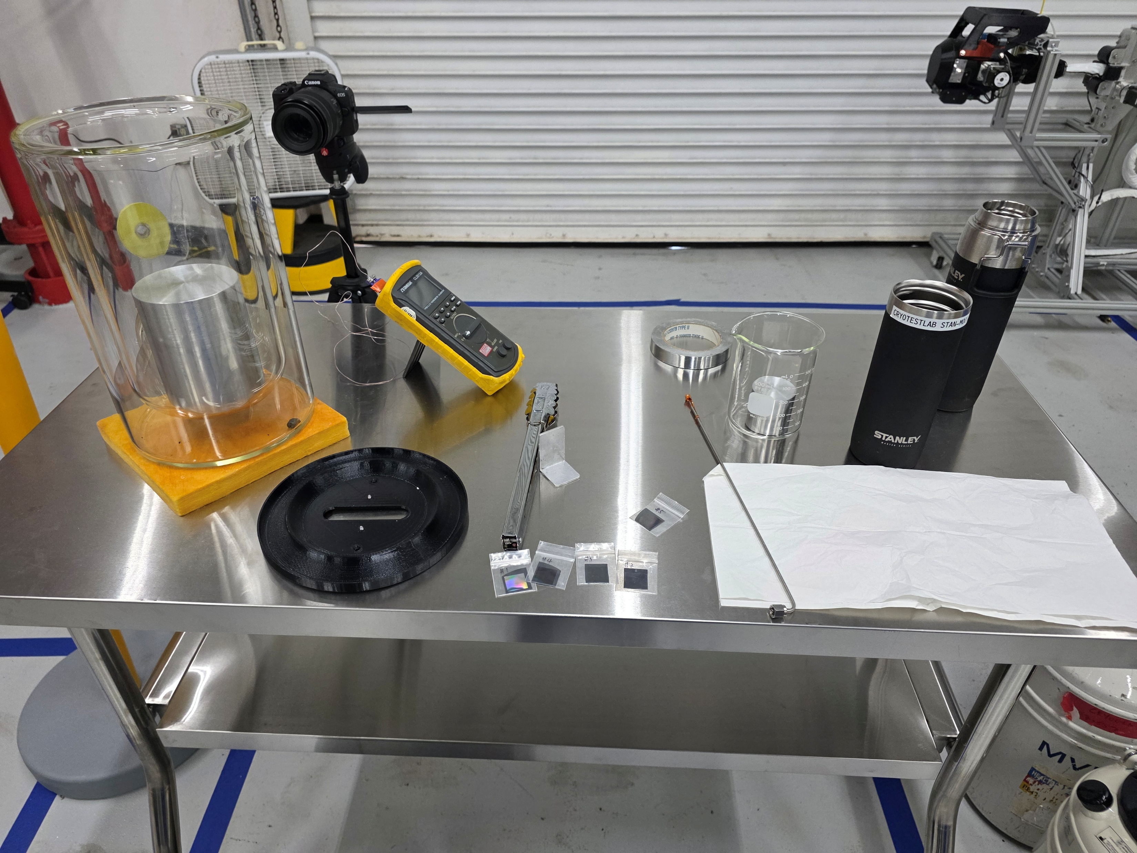
New Setup
Added smaller beaker with additional LN2 and aluminum stand
  Results in quiescent LN2 in the same beaker as the sample
  Significantly reduced quantity of LOx used
Added two fans several feet away
  Constant airflow along bottom 2/3rds of beaker prevents moisture and frost buildup
Demarcated testing area for LOx
  Eliminated ignition sources within five feet
  Moved to High Bay for improved ventilation and safer diffusion
    This was a mistake

Slide 9
New Setup
Vacuum Jacketed Beaker
Second Beaker
Test Droplet
Test Cryogen
Sample
LN2
To Pump
Aluminum Stand
TFAWS 2025 – August 4-7, 2025

Slide 10
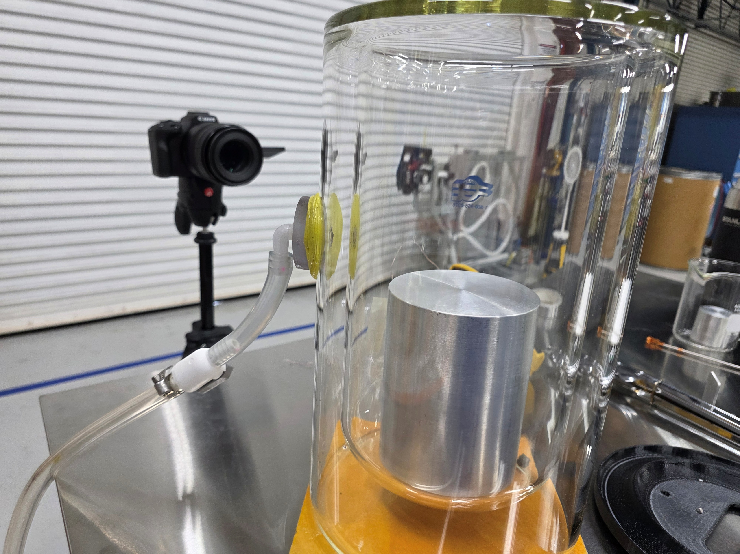
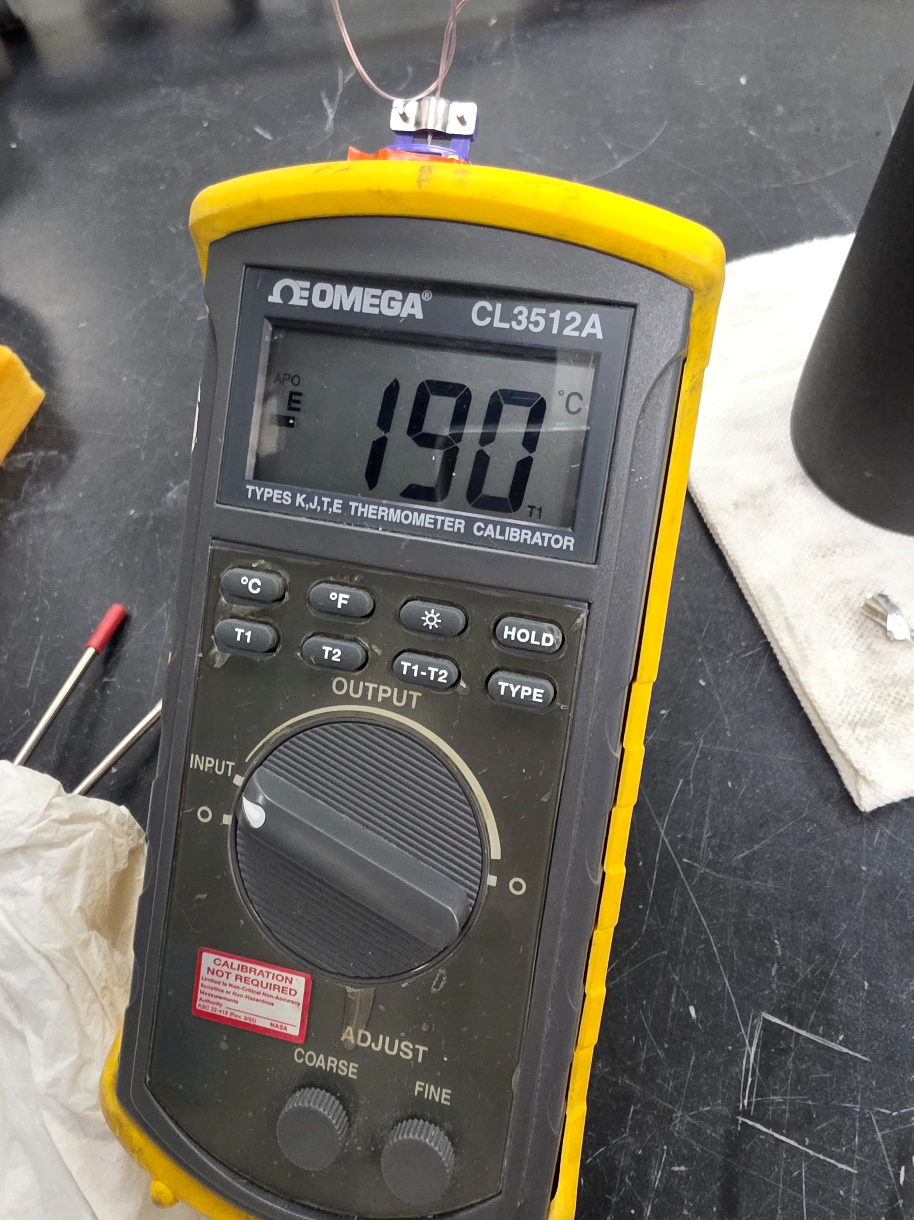
New Setup

Slide 11
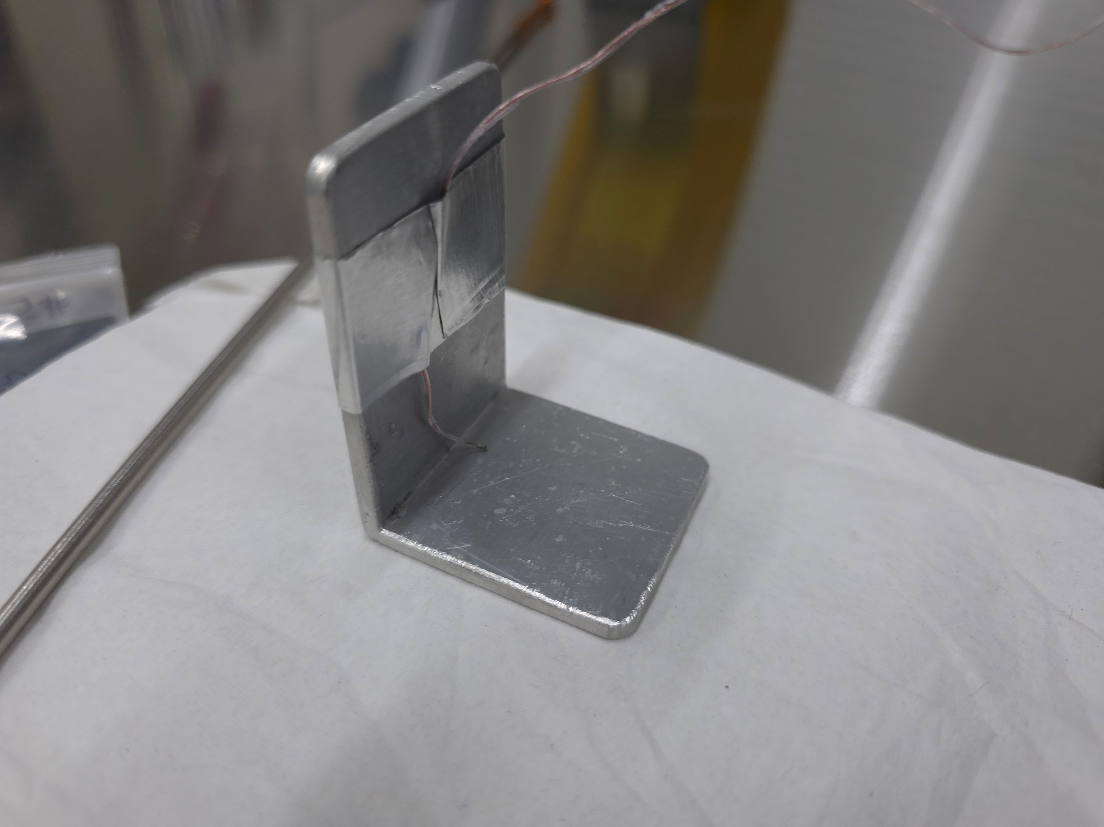
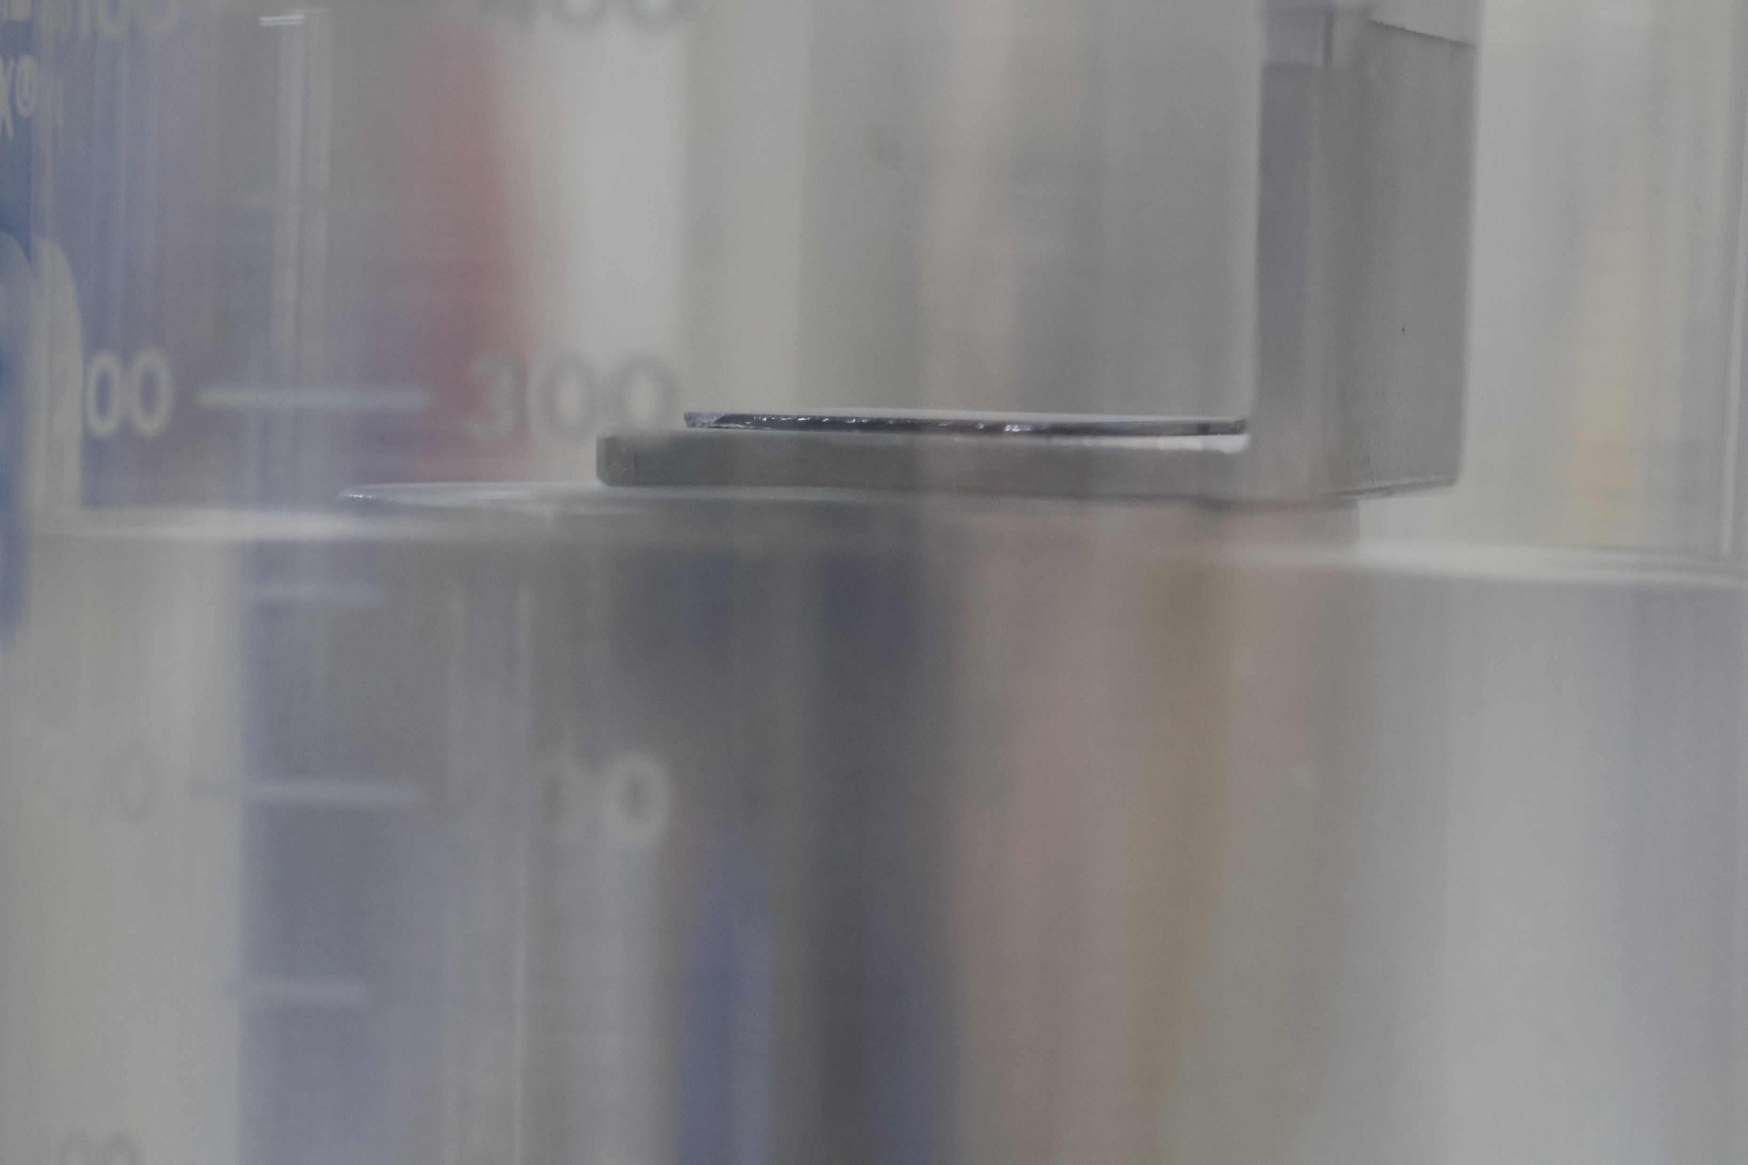
New Setup

Slide 12
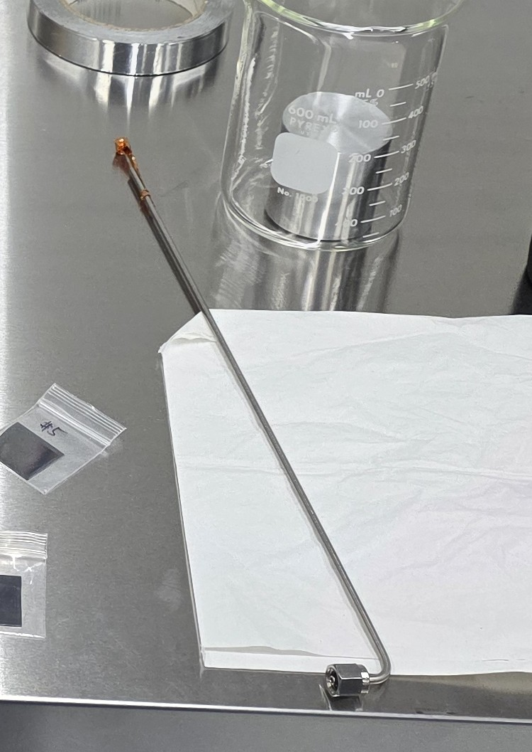
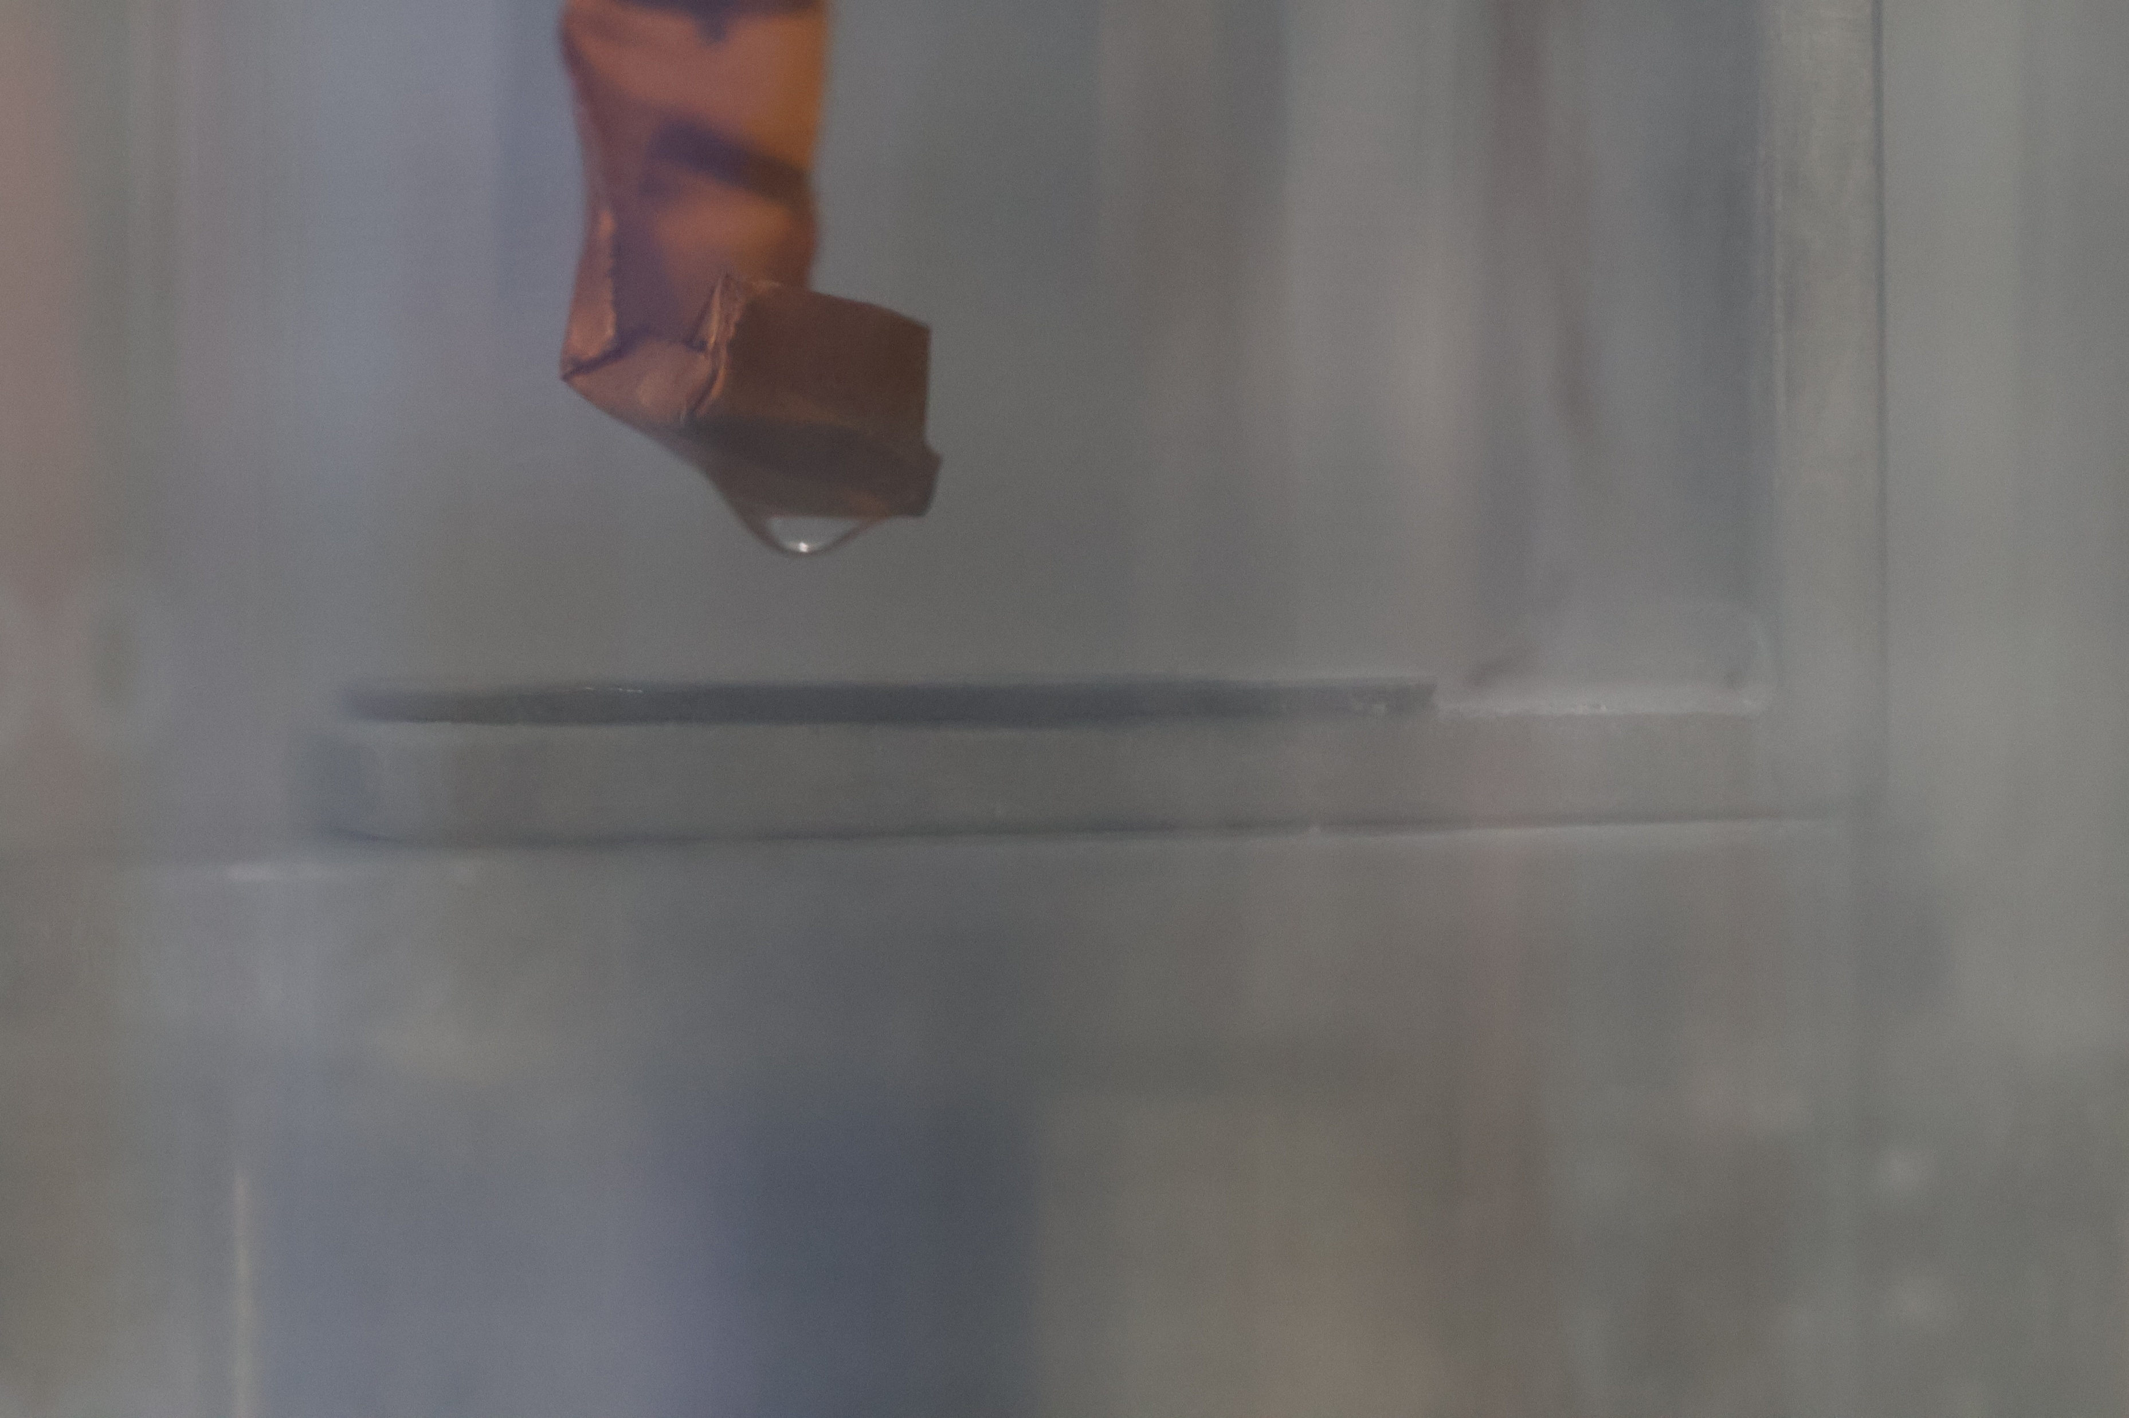
New Setup

Slide 13
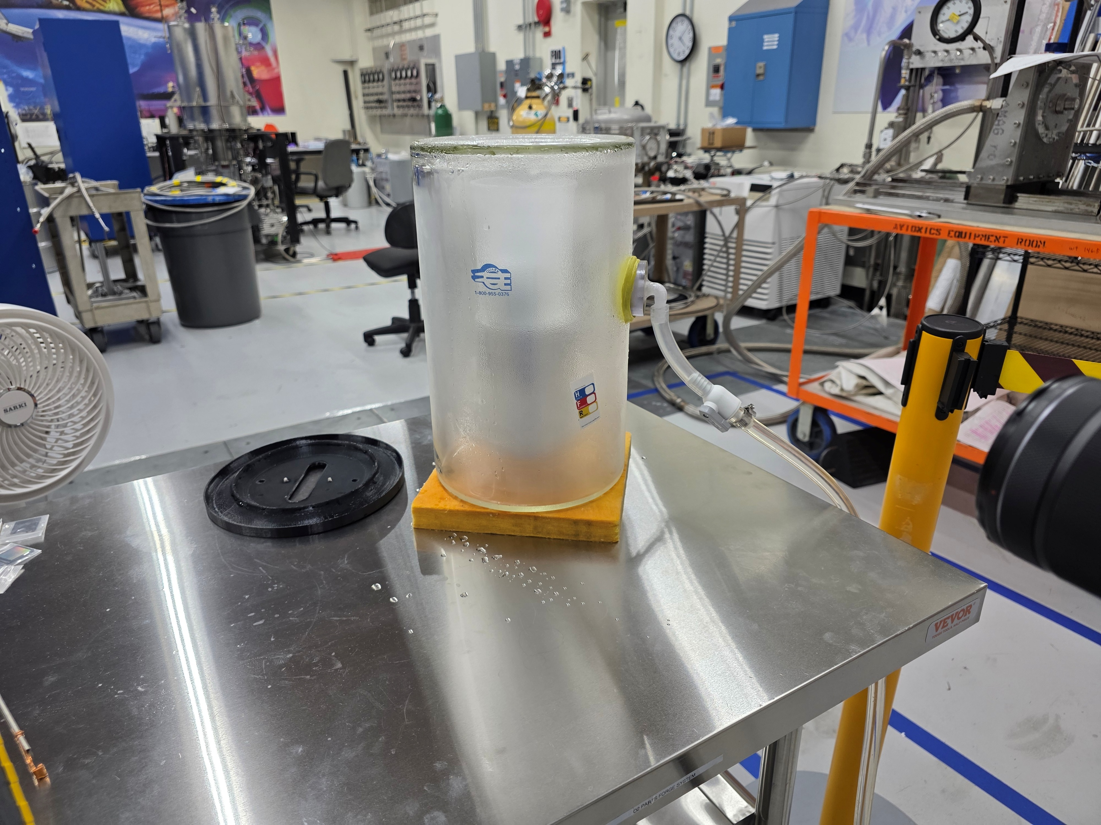
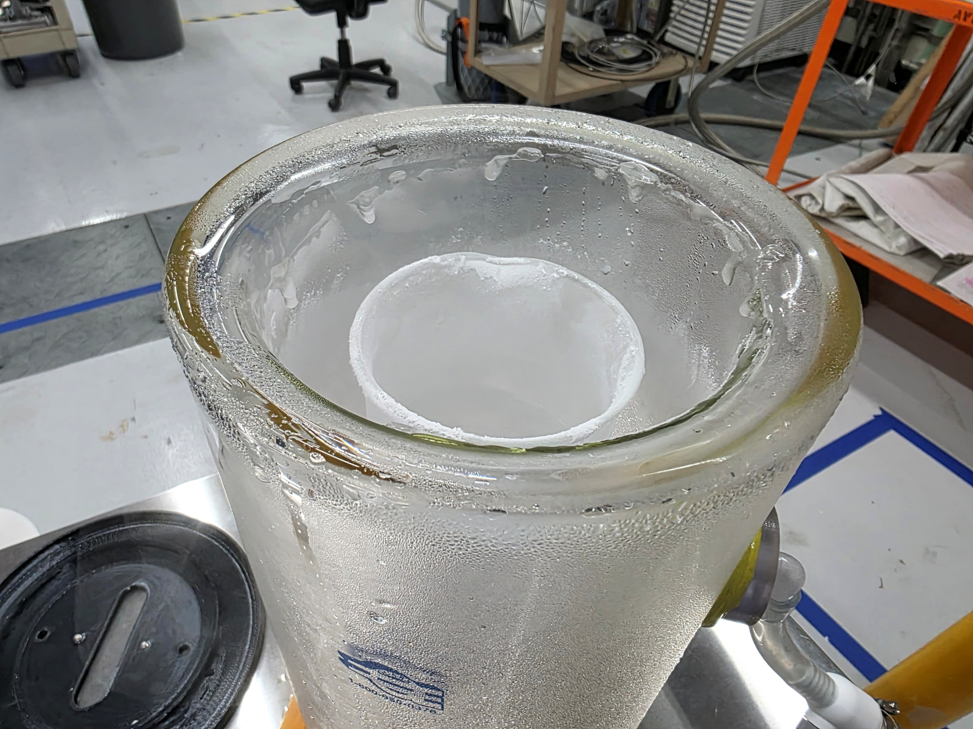
Problems

Slide 14
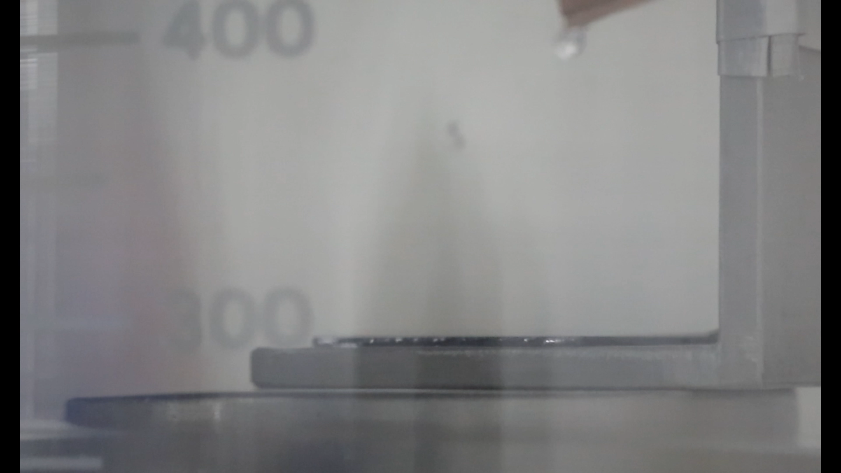
Results: Sample 1

Slide 15
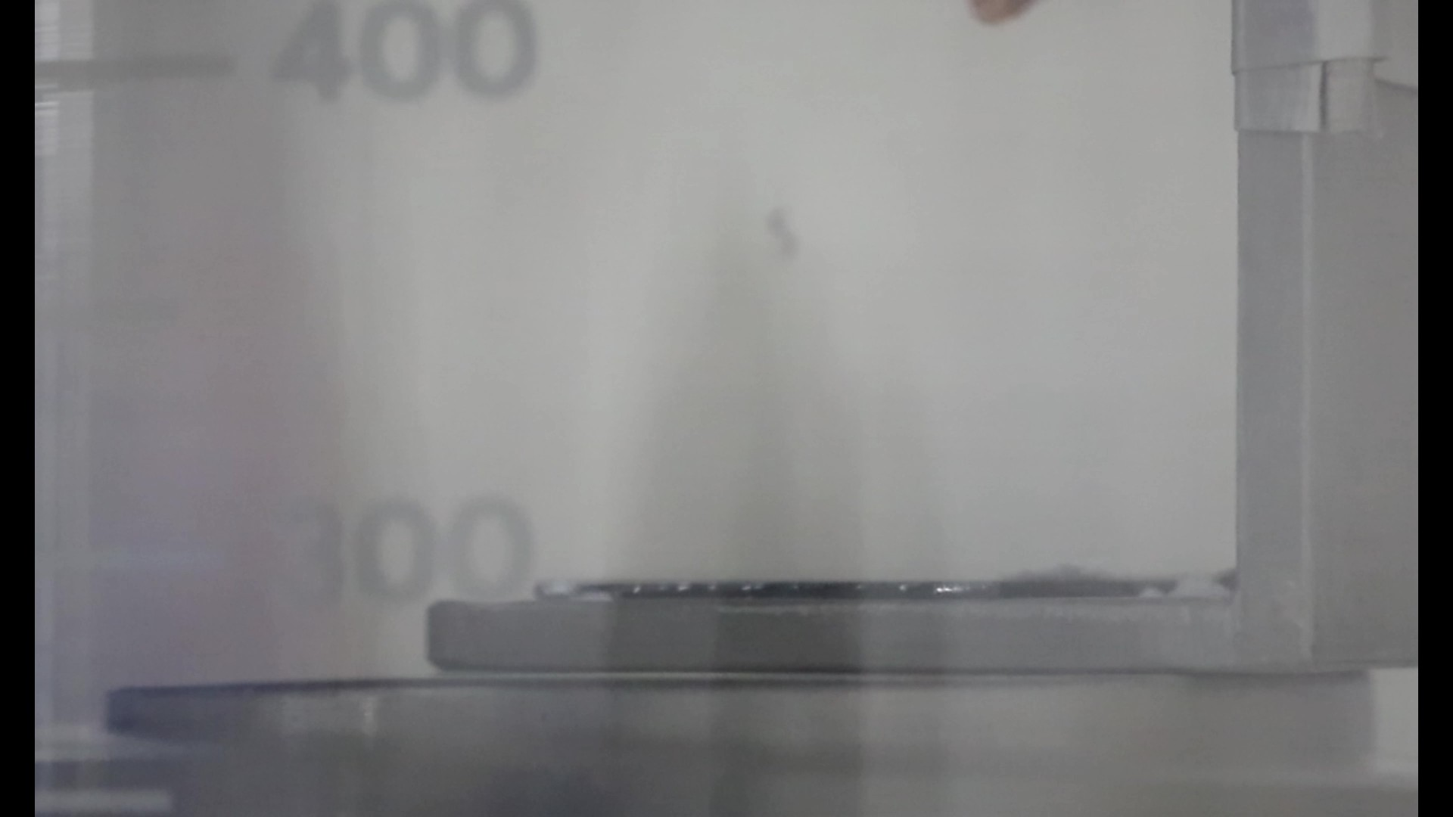
Results: Sample 1
~17°

Slide 16
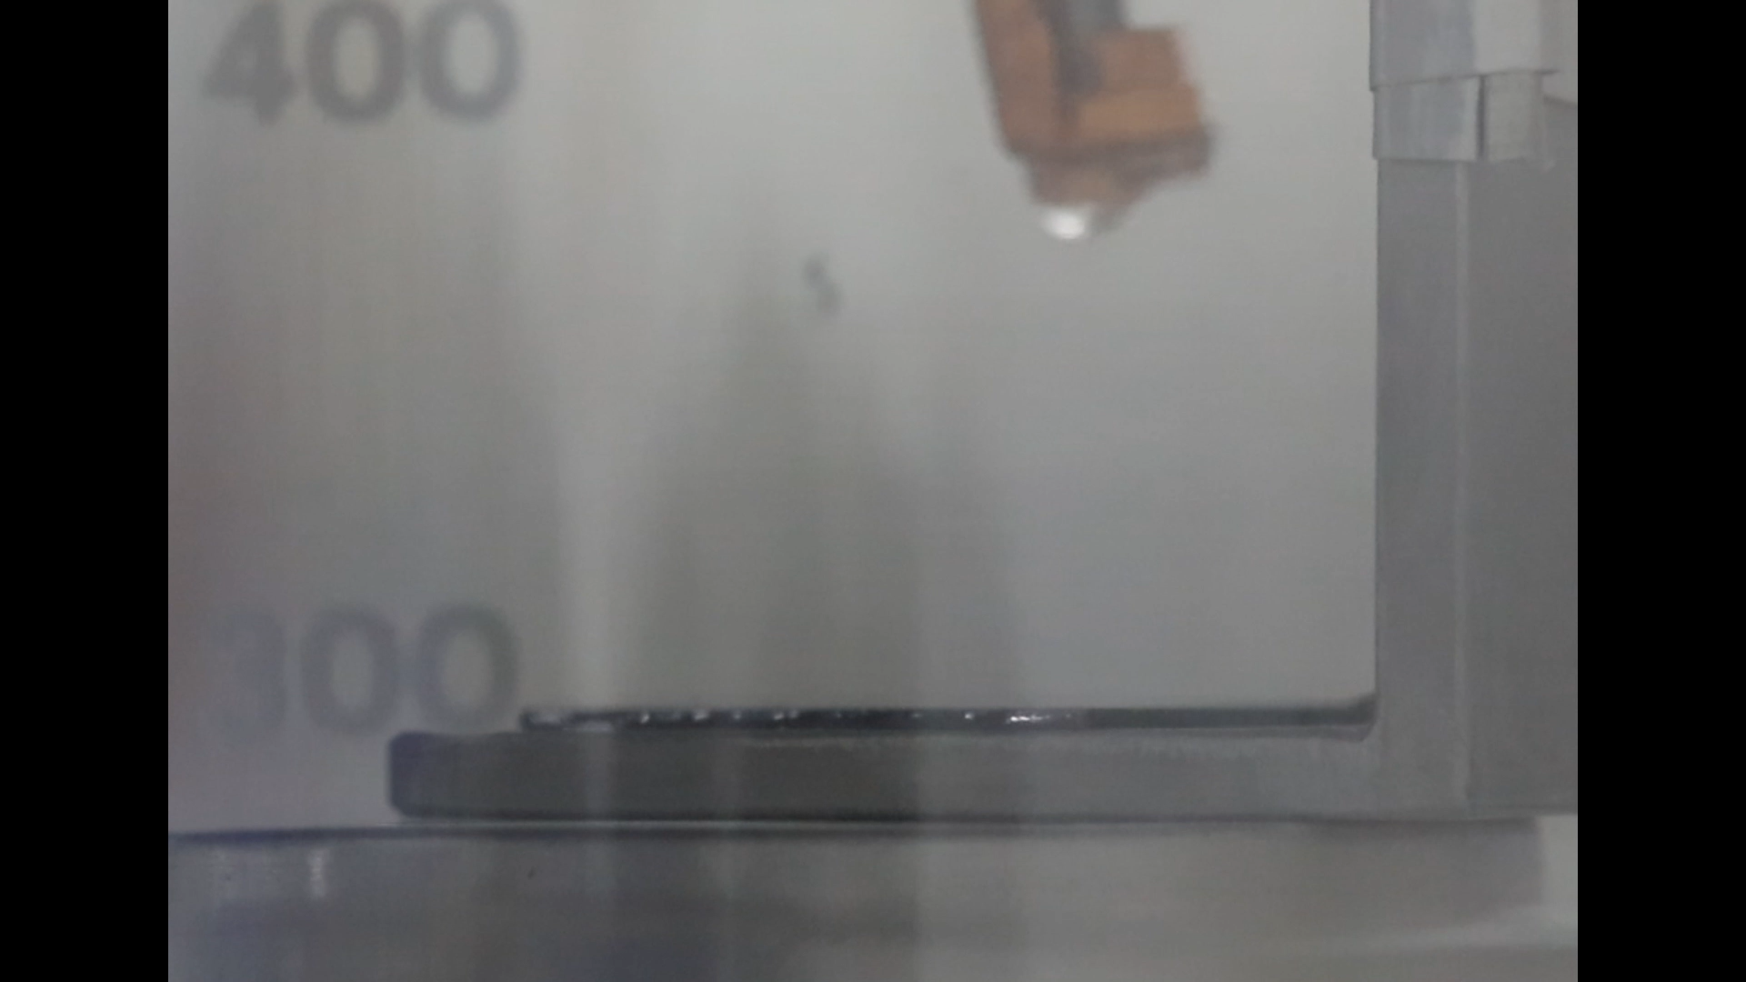
Results: Sample 1

Slide 17
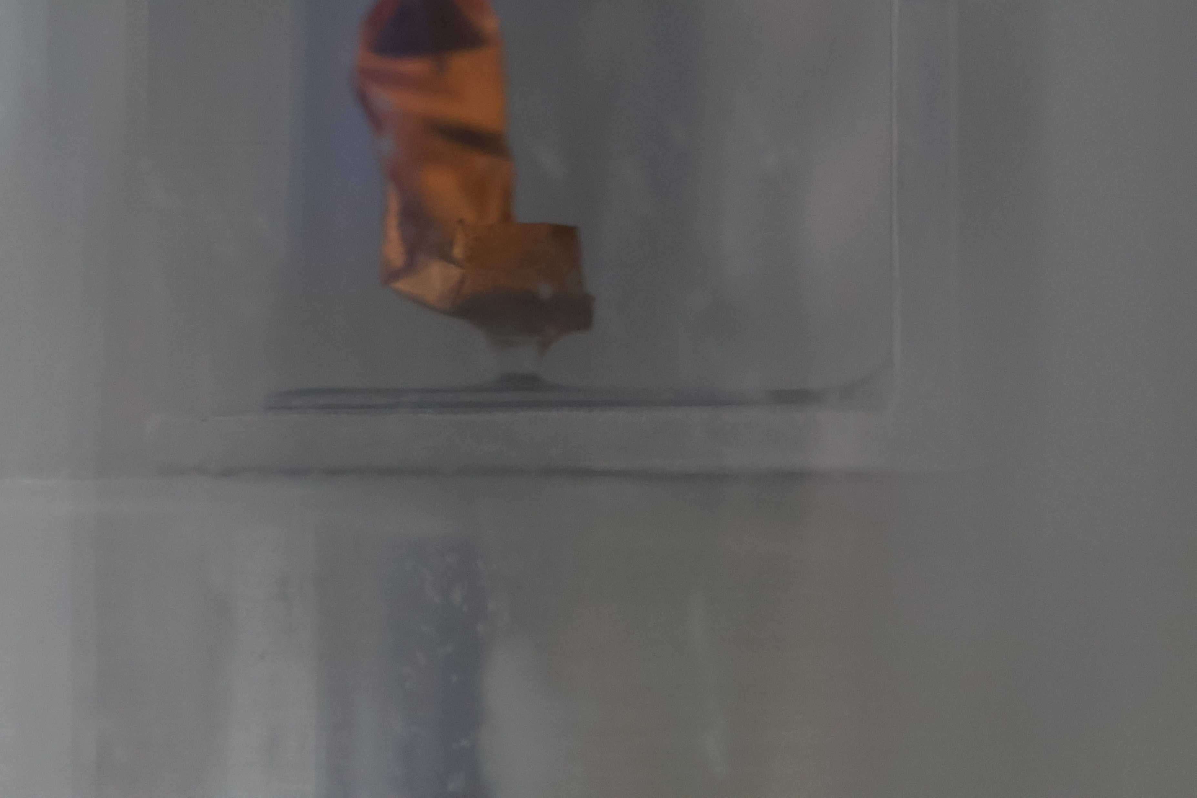
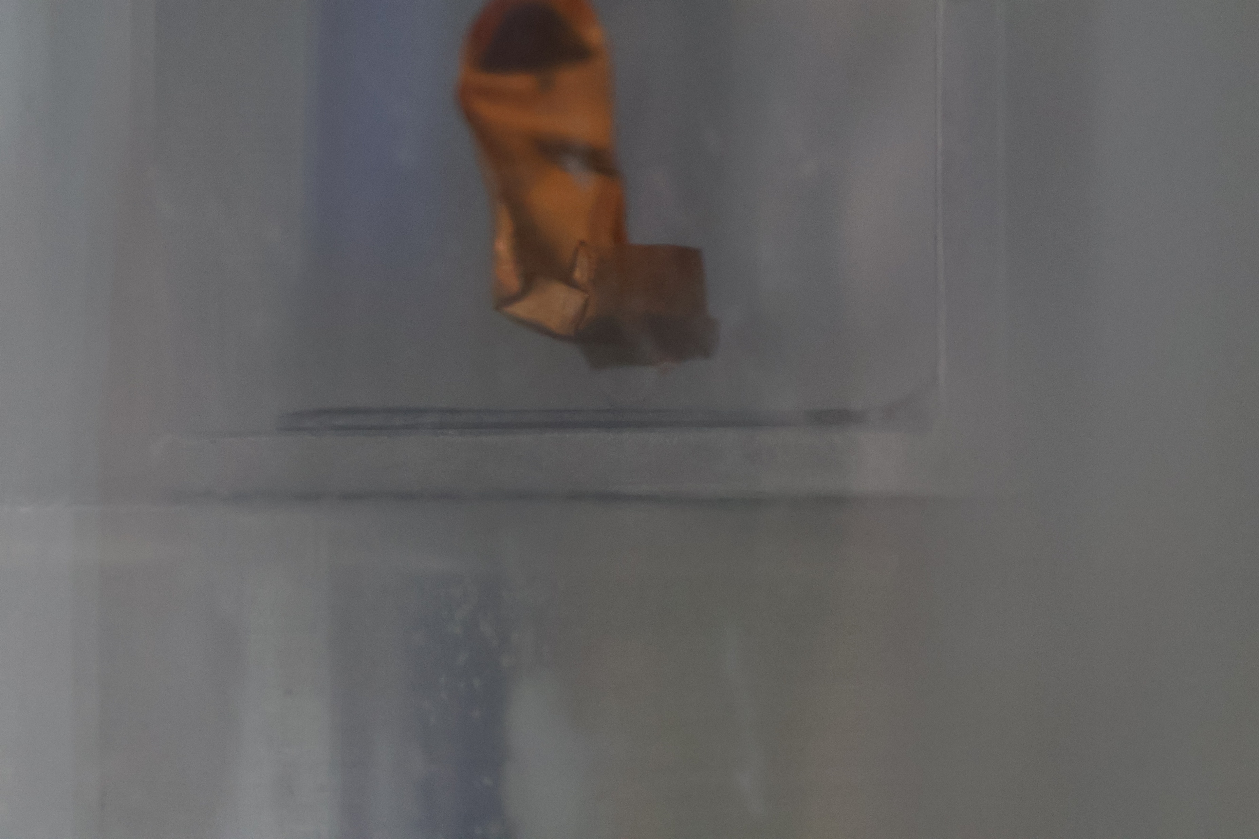
Results: Sample 2

Slide 18
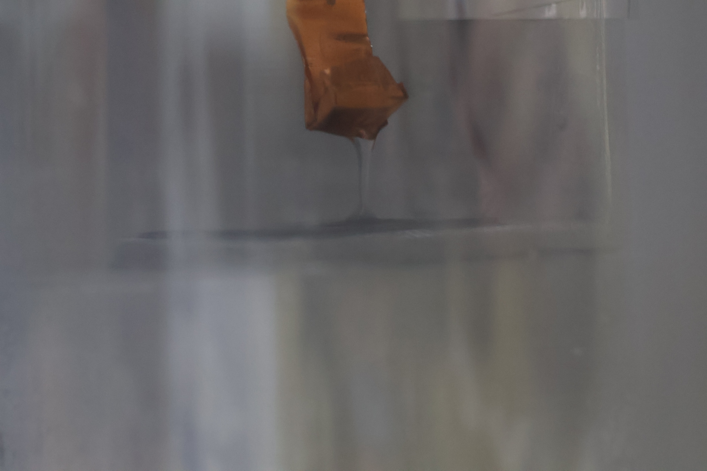
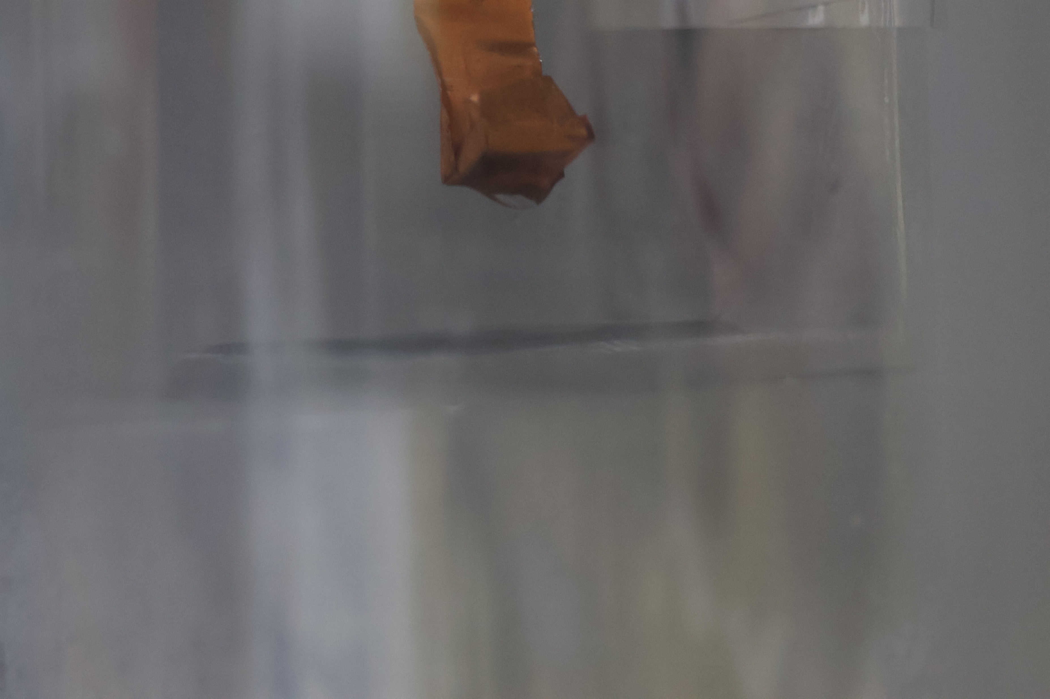
Results: Sample 3

Slide 19
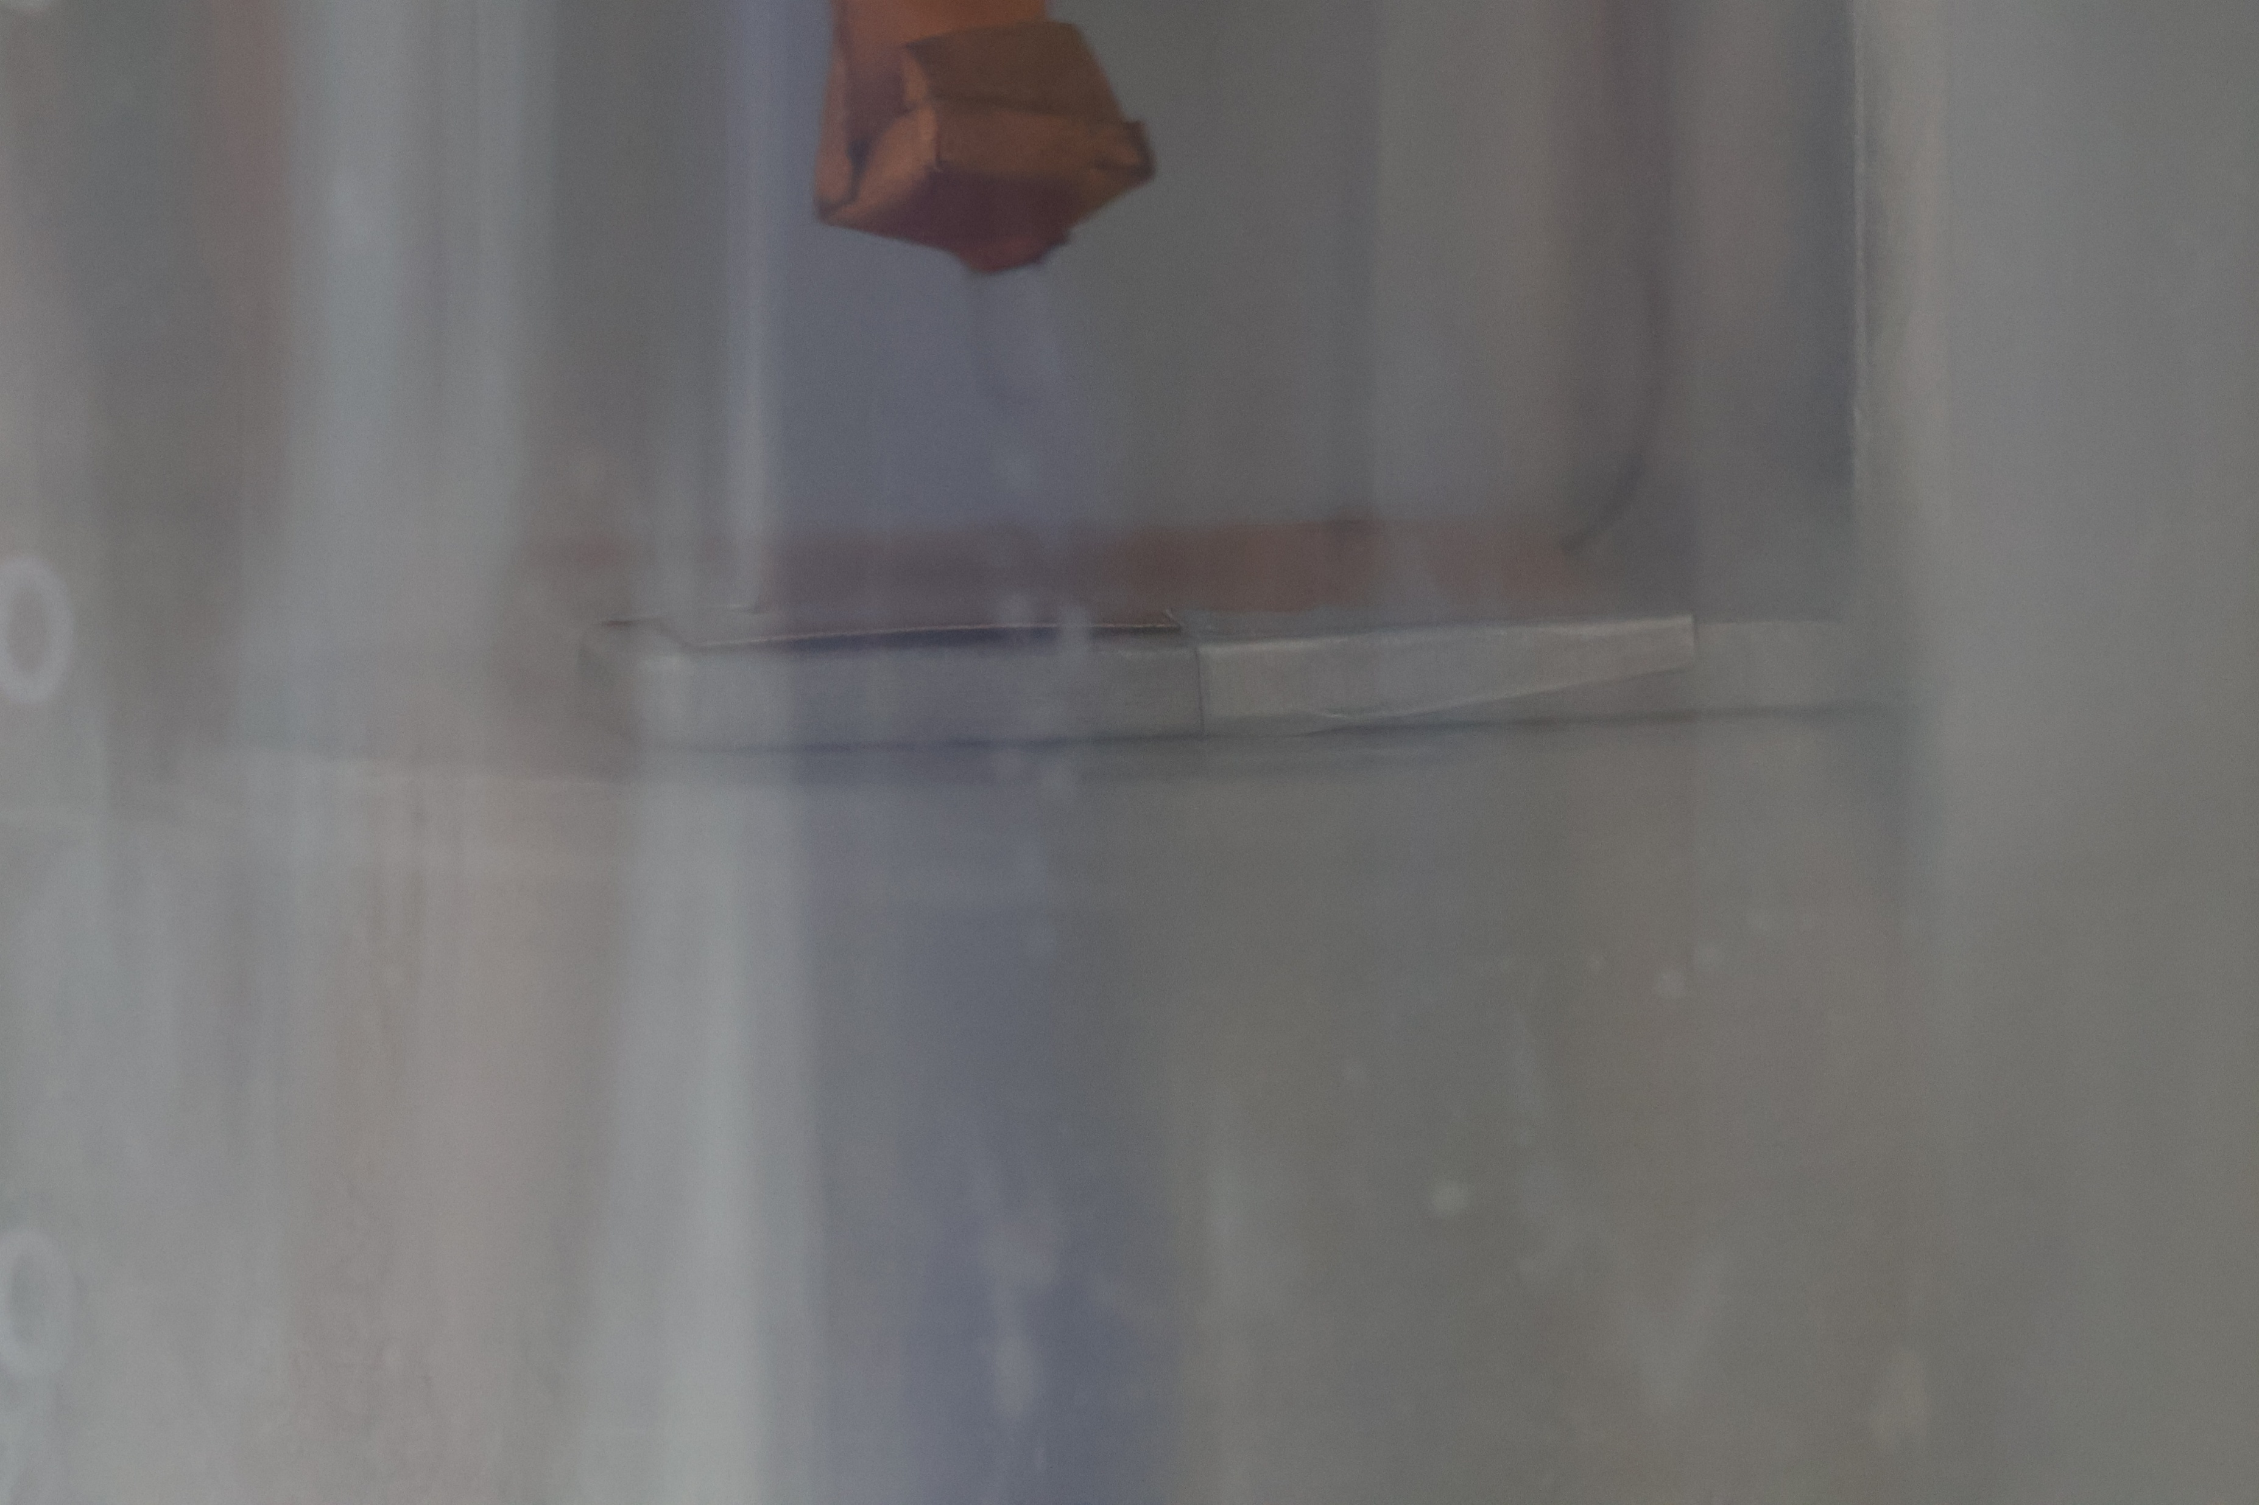
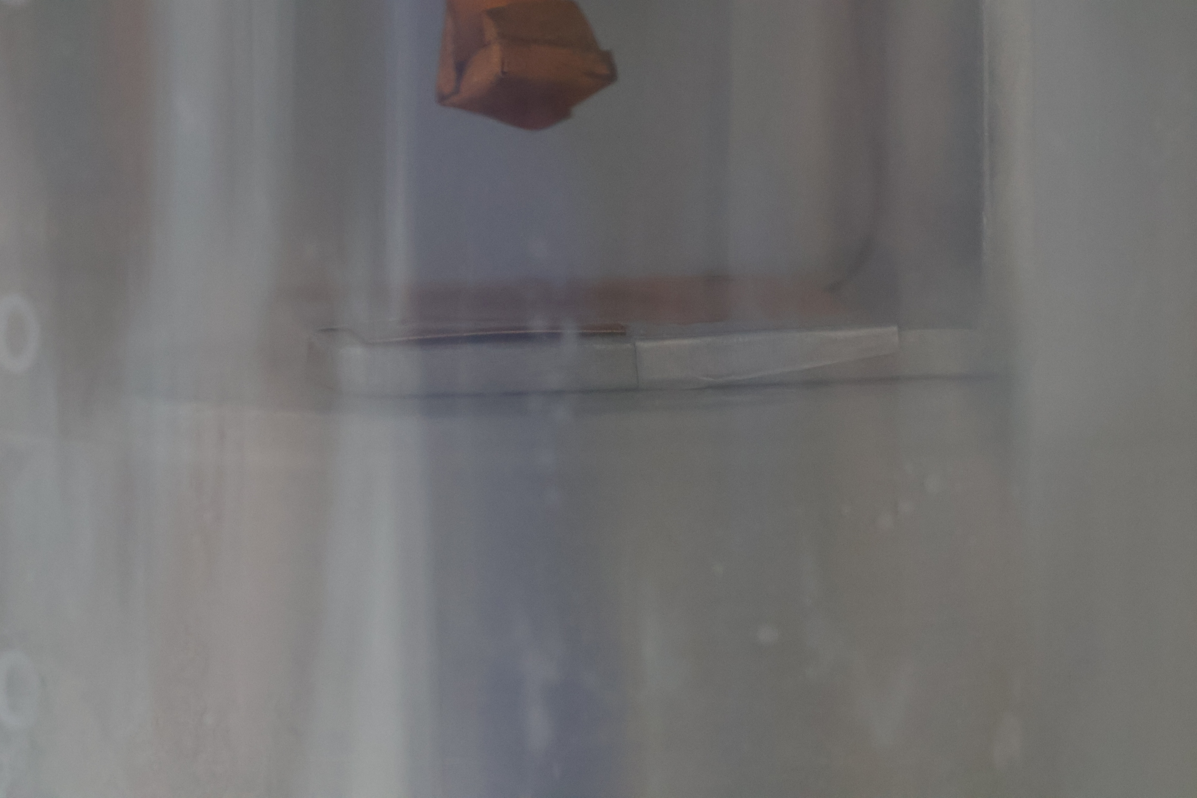
Results: Sample 4

Slide 20
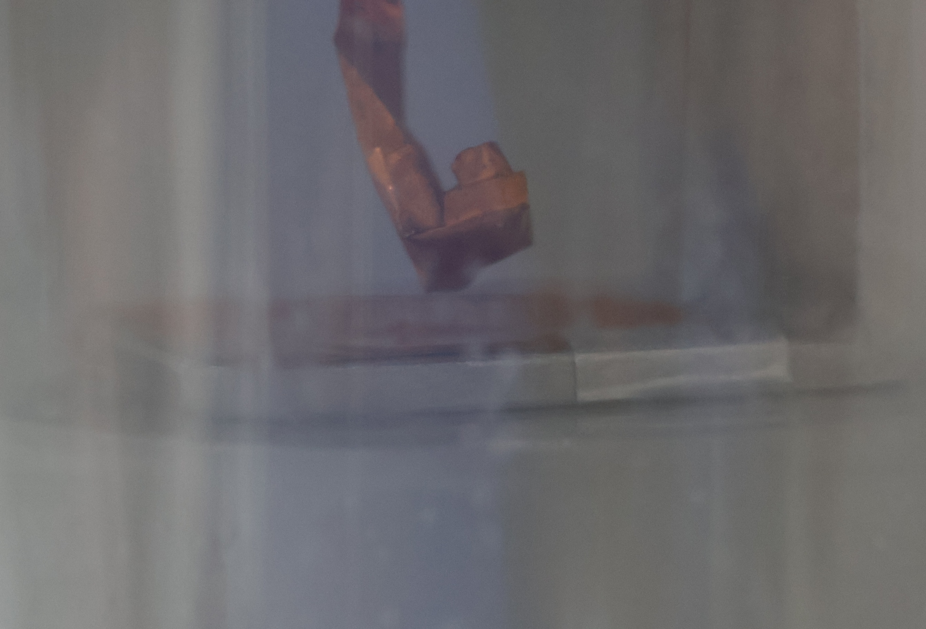
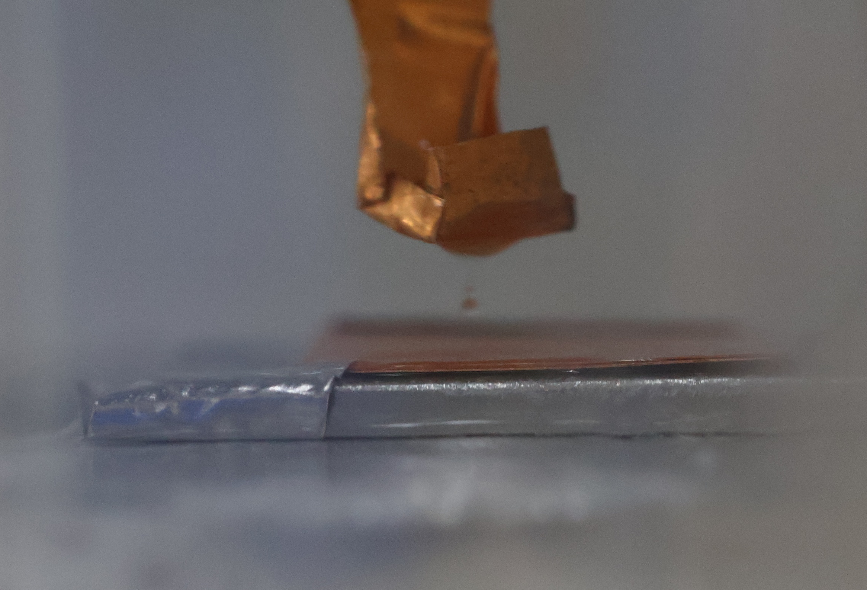
Results: Sample 5 and 6

Slide 21
Conclusion
Test setup works
  2nd beaker allows for adequately chilled test cryogen
  Camera can capture images of the test through both beakers
Alternative materials needed
  SU-8 unsuitable as a cryophobic material
  Copper with greases similarly unsuitable
LOx essential for improving test
  Even with appropriate material, LN2 likely has too little surface tension

Slide 22
Future Work
Refine setup to allow efficient testing
  Consistent dispersal of cryogen onto surface
  Remove excess moisture
  Improve camera setup to allow better images
Identify other materials for testing
  Alternative polymers and patterns
  ALD and sputtered coatings
Test with LOx
  Should be approved by mid august
  Mai Harrison will continue testing once approved

Slide 23
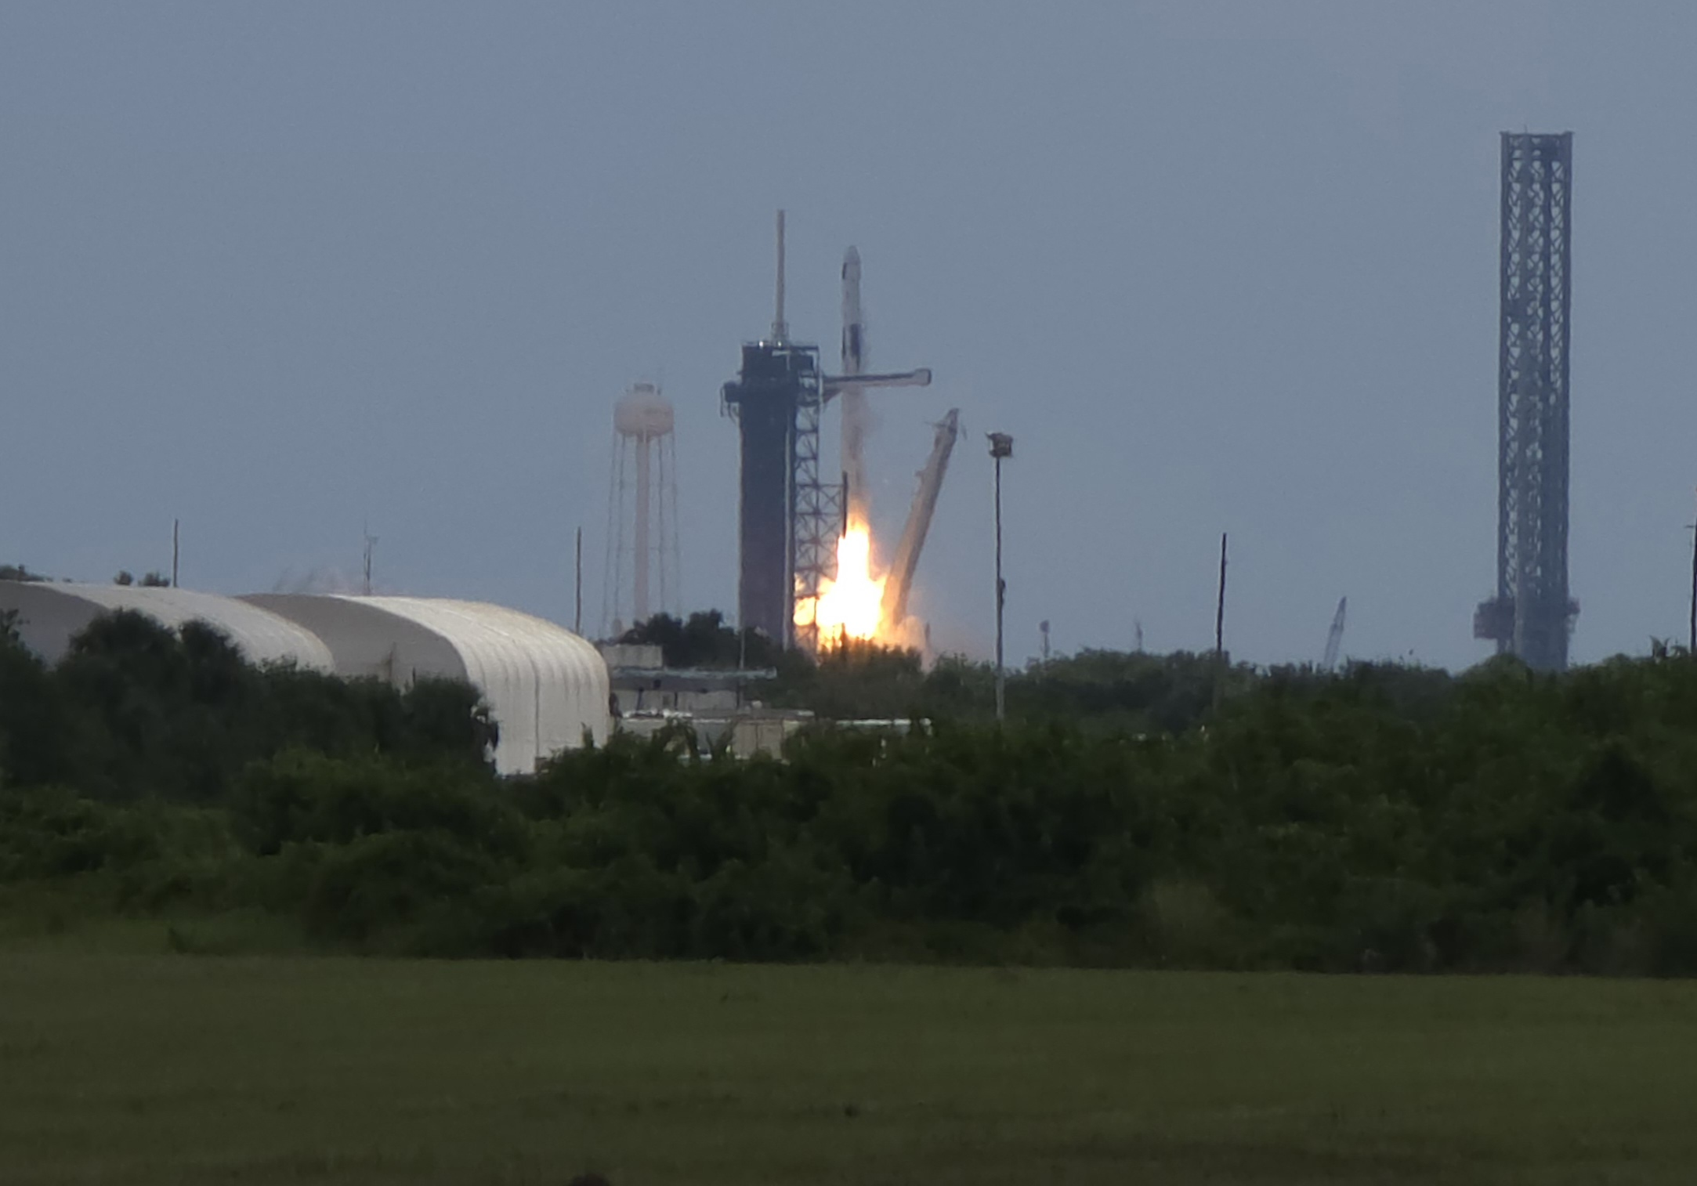
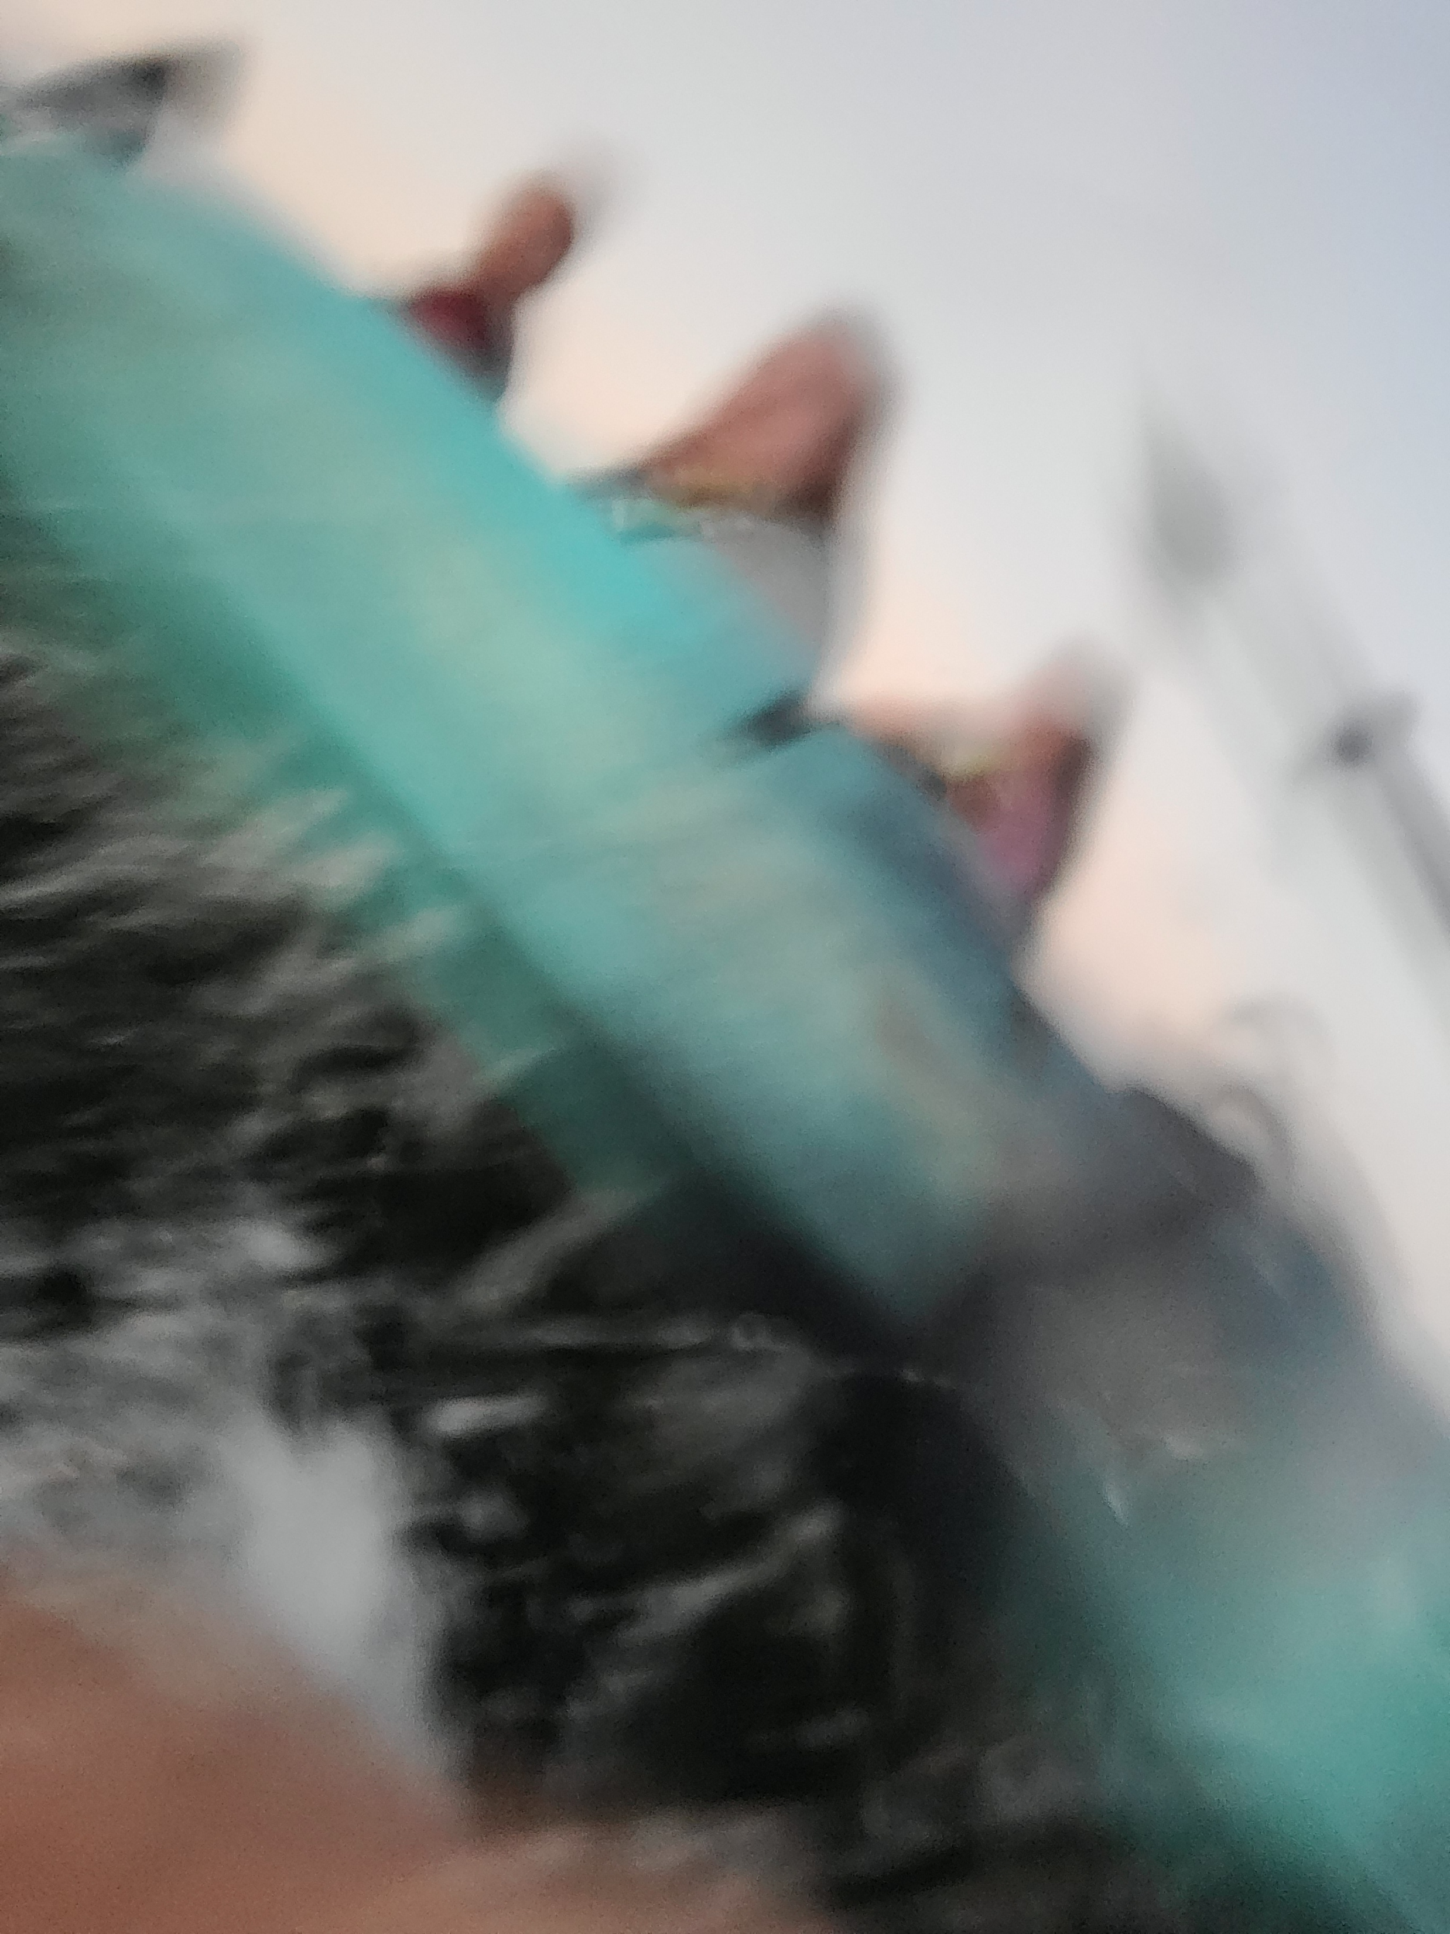
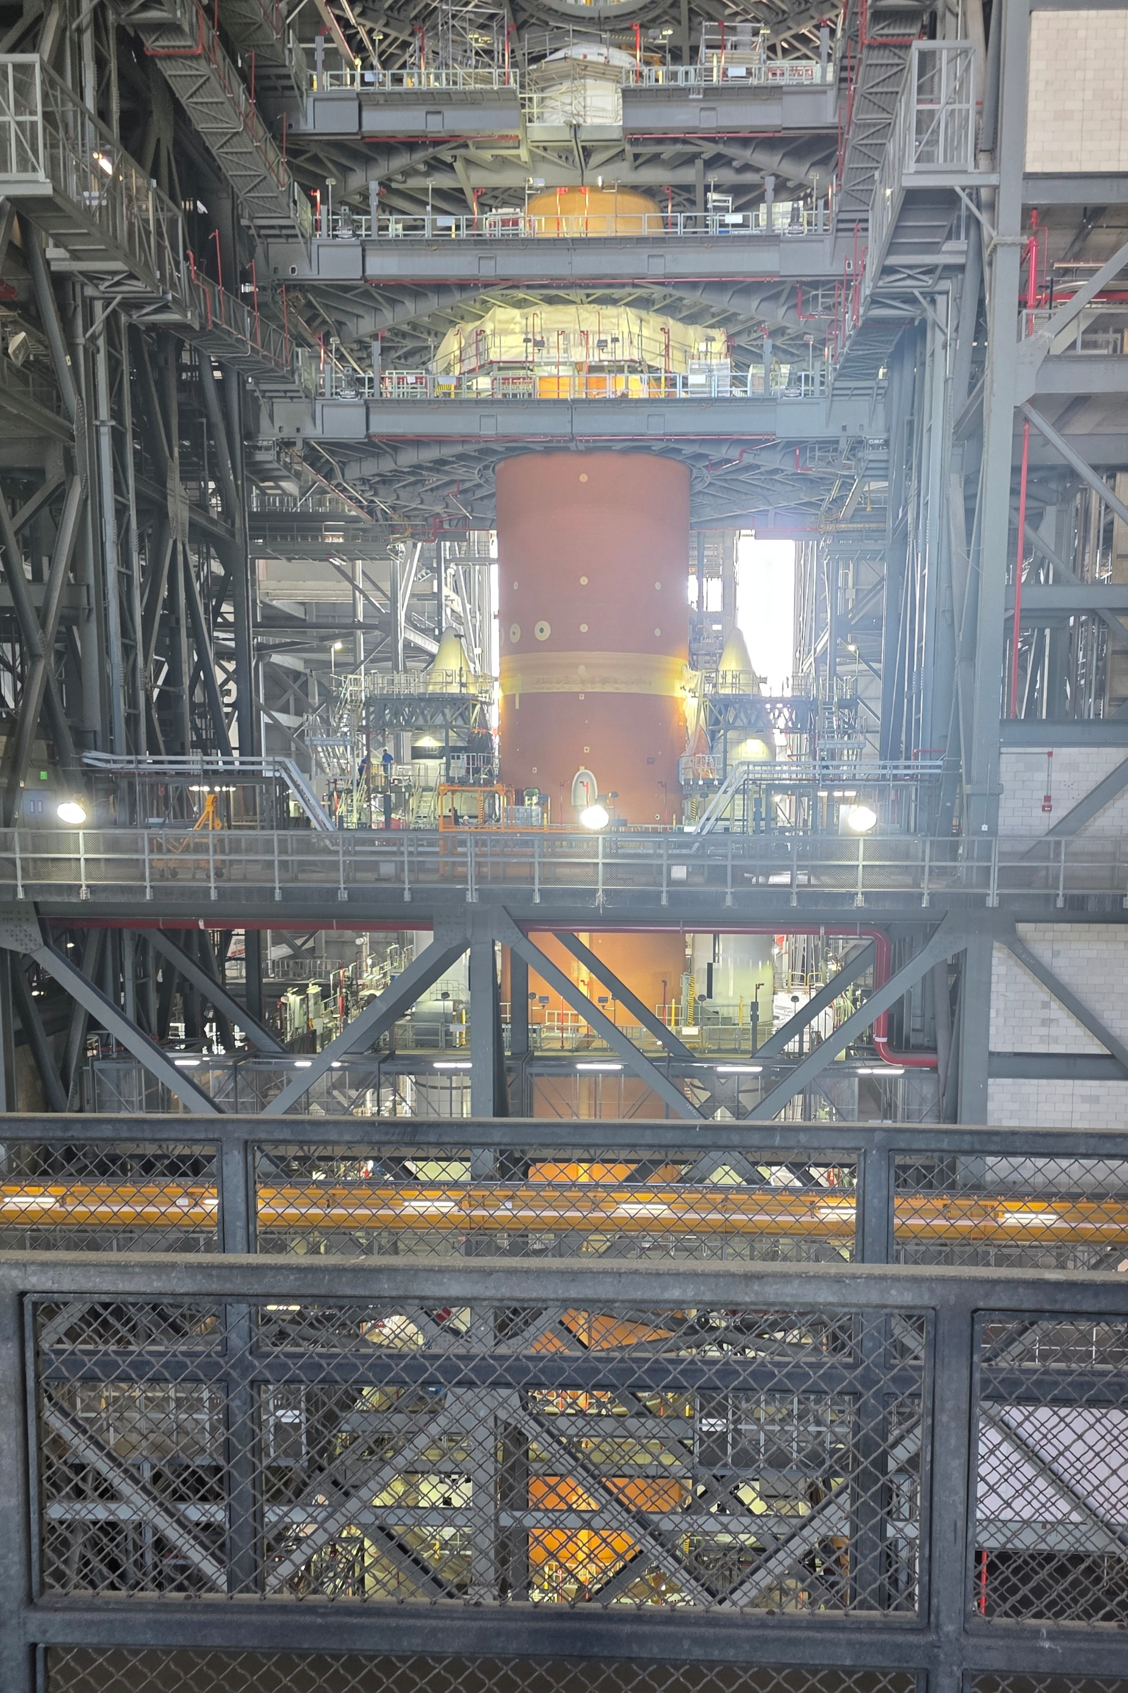
Acknowledgements
This work is supported by NASA MUREP Space Technology Artemis Research (M-STAR) under award #80NSSC23M0207
KSC Cryogenics Test Laboratory staff
Samantha Daigle and Jesus Badal

