Slide 1

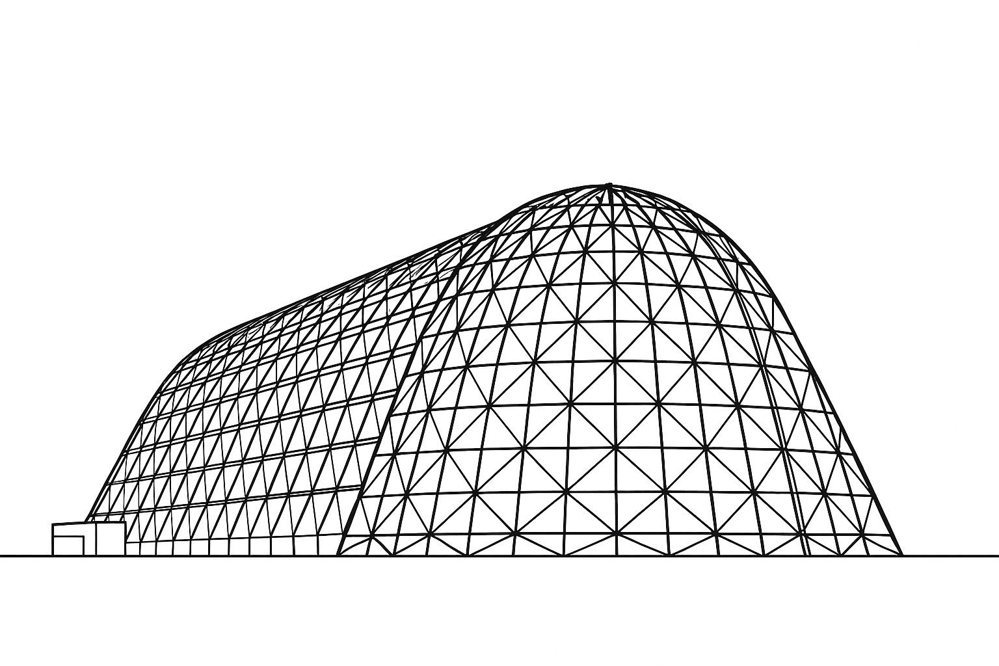

Preliminary CFD Simulations of a Cryogenic Film Condensation Experiment
TFAWS 2025 Cryogenics Technical Session
Presented by: Justin Pesich
NASA Glenn Research Center
Fluid and Cryogenic Systems Branch (Code LTF)
Thermal & Fluids Analysis Workshop 2025
NASA Ames Research Center
San Jose, CA
August 4-7, 2025

Slide 2
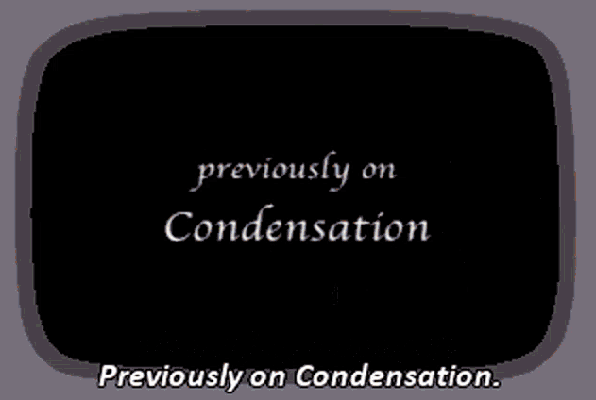
Outline
Motivation
CFM Model Validation Roadmap
Fundamental Film Condensation Experiment
STAR-CCM+ Fluid Film Model with Phase Change
Preliminary CFD Results
Nusselt Theory, CFD, and Experiment
Mesh independence
Surface Tension
Drag
References

Slide 3
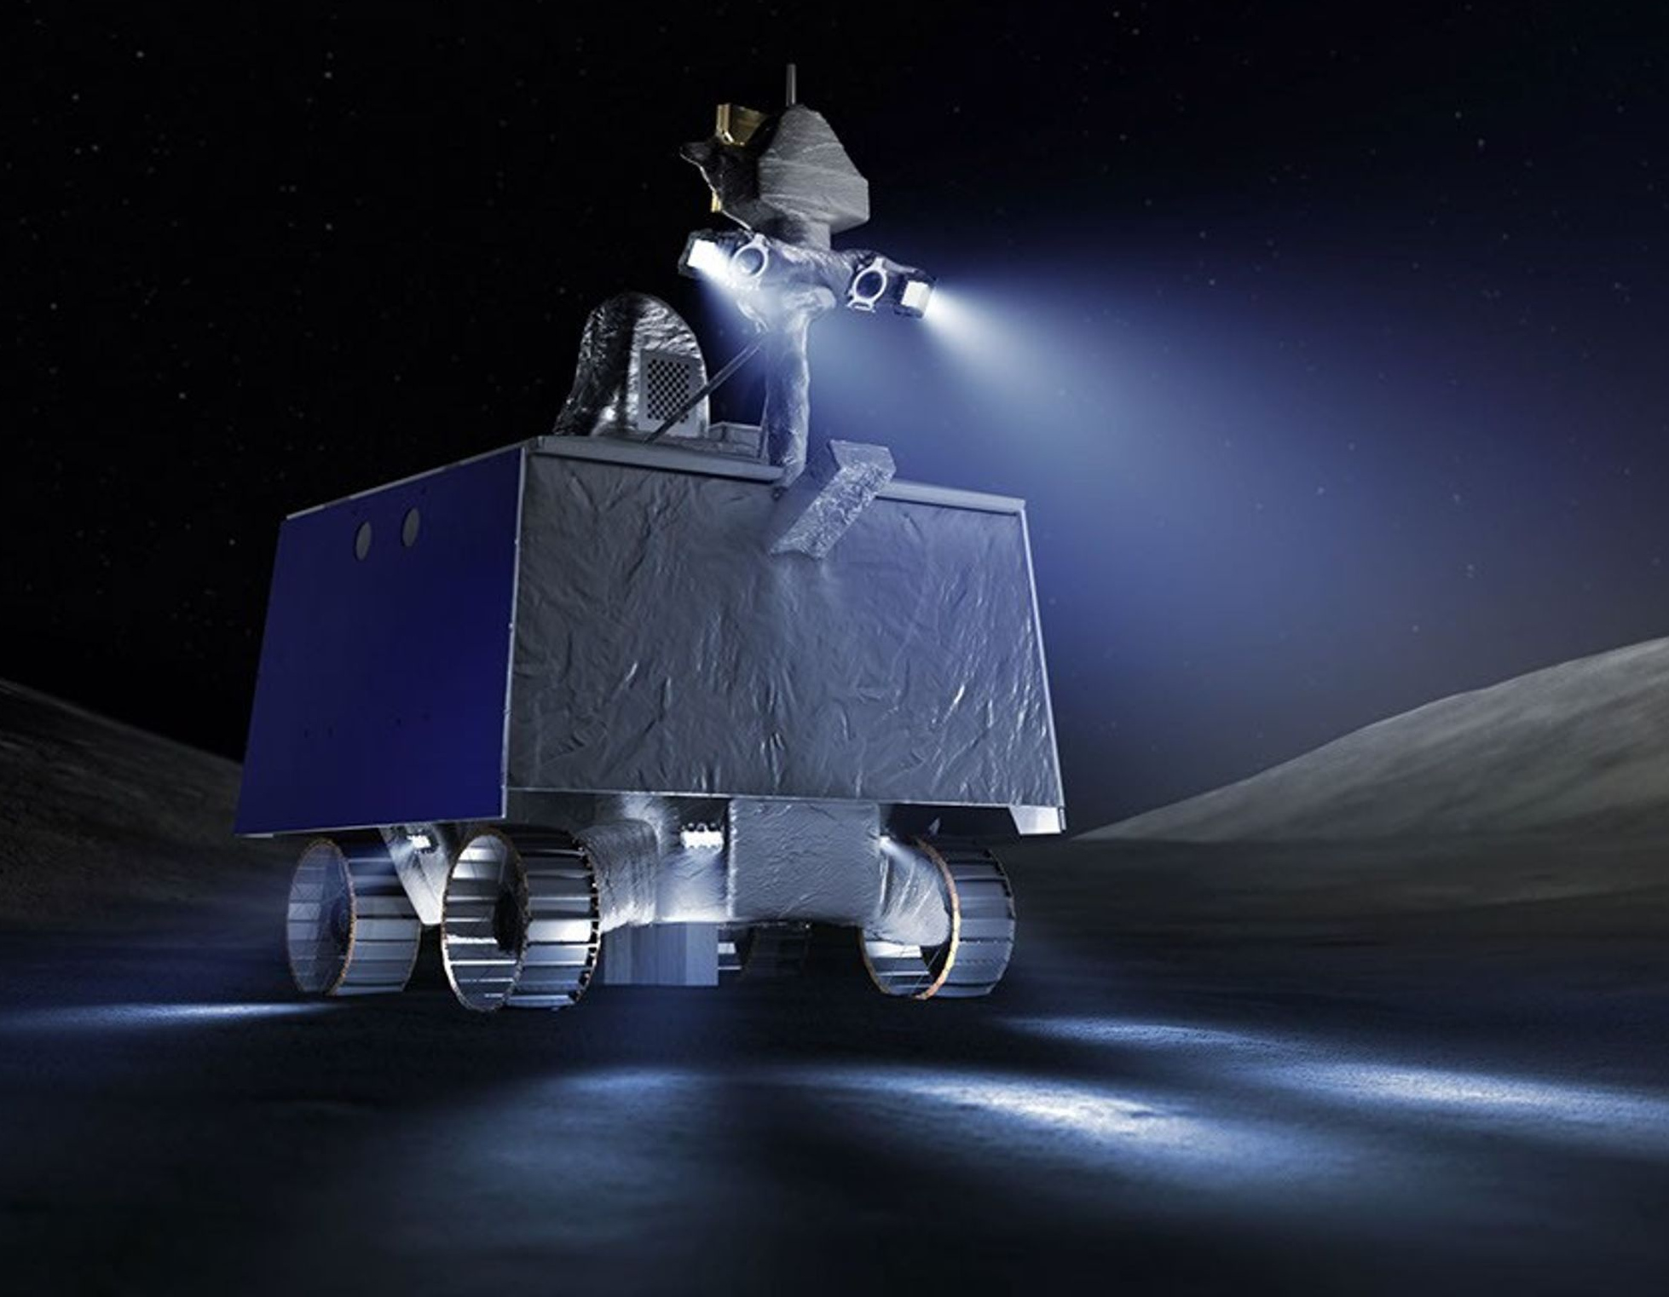
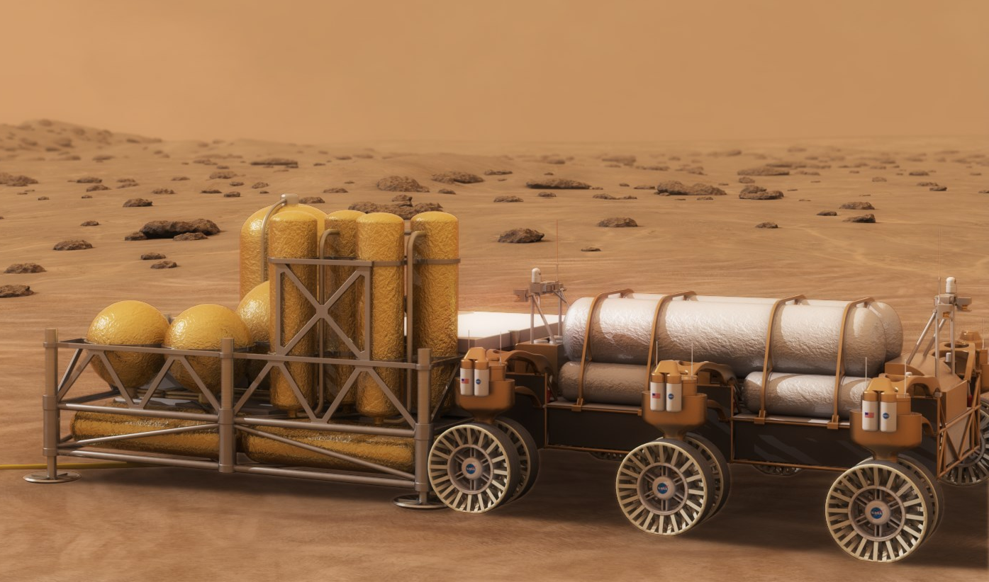
Motivation
In-Situ Resource Utilization (ISRU) is an enabling technology to maintain a sustainable presence on the Lunar and Martian surfaces
ISRU plants will require liquefaction technologies to accumulate cryogenic propellants for ascent vehicles (LOX, LCH4) or life support (LOX)
Liquefaction involves injecting gaseous propellant into a tank with active cooling to promote condensation
CFD models can be utilized to predict liquefaction rates of cryogens at various operating conditions and inform lower-fidelity nodal models that can predict the entire liquefaction process practically
VIPER
Mars ISRU plant
Credit: NASA [1-2]

Slide 4
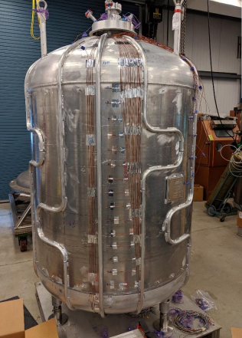
CFD Model Validation Roadmap
Fundamental Film Condensation Experiment
Cryogenic Fluid In-situ Liquefaction for Landers (CryoFILL)
Brassboard and Prototype testing
Nitrogen used as surrogate for Oxygen in Brassboard testing
Oxygen liquefaction for Prototype testing
Broad Area Cooling Neon loop
CryoFILL Prototype Tank
Ref [3]: Johnson et al., “Liquefaction of Cryogenic Fluids for Production and Storage of Commodities on Extra-Terrestrial Surfaces,” Space Cryogenics Workshop, 2021.

Slide 5
Film Condensation Experiment: Overview
Combustion Research and Flow Technology Inc. (CRAFT Tech) and University of Connecticut (UCONN) have completed two separate Phase I SBIR contracts on Film Condensation experimentation and modeling (Ref. [4])
July 2022 – Jan 2023 (80NSSC22PA988)
Aug 2024 – Feb 2025 (80NSSC24PB292)
Phase II has been awarded for the most recent Phase I contract
SBIR Modeling Objectives:
Develop accurate sub-grid CFD models for modeling condensation of cryogens
Modeling framework shall capture growth and transport of liquid condensate while conserving mass, momentum, and energy
SBIR Experimental Objectives:
Conduct fundamental film condensation experiments on a flat plate using Methane, Oxygen, and Nitrogen
Obtain measurements of pressure, temperature, flow rate, and film thickness (optical)

Slide 6
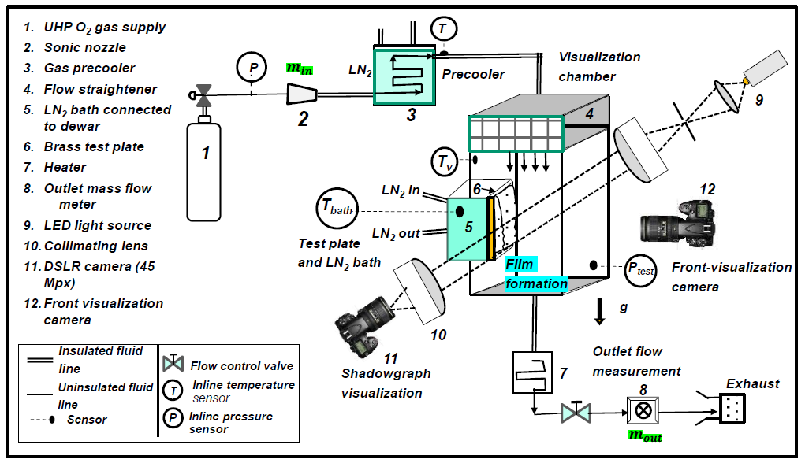
Film Condensation Experiment: Schematic
Credit: UCONN

Slide 7
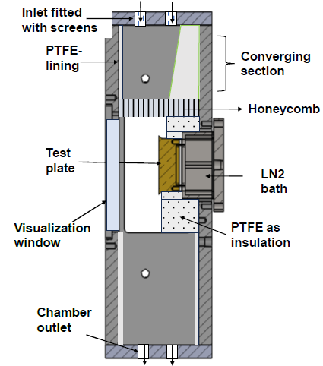
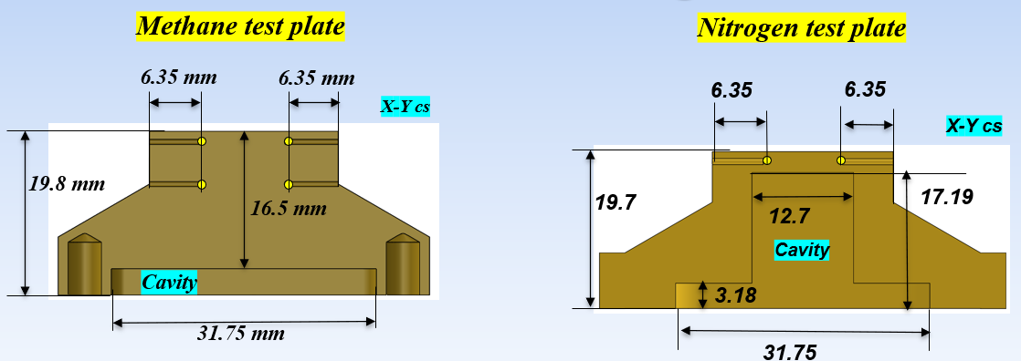
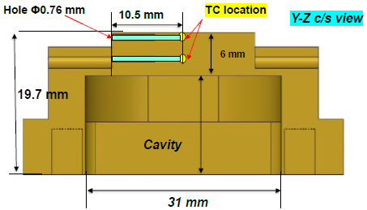
Film Condensation Experiment: Chamber and Test Plate
Visualization Chamber
Brass Test Plates
Oxygen test plate
Credit: UCONN

Slide 8
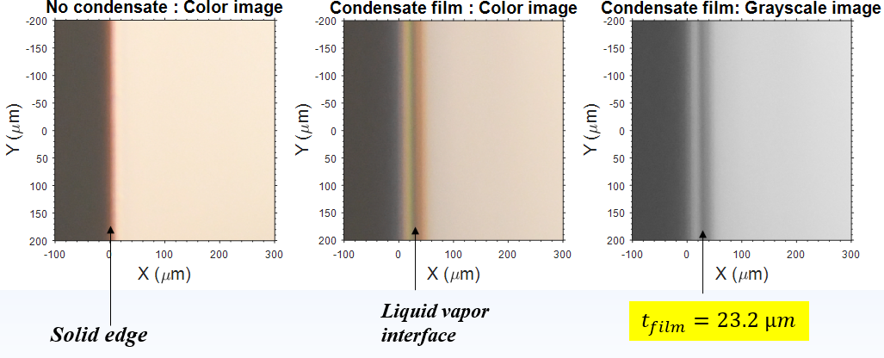
Film Condensation Experiment: Film Thickness Measurement
Credit: UCONN

Slide 9
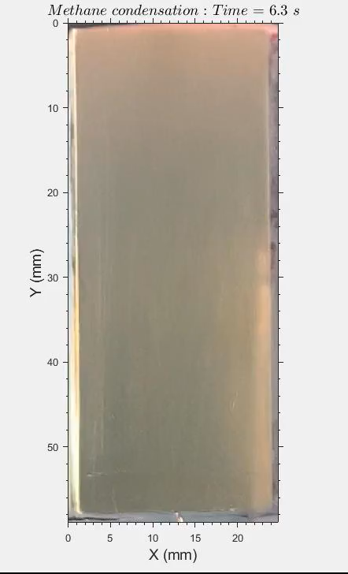
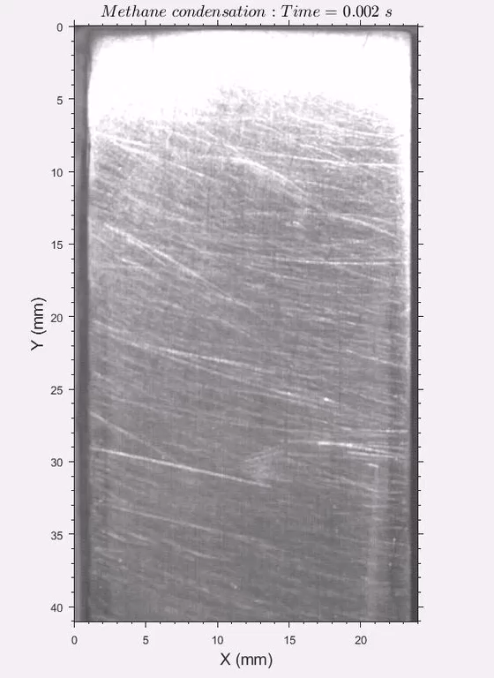
Film Condensation Experiment: Front Visualization
Film Condensation: ~10K Subcooling
Dropwise Condensation: ~18K Subcooling
KEY FINDING: PLATE SUBCOOLING DIRECTLY AFFECTS MODE OF CONDENSATION
Credit: UCONN

Slide 10

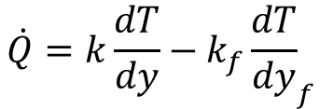

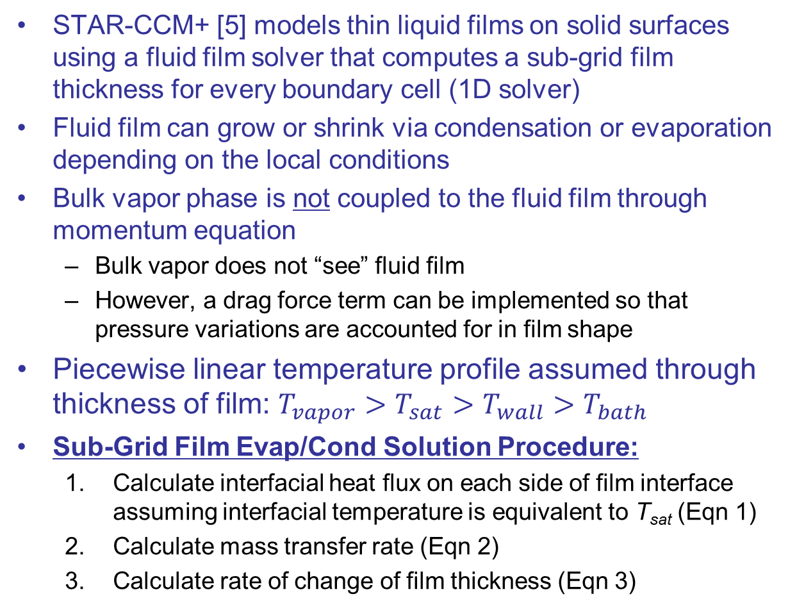

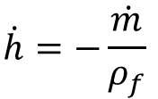
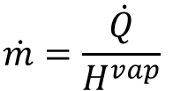

STAR-CCM+ Fluid Film Model with Phase Change
STAR-CCM+ [5] models thin liquid films on solid surfaces using a fluid film solver that computes a sub-grid film thickness for every boundary cell (1D solver)
Fluid film can grow or shrink via condensation or evaporation depending on the local conditions
Bulk vapor phase is not coupled to the fluid film through momentum equation
Bulk vapor does not “see” fluid film
However, a drag force term can be implemented so that pressure variations are accounted for in film shape
Piecewise linear temperature profile assumed through thickness of film: ${T_{vapor}>T}_{sat}>T_{wall}>T_{bath}$
Sub-Grid Film Evap/Cond Solution Procedure:
Calculate interfacial heat flux on each side of film interface assuming interfacial temperature is equivalent to T_{sat} (Eqn 1)
Calculate mass transfer rate (Eqn 2)
Calculate rate of change of film thickness (Eqn 3)
$$T_{vapor}$$
$$T_{sat}$$
$$T_{wall}$$
Vapor BL
$$T_{bath}$$
solid
film
$$\dot{Q}=k\frac{dT}{dy}−k_{f}{\frac{dT}{dy}}_{f}$$
Eqn 1
$$\dot{m}=\frac{\dot{Q}}{H^{vap}}$$
Eqn 2
$$\dot{h}=−\frac{\dot{m}}{ρ_{f}}$$
Eqn 3
Source: Ref [5]

Slide 11

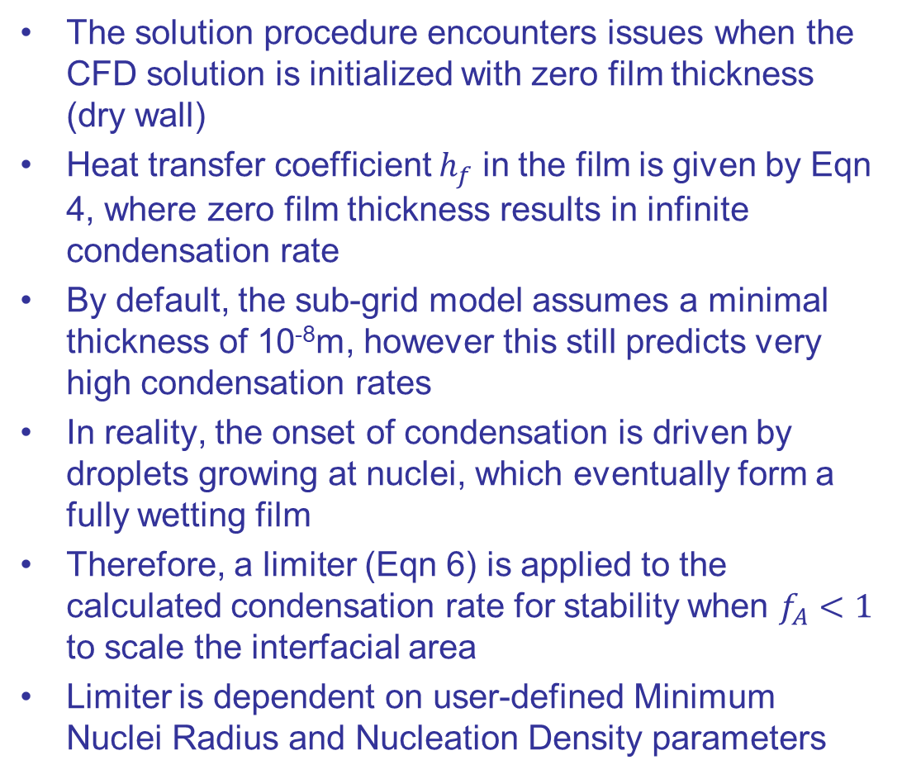


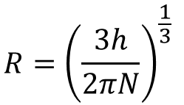
Condensation on a Dry Wall
The solution procedure encounters issues when the CFD solution is initialized with zero film thickness (dry wall)
Heat transfer coefficient $h_{f}$ in the film is given by Eqn 4, where zero film thickness results in infinite condensation rate
By default, the sub-grid model assumes a minimal thickness of 10⁻⁸m, however this still predicts very high condensation rates
In reality, the onset of condensation is driven by droplets growing at nuclei, which eventually form a fully wetting film
Therefore, a limiter (Eqn 6) is applied to the calculated condensation rate for stability when $f_{A}<1$ to scale the interfacial area
Limiter is dependent on user-defined Minimum Nuclei Radius and Nucleation Density parameters
$$h_{f}=\frac{2k_{f}}{h}$$
Eqn 4
$$R={\left(\frac{3h}{2πN}\right)}^{\frac{1}{3}}$$
Eqn 5
$$f_{A}=2πNR_{eff}^{2}$$
Eqn 6
$$R_{eff}=\max_{}\left(R,R_{min}\right)$$
Eqn 7
This procedure does not affect the steady state solution, only initial transient
Source: Ref [5]

Slide 12
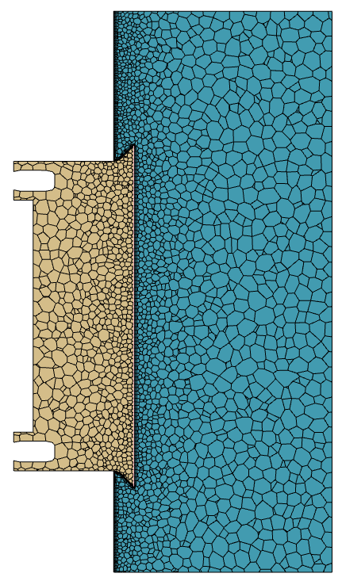
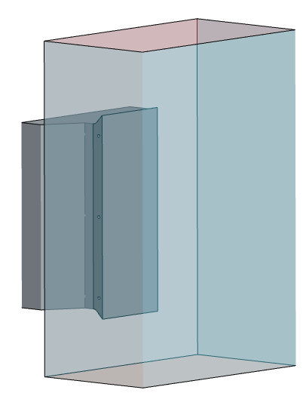
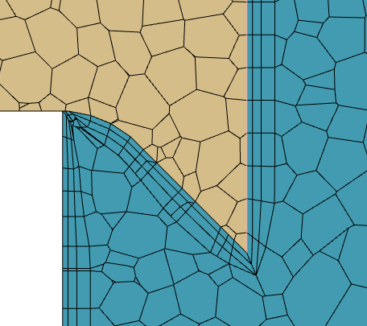
CFD Model Setup
Working fluid: Methane (CH4)
Compressible ideal gas + LCH4 film
Temperature-dependent vapor properties
Constant liquid film properties
Vapor phase coupled to fluid film via condensation and evaporation model
Laminar flow
3D Conjugate Heat Transfer
Brass temperature-dependent properties
Surface Tension neglected
Sensitivity study considered
Unsteady Δt = 0.05s
Run until steady state condition is achieved (constant liquefaction rate)
Mesh ~204k cells
Fluid Domain
Solid Brass
Condensing surface 22.6mm x 55.8mm

Slide 13
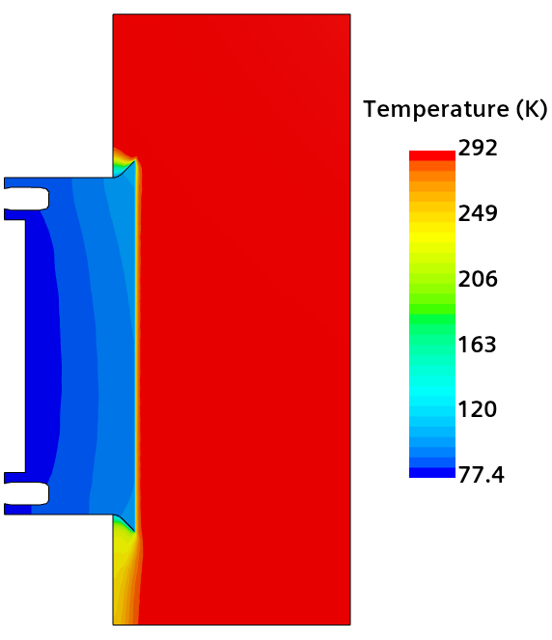

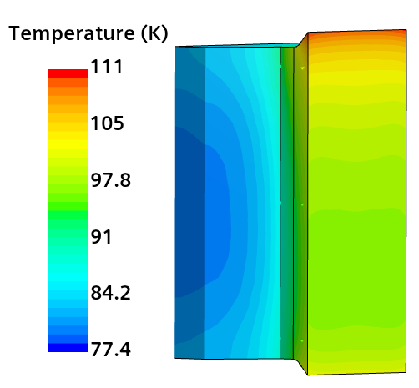

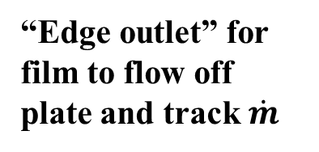
Model Boundary Conditions
Sym planes
V_{in} = 0.5m/s
T_{vapor,in} = 292.1K
q" = 0
T_{i,fluid} = 292.1K
T_{i,solid} = 115K (slightly above saturation temp)
T_{bath} = 77.4K
Condensing surface/film region
“Edge outlet” for film to flow off plate and track $\dot{m}$
q" = 0
Pressure Outlet
14.7psia

Slide 14
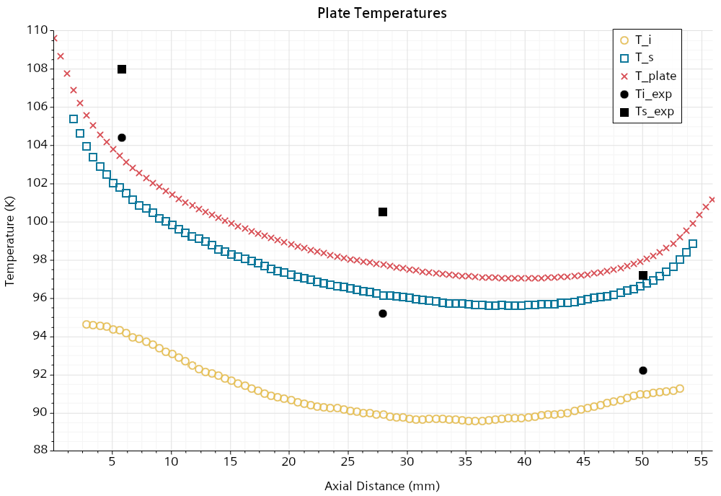
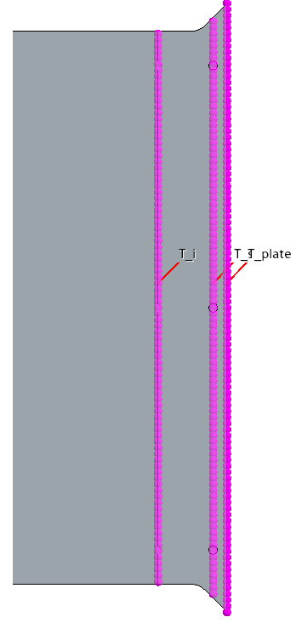
Preliminary CFD Results: Plate Temperatures
Downstream temperatures match reasonably well
Upstream and center temperature predictions are significantly under-predicted by 5-10K
Constant wall temperature set to LN2 bath temperature likely not accurate due to stratification and heat leak
T_i
T_s
T_plate
T_plate is solid metal surface temperature

Slide 15
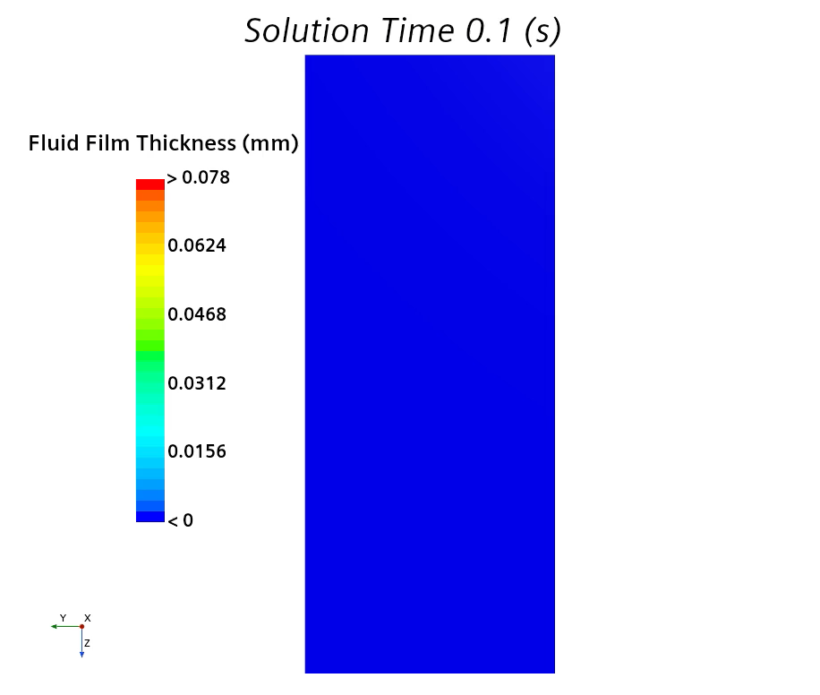
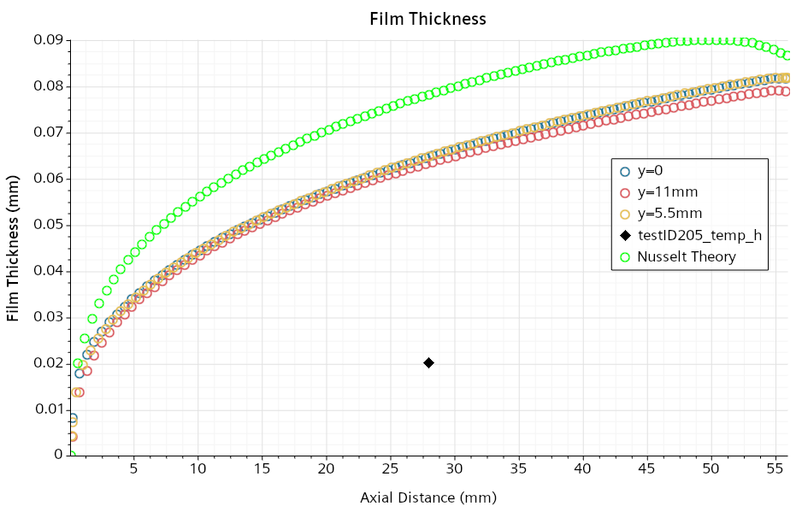
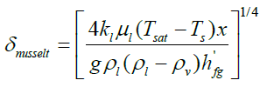
Preliminary CFD Results: Film Thickness
Film thickness likely over-predicted due to under-prediction of solid temperatures
% error = 222% (3x over-predicted)
Sub-grid model slightly out-performs Nusselt Theory [6]
Condensing surface 22.6mm x 55.8mm

Slide 16
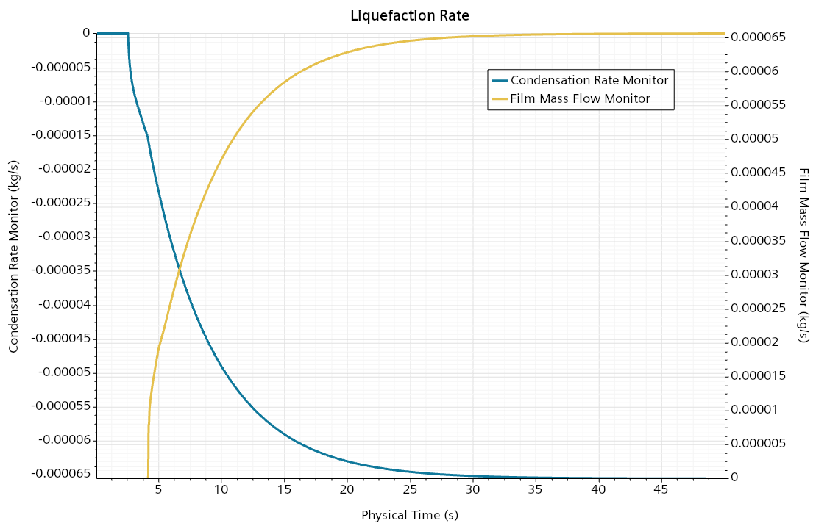
Preliminary CFD Results: Liquefaction Rate
Liquefaction rate leveling off indicates steady state condition
Integrated condensation rate and mass flow of film off plate boundaries are identical at steady state
Simulation took 1.2 hrs on 8 cores to complete 50s

Slide 17
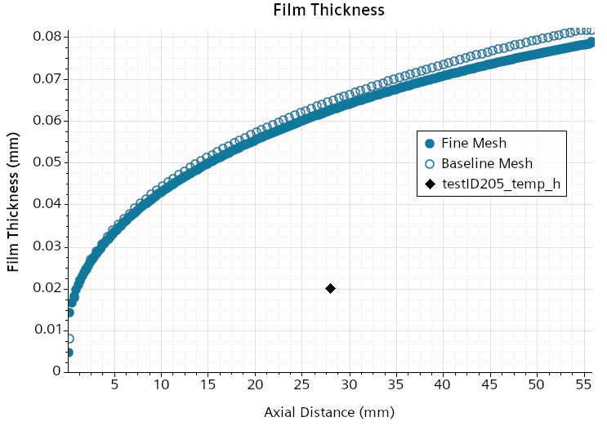
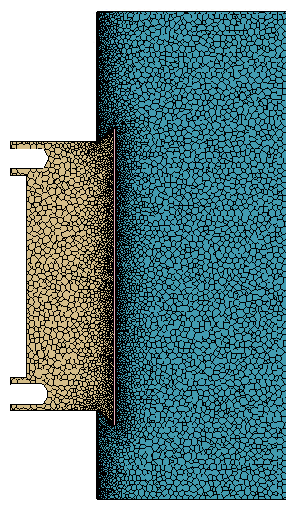
Mesh Independence
Baseline Mesh
0.5mm plate
Fine Mesh
0.2mm plate
~204k cells
~2.8M cells

Slide 18
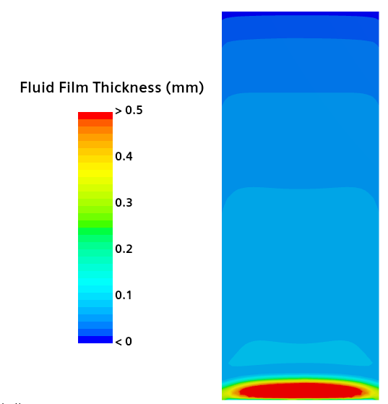
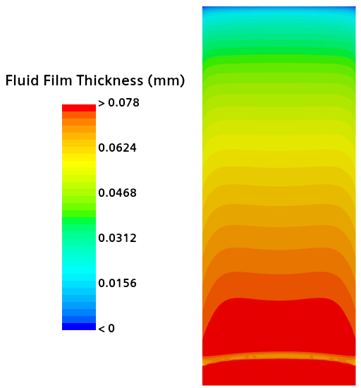
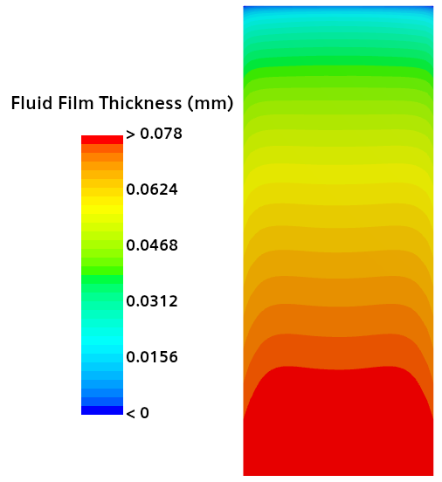
Effect of Surface Tension
Film solver yielded a large discontinuity when using a 0 degree contact angle
Solution for 2 degree contact angle identical to baseline case with no surface tension
STAR-CCM+ uses surface tension model by Brackbill et al. [7]
0deg Contact Angle
2deg Contact Angle

Slide 19
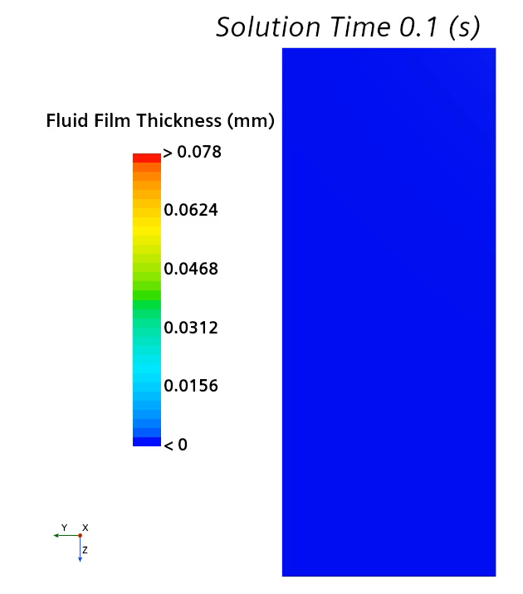
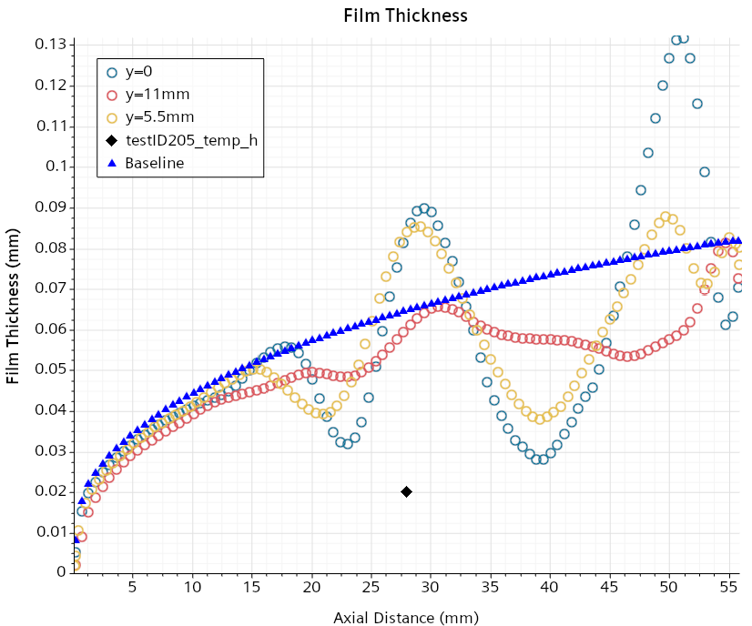
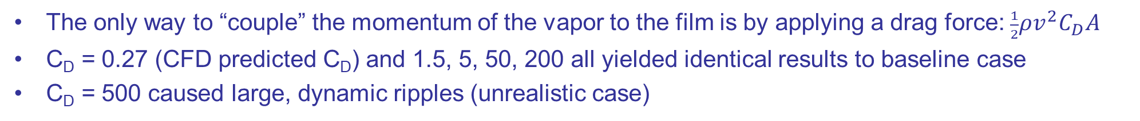
Drag Force
The only way to “couple” the momentum of the vapor to the film is by applying a drag force: $\frac{1}{2}ρv^{2}C_{D}A$
C_{D} = 0.27 (CFD predicted C_{D}) and 1.5, 5, 50, 200 all yielded identical results to baseline case
C_{D} = 500 caused large, dynamic ripples (unrealistic case)
C_{D} = 500

Slide 20
Conclusions and Discrepancy Investigations / Future Work
STAR-CCM+ fluid film model with phase change provides a robust CFD framework to predict film condensation for liquefaction applications
Surface Tension model with 0 deg contact angle introduced instabilities, but is not necessary
Drag force negligible for films on the order of 10 µm (not surprising)
Determine if over-prediction of film thickness is common between Methane, Nitrogen and Oxygen experiments
Oxygen dataset contains multiple film thickness measurements along the length of the plate
Determine sensitivity of film thickness to inlet vapor temperature
Over-simplified boundary conditions
LN2 bath temperature
Heat leaks into visualization chamber (Thermal Desktop model of entire chamber)
If we force the internal plate temperatures to match the data, does CFD predict an accurate film thickness? If not, why?
Inquire on accuracy of measurement technique
Error bars ±15 µm is on the same order as measurement (20-30 µm)
Contractor reported plate torsion
Horizontal plate film condensation experiment: larger film will provide more accurate measurement and drag study

Slide 21
References
https://science.nasa.gov/mission/viper/
https://www.nasa.gov/overview-in-situ-resource-utilization/
Johnson, W. L., Dimston, A. E., Valenzuela, J. G., Kashani, A., Smith, J. W., Chan, H. M., Wendell, J. C., Stephens, J. R., Balasubramaniam, R., Johnson, K. P., and Miller, E. J., “Liquefaction of Cryogenic Fluids for Production and Storage of Commodities on Extra-Terrestrial Surfaces,” Space Cryogenics Workshop, 2021.
Pesich, J. M., “A Summary of Recent SBIR and STTR Projects in Support of Cryogenic Fluid Management Modeling,” TFAWS presentation, 2024.
Siemens Simcenter STAR-CCM+, Ver. 19.02.009-R8 (2402), Plano, TX, 2024.
Ghiaasiaan, S. M., Two-Phase Flow, Boiling, and Condensation, 2nd ed., Cambridge University Press, Cambridge, UK, 2017, Chap. 15, pp. 566–568.
Brackbill J. U., Kothe, D. B., Zemach, C., “A continuum method for modeling surface tension,” J. Comp. Phys. Vol. 100, 1992, pp. 335–354.

Slide 22
backup

Slide 23
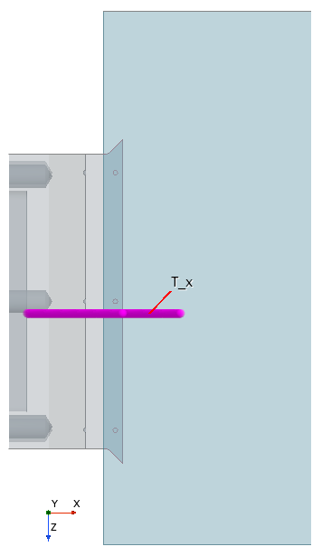
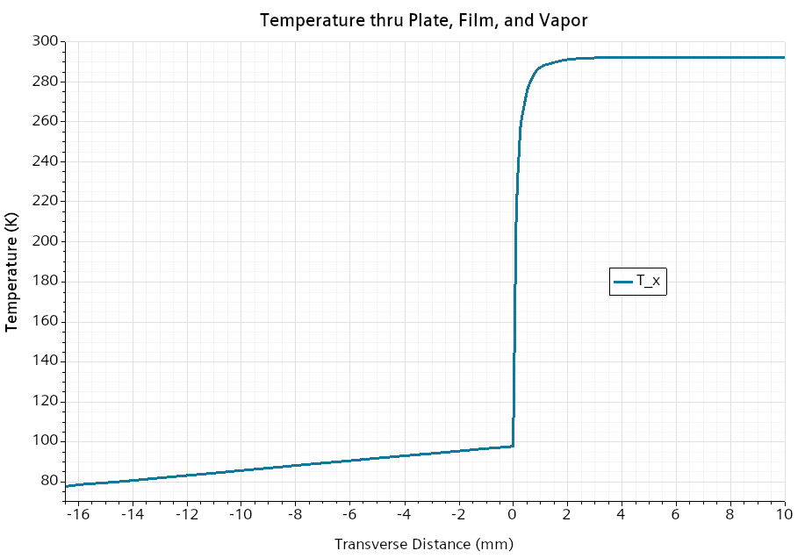
Temperature Results thru Plate, Film, and Vapor

Slide 24
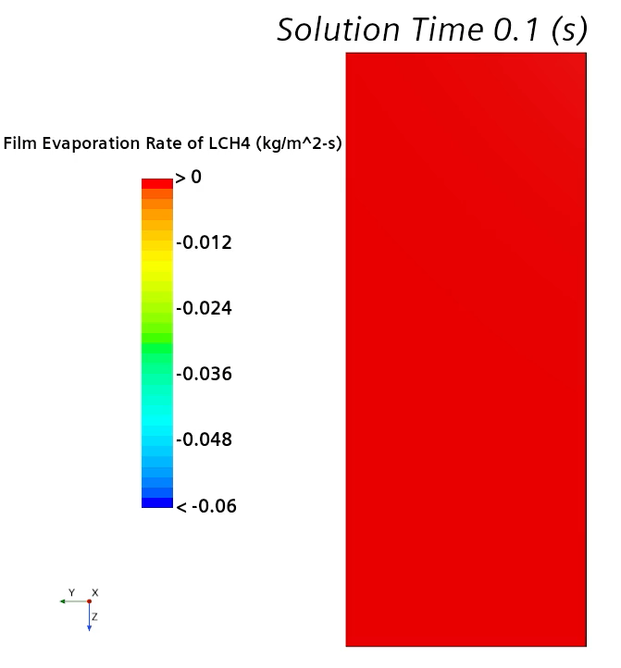
Film Thickness and Condensation Rate

Slide 25
Nusselt Theory for Film Condensation [5]
Assumptions:
Steady state, laminar film flow
Constant wall temperature
Stagnant, pure, saturated vapor
Zero shear stress at the film surface
Constant-property condensate liquid
Negligible liquid inertia
Linear temperature profile across the condensate
Main Shortcomings:
Does not account for subcooling of the condensate film
Does not account for forced convection where shear stress at the film interface is significant
Does not account for ripples or waves (Re_{f} > 33) which cause mixing and enhances heat transfer
±50% accuracy

Slide 26

Condensation on a Dry Wall cont.
Varying Film Thickness
$$R_{min}={10}^{−6}m$$

Slide 27
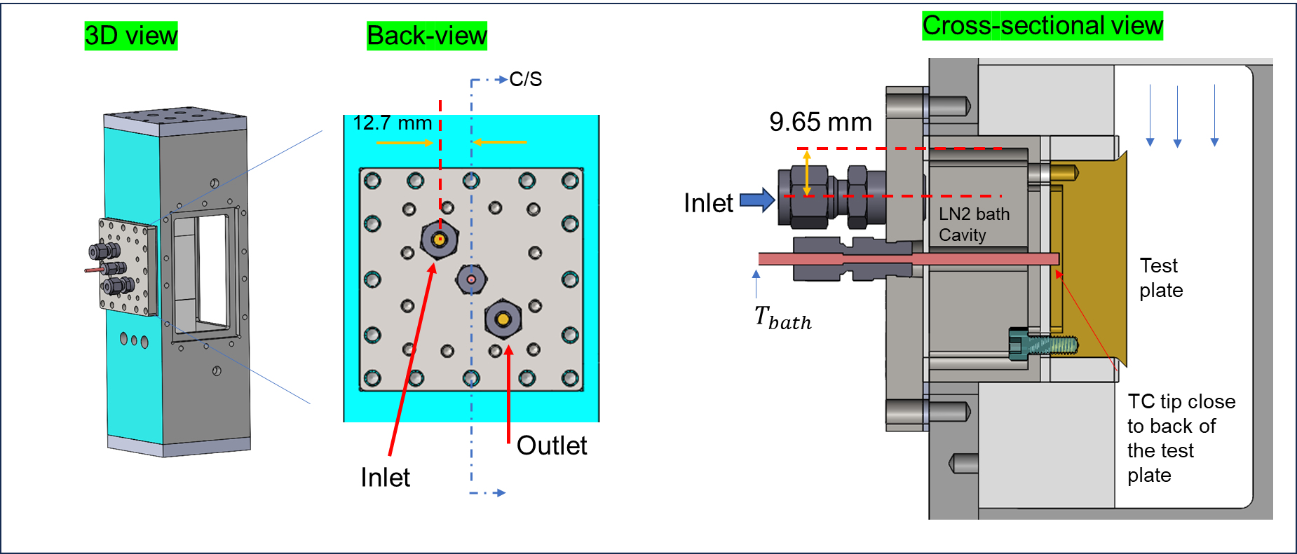
LN2 Bath
Credit: UCONN

Slide 28
Film Thickness Measurement Location
Credit: UCONN

