Slide 1


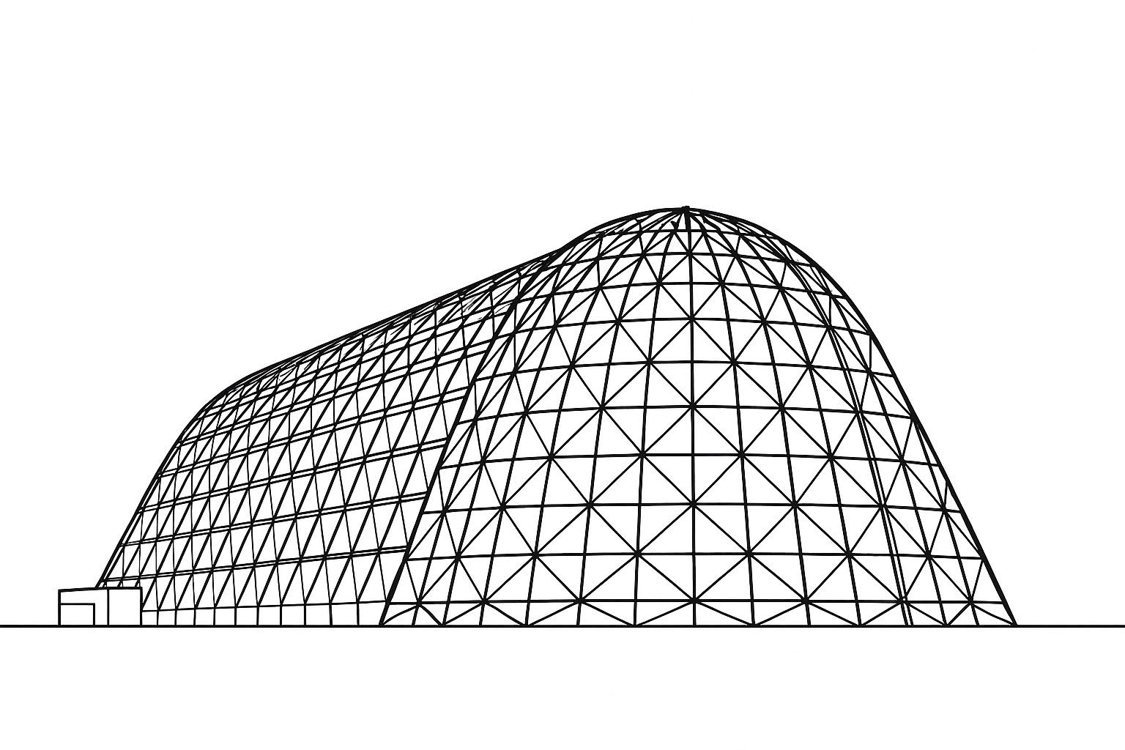
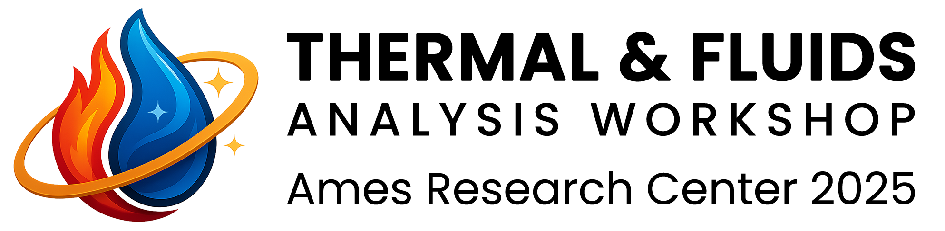
Custom CFD and Digital Twin Frameworks for Thermo-Fluid System Optimization
TFAWS 2025 Interdisciplinary 1 Session
Presented by:
Ender Demirel, PhD

Slide 2
Outline
Introduction of SunMan Engineering
Motivation & Background
Our Approach
Target Applications
Digital Twin & Simulation Optimization
Benefits of Our Approach
Our Capabilities

Slide 3
Company Introduction
At SunMan Engineering, mechanical engineering is the foundation of our product innovation services.
With over 30 years of expertise and 1,600+ successfully completed projects, we excel in end-to-end mechanical product development—from initial concept sketches to production-ready systems—serving industries such as medical devices, aerospace, IoT, robotics, and industrial automation.
Whether it’s a compact wearable, a rugged aerospace assembly, or a fluid dynamics-powered robotic module, our multidisciplinary team transforms ideas into fully engineered, manufacturable solutions.

Slide 4
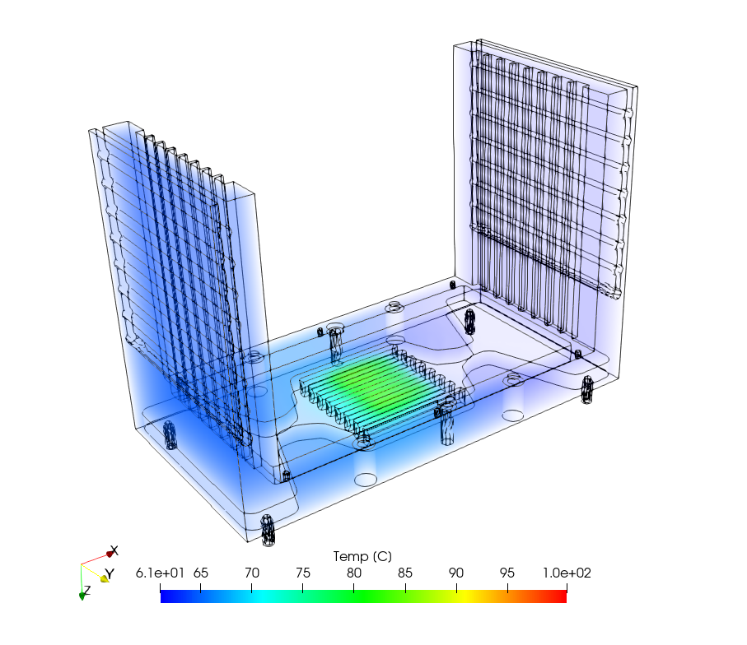
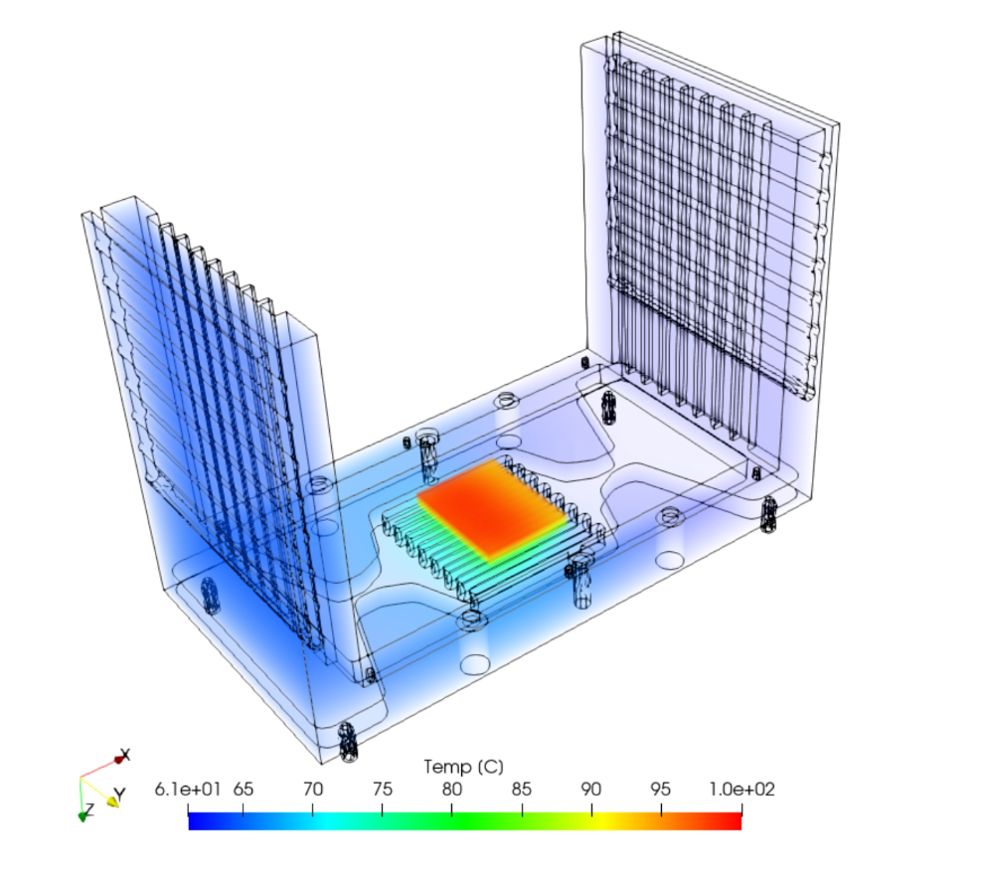
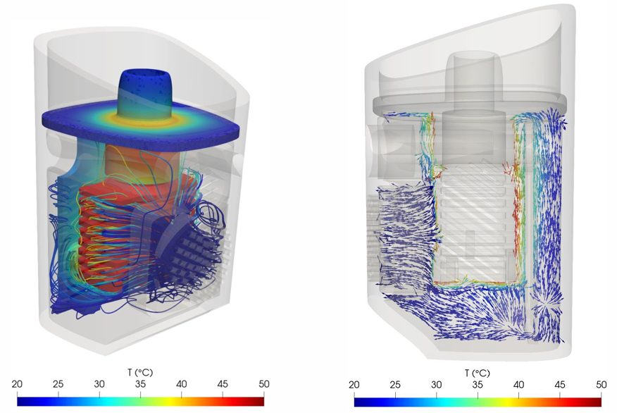
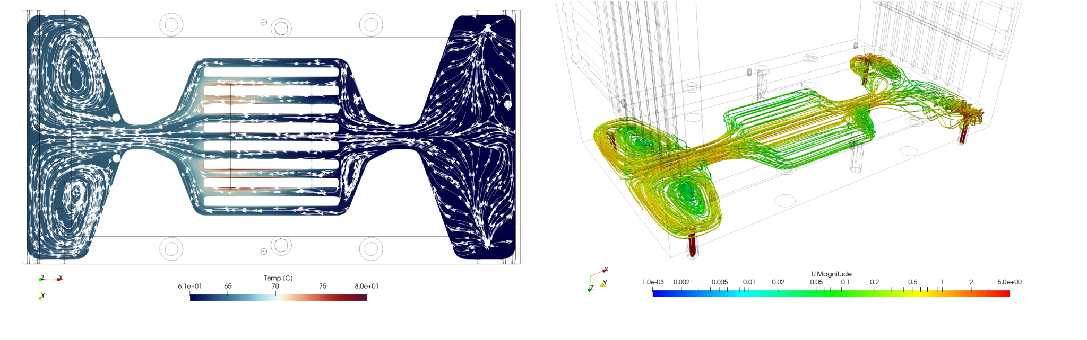
Motivation & Background
Complex flow and thermal problems require multi-physics, high-resolution, and adaptive methods
Traditional tools often fall short for real-world system behavior.
Need for simulation-driven R&D and AI integration

Slide 5
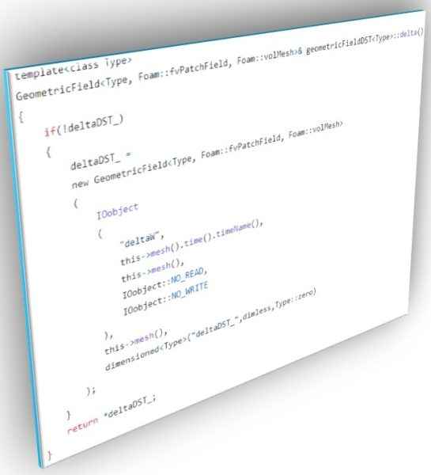
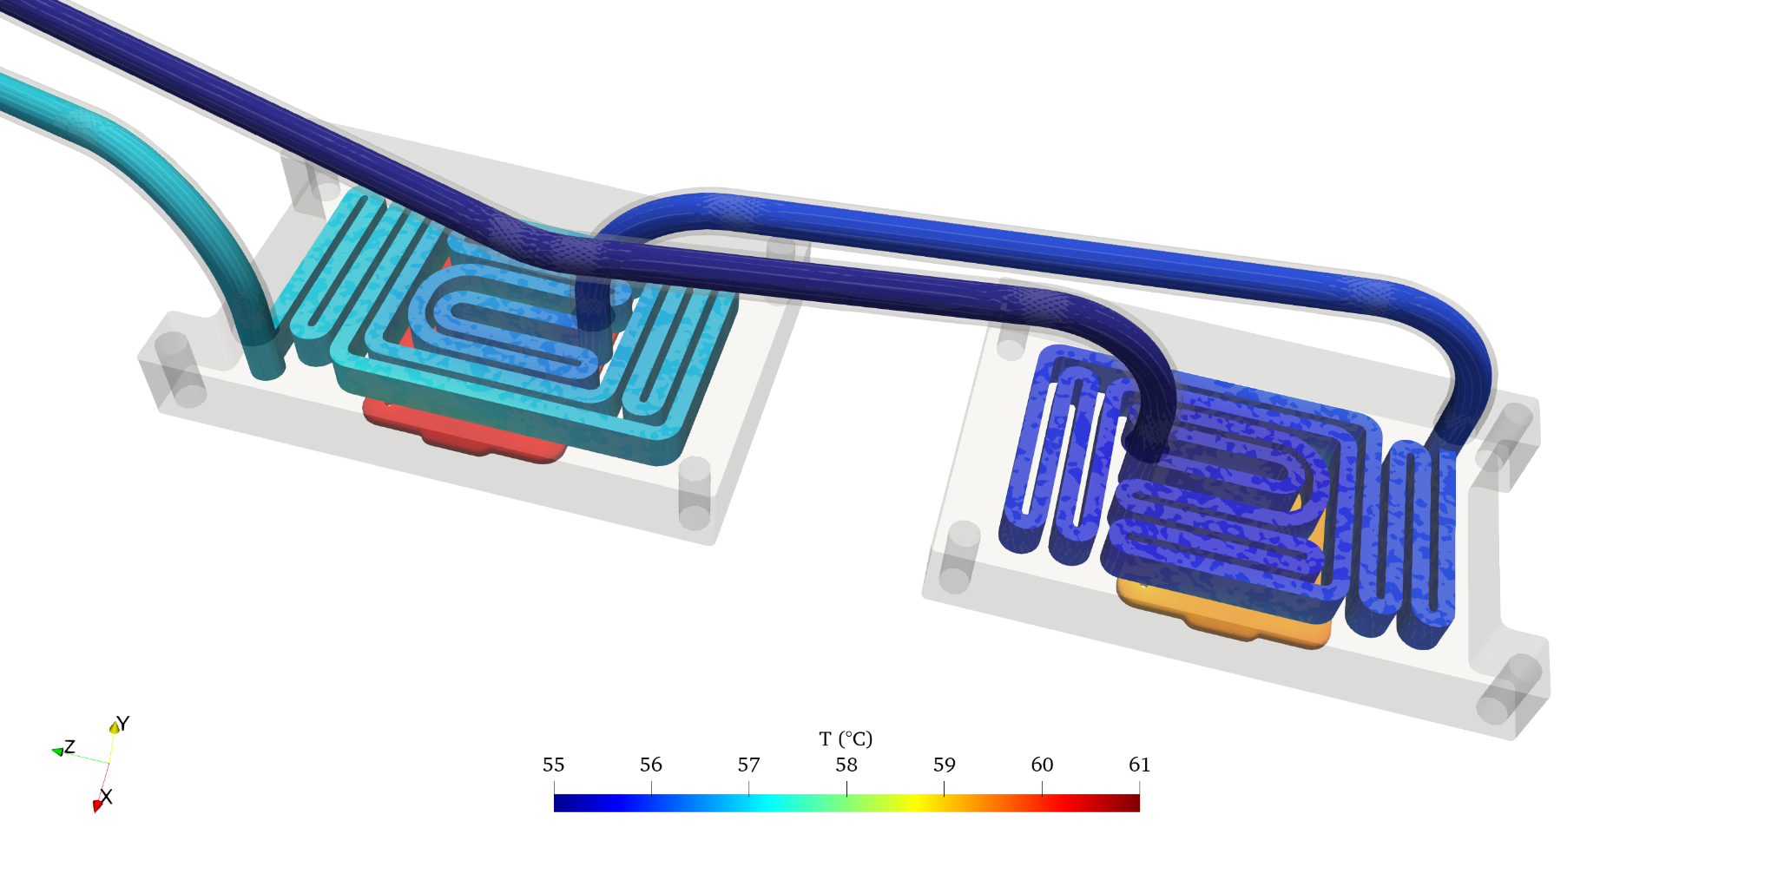
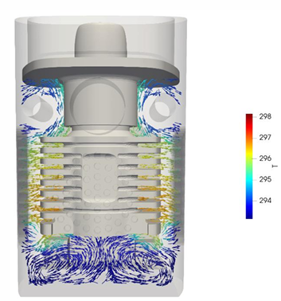
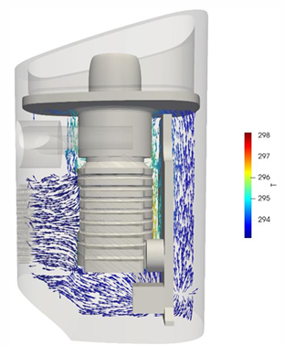
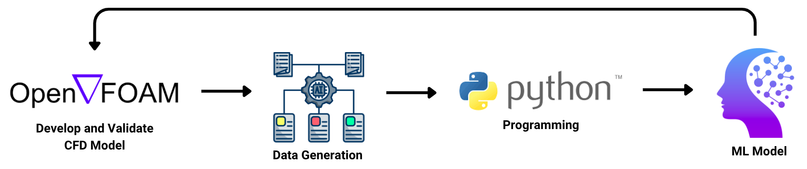
Our Approach
High-resolution CFD simulations considering compressibility, turbulence (RANS and LES), heat transfer, reaction, and phase change
Custom solver development
Integration of Machine Learning (ML) models with CFD
Digital twin creation for real-time & realistic system behavior modeling

Slide 6
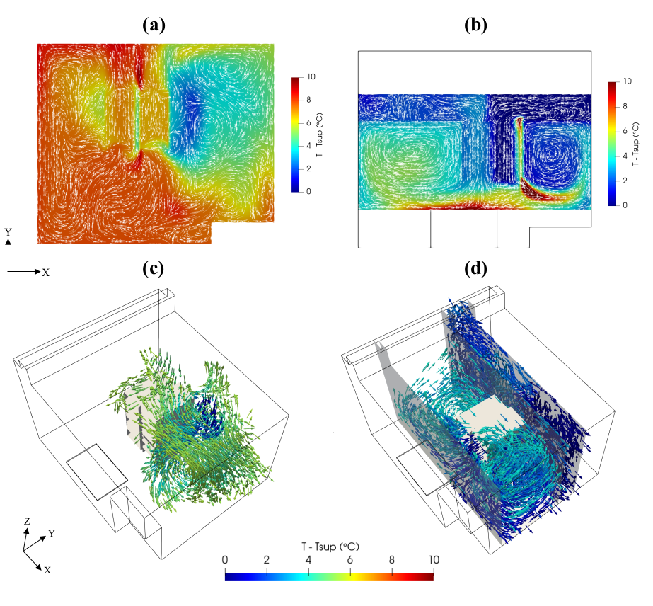
Target Applications
Thermal Systems
Thermal Modeling of data centers
Conjugate Heat Transfer (CHT) thermal modeling of liquid-cooling for IT systems
Cooling of medical devices
Our open-source framework can be extended to a wide variety of flow and thermal problems, making it suitable for diverse engineering applications.

Slide 7
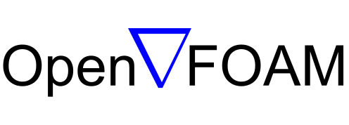
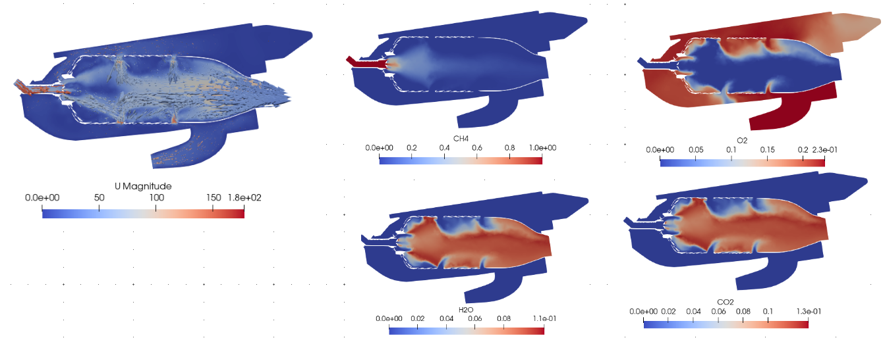
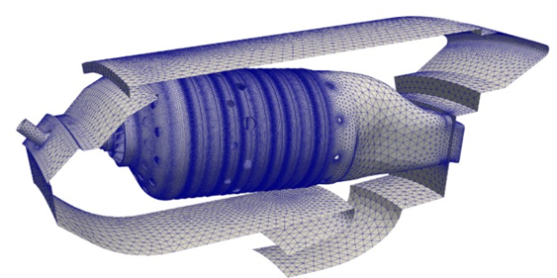
Target Applications
Combustion Modeling
Our modeling framework supports the simulation of compressible flow, turbulence, and chemical reactions involved in combustion processes.
By integrating OpenFOAM with ChemKin reaction mechanisms, we can realistically simulate complex combustion processes, including the formation and transport of all reaction products under turbulent and compressible flow conditions.
ChemKin
+
Flow simulation
Reaction Mechanism

Slide 8
Digital Twin Capabilities
Integration with control systems for closed-loop feedback and intelligent decision-making Support for life-cycle assessment and long-term performance tracking Experimental planning aid, helping define sensor placement, test conditions, and data needs Collaboration-ready platform, facilitating multidisciplinary engineering and research workflows Model update and calibration based on live or historical sensor data
Decision support for asset management, maintenance scheduling, and operational planning Real-time system-level simulation under dynamic and realistic operating conditions Performance monitoring and diagnostics based on virtual replicas Early detection of inefficiencies, anomalies, and failure-prone regions
Scenario testing for various operating and boundary conditions without disrupting physical systems Predictive analytics using integrated AI models for forecasting system behavior Optimization of operational strategies for enhanced energy efficiency and reliability Virtual prototyping and design evaluation before physical implementation

Slide 9
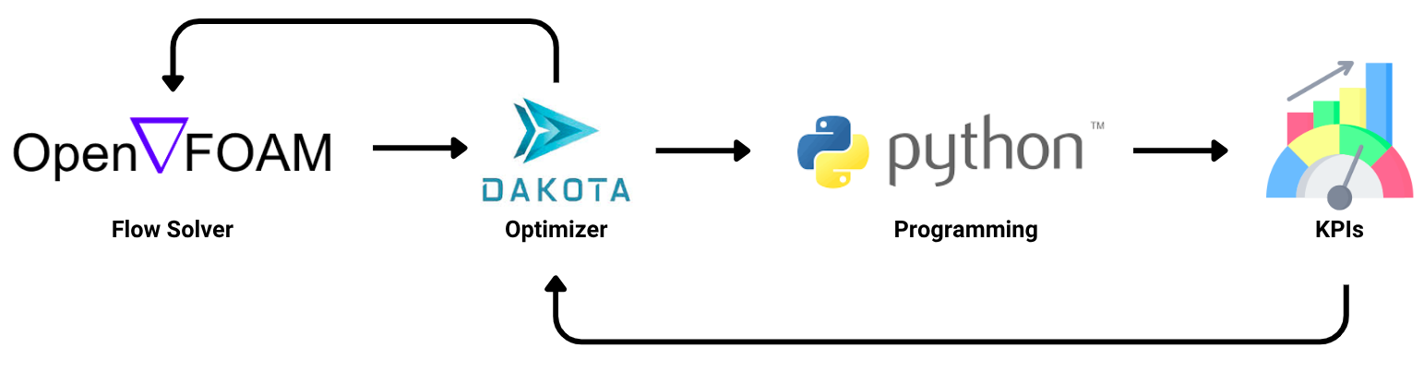
Simulation-Optimization Framework
Define design parameters:
Identify geometric, material, and operating parameters to be varied
Determine Key Performance Indicators (KPIs)
Select measurable outputs to assess system performance (e.g., thermal resistance, pressure drop, energy consumption)
Develop and Validate Simulation Model
Build a high-fidelity CFD model and validate it with experimental or reference data
Apply Optimization Algorithms or Surrogate Models
Use AI/ML or optimization techniques to identify optimal design regions

Slide 10
Benefits of Our Approach
Enables simulation-driven decision-making without any limitations High accuracy in capturing multi-physics interactions, including thermal, fluid, and chemical phenomena Faster design iterations through AI-accelerated simulations and surrogate modeling Reduced computational cost by integrating data-driven models with physics-based solvers Realistic system behavior via digital twins that operate under actual or predicted boundary conditions
Energy efficiency optimization by identifying and mitigating sources of performance loss Rapid prototyping and scenario testing without physical trials Intelligent control strategies enabled by ML-based predictions integrated into CFD frameworks Simulation-supported experimental design, reducing trial-and-error and improving experimental targeting

Slide 11
Our Capabilities
Concept-to-Production Mechanical Design We develop complete mechanical systems and subsystems with a focus on functionality, manufacturability, and long-term reliability. This includes kinematic linkages, thermal structures, enclosures, sensor integration, and more.
Precision CAD Modeling & Assembly Using industry-leading tools like SolidWorks, Creo, and Autodesk Inventor, our engineers deliver high-precision, parametric 3D models, from micro-mechanisms to large-scale assemblies.
Design for Manufacturing (DFM) Our designs are production-ready, with attention to material selection, tolerance analysis, moldability, cost efficiency, and simplified assembly.
Simulation-Driven Design Through FEA, CFD, and thermal simulations, we optimize structural integrity and thermal performance, reducing prototyping cycles and minimizing rework.
Enclosure & Packaging Design We create high-performance enclosures for electronics and smart systems, balancing thermal, EMI, mechanical, and ergonomic requirements.
Mechanism & Actuation Systems From robotics to medical instruments, we engineer gear trains, cam systems, sliders, springs, and actuators to achieve precise motion and force outputs.

Slide 12
Q&A
Thanks!
We’d Love Your Feedback.
www.SunManTechnology.com

