Slide 1

Simulation of Time-Dependent Heat Transfer in Spherical Bubbles With Application to Bubble-Through Nuclear Thermal Rocket Engines
Dakota Santana D. Keith Hollingsworth Ph.D. Student Professor
Department of Mechanical and Aerospace Engineering
The University of Alabama in Huntsville
POC: Dakota, djs0057@uah.edu

Slide 2
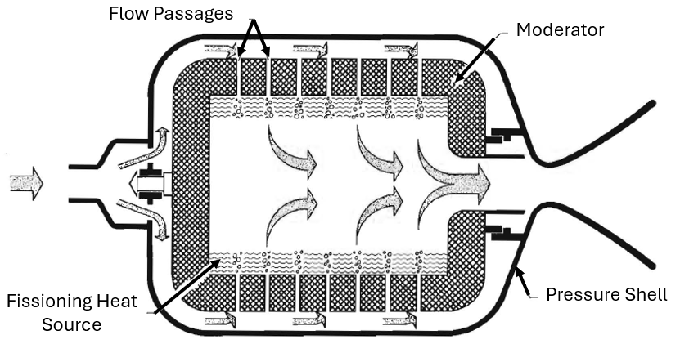
Bubble-Through Liquid Nuclear Thermal Rocket
History
Proposed in 1954 by McCarthy
Theorized Specific Impulse 50 – 100% greater than solid cores
Sporadically studied since with recent design effort referred to as Centrifugal Nuclear Thermal Rocket (CNTR)
Operations
Fissile liquid produces a nuclear hear source
Centrifuge contains the liquid
Bubbles radially inward cooling the centrifuge and heating up in the liquid
H₂
4000 K < T < 6000 K
I_{sp} ~ 1200 – 1800 s
U + Refractory
(Rom, 1968)

Slide 3
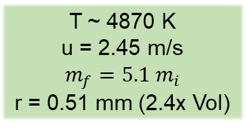
Bubble Conditions As Predicted by Engineering Model* *Keese and Hollingsworth, 2022
T = 4887 K, g = 1151
Rapidly Changing Bubble Conditions
Hydrogen Dissociation →
Conductivity and volumetric specific heat of gas approaches the liquid within 1 order of magnitude
Thermal Gradient →
Marangoni numbers up to 6000 predict surface tension induced advection
Gas Material Properties may vary up to 50% from top to bottom of bubble
Time dependent thermal boundary condition on the bubble
Morphology →
Impact of rapid expansion
T ~ 4870 K
u = 2.45 m/s
$$m_{f}=5.1 m_{i}$$
r = 0.51 mm (2.4x Vol)
T = 4868 K, g = 1175
2.9ms
Size Change to Scale
T = 3228 K, g = 1528
T ~ 2981 K
u = 2.47 m/s
r = 0.39 mm
T = 2935 K, g = 1547

Slide 4
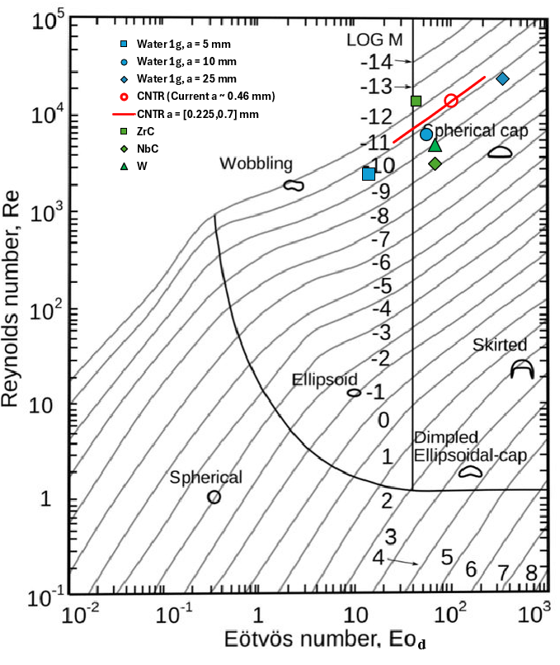
Exploration Space
Traditional Heat/Mass Transfer models assume:
Bubble → Liquid (min Nu, Sh = 2)
Liquid → Bubble (min Nu, Sh = 6.58) [shown in graph]
Choice dictated by rate-limited phase
Validation Framework and Respective Challenges
Low Re:
Resolving bubble interface (reference cases have fixed interface)
Pulling and processing data
High Re:
Spurious currents from low Capillary numbers
3D LES capability
Spheroid:
Alternative bubble shape
Required step for stable spherical cap bubble
High Re
Juncu, 2010
Saboni, 2016
Wadewitz and Specht, 2001
Predicted Analytical
Spheroid
Low Re
Clift et. al., 1978
Colombet et. al., 2013

Slide 5

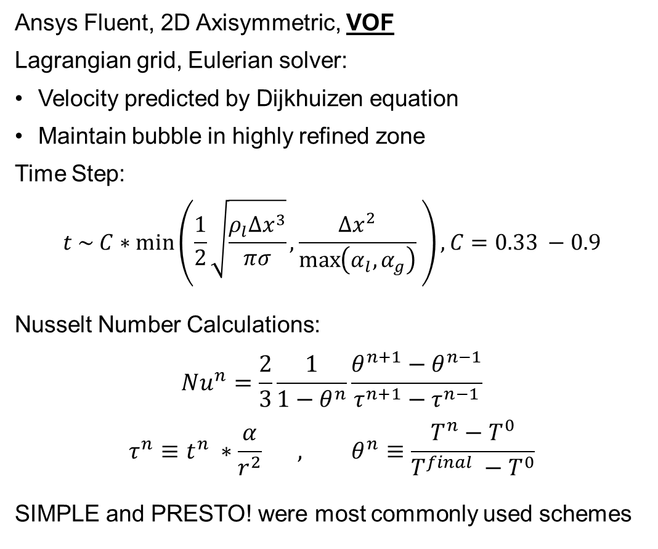
CFD Setup
Ansys Fluent, 2D Axisymmetric, VOF
Lagrangian grid, Eulerian solver:
Velocity predicted by Dijkhuizen equation
Maintain bubble in highly refined zone
Time Step:
$$t \sim C∗\min\left(\frac{1}{2}\sqrt{\frac{ρ_{l}{Δx}^{3}}{πσ}},\frac{Δx^{2}}{\max\left(α_{l},α_{g}\right)} \right), C=0.33 −0.9$$
Nusselt Number Calculations:
$$Nu^{n}=\frac{2}{3}\frac{1}{1−θ^{n}}\frac{θ^{n+1}−θ^{n−1}}{τ^{n+1}−τ^{n−1}}$$
$$τ^{n}≡t^{n} ∗\frac{α}{r^{2}} , θ^{n}≡\frac{T^{n}−T^{0}}{T^{final} −T^{0}}$$
SIMPLE and PRESTO! were most commonly used schemes
Inlet $V_{eularian}=0$
Res/8
Res/4
Res/2
Res ~ r/40 – r/80
Structured Quad Grid + Tri Transitions
r = Bubble Radius
Pressure Outlet
Roughly to Scale
Pressure Outlet

Slide 6
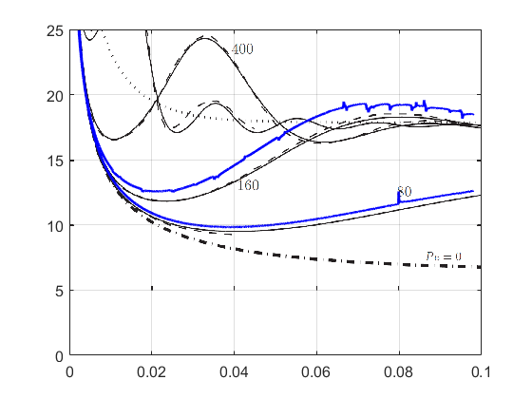
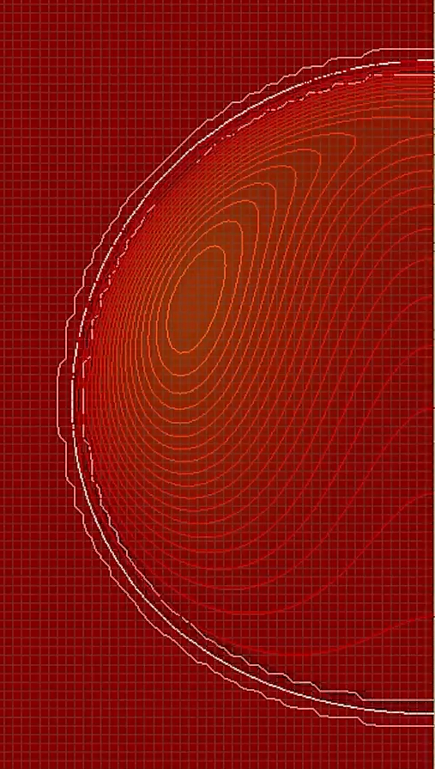
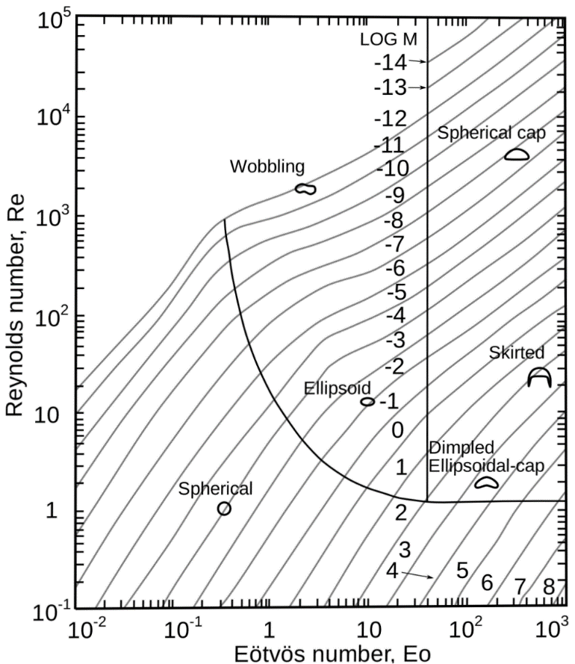

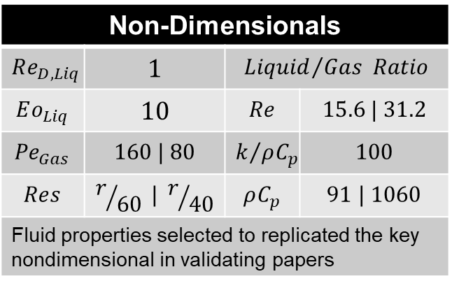

Preliminary Investigation
Non-Dimensionals
$$Re_{D,Liq}$$ | $$1$$ | $${Liquid}/{Gas} Ratio$$
$$Eo_{Liq}$$ | $$10$$ | $$Re$$ | $$15.6 | 31.2$$
$${Pe}_{Gas}$$ | $$160 | 80$$ | $$k/{ρC_{p}}$$ | $$100$$
$$Res$$ | $$r/{60} | r/{40}$$ | $$ρC_{p}$$ | $$91 | 1060$$
Fluid properties selected to replicated the key nondimensional in validating papers
Pe = 160
$$Nusselt Number \left(Nu\right)=\frac{2hr}{k}$$
(Colombet, 2013)
$$Fourier Number \left(Fo\right)=\frac{α_{Gas}t}{r^{2}}$$
Mean Velocity Error < 1.5%

Slide 7
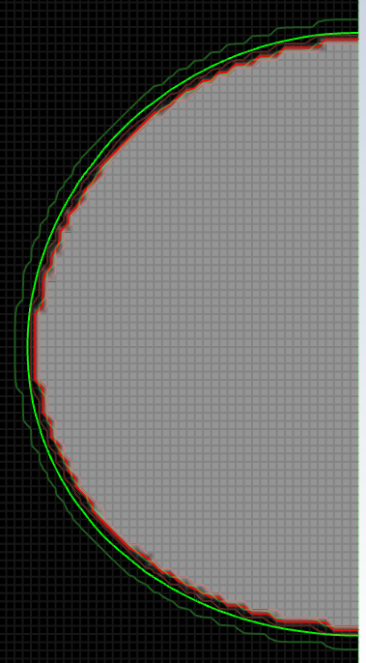
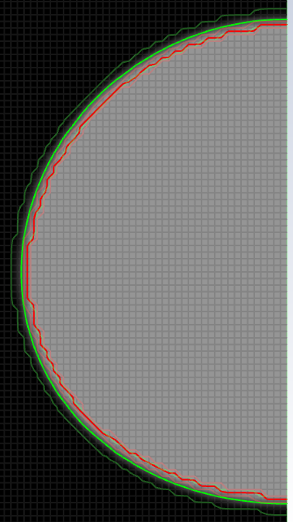
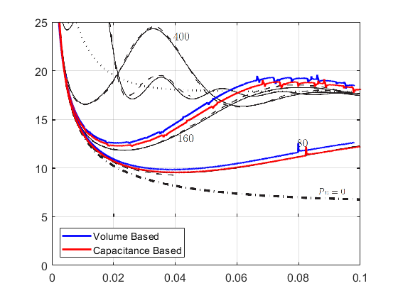
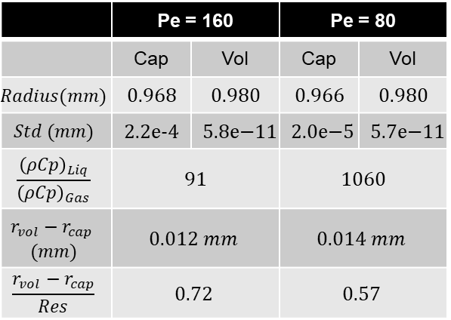

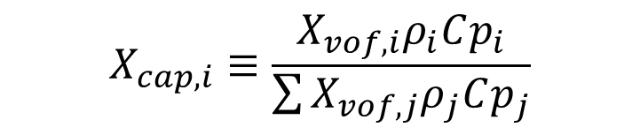

Capacitance Factor Correction
$$X_{cap,i}≡\frac{X_{vof,i}ρ_{i}Cp_{i}}{\sum{X_{vof,j}ρ_{j}Cp_{j}}}$$
Capacitance Based
Volume Based
 | Pe = 160 |  | Pe = 80
 | Cap | Vol | Cap | Vol
$$Radius(mm)$$ | $$0.968$$ | $$0.980$$ | $$0.966$$ | $$0.980$$
$$Std (mm)$$ | 2.2e-4 | $$5.8\text{e}\text{−11}$$ | $$2.0\text{e}\text{−5}$$ | $$5.7\text{e}\text{−11}$$
$$\frac{{\left(ρCp\right)}_{Liq}}{{\left(ρCp\right)}_{Gas}}$$ | $$91$$ |  | $$1060$$
$$r_{vol}−r_{cap}$$ $$(mm)$$ | $$0.012 mm$$ |  | $$0.014 mm$$
$$\frac{r_{vol}−r_{cap}}{Res}$$ | $$0.72$$ |  | $$0.57$$
$$Nusselt Number \left(Nu\right)=\frac{2hr}{k}$$
$$Fourier Number \left(Fo\right)=\frac{α_{Gas}t}{r^{2}}$$

Slide 8
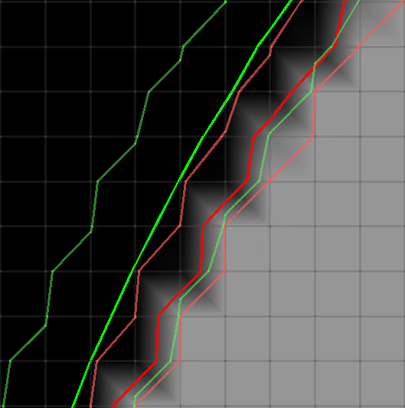
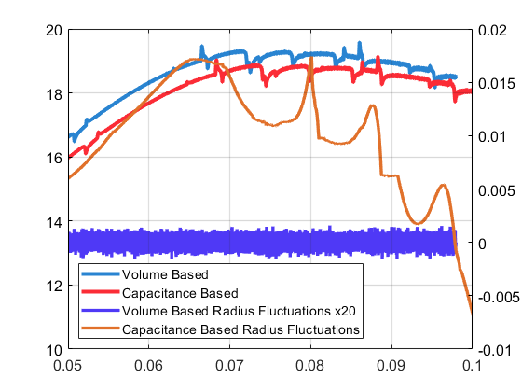
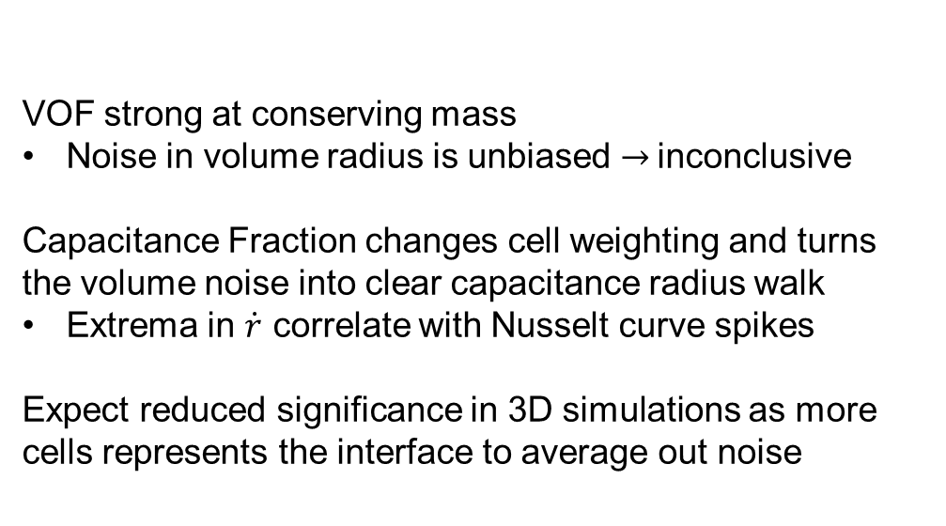



Noise Investigation
Spikes in Nusselt curves
Continuous
Persist through filtering
Investigate change in change in radius:
$${\dot{r}}^{n} =\frac{1}{\overline{r}}\frac{r^{n+1}−r^{n+1}}{2Δτ}$$
Liquid
Liquid
Gas
VOF strong at conserving mass
Noise in volume radius is unbiased → inconclusive
Capacitance Fraction changes cell weighting and turns the volume noise into clear capacitance radius walk
Extrema in $\dot{r}$ correlate with Nusselt curve spikes
Expect reduced significance in 3D simulations as more cells represents the interface to average out noise
Gas
$$Nusselt Number \left(Nu\right)=\frac{2hr}{k}$$
$$Fourier Number \left(Fo\right)=\frac{α_{Gas}t}{r^{2}}$$

Slide 9
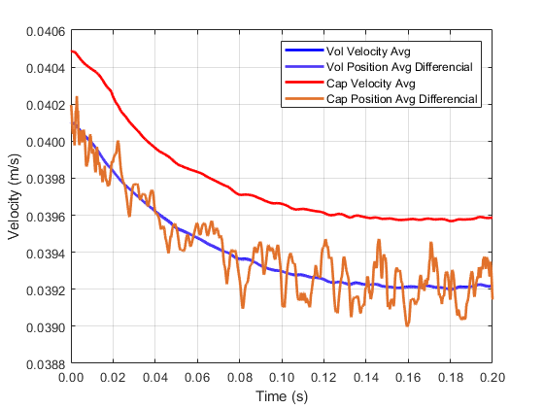
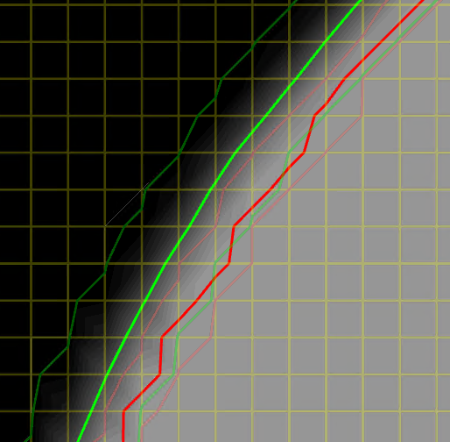
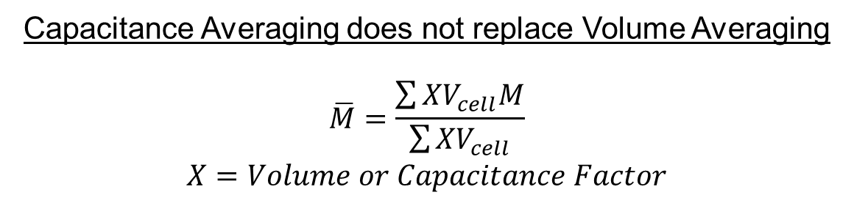
Shortcoming of Capacitance Factor
Capacitance Averaging does not replace Volume Averaging
$$\overline{M}=\frac{\sum{{XV}_{cell}M}}{\sum{{XV}_{cell}}}$$
$$X=Volume or Capacitance Factor$$
Capacitance weighting downplays behavior at outer edges

Slide 10
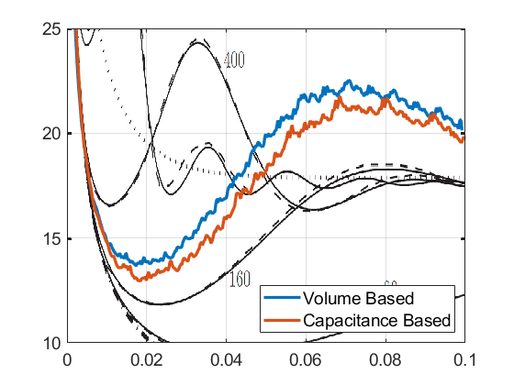
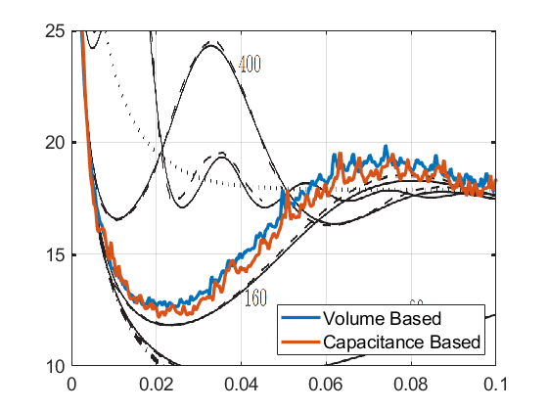
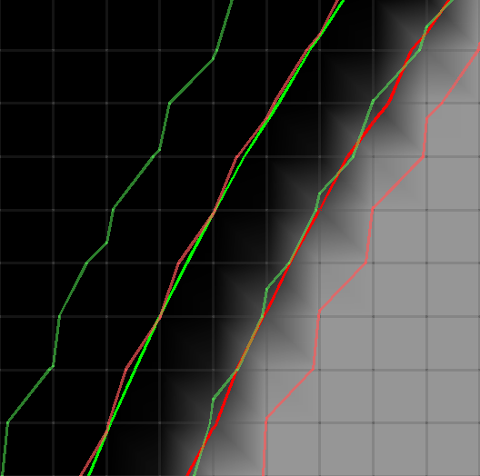
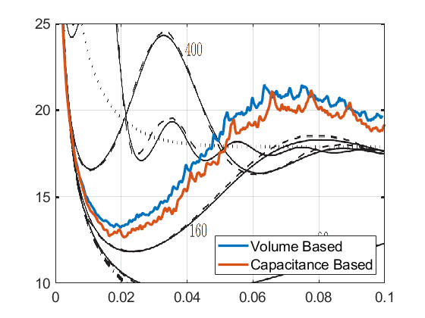
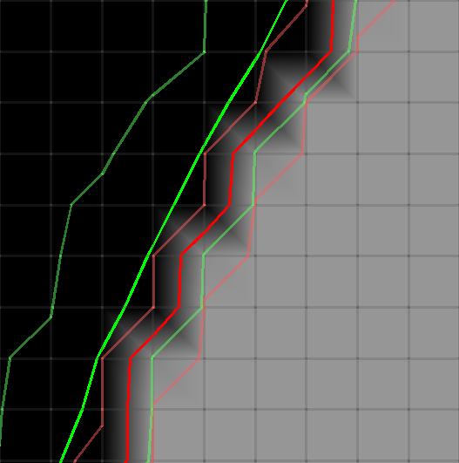
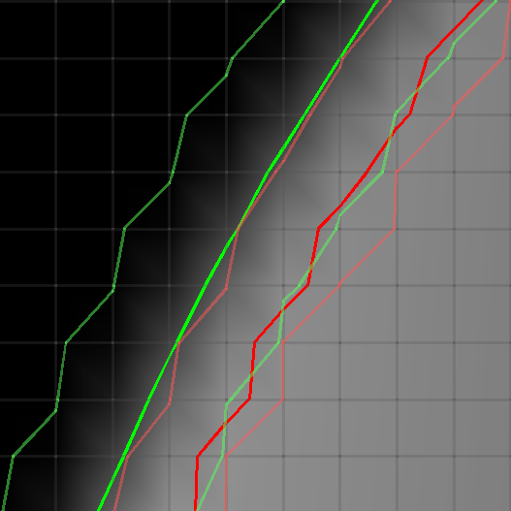
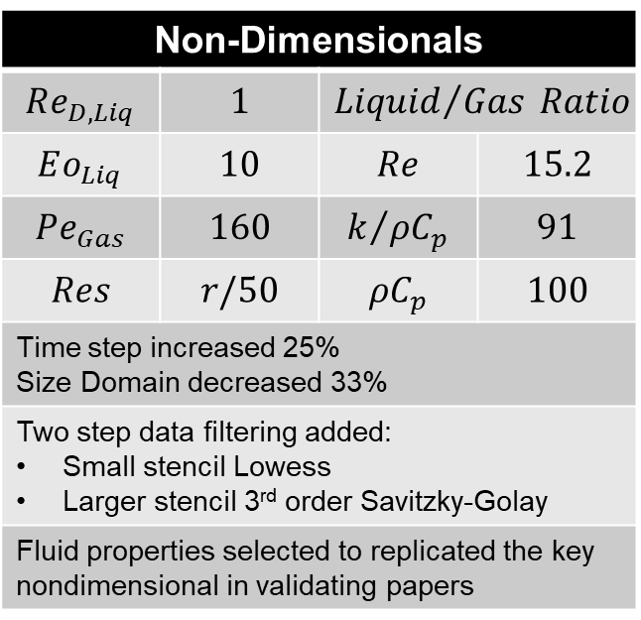
Different Surface Reconstructions
Compressive
Non-Dimensionals
$$Re_{D,Liq}$$ | $$1$$ | $${Liquid}/{Gas} Ratio$$
$$Eo_{Liq}$$ | $$10$$ | $$Re$$ | $$15.2$$
$${Pe}_{Gas}$$ | $$160$$ | $$k/{ρC_{p}}$$ | $$91$$
$$Res$$ | $$r/50$$ | $$ρC_{p}$$ | $$100$$
Time step increased 25% Size Domain decreased 33%
Two step data filtering added: Small stencil Lowess Larger stencil 3rd order Savitzky-Golay
Fluid properties selected to replicated the key nondimensional in validating papers
PLIC
HRIC
CICSAM

Slide 11
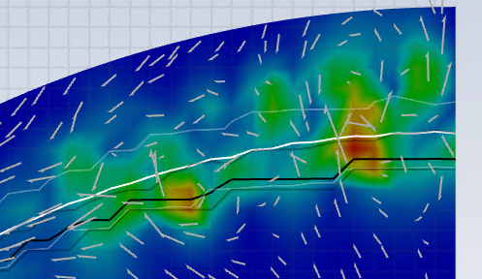
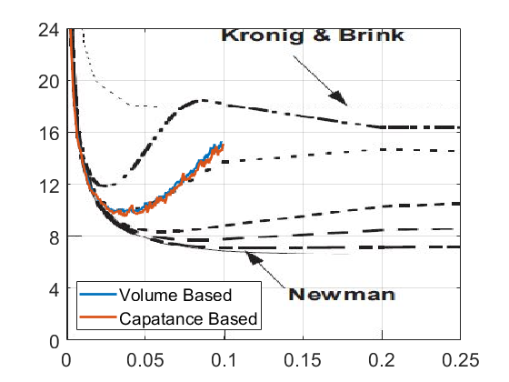
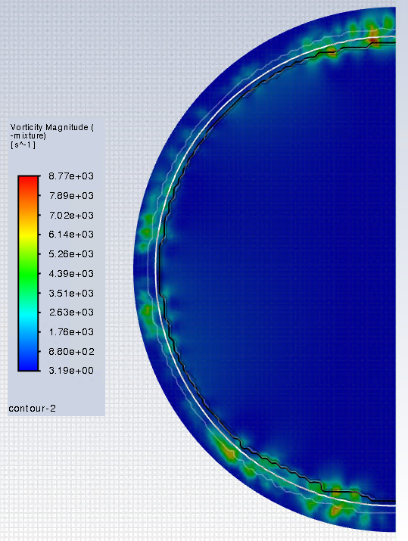
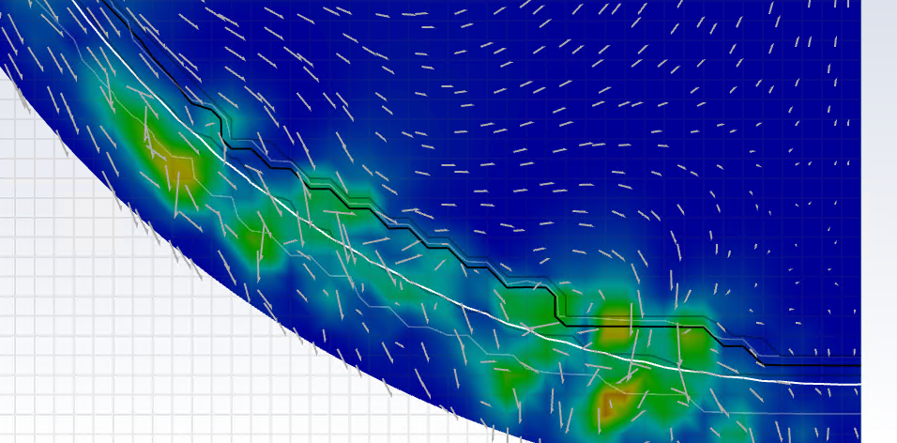








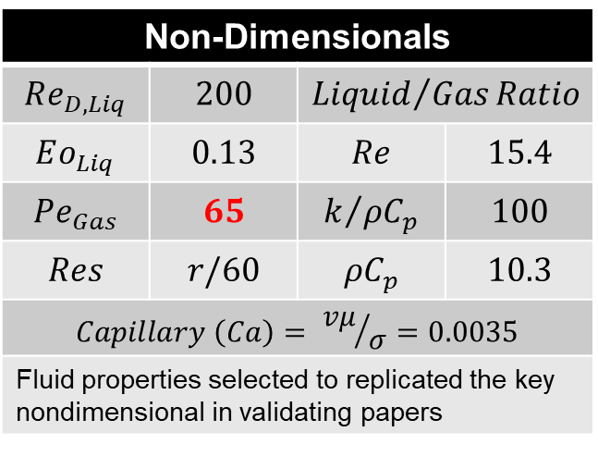

High Reynolds Number
Non-Dimensionals
$$Re_{D,Liq}$$ | $$200$$ | $${Liquid}/{Gas}Ratio$$
$$Eo_{Liq}$$ | $$0.13$$ | $$Re$$ | $$15.4$$
$${Pe}_{Gas}$$ | $$65$$ | $$k/{ρC_{p}}$$ | $$100$$
$$Res$$ | $$r/60$$ | $$ρC_{p}$$ | $$10.3$$
$$Capillary \left(Ca\right)= {vμ}/σ=0.0035$$
Fluid properties selected to replicated the key nondimensional in validating papers
$$Pe=∞$$
$$Pe=65$$
$$Pe=39$$
$$Nusselt Number \left(Nu\right)=\frac{2hr}{k}$$
$$Pe=19.5$$
$$Pe=13$$
$$Pe=6.5$$
$$Pe=0$$
(Saboni, 2016)
$$Fourier Number \left(Fo\right)=\frac{α_{Gas}t}{r^{2}}$$
Predicted Velocity Error ~ 6%
(interfacial behavior maybe overly suppressed)

Slide 12
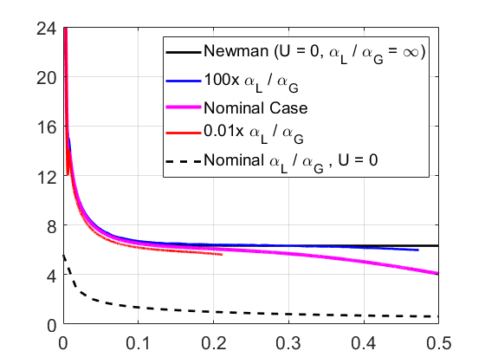


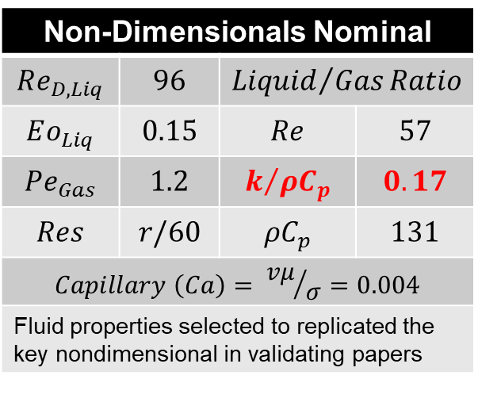
Uranium Case
Liquid Uranium + Gaseous Hydrogen
4000 K, 100 atm, 2000 gs
Non-Dimensionals Nominal
$$Re_{D,Liq}$$ | $$96$$ | $${Liquid}/{Gas}Ratio$$
$$Eo_{Liq}$$ | $$0.15$$ | $$Re$$ | $$57$$
$${Pe}_{Gas}$$ | $$1.2$$ | $$k/{ρC_{p}}$$ | $$0.17$$
$$Res$$ | $$r/60$$ | $$ρC_{p}$$ | $$131$$
$$Capillary \left(Ca\right)= {vμ}/σ=0.004$$
Fluid properties selected to replicated the key nondimensional in validating papers
$$Nusselt Number \left(Nu\right)=\frac{2hr}{k}$$
$$Fourier Number \left(Fo\right)=\frac{α_{Gas}t}{r^{2}}$$

Slide 13
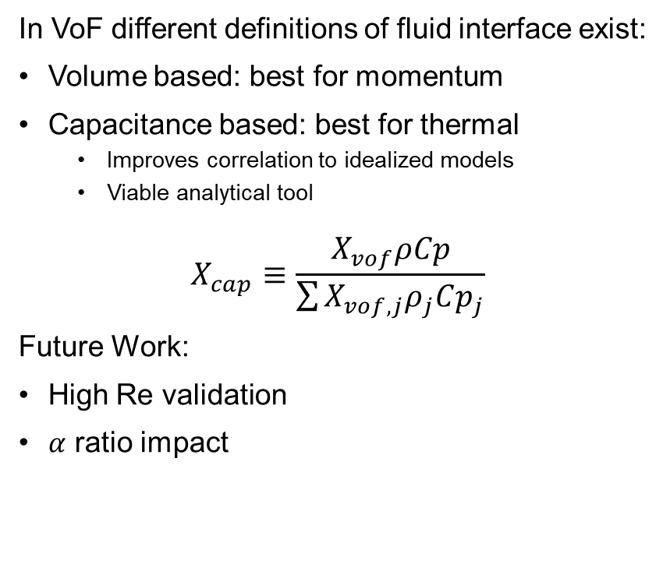
Conclusion
In VoF different definitions of fluid interface exist:
Volume based: best for momentum
Capacitance based: best for thermal
Improves correlation to idealized models
Viable analytical tool
$$X_{cap}≡\frac{X_{vof}ρCp}{\sum{X_{vof,j}ρ_{j}Cp_{j}}}$$
Future Work:
High Re validation
$α$ ratio impact
VoF Interface
Capacitance Interface

Slide 14
References
R. Clift, J. Grace, M. Weber, Bubles Drops and Particles, Academic Press, San Diego, 1978
D. Colombet et. al., “Mass or heat transfer inside a spherical gas bubble at low to moderate Reynolds number,” International Journal of Heat and Mass Transfer, 2013
Dijkhuizen,W.; Roghair, I.; Annaland, M.V.S.; Kuipers, J. DNS of gas bubbles behaviour using an improved 3D front tracking model—Drag force on isolated bubbles and comparison with experiments. Chem. Eng. Sci. 2010, 65, 1415–1426.
G. Juncu, “A numerical study of the unsteady heat/mass transfer inside a circulating sphere,” International Journal of Heat and Mass Transfer, 2010
J. Keese and K. Hollingsworth, "One-Dimensional Steady-State Thermal Model of CNTP Reactor," Nuclear Technology, 2023.
F. E. Rom, “Nuclear-Rocket Propulsion,” NASA TM X-1685, NASA, Nov. 1968
A. Saboni, “Mass transfer into a spherical bubble,” Chemical Engineering Science, 2016
A. Wadewitz and E. Specht, “Limit value of the Nusselt number for particles of different shape,” International Journal of Heat and Mass Transfer, 2001

Slide 15
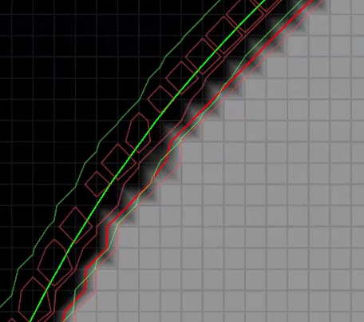


Error Investigation
$$\frac{1}{\overline{r}} \frac{dr}{dτ}$$
$$Fourier Number \left(Fo\right)=\frac{α_{Gas}t}{r^{2}}$$
Correlates to the island, mean radius calculated from this area is ~80% greater

Slide 16
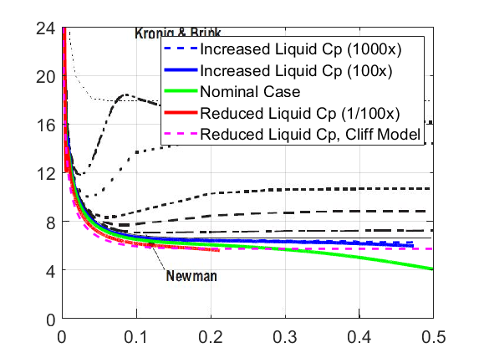
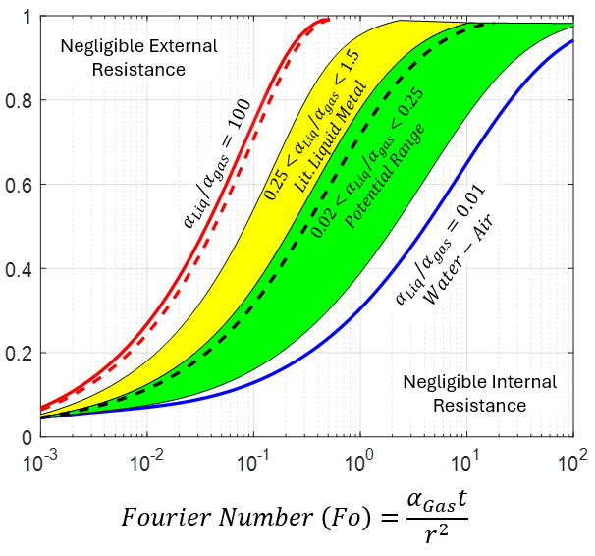
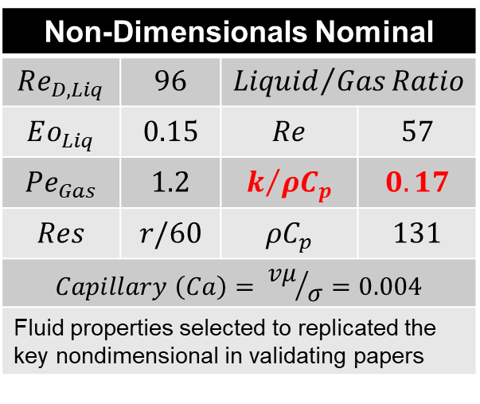
Uranium Case
Liquid Uranium + Gaseous Hydrogen
4000 K, 100 atm, 2000 gs
Non-Dimensionals Nominal
$$Re_{D,Liq}$$ | $$96$$ | $${Liquid}/{Gas}Ratio$$
$$Eo_{Liq}$$ | $$0.15$$ | $$Re$$ | $$57$$
$${Pe}_{Gas}$$ | $$1.2$$ | $$k/{ρC_{p}}$$ | $$0.17$$
$$Res$$ | $$r/60$$ | $$ρC_{p}$$ | $$131$$
$$Capillary \left(Ca\right)= {vμ}/σ=0.004$$
Fluid properties selected to replicated the key nondimensional in validating papers
Pure Diffusion
No Convection
Finite Difference Model
$$Nusselt Number \left(Nu\right)=\frac{2hr}{k}$$
$$Fourier Number \left(Fo\right)=\frac{α_{Gas}t}{r^{2}}$$

