Slide 1

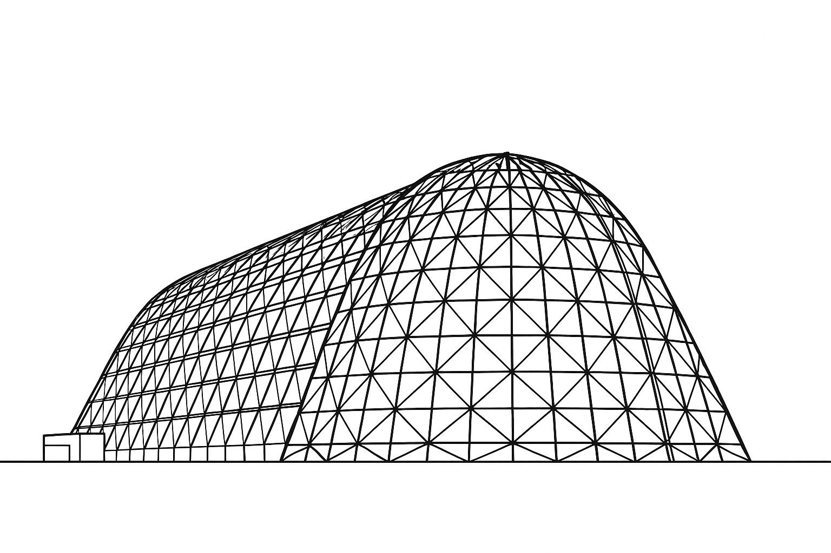

Numerical Analysis On Tree-Shaped Disc Heat Convection
TFAWS 2025 Interdisciplinary Technical Session
Presented by: Derli Amaral
Derli Amaral
Sam Houston State University
Thermal & Fluids Analysis Workshop 2025
NASA Ames Research Center
San Jose, CA
August 4-7, 2025

Slide 2
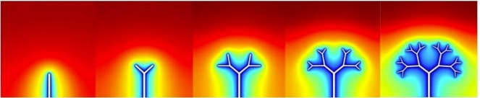
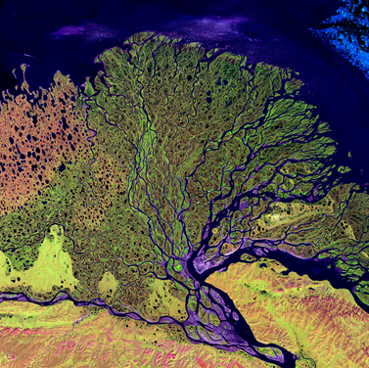
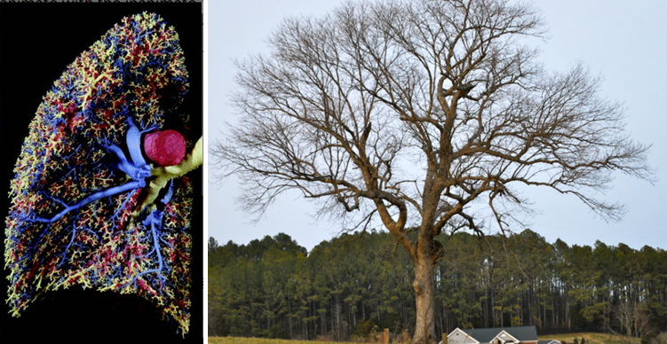
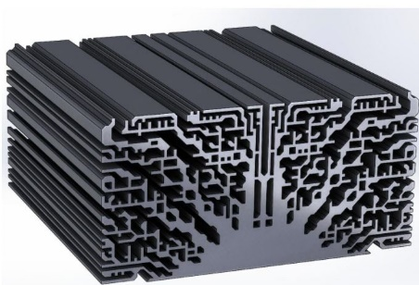
Introduction
“For a finite-size system to persist in time (to live), it must evolve in such a way that it provides easier access to the imposed currents that flow through it.”
Design in Nature – Constructal Theory
time

Slide 3
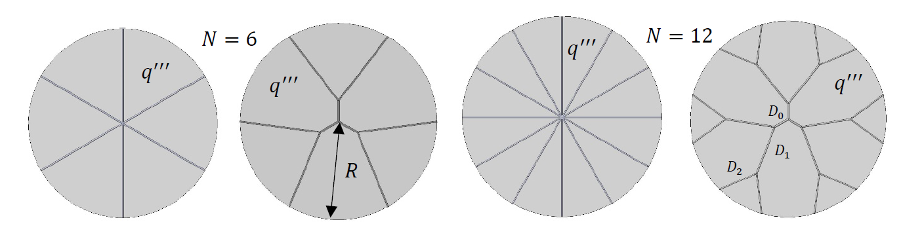
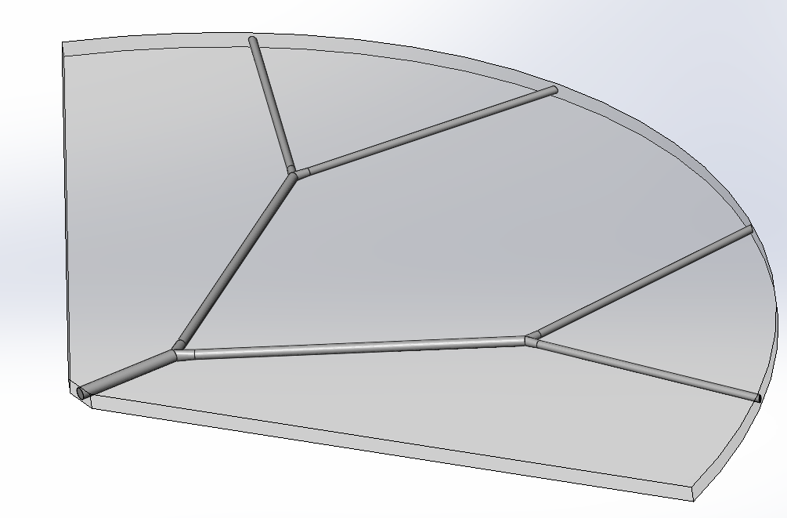
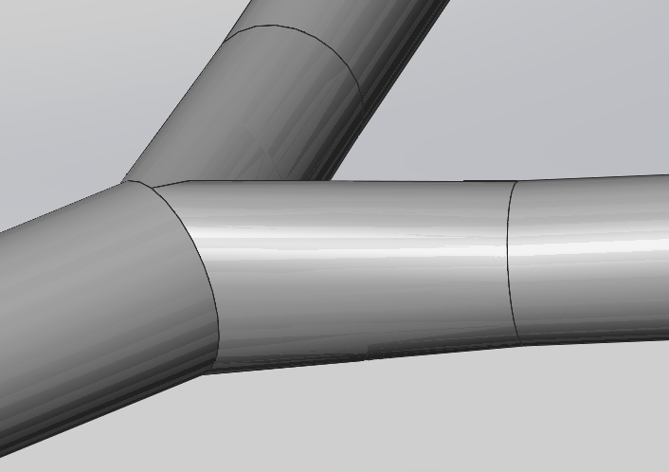
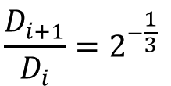
Geometry
$$\frac{D_{i+1}}{D_{i}}=2^{−\frac{1}{3}}$$
q’’’
flow

Slide 4
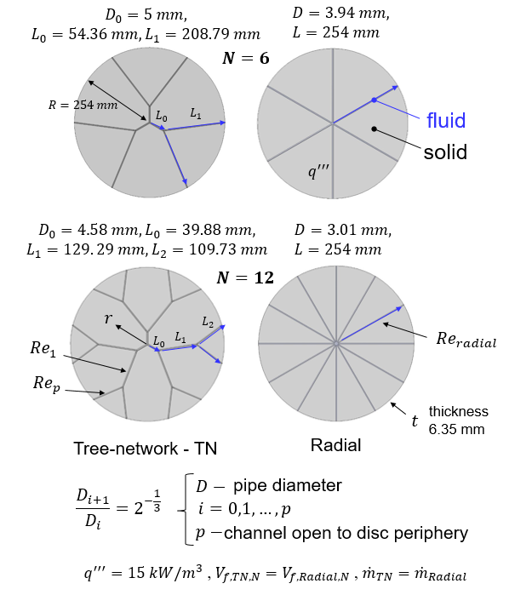
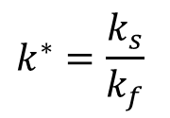


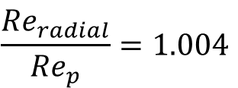
Geometry
$$k^{∗}=\frac{k_{s}}{k_{f}}$$
$$k^{∗}=1, 4, 18, 63, 267$$
$$\frac{{Re}_{radial}}{{Re}_{p}}=1.004$$
${Re}_{p}$ from 0 to 2000 (laminar)

Slide 5
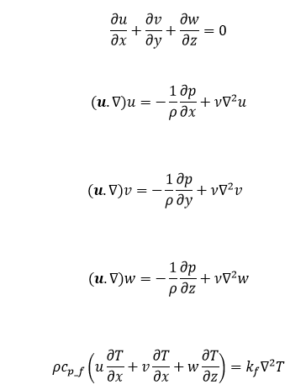
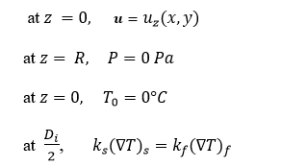
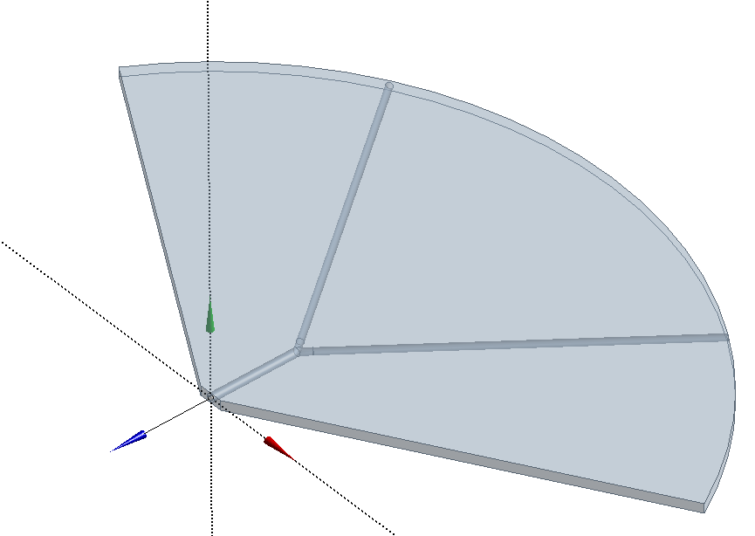

Equations and Boundary Conditions
Steady-state condition,
Incompressible laminar flow
Constant properties
No viscous dissipation
Fully developed flow at the inlet
$$u_{z=0}(x,y)=−\frac{1}{4μ}\left(\frac{dp}{dz}\right)R_{0}^{2}\left[1−\frac{\left(x^{2}+y^{2}\right)}{R_{o}^{2}}\right]$$
y
z
x

Slide 6
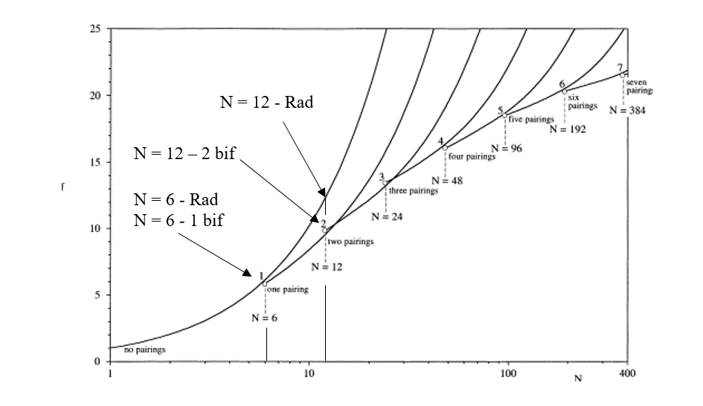
Pressure loss
radial networks (no bifurcation) yields best thermal performance
more complex tree-shaped networks deliver best hydraulic performance
T_{max}
ΔP of f
f
[13] Wechsatol, W., Lorente, S., & Bejan, A. (2003). Dendritic heat convection on a disc. International Journal of Heat and Mass Transfer, 46(23), 4381-4391. doi:10.1016/S0017-9310(03)00295-3
N
Number of outlets

Slide 7
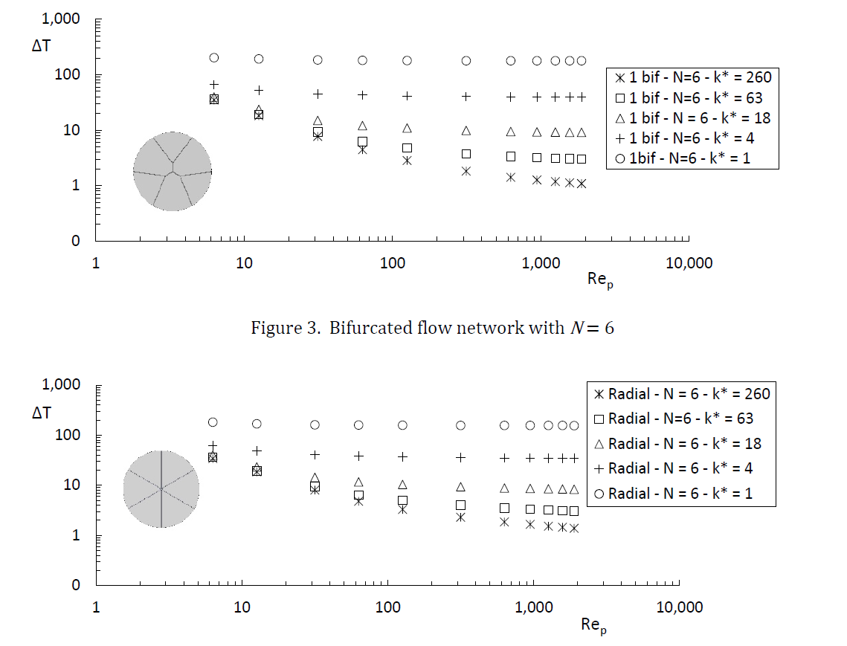
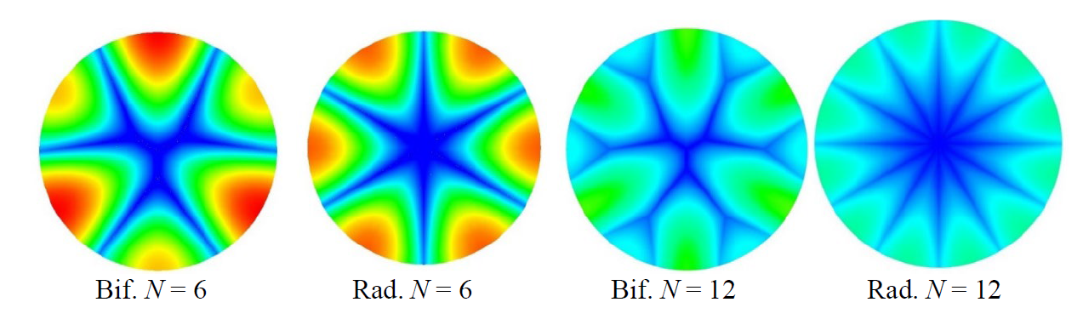
Results
k*=260
Lower Max. Temperature
T_{max}
T_{o}
ΔT= T_{max}-T_{o}

Slide 8
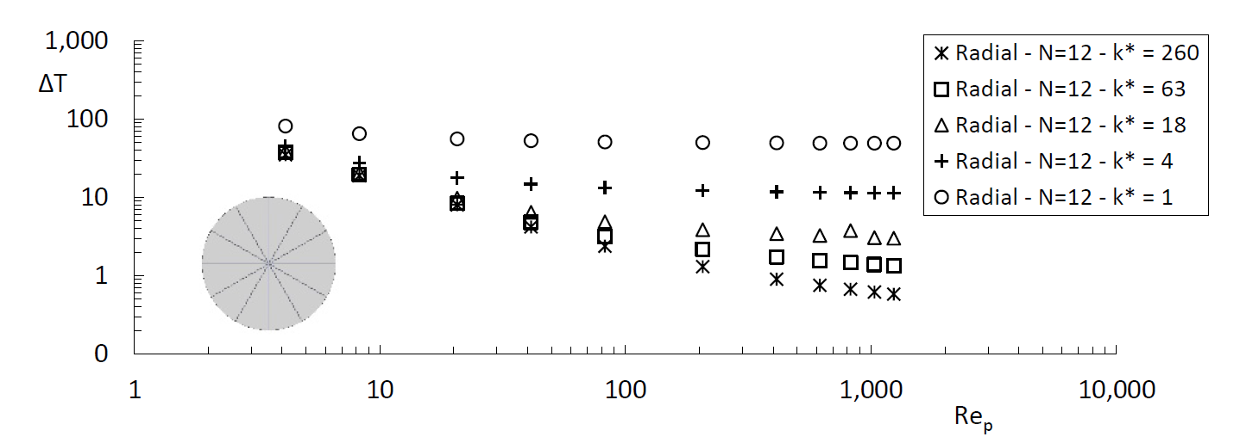
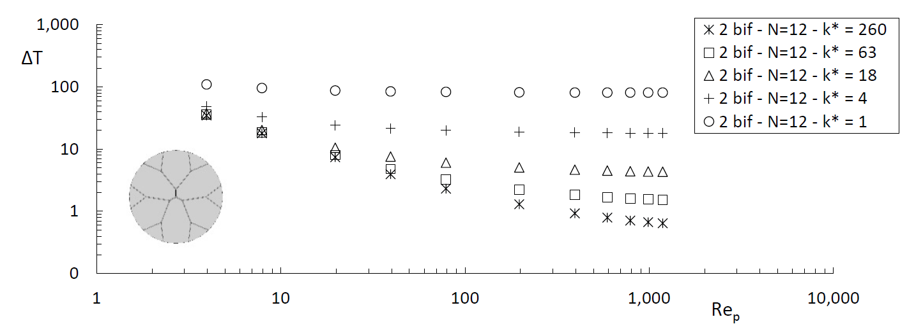
Results
k*=260
Lower Max. Temperature

Slide 9
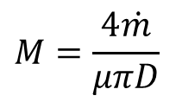



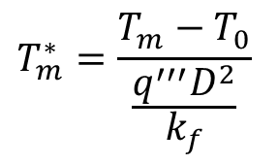
Results
$$T_{m}^{∗}=\frac{T_{m}−T_{0}}{\frac{q^{′′′}D^{2}}{k_{f}}}$$
$$M=\frac{4\dot{m}}{μπD}$$
$$T_{m}$$
$$T_{0}$$
Re_{p} = 6 and $k^{∗}$= 1

Slide 10
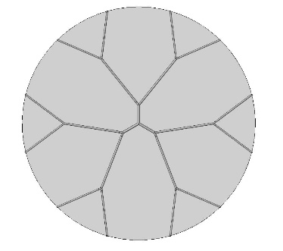
Results
Lower Max. Temperature
k*=260
TN – Three Network – Bif.

Slide 11

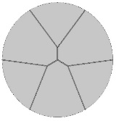
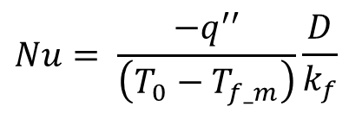
Results
$$Nu= \frac{−q^{′′}}{\left(T_{0}−T_{f_m}\right)}\frac{D}{k_{f}}$$

Slide 12
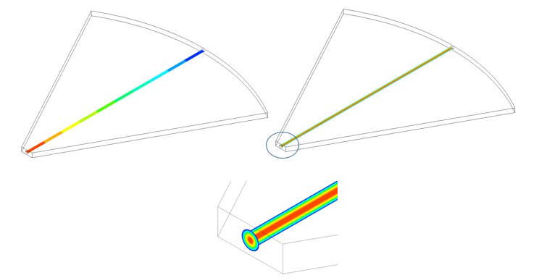
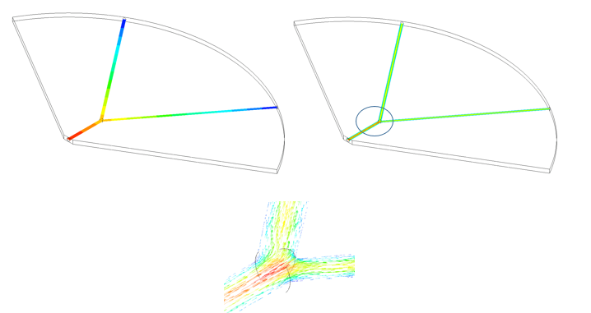
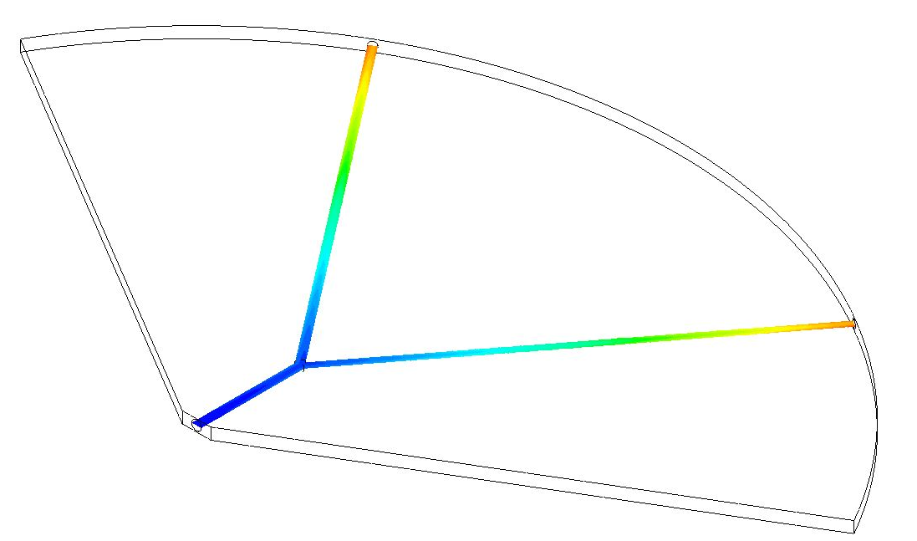
Results
Results:
Velocity distribution
Pressure loss
Pressure loss
Velocity distribution
Fluid Temperature

Slide 13
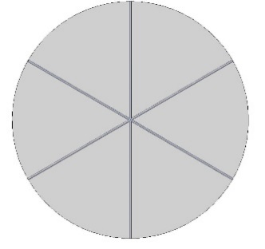
Results

Slide 14
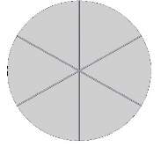
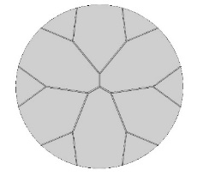
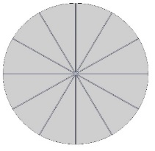
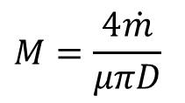
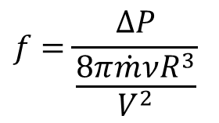
Results
Results:
$$f=\frac{∆P}{\frac{8π\dot{m}νR^{3}}{V^{2}}}$$
$$M=\frac{4\dot{m}}{μπD}$$

Slide 15
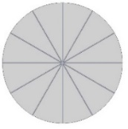

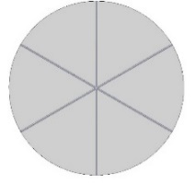
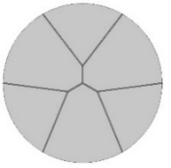









Results
Conclusions:
$$→$$
Thermal resistance: $k^{∗}=1$
Flow resistance: $300<{Re}_{p}<2,000$
Nusselt:
$$k^{∗}=260$$
$$→$$
$$→$$
$${Re}_{p}<300$$
$$→$$
$${Re}_{p}>300$$
Decision to choose the flow network with the best performance depends on factors that go beyond the network being either radial or bifurcating

