Slide 1

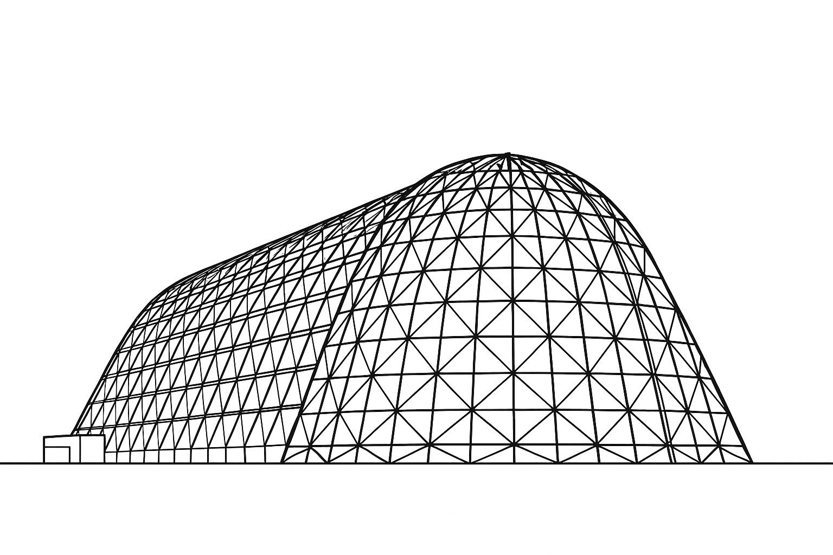

Methods for Modeling Lunar Dust in Thermal Desktop Based on Lunar Dust Level Sensor and Effects on Surfaces Test Data
TFAWS 2025 Interdisciplinary Technical Session
Presented by: Jessie Beddoe
Jessie Beddoe: Barrios Technology
Lisa Erickson: Johnson Space Center
Cheyn Worn: Johnson Space Center
Thermal & Fluids Analysis Workshop 2025
NASA Ames Research Center
San Jose, CA
August 4-7, 2025

Slide 2
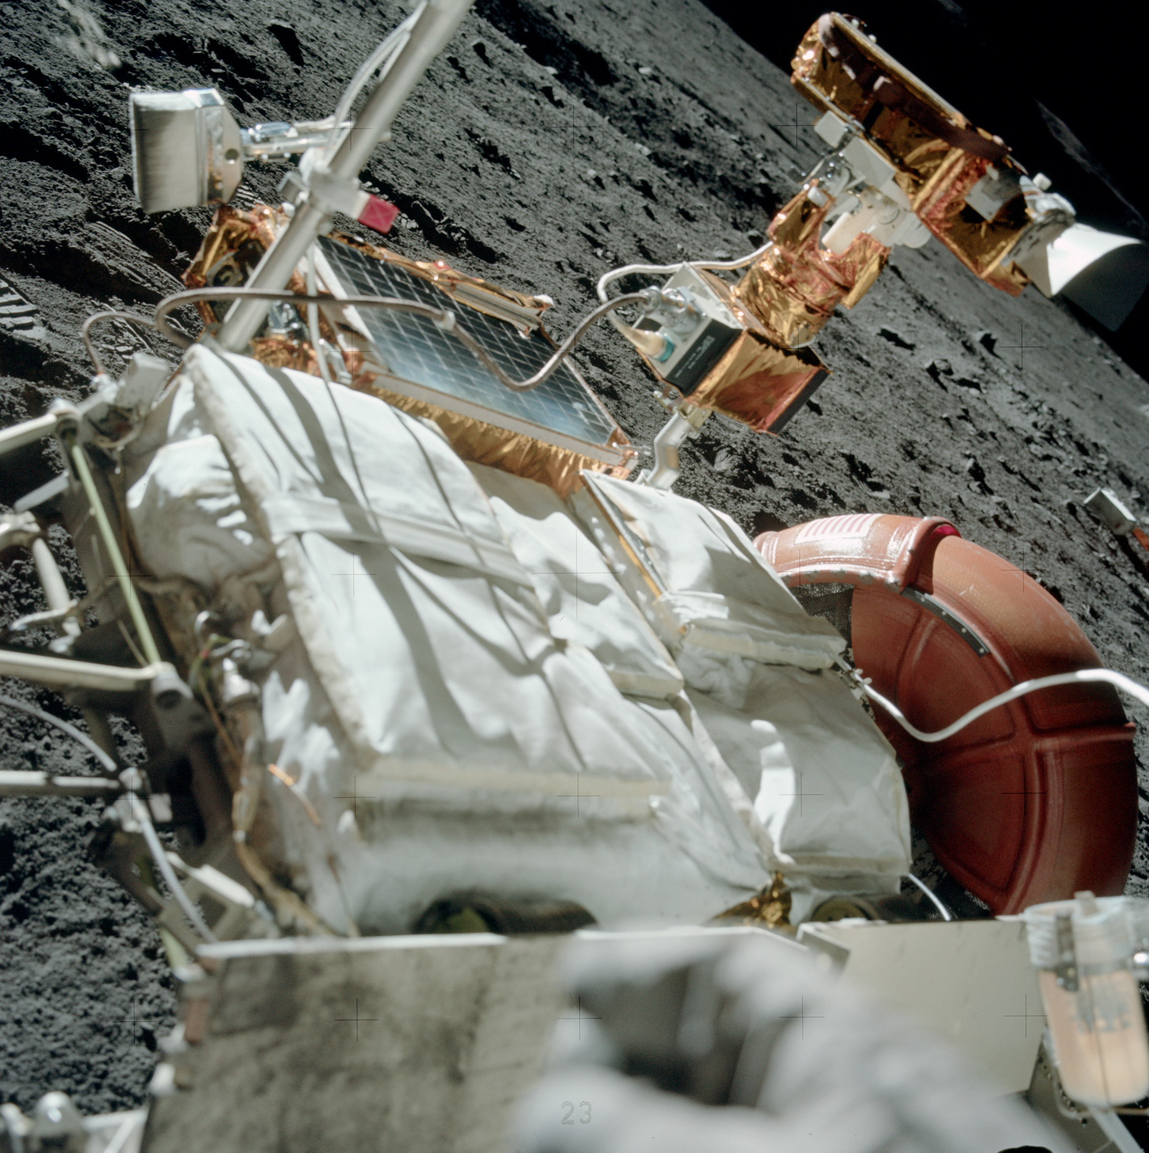
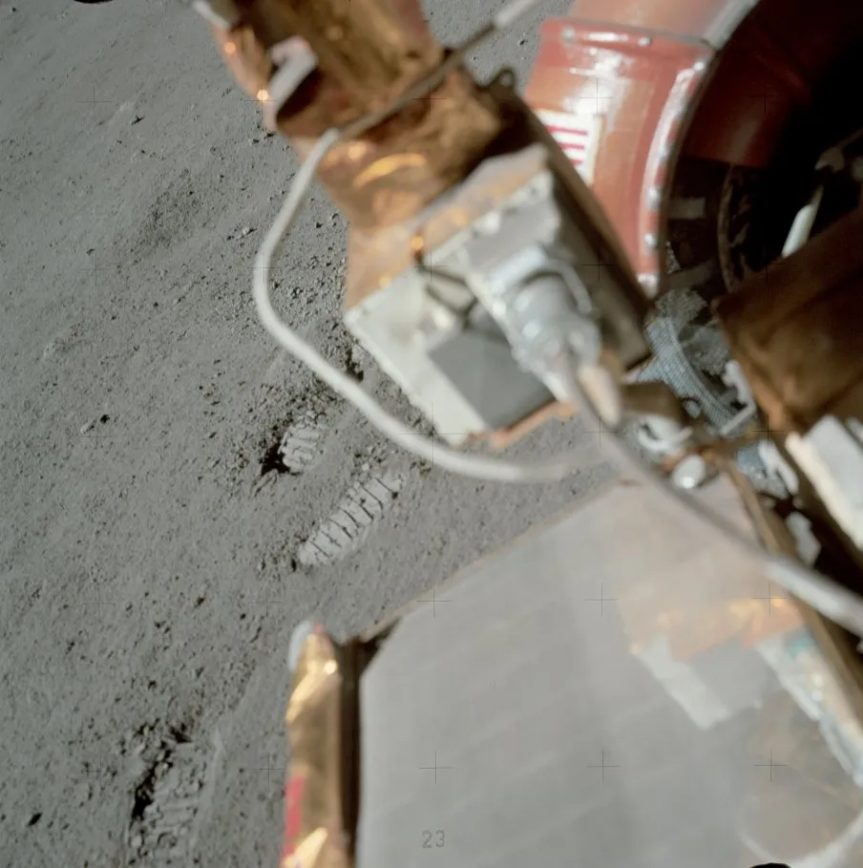
The Lunar Dust Problem
The term “lunar dust” refers to any particles of lunar regolith/simulant smaller than 20μm, with the median size being approximately 0.30 to 0.60μm^{[1]}
  It is highly susceptible to electrostatic and magnetic effects, being attracted to almost any non-grounded, charged surface^{[1,2]}
  It has generally high solar absorptivity (α) and infrared emissivity (ε), which can be a problem for low α/ε surfaces ^{[3]}
  Lastly, lunar dust has very low thermal conductivity^{[4,5]}
How can analysts assess the risk that dust may cause to hardware returning to the lunar surface?
²
This study will analyze four different methods of modeling dust in Thermal Desktop and compare the resulting error when correlated to the LDES LHS1D test data
^{[6]}

Slide 3

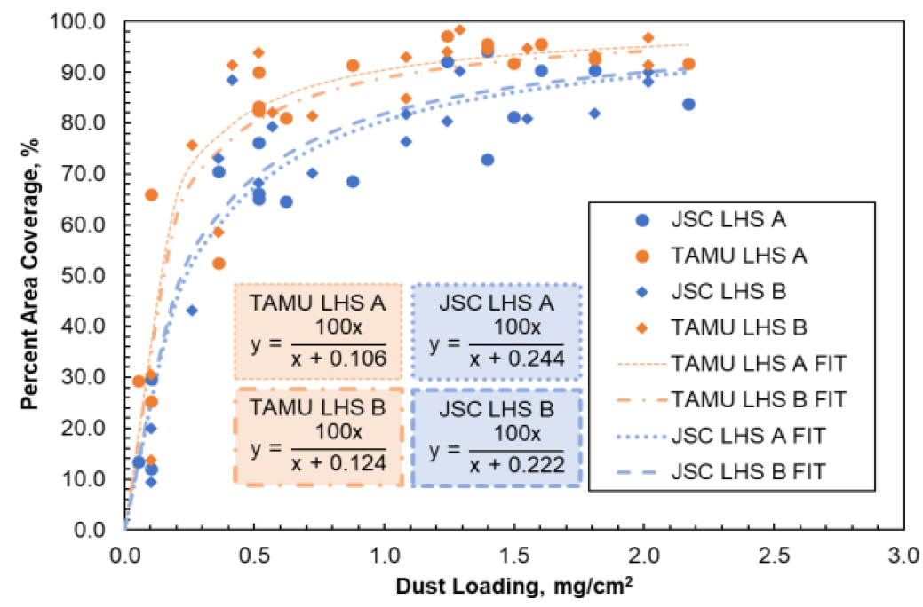
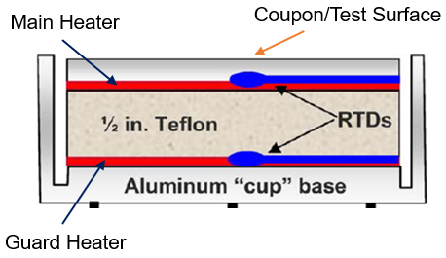
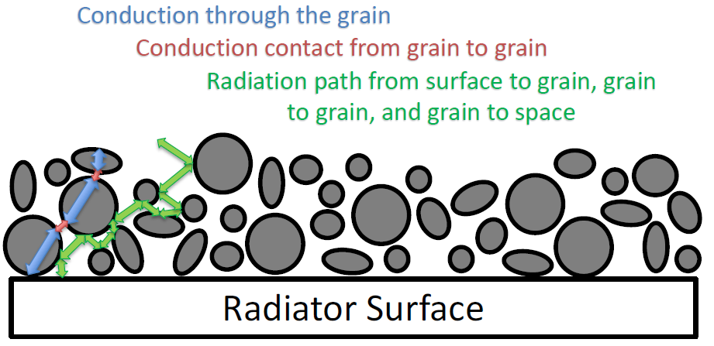

Important Inputs To The Problem
LDES ^{[7]}
(Lunar Dust Level Sensor and Effects on Surfaces)
JSC + Texas A&M^{[8]}
(E.Goodman, C.Kurwitz, K.Hurlbert, L.Suess)
This project aimed to quantify the impact of lunar dust on the emissive potential of surfaces
  The study output an effective emissivity ($ε_{eff}$) based on an energy balance calculated at the coupon surface
This project observed that low-density dust (LHS-1D) did not layer evenly onto surfaces, but instead formed complex 3D structures, coined “fairy castles”
  These structures introduce a difficult heat flow path from the substrate to space
  They also prevent % area coverage on a surface from
High ε materials = ↓
Low ε materials = ↑ then ↓
  increasing linearly

Slide 4
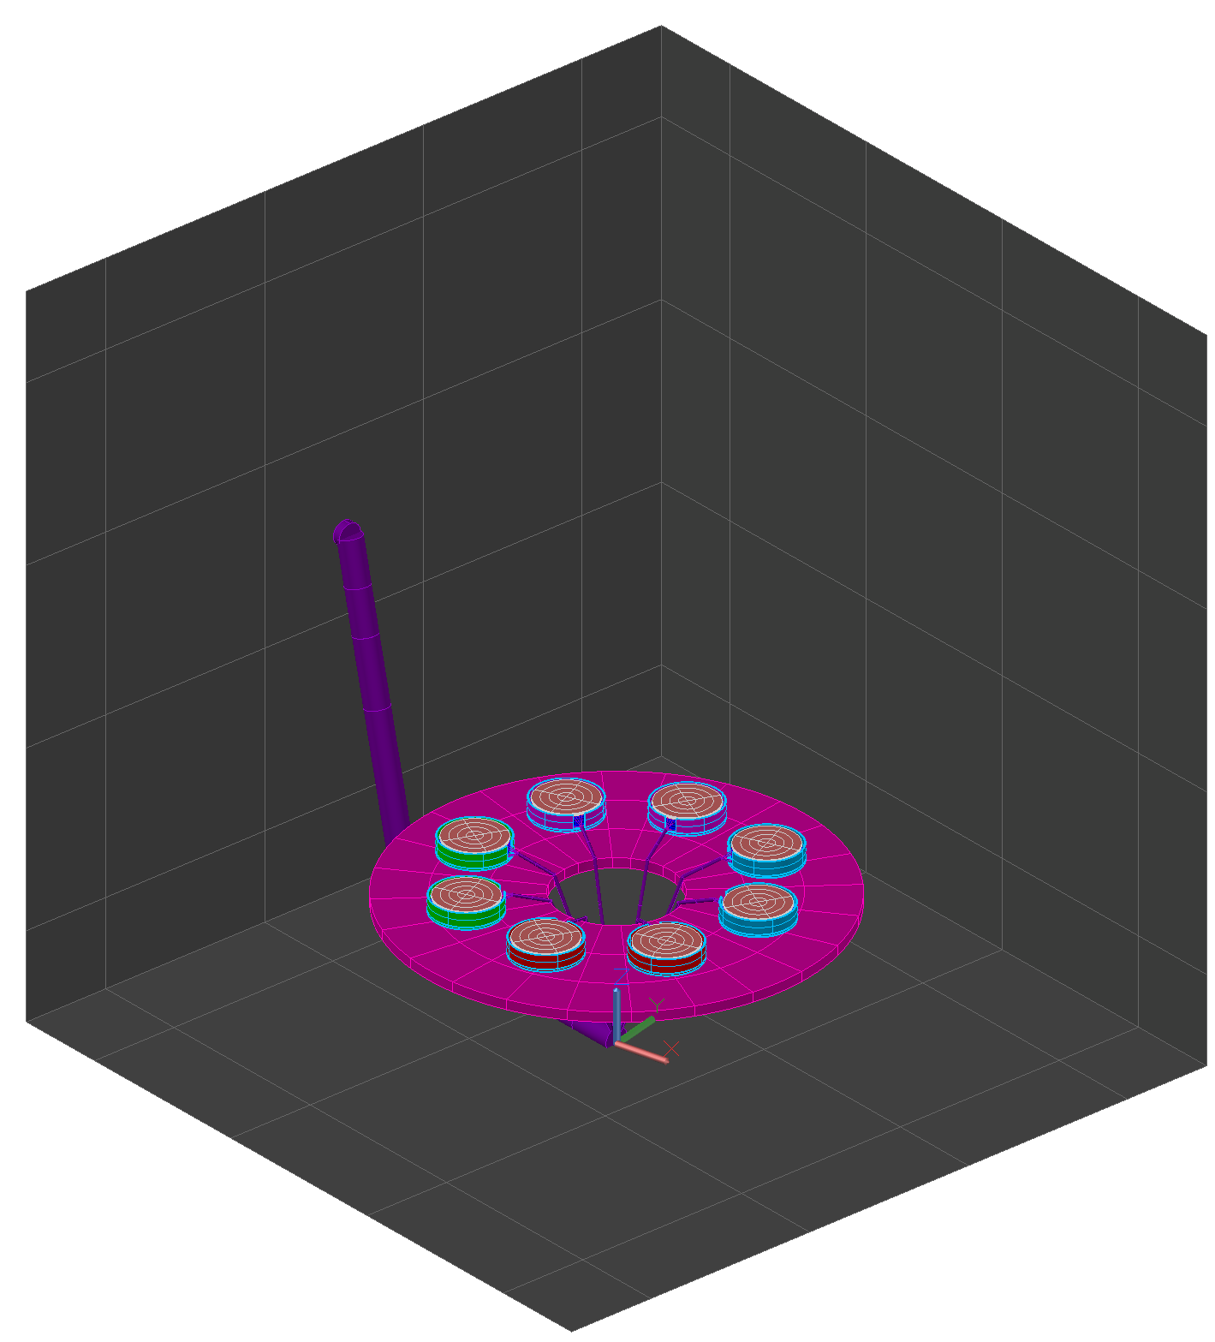
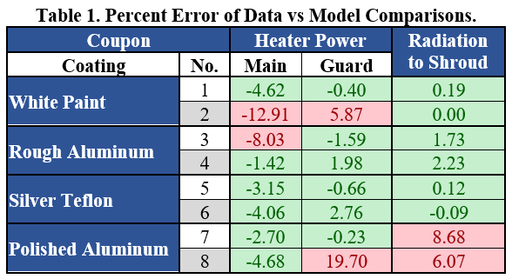
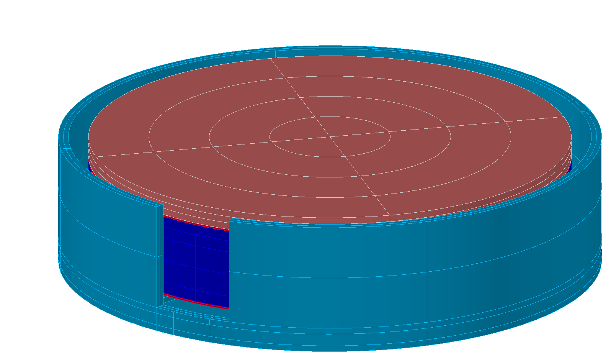
Where to Start? Modeling and Correlation!
A recreation of the test setup was modeled, with significant structures modeled in detail and insignificant ones modeled as equivalent conductance
The sensor gives two correlation metrics, the main and guard heater power, with main heater power being favored
Using this model, a baseline correlation was done that compared heater power between the model and the test data.
  The lowest error coupons* for each coating were chosen for subsequent dust testing rounds for low, medium, and high dust coverage
TVAC Shroud
TVAC Shroud
Wiring
Wiring
Sensor
Table
Table
*Coupons 7 & 8 were not used

Slide 5
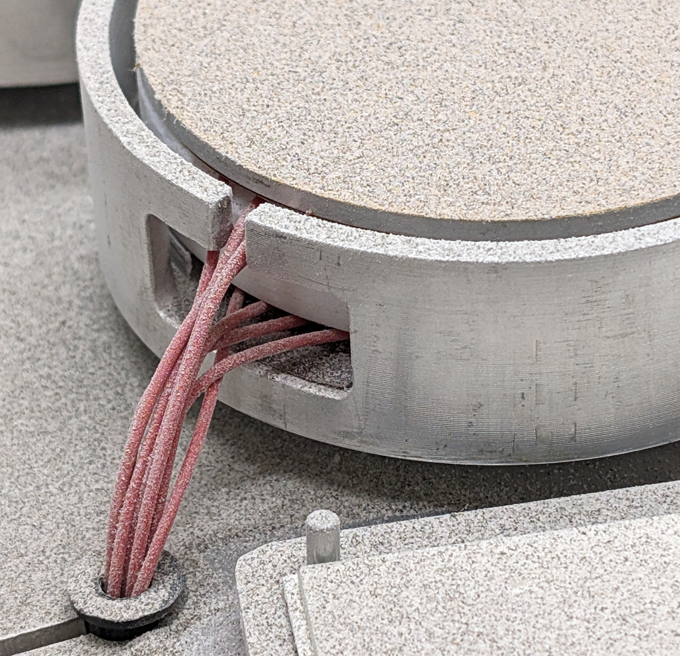
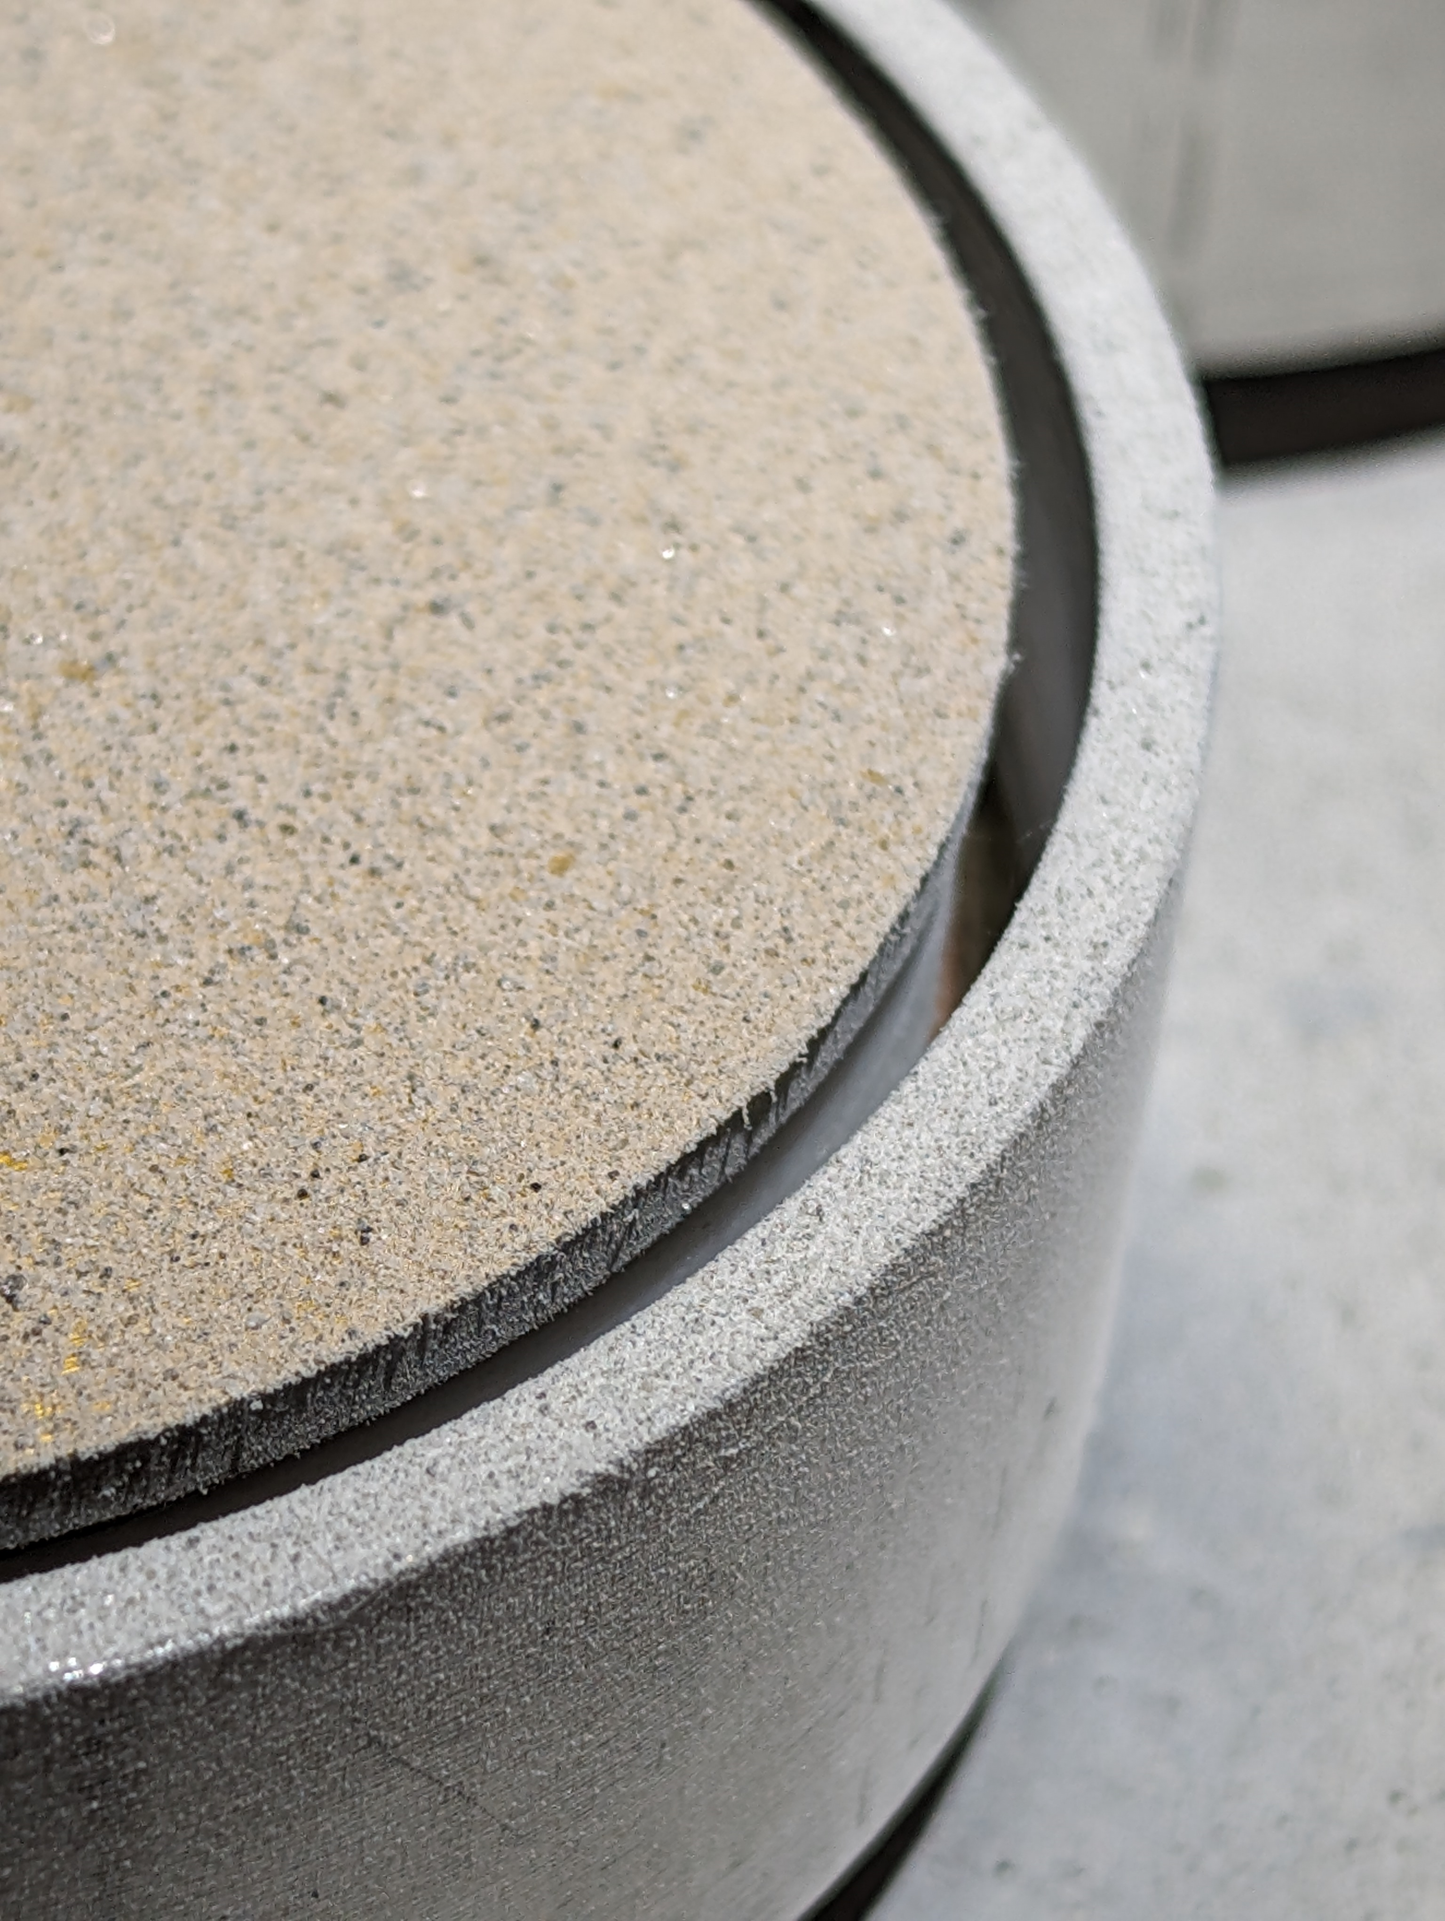
Where to Apply the Dust?
Since correlation must consider all parts of the system, we have to know what areas are affected by dust
Dust accumulates on multiple surfaces that could impact heat flow in the system
Dust is also visible on vertical surfaces
To account for this additional dust, it is assumed:
  Affected vertical surfaces will have 5% of the coupon dust coverage present
  Affected horizontal surfaces will have 50% of the coupon dust coverage present
So… We need to account for more dust than just what is present on the coupon!

Slide 6
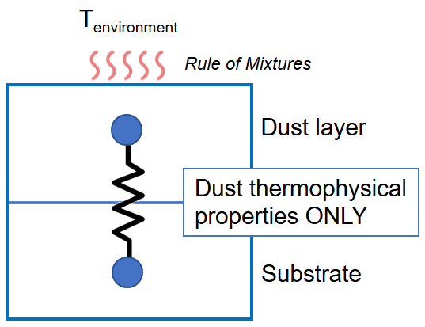
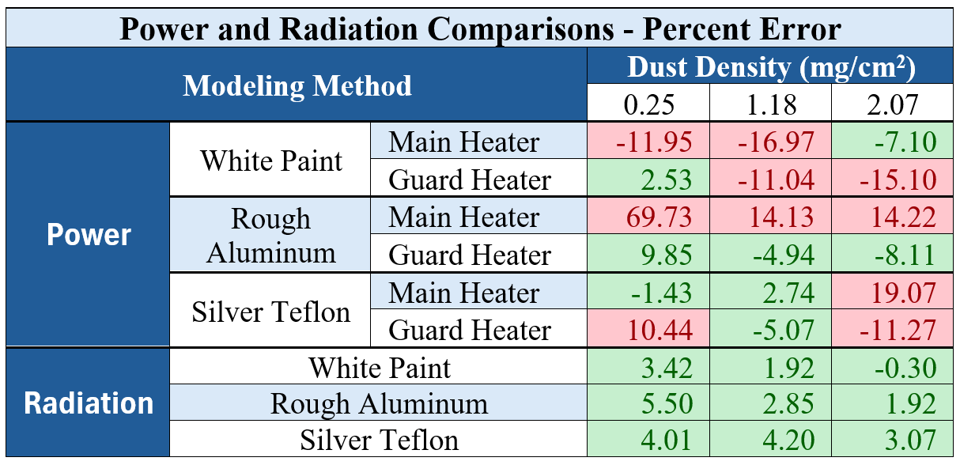
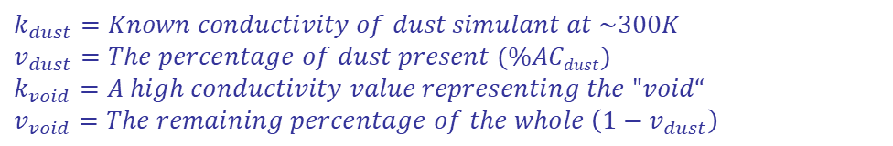
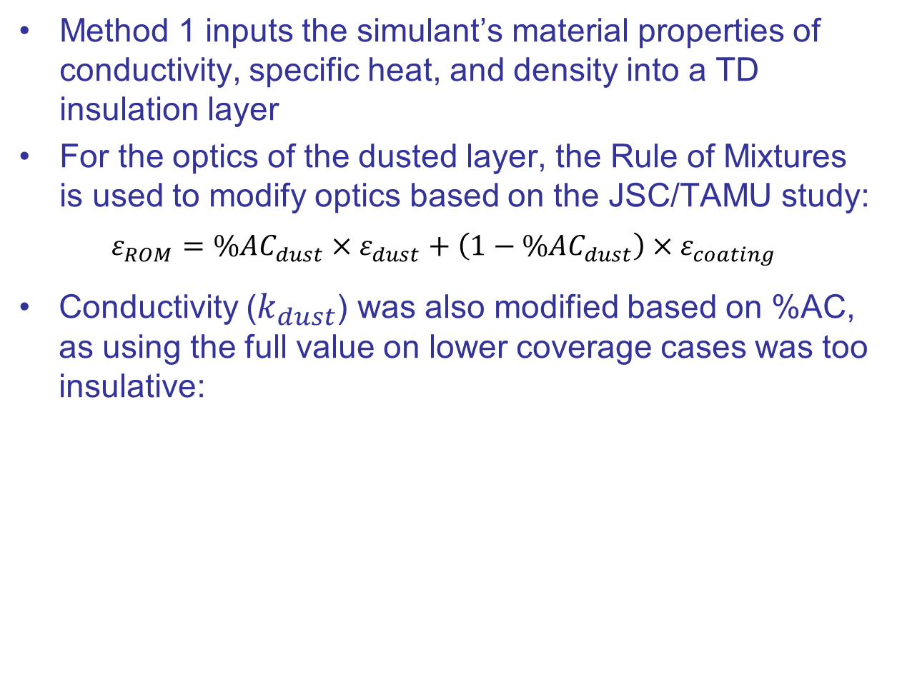
Method 1 – Make A Simulant Layer
Method 1 inputs the simulant’s material properties of conductivity, specific heat, and density into a TD insulation layer
For the optics of the dusted layer, the Rule of Mixtures is used to modify optics based on the JSC/TAMU study:
$$ε_{ROM}={\%AC}_{dust}×ε_{dust}+\left(1−{\%AC}_{dust}\right)×ε_{coating}$$
Conductivity ($k_{dust}$) was also modified based on %AC, as using the full value on lower coverage cases was too insulative:
^{[9]}
$$k_{adjusted}=\frac{k_{void}∗k_{dust}}{\left(v_{void}∗k_{dust}\right)+(v_{dust}∗k_{void}) }$$
^{[5]}
$$k_{dust}=Known conductivity of dust simulant at \sim 300K$$
$$v_{dust}=The percentage of dust present (\%ACdust)$$
$k_{void}=A high conductivity value representing the "void“$
$$v_{void}=The remaining percentage of the whole \left(1−v_{dust}\right)$$
Where…

Slide 7
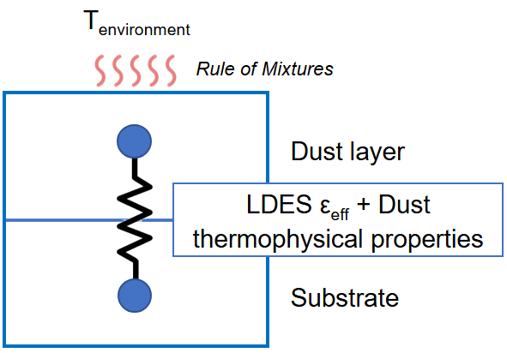
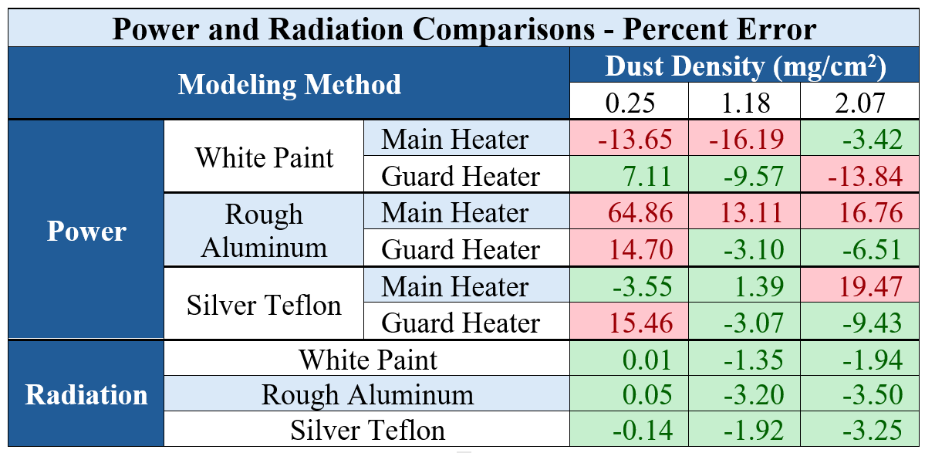
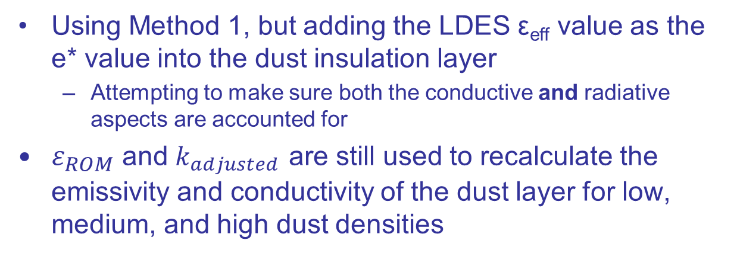
Method 2 – Adding in the LDES ε_{eff}
Using Method 1, but adding the LDES ε_{eff} value as the e* value into the dust insulation layer
  Attempting to make sure both the conductive and radiative aspects are accounted for
$ε_{ROM}$ and $k_{adjusted}$ are still used to recalculate the emissivity and conductivity of the dust layer for low, medium, and high dust densities
Results were mixed:
  For the White Paint coupon, this method performs better than Method 1 at the medium and high dust densities
  All other coupons perform worse than Method 1 at the low dust density but perform better than Method 1 for the guard heaters at medium and high dust densities
Addition of ε* as ε_{eff} + properties double counting?

Slide 8
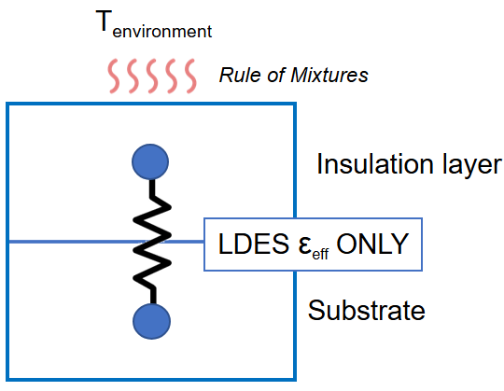
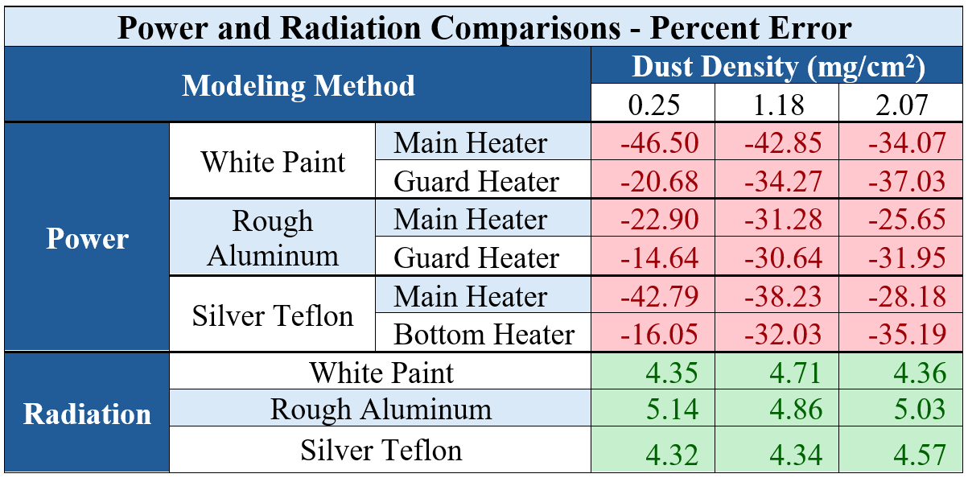
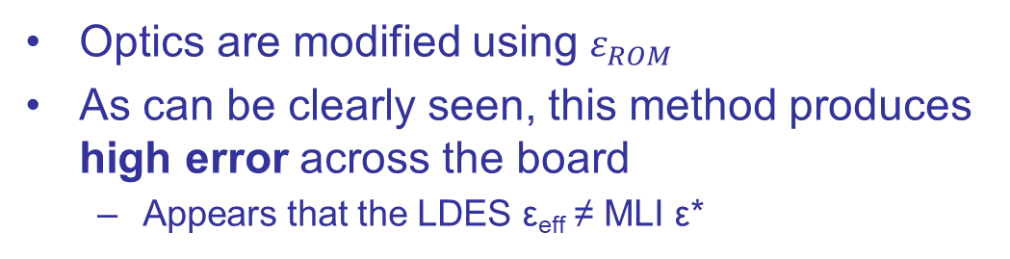
Method 3 – Only LDES
Method 3 aims to use the LDES ε_{eff} as ε* is used in theory
  ε* is often a value for MLI found through physical testing, combining the radiative and conductive components into a single value
Thermal analysts often use ε* within a layer of arithmetic insulation
  The layer is then “massless” and it will respond instantaneously to any change in energy balance
Optics are modified using $ε_{ROM}$
As can be clearly seen, this method produces high error across the board
  Appears that the LDES ε_{eff} ≠ MLI ε*

Slide 9
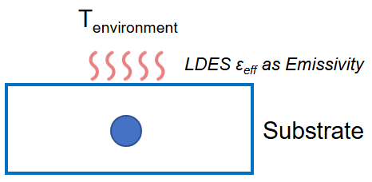
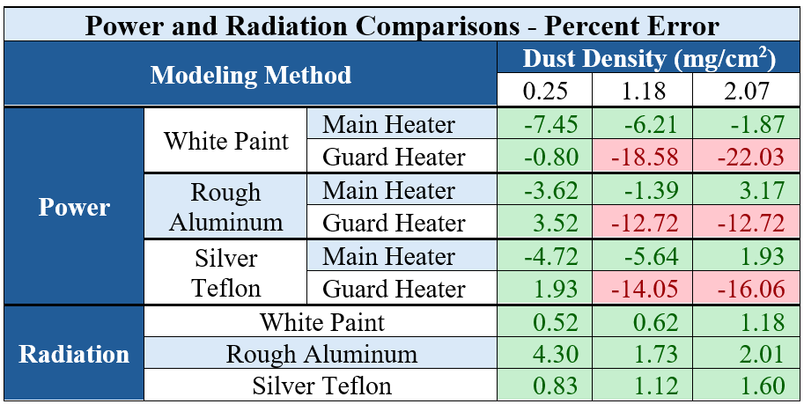
Method 4 – Removing the Insulation Layer
Method 4 simply replaces the ε within the TD optics card of the dusted surface with the LDES ε_{eff} value
  Theoretically, the calculated ε_{eff} value represents the combined heat path through the dust and radiation to the shroud
This was intended to integrate the LDES team’s equation flow back into the test system to see if it behaves as expected from the test data
This method appears to work very well for all coupons and dust densities for the main heater, as well as for lower dust densities for the guard heater
For medium and high dust densities for the guard heater, the model underpredicts heater power more than Methods 1 and 2

Slide 10
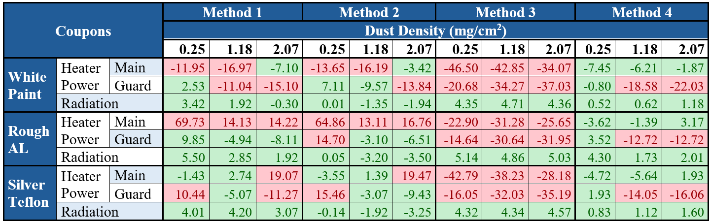
Conclusion
Of all methods tested analyzed, it appears that the best performing modeling method is #4, but this team makes no modeling recommendations at this time, only providing a preliminary prediction on how dust will affect coatings in this specific use case
Further testing is needed due to the following:
  It uses ε_{eff} as ε, “wrapping up” all effects of the dust layer into a single value
  Only one test point was obtained – one coupon temperature and one sky (shroud) temperature for all test series
  There was no solar simulator used in the test, so no impacts on solar absorptance could be evaluated
  The only reliable correlation metric was heater power for the main heater – no temperature sensors

Slide 11
Special Thanks To:
The LDES team and the University of Alabama at Huntsville’s Dr. Hollingsworth for their research and collaboration
~
The Gateway program, the Blue Origin program, and the Lunar Terrain Vehicle and Pressurized Rover program for their generous funding
~
We also thank Sam Wilcox and Jonah Smith for model review and advice
Questions?

Slide 12
References
^{[1]}Jin, Hong. et al., “Properties of Lunar Dust and their Migration on the Moon,” Space: Science & Technology [online journal], Vol. 4, URL: https://doi.org/10.34133/space.0142, Apr. 2024.
^{[2]}John, K., and Fritz, A., “Survive the Dust: Dust Mitigation Technology to Enable Survive the Night Capabilities,” Commercial Lunar Payload Services Survive the Night Technology Workshop, Dec. 2022.
^{[3]}Zinecker, A., and Spivey, B., “Thermo-Optical Properties of Lunar Dust Simulants” 54th Lunar and Planetary Science Conference, Mar. 2023.
^{[4]}Austen, D., and Shafirovich, E., “SPECIFIC HEATS AND THERMAL DIFFUSIVITIES OF LHS-1 LUNAR REGOLITH SIMULANT AT LOW TEMPERATURES,” Aerospace and Mechanical Engineering Dept., The University of Texas at El Paso, El Paso, TX, 2023.
^{[5]}Woods-Robinson, R., Siegler, M., and Paige, D., “A Model for the Thermophysical Properties of Lunar Regolith at Low Temperatures,” Journal of Geophysical Research: Planets [online journal], Vol. 124, Issue 7, URL: https://agupubs.onlinelibrary.wiley.com/doi/epdf/10.1029/2019JE005955, Jul. 2019.
^{[6]}Jones, Eric., Apollo Lunar Surface Journal, Apollo 17 Image Library, URL: https://www.nasa.gov/history/alsj/a17/images17.html#Crew, 1995-2014.
^{[7]}Hollingsworth, K., Witte, L., Hinke, J., and Hurlbert, K., “Reduction in Emittance of Thermal Radiator Coatings Caused by the Accumulation of a Martian Dust Simulant,” ScienceDirect [online journal], Vol. 26, Issue 17-18, URL: https://www.sciencedirect.com/science/article/abs/pii/S1359431106000603, Dec 2006.
^{[8]}Quick, E., Kurwitz, C., Hurlbert, K., Suess, L., “Determination of Percent Area Coverage of Lunar Simulant on a Surface and Observations of Fairy Castle Structures,” ASCEND Conference, 2024.
^{[9]}University of Cambridge, “Derivation of the Rule of Mixtures and Inverse Rule of Mixtures,” Dissemination of IT for the Promotion of Materials Science [online article], URL: https://www.doitpoms.ac.uk/tlplib/bones/derivation_mixture_rules.php [cited 2004-2025].

